Slide 1




Difference between AEH and ALH from GEMS
TEMPO/GeoXO ACX Joint Science Team Workshop
August 19-22, 2025, CfA, Cambridge, MA.
Sang Seo Park, Seungjae Lee (UNIST)
Jhoon Kim, Yujin Chai, Minseok Kim (Yonsei Univ.)

Slide 2
Introduction
Importance of Aerosol retrieval from Environmental Satellite
  Main Object for Environmental Satellite: Trace Gas Observation
  Tracking local emission source & long-range transport
  → For the accurate gaseous retrieval, accurate aerosol information is important.
  Aerosol Information : AOD, Type, and Signle Scattering Albedo
  Additionally, the aerosol layer height is also important for optical path length estimation
GEMS Aerosol Product
  GEMS Aerosol Optical Properties (L2AERAOD)
  → AOD, SSA, Types + Aerosol Layer Height (ALH)
  In addition, Aerosol Effective Height product (L2AEH) from GEMS is also now in operation.
  Two independent aerosol vertical profile products are potentially provided to the aerosol vertical shape information.
  → Possible to apply the surface PM estimation or AMF estimation.

Slide 3
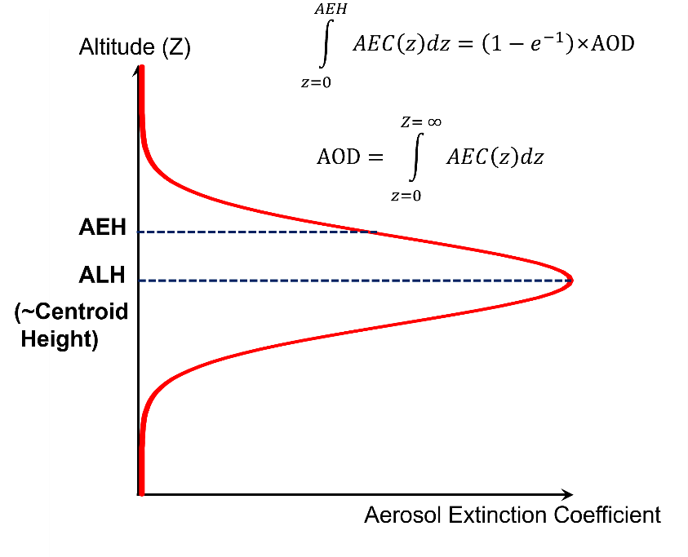

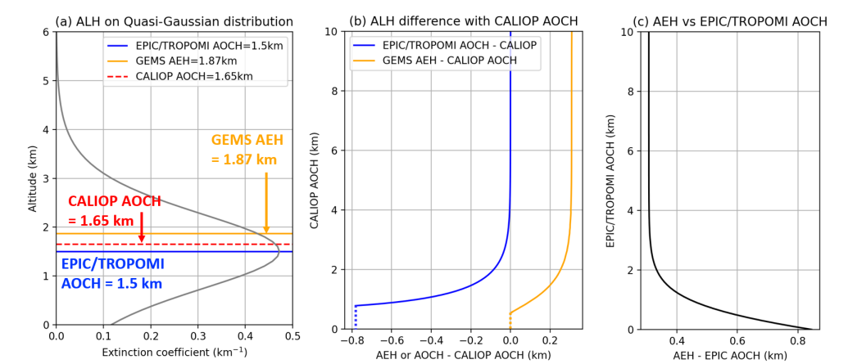
Definition of Aerosol height parameters
Aerosol layer height [km] (ALH)
  where B_{sc}(i) is the attenuated backscatter at height H(i), and n is the number of layers up to 10 km from the surface.
Aerosol Effective height [km] (AEH)
AEH vs ALH
  Both Parameters assume that Gaussian vertical aerosol distribution with full width half maximum (FWHM) of 1 km
  AEH denotes the middle of layer between top and center height.
  ALH defines most thick layer altitude.
  Difference (ALH-AEH) depends on the aerosol vertical distribution
Kim et al. (2024, AMT)
Notes:
This slide presents the final aerosol product from GEMS, focusing on Aerosol Layer Height (ALH).
The Aerosol Layer Height is defined by the equation shown. Here, ZaerZ_{aer}Zaer​ is the sum of the attenuated backscatter (Bsc(i)B_{sc}(i)Bsc​(i)) at different heights (H(i)H(i)H(i)), normalized by the total backscatter across all layers up to 10 km from the surface. This calculation assumes a Gaussian vertical aerosol distribution with a full width half maximum (FWHM) of 1 km.
On the right, we have visual representations of aerosol layers at different heights. The graphic shows two examples: one with an aerosol layer height of 5 km and another with an aerosol layer height of 4 km.

Slide 4
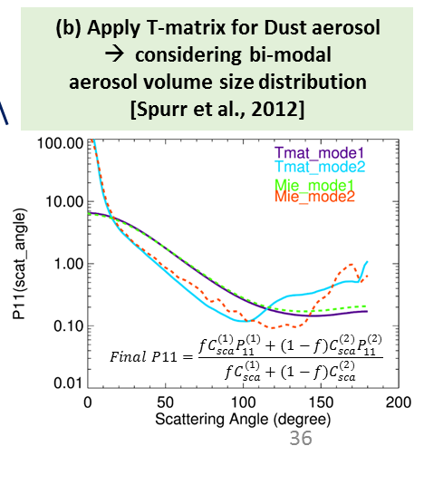
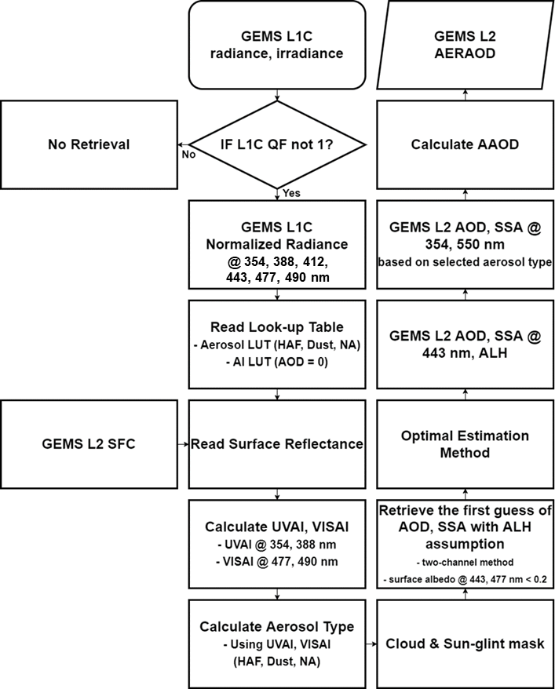
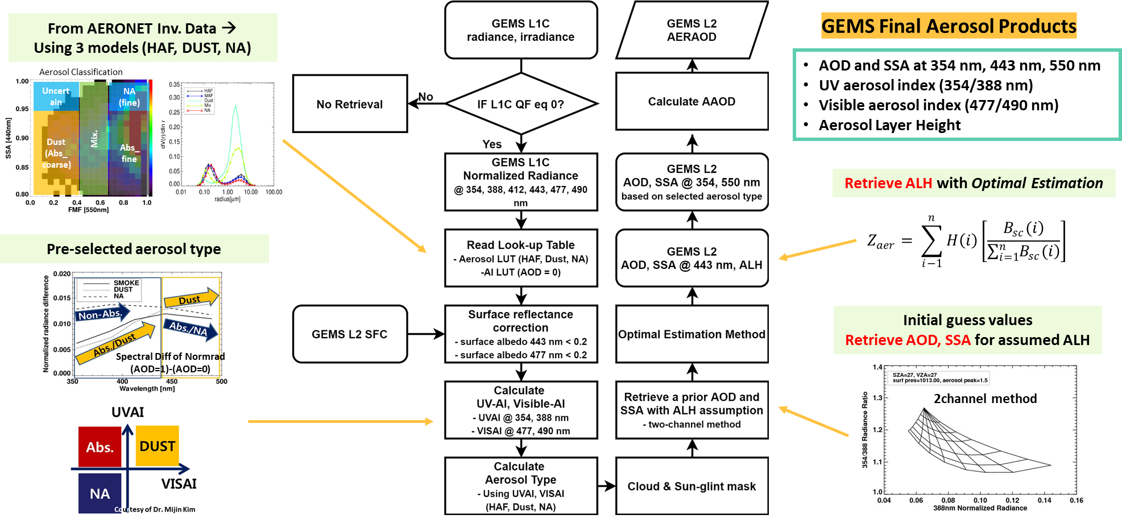
GEMS AERAOD algorithm flowchart
Courtesy,
Prof. Jhoon Kim
(GEMS Group)
Cho et al. (2024)
Notes:
This is the flowchart
GEMS aerosol algorithm uses level 1c data, especially at 6 wavelength that is processes with spectral binning.
And Look up table is made for highly absorbing fine, dust, and non-absorbing aerosol types.
Also, for dust type aerosol we used t-matrix to consider non-sphericity.
So, after preparing data for retrieval. algorithm calculates uv aerosol index and visible aserosol index first,
and classifies aerosol types.
And after pixel masking, first guess of AOD and SSA is retrieved and then final AOD, SSA, and aerosol height is retrieved with optimal estimation.

Slide 5
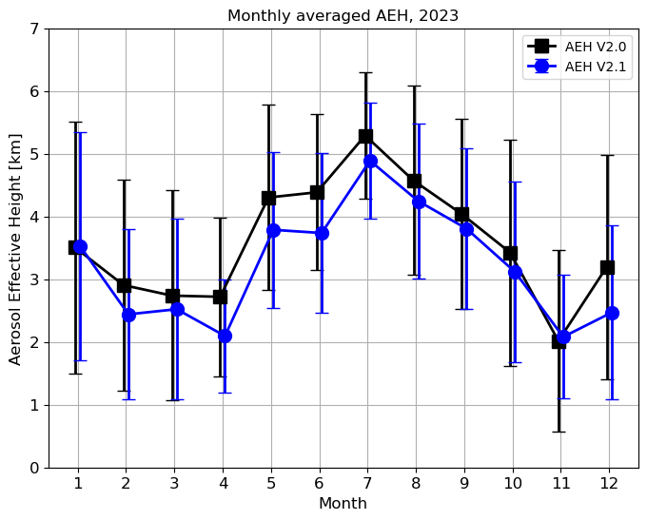
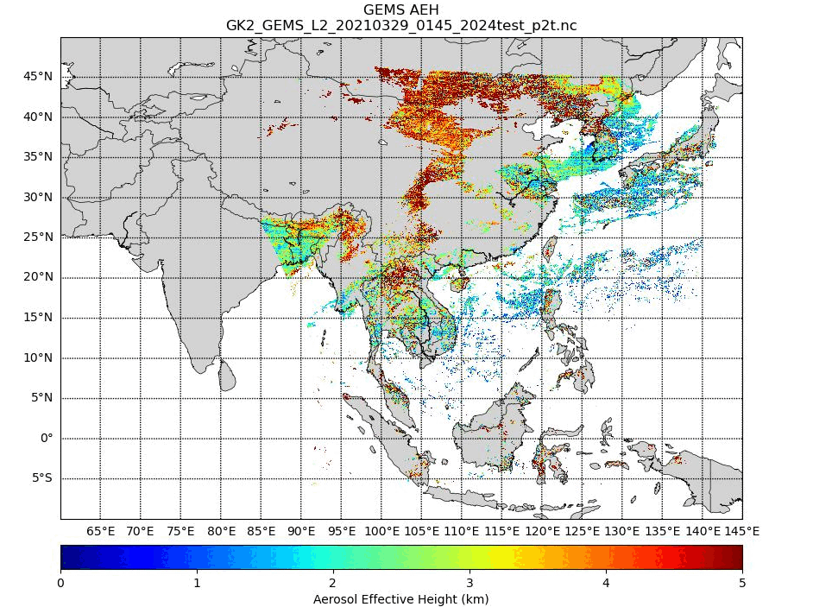
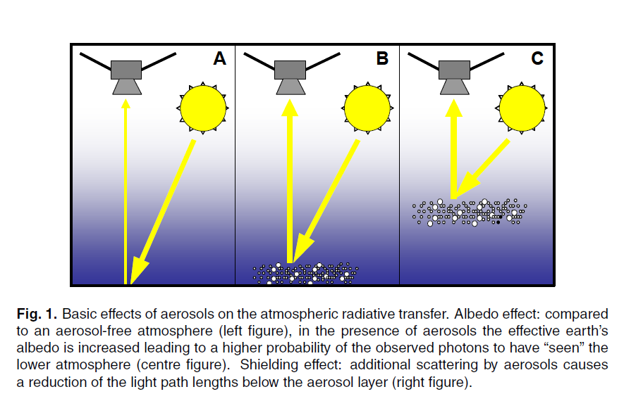
GEMS AEH Retrieval Algorithm
[Park et al. (2025, AMT)]
Additional Consideration for Pressure variation
Wagner et al. (2010)
O₄ SCD : Easy to convert to optical path length
1) Aerosol Height↑ →Optical Path Length↓
∴ O₄ Slant Column Density↓
2) AOD↑ → Surface reflected photon ↓
∴ O₄ Slant Column Density↓

Slide 6
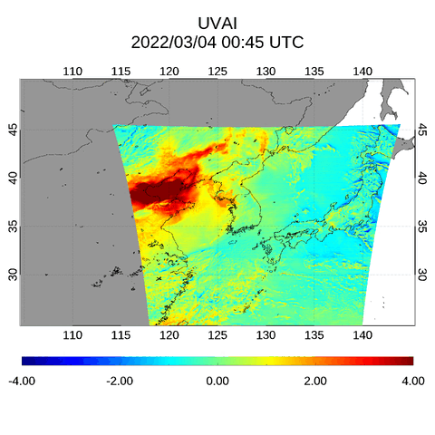
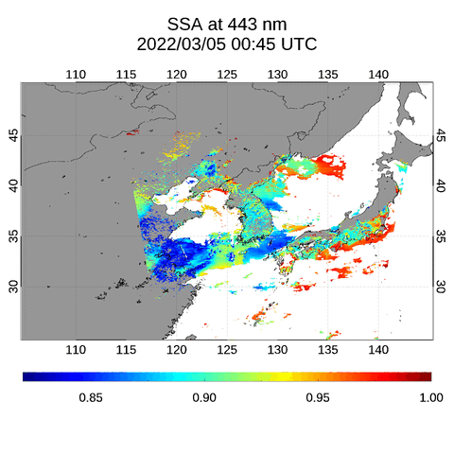
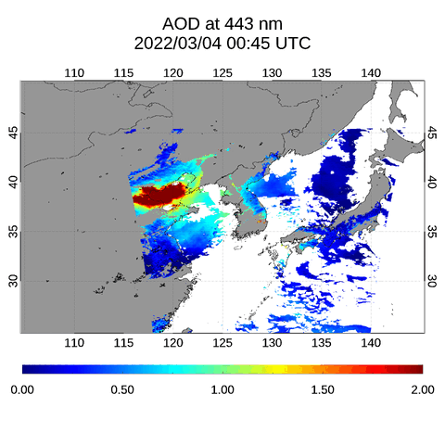
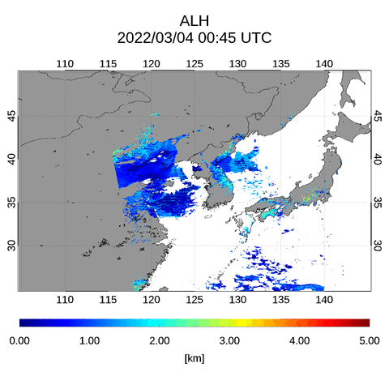
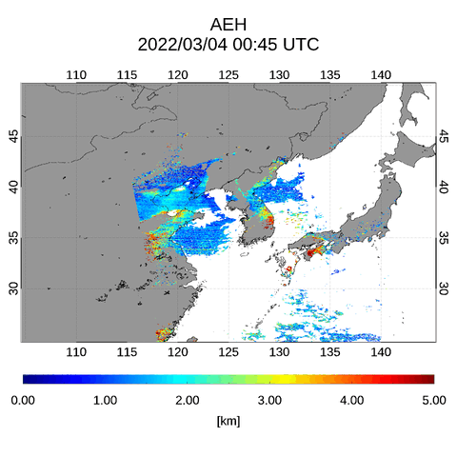
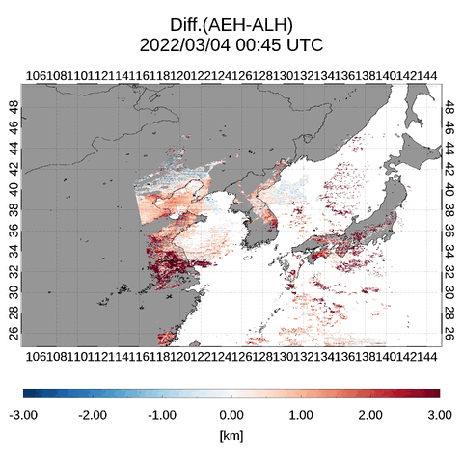
Case Study: GEMS ALH vs GEMS AEH (Mar. 4, 2022, Dust)

Slide 7
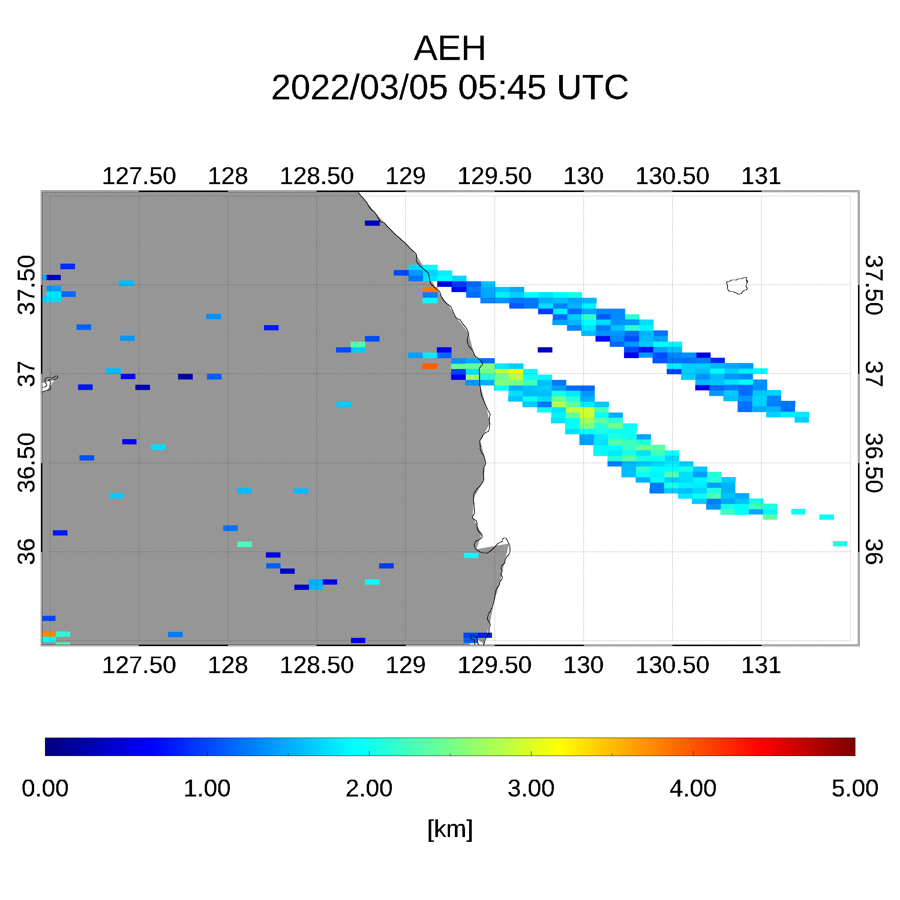
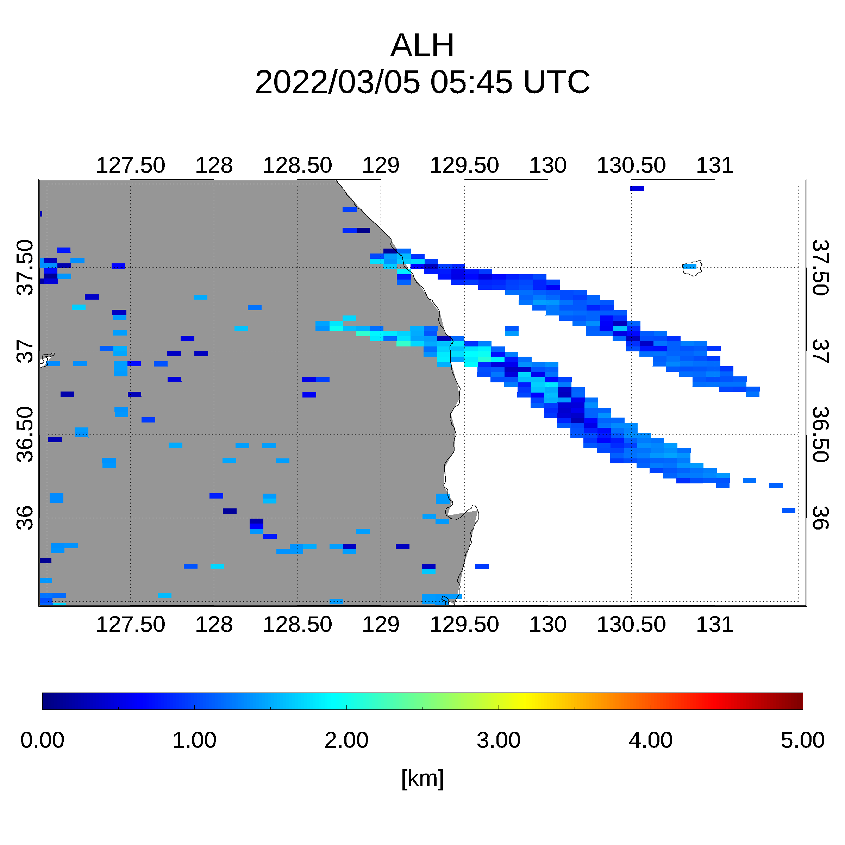
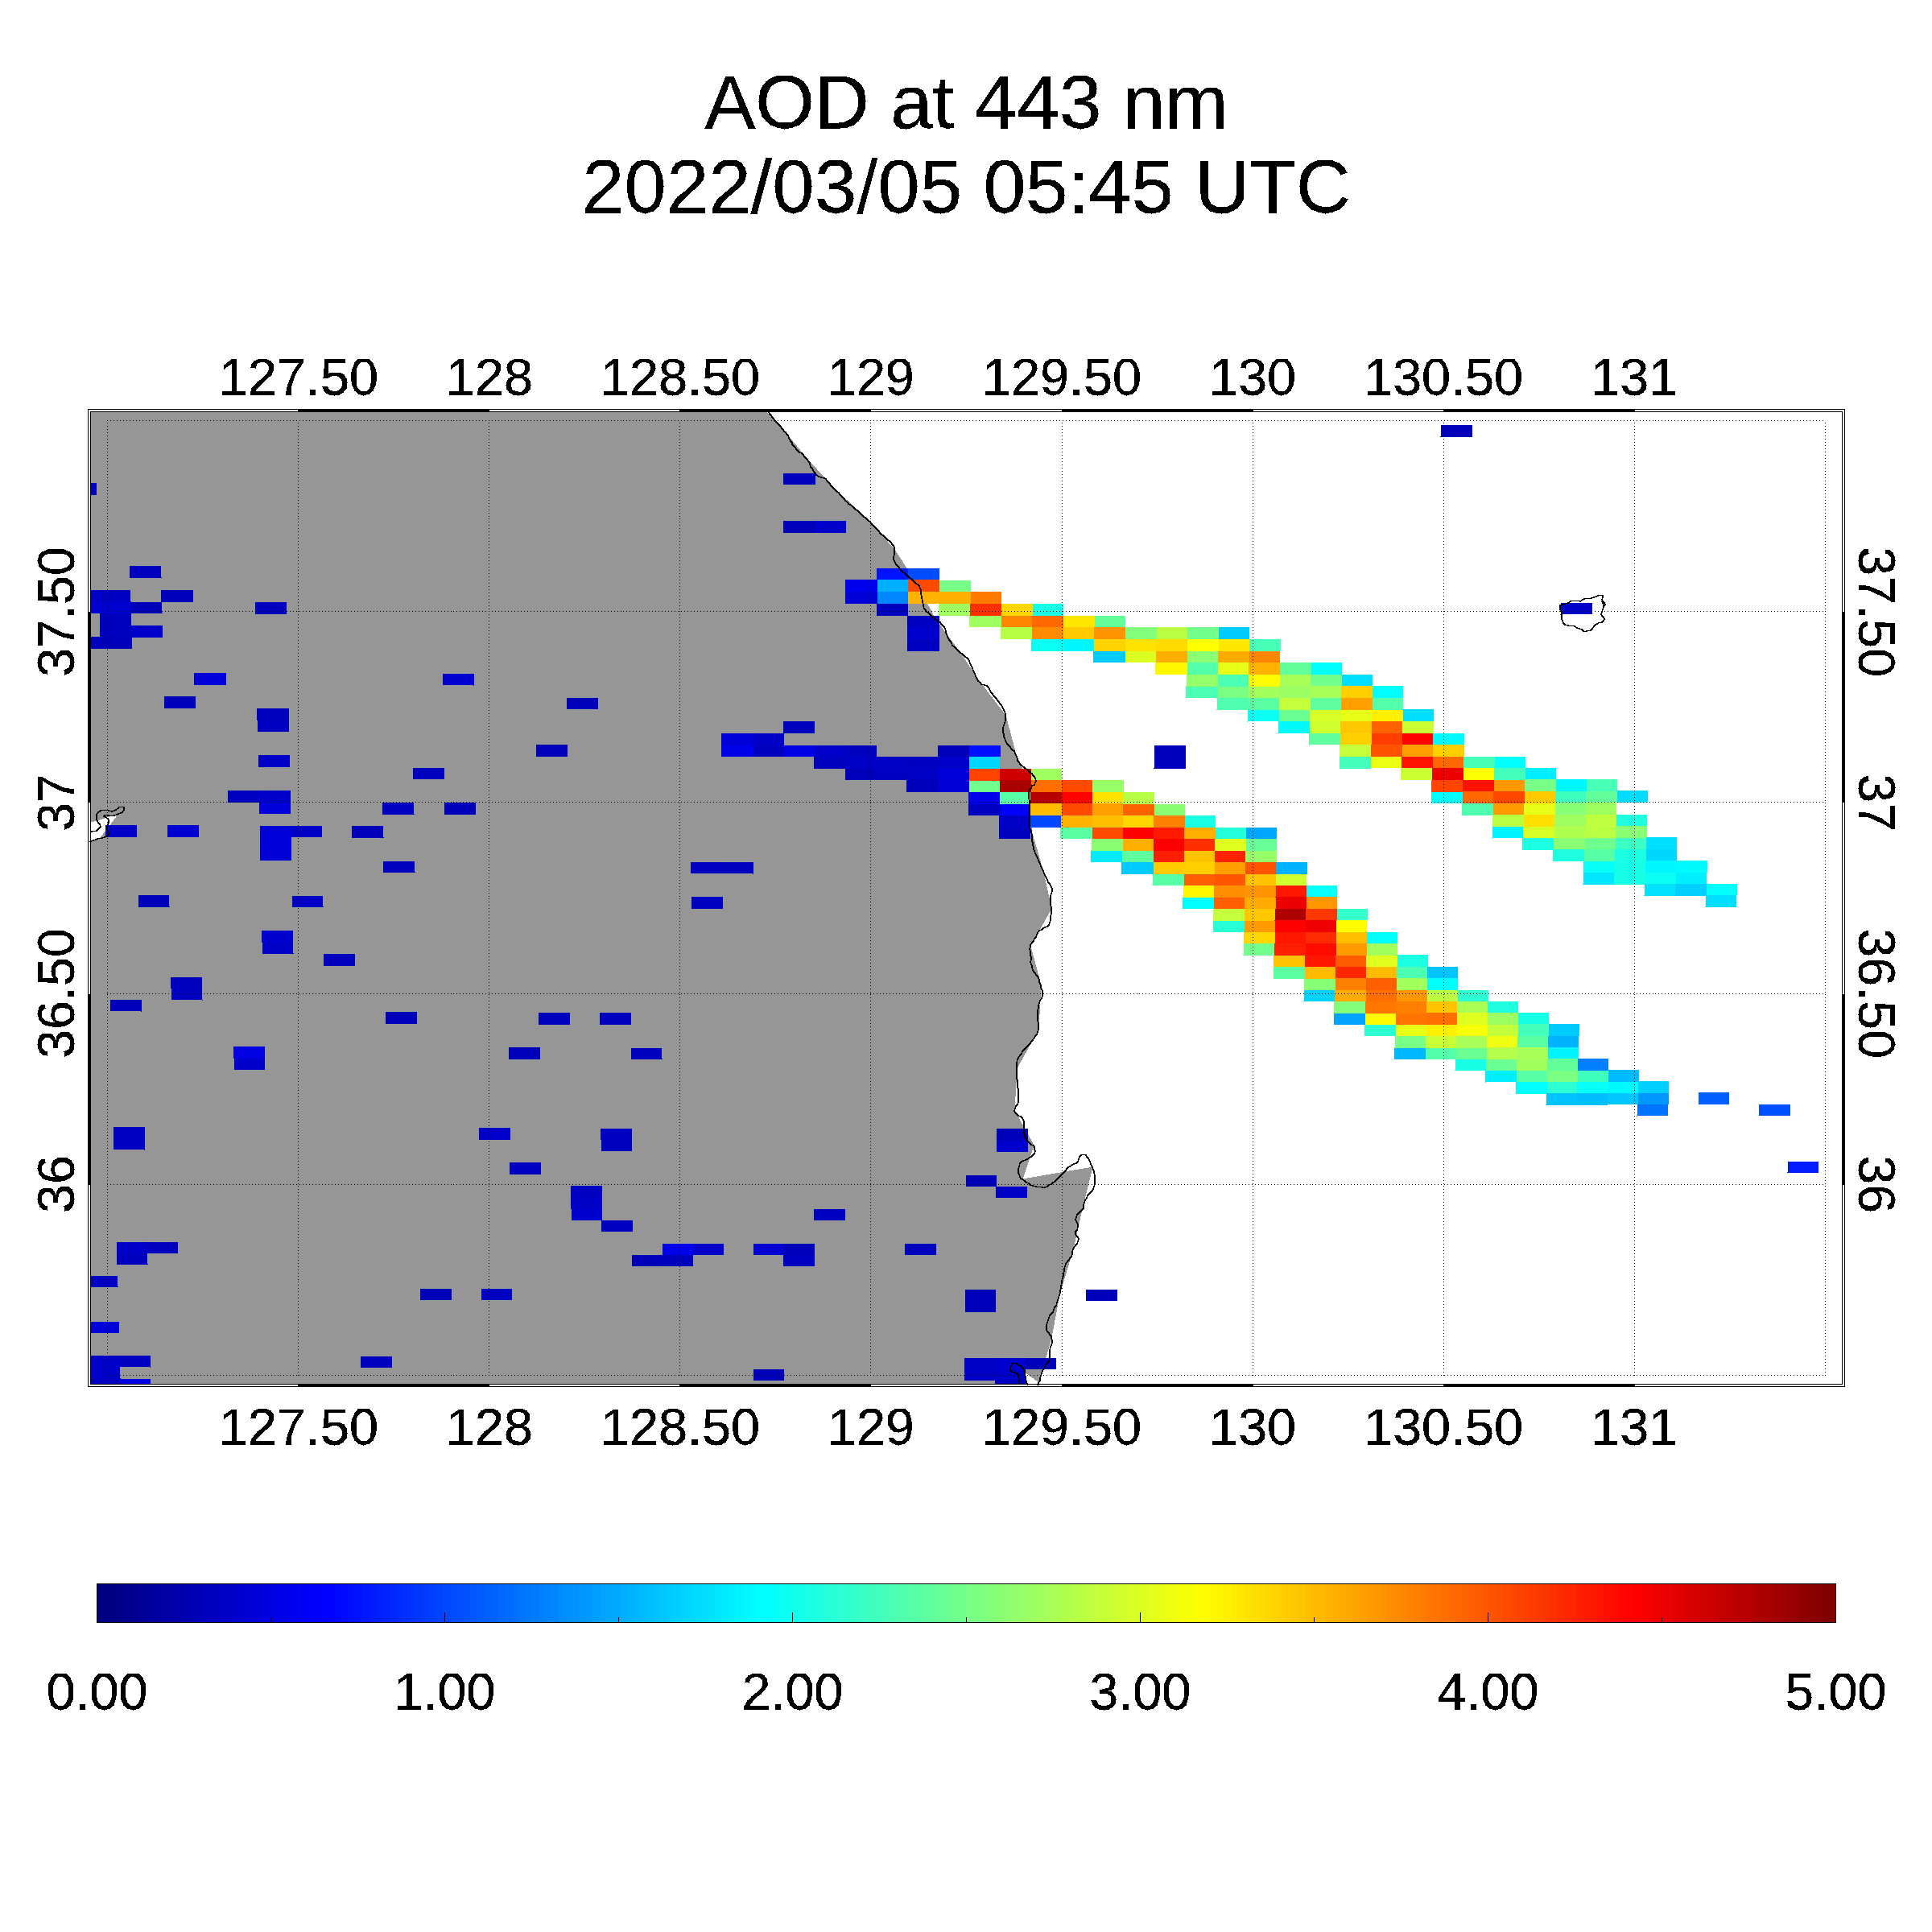
Case Study: GEMS ALH vs GEMS AEH (Mar. 4, 2022, Dust)

Slide 8
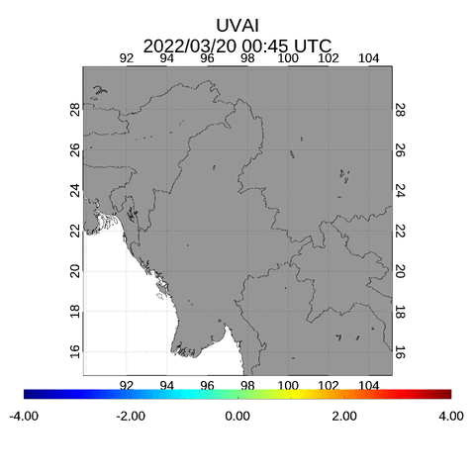
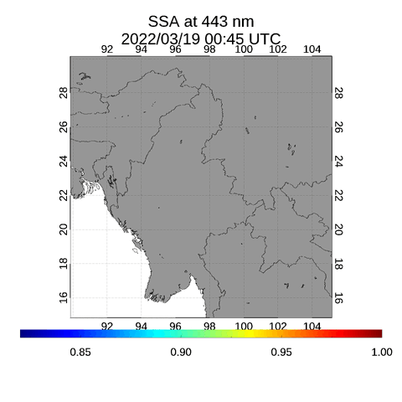
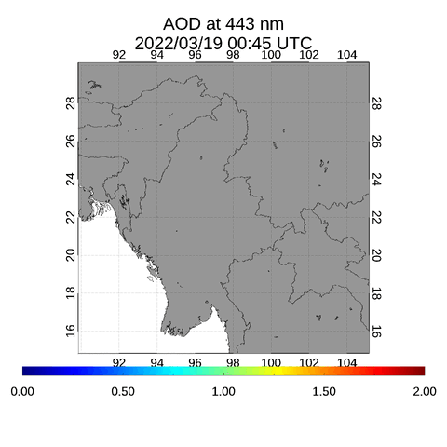


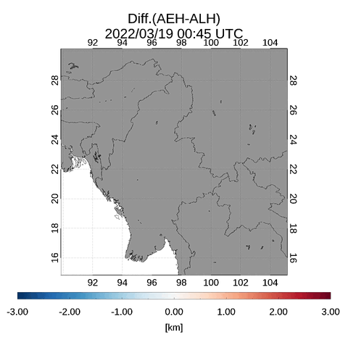
Case Study: GEMS ALH vs GEMS AEH (Mar. 19, 2022, Wildfire)

Slide 9
GEMS ALH vs GEMS AEH – According to Aerosol Type
Y2023-2024 : GEMS domain (AOD₄₄₃>0.5)
Case
AEH
ALH

Slide 10
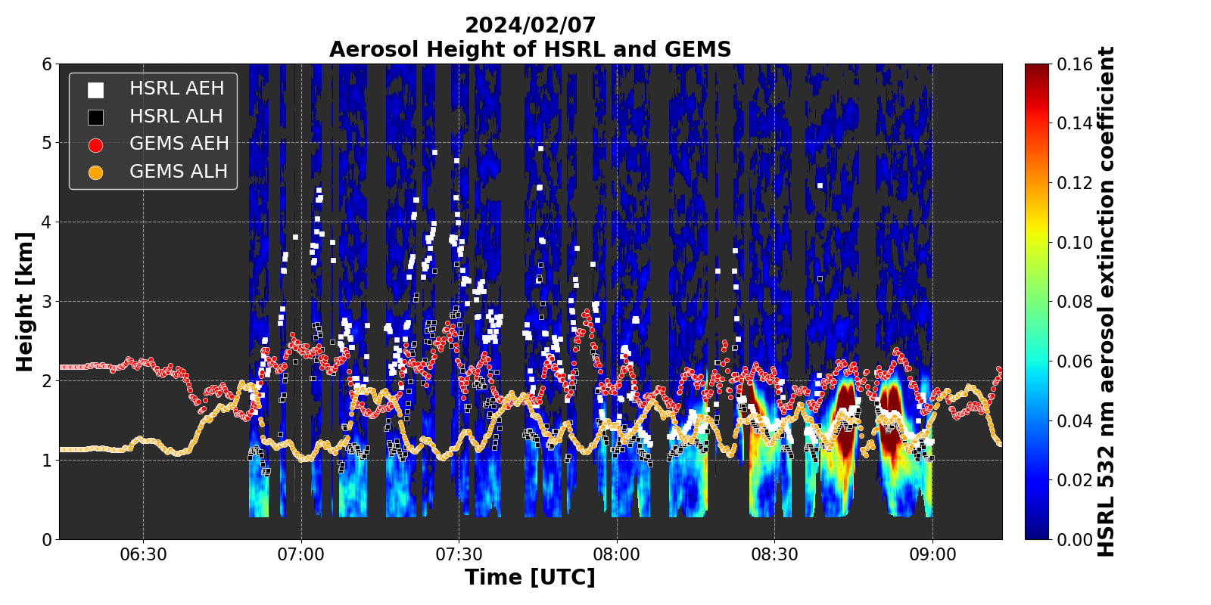
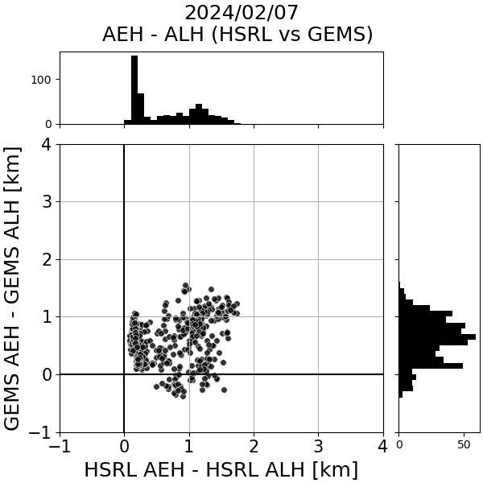
Further Study: AEH-ALH characteristics according to aerosol profiles

Slide 11
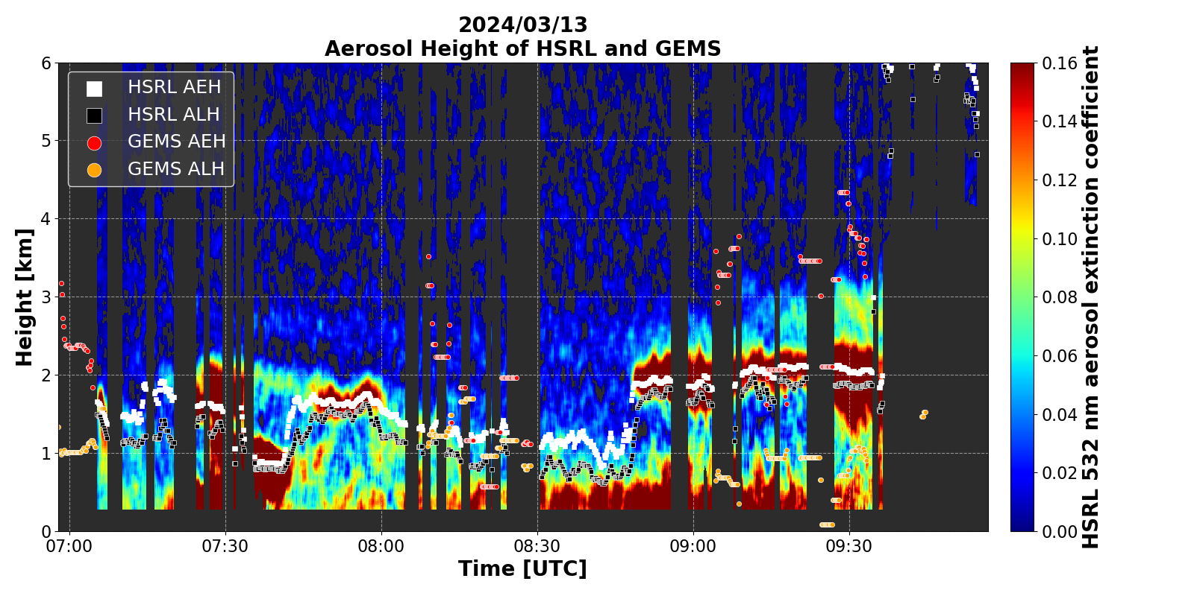
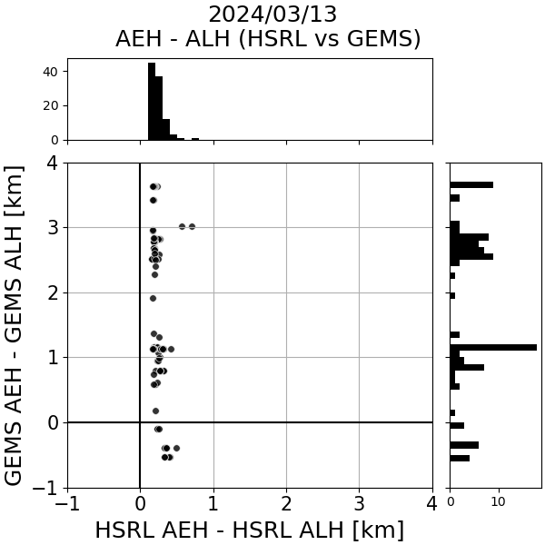
Further Study: AEH-ALH characteristics according to aerosol profiles

Slide 12
Summary
The GEMS retrieves both the ALH and AEH products by independent algorithm processes
  AEH: O₄ SCD from the L1C radiance by DOAS & Surface Pressure correction
  ALH: Optimal Estimation method (simultaneous estimation of AOD, SSA) from a-priori aerosol profile structure
From the case studies, the AEH-ALH shows the systematic biases. The systematic difference between AEH and ALH shows the significant aerosol type dependence.
The AEH-ALH difference is thought to be significant dependence of aerosol vertical profiles.
→ The ground-based lidar or HSRL (in ASIA-AQ campaign) case studies will be analyzed for the further study.
GEMS Retrieval results: Some improvement points are still remained.
  Surface Reflectance uncertainty effect over land
  Spectral uncertainty of AOD & Type Determination uncertainty

