Slide 1
TEMPO Nighttime Light: From First comparison with VIIRS-DNB and ISS Astronaut Photo to Circadian Stimulus
Zhixin (May) Xue¹ , Meng Zhou² , Jun Wang¹
¹The University of Iowa.
²University of Maryland
August 21, 2025

Slide 2
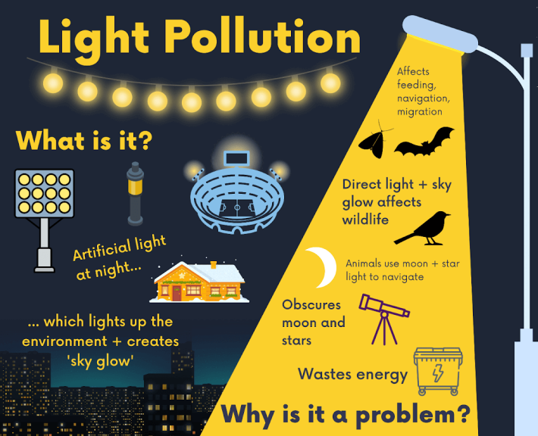
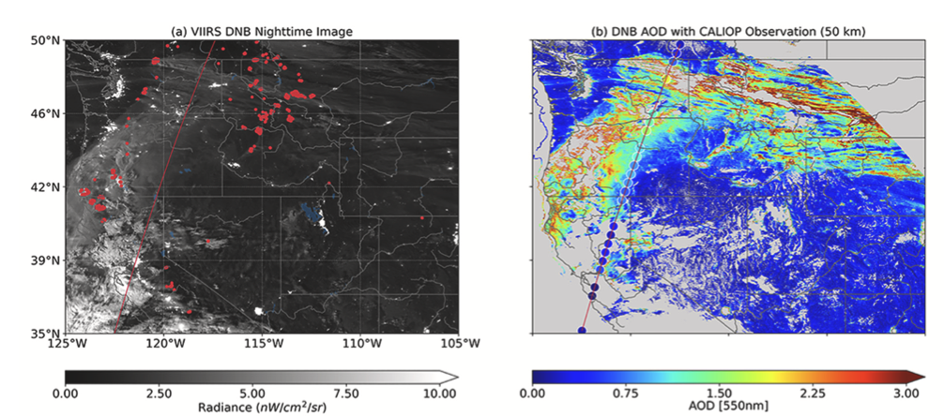
Why Nighttime data is important?
Artificial Light At Night (ALAN)
Nighttime aerosol monitoring
Improve the analysis and forecast of regional to global biomass-burning aerosol distributions
filling a critical gap in the diurnal description of a key element of Earth’s climate system
Too much blue light exposure at night may result in:
Disruption of wildlife
Impact to our circadian rhythms
Reduced concentration the next day
health issues
Zhou, M., Wang, J., Chen, X., Xu, X., Colarco, P.R., Miller, S.D., Reid, J.S., Kondragunta, S., Giles, D.M. and Holben, B., 2021. Nighttime smoke aerosol optical depth over US rural areas: First retrieval from VIIRS moonlight observations. Remote Sensing of Environment, 267, p.112717.

Slide 3
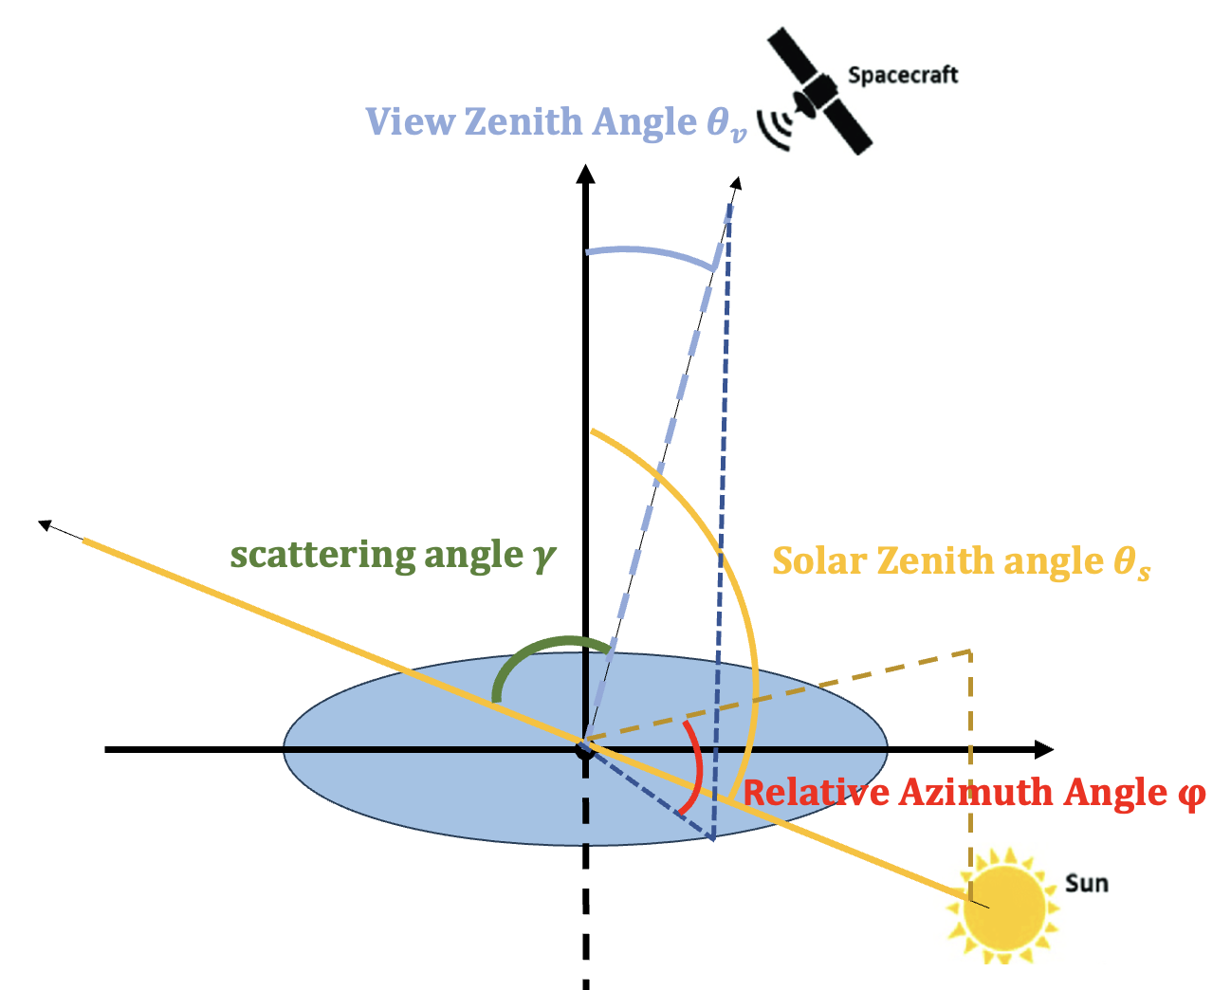
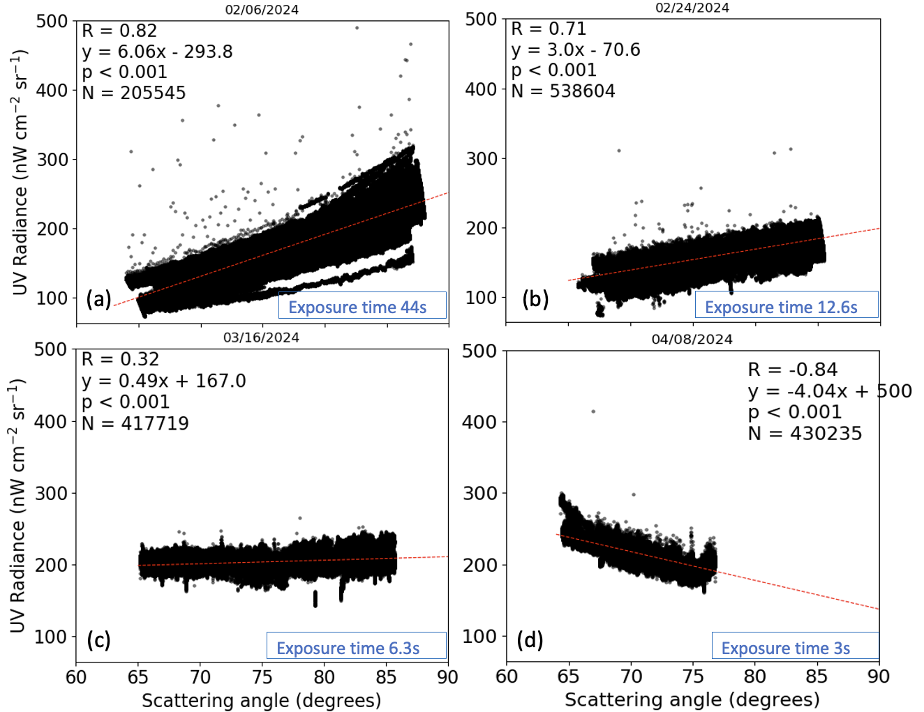
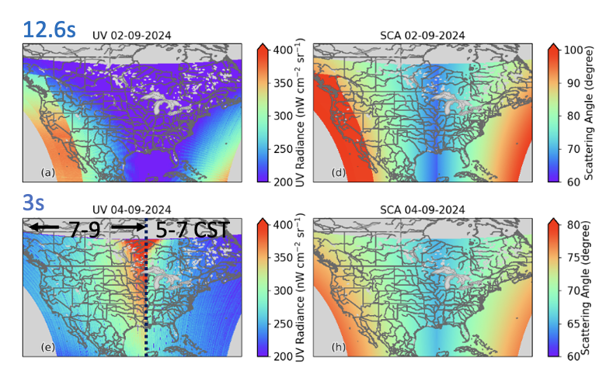
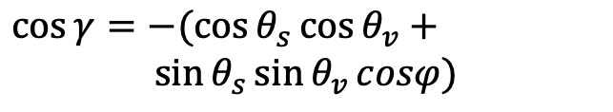
Scattering angle correction
• The correlation between SA and TEMPO UV radiances varies with different exposure time.
• The slope remains relative stable for each specific exposure time,
indicating a consistent geometric influence on radiance measurements.
$$\cos{γ}=−(\cos{θ_{s}}\cos{θ_{v}}+$$
$\sin{θ_{s}}\sin{θ_{v}}cosφ)$

Slide 4
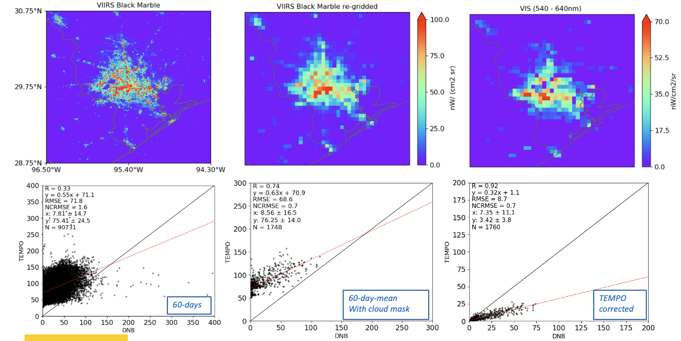
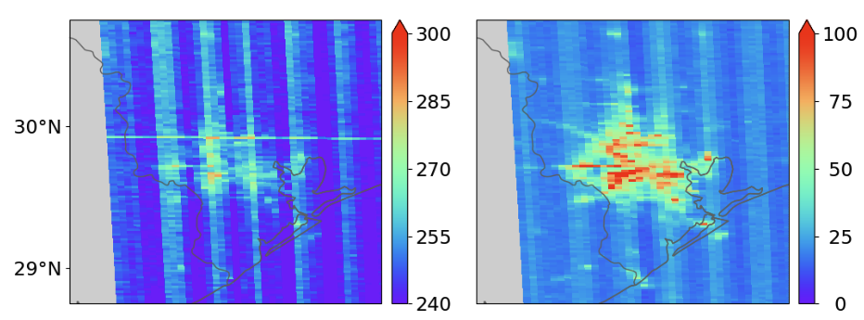
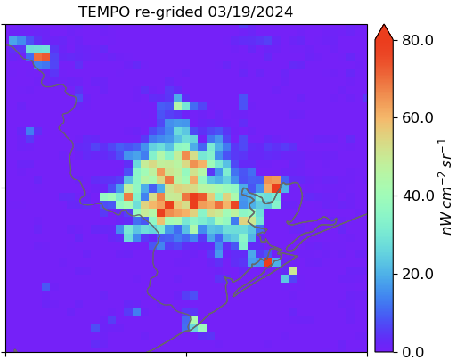
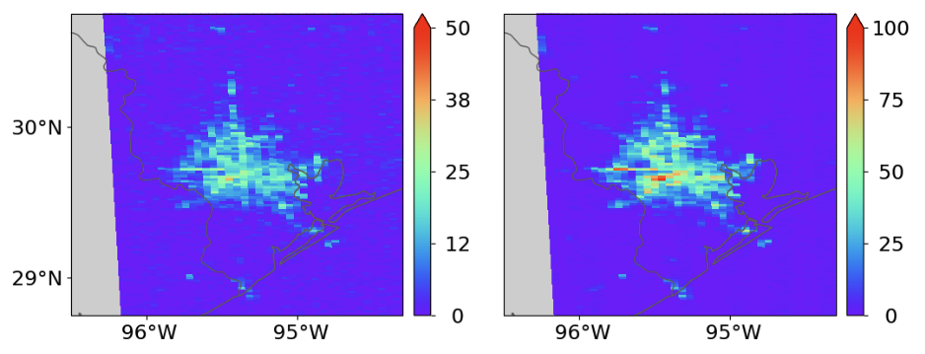
Scattering angle correction
April 23rd, 2024
290 - 490nm
540 - 640nm
Before correction
Background noise is effectively removed in the VIS channel, but some remains in the 290-490nm channel, likely due to moonlight, as April 23rd, 2024 coincided with a full moon.
After correction
Notes:
To edit map or change the state color:
1. Double click the state that you want to change.
2. Click ‘Shape Format’ tab, or right click and select the ‘Format Shape’ option.
3. Click the ‘Solid fill’ option and select one of the theme colors from the color menu.

Slide 5
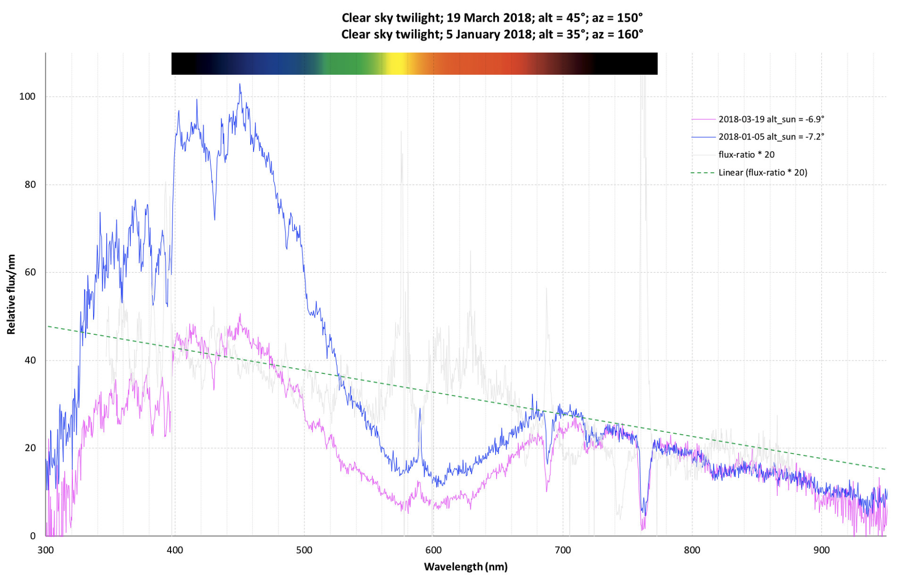
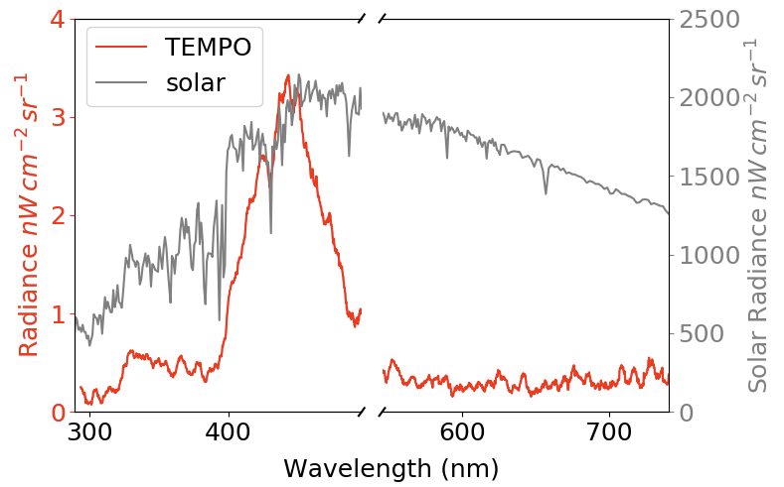
Twilight Spectra correction
Twilight spectra differ significantly from solar spectra due to atmospheric scattering, absorption, and geometry. They are more blue-shifted, and show enhanced atmospheric absorption features.
for artificial light at night, light bulbs are designed to minimize UV emission (<400nm)
By analyzing twilight spectra in the UV range (<400 nm), it becomes possible to estimate the direct twilight contribution. This, in turn, allows for isolating and quantifying the city light signal.

Slide 6
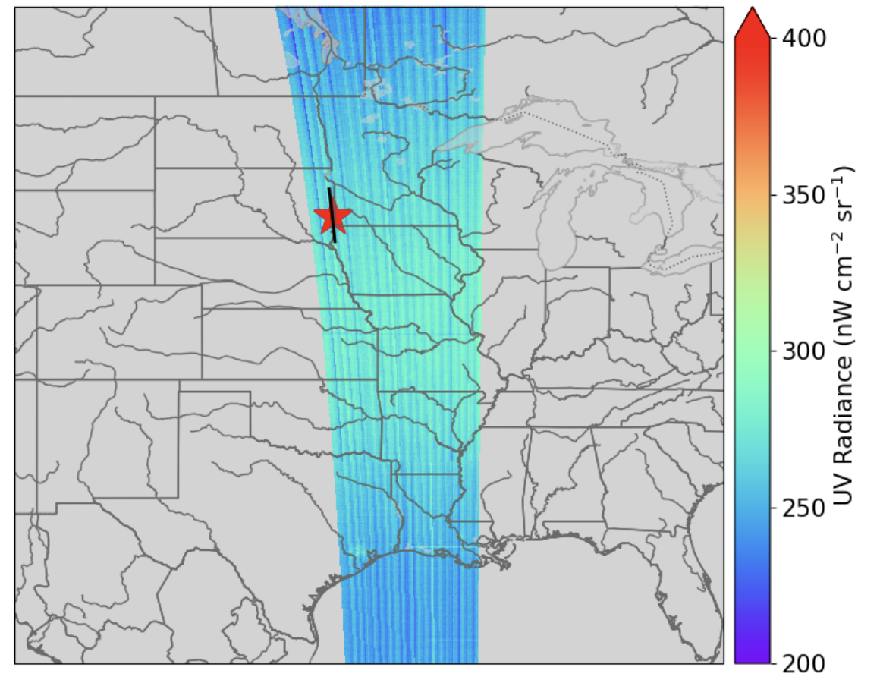
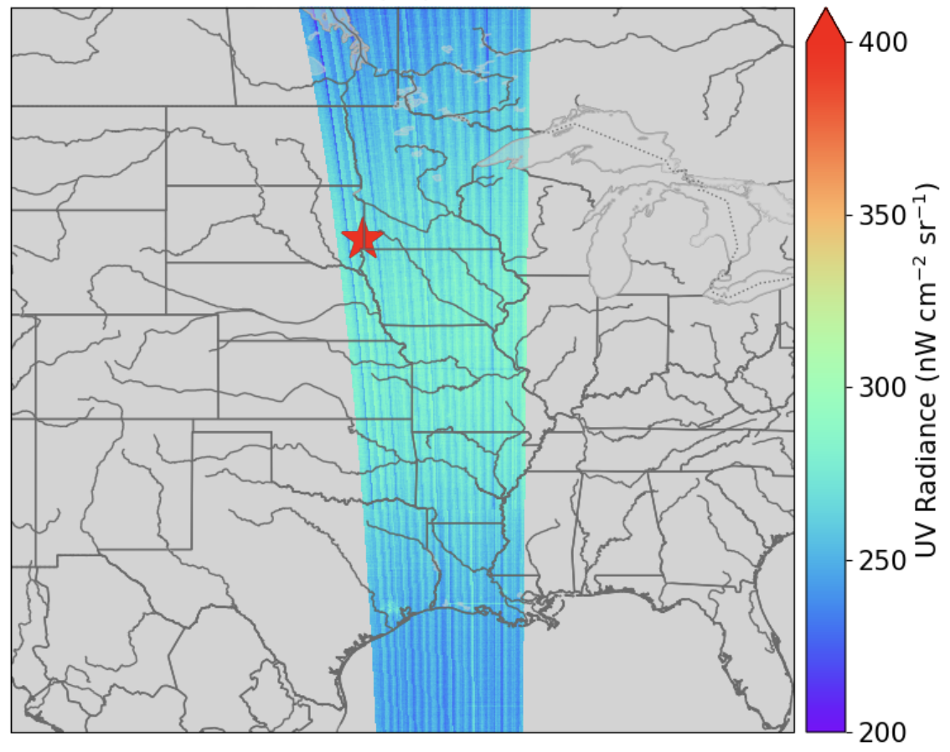
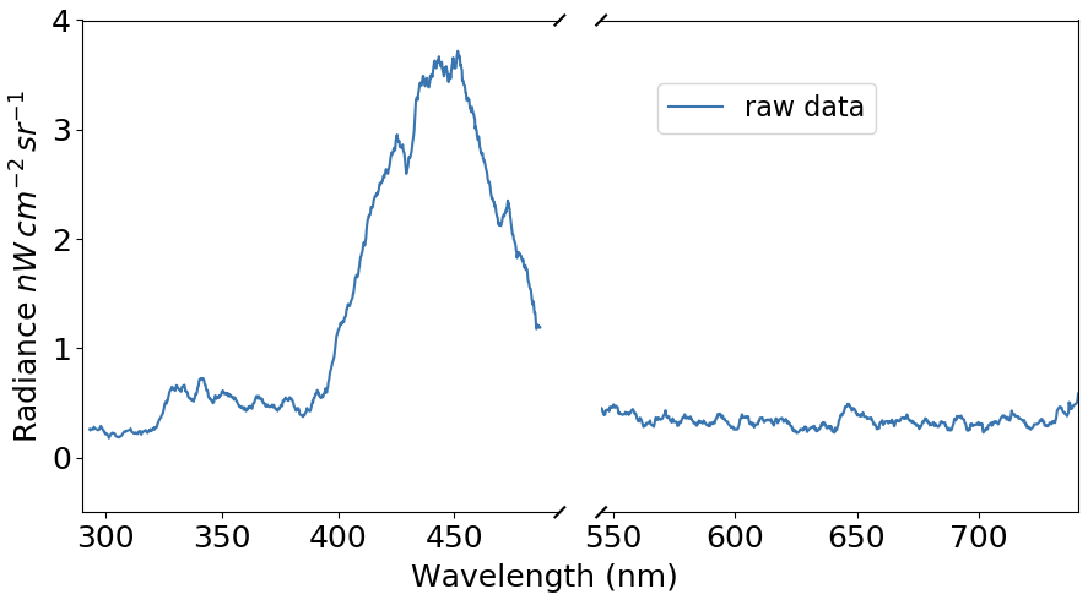
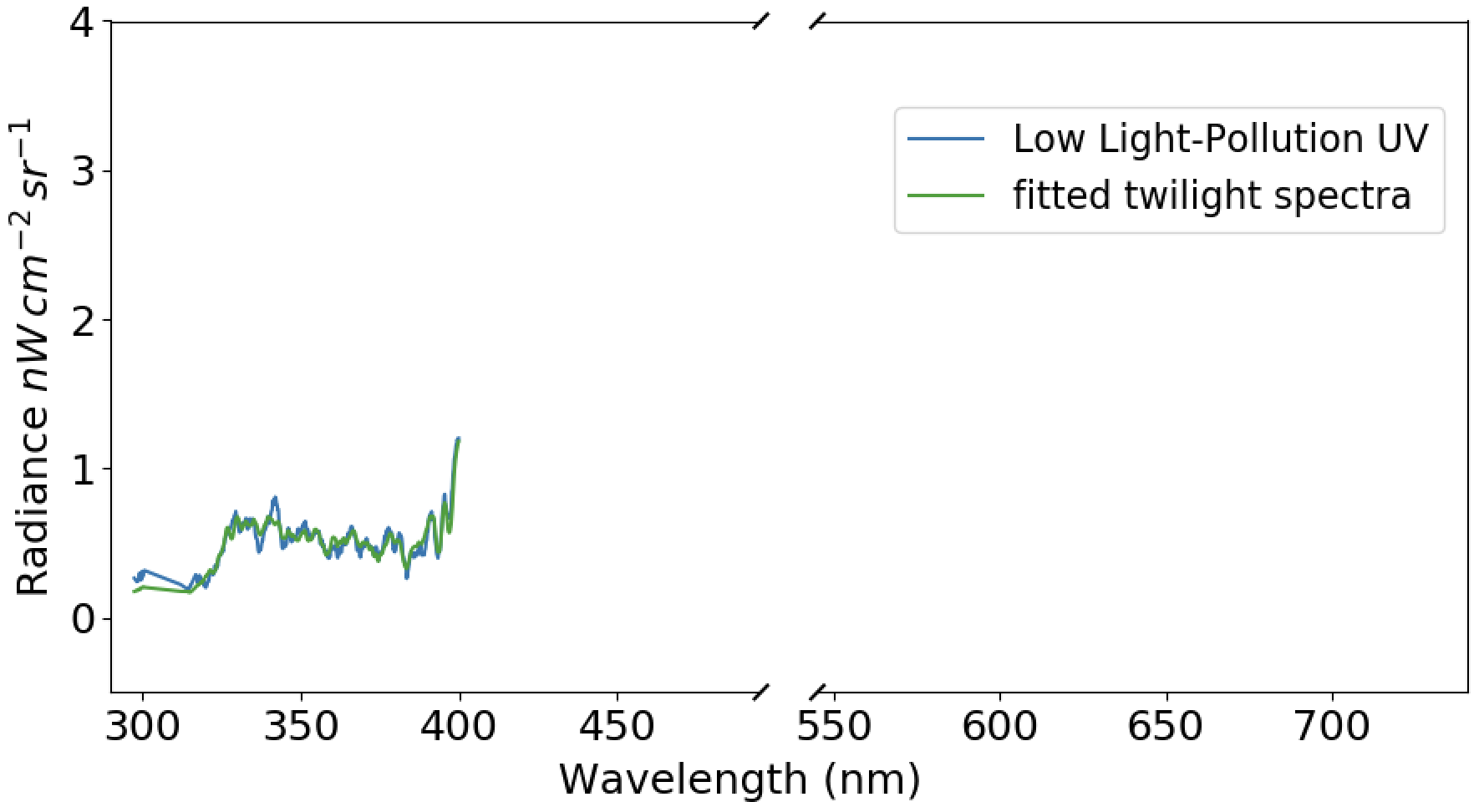
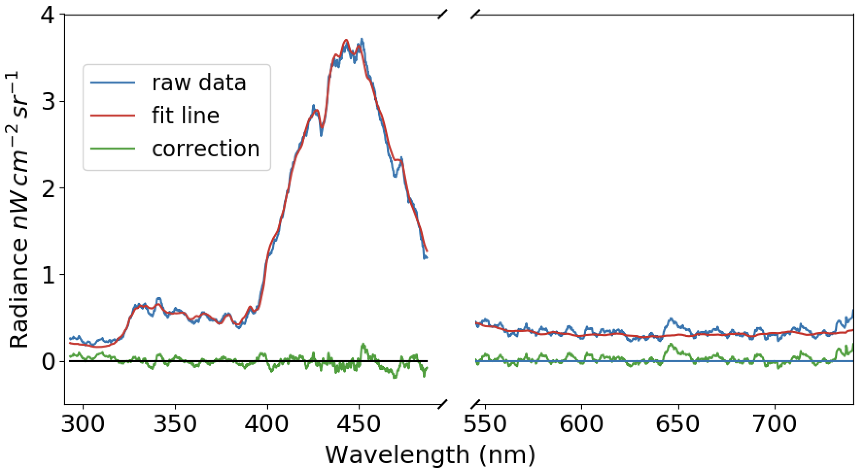
Twilight Spectra correction
Background estimated using the median across nearby pixels (per wavelength).
A narrow spatial window is used, assuming stable surface properties.
This method captures and removes twilight + moonlight contributions.

Slide 7
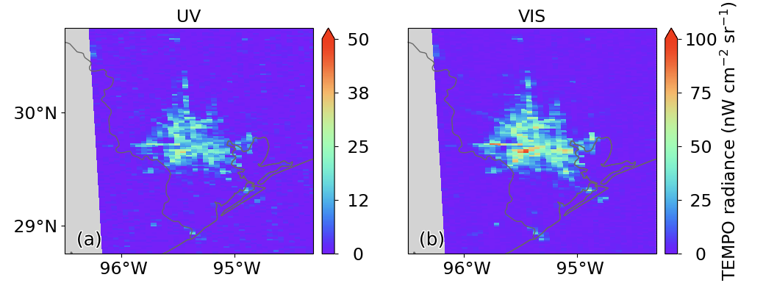
Twilight Spectra correction
the VIS The VIS map remains clear, and the UV map shows noticeably reduced background noise

Slide 8
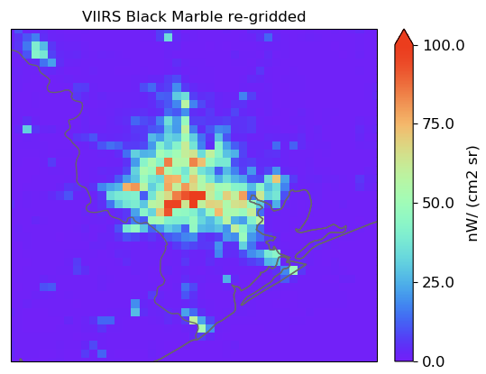
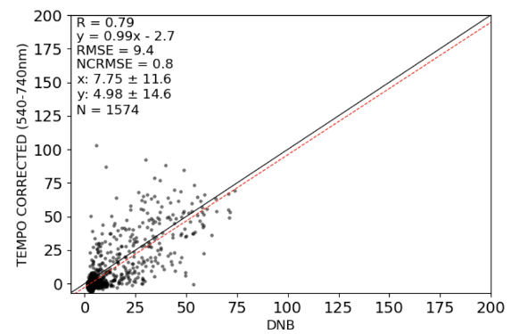
Pixel-by-Pixel Comparison: TEMPO vs. VIIRS Black Marble
Differences arise from sensor wavelength ranges, spectral response functions, and observation times.
Variations in light-source composition further affect results (e.g., high-pressure sodium lamps emit at ~820 nm, outside TEMPO’s range but within DNB’s, leading to higher Black Marble signals).

Slide 9
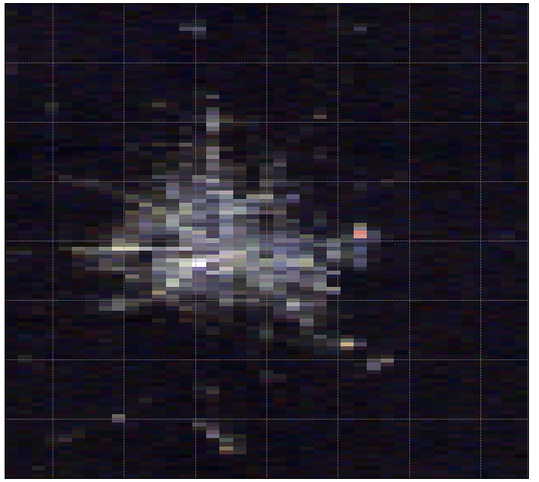
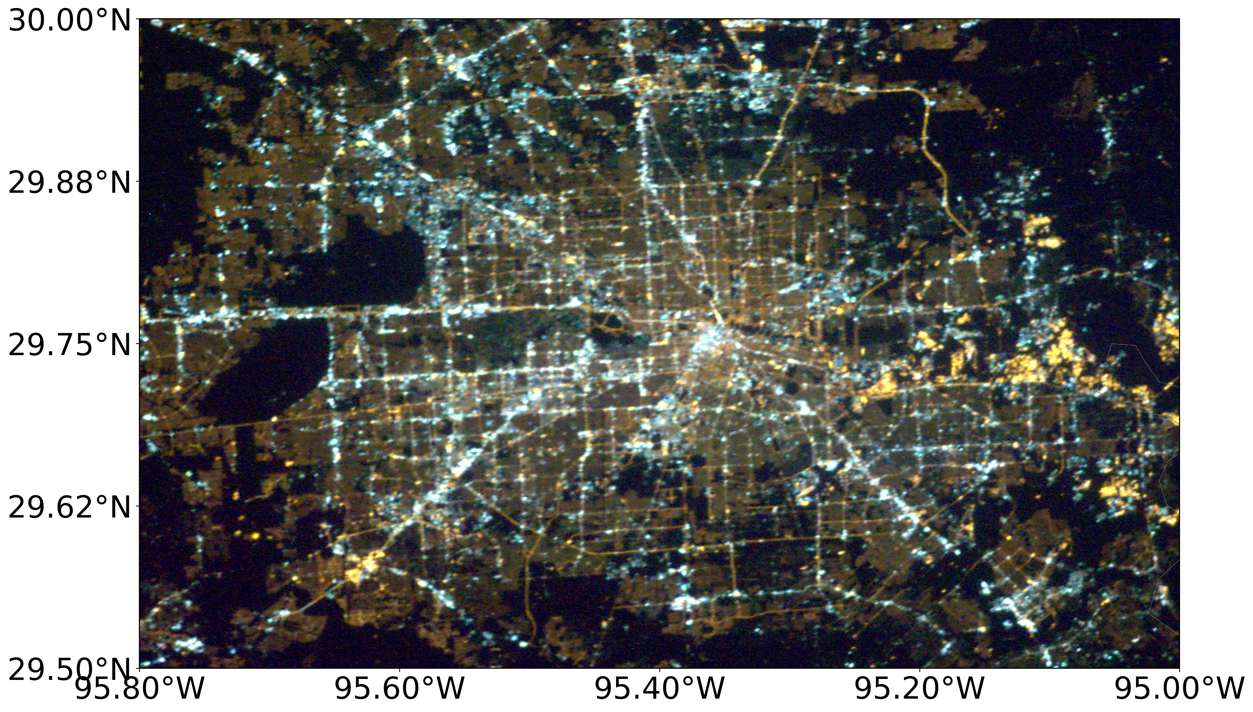
TEMPO vs. ISS Astronaut Photo
RGB image

Slide 10
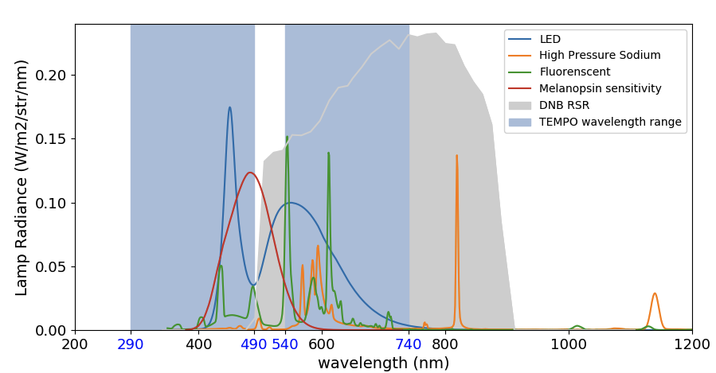
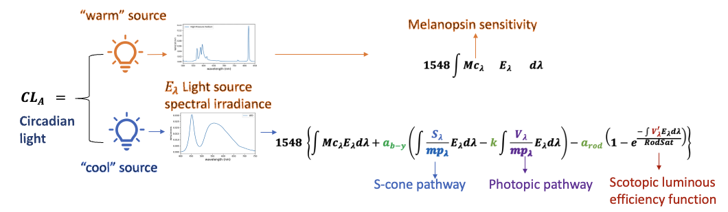
Circadian light model
Circadian light is directly linked to the suppression of melatonin, with blue light playing a dominant role in circadian light calculations.
Rea, M.S., Figueiro, M.G., Bullough, J.D. and Bierman, A., 2005. A model of phototransduction by the human circadian system. Brain Research Reviews, 50(2), pp.213-228.

Slide 11
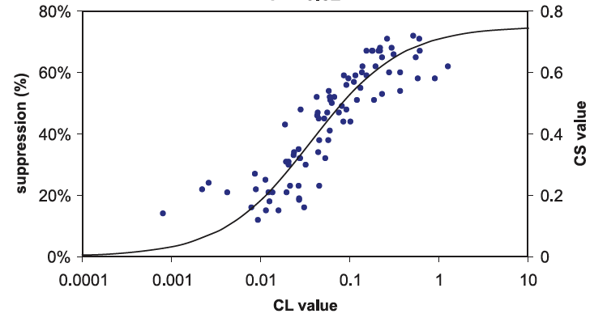
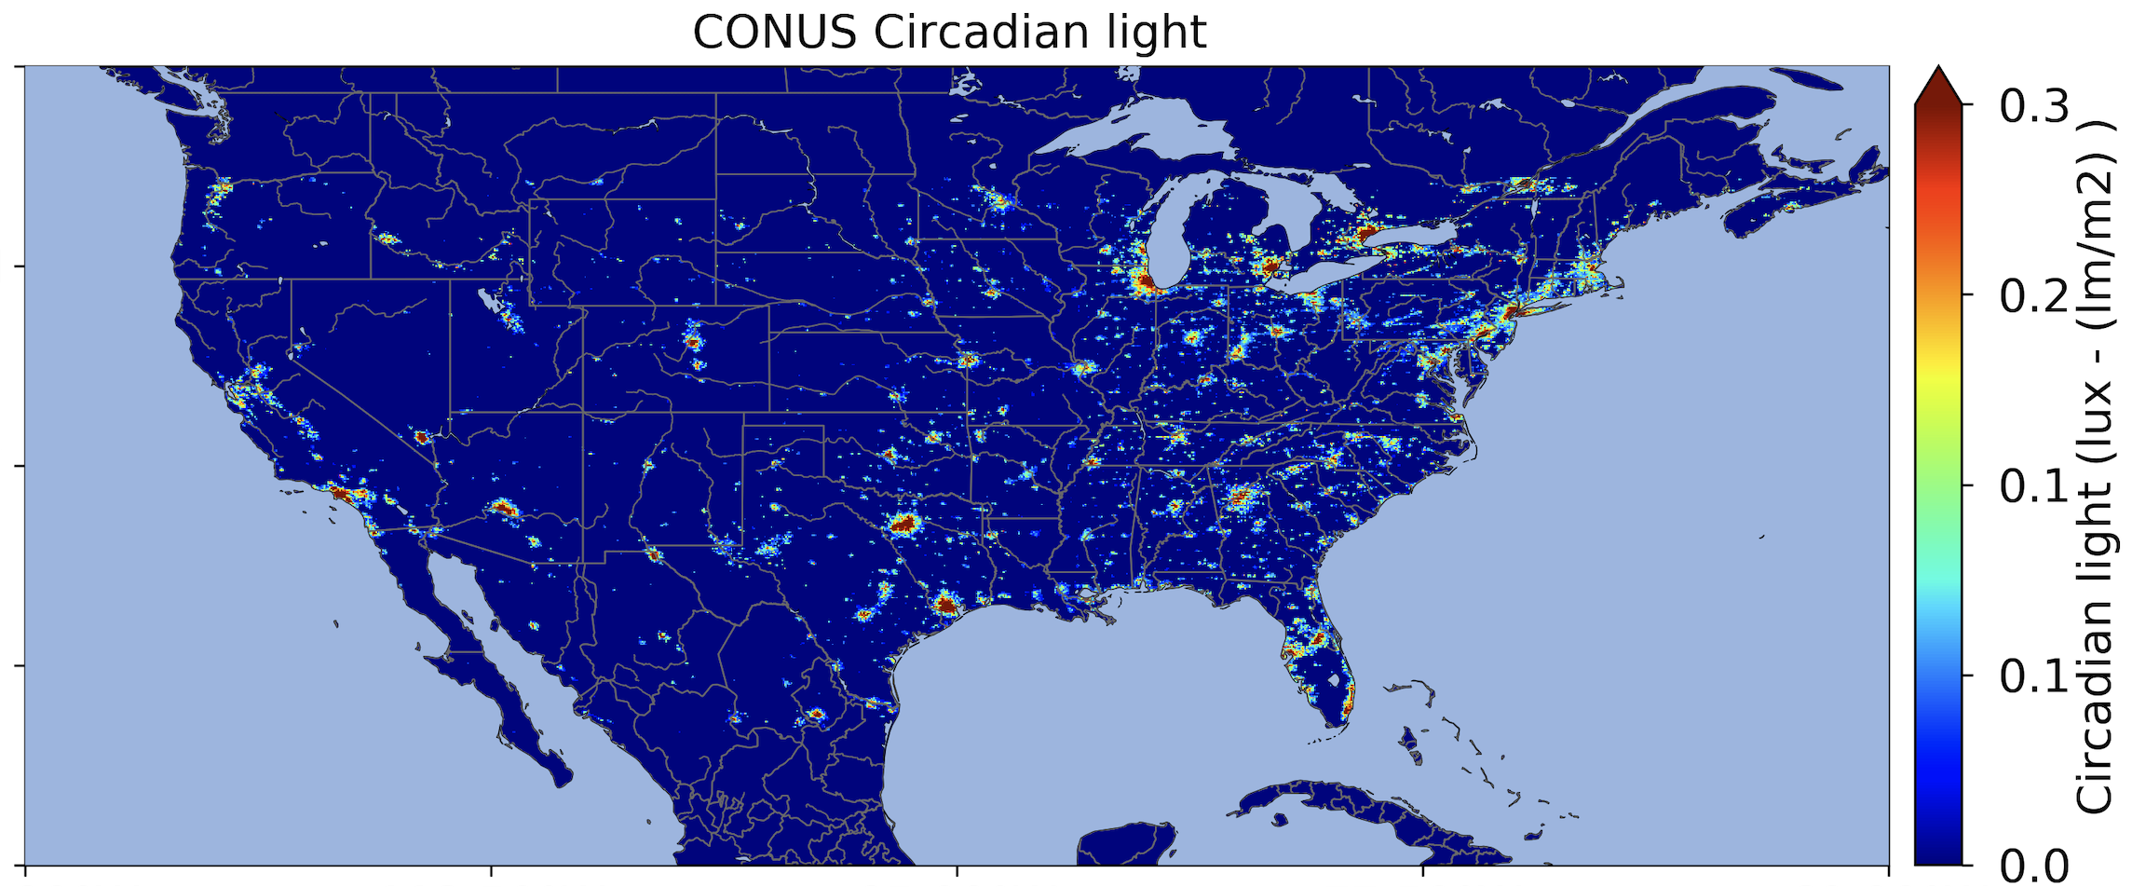
Circadian light map
Dallas and Houston areas exhibit both the highest circadian light levels and the largest geographic extent.

Slide 12
Summary
Both correction methods effectively remove background noise in TEMPO nighttime observations, producing results comparable to ISS astronaut photos and VIIRS-DNB data.
Combining both methods further reduces background residue, particularly in the blue channel.
After correction, TEMPO data offers valuable insights for spectral analysis of nighttime city lights, enabling a deeper understanding of their effects on light pollution and public health.
Notes:
To edit map or change the state color:
1. Double click the state that you want to change.
2. Click ‘Shape Format’ tab, or right click and select the ‘Format Shape’ option.
3. Click the ‘Solid fill’ option and select one of the theme colors from the color menu.

Slide 13
Thank you
Zhixin (May) Xue
zhixin-xue@uiowa.edu
uiowa.edu

Slide 14
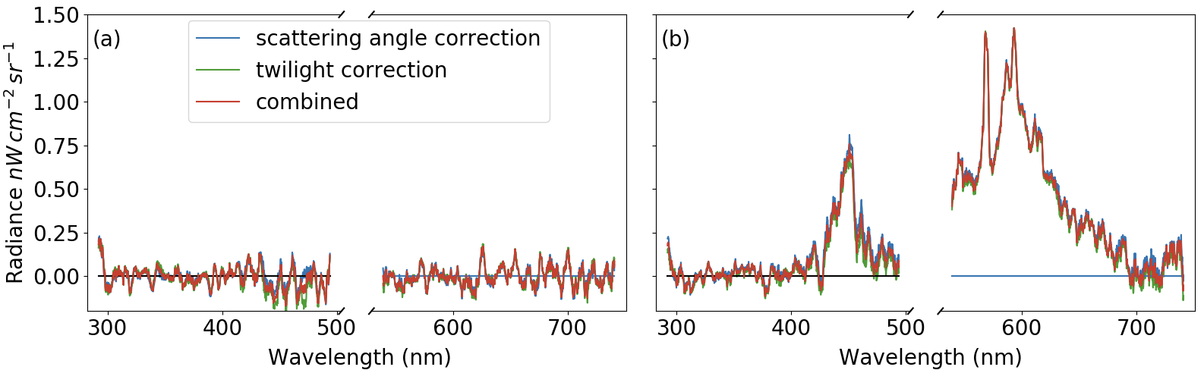
Twilight Spectra correction
The radiance values corrected by the two methods are similar in the visible (VIS) range. However, the twilight spectra method yields noticeably lower correction values in the blue channel (450–490 nm).

Slide 15
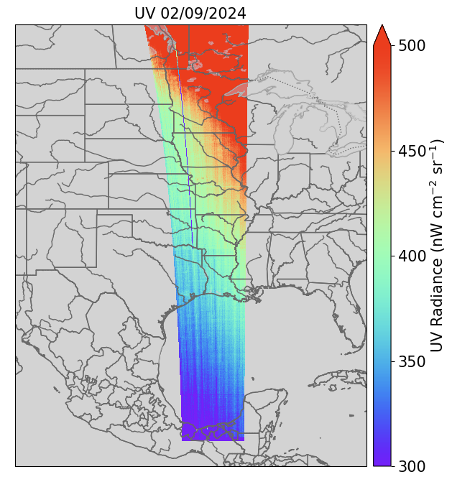
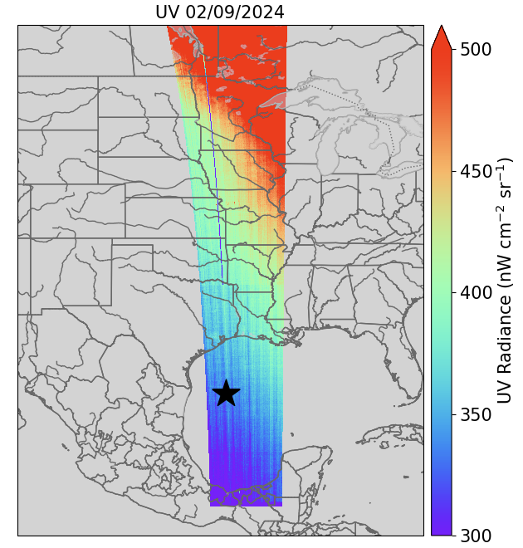
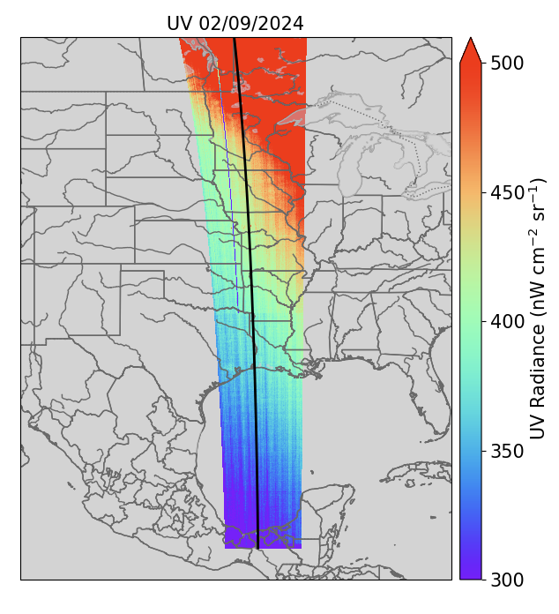
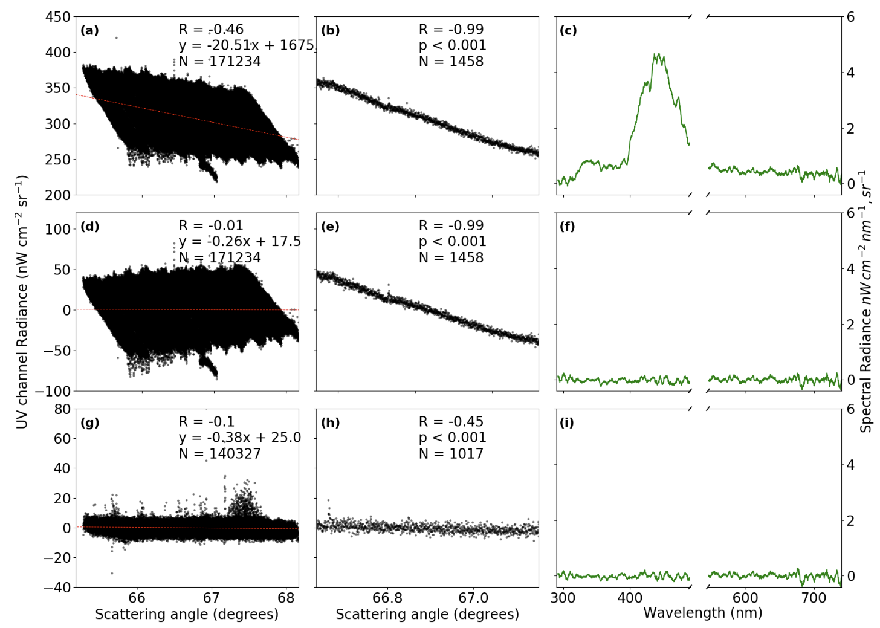
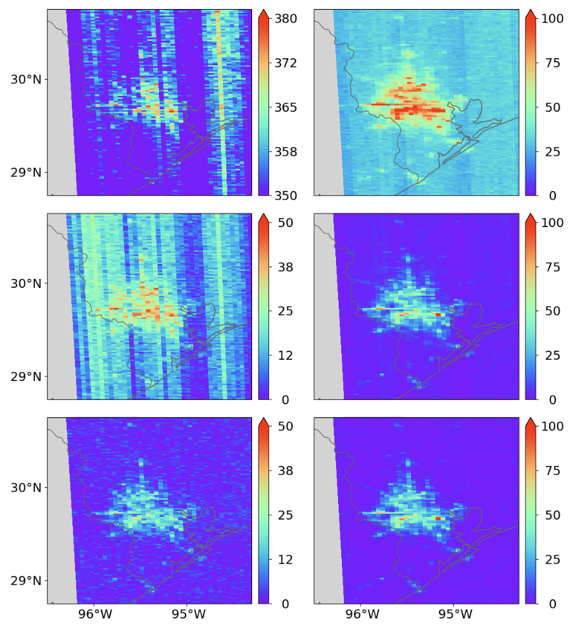
Scattering angle correction
Step
1
2
3

Slide 16
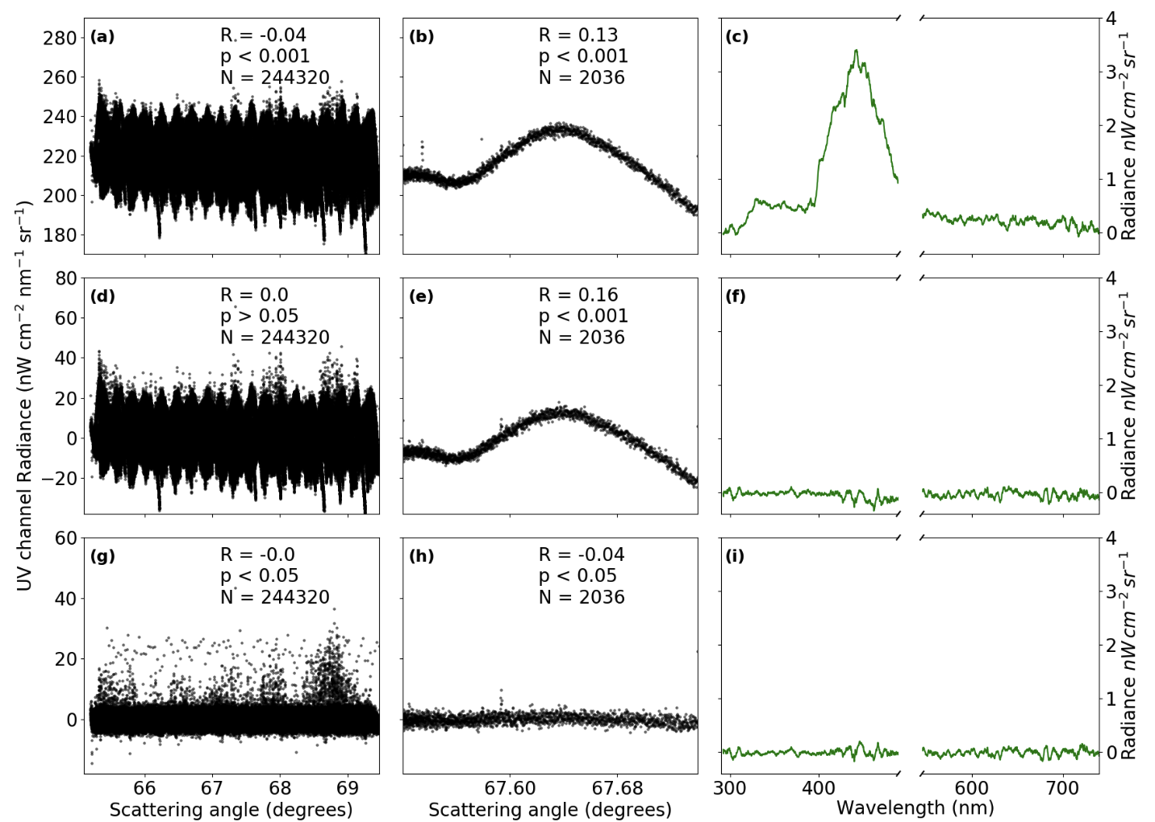
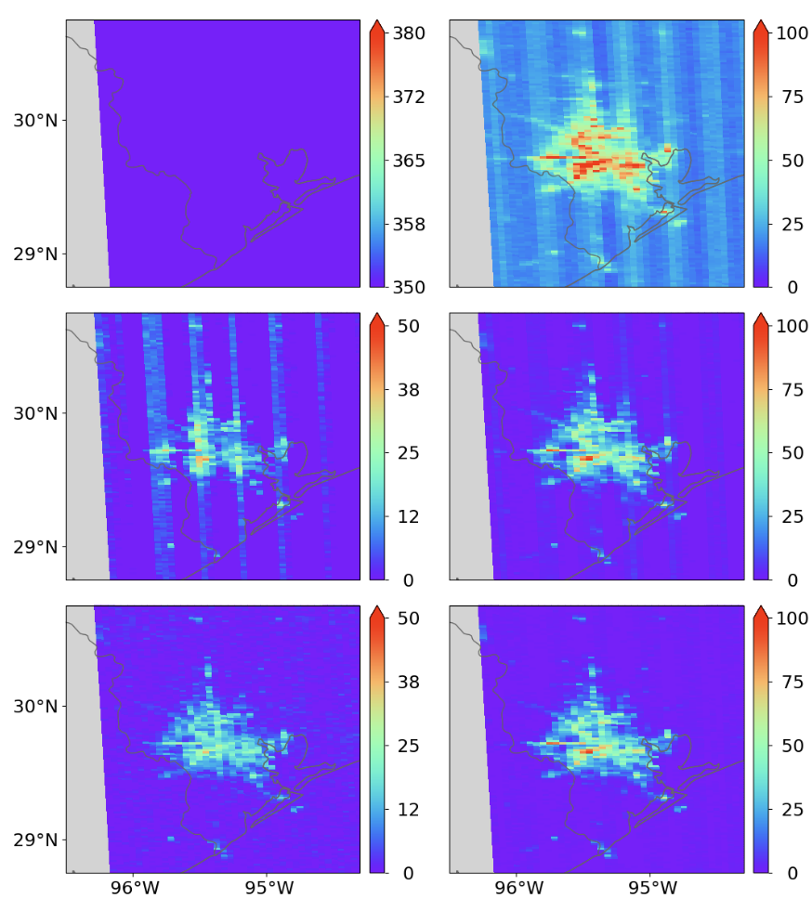
Notes:
To edit map or change the state color:
1. Double click the state that you want to change.
2. Click ‘Shape Format’ tab, or right click and select the ‘Format Shape’ option.
3. Click the ‘Solid fill’ option and select one of the theme colors from the color menu.

Slide 17
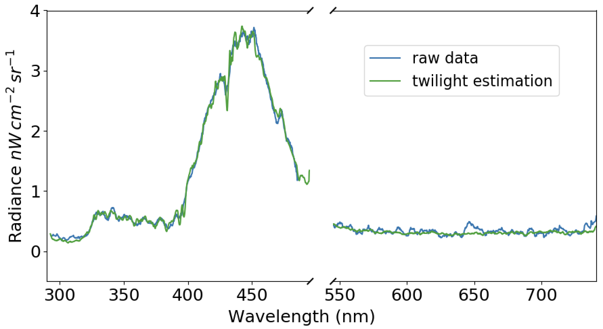
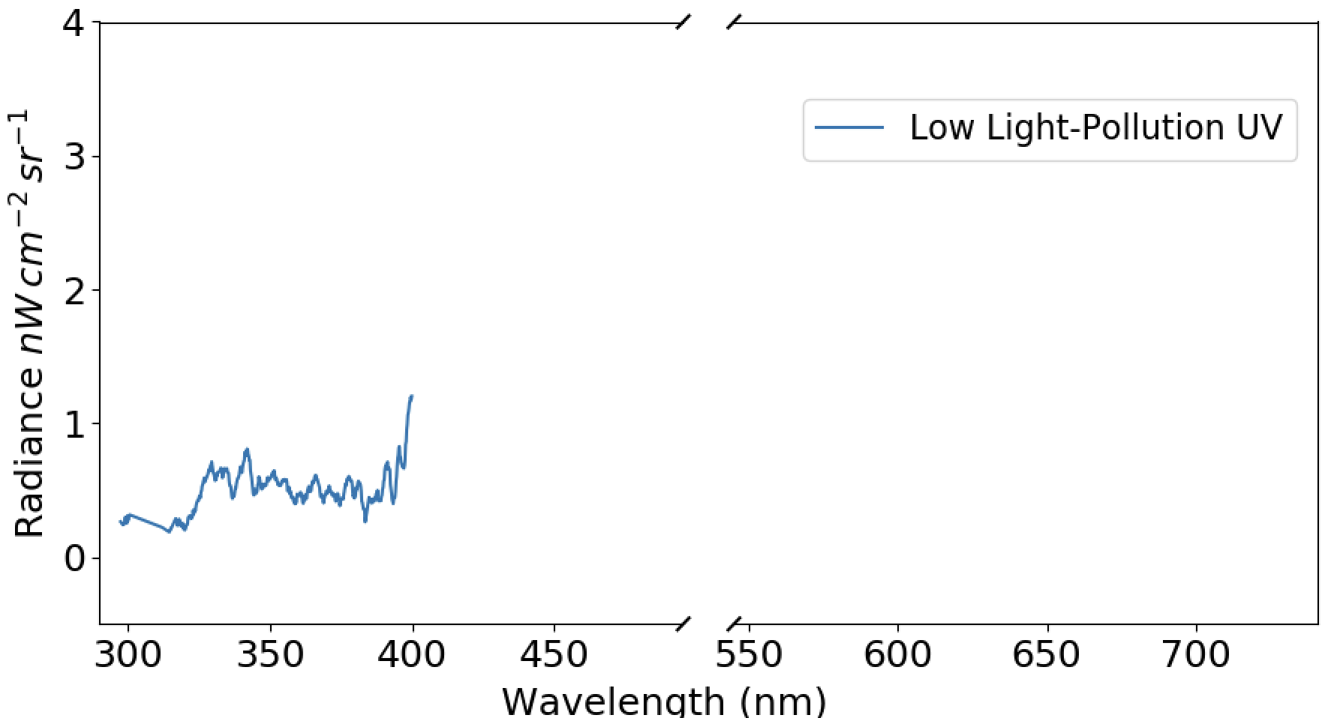
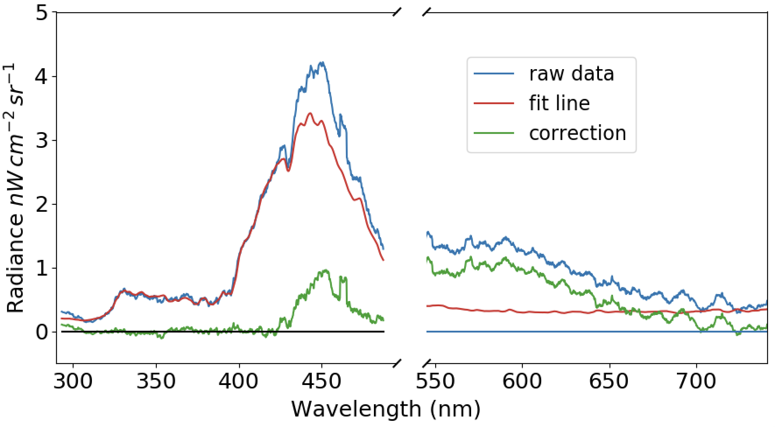
Twilight Spectra correction
Background Correction Process (per scan line):
Moving Window: Slide a 100-pixel-wide window along the vertical scan line.
Twilight Spectrum Estimation: At each window, compute the median spectrum to estimate the twilight background.
Linear Regression (per pixel):
Use 290–390 nm range (minimal city light) for regression between the pixel spectrum and twilight background.
Predict background over 390–490 nm and 540–740 nm using the fitted model.
Background Subtraction: Subtract the estimated background from the original spectrum for correction.

Slide 18
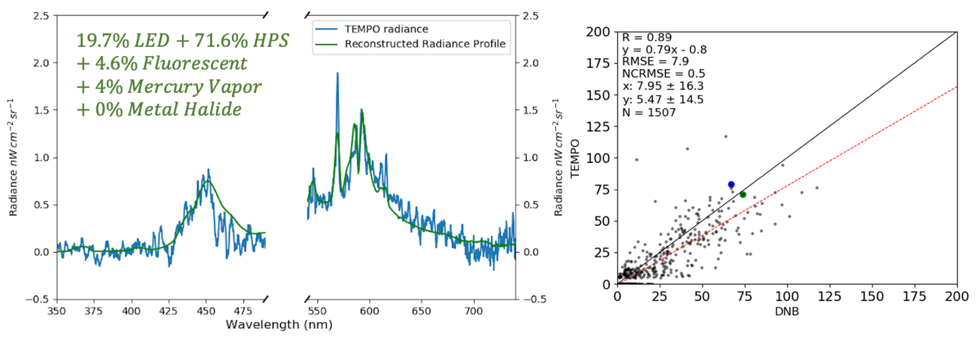
Notes:
To edit the bar chart:
1. Right click on the bar chart above.
2. Select ‘Edit Data in Excel’.
3. Enter your data in the Excel spreadsheet pop-up box including axis labels.
4. If your data contains more than 4 rows of data, select the blue highlight box in the lower right hand corner of your Excel spreadsheet pop-up box.
5. Drag the blue box down until all rows and columns in your dataset are contained within the box.
6. Color will populate your chart automatically, but to customize colors, click on a bar and select your preferred color.

Slide 19
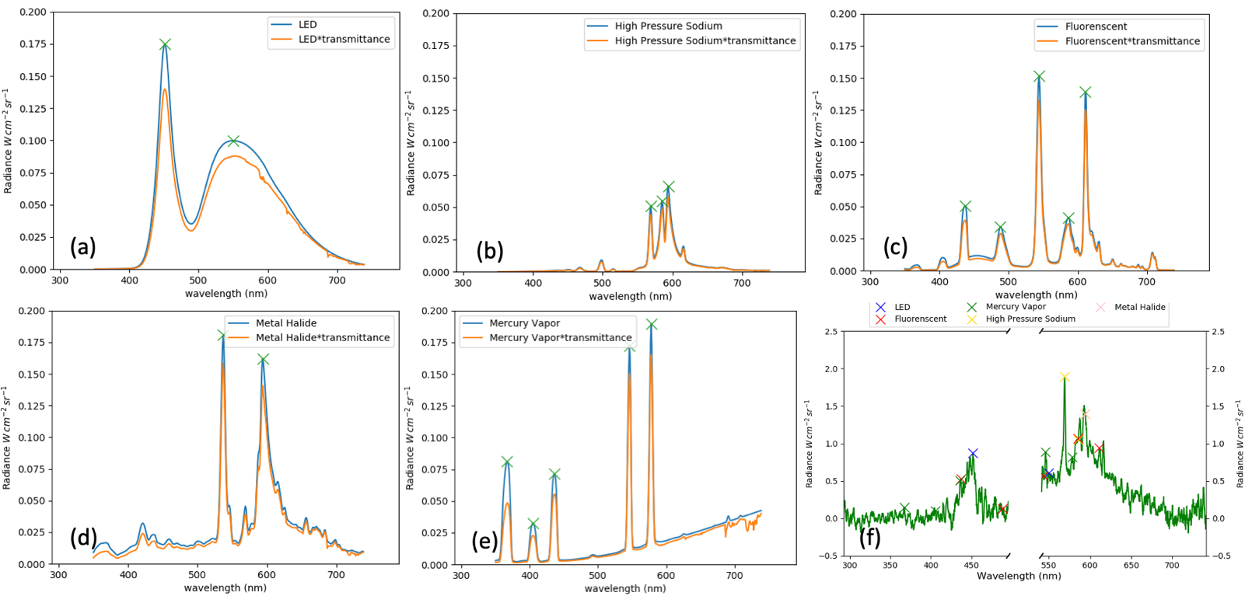
Notes:
To edit the pie chart:
1. Right click on the pie chart above.
2. Select ‘Edit Data in Excel’.
3. Enter your data in the Excel spreadsheet pop-up box including axis labels.
4. If your data contains more than 4 rows of data, select the blue highlight box in the lower right hand corner of your Excel spreadsheet pop-up box.
5. Drag the blue box down until all rows and columns in your dataset are contained within the box.
6. Color will populate your chart automatically, but to customize colors, click on a wedge and select your preferred color.

Slide 20
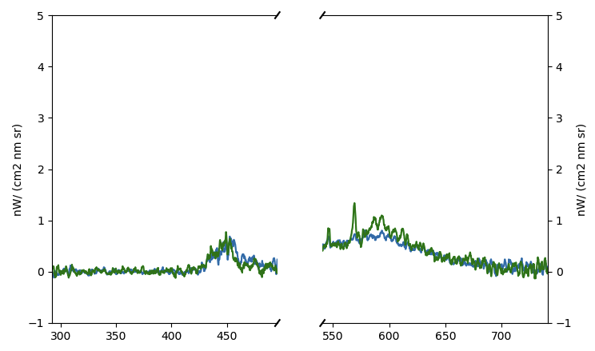
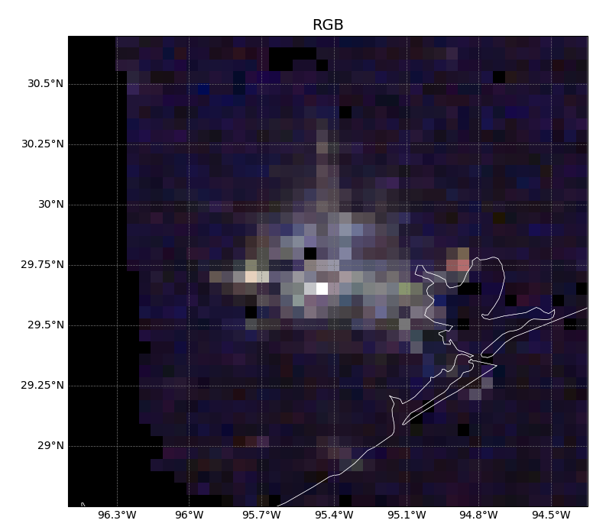
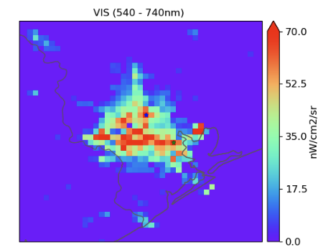
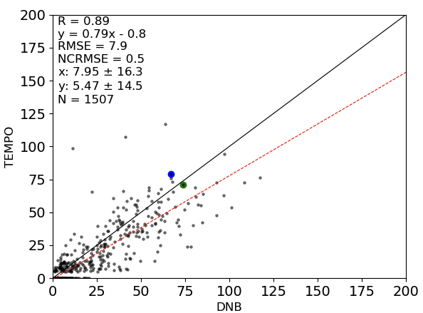
c | Ratio (TEMPO 540-640/DNB) | Ratio (TEMPO 540-740/DNB)
LED | 0.9 | 1.11
High Pressure Sodium | 0.82 | 0.92
Fluorenscent | 1.17 | 1.3
Mercury Vapor | 0.27 | 0.53
Metal Halide | 0.64 | 0.86

Slide 21
Notes:
To edit map or change the county color:
1. Click the county you want to change.
2. Click ‘Shape Format’ tab, or right click and select the ‘Format Shape’ option.
3. Click the ‘Solid fill’ option and select one of the theme colors from the color menu.

Slide 22
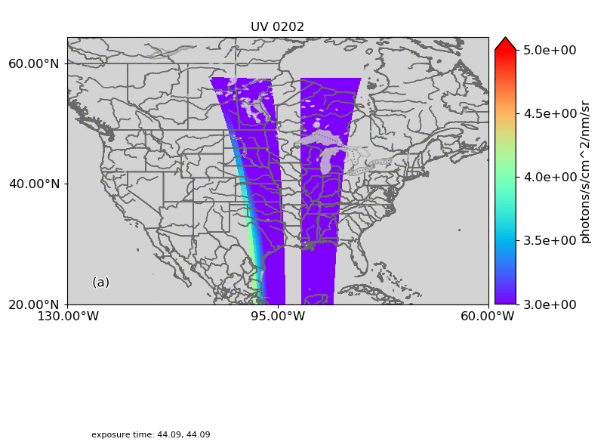
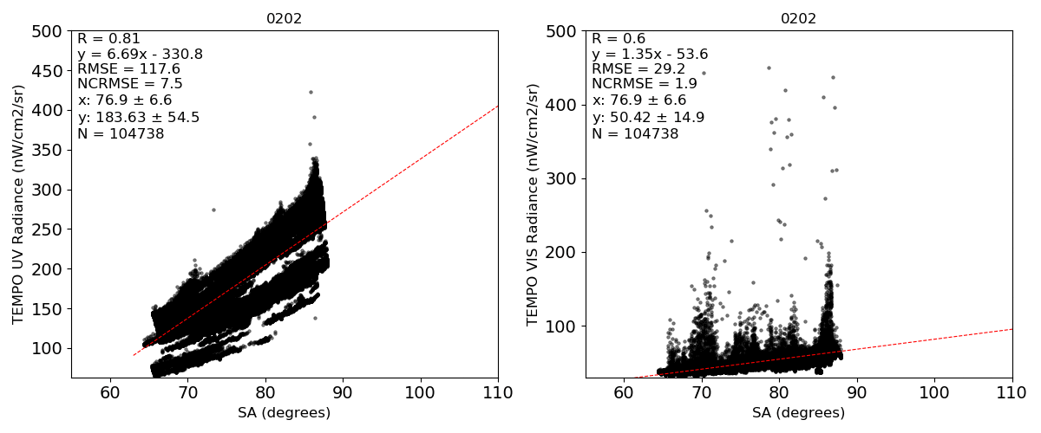
Exposure time 44s
Impact of Solar Geometry & Exposure Time on UV Radiances

Slide 23
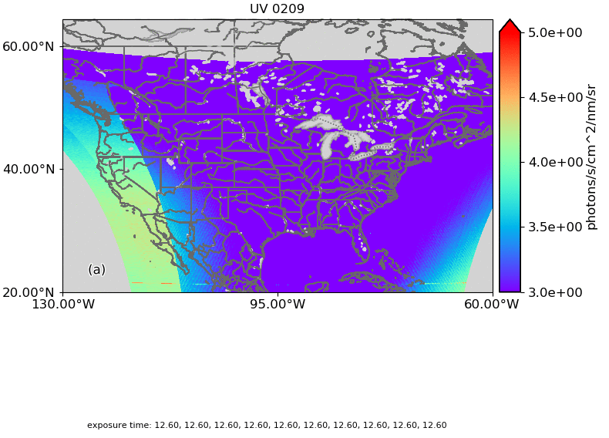
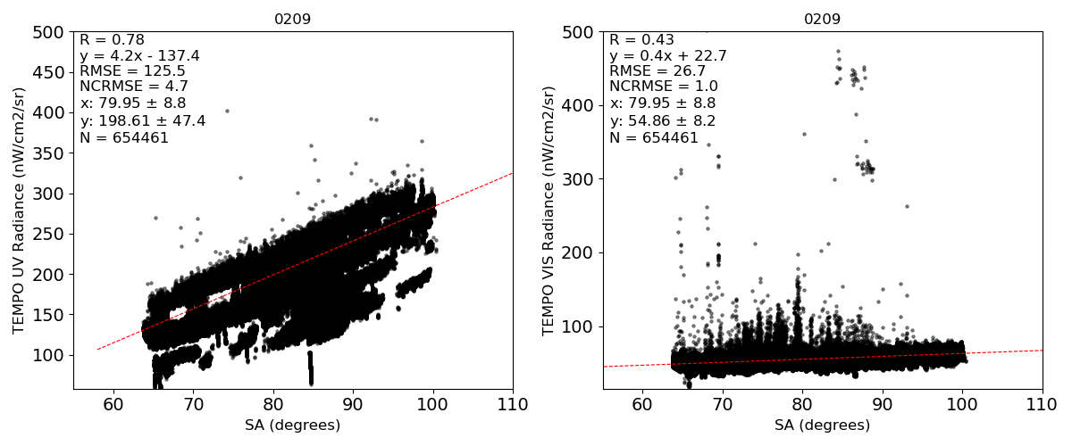
Impact of Solar Geometry & Exposure Time on UV Radiances
Exposure time 12.6 s

Slide 24
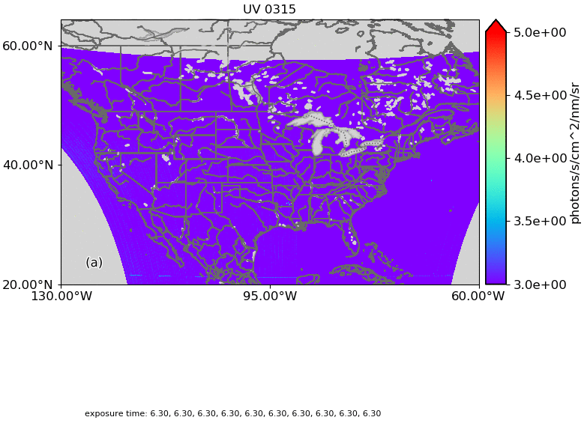
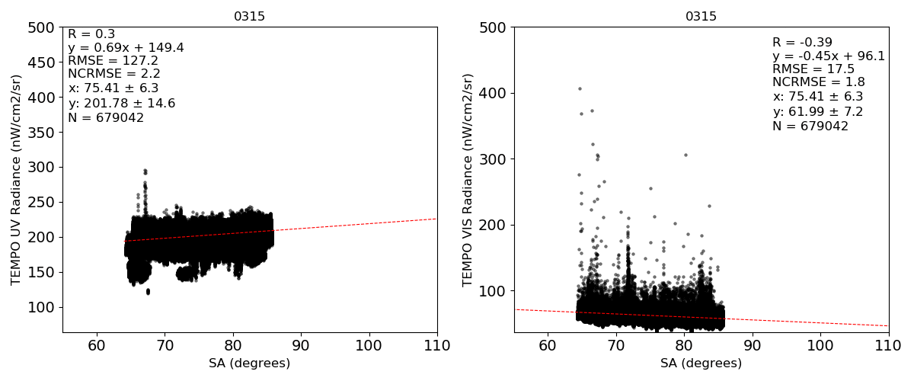
Impact of Solar Geometry & Exposure Time on UV Radiances
Exposure time 6.3 s

Slide 25
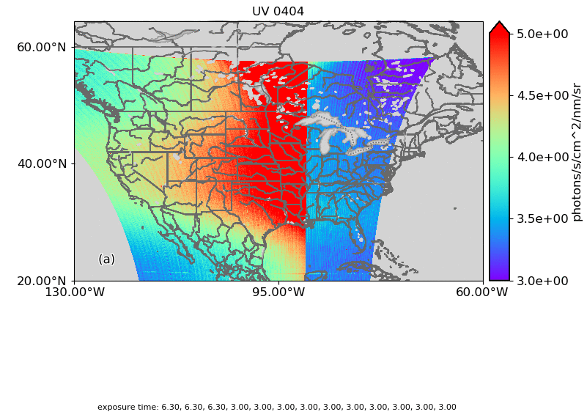

Impact of Solar Geometry & Exposure Time on UV Radiances
Exposure time 3 s

Slide 26

Exposure time 44s

Slide 27

Exposure time 12.6 s

Slide 28

Exposure time 6.3 s

Slide 29

Exposure time 3 s

Slide 30
Notes:
To edit map or change the state color:
1. Double click the state that you want to change.
2. Click ‘Shape Format’ tab, or right click and select the ‘Format Shape’ option.
3. Click the ‘Solid fill’ option and select one of the theme colors from the color menu.

Slide 31

Notes:
To edit map or change the state color:
1. Double click the state that you want to change.
2. Click ‘Shape Format’ tab, or right click and select the ‘Format Shape’ option.
3. Click the ‘Solid fill’ option and select one of the theme colors from the color menu.

Slide 32
Notes:
To edit map or change the state color:
1. Double click the state that you want to change.
2. Click ‘Shape Format’ tab, or right click and select the ‘Format Shape’ option.
3. Click the ‘Solid fill’ option and select one of the theme colors from the color menu.

Slide 33

Notes:
To edit map or change the state color:
1. Double click the state that you want to change.
2. Click ‘Shape Format’ tab, or right click and select the ‘Format Shape’ option.
3. Click the ‘Solid fill’ option and select one of the theme colors from the color menu.

Slide 34
Notes:
To edit map or change the state color:
1. Double click the state that you want to change.
2. Click ‘Shape Format’ tab, or right click and select the ‘Format Shape’ option.
3. Click the ‘Solid fill’ option and select one of the theme colors from the color menu.

Slide 35
Notes:
To edit map or change the state color:
1. Double click the state that you want to change.
2. Click ‘Shape Format’ tab, or right click and select the ‘Format Shape’ option.
3. Click the ‘Solid fill’ option and select one of the theme colors from the color menu.

Slide 36
Notes:
To edit map or change the state color:
1. Double click the state that you want to change.
2. Click ‘Shape Format’ tab, or right click and select the ‘Format Shape’ option.
3. Click the ‘Solid fill’ option and select one of the theme colors from the color menu.

