Slide 1
TEMPO at Night: Lightning Flashes and on-Orbit Instrument Performance
S.V. Marchenko^{1,2}, J.L. Carr³, H. Chong⁴, J.C. Houck⁴, X. Liu⁴,
D.E. Flittner⁵, J. Joiner²
  ¹ Science Systems and Applications, Inc
  ² NASA Goddard Space Flight Center
  ³ Carr Astronautics, Greenbelt, MD, USA
  ⁴ Atomic and Molecular Physics Division, Center for Astrophysics | Harvard & Smithsonian, Cambridge, MA, USA
  ⁵ NASA Langley Research Center, Hampton, VA, USA
TEMPO/GeoXO ACX Workshop, August 2025

Slide 2
What is TEMPO’s on-orbit:
        instantaneous field of view (IFOV) ?
        spatial co-alignment of the spectral detectors (Band 1 & 2) ?
Notes:
Tough questions for a hyperspectral instrument

Slide 3
Typical lighting flashes are far exceeding TEMPO’s IFOVs:
- clustering
- ambient scattering for the intra-cloud discharges (the ones we predominantly
detect from orbit)
- oblique trajectories
The blue corona discharges:
- ‘tiny’ ( < 10 km² )
- close to the cloud tops (mostly, the rapidly developing cumulonimbus clouds
- predominantly blue, but frequently with detectable green and red continuum
components.
- adhere to the severe weather regions (the Caribbean, among others)
September-October 2024: the hurricanes Helene & Milton
Notes:
Tough questions for a hyperspectral instrument

Slide 4
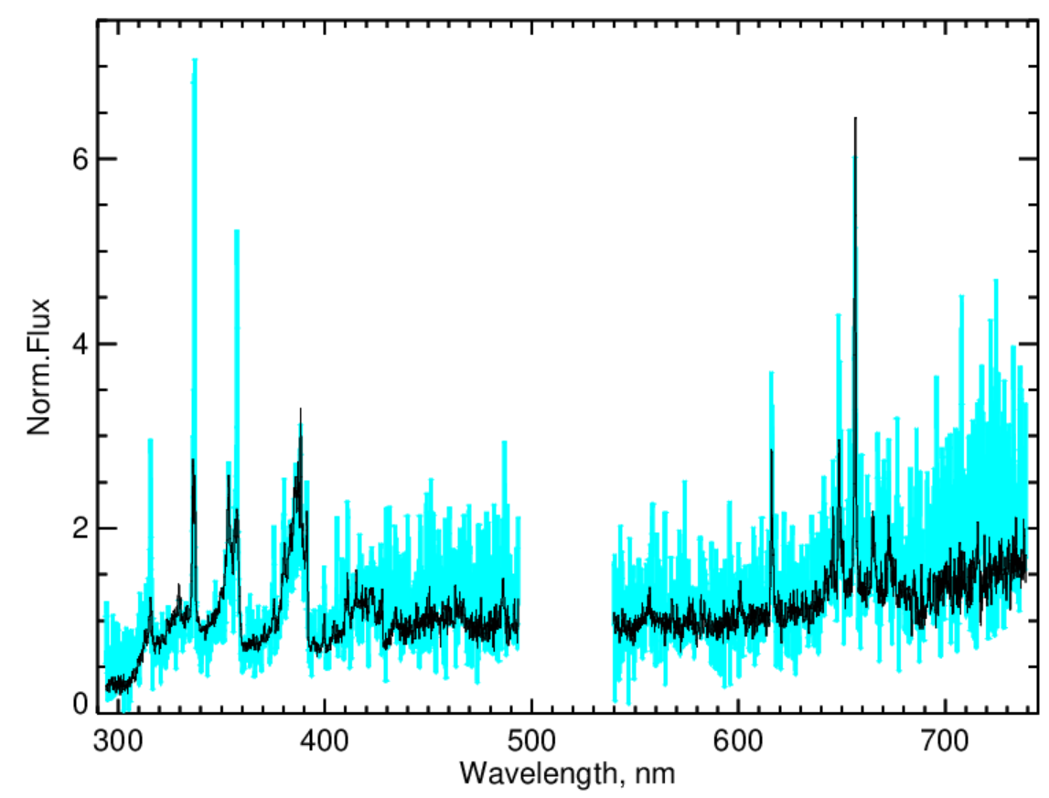
The Milton’s aftermath:
the twilight granule from 2024/10/15, T=01h04m59s (UTC)
Broad flashes (FWHM > 5 pix)
Narrow flashes (FWHM < 2 pix)

Slide 5
Event selection (October 1-15, 2024):
IFOV – 250 events
- 3 broad spectral samples for each band
- isolated events
- coinciding (< 2 pix) maxima in B1 & B2
- 10σ (B1) or 5σ (B2) detection thresholds
Band 1 & 2 co-registration – subsample of 71 flashes
- as above
- FWHM < 5 pix
- average 337.5 nm flux (strong emissions!) at least 1.3x of the
B1 average

Slide 6
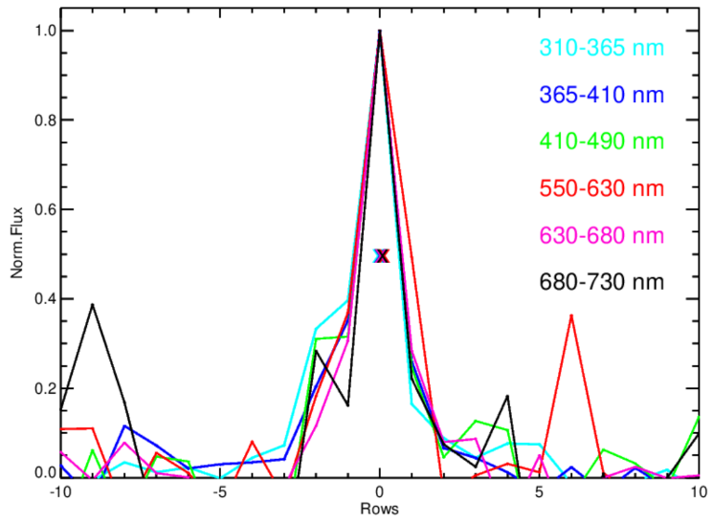
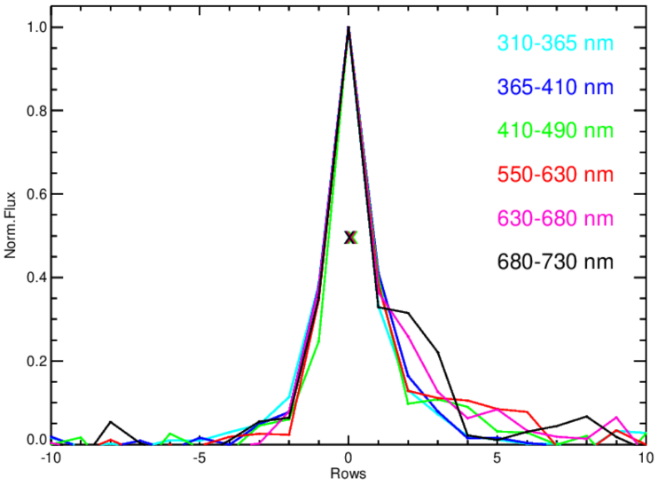
October 11, 2024 (FWHM = 1.45 ± 0.18 pix)
October 15, 2024 (FWHM = 1.56 ± 0.06 pix)
North-south spatial profiles

Slide 7
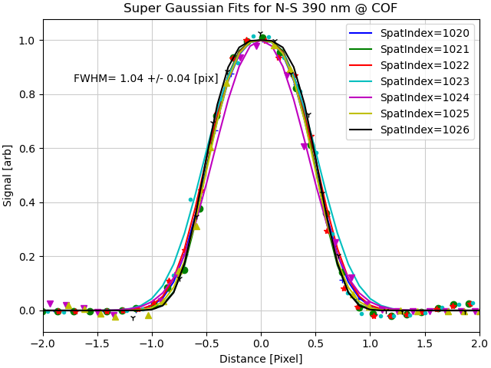
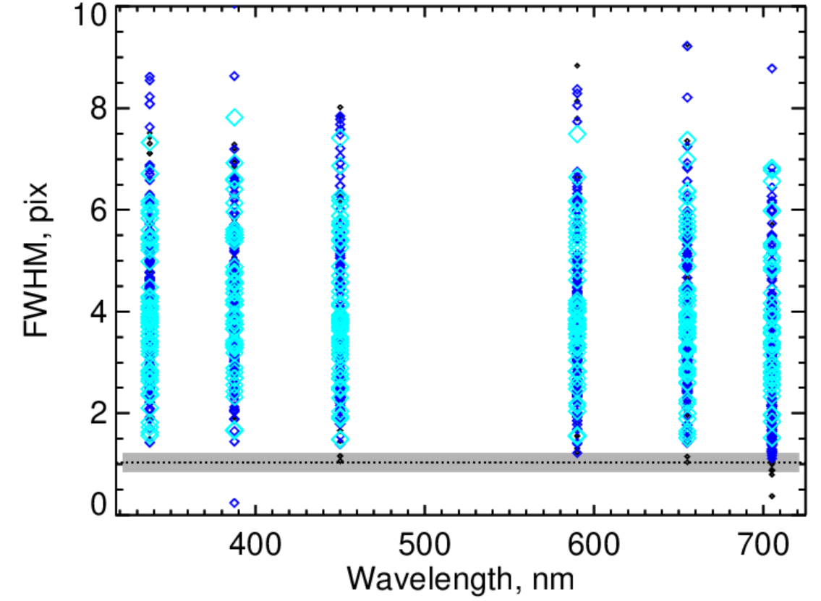


Ground IFOV Orbit
FWHM = 1.04 ± 0.04 pix

Slide 8
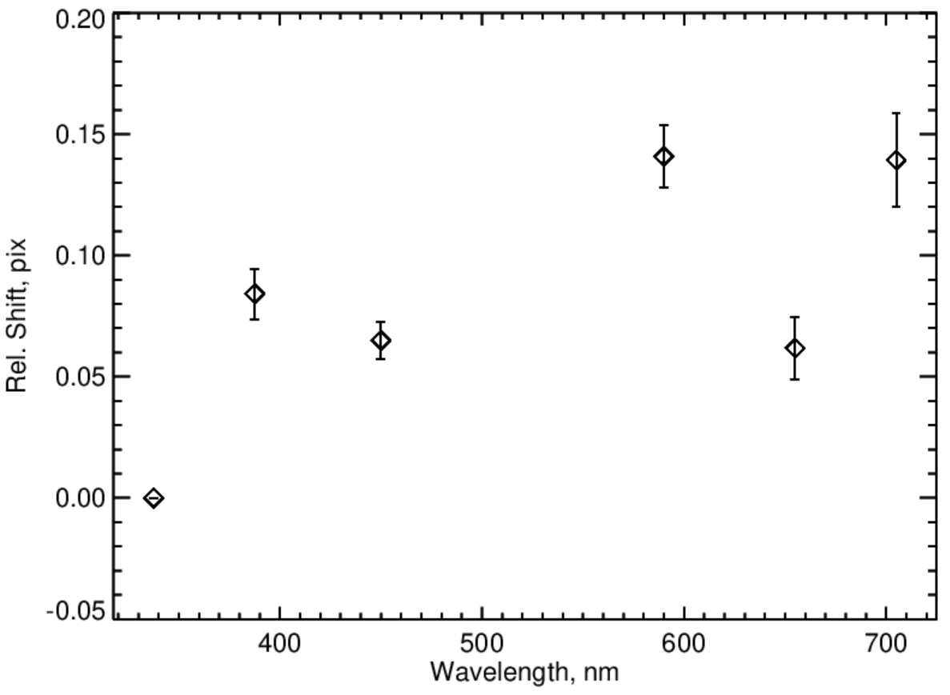
Orbit: the spatial co-registration of Bands 1 & 2
reference

Slide 9
TEMPO’s IFOV:
Some of the measurements come close (to within the typical 0.19 pix measurement uncertainty) to FWHM≈1.0 pix pre-flight estimates.
TEMPO’s spatial co-alignment of Bands 1 & 2:
< 0.15 pix, thus closely matching the pre-flight co-registration assessments.

