Slide 1

Assessing Temporal Variability in Nighttime Lights Using TEMPO Observations
Zhuosen Wang^{1,2}, Virginia Kalb², Ranjay Shrestha^{2,3}, Jim Carr⁴, Miguel Román²
¹ESSIC, University of Maryland College Park
²NASA Goddard Space Flight Center
³SSAI
⁴Carr Astronautics Corp.
August 2025

Slide 2
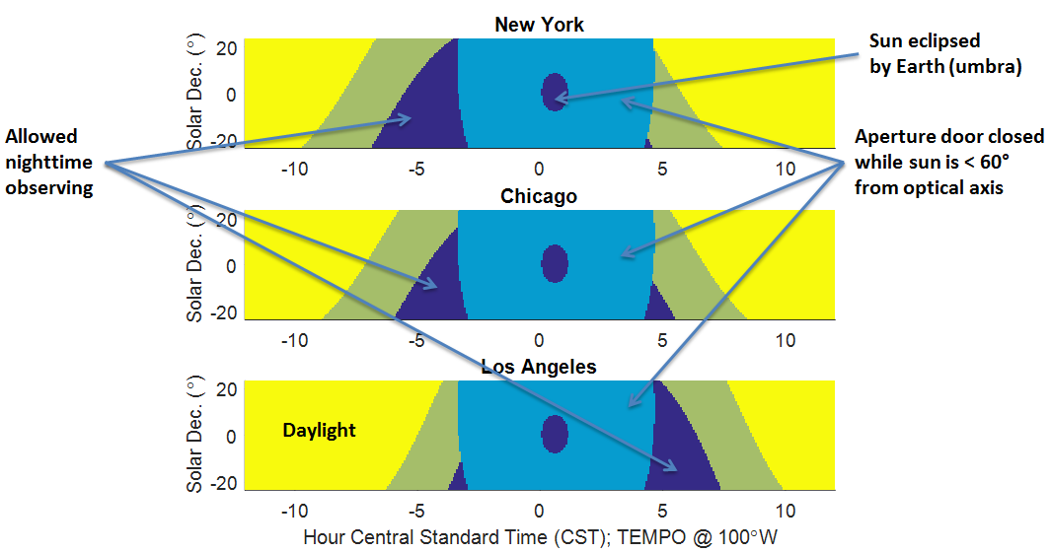
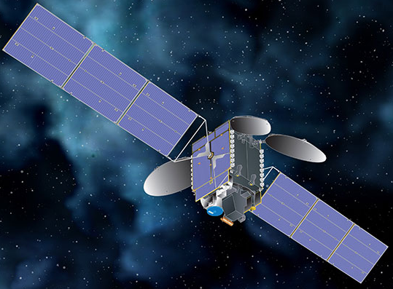
TEMPO nighttime light observations
Nighttime multiple observations per night (Eastern U.S.)
TEMPO launched
Nighttime observations
Nighttime observations
04/2023
09/2023
04/2024
09/2024
12/2024 – 01/2025
04/2025

Slide 3
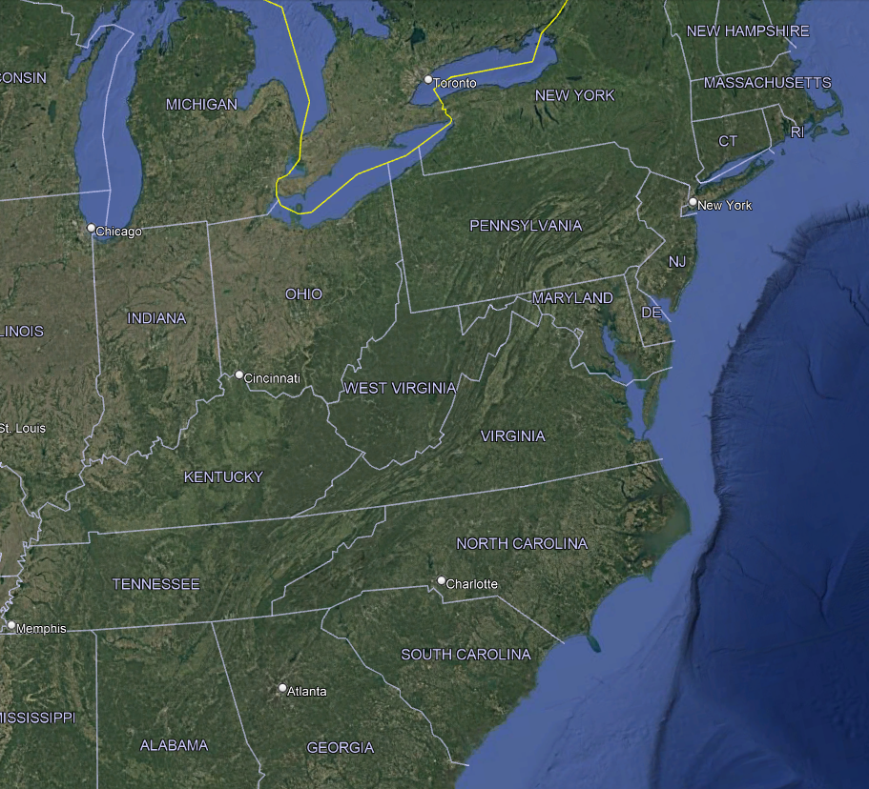
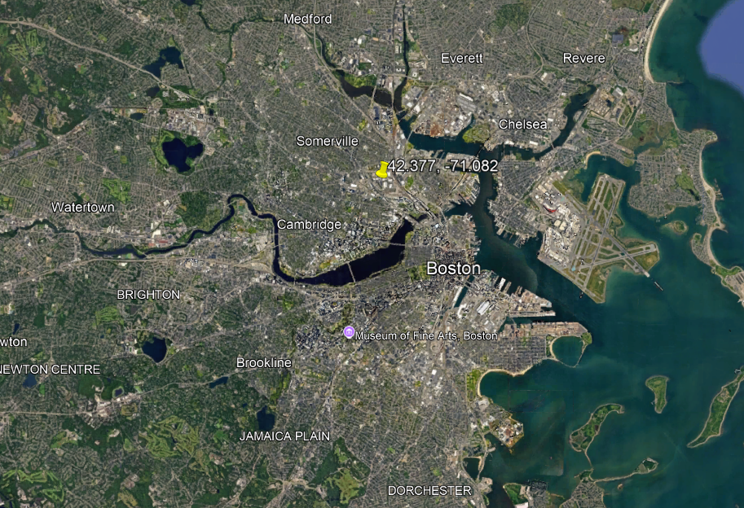
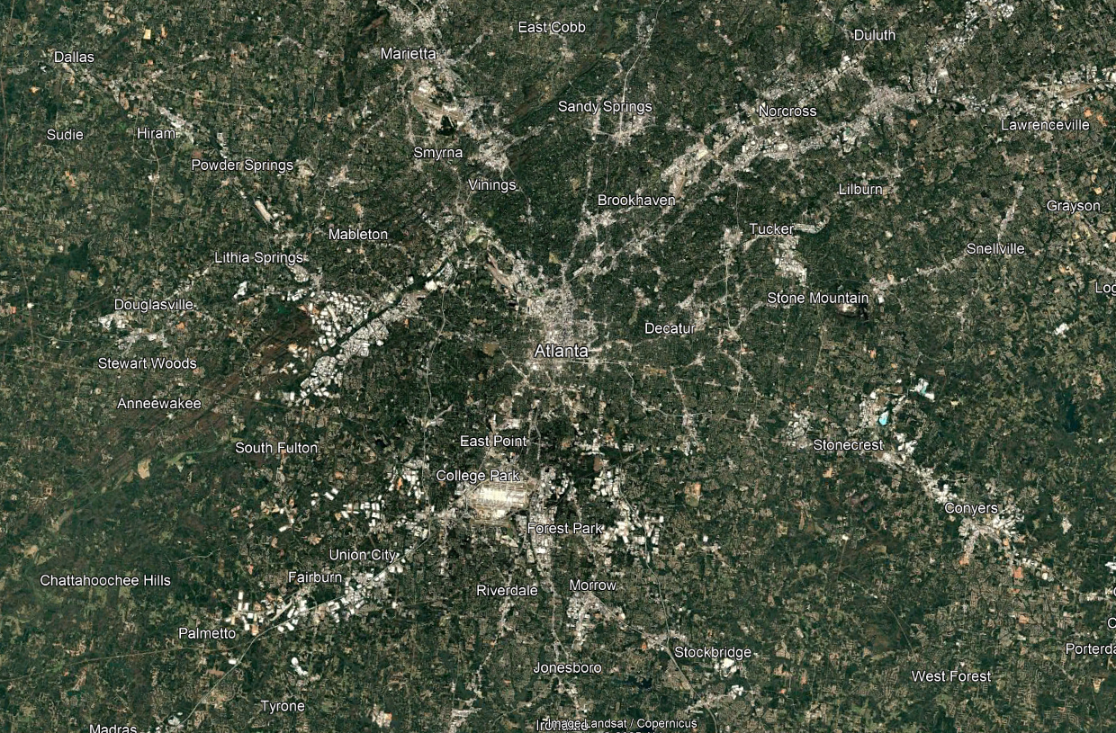
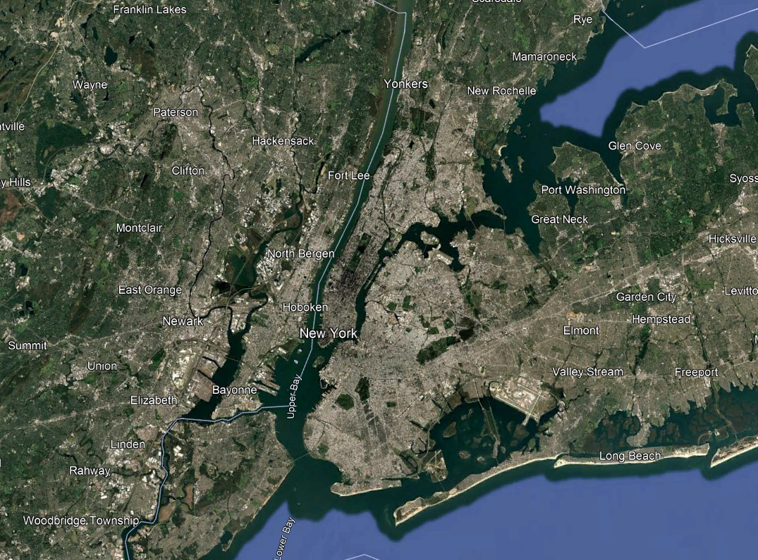
Study Areas
Boston
Boston
Atlanta
New York
New York
Atlanta

Slide 4
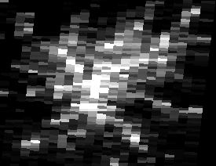
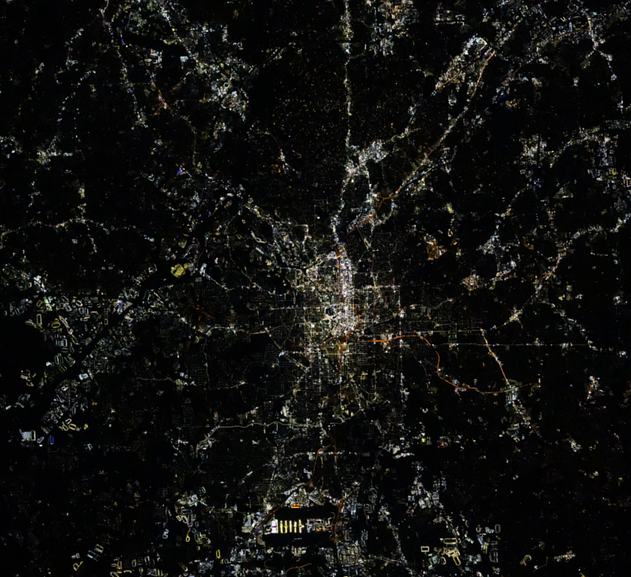
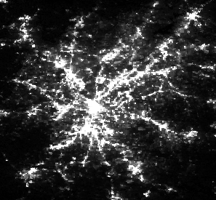
TEMPO at Night
Atlanta, GA
TEMPO
VIIRS DNB
12/12/2024
ISS on 10/19/2024

Slide 5
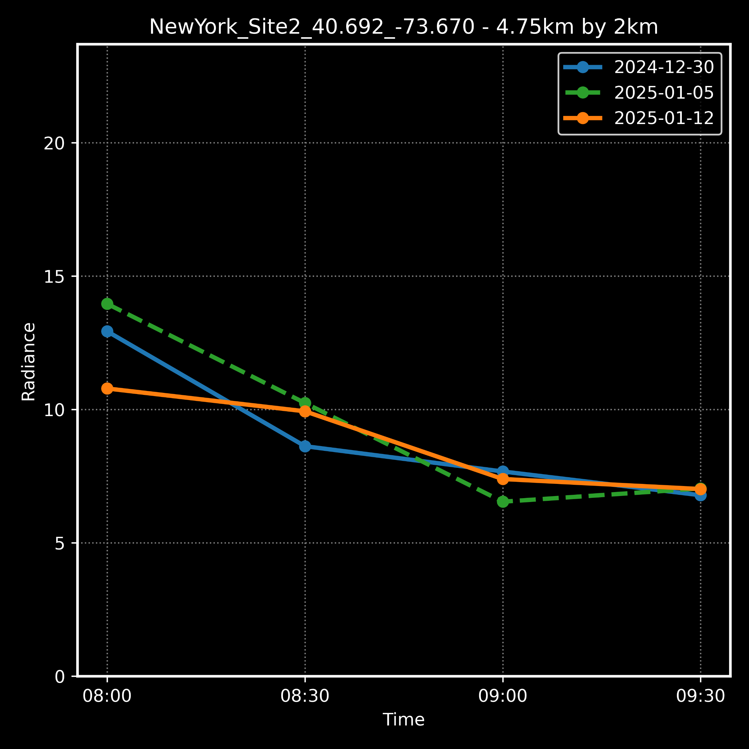
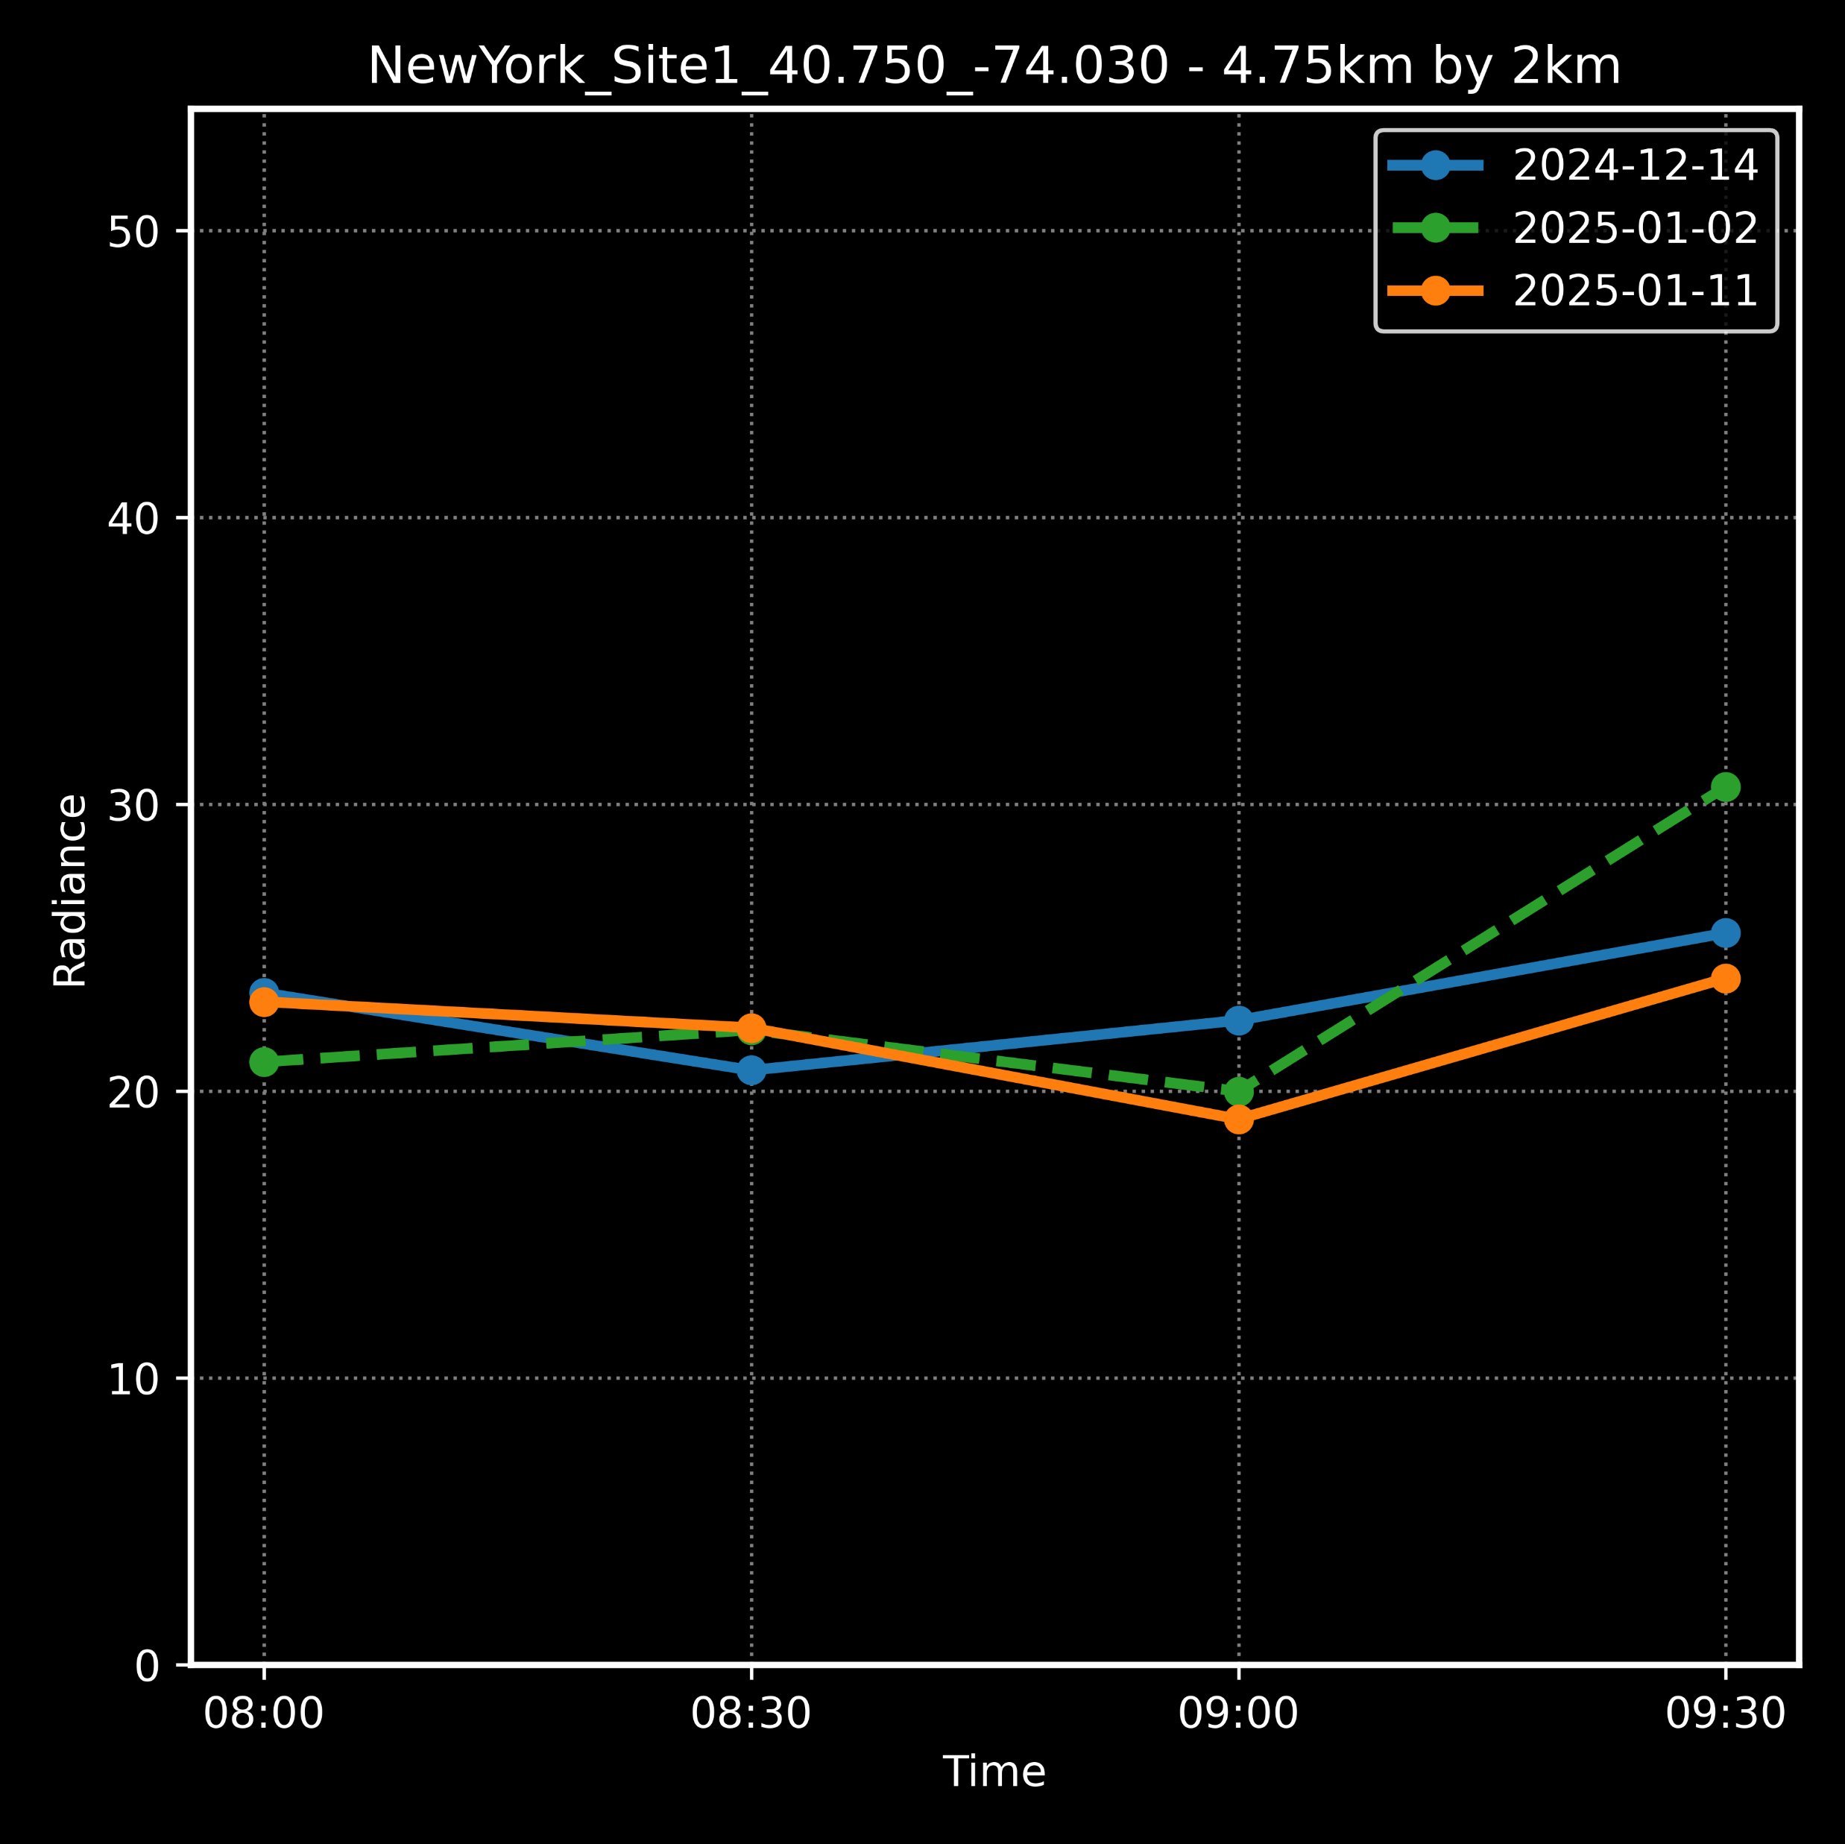
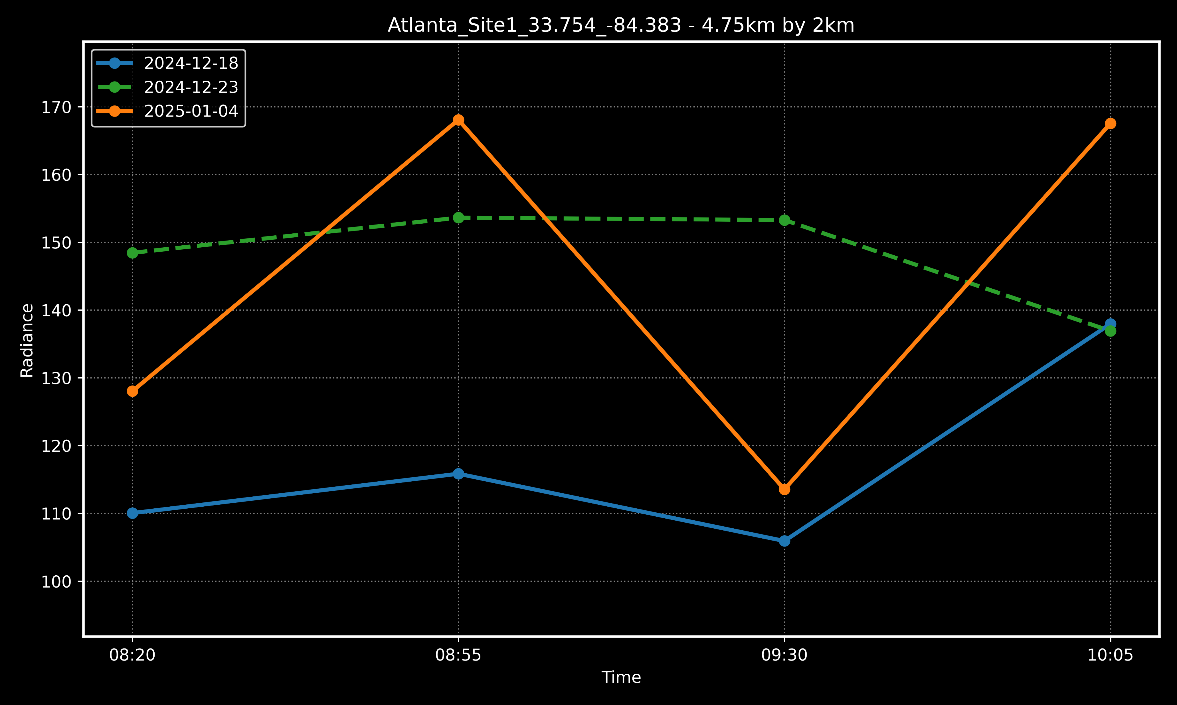
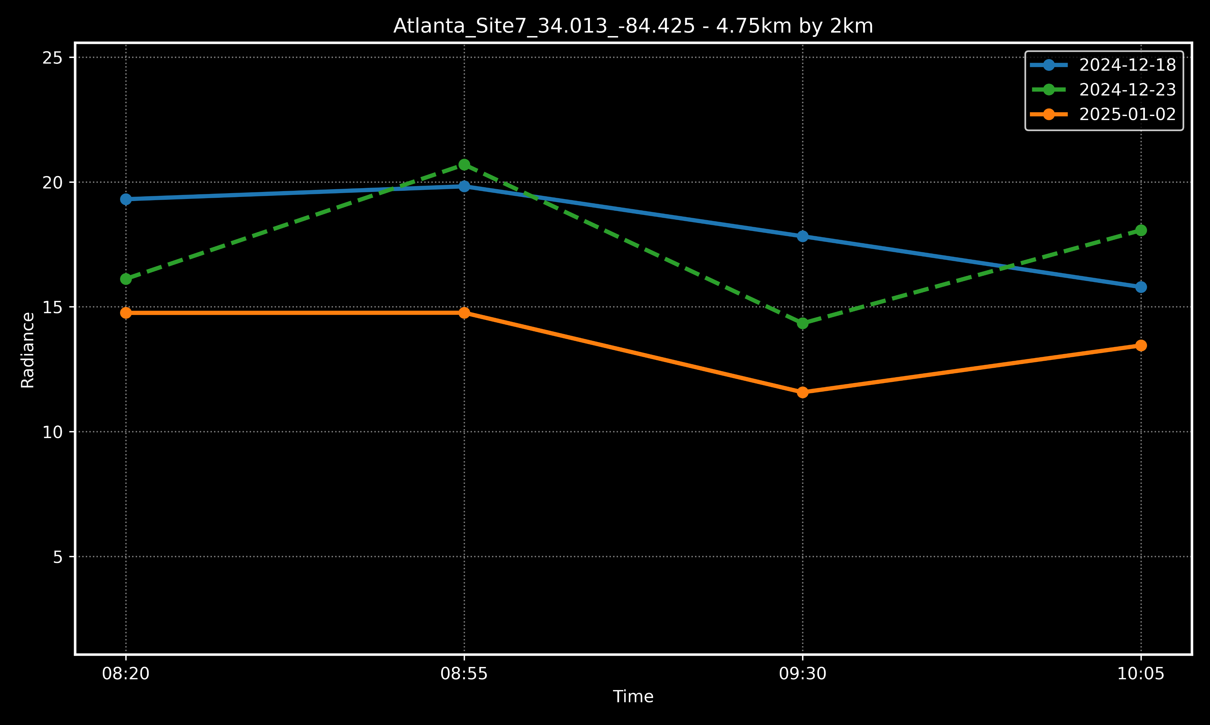
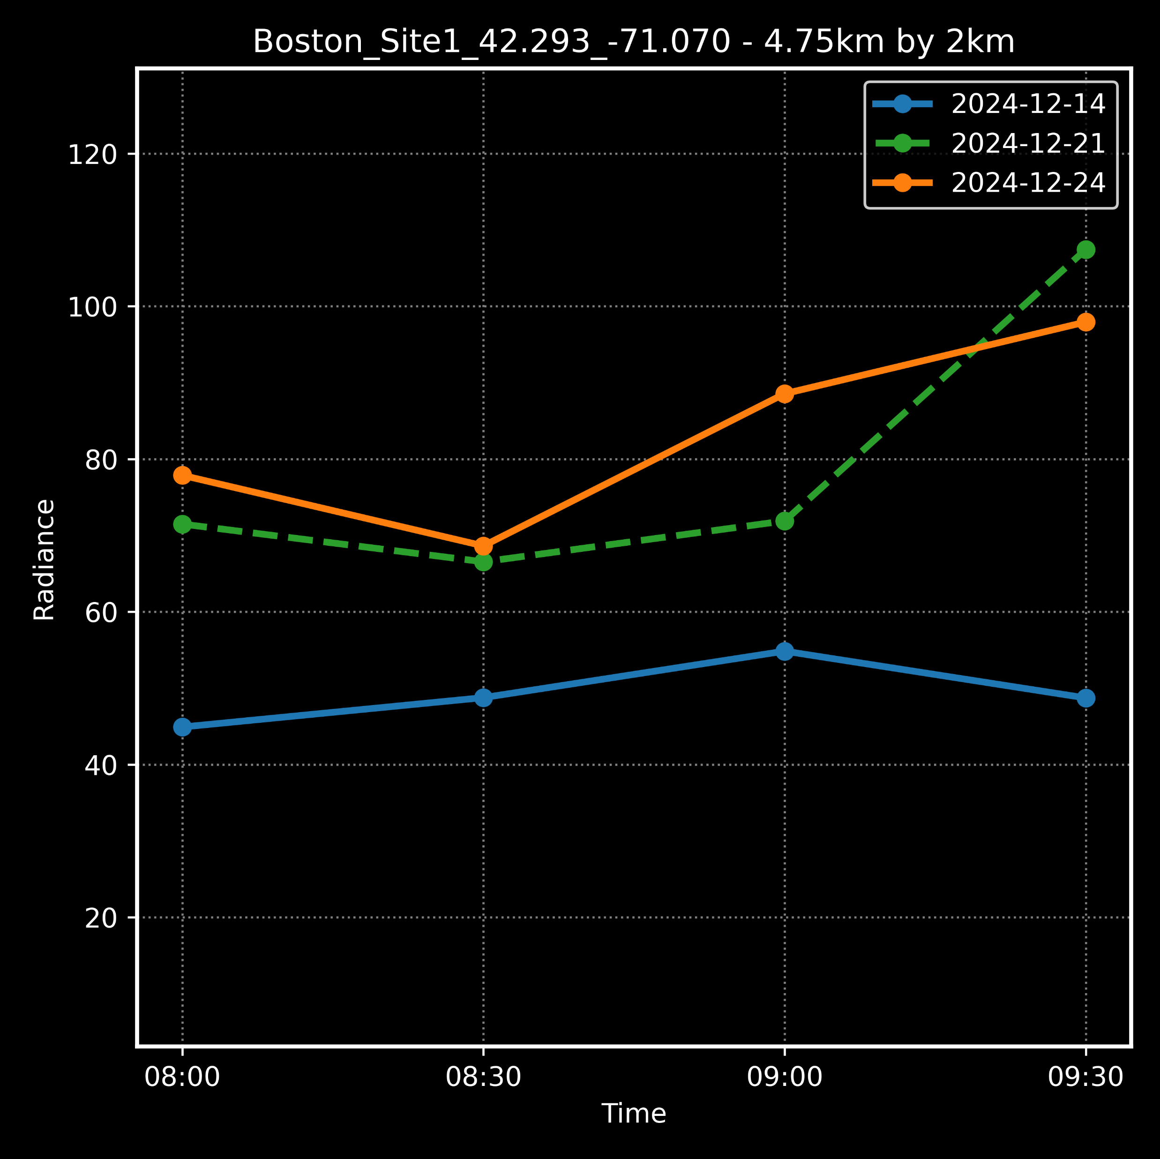
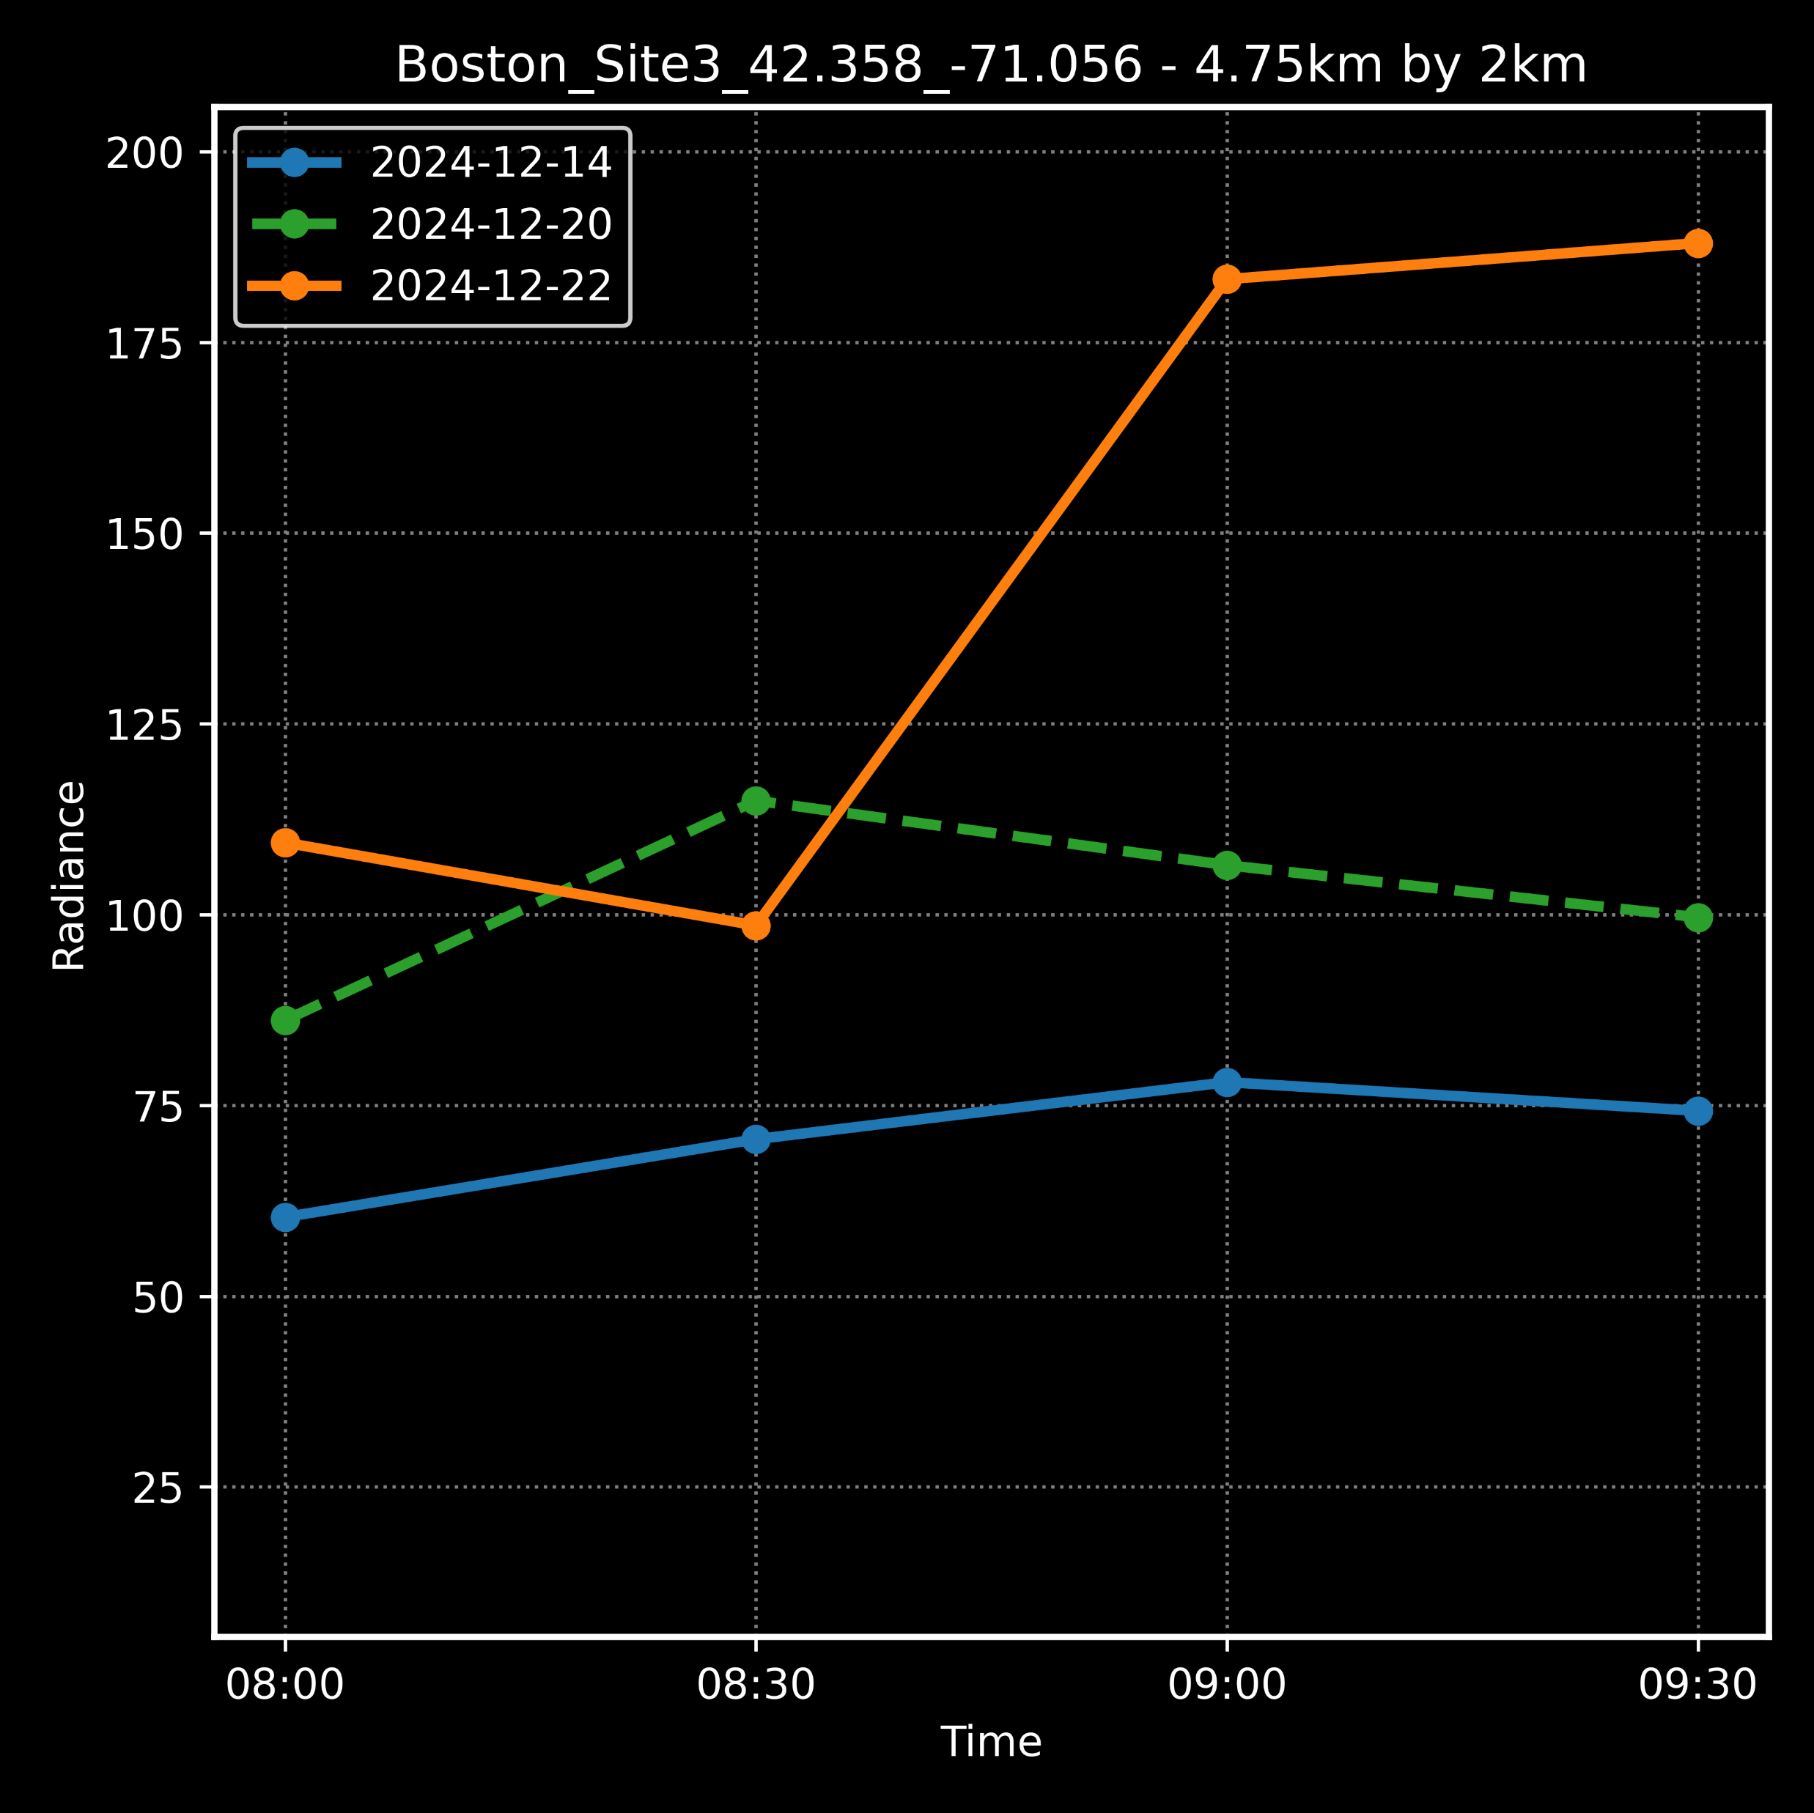
TEMPO: Diurnal Variation

Slide 6
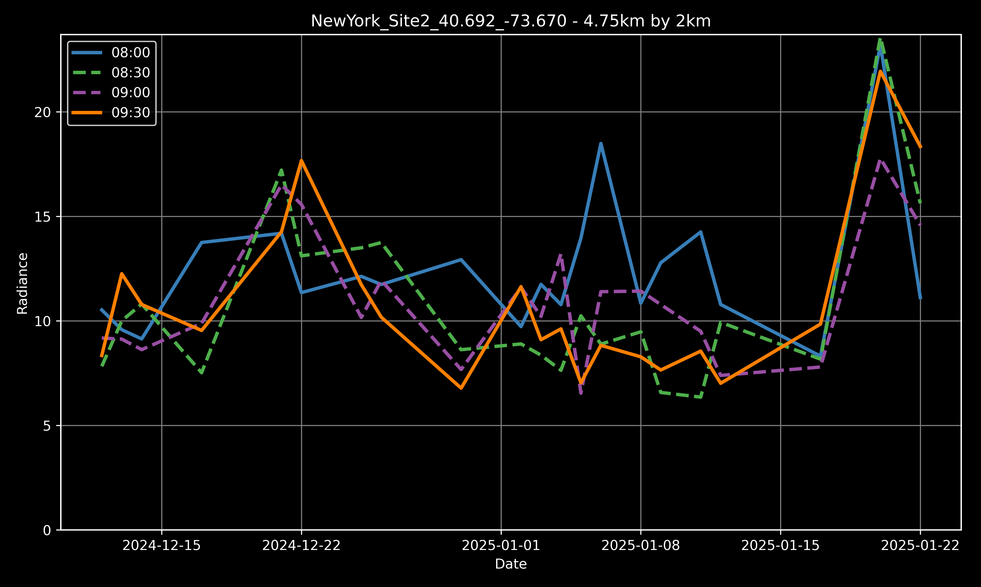
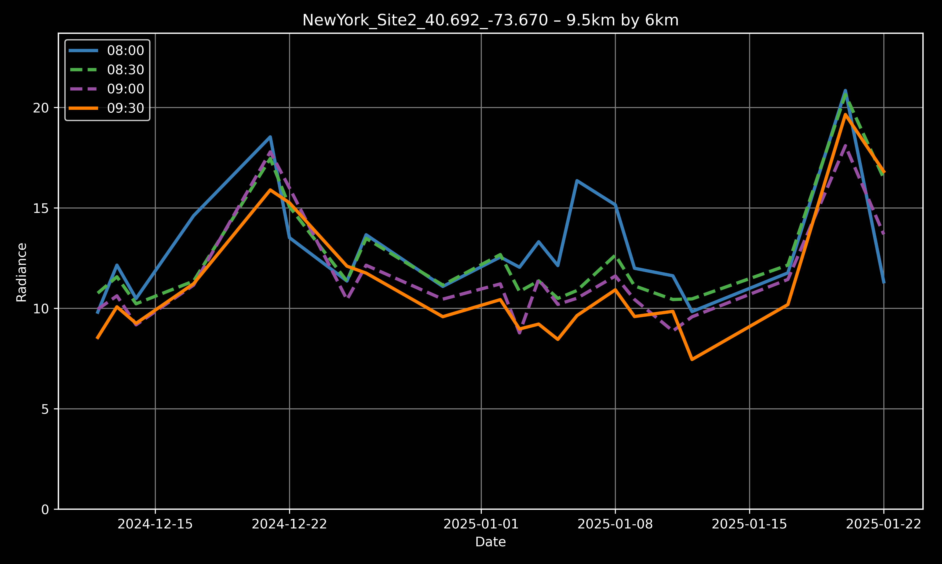
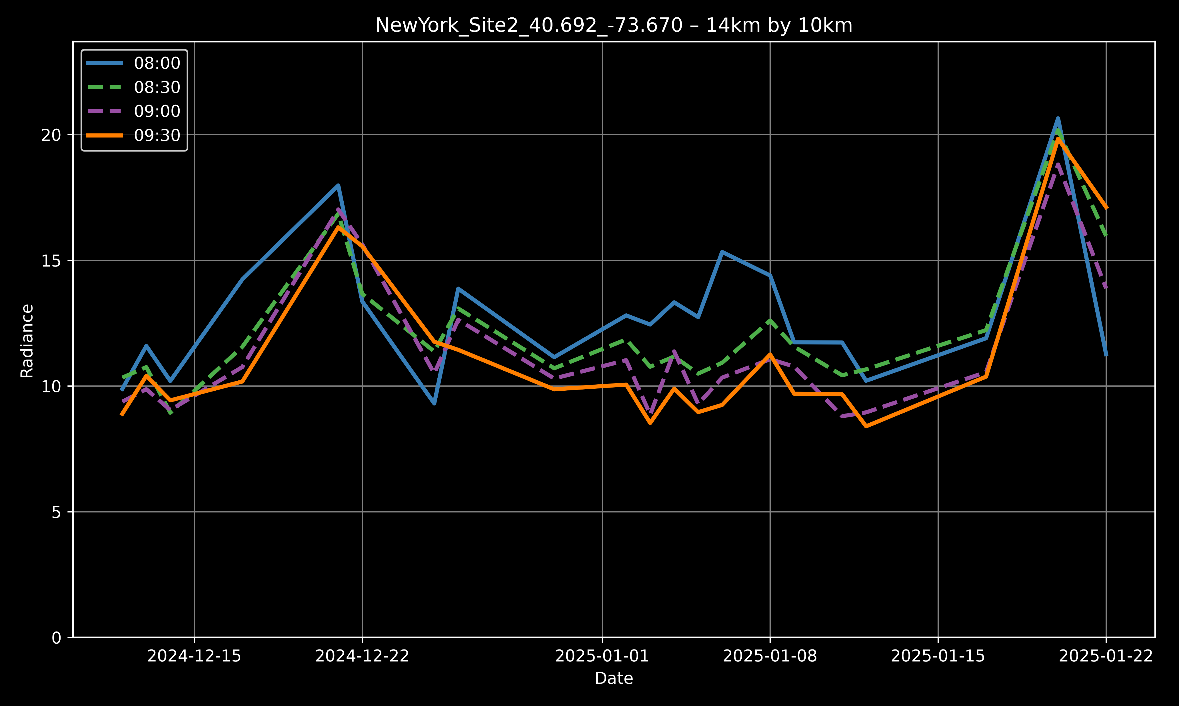
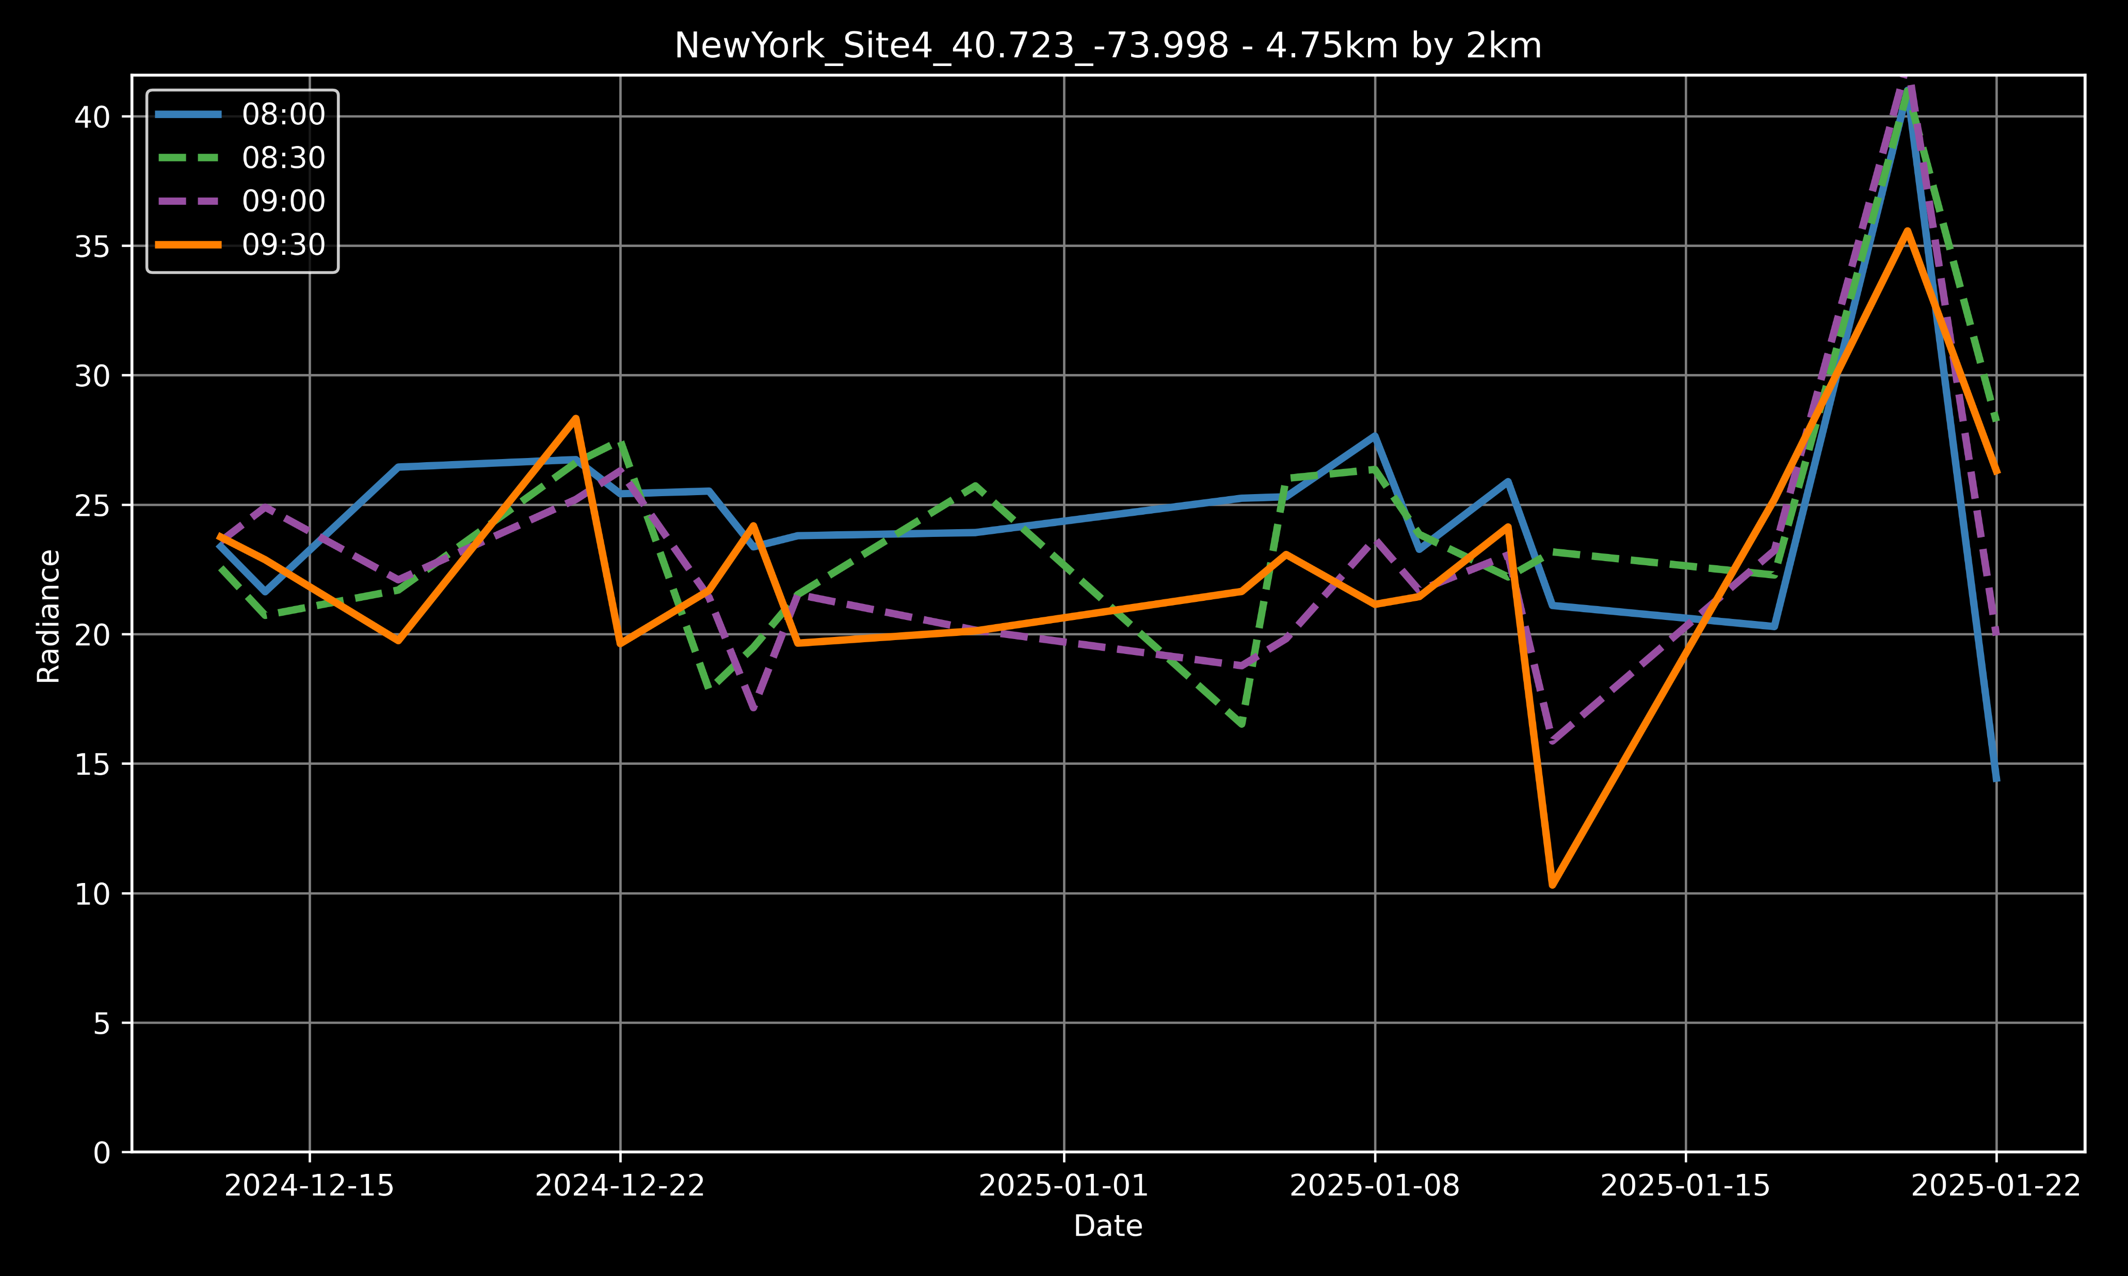
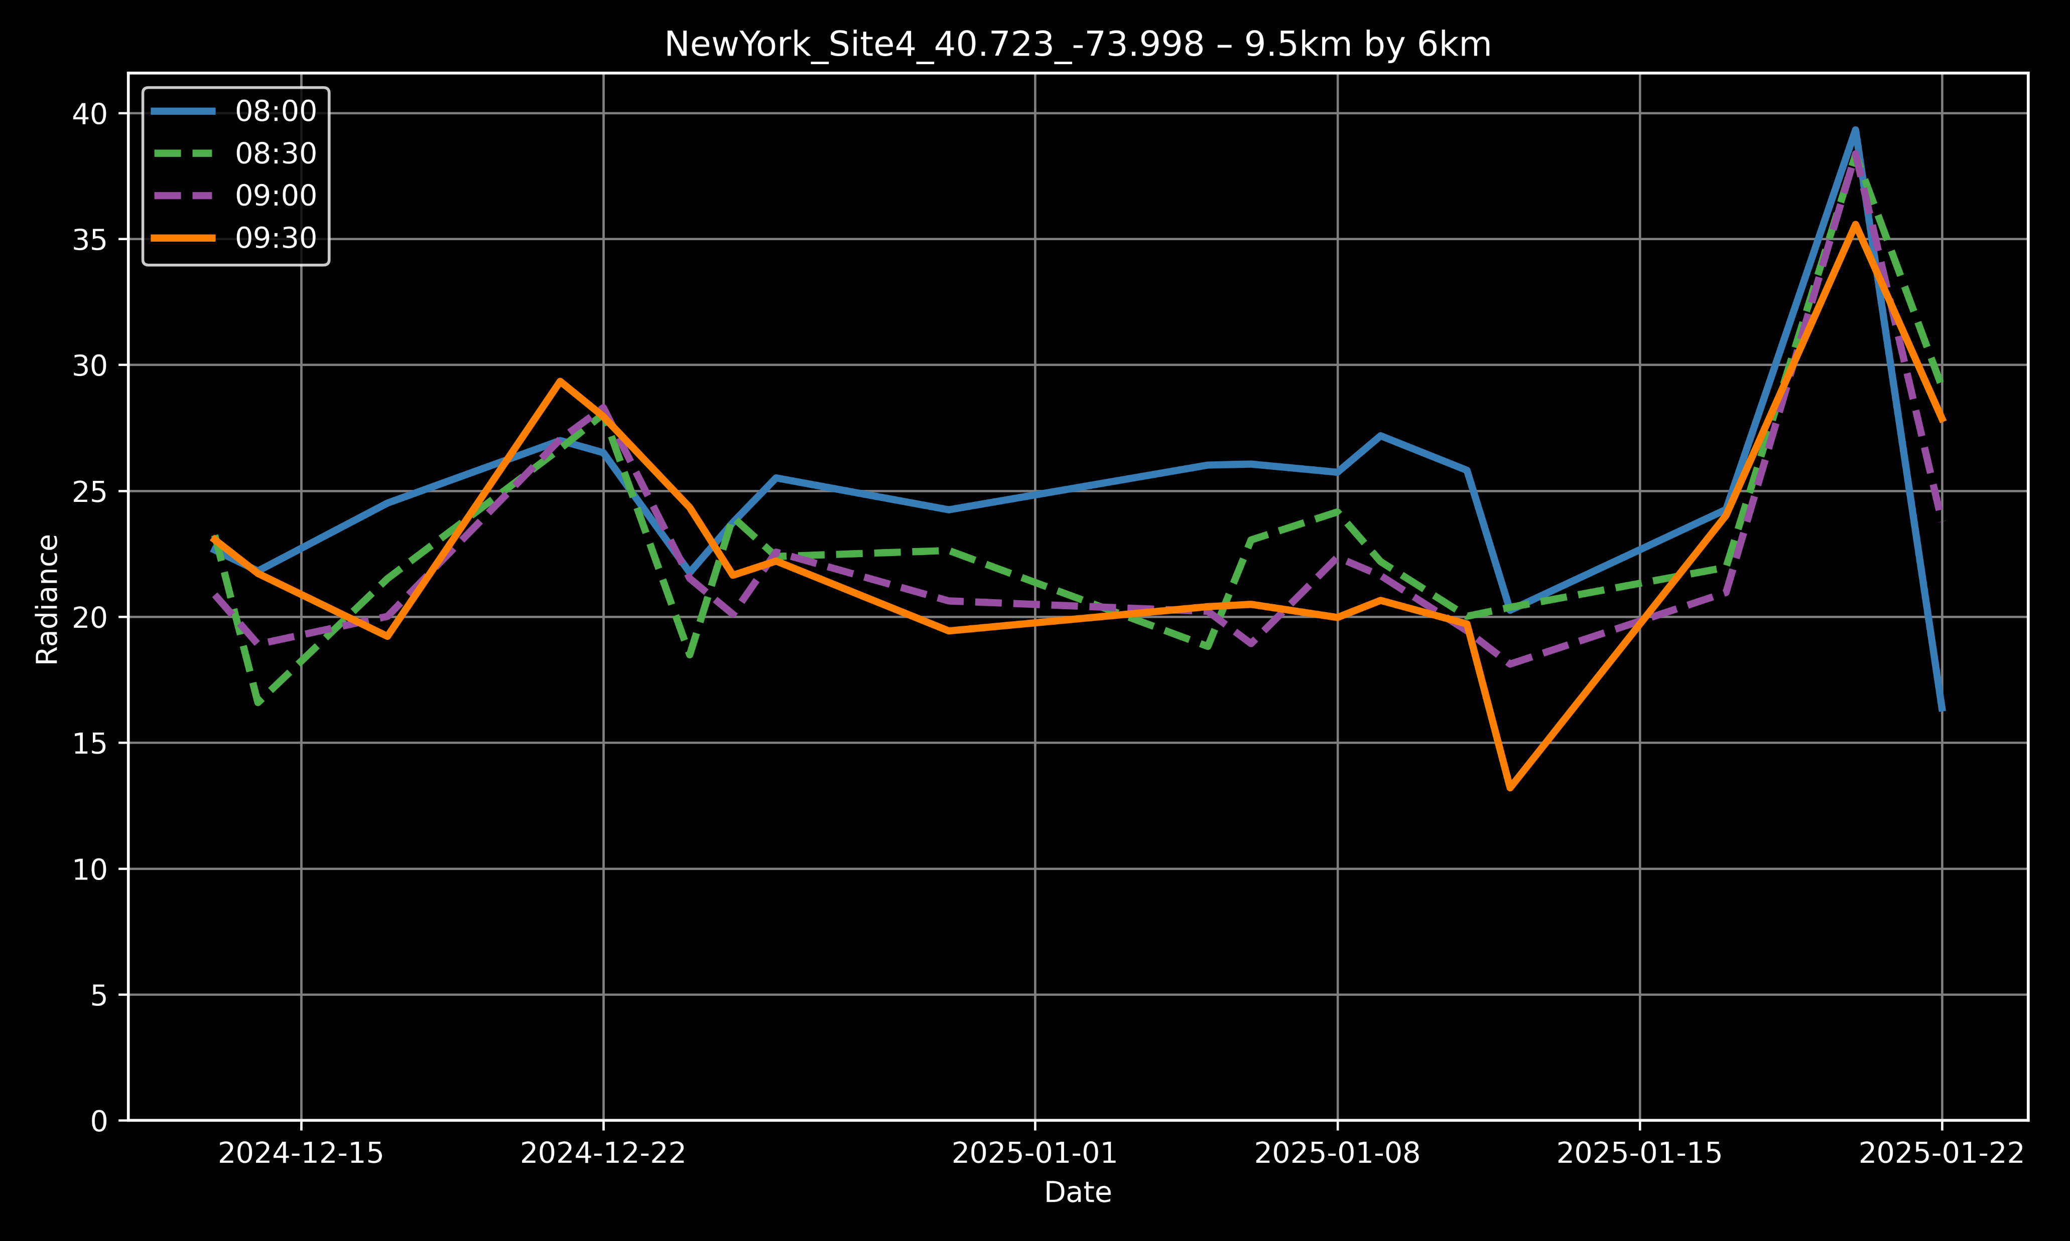
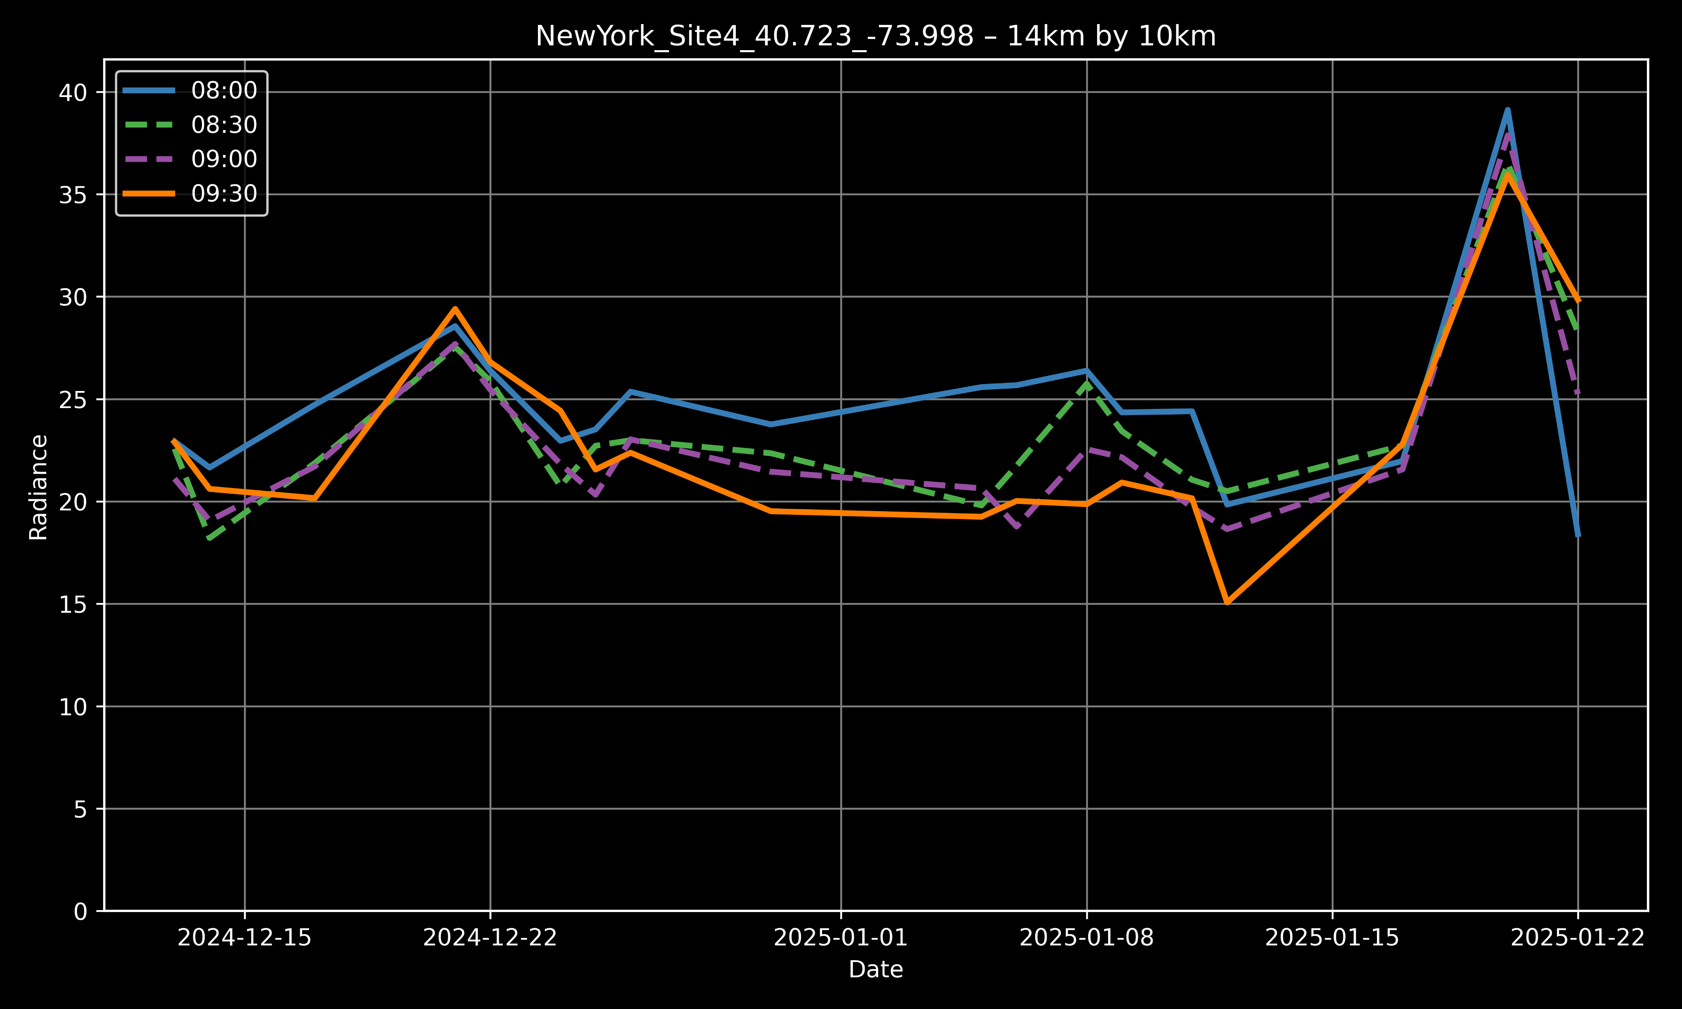
TEMPO: Temporal Variation
New York Residential Site
New York Commercial Center

Slide 7
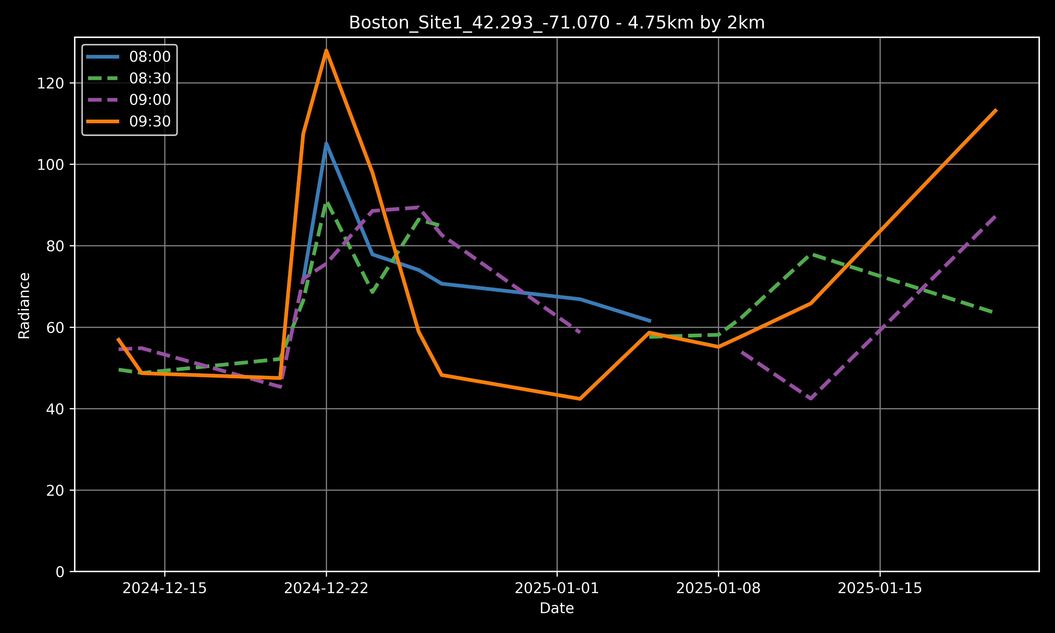
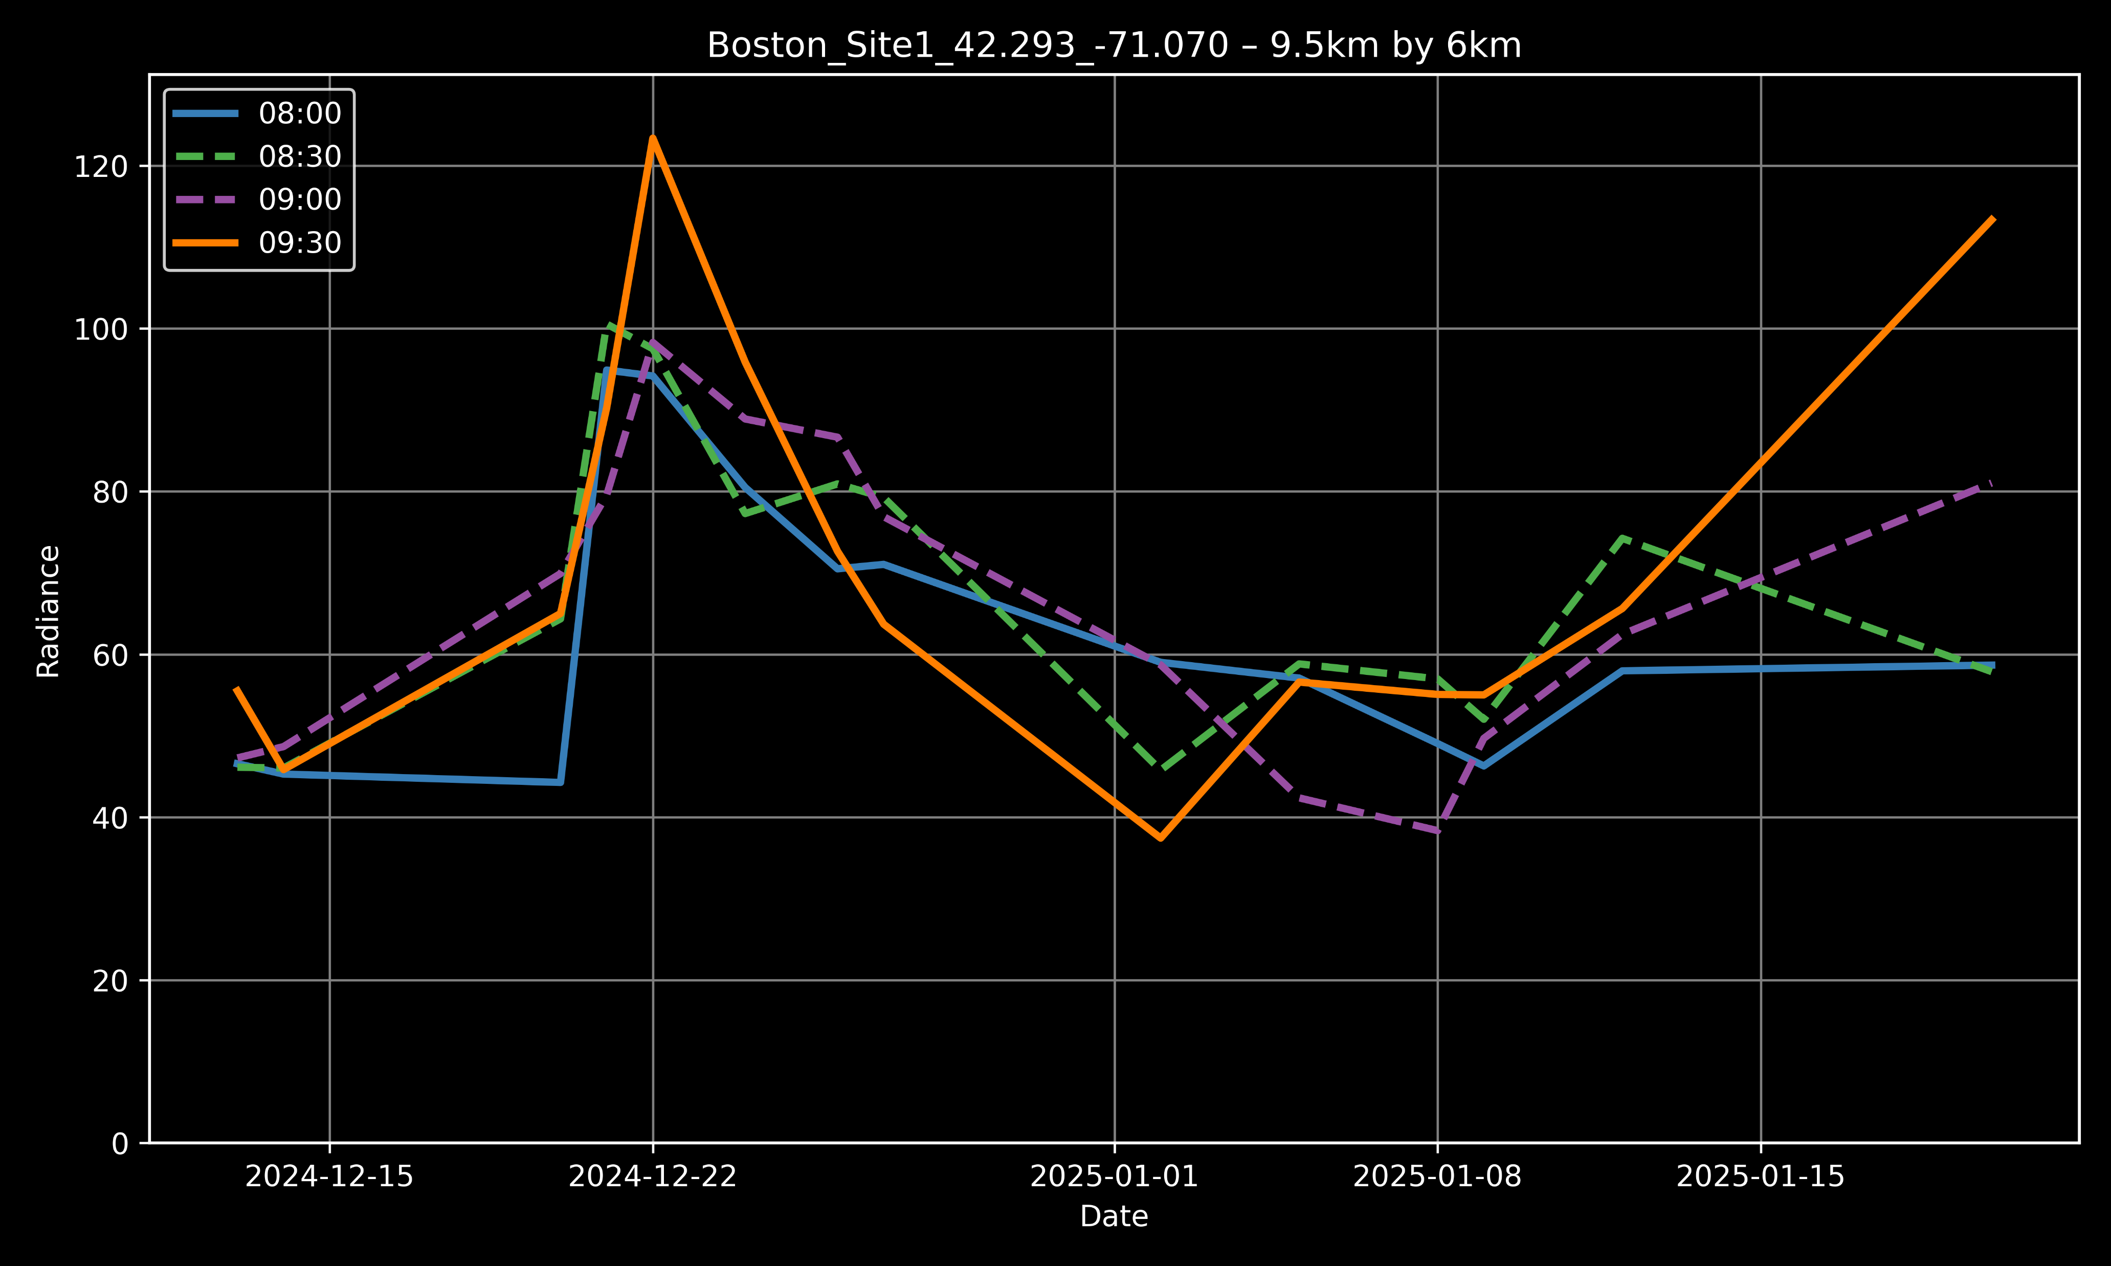
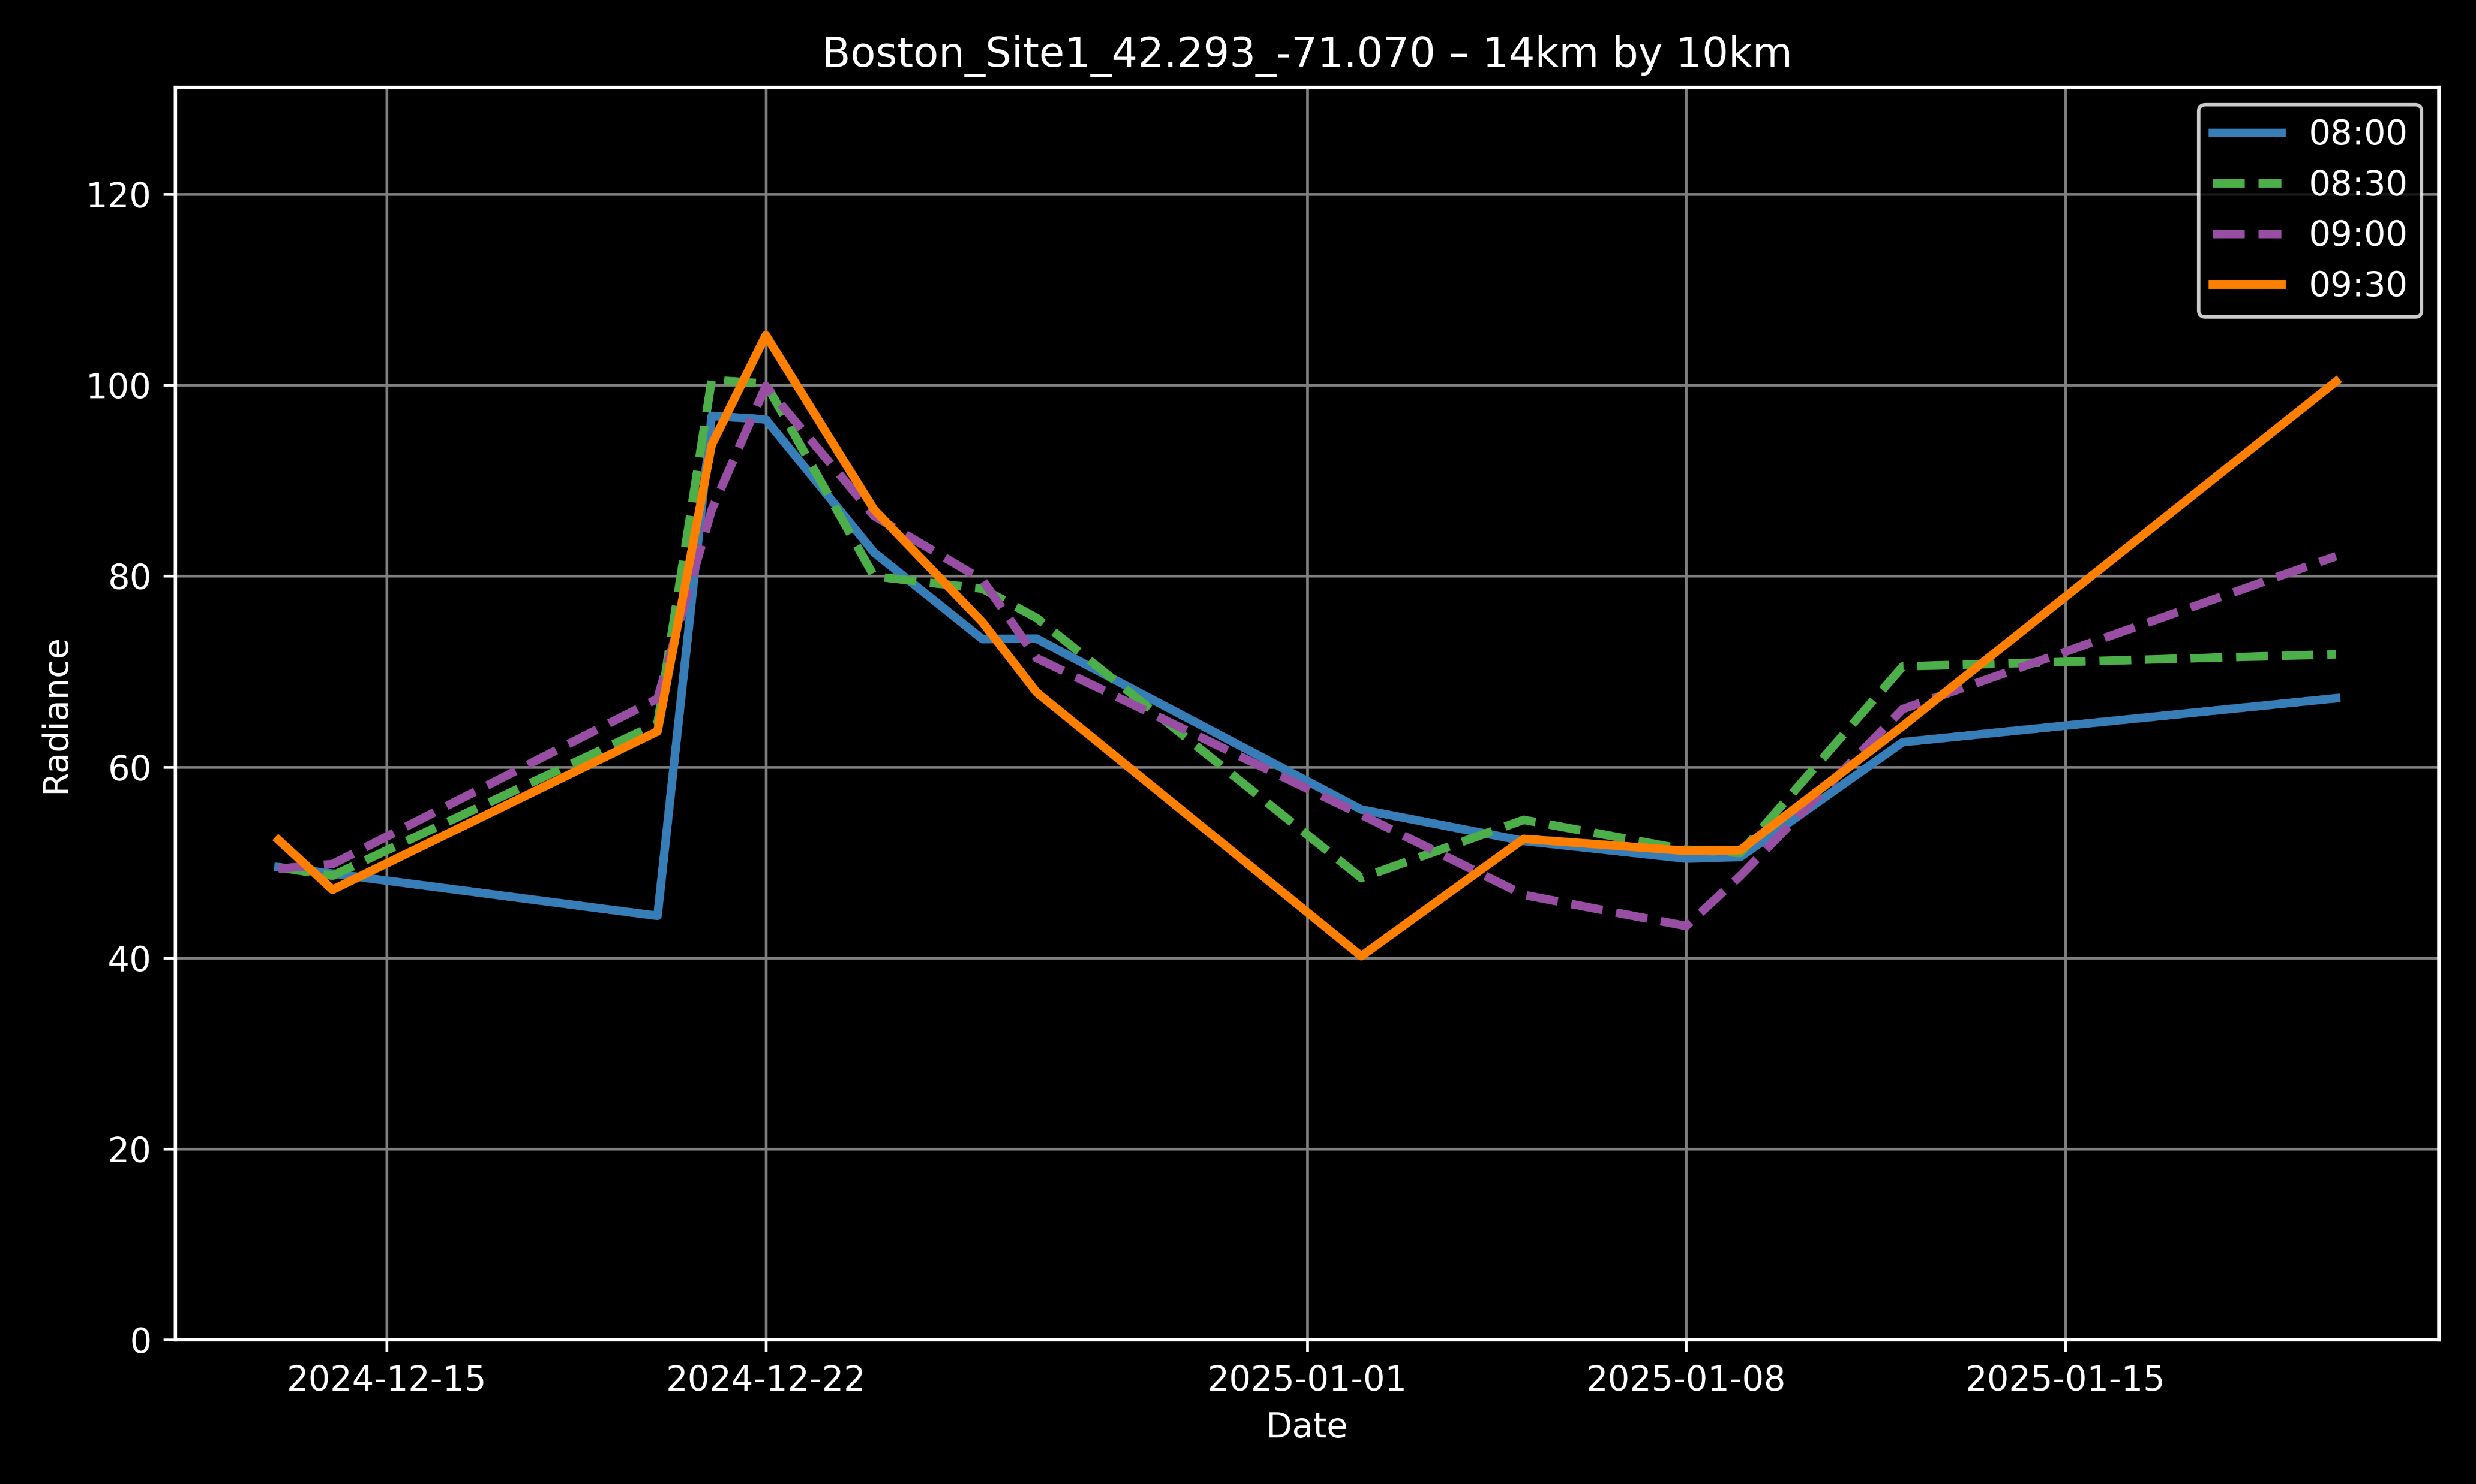
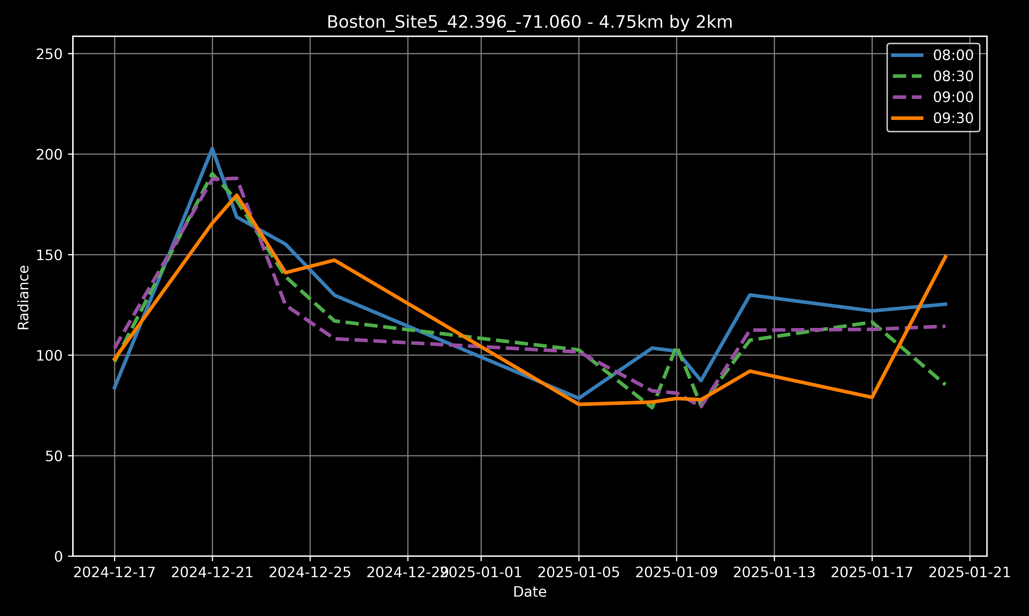
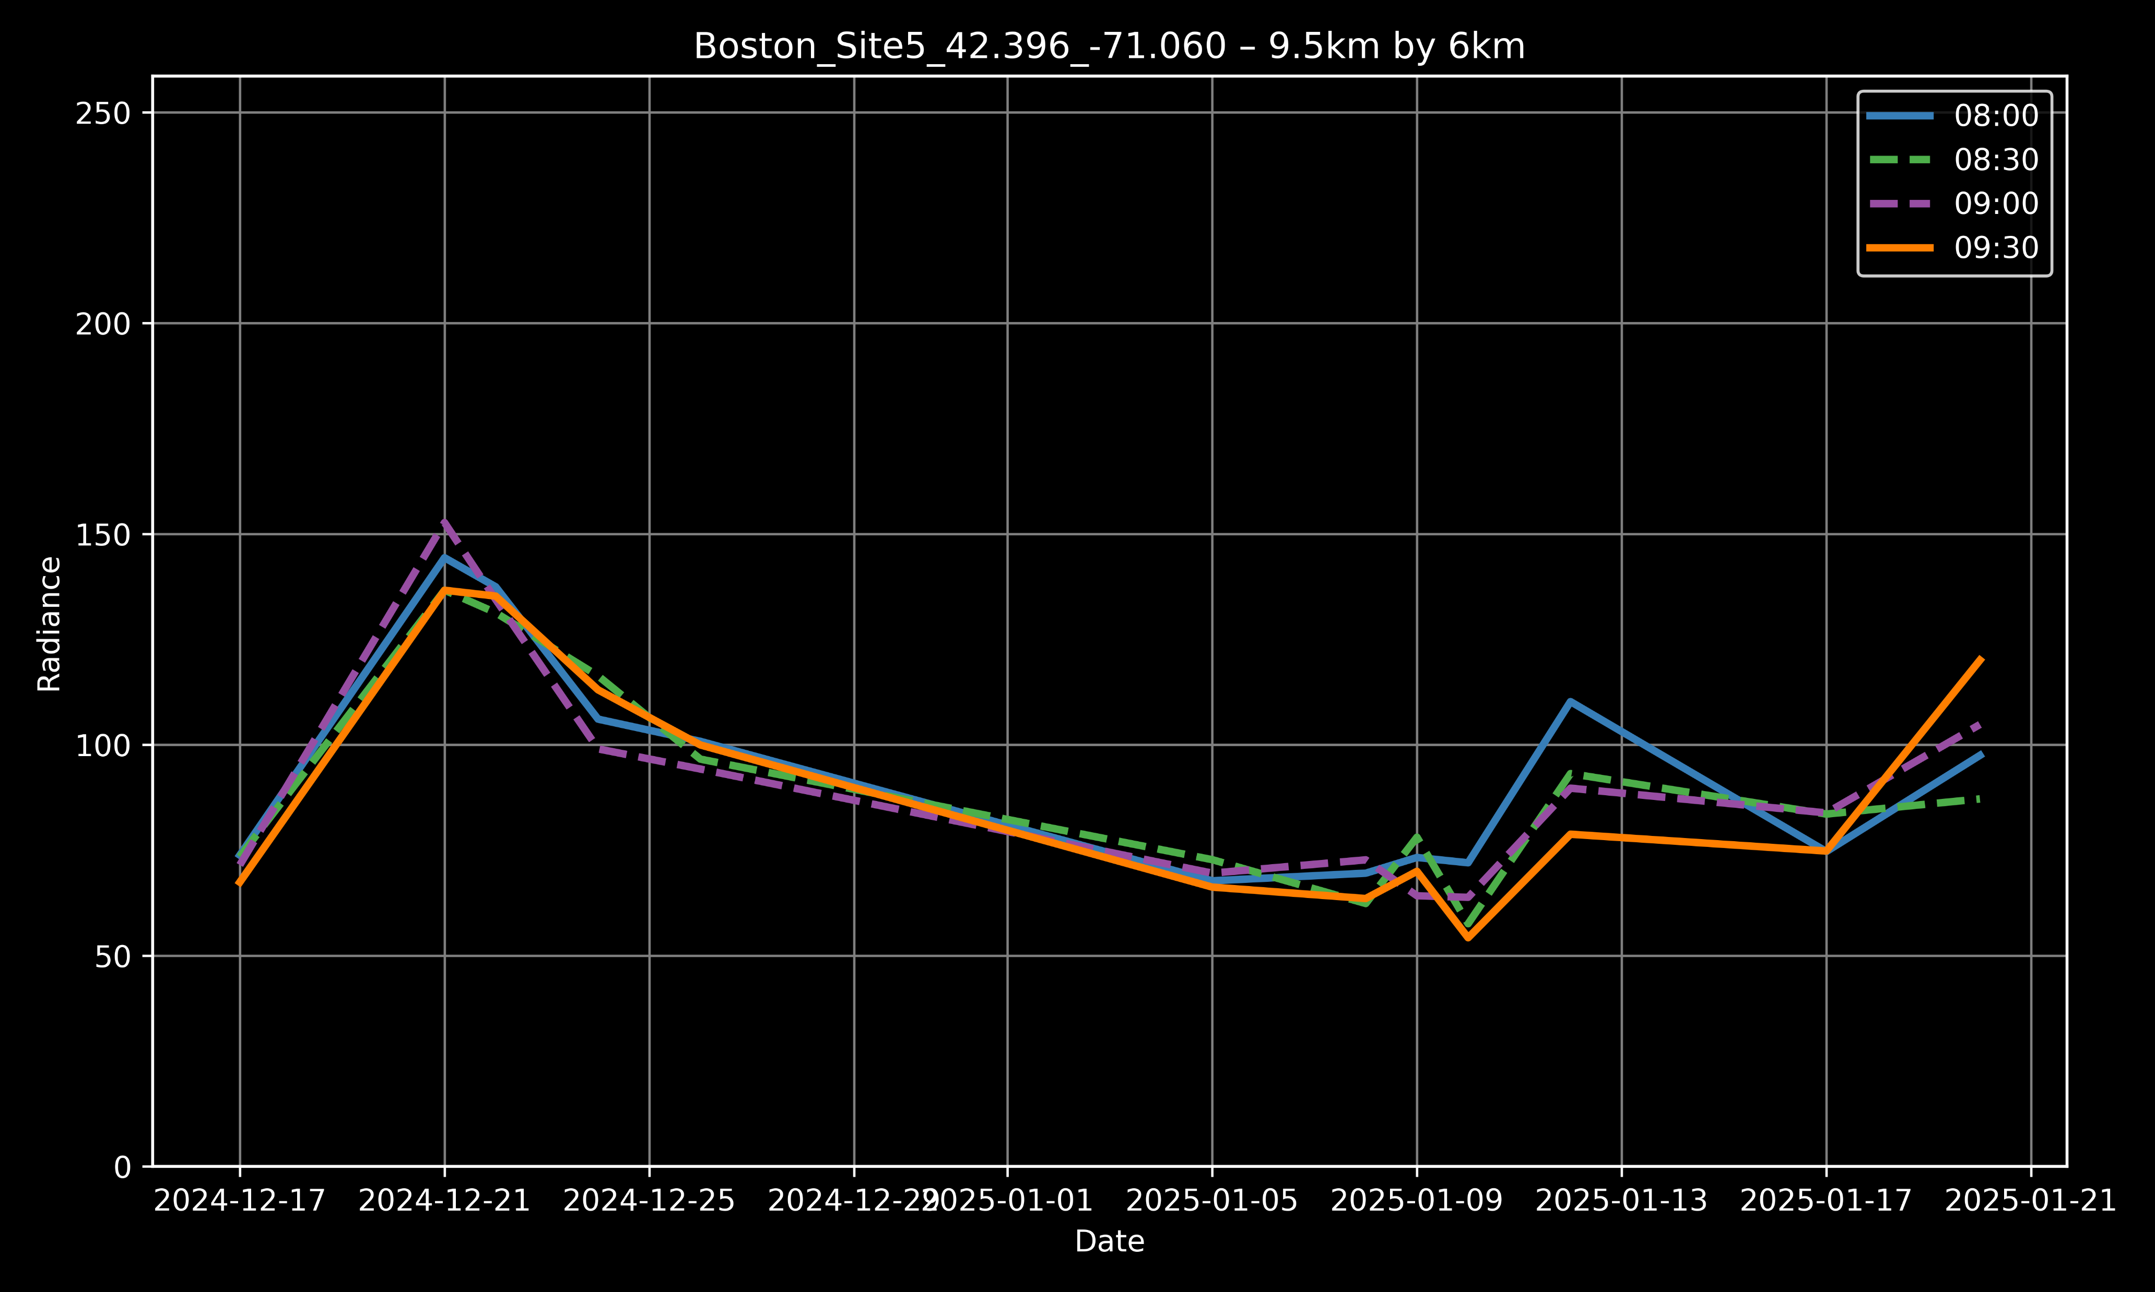
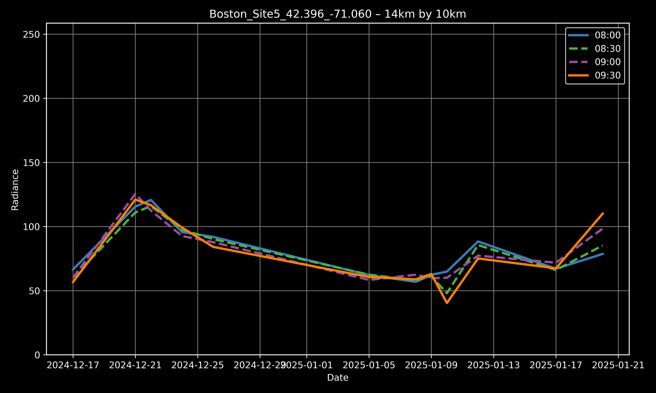
TEMPO: Temporal Variation
Boston Residential Site
Boston Industrial Site

Slide 8
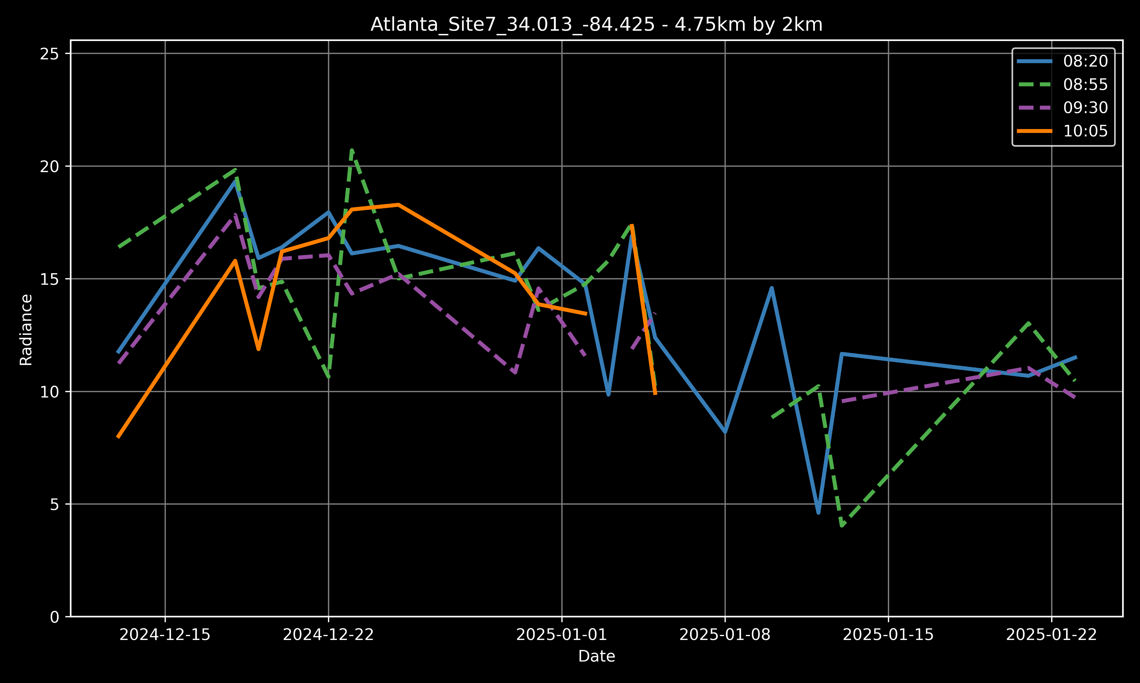
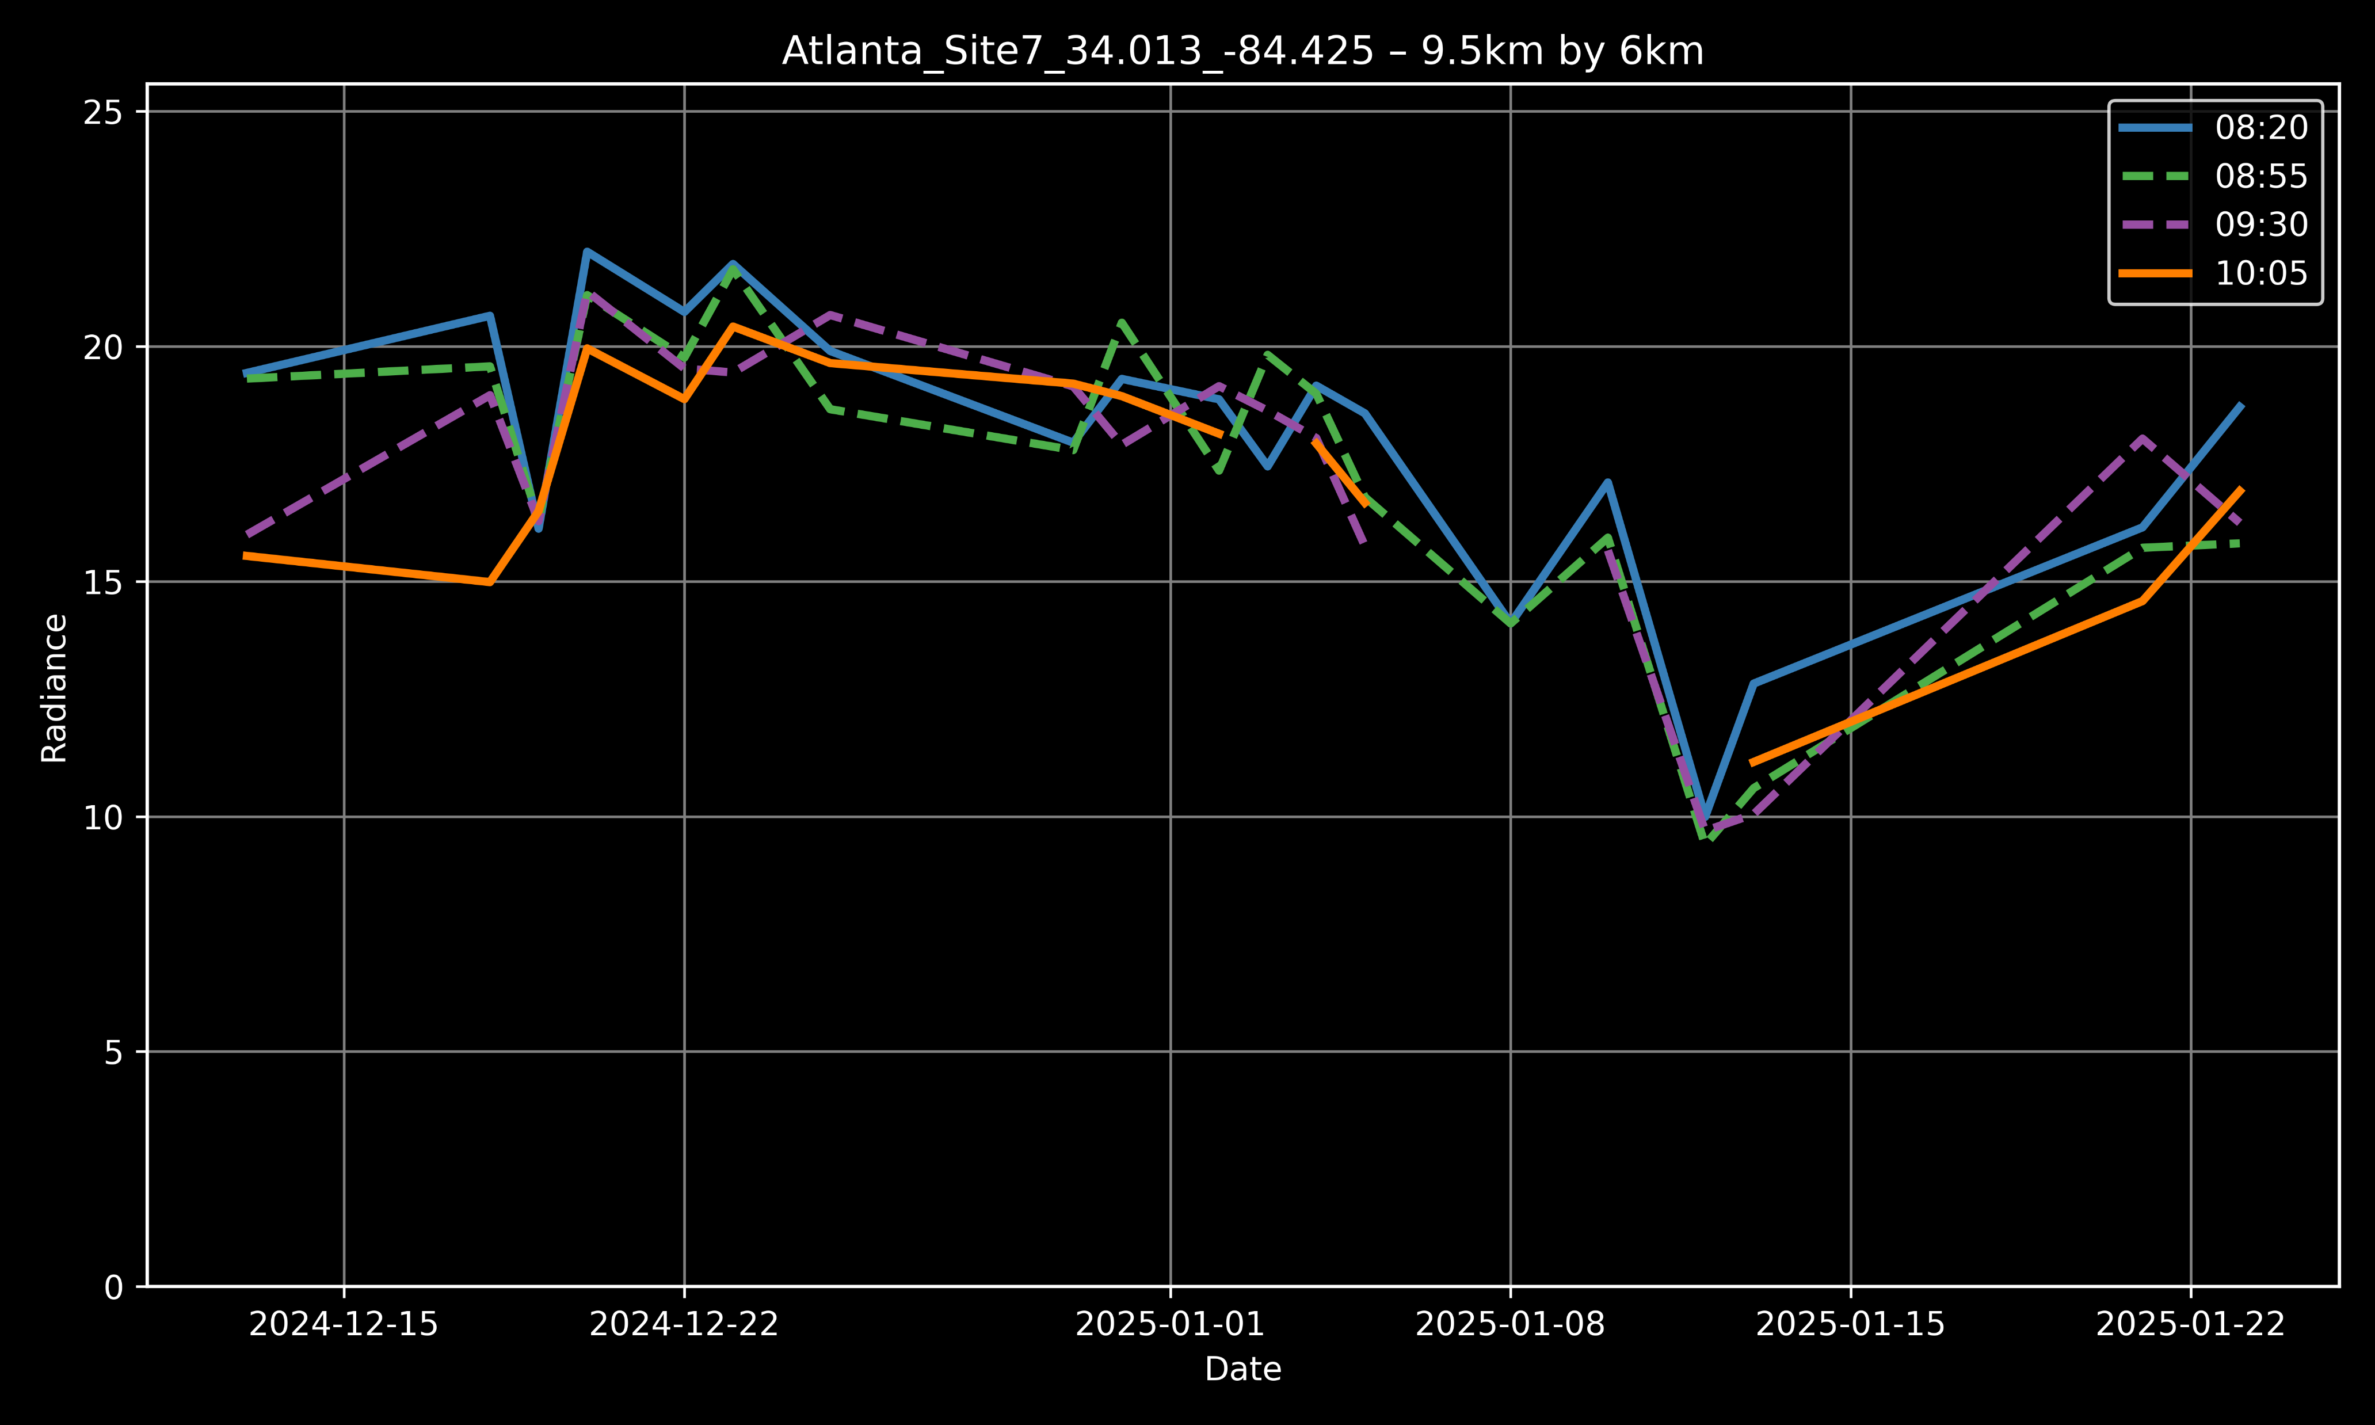
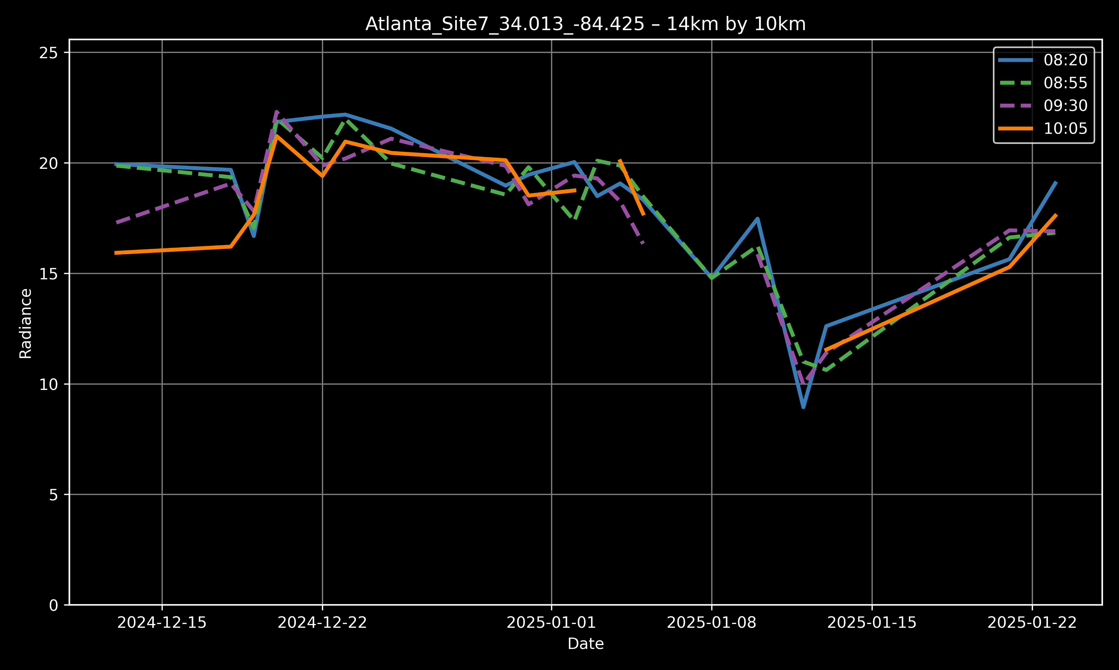
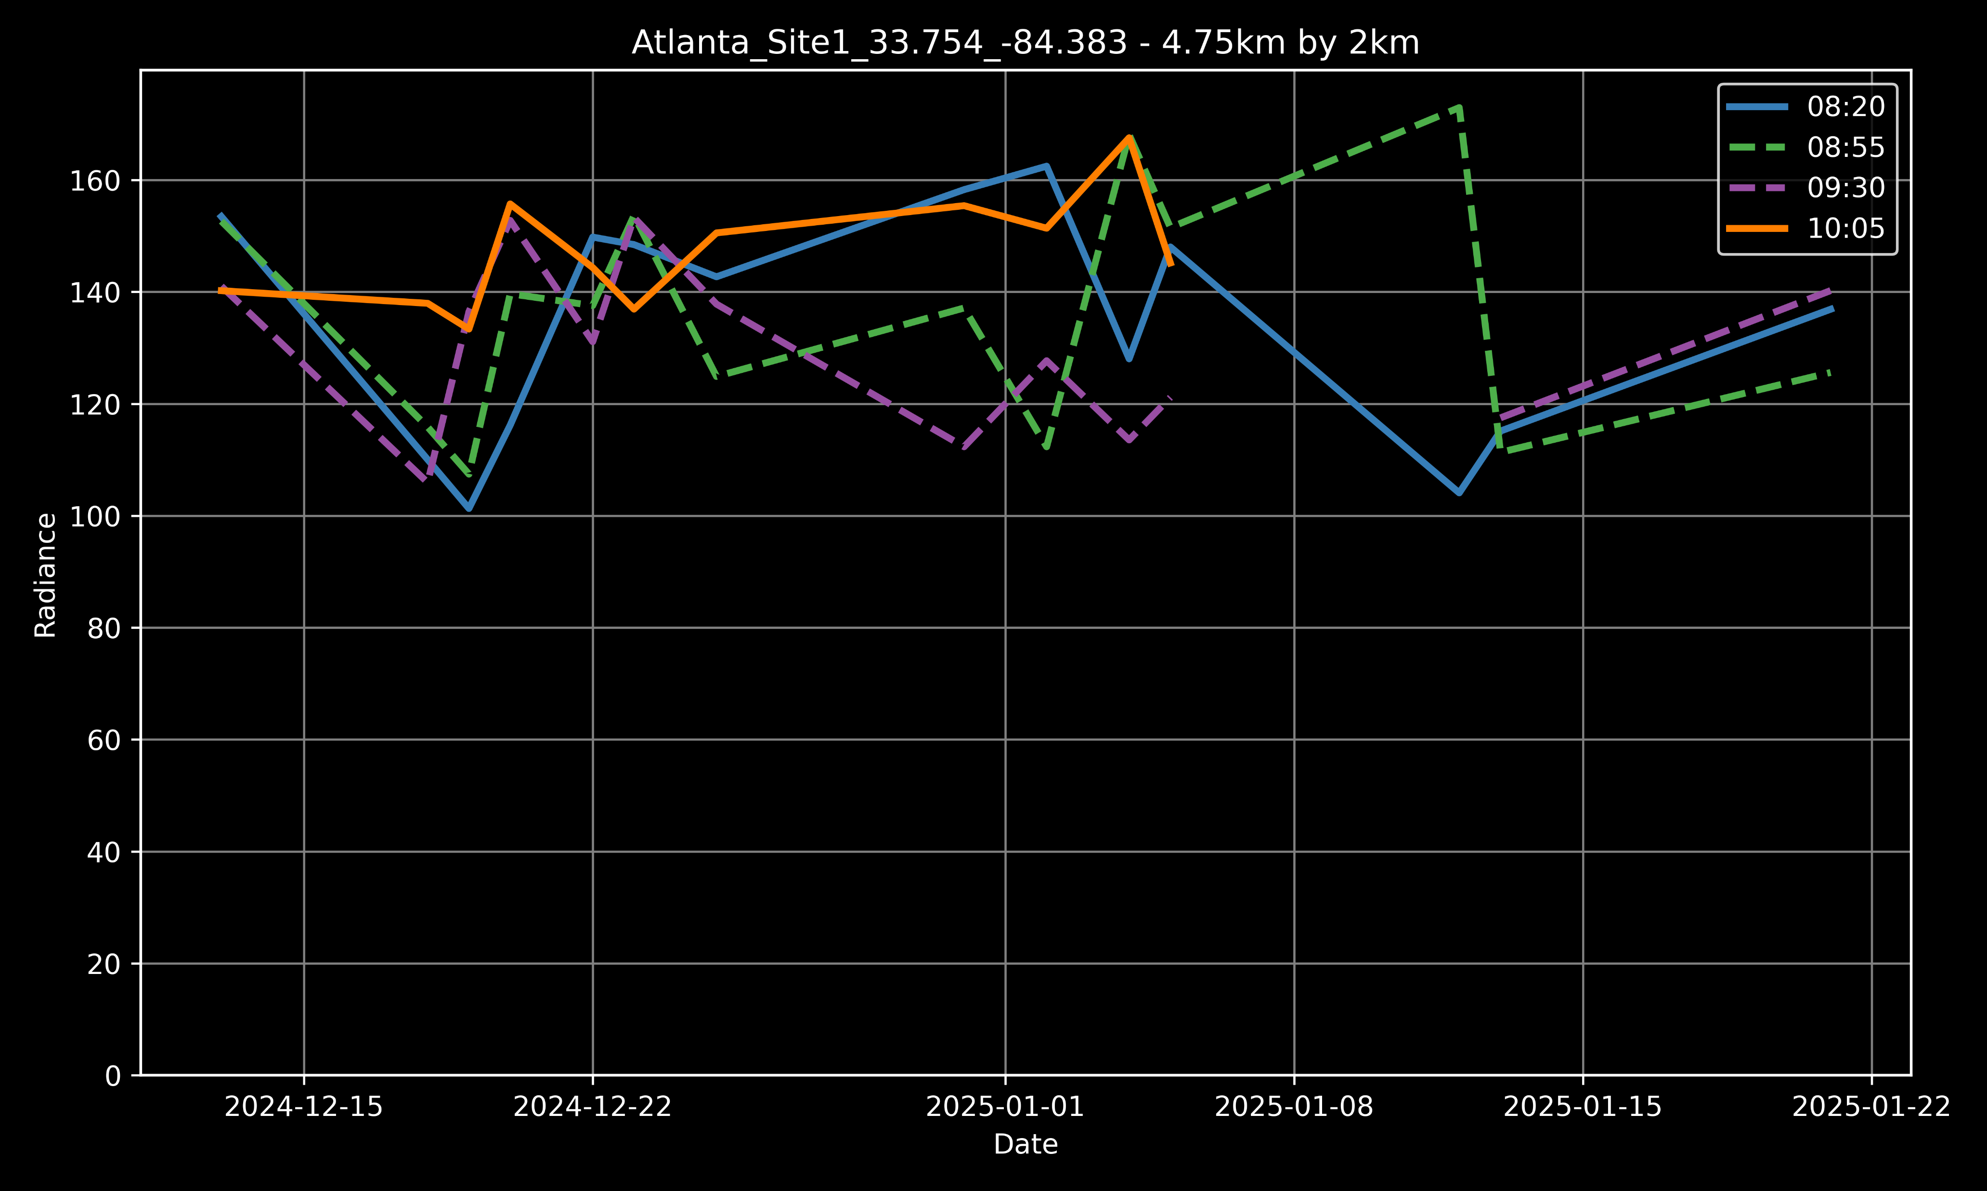
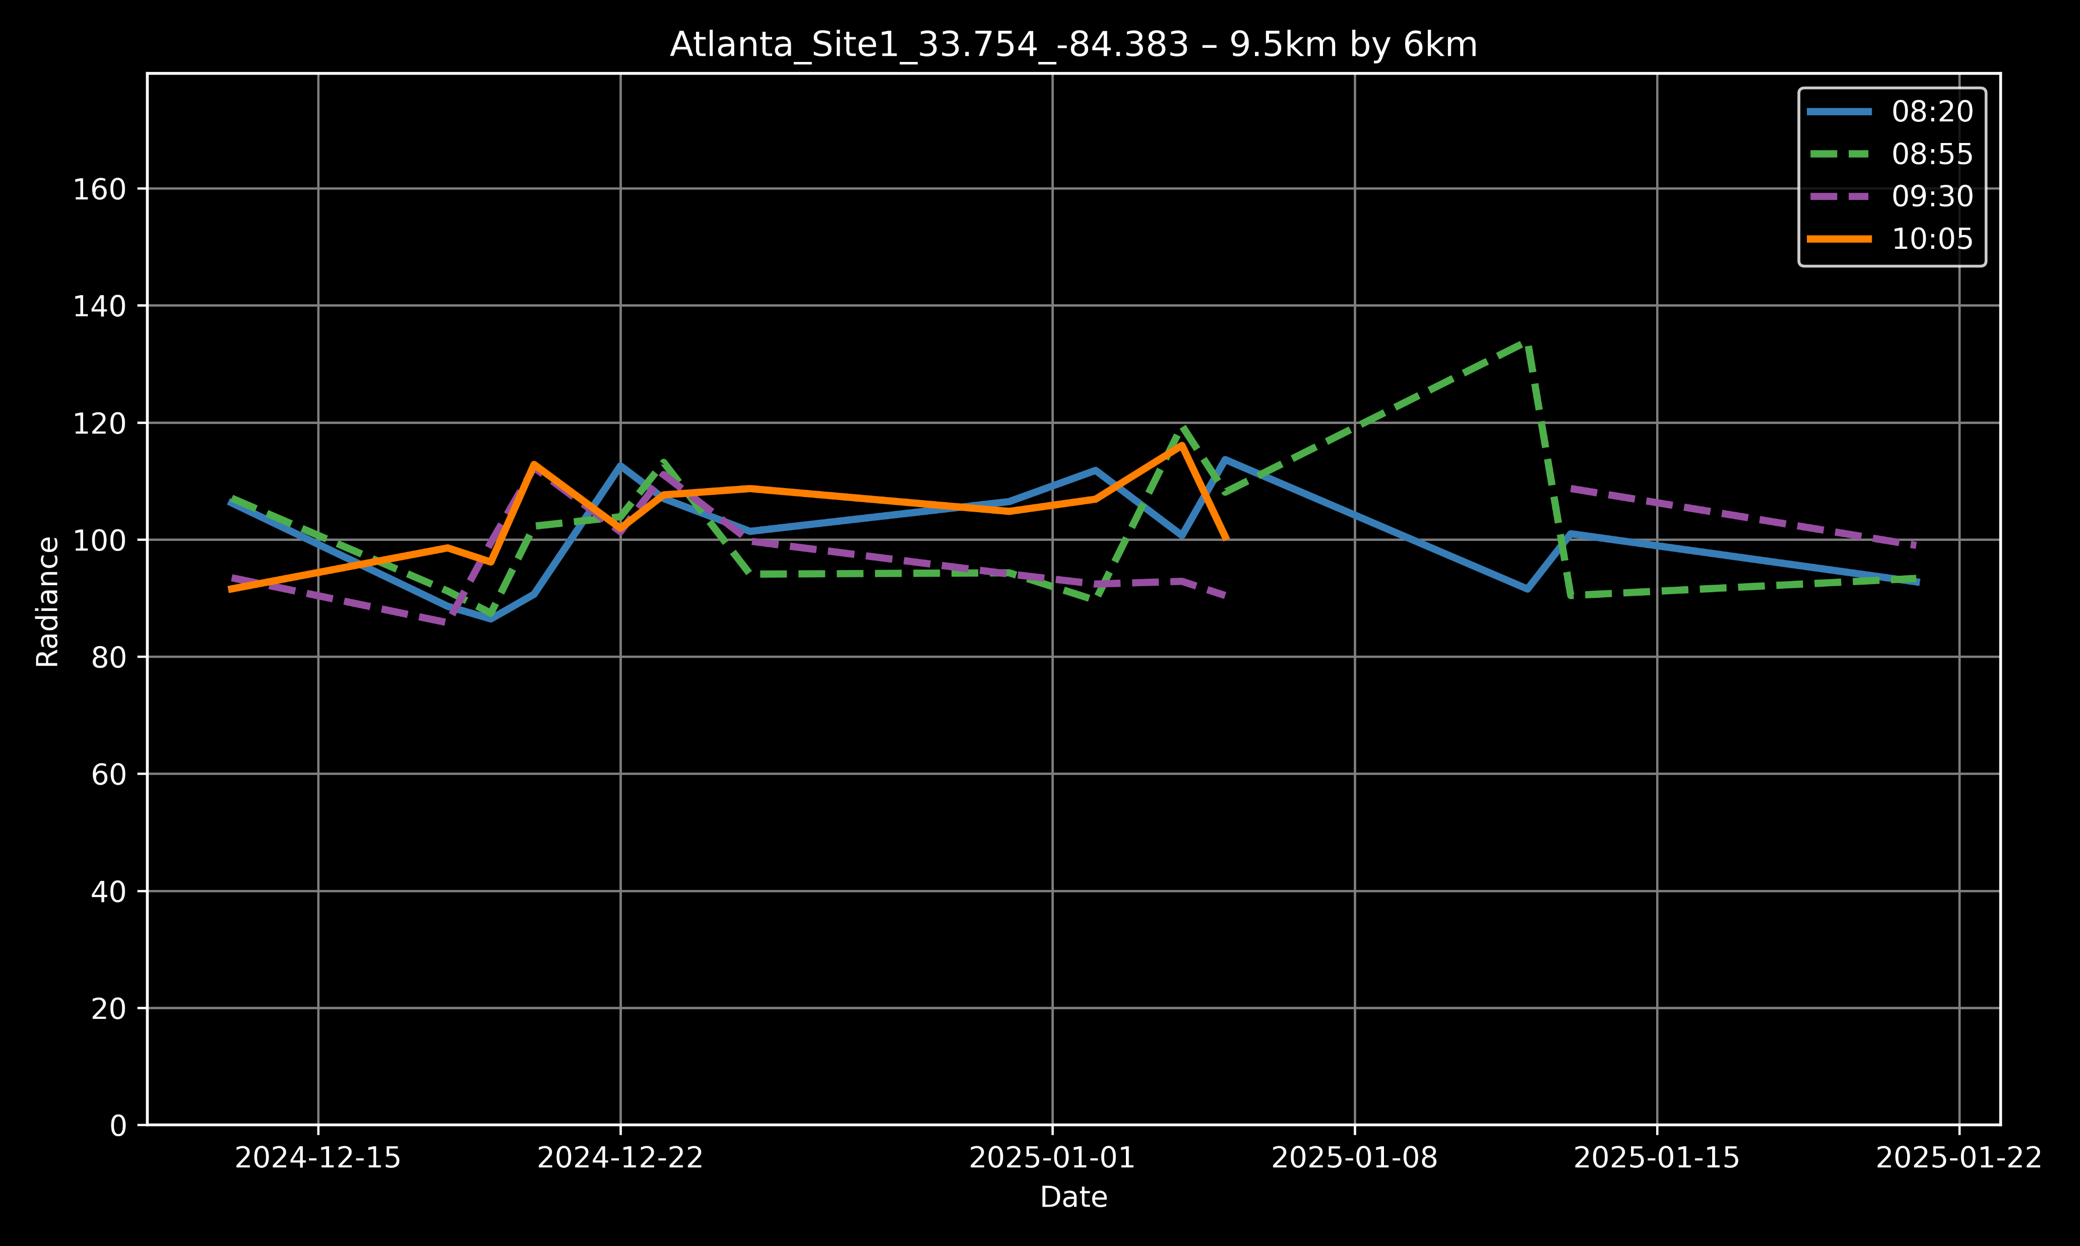
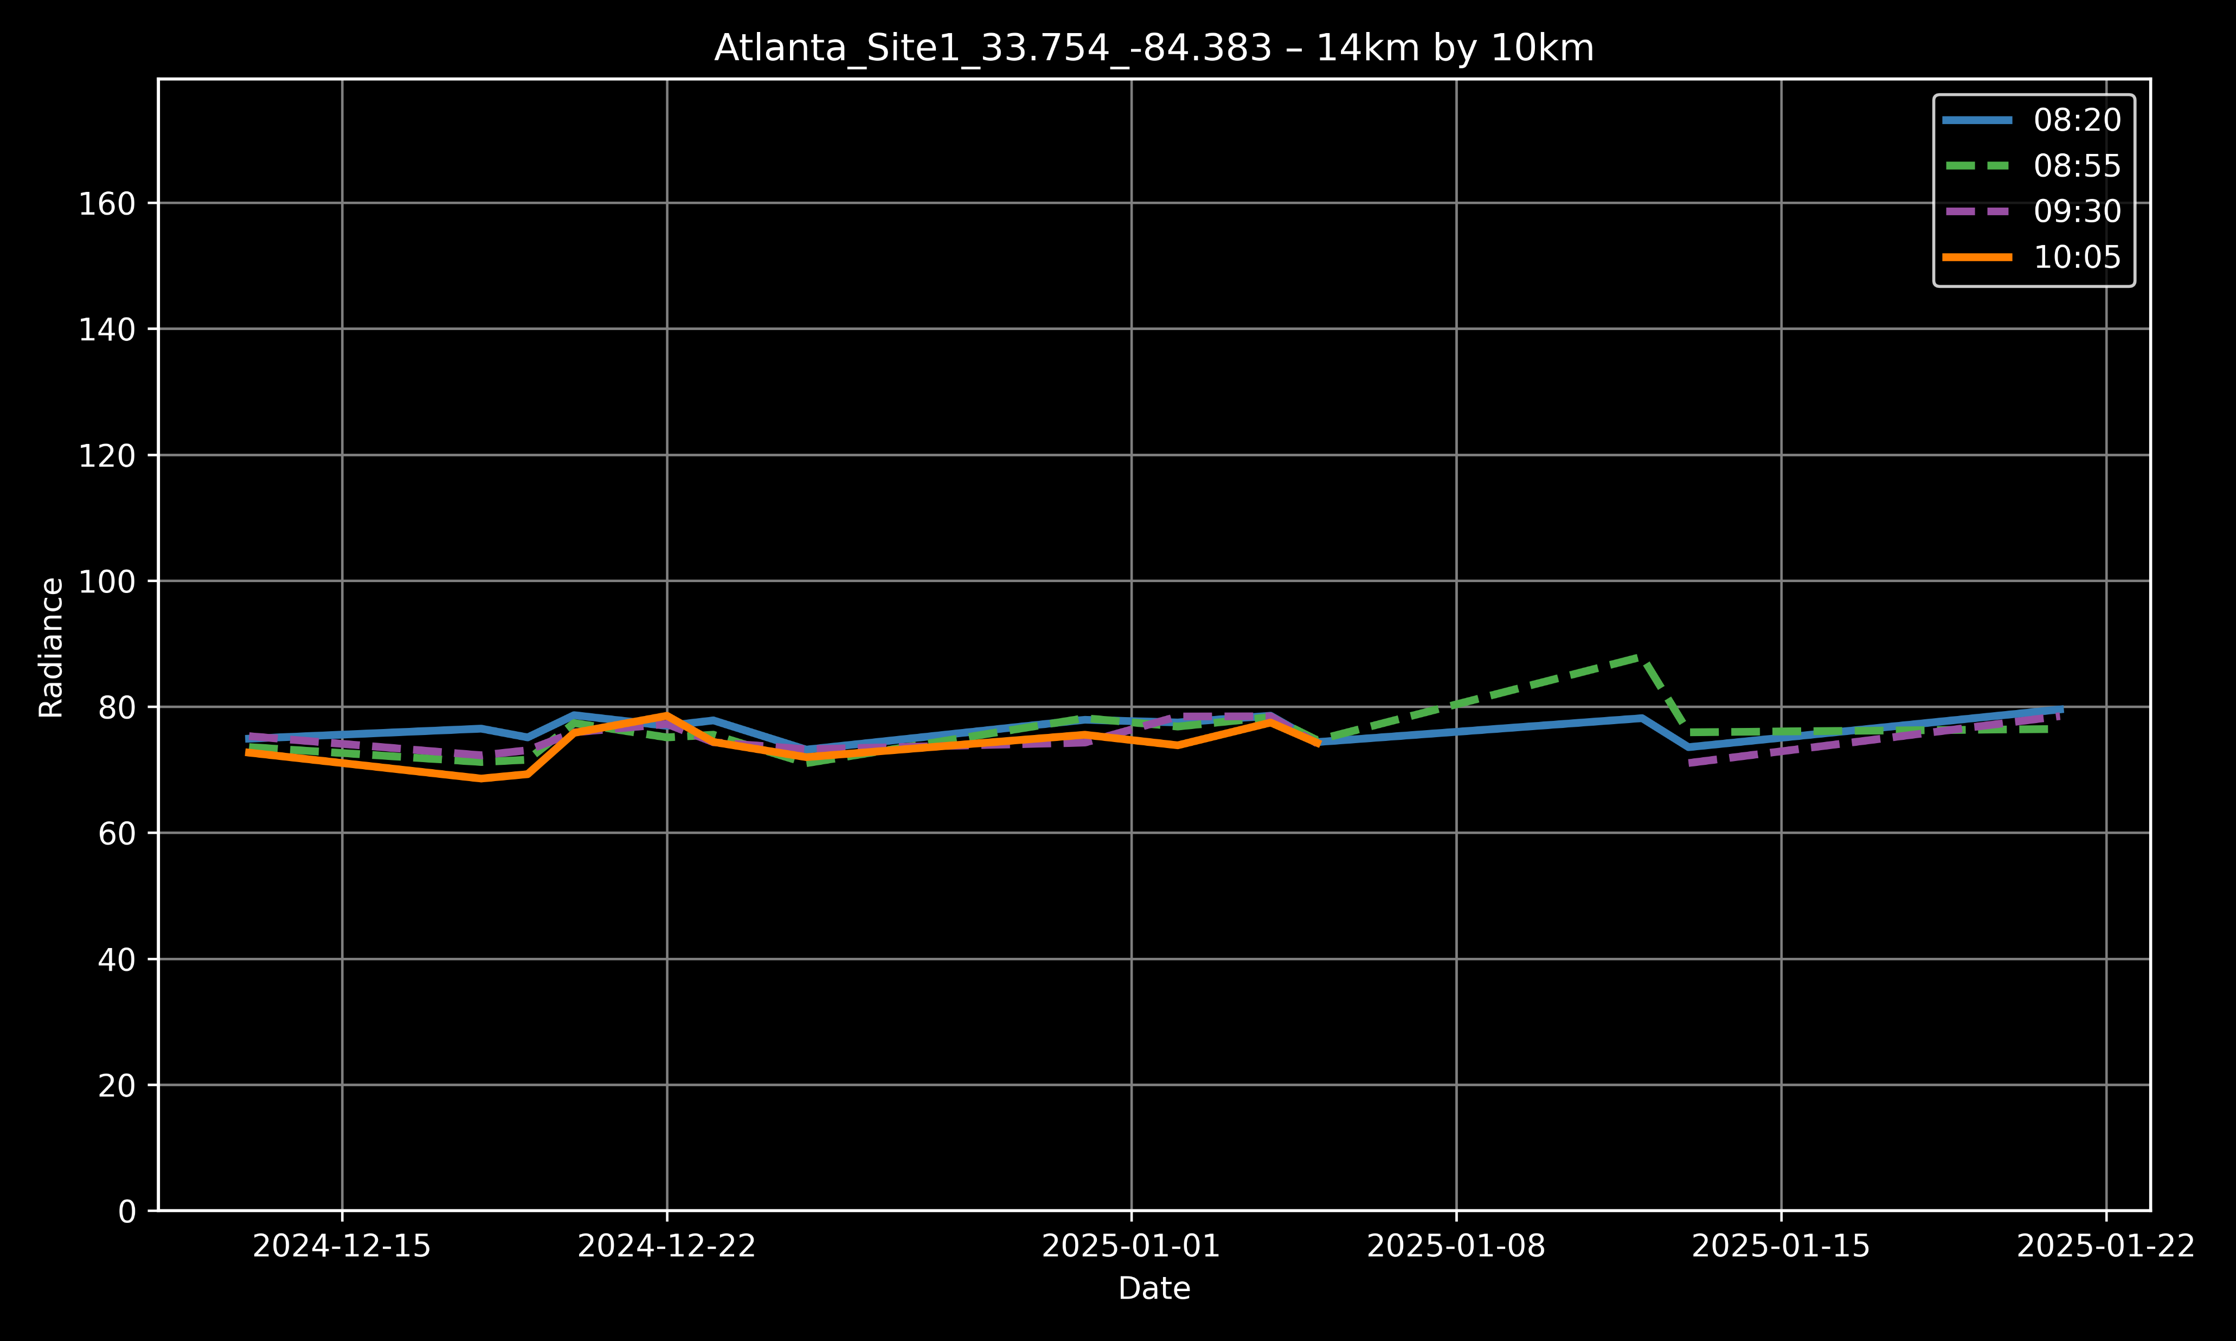
TEMPO: Temporal Variation
Atlanta Residential Site
Atlanta Commercial Center

Slide 9
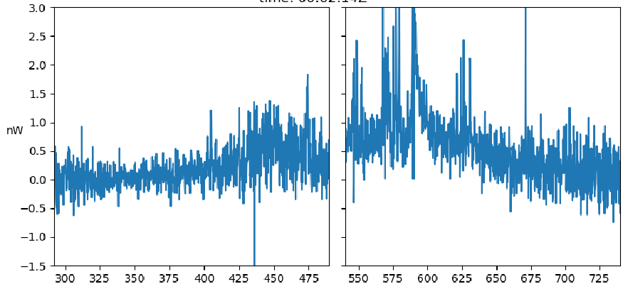
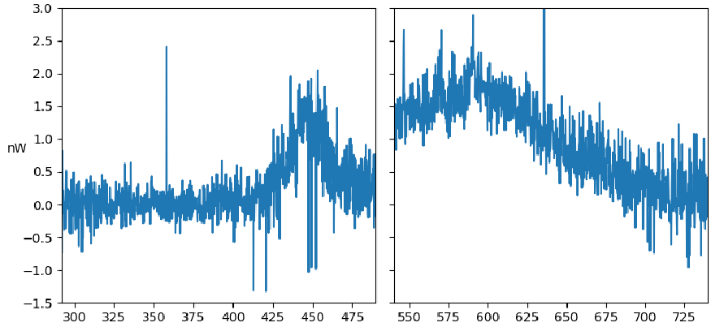
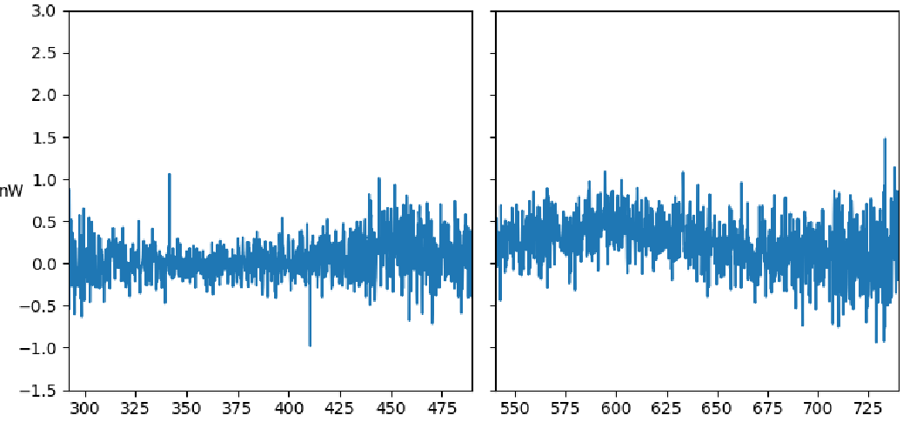
TEMPO’s View of Land Use Types
Industrial area
Commercial Center
Residential area

Slide 10
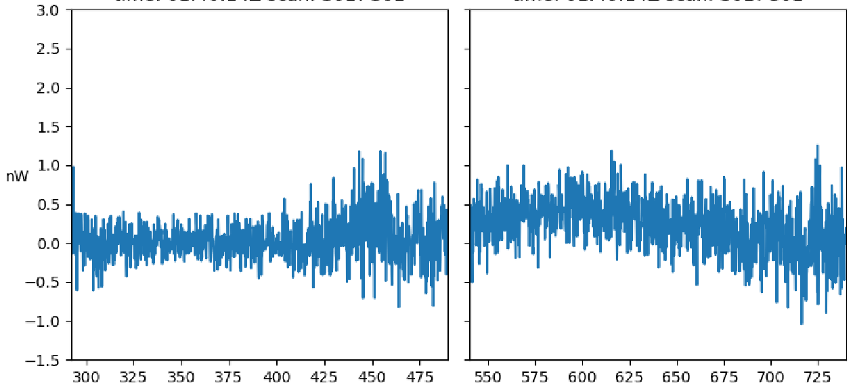
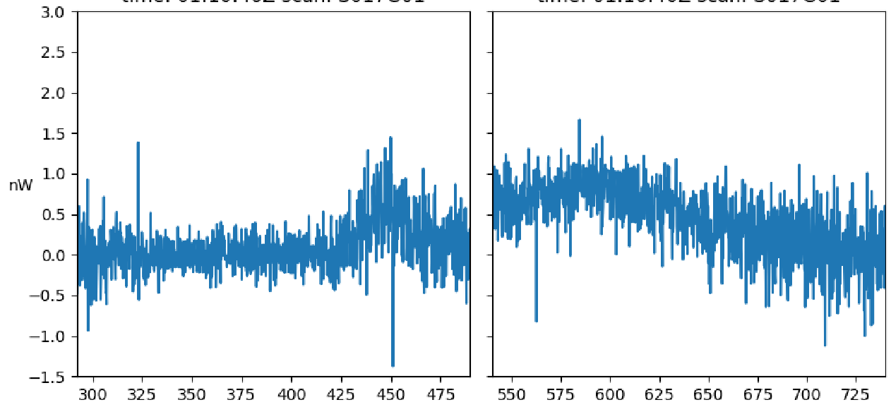
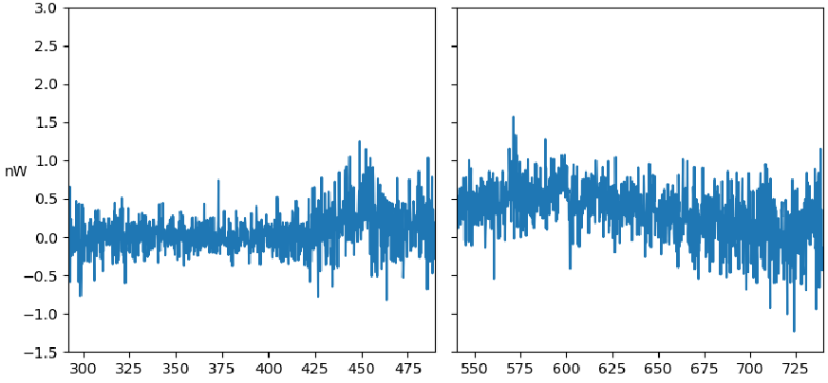
TEMPO: Spectral Variation
The spectrum is generally consistent across different dates and times for each land use type
Spectral variations were observed in residential areas during holiday periods
Boston residential area on 12/14/2024
Boston residential area on 12/24/2024
New York residential area on 12/13/2024
New York residential area on 12/22/2024

Slide 11
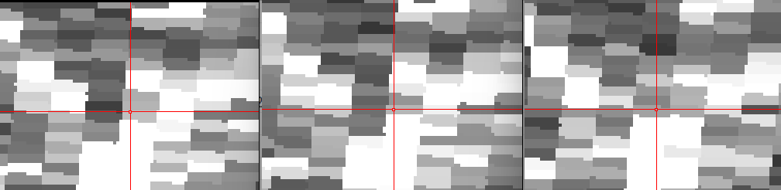
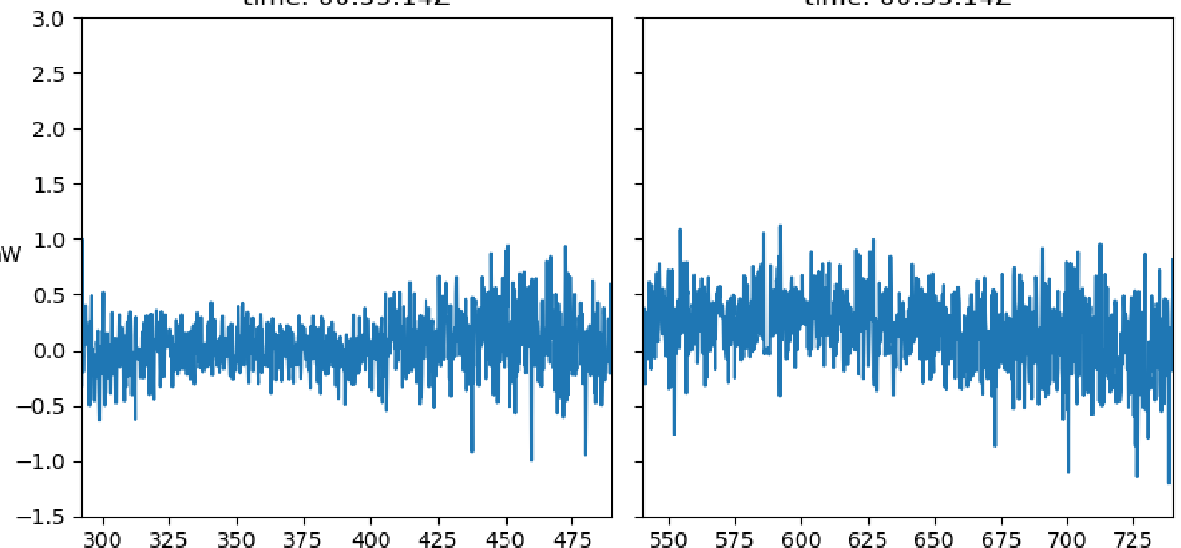
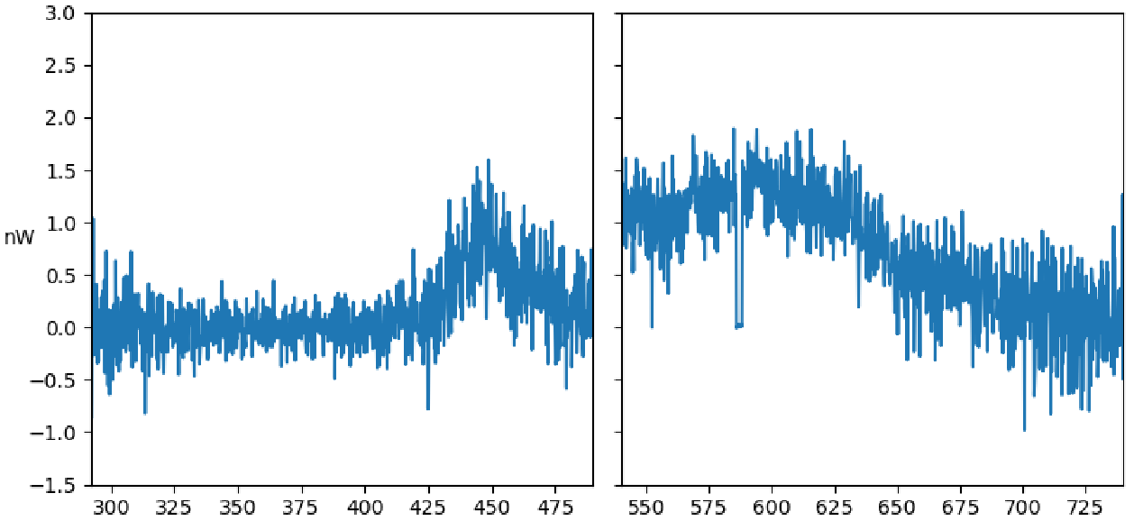
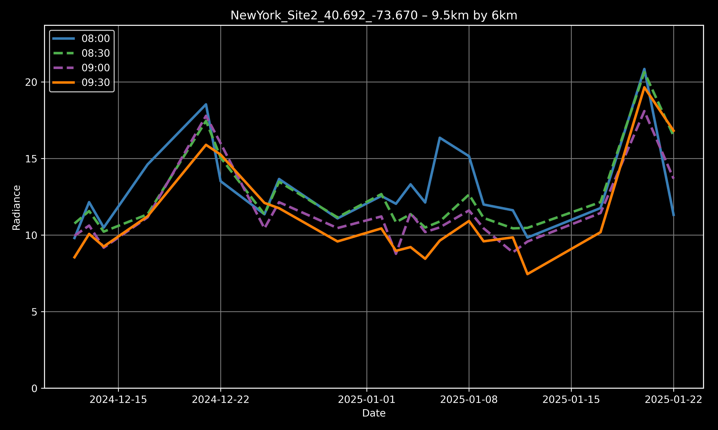
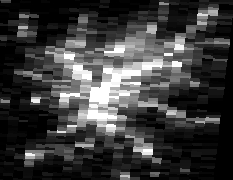
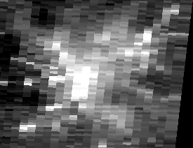
TEMPO: Uncertainty
Atmospheric effect (aerosol)
- No atmospheric correction
Lunar effect
- Some of surface reflected moonlight may
be subtracted as background
Geometric effect
- Geolocation correction, footprint mismatch
Cloud
- No cloud flag, the spectra of cloud is flat
Snow
- Snow increases the radiance
Geometric effect
Atlanta at 8:22pm (left), 9:00 (middle), and 10:05 (right) on 12/21/2024
Cloud effect
Snow
TEMPO hyperspectral observations in Atlanta commercial center under cloudy (left) and clear sky (right)
TEMPO nighttime observations under clear (left) and cloudy sky (right) in Atlanta

Slide 12
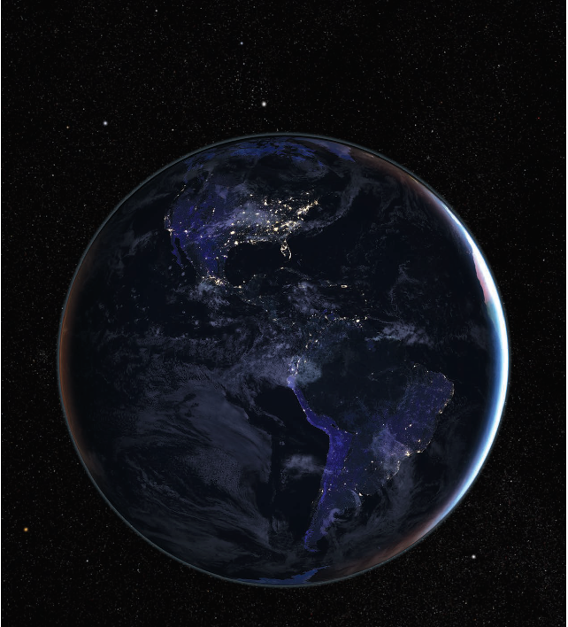
Conclusion
Significant nighttime light intra-day variation was observed
Holiday lighting enhances nighttime brightness, particularly in residential area
Temporal variation in nighttime light is dependent on land use types
Further analysis is required to quantify uncertainties

