Slide 1
NASA’s Black Marble Product Suite
Turning Night Lights into Actionable Intelligence
Miguel O. Román, PhD
NASA Goddard Space Flight Center

Slide 2
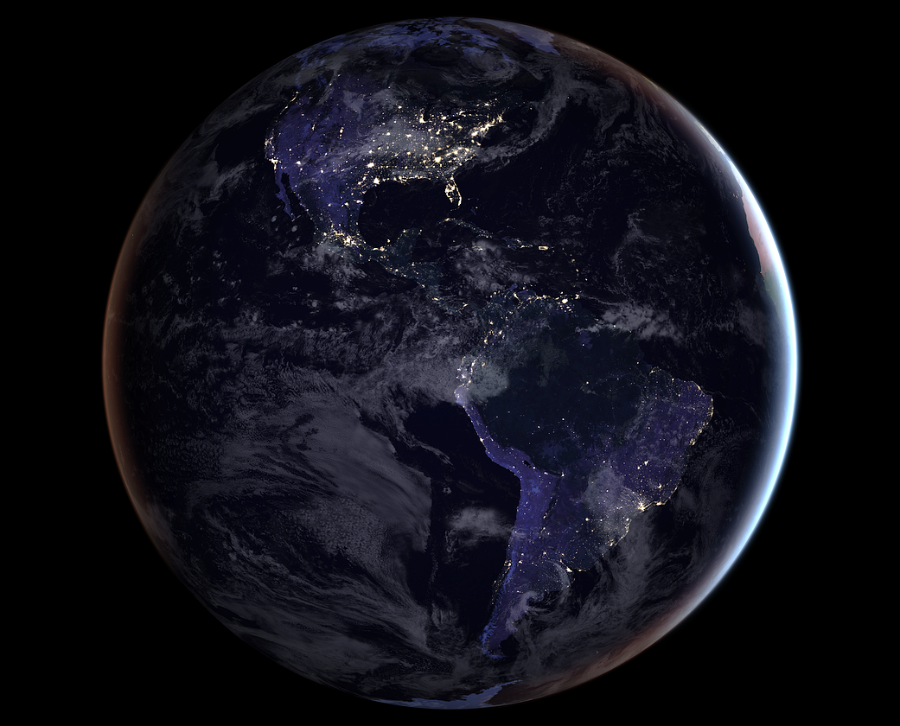
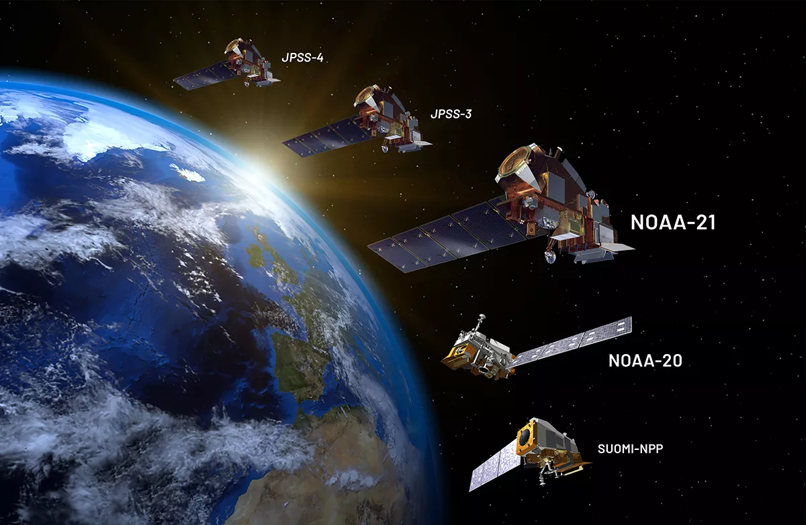

Black Marble Data
“Since its creation, NASA has been at the forefront of our national security, technological innovation, and economic prosperity.”
Sen. Ted Cruz (R-Texas)
The only operational, publicly available nightlights product delivering calibrated, high-resolution observations.
Provides a consistent global view of Earth at Night since 2012, with daily data captured at 1:30 AM local time.
Offers a common operating picture of human activity and infrastructure, empowering innovation and informing U.S. economic and security interests.

Slide 3
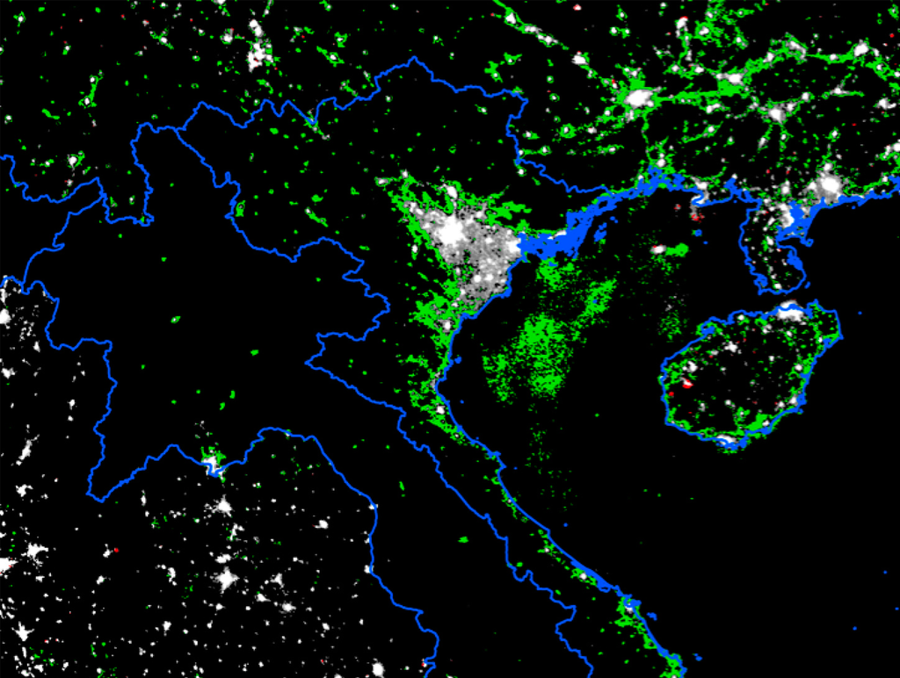
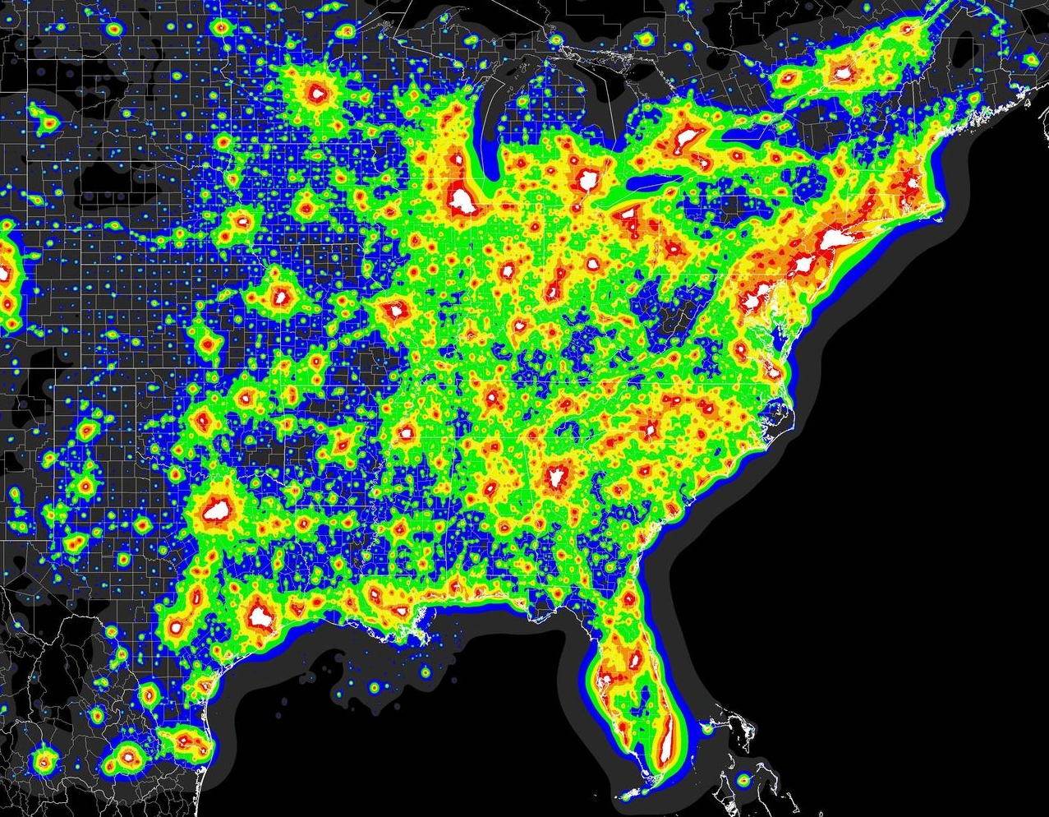

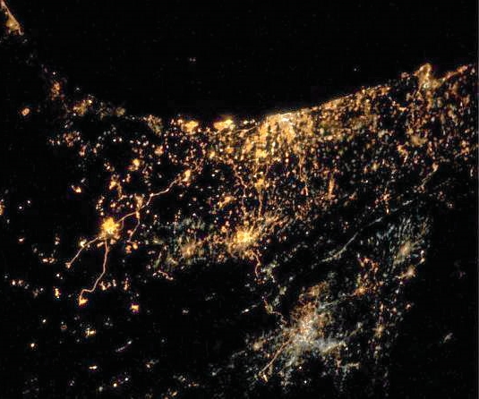
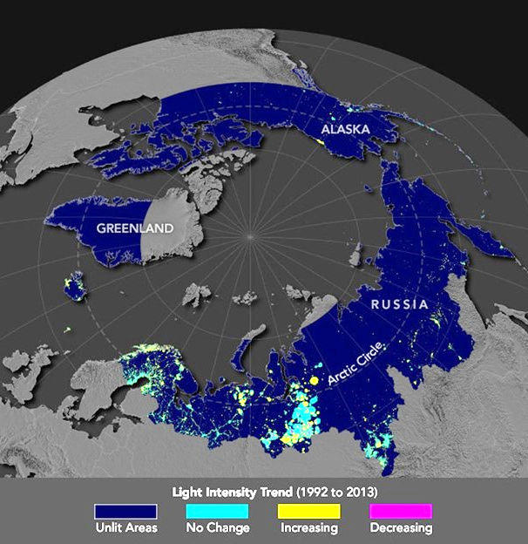
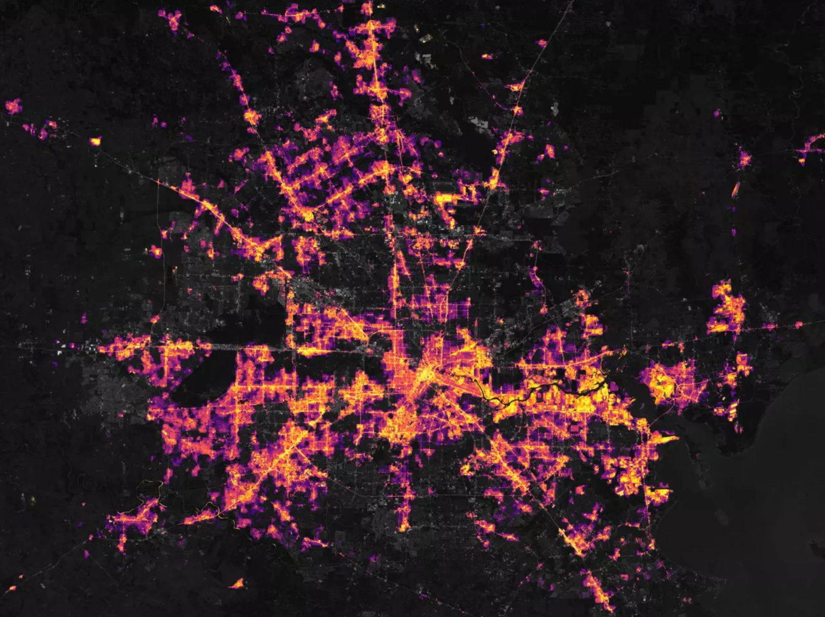
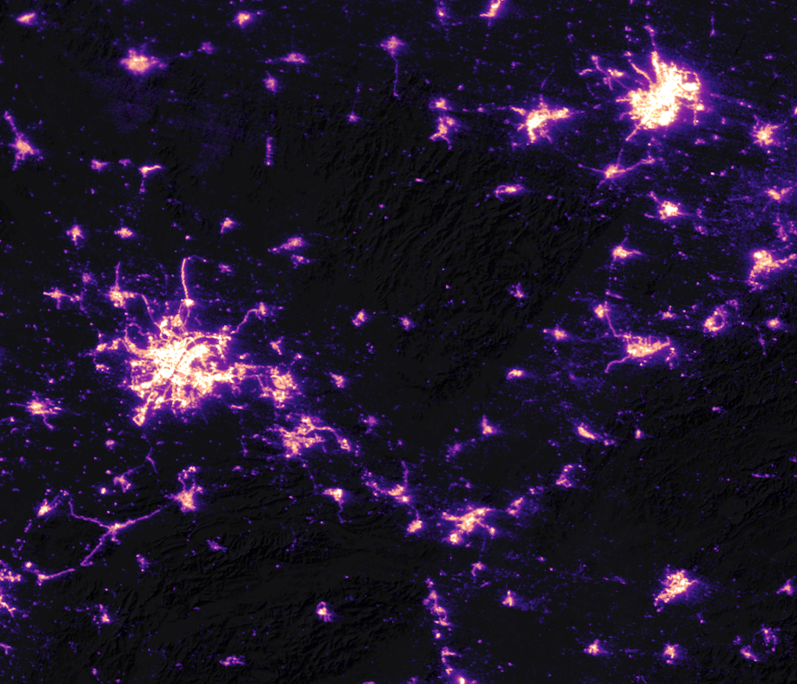
Global Nighttime Intelligence
A common operating picture of Earth at Night that…
Securing National Interests
Strengthening the U.S. Economy
Protecting Lives and Critical Infrastructure
Use Cases Include:
Tracking disruptions across global supply chains.
Monitoring industrial growth and encroachment in the Arctic.
Observing fishing fleets and maritime operations in strategic waters.
Enhancing energy sector oversight with improved flare detection and infrastructure monitoring.
Supporting U.S. forces, businesses, and first responders during major disasters.
Electrical Infrastructure
& Gas Flares
Maritime Activity & Clandestine Operations
Arctic Interest
Global Conflicts
Human Health
Disasters, Fires, & Power Outages

Slide 4
Black Marble Data
Agencies:
NASA-built and NOAA-operated.
NASA creates and distributes the data product.
Operating Satellites:
SNPP (Suomi-NPP)
NOAA-20
NOAA-21
Instrument:
Visible Infrared Imaging Radiometer Suite (VIIRS)
Sensor:
Day-night-band (DNB) on the VIIRS instrument

Slide 5
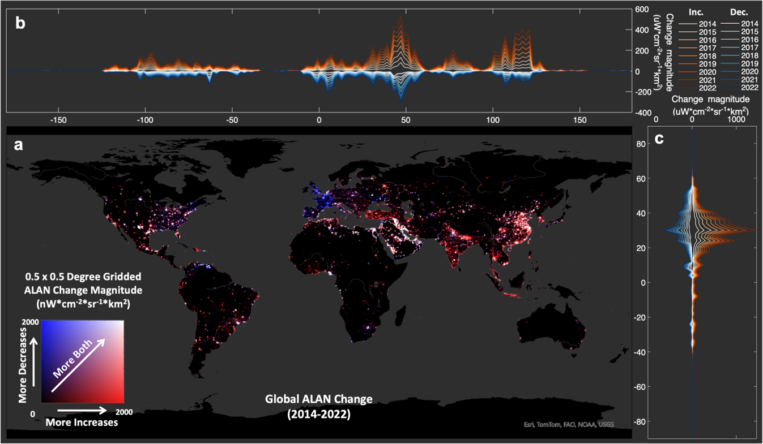
1) Securing National Interests
Quantifying Global Economic Shifts
Energy Transitions in Europe: Captures the widespread shift to LED lighting, offering a spatially resolved, time-stamped record of reduced radiance consistent with national energy efficiency policies and urban lighting retrofits.
Electrification in India: Reveals accelerating access to electricity through measurable increases in nighttime radiance across rural and peri-urban regions, supporting insights into infrastructure expansion and development equity.
Conflict-Driven Deurbanization: Tracks abrupt light loss and gradual recovery in areas affected by conflict and instability (e.g., Ukraine, Syria, and Venezuela), providing timely data for humanitarian assessments and resilience monitoring.
https://spacenews.com/viewing-earth-from-space-at-night-tracking-our-changing-black-marble/

Slide 6
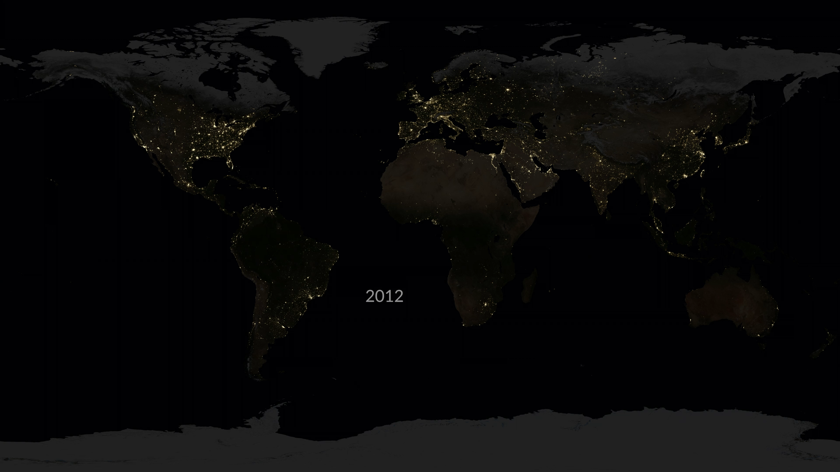
1) Securing National Interests

Slide 7
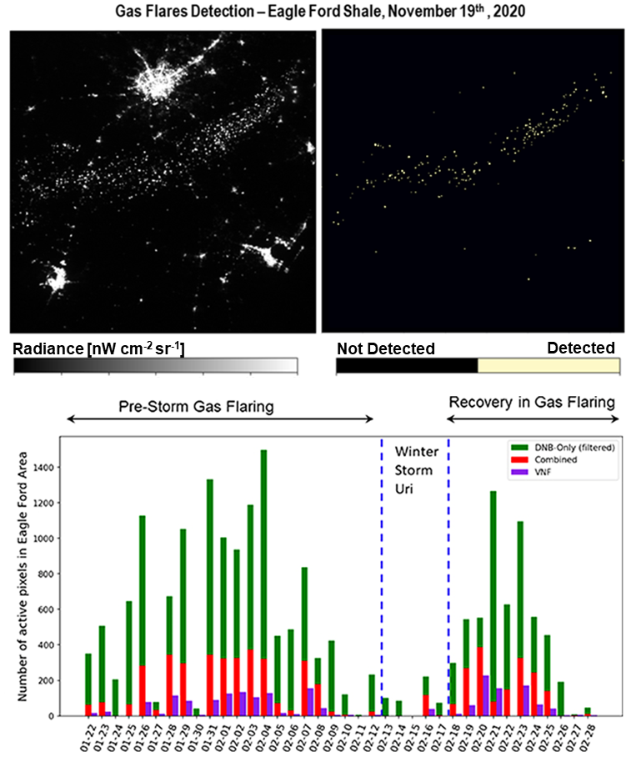
2) Strengthening the U.S. Economy
Applying cutting-edge AI/ML to deliver actionable intelligence for a resilient and competitive U.S. energy sector.
Differentiating Capabilities:
Automated Detection: Uses AI/ML to accurately distinguish gas flares from other nightlight sources, capturing subtle operational signals in key energy regions such as the Eagle Ford Shale, Texas.
Smart Data Fusion: Combines VIIRS observations with advanced cross-calibration and filtering techniques to minimize false positives, resolve overlapping signals, and adjust for environmental conditions like moonlight, haze, and cloud cover.
Low-Latency Intelligence: Provides near-real-time visibility to support faster, more informed decisions across energy and infrastructure operations.
Chakraborty et al., 2023.

Slide 8
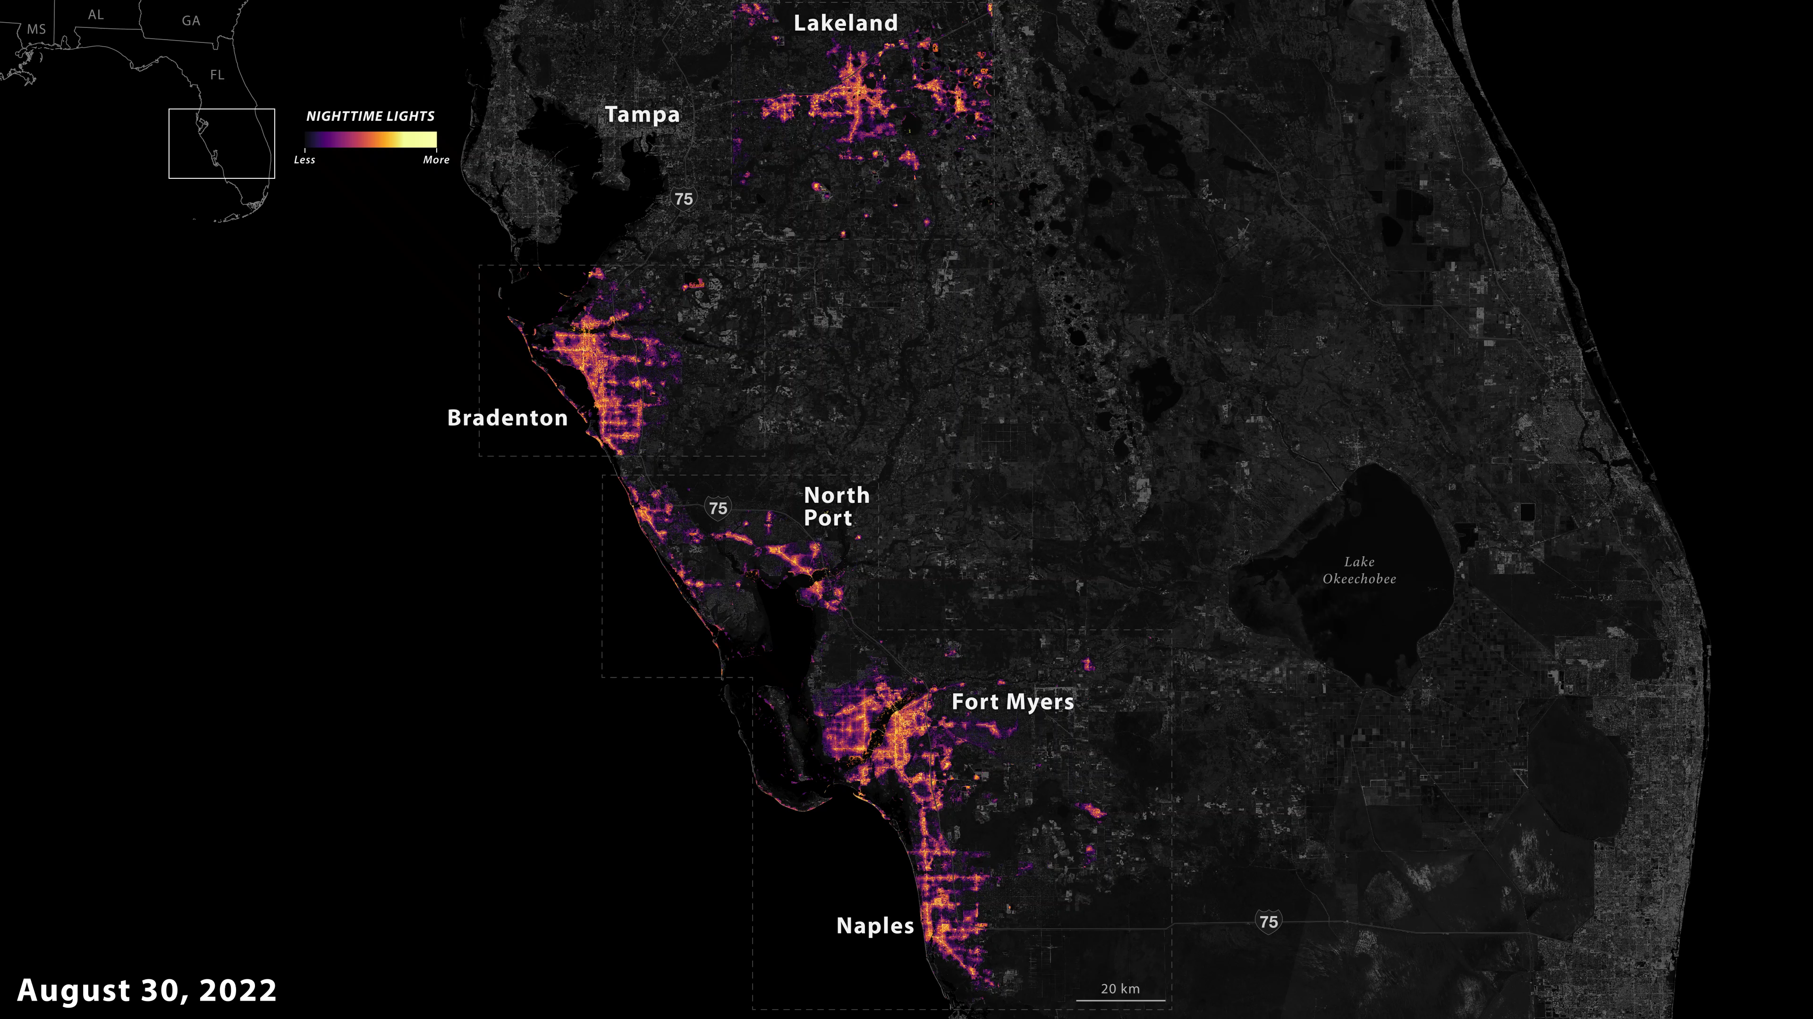
3) Protecting Lives & Critical Infrastructure
Captured widespread outages in Southwest Florida during Hurricane Ian (Sept 29, 2022), revealing power loss that disrupted ports, fuel depots, and transportation routes.
Enabled granular, neighborhood-level outage mapping, empowering emergency teams to assess conditions near critical supply chain nodes and hazardous sites.
Informed real-time supply chain continuity, guiding restoration efforts at logistics hubs, terminals, and distribution networks.

