Slide 1
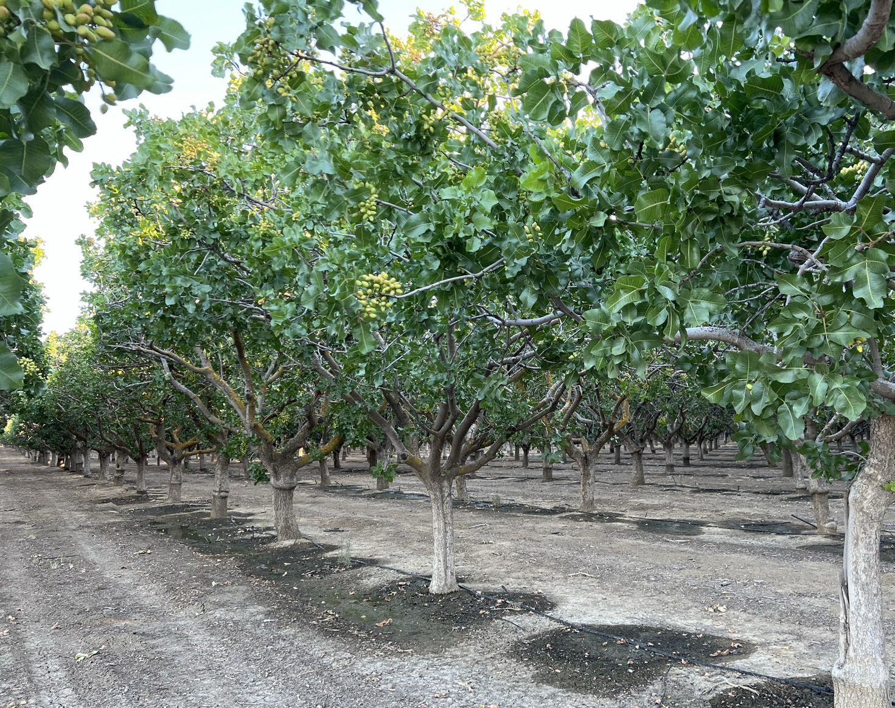



Towards Quantifying NO_{x} Fluxes from Agricultural Land
TEMPO/GeoXO ACX Joint Science Team Workshop
Aug 21, 2025
PI: Dien Wu (CSU Atmos Sci)
Co-Is: Stephen Ogle & Ram Gurung (CSU Ecology), Anping Chen (CSU Biology)
Collaborators: Joshua Laughner & Le Kuai (Caltech/JPL)

Slide 2


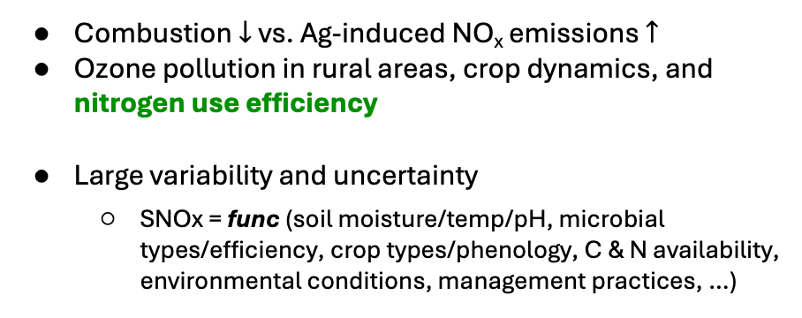
Why NOx over Agricultural Lands?
Combustion $↓$ vs. Ag-induced NO_{x} emissions $↑$
Ozone pollution in rural areas, crop dynamics, and nitrogen use efficiency
Large variability and uncertainty
  SNOx = func (soil moisture/temp/pH, microbial types/efficiency, crop types/phenology, C & N availability, environmental conditions, management practices, …)
Three specific challenges
- Heterogeneity: e.g., most in Central valley and the Midwest in summer
- Bottom-up: limited soil samples + simplification in how soil/microbes respond to the env
- Top-down: co-located combustion sources + limited atmos observations during storm events
Notes:
~15% globally but can reach up to 50% regionally
Similar concept as irrigation use efficiency (# input vs. output like crop yield)
Corn (C4); winter wheat (C3)

Slide 3
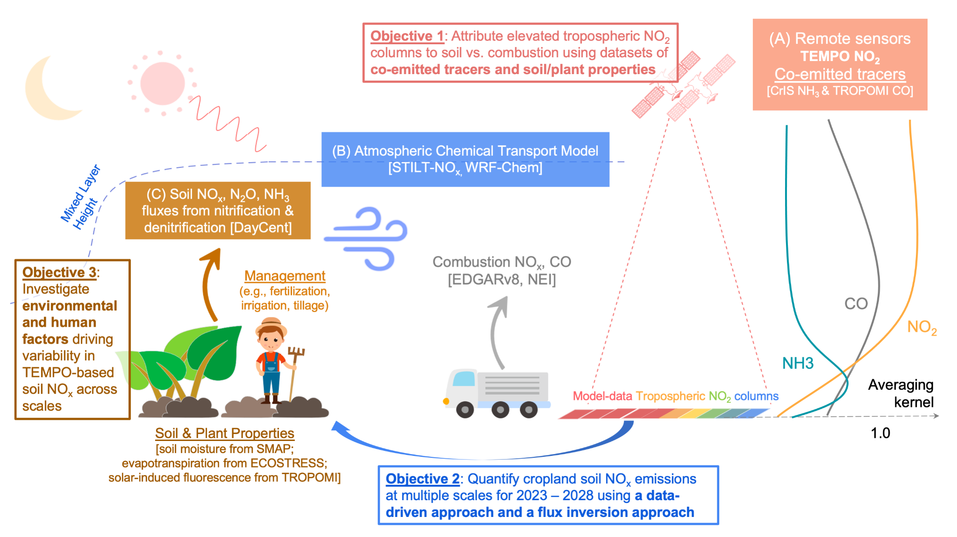
Objective: Investigate the magnitude, variability, and responses of SNOx to environmental and management factors
1. Source Attribution
3. Identify the drivers of posterior fluxes
2. Flux Estimates
Notes:
From a land-atmosphere interaction viewpoint

Slide 4
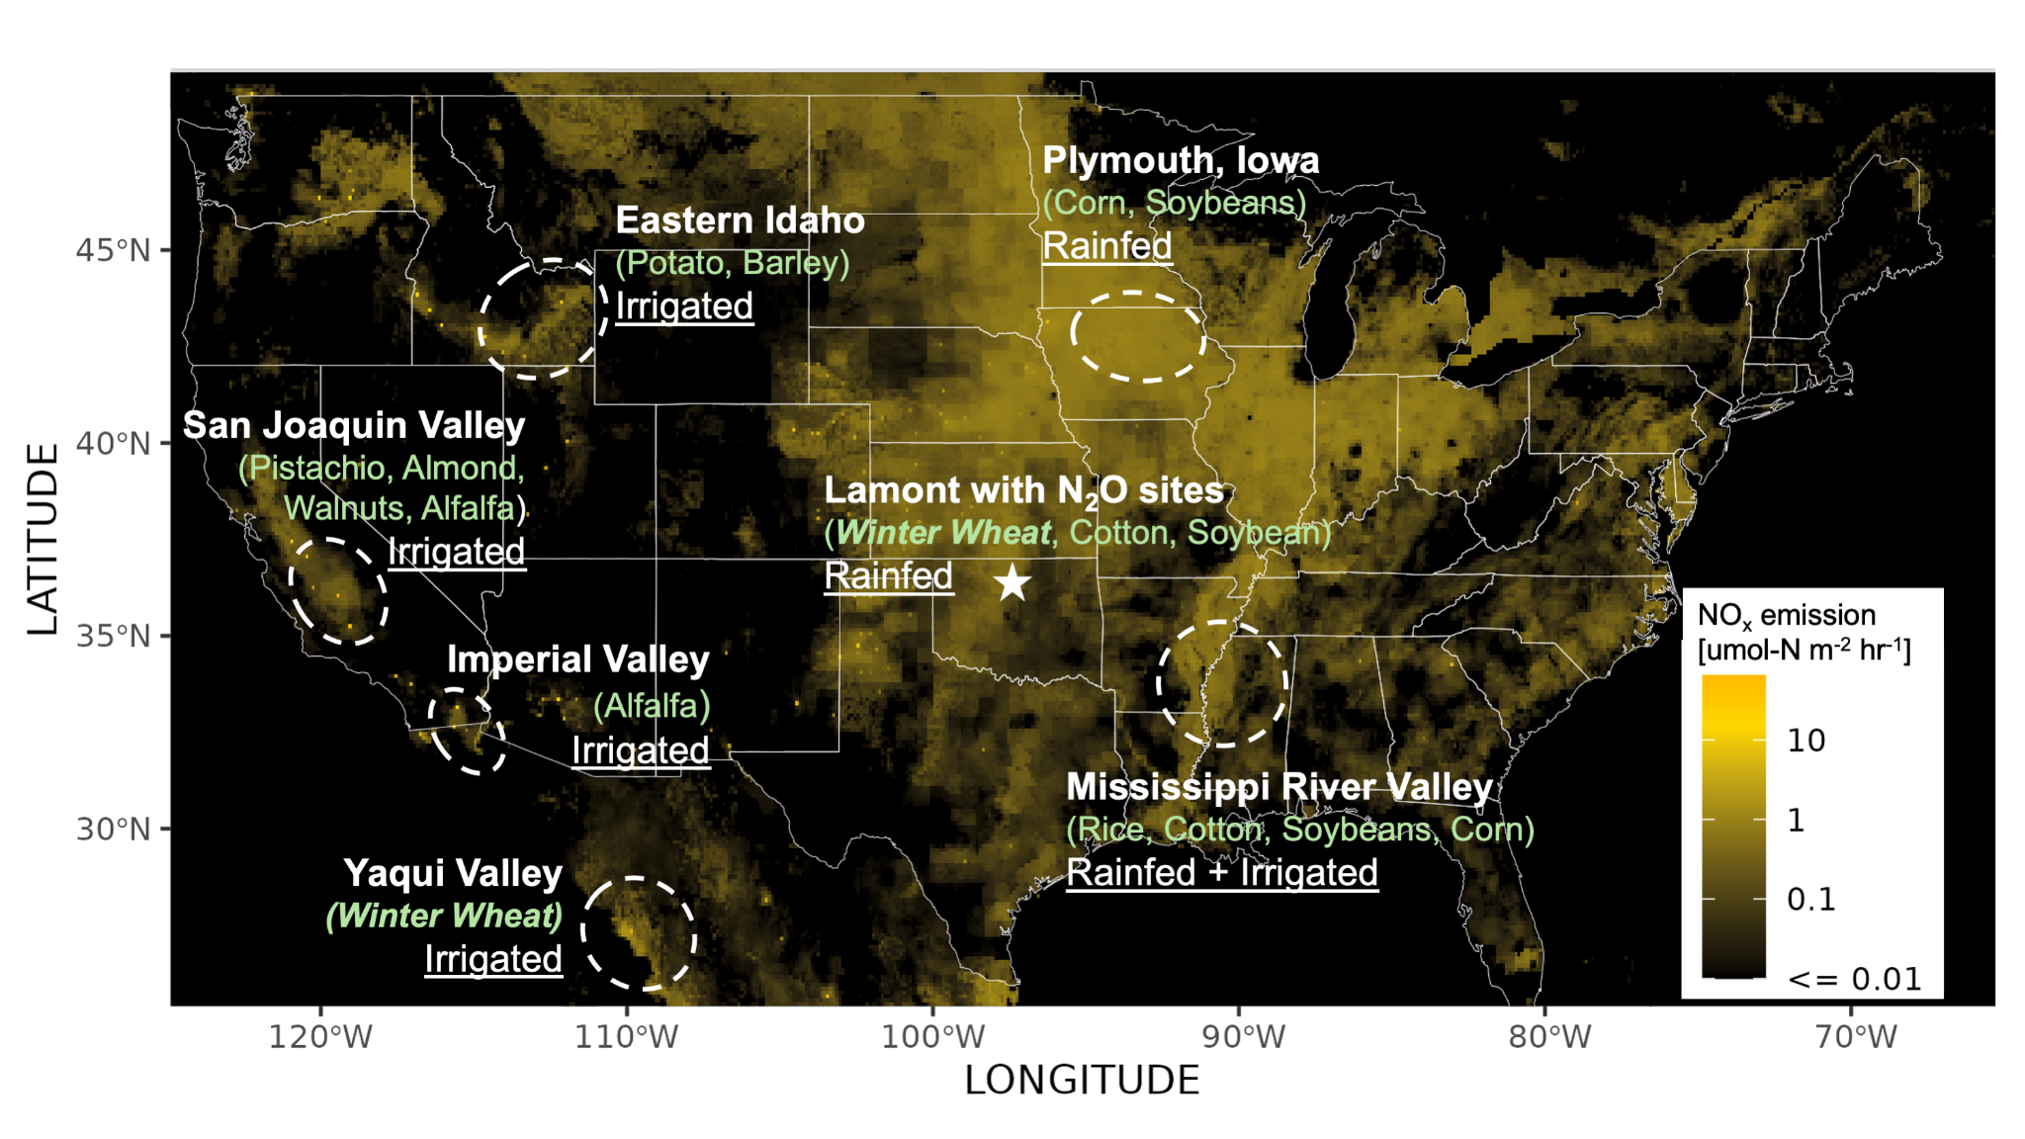
Advance #1 – Heterogeneity
Irrigated vs. rainfed
Crop types (C3/C4) & phenology
Management practices
Episodic events vs. annual trend
# of soil samples in priors
Notes:
Not just spatial locations; but --

Slide 5

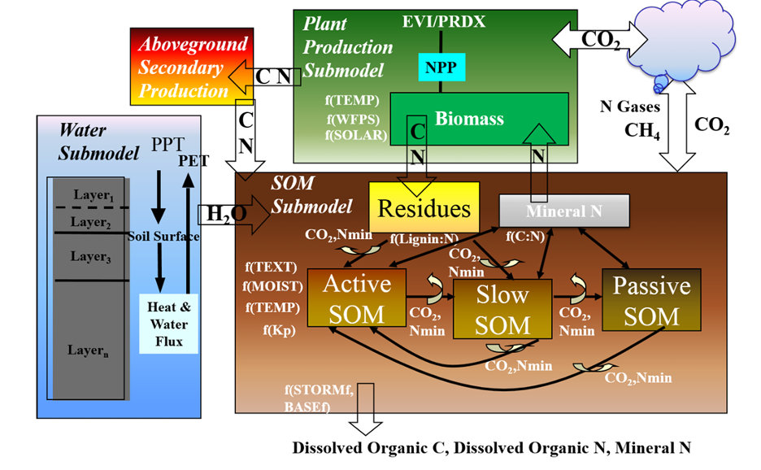
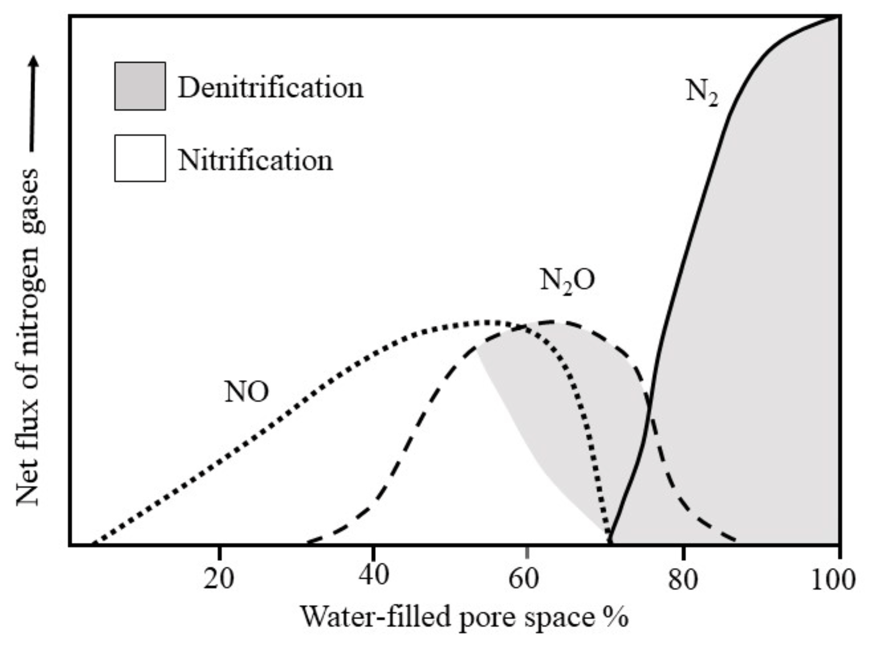
Advance #2 – Representations of Soil, Canopy & Management Processes
Previous studies used empirical emission parameterization and scaled the model sensitivity
Our DayCent: A biogeochemical model with Carbon- Nitrogen dynamics and knowledge of management practices (cropping history, synthetic fertilization, manure amendments, tillage practices, irrigation management, winter cover crops)
🌾 Plant growth
💨 Trace gas fluxes
💧Soil water and temp flows between layers
Wetter soil
Organic matter formation and decomposition; Nitrification and denitrification; NH3 volatilization; Methanogenesis
[Huber et al., 2024; Davison et al., 1991; Del Grosso et al., 2000; Parton et al. 2001]
Notes:
Priors matter for your inversion!

Slide 6
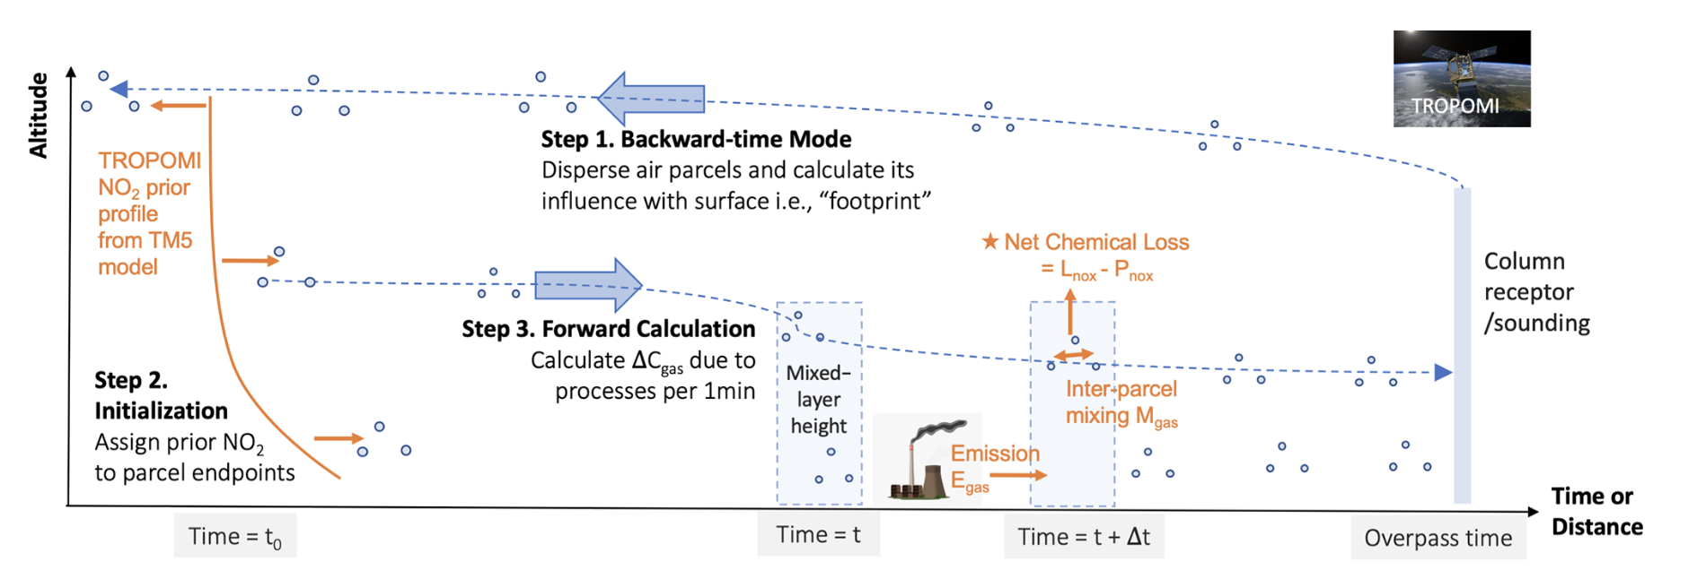
Lagrangian Transport Operator: (X-)STILT
Advance #3 – Source Attribution and Flux Estimates
TEMPO sounding
1) Backward-time mode
3) Forward calculation
2) Boundary condition
Useful:
Account for sensor-specific averaging kernels
Explicitly identify source regions → source attribution
Flexible model grid cell sizes → minimize numerical diffusion
Reuse of meteorology/transport
Explicit calculations of transport Jacobian
[Lin et al., 2003; Fasoli et al., 2018; Wu et al., 2018]
Notes:
STILT is widely used in GHG community
When you miss something, go building one → nox chem

Slide 7
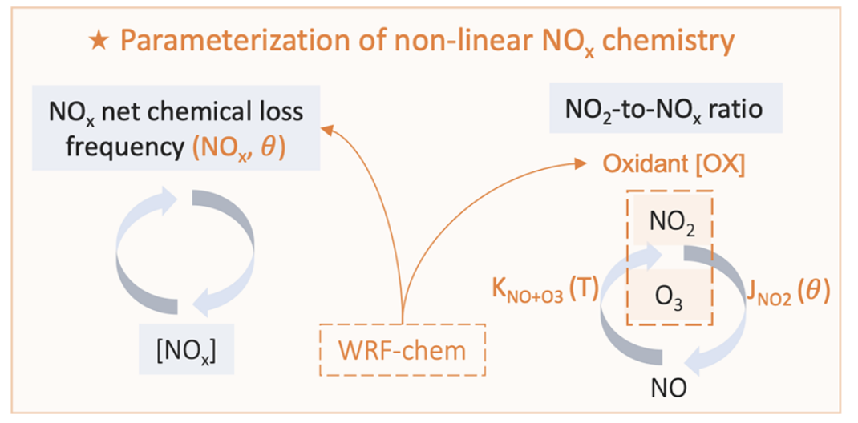
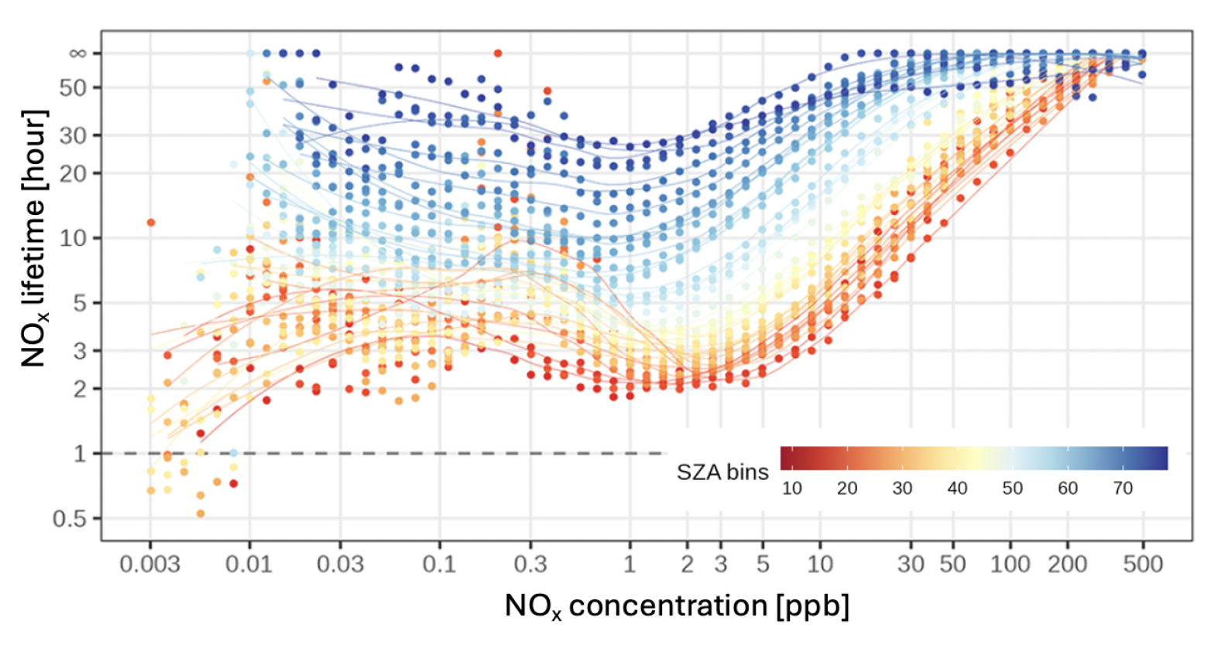
Lagrangian Chemical Transport Operator: STILT-NO_{x}
Advance #3 – Source Attribution and Flux Estimates
TEMPO sounding
1) Backward-time mode
3) Forward calculation
2) Boundary condition
New and Useful:
Account for sensor-specific averaging kernels
Explicitly identify source regions → source attribution
Flexible model grid cell sizes → minimize numerical diffusion
Reuse of meteorology/transport
Explicit calculations of transport Jacobian
Speed up chem calculation and preserve the NON-linearity
[Laughner and Cohen, 2019; Wu et al., 2023]
Notes:
STILT is widely used in GHG community
When you miss something, go building one → nox chem

Slide 8
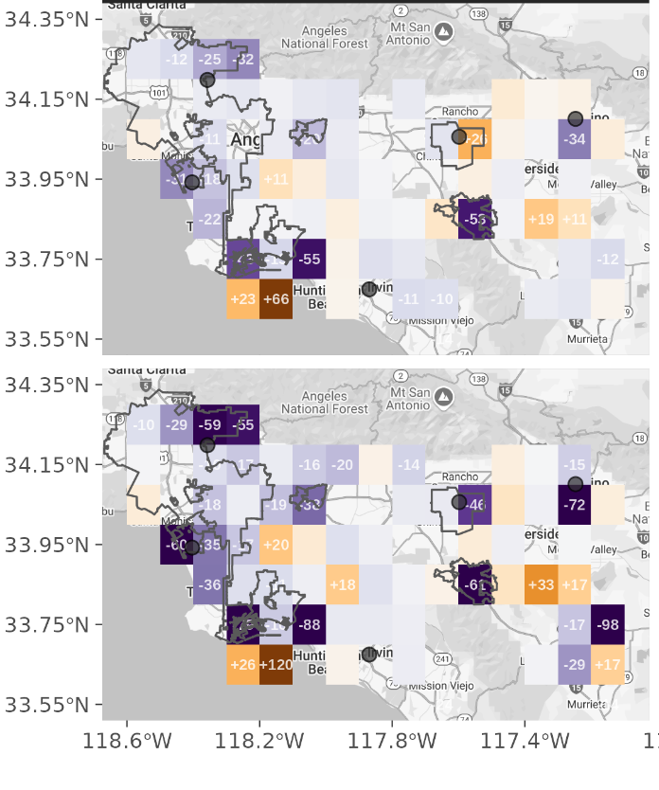
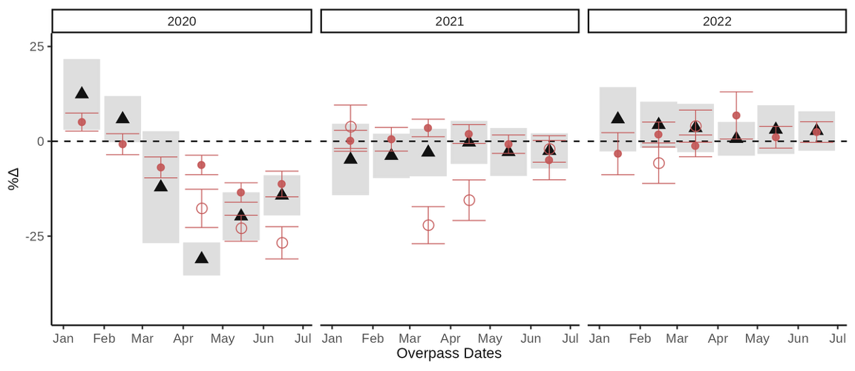
STILT-NOx with a simplified Local Ensemble Transform Kalman Filter (LETKF)
(with accounts of errors in wind, PBLH, chem, and background!!!)
Advance #3 – Source Attribution and Flux Estimates
Spatially resolved estimates over “short pulses”
Examples: LA FF NOx using STILT-NOx and TROPOMI NO₂ (Jan to June 2020 - 2022)
Weekdays
Spatially integrated, multi-year estimates
Posterior on Weekdays
Weekends
Posterior on Weekends
Traffic Counts
[Hunt et al., 2007; Miyazaki et al., 2012; Wu et al., in prep, a]
Notes:
Encouraging comparisons considering the simplified chem

Slide 9
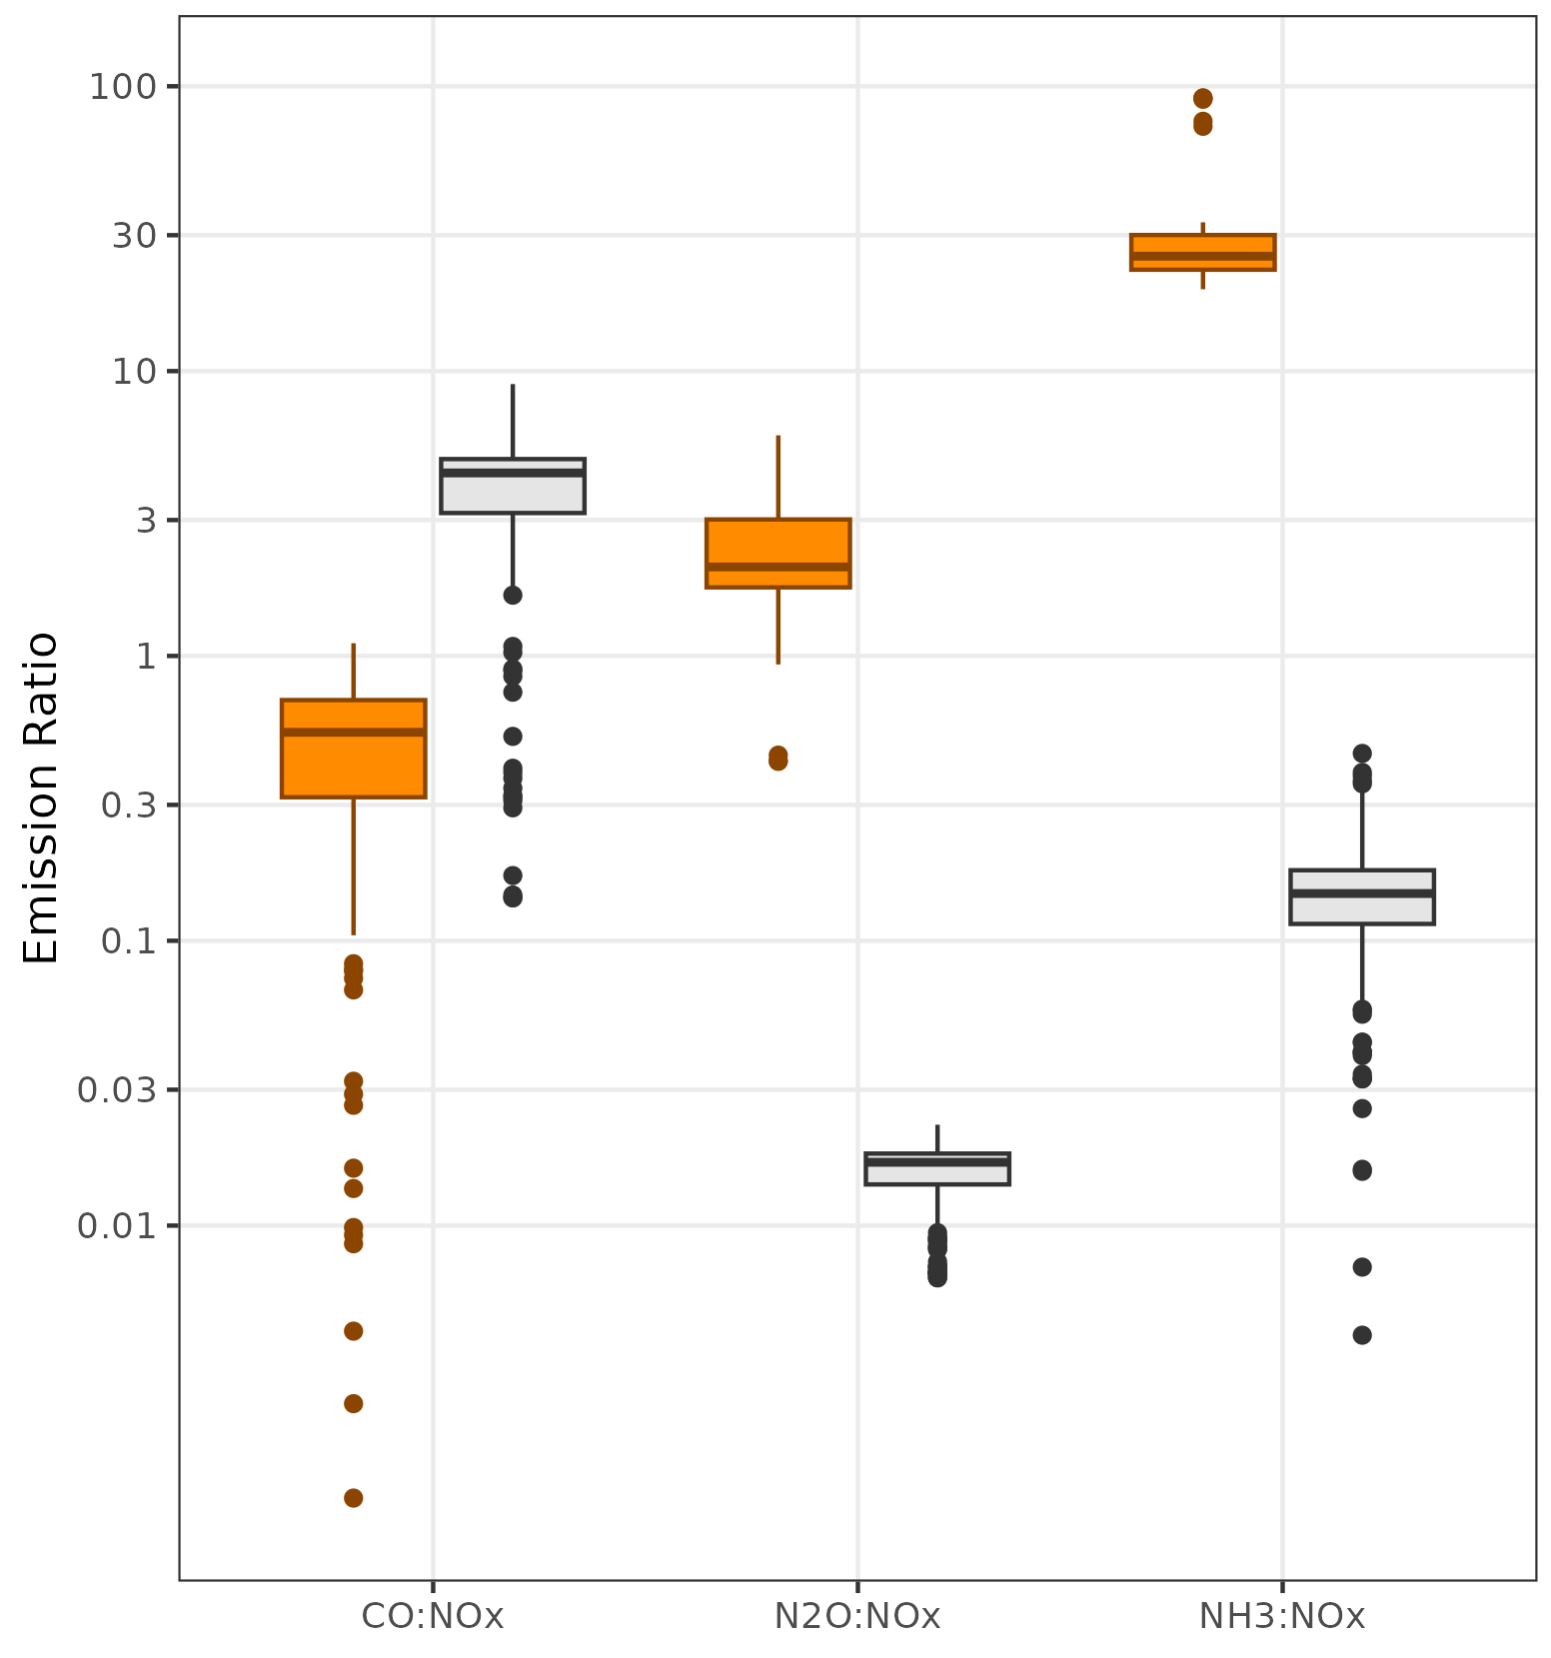
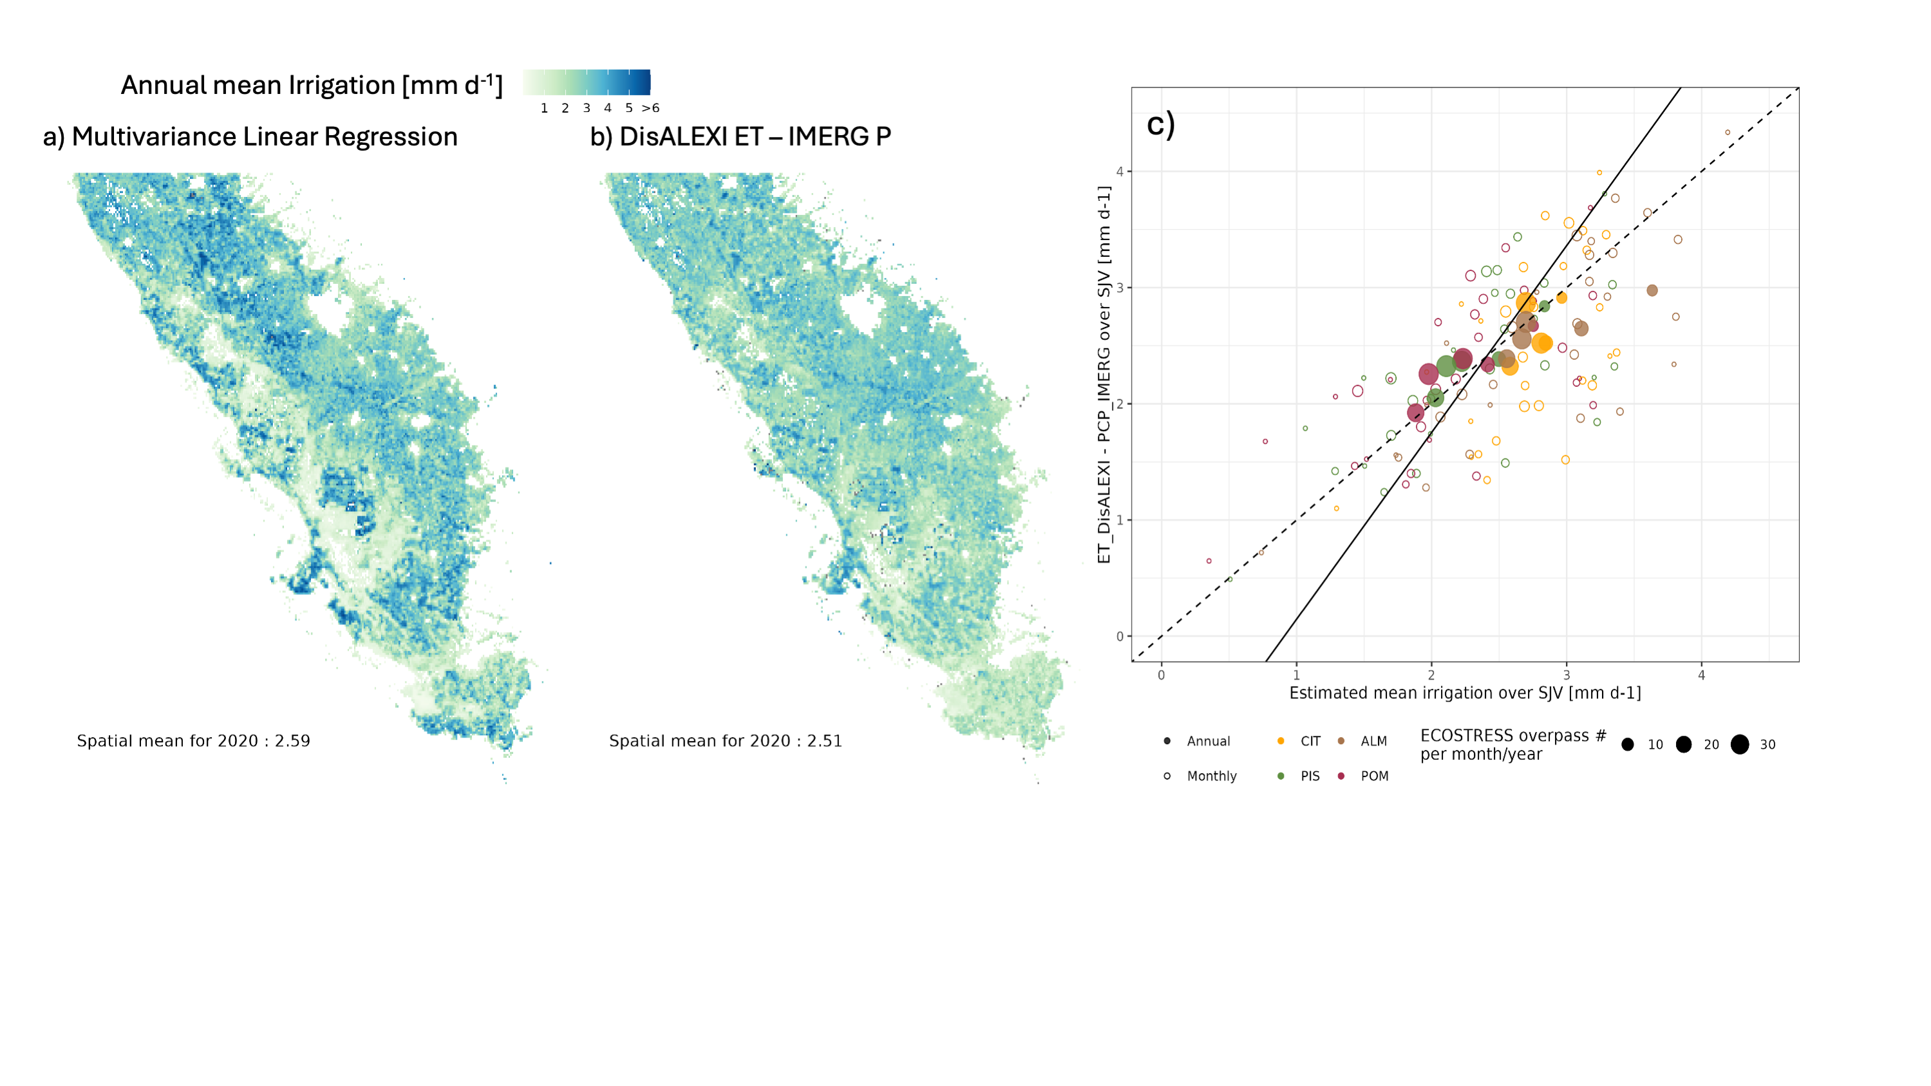
Advance #4 – Independent Proxy Data to Understand Drivers of SNOx and column NO2
Crop proxies (LAI, SIF, ET, Soil Moisture, Irrigation)
FF vs. Ag tracers (e.g., TROPOMI CO vs. CrIS NH₃)
An example: 1km Irrigation estimates using ECOSTRESS land surface temperature and water meter readings
An example: inventory-based tracer-NOx ratios
CO:NO_{x} ratio
N₂O:NO_{x} ratio
NH₃:NO_{x} ratio
Ag
Traffic
[Wu et al., in prep, b]
Notes:
Advance 3 – supporting datasets

Slide 10
Quantify soil NOx fluxes using sophisticated a biogeochemical model and an LPDM inverse modeling framework
Post-inversion diagnosis and evaluation against in situ/aircraft measurements (e.g., FarmFlux)
Attribute sources using multi-tracer observations, land cover types, and trajectory tracking
Investigate the underlying drivers of flux variability by leveraging supporting data from local stakeholders and other satellites (SMAP, ECOSTRESS)
Postdoc wanted!! dienwu.me

Slide 12
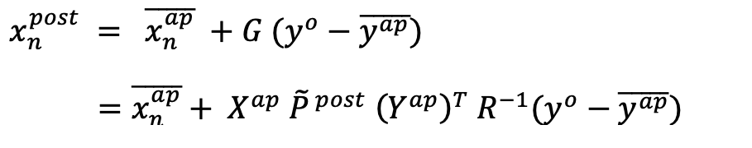
* Data-driven mass balance → spatially integrated multi-year fluxes
* STILT-NOx with a simplified Local Ensemble Transform Kalman Filter → spatially resolved ”pulses”
Advance #3 – Source Attribution and Flux Estimates
G: Kalman gain matrix
R: model-data mismatch matrix
Diag(R) = var(wind) + var(pblh) + var(bg) + var(chem)
Local Posterior errors
y^{ap}: 30 sets of modeled perturbations in concentration space
x^{ap}: Prior ensemble means fixed per month across 3 years (monthly EDGAR v8 for year 2019); with 30 emission perturbations per grid n
[Hunt et al., 2007; Miyazaki et al., 2012; Wu et al., in prep, a]

