Slide 1
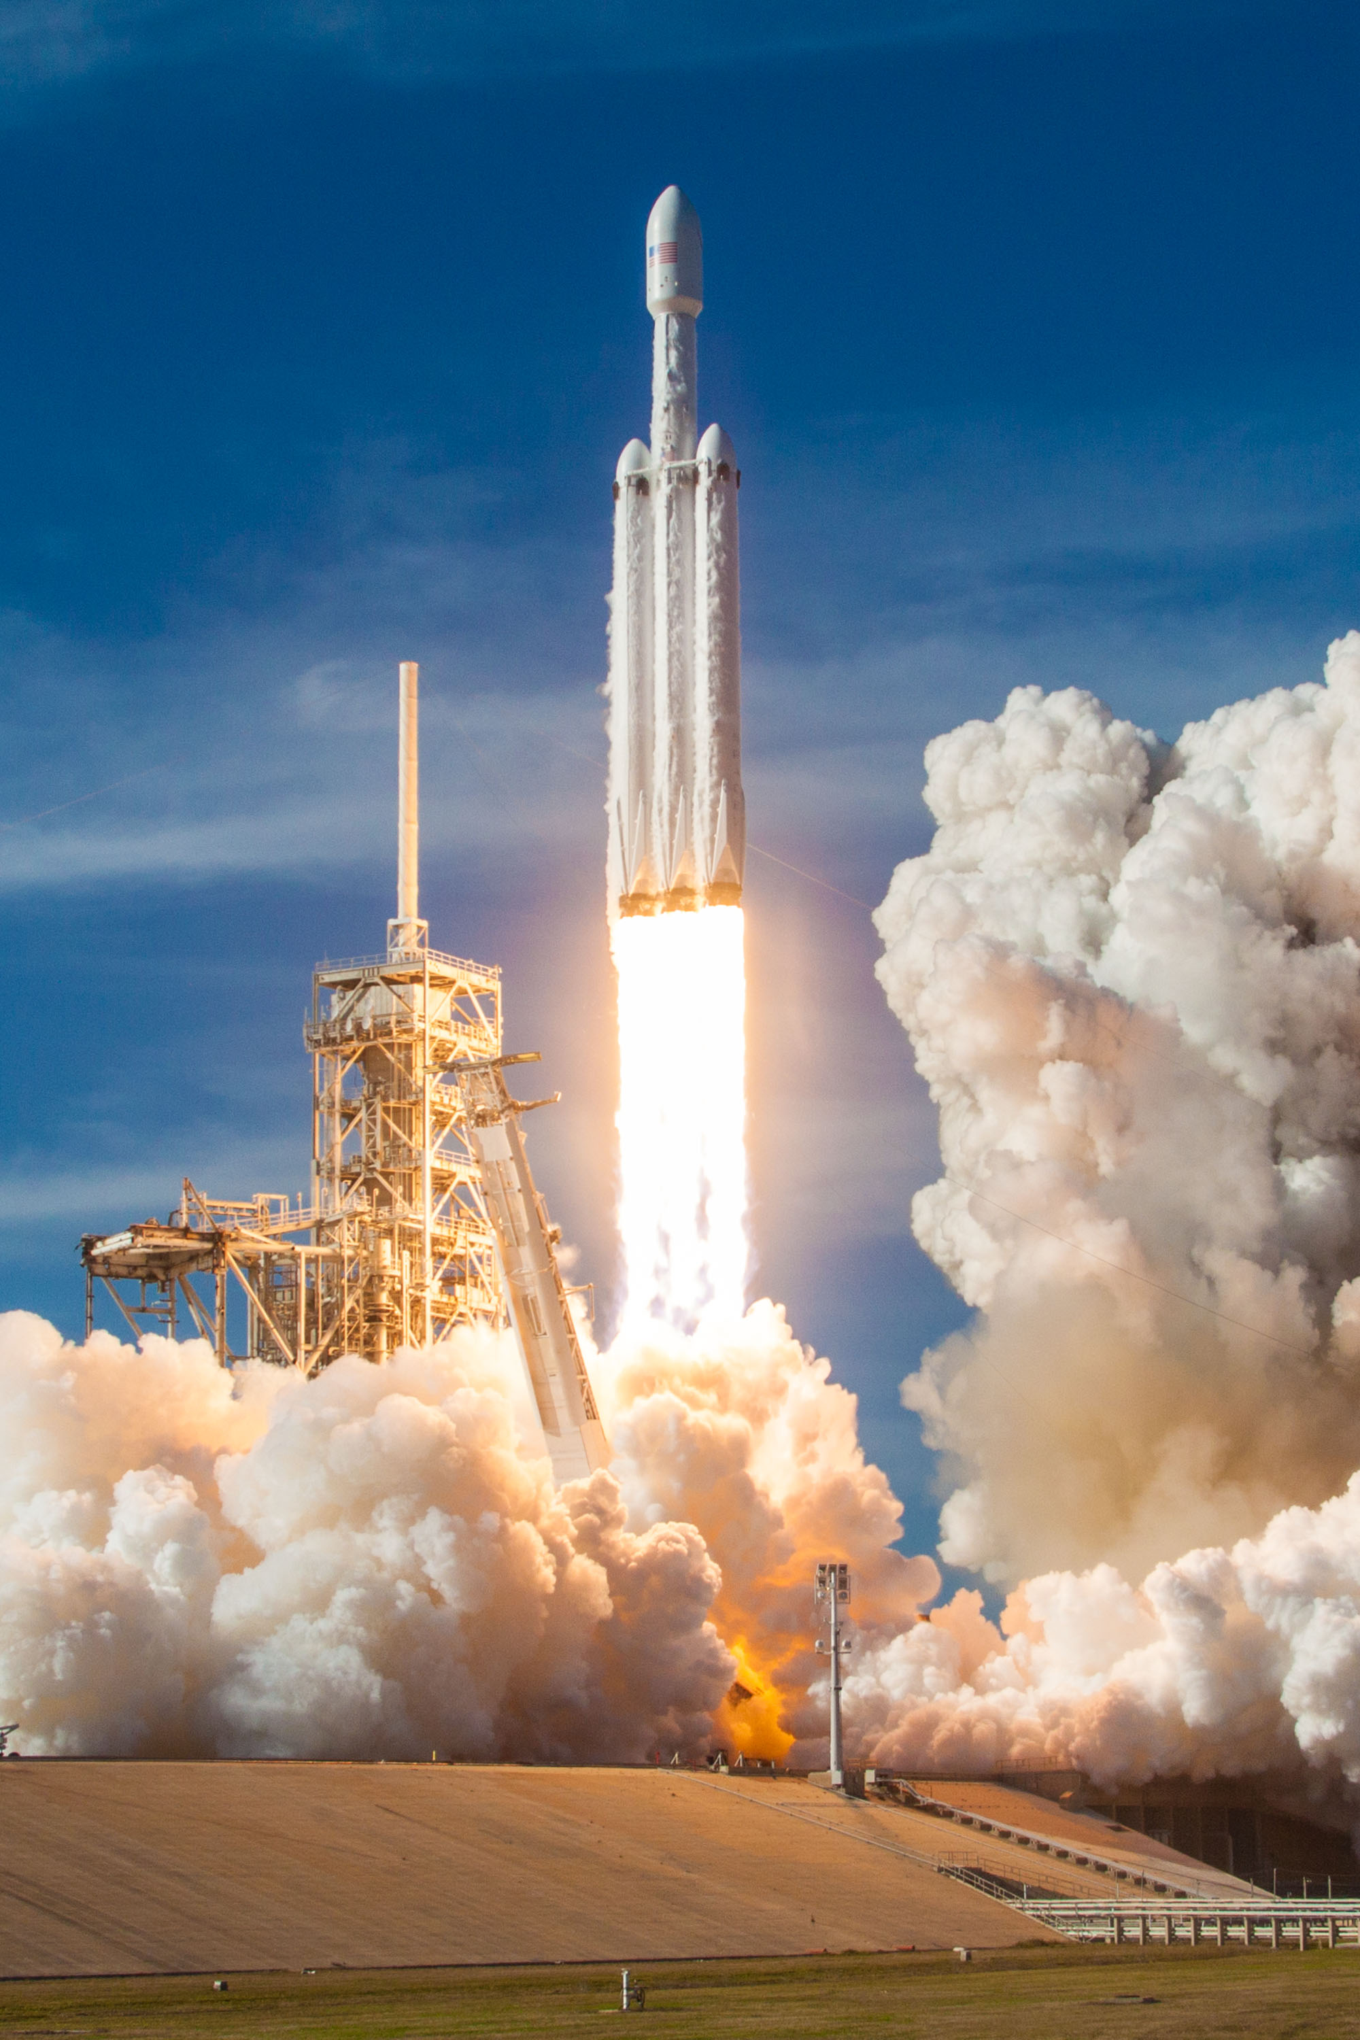

Geostationary satellite observations of rocket launch nitrogen oxide emissions
Joseph O. Palmo¹, Helena McDonald², Arlene M. Fiore³, Sebastian D. Eastham⁴
¹Department of Civil and Environmental Engineering, MIT
²Department of Aeronautics and Astronautics, MIT
³Department of Earth and Planetary Sciences, MIT
⁴Department of Aeronautics, Imperial College London
SpaceX Falcon Heavy
Image credit: Wikipedia
Notes:
Hi everyone, I’m Joe, I’m a PhD student all the way over at MIT, and I’m excited to share with you some of the work we’ve been doing quantifying NOx emissions from rocket launches using TEMPO

Slide 2
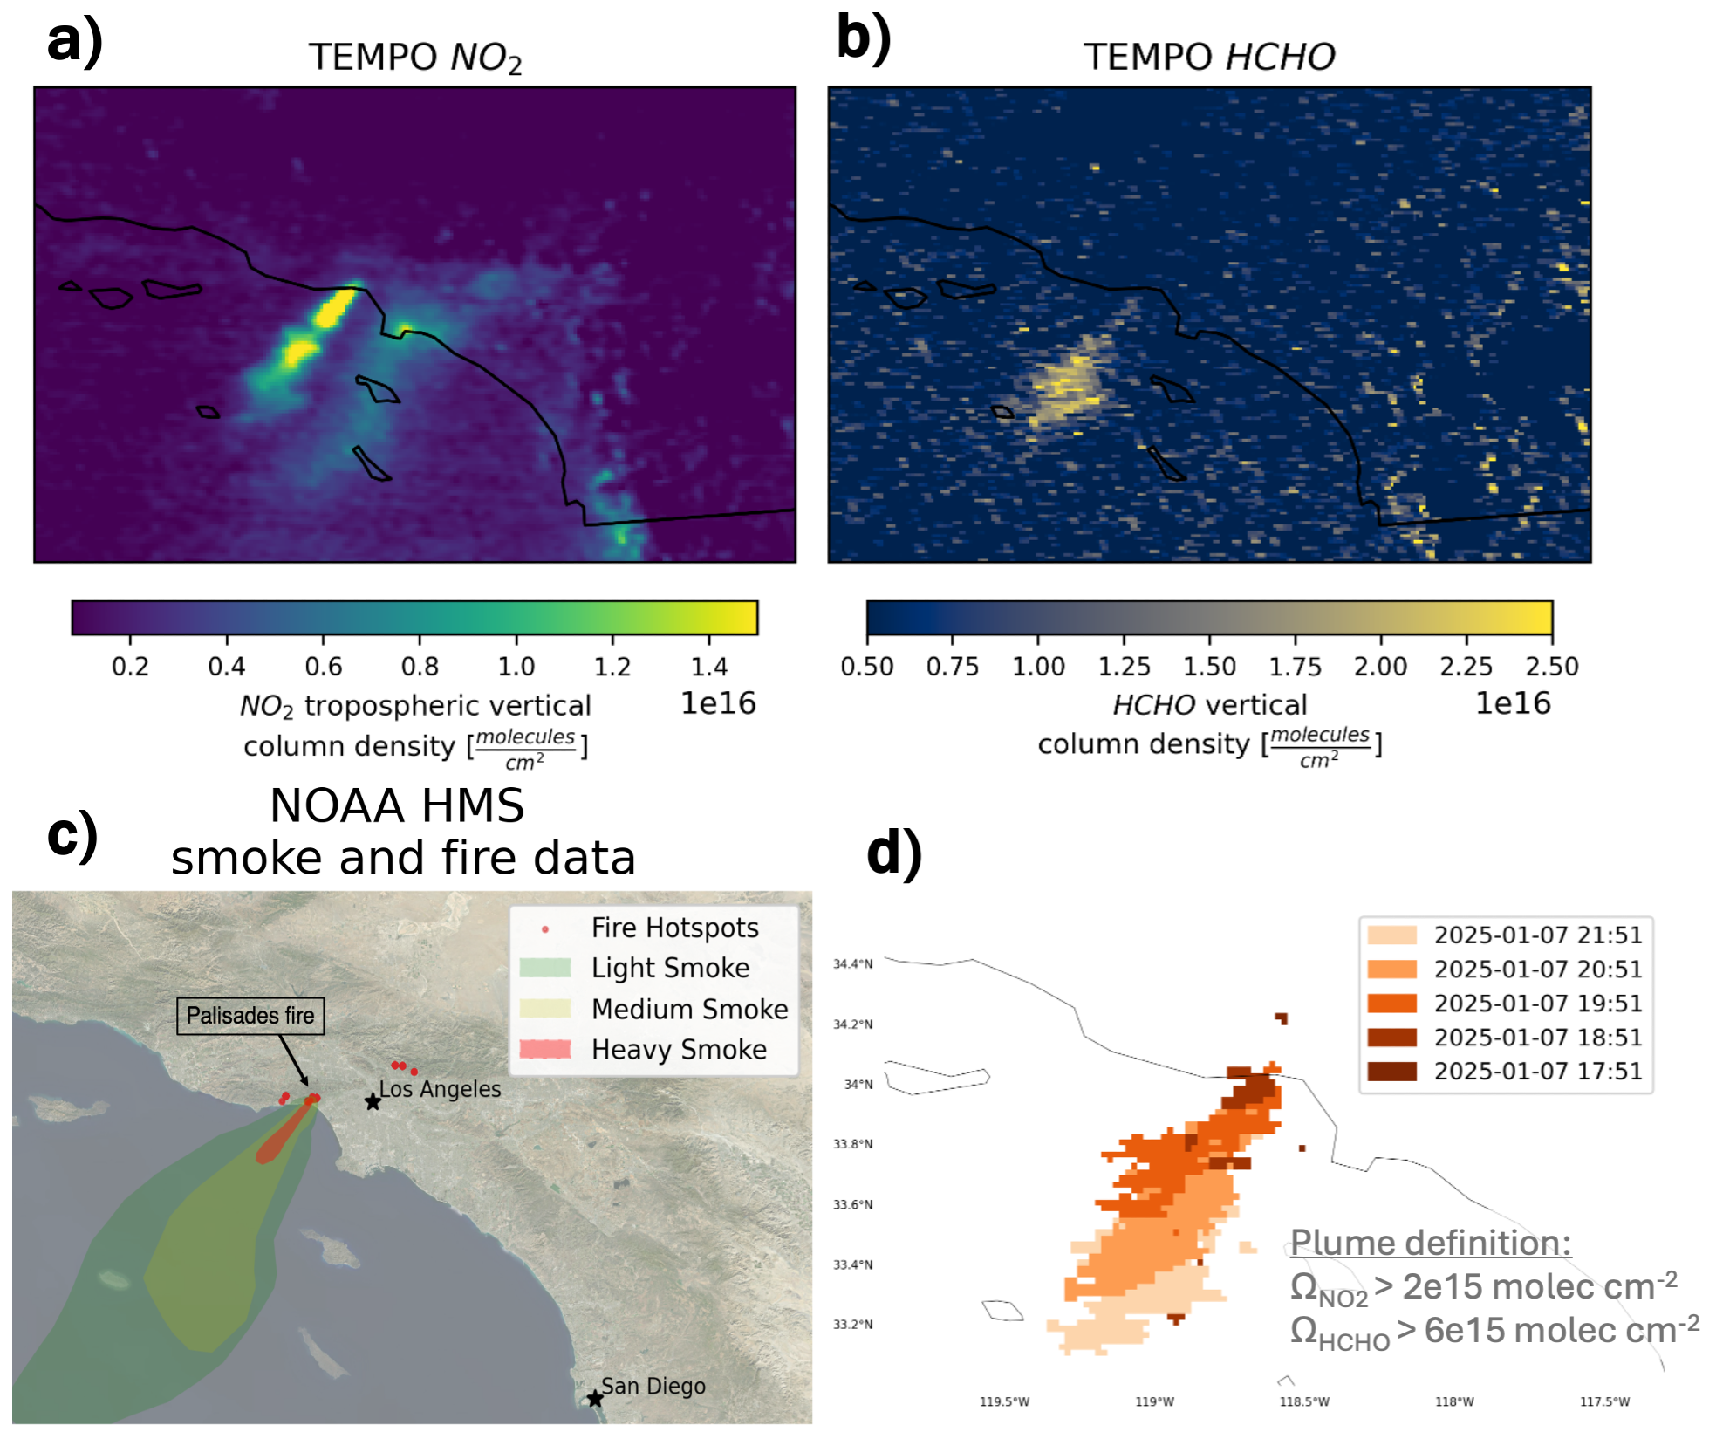
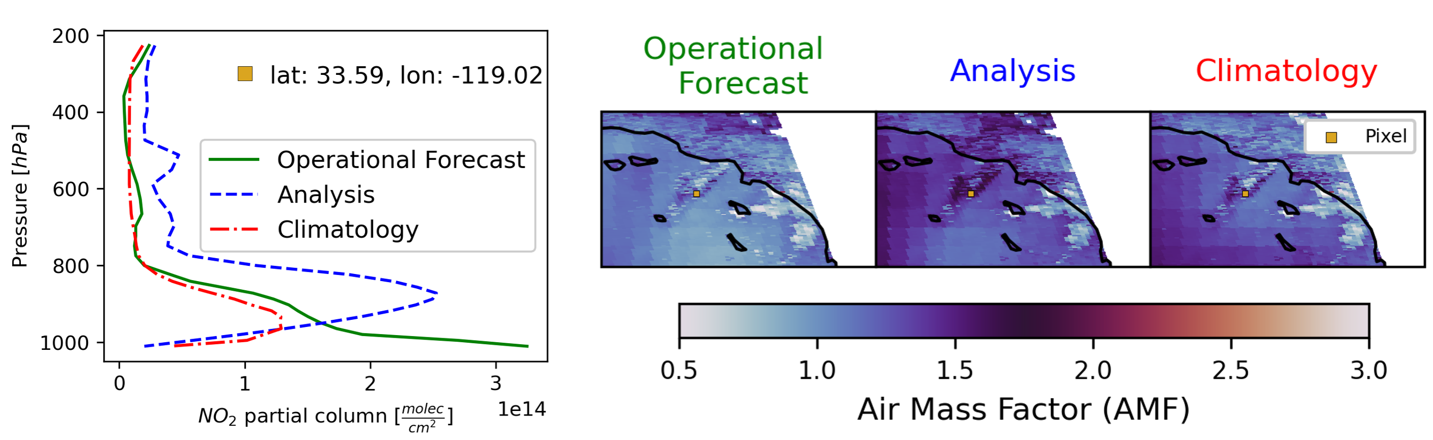
PhD work → Analyzing wildfire smoke with TEMPO
1) Wildfire smoke retrieval uncertainty
2) Diurnal variation in fire emissions
Notes:
But before I do that, given this audience I wanted to briefly say that this rocket stuff has been a side project, and the main focus of my PhD will be on wildfire smoke. I aim to define wildfire related uncertainties in the TEMPO products, and also quantify emissions at an hourly resolution. So if you’re interested I’d love to talk more about it.

Slide 3

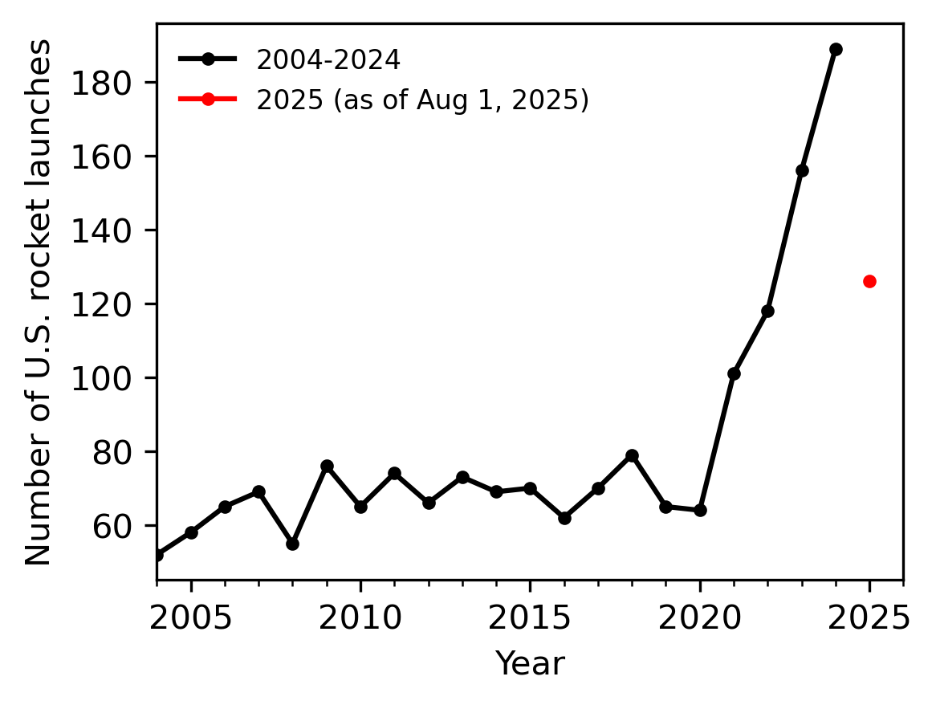

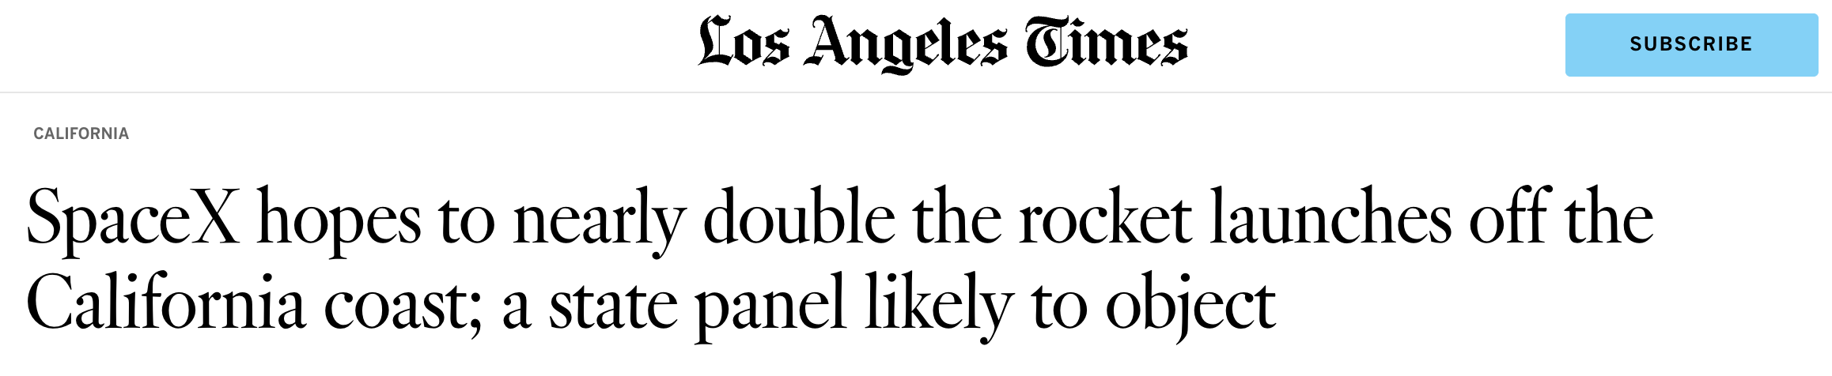

The rate of rocket launches is accelerating
Data from GCAT
Notes:
So rocket launches – not often discussed as a source of air pollution, but I think that’s partly because they are tough to observe
As you can see on the right, the number of launches in the U.S. has tripled since 2005
The fact that these launches are increasing means more people are paying attention
It is becoming important for us to quantify emissions from these sources and include them in our models

Slide 4
NO_{x}
Notes:
One of the emitted pollutants in a rocket launch plume is NOx – which is toxic and contributes to the formation of ozone in the troposphere
We know this much, and recently people have been working to try to quantify the impacts that more launches have by developing inventories

Slide 5
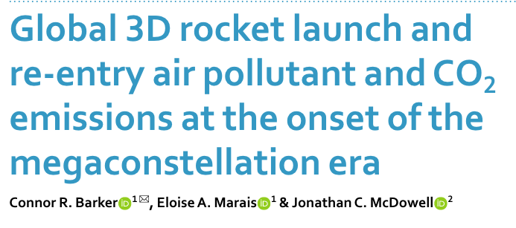
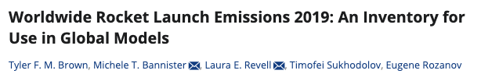
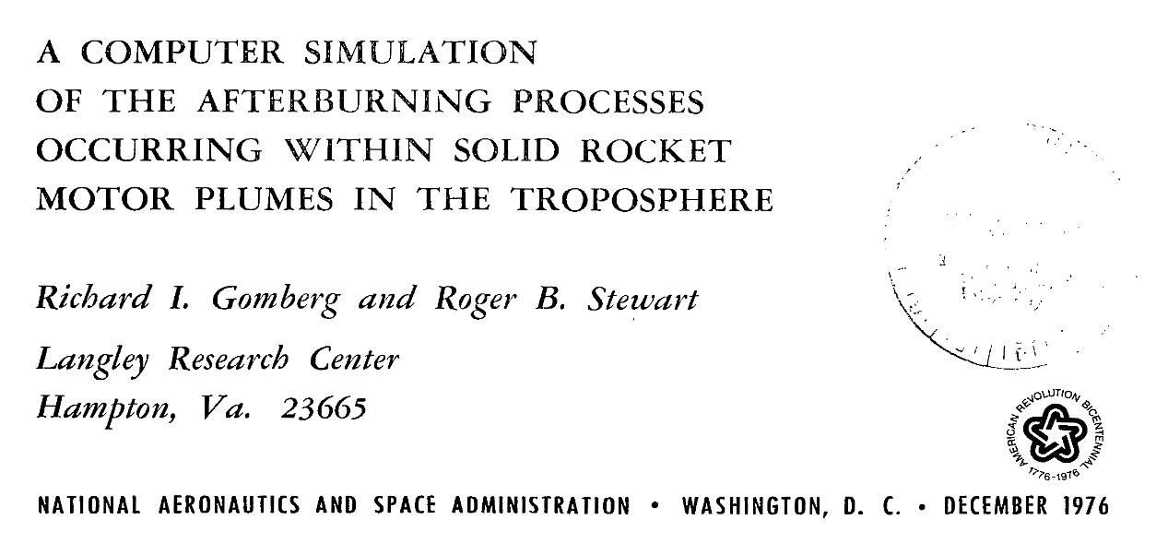
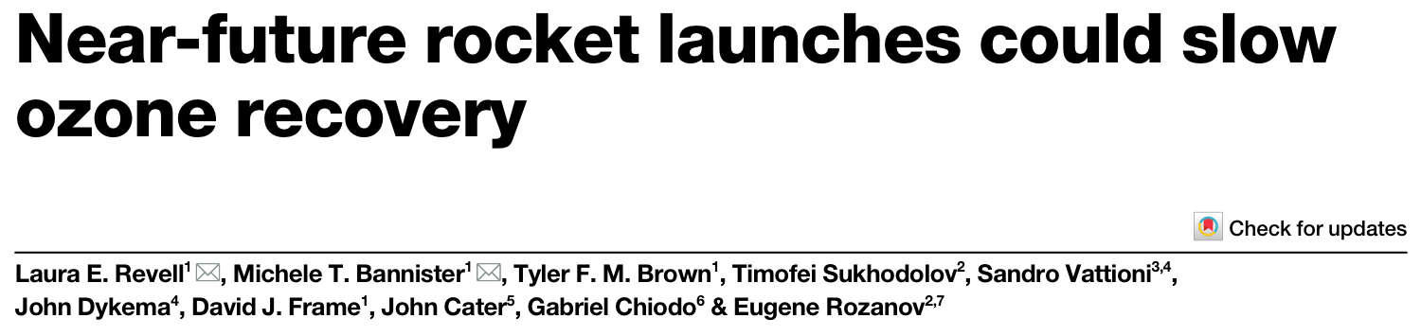
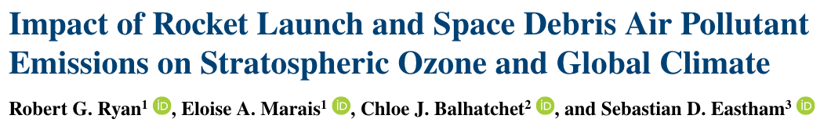
Barker et al 2024
Brown et al 2024
NO_{x}
Revell et al 2025
Ryan et al 2021
Notes:
But since there are no direct observations, inventories are based on only bottom-up estimates of emission factors related to calculated fuel burn rates and modeling studies
And if you look to see where these numbers come from…they are about 50 years old
This is a report from 1976, and then
The newest points on the plot came out around the turn of the century
What would be really nice is top-down constraints to evaluate our inventories and fill this gap in our understanding!

Slide 6

NO_{x}
Notes:
Now we have TEMPO – unprecedented hourly coverage, NO2 columns at high resolution

Slide 7
Can we detect rocket launch plumes using TEMPO?
How can we estimate rocket launch NO_{x} emissions using TEMPO?
Where do we go from here?
NO_{x}
Notes:
The first obvious question is – can we see these plumes?

Slide 8
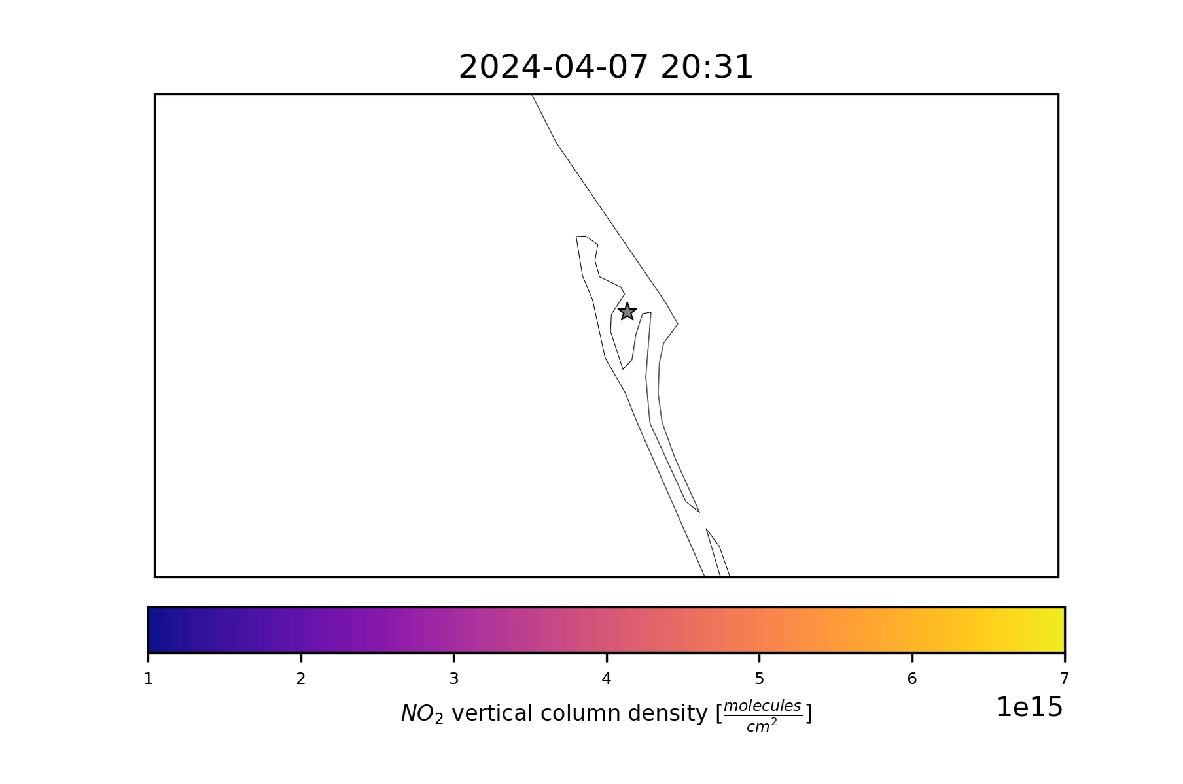
TEMPO captures rocket launch NOx emissions
Look for the plume right here!
Delta-IV Heavy
Cape Canaveral, FL
Launched at:
2024-04-09
12:53 PM EST
Notes:
And we can! It wouldn’t be a very good story if we couldn't see it
I’m going to show an example here – Delta 4 Heavy launch in Cape Canaveral, FL
Show the day before the launch up to just past launch time
So you can get an idea of how these launches look in the TEMPO record
This is the day before…you can see some NO2 floating over from Orlando
And now keep an eye out for the plume

Slide 9
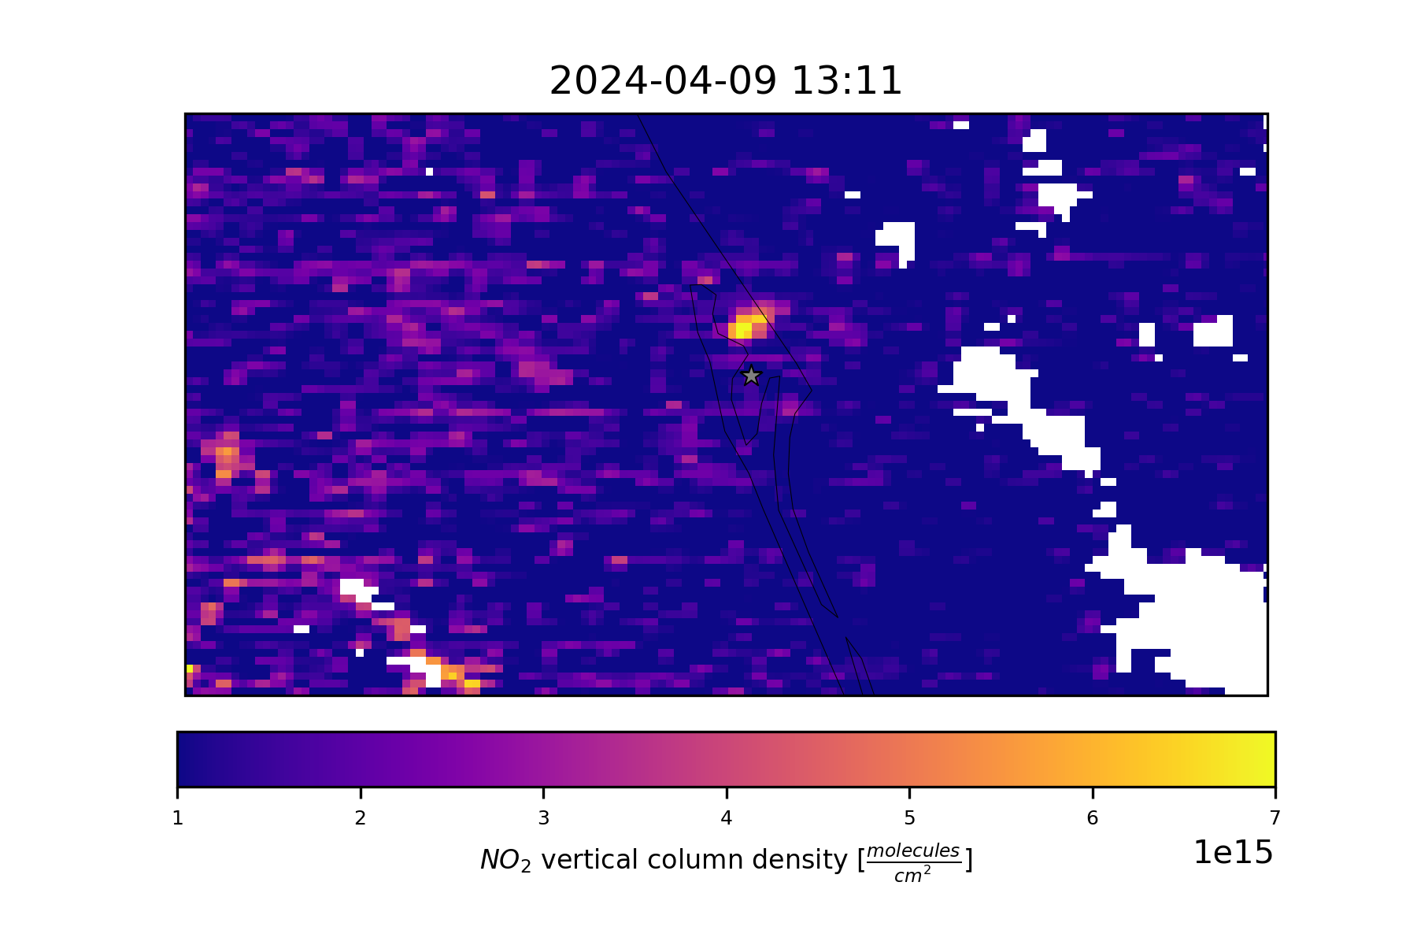
TEMPO captures rocket launch NOx emissions
Look for the plume right here!
Delta-IV Heavy
Cape Canaveral
Launched at:
2024-04-09
12:53 PM EST
Notes:
So this is what the plume looks like
It only stayed around for a single hour

Slide 10
Can we detect rocket launch plumes using TEMPO?
How can we estimate rocket launch NO_{x} emissions using TEMPO?
Where do we go from here?
NO_{x}
Notes:
Okay great – we can see plumes! The next question is, can we estimate NOx emissions from these plumes using TEMPO.

Slide 11
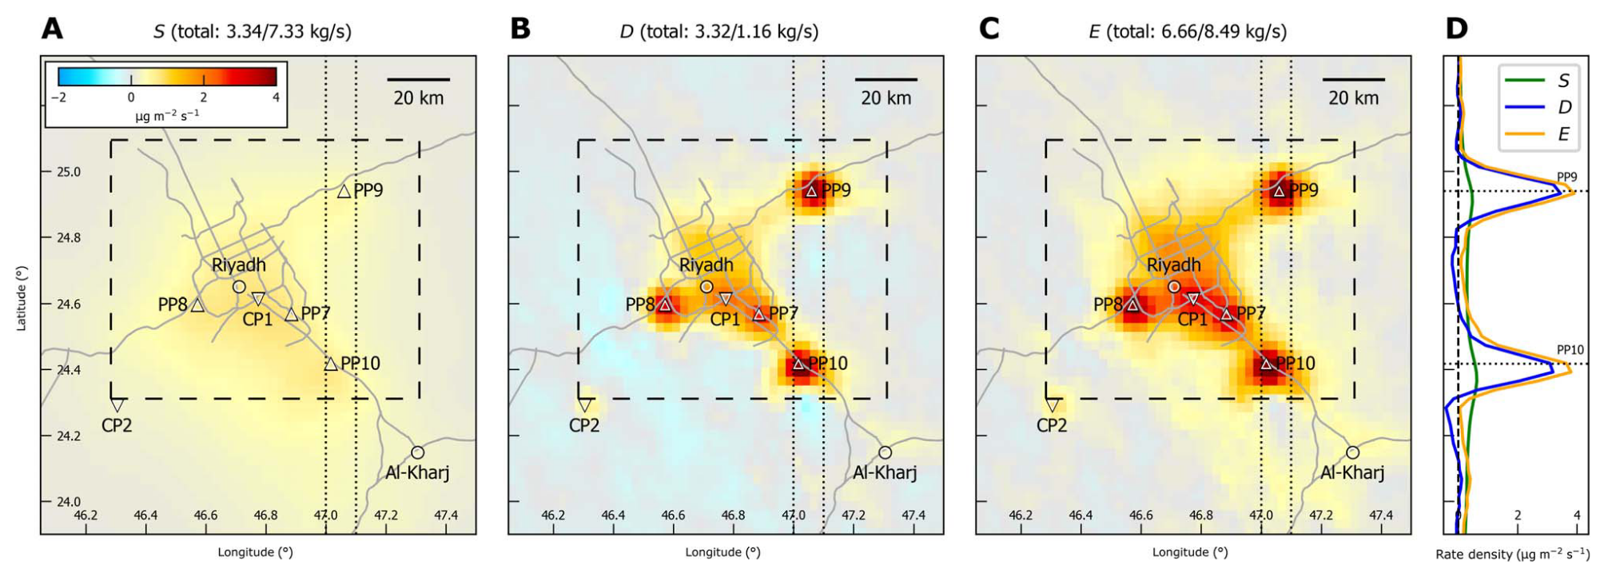
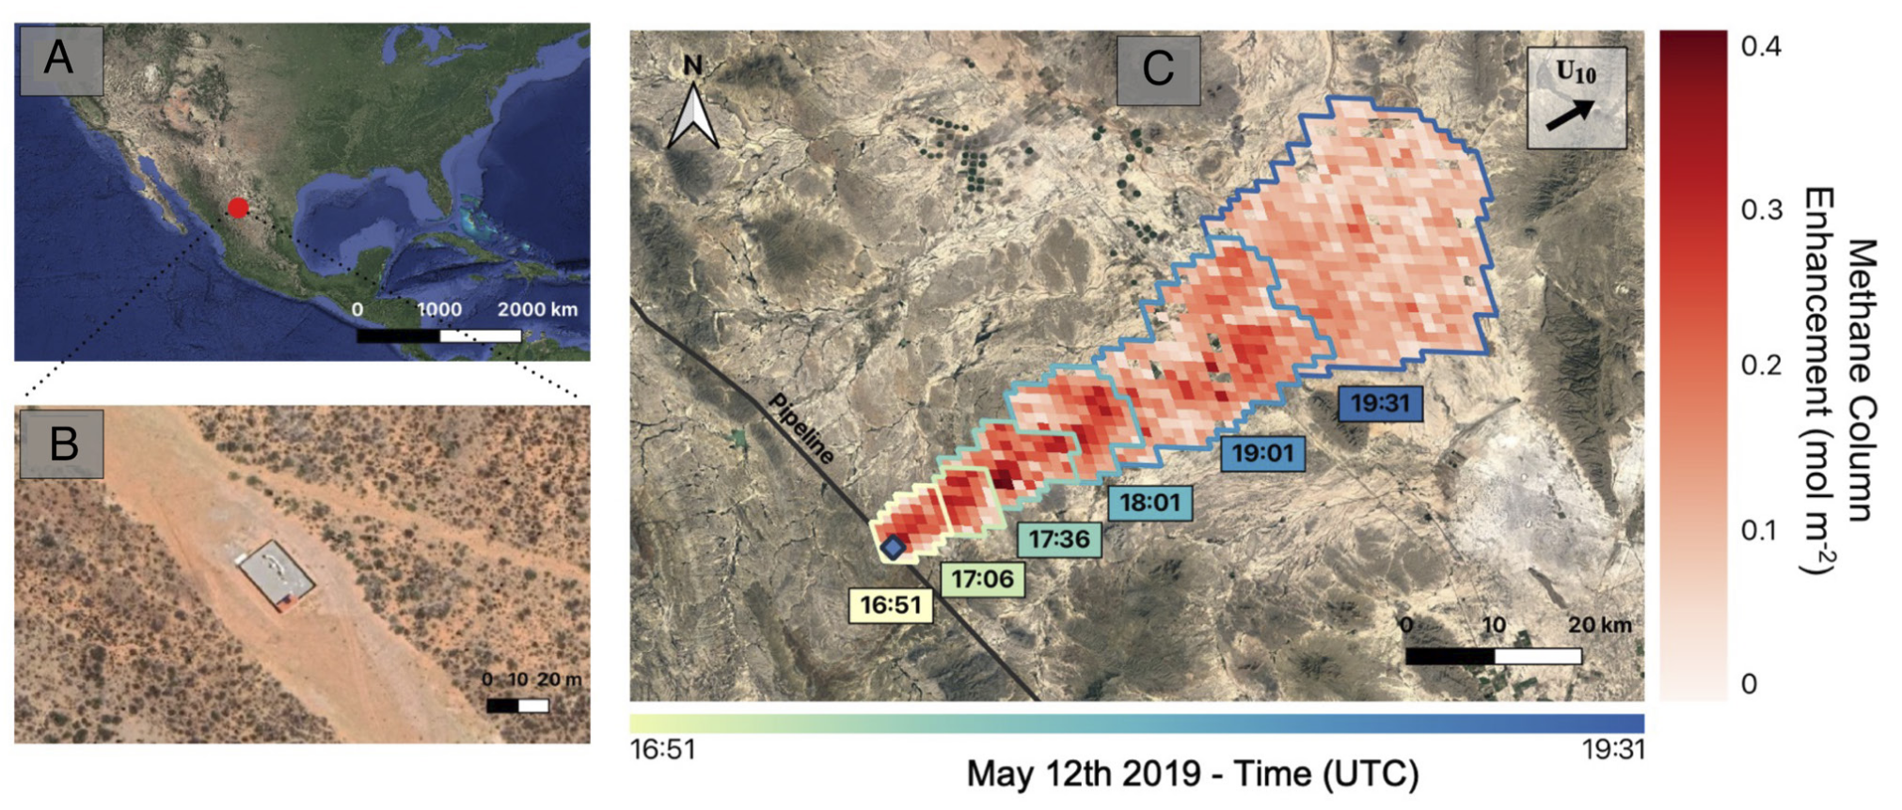
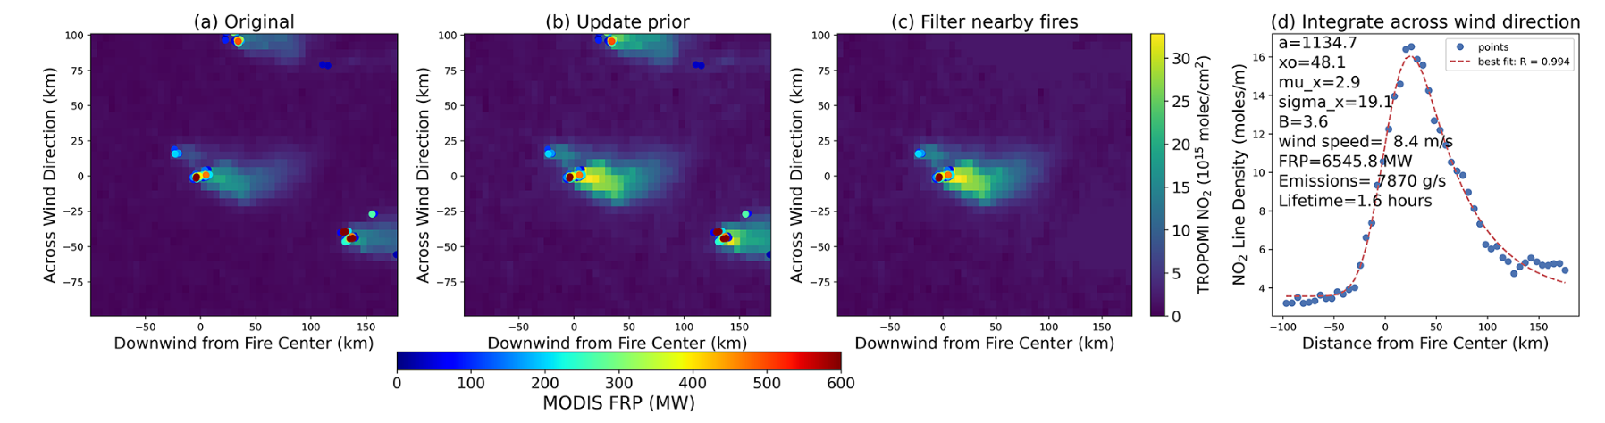
Power plant (e.g. Beirle et al. 2019)
Natural gas leak (e.g. Watine-Guiu et al. 2024)
How is this type of plume different from other cases?
NO_{x}
Fire (e.g. Jin et al. 2021)
Notes:
To start, let’s think about our plume – how is it different from other cases that people have encountered, like: …
All of these plumes are continuous, concentrated mostly in the boundary layer, and they are blown away from the source
Rocket launch plumes, however, are different from this, so we need to establish a few assumptions:

Slide 12
Assumptions / Observations:
Emission time is rapid
Plume is distributed quasi-vertically
Plume only visible for a single retrieval, maybe two
Stable NO:NO₂ ratio
NO_{x} loss before observation time
We need to employ a strategy that enables plume detection and emission quantification from a single retrieval
How is this type of plume different from other cases?
NO_{x}
Notes:
Puff
Vertical / 90° angle upwards
Plume is transient
need to quantify emissions from a single retrieval

Slide 13
Assumptions / Observations:
Emission time is rapid
Plume is distributed quasi-vertically
Plume only visible for a single retrieval, maybe two
Stable NO:NO₂ ratio
NO_{x} loss before observation time
We need to employ a strategy that enables plume detection and emission quantification from a single retrieval
How is this type of plume different from other cases?
NO_{x}
Notes:
Puff
Vertical / 90° angle upwards
Plume is transient
need to quantify emissions from a single retrieval

Slide 14

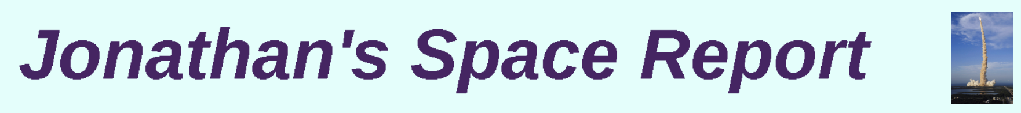
We gather TEMPO NO₂ L3 data for launches
TEMPO L3 NO₂ (0.02° x 0.02°) (Nowlan et al. 2025)
  tropospheric column
  Cloud cutoff (cloud_fraction < 0.3)
  Remove bad pixels (main_data_quality != 0)
Launch information from Jonathan’s Space Report
General Catalog of Artificial Space Objects (GCAT)
  Launch Timing (UTC, minute resolution)
  Launch Site (lat, lon)
  Launch Vehicle
Notes:
We need TEMPO data for specific launches
Here is some info about the L3 TEMPO NO2 product and the data cleaning we do,
And then how we match that up to launches is by using the General Catalog of Artificial Space Objects, catalogued in Jonathan’s Space Report and kept up to date constantly

Slide 15
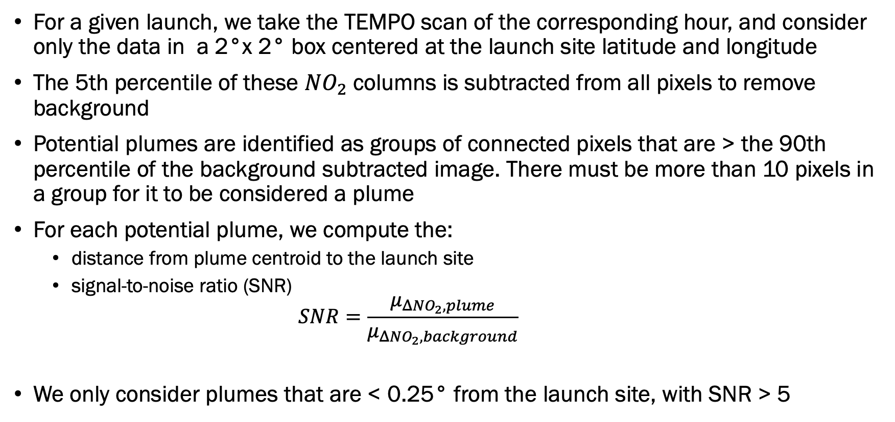
Detections are confirmed with an SNR criteria
For a given launch, we take the TEMPO scan of the corresponding hour, and consider only the data in a 2°x 2° box centered at the launch site latitude and longitude
The 5th percentile of these $NO_{2}$columns is subtracted from all pixels to remove background
Potential plumes are identified as groups of connected pixels that are > the 90th percentile of the background subtracted image. There must be more than 10 pixels in a group for it to be considered a plume
For each potential plume, we compute the:
  distance from plume centroid to the launch site
  signal-to-noise ratio (SNR)
    $$SNR=\frac{μ_{ΔNO_{2}, plume}}{μ_{ΔNO_{2}, background}}$$
We only consider plumes that are < 0.25° from the launch site, with SNR > 5
Varon et al. 2018,
Kuhlmann et al. 2024

Slide 16
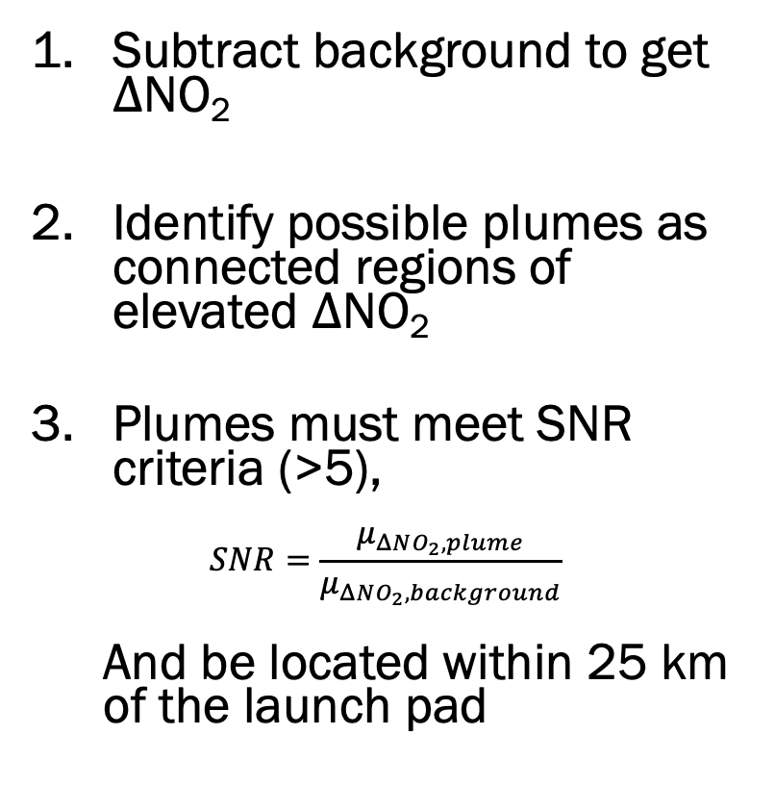
Detections are confirmed with an SNR criteria
Subtract background to get $Δ$NO₂
Identify possible plumes as connected regions of elevated $Δ$NO₂
Plumes must meet SNR criteria (>5),
$$SNR=\frac{μ_{ΔNO_{2}, plume}}{μ_{ΔNO_{2}, background}}$$
  And be located within 25 km of the launch pad
Notes:
To confirm plume detections, we develop a very simple algorithm
If there are questions I can talk more about this but the main steps are:
...
Now I will show some example detections

Slide 17
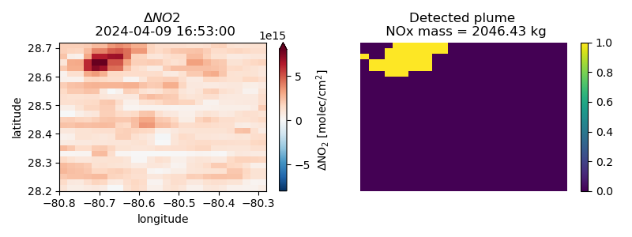
Detections are confirmed with an SNR criteria
Notes:
Launch we saw before

Slide 18
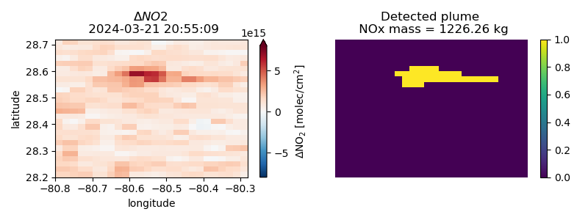
Detections are confirmed with an SNR criteria

Slide 19
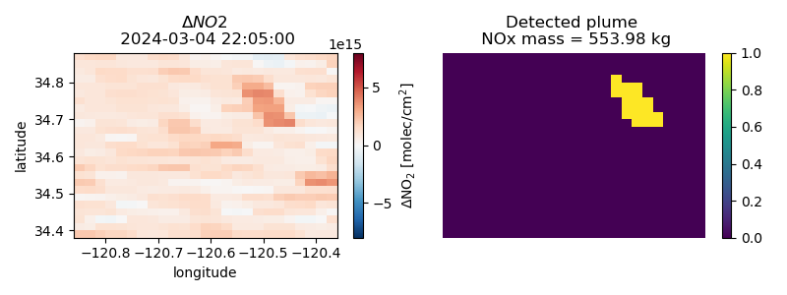
Detections are confirmed with an SNR criteria

Slide 20
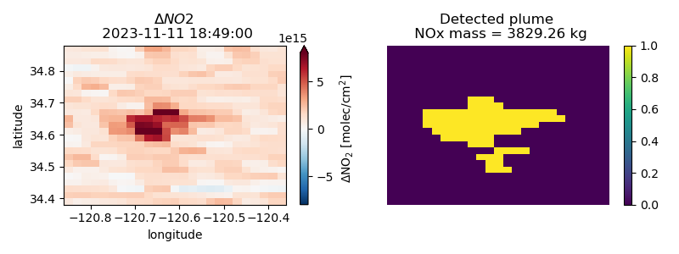
Detections are confirmed with an SNR criteria

Slide 21
Assumptions / Observations:
Emission time is rapid
Plume is distributed quasi-vertically
Plume only visible for a single retrieval, maybe two
Stable NO:NO₂ ratio
NO_{x} loss before observation time
We need to employ a strategy that enables plume detection and emission quantification from a single retrieval
How is this type of plume different from other cases?
NO_{x}
Notes:
Puff
Vertical / 90° angle upwards
Plume is transient
need to quantify emissions from a single retrieval

Slide 22
Assumptions / Observations:
Emission time is rapid
Plume is distributed quasi-vertically
Plume only visible for a single retrieval, maybe two
Stable NO:NO₂ ratio
NO_{x} loss before observation time
We need to employ a strategy that enables plume detection and emission quantification from a single retrieval
How is this type of plume different from other cases?
NO_{x}
IME approach
Notes:
Puff
Vertical / 90° angle upwards
Plume is transient
need to quantify emissions from a single retrieval

Slide 23
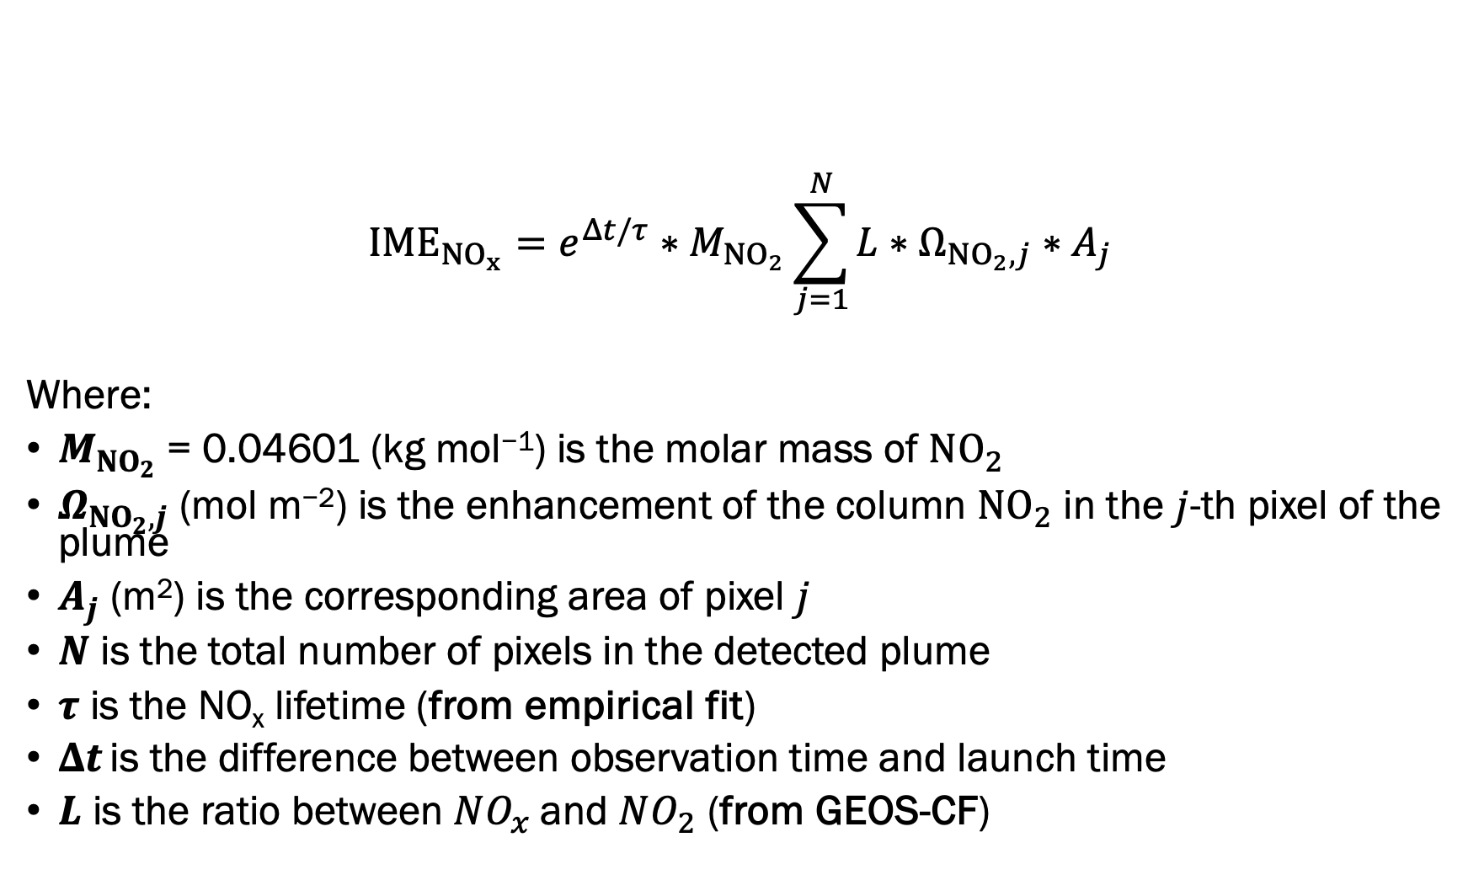
Integrated mass enhancement (IME) calculation
$$IME_{NO_{x}}={e^{Δt/τ}∗M}_{NO_{2}}\sum_{j=1}^{N}{L∗Ω_{NO_{2}, j}∗A_{j}}$$
Where:
$M_{NO_{2}}$= 0.04601 (kg mol⁻¹) is the molar mass of $NO_{2}$
$Ω_{NO_{2}, j}$ (mol m⁻²) is the enhancement of the column $NO_{2}$ in the $j$-th pixel of the plume
$A_{j}$ (m²) is the corresponding area of pixel $j$
$N$ is the total number of pixels in the detected plume
$τ$ is the NO_{x} lifetime (from empirical fit)
$Δt$ is the difference between observation time and launch time
$L$ is the ratio between $NO_{x}$and $NO_{2}$ (from GEOS-CF)
Watine-Guiu et al. 2023,
Kuhlmann et al. 2024
Notes:
This is the integrated mass enhancement equation we use to calculate NOx emissions from a plume
We sum up the mass of NO2 from each pixel in the plume
we scale that mass to NOx using the effective mean L value, and we account for plume chemical processing using this exponential term

Slide 24
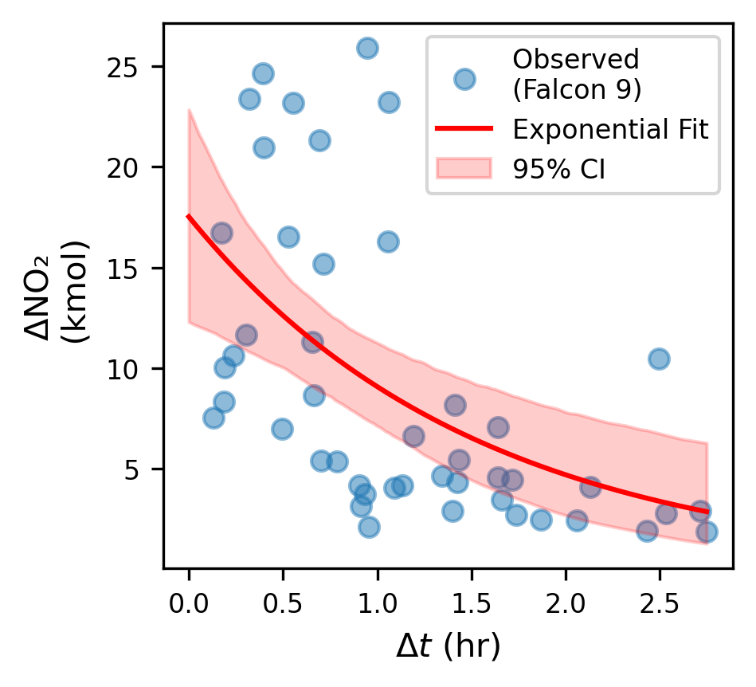

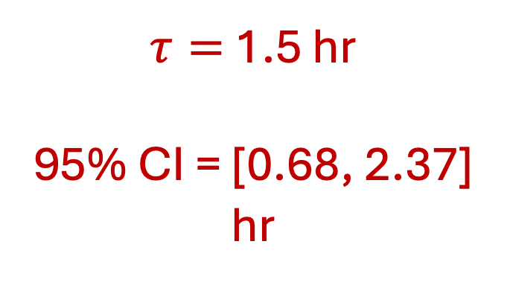
We must account for NO_{x} loss during rapid plume physical and chemical processing
$τ=$ 1.5 hr
95% CI = [0.68, 2.37] hr
Total plume NO₂ enhance-ment
$Δt$ = obs time – launch time
Notes:
One thing about these plumes is that different plumes are being observed at different points in their lifetimes
We have a different deltaT
During this time, there will be some chemical loss of NOx to account for, and we can approximate this using the evolution of NO2 enhancements in observed plumes
We take just Falcon 9 data, and assume all these plumes will show similar behavior
We can fit an exponential and compute an effective NOx lifetime within these plumes

Slide 25

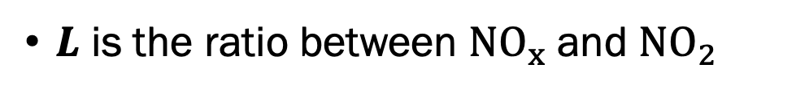
We estimate NO_{x}:NO₂ ratio
z
NO_{x}
L = $\frac{NO_{x}}{NO2}$
$L$ is the ratio between $NO_{x}$and $NO_{2}$
Notes:
Another thing we need to know if we want to get to NOx emissions is the NOx:NO2 ratio in the plume, which we denote using L
The assumption we make here is that the plume reaches steady state with the background atmosphere within minutes
We can then estimate the L using GEOS-CF...

Slide 26
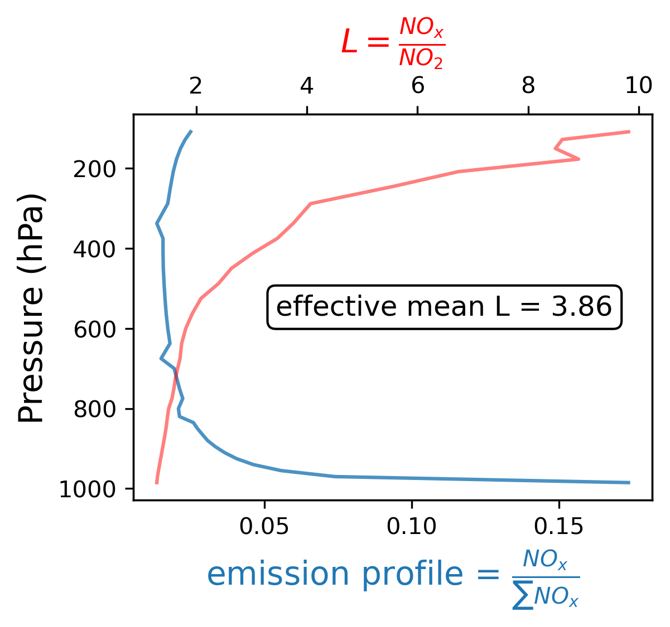
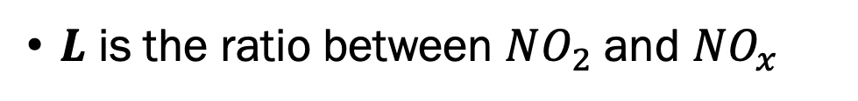
We estimate NO_{x}:NO₂ ratio using GEOS-CF
From nearest GEOS-CF pixel
z
NO_{x}
L = $\frac{NO_{x}}{NO2}$
From Pradon et al 2023 (fuel burn emission profiles)
$L$ is the ratio between $NO_{2}$and $NO_{x}$
Notes:
We can then estimate the L using GEOS-CF...
For each launch, we take the nearest GEOS-CF pixel in space and time, and grab the L information
But our plume is larger/more dense near the surface, and to account for that we weight our L profile by a launch emissions profile we take from Pradon et al 2023
This gives us a single, effective mean value for L for each launch

Slide 27
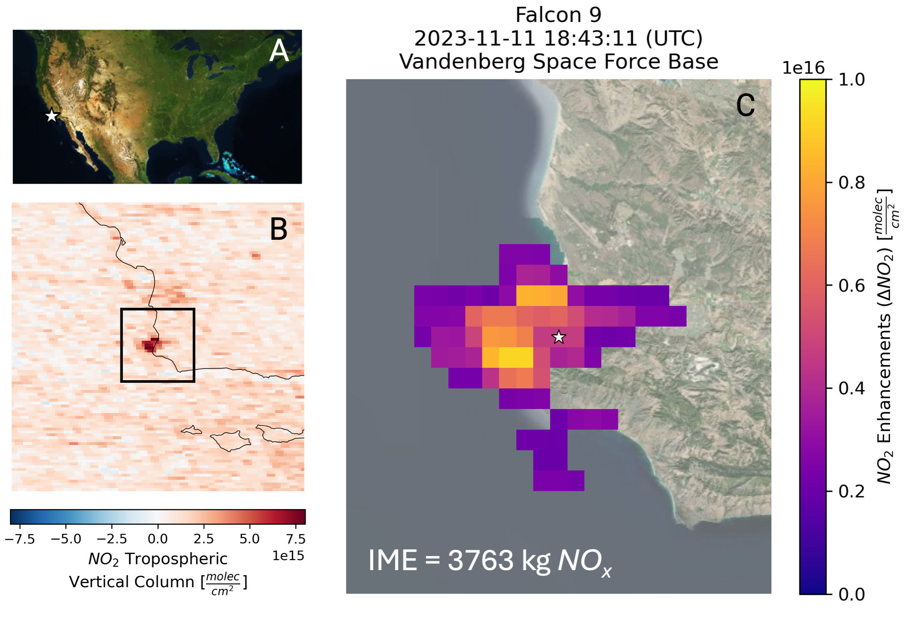
Results
We quantify emissions from 49 launches
  169 eligible launches – 30% detection rate
We observe plumes in successive retrievals from 22 of these launches

Slide 28
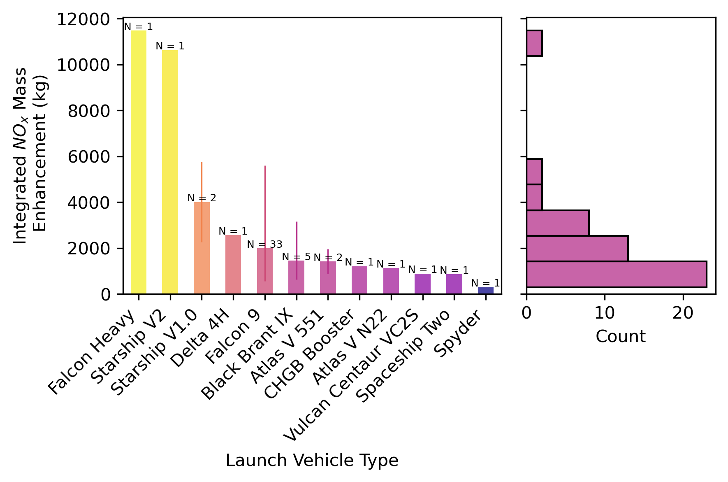
Different (size) rockets exhibit different emission profiles
Notes:
When we separate these emissions by launch vehicle, we see what we expect which is that larger rockets emit more NOx
Most of our observed plumes are from the Falcon 9,
(Generated in emissions_breakdown.ipynb)

Slide 29
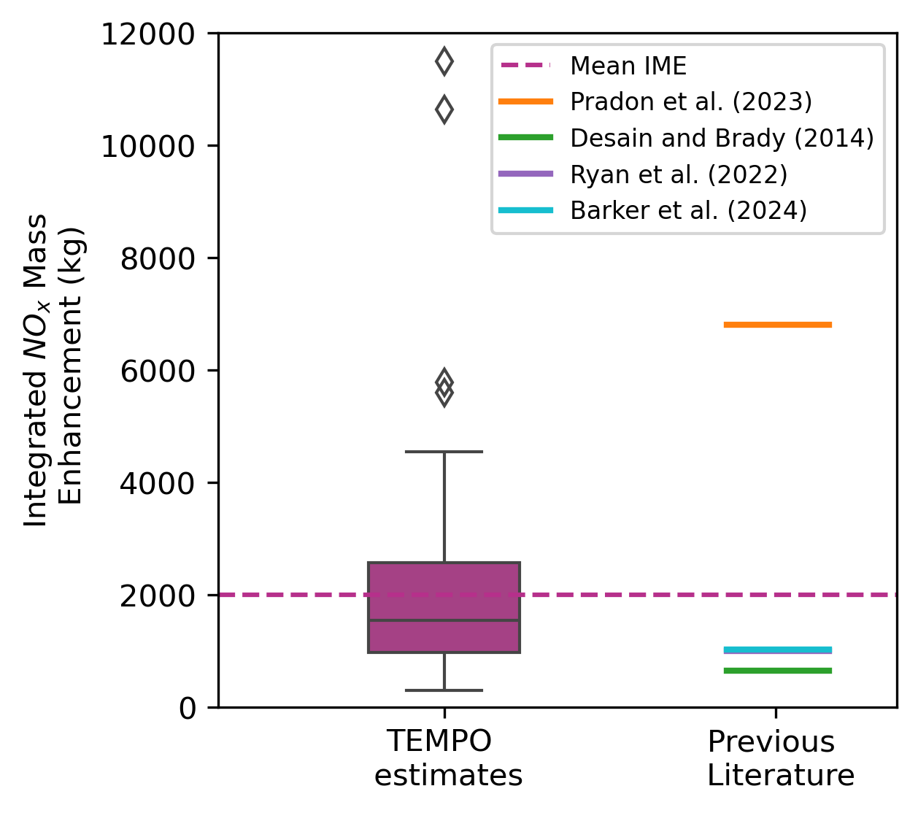
Our estimates are within the range reported in previous literature (Falcon 9 comparison)
Notes:
We compare to previous literature for a Falcon 9 size rocket.
Our results are within the previous range of literature

Slide 30
Can we detect rocket launch plumes using TEMPO?
How can we estimate rocket launch NO_{x} emissions using TEMPO?
Where do we go from here?
NO_{x}

Slide 31
Conclusions and future work
We present the first space-based detection and quantification of rocket launch NO_{x} using TEMPO observations
  We detect 49 rocket launch NO₂ plumes since Aug. 2023
  We develop an emissions estimation framework and quantify NO_{x} across 12 different launch vehicles
  Our Falcon 9 NO_{x} emissions estimate agrees with previous bottom-up estimates
Our approach encourages more sophisticated plume modeling, emissions inventory development, and assessments of global impact
NO_{x}
Notes:
This isn’t a ton of NOx, but where is it

Slide 32
Supplementary slides

Slide 33
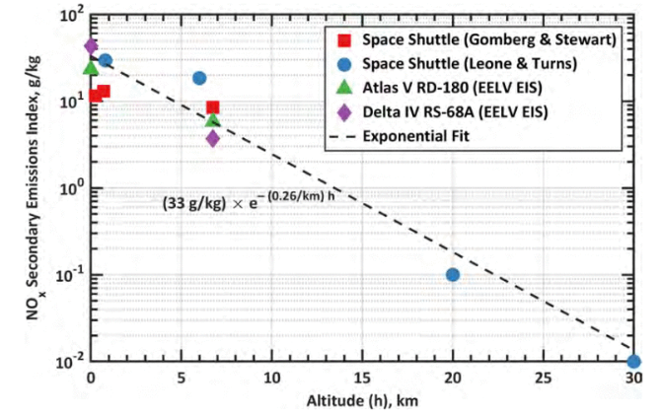
Commercial Space Vehicle Emissions Modeling (2021)

Slide 34
Detections are confirmed with an SNR criteria
For a given launch, we take the TEMPO scan of the corresponding hour, and consider only the data in a 2°x 2° box centered at the launch site latitude and longitude
The 5th percentile of these $NO_{2}$columns is subtracted from all pixels to remove background
Potential plumes are identified as groups of connected pixels that are > the 90th percentile of the background subtracted image. There must be more than 10 pixels in a group for it to be considered a plume
For each potential plume, we compute the:
  distance from plume centroid to the launch site
  signal-to-noise ratio (SNR)
    $$SNR=\frac{μ_{ΔNO_{2}, plume}}{μ_{ΔNO_{2}, background}}$$
We only consider plumes that are < 0.25° from the launch site, with SNR > 5
Varon et al. 2018,
Kuhlmann et al. 2024

Slide 35
We must account for NO_{x} loss during rapid plume physical and chemical processing
$τ=$ 1.5 hr
95% CI = [0.68, 2.37] hr
Total plume NO₂ enhance-ment
$Δt$ = obs time – launch time
Notes:
One thing about these plumes is that different plumes are being observed at different points in their lifetimes
We have a different deltaT
During this time, there will be some chemical loss of NOx to account for, and we can approximate this using the evolution of NO2 enhancements in observed plumes
We take just Falcon 9 data, and assume all these plumes will show similar behavior
We can fit an exponential and compute an effective NOx lifetime within these plumes

Slide 36
We estimate NO_{x}:NO₂ ratio
z
NO_{x}
L = $\frac{NO_{x}}{NO2}$
$L$ is the ratio between $NO_{x}$and $NO_{2}$
Notes:
Another thing we need to know if we want to get to NOx emissions is the NOx:NO2 ratio in the plume, which we denote using L
The assumption we make here is that the plume reaches steady state with the background atmosphere within minutes
We can then estimate the L using GEOS-CF...

Slide 37
We estimate NO_{x}:NO₂ ratio using GEOS-CF
From nearest GEOS-CF pixel
z
NO_{x}
L = $\frac{NO_{x}}{NO2}$
From Pradon et al 2023 (fuel burn emission profiles)
$L$ is the ratio between $NO_{2}$and $NO_{x}$
Notes:
We can then estimate the L using GEOS-CF...
For each launch, we take the nearest GEOS-CF pixel in space and time, and grab the L information
But our plume is larger/more dense near the surface, and to account for that we weight our L profile by a launch emissions profile we take from Pradon et al 2023
This gives us a single, effective mean value for L for each launch

Slide 38
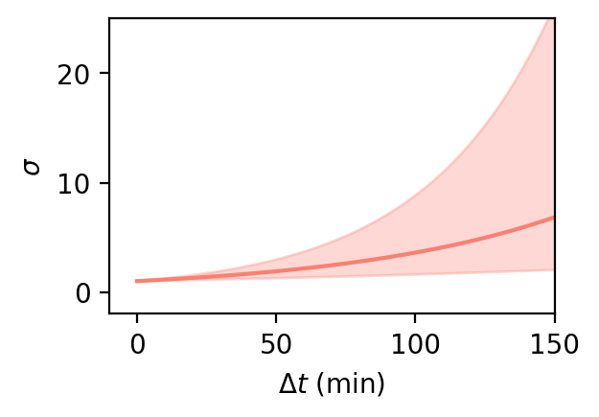
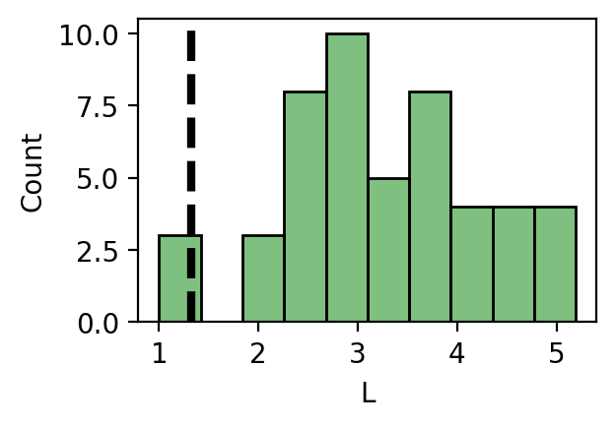
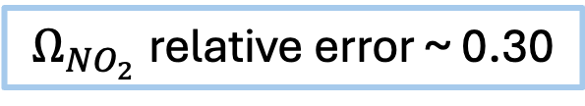
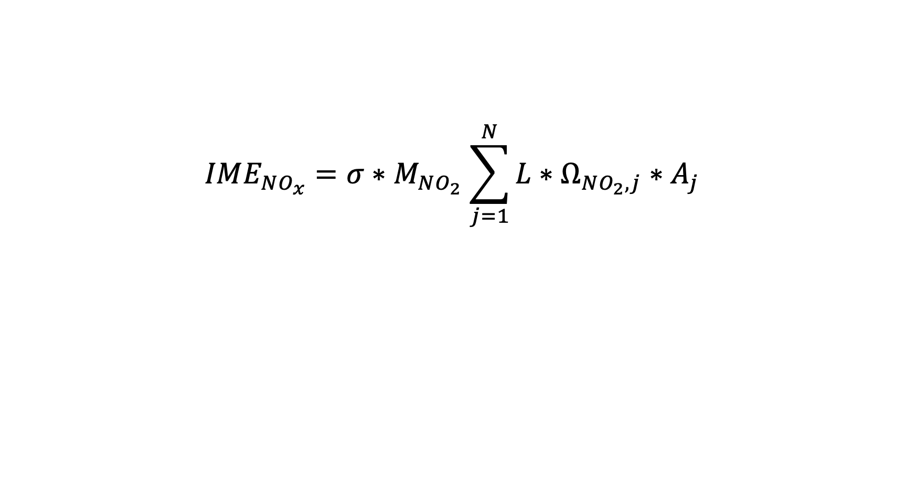
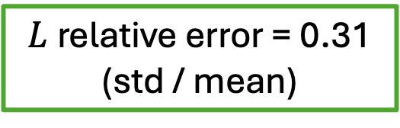
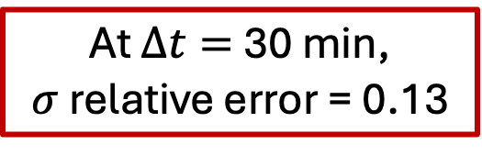
Error analysis
$Ω_{NO_{2}}$relative error ~ 0.30
$$IME_{NO_{x}}=σ{∗M}_{NO_{2}}\sum_{j=1}^{N}{L∗Ω_{NO_{2}, j}∗A_{j}}$$
At $Δt=$ 30 min, $σ$relative error = 0.13
$L$relative error = 0.31
(std / mean)

Slide 39
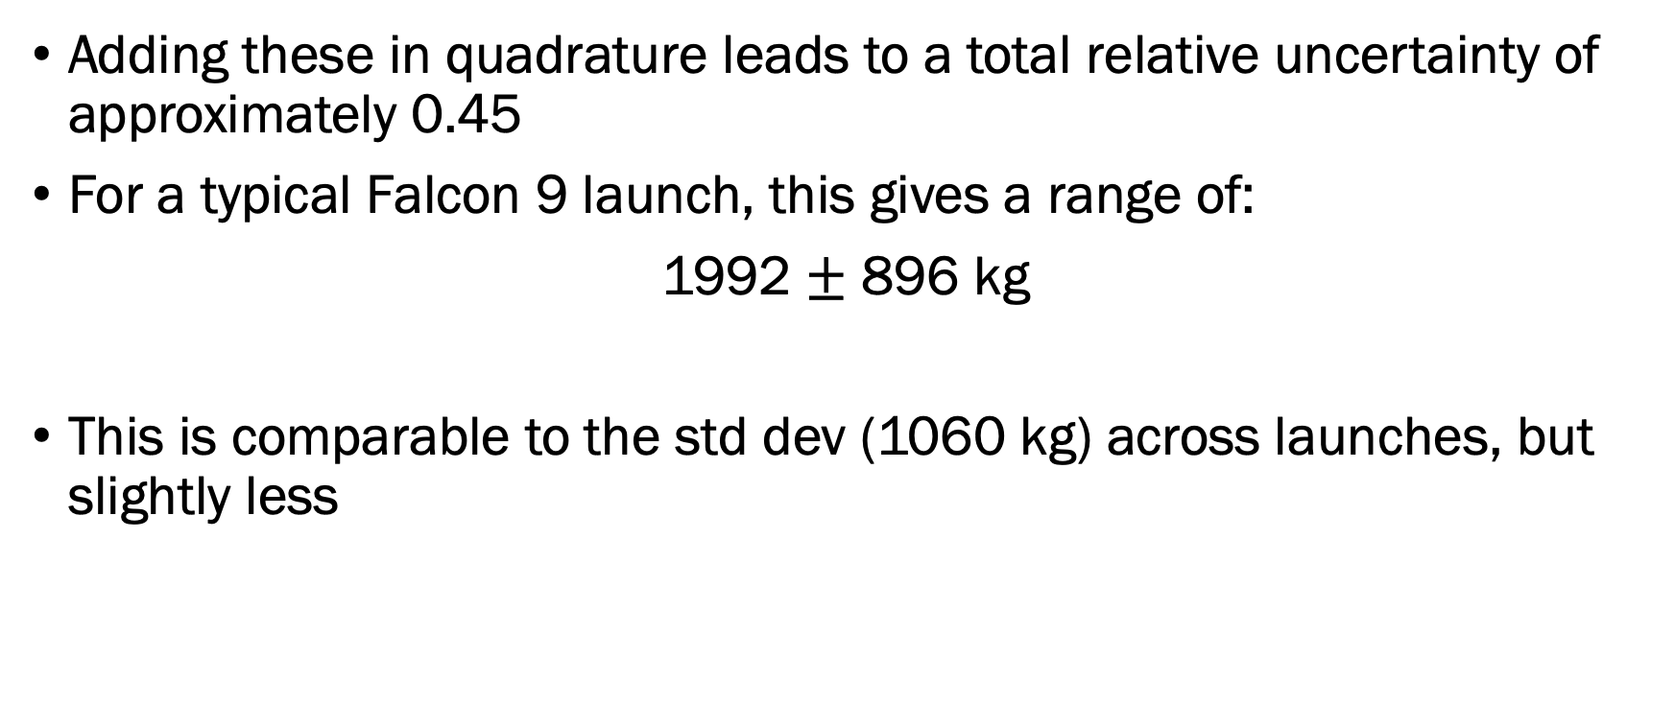
Error analysis
Adding these in quadrature leads to a total relative uncertainty of approximately 0.45
For a typical Falcon 9 launch, this gives a range of:
1992 $±$ 896 kg
This is comparable to the std dev (1060 kg) across launches, but slightly less

Slide 40
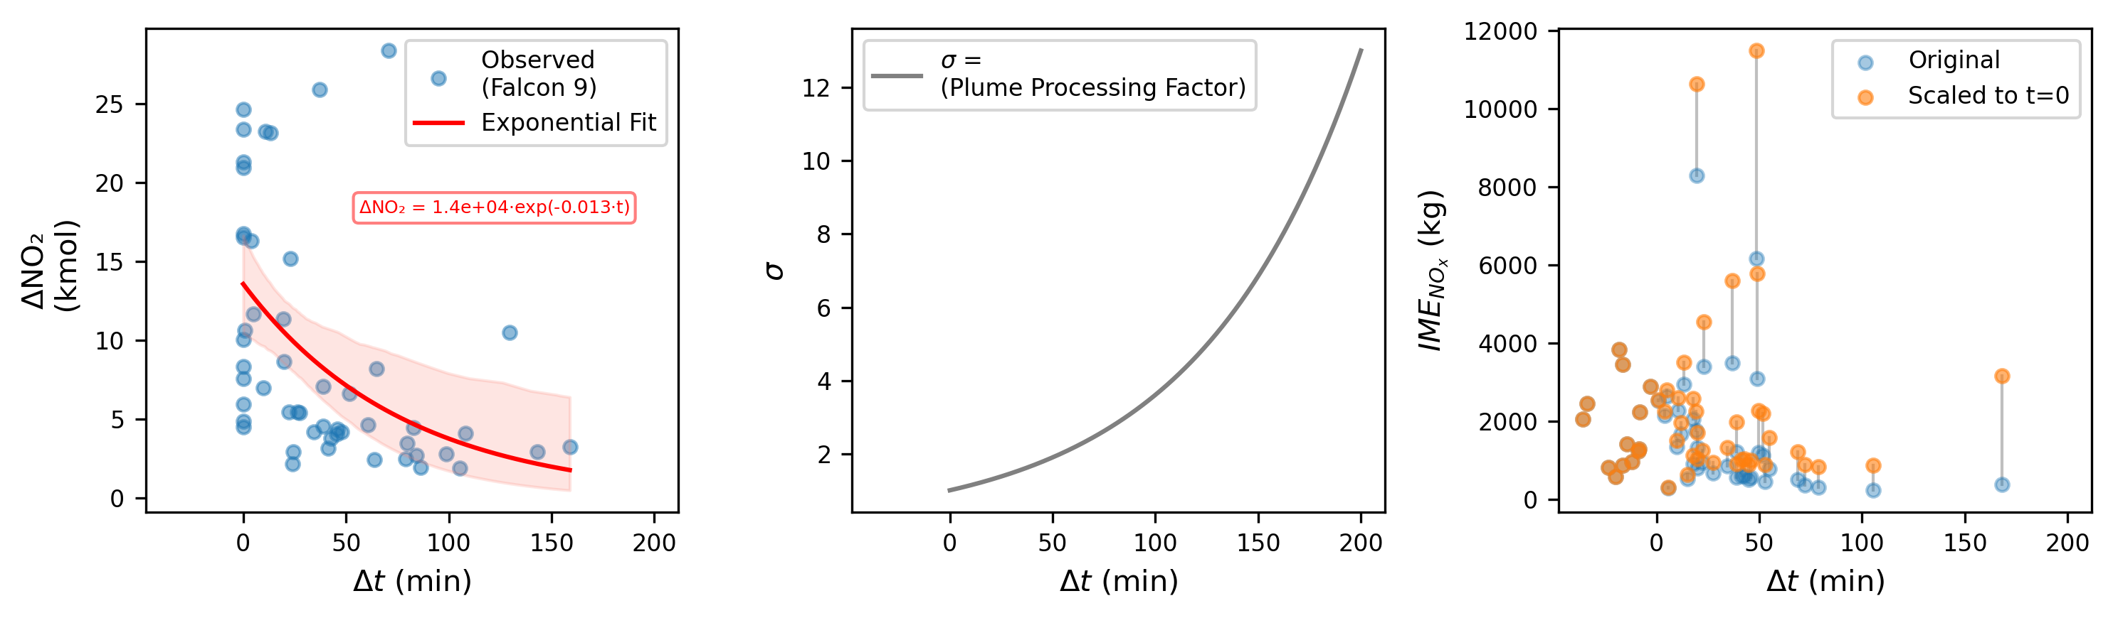
We must account for NO_{x} loss during rapid plume chemical processing

Slide 41
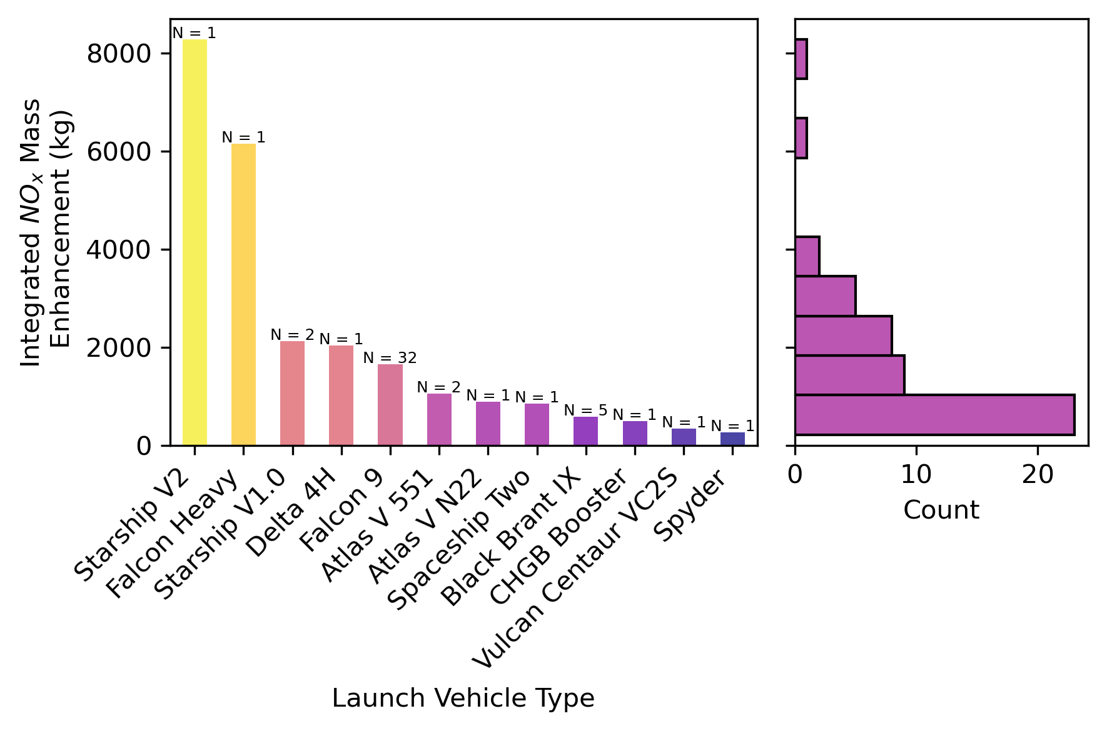
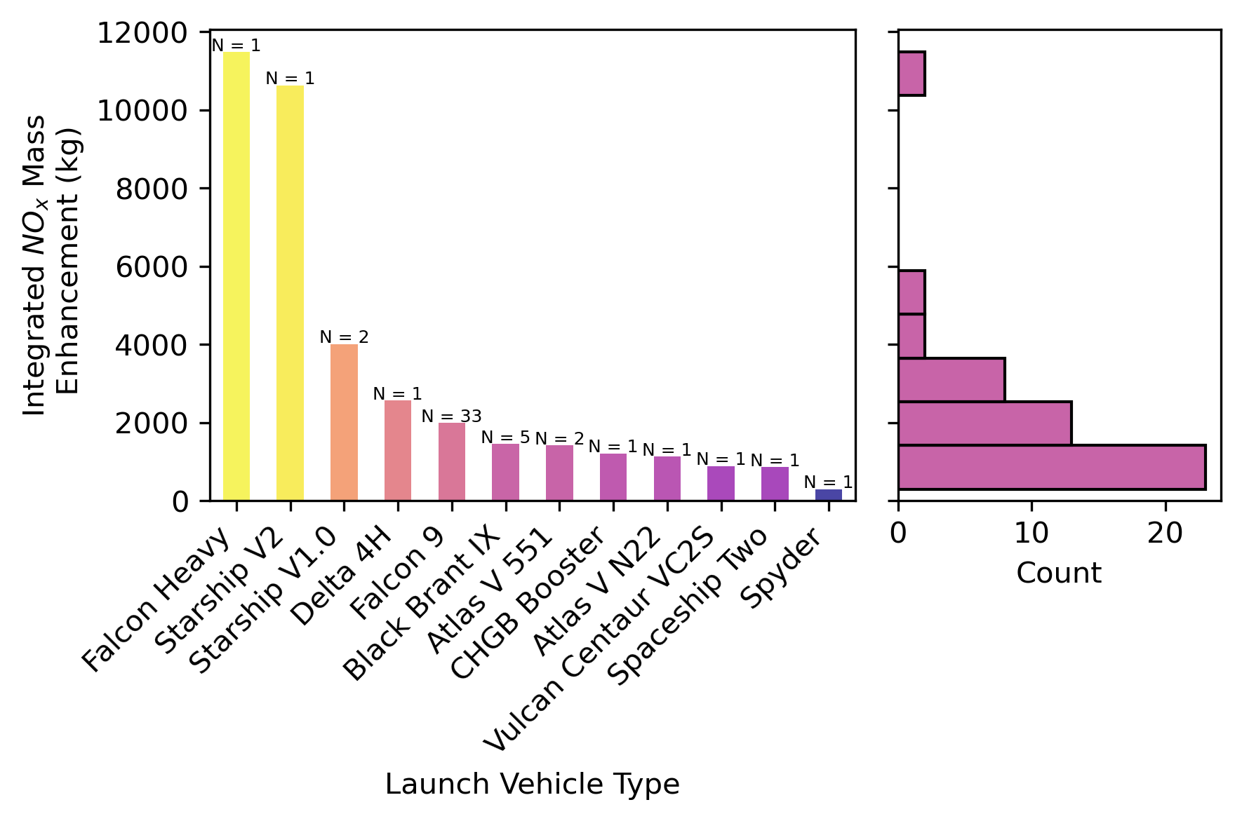

𝜎 correction increases emissions estimates
$σ$ correction

Slide 42
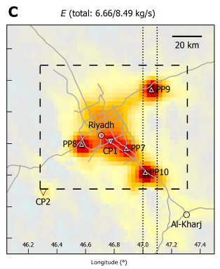
How much NOx does a rocket emit?
So a Falcon 9 launch is like if you took all the emissions over a ~2 min span from a large, polluted city, and spread it throughout a vertical column in the troposphere
Beirle et al. 2019

Slide 43
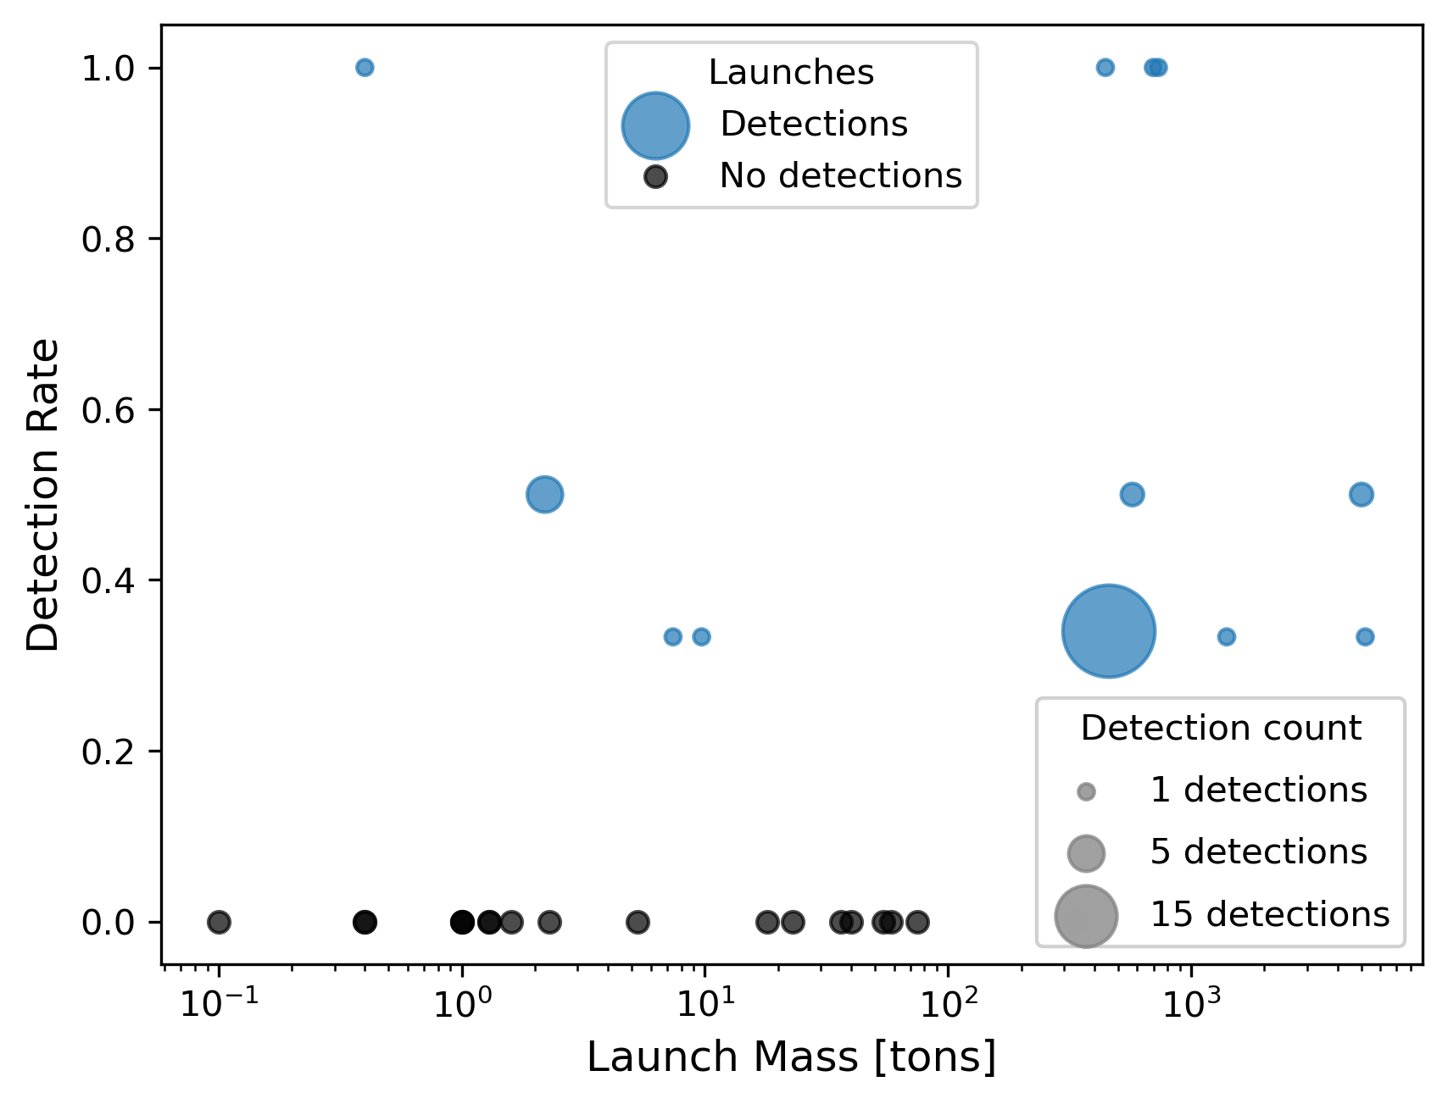

Slide 44
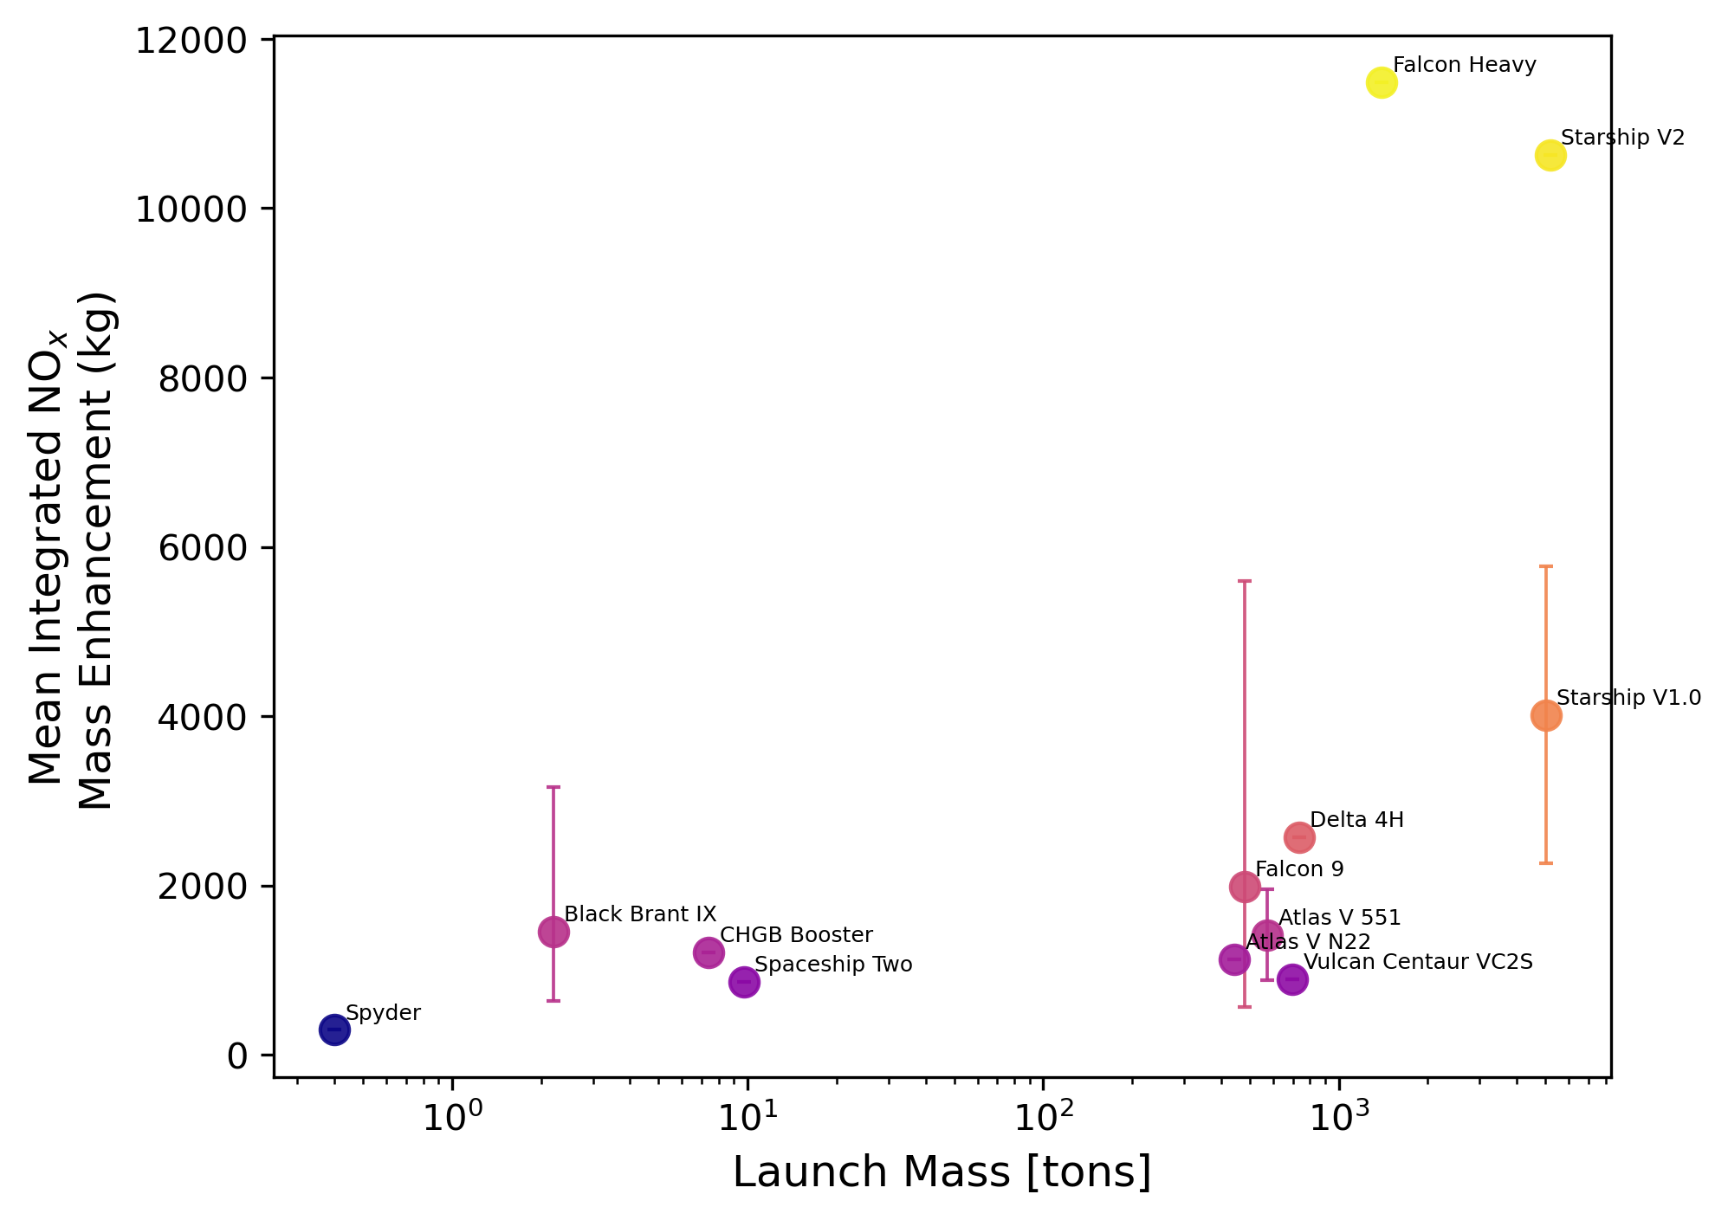
Different (size) rockets exhibit different emission profiles

Slide 45
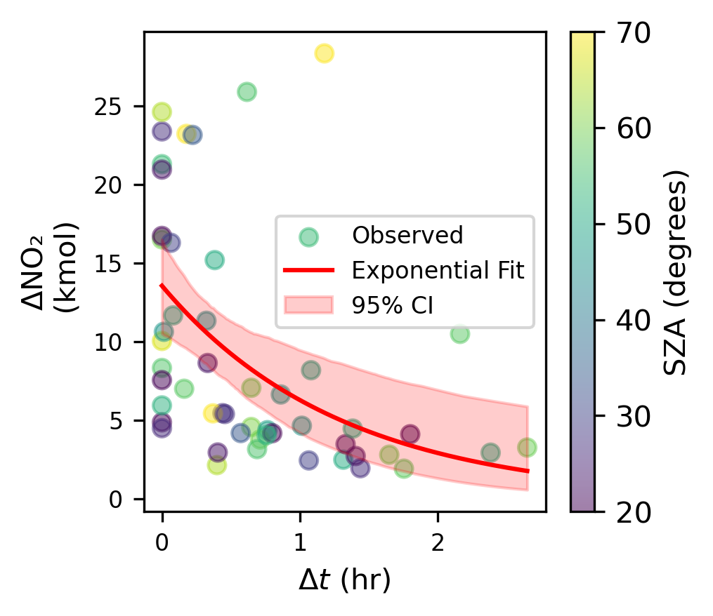

Slide 46
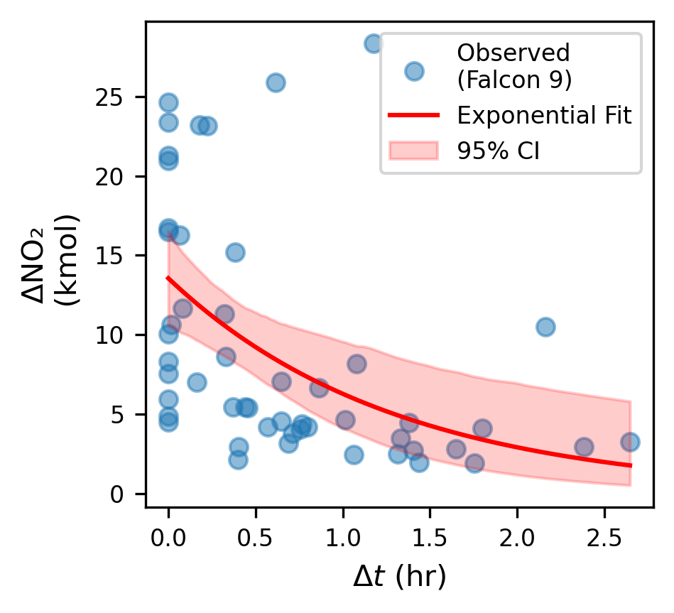
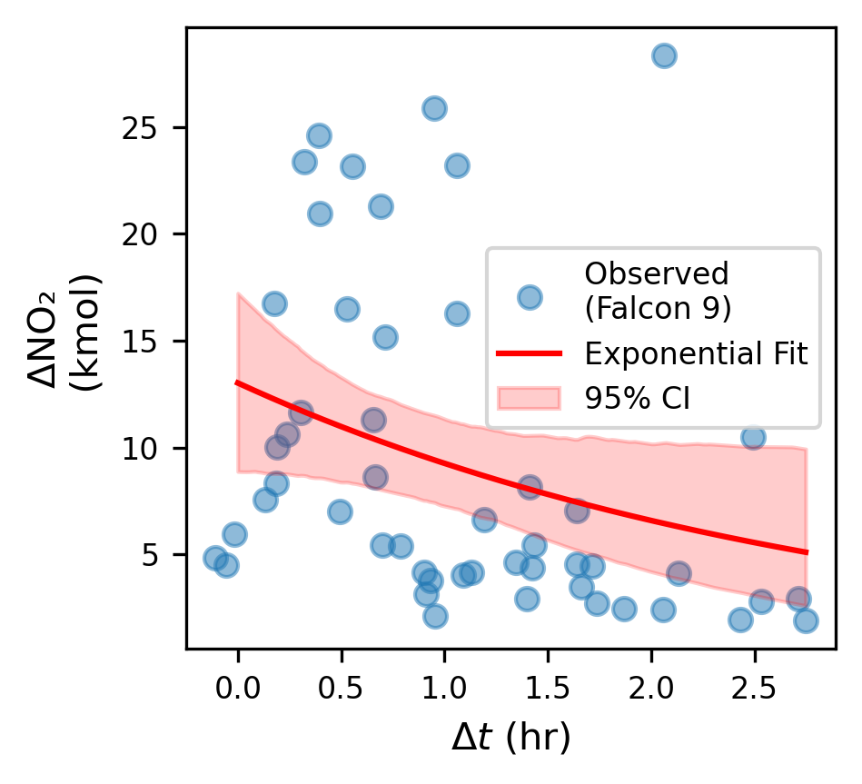

Slide 47
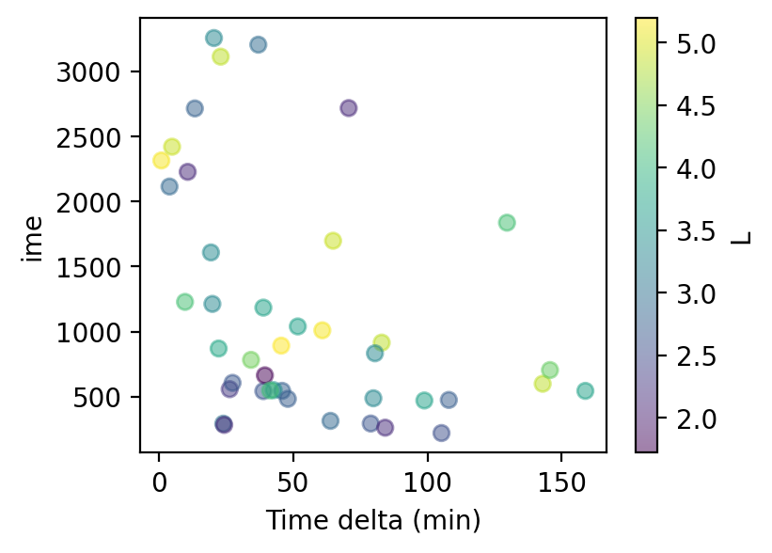

Slide 48
