Slide 1


Urban NOx Emissions from TEMPO
Zigang Wei¹ and Shobha Kondragunta²
¹STC at NOAA | ²NOAA
TEMPO-ACX Science Team Meeting
August 19-23, 2025
Disclaimer: The scientific results and conclusions, as well as any views or opinions expressed
herein, are those of the author(s) and do not necessarily reflect those of NOAA or
the Department of Commerce.
POC: Brian McDonald, NOAA/OAR/CSL

Slide 2
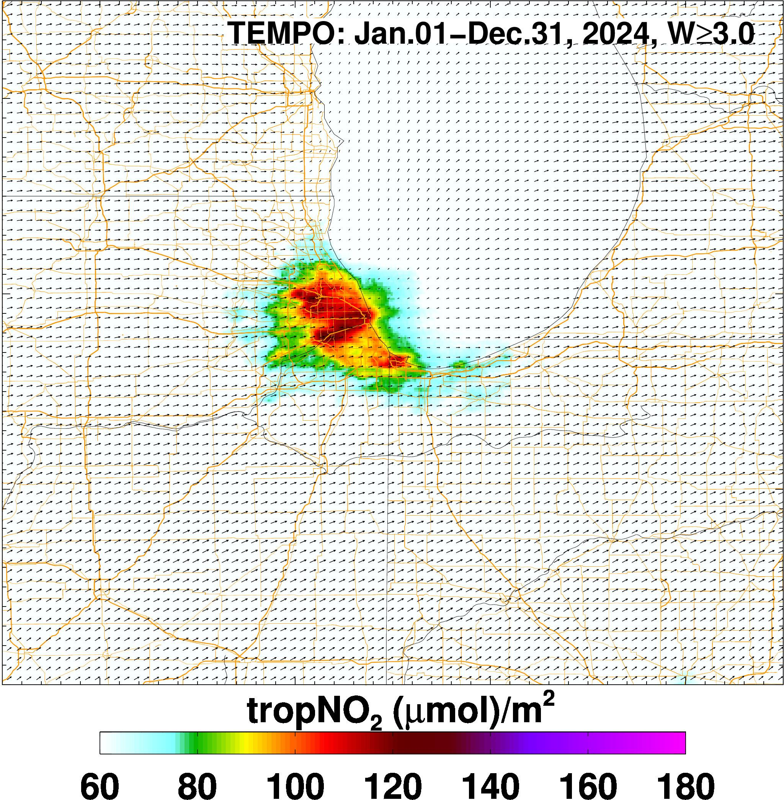
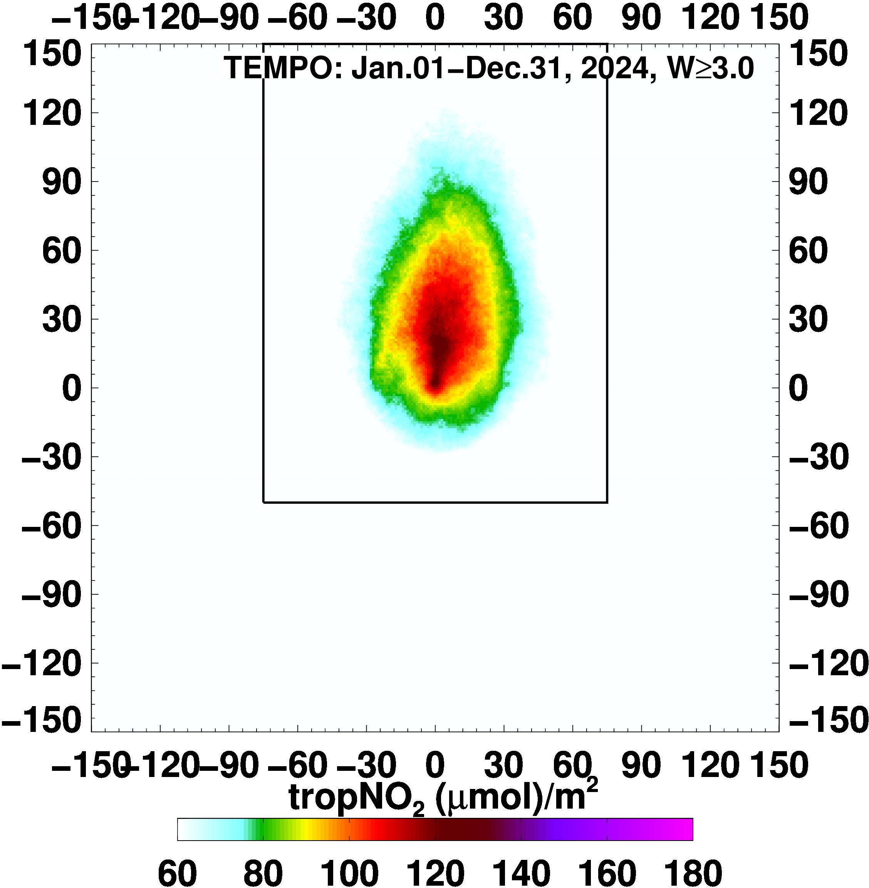
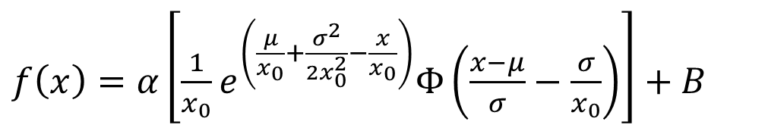
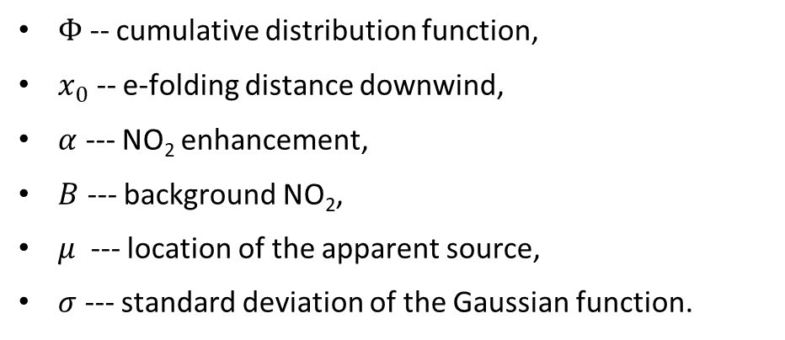
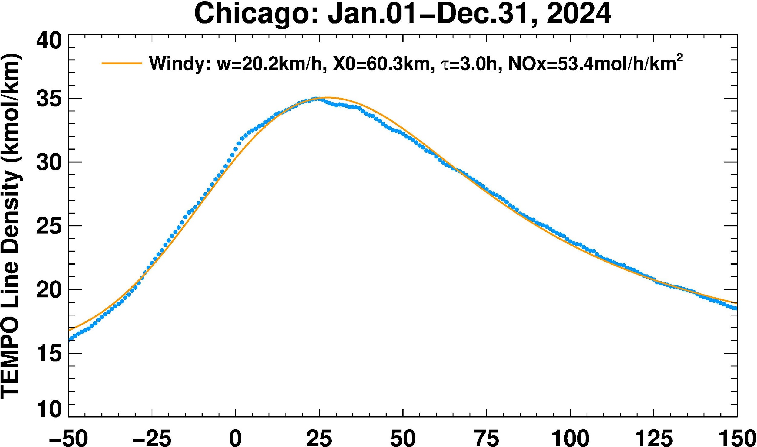

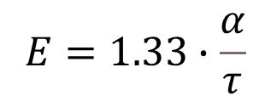
Exponentially Modified Gaussian Method Applied to TEMPO and TROPOMI

Slide 3
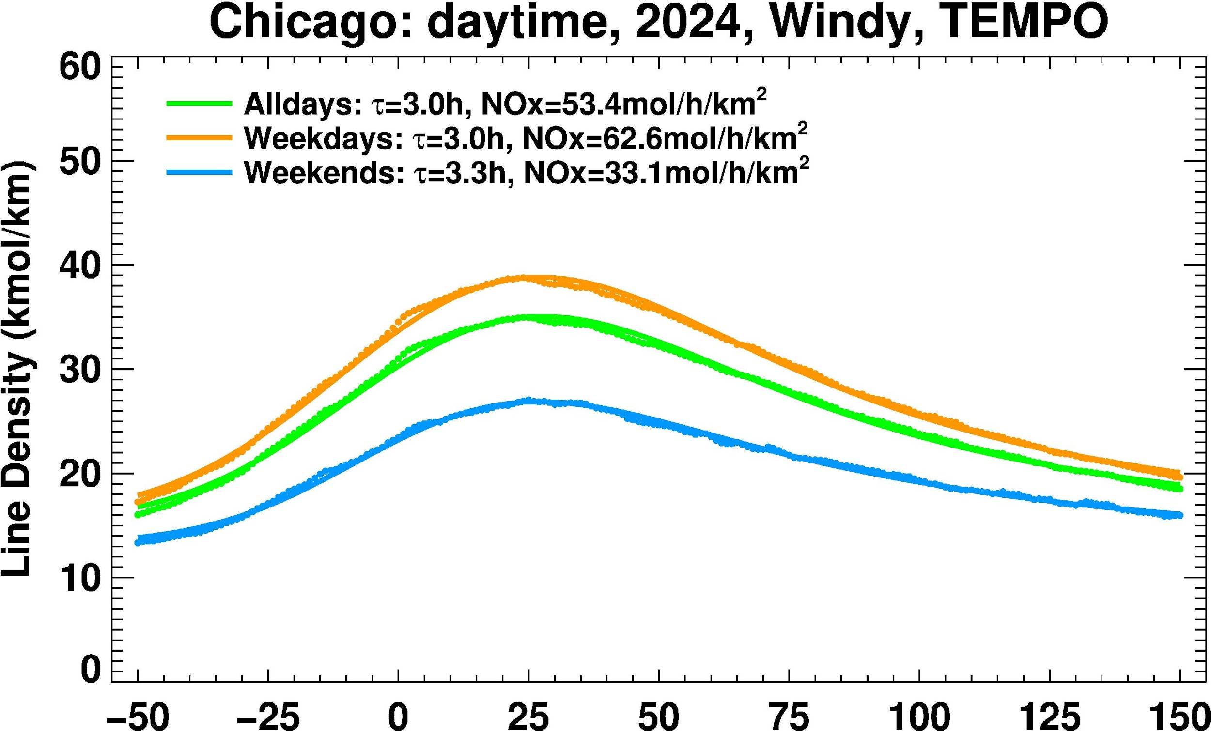
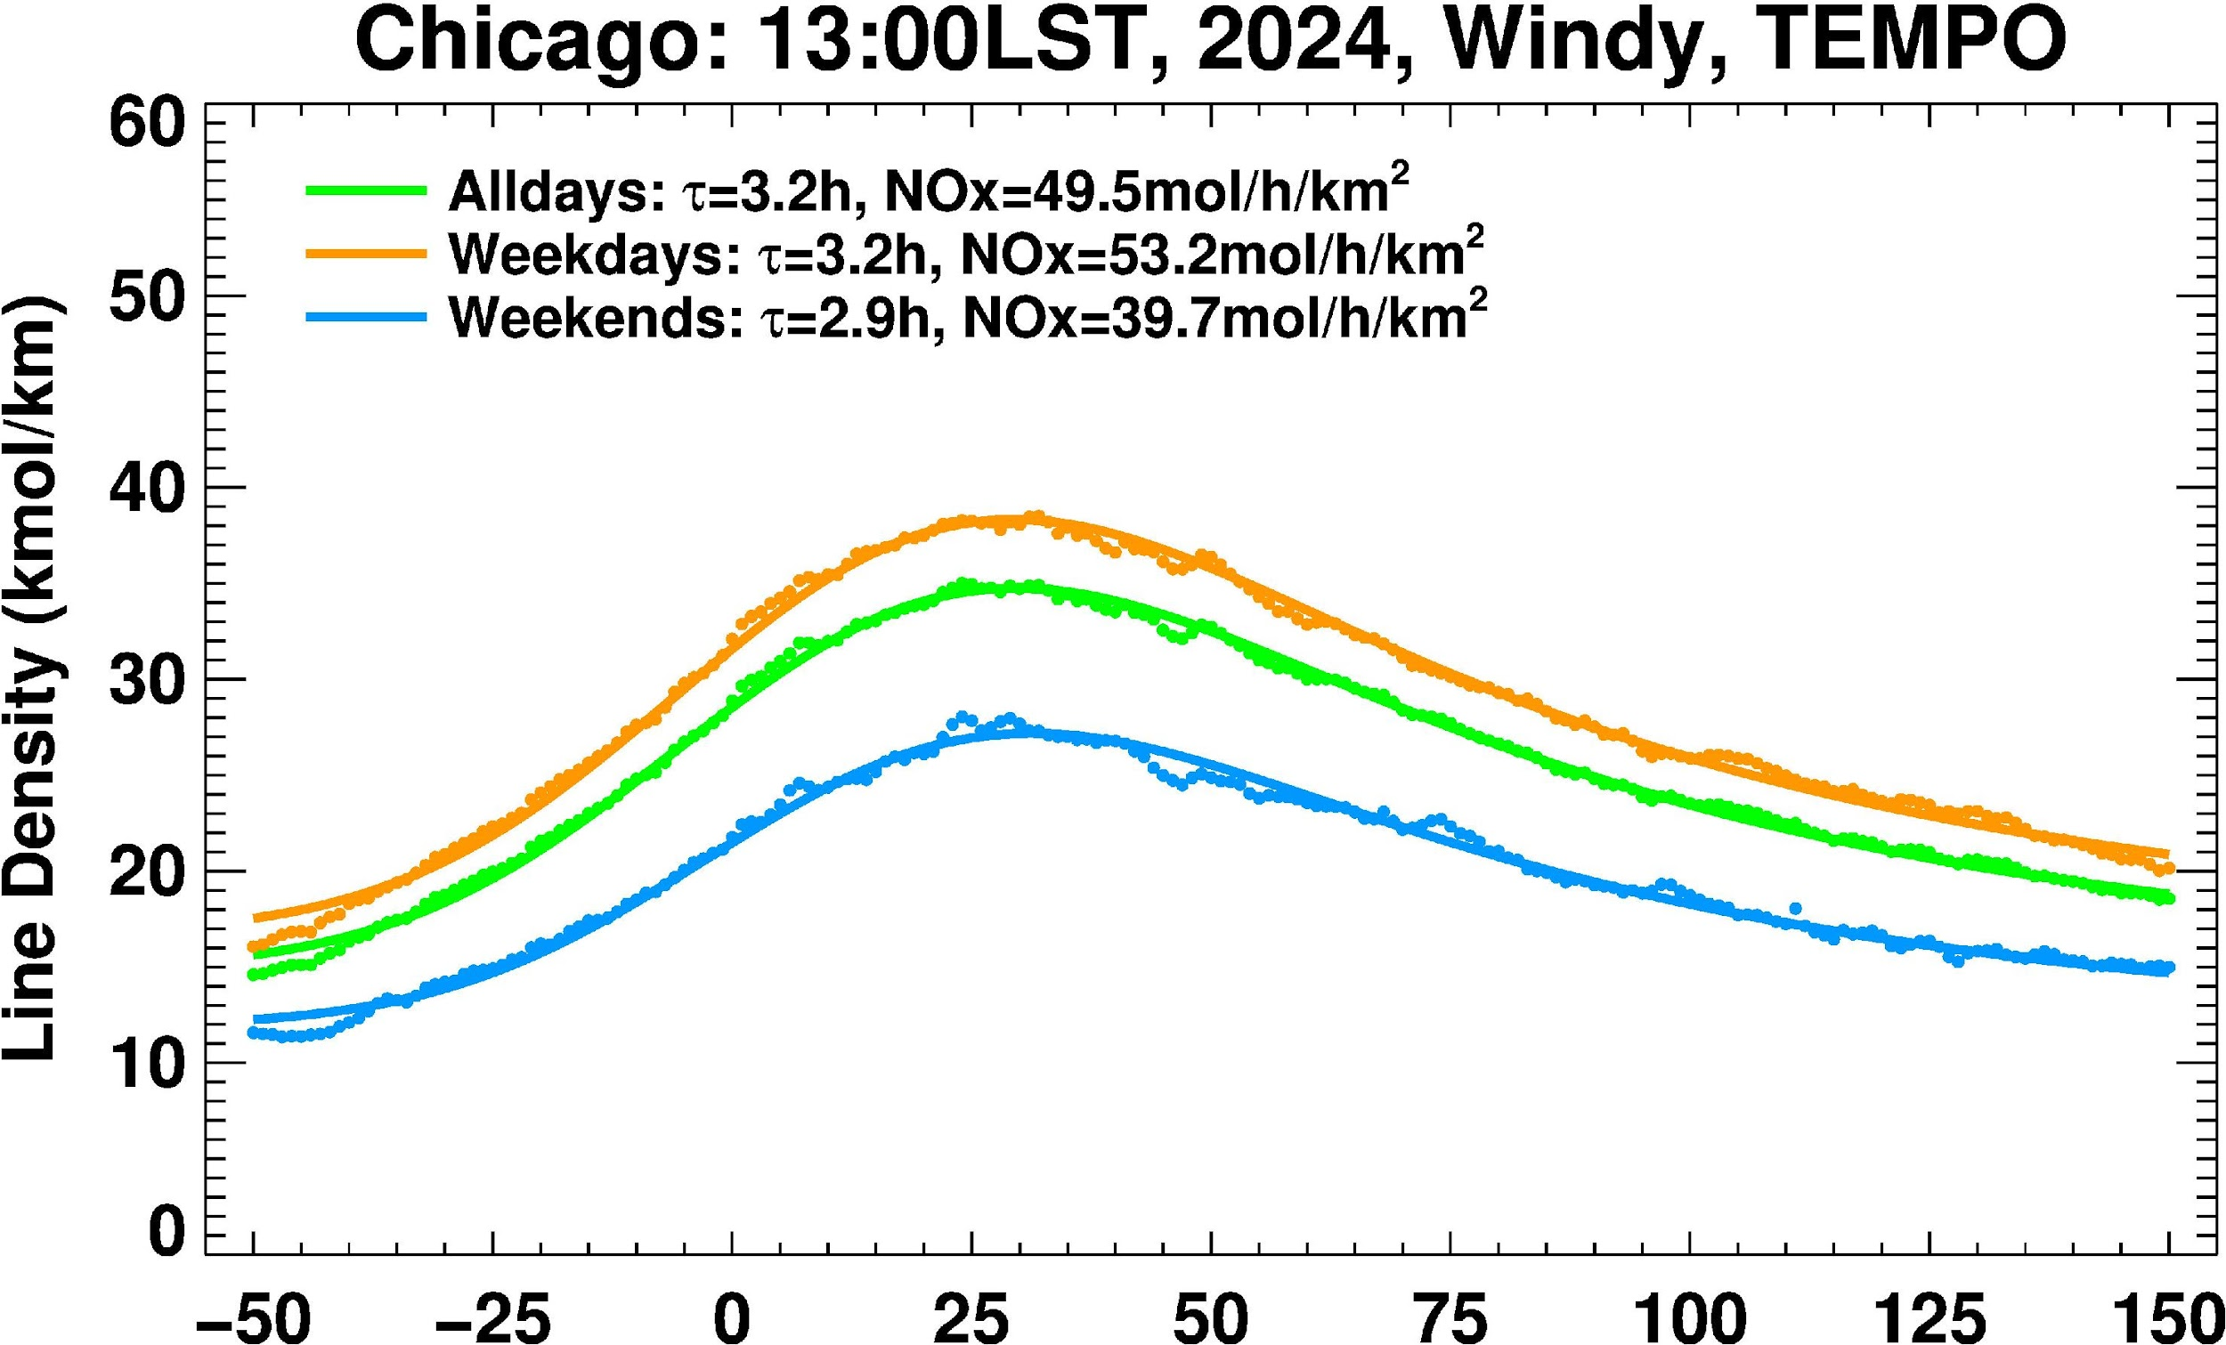
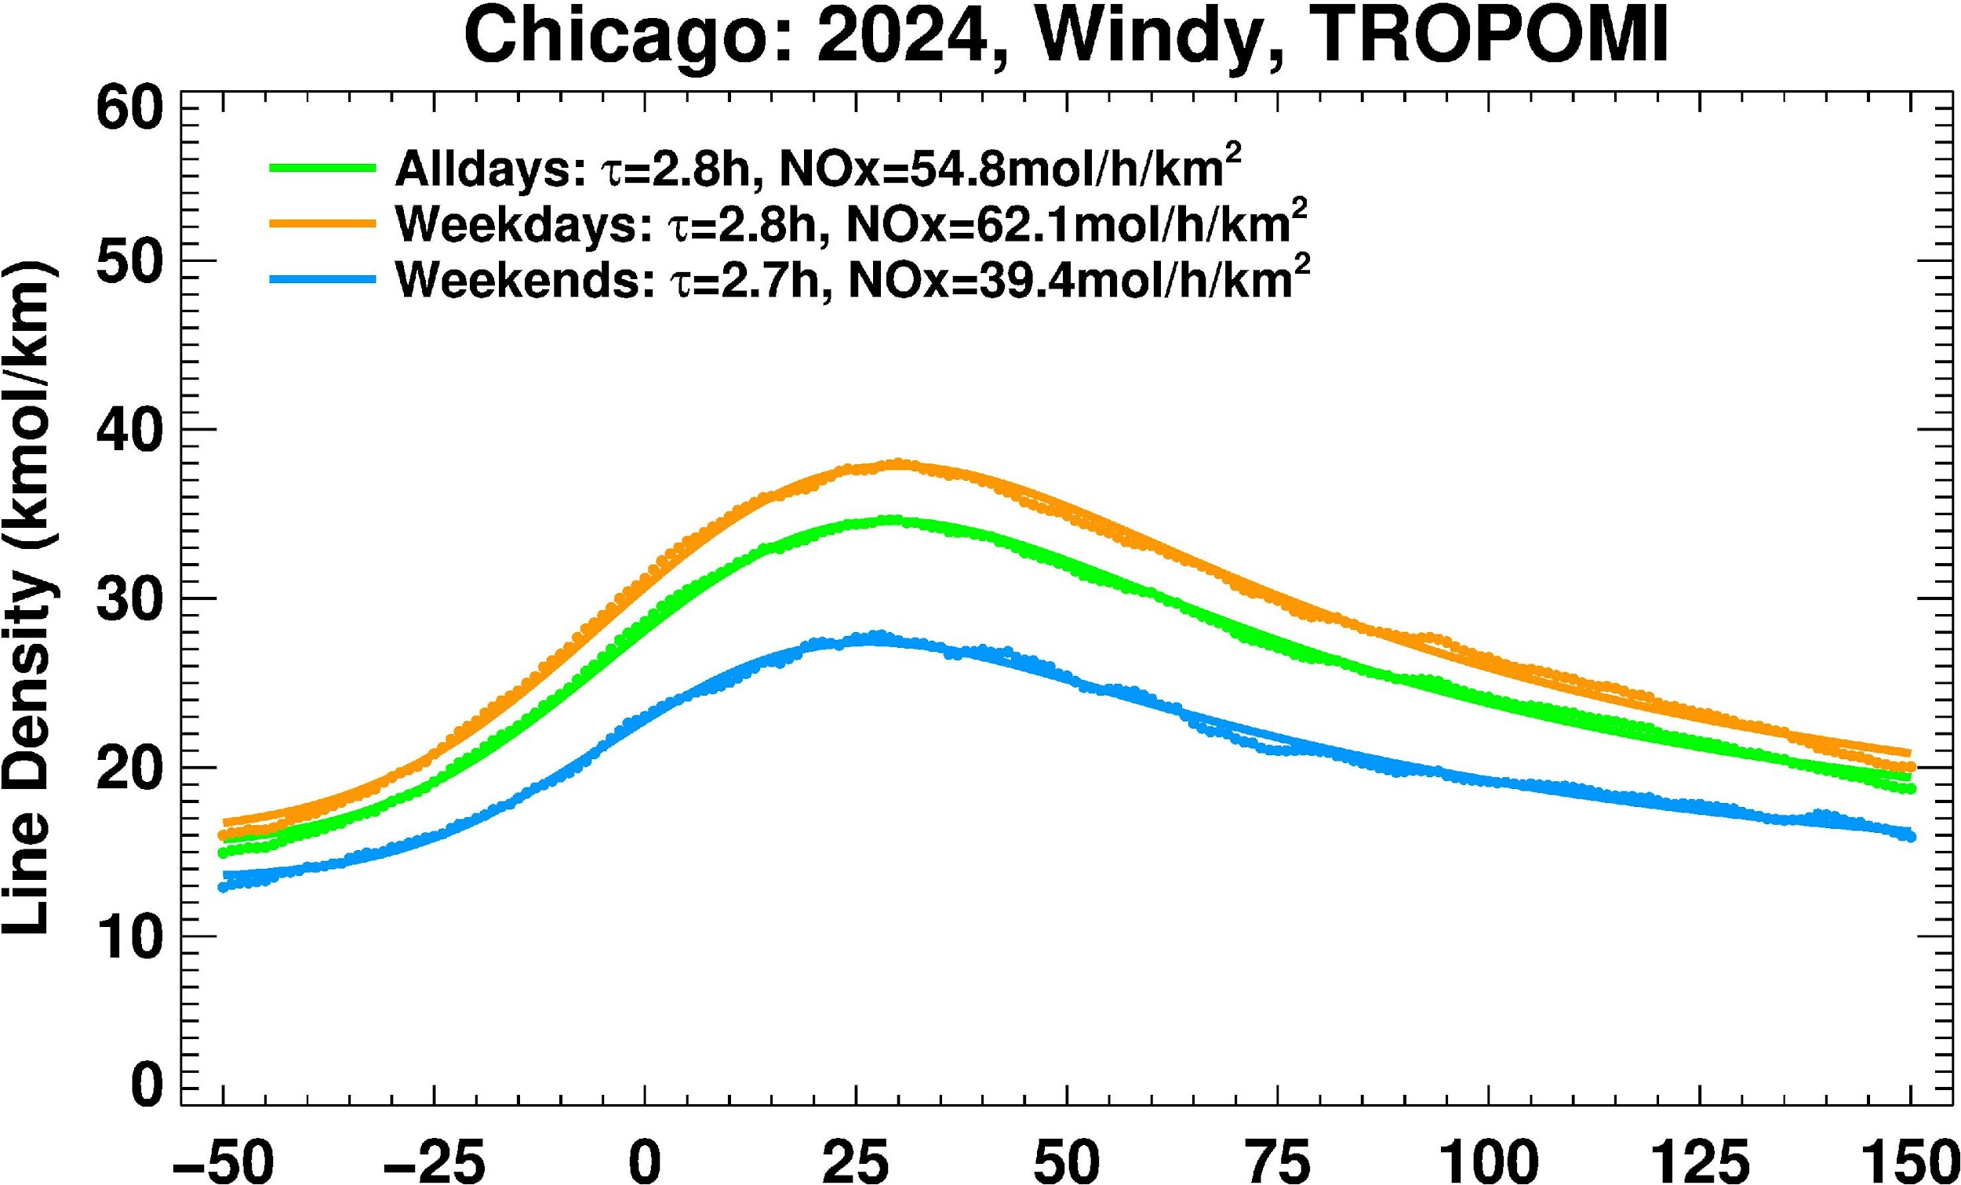
Line Density Plots: Weekdays vs Weekends for Chicago
Weekday NOx emissions are higher than weekends from both TEMPO and TROPOMI, reflecting reduced weekend activity.
Local-time matched TEMPO (13–14 LT) yields results closer to TROPOMI, showing the role of overpass timing.
Lifetime shows consistence between weekdays and weekends. The lifetime estimated from TEMPO shows slightly longer than from TROPOMI.

Slide 4
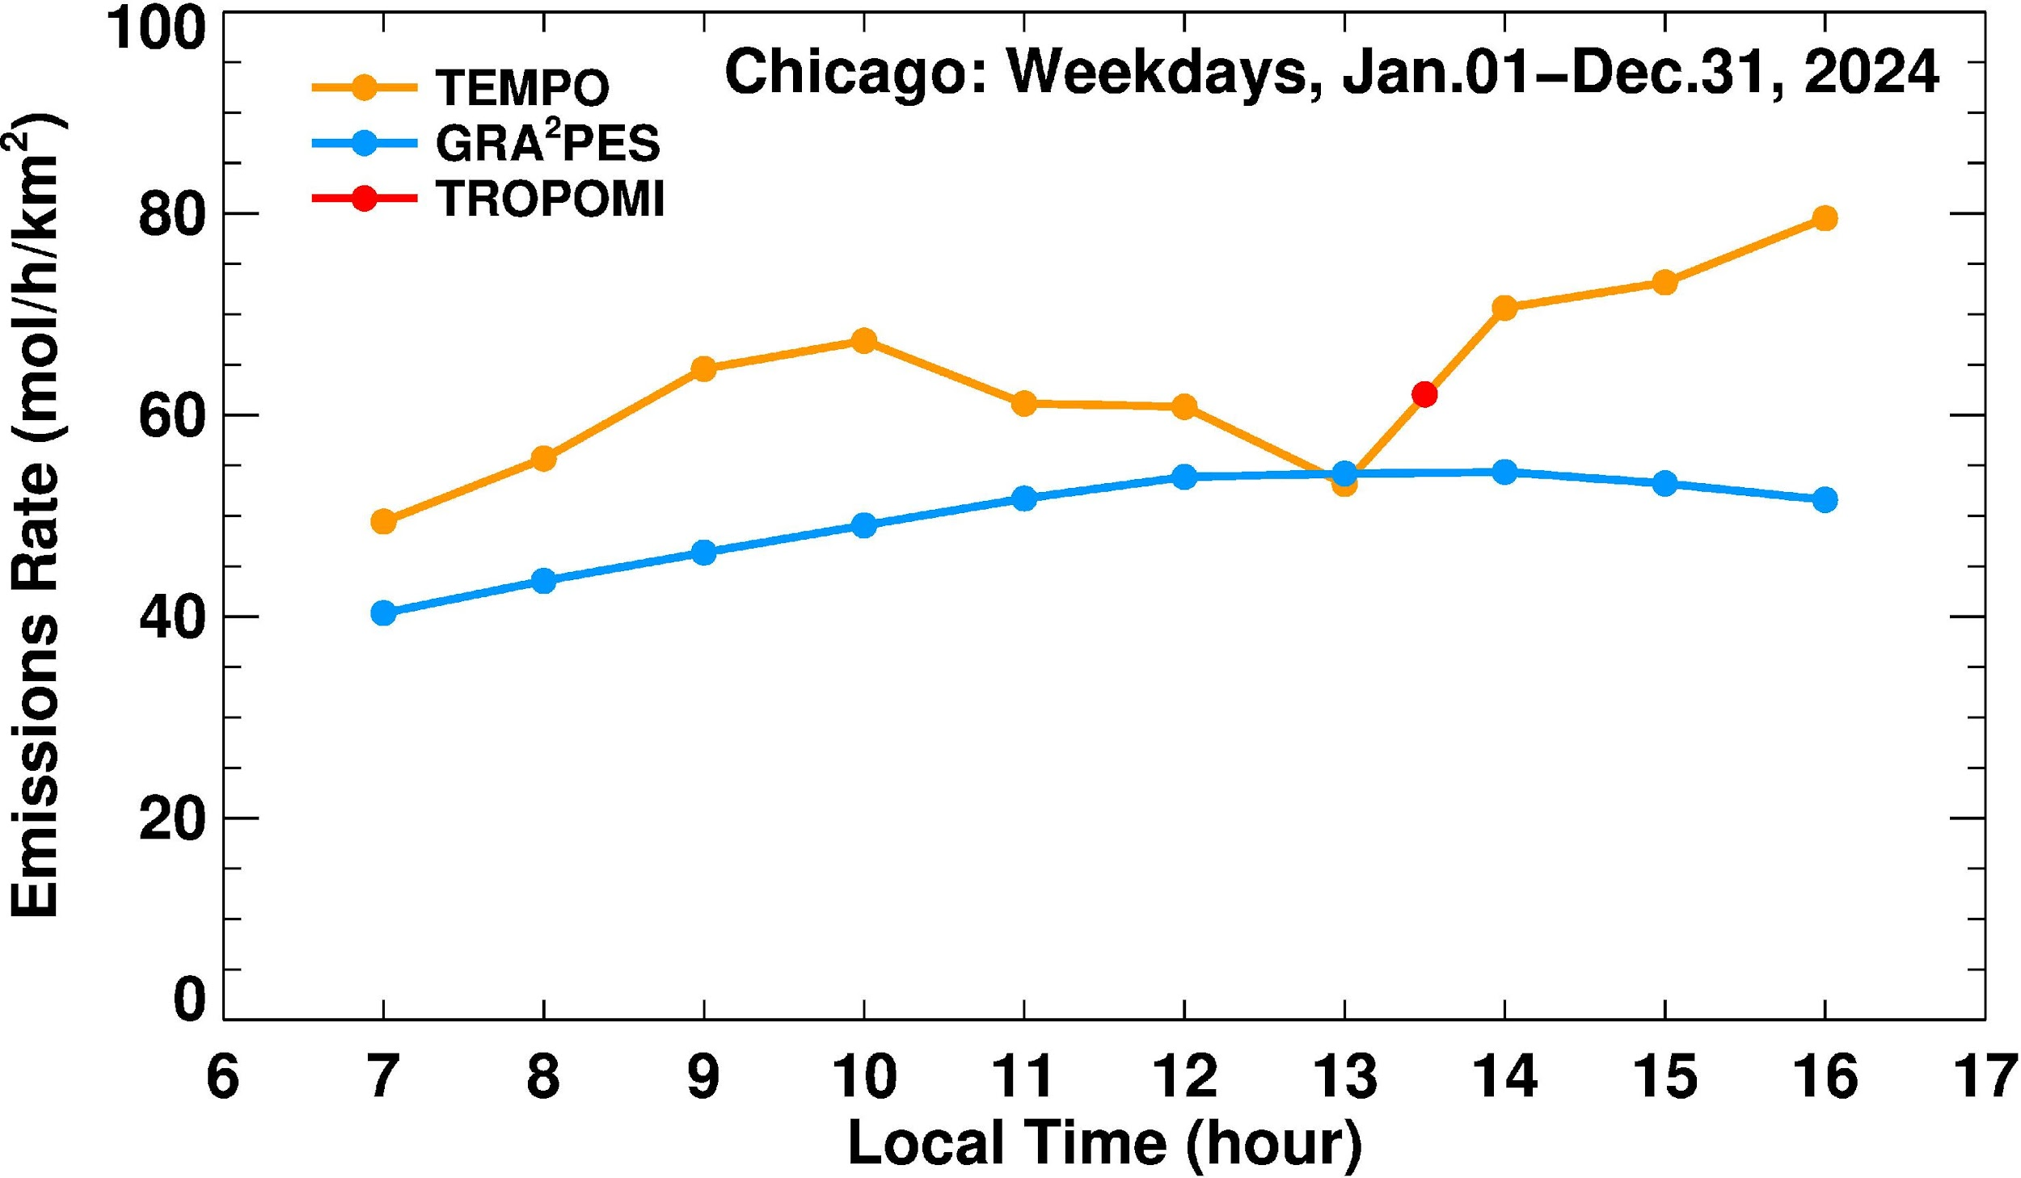
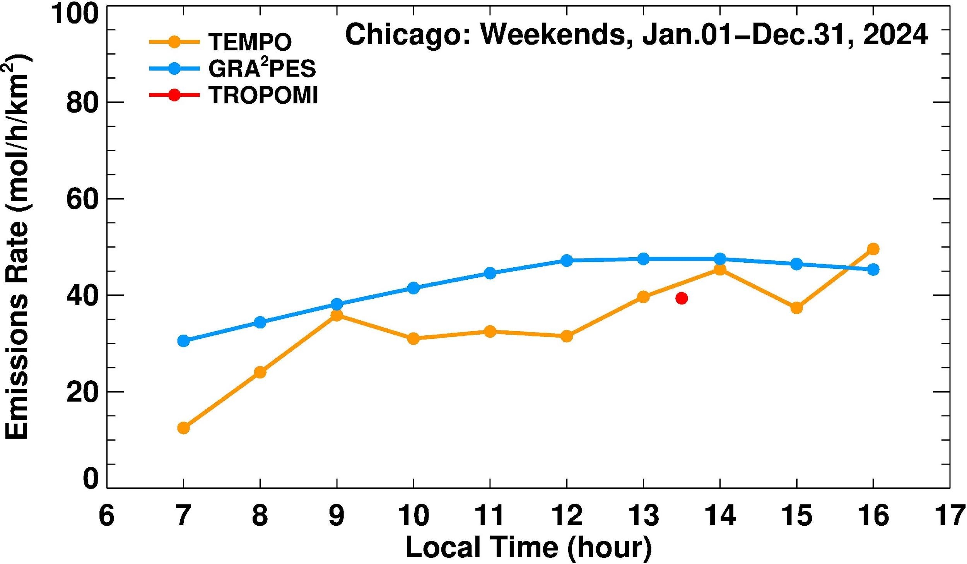
Diurnal Variation in NOx Emissions
NOx emissions are significantly higher on weekdays than on weekends
TEMPO and TROPOMI NOx emissions show strong agreement. Both consistently estimate higher NOx emissions than the GRA²PES inventory, especially during peak traffic hours
TEMPO data reveals a clear daily cycle with morning and afternoon emission peaks that are not captured in GRA²PES.

Slide 5
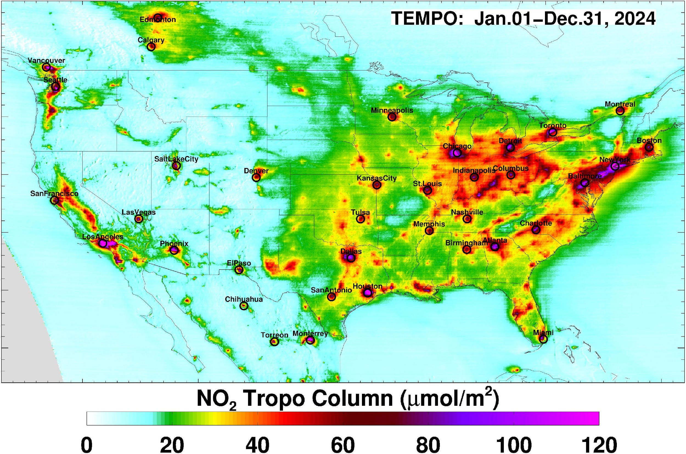
Selecting Major Emissions Areas
City selection is based on the major hotspots on TEMPO tropNO₂ annual mean maps.
Fitting period: Jan.01—Dec.31, 2024, all days and all scans of TEMPO were included.
Fitting domains: 30~75km in the upwind, 50~200km in the downwind, 30~100km in the cross wind directions. Depends on the pollution plume range from TEMPO annual mean.

Slide 6
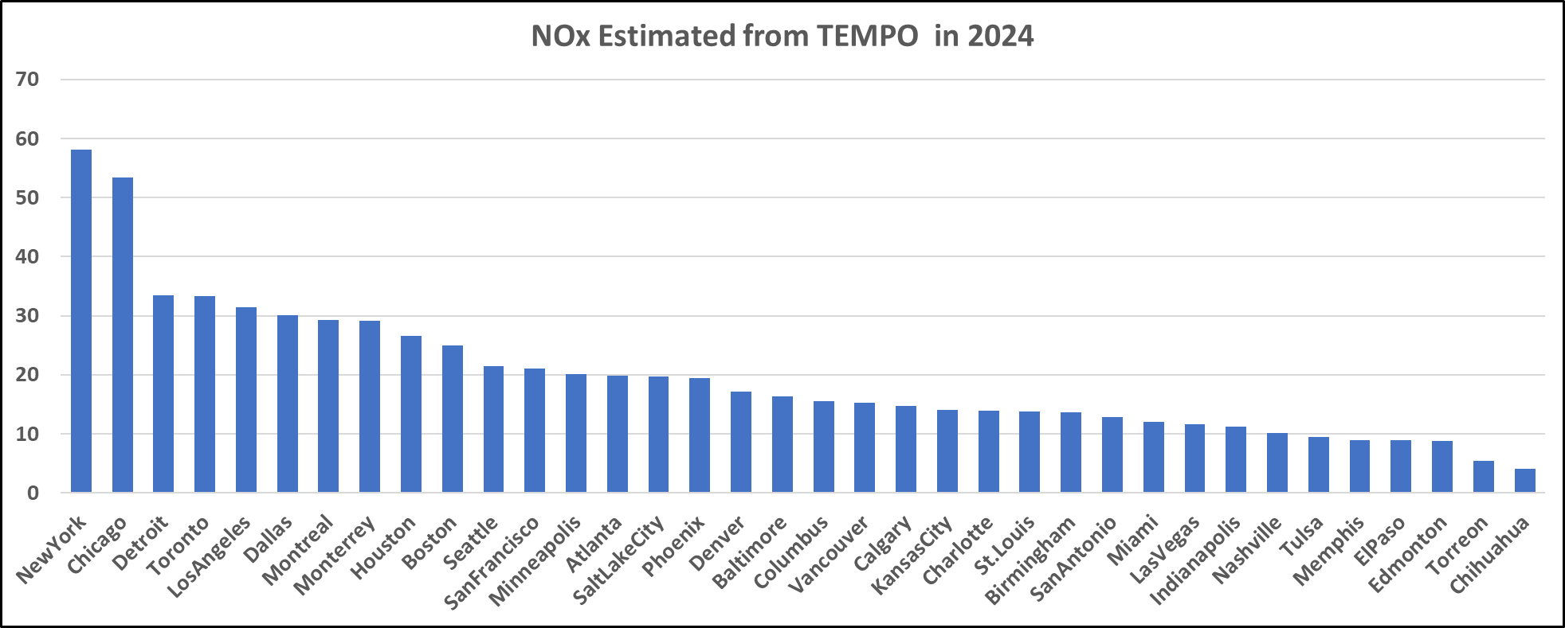
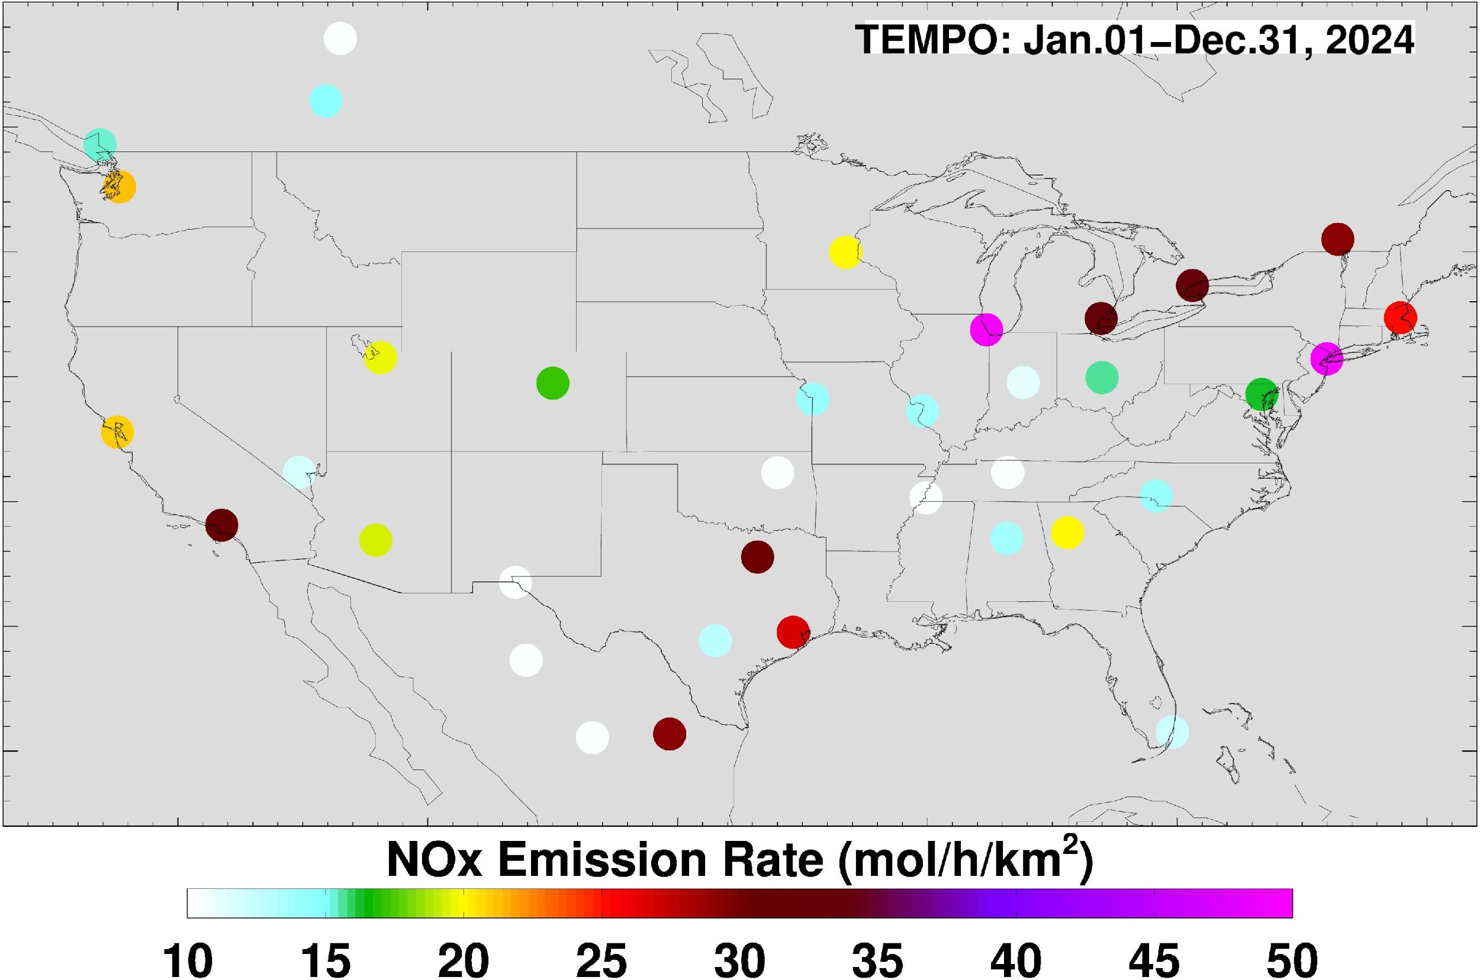
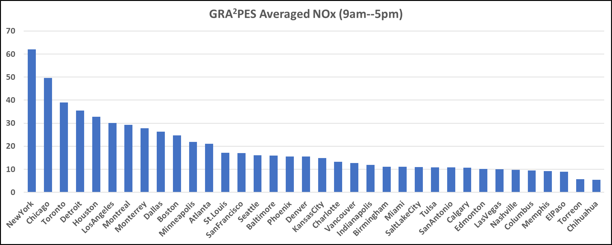
NOx emissions Across the US

Slide 7
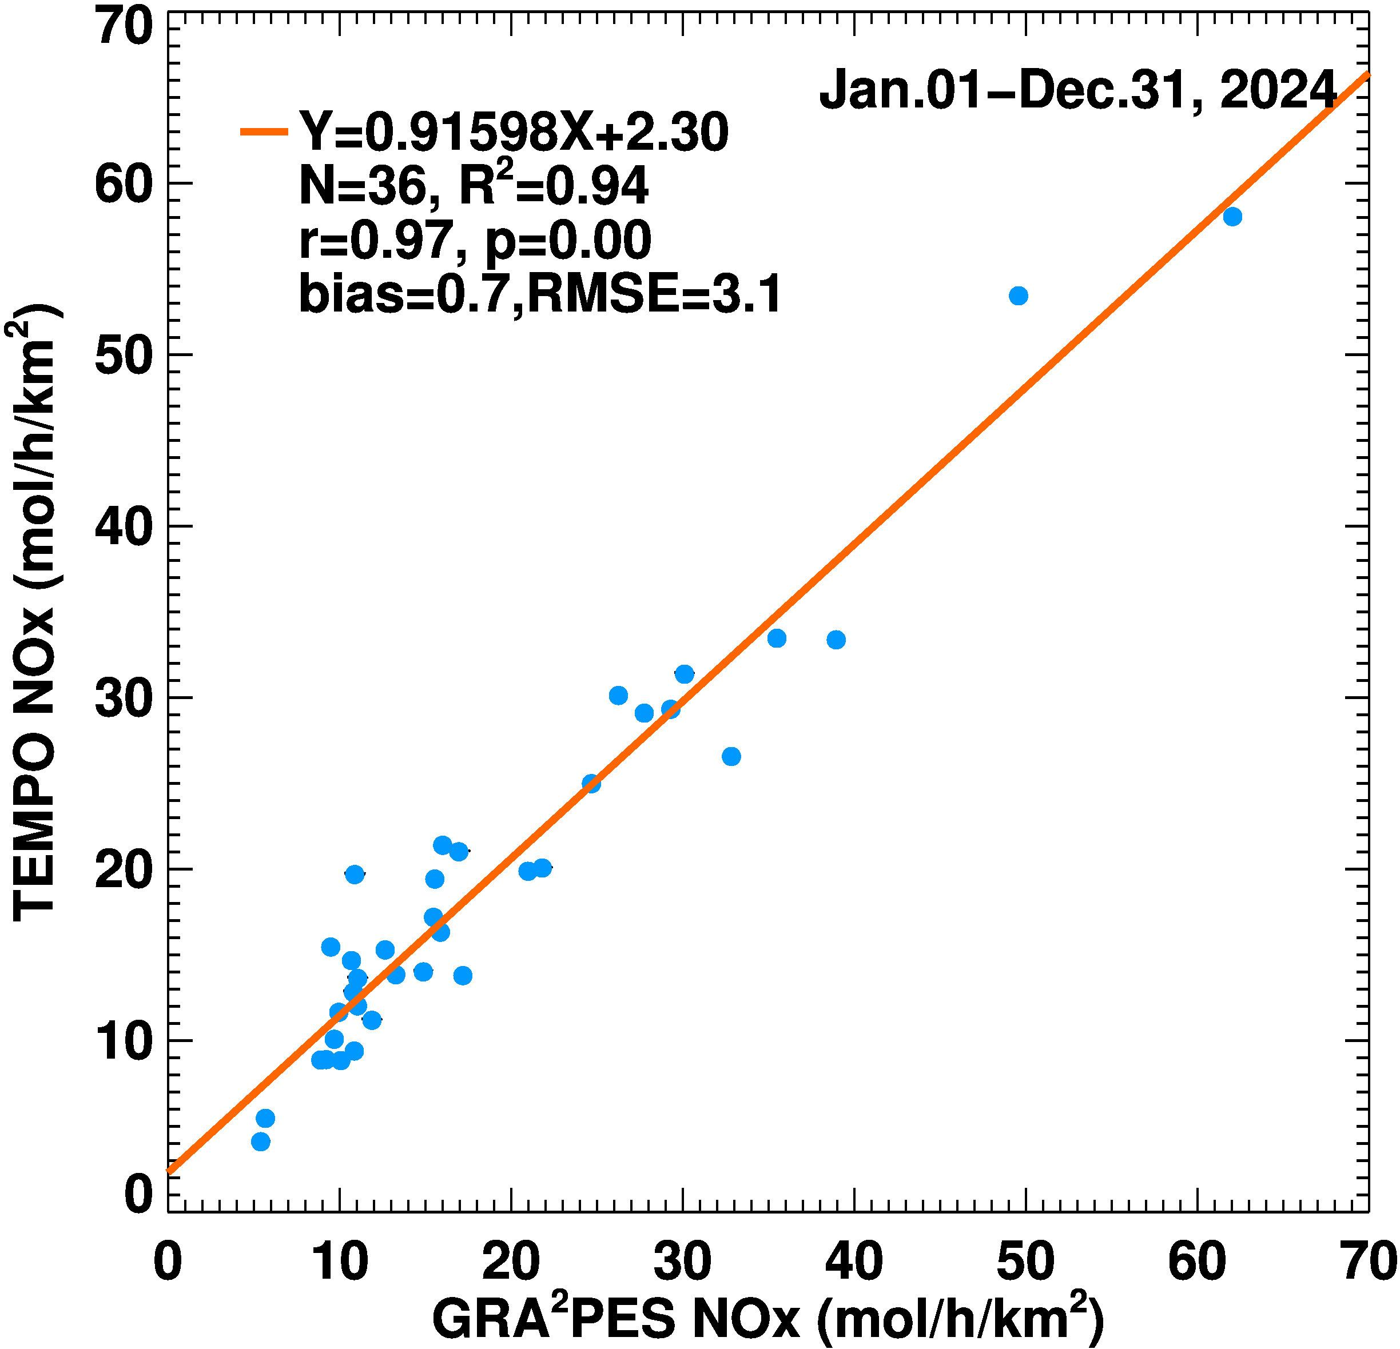
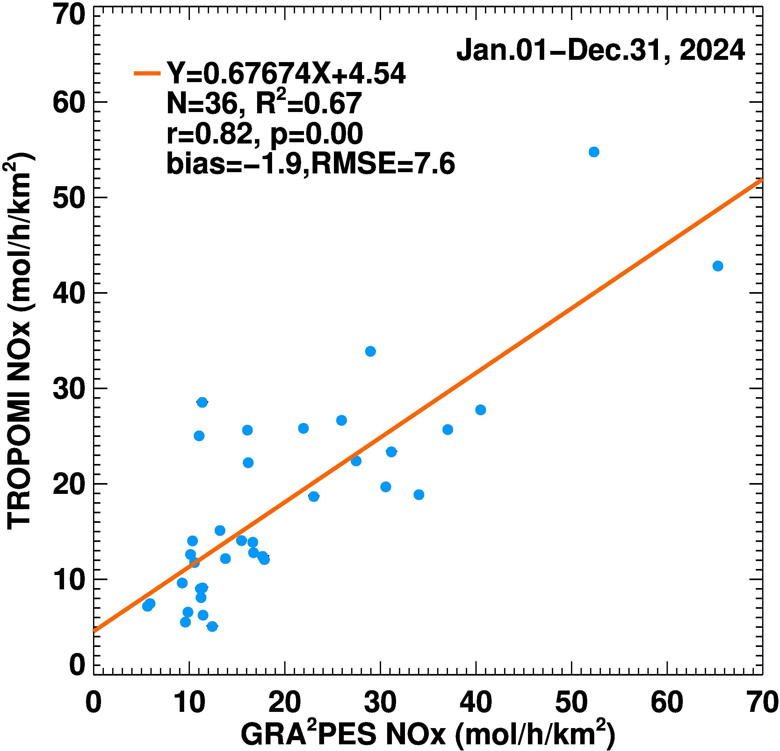
TEMPO/TROPOMI vs. GRA²PES
TEMPO vs averaged GRA²PES (2021) in local solar time 9 AM - 5 PM
TROPOMI vs averaged GRA²PES (2021) local solar time 1 PM - 2 PM

Slide 8
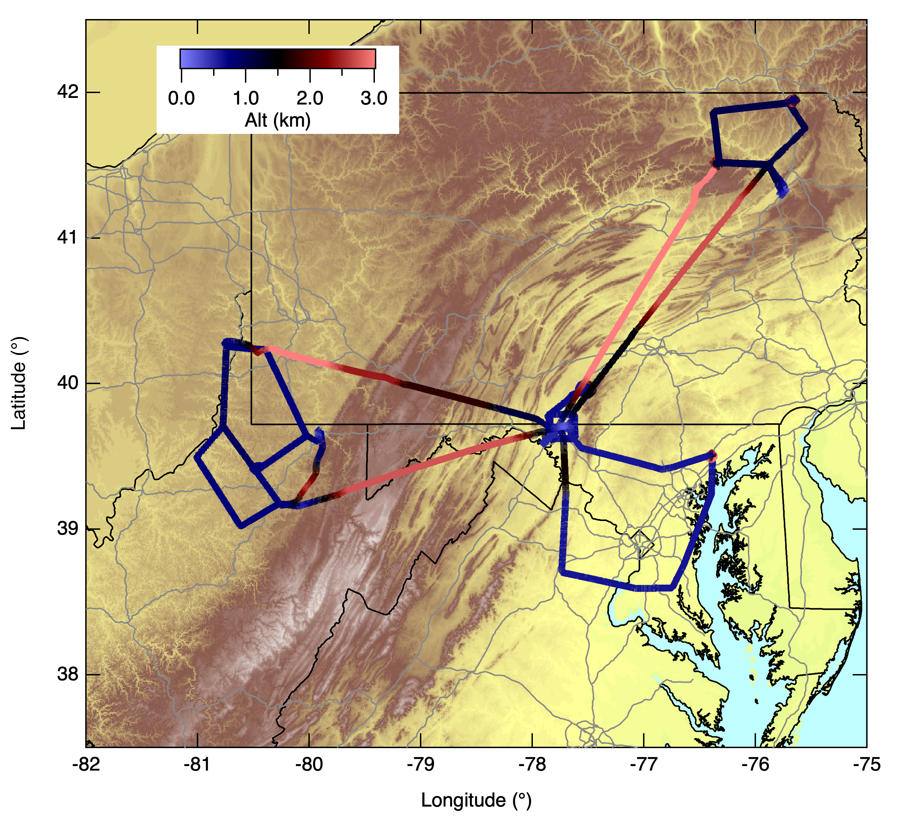
Conclusions
Spot check verification of GRA²PES with TEMPO shows that the inventory is remarkably similar though it is based on 2021 and TEMPO data are based on 2023.
Why? Inventories on annual scale do not capture sudden short-term changes in emissions. Forecast models need those updates in real time to be accurate.
Goal is to update the inventory with TEMPO data in near real time so forecast models have updated information.
TEMPO Emissions have uncertainties associated with domain selection and wind data. Verification is needed.
Baltimore-Washington urban corridor was well sampled during the BAQMS campaign. Data will be used in verifying TEMPO NOx emissions

