Slide 1



Composition Modeling
and DA at NOAA/NWS
Cory R Martin, PhD
Physical Scientist, NWS/NCEP/Environmental Modeling Center
National Weather Service

Slide 2
Current and Planned Operational Systems
GCAFS: Global Chemistry and Aerosol Forecast System
  5 day forecasts of aerosols twice daily
  introducing aerosol optical depth data assimilation
    VIIRS AOD retrievals in version 1
  V1 planned to go operational in first half of 2026
    Replaces GEFS-Aerosol member
AQM: Air Quality Model
  72 hour forecasts of ozone and PM2.5 twice daily
  work underway for assimilation of trace gas and AOD retrievals and in situ observations

Slide 3
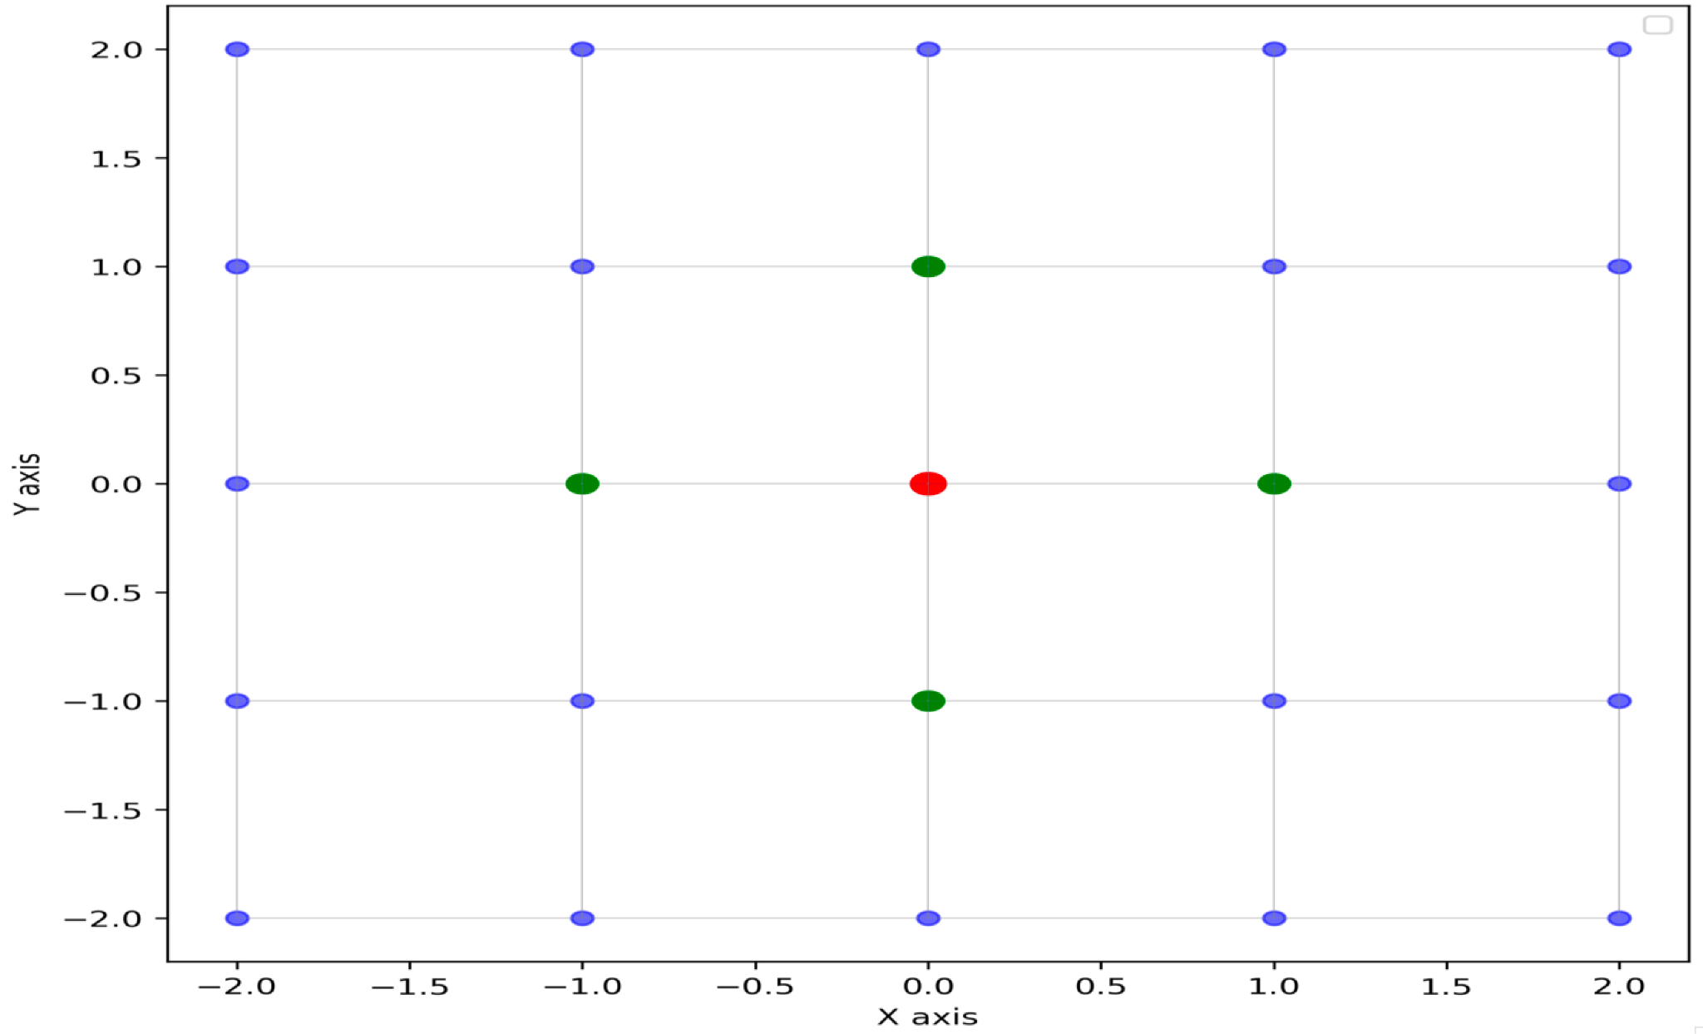
GCAFS - Background Error Tuning
For 3DVar, the background error covariance (B) matrix is essential to the quality of the analysis, thus a lot of time is spent on developing and tuning the B matrix.
As we cannot run an ensemble of forecasts to provide the flow dependent component due to computational cost, we use a “variance partitioning” method to estimate this:
Neighboring gridpoints are used to compute the variance around each gridpoint as a proxy for uncertainty at that gridpoint

Slide 4
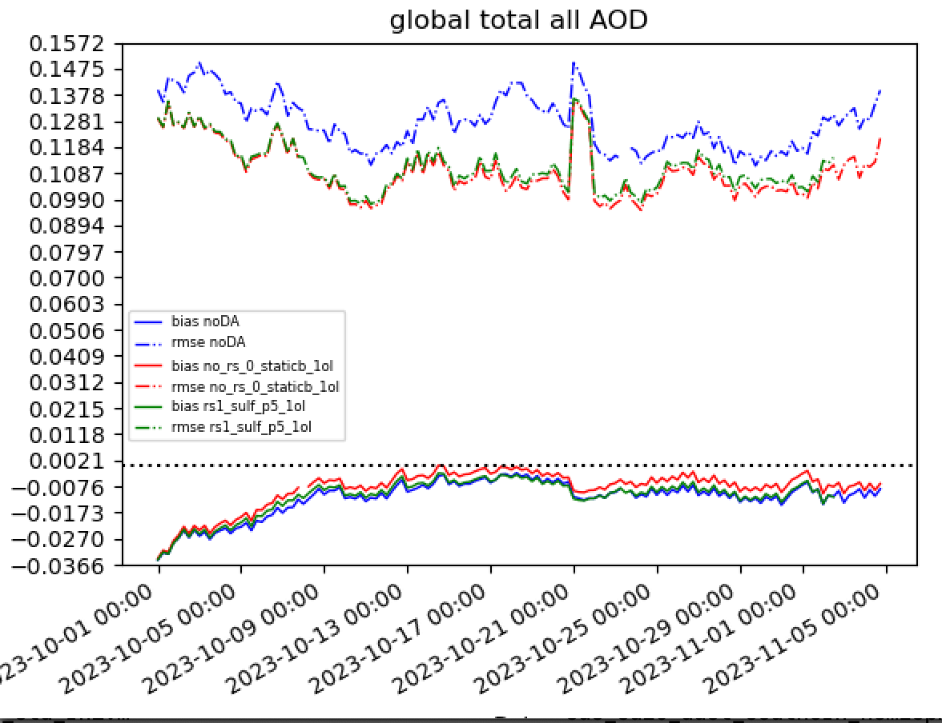
GCAFS - Background Error Tuning
Global total AOD differences with CAMS reanalyses, bias (solid) and rmse (dash-dot)
noDA (blue)
DA with unrescaled background uncertainty (red)
DA with decreased SULF rescaling (green)

Slide 5
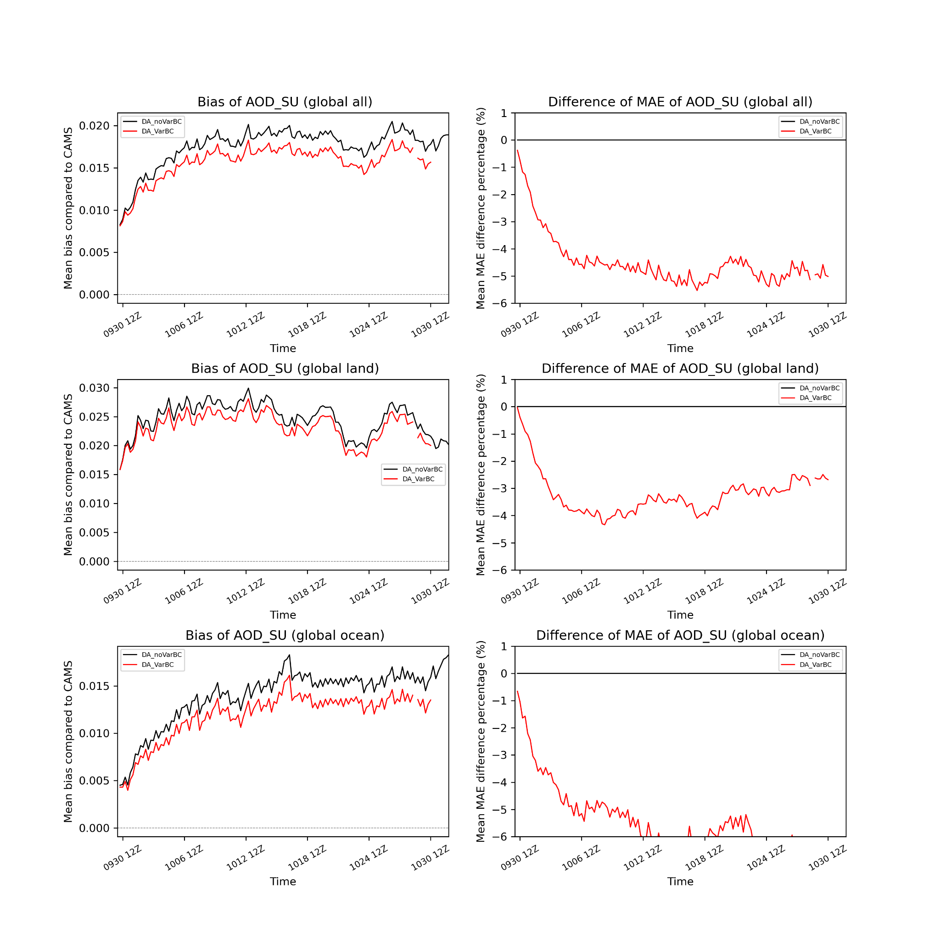
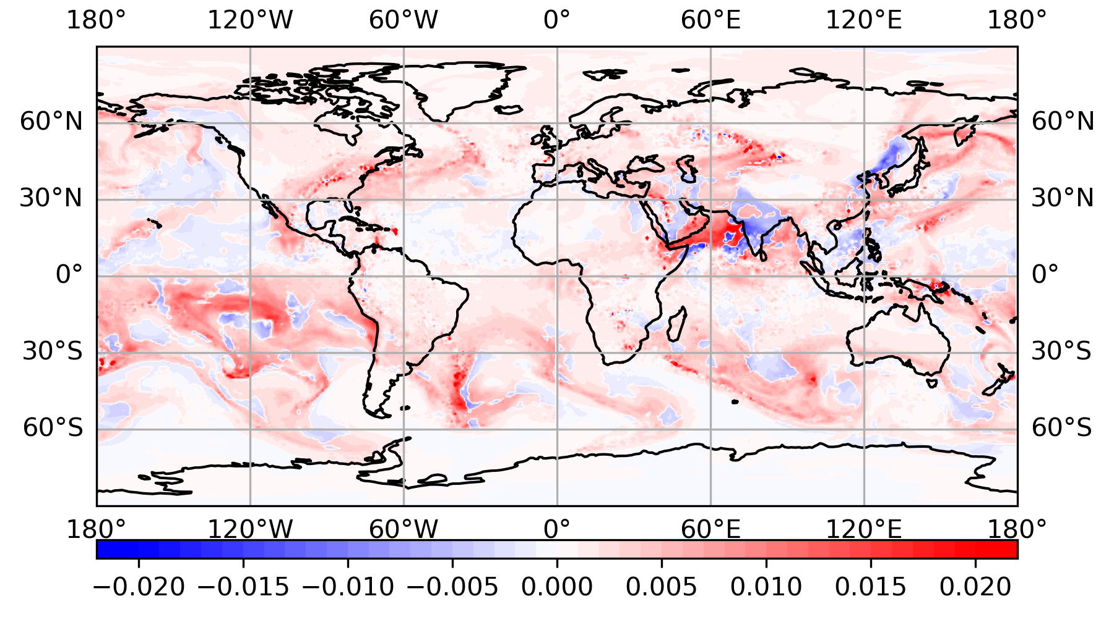
GCAFS - Variational Bias Correction
Variational bias correction is applied to VIIRS NPP AOD using predictors of wind speed and constant.
Abs. error of Sulfate AOD between noVarBC and VarBC
Red: VarBC is better; Blue: VarBC is worse
Mean abs. Error of sulfate AOD is 5% lower with VarBC.

Slide 6
Future AQM Development
The current AQM does not contain any constraint from observations beyond fire emissions (nor does the GEFS-Aerosol member).
Planned upcoming upgrades include:
Increase in horizontal resolution
Update to newest chemical mechanisms
Emissions updates
Inclusion of data assimilation
  in situ PM2.5
  AOD, trace gas retrievals from both LEO and GEO

Slide 7
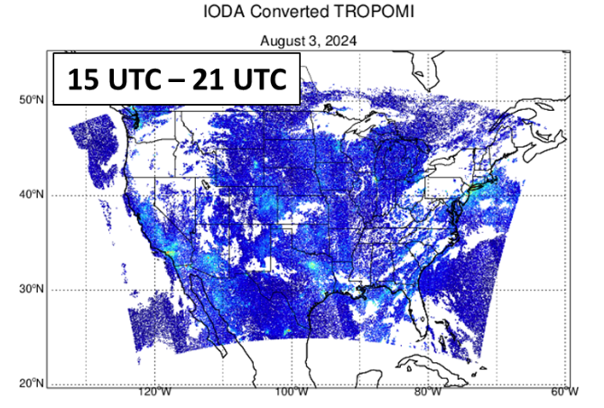
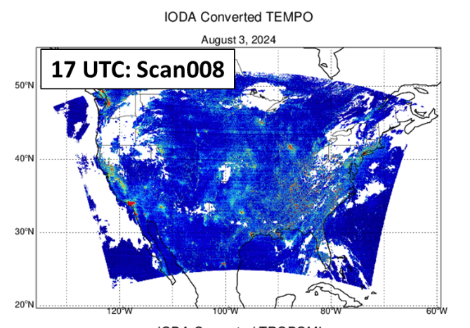
AQM - Trace Gas Assimilation
For regional models, polar orbiters have limited value; geostationary much more useful
Figs. courtesy Hyundeok Choi

Slide 8
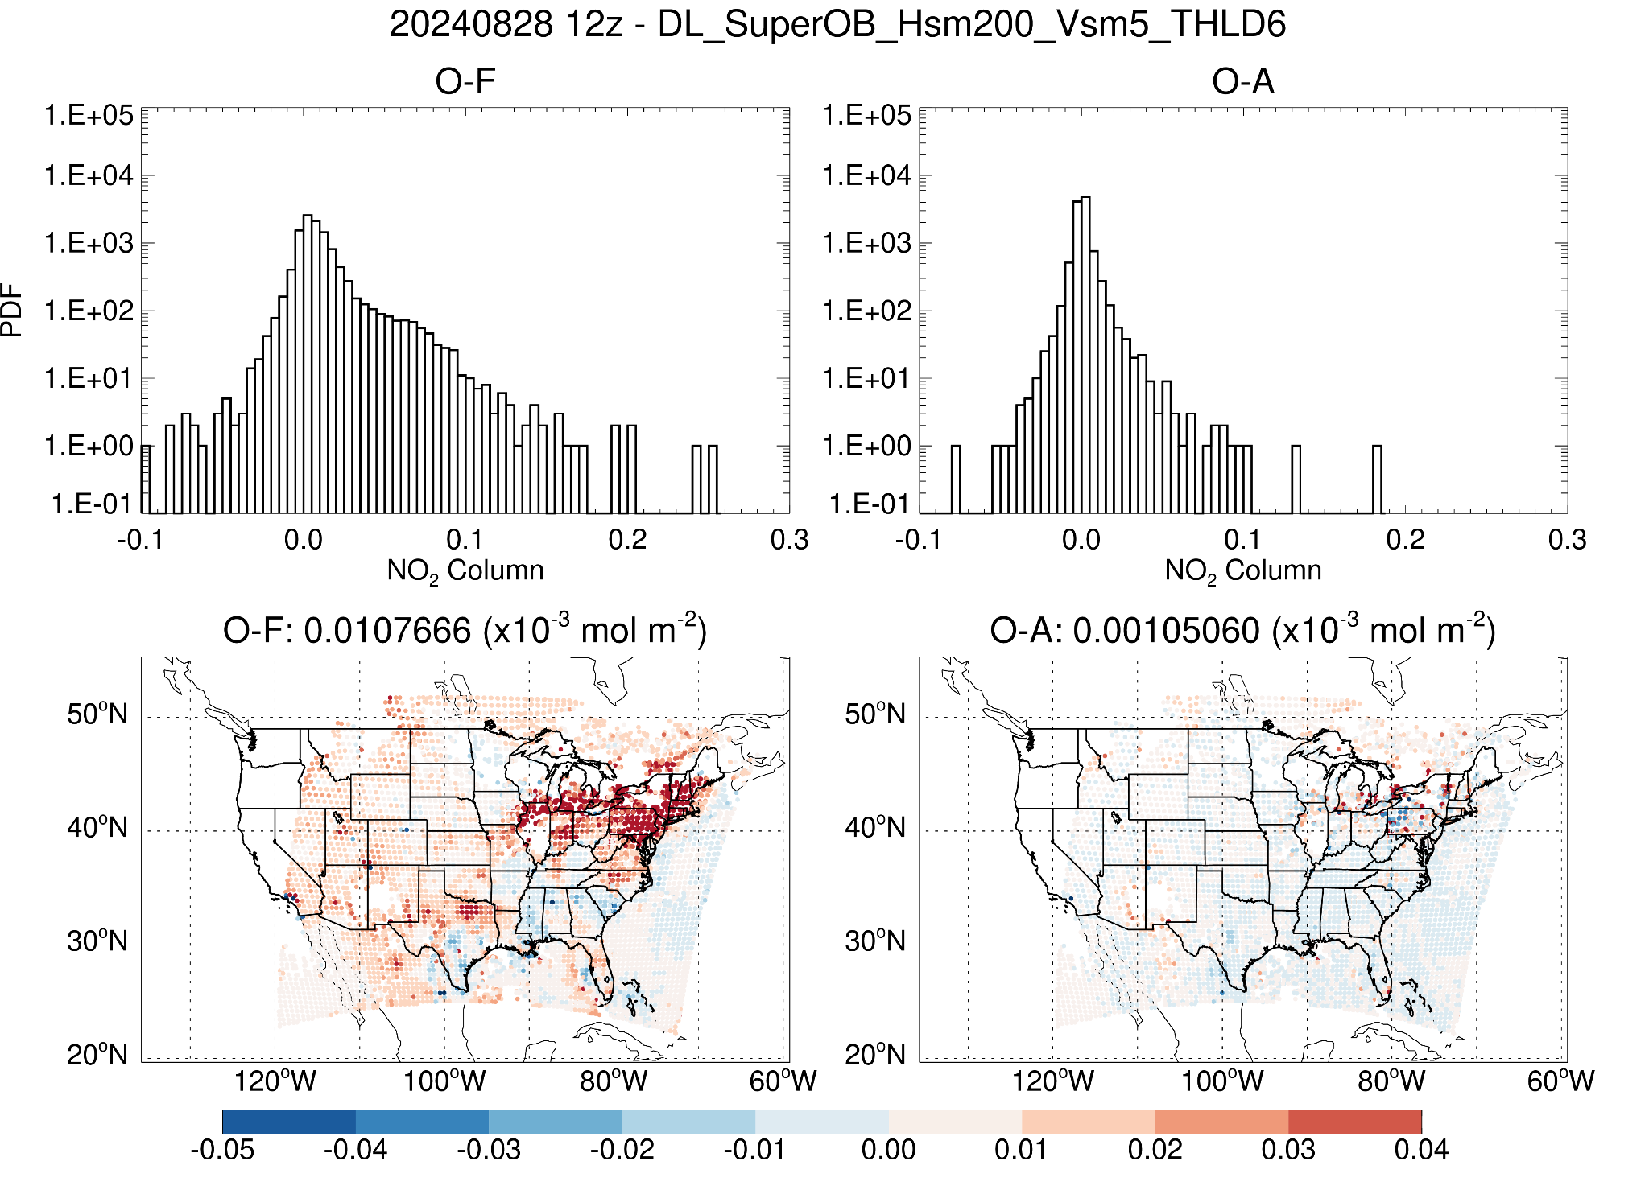
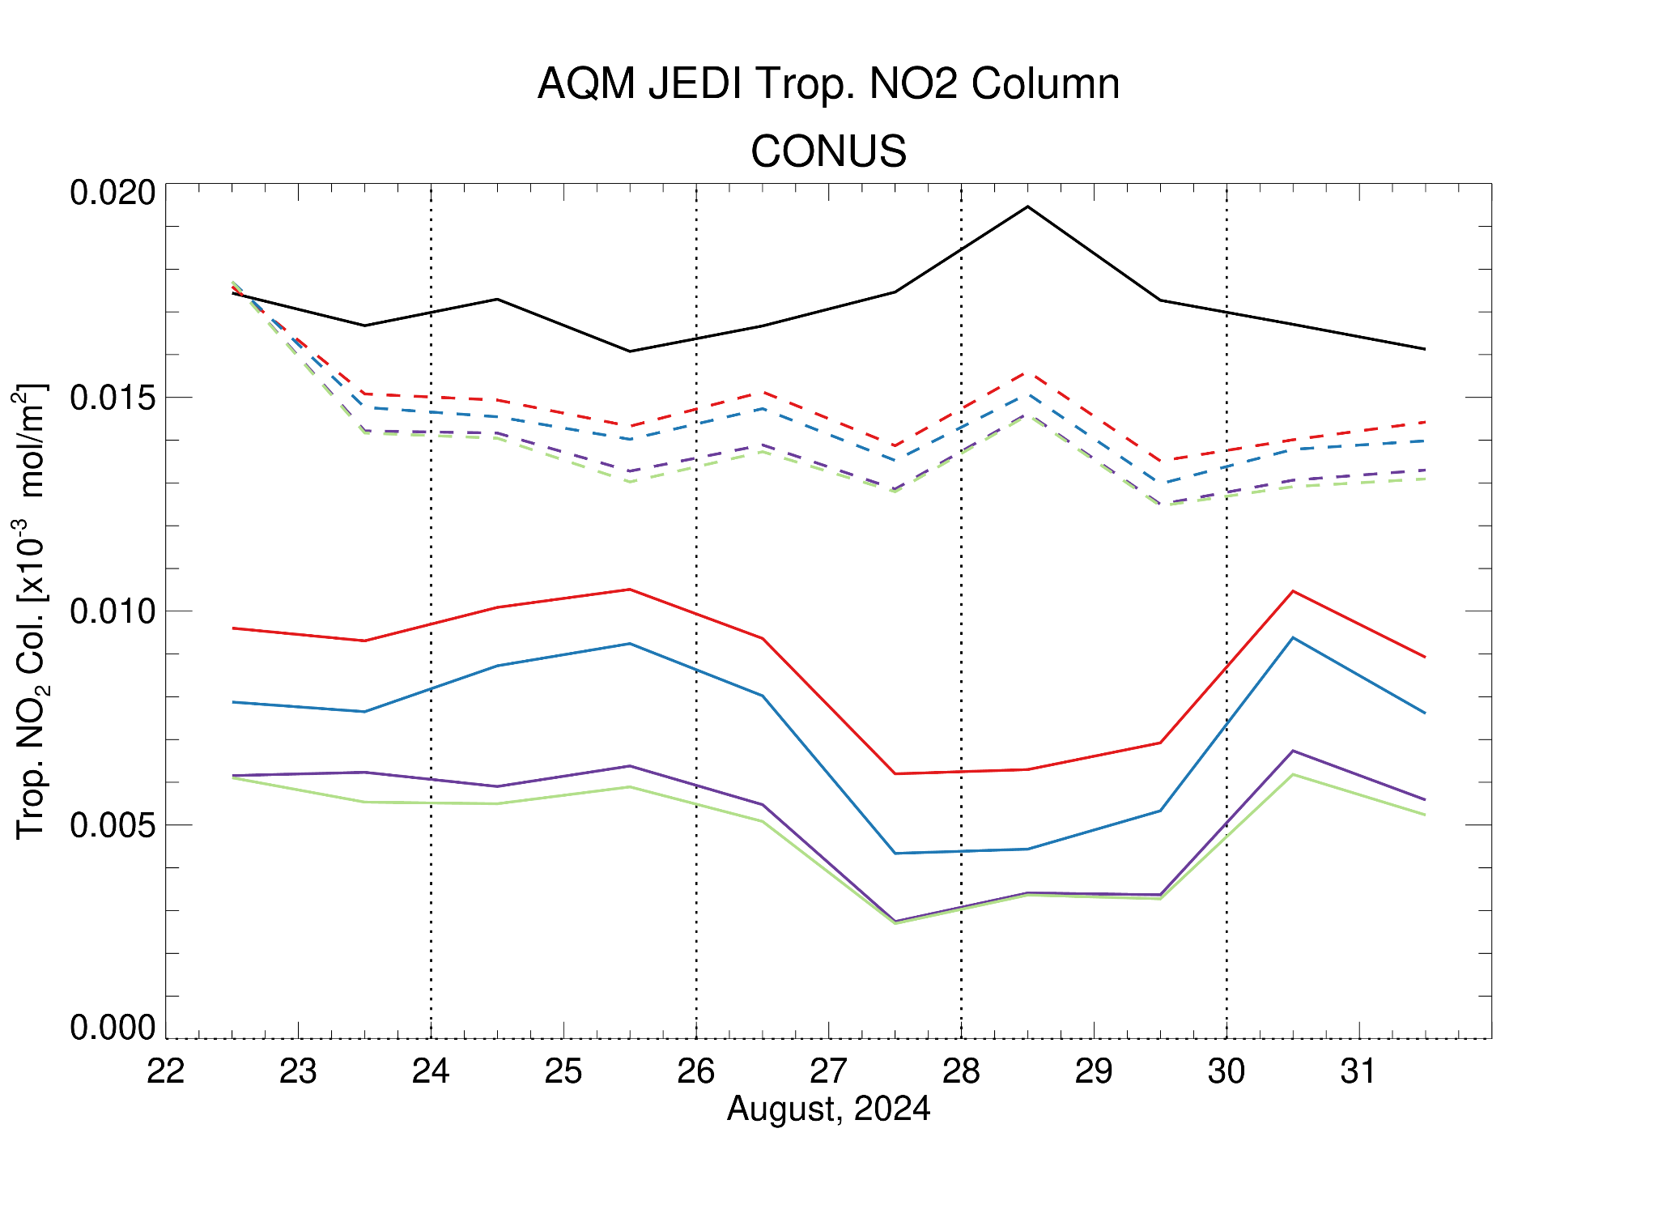
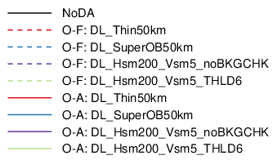
AQM - Trace Gas Assimilation
Tuning still underway but results are promising using TEMPO for short-term forecast improvement
Figs. courtesy Hyundeok Choi

Slide 9
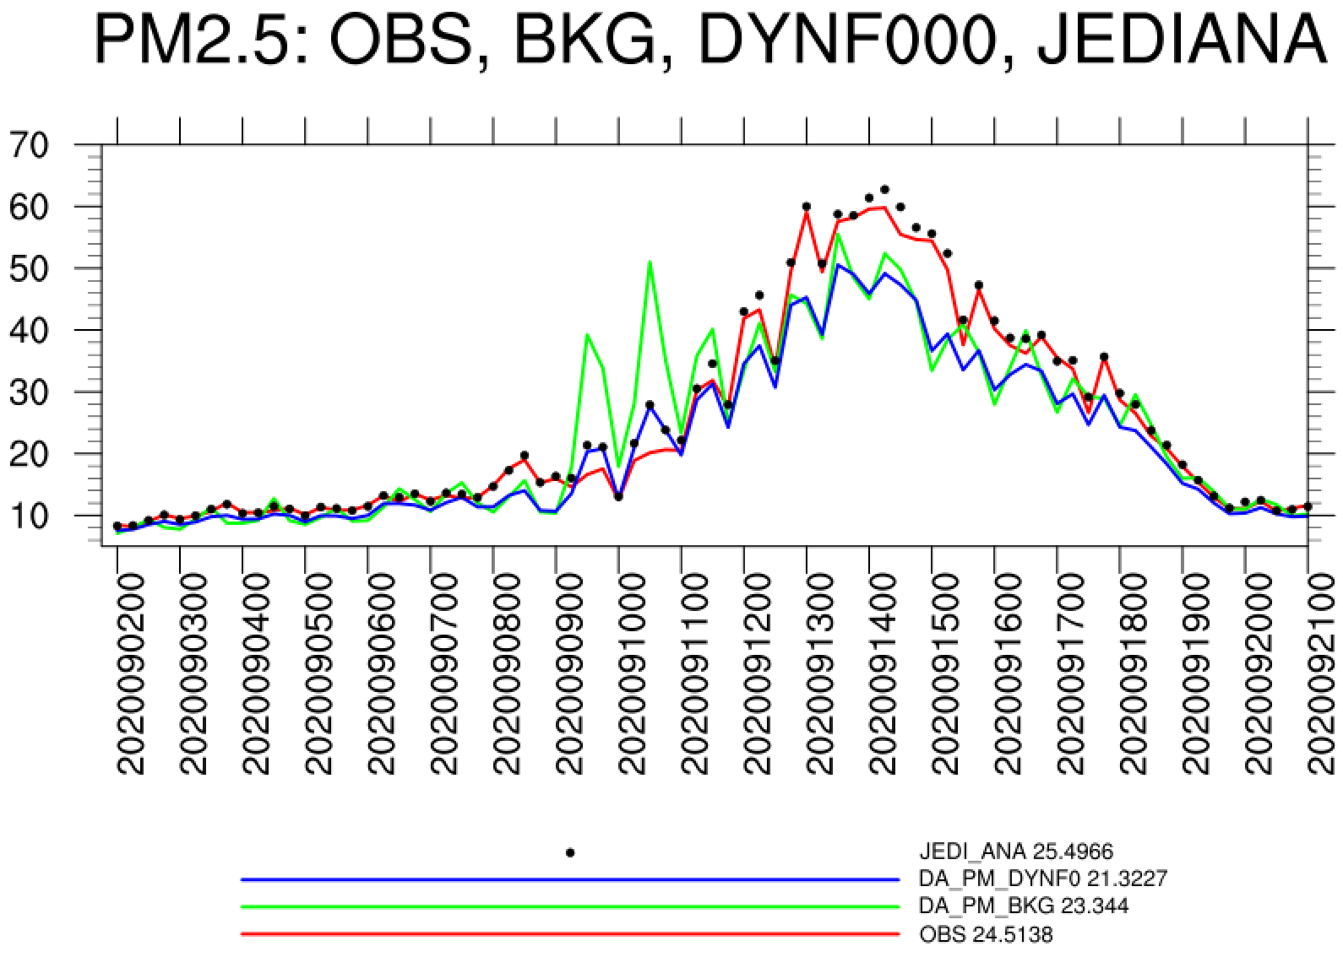
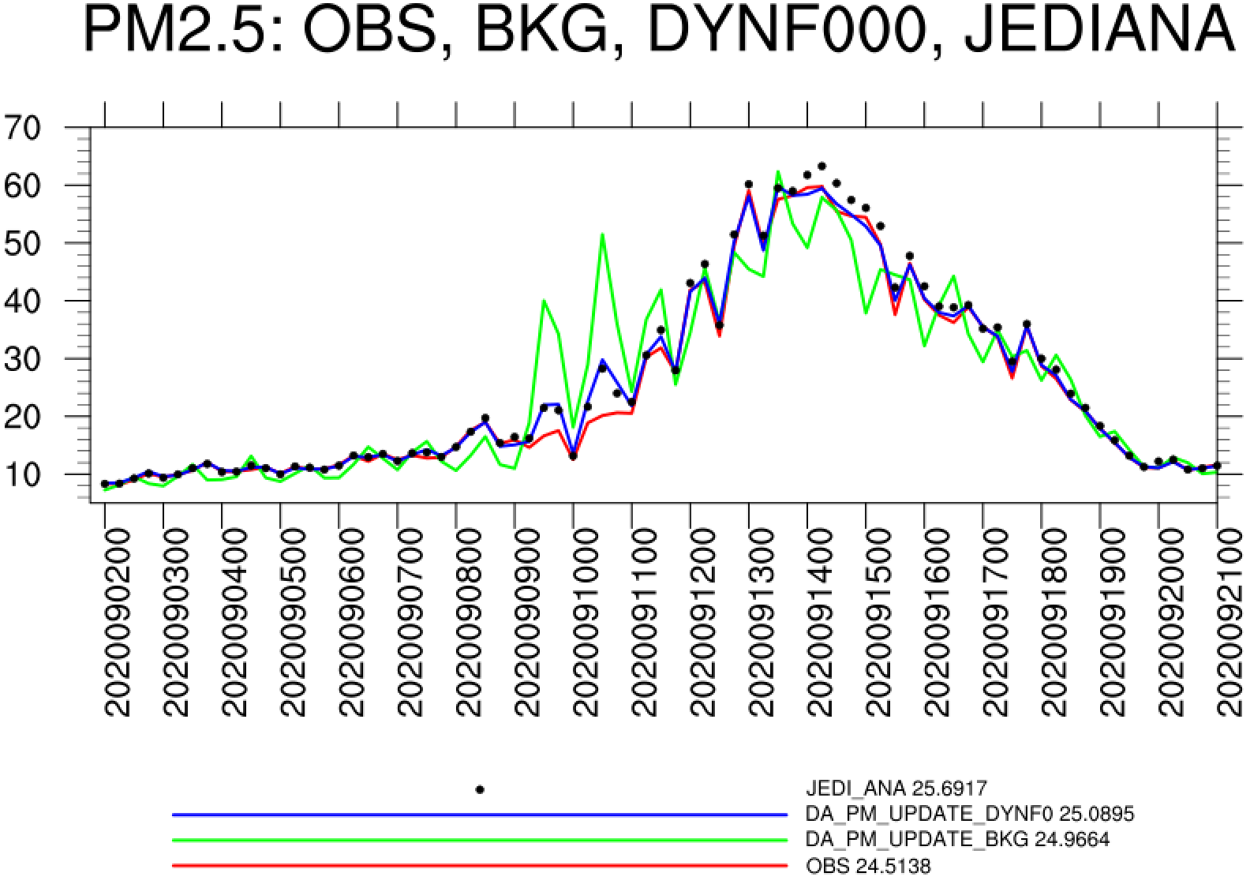
AQM - Surface PM2.5 Assimilation
JEDI analyzed PM is much close to AirNow obs.
When only mass concentrations were updated, most of assimilated signal lost after model initialization.
Updating all the prediction variables including total particle numbers and total surface areas concentrations helps to mitigate the issue.
EXP: DA_PM2.5_UM
JEDI analysis
0h FCST after model initialization
Background
OBS
EXP: DA_PM2.5
JEDI analysis
0h FCST after model initialization
Background
OBS
Figs. courtesy Hongli Wang

Slide 10
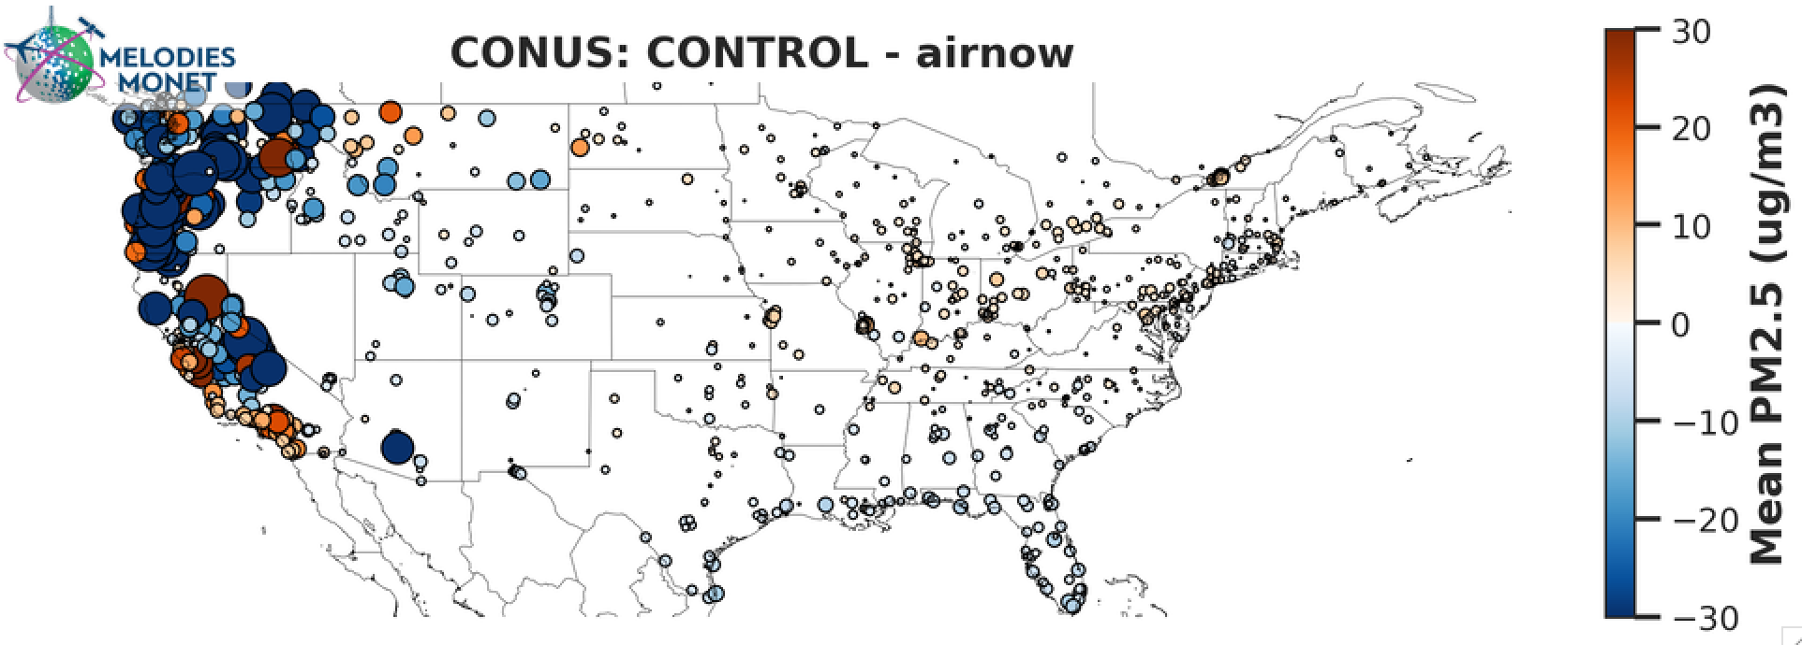
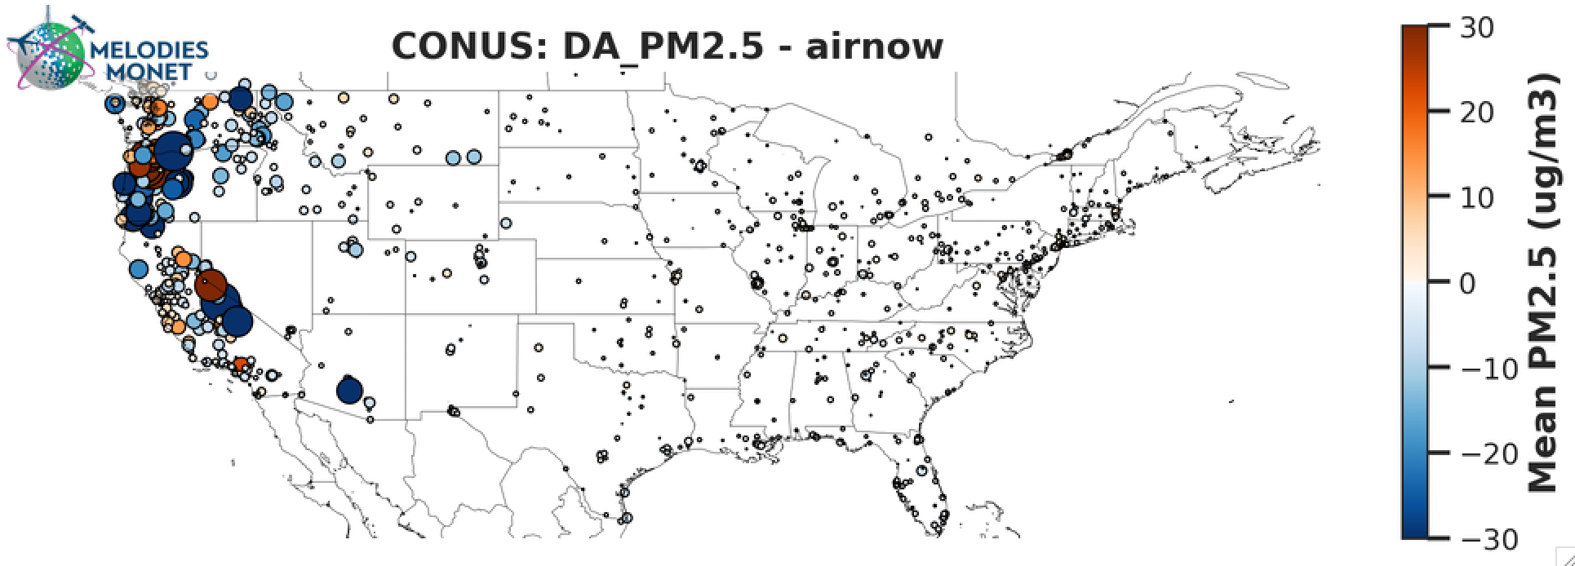
AQM - Surface PM2.5 Assimilation
1h forecast bias
NOAA GSL has made significant efforts in reducing surface PM2.5 bias and RMSE through assimilation of surface obs.
Work assimilating VIIRS AOD concurrently with surface obs is ongoing with limited success (not shown)
1h forecast bias
Figs. courtesy Hongli Wang

Slide 11
Ongoing and Future Work
Final tuning, configuration, and validation of initial GCAFS system underway
  Evaluation in second half of 2025; plan to transition to operations in early 2026
Increase readiness level of AQM DA
  Combine trace gas and aerosol/PM into one cycling system
  Refine background error and QC decision
  Explore VarBC (more difficult with a regional model)
Looking ahead with GCAFS:
  Short term: more obs assimilated, higher resolution
  Longer term: more complex chemistry, nests, possibly include/replace AQM

Slide 12

Questions?
email: cory.r.martin@noaa.gov
Acknowledgements:
Barry Baker, Hyundeok Choi, Ruifang Li, Li Pan, Andy Tangborn, Hongli Wang, Kai Wang, Yaping Wang, Fanglin Yang, and others…

