Slide 1
Capability demonstration of a JEDI-based system for TEMPO assimilation
Maryam Abdi-Oskouei^{1,2}, Jérôme Barré^{1,2}
Shih-Wei Wei, Sarah Lu, Ashley Griffin, Clementine Hardy Gas, Francois Hebert, Stephen Herbener, Eric Lingerfelt, Evan Parker, Christian Sampson, Steve Vahl, Fabio Diniz, Ben Johnson, Cheng Dang, Benjamin Ruston, Yannick Tremolet,
Viral Shah, Emma Knowland, Ricardo Todling, Ronald Gelaro,
Caroline Nowlan, Gonzalo Gonzalez Abad, Xiong Lu, Brian McDonald, Laura Judd,
Luke Valin, Thomas Hanisco, Benjamin Menetrier, Daniel Holdaway, Cory Martin, Anna Shlyaeva, Dom Heinzeller, Steven Pawson, Thomas Auligne
¹ JCSDA/UCAR
² Now at GMAO
TEMPO/GeoXO ACX Joint Science Team Workshop
August 2025

Slide 2
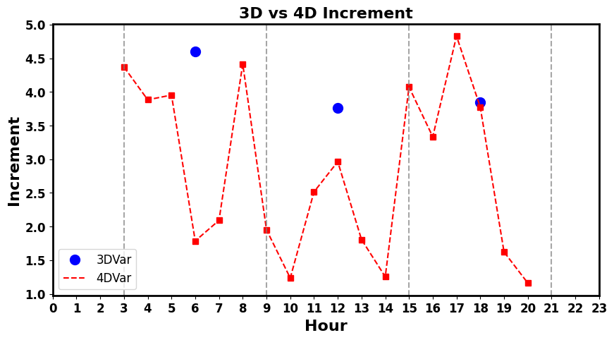
Harnessing the full potential of TEMPO hourly data with JEDI and 4D assimilation
3D DA adjustments to the forecast once in each assimilation window (once every 6h)
3D vs 4D increment of NO₂
TEMPO
4D DA adjustments to the forecast at observation time (hourly) can better capture the diurnal variability of air pollutants
JEDI is a generic data assimilation frameworks that supports 4D methodology for atmospheric composition

Slide 3
Experiment setup: EDA 4DEnVar using JEDI/GEOS-CF
August 2023 mean
TROPOMI
NASA’s GEOS-CF model interfaced with JEDI
EDA 4DEnVar with 32 members for Aug 2023.
  Deterministic C360 (0.25º) resolution
  Ensemble C90 (1º) resolution
Assimilation observations:
  TEMPO tropospheric NO₂ (SZA < 70º, CF < 0.15)
  TROPOMI tropospheric NO₂ (qa > 0.75, -65º < lat < 65º)
Independent observations:
  Pandora total column NO₂
  AirNow surface NO₂ and O₃
  AEROMMA field campaign in-situ NO₂
  STAQTS field campaign, tropospheric NO₂
TEMPO

Slide 4
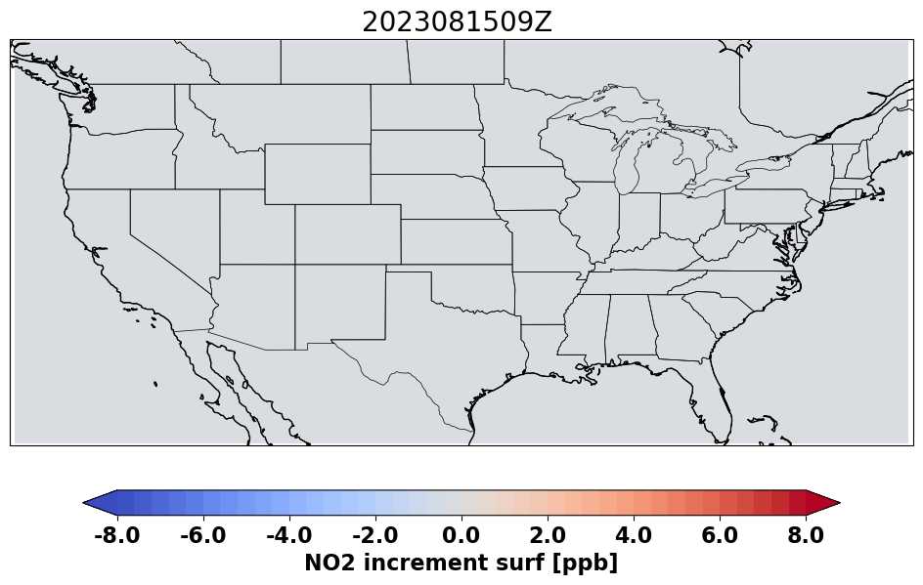
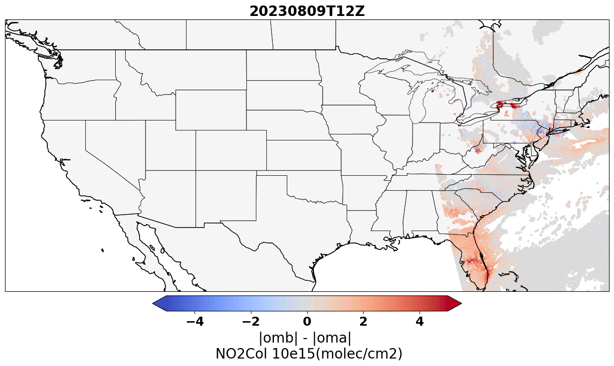
Temporal and Spatial variability of assimilation impact
Hourly NO₂ increment at surface
Analysis impact
Analysis impact (|omb|-|oma|)
NO2 [1e15 molec/cm2]

Slide 5
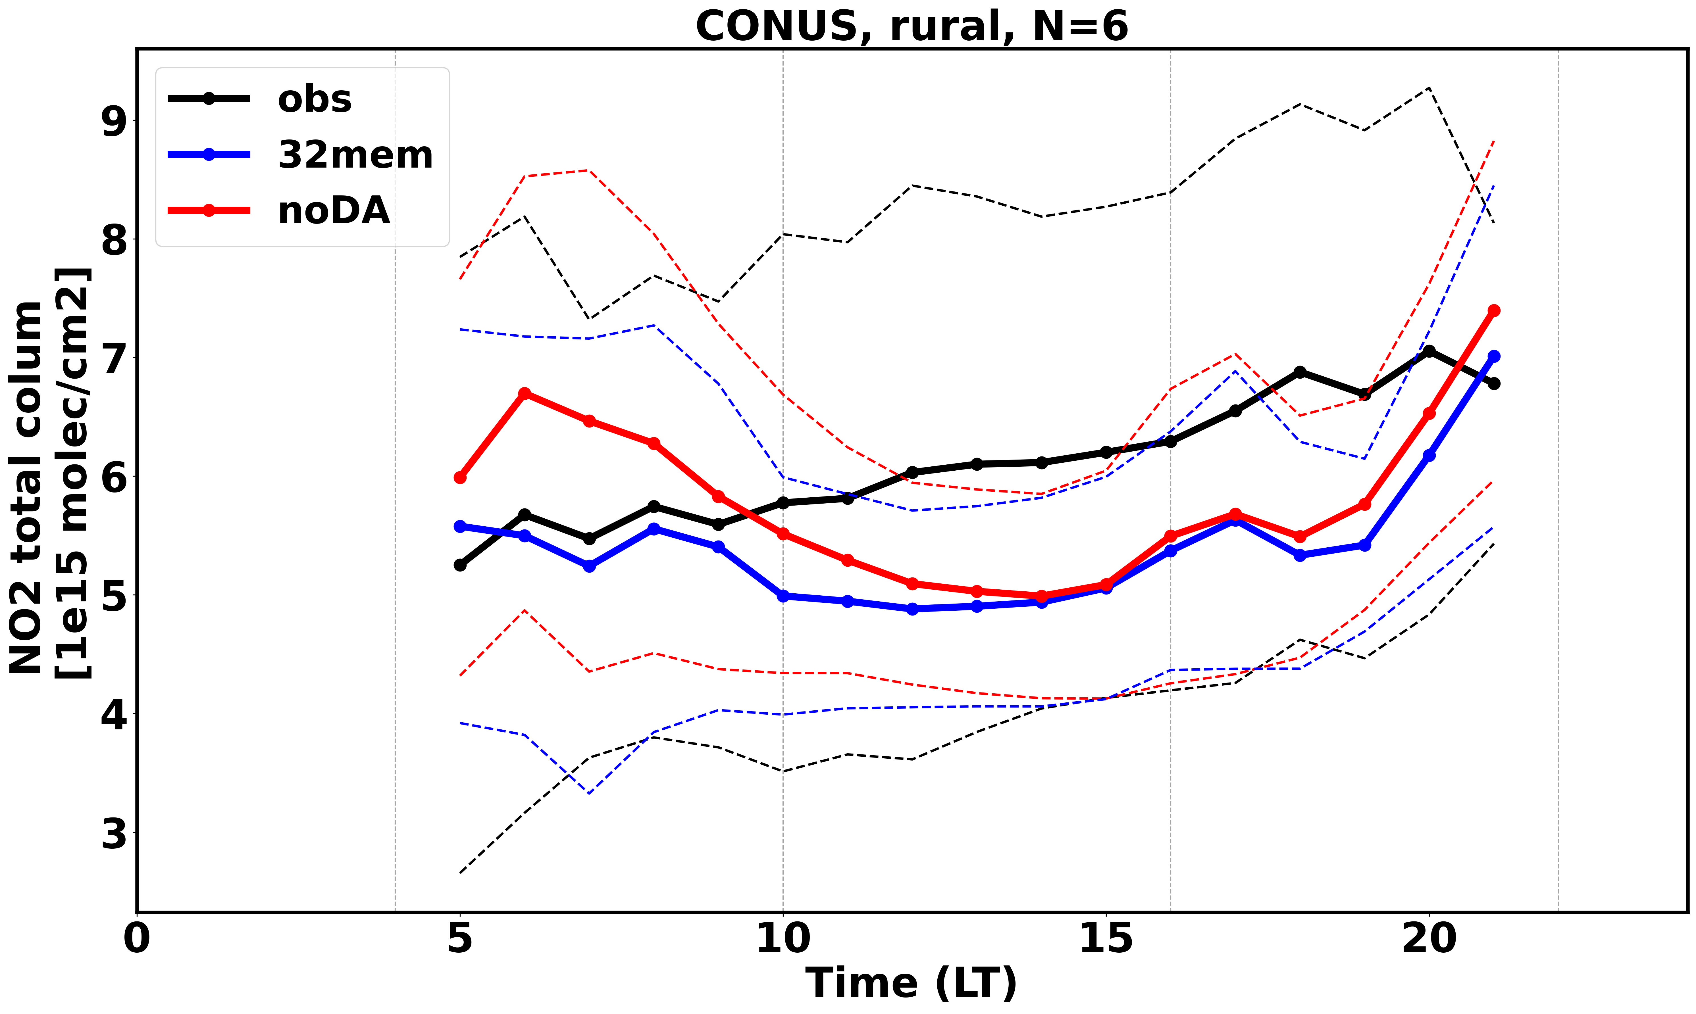
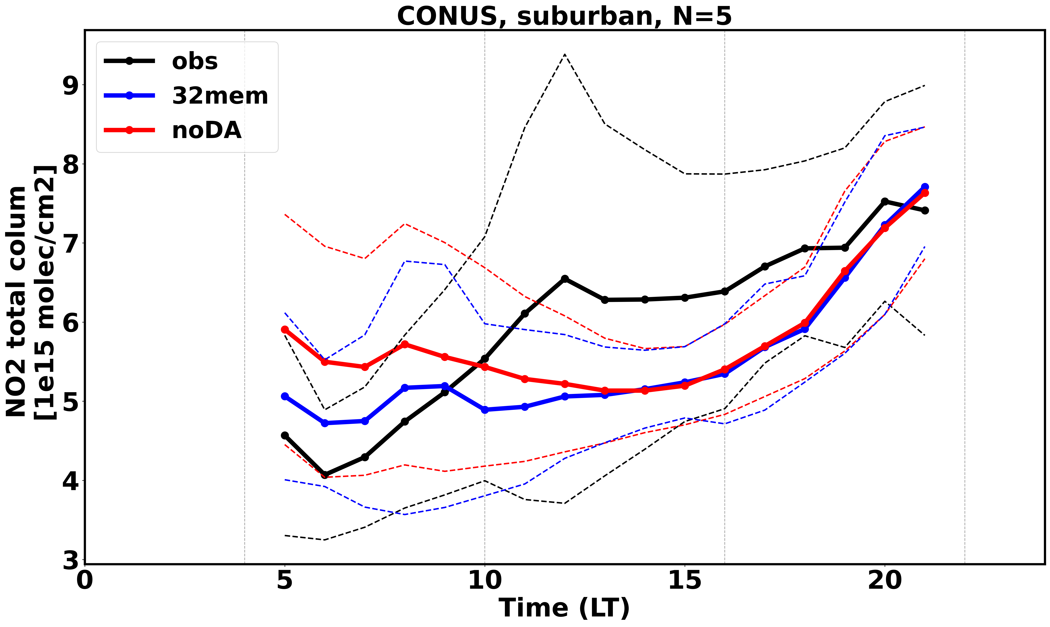
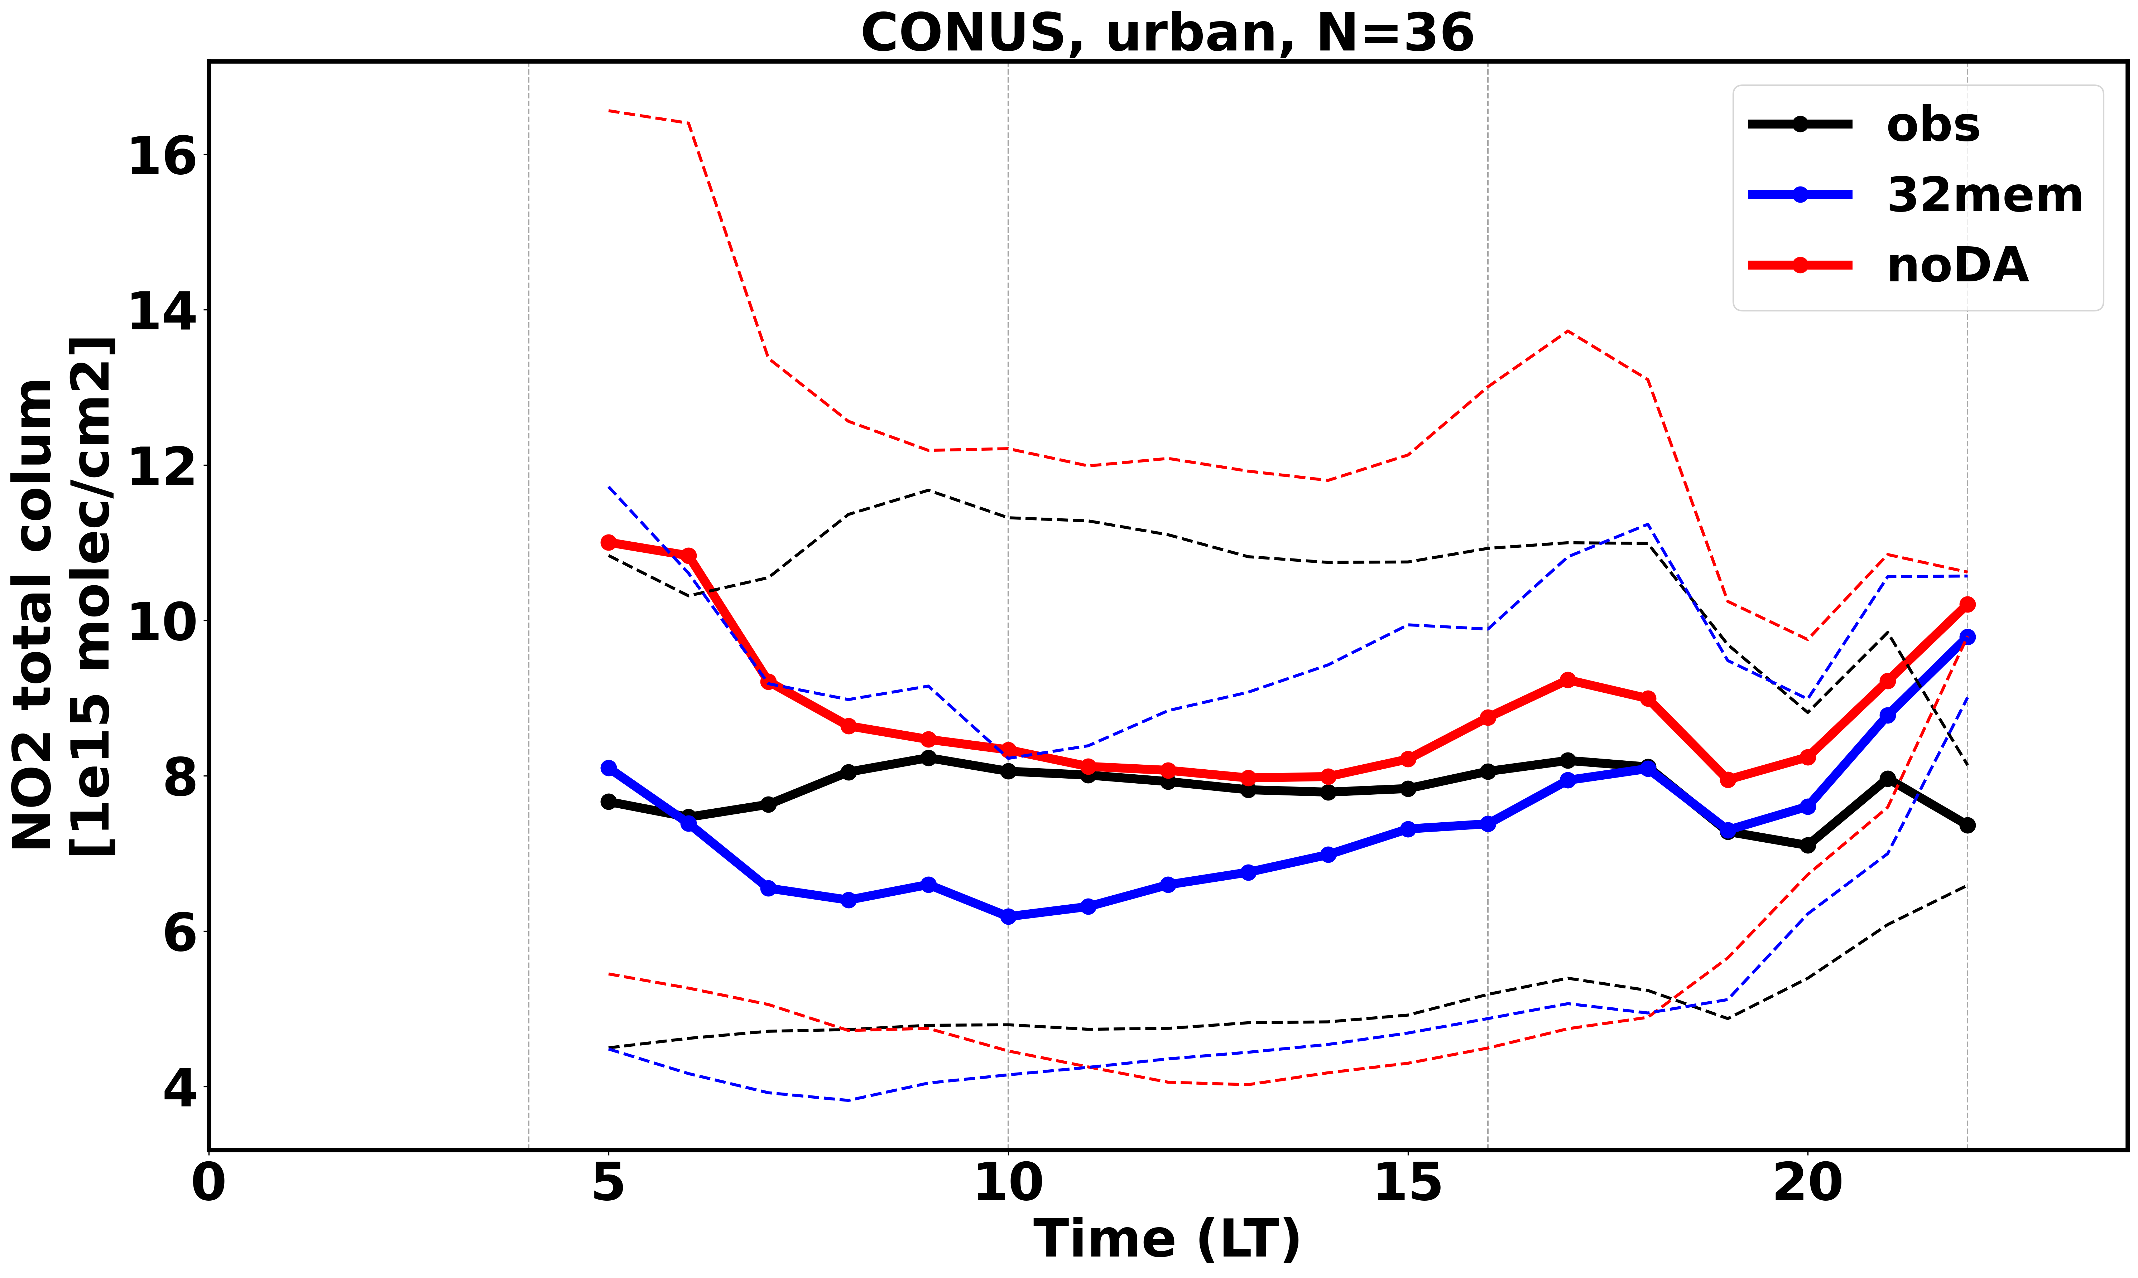
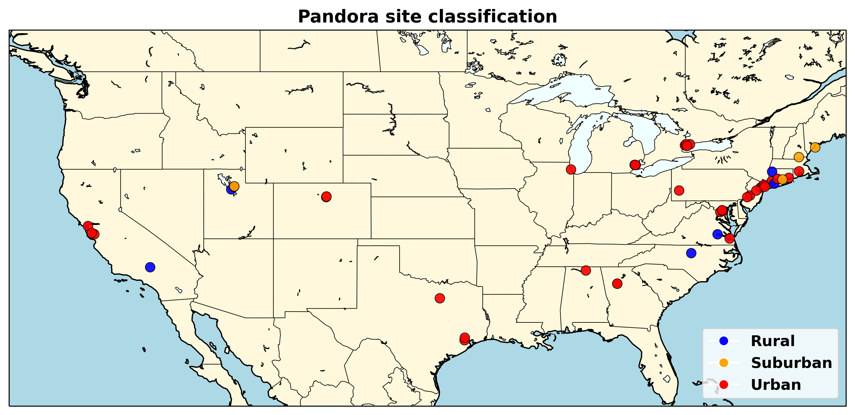

Comparison with independent observation (Pandora)
Aug 2023

Slide 6
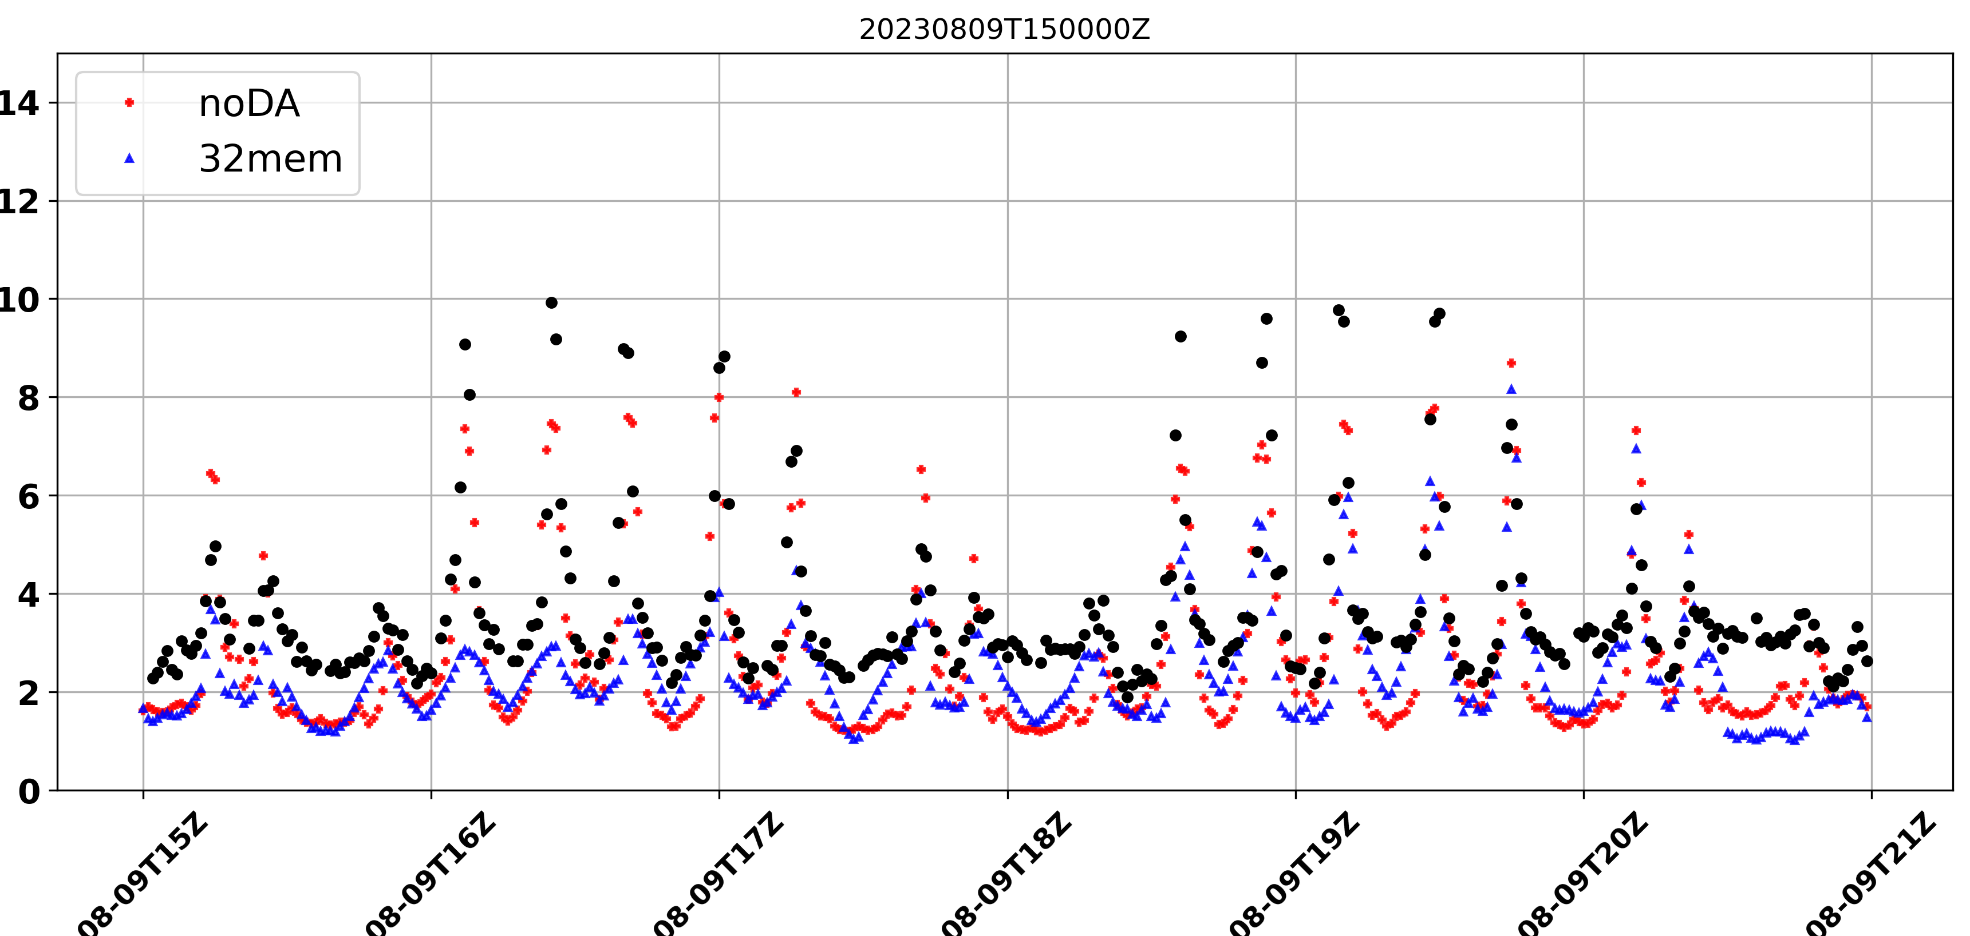
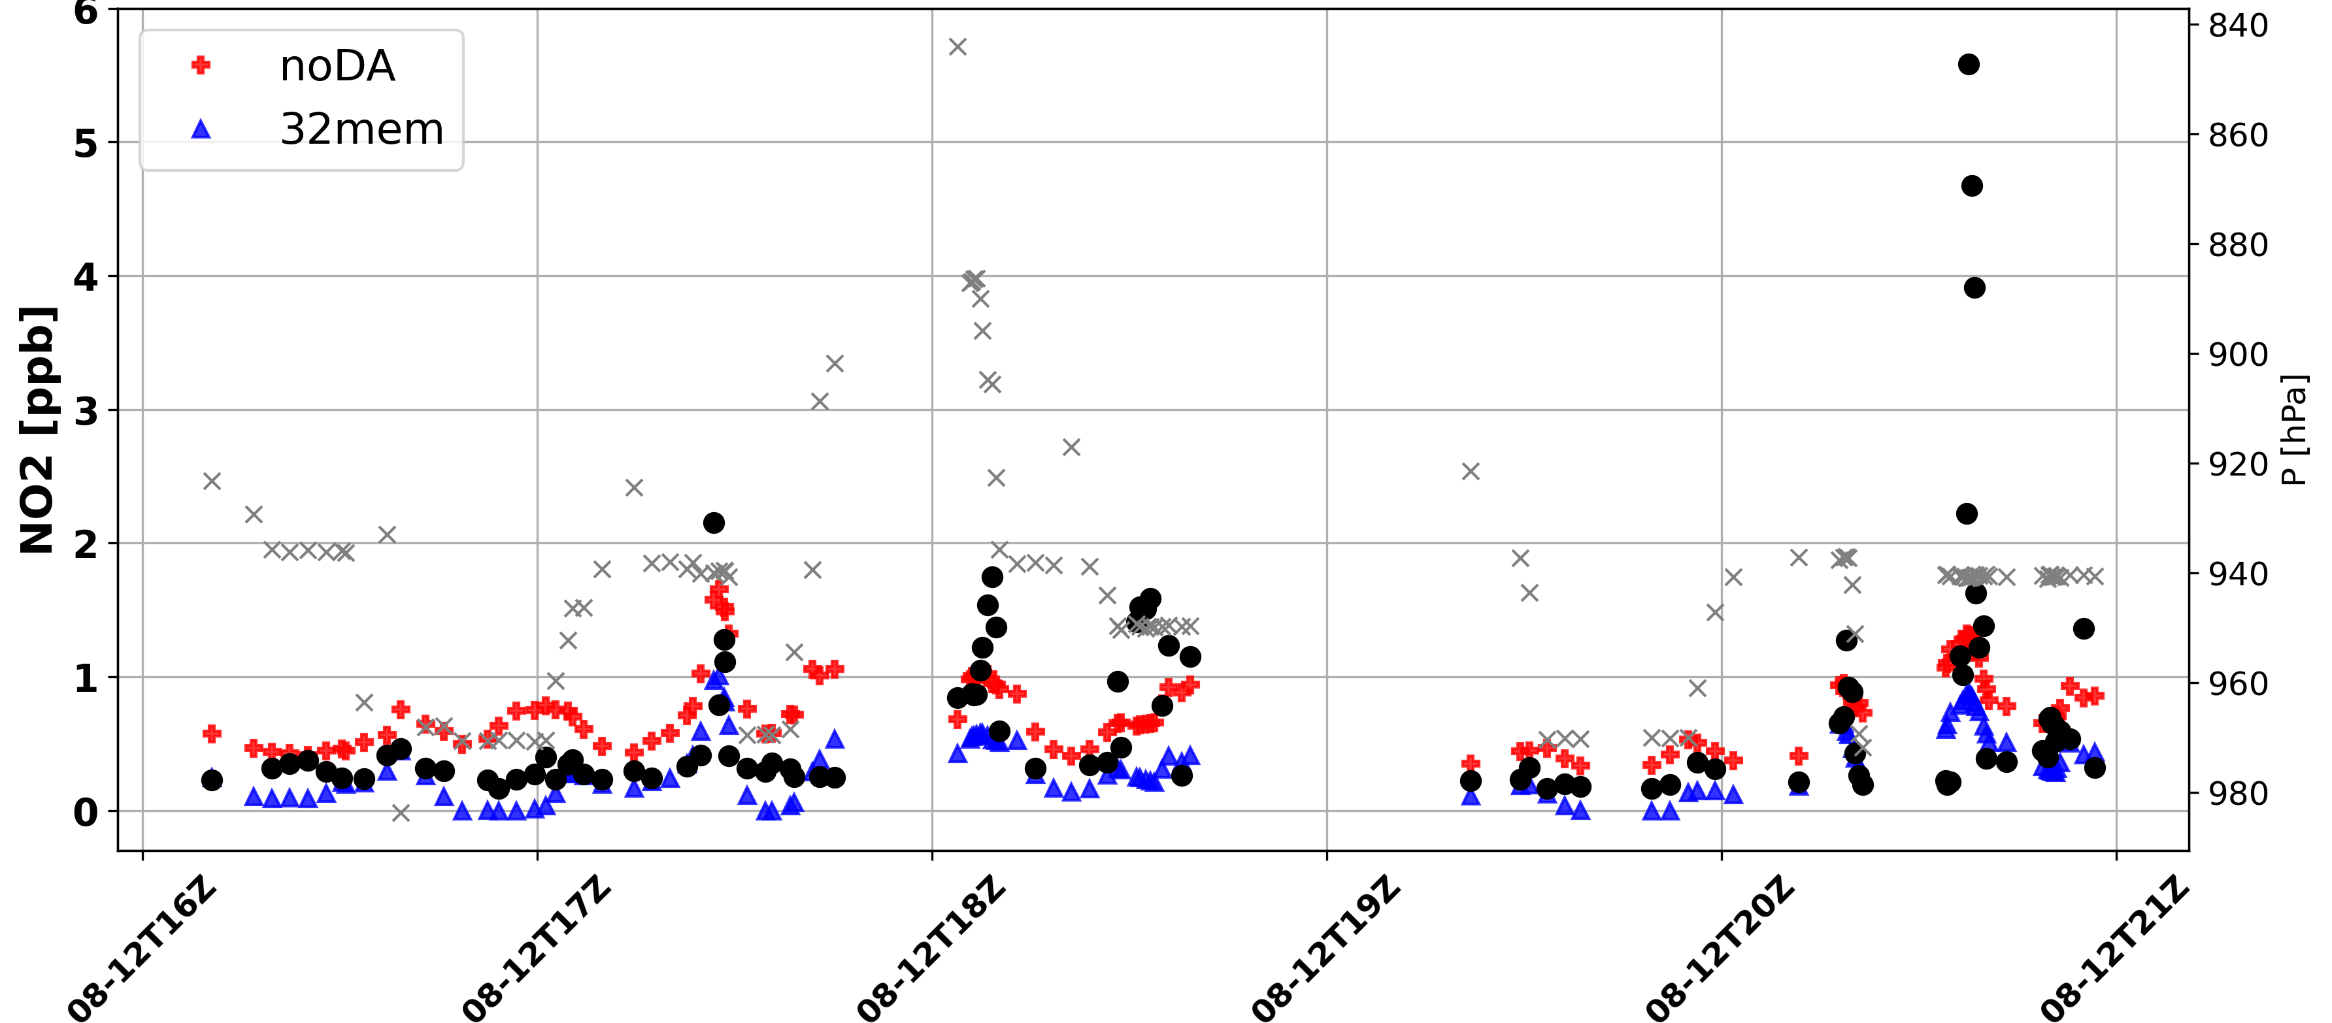

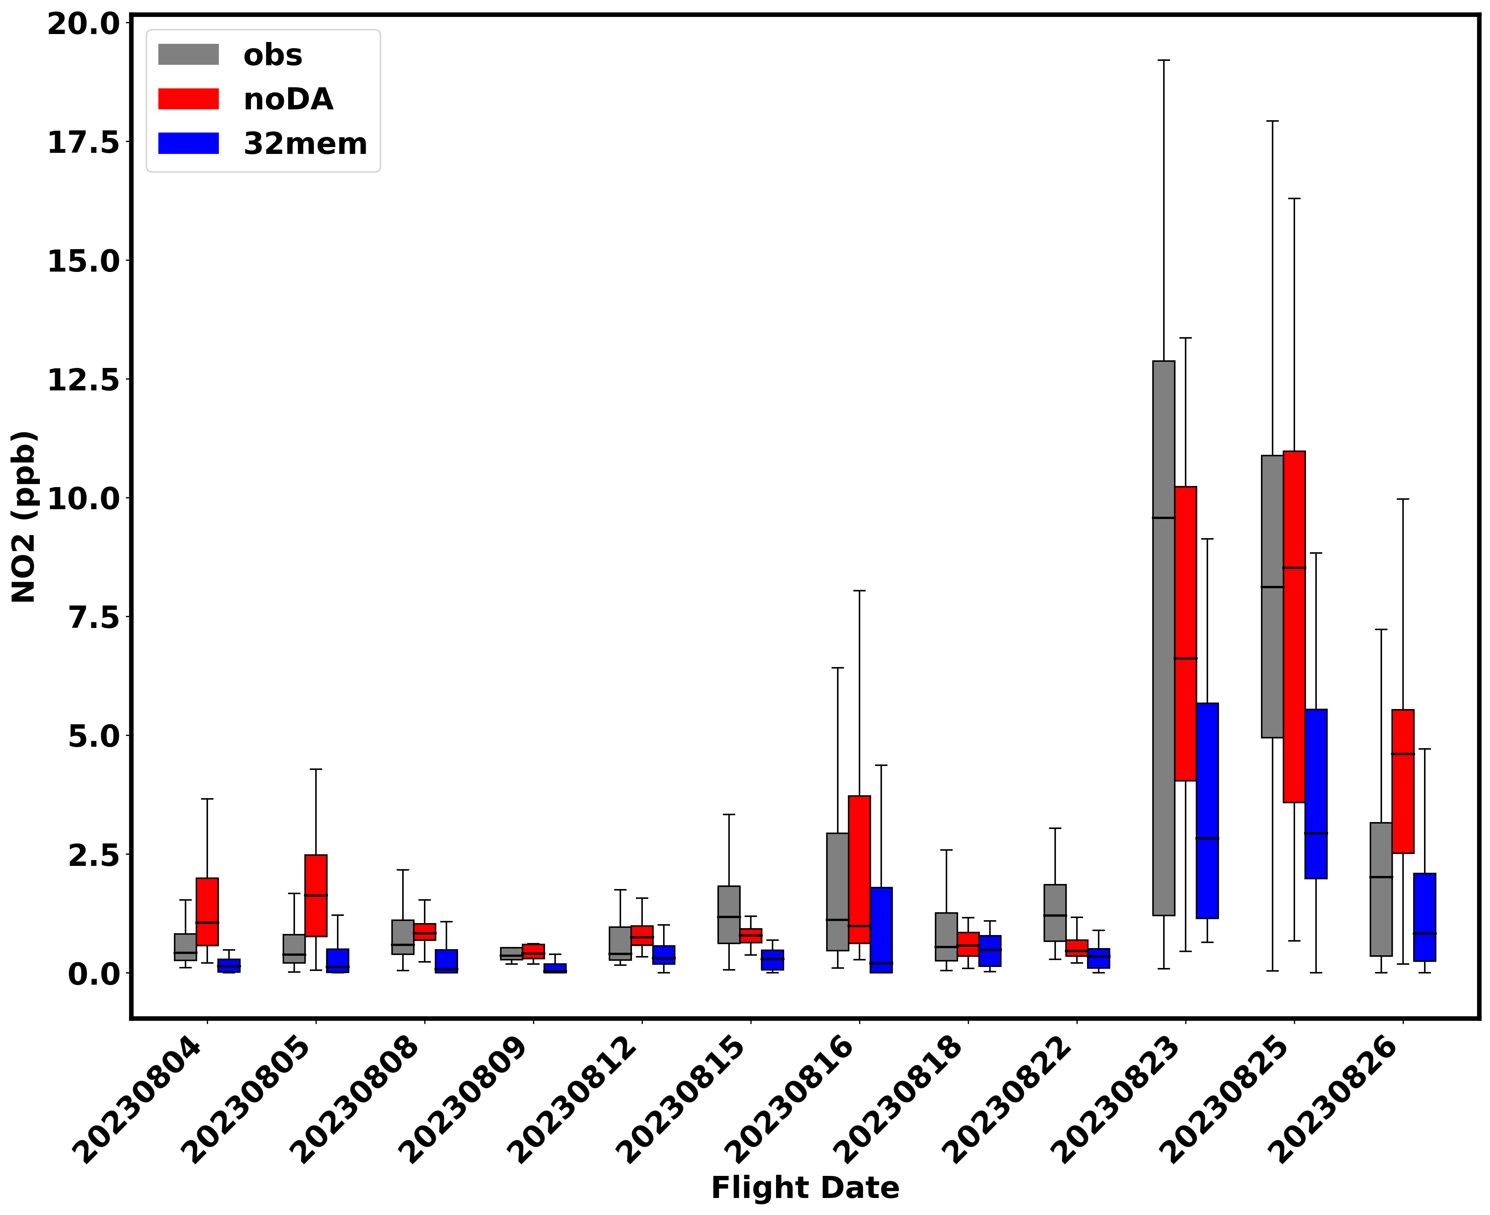

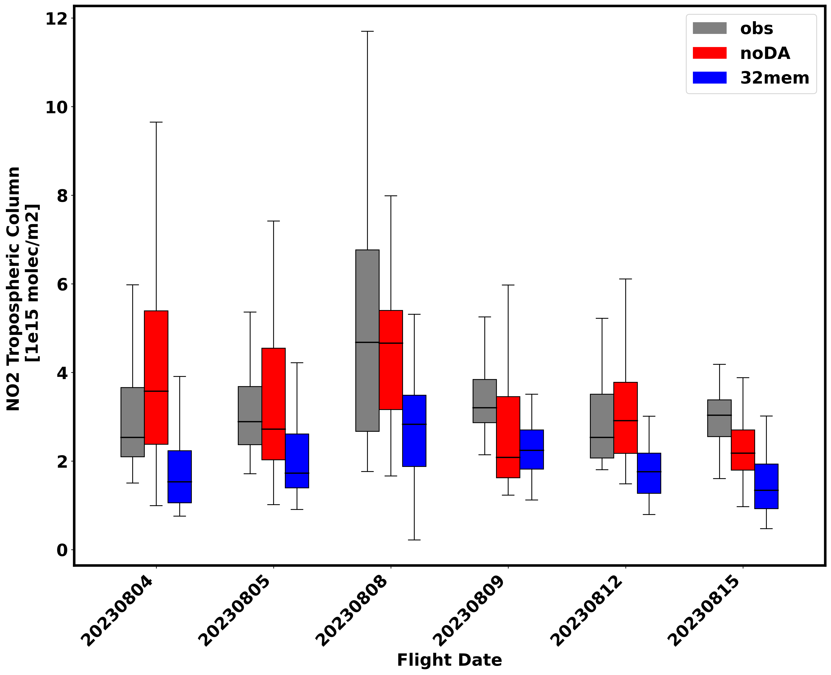
Comparison with independent observation (field campaigns)
AEROMMA
STAQS
2023-08-09
2023-08-12
noDA
32mem
obs
noDA
32mem
obs
Trop NO2 [1e15 molec/cm2]
Notes:
Urban sites
Representativeness error

Slide 7
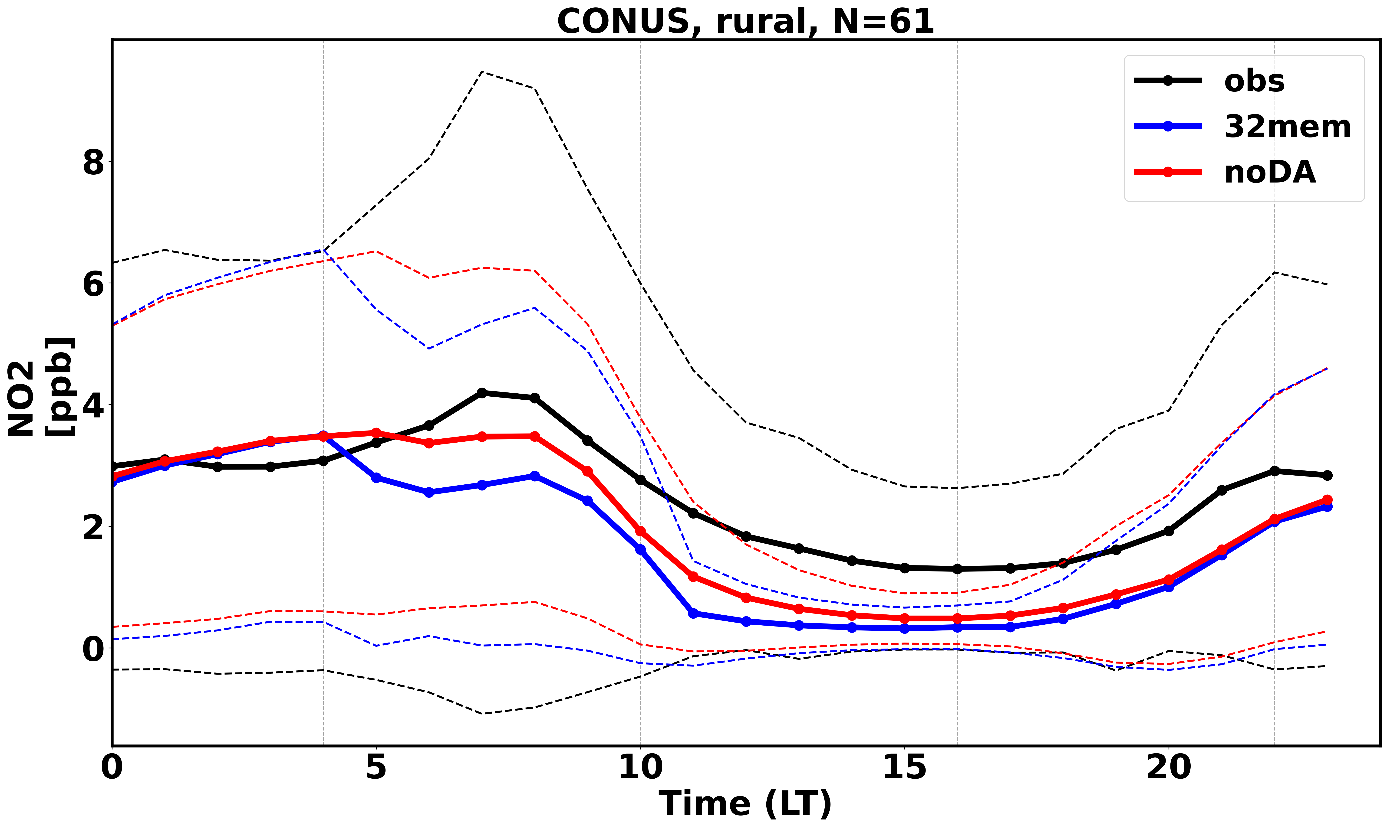
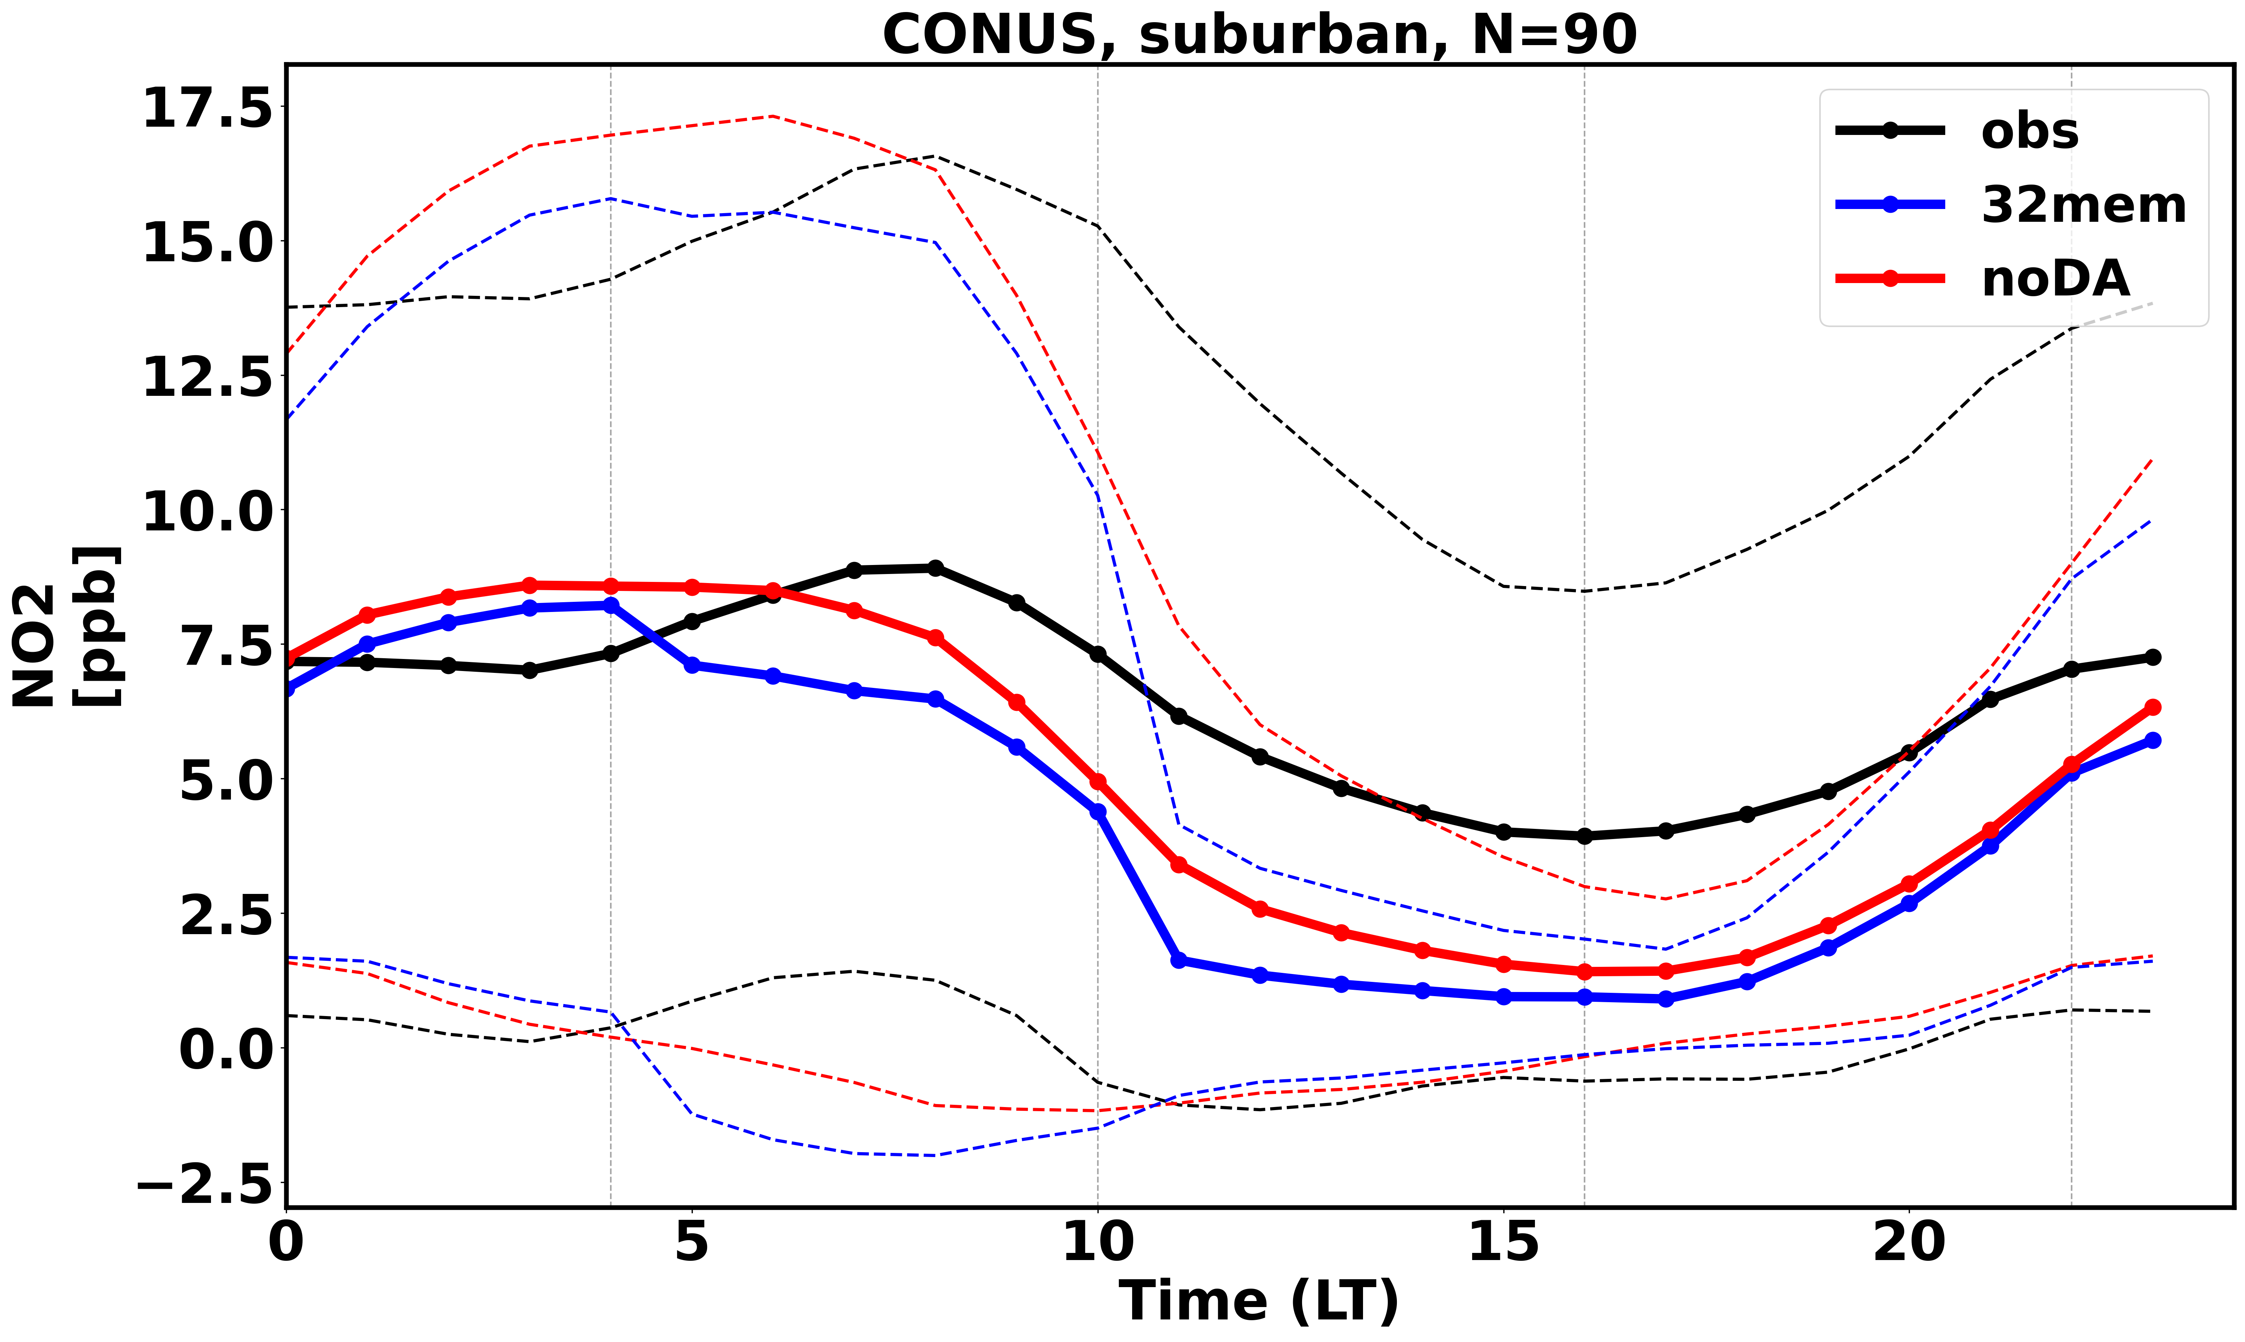
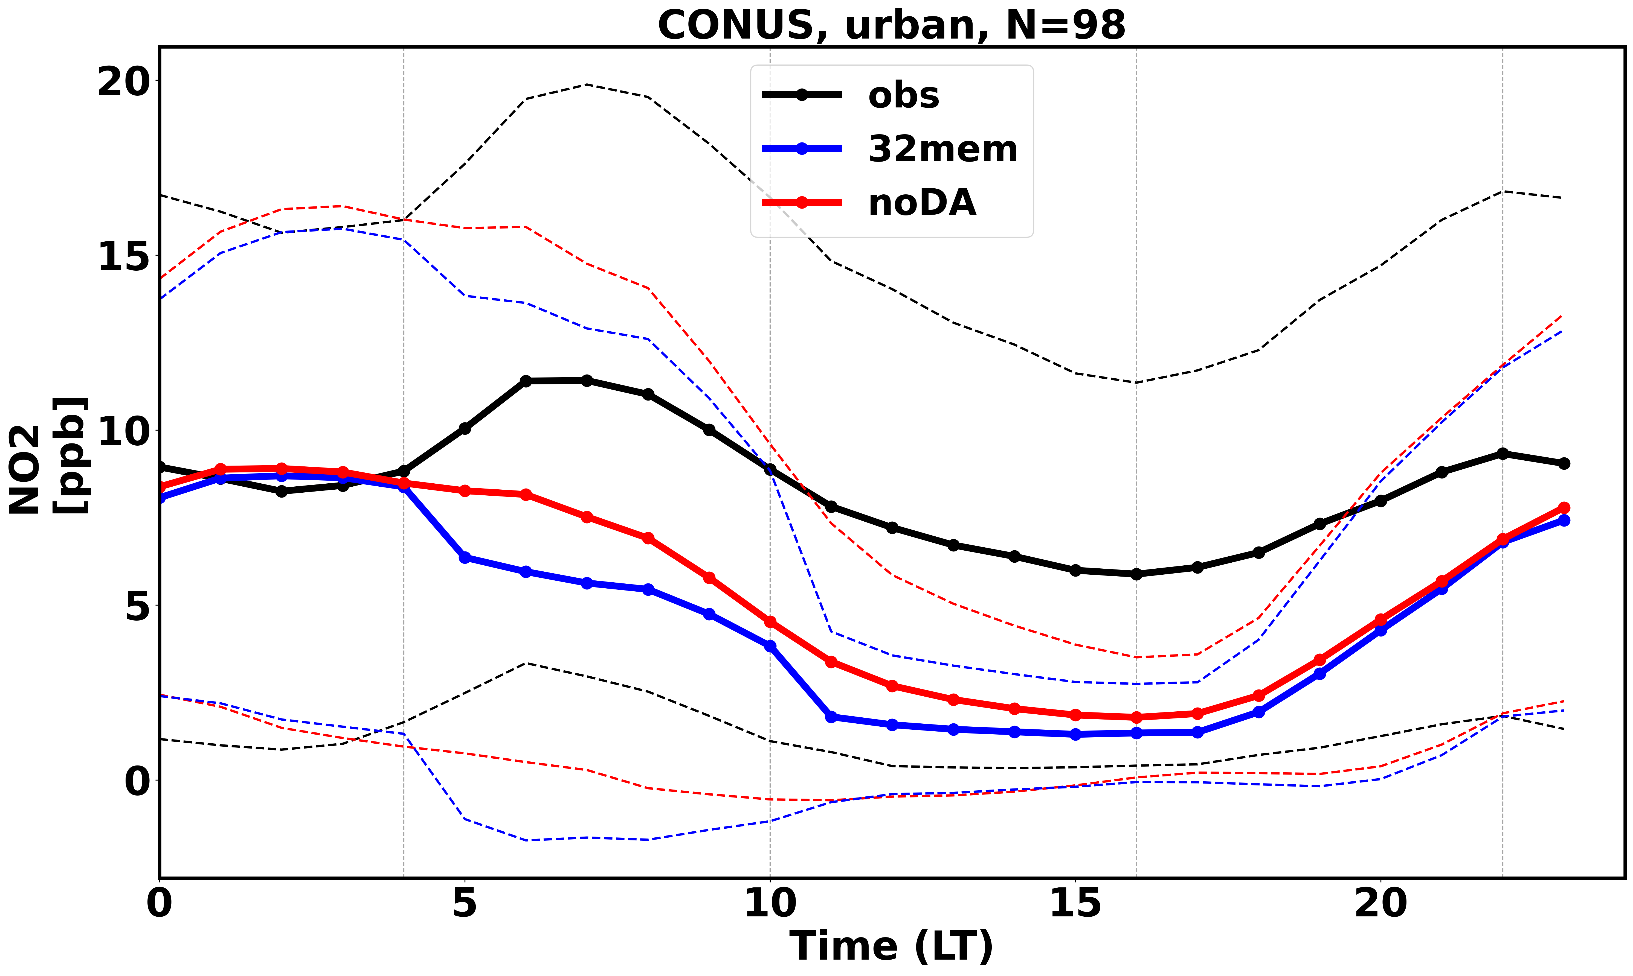
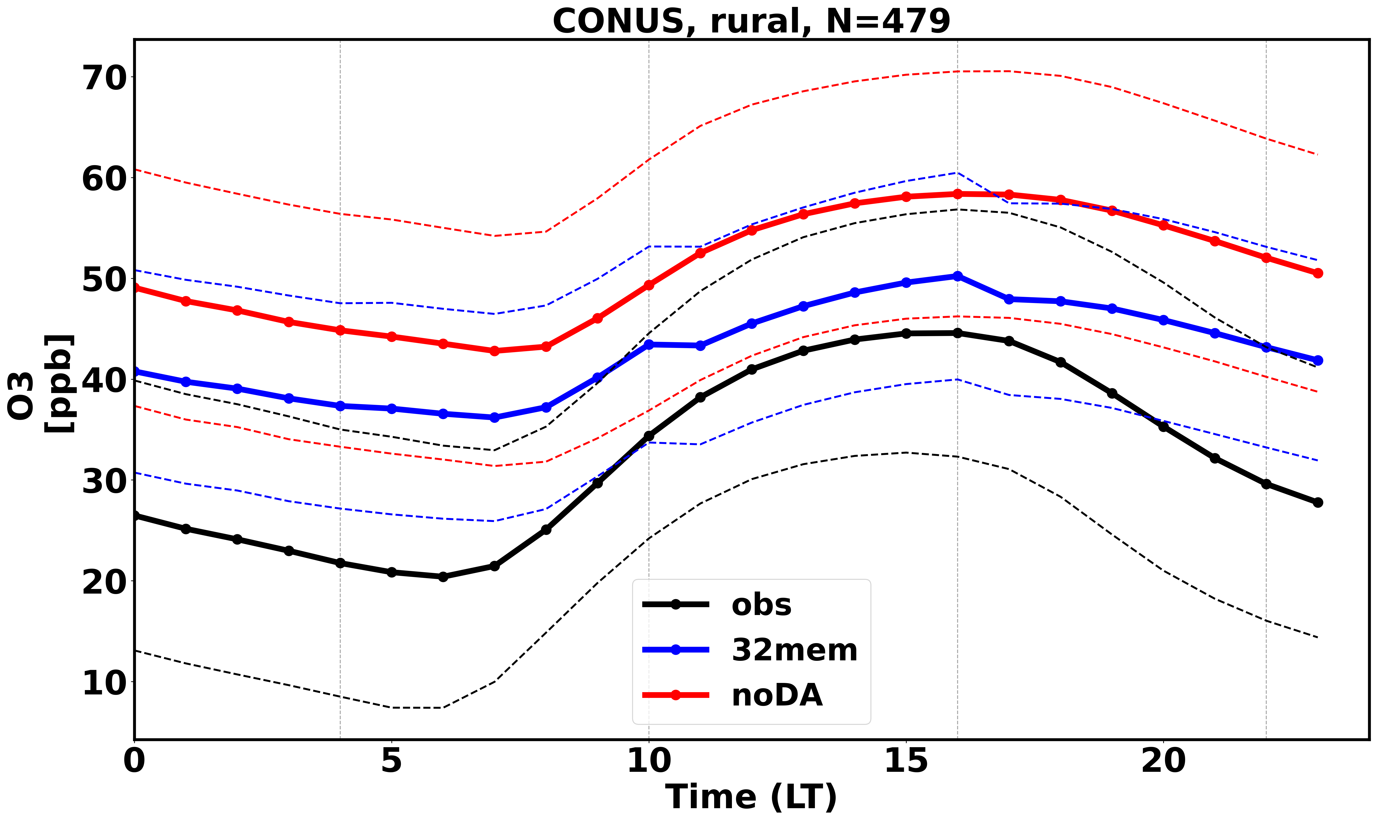
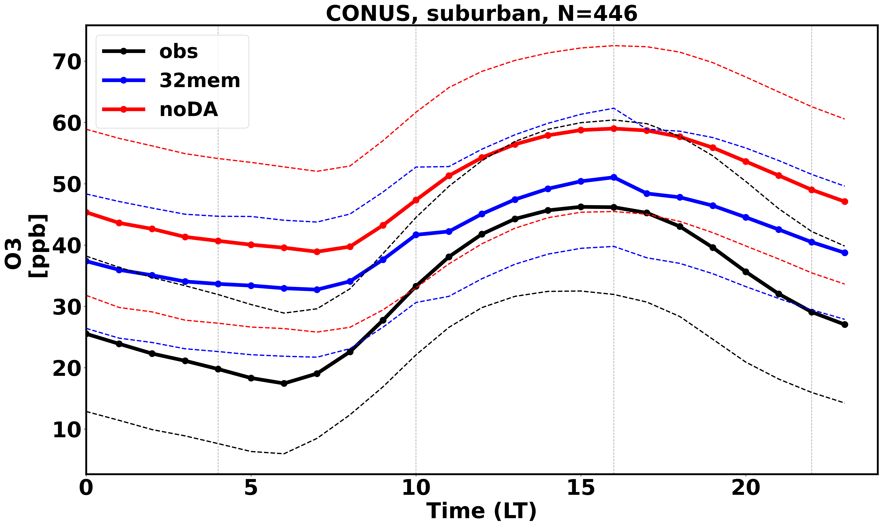
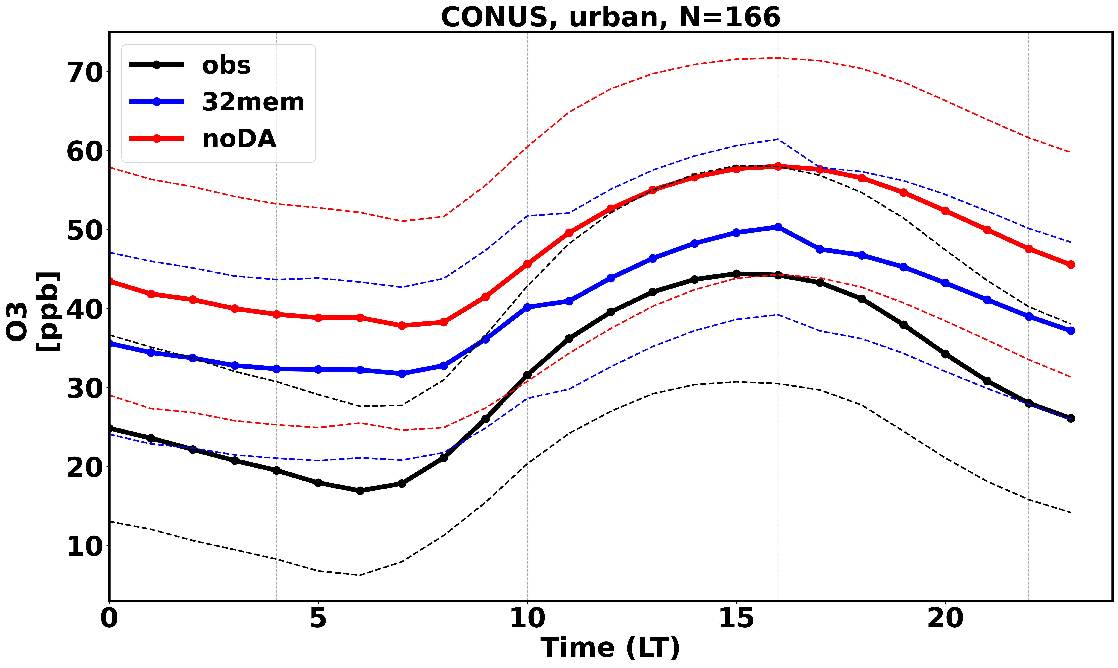
Comparison with independent observation (AirNow)

Slide 8
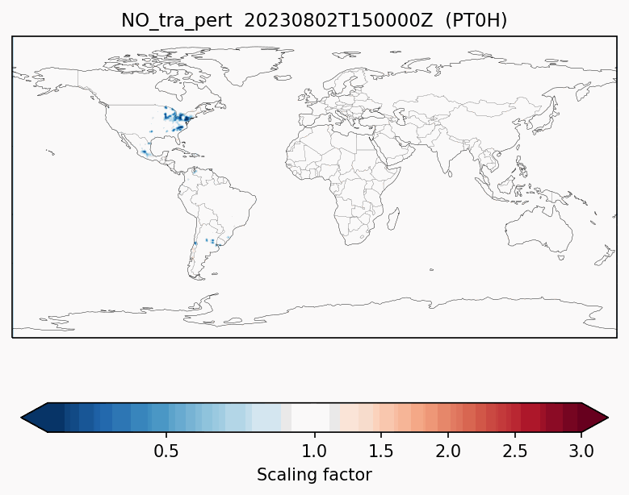


Emission scaling factors with JEDI 4DEnVar
The JEDI 4DEnVar allows to derive hourly scaling factors on the SECTOR level
We use persistence functions to carry the scaling factors from one day to another, i.e. the prior information on the next DA windows is already scaled by previous satellite observation information:
TEMPO and TropOMI
Currently it is a 6 hour DA window so the temporal extent of the scaling factors are within the window. JEDI could work with longer windows
Residential, Commercial, Others
Industry
Energy production
Traffic

Slide 9
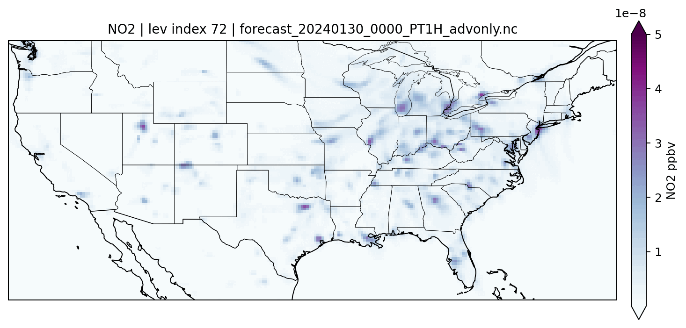
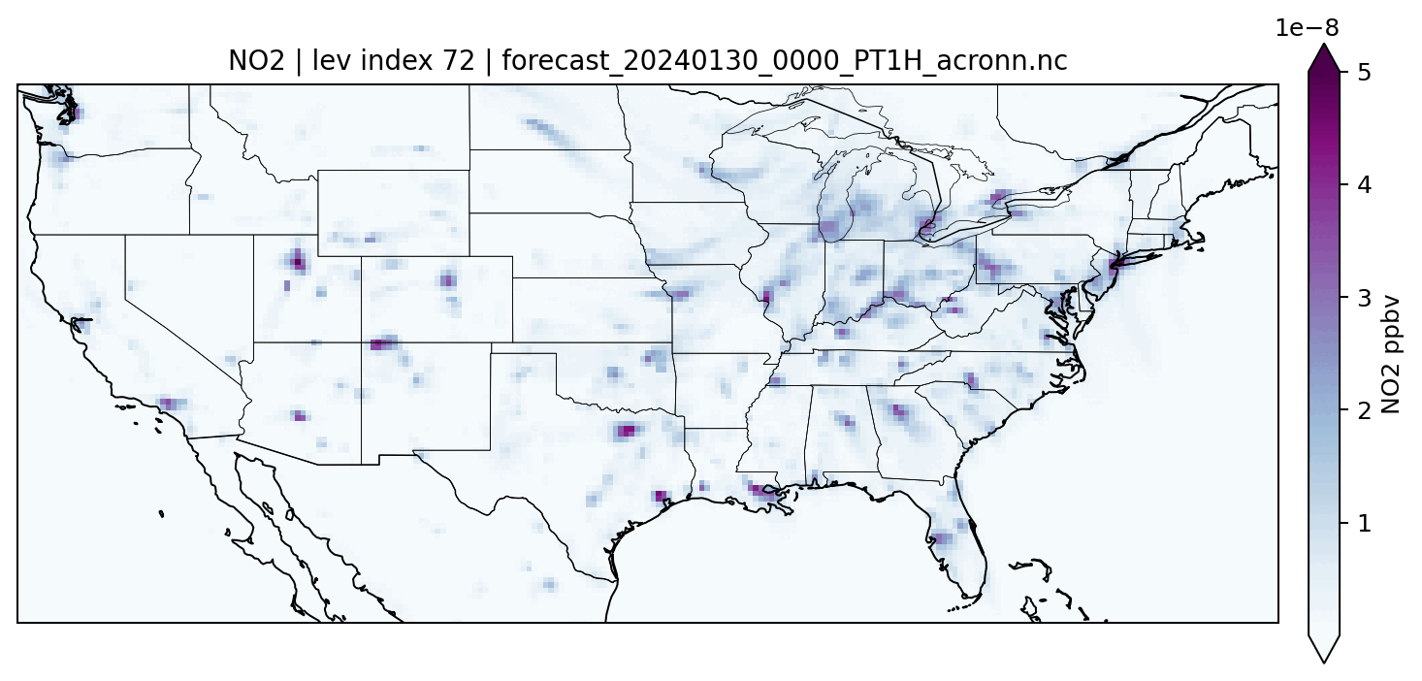
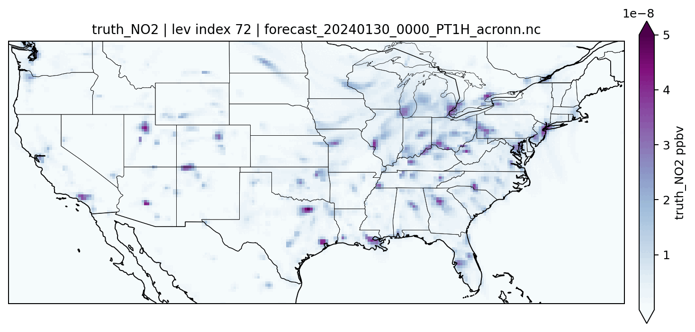
AI model trajectory emulator
Advection Only
Atmospheric COmposition Recursive Neural Network: ACORNN
Leverages advection schemes
Calls recursively advection then AI emulation
Currently the advection scheme is a simple semi lagrangian: differentiable with possibility of TL and AD
The AI part is a Convolution Neural network on the entire GEOS vertical profile: it is fully differentiable with possibility of TL and AD and doesn’t care about the model geometry
This is a proof-of-concept prototype: Trains and runs on a single Mac with GPUs
The training approach is stochastic so only a fraction of the training (~10-15%) set is needed.
Next steps:
large training on the GEOS-CF outputs
Integration on JEDI DA with much faster ensemble generation for 4DEnVar
TL and AD parts can be developed to run JEDI 4DVar with TL/AD
Advection + AI
GEOS-CF

Slide 10
Summary
First TEMPO + TROPOMI NO₂ assimilation system in JEDI with GEOS-CF and EDA 4DEnVar
Large spatial and temporal variability in the increments
Independent evaluations show improved NO₂ columns, especially during morning hours in urban/suburban regions
Current and next steps:
Tuning hourly sectoral-based emission inversion system
Enhancing scalability with AI-based emulators
Reducing representativeness errors by refining model resolution

Slide 12
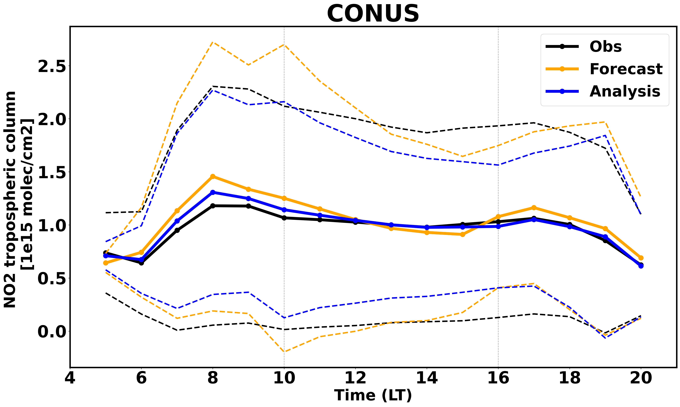
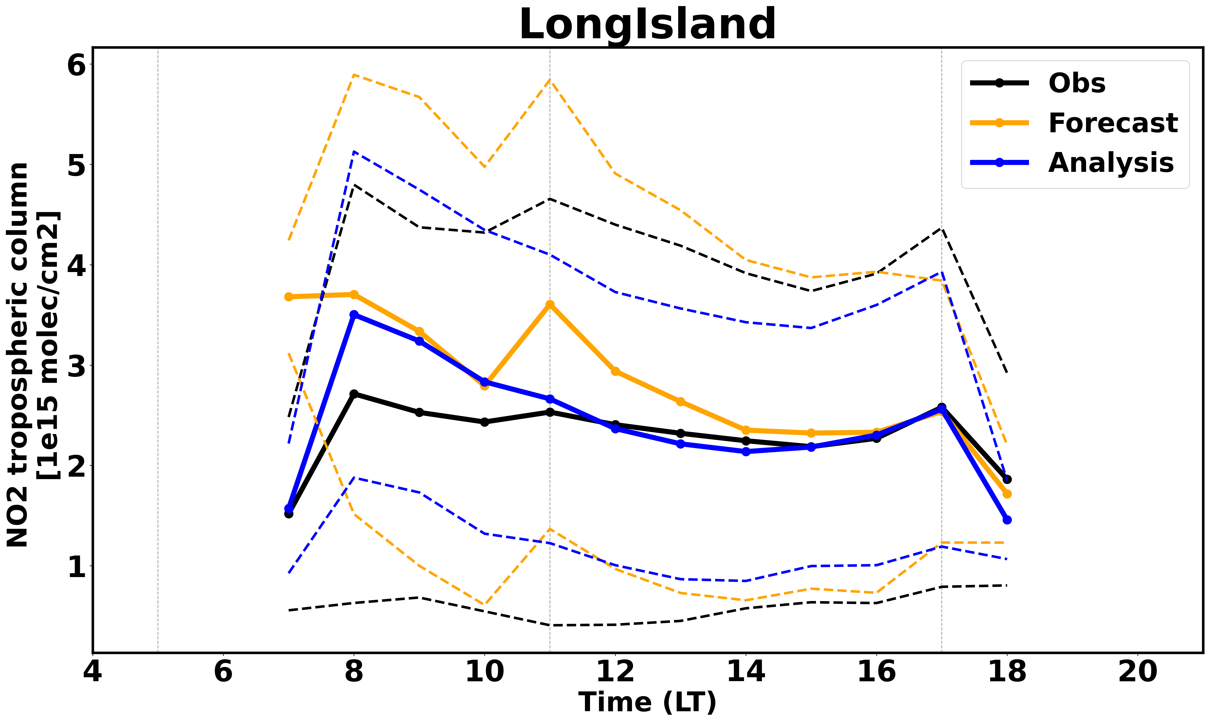
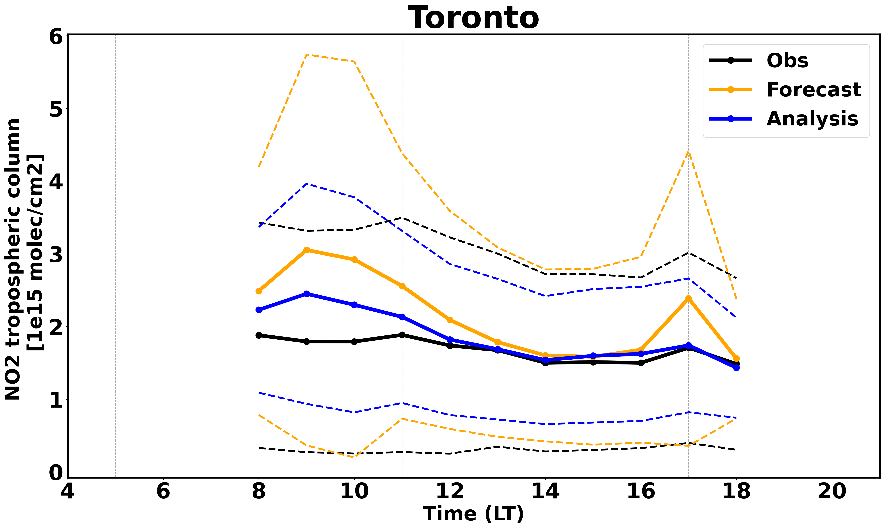
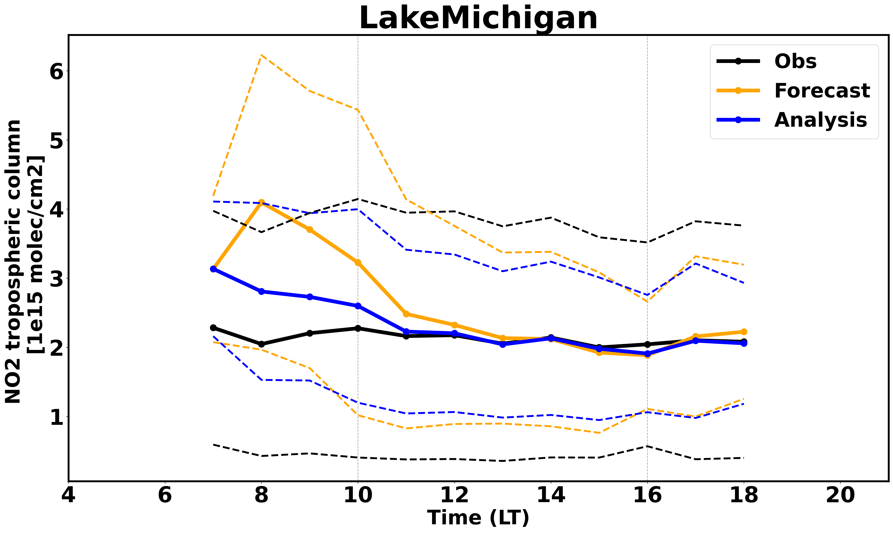
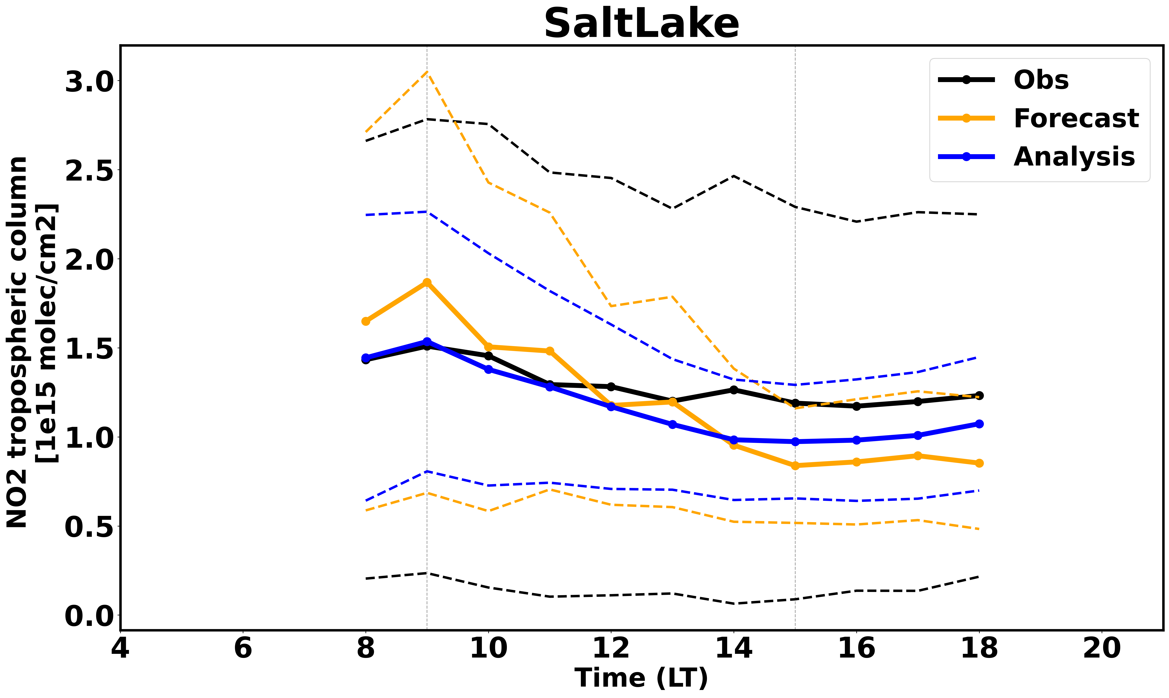
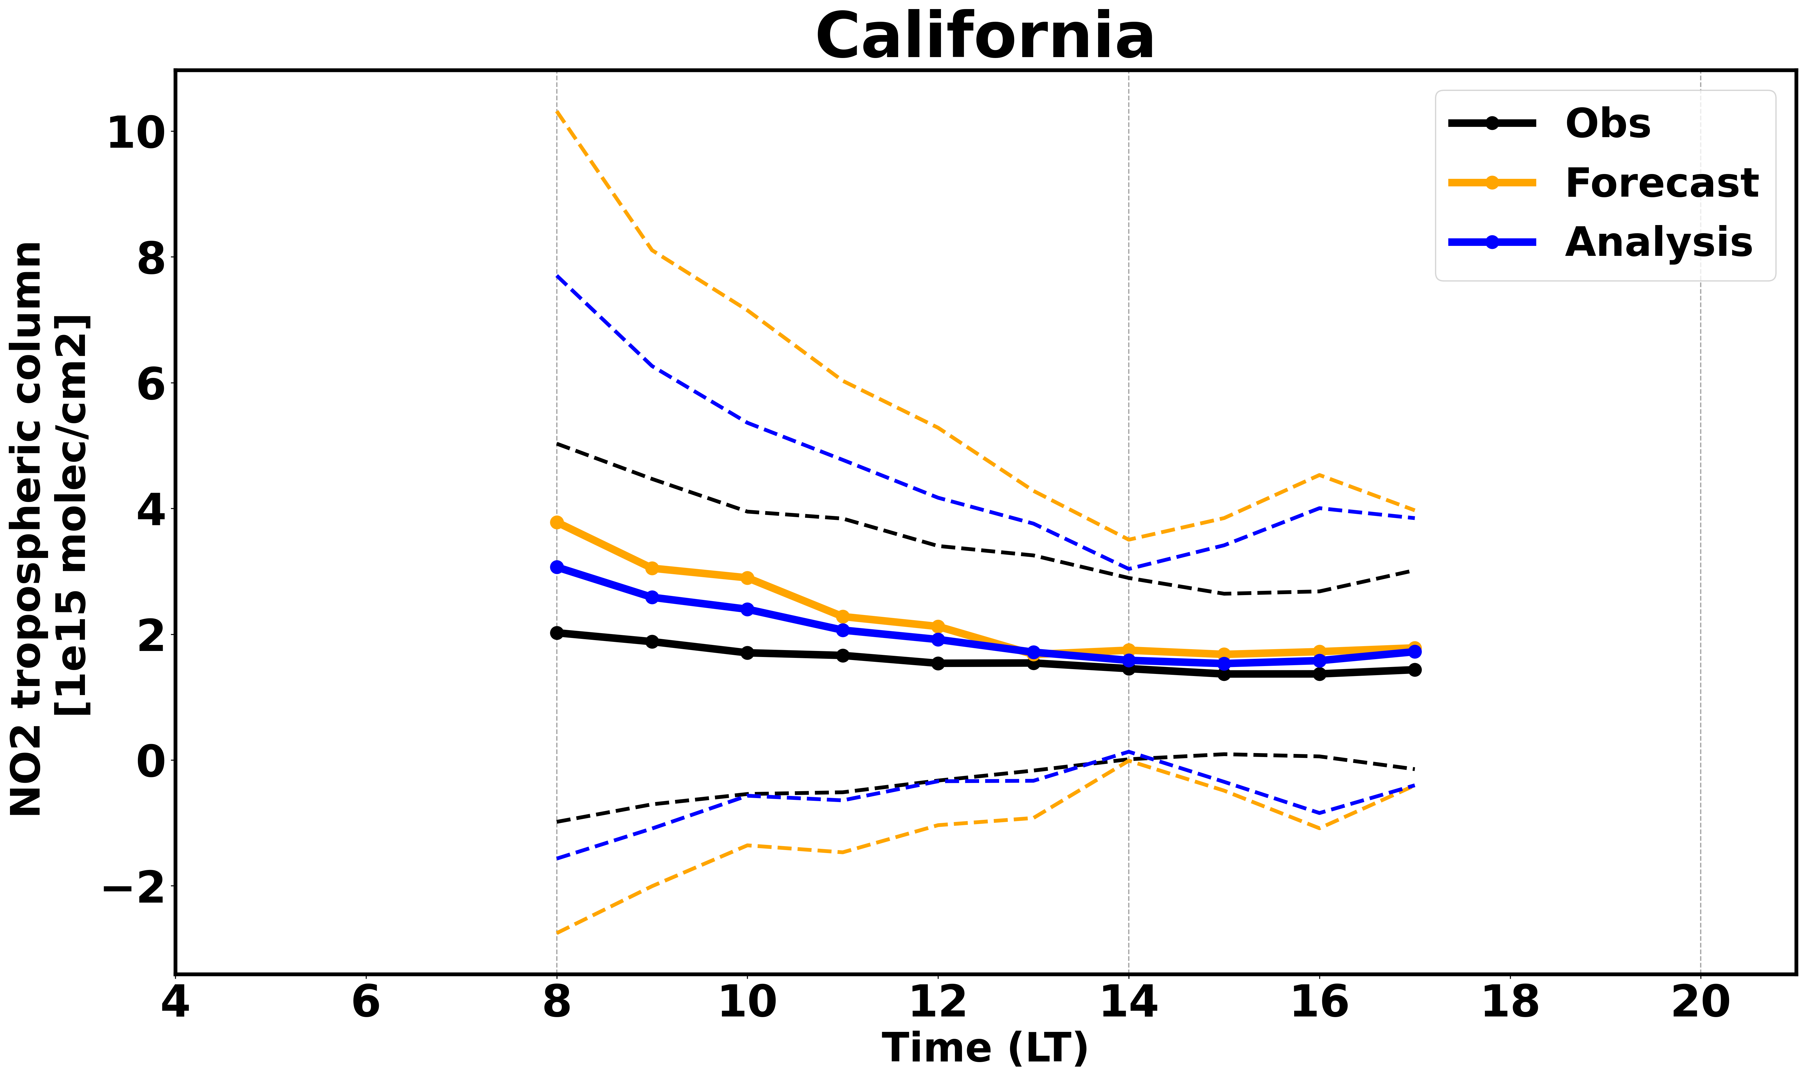
Obs Space impact
Aug 2023

Slide 13
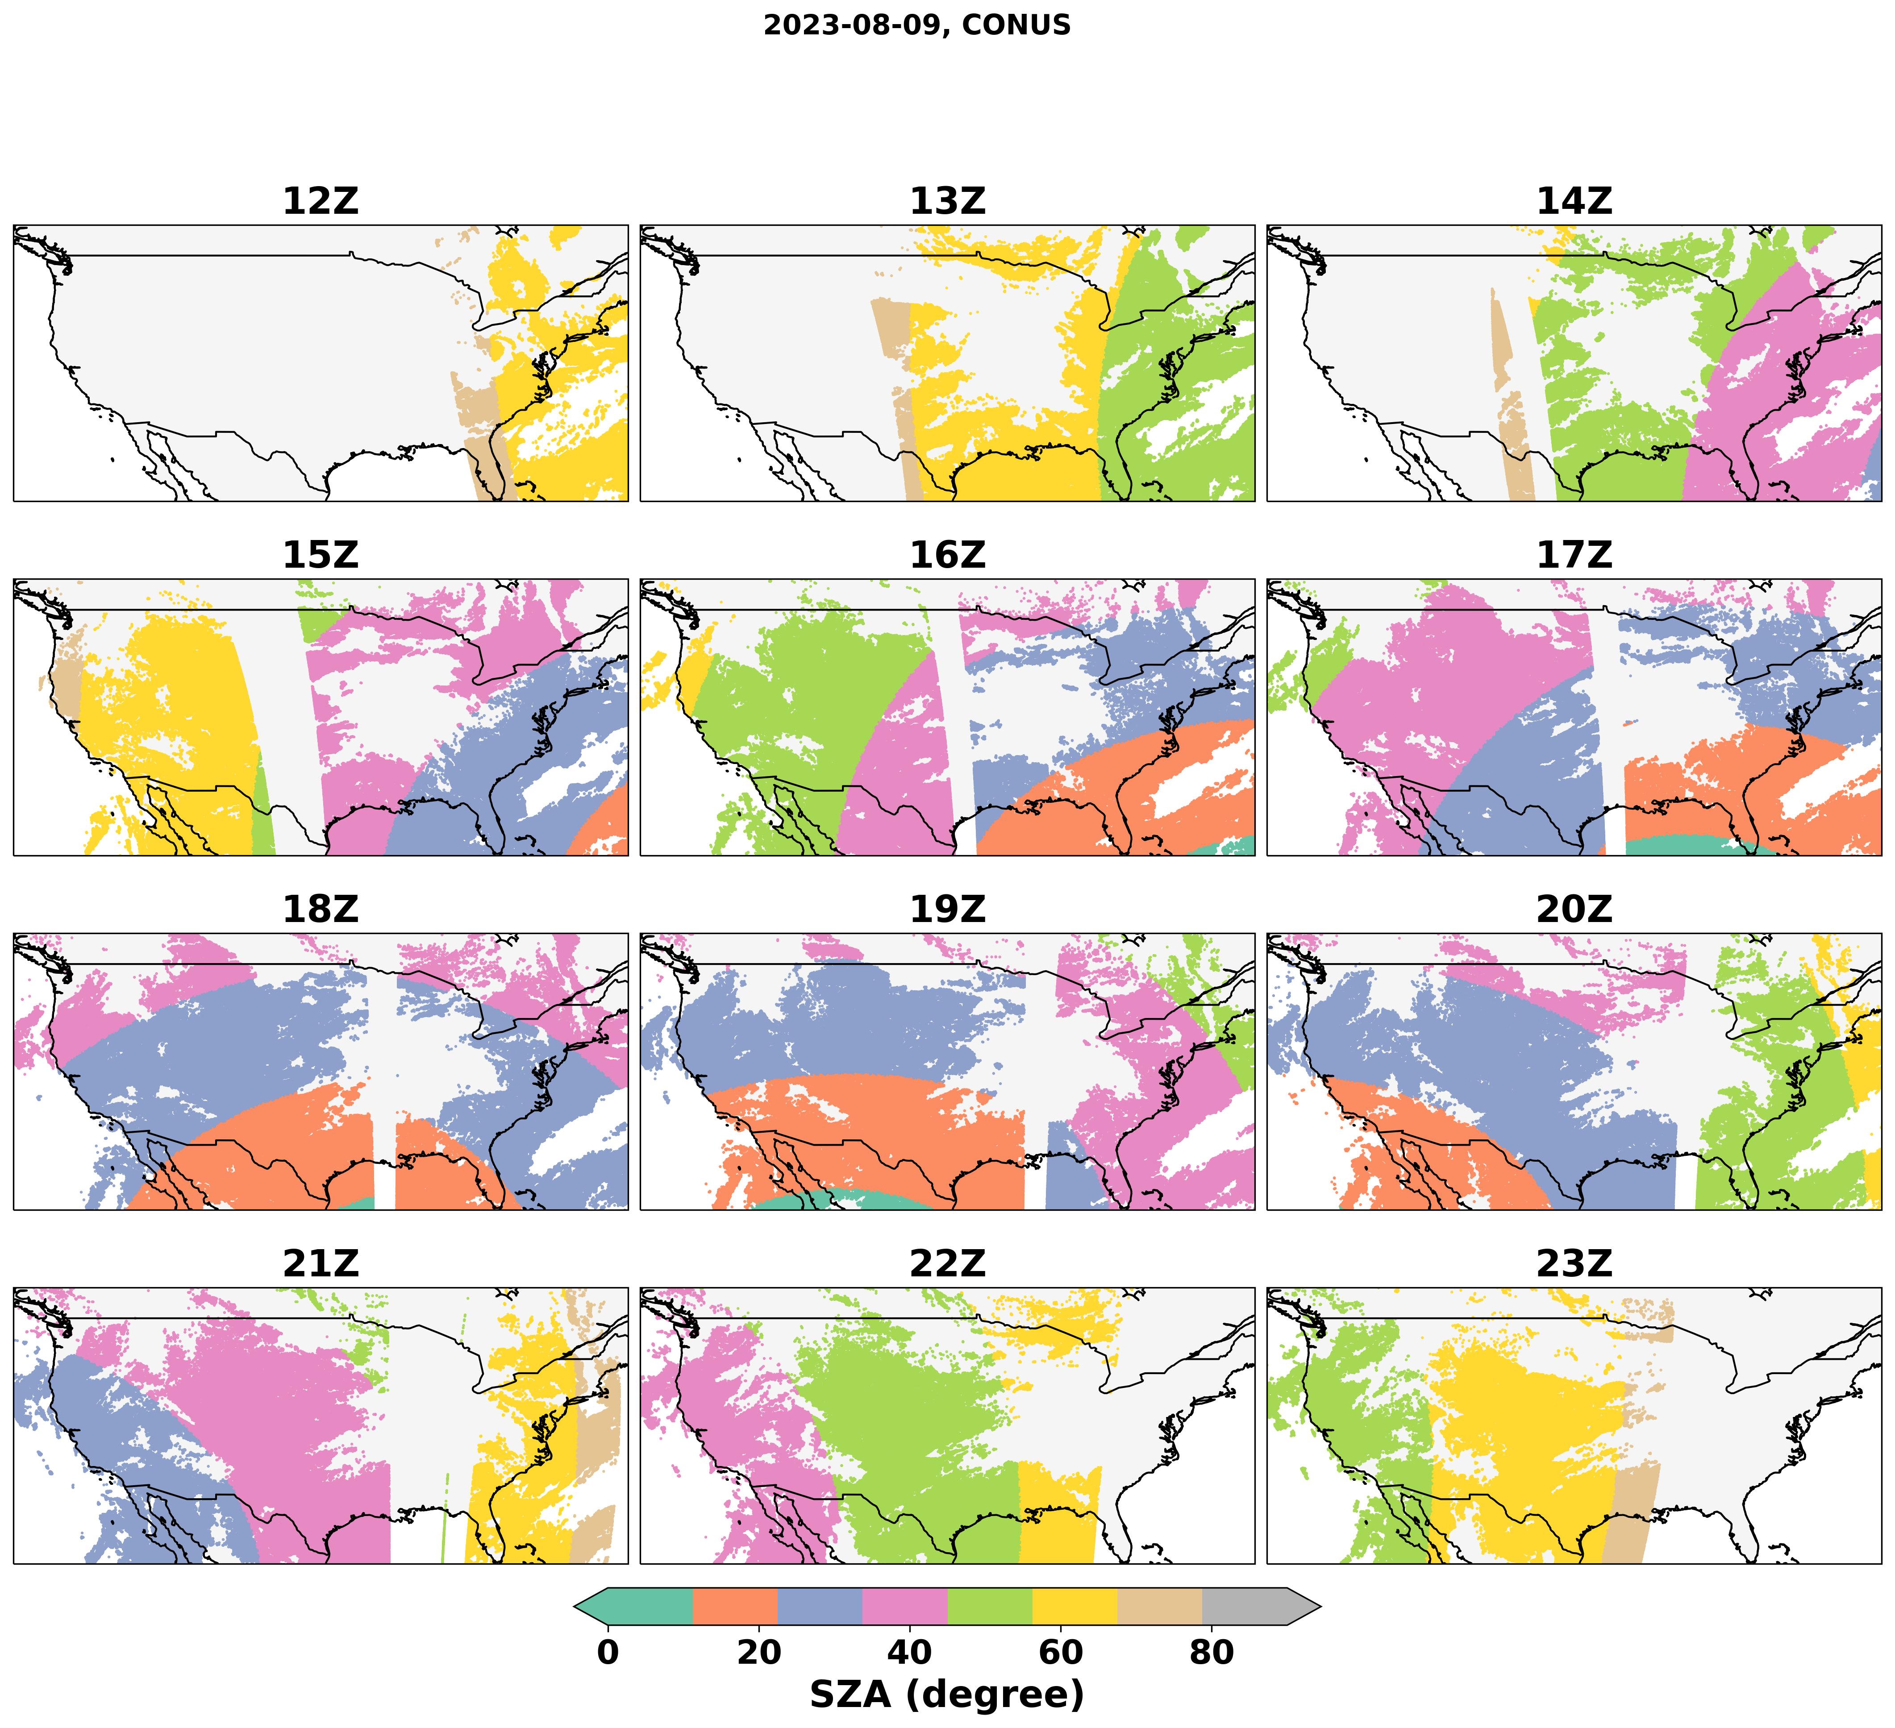
Hourly SZA on 2023-08-09

Slide 14
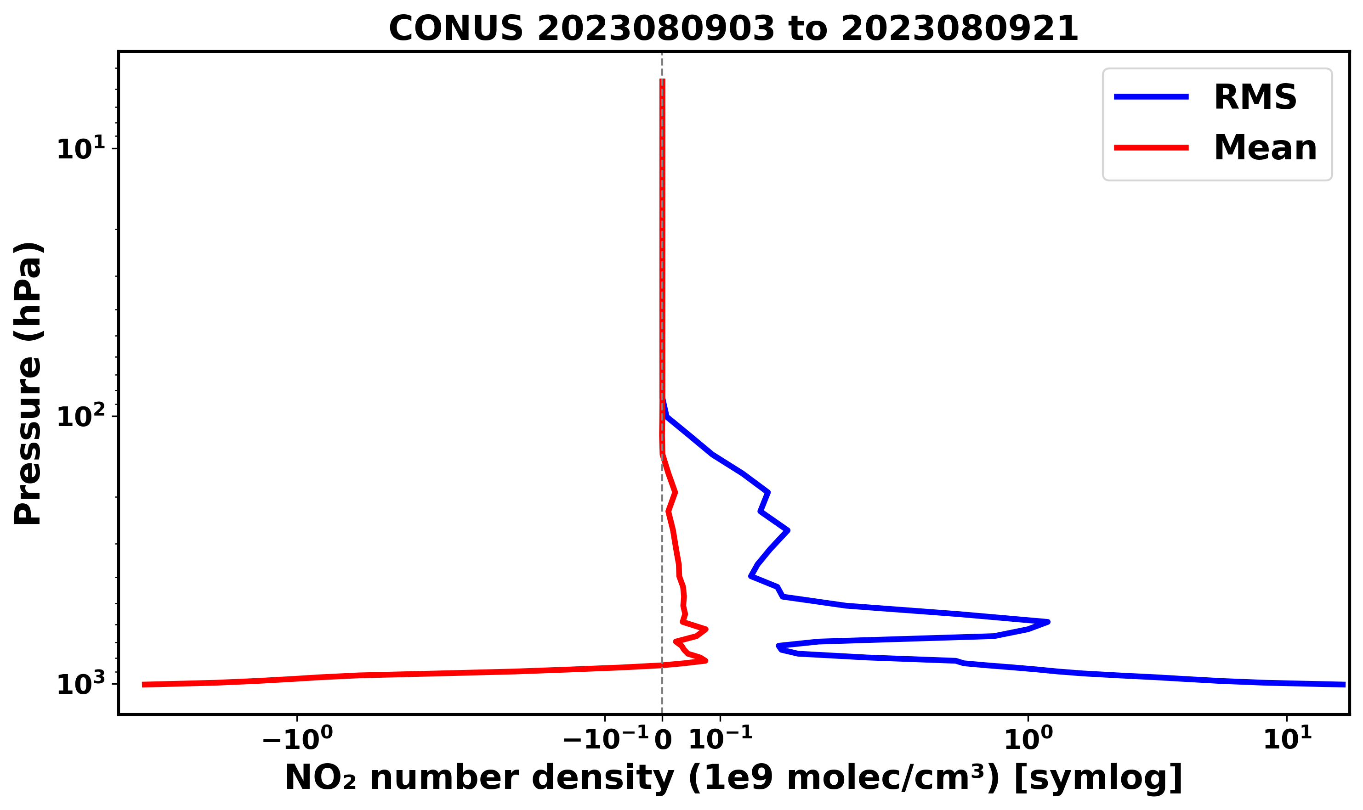
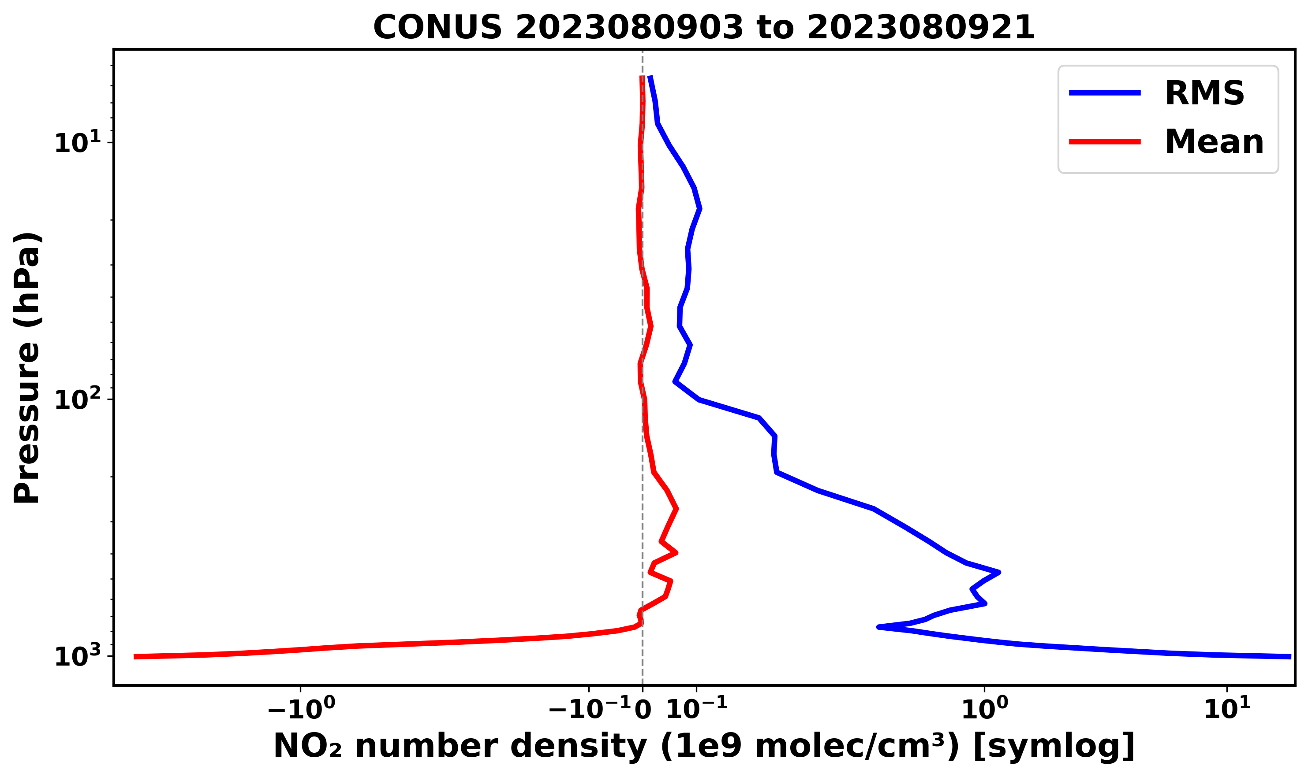
Tuning vertical localization

