Slide 1
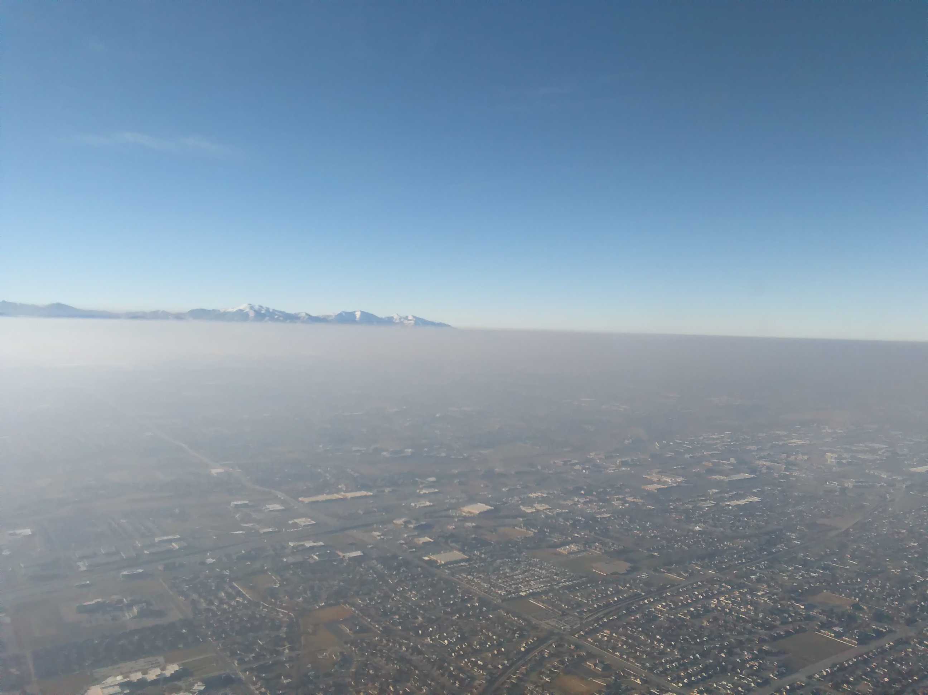
A Winter Air Quality Field Campaign in the Southwest US
NOAA Chemical Sciences Laboratory: Steven Brown, Carsten Warneke, Ann Middlebrook, Caroline Womack, Owen Cooper, Greg Frost
NOAA NESDIS Center for Satellite
Applications and Research: Shobha Kondragunta
NOAA Climate Program Office: Monika Kopacz
TEMPO / GeoXO Joint Science Team Workshop, Cambridge, MA August 2025
Salt Lake City, Utah, January 2017

Slide 2
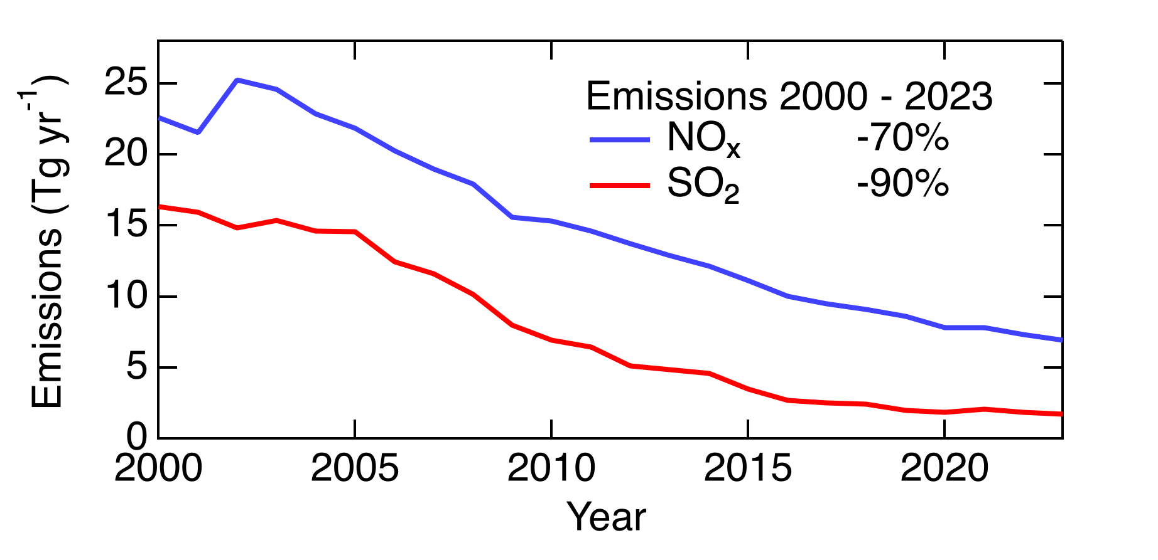
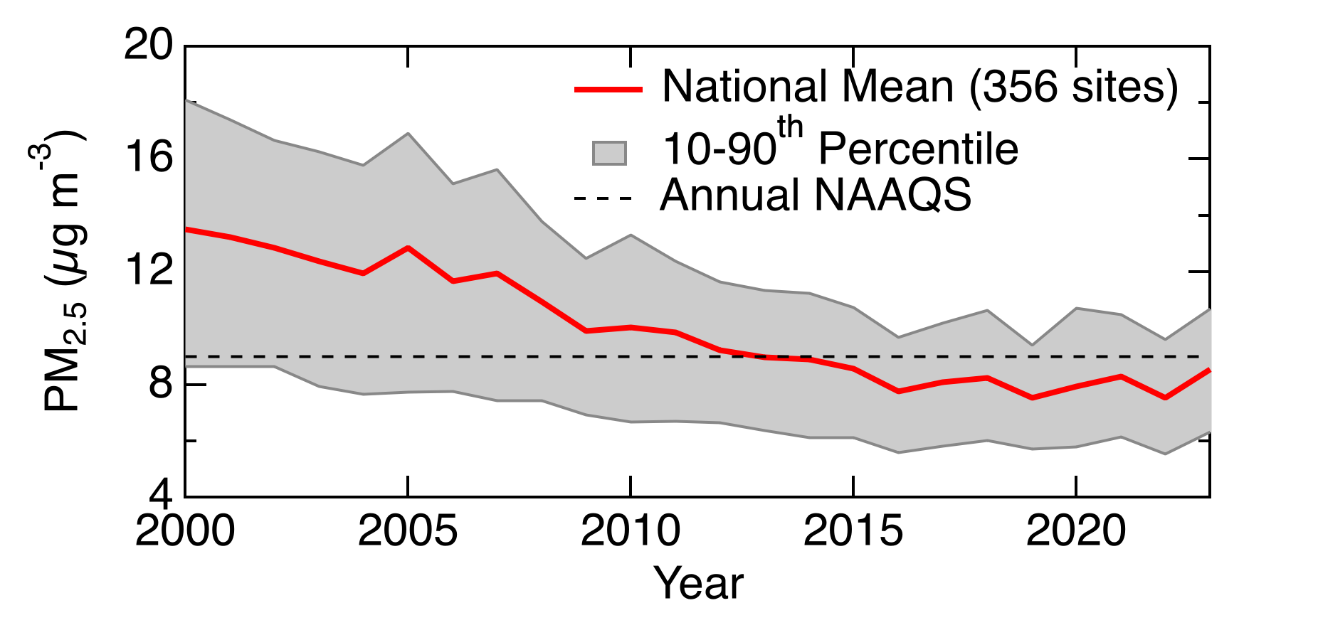
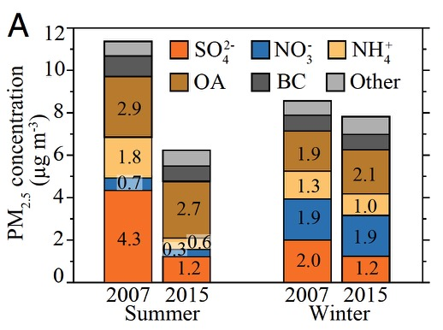
U.S. Emissions and PM Trends
1) Emissions have declined substantially
2) Annual PM_{2.5} has declined somewhat
3) Summer decreases faster than winter
4) Seasonal shifts in aerosol composition
Shah, PNAS 2018:
Population weighted Eastern U.S. PM_{2.5}
Chan, Atmos Environ 2018
Total
Sulfate

Slide 3
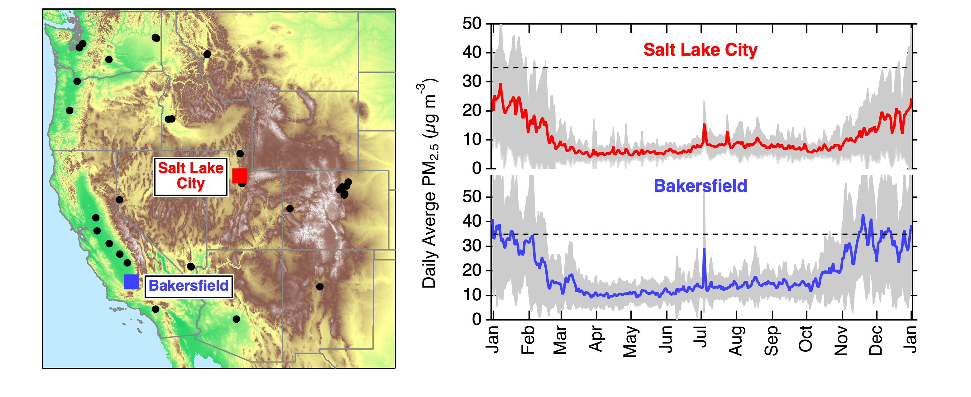
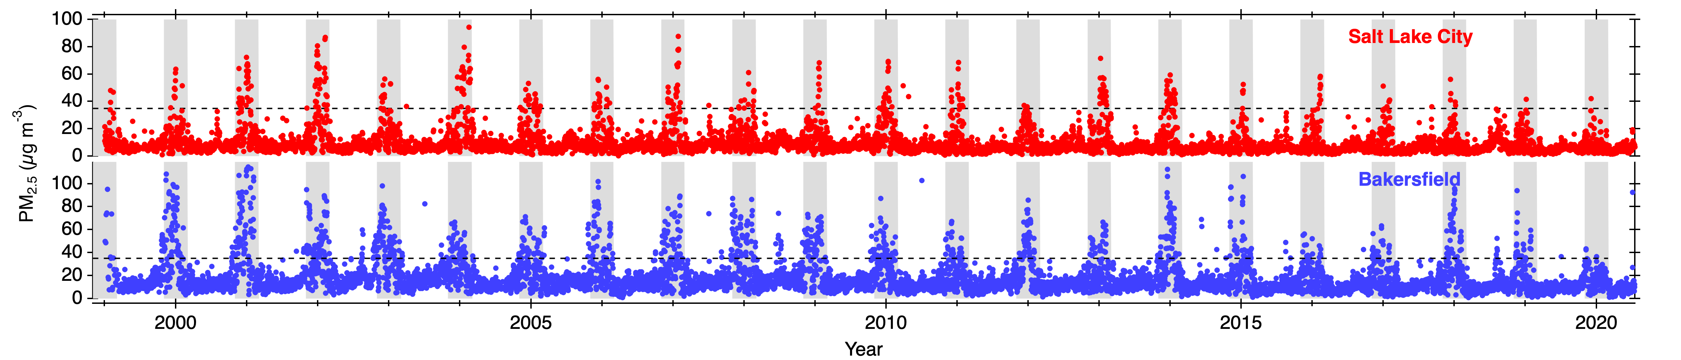
Western United States Surface PM_{2.5}
Wintertime maximum in PM_{2.5} for Western U.S. Basins
Similar for urban (e.g., Salt Lake City) and agricultural (e.g., CA Central Valley) areas
Hallar et al., BAMS 2021

Slide 4
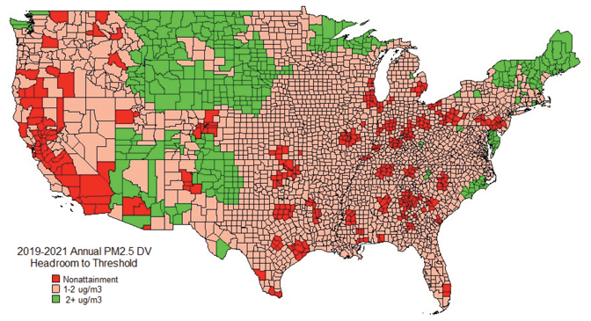
Non-Attainment Areas – 9 µg m⁻³ Annual PM_{2.5} NAAQS
Stella Env. Mag. 2023
EPA projected, Feb 2024
SNPP VIIRS
Shobha Kondragunta

Slide 5
Satellite Derived Surface PM_{2.5}

Slide 6
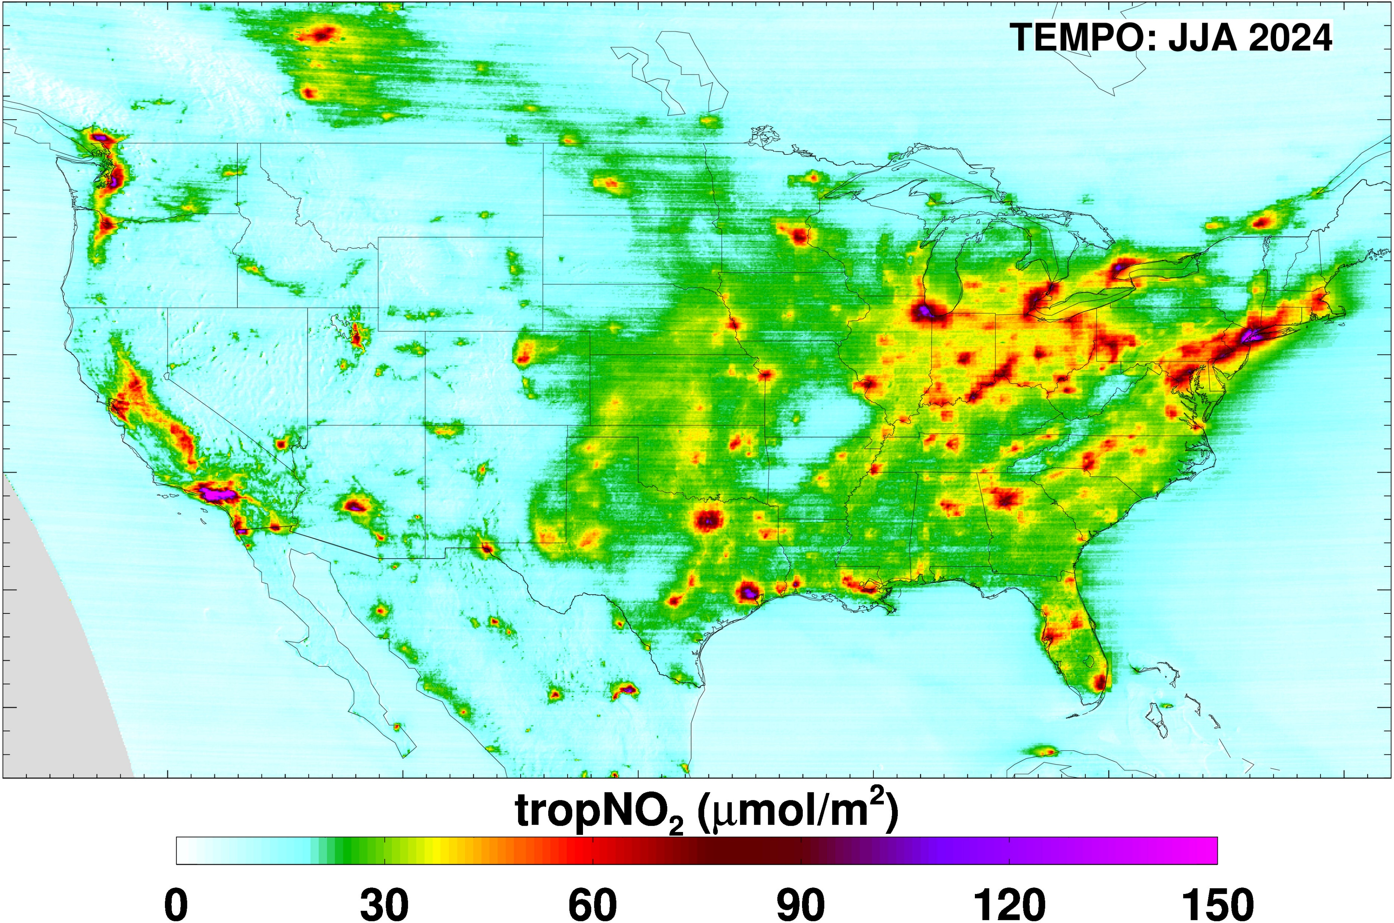
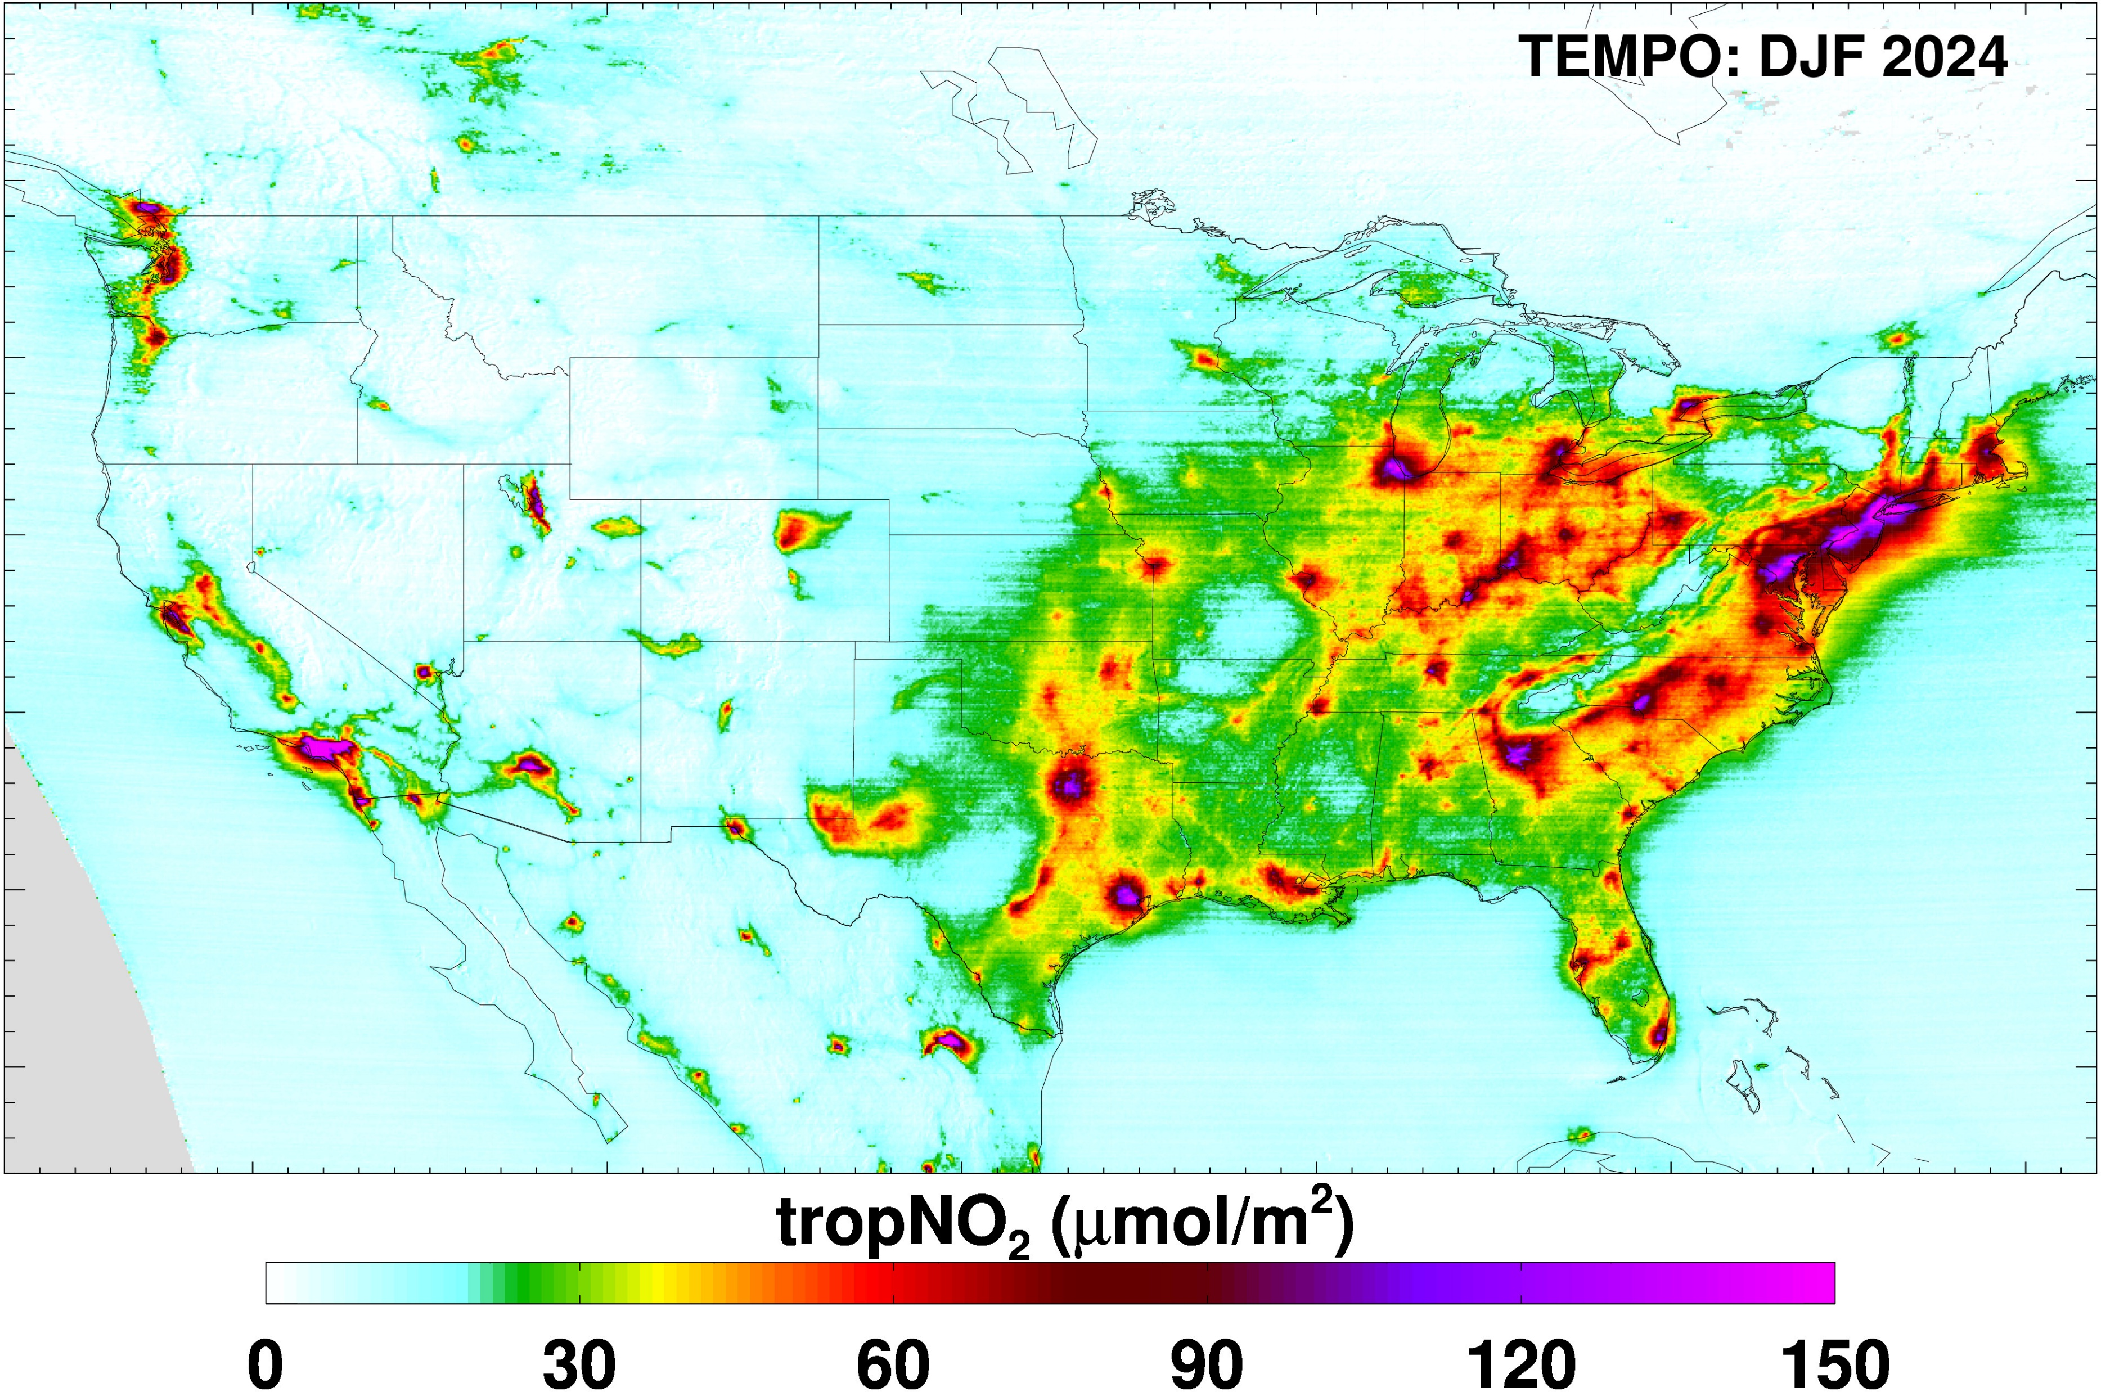
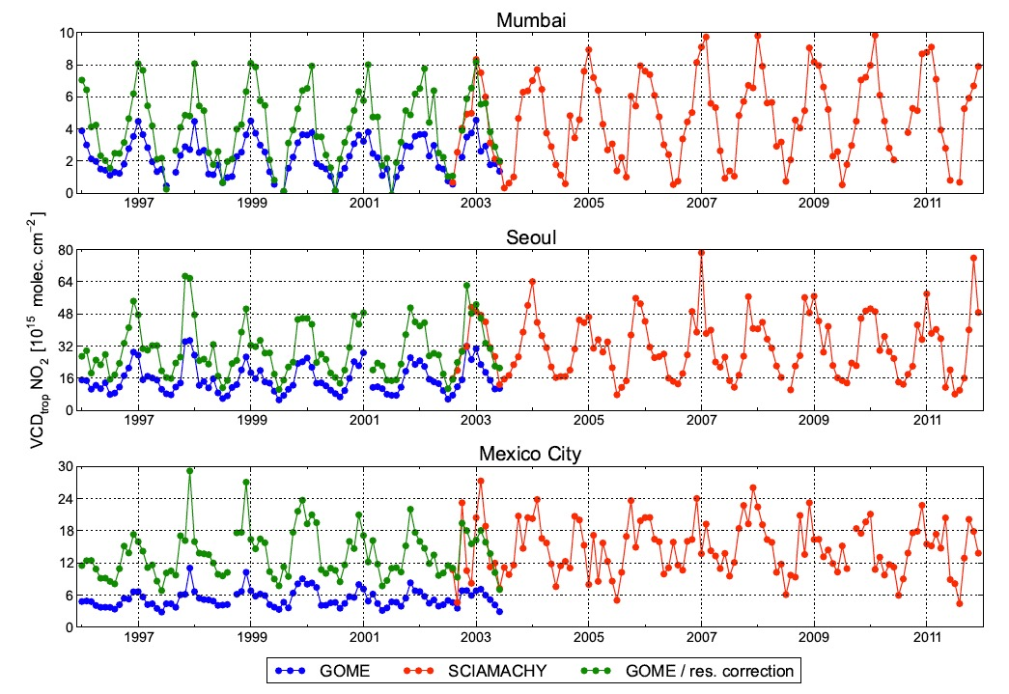
Seasonal Cycle in Satellite NO₂ Columns
Well-known seasonal cycle in satellite NO₂ columns (factor of ~3)
Emissions, chemical lifetime, oxidation mechanism, BL dynamics
Hilboll ACP 2013

Slide 7
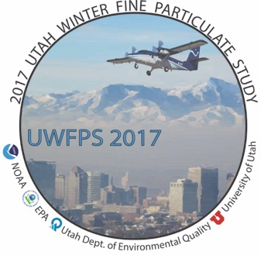

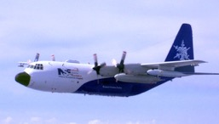
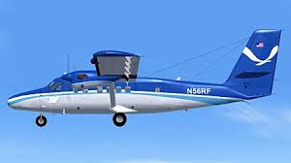

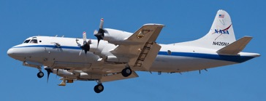
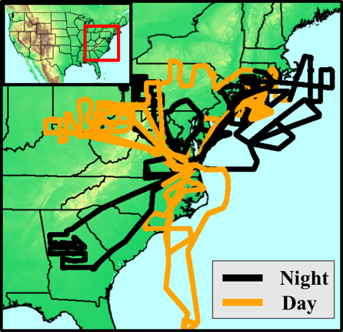
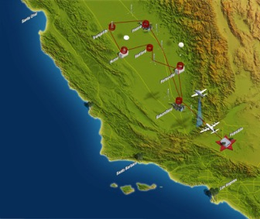
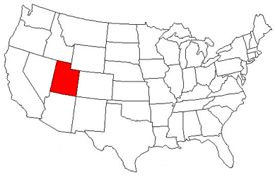
U.S. Winter Aircraft Studies
DISCOVER-AQ 2013
Deriving Information on Surface Conditions from Column and Vertically Resolved Observations Relevant to Air Quality
WINTER 2015
Winter Investigation of Transport Emissions and Reactivity
UWFPS 2017
Utah Winter Fine Particulate Study
NSF C 130
NOAA Twin Otter
NASA P-3

Slide 8
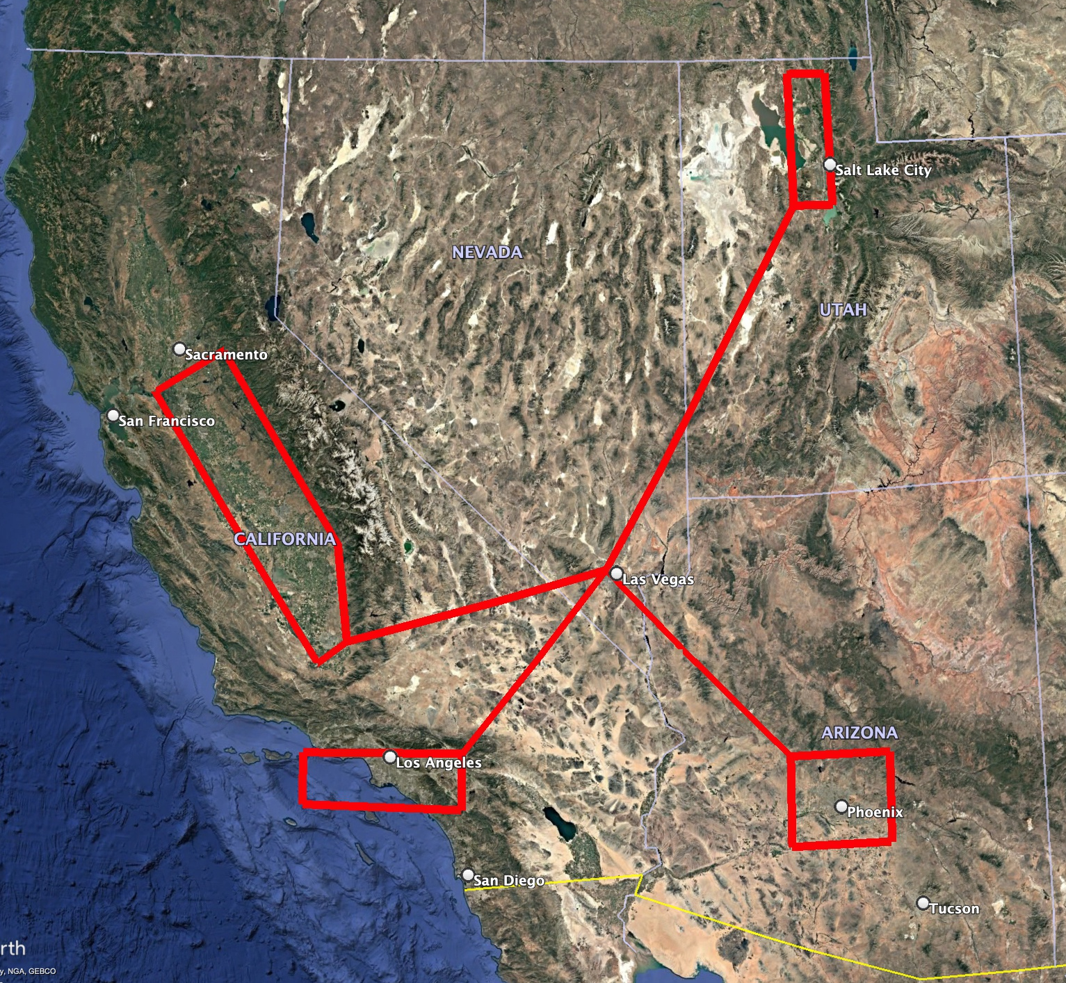
Winter 2028 Airborne Deployment out of Las Vegas
P-3 Based in Las Vegas, NV in range of the San Joaquin Valley, Los Angeles Basin, Phoenix Basin (<1 hour transits) and Salt Lake Basin (1.2 hour transit)
Climatology of southwest U.S. makes combined wintertime in-situ / remote sensing field campaign feasible
Statements of interest / support from stakeholders in all four of the southwestern states (CA, NV, AZ, UT) in support of a winter field study
Under-sampled region during winter pollution season

Slide 9
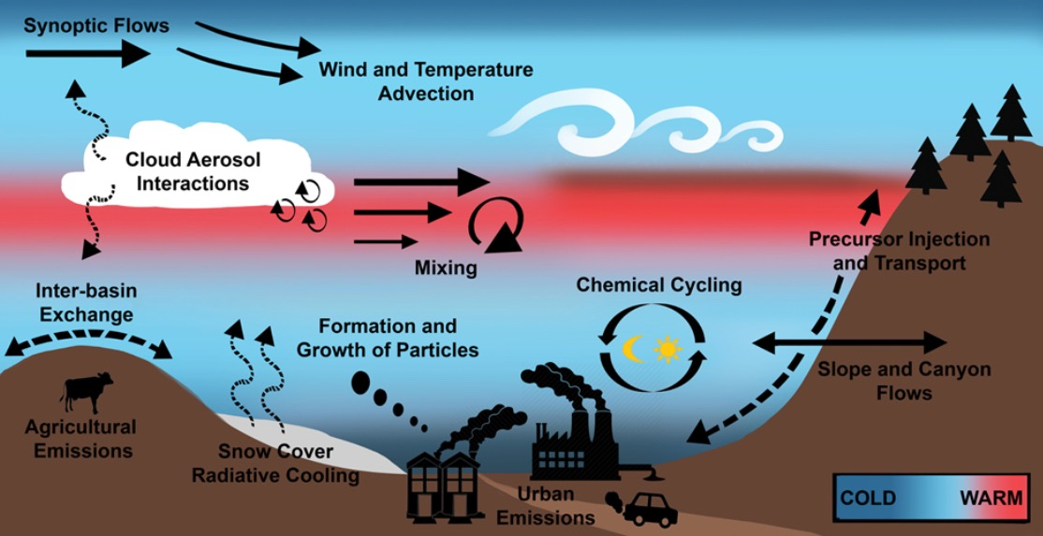
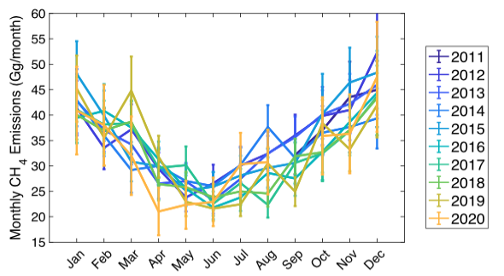
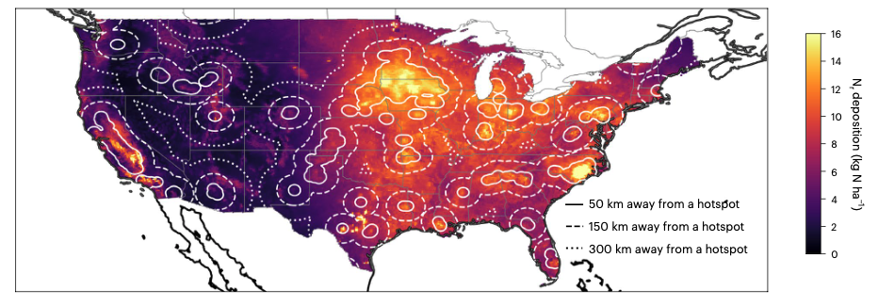
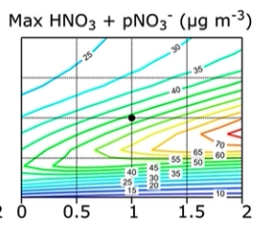
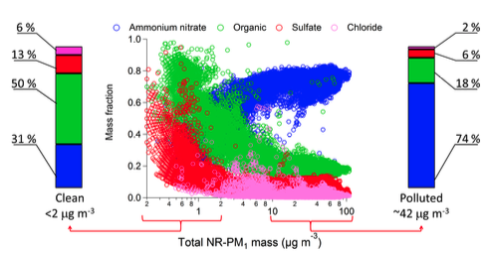
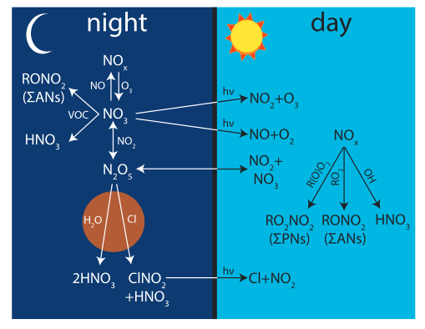
Winter Air Quality Science Topics (Partial List)
Basin & cold pool boundary layer dynamics, and interaction with emissions and chemistry
Air pollutant and greenhouse gas emissions and seasonality
Agricultural, urban and industrial emissions and their interactions
Chemical cycles governing air quality that are unique to the winter season
Aerosol thermodynamics, semi-volatile species, limiting reagents
NO_{x} lifetime, oxidation mechanisms and transport
High SZA remote sensing retrievals and diel cycles
Zeng, Nat Com 24
Hallar, BAMS 21
Womack, GRL 19
Pan, Nat Geo 24
Kenagy, JGR 18
Franchin, ACP 18
Lack of seasonal airborne observations limits understanding of these issues

Slide 10




Stakeholder Statements of Interest
Clark County Nevada Department of Environmental Sustainability
  Meeting on June 4, 2025
  “DES supports your anticipated 2028 field study, and we believe there is value in furthering aerosol science. We would also be happy to engage with you as you develop your studies scope”
Utah Department of Environmental Quality
  Meeting on June 3, 2025
  Letter of support outlining background of regional particulate matter pollution, Utah’s interest in airborne measurements to address this issue, and the factors that make Utah scientifically unique
Arizona State University, Global Futures Initiative
  Meeting on June 6, 2025
  Strong expression of support for a PM field study; letter of support available upon request
California Air Resources Board
  Meeting on June 18, 2025
  Expression of support – see next talk

