Slide 1

Analysis of Summertime Air Quality in Urban Areas in the United States
TEMPO Science Team Meeting 2025
Katherine Travis¹, James Crawford¹, Laura Judd¹, Prajjwal Rawat¹, Mary Angelique Demetillo¹, Tabitha Lee¹, Rachel Mooers²
NASA Langley Research Center¹, Boston University²
katherine.travis@nasa.gov
*Thanks to EPA colleagues Jim Szykman, Barron Henderson, Luke Valin for their input

Slide 2

Where have there been polluted days between June-August 2022 and 2024?
Days with 24-hour average PM_{2.5} > 12 $μ$g m⁻³
Days with MDA8 ozone > 70 ppb
34 Major Cities (>200,000 people) in 21 States
*2023 had too many fires to include in this analysis.
Notes:
At least 10 ozone exceedances, at least 30 PM exceedances of the annual standard of 12

Slide 3
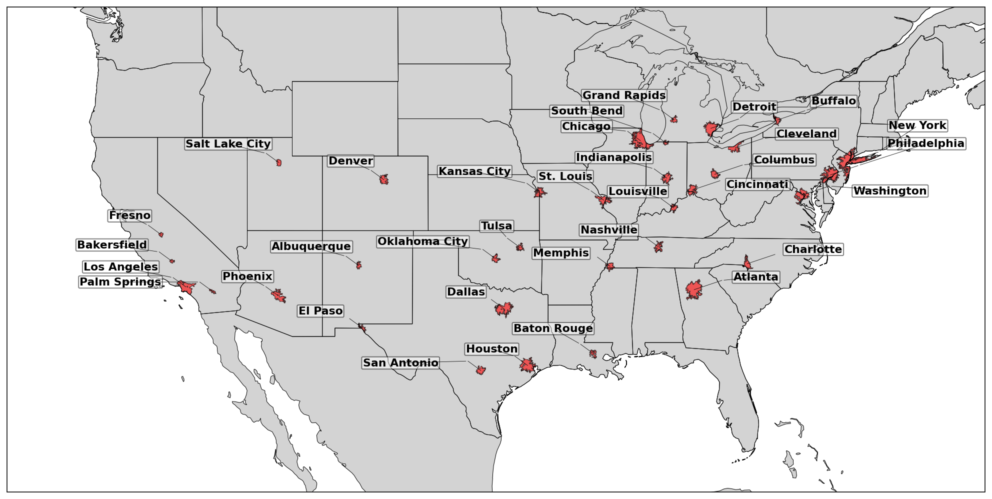
Which cities with >200,000 people have there been days with both ozone and PM_{2.5} pollution in 2022 and 2024?
*excluding 2023 due to fires

Slide 4
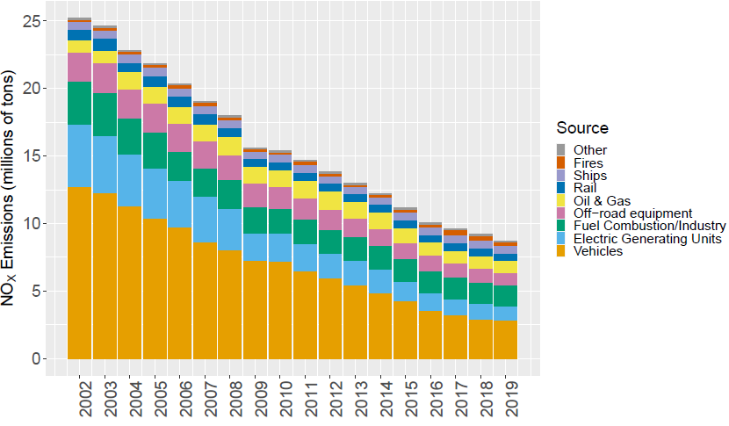
Where do modeled trends not match measurements?
EQUATES: EPA’s Air QUAlity TimE Series Project
2002 – 2019 CONUS model run at 12km using CMAQv5.3.2.
Unique in its application of consistent emissions and modeling methodologies across the entire analysis period (Simon et al., 2024 ACP).
Decline in Anthropogenic NO_{x} Emissions
https://www.epa.gov/cmaq/equates

Slide 5
There are 9 cities with multiple issues in trend and/or magnitude for NO₂, ozone, and PM_{2.5}

Slide 6
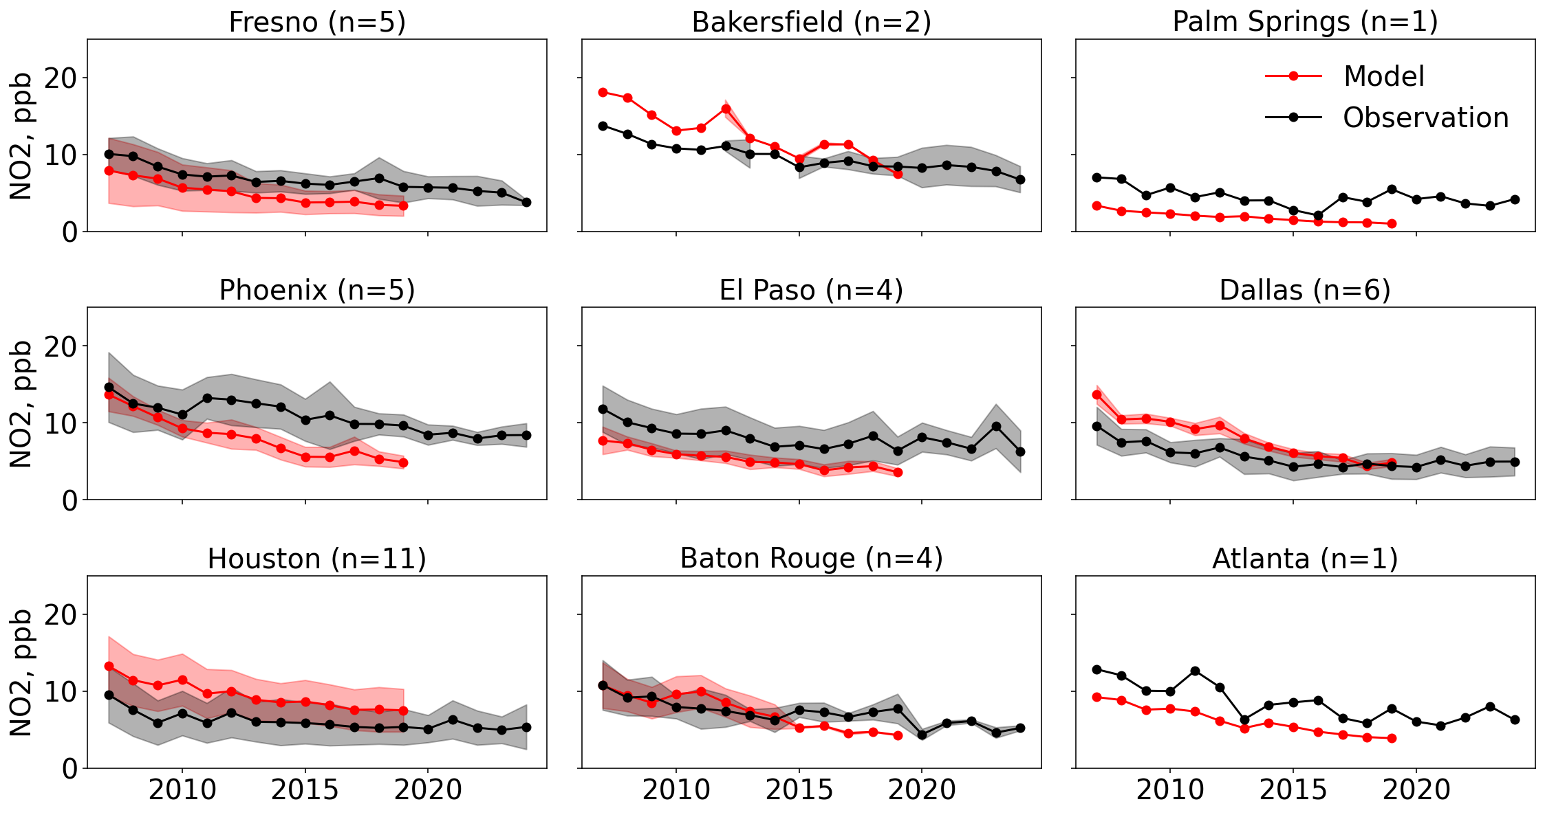
These cities mainly show underestimated NO₂ or overly steep trend
n=number of monitors with > 6 yrs coverage
Houston has the only consistent overestimate (~3 ppb/50%).
Significant underestimates in 2019: -80% Palm Springs, -50% Atlanta, Phoenix, Baton Rouge, -40% El Paso, Fresno.
Poorly captured trends in Bakersfield, Phoenix, Dallas, and Baton Rouge.
Notes:
Atlanta is NOx-limited. Xiaomeng Jin - EnvironSciTechnol. 2020 June 02; 54(11): 6518–6529. doi:10.1021/acs.est.9b07785.
Decrease in Fresno (-4ppb), Bakersfield (-5 ppb), Palm Springs (-2 ppb), Phoenix (-5 ppb), El Paso (-5 ppb), Dallas (-5 ppb), Houston (-4 ppb), Baton Rouge (-3 ppb), Atlanta (-5 ppb)

Slide 7
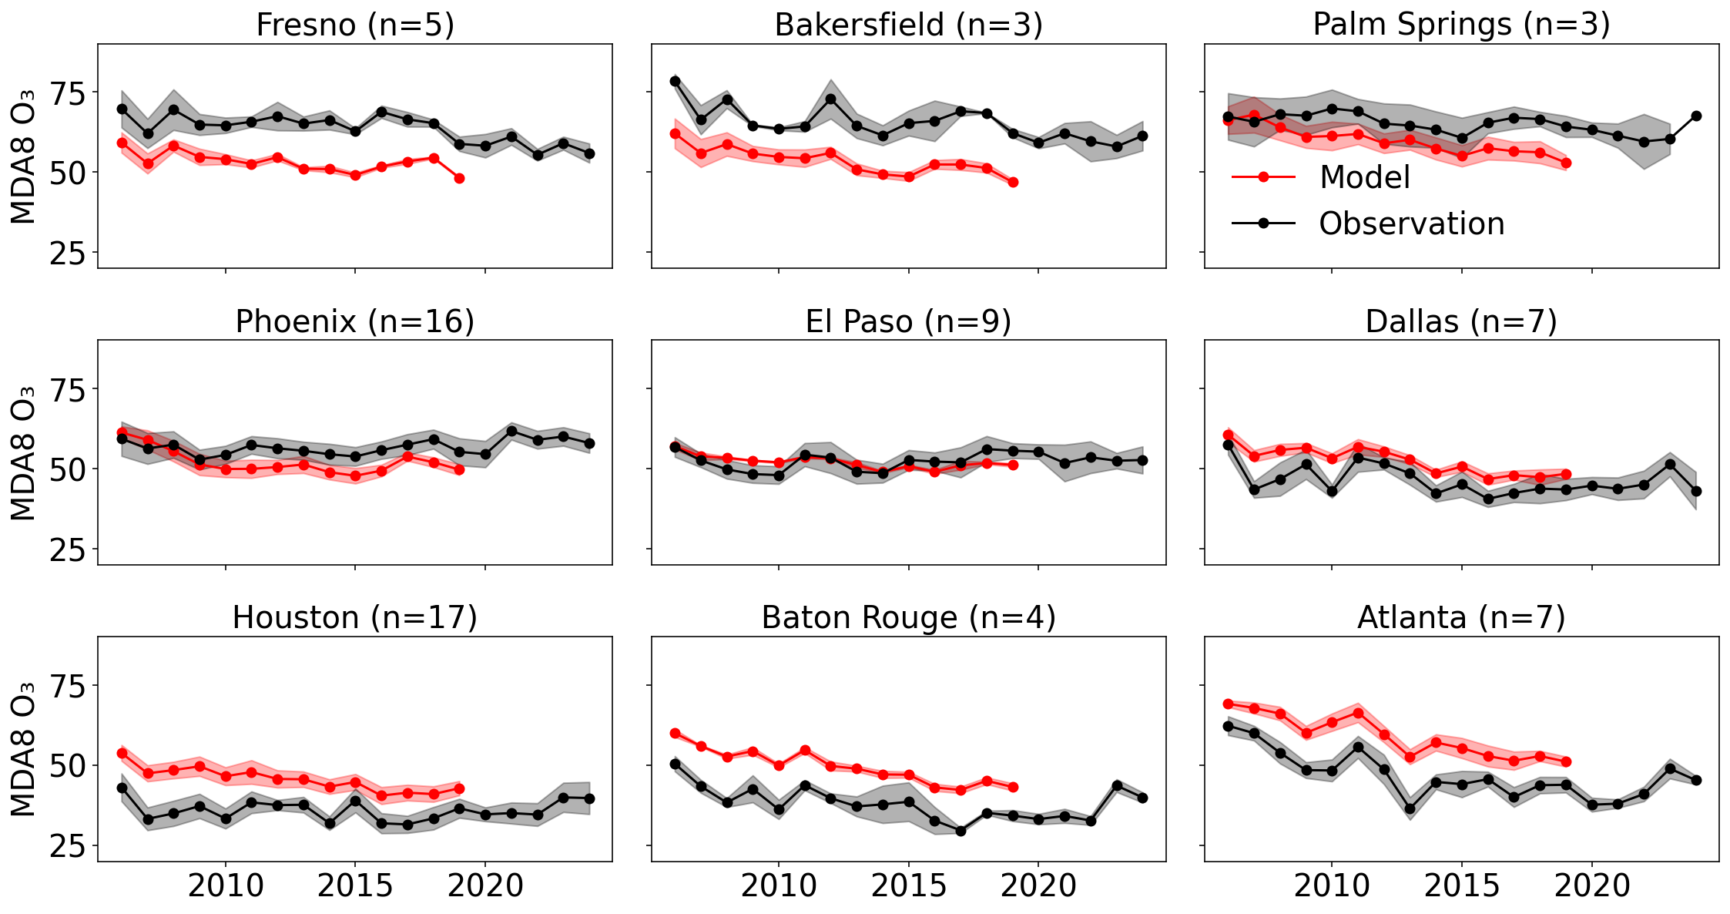
Eight of these cities have poorly modeled ozone
Underestimated ozone in Fresno (-11 ppb), Bakersfield (-15 ppb), Palm Springs (-11 ppb), Phoenix (-6 ppb).
Overestimated ozone in Dallas (5 ppb), Houston (6 ppb), Baton Rouge (9 ppb), Atlanta (7 ppb).
Largest decrease in Atlanta (-16 ppb)
Underestimated ozone in the west/overestimated ozone in the southeast is a long-standing issue. (Skipper et al., 2024)
Notes:
Southeast has seen the largest decline in ozone out of all the locations.

Slide 8
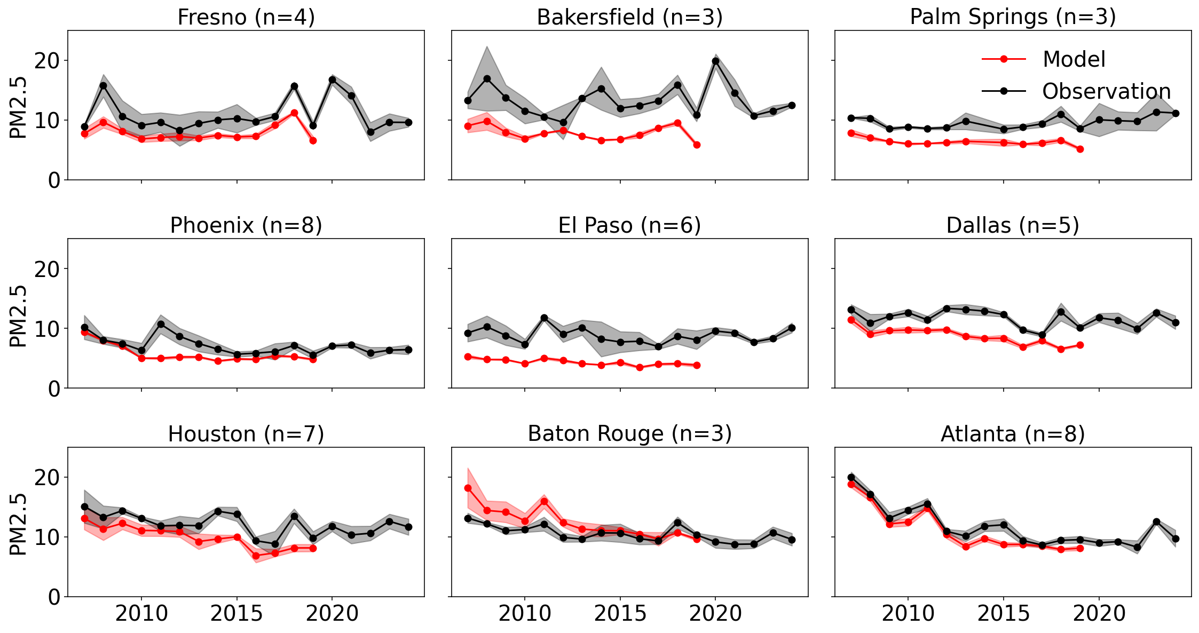
Daily average PM_{2.5} is generally biased low
Biases of -50% (El Paso, Bakersfield), -40% (Palm Springs), -30% (Dallas, Fresno), -20% (Houston).
Largest decrease in Atlanta (-10 $μ$g m⁻³).
Nassau & Jaeglé, 2025: PM_{2.5} declines have stagnated/reversed due to slowing sulfate reductions and increased OA.

Slide 9
TEMPO NO₂ and HCHO are biased low at high values (>1-1.5E16 molec cm⁻²)
n=31
n=21
Adapted from ongoing reports produced by the EPA (Henderson, 2025).
Rawat et al. submitted – HCHO is biased low by ~20% for values > 1.5×10¹⁶ molecule cm⁻²
Ghahremanloo et al., 2025 – NO2 is biased low by ~30% for values > 1.3×10¹⁶ molecule cm⁻²
Notes:
Highest HCHO is in the Southeast. Highest NO₂ is in Mexico City and New York/New Jersey.

Slide 10
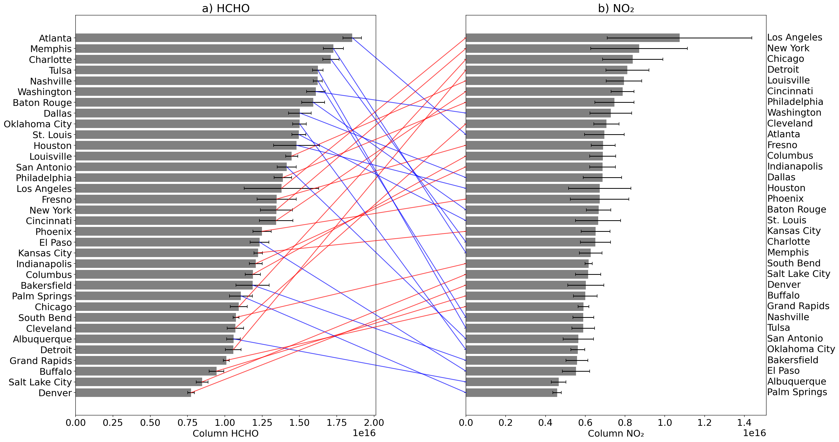
10 cities rank in the top half for both TEMPO HCHO and NO₂
Atlanta, Baton Rouge, Dallas, Fresno, Houston, Los Angeles, Louisville, New York, Philadelphia, Washington.
Notes:
Big difference in HCHO vs. NO₂ rank: Detroit (#30 / #4), Tulsa (#4 / #28), Chicago (#26 / #3), Nashville (#5 /#27)

Slide 11
Ranking all cities by TEMPO HCHO and NO₂ highlights cities with high values for both
5 cities that overlap with poor model trends: Atlanta, Baton Rouge, Dallas, Fresno, Houston
Notes:
Big difference in HCHO vs. NO₂ rank: Detroit (#30 / #4), Tulsa (#4 / #28), Chicago (#26 / #3), Nashville (#5 /#27)

Slide 12
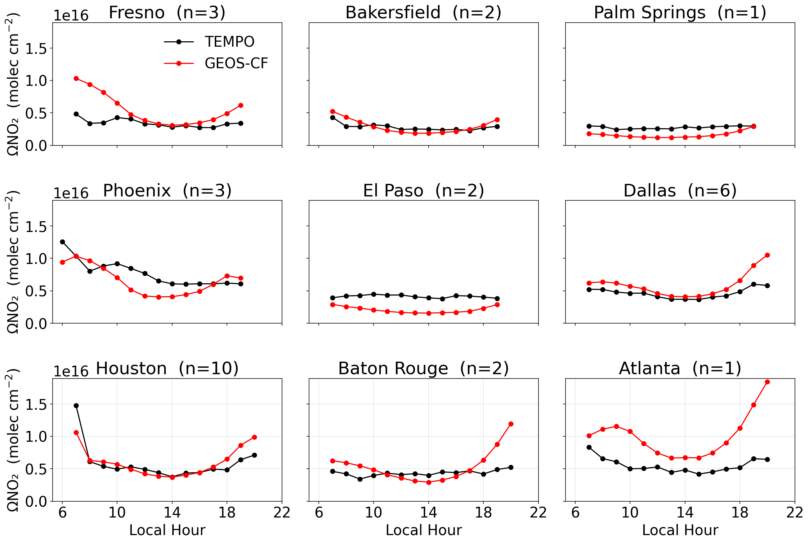
GEOS-CF has a more pronounced diurnal cycle for column NO₂ in most of the cities
The morning and afternoon hours tend to be exaggerated in the model.
Particularly poor performance occurs in Fresno, Dallas, Baton Rouge, and Atlanta.
2024 June-August

Slide 13
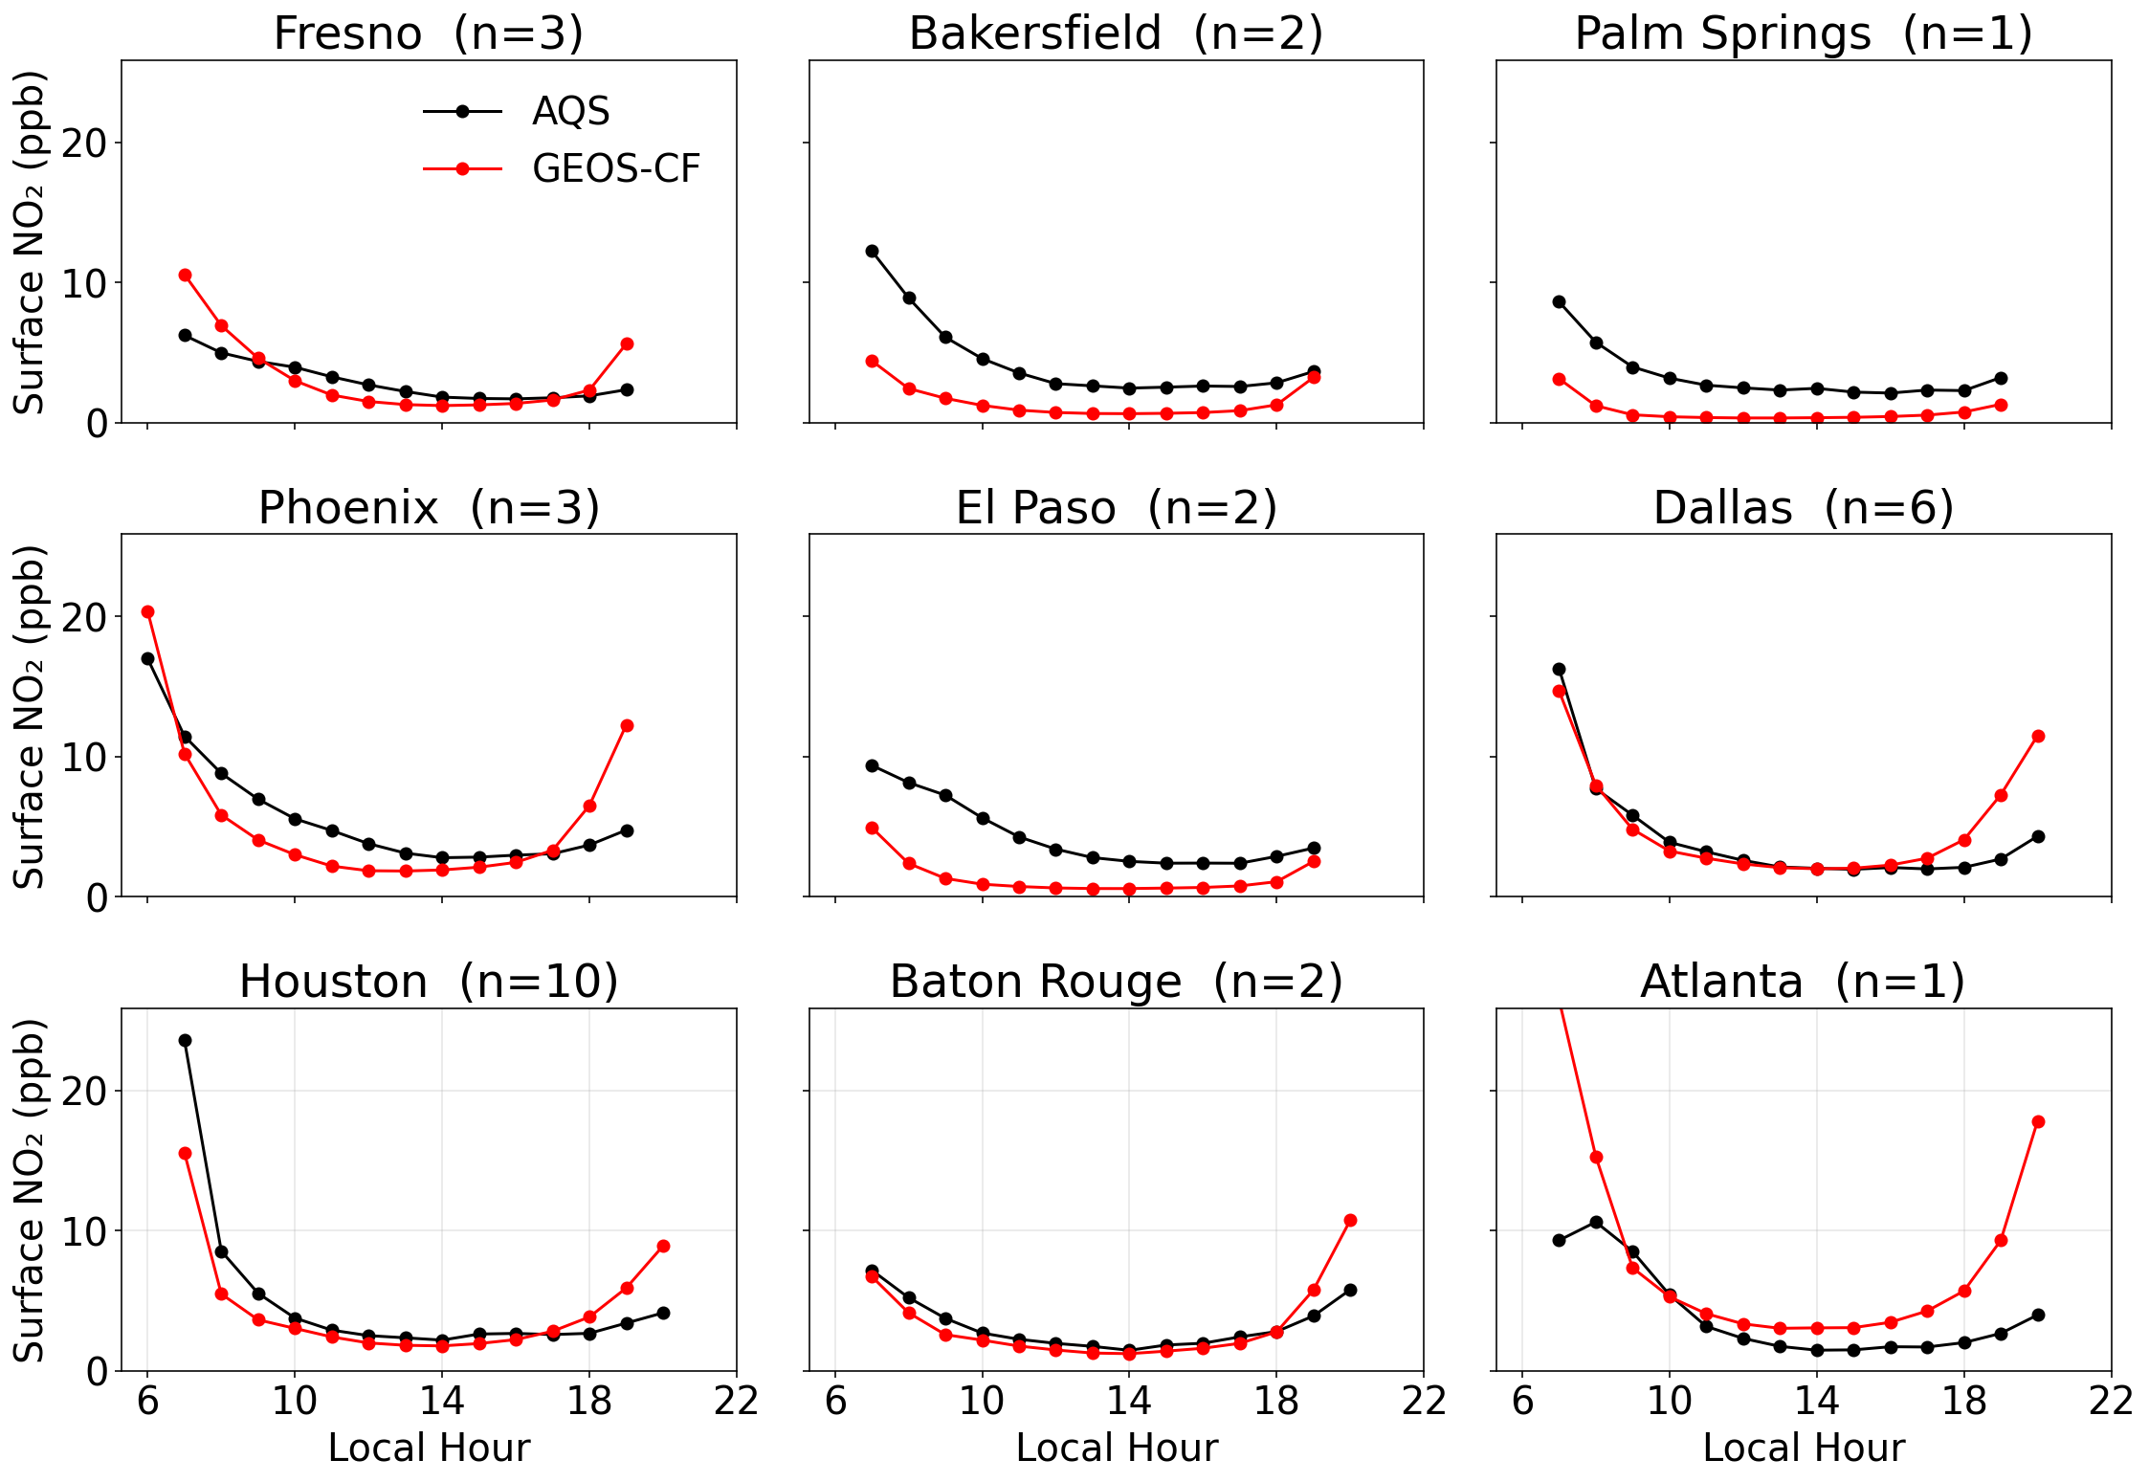
The surface NO₂ comparison shows a similar issue
The morning and afternoon hours tend to be exaggerated in the model.
Particularly poor performance occurs in Fresno, Dallas, Baton Rouge, and Atlanta.
2024 June-August
Notes:
Find out

Slide 14
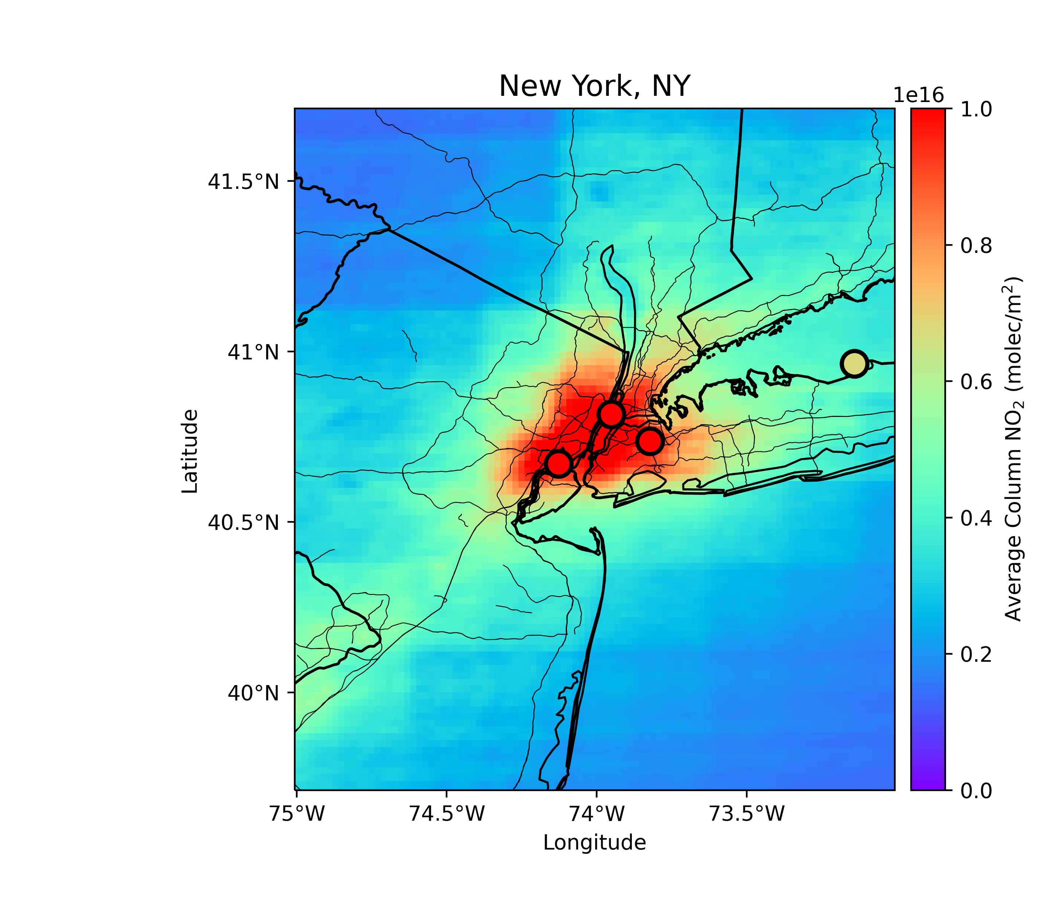
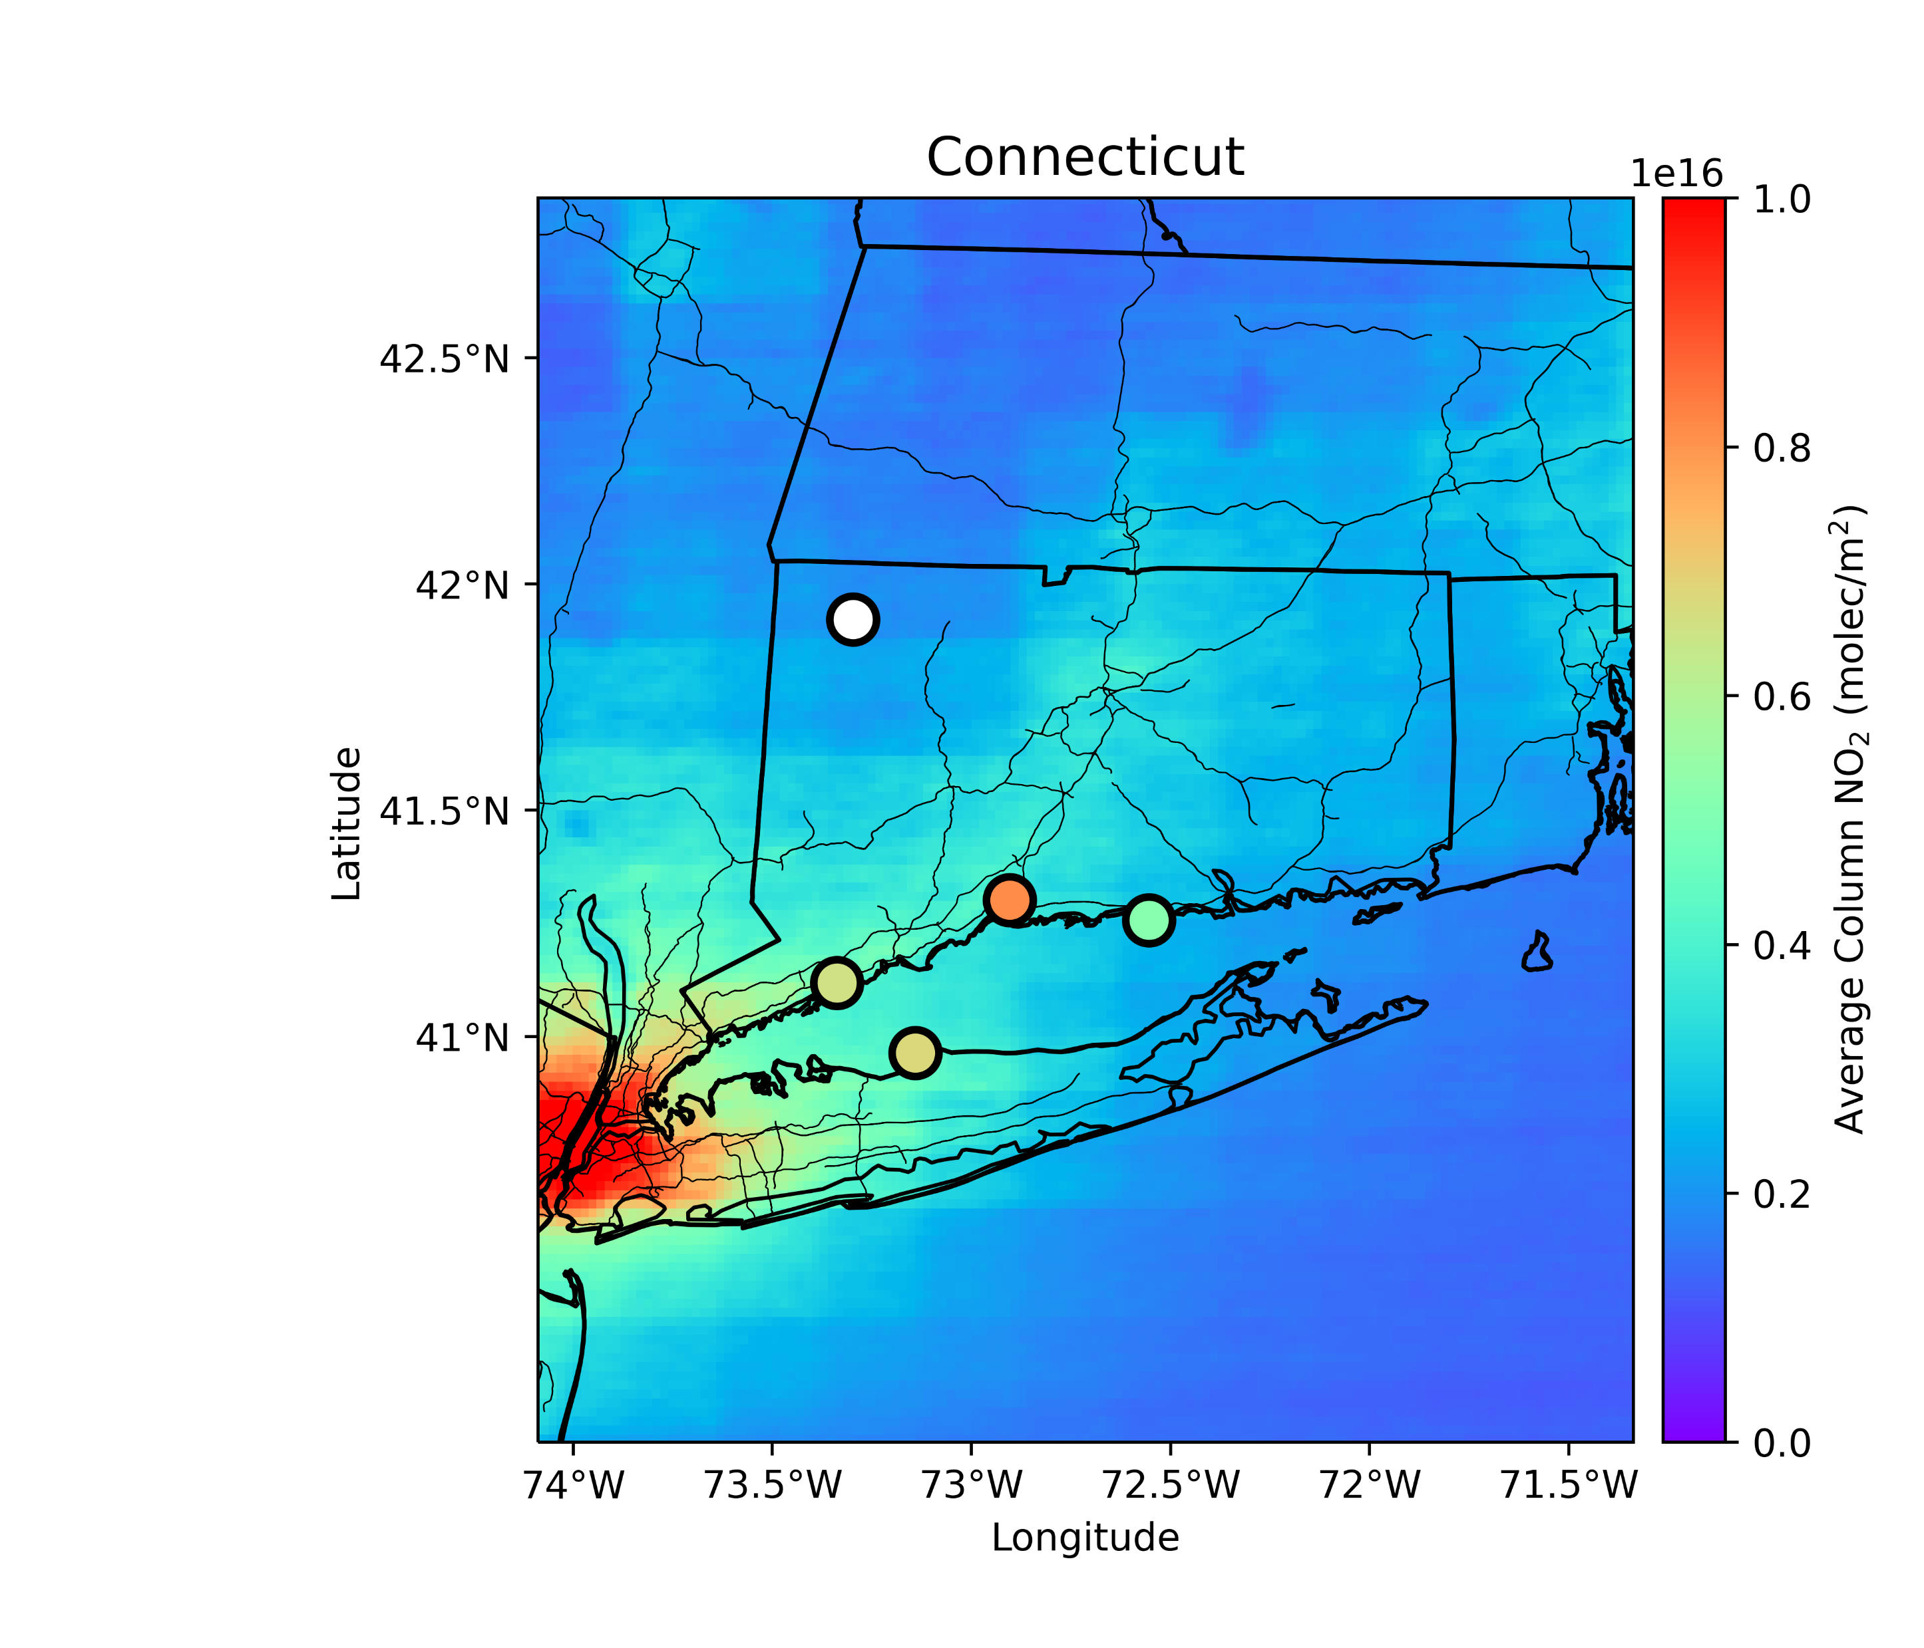
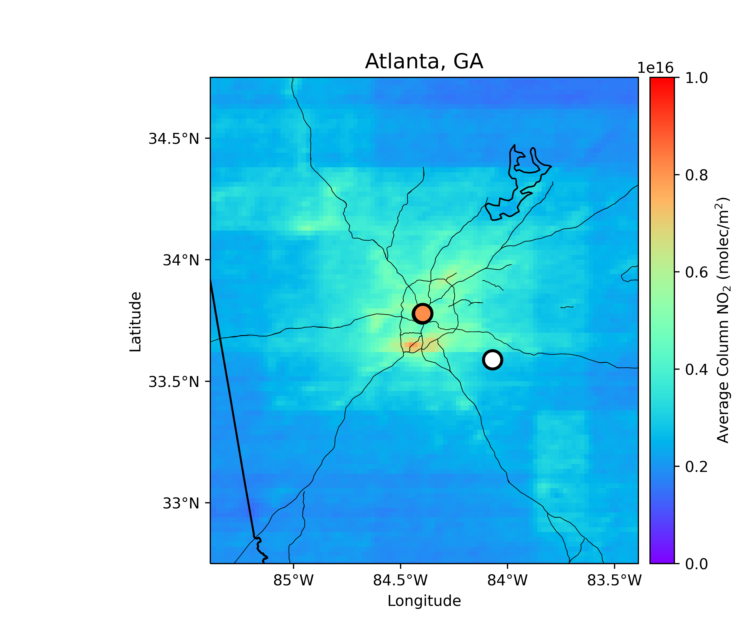
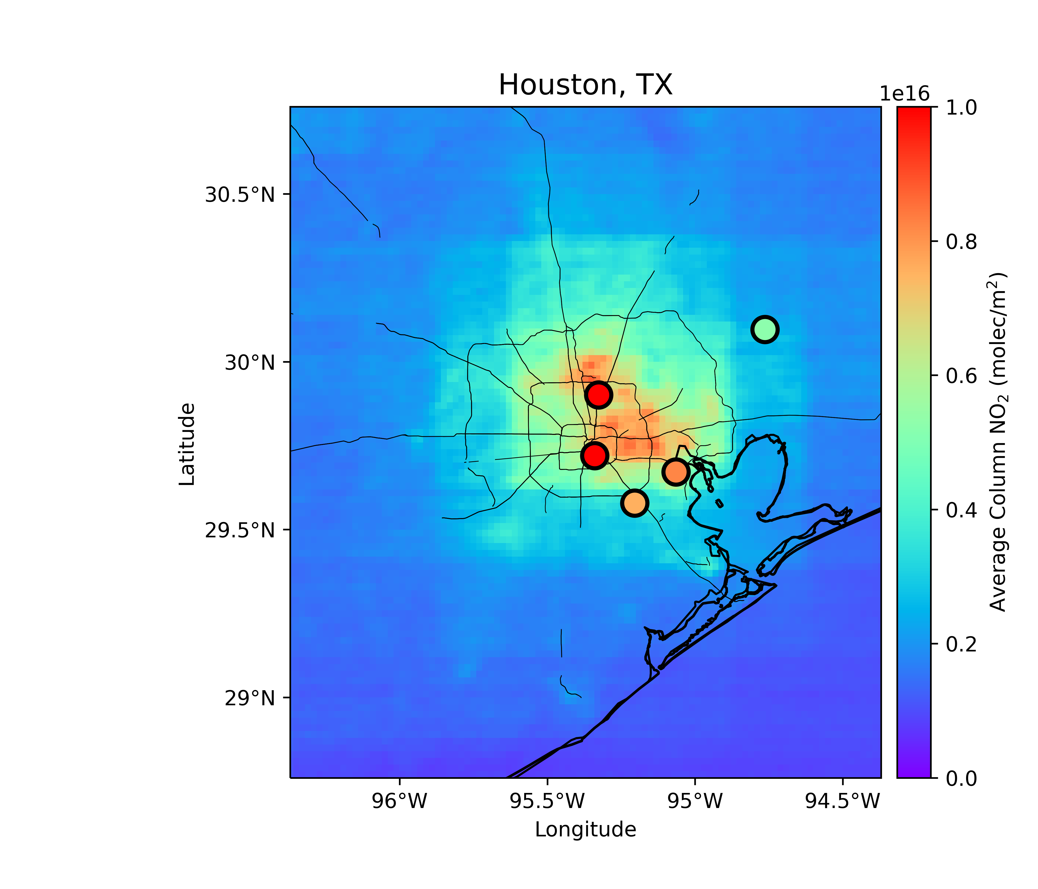
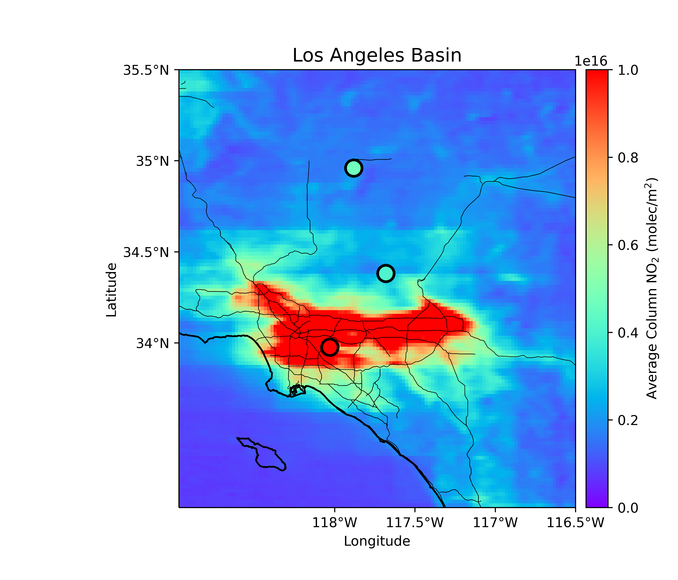
Rachel Mooers: Poster #16 – Performance of TEMPO Diurnal Variability compared to Pandora Observations in US Cities
New York, NY : High average NO₂, largest urban area in the U.S. by population, subject to coastal effects.
Connecticut: Suburban, downwind of NYC, subject to coast effects. TEMPO is biased high compared to coincident Pandora observations (Figure 2 Panels 3-4).
Atlanta, GA: NO₂ pollution from urban sources and high biogenic VOCs. Its flat, inland location provides a chance to study emissions and transport without being confounded by complex topography.
Houston, TX: Anthropogenic NO₂ emissions from a variety of sources including automobiles and oil refining. Five local Pandora sites.
Wrightwood and LA Basin, CA: Poor TEMPO performance, possibly because of the terrain, making it a good opportunity to understand TEMPO in a mountainous area.

Slide 15
Conclusions
There are 34 cities in 21 states with multiple days of high PM_{2.5} and ozone in 2022 and 2024.
Atlanta, Baton Rouge, Dallas, Fresno, and Houston have model difficulties capturing the trend and/or magnitude of surface NO₂, ozone, and PM_{2.5} and have high TEMPO column NO₂ and HCHO.
GEOS-CF comparison shows an overly pronounced diel cycle particularly clear in Atlanta, Baton Rouge, Dallas, and Fresno.
EPA model (EQUATES) highlights an unresolved community-wide issue of overestimated ozone in the Southeast, underestimated ozone in the West (e.g., Skipper et al., 2024).
katherine.travis@nasa.gov
Notes:
TEMPO is biased low against Pandora at the highest NO2 and HCHO columns.
Mexico City should be an excellent location to explore high column NO₂.
High column NO2 and HCHO: Atlanta, Baton Rouge, Dallas, Fresno, Houston, Los Angeles, Louisville, New York, Philadelphia, Washington.
AQ model vs obs issues: Fresno, Bakersfield, Palm Springs, Phoenix, El Paso, Dallas, Houston, Baton Rouge, Atlanta
Pandoras in Atlanta (n=3), Dallas (n=1 at Arlington, Texas)

Slide 16
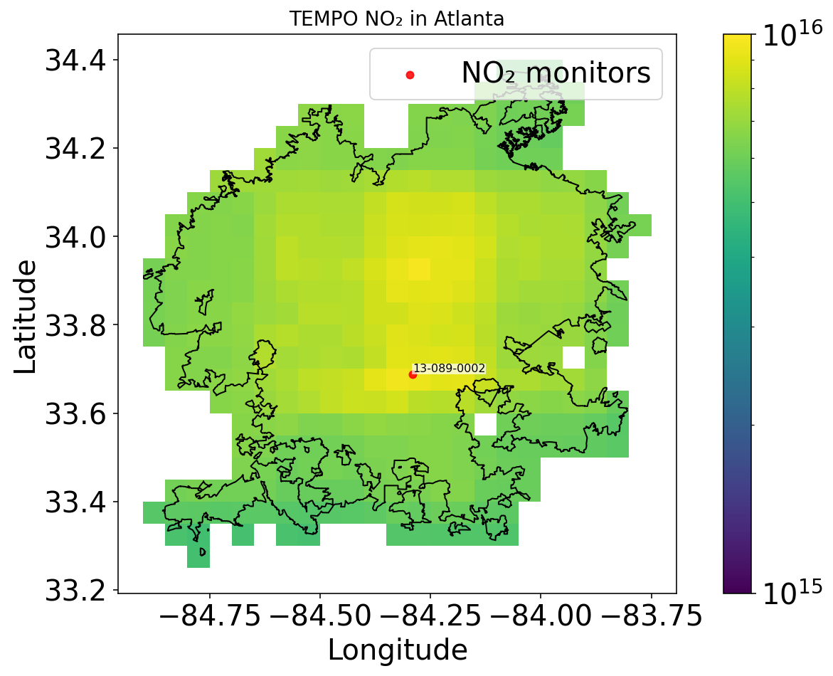
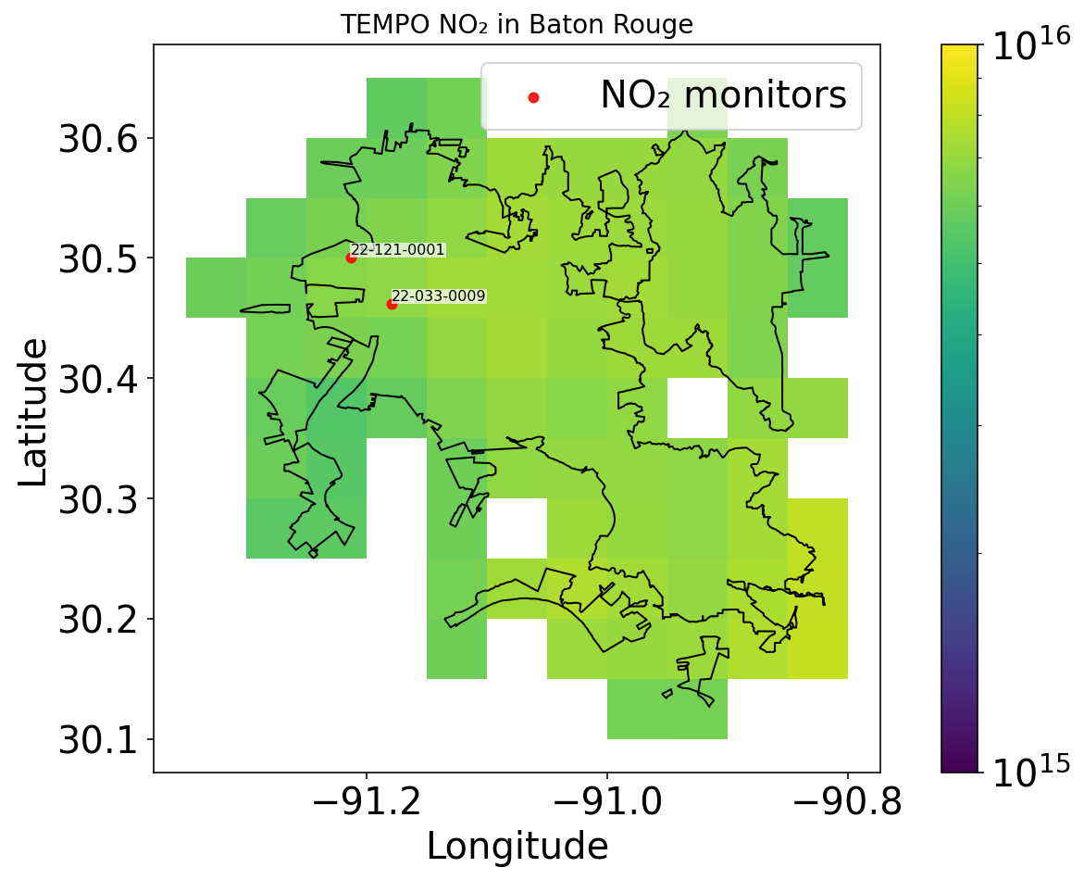
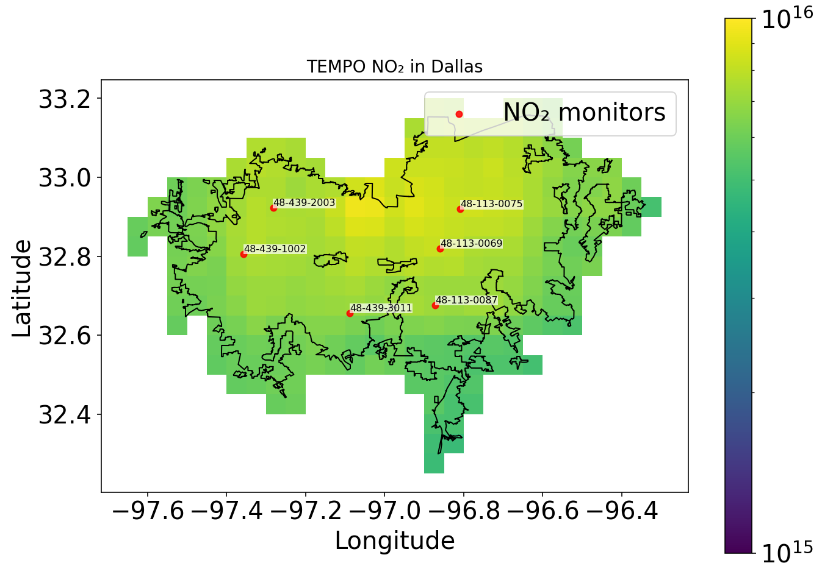
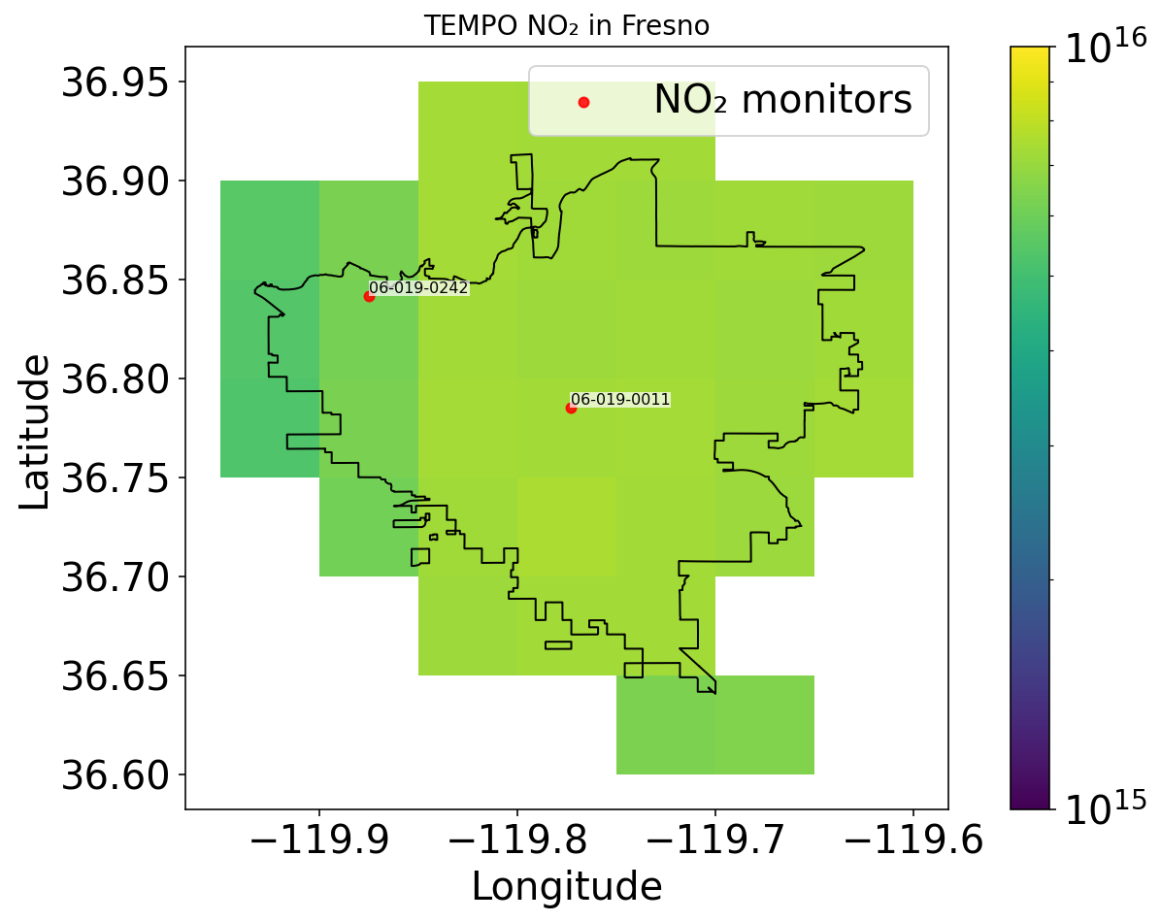
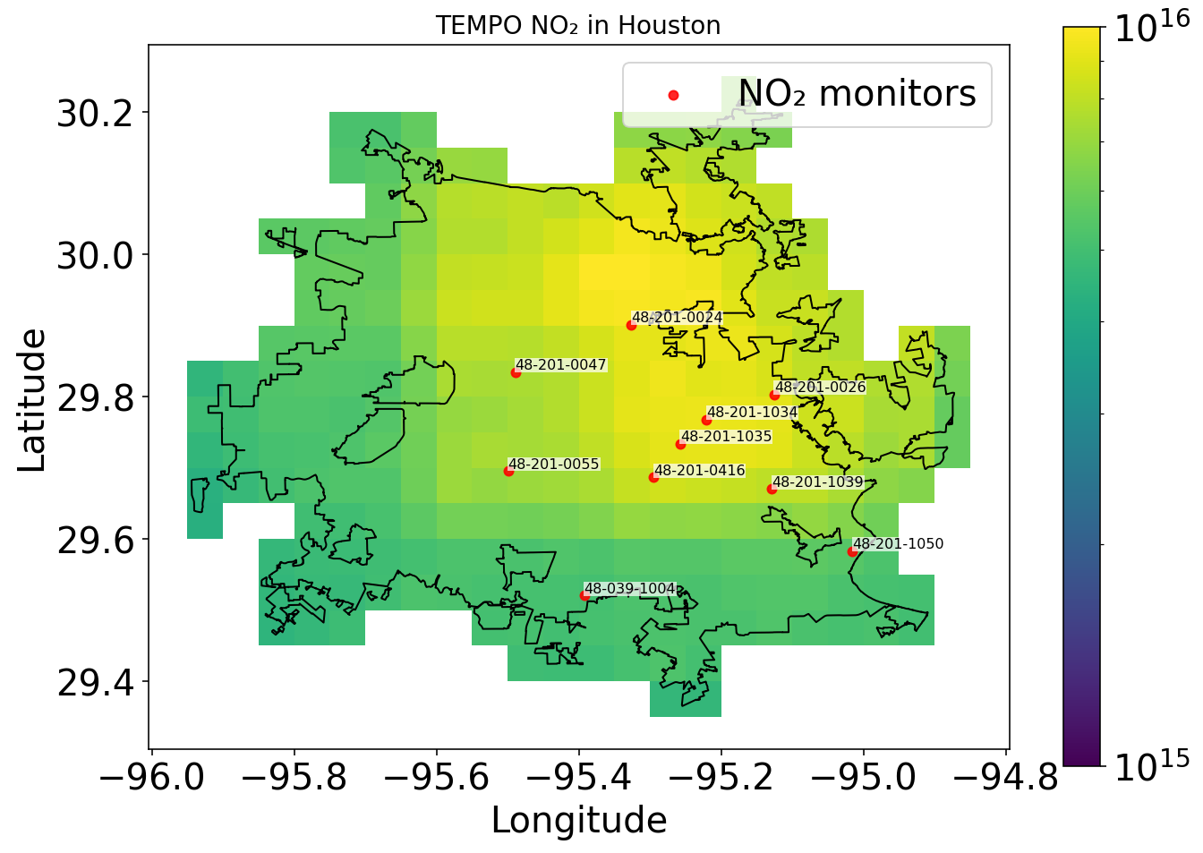

Slide 17
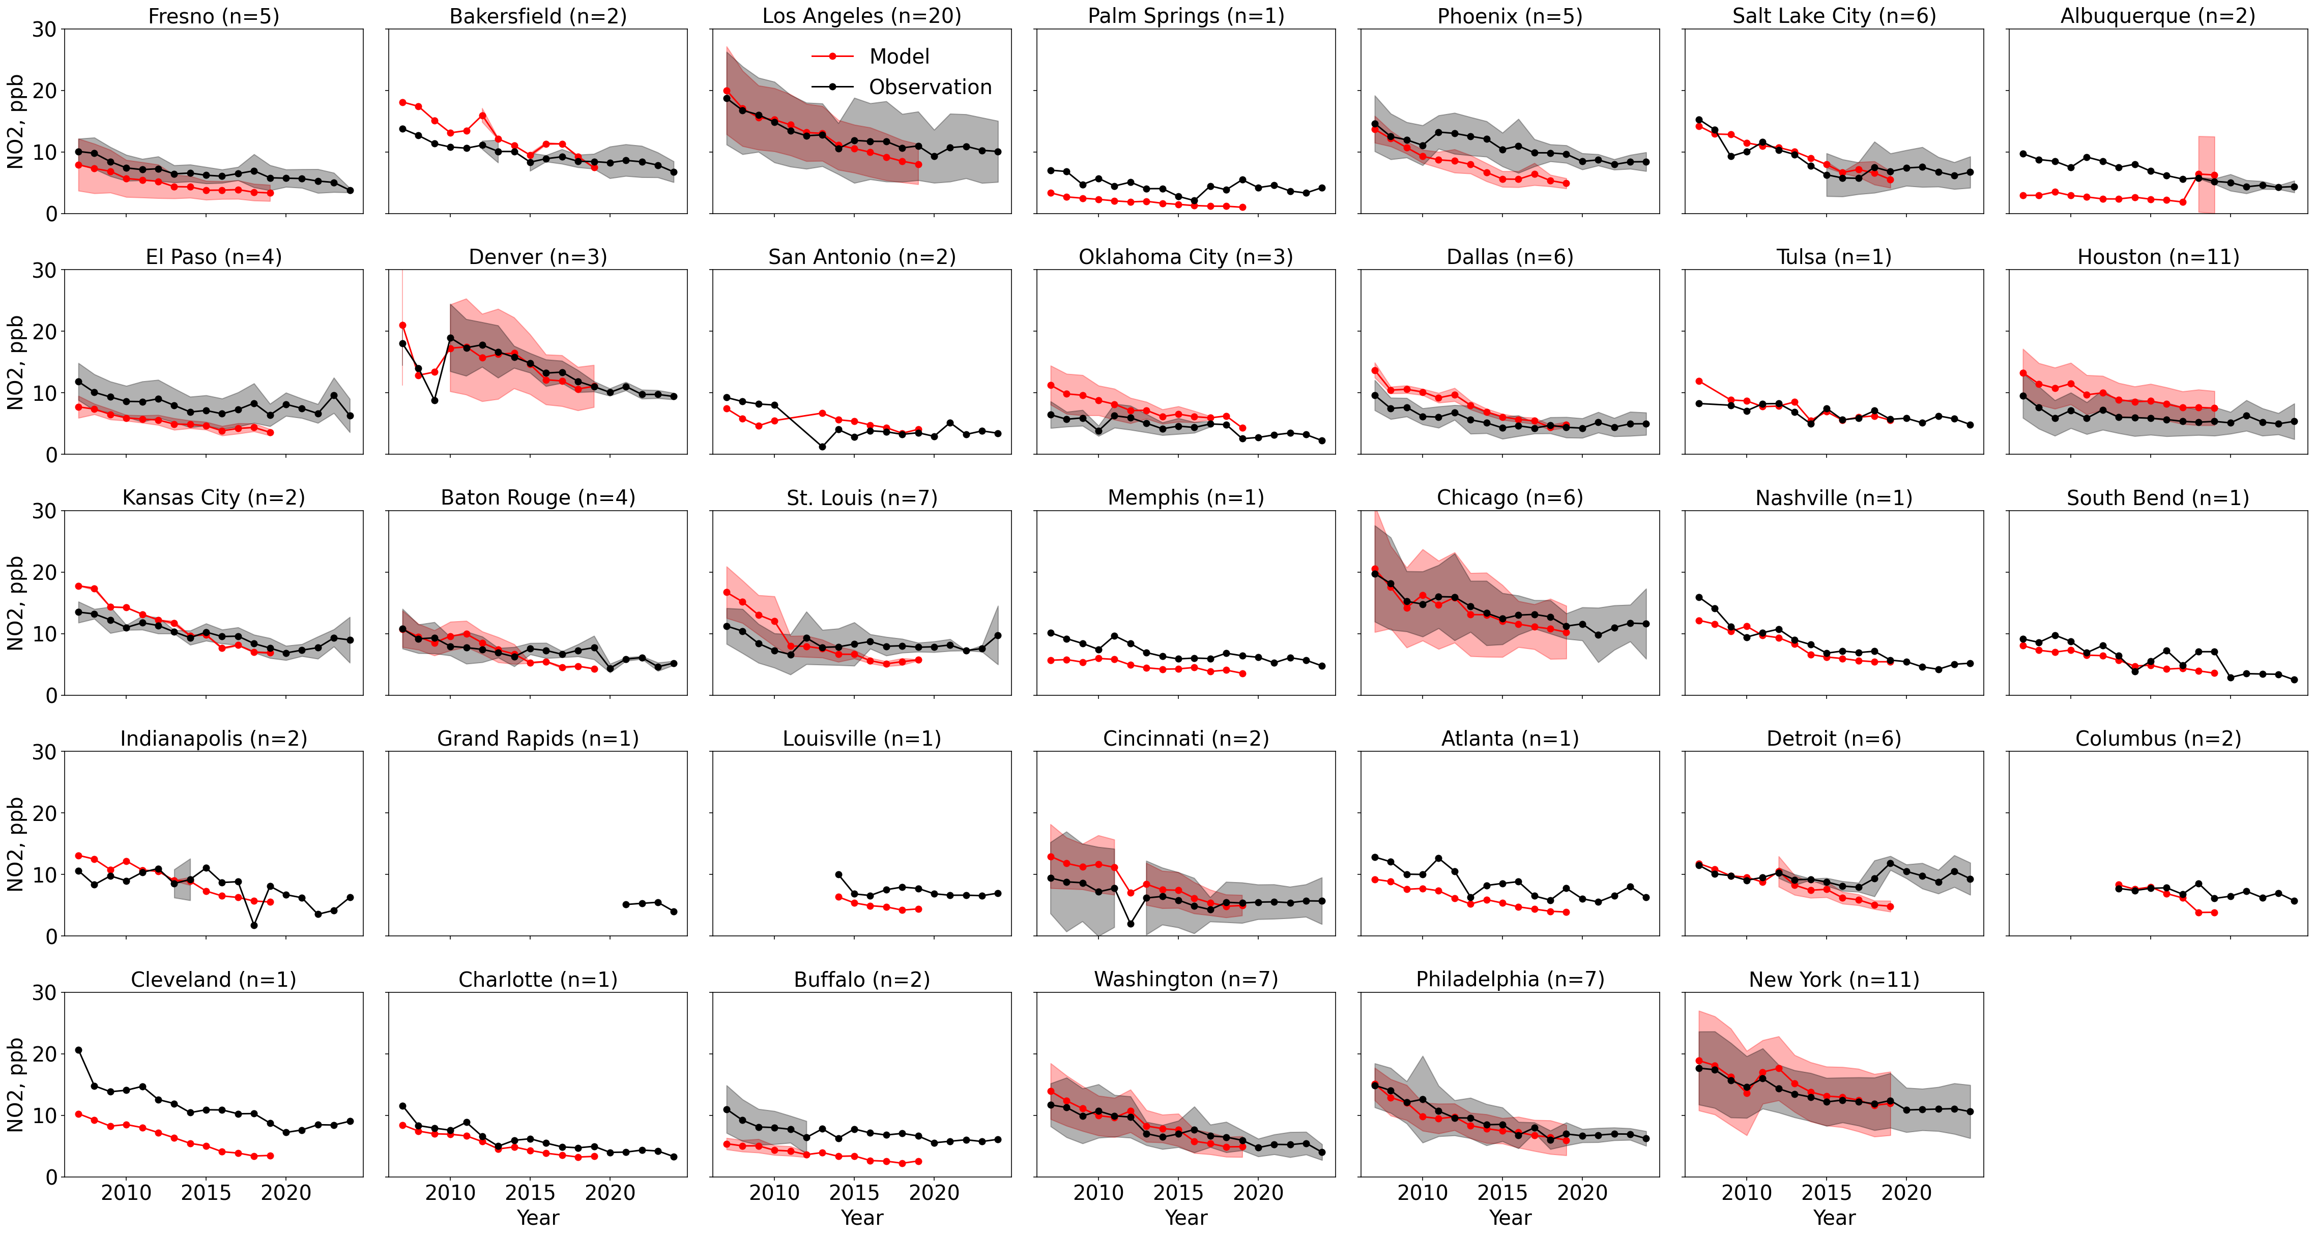

Slide 18
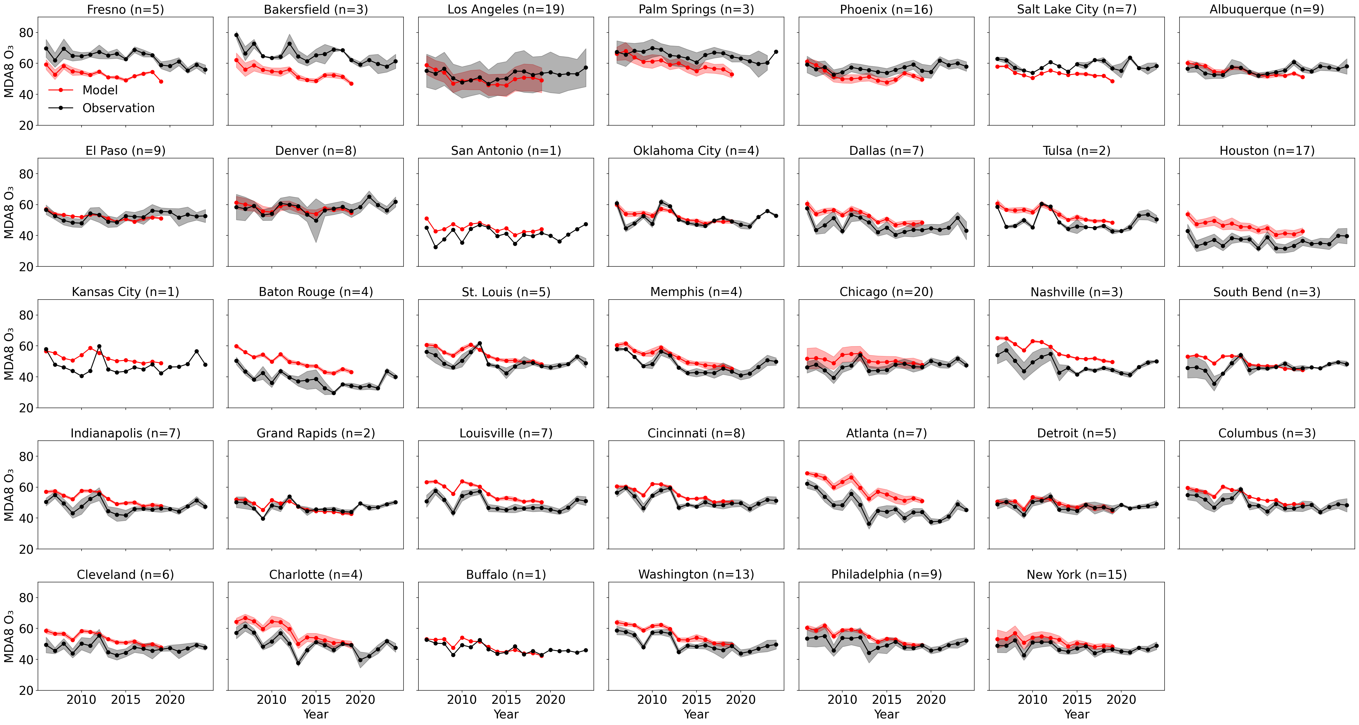

Slide 19
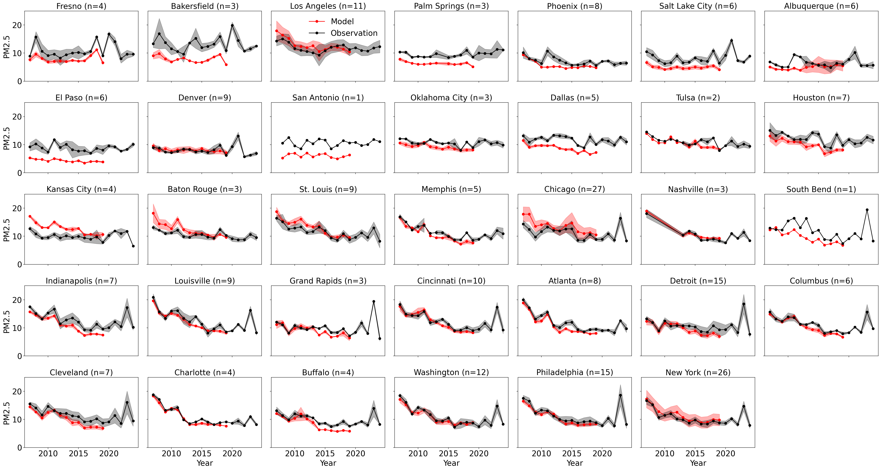

Slide 20
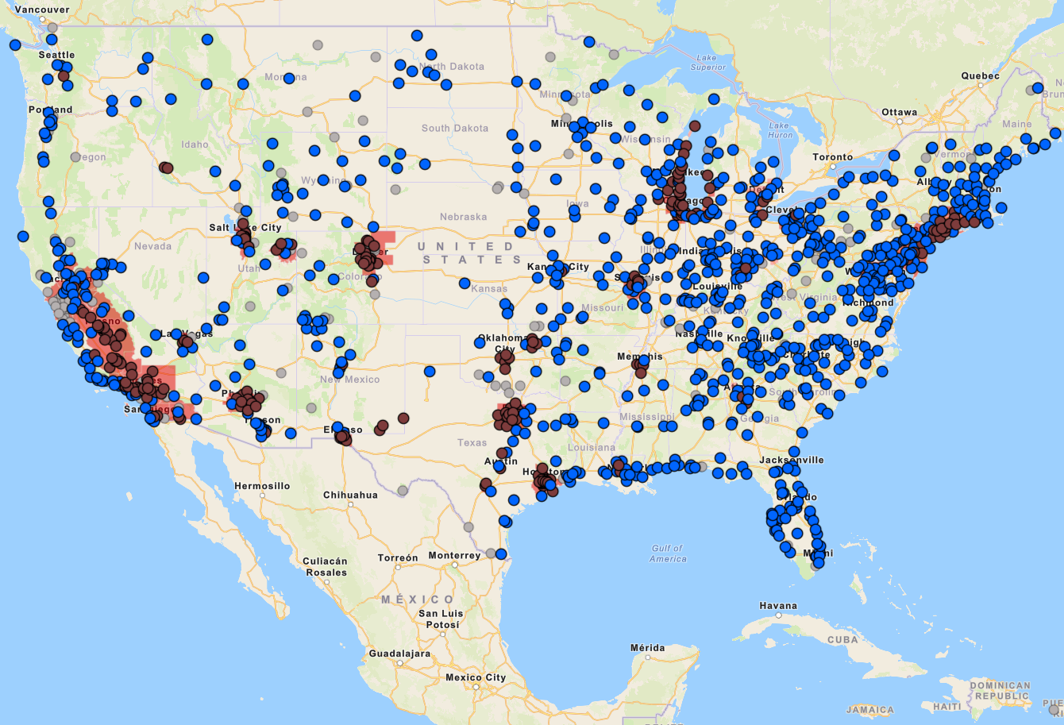
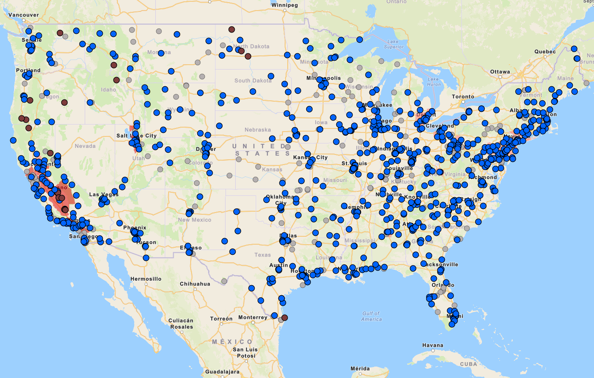
Ozone and PM2.5 Non-attainment Areas
Ozone
PM2.5
California, Utah, Colorado, Arizona, Texas, Missouri, Georgia, Illinois/Michigan/Indiana, Ohio, DC/Maryland, Pennsylvania, New York, Connecticut
California, Utah, Wisconsin, Michigan, Ohio, Alabama, Tennessee, West Virginia, Pennsylvania, New York, Connecticut

