Slide 1



Supporting Decision Needs and Use Cases with TEMPO:
Lessons Learned from NASA Health and Air Quality Applied Sciences Team
Jenny Bratburd, PhD
University of Wisconsin-Madison
21 August 2025

Slide 2
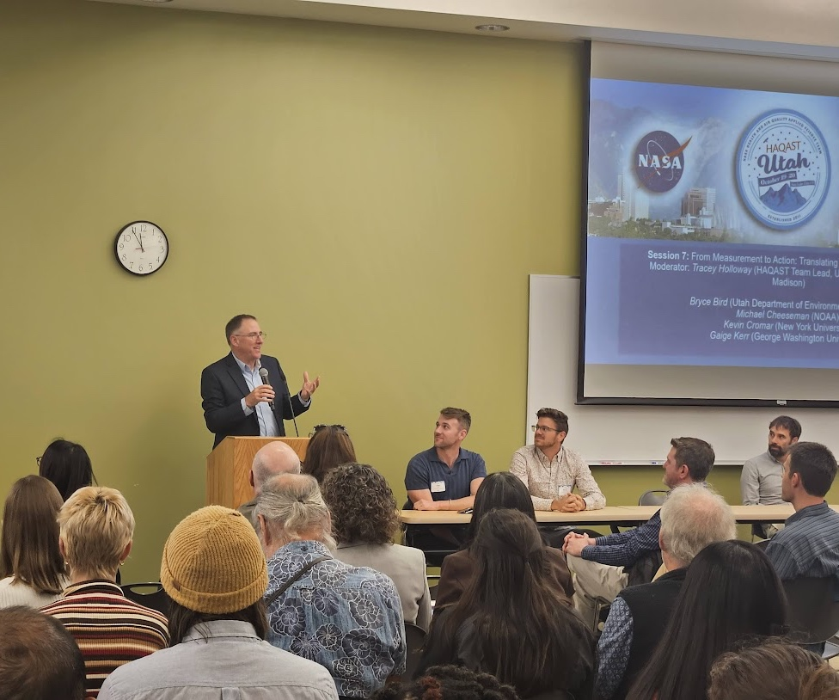
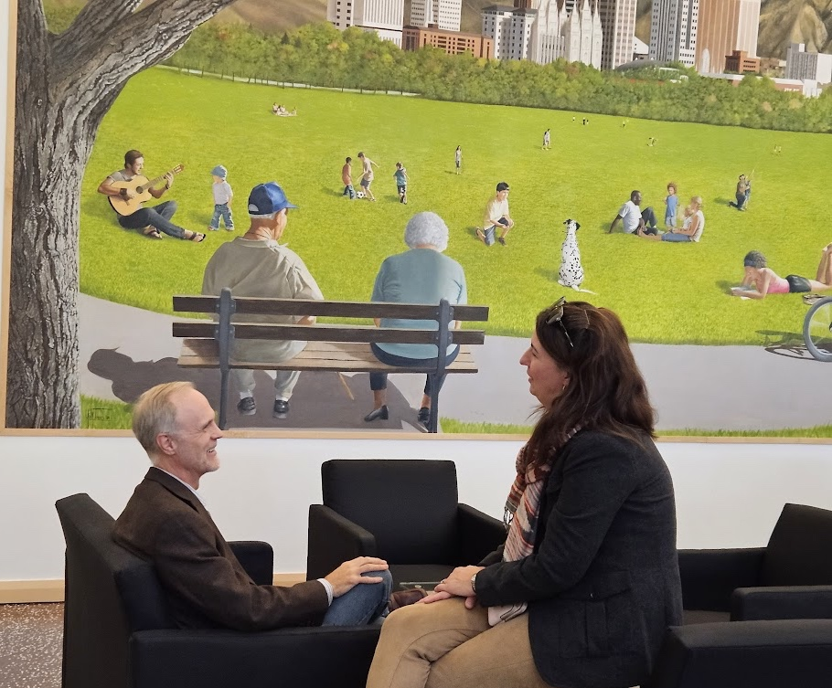
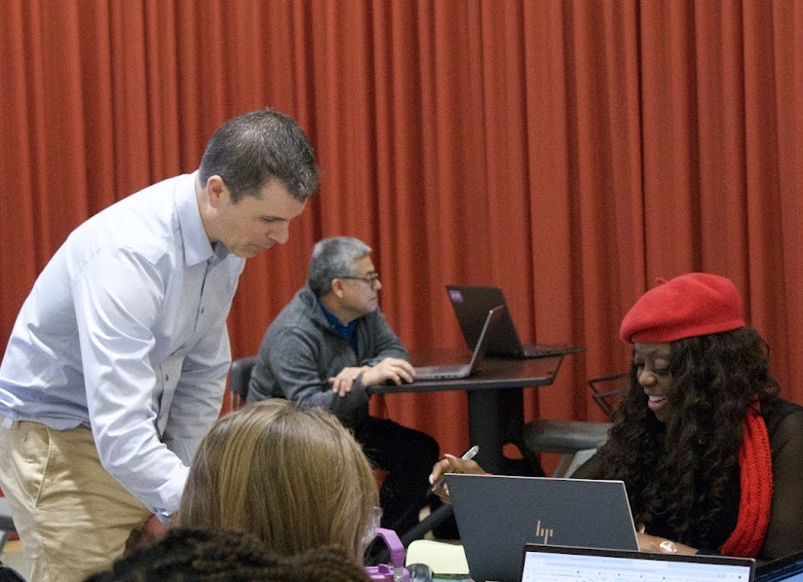
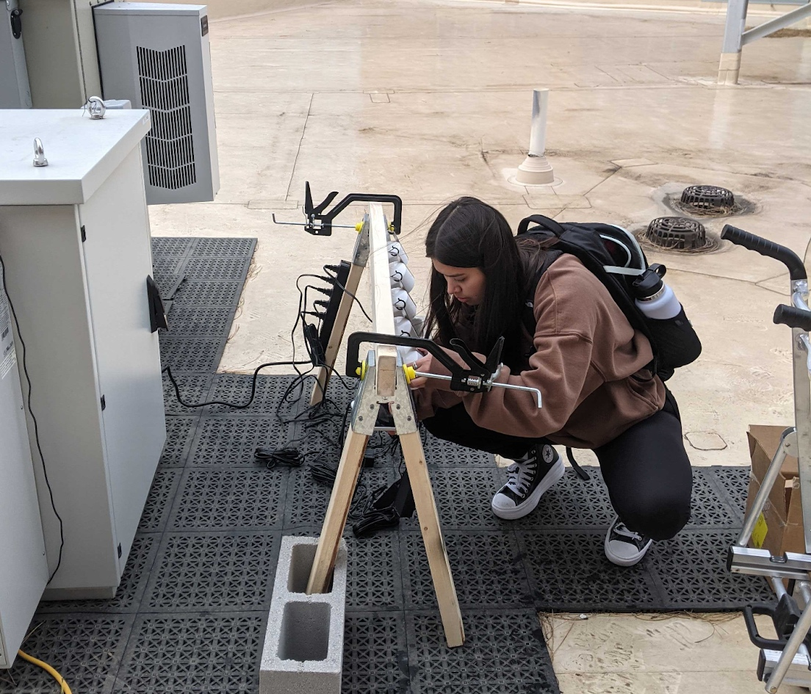
Building Trust
Data for improved decision-making depends on
  Trust, understanding
Trust built through
  Repeated interactions
  Listening
  Networks and relationships
Notes:
Dataset and tools require people to build them, operate them
-terms: models, risk; acronyms

Slide 3
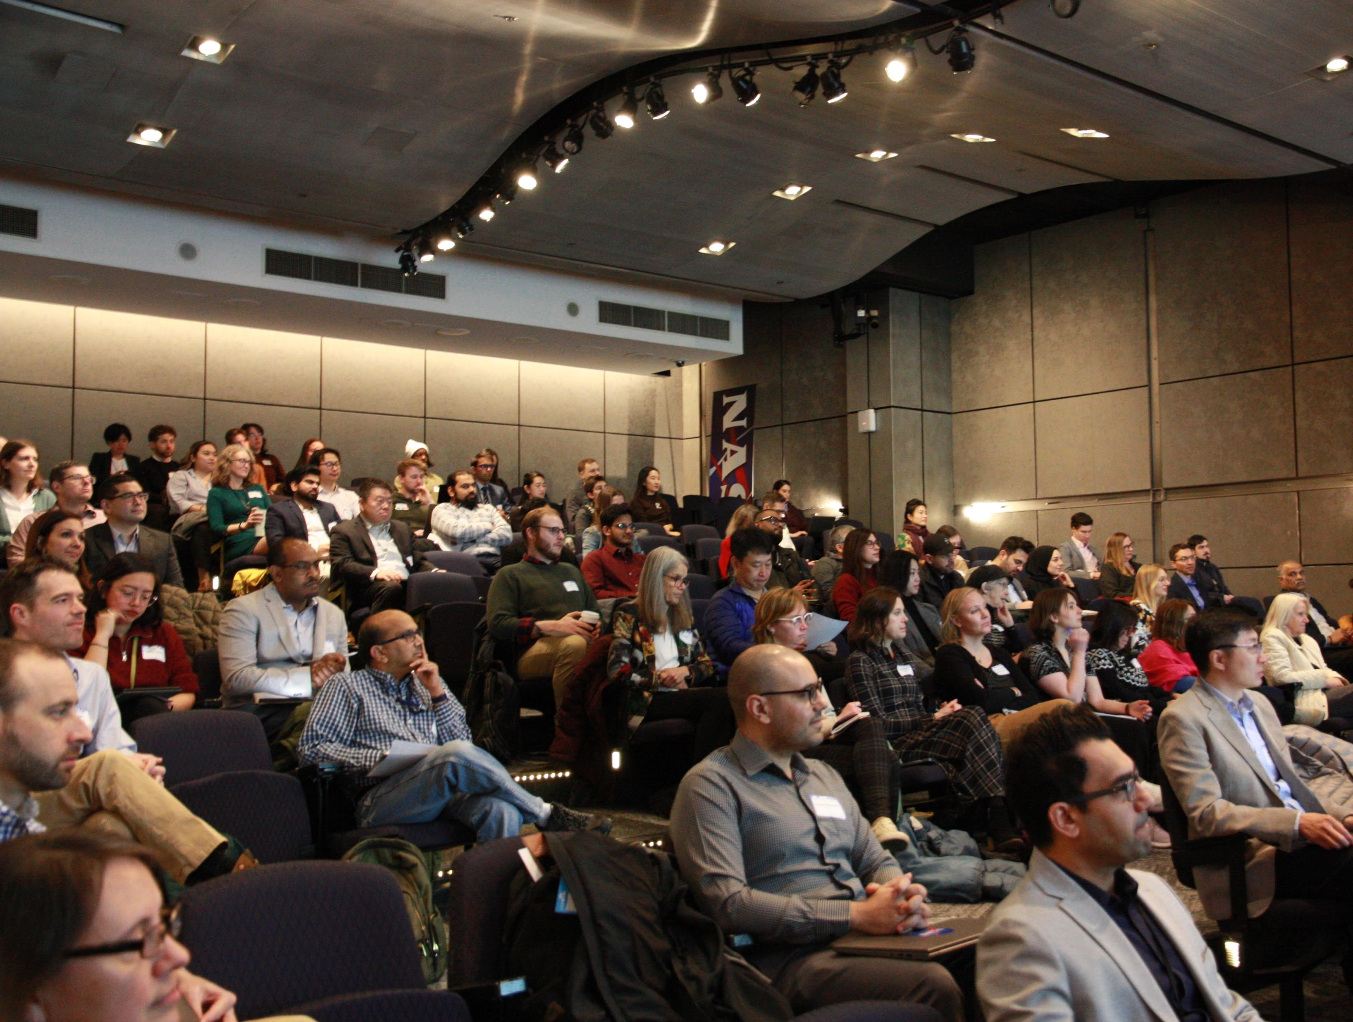
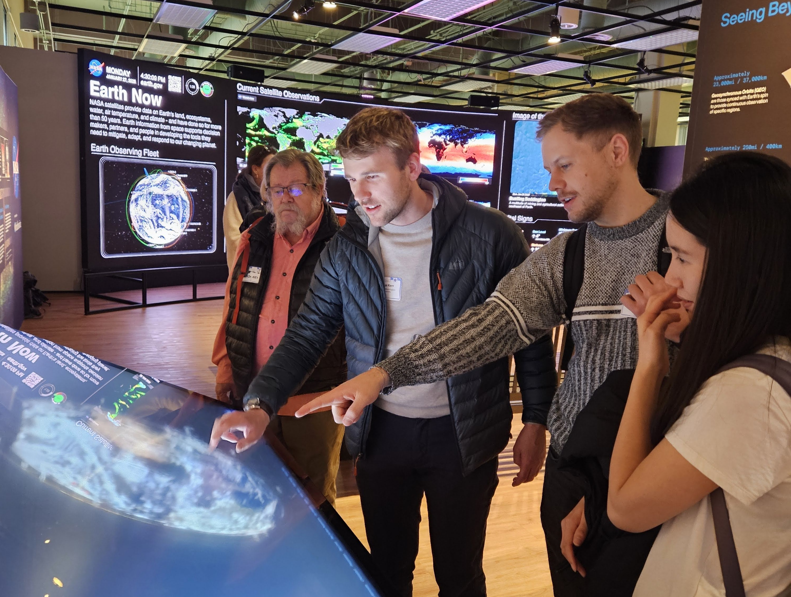
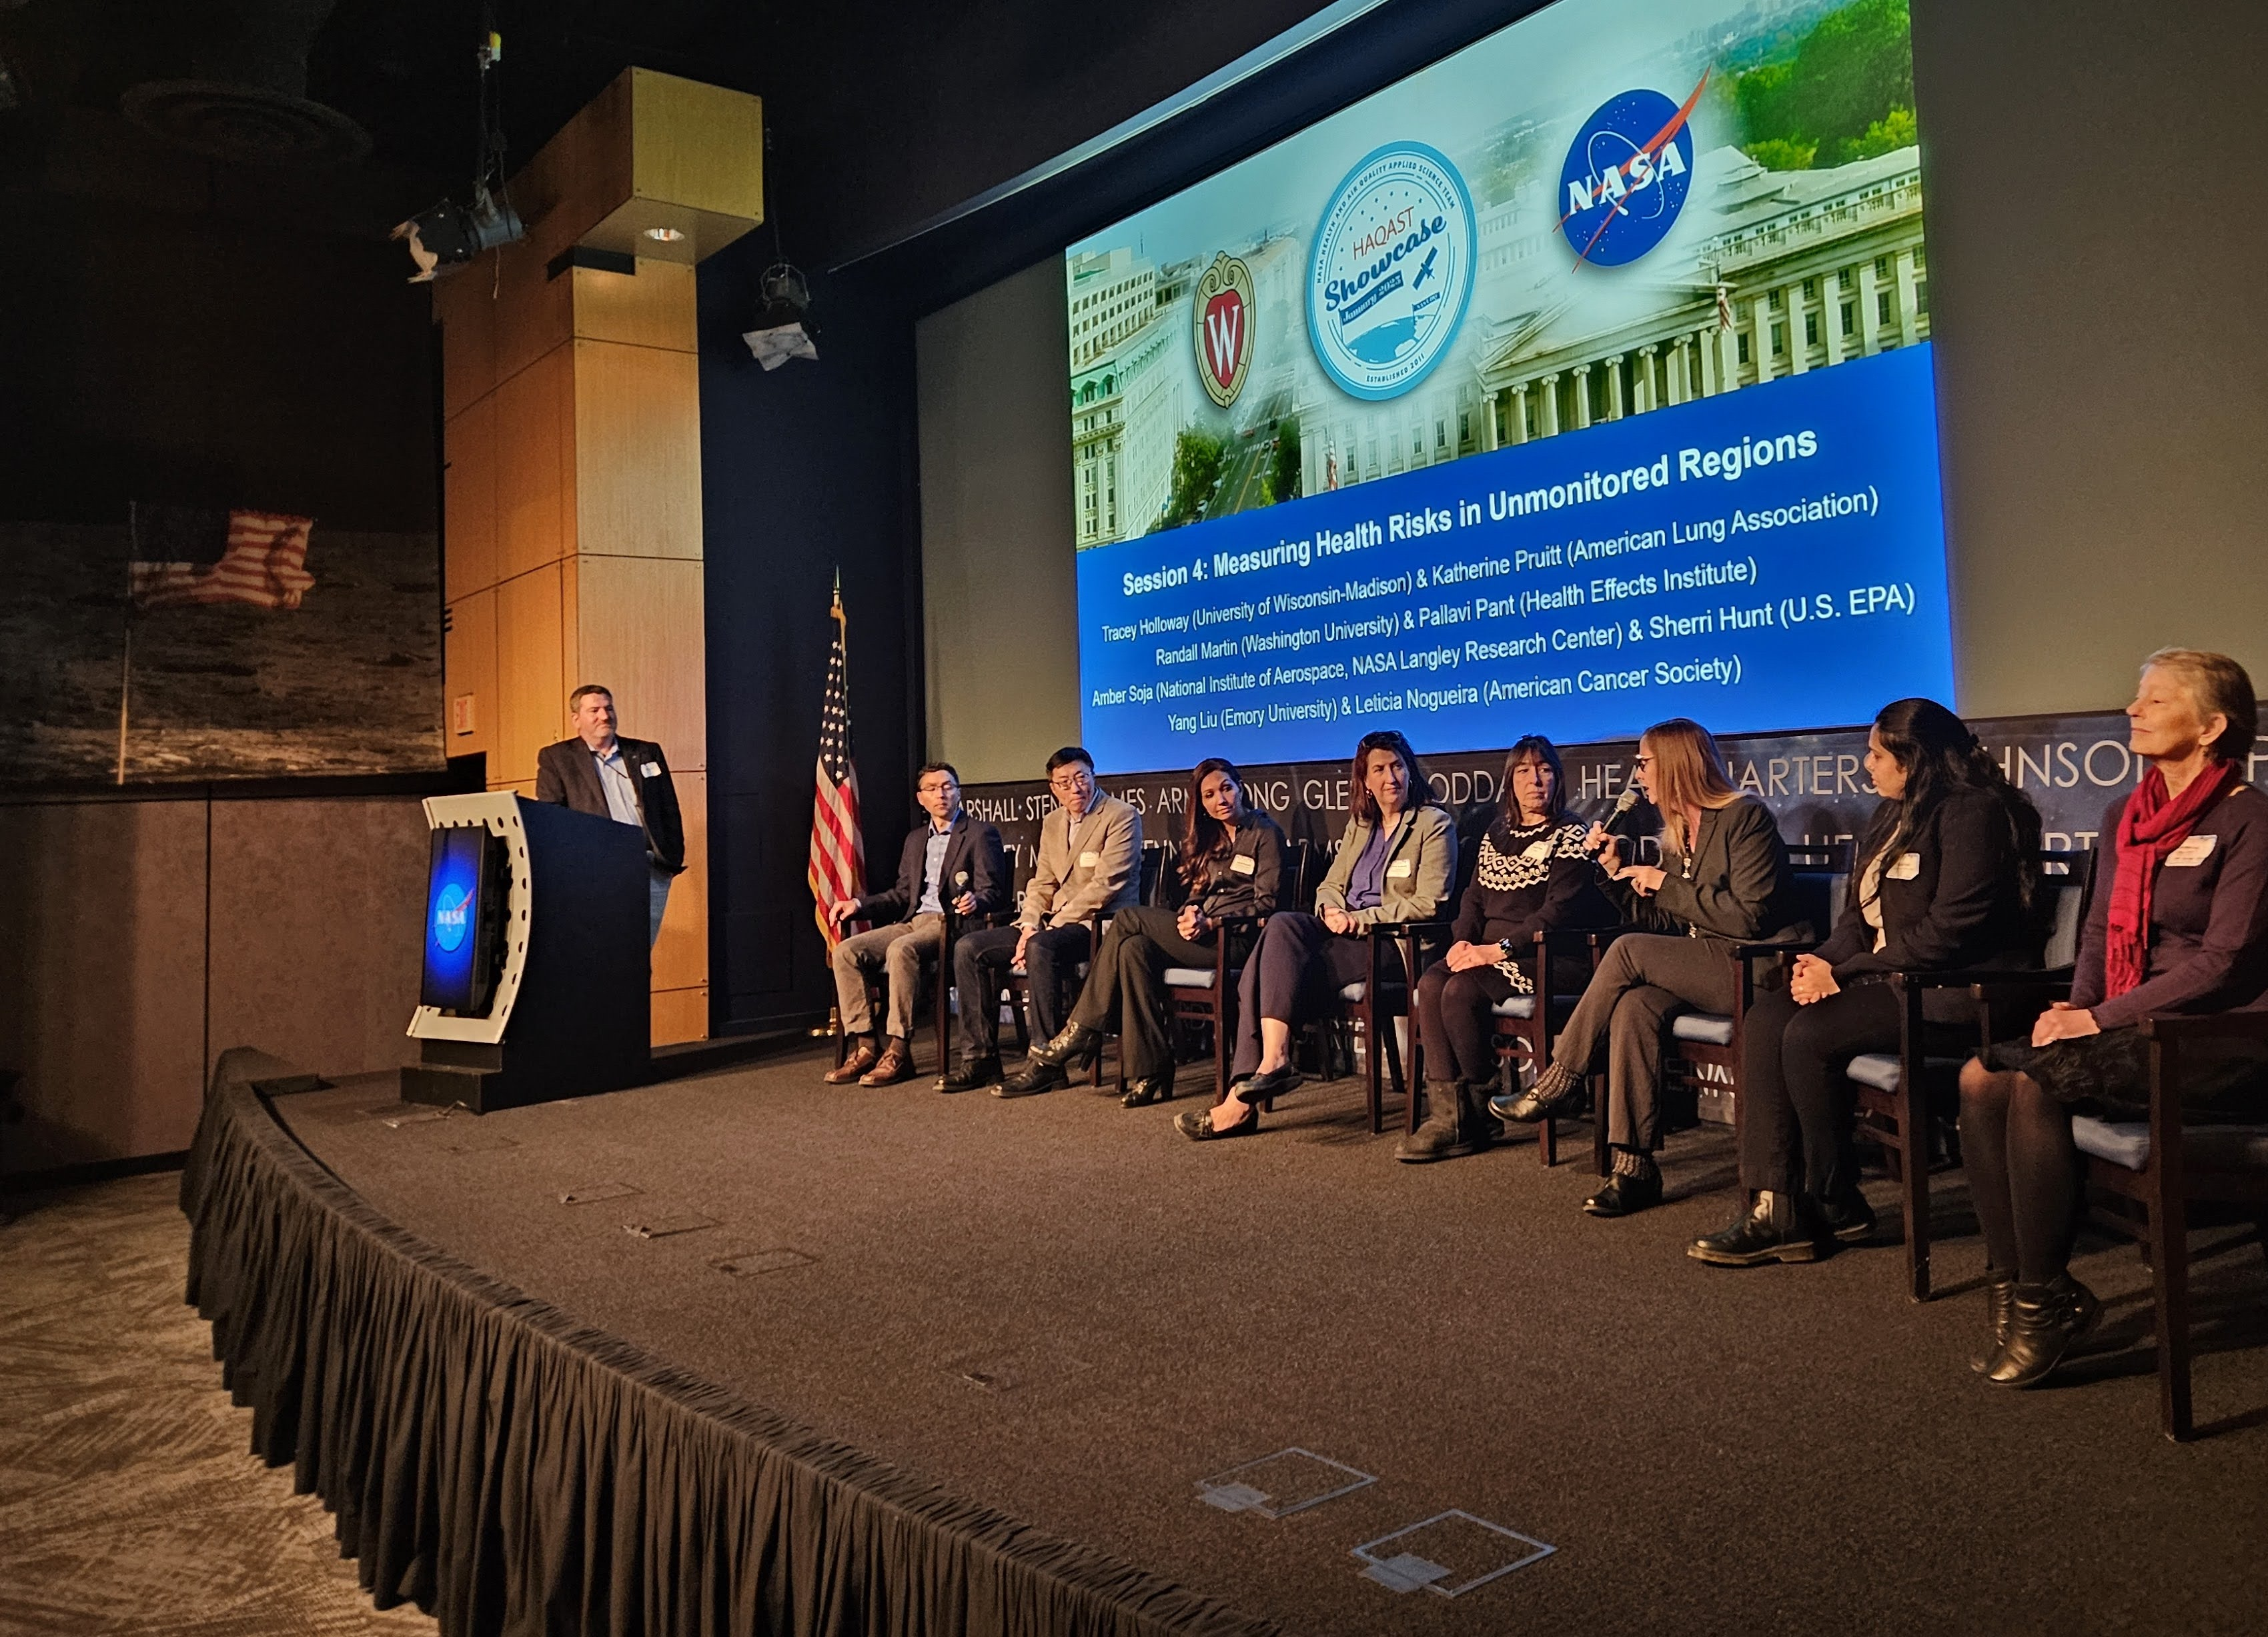
The Health and Air Quality Applied Sciences Team
Decade-long NASA effort to support
  Timely, actionable science for real-world health and air quality challenges
  Collaboration across sectors, and between researchers and stakeholders
  https://haqast.org/

Slide 4
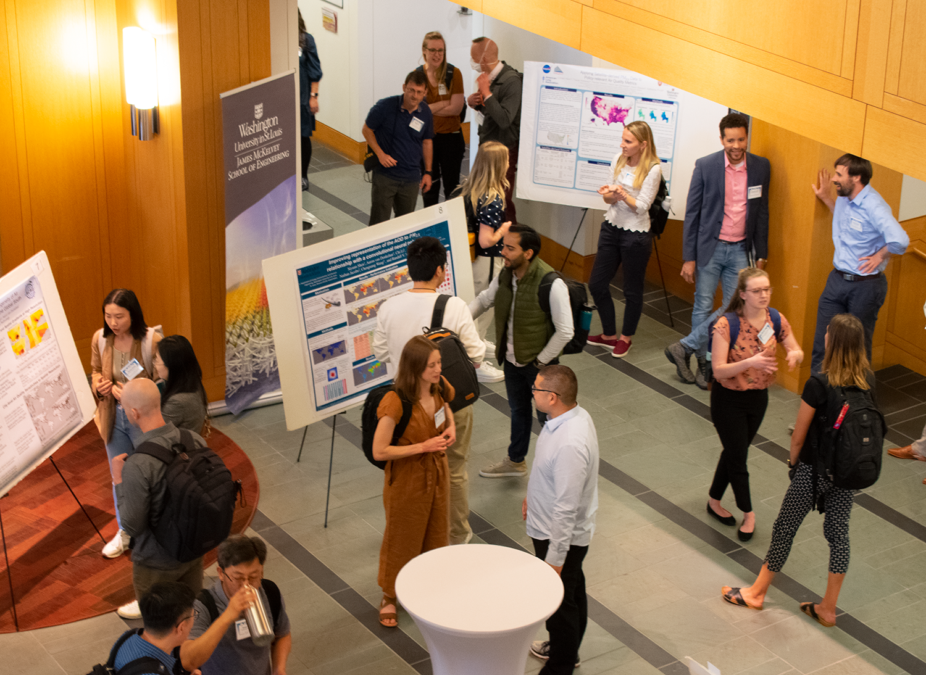

Building Connections and Understanding
“I think being able to attend and present HAQAST meetings has helped make connections between my agency needs and what researchers and NASA staff can provide to not just us but all stakeholders. I have seen over time researchers understanding and using the terms that air quality regulators are familiar with. We have really benefited from satellite fire and smoke data in helping bridge gaps in our ground based monitoring network to keep the public informed of potential health threats in a timely manner.”
– State air quality manager
Next Meeting: HAQAST St. Louis November 6-7 (hybrid & free)
https://haqast.org/haqast-st-louis/

Slide 5



Slide 6
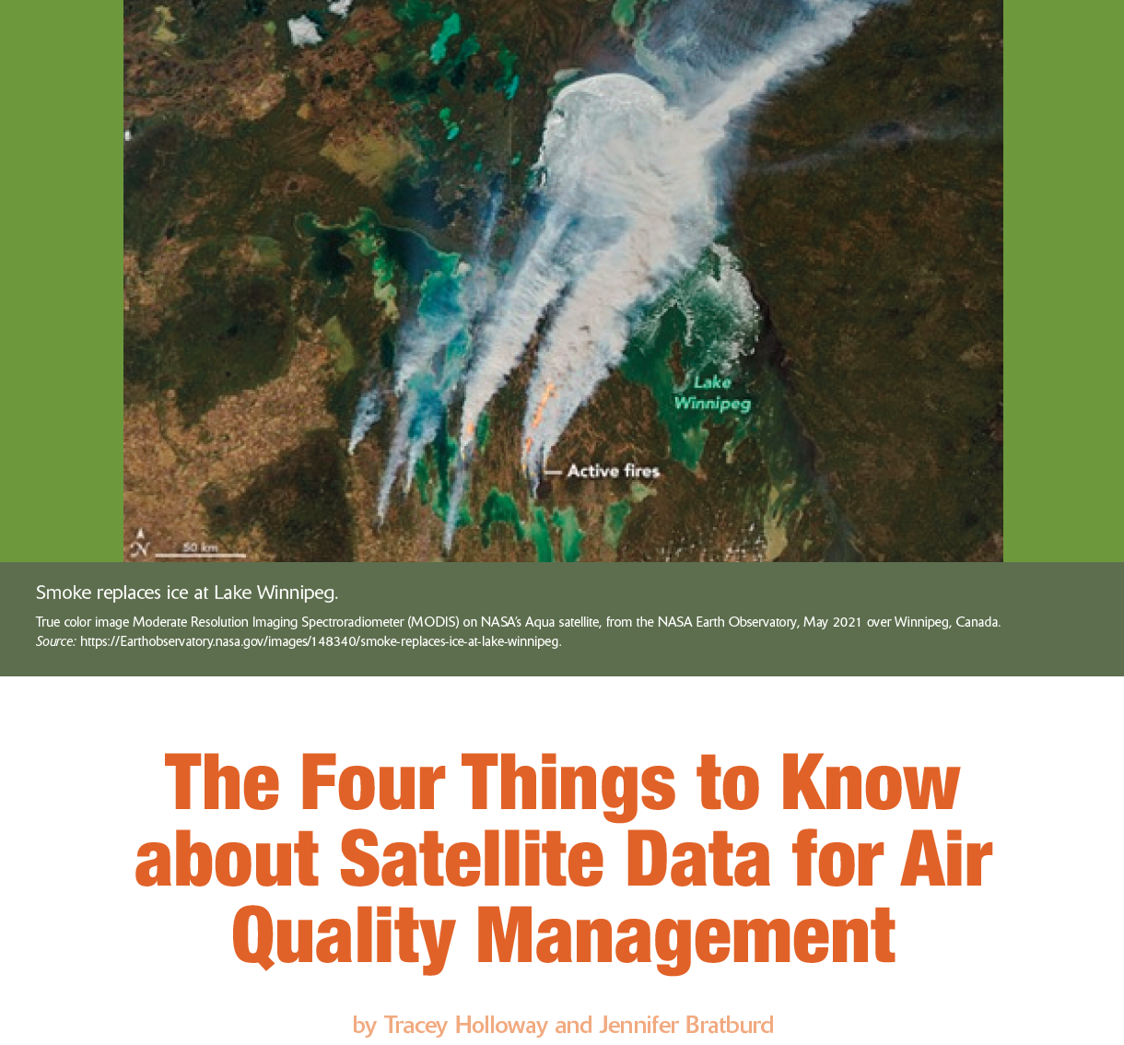
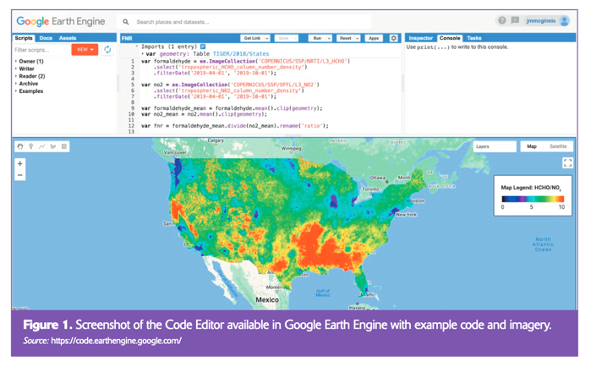
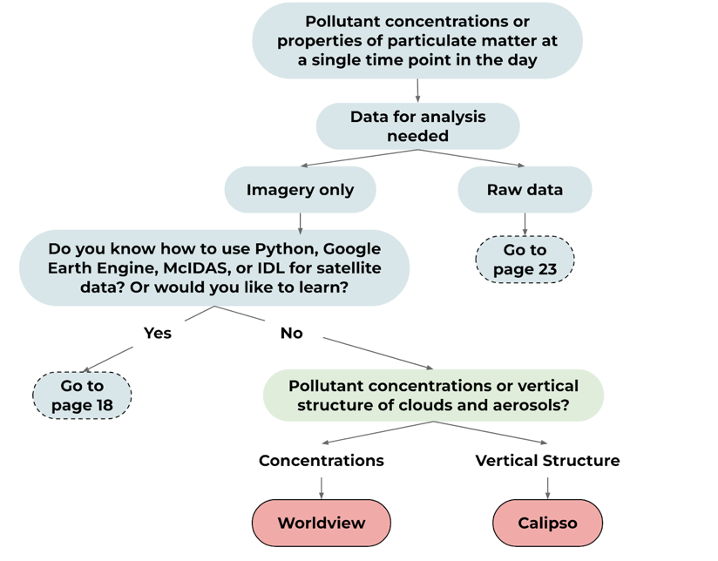


Resources to Support Users
Short Explainers
Satellite Data Flowchart
Training/Tutorials
https://haqast.org/getting-started/
https://haqast.org/data-and-tools

Slide 7
HAQAST 2025 - 2029
2025
2029
Member projects
Affinity Groups
Tiger Teams
Outreach & communications
Notes:
Private for-profit engagement
Training, tutorials
AI LLM models → how they direct traffic (or not)

Slide 8

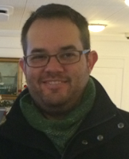


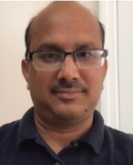
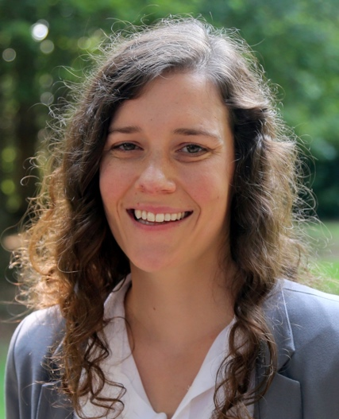
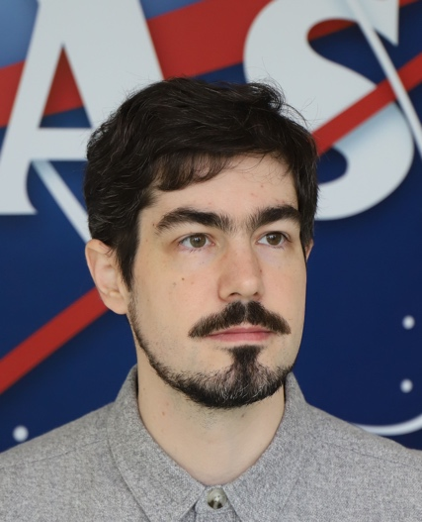
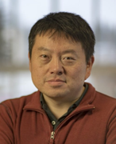
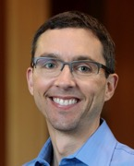


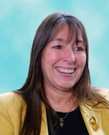

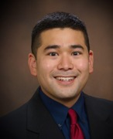


NASA Health and Air Quality
Applied Sciences Team Members (HAQAST)
2025-2029
Tracey Holloway (Team Lead, UW-Madison)
Daniel Anderson (University of Maryland Baltimore County)
Xi Chen (University of Iowa)
Arlene Fiore (Massachusetts Institute of Technology)
Pawan Gupta (NASA Goddard)
Jennifer Kaiser (Georgia Tech)
Carl Malings (Morgan State University)
Jingqiu Mao (University of Alaska, Fairbanks)
Randall Martin (Washington University)
Aaron Naeger (NASA Marshall)
Jeffrey Pierce (Colorado State University)
Amber Soja (National Institute of Aerospace)
Travis Toth (NASA Langley)
Christopher Uejio (Florida State University)
haqast.org

Slide 9
NASA Health and Air Quality
Applied Sciences Team Members (HAQAST)
2025-2029
Tracey Holloway (Team Lead, UW-Madison)
Daniel Anderson (University of Maryland Baltimore County)
Xi Chen (University of Iowa)
Arlene Fiore (Massachusetts Institute of Technology)
Pawan Gupta (NASA Goddard)
Jennifer Kaiser (Georgia Tech)
Carl Malings (Morgan State University)
Jingqiu Mao (University of Alaska, Fairbanks)
Randall Martin (Washington University)
Aaron Naeger (NASA Marshall)
Jeffrey Pierce (Colorado State University)
Amber Soja (National Institute of Aerospace)
Travis Toth (NASA Langley)
Christopher Uejio (Florida State University)
haqast.org
Notes:
Prescribed burns
PM2.5 datasets
Wildfire forecasts
Diurnal bias in sectorized emissions
Understanding ozone events
Near real time surface ozone
Identifying pollution hotspots relevant to monitor siting
Evaluating policy impacts

Slide 10
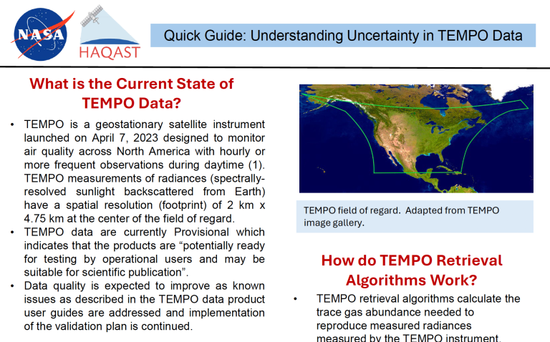
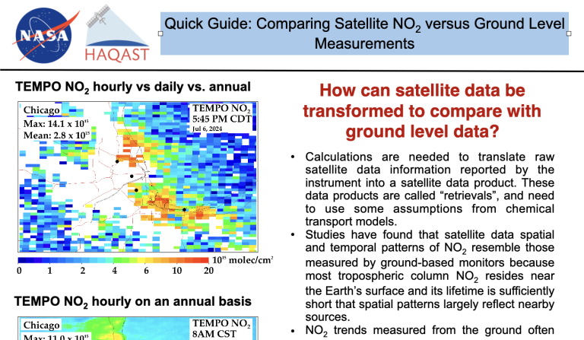
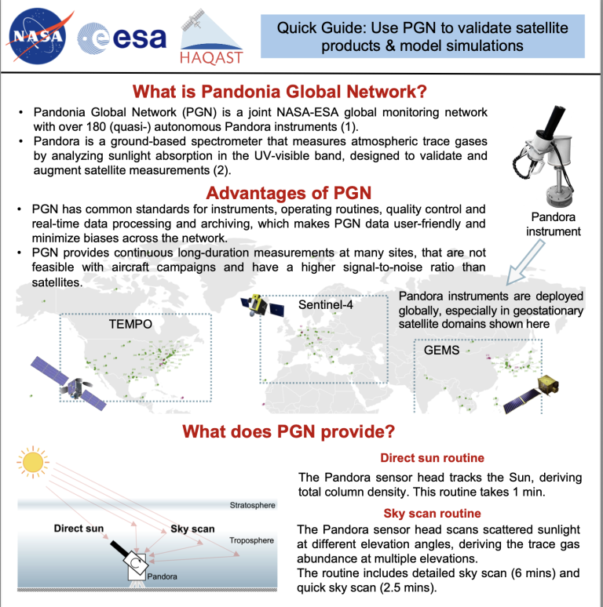
Comparing TEMPO with surface measurements
How to compare satellite column data with ground-level data, with relevance to air quality management and pollution exposure?
Quick guides, tutorials, & training from HAQAST TEMPO Tiger Team: https://haqast.org/tempo-applications-for-surface-ozone-tiger-team/
Arlene Fiore

Slide 11
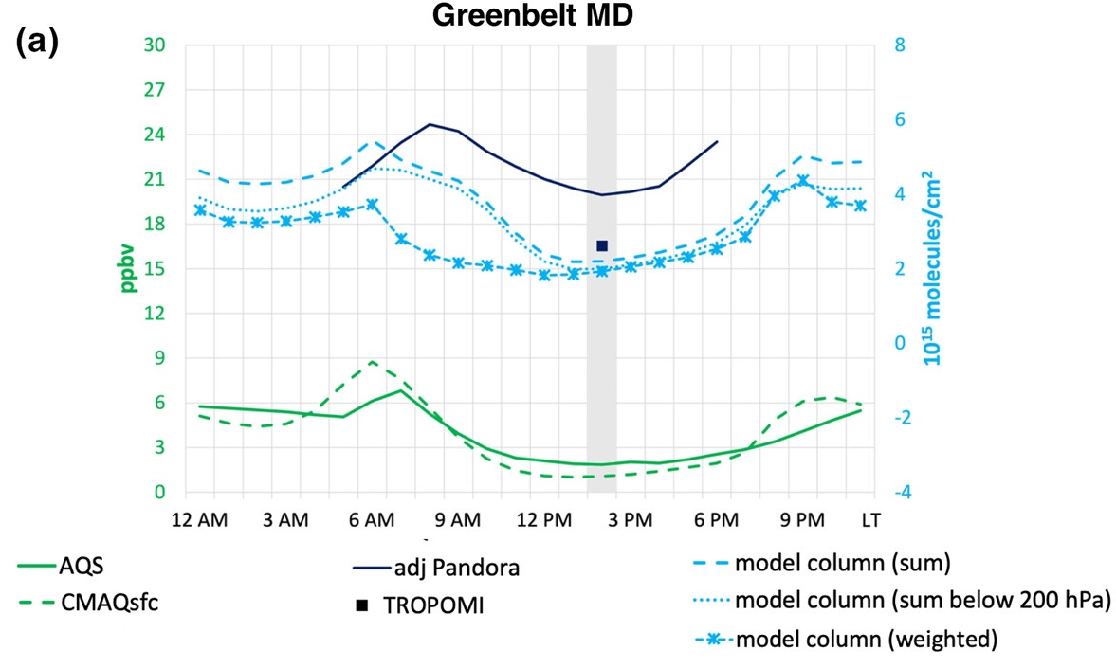
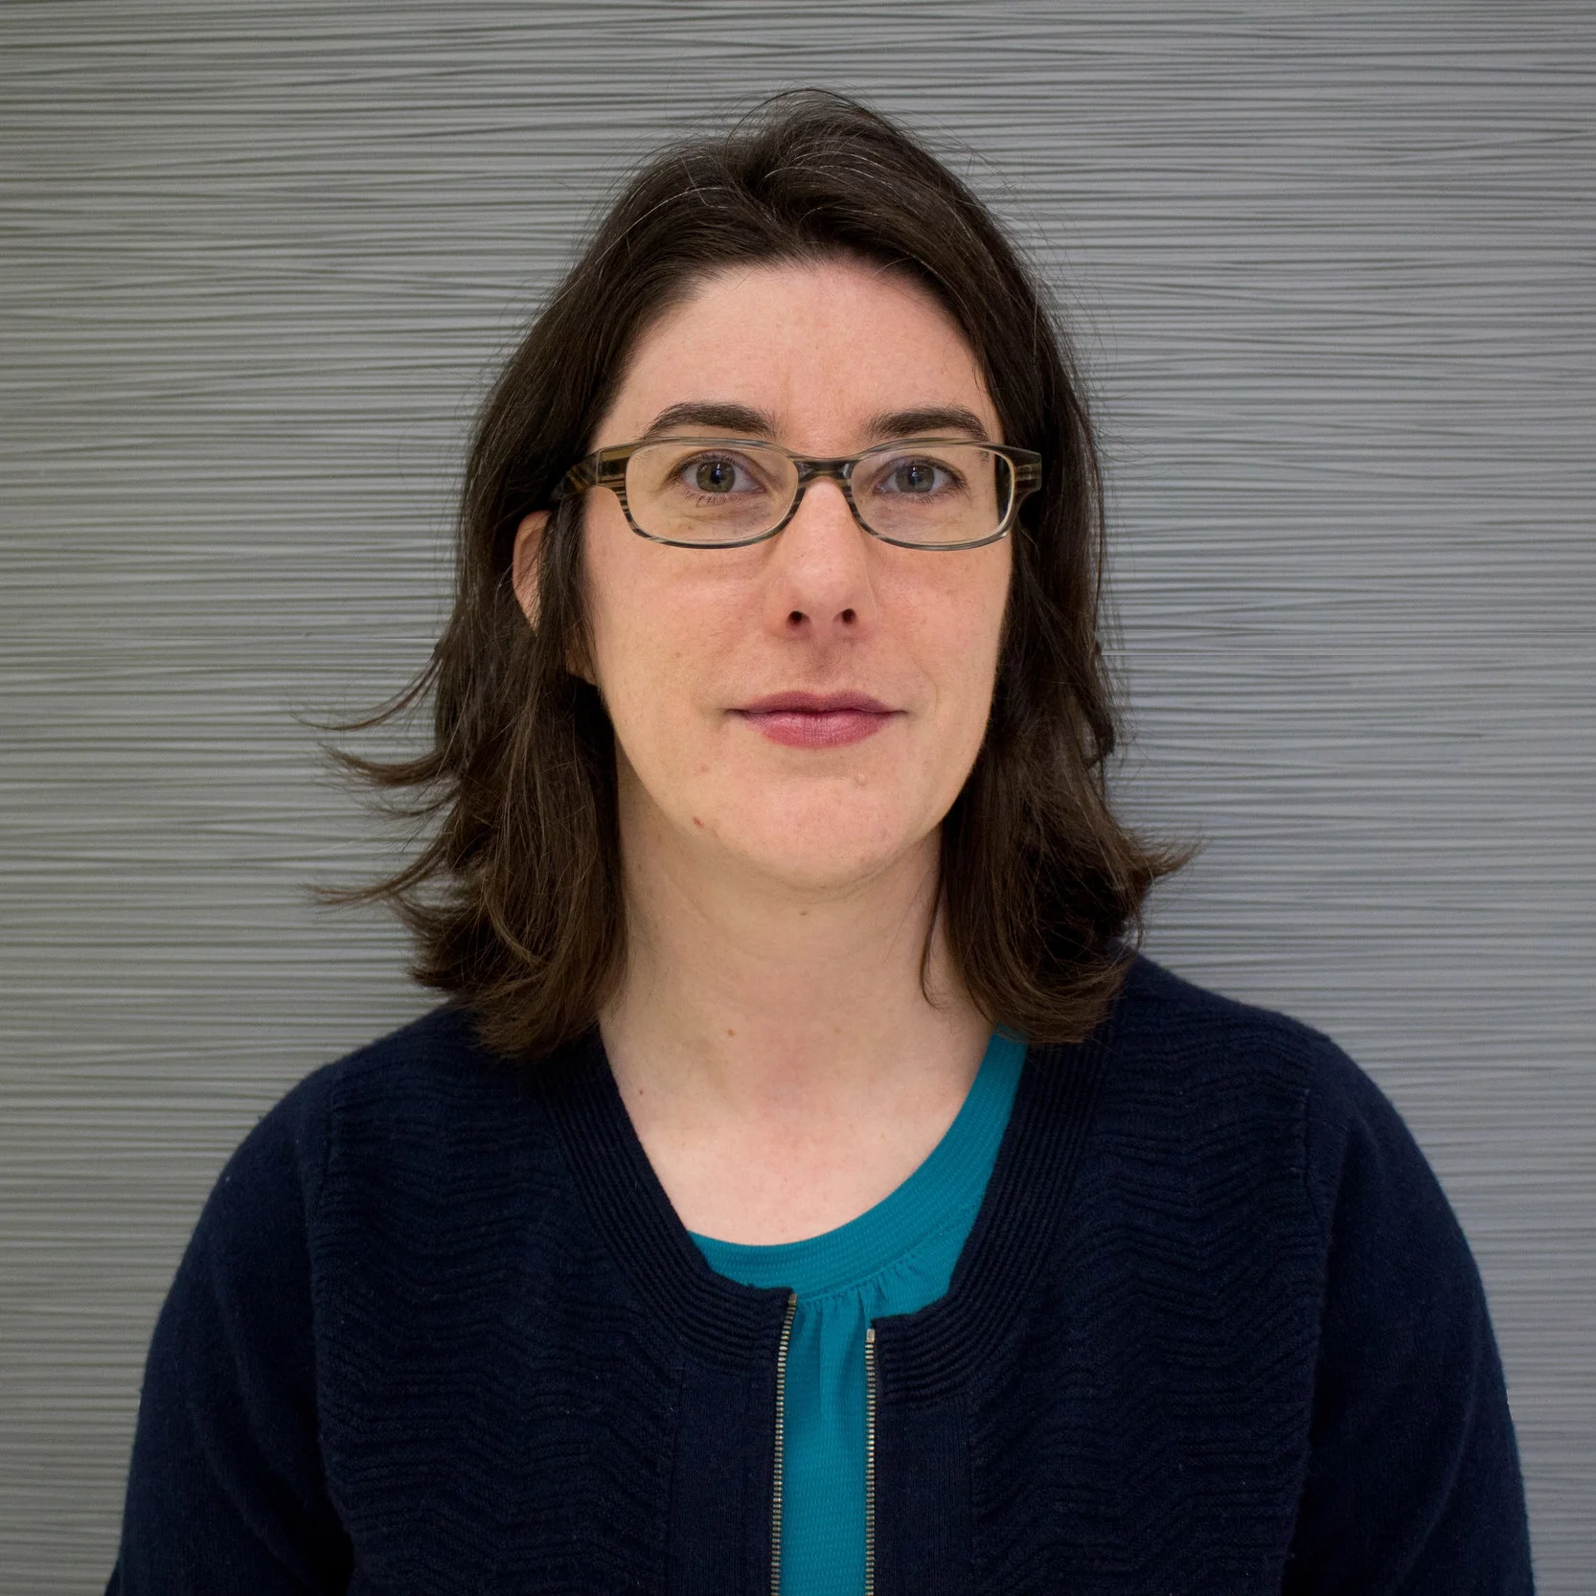
Modeling Column vs Surface NO₂
July 2019 average
Satellite observations of NO₂ show column values, which show different hourly patterns than surface monitoring of NO₂
Model simulations of column NO₂ are sensitive to calculation approach
Column NO₂ values lag surface NO₂ in the morning but lead surface NO₂ in the evening
Harkey and Holloway (2024) JGR Atmospheres
Monica Harkey
Notes:
Notes from Monica: Level 3 sensitivity (averaging kernal, AMF); regrid with WHIPS level-2; computational time; and WHIPS does not support TEMPO; would like quantification about viewing angle (stakeholders might not be aware – if only good between 10 and 3) ; vertical sensitivity information for level 3. ; Meteorology is going to mix things surface for the column, not 1:1. - delay wen column sees maximum, and when actually breathing maximum
Morning → emissions increase NO₂ increase at surface,
PBLH increase → NO₂ increase in column
column lags surface by 1 – 2 hours
Evening
emissions decrease
photolysis decrease → NO₂ increase (all levels)
PBLH decrease → NO₂ mixed down to surface
→ surface lags column 1+ hours

Slide 12
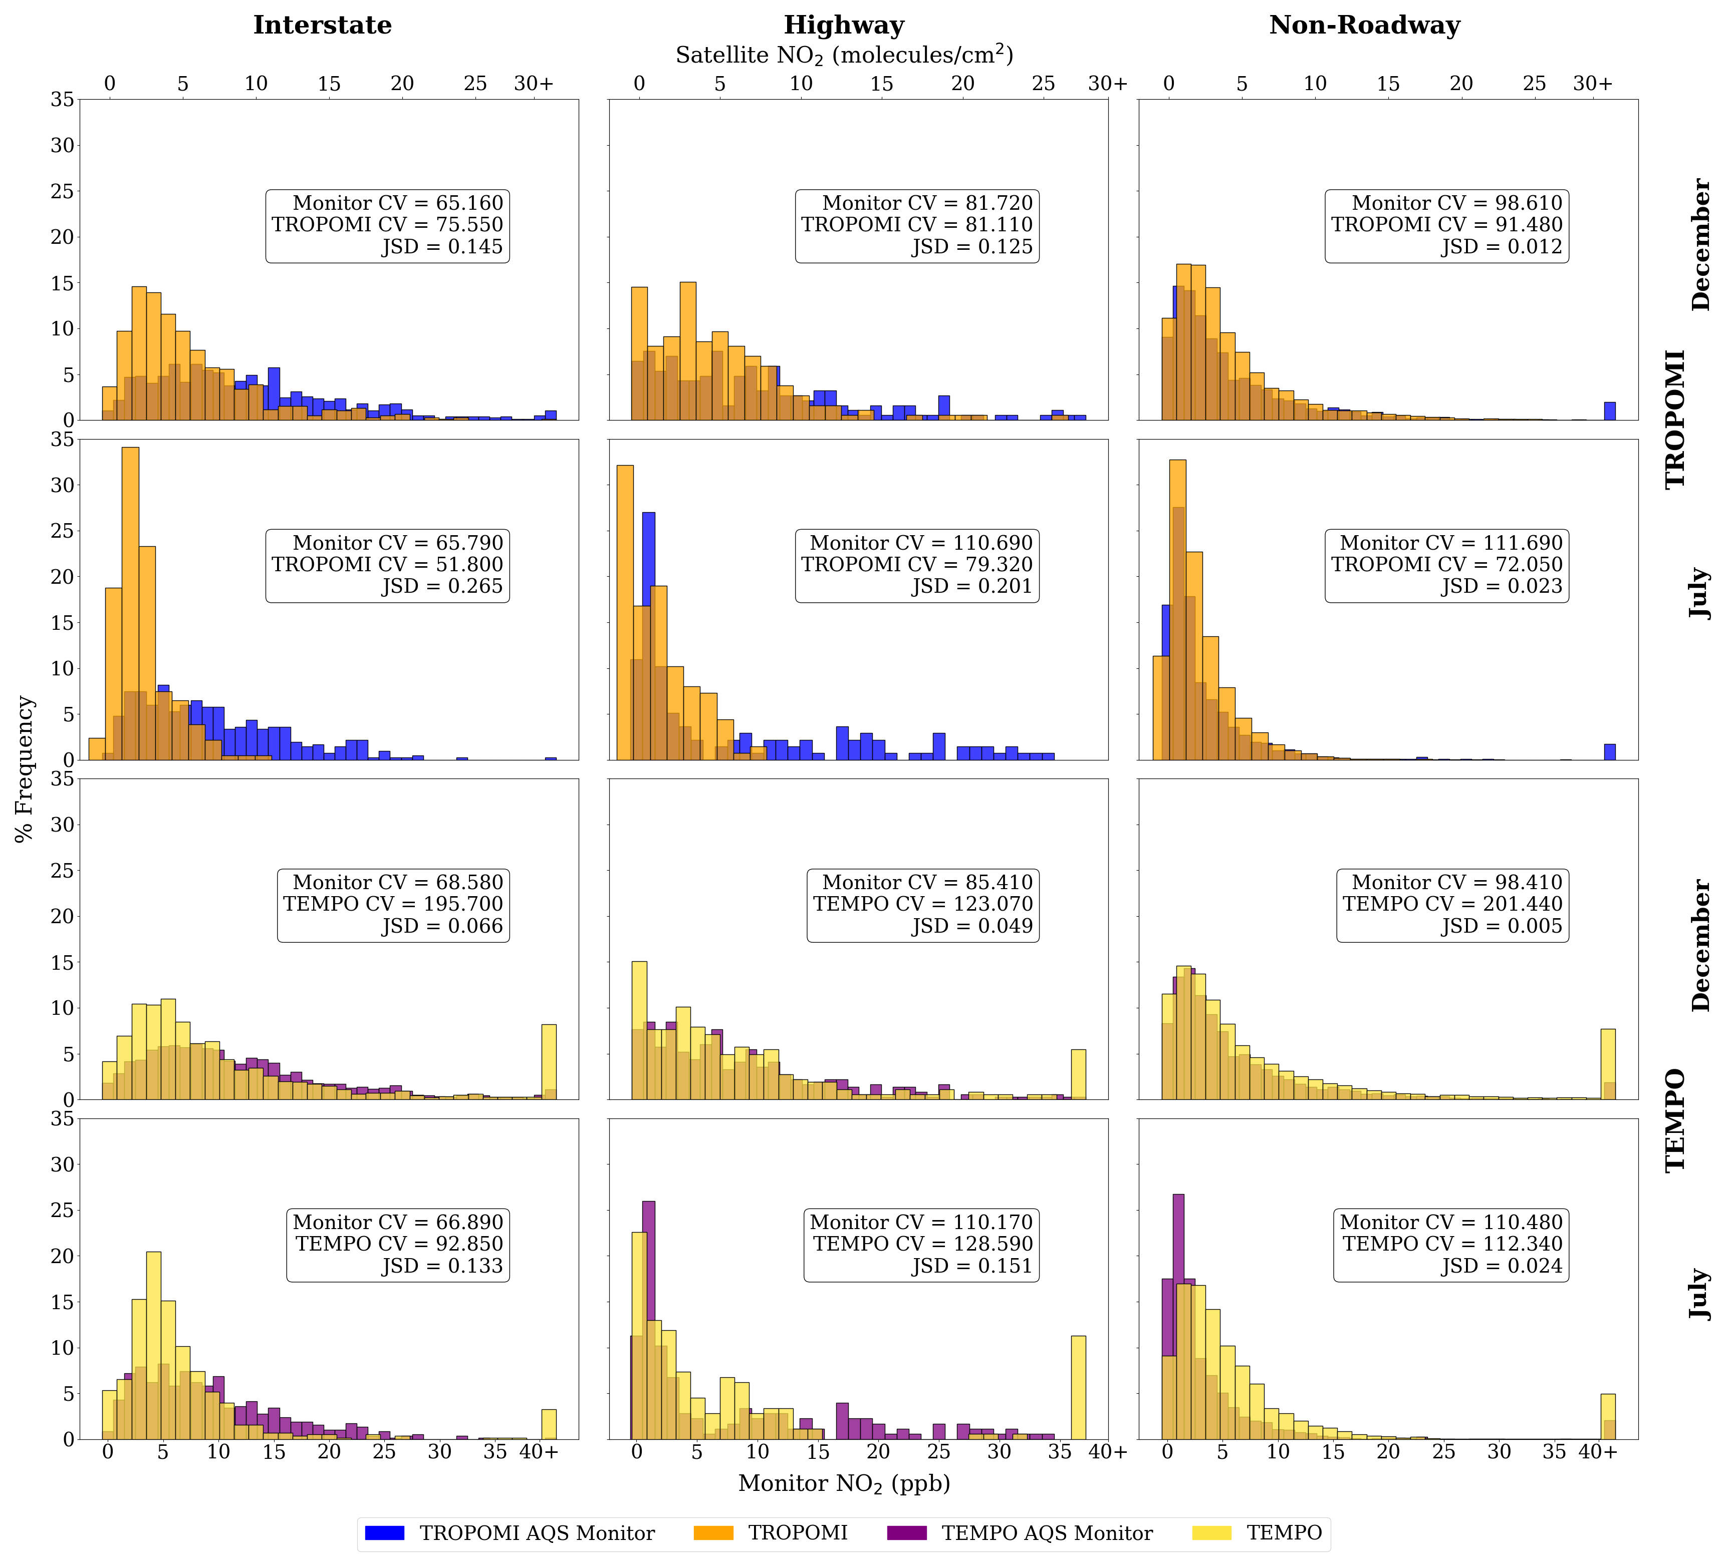

TEMPO aligns more closely than TROPOMI with ground-based measurement
Comparing distributional alignment among estimates of NO₂ abundance from TROPOMI, TEMPO, and ground monitors
  Jensen–Shannon divergence (JSD) - smaller number, greater alignment
TEMPO consistently aligns more closely with ground-based measurements than TROPOMI
  Esp. high-NO₂ areas, such as highways and interstates
Both satellite instruments show limitations in representing peak concentrations at high-polluting sites
Acker et al. (2025) Atmospheric Chemistry and Physics.
Summer Acker
Notes:
Hourly AQS measurements at 13:00 and 14:00 local time (LT) were averaged to align with the TROPOMI overpass of ≈13:30 LST. Hourly AQS measurements from 12:00 to 23:00 GMT were compared with hourly TEMPO data for daylight hours. For both the TROPOMI and TEMPO analyses, AQS data were filtered to ensure consistency with satellite data availability. As a result of filtering monitoring data for TROPOMI and TEMPO separately, the subsets of monitor data available for comparison with each instrument differ, even for the same time periods.

Slide 13
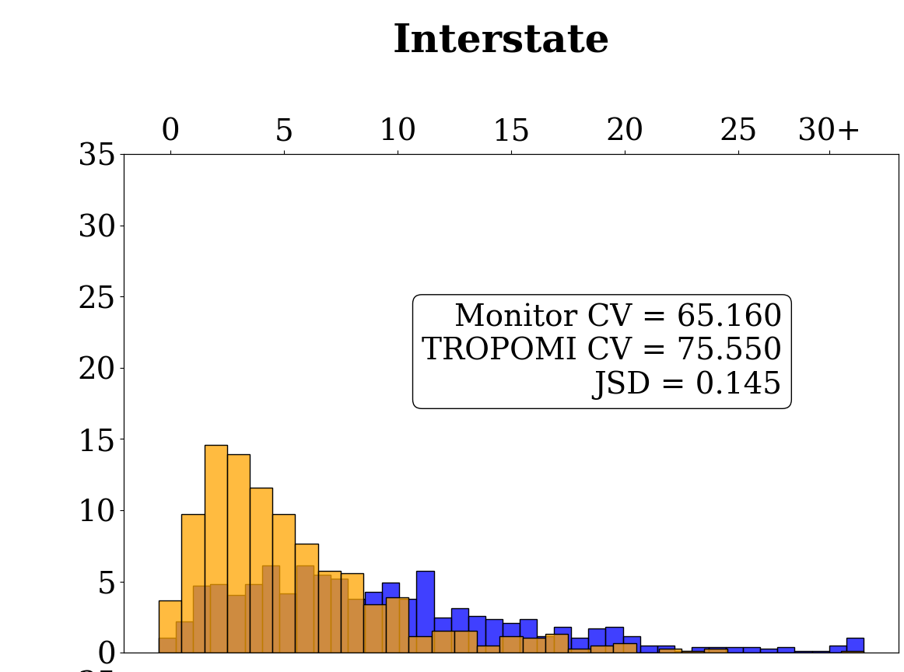
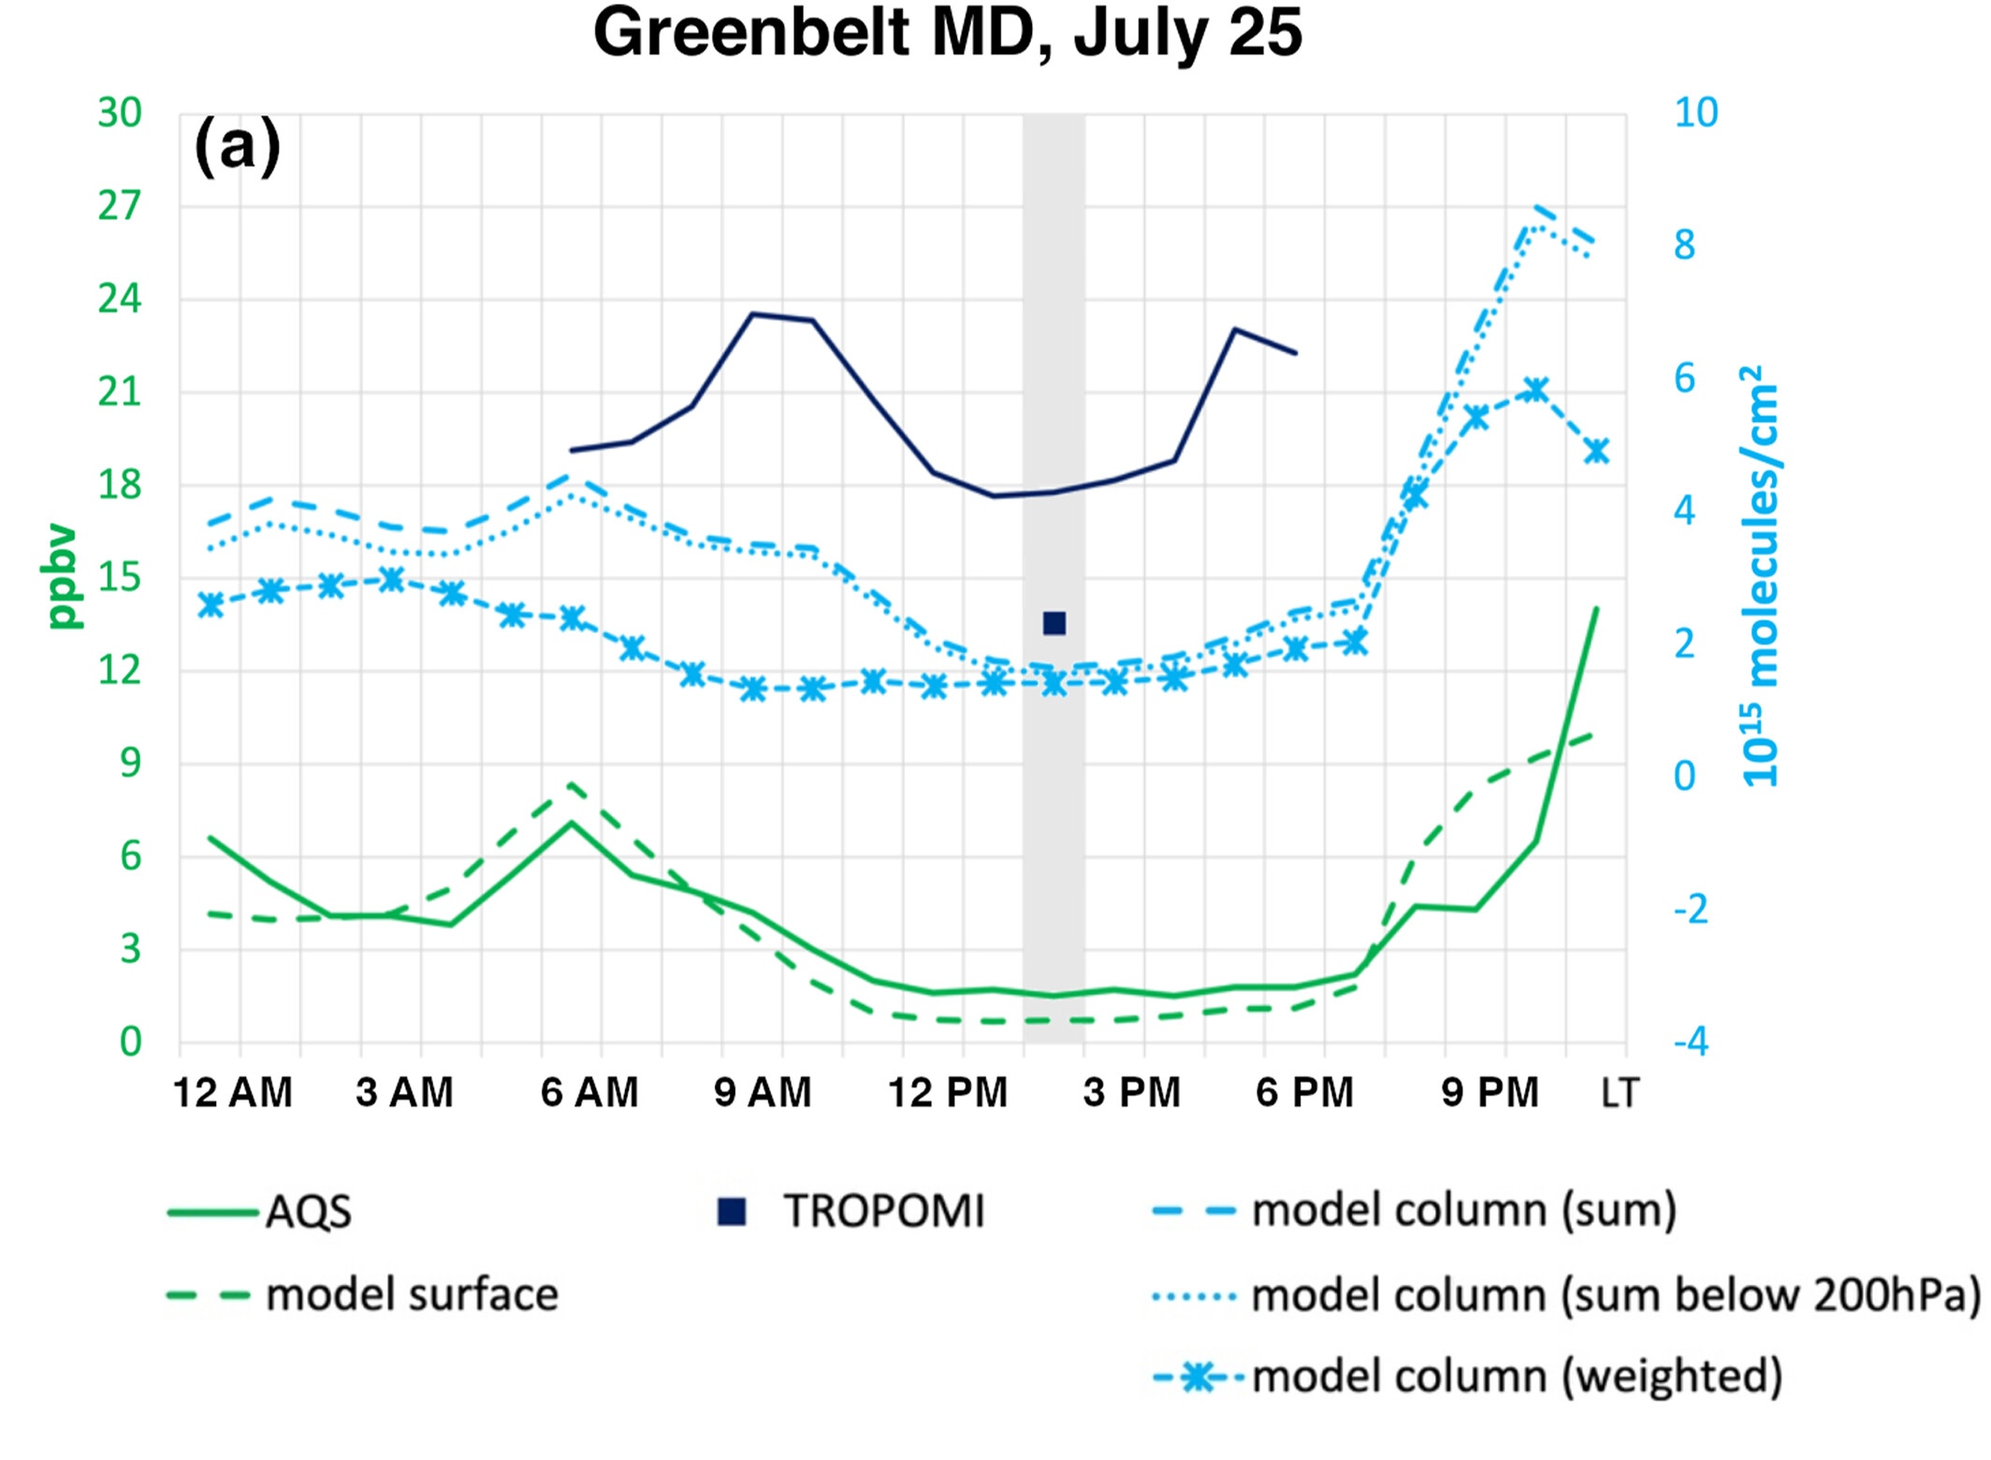
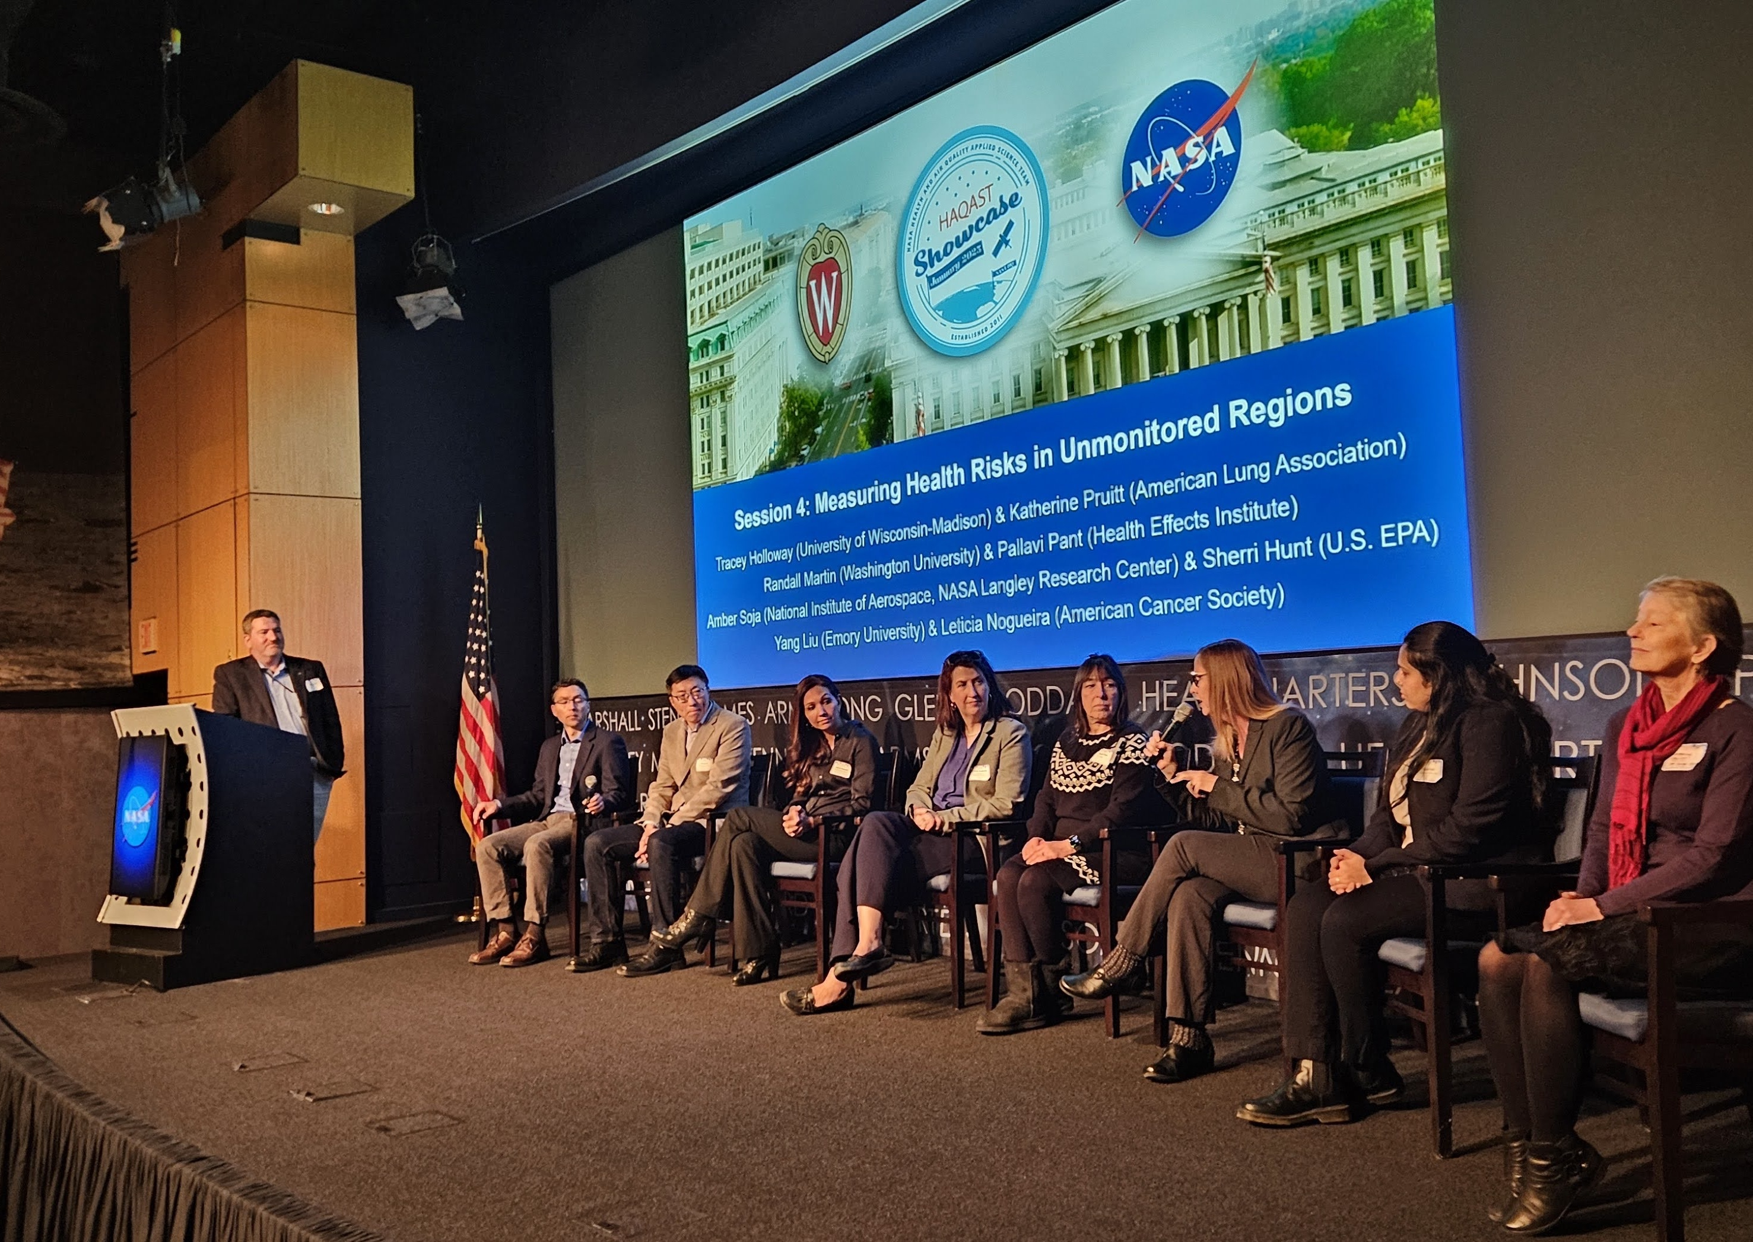
Conclusions
Continued interest from air quality management and health communities on using TEMPO data for new and continuing applications
Continued need for
  Quantification and understanding of uncertainties
  Training, tutorials, guides
  Trust and collaboration

Slide 14
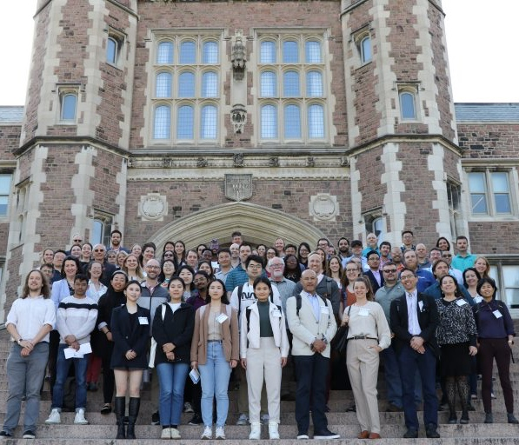
Opportunities to Engage!
HAQAST website
  haqast.org
HAQAST Meetings https://haqast.org/haqast-st-louis/
Mailing list https://explore.wisc.edu/haqastlanding
LinkedIn https://www.linkedin.com/company/nasa-health-and-air-quality-applied-sciences-team
Email: bratburd@wisc.edu

