Slide 1
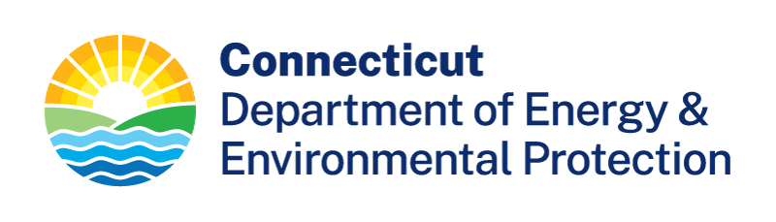

Connecticut DEEP Stakeholder Needs
2025 TEMPO/GeoXO ACX Joint Science Team Workshop
August 19 - 22, 2025
Amanda Fritz
Bureau of Air Management

Slide 2
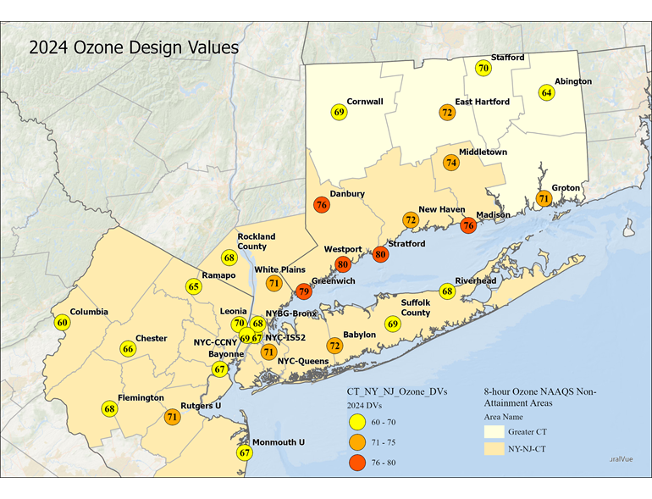
2024 Ozone Design Values
The highest ozone design values continue to occur along the coast in southwest Connecticut.
2008 NAAQS = 75 ppb
2015 NAAQS = 70 ppb

Slide 3
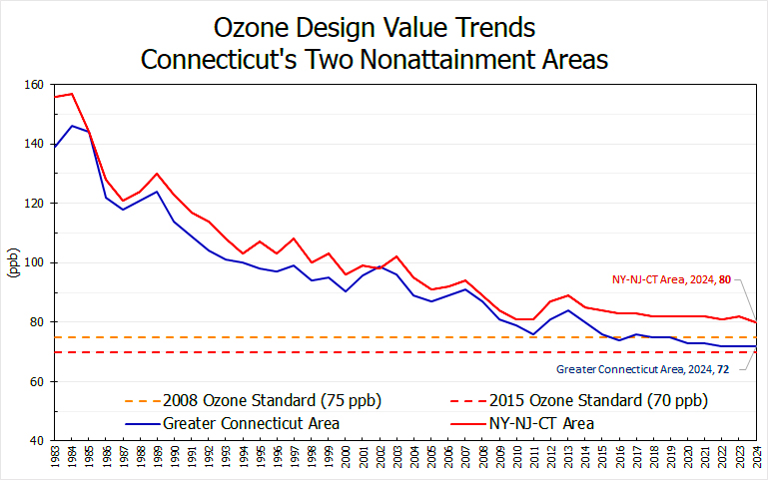
Ozone Design Value Trends
Connecticut continues to be in ozone nonattainment through 2024.

Slide 4
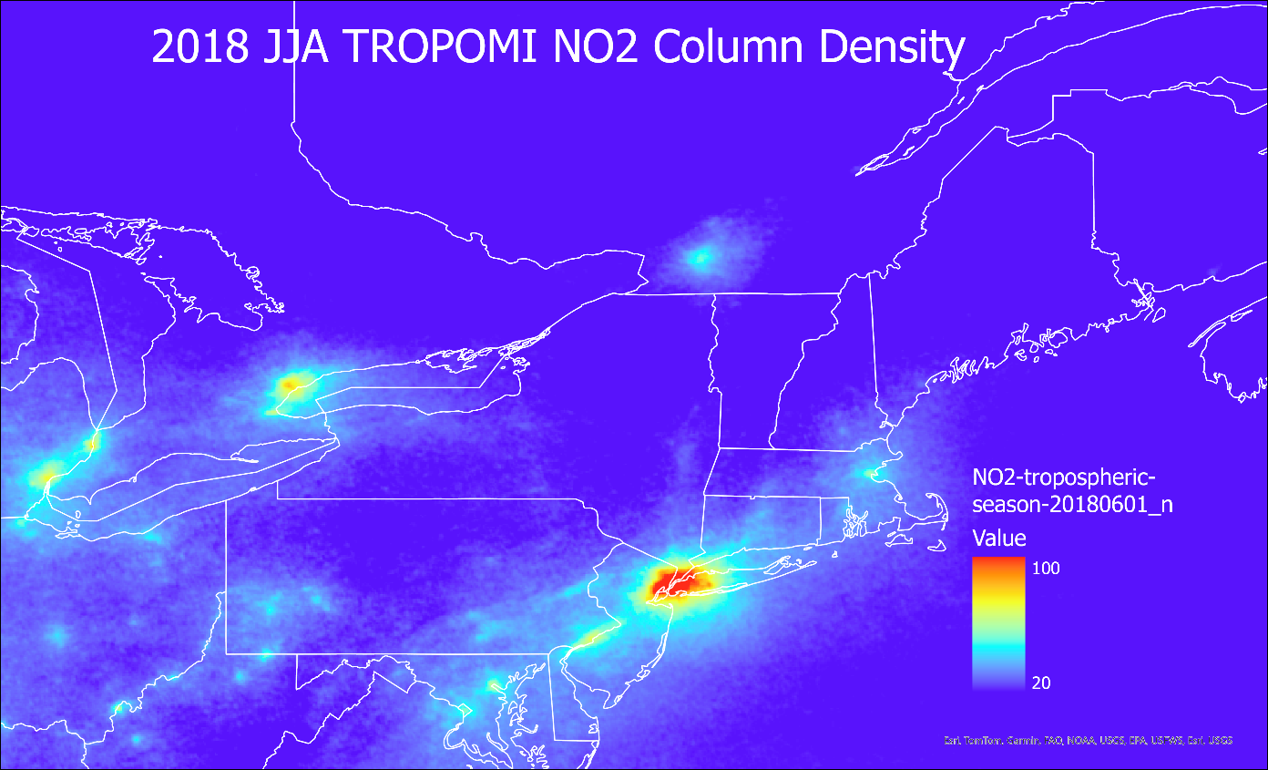
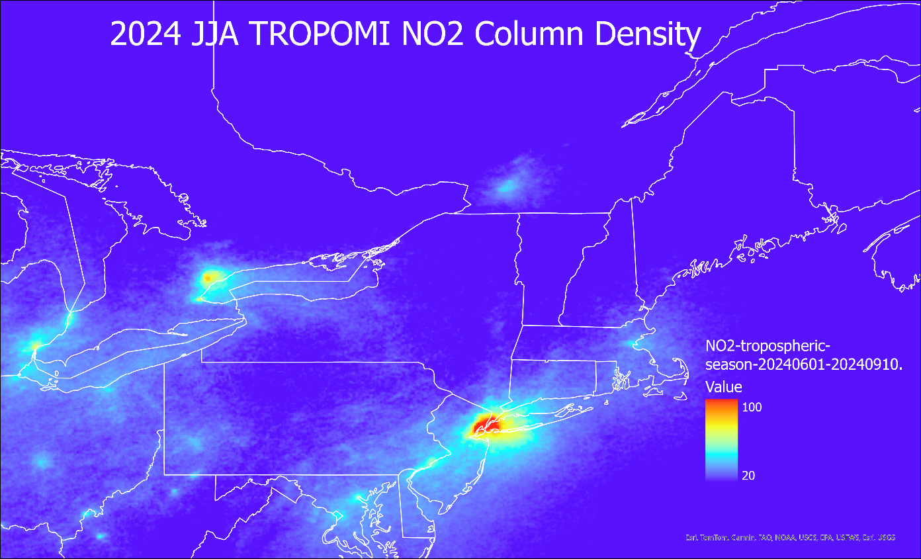
2018 & 2024 Summer NO2 Column
TROPOMI data shows a decreasing trend from 2018 to 2024 for the New York City Metro area during the summer months.
High spatial resolution is essential for the surveillance of long-term trends to better determine sources contributing to ozone nonattainment in Connecticut.

Slide 5
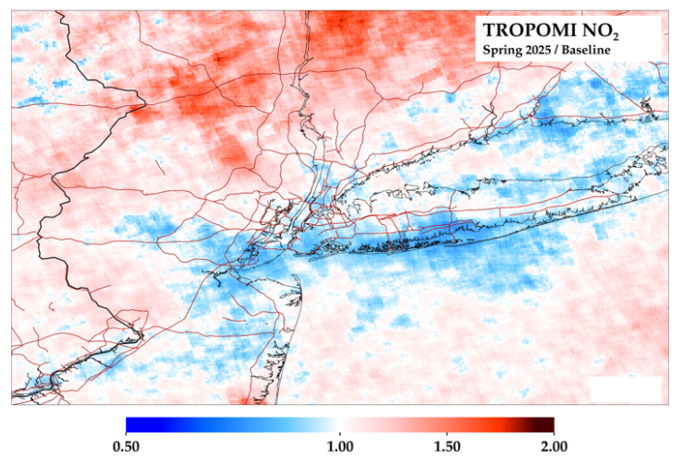
NYC Congestion Pricing
There is no signal in Manhattan due to congestion pricing.
  NO2 differences are well within uncertainties due to natural variability and the instrument measurement.
High resolution data is essential for analyzing the effectiveness of control strategies.
Courtesy of Dan Goldberg, George Washington University
The “Baseline” is every March through May since 2019 excluding 2020.
Notes:
While we are trying to create and implement control strategies to decrease NO2 and ozone levels, there are some things we cannot control.

Slide 6
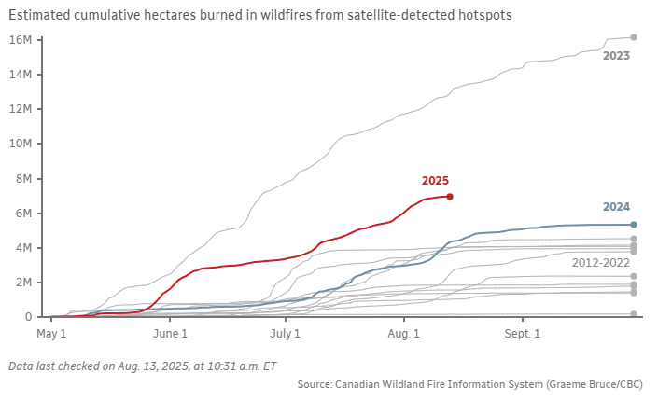
Canadian Wildfire Comparison
This chart shows the estimated cumulative hectares burned in wildfires from satellite-detected hotspots.
The hectares burned in 2025 shows that this is the second worst Canadian fire season going back to at least 2012.
  2023 is the only year with more hectares burned.
https://www.cbc.ca/newsinteractives/features/wildfires-tracker-canada

Slide 7
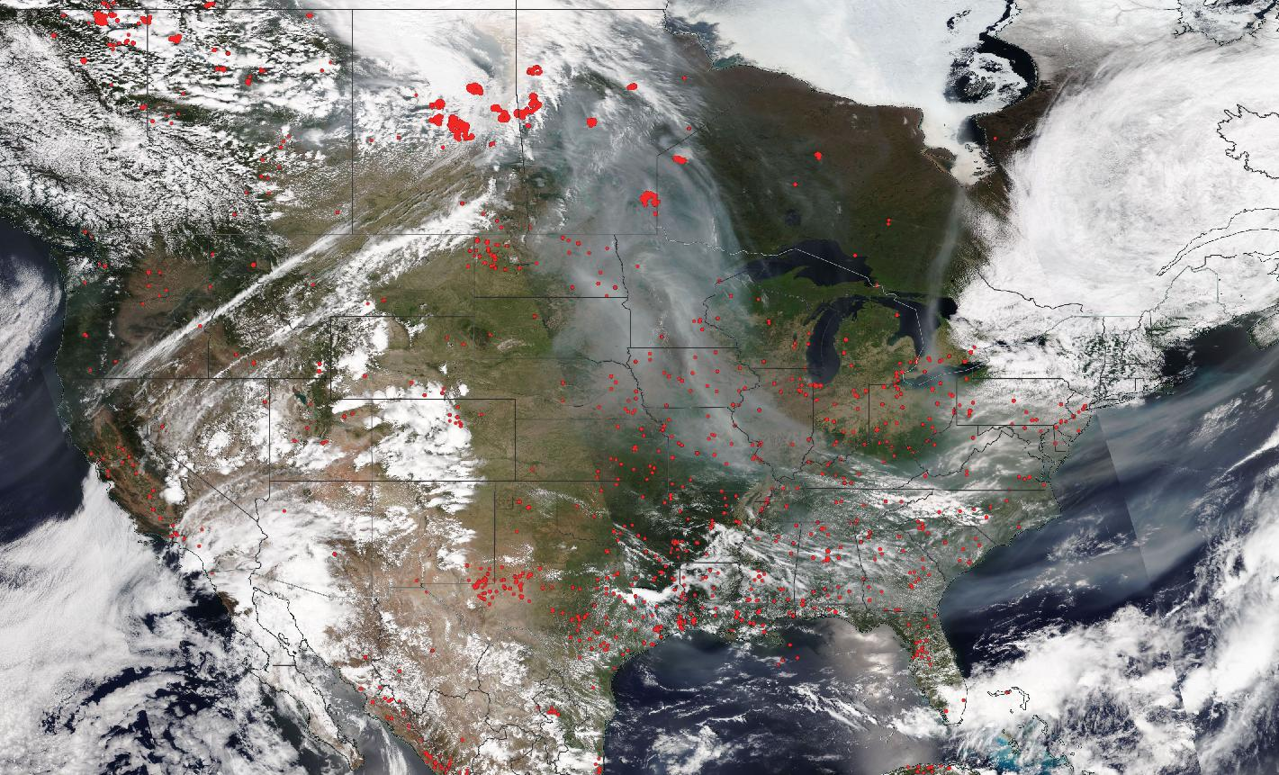
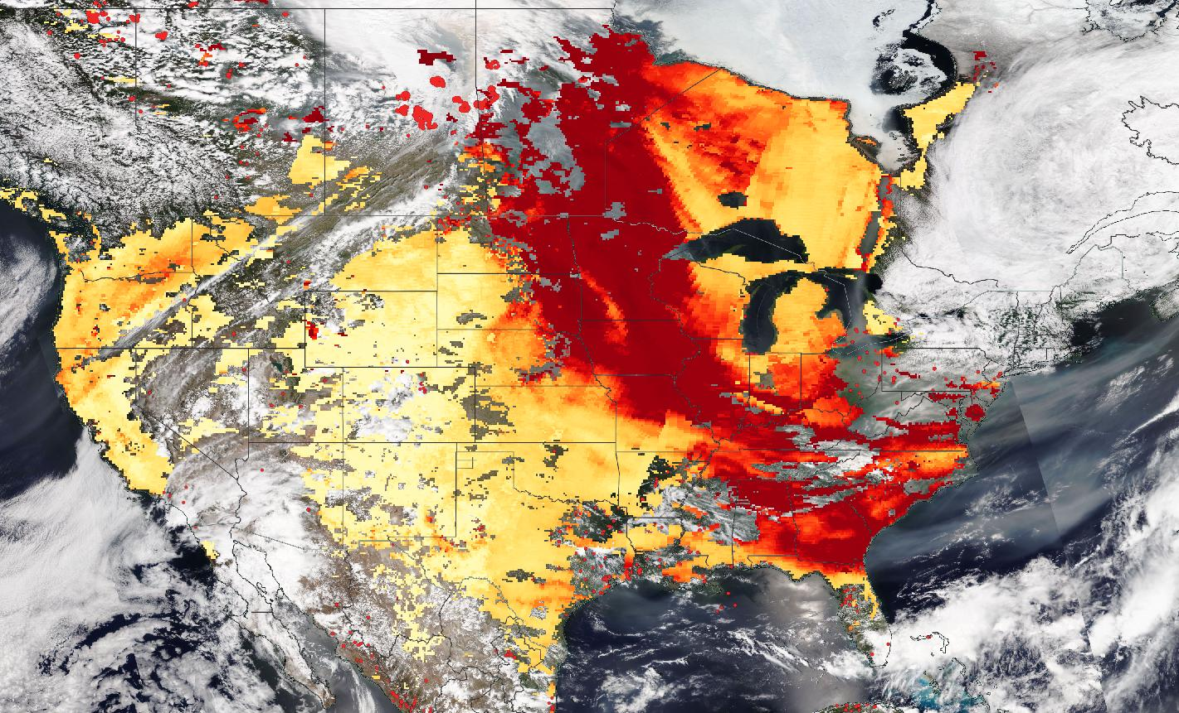
Tracking Wildfire Smoke
June 1, 2025 – True Color with Fires and Thermal Anomalies
June 1, 2025 - AOD
An ongoing challenge for forecasting in Connecticut is tracking smoke plumes from Canadian wildfires, particularly regarding smoke enhancement to ozone.
We need to better understand the impacts to ozone production from “new” vs “old” smoke.

Slide 8
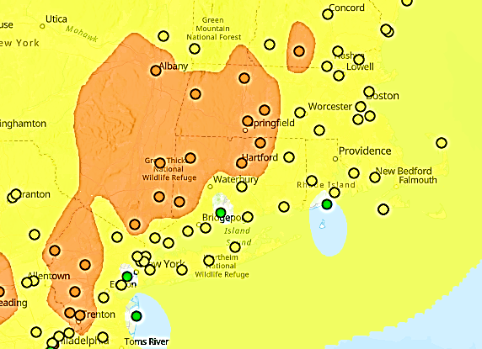
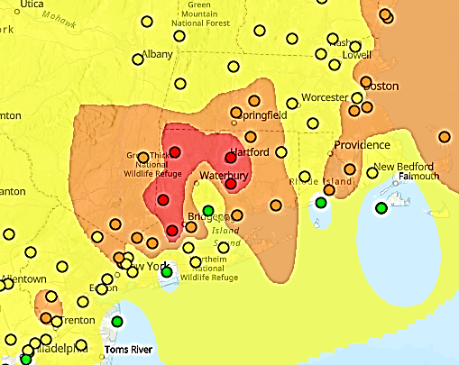
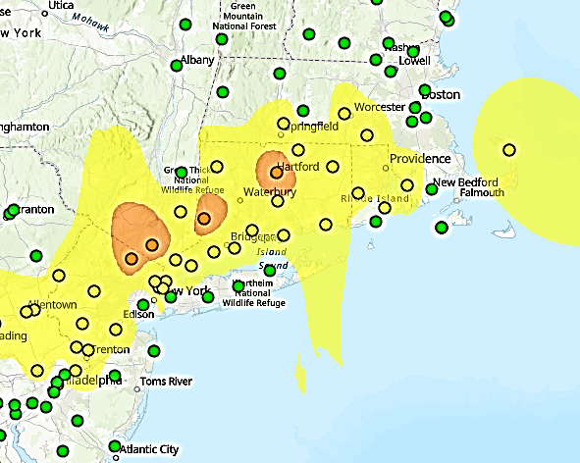
Ozone Exceedance Event: June 4 - 6, 2025
Daily Ozone AQI
Wednesday, June 4, 2025
Daily Ozone AQI
Thursday, June 5, 2025
Daily Ozone AQI
Friday, June 6, 2025
June 5th showed the greatest impacts to Connecticut’s air quality for this event with five sites reaching UNHEALTHY ozone levels and elevated PM2.5 levels.

Slide 9
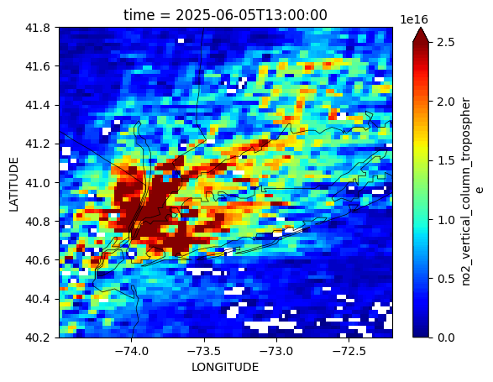
TEMPO NO2 Animation: June 5, 2025
The significant NO2 plume over the NYC Metro area decreases in the afternoon as ozone formation occurs.
TEMPO hourly and sub-hourly scans over NYC (and other urban areas and events) are a major advancement in tracking and understanding emission sources on exceedance days.

Slide 10
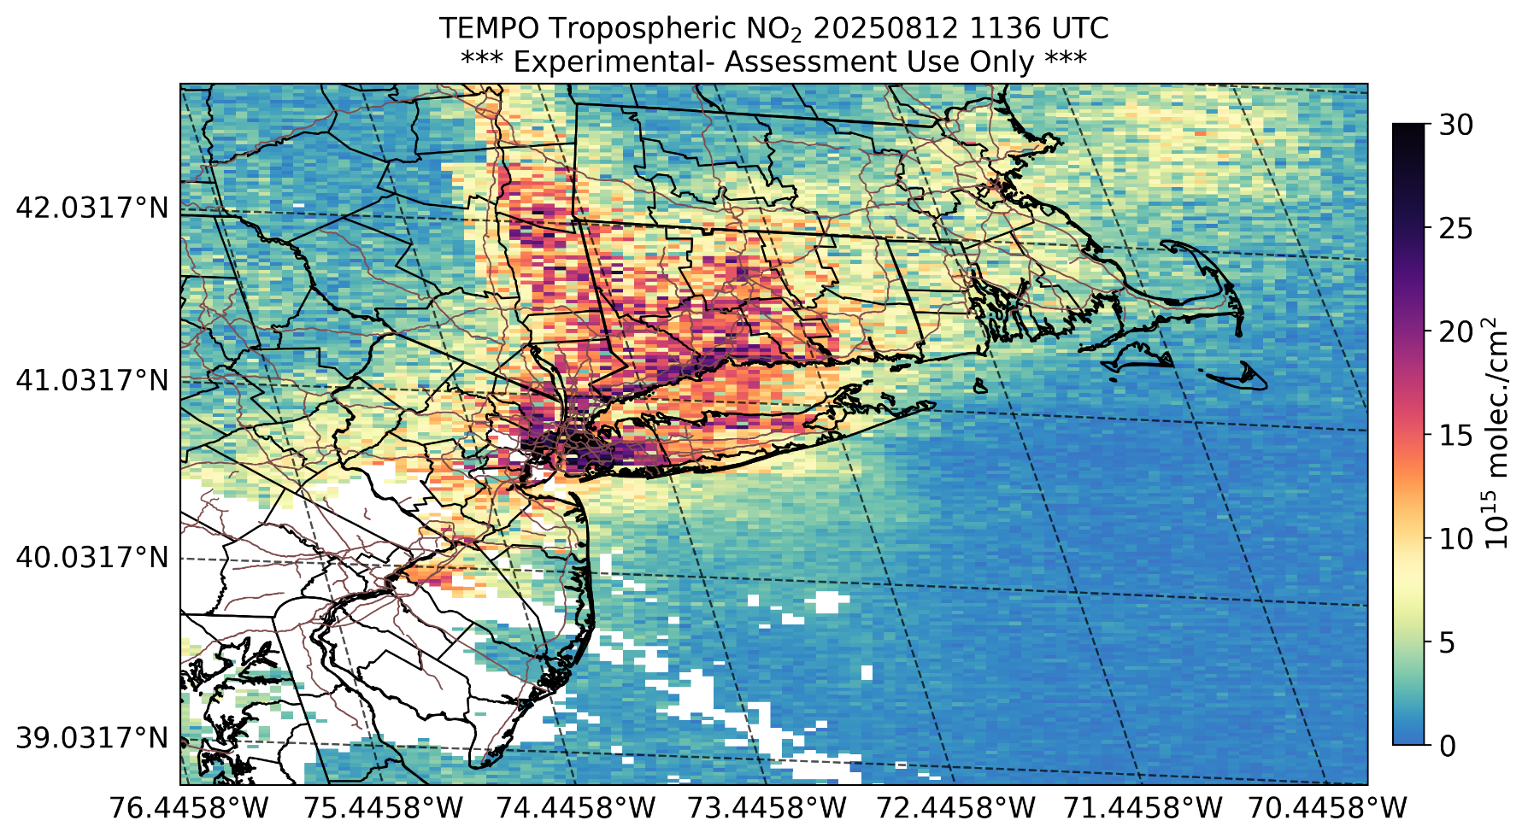
TEMPO NRT NO2 Data: August 12, 2025
Connecticut DEEP issues next day ozone and PM2.5 forecasts with the occasional upgrade from MODERATE to USG for the current day.
Near Real Time (NRT) NO2 data will aid in same day forecasting decisions in the future.

Slide 11
GeoXO ACX Stakeholder Needs
High pixel resolution for urban-scale surveillance and evaluation of control strategies;
Better understanding of transport from smoke and smoke enhancement to ozone levels through post processing and modeling;
Hourly NO2 scans for a better understanding of the NO2 availability and sources contributing to ozone formation on exceedance days;
Access to reliable NRT NO2 data to provide more accurate updated ozone forecasts on the day of close call exceedance days;
Data output in netcdf and hdf files to be formatted for easy display for GIS applications.

