Slide 1

TEMPO/GeoXO ACX Joint Science Team Meeting
Applications of TEMPO Data in the NASA HAQ Program
August 21, 2025
John Haynes, MS
jhaynes@nasa.gov
Program Manager, Health and Air Quality
Program Applications Lead, TEMPO
Earth Action
Earth Science Division
NASA Science Mission Directorate

Slide 2



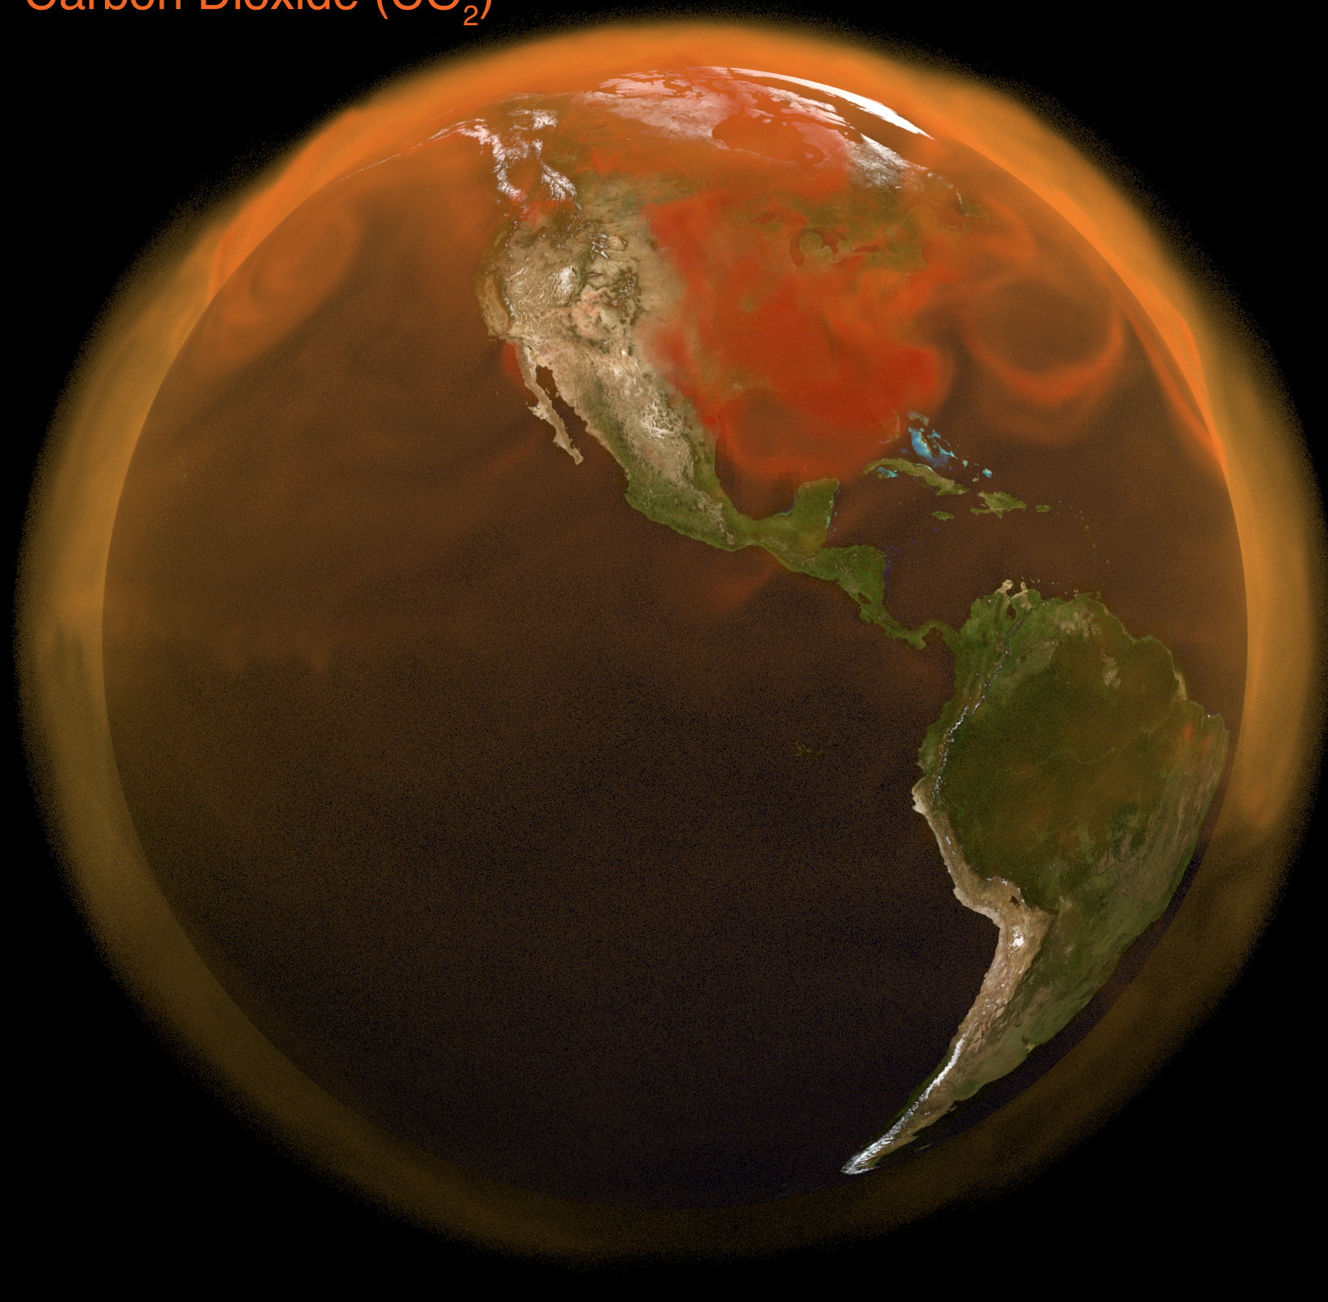





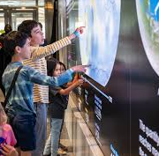




Agriculture
Capacity
Building
ACTION
Wildland Fires
Greenhouse Gas Center
Satellite Needs Working Group
Empowering communities across the world to find solutions to the challenges they face every day.
Disasters
Ecological
Conservation
Energy and Infrastructure
Commercial SmallSat Data Acquisition
Earth Information Center
Health and
Air Quality
Mission Engagement
Water
Resources
Website: https://appliedsciences.nasa.gov/

Slide 3


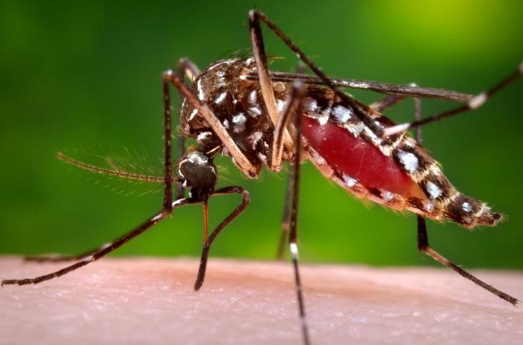
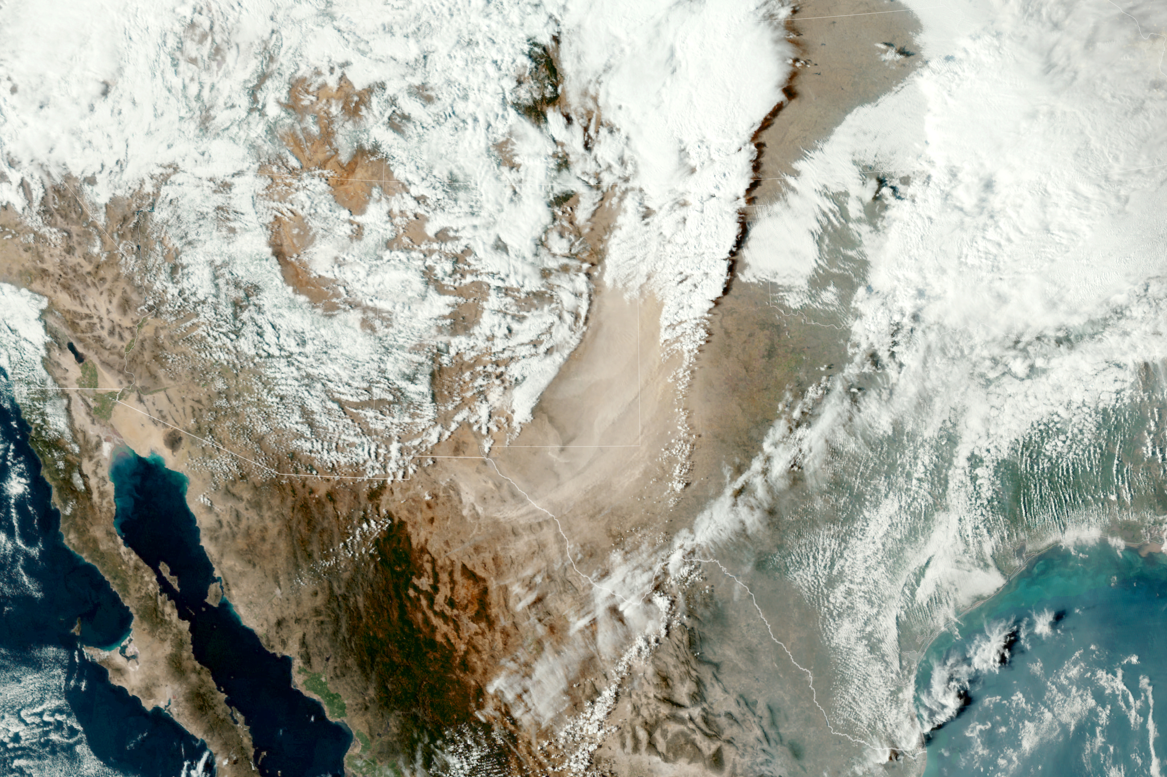

NASA Health and Air Quality Applications
We support the use of Earth observation data in air quality management and public health applications, including:
  Infectious diseases and environmental health
  Toxic and pathogenic exposures and health-related hazards
  Implementation of air quality standards, policies, and regulations
  Effects of climate change on public health and air quality
Aedes aegypti
Dust plume over TX/NM
Major Partners include International (e.g., GEO, WHO, UNICEF, PAHO), Federal (e.g., CDC, EPA, NIH, NOAA), State (e.g., South Dakota, California, Texas), and Private sectors (e.g., Google, Moore Foundation).

Slide 4




ROSES 24 HAQ: Satellite-Derived PM_{2.5} to Support Public Health Outreach in the U.S.
Project PI & Team: Dr. Tracey Holloway (PI, U. of WI); Dr. Randall Martin & Dr. Chi Li (Co-Is, WUSL); Summer Acker & Chandler Wells (interns, U. of WI); Dr. Viral Shah* (NASA GSFC) & Dr. Jenny Bratburd* (U. of WI) (collaborators)
Stakeholders:
Project Summary:
Develop new U.S.-specific satellite-derived PM_{2.5} product with novel deep learning algorithms
Calculate satellite-derived annual PM₂.₅ estimates for ~80% of U.S. counties lacking monitors
Automate and document workflows
  Stakeholder Engagement Plan: Monthly meetings or as preferred by stakeholder partners; on-ramp for new partners through HAQAST; co-authorship of manuscripts (two with ALA in review)
Earth Observations/Tools: AOD data from MODIS, VIIRS, MISR, PACE; aerosol properties from HARP2 and TEMPO
Geographic Scope: USA
Current ARL: 6 Goal ARL: 8-9

Slide 5
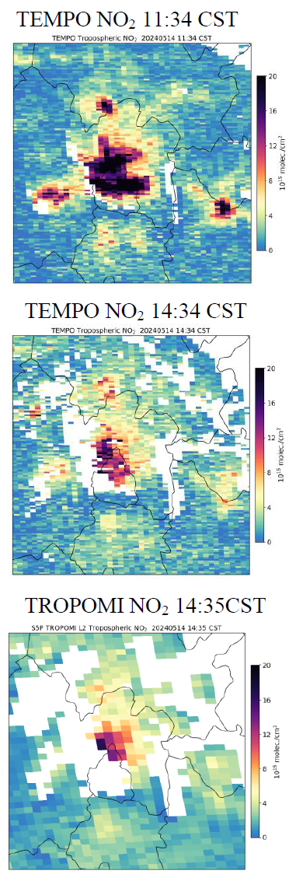
ROSES 24 HAQ: Health impacts of air pollution mixtures and sub-daily variation: epidemiological support for Mexican air quality planning with satellite data and massive registries
Project Team: PI Ivan Gutierrez-Avila (ISMMS), Co-PI Allan Just (Brown), Co-PI Aaron Naeger* (NASA MSFC),
Elena Colicino (ISMMS), and Kelley Murphy (UAH). Local site collaborators: Michel Grutter (UNAM)
Stakeholders: Horacio Riojas (Collaborative Center WHO-PAHO-INSP, Mexico) and Victor H. Páramo (CAMe)
Project Summary:
  Integrate new Earth observations into exposure estimates (PM_{2.5}, O₂, SO₂, NO₂) for Central Mexico.
  Construct epidemiologic models to estimate Concentration-Response Functions (ER, hospital discharges and mortality) for air quality management.
  Leverage new geostationary observations for epidemiologic models of air pollution mixtures and sub-daily variation
  Concentration Response Functions will inform health impact assessments for the Program to Improve Air Quality (PROAIRE).
Stakeholder Engagement Plan: In person and virtual workshops.
Earth Observations/Tools: AOD (MODIS, VIIRS, ABI, and forthcoming data from OCI and TEMPO); NO₂, O₃, SO₂ (TEMPO and TROPOMI); MERRA-2 and GEOS-CF; ground-based Pandora (trace gases) and AERONET (AOD) stations for validation. Synergy with EVS-4 Hemispheric Airborne Measurements of Air Quality (HAMAQ) campaign (2028).
Geographic Scope: Cluster of 11 metro areas from, including the Mexico City Metropolitan Area (MCMA), ~40 million people
Current/Goal ARL: Current: Level of 3 with viability established and major components, Tasks 1 & 2 are at ARL 4. Goal: ARL 7
Notes:
Icahn School of Medicine at Mount Sinai (ISMMS)
National Autonomous University of Mexico (UNAM)
Environmental Commission of the Megalopolis (CAMe)

Slide 6
ROSES 24 HAQ: Rapid Assessment of Smoke impacts on OZone and PM for all U.S. Regions- Air Quality (RAZOR-AQ)
Project PI and team:
PI: Dan Jaffe | University of Washington (UW)
Haebum Lee | University of Washington (UW)
Katelynn O’Dell | Climate Strategies LLC
Min Zhong | PA Department of Environmental Protection
Mary Uhl | Western States Air Resources Council (WESTAR)
Daniel Goldberg* | George Washington University (GWU)
Stakeholder Engagement: States, MJOs, EPA and health scientists (monthly or quarterly team meetings)
Steering committee:
Melissa Maestas | South Coast Air Quality Management District (AQMD)
Heather Simon | EPA-OAR
Ranil Dhammapala | South Coast Air Quality Management District (AQMD)
Byeong-Uk Kim* | Georgia Dept. of Natural Resources.
Zach Adelman | Lake Michigan Air Directors Consortium (LADCO)
Scott Landes | Colorado Department of Public Health and Environment (CDPHE)
Beth Friedman | WA Department of Ecology (DOE)
Barron Henderson* | EPA-ORD
Matthew Densberger | CA Air Resources Board (CARB)
Notes:
MJO: Multi-jurisdictional Organizations

Slide 7
Identify surface smoke impacts on daily PM_{2.5} at every regulatory AQ monitor in the US;
2. Develop interpretable machine learning models to hindcast the MDA8 O₃ for every regulatory AQ monitor in the U.S. for every day and use this to estimate smoke impacts on the MDA8;
3. Provide a database and R-shiny app of the daily estimate of the PM_{2.5} and O₃ enhancements due to smoke;
4. Estimate health outcomes from non-smoke and smoke PM_{2.5} and O₃ for all CBSAs in the US;
5. Support federal, state, local and tribal efforts to reduce the public’s exposure to smoke and meet statutory requirements for identification of exceptional events.
Project Goals:
Earth Observations:
Surface AQ observations
NOAA HMS Fire and Smoke Product
AOD from TEMPO and GOES instruments
MERRA-2
TROPOMI satellite products
Other TEMPO satellite products
ARL:
Current ARL: 3 (Feasibility study and some characterization completed)
Goal ARL: 7 (Application Prototype in Partner’s Decision Making)
Notes:
MDA8: Daily maximum 8-hr average
CBSAs: Core Based Statistical Areas

Slide 8


NASA Health and Air Quality Applied Sciences Team (HAQAST)
Entering its 4th Generation (2025-2029).
14 Members/PIs selected in June 2025 in response to ROSES 2024 HAQAST.
Team Lead -- Tracey Holloway (U. of Wisconsin).
Public meetings held semi-annually. Last meeting was the HAQAST Showcase in Washington, DC (January 2025).
Core projects to be executed by each PI.
A unique feature of HAQAST is Tiger Teams (TTs). TTs are short-term, high-impact collaborative efforts between HAQAST members and public stakeholders to identify and solve critical problems using NASA data and products. Details of past TTs can be found here: https://haqast.org/tiger-teams/. TT topics have included extreme heat/wildfires, oil and gas emissions, and supporting TEMPO applications for surface ozone.
Next public meeting is November 6-7, 2025, in St. Louis, MO (also virtual).
https://haqast.org/

Slide 9
HAQAST Core Projects Significantly Leveraging TEMPO
Tracey Holloway (U. of WI): Advancing Satellite Data for Health and Air Quality Management Across Scales
Daniel Anderson (UMBC): Determining near real time surface ozone concentrations from TEMPO and machine learning: A feasibility study
Xi Chen (U. of IA): Support Air Quality and Public Health Management in Wildfires: Satellite and Machine Learning Based Air Quality Forecast
Arlene Fiore* (MIT): New urban-to-global viewpoints on air pollution for public policy and health applications
Jen Kaiser* (GA Tech): Using Earth Observations to Investigate Diurnal Bias in Sectorized Emissions, and its Impact on Simulating Exposure of Air Pollution and Implications for Control Strategy Design and Public Health Assessment
Randall Martin (WUSL): Advancing Satellite-derived Fine Particulate Matter Data to Support the Health and Air Quality Management Communities
Jeffrey Pierce (CSU): Leveraging satellites and low-cost monitors to strengthen air pollution and health decision making in under-monitored regions
Aaron Naeger* (NASA MSFC): Supporting the Health and Air Quality Management Communities by Advancing Satellite-based Fine Particulate Matter Estimates for Applications across Multiple Scales

Slide 10

AIR4US
The Air quality Information Resource for the United States
A multi-agency effort to support air quality information data management and services by advancing the value, completeness, transparency, and accessibility of air quality information needed for decision-making at the local, state, and regional scale.
What is it? An online portal with datasets and services integrated at earth.gov to increase efficiency of the most critical information for air quality decision makers.
Stakeholders: Local, State, and Regional Air Quality Managers
Goal: Protect the nation’s health and economy, while also advancing US scientific and technological leadership.
NASA Leads: John Haynes* (HQ), Emma Knowland* (HQ), Laura Judd* (LaRC)
NASA Centers: GSFC, MSFC, JPL
Launch: Planned for FY26 Q4

Slide 11



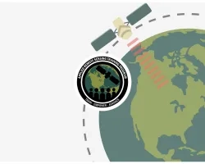
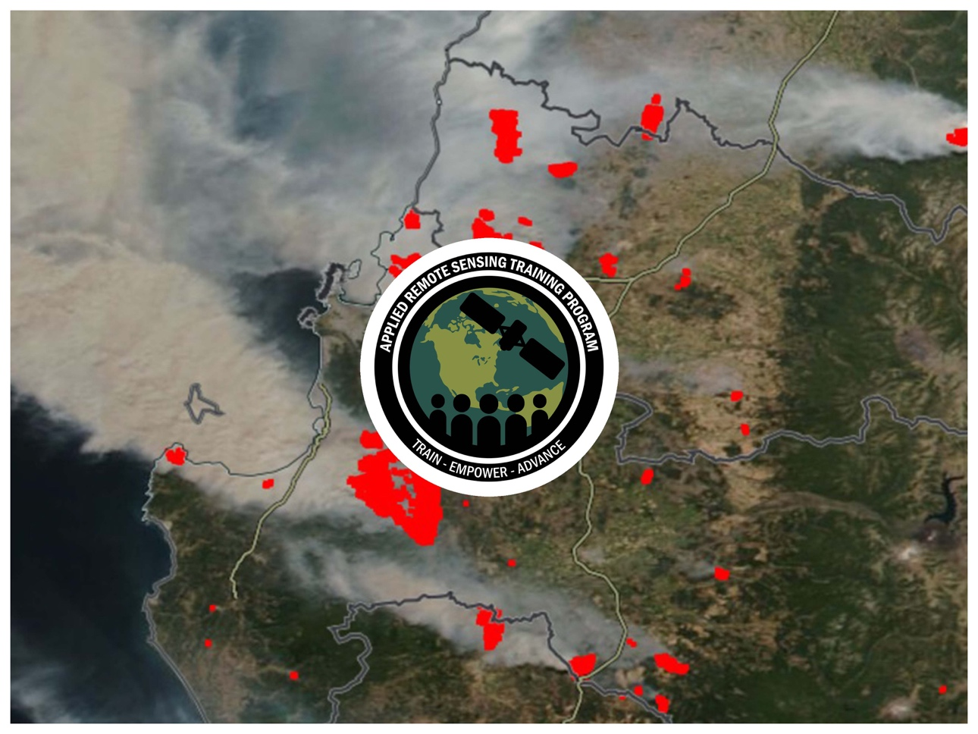
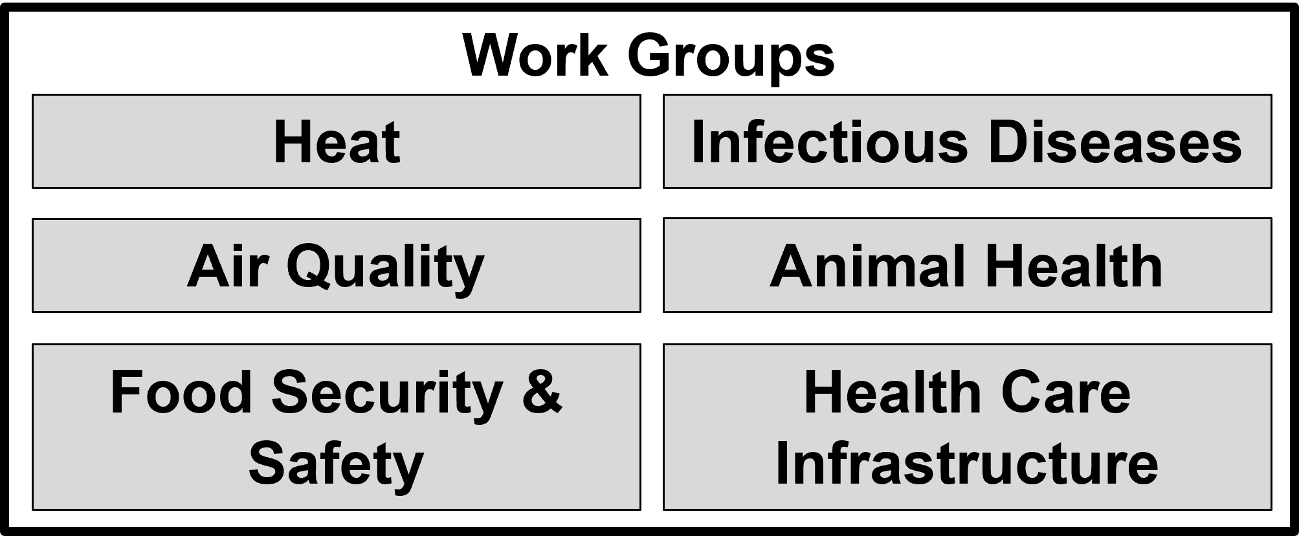
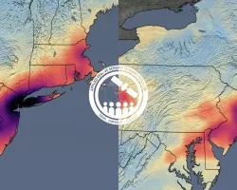
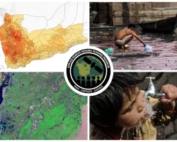
NASA Applied Remote Sensing Training Program (ARSET)
Courses with lectures and hands-on guided computer exercises on how to access, interpret, and use NASA satellite images for decision-support
Improving Health Decision-Making Using Environmental Observations
Global network of governments, organizations, and observers, who seek to use Earth observation data to improve health decision-making at the international, regional, country, and district levels
Fundamentals of
Remote Sensing
Monitoring
Wildfire Risk
Measuring Air Pollution
Assessing Waterborne Disease Risk
https://www.geohealthcop.org/
Notes:
GEO Health CoP wins AmeriGEO 2025 Team Excellence Award!

