Slide 1
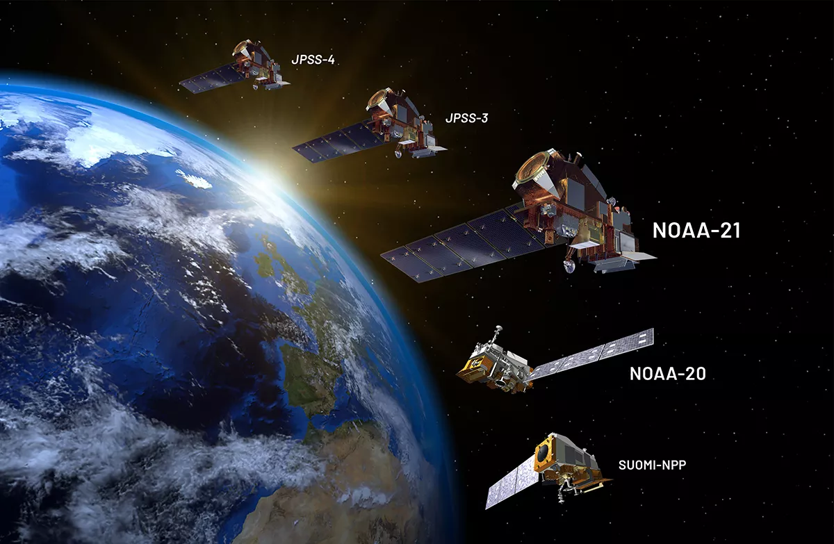




VOC observations from CrIS: Opportunities for GXS, synergy with TEMPO/ACX
Joint Polar Satellite System
VOC observations from CrIS: Opportunities for GXS, synergy with TEMPO/ACX
From NESDIS NOAA
Julieta Juncosa Calahorrano¹, Dylan B. Millet¹, Kelley C. Wells¹, Chengyuan Hu¹, Jared F. Brewer¹, and Vivienne H. Payne²
1 University of Minnesota
2 NASA Jet Propulsion Laboratory
TEMPO/GeoXO ACX Meeting, 08/2025

Slide 2
The Cross-track Infrared Sounders (CrIS) are an identical series of IR sounders on board the Suomi-NPP, NOAA-20, & NOAA-21 satellites with future launches planned on JPSS-3 & JPSS-4.
Continuity for isoprene, ammonia, PAN, methanol, and other VOCs to 2038.
In orbit
2027
Future missions
2032
2022
0.625 cm⁻¹ resolution in LWIR
Extremely low noise
14 km nadir footprint
~1:30 am/pm LT overpass
peak thermal contrast, vertical mixing, BVOC emissions
Near global coverage twice/day (8.7M spectra/day)
2017
2011

Slide 3

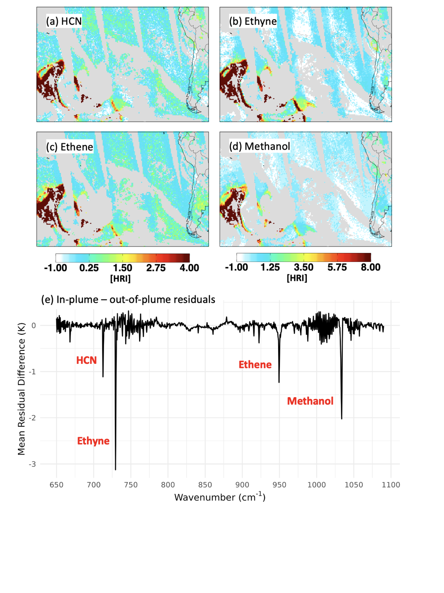

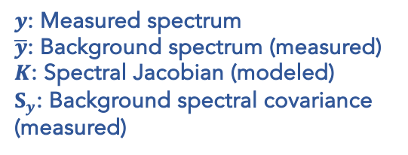
Several important volatile organic compounds (VOCs) are measurable in the thermal IR
→ Tracers for understanding biogenic, pyrogenic, anthropogenic emissions and changes over time
 | Biogenic | Fires | Anthropogenic | Lifetime (d)
Isoprene | X |  |  | < 0.1
Methanol | X | x | x | 13
Ethane |  | x | X | 45
Ethene | X | X | X | 1
Ethyne |  | X | X | 13
HCN |  | X |  | 150
Kelley Wells
We have recently developed CrIS retrievals for these species
→ All exhibit clear spectral signatures in the CrIS radiances
Retrievals employ the HRI to quantify the spectral signal for each VOC
Covers broad spectral range, provides high sensitivity
Reduced sensitivity to interferences
HRI metric originally developed and applied by IASI team
In-plume / out-of-plume spectral difference measured by CrIS
Ethane
Glycoaldehyde
$$HRI=\frac{K^{T}S_{y}^{−1}\left(y−\overline{y}\right)}{\sqrt{K^{T}S_{y}^{−1}K}}$$
$y$: Measured spectrum
$\overline{y}$: Background spectrum (measured)
$K$: Spectral Jacobian (modeled)
$S_{y}$: Background spectral covariance (measured)
HCN
Ethene
Methanol
Ethyne
Australian fire plume, 01/2020
In-plume – out-of-plume spectral difference illustrates detection of these VOCs

Slide 4
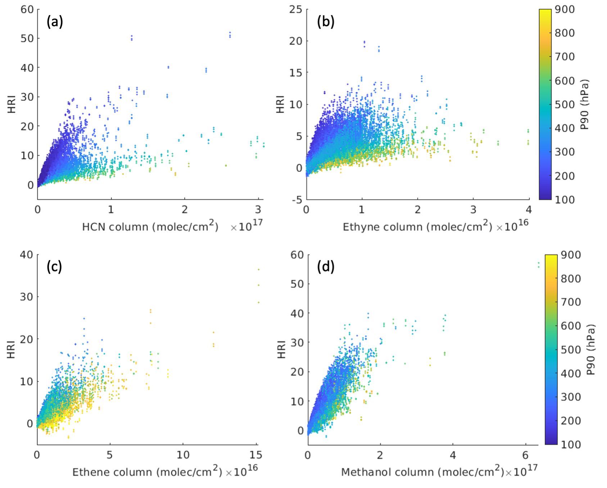



The HRI maps the VOC signal detected by CrIS…
VOC signals in Australian fire plume (1/2020) as measured by CrIS
HRI:column relationship simulated by LBLRTM
HCN
Ethyne
HRI
P₉₀ (hPa)
Column (molec/cm²)
Column (molec/cm²)
Ethene
Methanol
HRI
P₉₀ (hPa)
… but the strength of this signal depends on environmental factors
Column (molec/cm²)
Column (molec/cm²)
$$φ_{i}^{b}{(T}_{z})dτ$$
In particular, TIR retrievals depend on the thermal contrast between the Earth’s surface and the absorber
And therefore on the vertical location of the VOC in the atmosphere
P₉₀ = pressure below which 90% of the column resides
absorber
$$φ_{i}^{b}{(T}_{s})$$
Vertical dependence is stronger for HCN, ethyne
due to CO₂ effects
Weaker for methanol, ethene, isoprene

Slide 5
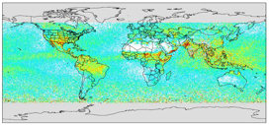
Updated Retrieval of Organics from CrIS Radiances (ROCRv2)
HRI
ROCRv2 uses a feedforward neural network to relate the HRI to the column density as a function of the atmospheric state
incorporates P₉₀ as an explicit predictor
retrieval can then be adapted to any observational or model constraint on the VOC vertical distribution
allows internally consistent comparisons for evaluation, source quantification
Temp (sfc, 4 atm)
H₂O vapor column
Column density
Surface pressure
Satellite view angle
P90
[Wells et al., 2025]

Slide 6
We are building a harmonized decadal record of isoprene and methanol to study the impact of climate variability on these VOCs
Our retrieval shows temporal and spatial consistency between the three CrIS instruments on board Suomi-NPP, NOAA-20, and NOAA-21, and we expect to keep the same consistency with CrIS instruments onboard JPSS3/4.
Post-adjustment signal (Amazonia)
Isoprene columns (SNPP, 2018)
Isoprene columns (NOAA-20, 2018)
SNPP NOAA-20 NOAA-21
Apr
Jul
Apr
Jul
Isoprene HRI
Sep
Dec
Sep
Dec
2012
2025
Detector-to-detector differences and instrument-specific ANN are employed to build the decadal record.
Methanol columns (SNPP, 2018)
Methanol columns (NOAA-20, 2018)
Apr
Jul
Apr
Jul
Methanol HRI
Sep
Dec
Sep
Dec
2012
[Wells et al., in prep]
2025

Slide 7
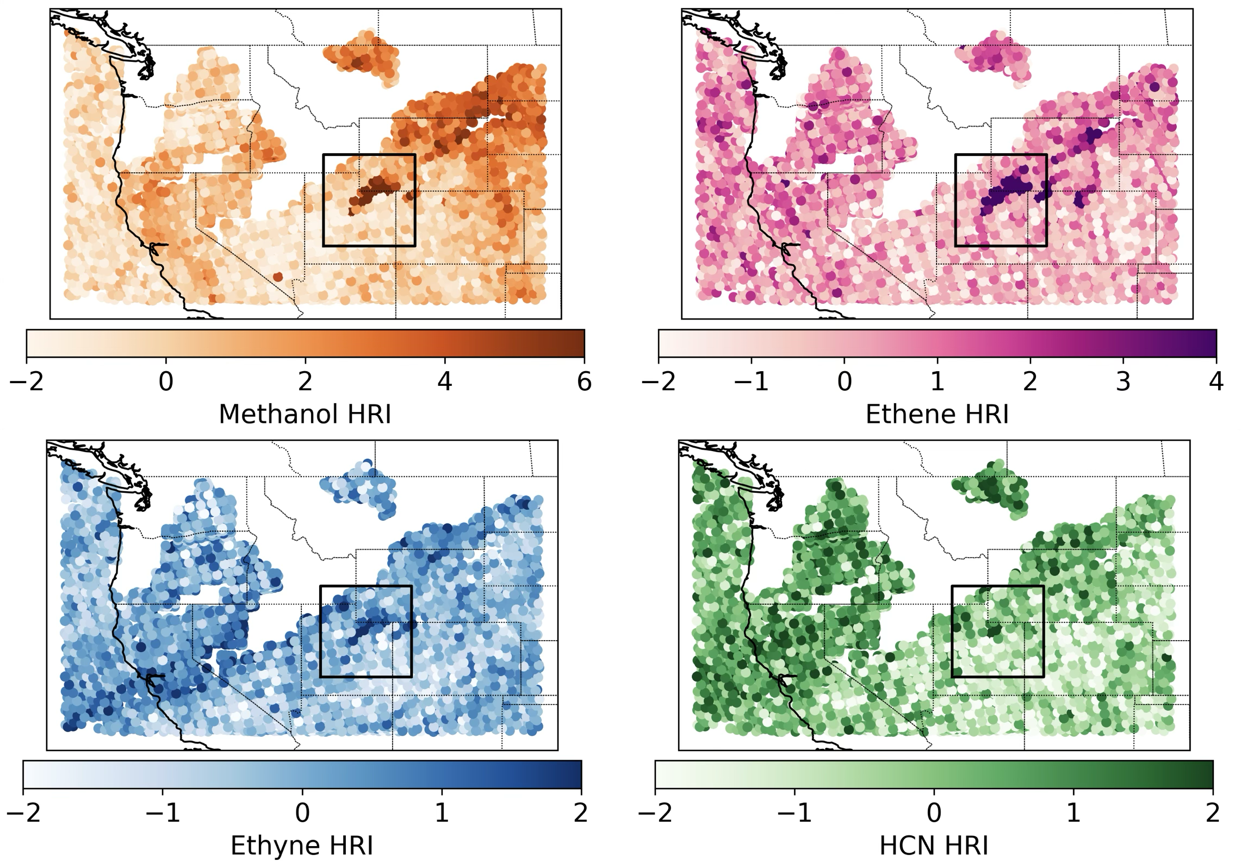
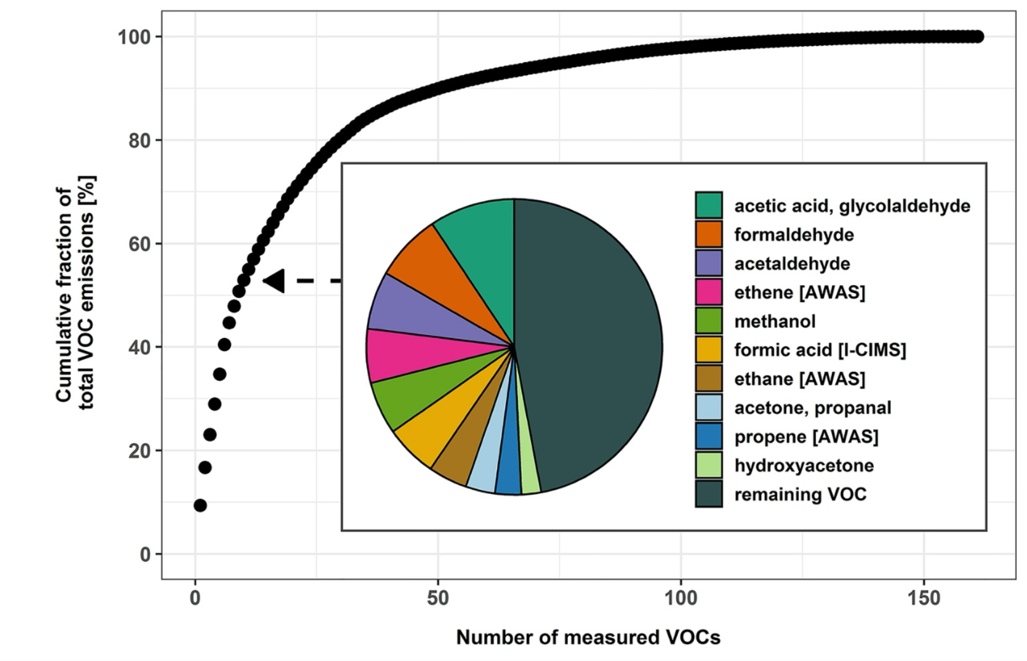
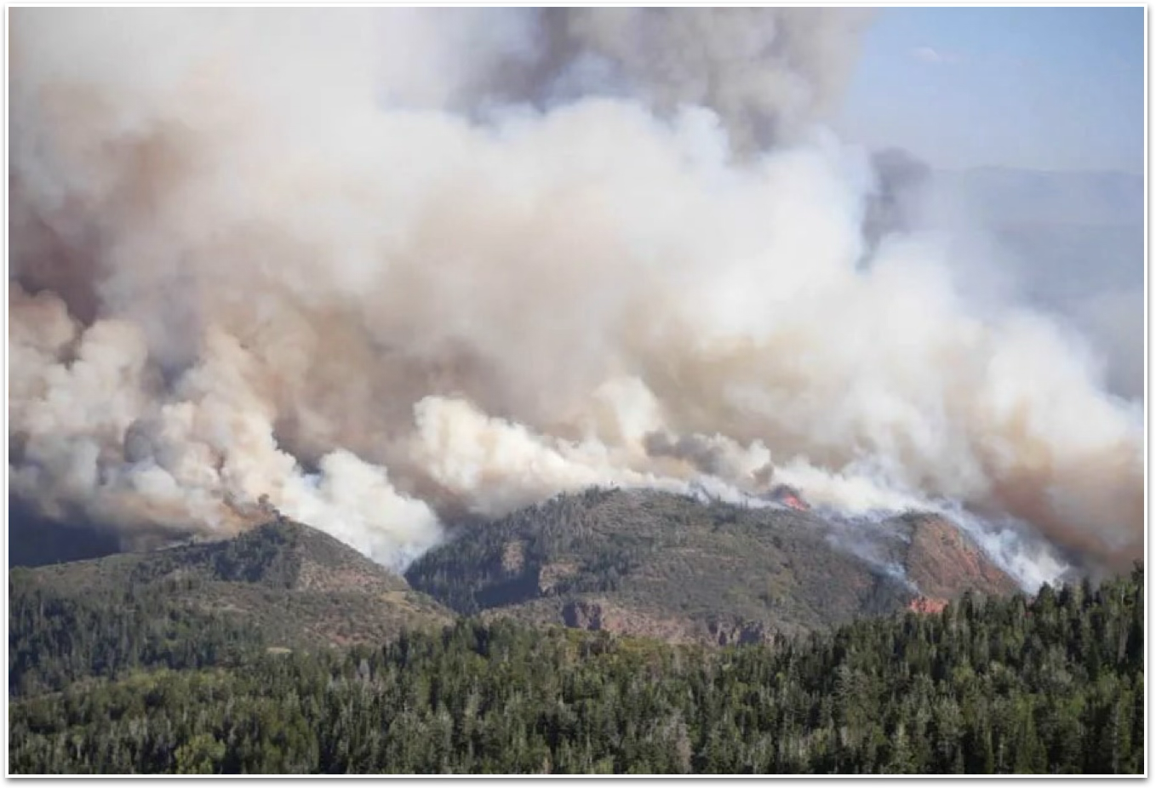
GXS observations would enable the detection of some of the most abundant VOCs in smoke.
Geostationary observations with high spatial resolution will map the diurnal variability of fires, advancing our understanding of biomass burning emissions and impacts.
Observations from the Western Wildfire Experiment for Cloud Chemistry, Aerosol Absorption, and Nitrogen (WE-CAN)
VOC enhancements in the Pole Creek fire plume (Sep 13, 2018) as measured by CrIS
a) Methanol
b) Ethene
c) Ethyne
d) HCN
HRI
HRI
Detectable in the Thermal Infrared
Detectable in the UV-VIS
Native footprint (14 km)
[Permar et al., 2021]
[Juncosa Calahorrano, et al., in prep]

Slide 8
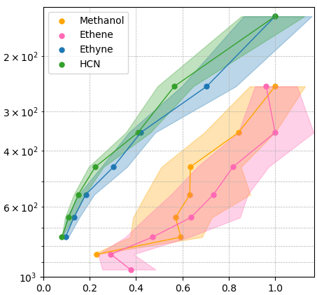
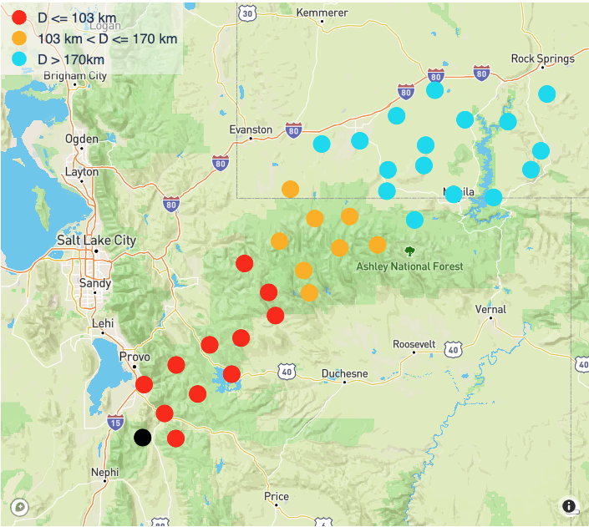
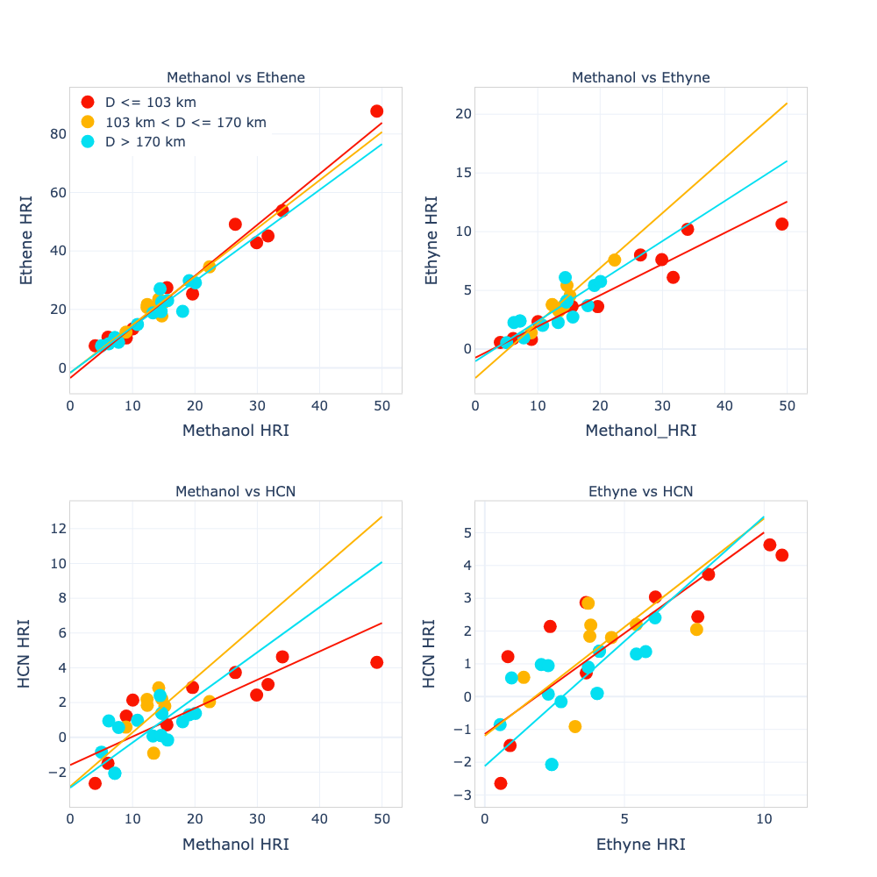
We observe tight spectral correlations between VOCs with similar vertical sensitivity
Plume injection height is one of the most challenging parameters to model. We leverage VOC with similar vertical sensitivities to derive column:column relationships from HRI:HRI relationships.
Methanol
Ethene
Ethyne
HCN
< 103 km
103 – 170 km
> 170 km
Ethyne and HCN have similarly steep vertical sensitivities - they are detected most strongly when lofted in the atmosphere.
After initial injection, the Pole Creek fire plume is lifted orographically as it is transported through the Uinta Range. As the topography changes, the plume subsides.
P90
(hPa)
Methanol and ethene have weaker (and comparable to each other) vertical sensitivities.
Synthetic data
CrIS retrievals
Normalized sensitivity (HRI:Ω)
< 103 km
103 – 170 km
> 170 km
< 103 km
103 – 170 km
> 170 km
VOC pairs with similar vertical sensitivities show statistically consistent HRI:HRI ratios during plume altitude change.
Ethene
HRI
HCN
HRI
Ethyne
HRI
Slopes (SE)*
1.74 (0.11)
1.69 (0.26)
1.56 (0.15)
Slopes (SE)
0.61 (0.12)
0.66 (0.29)
0.76 (0.18)
Slopes (SE)
0.27 (0.03)
0.47 (0.06)
0.34 (0.06)
VOC pairs with different vertical sensitivities show a change in HRI:HRI ratios during plume altitude change.
Methanol HRI
*HRI:HRI
Ethyne HRI
Methanol HRI

Slide 9
We observe tight spectral correlations between VOCs with similar vertical sensitivity
Plume injection height is one of the most challenging parameters to model. We leverage VOC with similar vertical sensitivities to derive column:column relationships from HRI:HRI relationships.
Differences in the HRI:HRI relationships can give us information of plume injection height (potentially) and plume altitude change.
We leverage these tight HRI:HRI relationships to derive column:column ratios, without needing to know the plume altitude. This enables process-based study of VOCs in smoke plumes.
< 103 km
103 – 170 km
> 170 km
< 103 km
103 – 170 km
> 170 km
VOC pairs with similar vertical sensitivities show statistically consistent HRI:HRI ratios during plume altitude change.
Ethene
HRI
HCN
HRI
Ethyne
HRI
Slopes (SE)*
1.74 (0.11)
1.69 (0.26)
1.56 (0.15)
Slopes (SE)
0.61 (0.12)
0.66 (0.29)
0.76 (0.18)
Slopes (SE)
0.27 (0.03)
0.47 (0.06)
0.34 (0.06)
VOC pairs with different vertical sensitivities show a change in HRI:HRI ratios during plume altitude change.
Methanol HRI
*HRI:HRI
Ethyne HRI
Methanol HRI

Slide 10


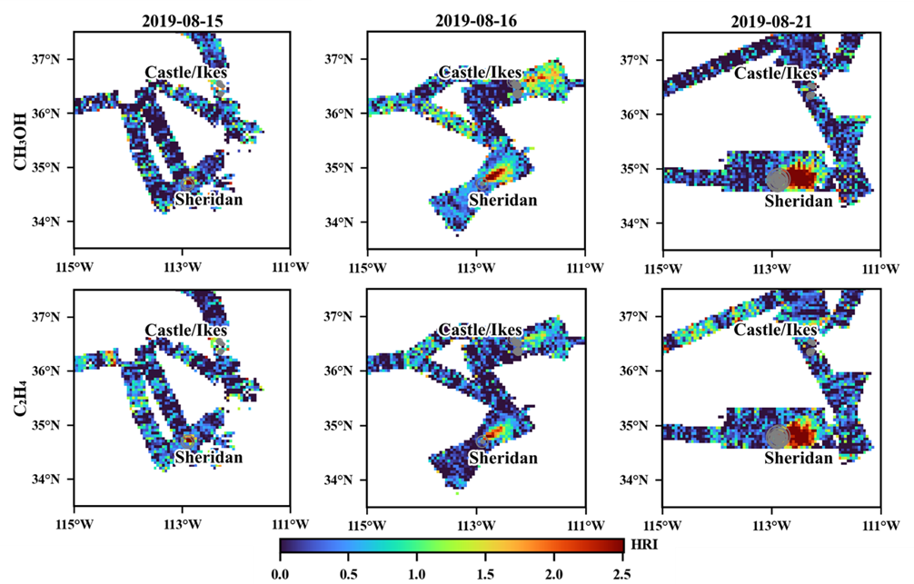
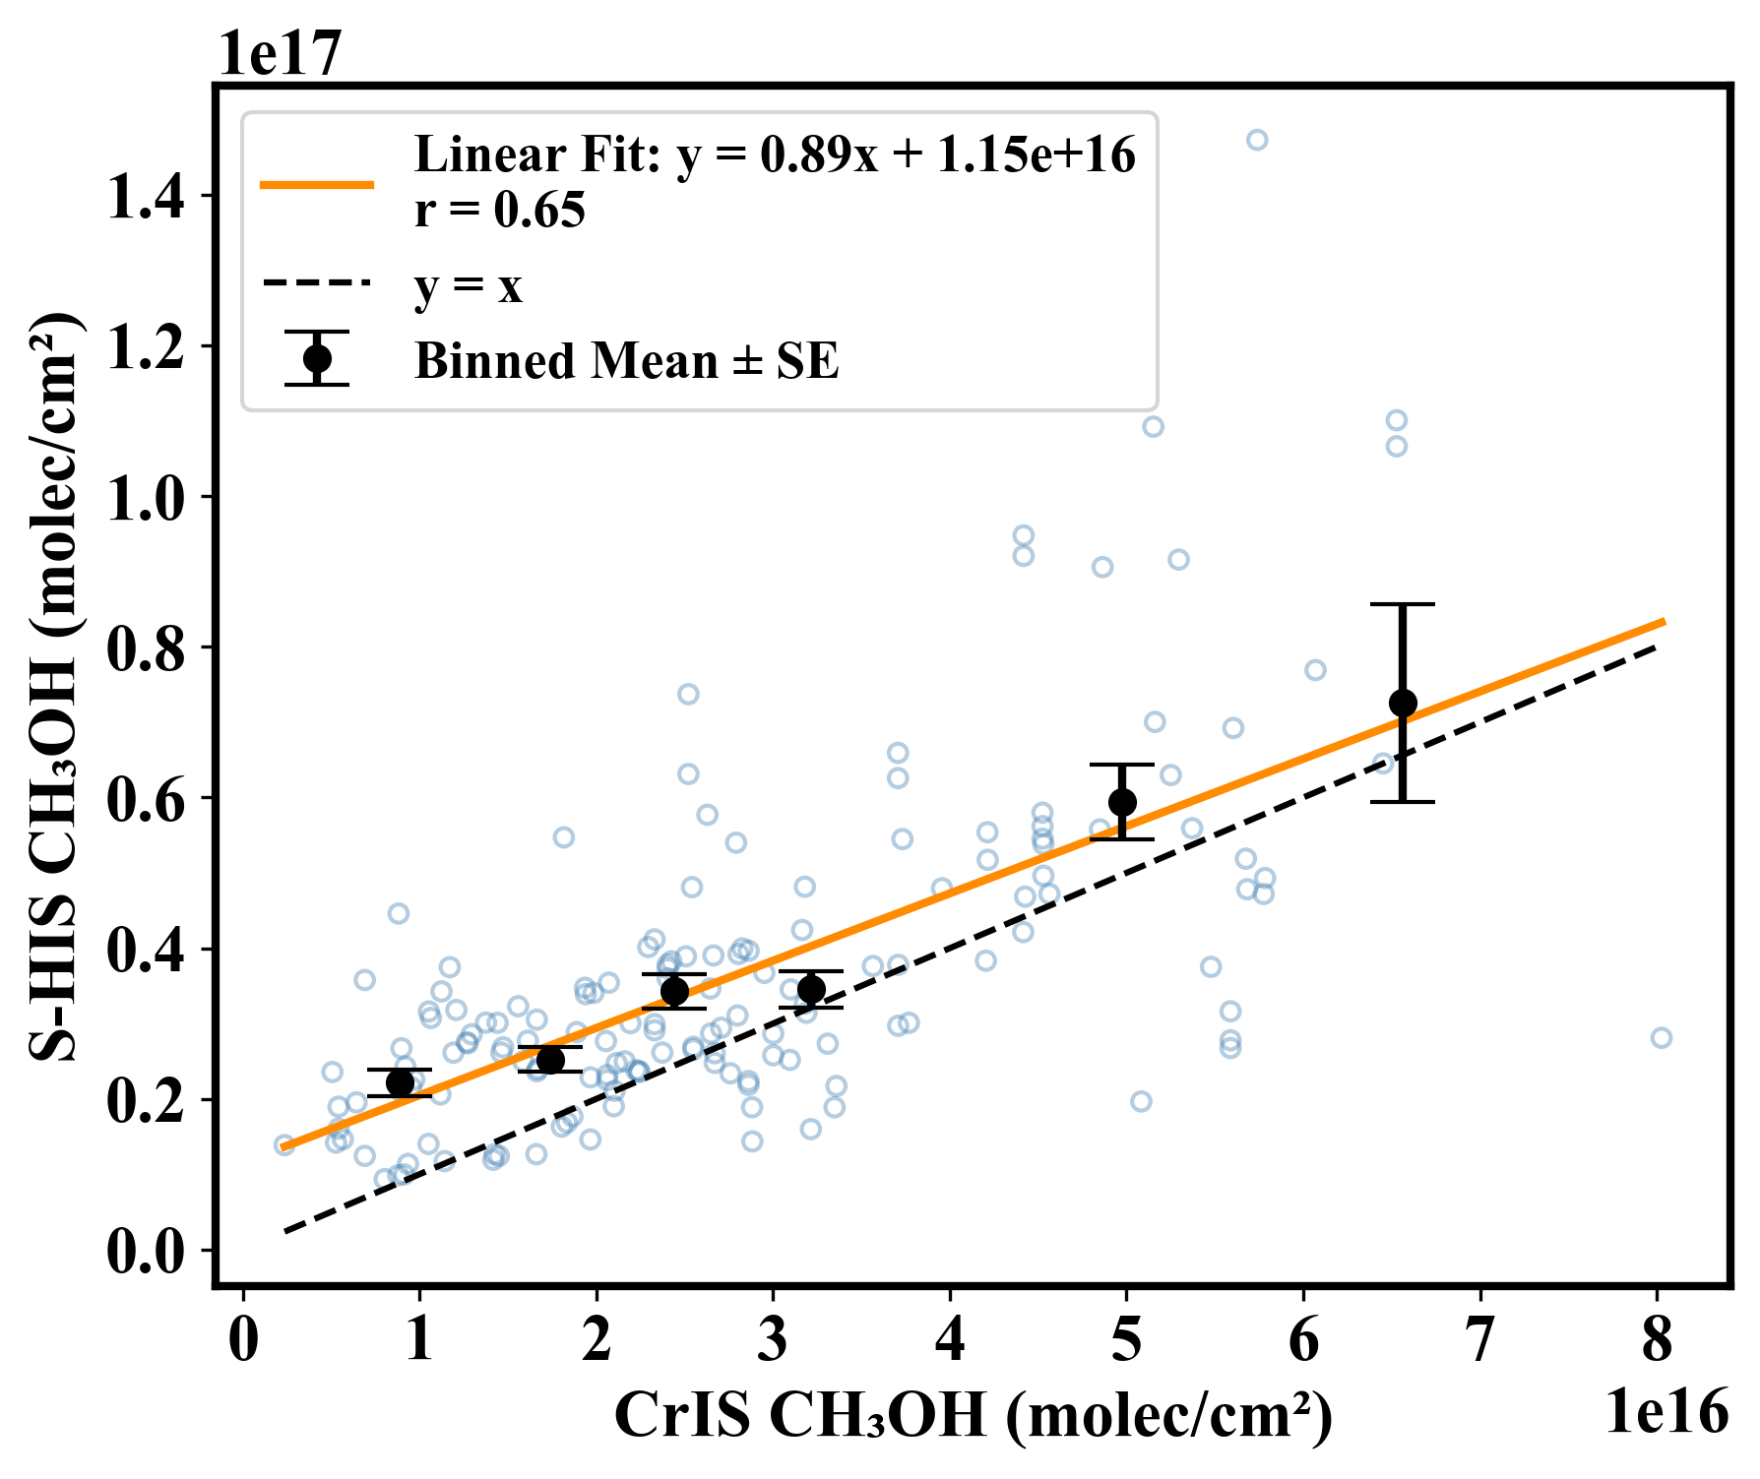
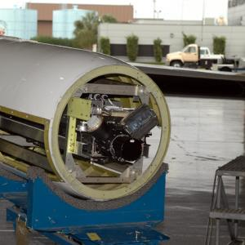
We are extending these retrieval capabilities to airborne observations from the S-HIS* instrument.
S-HIS was deployed onboard the NASA ER2 to observed wildfires during FIREX-AQ
NASA ER2
Typical observing altitude ~20 km
0.5 cm⁻¹ spectral resolution
Field of view extending ±45° from nadir
~2 km footprint
Chengyuan Hu
Plume sampled at a similar overpass time to CrIS
S-HIS detects VOCs enhancements in the Sheridan fire plume on three days.
S-HIS methanol (and ethene) retrievals show good agreement with CrIS retrievals in the Williams Flats fire smoke plume.
*Scanning High-Resolution Interferometer Sounder
Scanning high-resolution interferometer sounder
From airbornescience.nasa.gov
[Hu, et al., in prep]

Slide 11

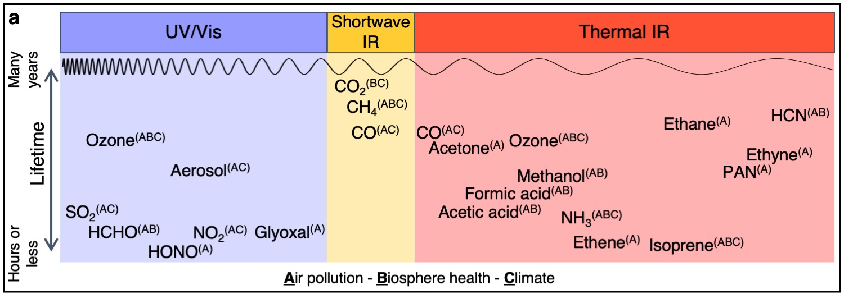
Measurements from UV through TIR are needed to monitor the tropospheric chemicals relevant to air pollution, the biosphere, and climate change
A range of key atmospheric chemicals are observable from space in the thermal IR … and are complementary to those detected in the UV/Vis.
Dylan Millet
Dylan Millet: dbm@umn.edu
Kelley Well: kcw@umn.edu
Julieta Juncosa Calahorrano: junco004@umn.edu
[Millet et al., AGU Advances, 2024]
Notes:
Which shows that using the full range of the spectrum from the UV/VIS to TIR will give us a more complete understanding of the composition of the troposphere.
As a community, we will benefit from coordinated efforts to study key atmospheric chemicals detected in different regions of the spectrum.
For example, TIR measurements in a geostationary satellite will provide better constraints on NH3 diurnal variability and provide more infromation about its role in air pollution as a precursor for aerosols.

Slide 13
Updated Retrieval of Organics from CrIS Radiances (ROCRv2)
HRI
ROCRv2 uses a feedforward neural network to relate the HRI to the column density as a function of the atmospheric state
incorporates P₉₀ as an explicit predictor
retrieval can then be adapted to any observational or model constraint on the VOC vertical distribution
allows internally consistent comparisons for evaluation, source quantification
Temp (sfc, 4 atm)
H₂O vapor column
Column density
Surface pressure
Satellite view angle
P90
VOC spectral signal (HRI): most important predictor
→ especially when concentrations enhanced
P90: next in importance
Retrieval mainly determined by VOC amount & its vertical distribution
Temperature inputs: modest impacts individually, collectively important given nature of TIR measurement
[Wells et al., 2025]

Slide 14
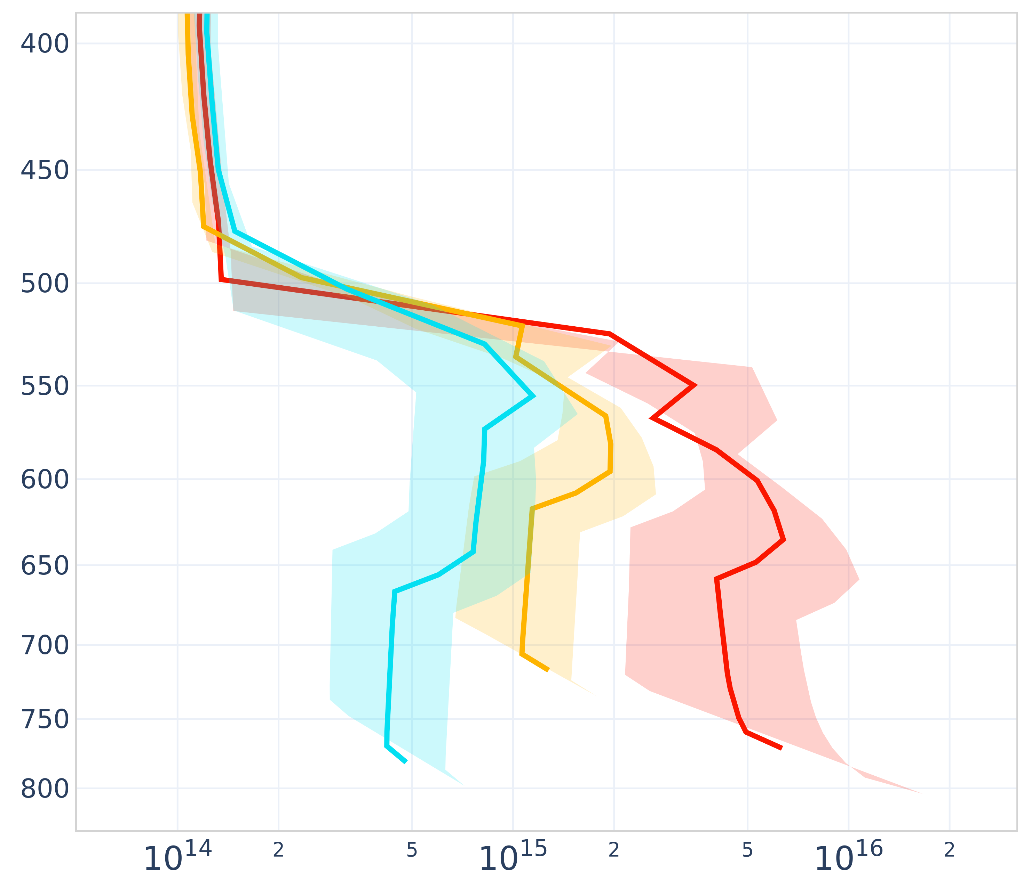
We observe tight HRI:HRI correlations between VOCs with similar vertical sensitivity
Plume injection height is one of the most challenging parameters to model. We leverage VOC with similar vertical sensitivities to derive column:column relationships from HRI:HRI relationships.
Methanol
Ethene
Ethyne
HCN
< 103 km
103 – 170 km
> 170 km
Ethyne and HCN have similarly steep vertical sensitivities - they are detected most strongly when lofted in the atmosphere.
GEOS-Chem vertical profiles
After initial injection, the Pole Creek fire plume is lifted orographically as it is transported through the Uinta Range. As the topography changes, the plume subsides.
P90
(hPa)
Pressure
(hPa)
Methanol and ethene have weaker (and comparable to each other) vertical sensitivities.
Synthetic data
CrIS retrievals
Normalized sensitivity (HRI:Ω)
Methanol column density (molec cm⁻²)
< 103 km
103 – 170 km
> 170 km
< 103 km
103 – 170 km
> 170 km
VOC pairs with similar vertical sensitivities show statistically consistent HRI:HRI ratios during plume altitude change.
Ethene
HRI
HCN
HRI
Ethyne
HRI
Slopes (SE)*
1.74 (0.11)
1.69 (0.26)
1.56 (0.15)
Slopes (SE)
0.61 (0.12)
0.66 (0.29)
0.76 (0.18)
Slopes (SE)
0.27 (0.03)
0.47 (0.06)
0.34 (0.06)
VOC pairs with different vertical sensitivities show a change in HRI:HRI ratios during plume altitude change.
Methanol HRI
*HRI:HRI
Ethyne HRI
Methanol HRI

Slide 15
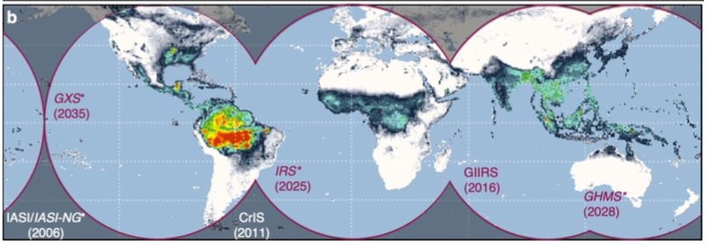
CrIS-like instruments in geostationary satellites can provide high-resolution (spatial and temporal) on isoprene, ammonia, PAN
Complementing the emerging UV/Vis air quality constellation (GEMS, TEMPO, Sentinel-4)
?
[Millet et al., AGU Advances, 2024]

