Slide 1

TEMPO Activities at NOAA
Shobha Kondragunta
GeoXO ACX Product Lead
Zigang Wei, Hai Zhang, Pubu Ciren, and Amy Huff
Science and Technology Corporation at NOAA
Acknowledgements：TEMPO L1B and L2 NO₂ data from NASA
Disclaimer: The scientific results and conclusions, as well as any views or opinions expressed
herein, are those of the author(s) and do not necessarily reflect those of NOAA or
the Department of Commerce.

Slide 2
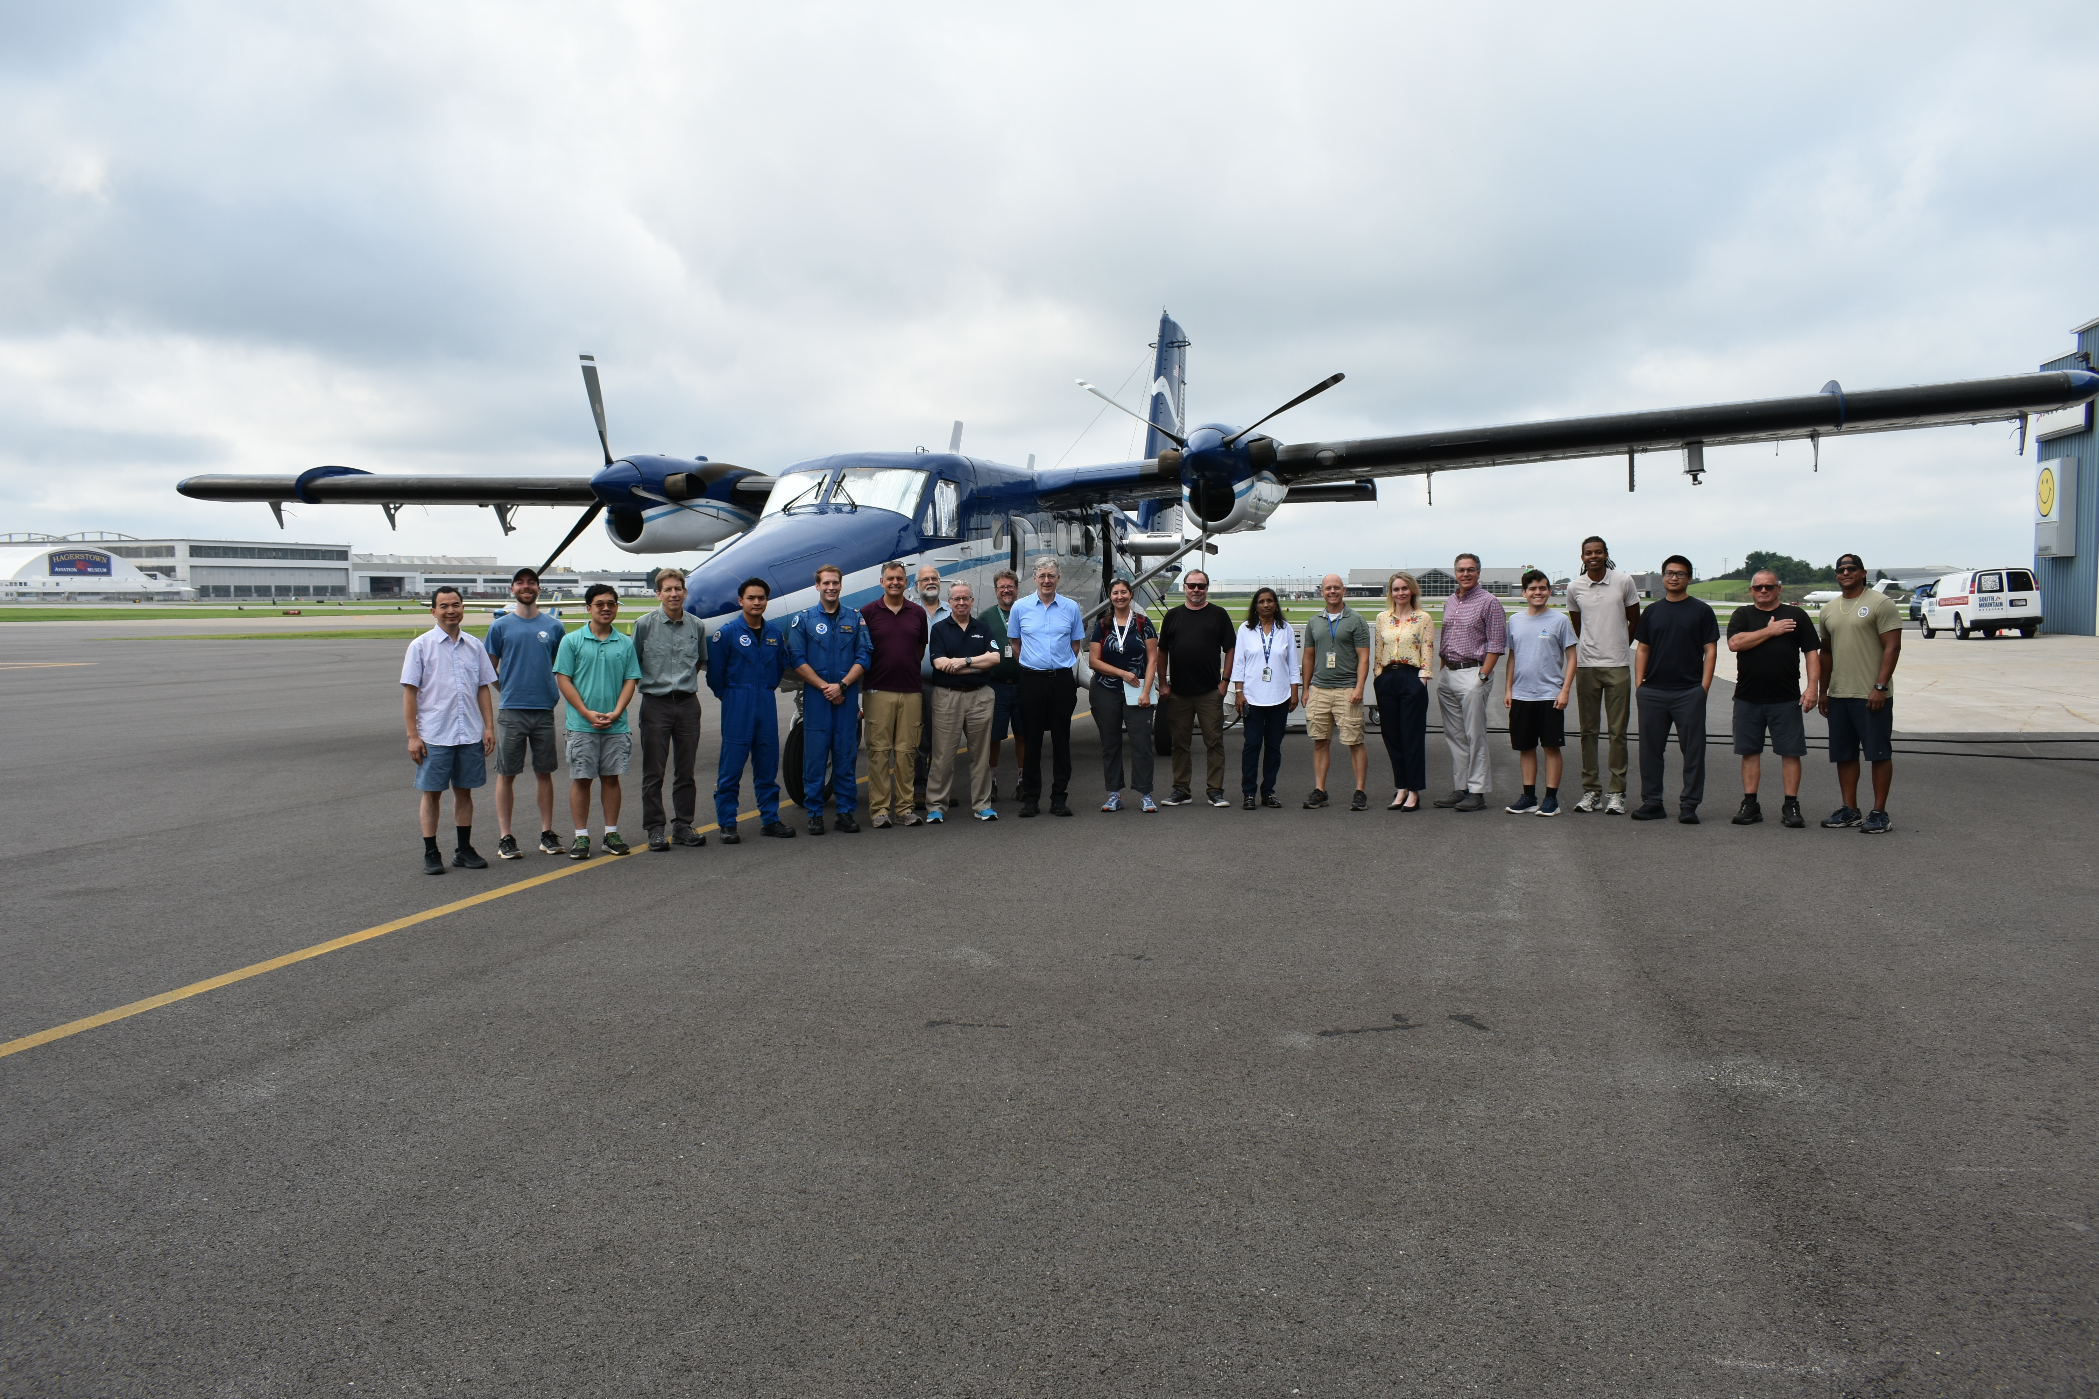
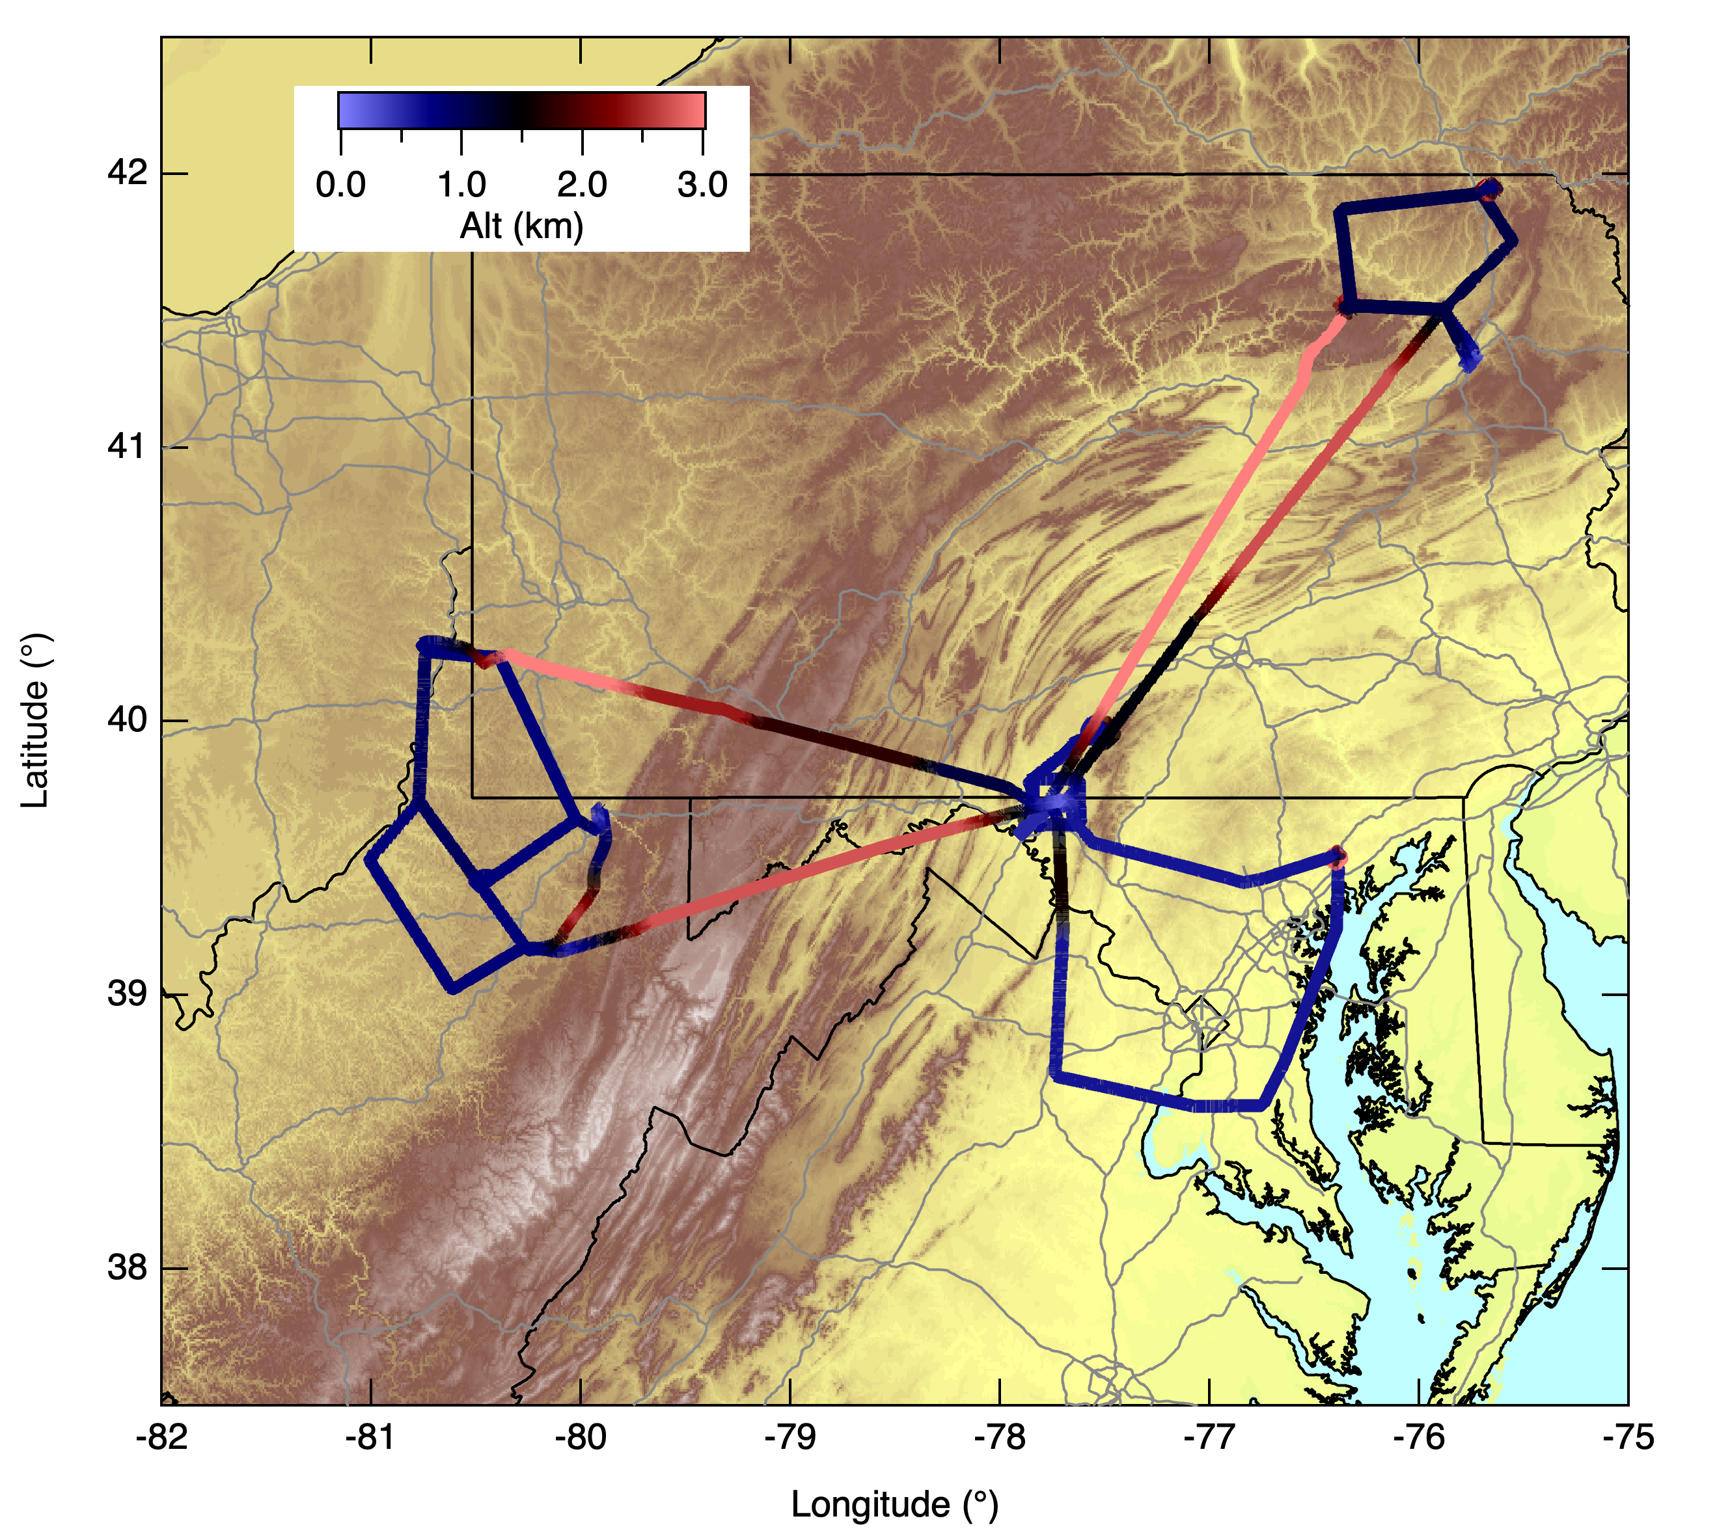
Summary of Ongoing TEMPO Activities at NOAA
Algorithm development for a suite of aerosol products completed
  Distributed one year’s worth of products to users for feedback. Products will flow through NASA ASDC when algorithms become operational.
  Issues being reported are mostly related to “cloud mask” and “snow mask”. Developing additional internal tests to screen cloud contaminated pixels.
Urban NOx emissions from TEMPO for rapid updates to emissions inventories
  Involves validation of TEMPO emissions with mass balance flights during aircraft campaigns.
Providing tailored TEMPO L2 products to stakeholders, especially to Maryland Department of the Environment (Joel Dreessen).
Conducting training on TEMPO aerosol products including furnishing python code etc. to some users
Evaluating NOAA fire emissions product using TEMPO tropNO₂ product
Contributed to TEMPO tropNO₂ validation report. Includes a contribution to the purchase of a Pandora instrument that is located in Essex, MD (PI: Tom Hanisco).
Scratching the surface of “science that we can do with TEMPO data”.
July 23, 2025 BAQMS Twin Otter flight. PI: Steve Brown (NOAA OAR)

Slide 3
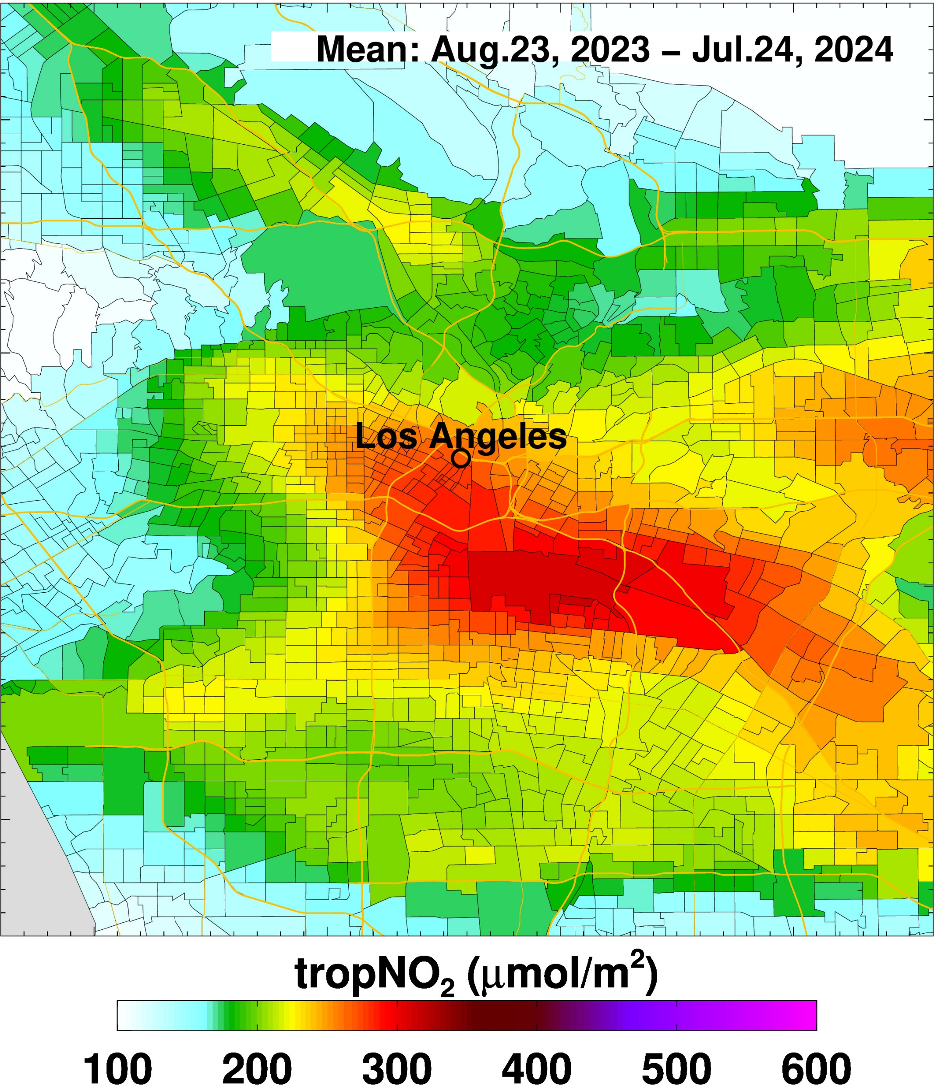
One year mean concentration

Slide 4
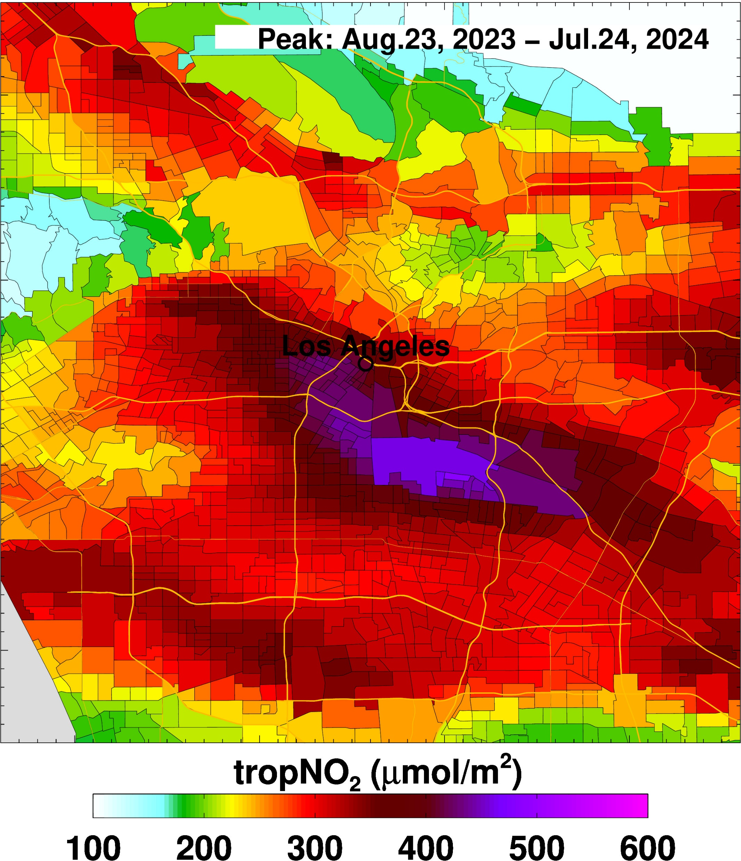
One year
average of daily peak concentration

Slide 5
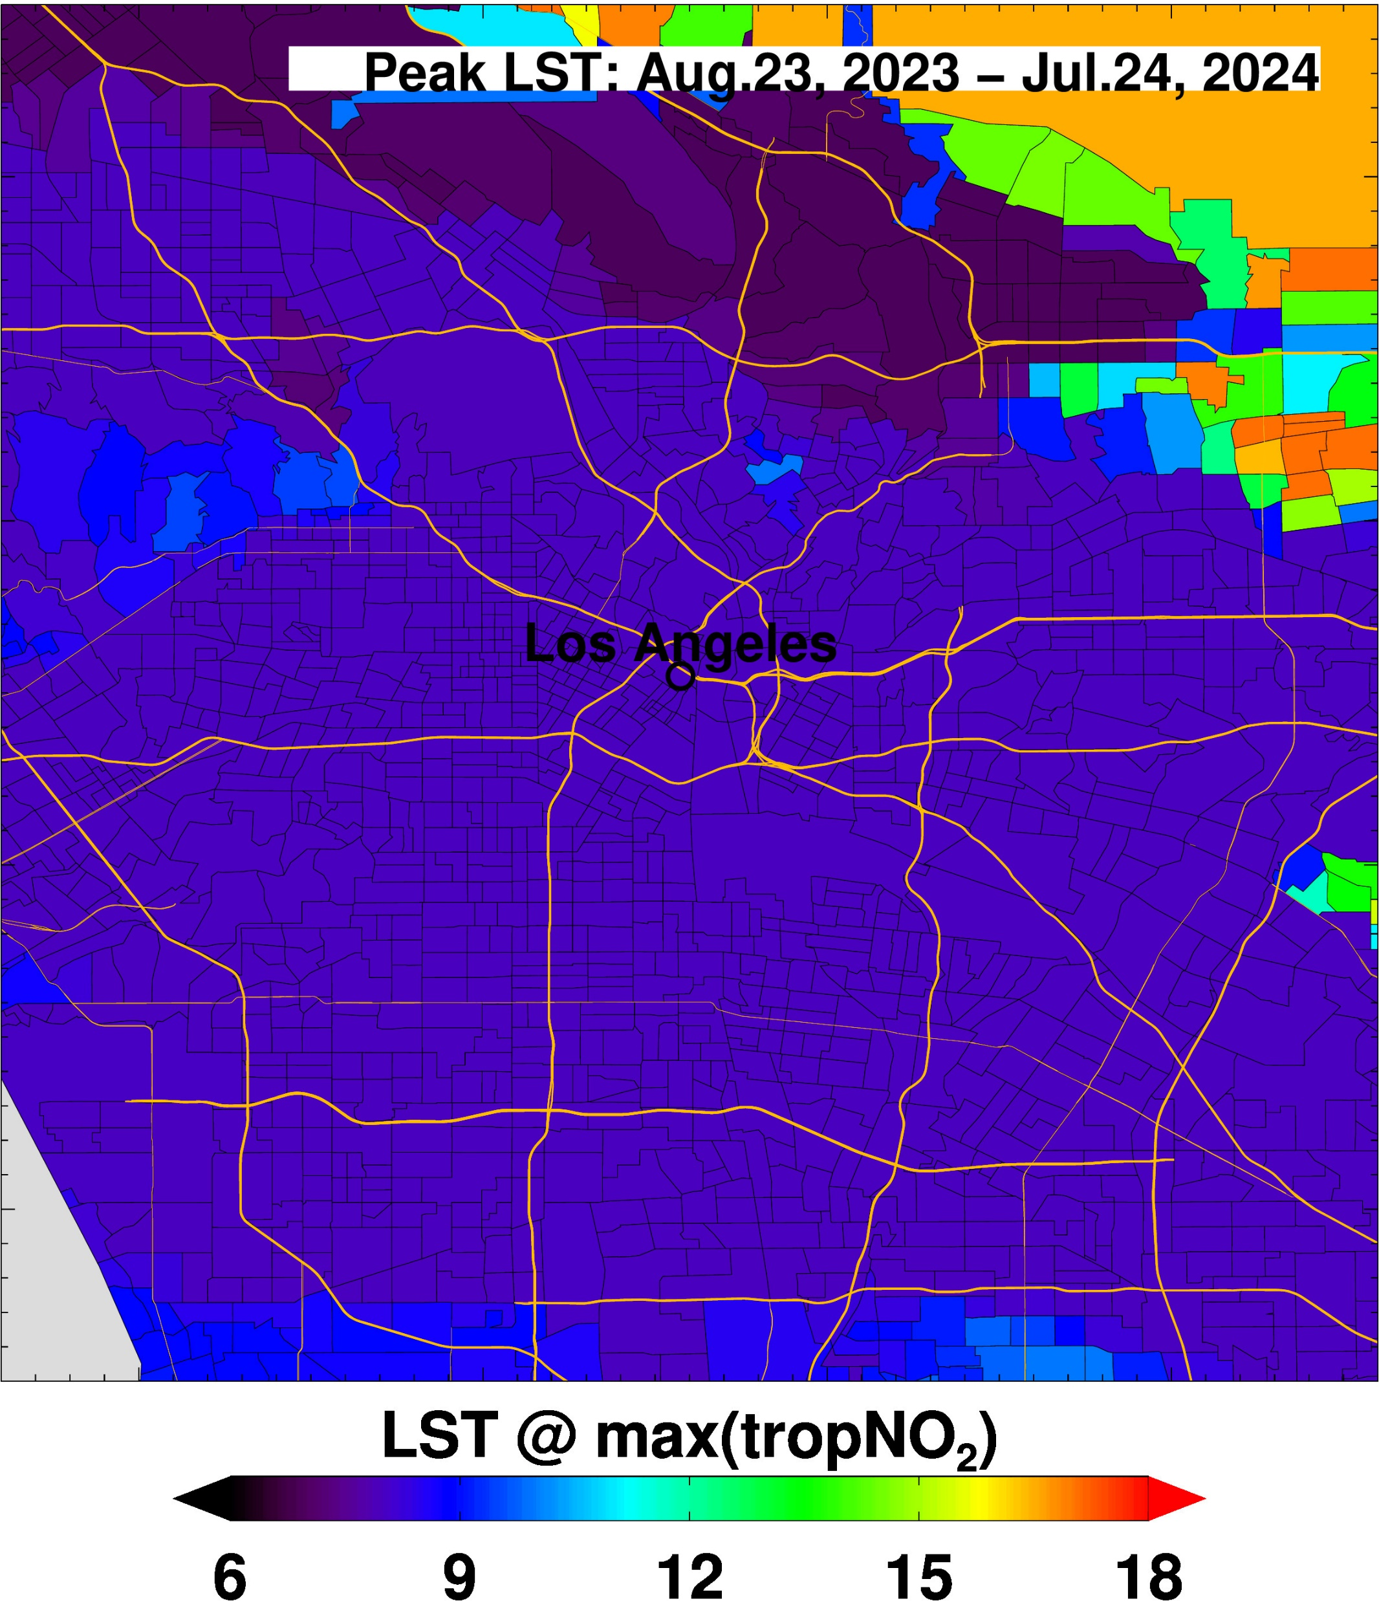
One year average of time when peak concentration is observed

Slide 6
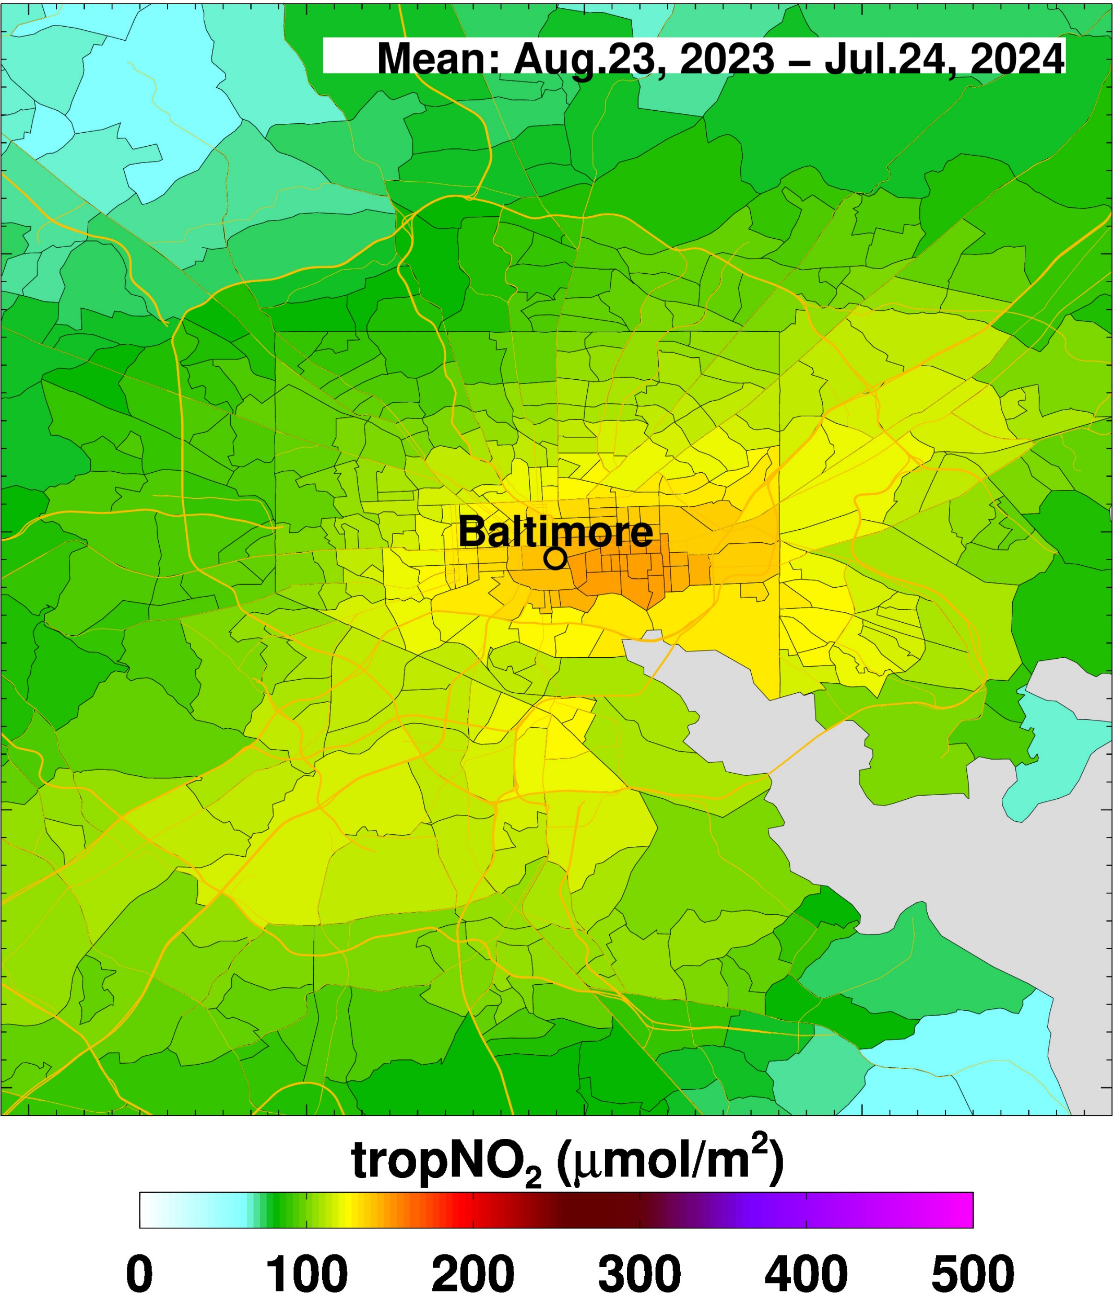
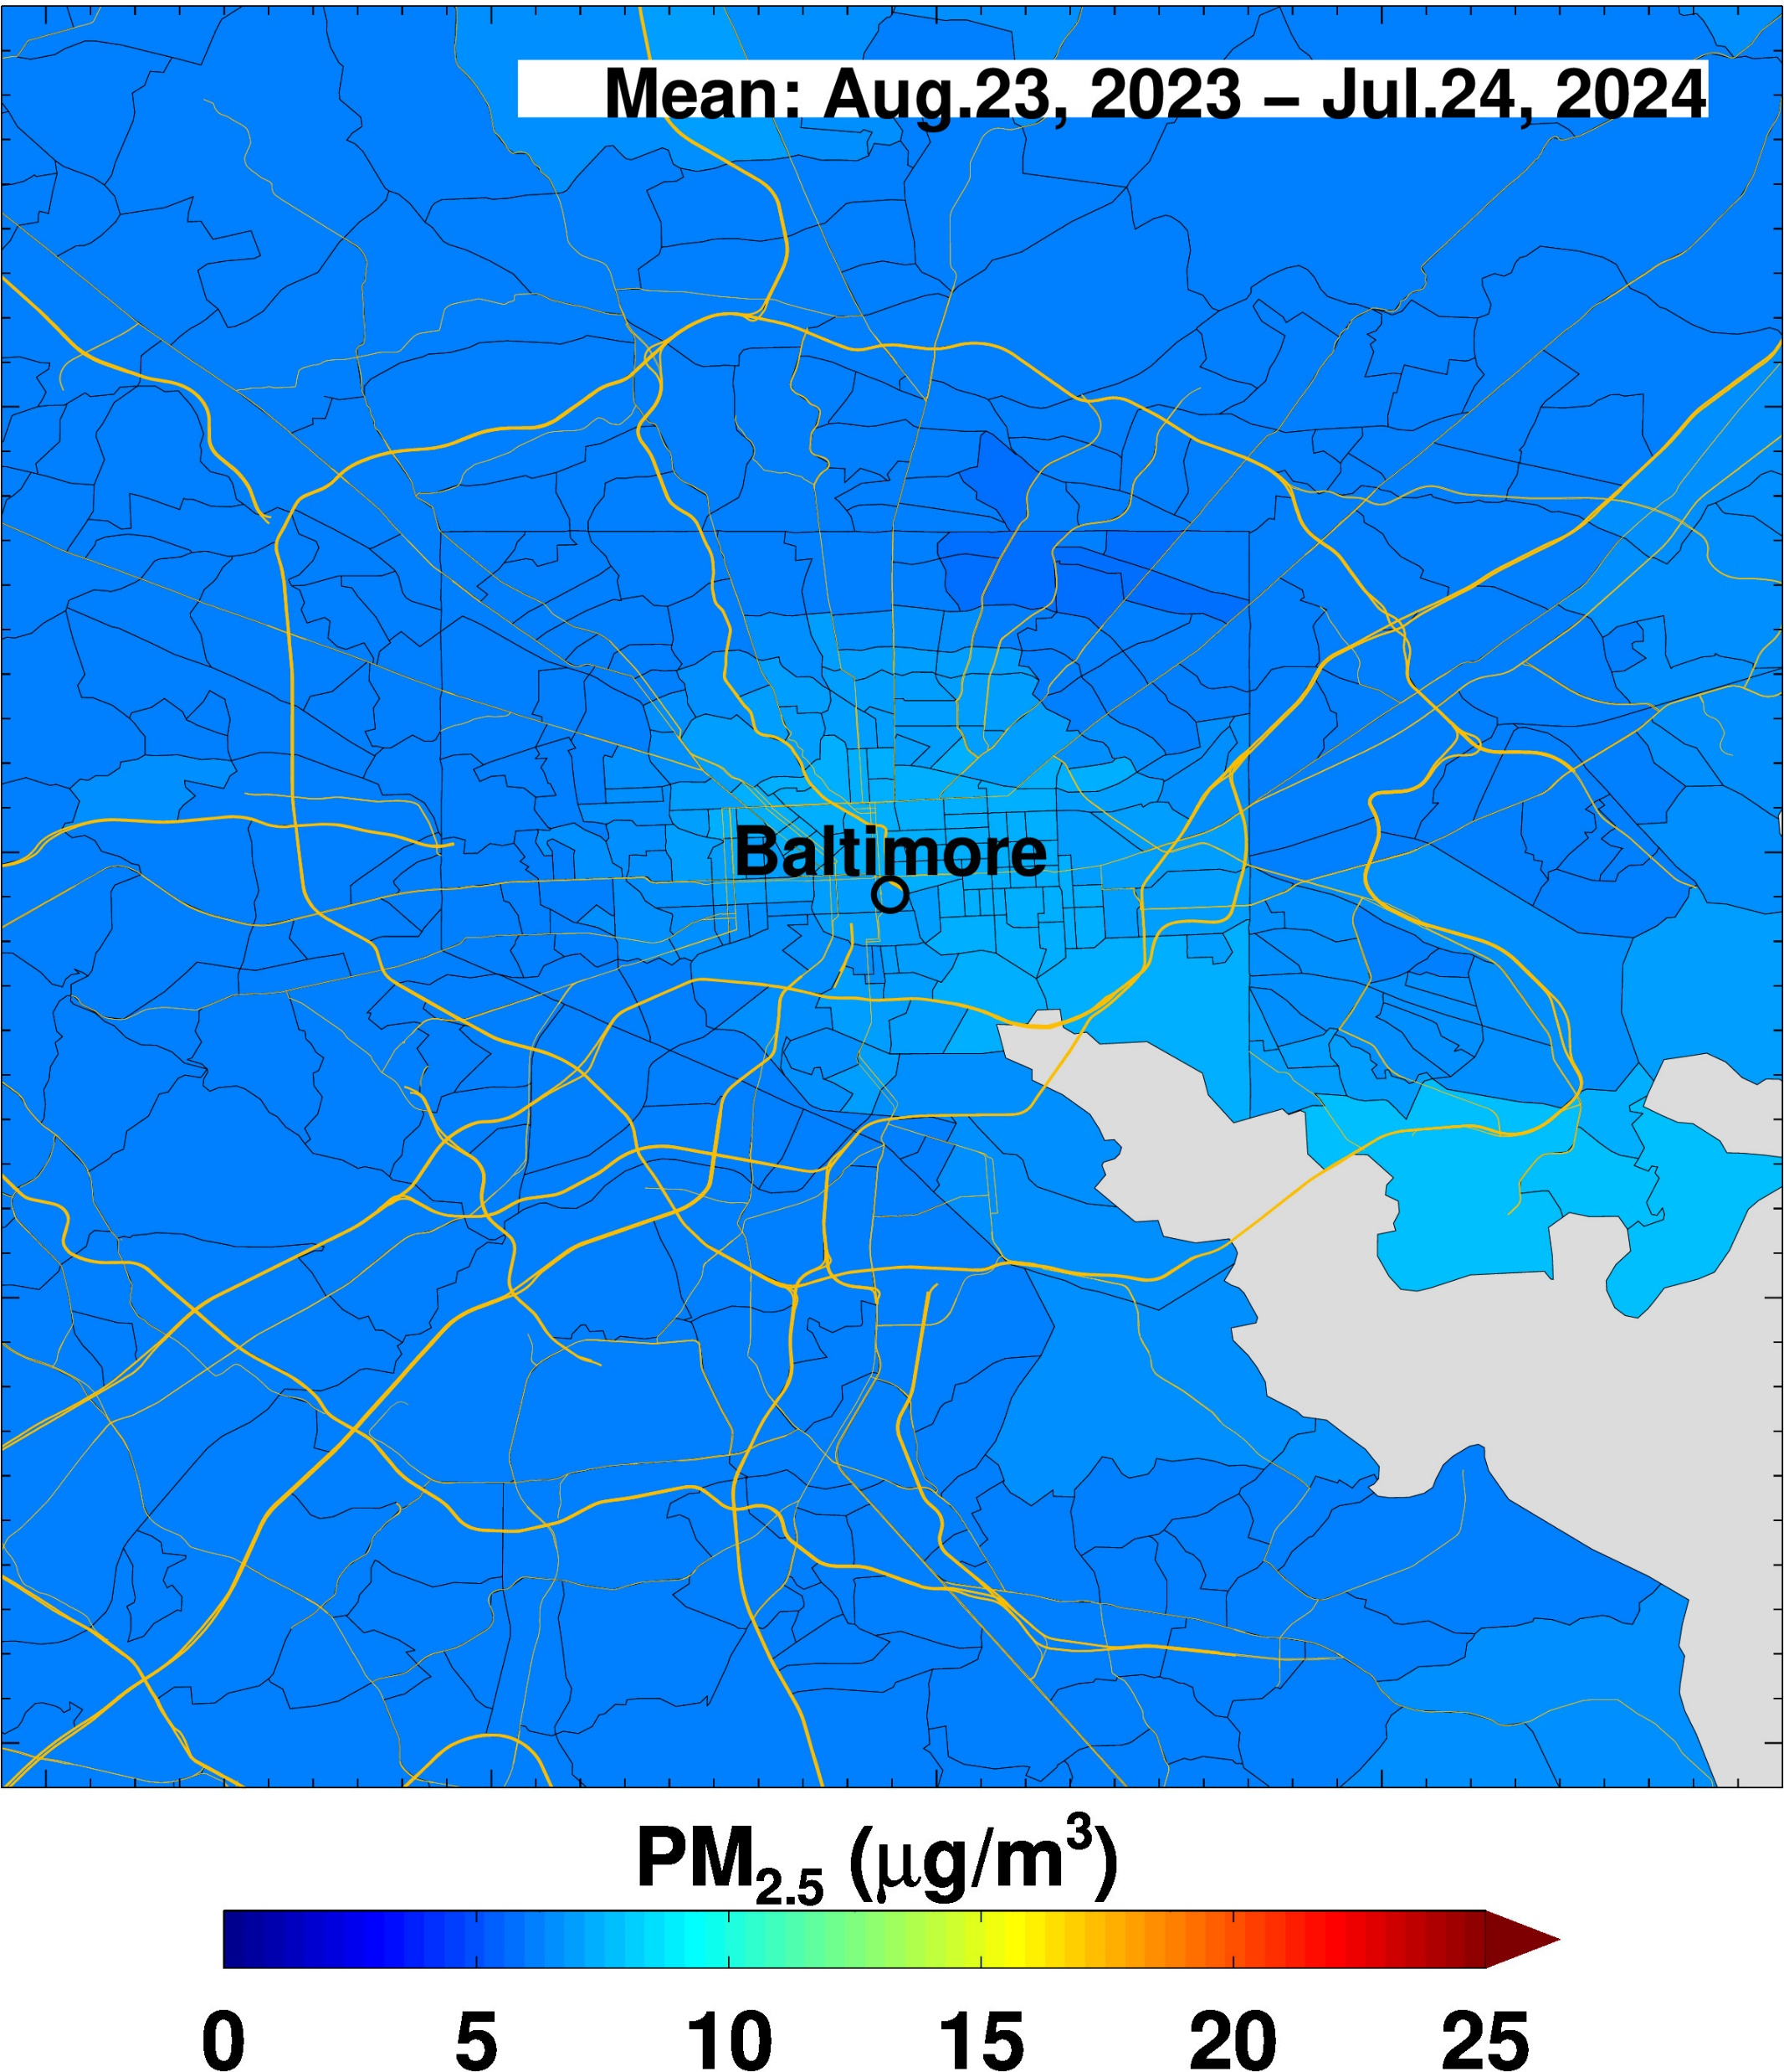
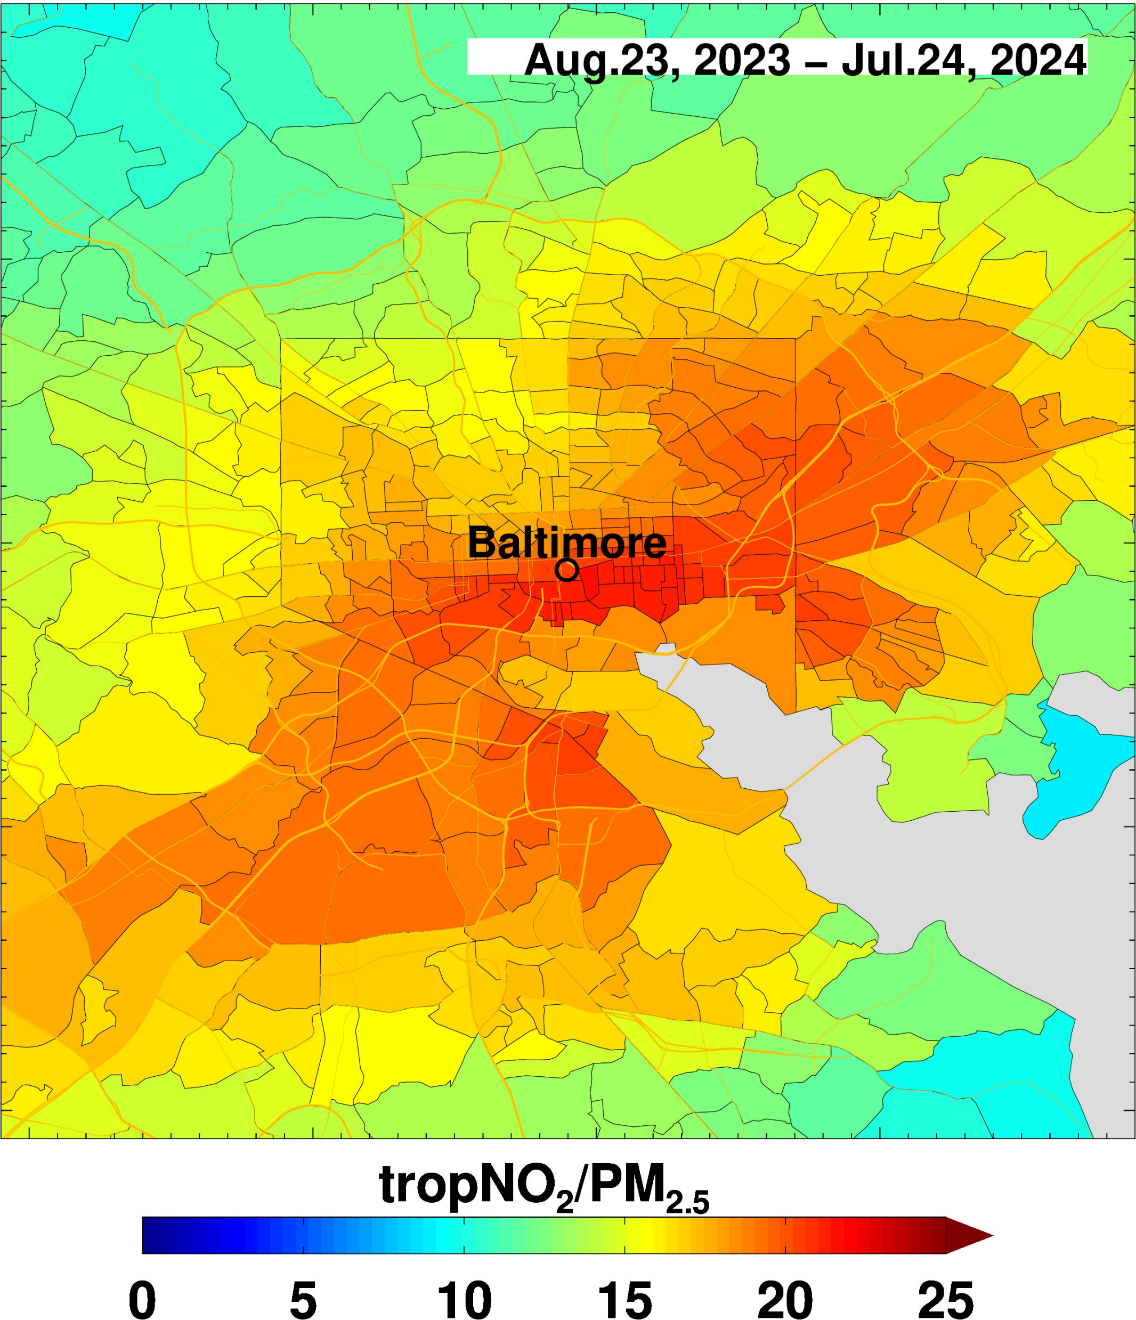
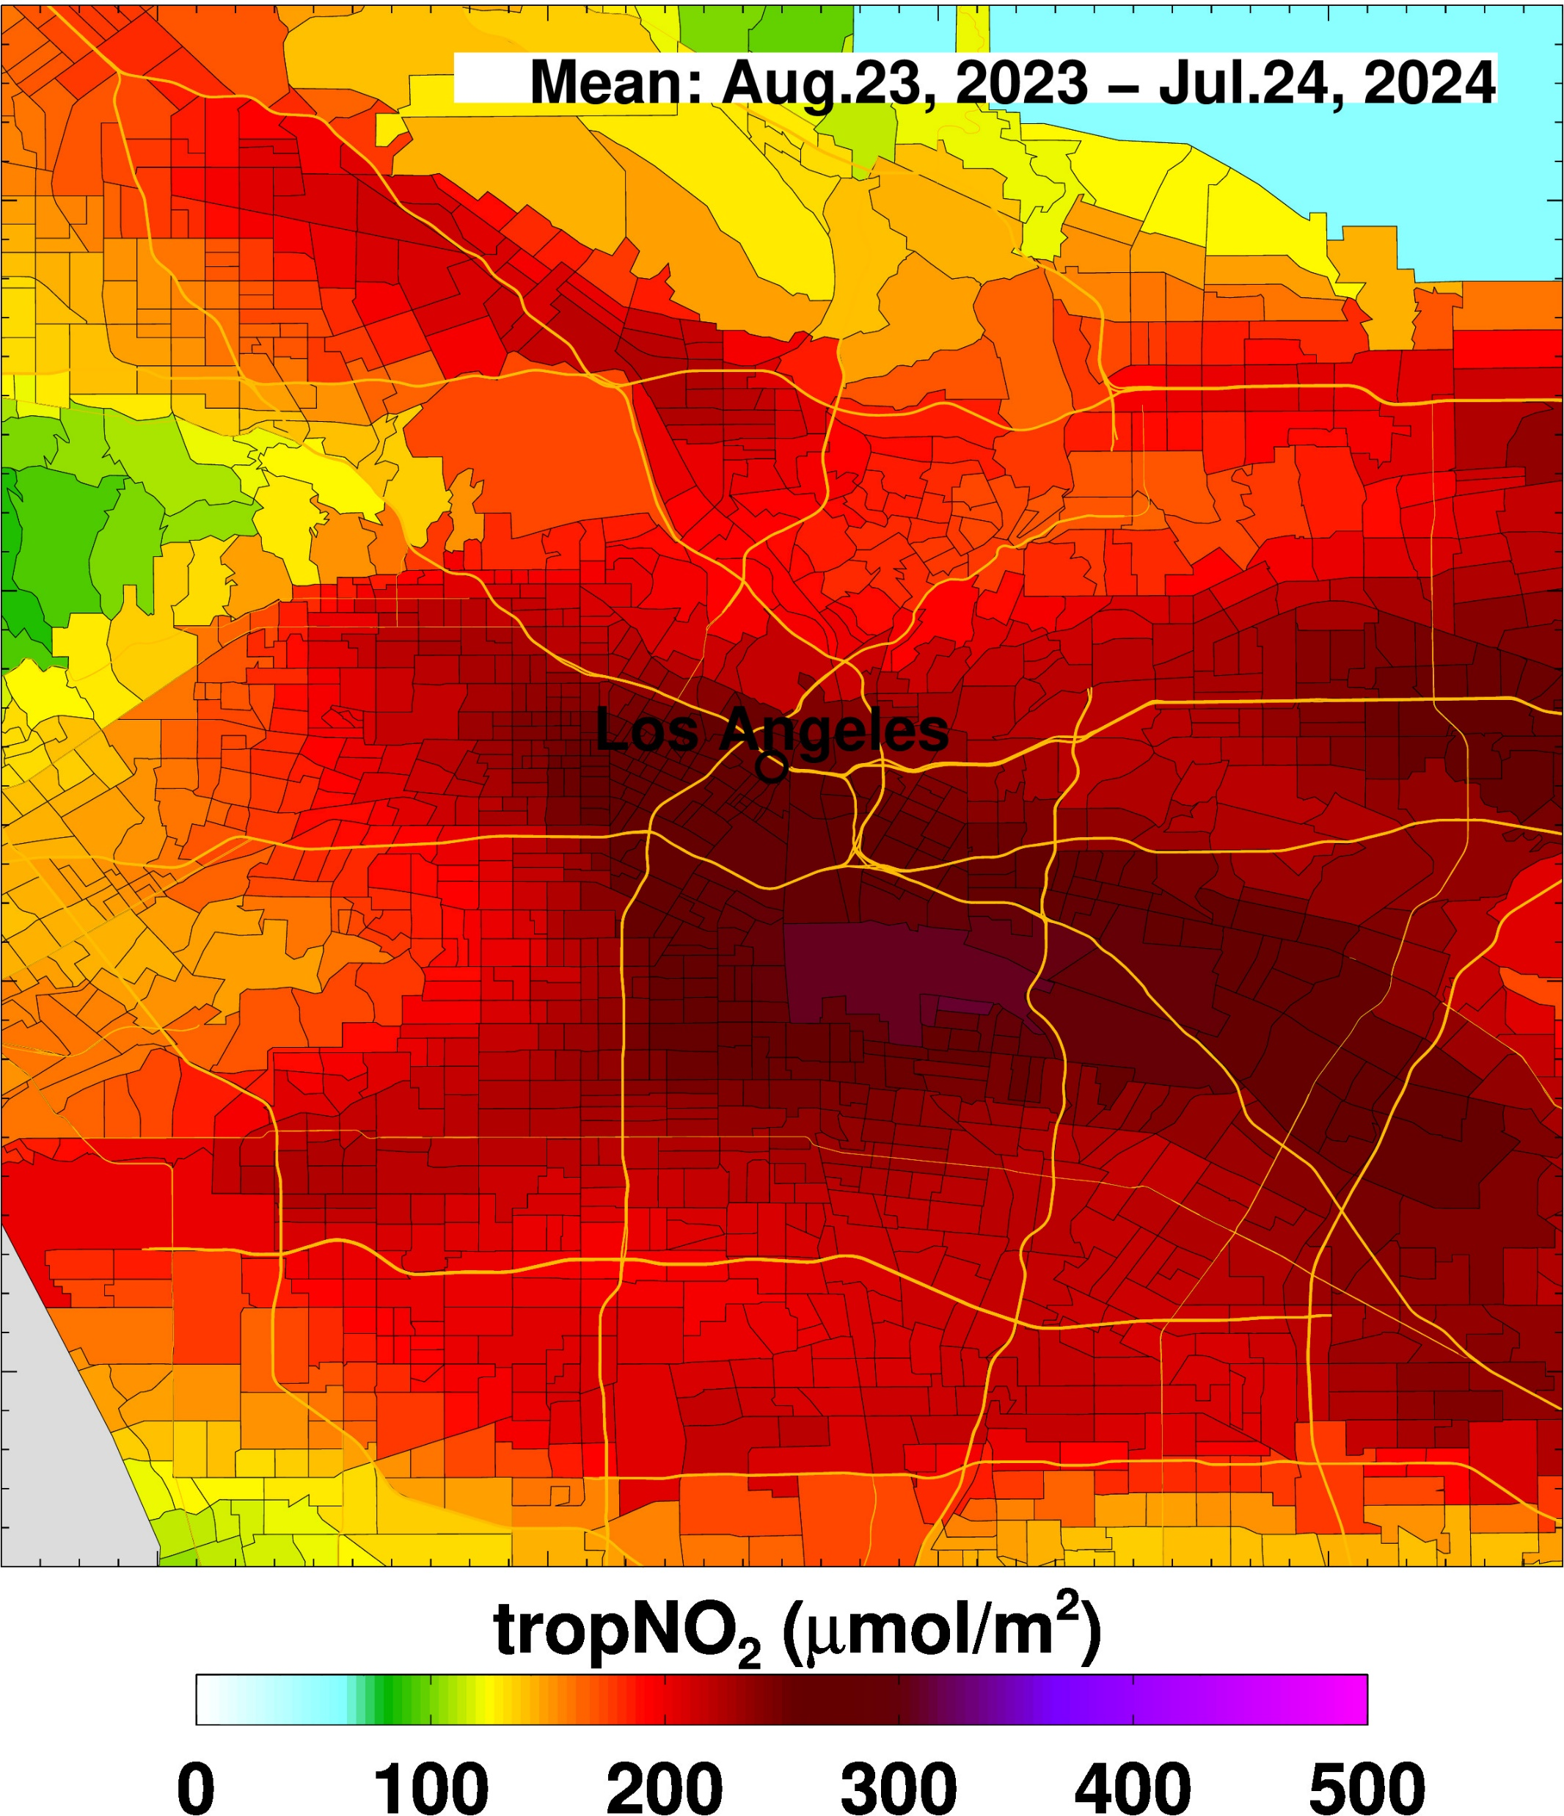
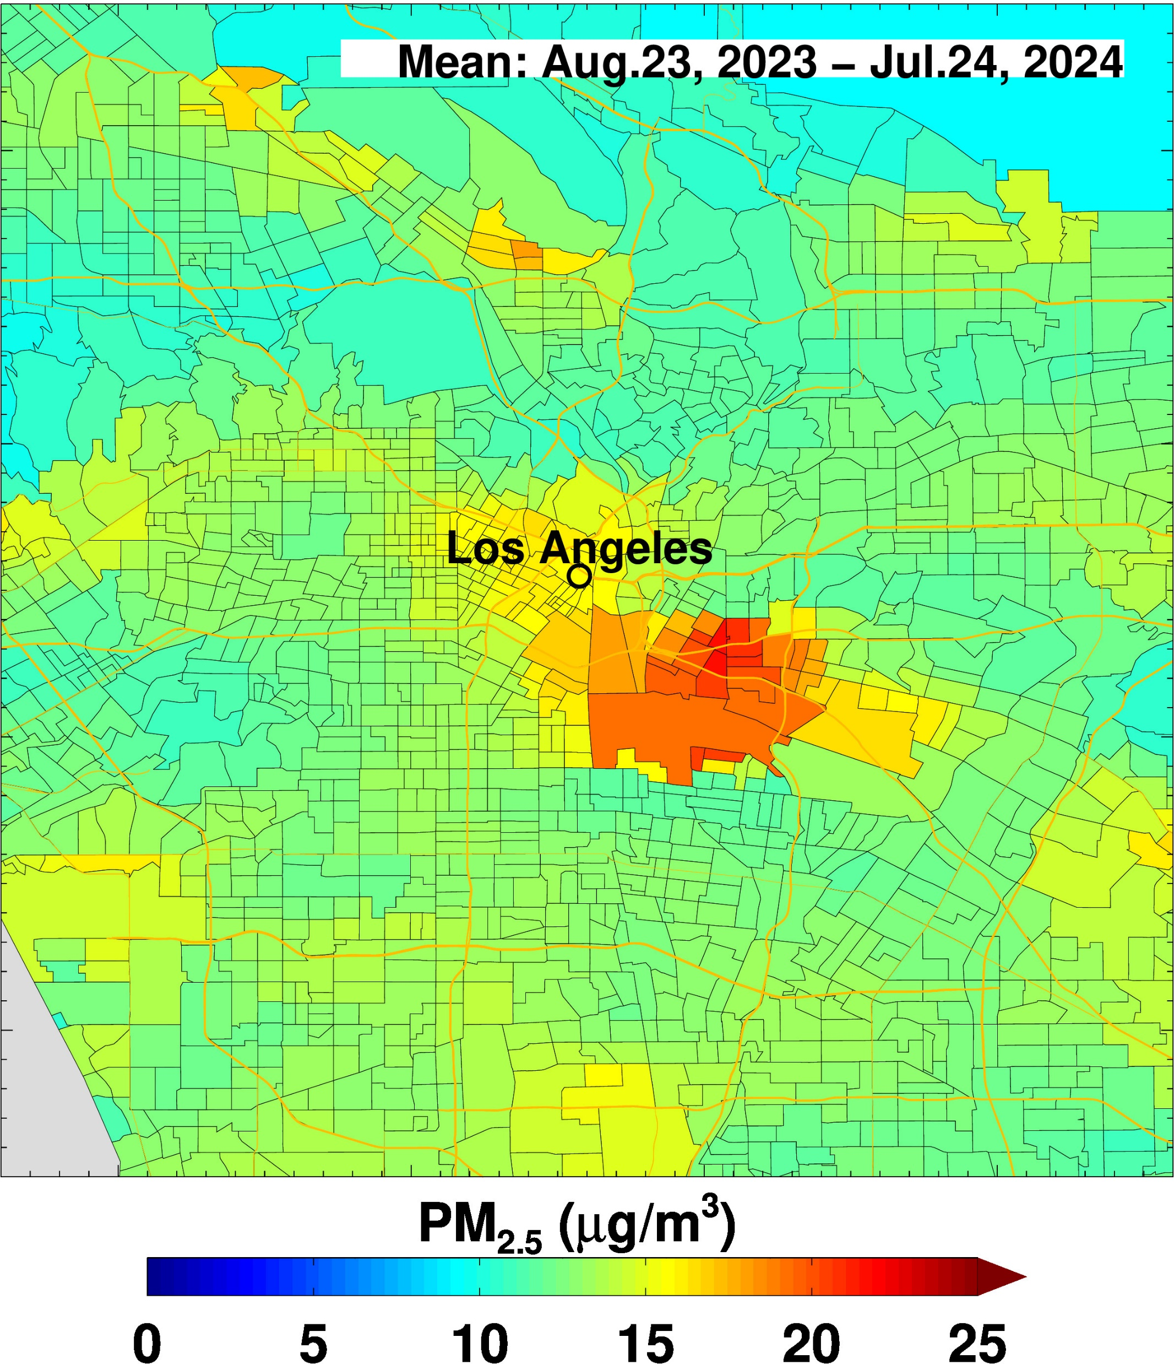
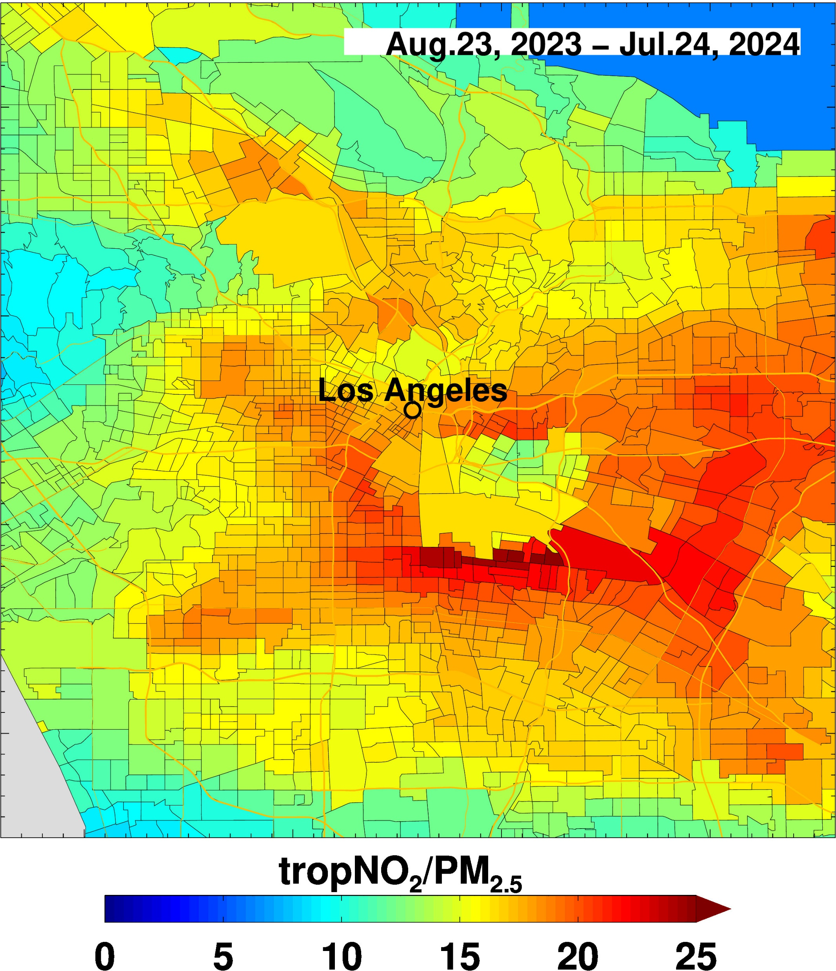
Ratio of tropNO₂/PM_{2.5} reveals that spatial patterns in pollution are mostly dominated by NO₂ except in regions with PM_{2.5} hot spots

Slide 7
Using multi-species observations from TEMPO, what can we learn about source sectors?
What can we learn about health impacts of species specific exposure? Is investigating the impact of peak exposure important?
How do health impacts of NO₂ compare to PM_{2.5}? In the absence of smoke from fires, do we worry about NO₂ pollution more than PM_{2.5}?

Slide 8
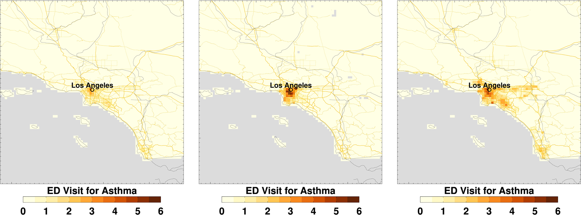
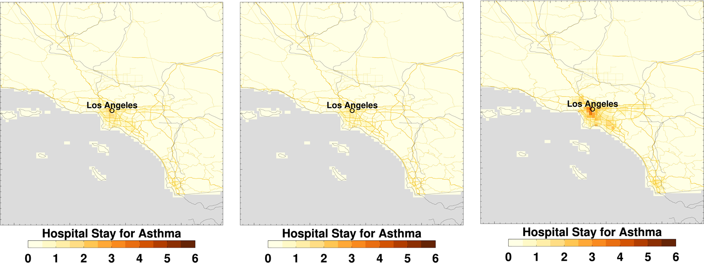
August 25-31, 2023
January 7-14, 2025
September 1-14, 2024
Impact of surface PM_{2.5}
Morbidity data from
O’Dell et al., https://agupubs.onlinelibrary.wiley.com/doi/10.1029/2021GH000457
∆ED visits: 208
∆ED visits: 238
∆ED visits: 515
/1000 in 0.05º x 0.05º
Impact of NO₂
Morbidity data from
Khattari et al., https://doi.org/10.3390/atmos15121472
∆Hospital stays: 150
∆Hospital stays: 103
∆Hospital stays: 292
/1000 in 0.05º x 0.05º

Slide 9
Timely AQ and Health Summaries
In partnership with EPA, CDC, and GWU, NOAA NESDIS is planning to develop a near real time exposure information using ABI and TEMPO L2 products for public consumption. These are analogous to monthly reports that NOAA NESDIS provides to media and public on a host of environmental hazards (e.g., fires) generated from satellites.

