Slide 1
Unified Ceilometer Network for Validation of TEMPO Aerosol‑Layer Height
TEMPO/GeoXO ACX Joint Science Team Workshop
August 19-22, 2025
Cambridge, MA
Ruben Delgado¹, James Szykman², Mitch Goldberg³, Mina Kang³, Shobha Kondragunta⁴,
John McNabb¹, Theodore Mackey¹, Jared Johnson¹, Eric Baumann², David Williams²
¹Center for Atmospheric Sciences, Hampton University, Hampton, VA
²U.S. EPA ORD CEMM, RTP, NC
³City College of New York
⁴NOAA NESDIS, College Park, MD

Slide 2
Why ALH Validation Matters
ALH drives radiative forcing, air‑quality exposure, and data assimilation accuracy.
Satellite ALH suffers from cloud/aerosol confusion and scene‑dependent biases.
Surface‑based truth is the missing link for algorithm tuning and validation of satellite data products.
UCN offers continuous vertical profiling to close this gap.

Slide 3


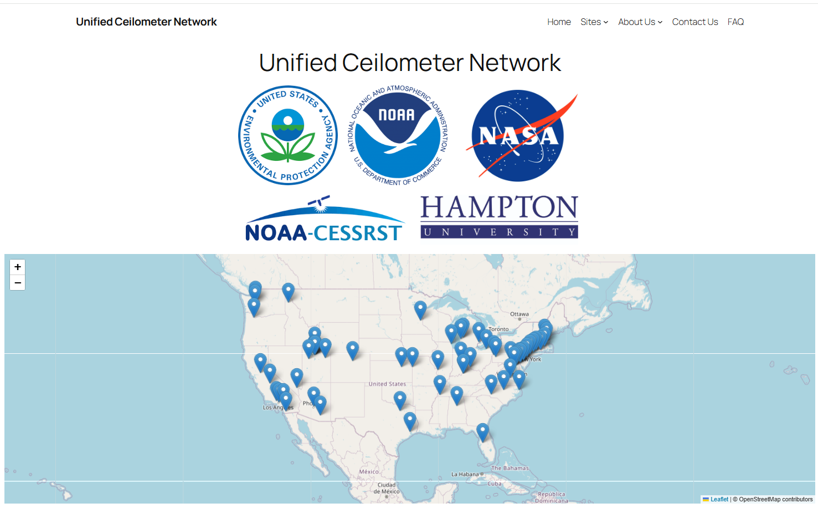
Unified Ceilometer Network (UCN)
Collaboration between Hampton University, EPA, NASA, NOAA, DOD, state and local agencies, and academia.
Network of ceilometers from U.S. Air Quality Network (~72 sites) and Academic Institutions.
Data archive of ceilometer attenuated backscatter profiles β(z); a subset of sites date back to 2001.
Near real-time data processing (MLH, NBL, residual layer (RL), aerosol layers) (Caicedo et al. 2020).
EPA PAMS/NCORE Sites
https://ucn.cas.hamptonu.edu

Slide 4
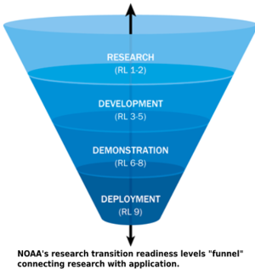
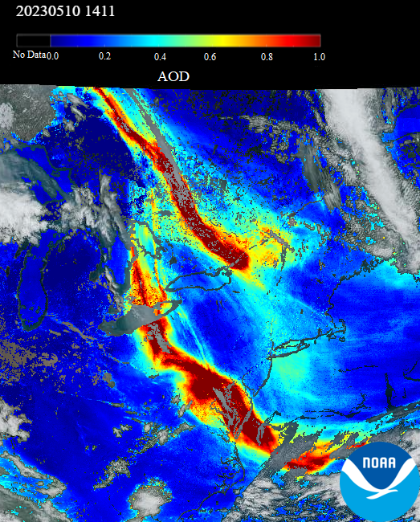
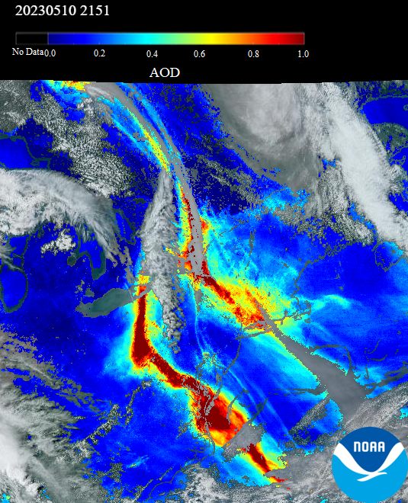
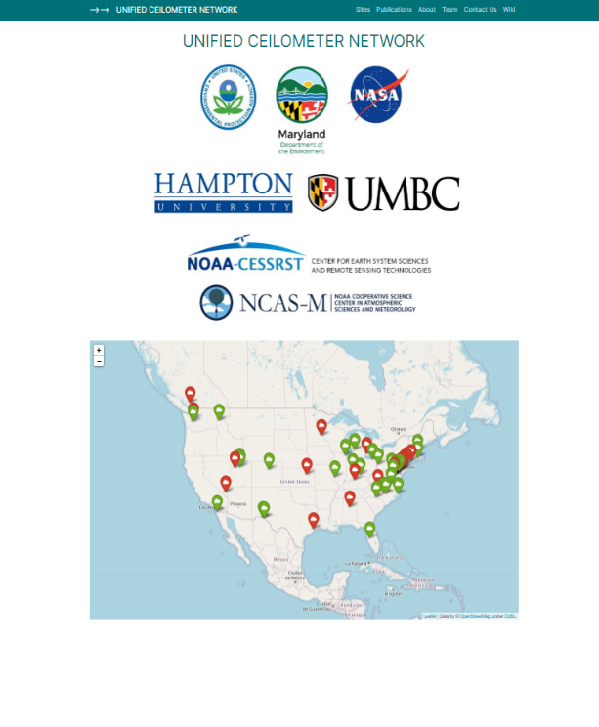
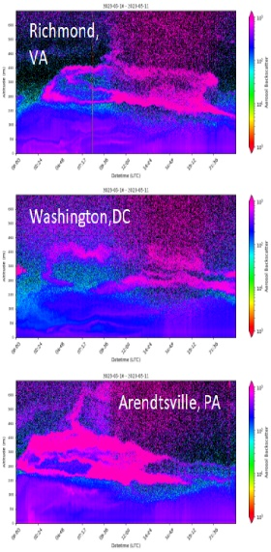
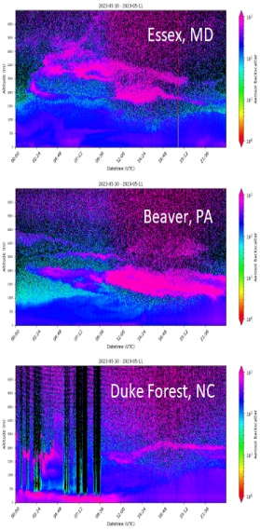
UCN: Ready‑Made Validation Backbone
Ceilometers (Vaisala and Lufft) across CONUS; harmonized ingest at NOAA/NESDIS.
High temporal and vertical resolution; hourly QC’d MLH + candidate ALH outputs.
Advantages: 24/7 sampling, co‑locations with AERONET and state air quality monitoring stations, open API access.
EPA PAMS/NCORE Sites
Readiness Level 8: Prototype Functionality
Prototype system, process, product, service or tool demonstrated in an operational or other relevant environment (functionality demonstrated in near-real world environment; subsystem components fully integrated into system).
https://ucn.cas.hamptonu.edu

Slide 5
Current Retrieval State‑of‑Play
Gradient/inflection, wavelet‑transform, and idealized‑fit algorithms dominate in operational ceilometer processing.
Emerging ML models (Random Forest, CNN) handle multilayer and noisy scenes but still lack broad validation datasets.
Satellite products: CALIOP v4, S5P/TROPOMI ALH, TEMPO early‑release layer heights—accuracy typically ±500 m to >1 km over land.
Notes:
Keep bullets tight; details live in the forthcoming review paper.

Slide 6
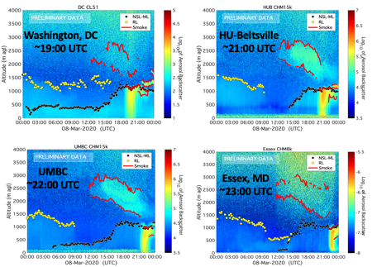
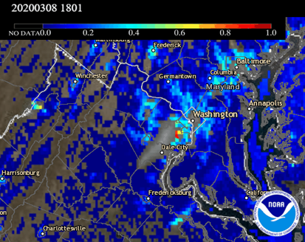
UCN Aerosol Layer Height
Network Sites Denser in Urban Corridors due to connection with EPA Photochemical Assessment Monitoring Stations.
Regional Smoke transport within PBL observed by ceilometers network supplementing GOES-16/ABI AOD
Huff et al. 2021
https://doi.org/10.1175/JTECH-D-20-0162.1

Slide 7
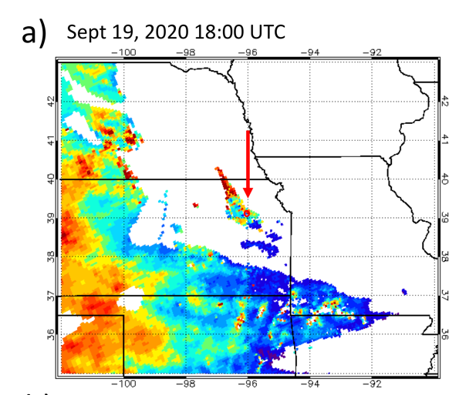
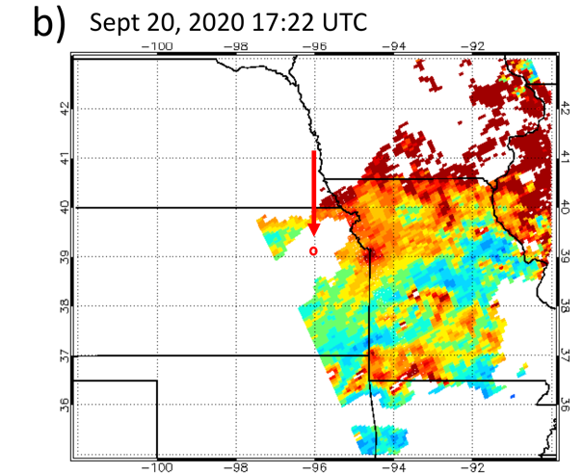
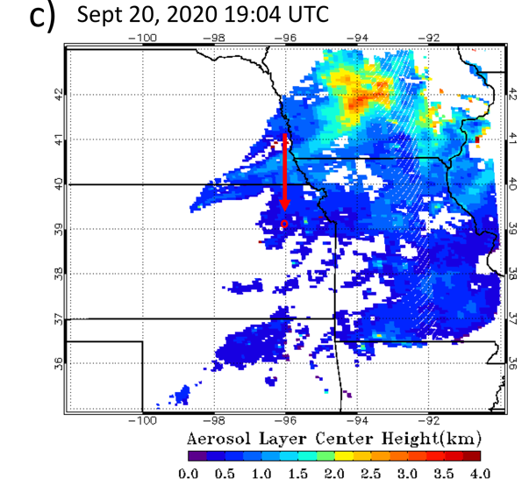
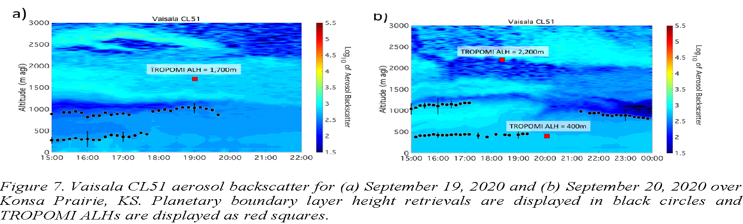
Illustrative Case Study: UCN vs TROPOMI ALH
TROPOMI
Aerosol Layer Heights
U.S. Region 7
CL51 at Konza Prairie Site
The UCN site in Konza Prairie, Kansas (EPA Region 7: 39.1022°N, 96.6096°W Bottom a-b) captured the evolution of the smoke plume transport. Ceilometer planetary boundary layer heights were calculated at the times of TROPOMI measurements and contrasted against TROPOMI ALH (Top a-c).

Slide 8
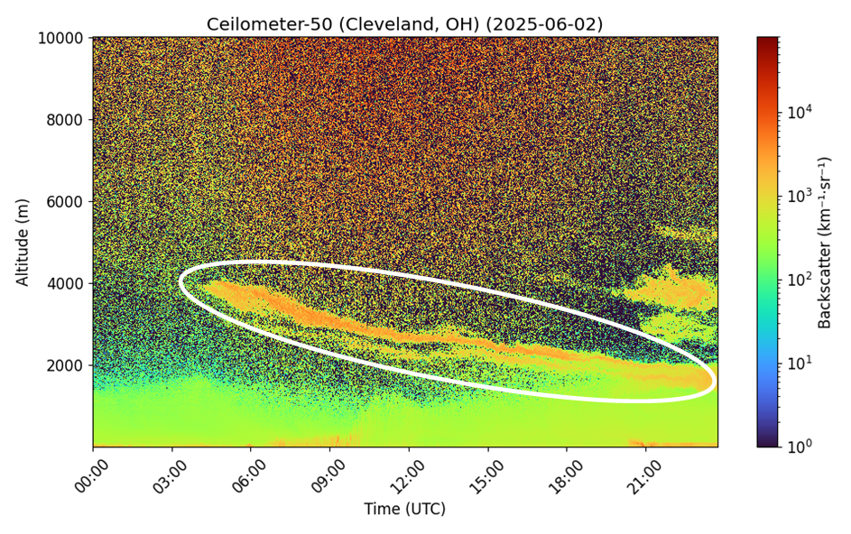
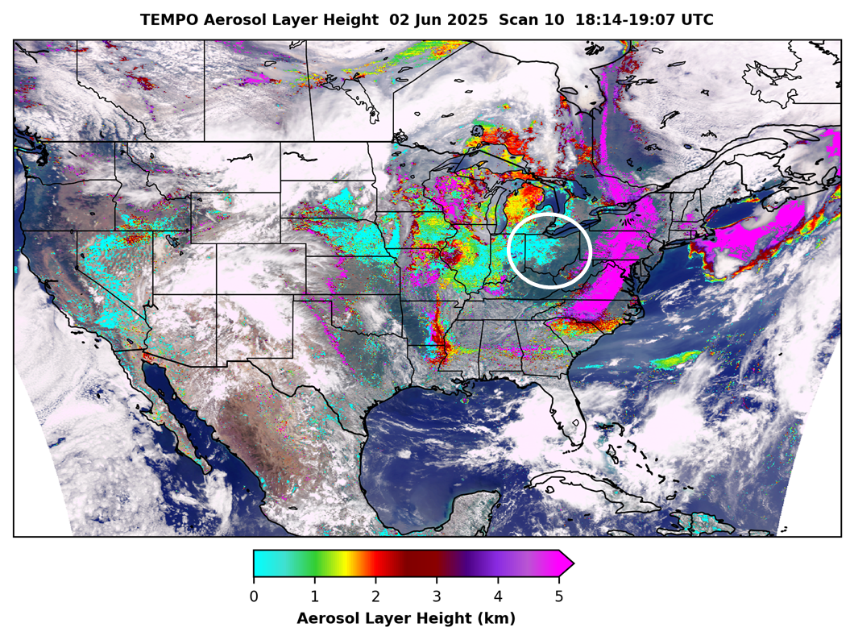
Illustrative Case Study: UCN vs TEMPO ALH
UCN ceilometer from Cleveland, OH (PAMS) shows smoke mixed down to the boundary layer by ~18:30 UTC; correlates with aerosol layer height from TEMPO Scan 10
Smoke plume
Credit: TEMPO AHL NOAA/NESDIS

Slide 9
Proposed Validation Framework
Step | What | Why
Collocation | ±30 min / 25 km satellite–ceilometer | balances temporal drift vs. sample size
Vertical Metric | Δz = z_sat – z_UCN (bias, RMSE, hit‑rate) | simple, interpretable
Uncertainty Stratification | AOD, cloud fraction, surface type | diagnose scene dependence
Multi‑sensor Fusion | Pair UCN with Raman/DIAL lidars (HU, LaRC), aircraft (e.g., AEROMMA) | anchor high layers & free‑troposphere smoke
Open Evaluation Portal | GitHub workflows; daily matchup plots | transparency, community feedback
Notes:
Highlight practicality: steps are actionable starting now.

Slide 10
Path Forward & Take‑Aways
Standardize: adopt common ALH algorithm and QC recipe across UCN.
Synergize: UCN–satellite-field campaign IOPs during extreme events.
Share: real‑time open matchup service under CEOS AC-VC umbrella.
“UCN offers an immediately actionable, community‑owned platform to close the satellite ALH validation gap.”
Notes:
Close strong: call to action & collaboration.

