Slide 1









A National Oceanic and Atmospheric Administration (NOAA) Educational Partnership Program with Minority Serving Institutions (EPP/MSI) Cooperative Science Center (CSC) since 2016 (#NA22SEC4810016)
CENTER FOR EARTH SYSTEM SCIENCES & REMOTE SENSING TECHNOLOGIES (CESSRST-II)
Developing Atmospheric Composition Validation Networks and Methods for GeoXO Era using TEMPO
August 20, 2025
Mina Kang, Mitch Goldberg, Shobha Kondragunta, Hai Zhang, Fred Moshary, Ruben Delgado, Yonghua Wu, Barry Baker, Wei Li
Postdoctoral Researcher
The City Collegee of New York

Slide 2

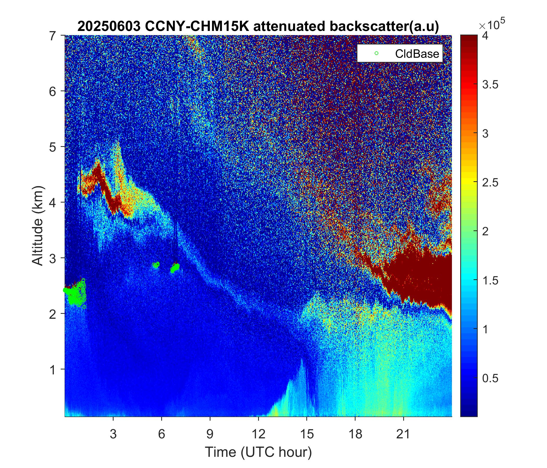
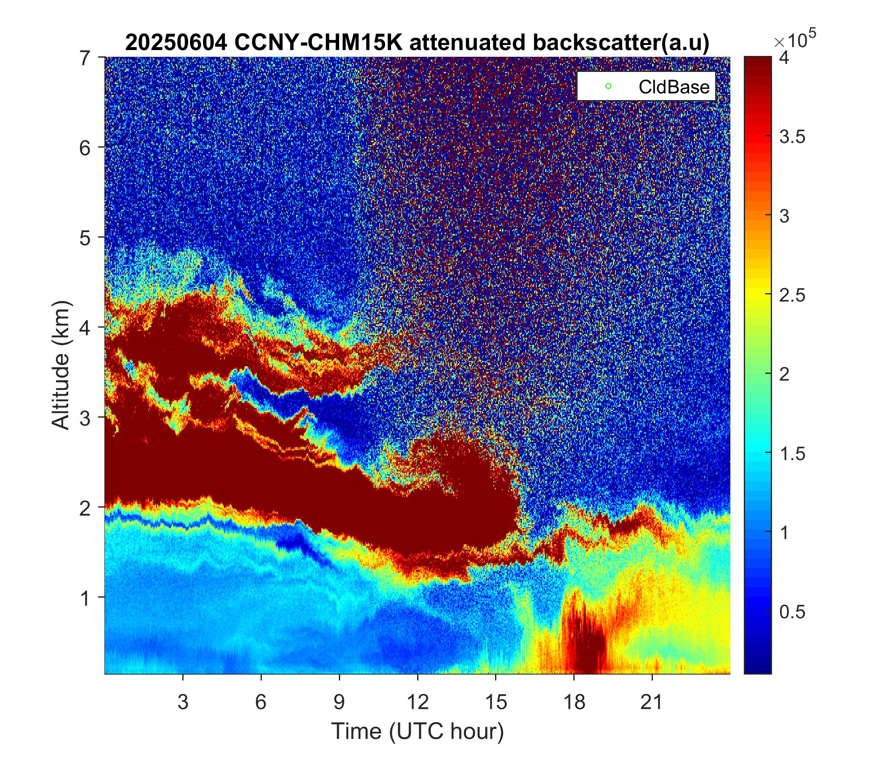
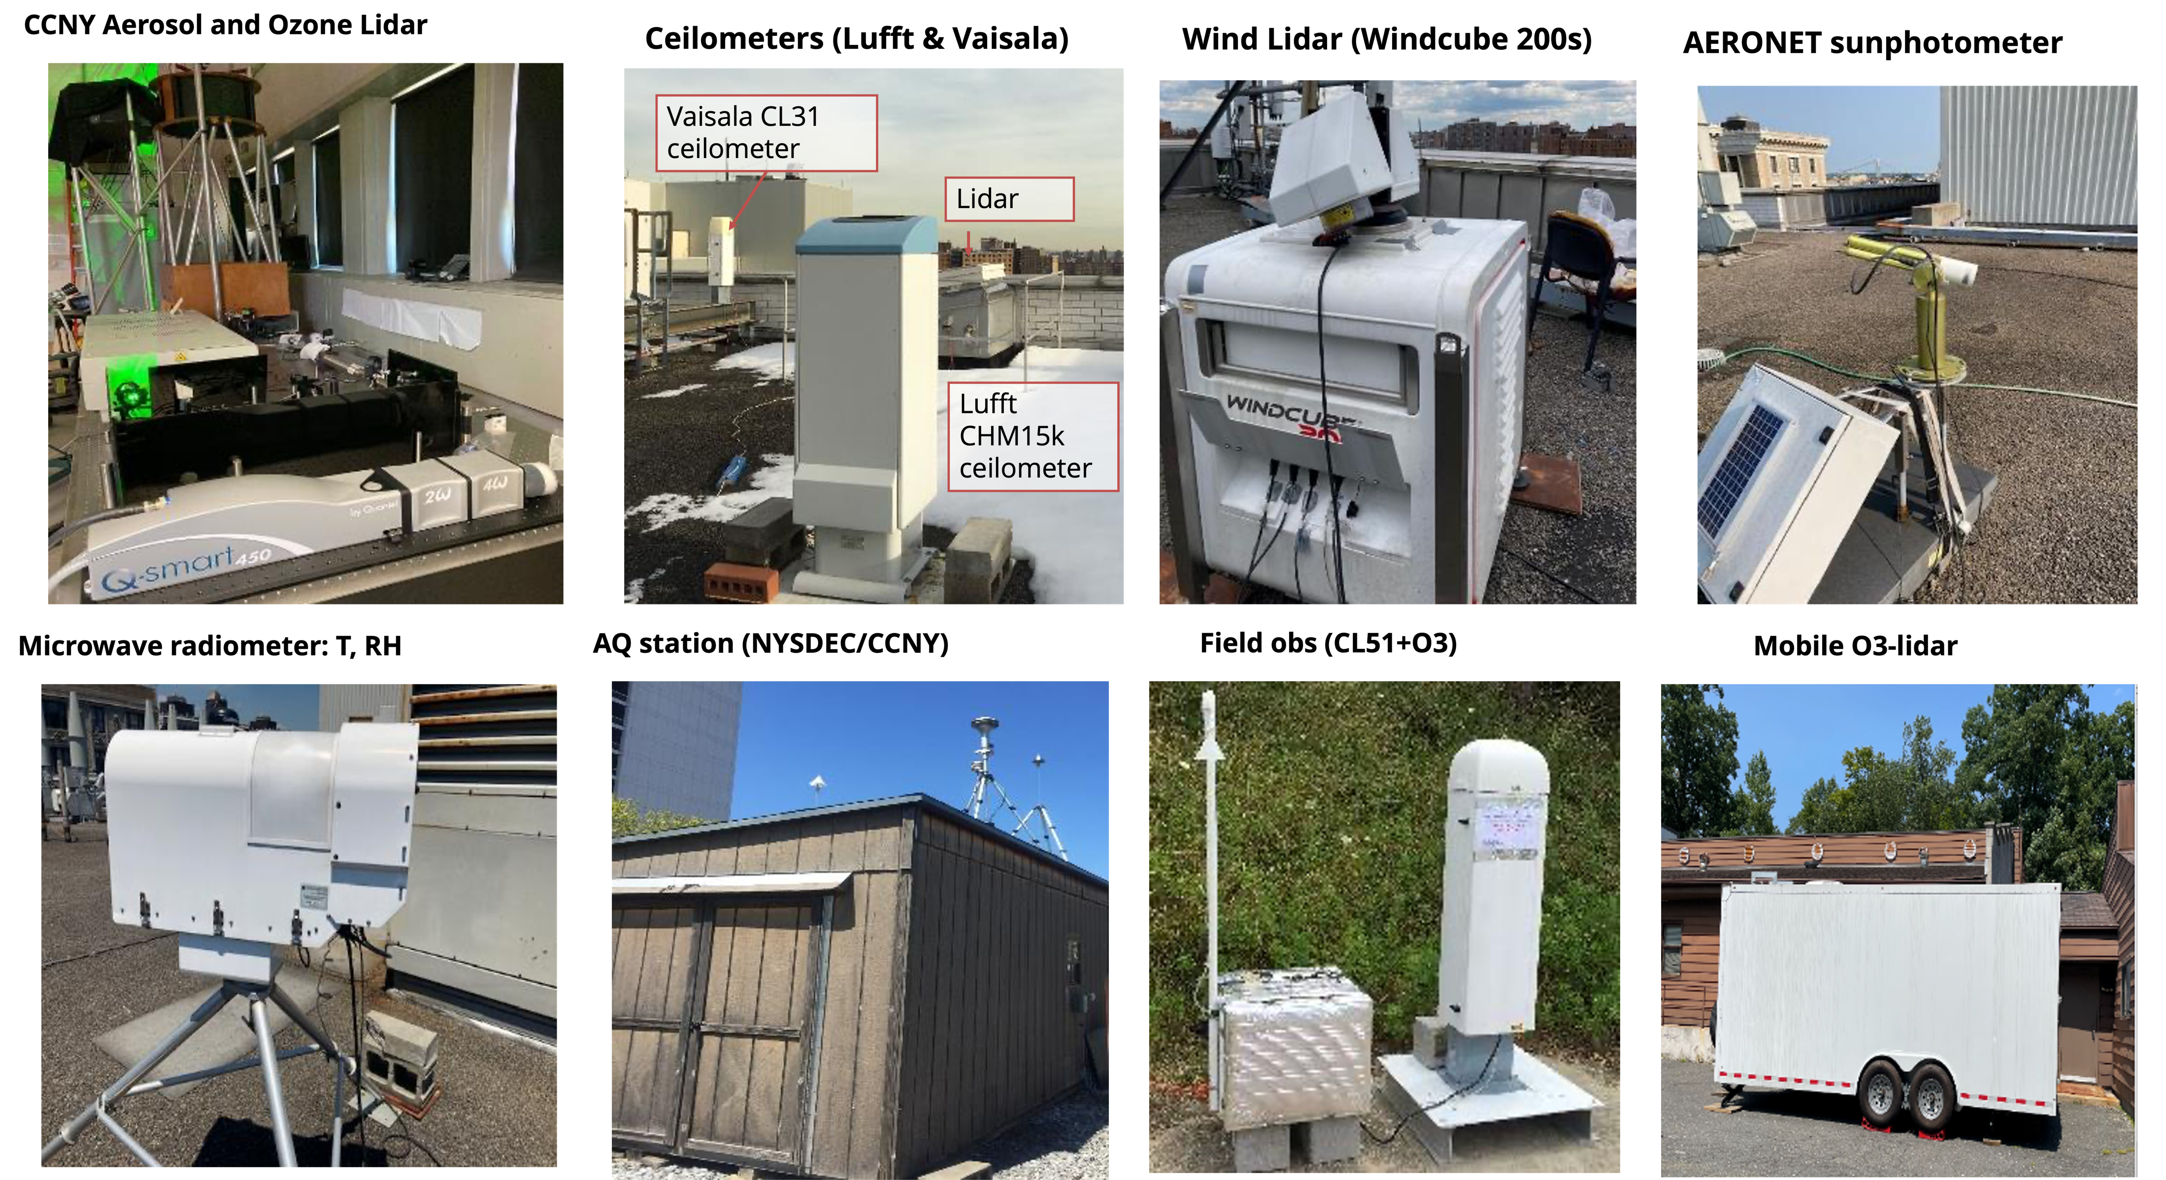
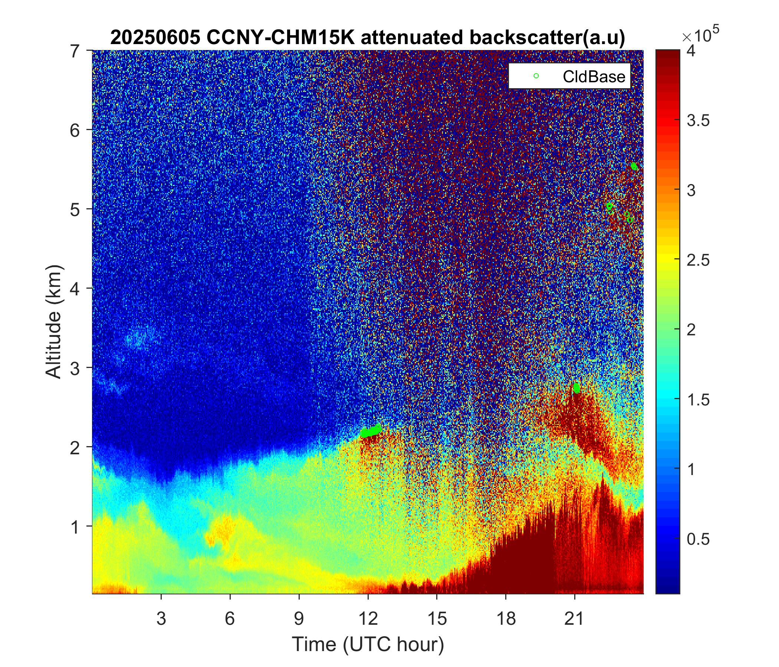
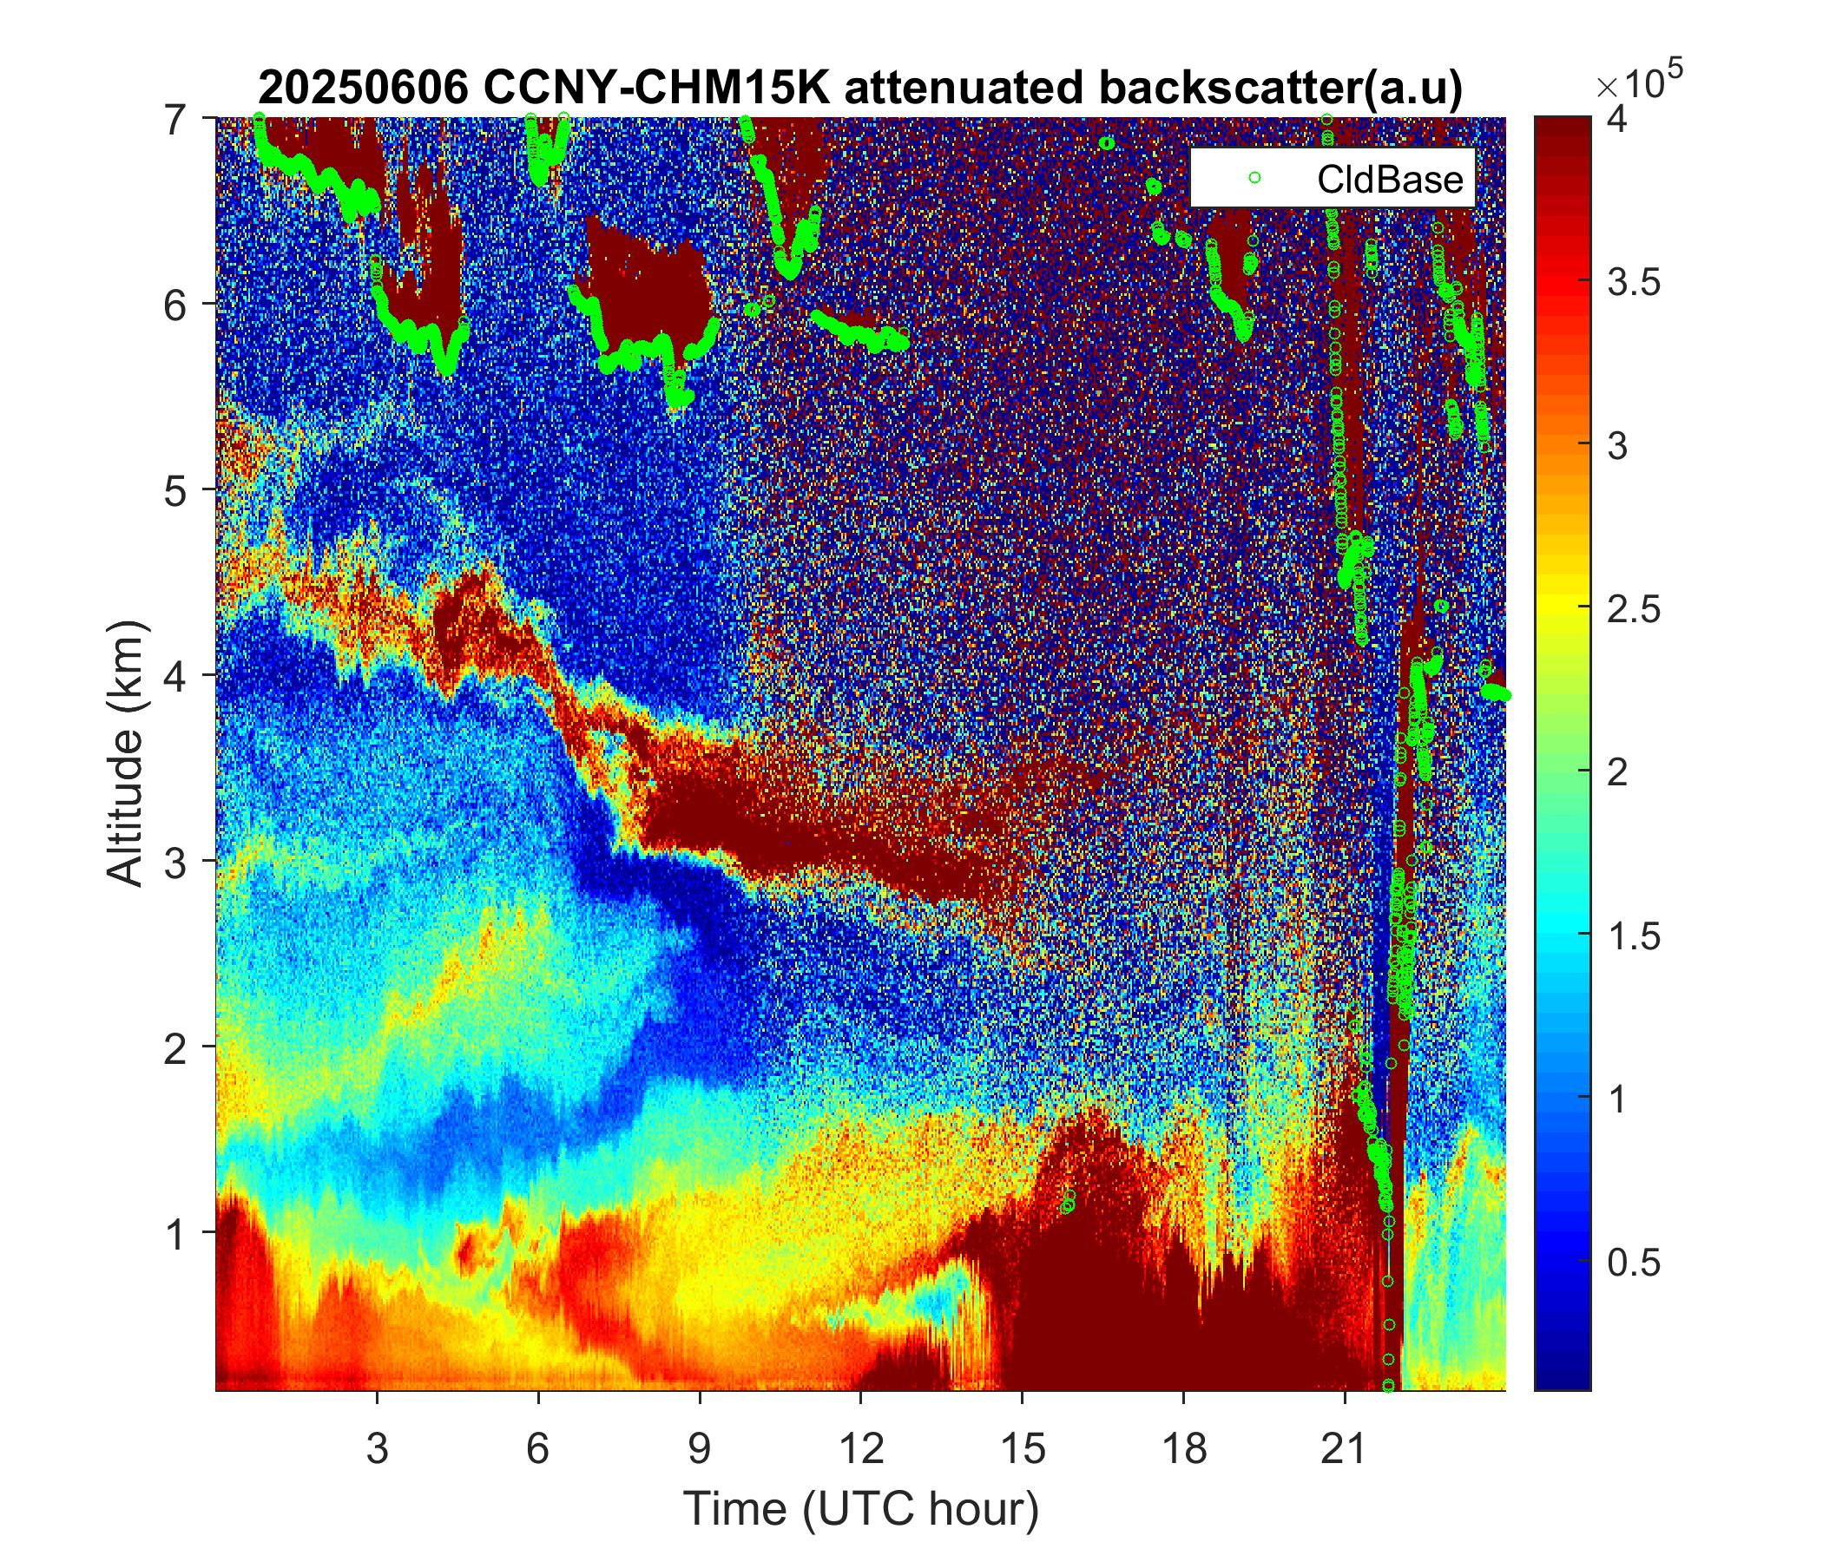
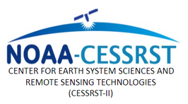

Joint Collaborative Research and Development Project (JCRDP)
    Develop a satellite-based atmospheric composition (AC) validation system through collaboration between CESSRST-II and NCAS-M researchers and students, with guidance from experts at NOAA, NASA, and EPA.
Ground-based observing instruments deployed at CCNY
Smoke layers observed by the CCNY CHM15k ceilometer, June 3–6, 2025
NCAS-M
CENTER FOR EARTH SYSTEM SCIENCES & REMOTE SENSING TECHNOLOGIES (CESSRST-II)

Slide 3
j
Conceptual Framework
*NAQFC: NOAA Air Quality Forecast Capability
*CAMS: Copernicus Atmosphere Monitoring Service Global Atmospheric Composition Forecasts
*UCN: Unified Ceilometer Network
*AQS: Air Quality System from the U.S. EPA
TEMPO L2 Product
(O3T, NO₂, HCHO,
AOD, ALH, PM2.5)
Forecast Model
(NOAA-NAQFC,
ECMWF-CAMS)
Ground-based Observations
(PGN, AERONET, UCN, AQS)
Collocation
Hourly Stats
Weekly/Monthly/Yearly Stats
Vertical Cross Section
This system will enhance NOAA’s AerosolWatch and provide additional independent functionality.
CENTER FOR EARTH SYSTEM SCIENCES & REMOTE SENSING TECHNOLOGIES (CESSRST-II)

Slide 4
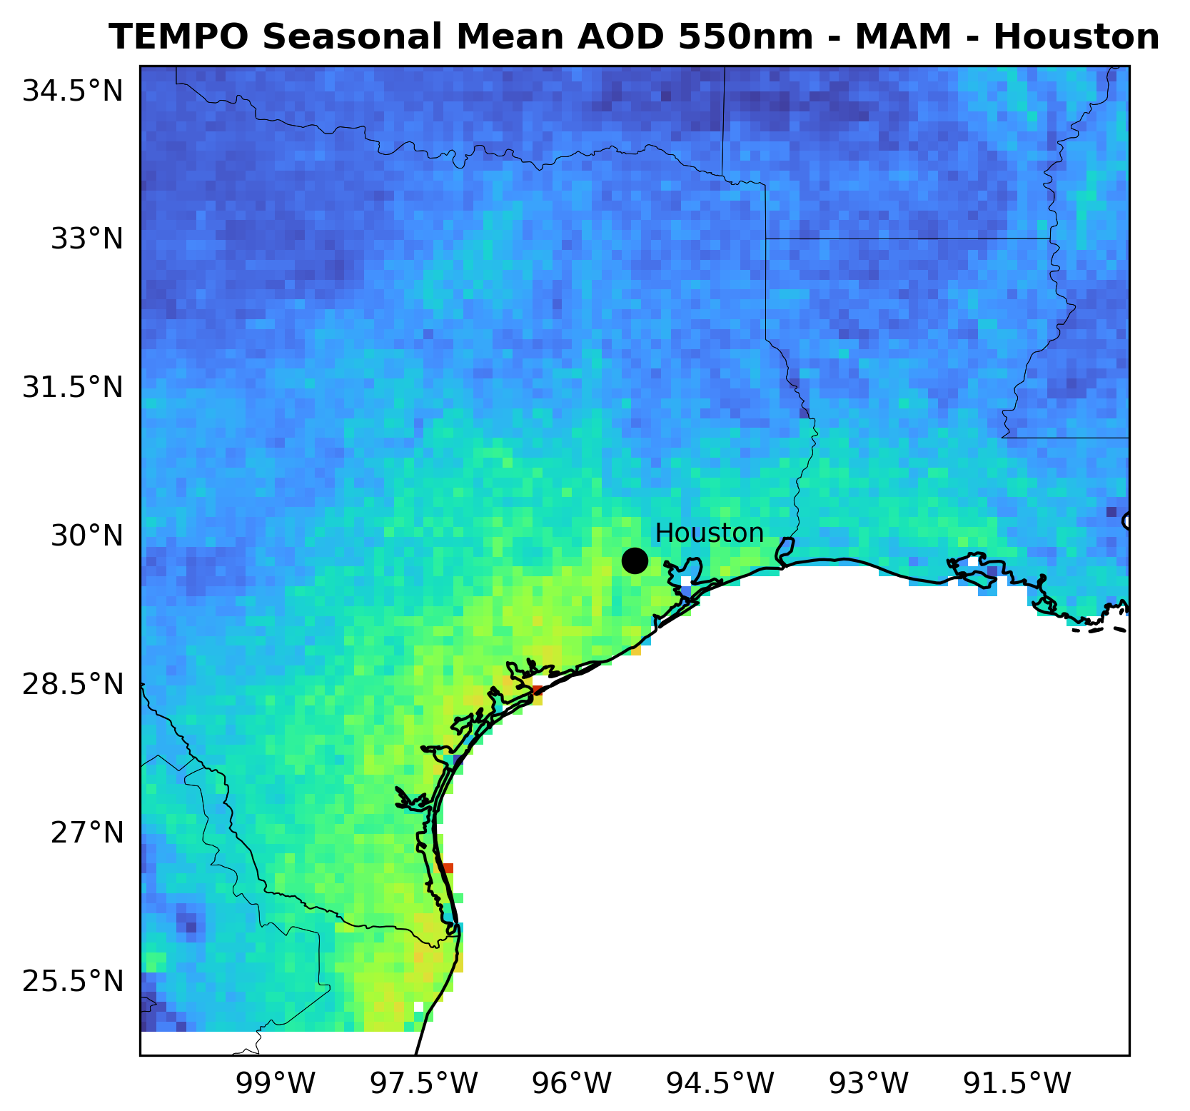
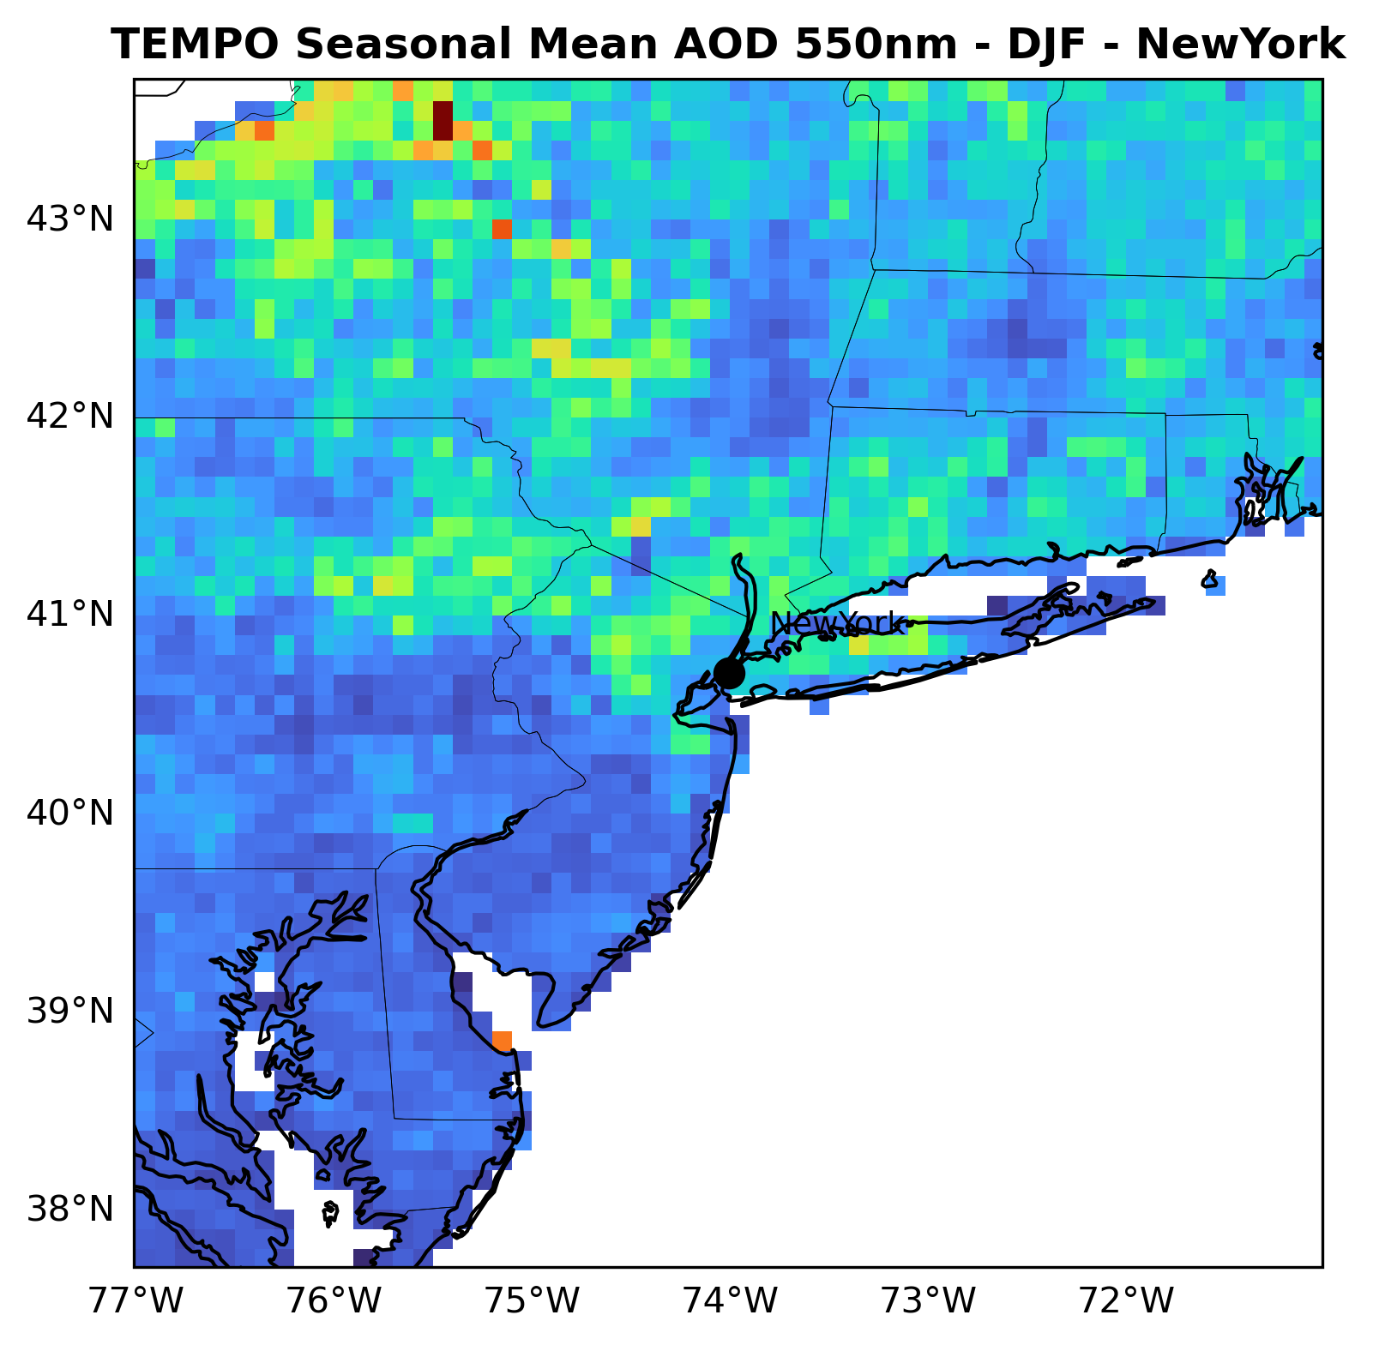
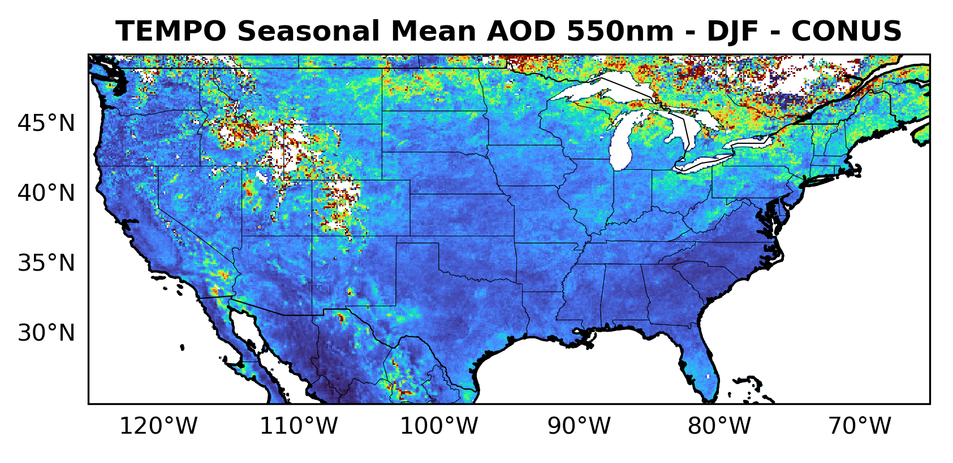
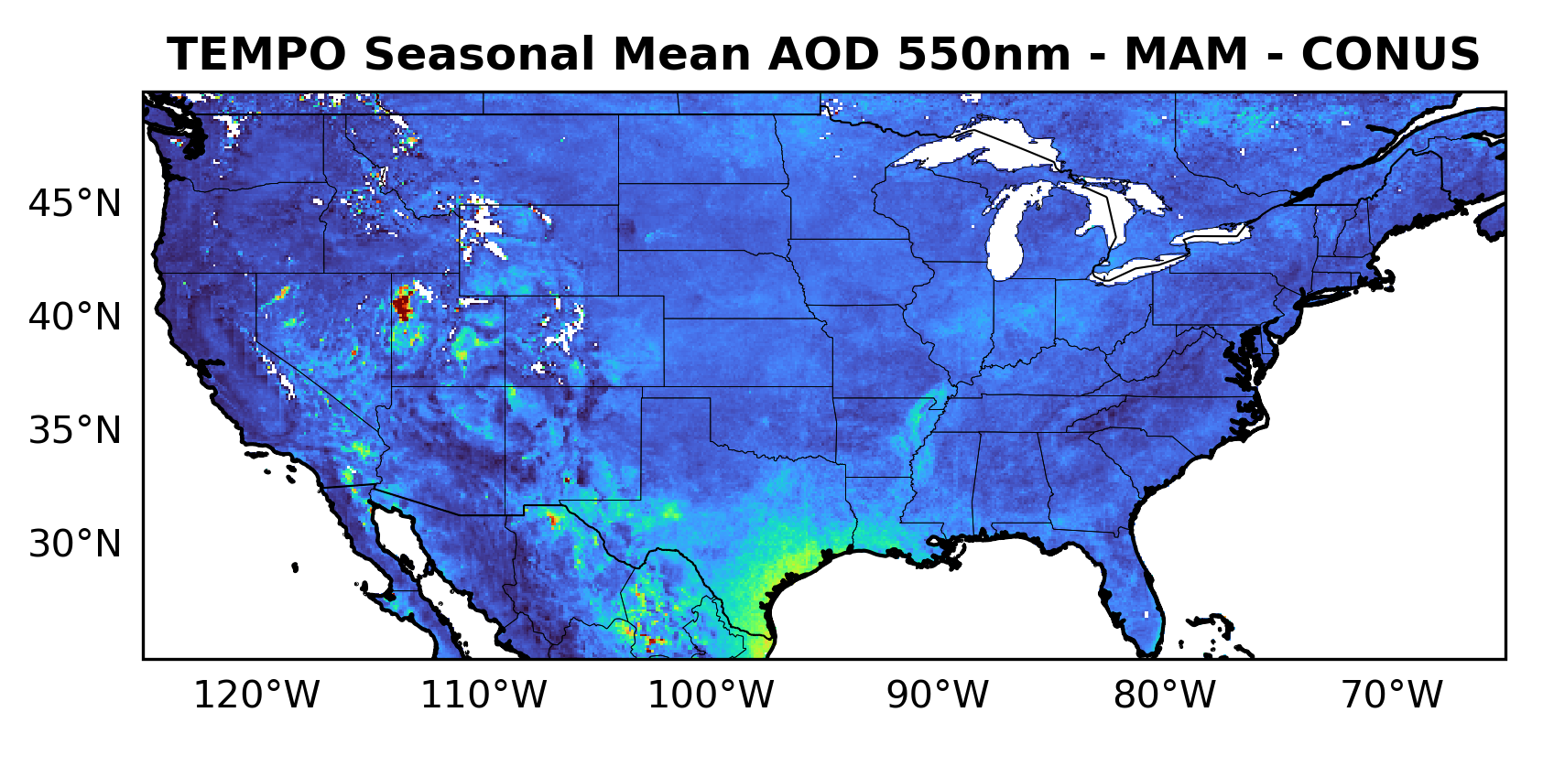
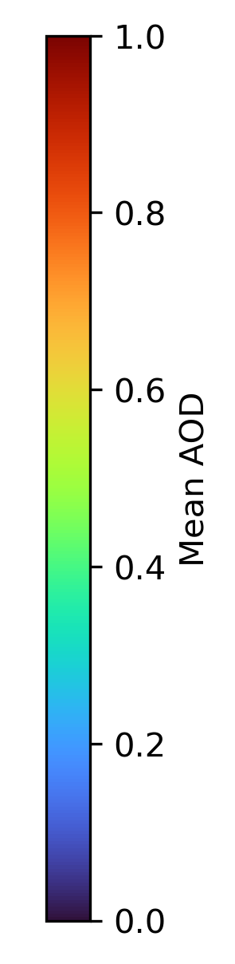
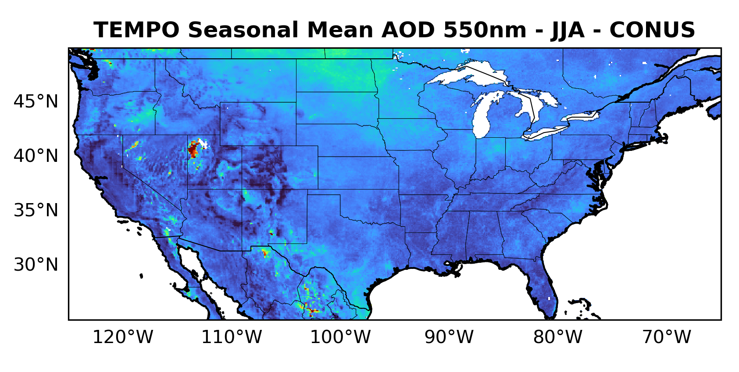
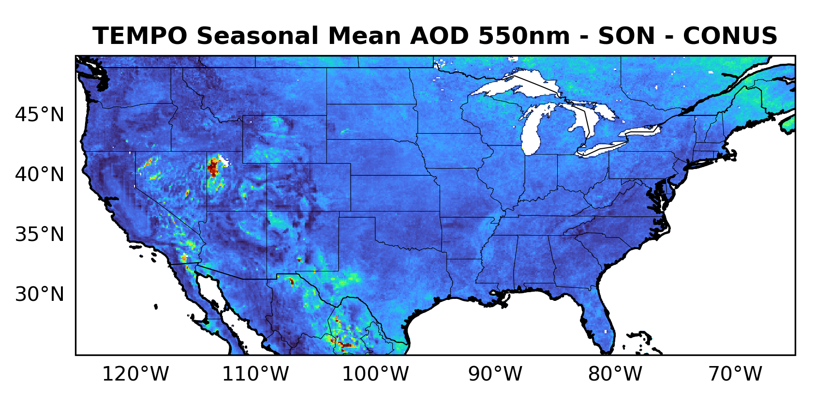
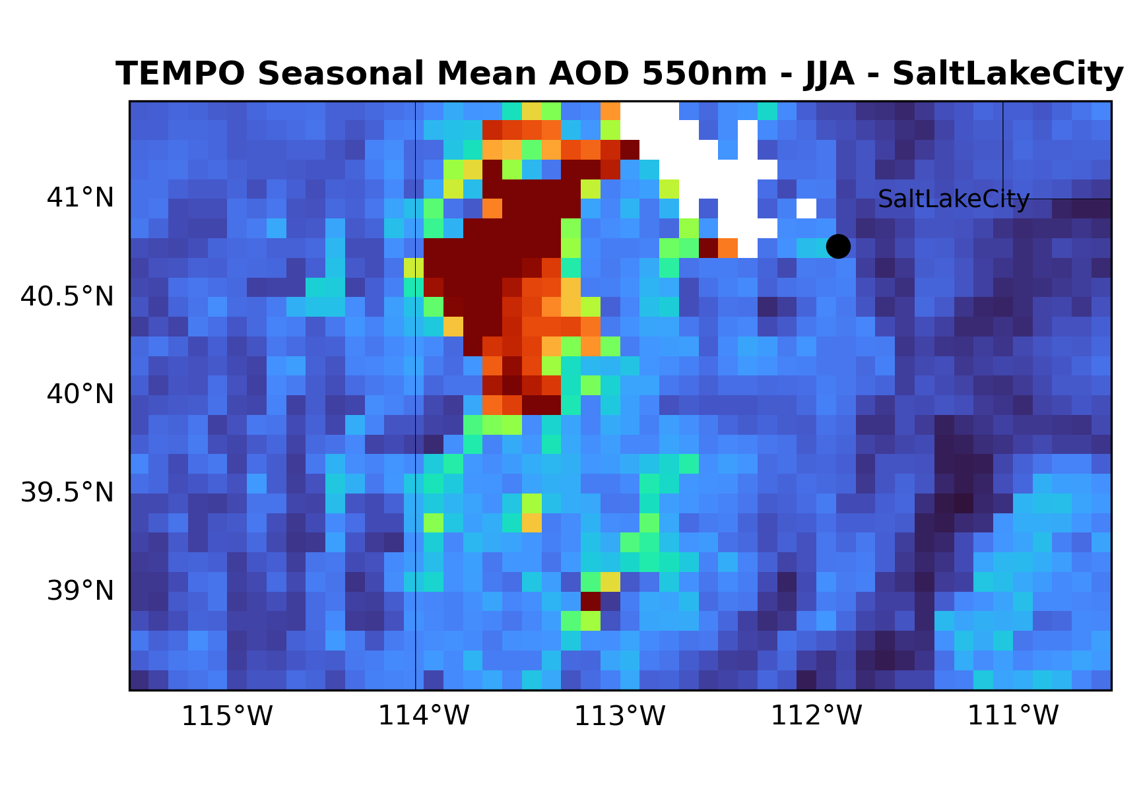
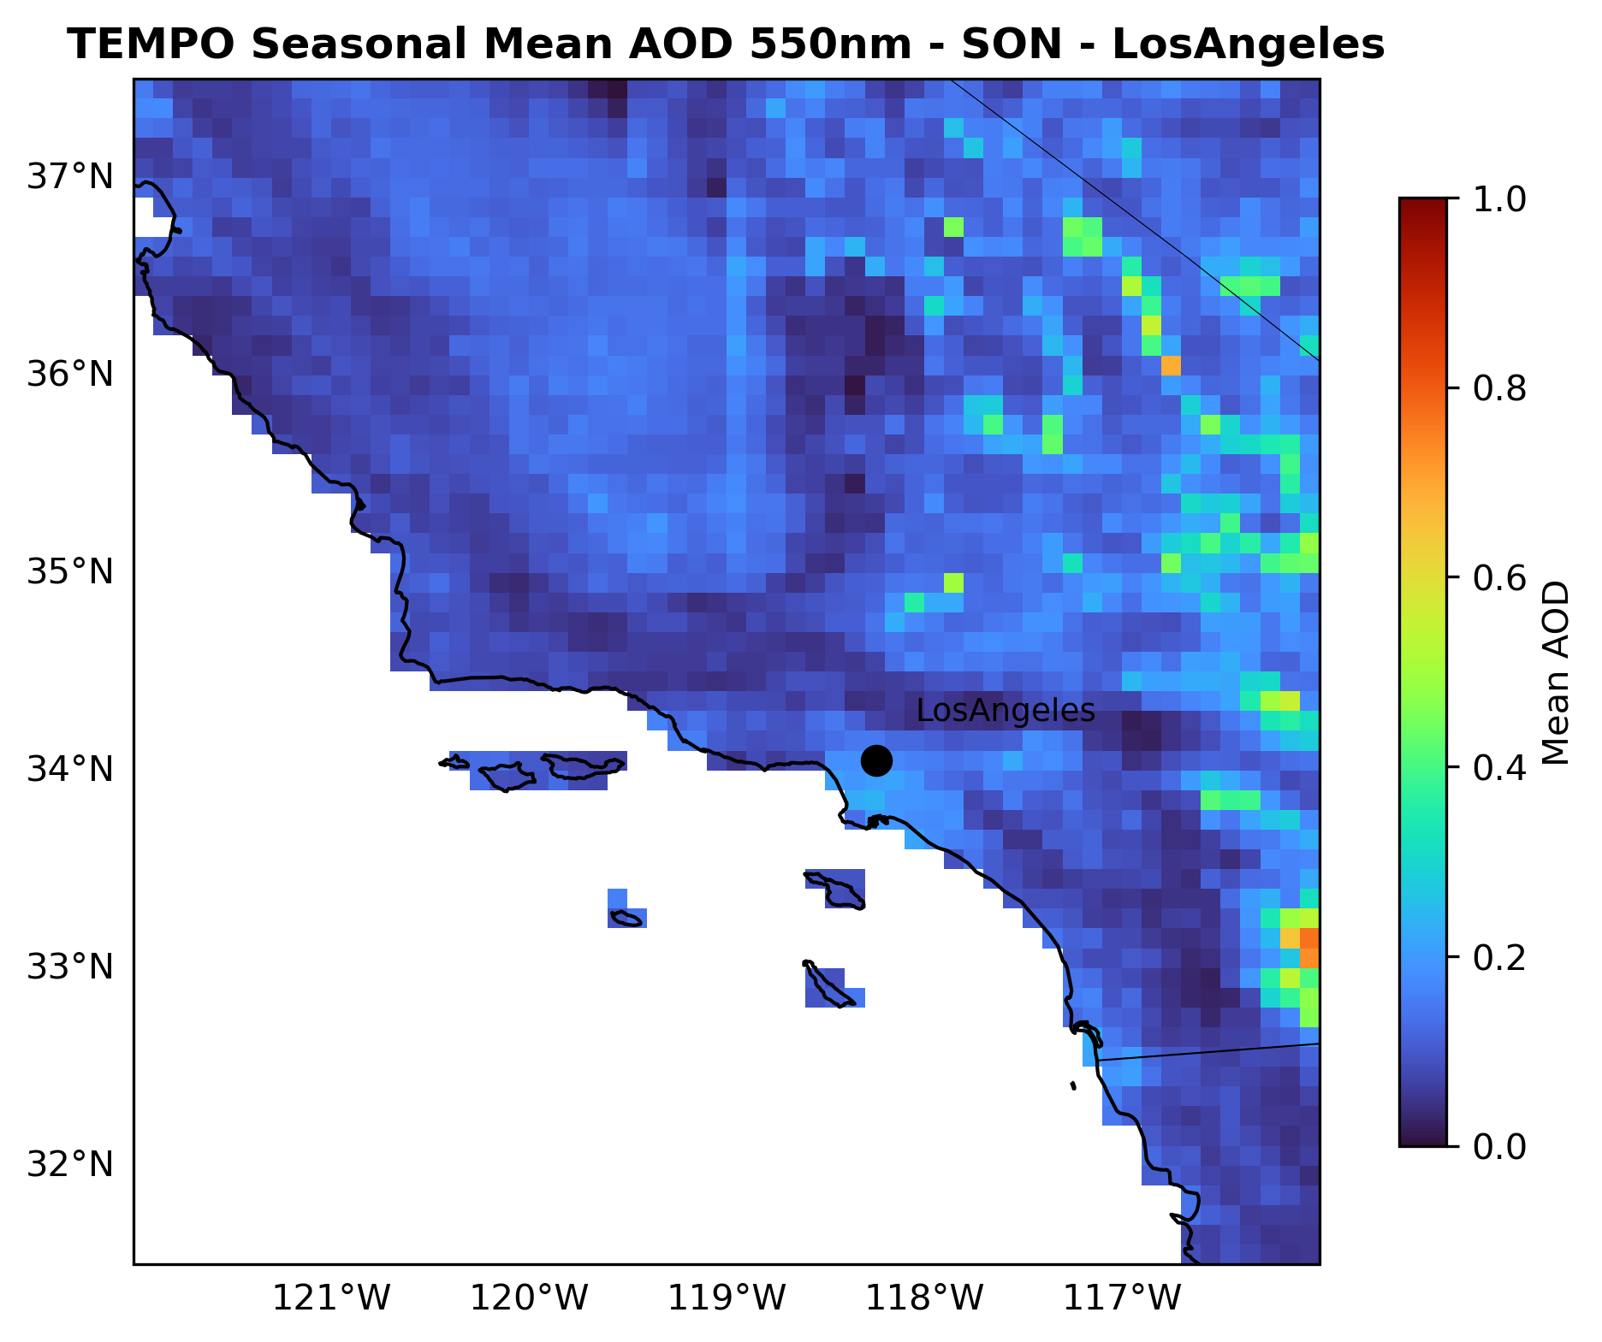
j
Seasonal Mean AOD (Aug. 2023 – Jul. 2024)
Land-only AOD with high quality retrieval and without high SZA, sunglint, or snow/ice contamination
CONUS
Major Cities
CENTER FOR EARTH SYSTEM SCIENCES & REMOTE SENSING TECHNOLOGIES (CESSRST-II)
Notes:
the surface in the Salt Lake City area is very bright, and VIIRS also has difficulty retrieving data in that region.

Slide 5
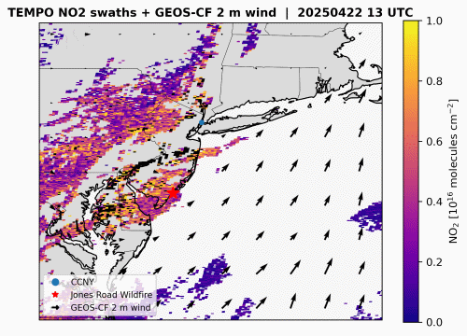
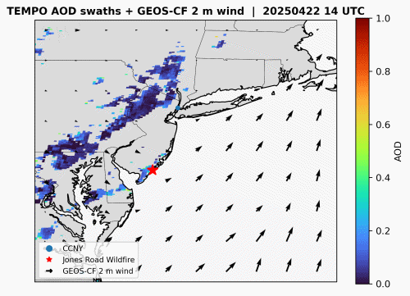
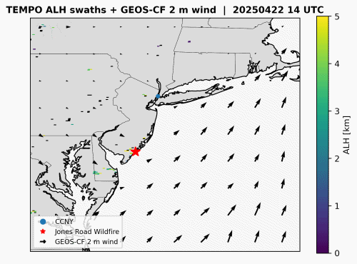
j
Case Study
Smoke plume from the Jones Road Fire in New Jersey at 13:45 UTC on April 22, 2025
CENTER FOR EARTH SYSTEM SCIENCES & REMOTE SENSING TECHNOLOGIES (CESSRST-II)
Notes:
The fire ignition time of the Jones Road Wildfire (Ocean County Fire) was at 9:45 AM EDT (1:45 PM UTC) on April 22, 2025, near 39.95°N, 74.35°W

Slide 6
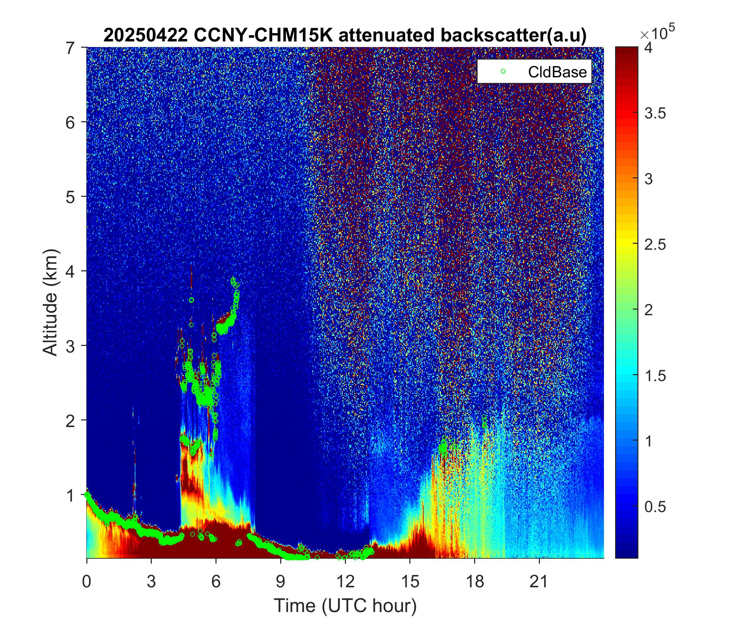
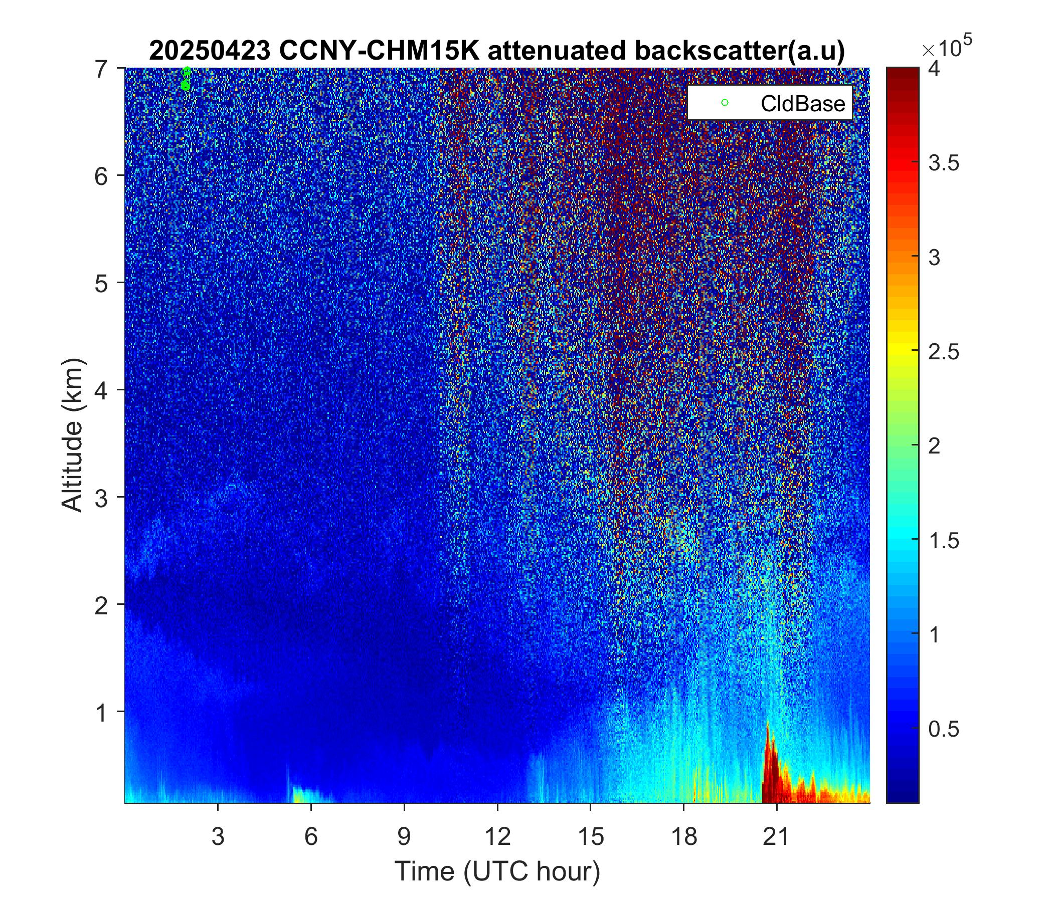
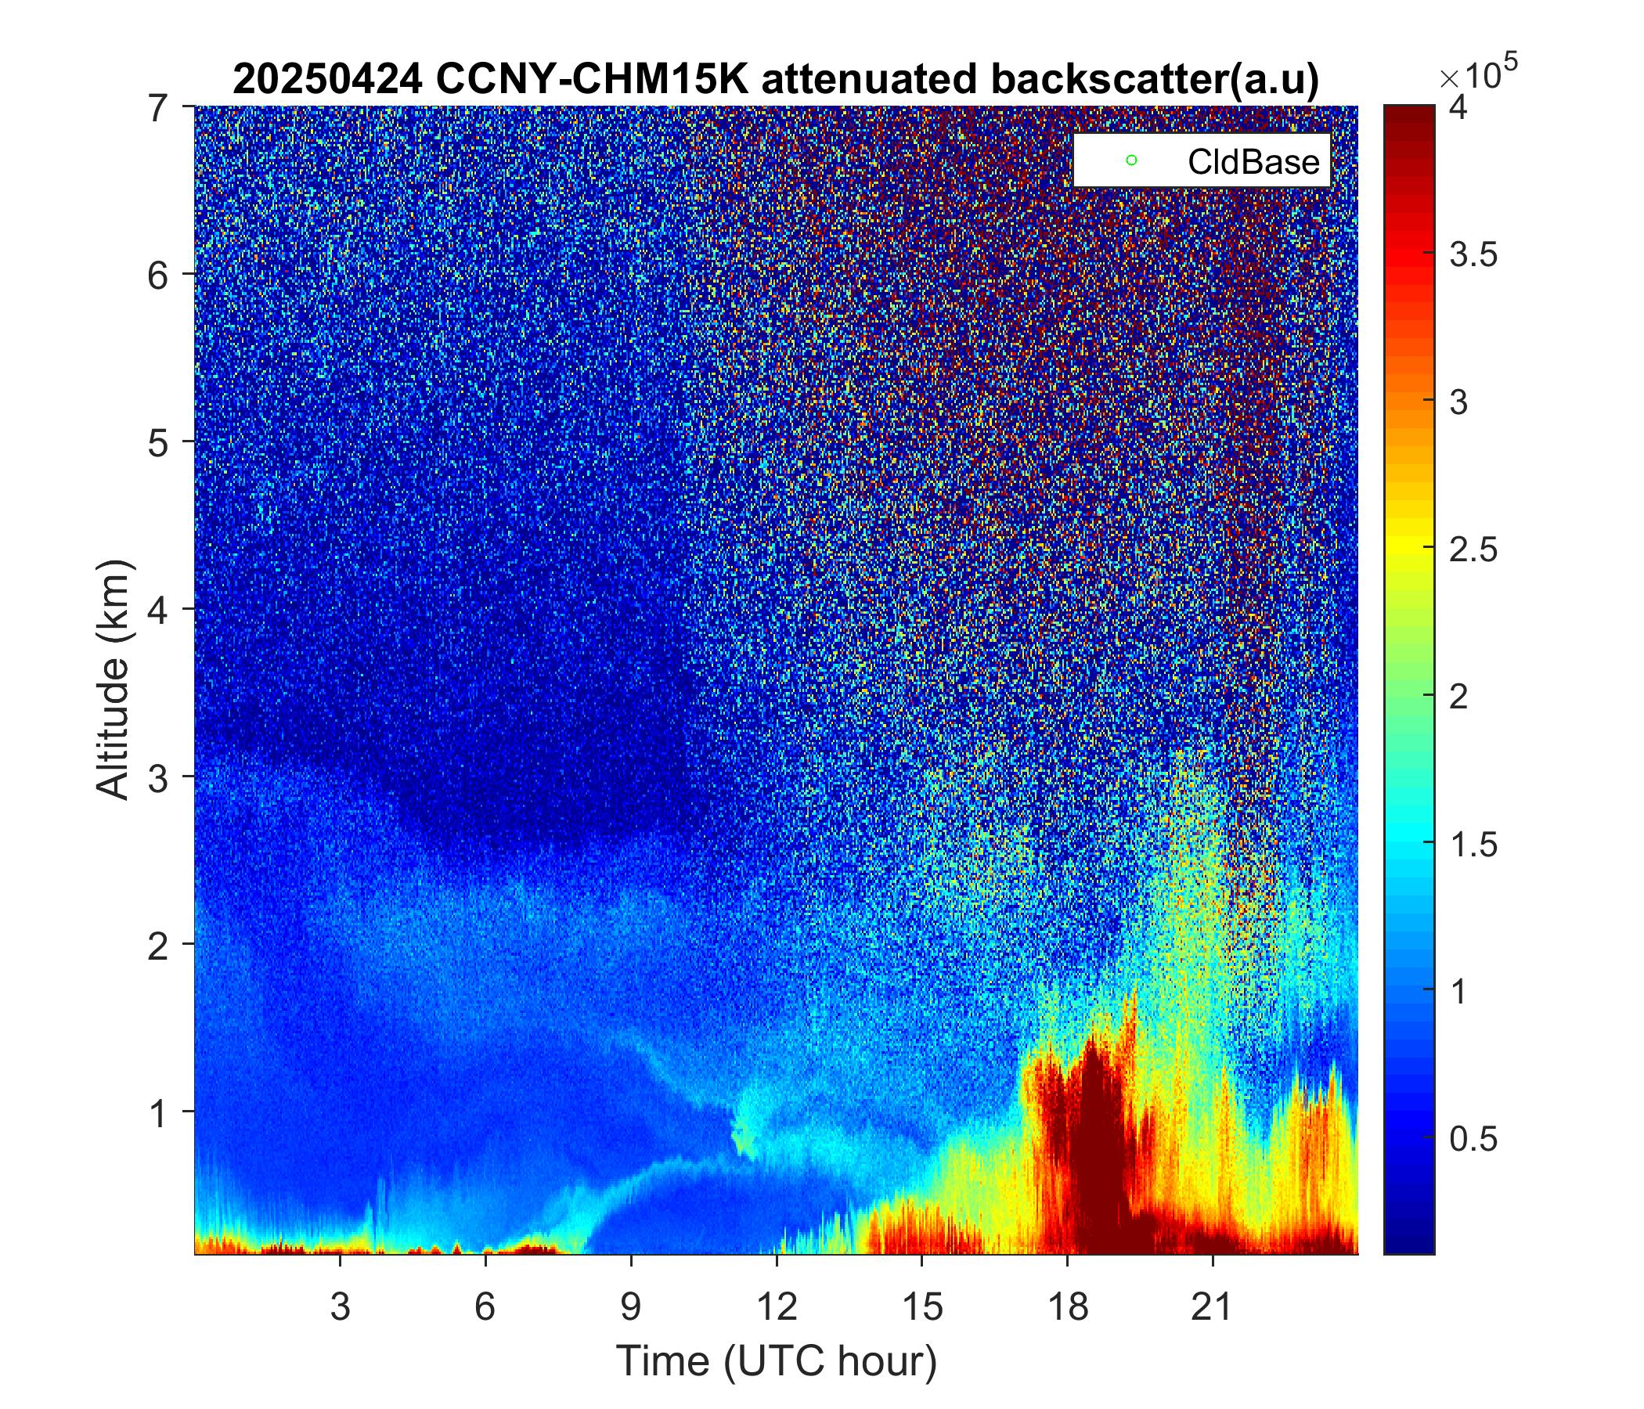
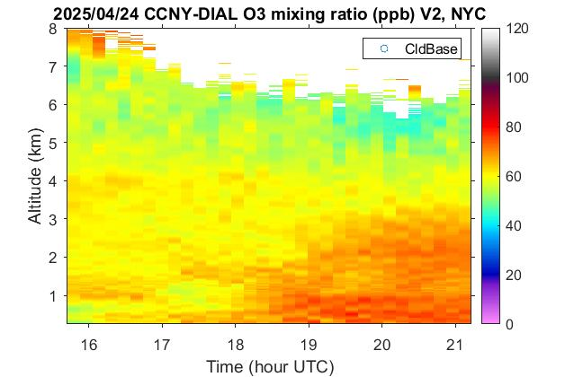
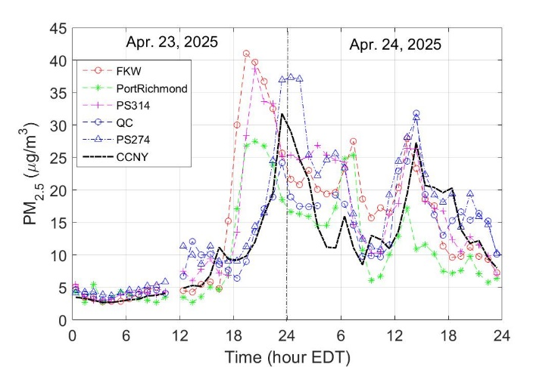
j
Case Study
Downwind Impacts: Smoke-Related PM_{2.5} and High Ozone Event (April 22–24, 2025)
See also: Dr. Moshary, “Synergistic observation of ozone and aerosol vertical distribution, transport, and application to air quality by ground-based lidar and satellite in New York City area” (Aug 20, 4:50 p.m.)
CENTER FOR EARTH SYSTEM SCIENCES & REMOTE SENSING TECHNOLOGIES (CESSRST-II)

Slide 7
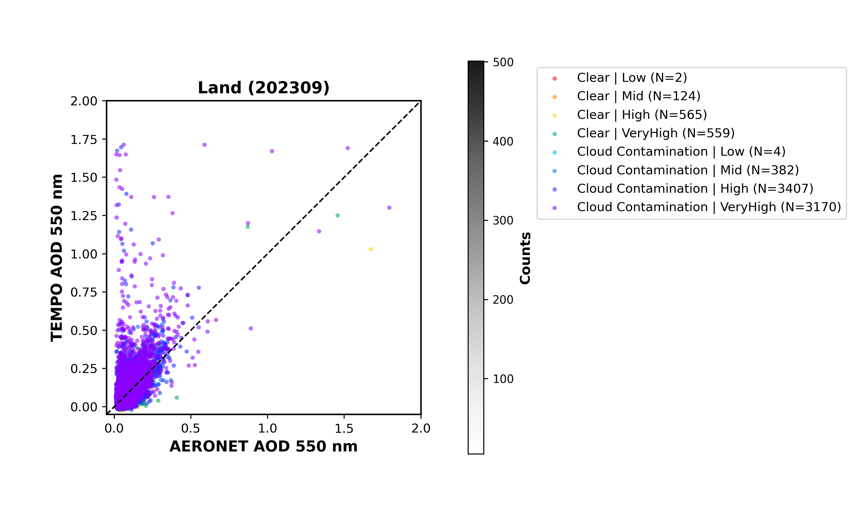
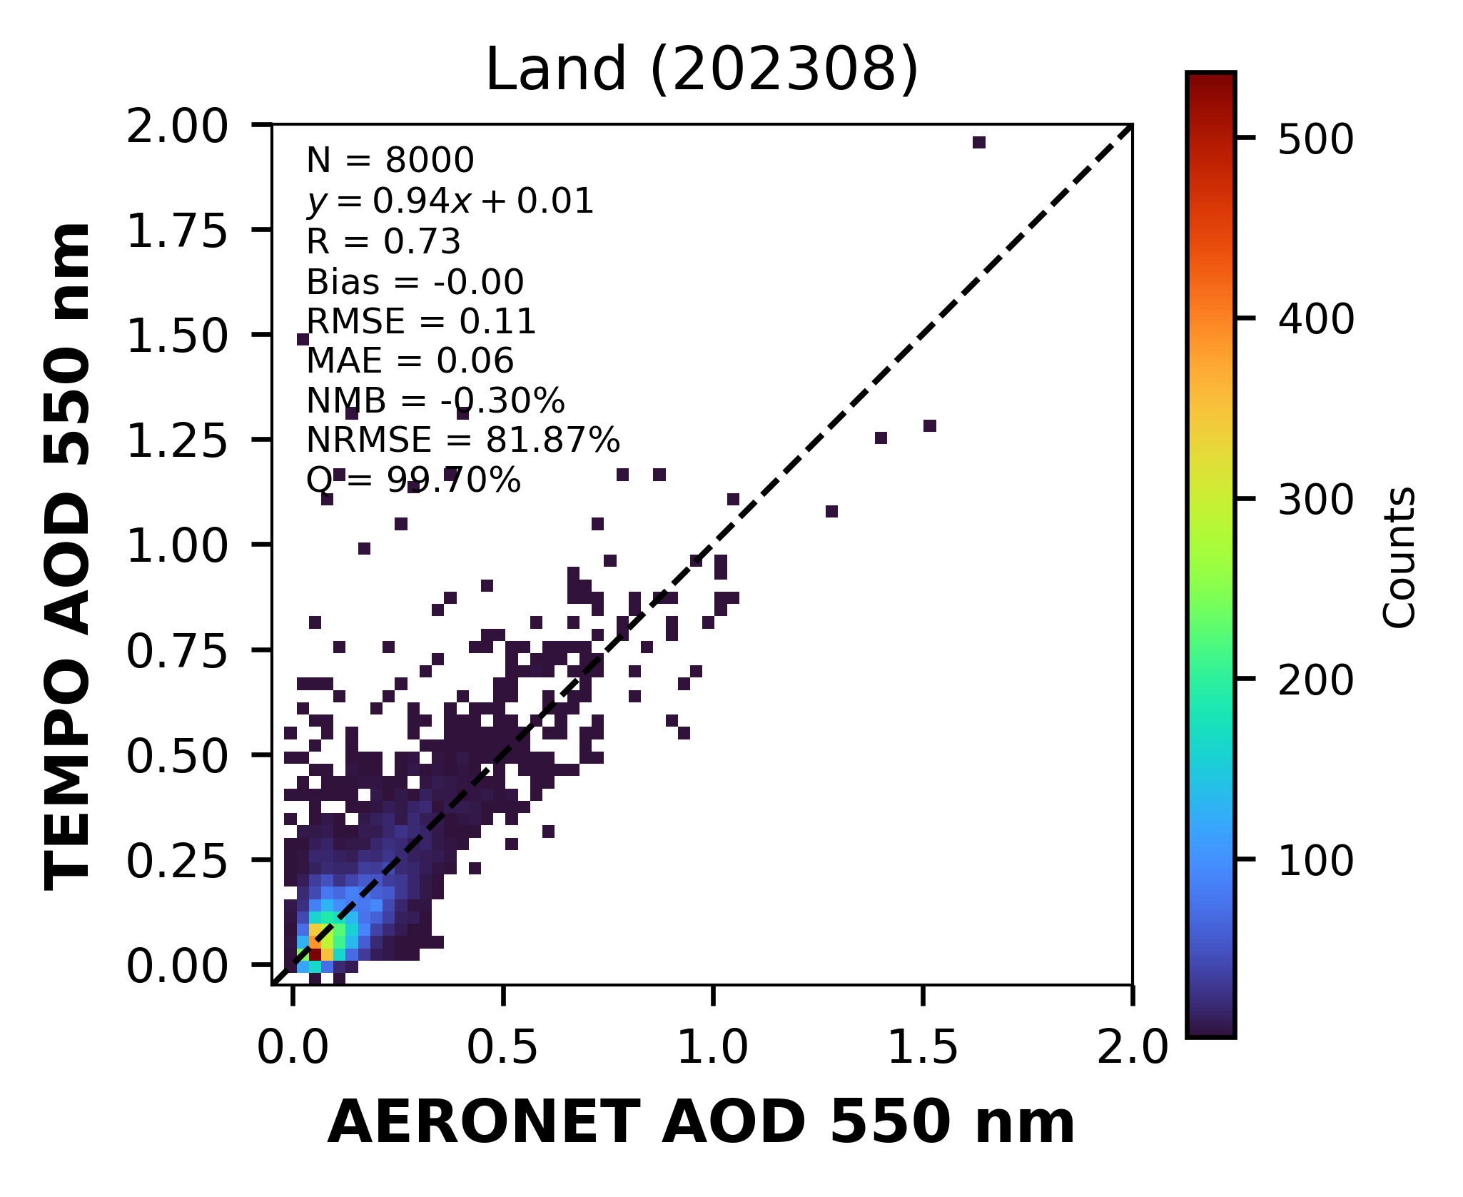
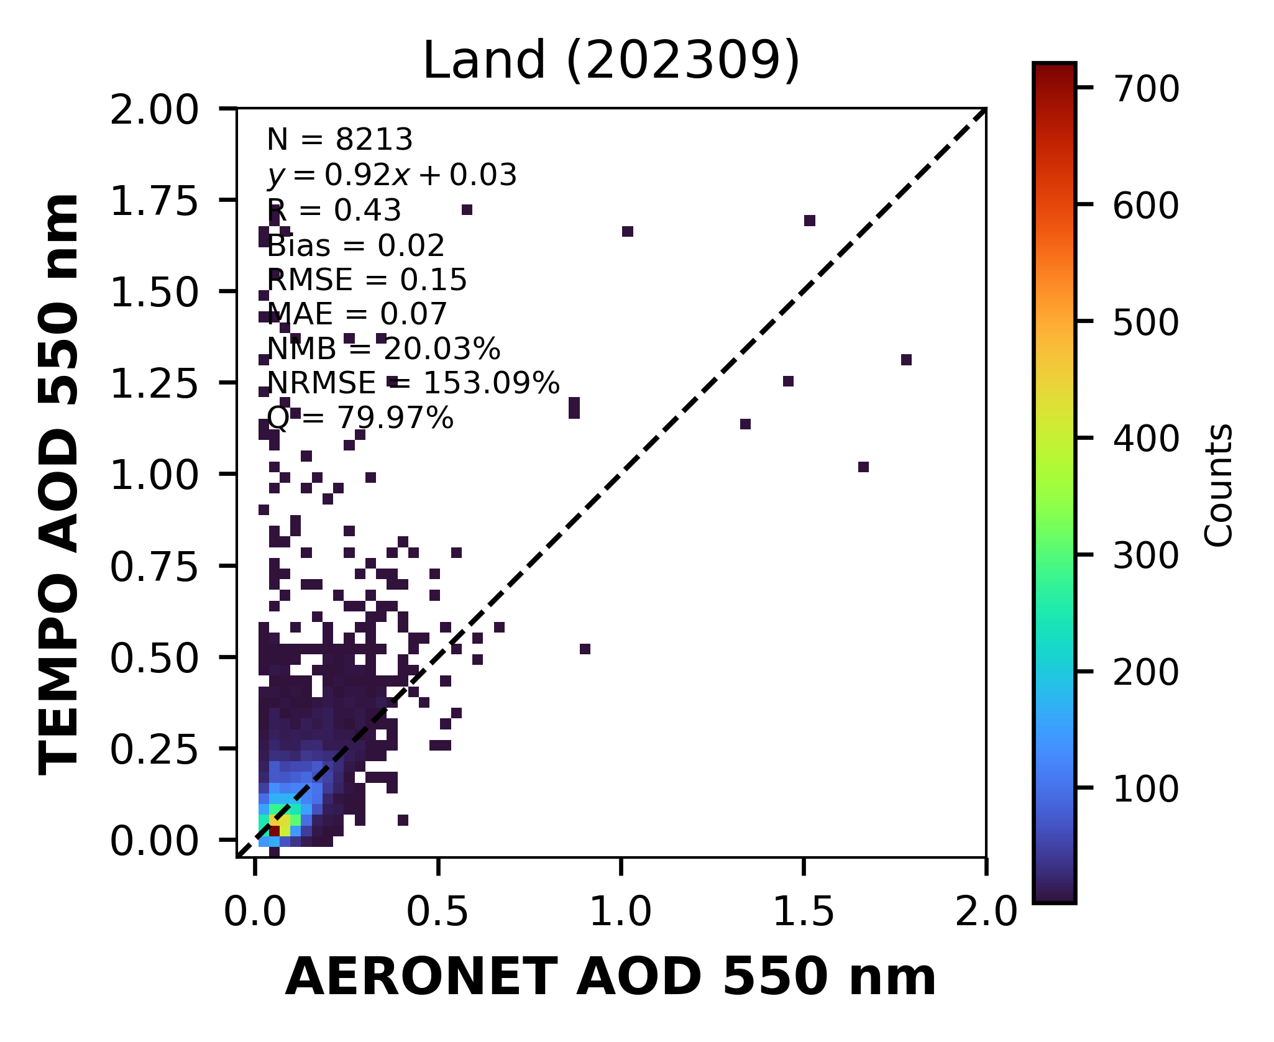
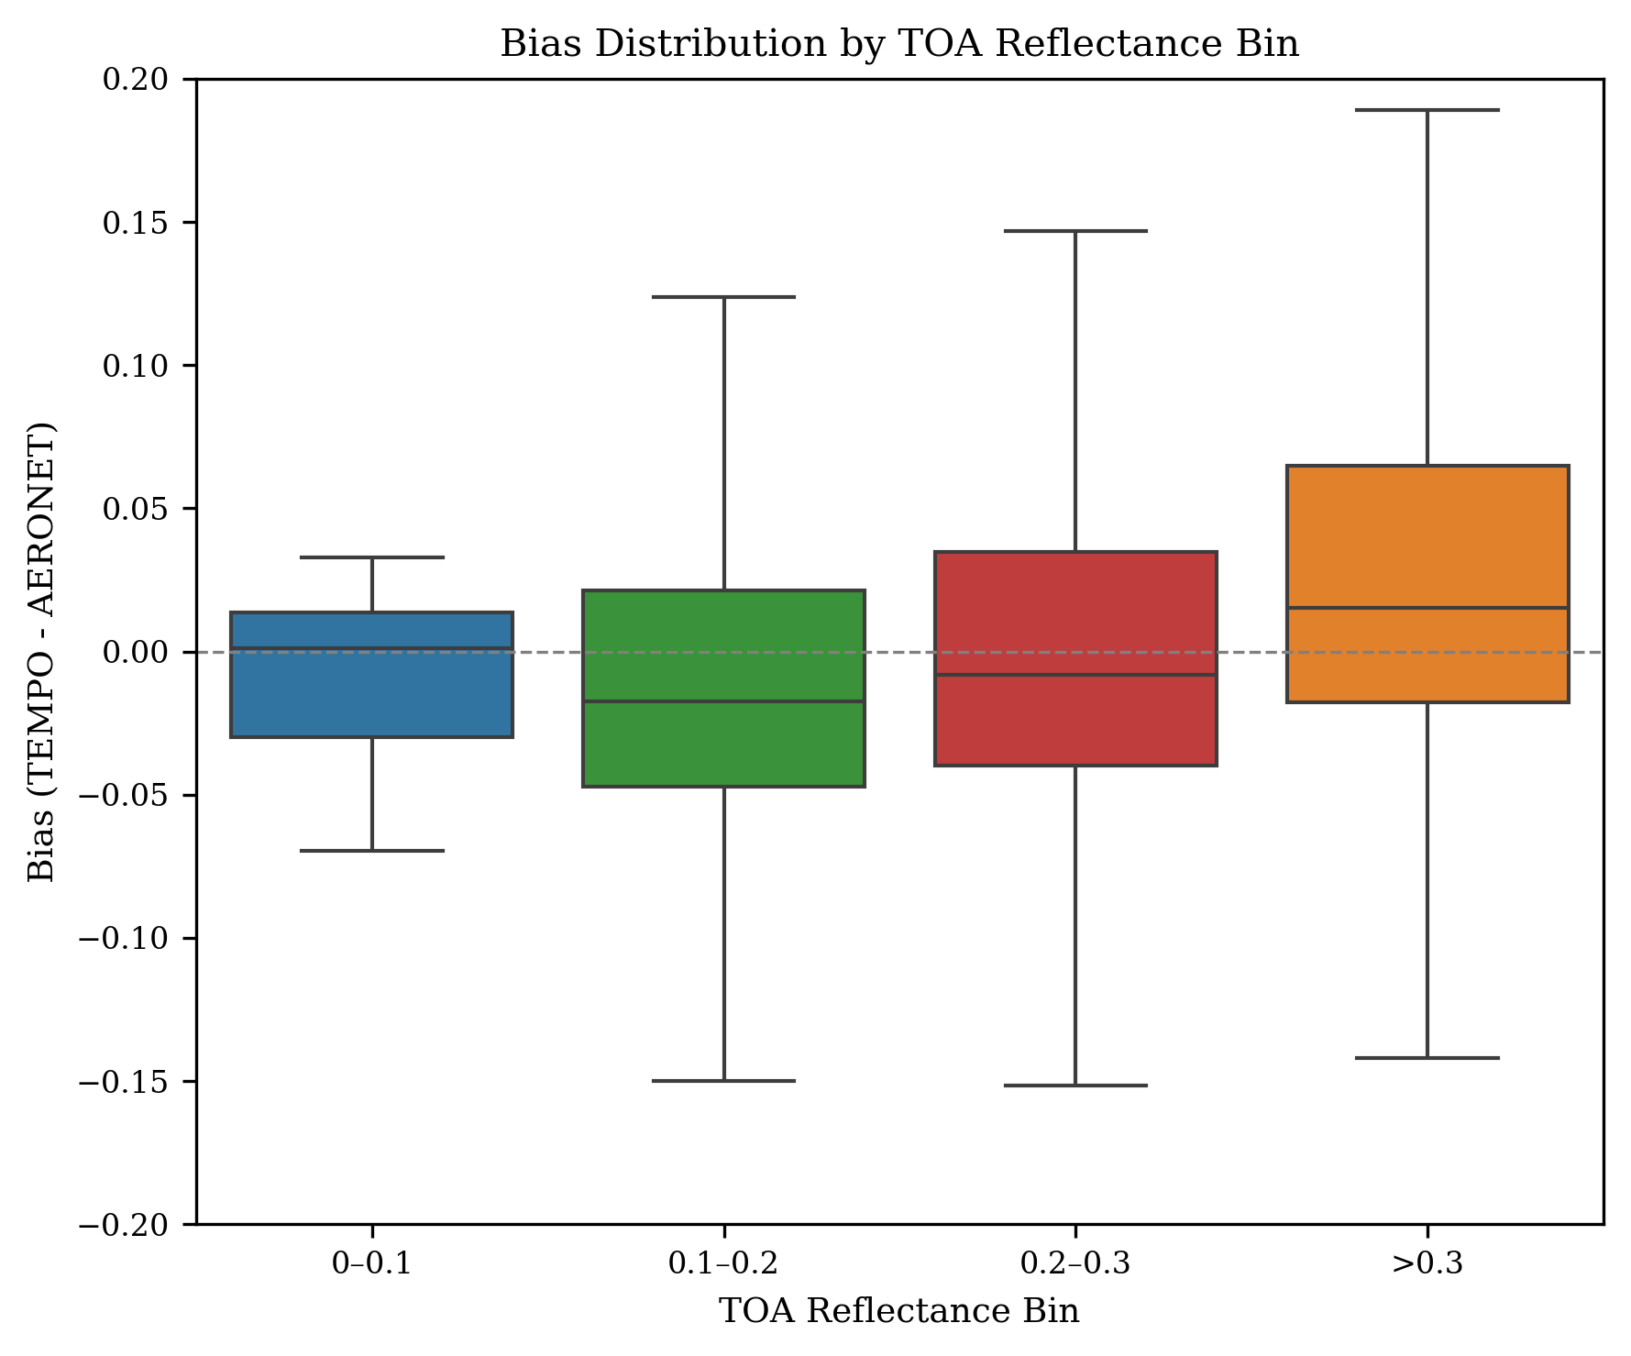
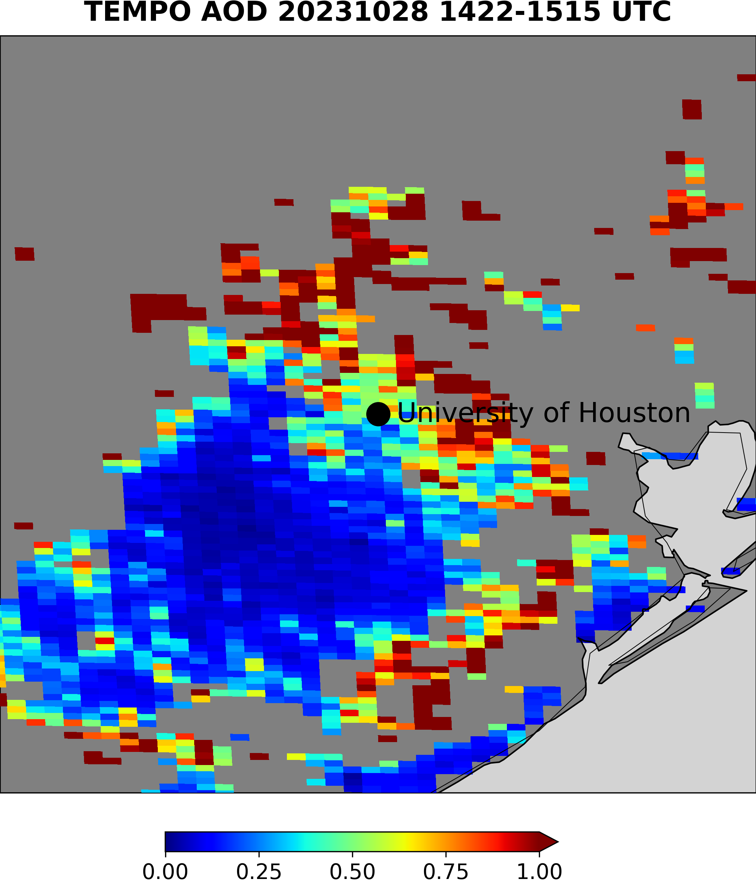
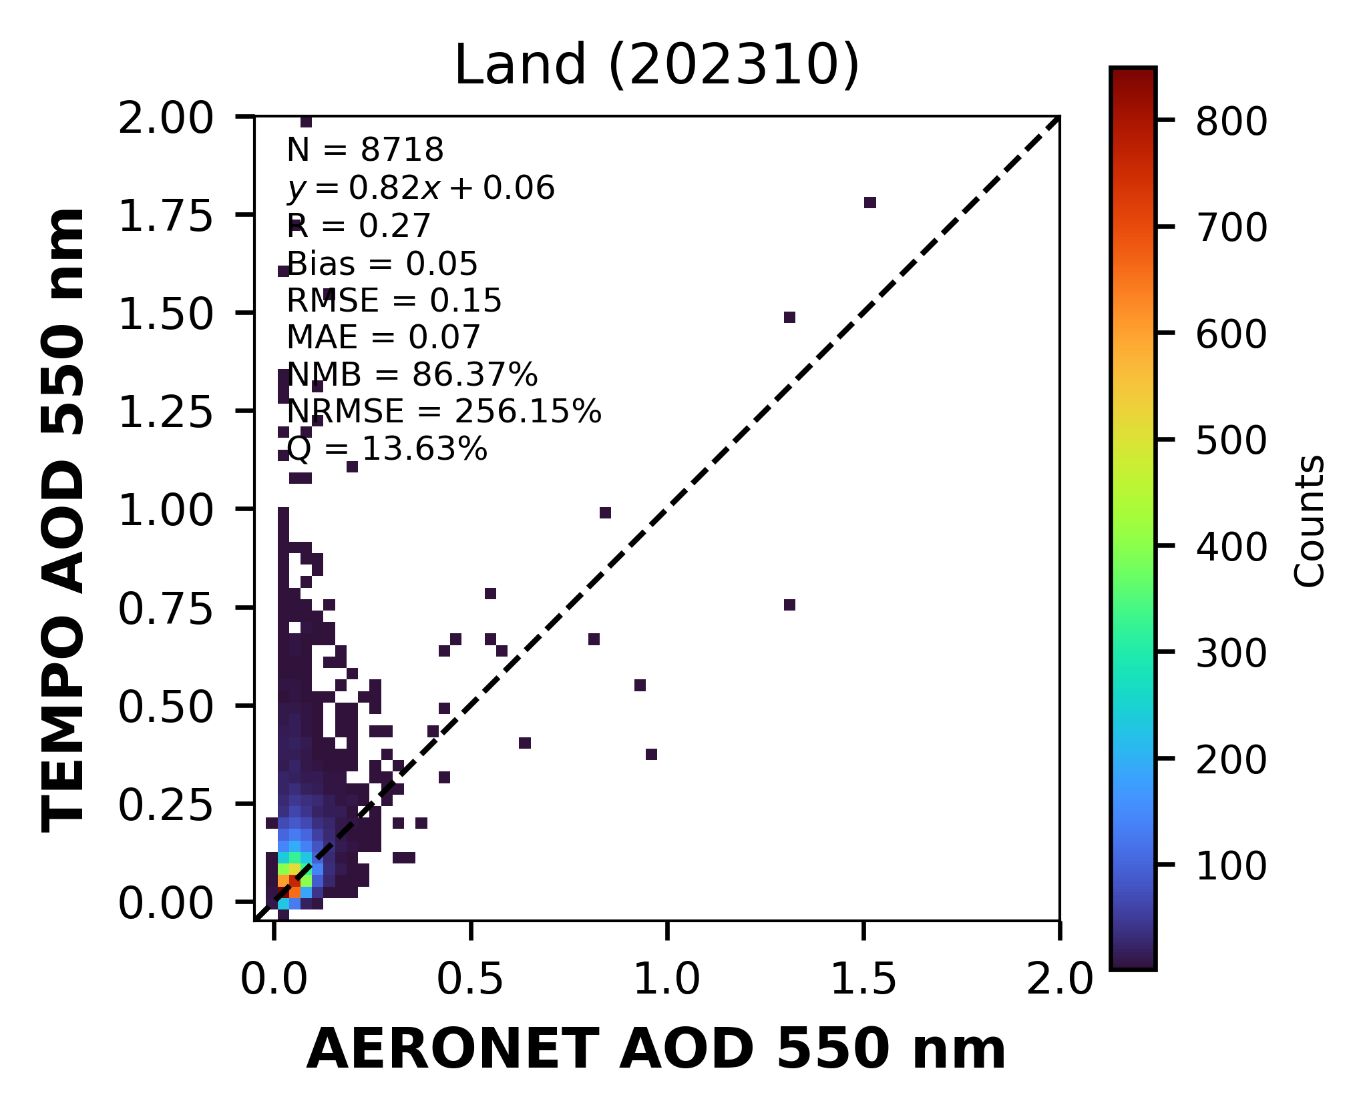
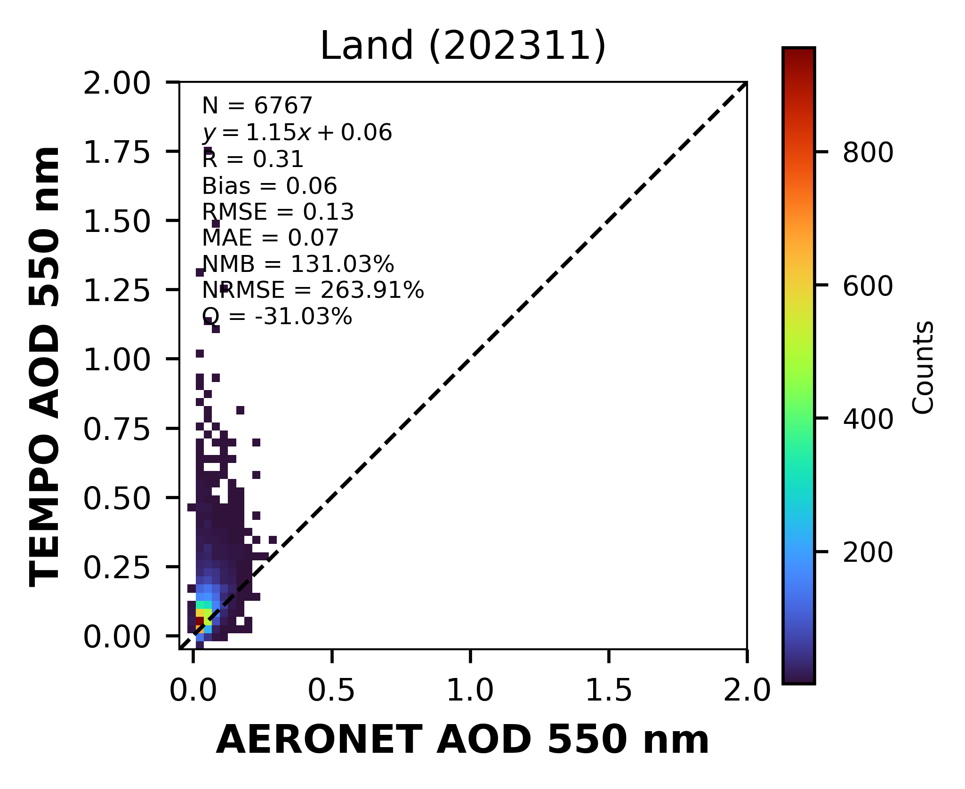
j
AOD Validation
TEMPO AOD: 0.76
AERONET AOD: 0.07
Outliers are dominated by cloud-/snow-contaminated pixels and bright-surface hotspots.
CENTER FOR EARTH SYSTEM SCIENCES & REMOTE SENSING TECHNOLOGIES (CESSRST-II)
Notes:
most of the outliers are due to cloud contamination and hotspots over bright surfaces . Higher TOA reflectance is associated with positive bias
.

Slide 8
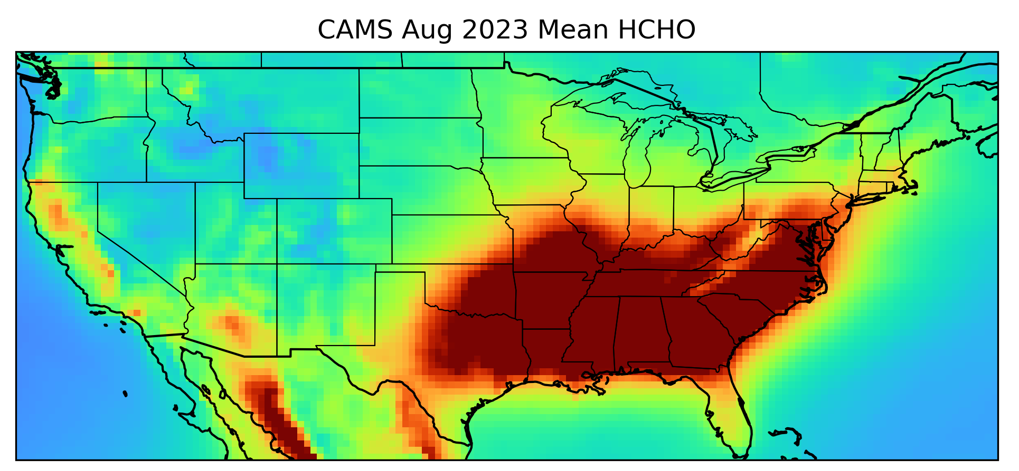
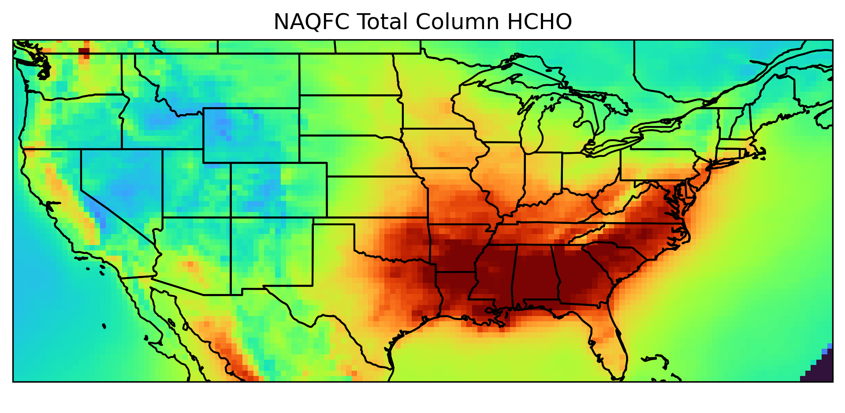
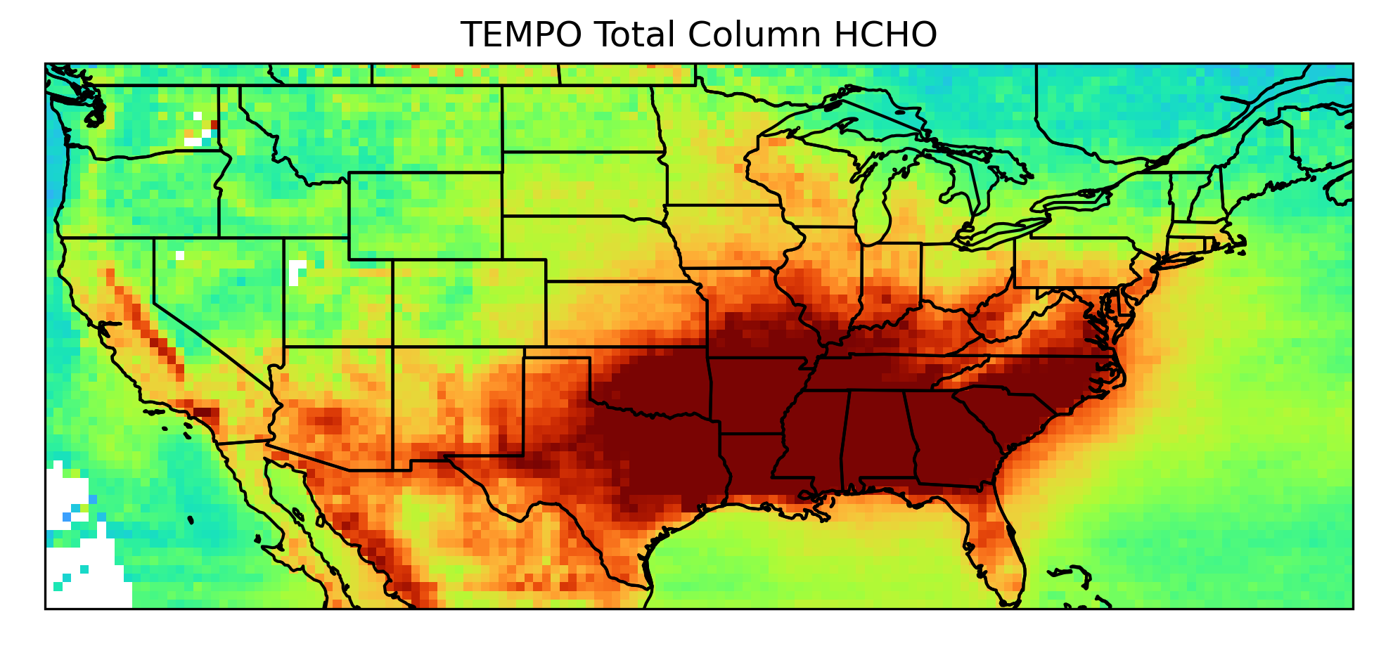
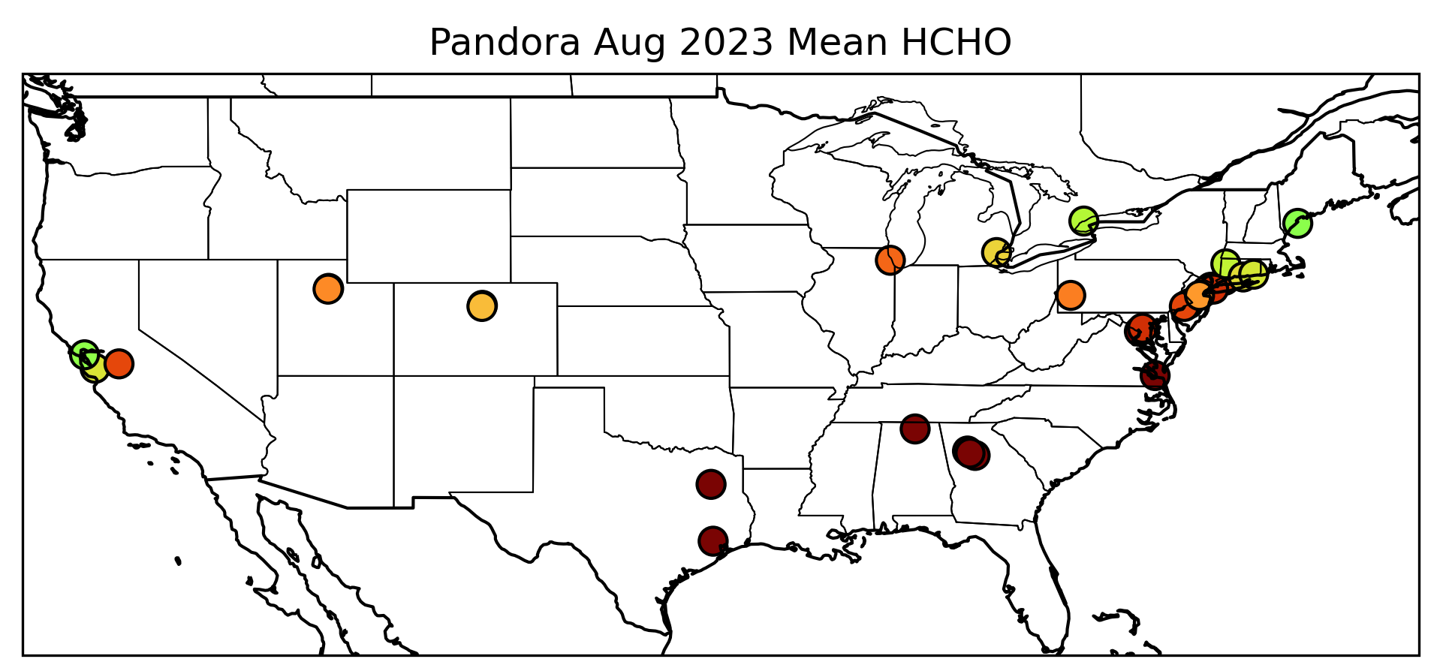
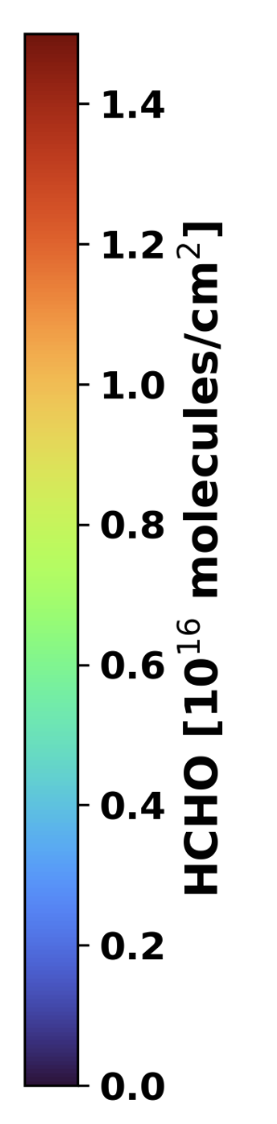
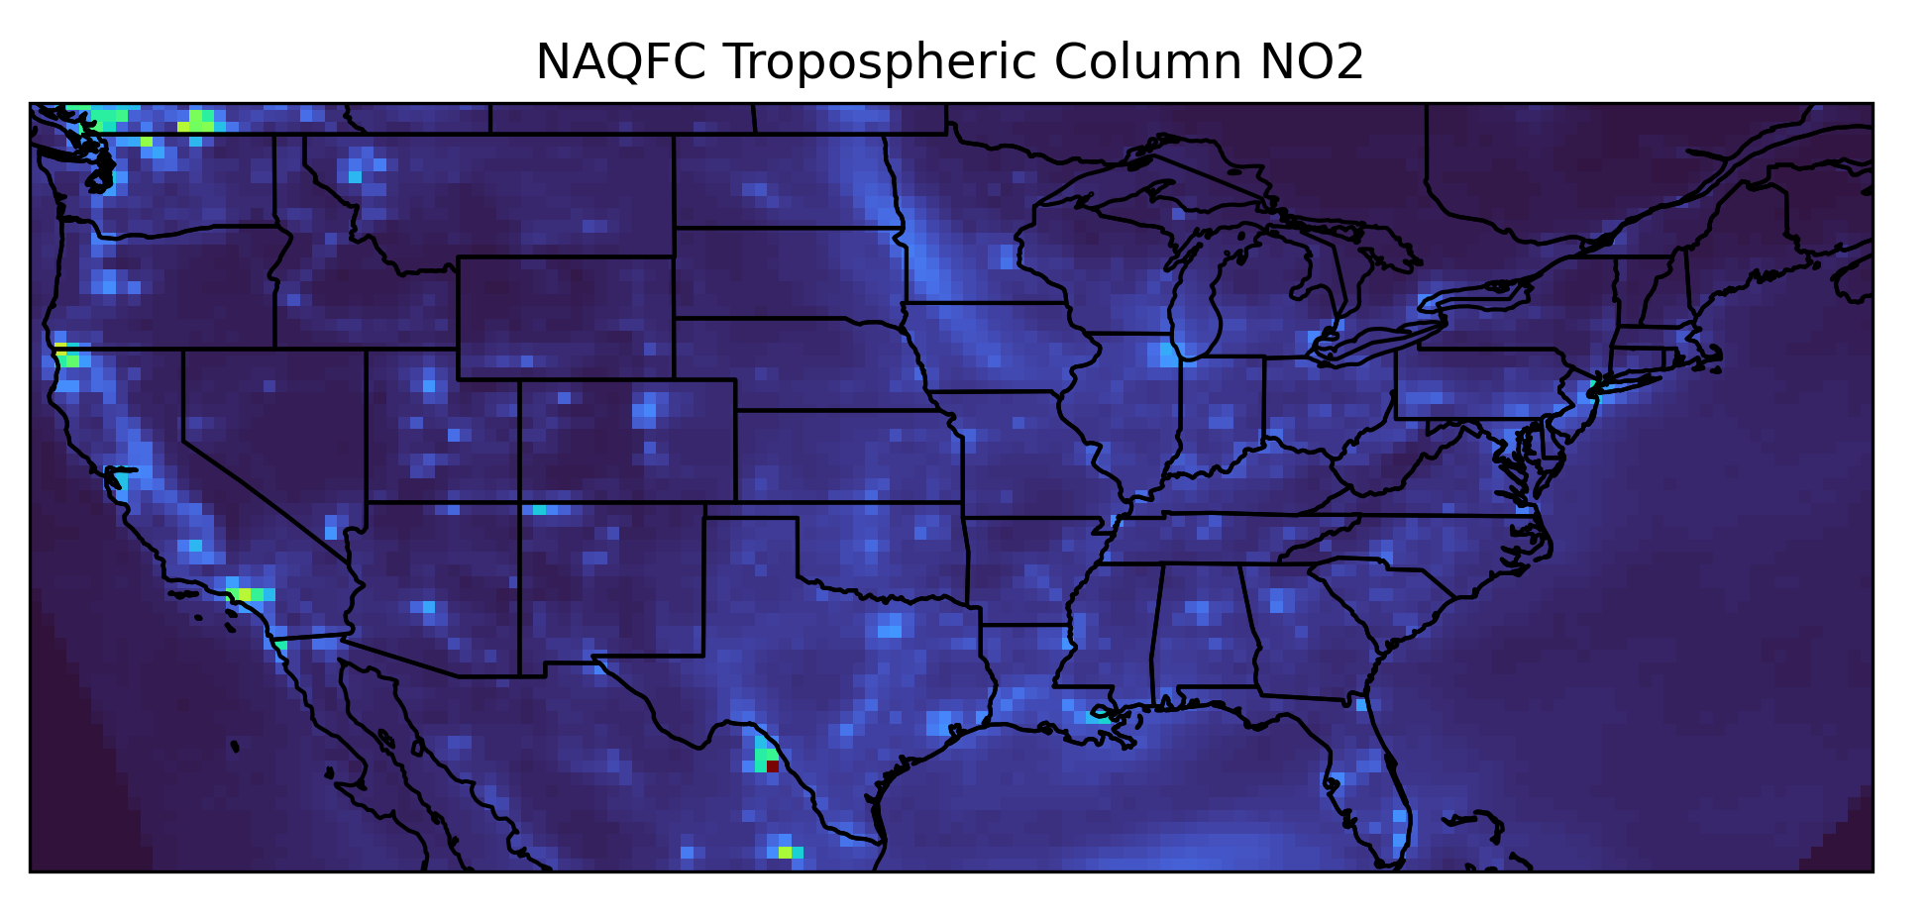
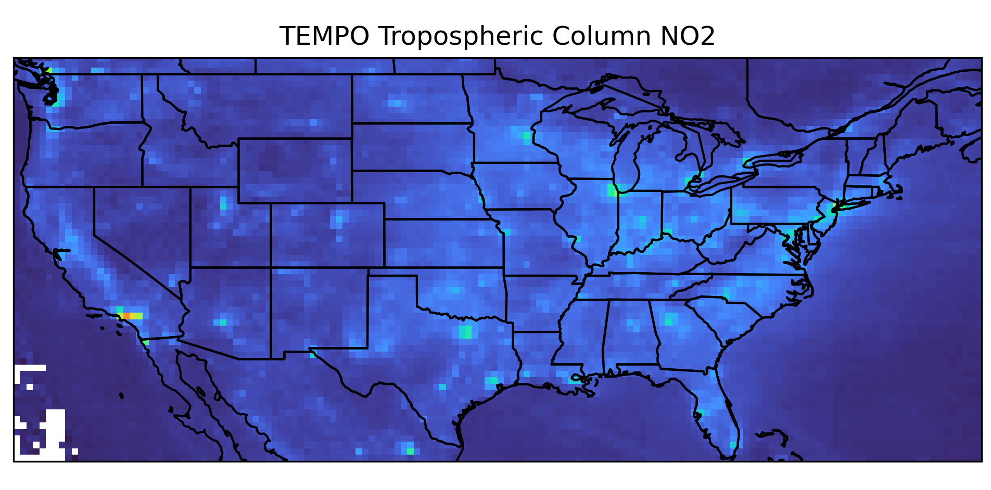
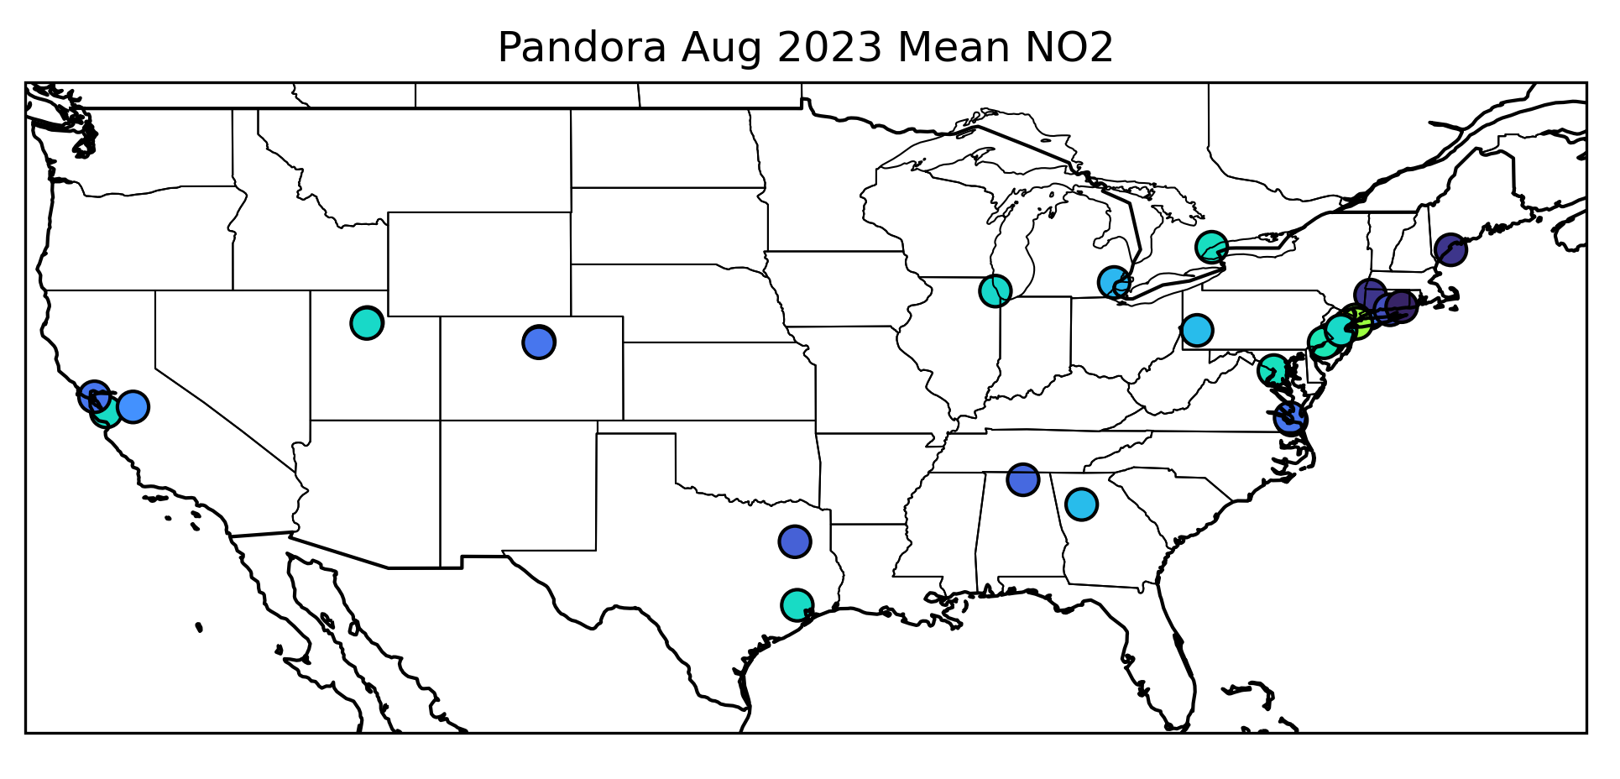
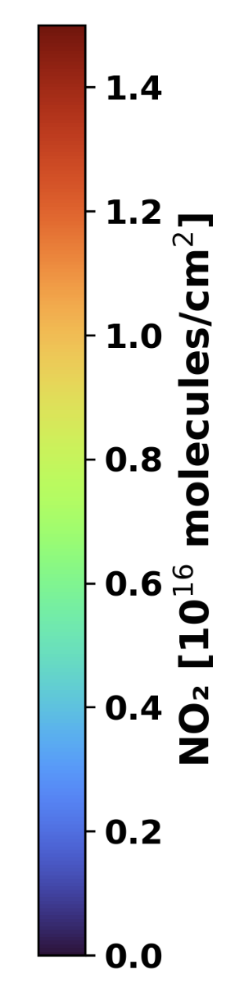
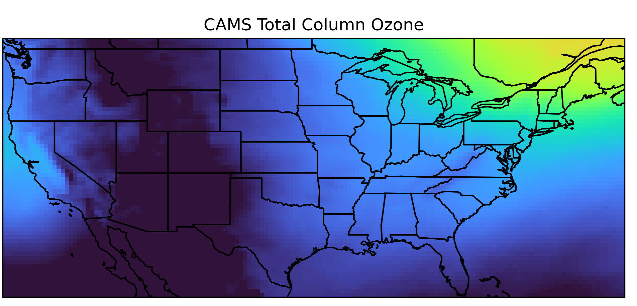
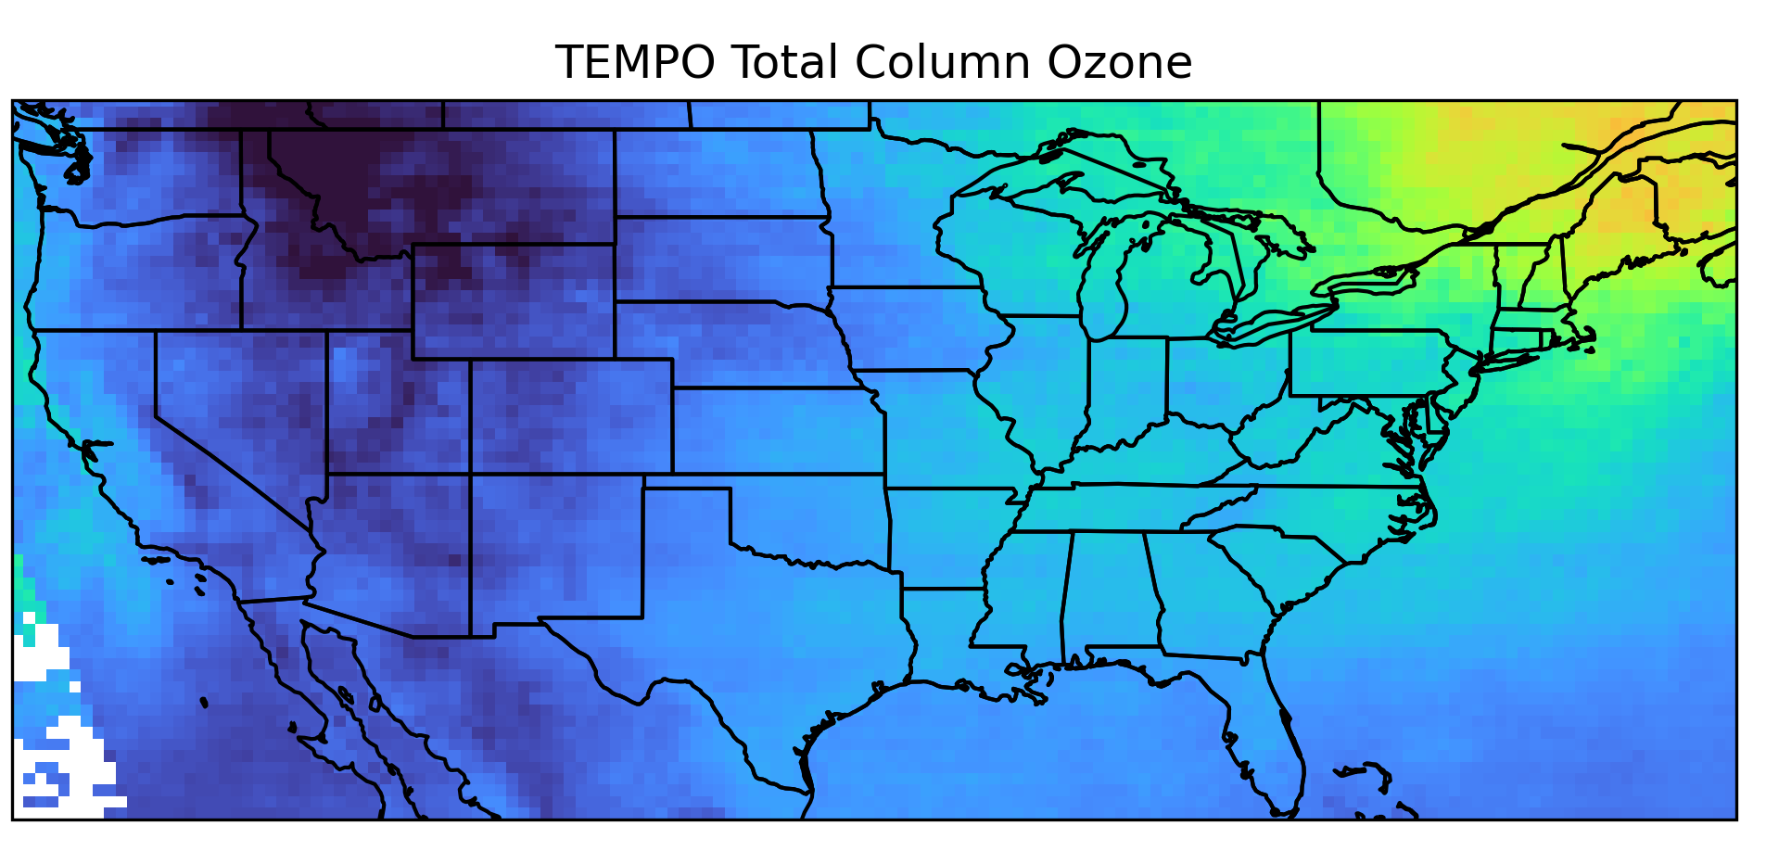
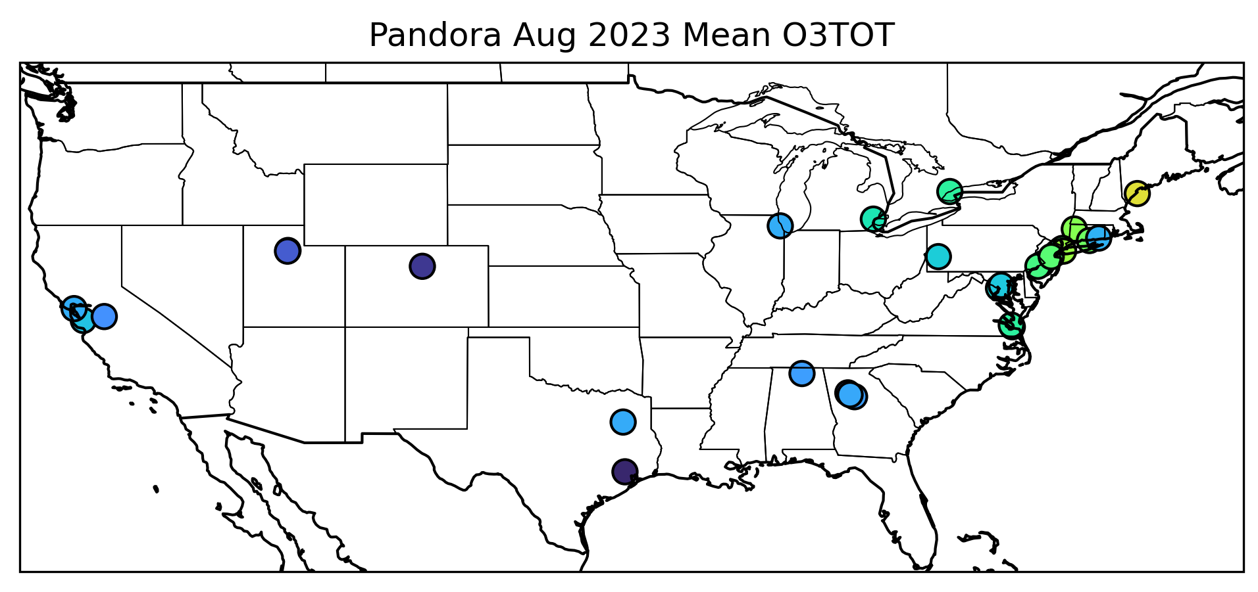
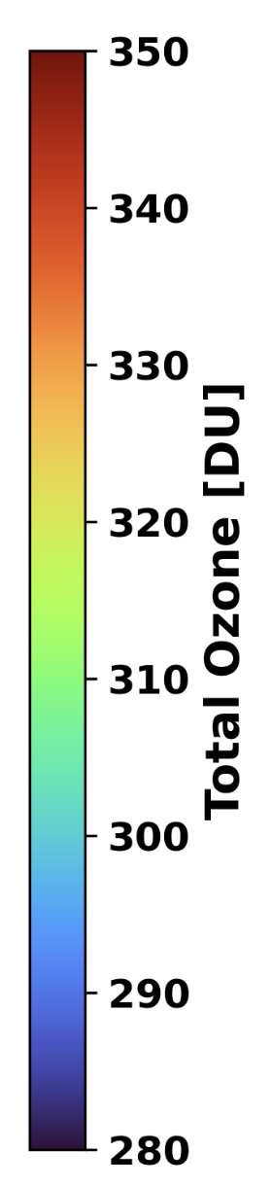
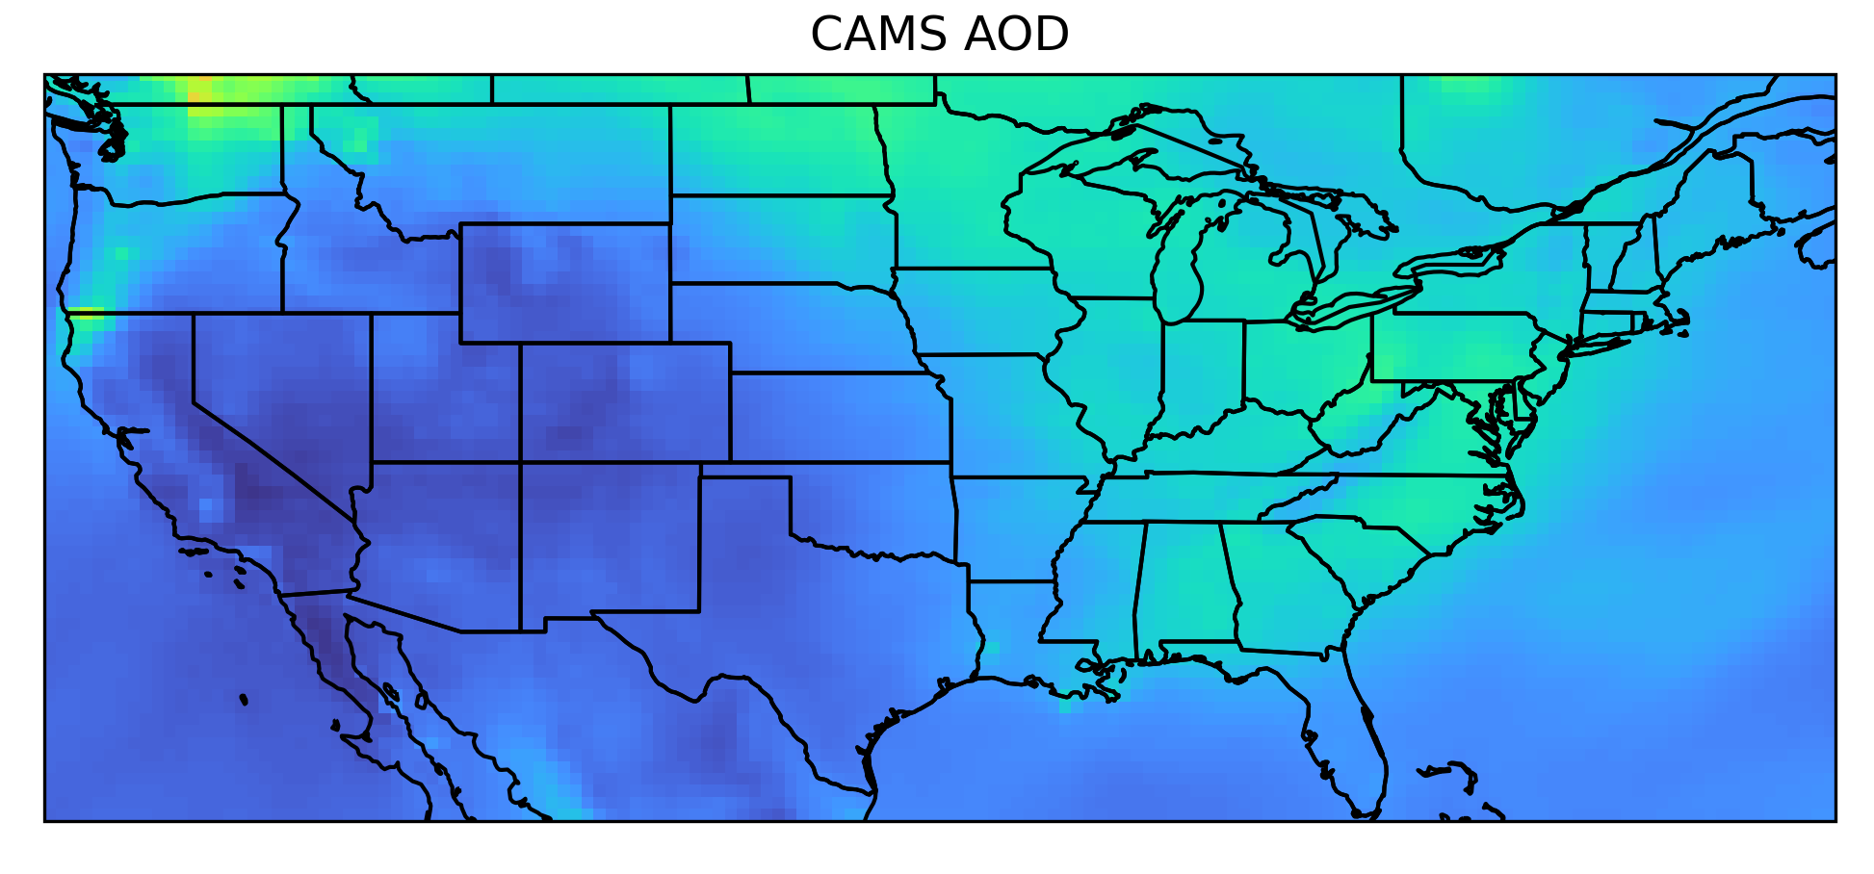
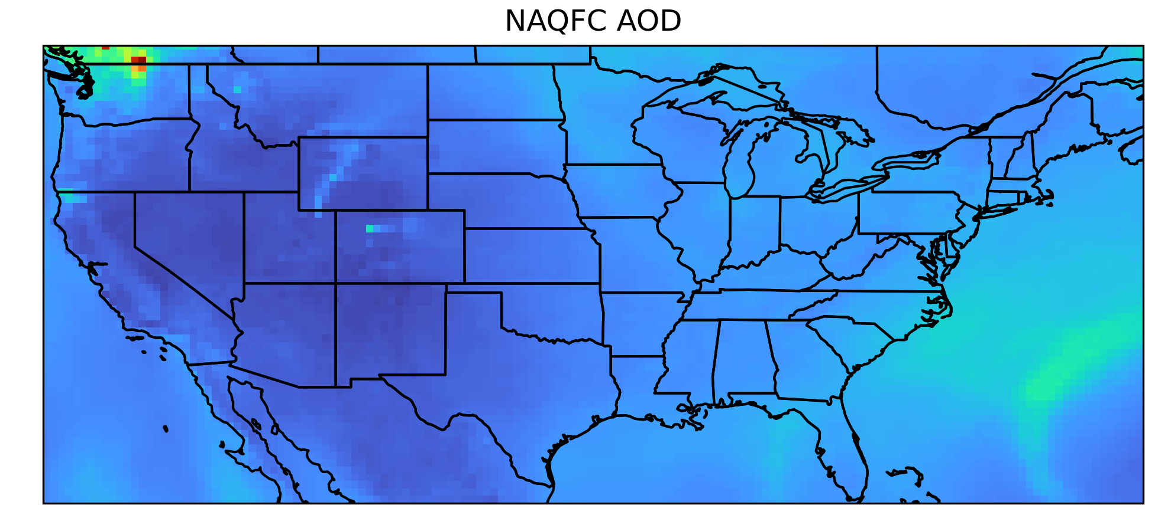
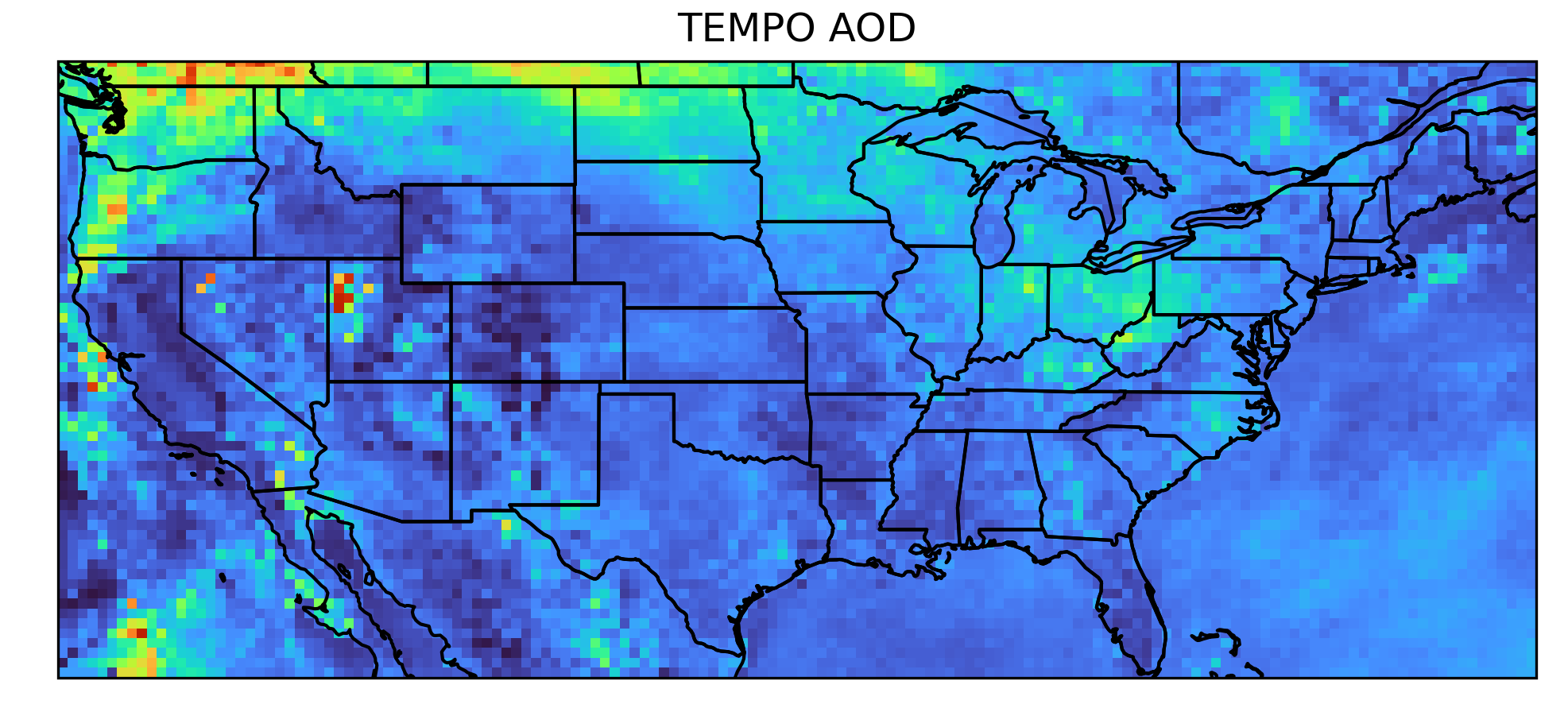
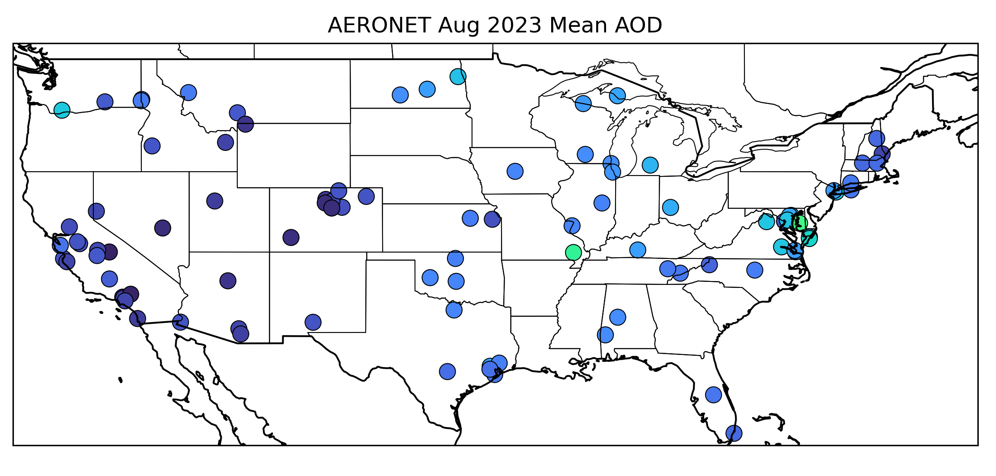
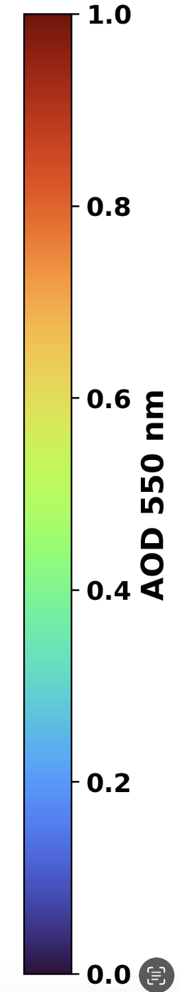
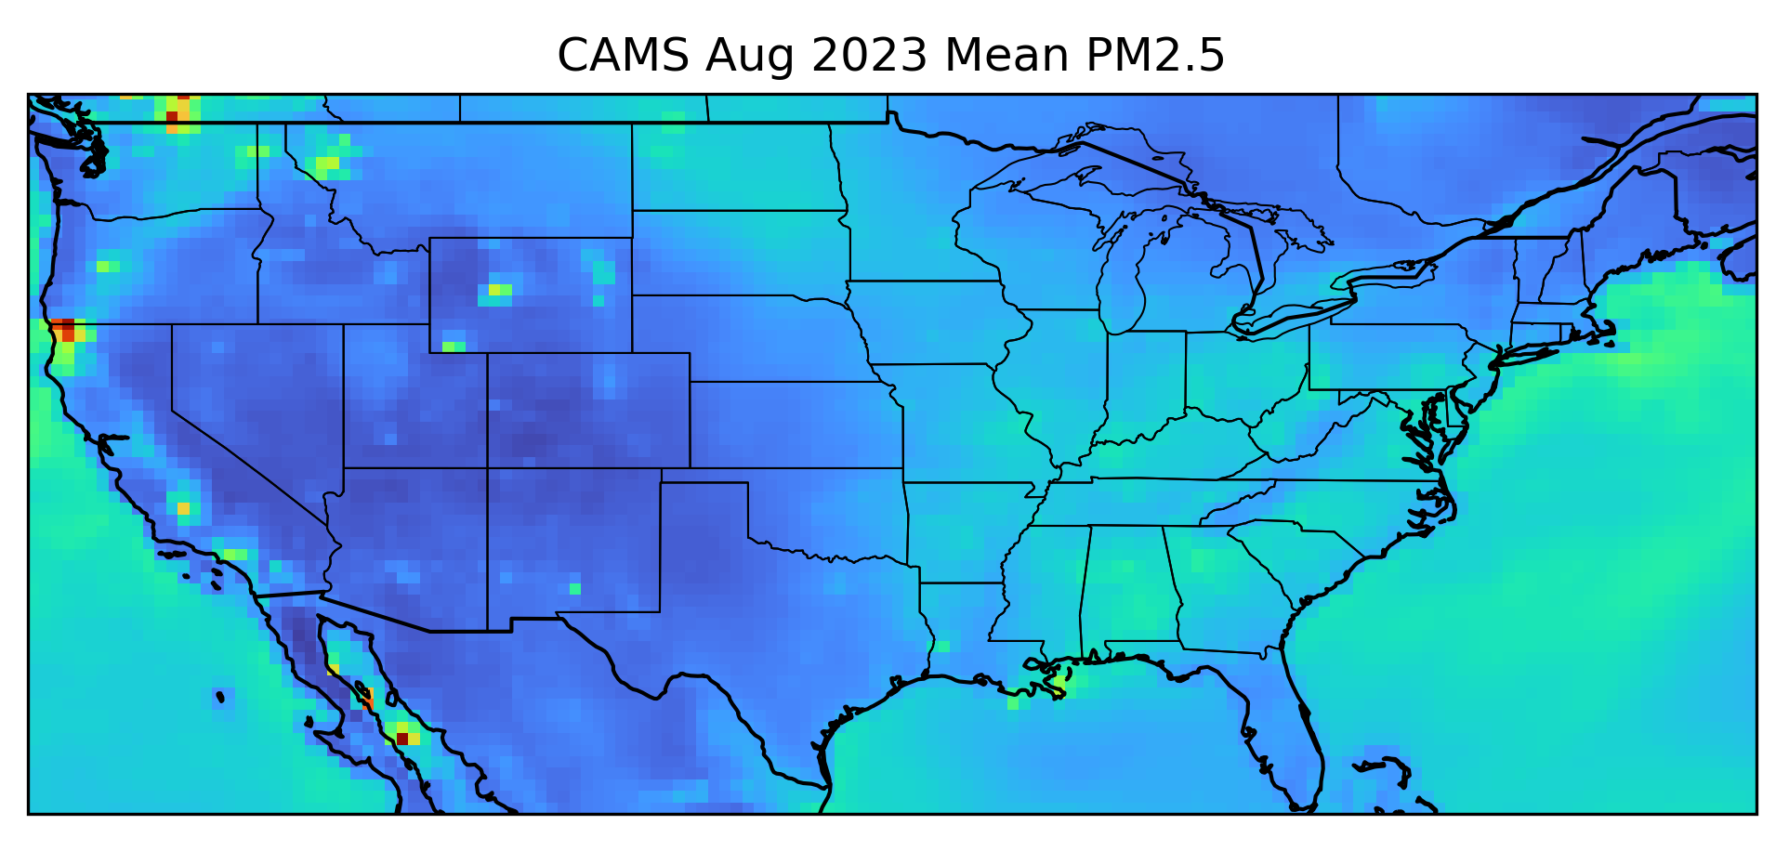
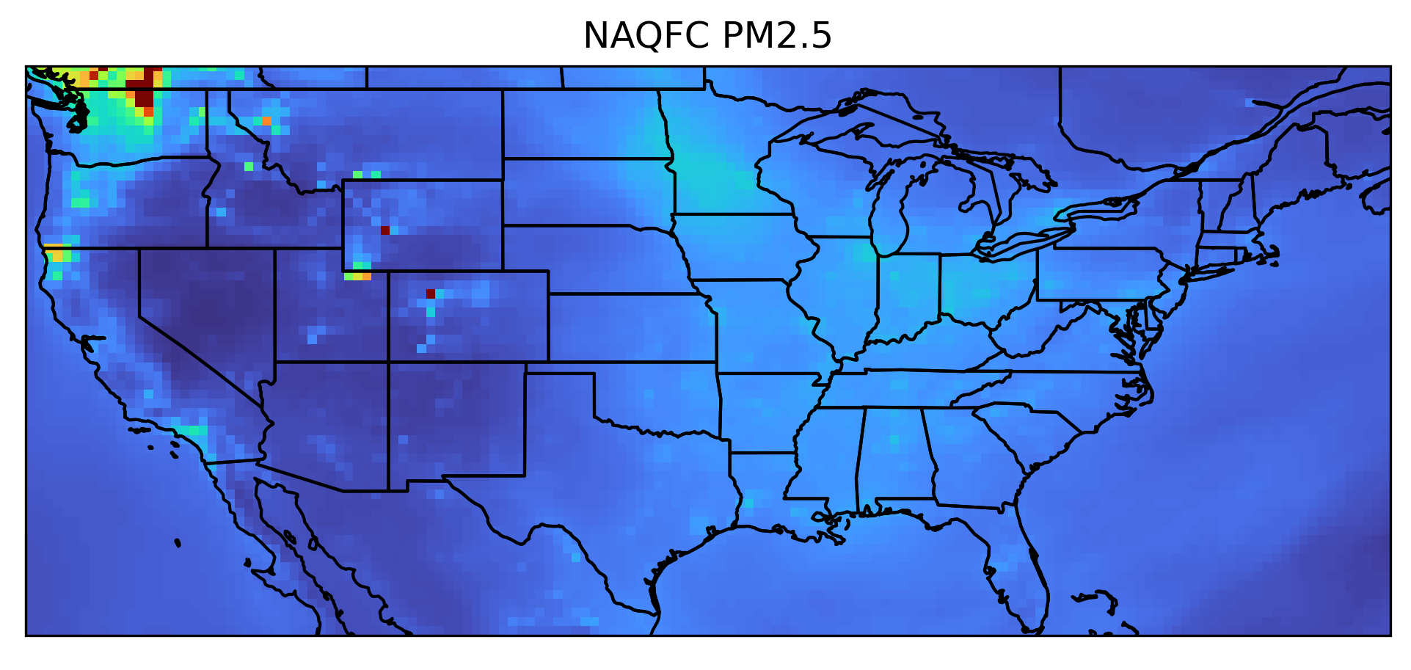



(Resampled to CAMS Resolution)
Monthly Average for August 2023
CAMS
NAQFC
TEMPO
Ground Meas
HCHO
NO2
Trop.
Trop.
O3T
AOD
PM2.5
Notes:
Cams no2 clound 0.3 & quality flag
AOD quality flag / sunglint, high sza vza /

Slide 9



(Resampled to CAMS Resolution)
Monthly Average for August 2023
CAMS
NAQFC
TEMPO
Ground Meas
HCHO
NO2
Tot.
Tot.
O3T
AOD
PM2.5

Slide 10

















Bias Relative to Pandora, AERONET, and AQS Observations – August 2023
CAMS
NAQFC
TEMPO
[10¹⁶ molecules/cm²]
HCHO | Corr | MB | RMSE
CAMS | 0.82 | -0.13 | 0.35
NAQFC | 0.76 | -0.17 | 0.43
TEMPO | 0.86 | 0.03 | 0.30
HCHO
[10¹⁶ molecules/cm²]
NO2_tot | Corr | MB | RMSE
CAMS | 0.72 | 0.24 | 0.30
TEMPO | 0.84 | -0.09 | 0.16
NO2_trop
NAQFC | 0.87 | -0.16 | 0.21
TEMPO | 0.87 | -0.01 | 0.12
NO2
Tot.
Tot.
[10¹⁶ molecules/cm²]
O3T
[DU]
O3T | Corr | MB | RMSE
CAMS | 0.88 | -4.40 | 6.29
TEMPO | 0.84 | -0.32 | 5.17
AOD
AOD | Corr | MB | RMSE
CAMS | 0.77 | 0.07 | 0.09
NAQFC | 0.72 | 0.03 | 0.06
TEMPO | 0.71 | 0.02 | 0.08
[µg/m3]
PM2.5
PM2.5 | Corr | MB | RMSE
CAMS | 0.41 | 2.45 | 4.58
NAQFC | 0.55 | -0.25 | 3.43
TEMPO | 0.84 | 1.61 | 2.71

Slide 11


Bias Relative to Pandora, AERONET, and AQS Observations – August 2023
CAMS
NAQFC
TEMPO
[10¹⁶ molecules/cm²]
HCHO | Corr | MB | RMSE
CAMS | 0.82 | -0.13 | 0.35
NAQFC | 0.76 | -0.17 | 0.43
TEMPO | 0.86 | 0.03 | 0.30
HCHO
[10¹⁶ molecules/cm²]
NO2_tot | Corr | MB | RMSE
CAMS | 0.72 | 0.24 | 0.30
TEMPO | 0.84 | -0.09 | 0.16
NO2_trop
NAQFC | 0.87 | -0.16 | 0.21
TEMPO | 0.87 | -0.01 | 0.12
NO2
Trpp.
Trpp.
[10¹⁶ molecules/cm²]
O3T
[DU]
O3T | Corr | MB | RMSE
CAMS | 0.88 | -4.40 | 6.29
TEMPO | 0.84 | -0.32 | 5.17
AOD
AOD | Corr | MB | RMSE
CAMS | 0.77 | 0.07 | 0.09
NAQFC | 0.72 | 0.03 | 0.06
TEMPO | 0.71 | 0.02 | 0.08
[µg/m3]
PM2.5
PM2.5 | Corr | MB | RMSE
CAMS | 0.41 | 2.45 | 4.58
NAQFC | 0.55 | -0.25 | 3.43
TEMPO | 0.84 | 1.61 | 2.71

Slide 12
j
Summary
    The atmospheric composition validation networks and procedure have been developed
    For NO₂ and HCHO, TEMPO shows high correlations and low biases, so they can serve as reliable references for models.
    For AOD, performance is similar to the models, but we expect further improvements once cloud screening is refined
    TEMPO shows strong agreement with ground-based observations, offering reliable validation for models today and key insights for future missions like GeoXO-AC
CENTER FOR EARTH SYSTEM SCIENCES & REMOTE SENSING TECHNOLOGIES (CESSRST-II)
Notes:
most of the outliers are due to cloud contamination and hotspots over bright surfaces . Higher TOA reflectance is associated with positive bias
.

Slide 13
Thank you
Questions
CENTER FOR EARTH SYSTEM SCIENCES & REMOTE SENSING TECHNOLOGIES (CESSRST-II)

Slide 14
















j
Application of Conceptual Framework
Weekday-Weekend NO₂ Variation
Monthly Validation of O₃ Total Column
CENTER FOR EARTH SYSTEM SCIENCES & REMOTE SENSING TECHNOLOGIES (CESSRST-II)

