Slide 1
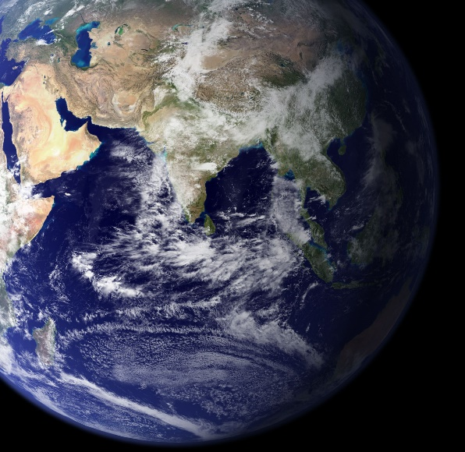




Validation of TEMPO V4* tropospheric ozone profiles using TOLNet
Matthew Johnson
Earth Science Division
NASA Ames Research Center
2025 TEMPO/GeoXO ACX Joint Science Team Workshop
Center for Astrophysics | Harvard & Smithsonian, Cambridge, MA
August 20, 2025
*Beta version of the TEMPO V4 ozone profile product

Slide 2
Acknowledgments
Coauthors: Junsung Park¹, Xiong Liu¹, John Sullivan², Michael Newchurch³, Claudia Bernier⁴, Laura Judd⁵, Angelique Demetillo⁵, and the TOLNet Science Team
¹Smithsonian Astrophysical Observatory (SAO)
²NASA GSFC
³University of Alabama in Huntsville
⁴NASA Postdoctoral Program, NASA ARC
⁵NASA LaRC
Funding: TOLNet Science Team through the Tropospheric Composition Program
Computation: NASA high-end computing (HEC) program through the NASA Advanced Supercomputing (NAS) Division at NASA ARC

Slide 3
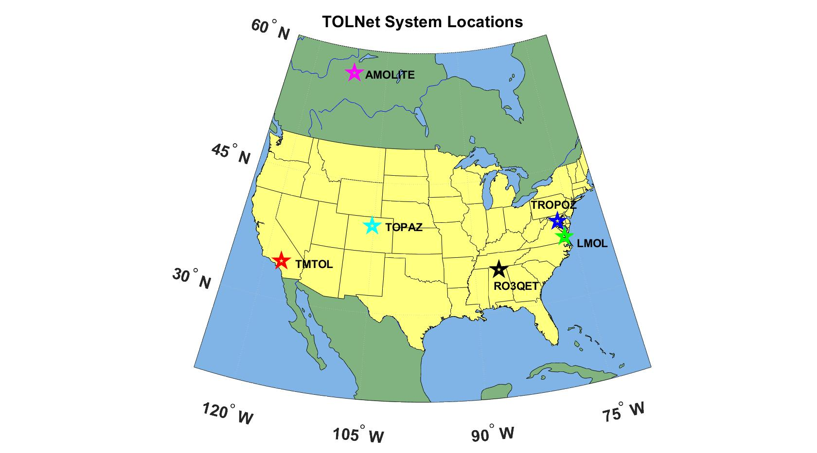
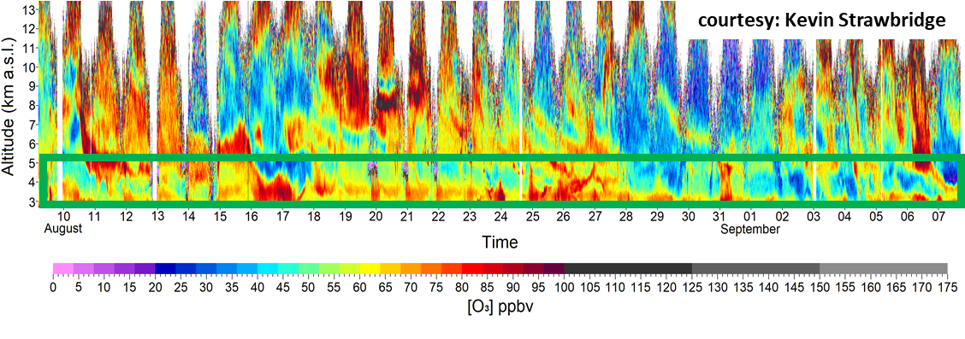
Tropospheric Ozone Lidar Network (TOLNet)
Established in 2011 and consists of 12+ lidar systems in North America.
Main goals are to provide data for:
Understanding physiochemical processes controlling tropospheric O₃ concentrations and morphology.
Evaluation of satellite profile products retrieving tropospheric O₃ (e.g., TROPOMI, CrIS, and TEMPO).
Chemical transport and air quality model evaluation.
TOLNet includes a daily automated air quality forecast system using five separate models.
AMOLITE
CCNY
HAMPTON U.
Ozone lidar data is highly accurate and consistent between systems (Leblanc et al., 2018).
Multiple SMOL lidars have recently been developed and deployed for air quality campaigns.
TOLNet frequently used for evaluating air quality models and satellite retrievals.
Leblanc et al. (2018)

Slide 4
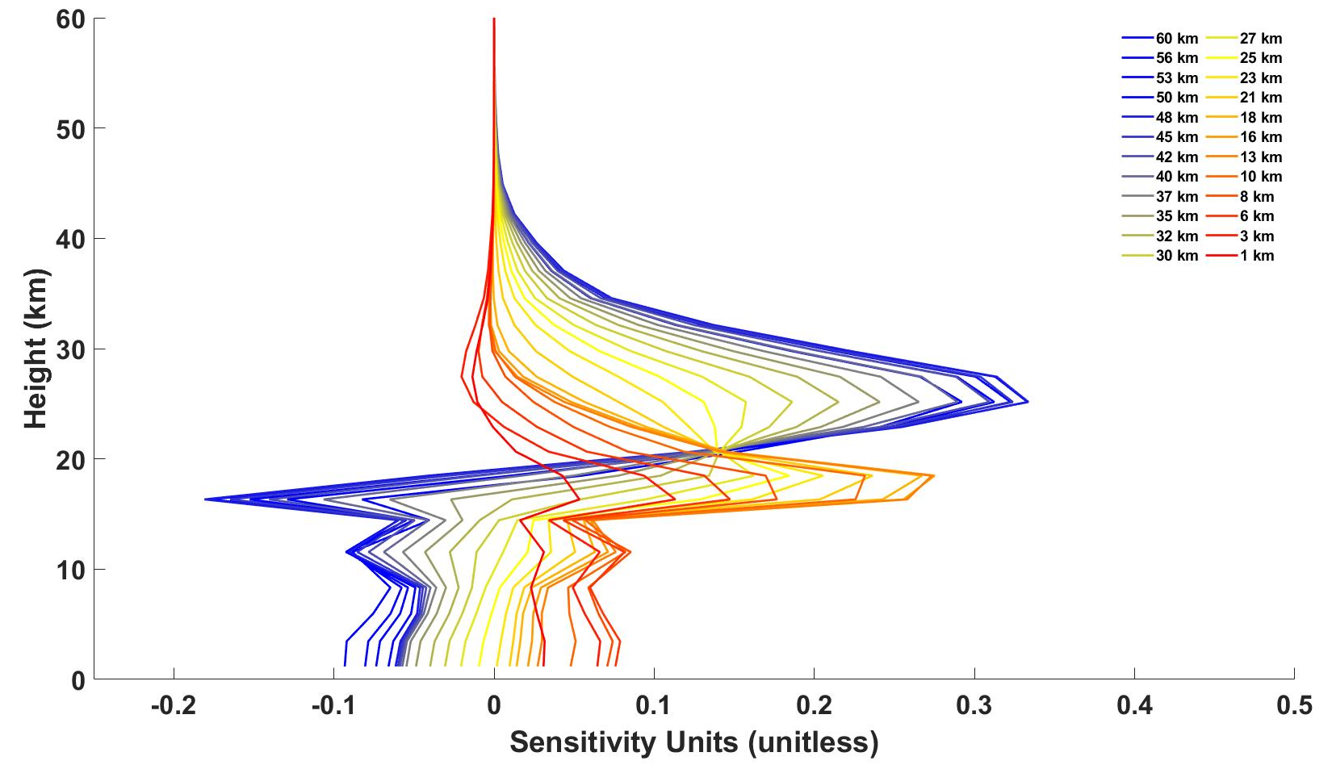
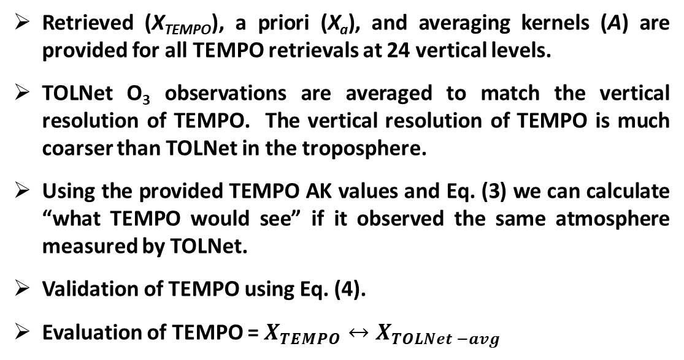
TEMPO V4* O₃ Profile Validation with TOLNet
We apply val/eval methods :
$X_{TEMPO}=X_{a}+A\left[X_{true} −X_{a}\right]+ ε$ (1)
$X_{TOLNet −avg}=X_{TOLNet−raw}$ (2)
$X_{TOLNet −AK}=X_{a}+A\left[X_{TOLNet −avg} −X_{a} \right]$ (3)
$X_{TEMPO}↔X_{TOLNet −AK}$ (4)
Retrieved (X_{TEMPO}), a priori (X_{a}), and averaging kernels (A) are provided for all TEMPO retrievals at 24 vertical levels.
TOLNet O₃ observations are averaged to match the vertical resolution of TEMPO. The vertical resolution of TEMPO is much coarser than TOLNet in the troposphere.
Using the provided TEMPO AK values and Eq. (3) we can calculate “what TEMPO would see” if it observed the same atmosphere measured by TOLNet.
Validation of TEMPO using Eq. (4).
Evaluation of TEMPO = $X_{TEMPO}↔X_{TOLNet −avg}$
Example TEMPO ozone AK at Kenosha, WI on August 4, 2023 at 21 UTC.
Extended TOLNet lidar profiles above the level of observation well into the stratosphere using ozonesondes launched in proximity to lidar sites.
TEMPO data filter for high quality retrievals: cloud fraction < 0.3, solar zenith angle < 70°, and rms fit < 3.
Colocation criteria: 5 km and 30 minutes.

Slide 5
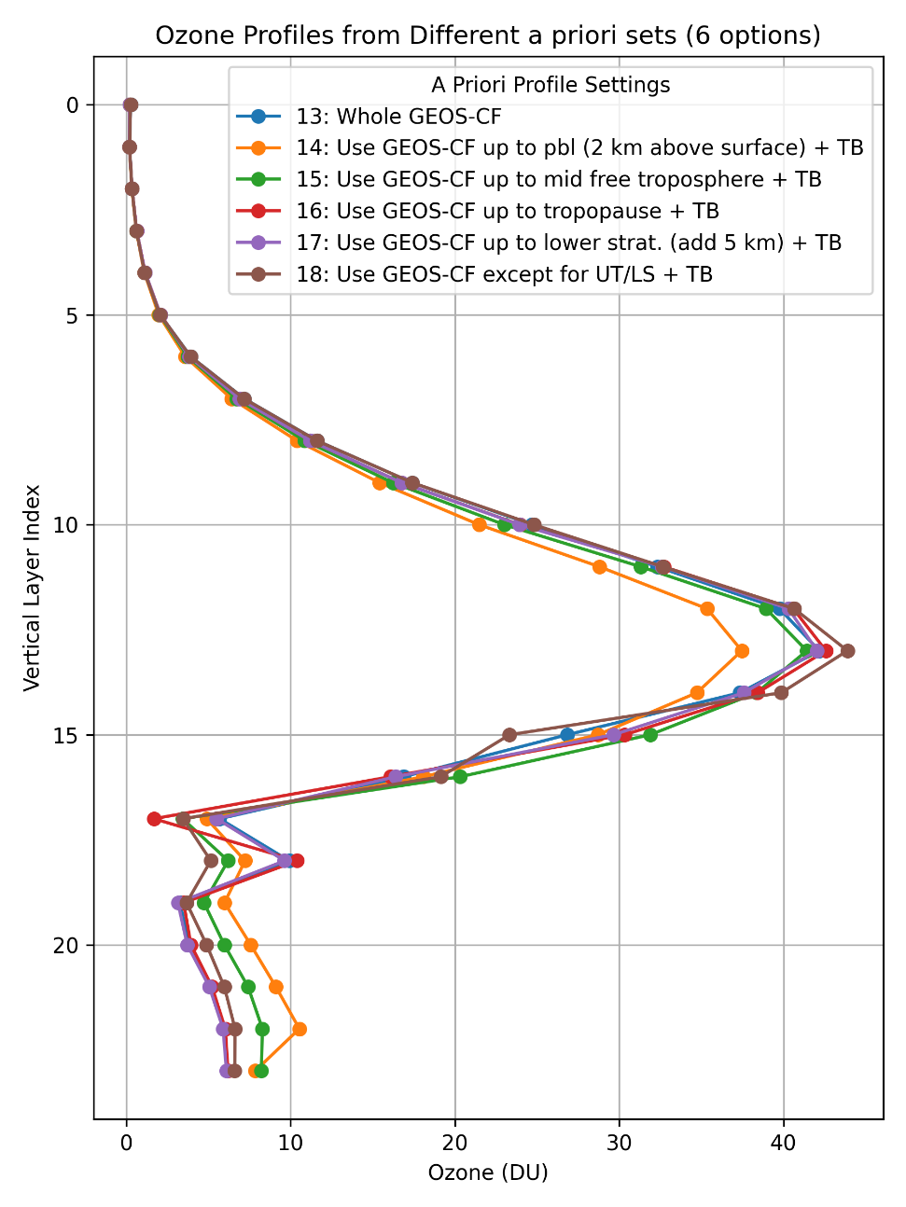
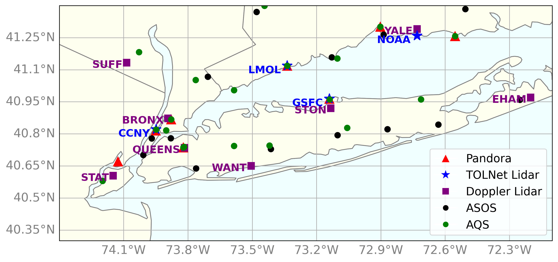
TEMPO V4* O₃ evaluation: Different a priori profiles
Initial validation of TEMPO V3 retrievals displayed large biases and excess variability: Don’t worry V4* is much improved!
Here we validate TEMPO V4* O₃ profiles retrievals (UV-only) using various a priori profile sources (Aug. 2-15, 2023).
TOLNet stations from AGES+; focusing on the Chicago (Kenosha, WI) and NYC regions of this campaign.
Large focus on the NYC portion of AGES+ where multiple TOLNet lidars were taking observations.

Slide 6
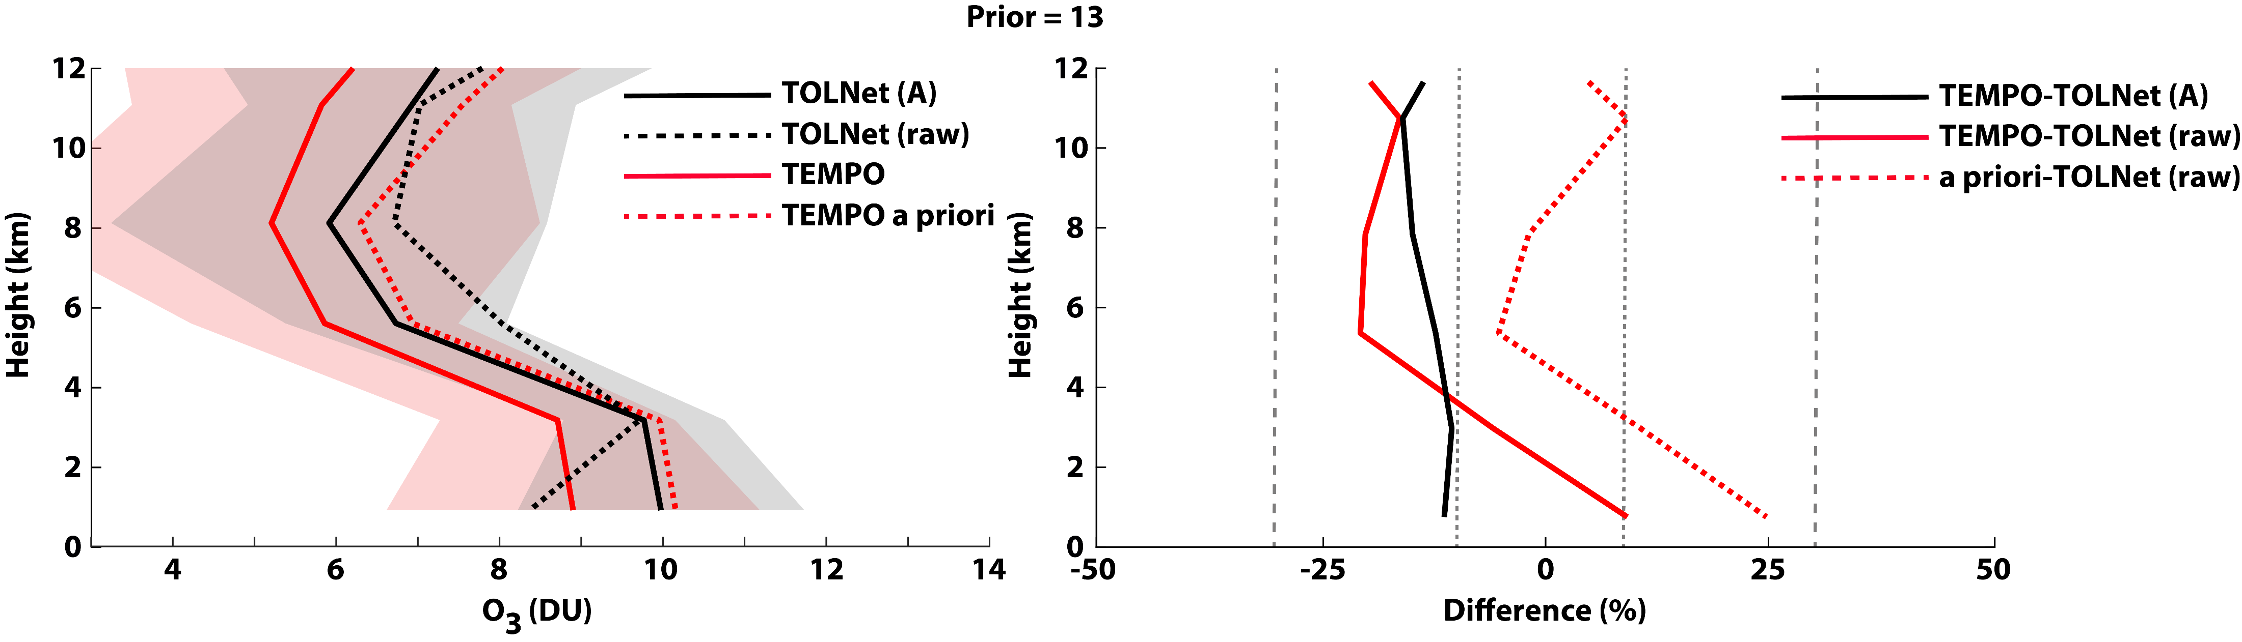
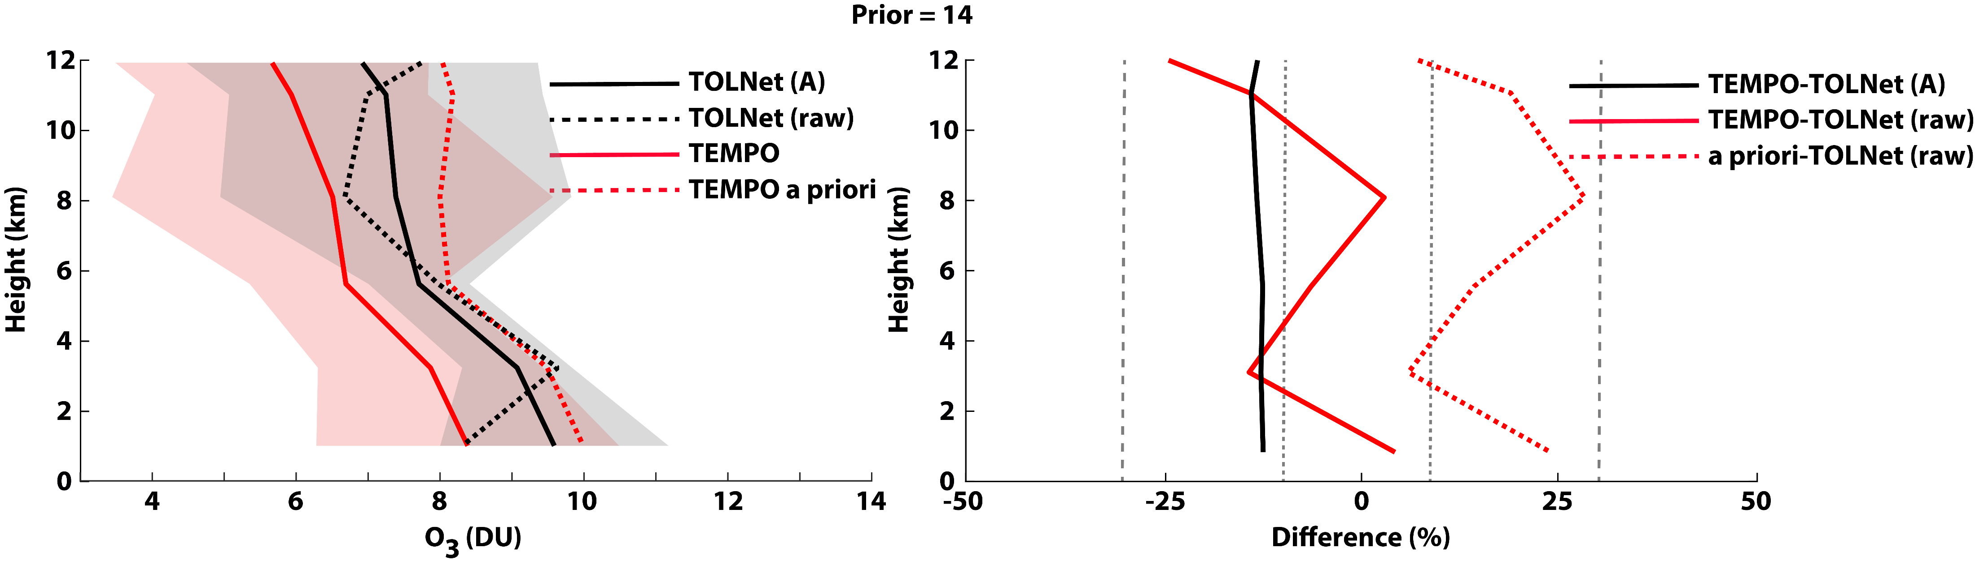
TEMPO V4* O₃ evaluation: AGES+
N = 862
TOLNet-AK:
TEMPO Bias (DU) = -0.95
TEMPO Bias (NMB%) = -12.5
TEMPO R² = 0.67
TOLNet-Raw
TEMPO Bias (DU) = -1.05
TEMPO Bias (NMB%) = -10.3
TEMPO R² = 0.20
Prior Bias (DU) = 0.19
Prior Bias (NMB%) = 7.8
Prior R² = 0.18
TOLNet-AK:
TEMPO Bias (DU) = -1.12
TEMPO Bias (NMB%) = -13.2
TEMPO R² = 0.54
TOLNet-Raw
TEMPO Bias (DU) = -0.84
TEMPO Bias (NMB%) = -5.8
TEMPO R² = 0.15
Prior Bias (DU) = 0.84
Prior Bias (NMB%) = 18.4
Prior R² = 0.12

Slide 7
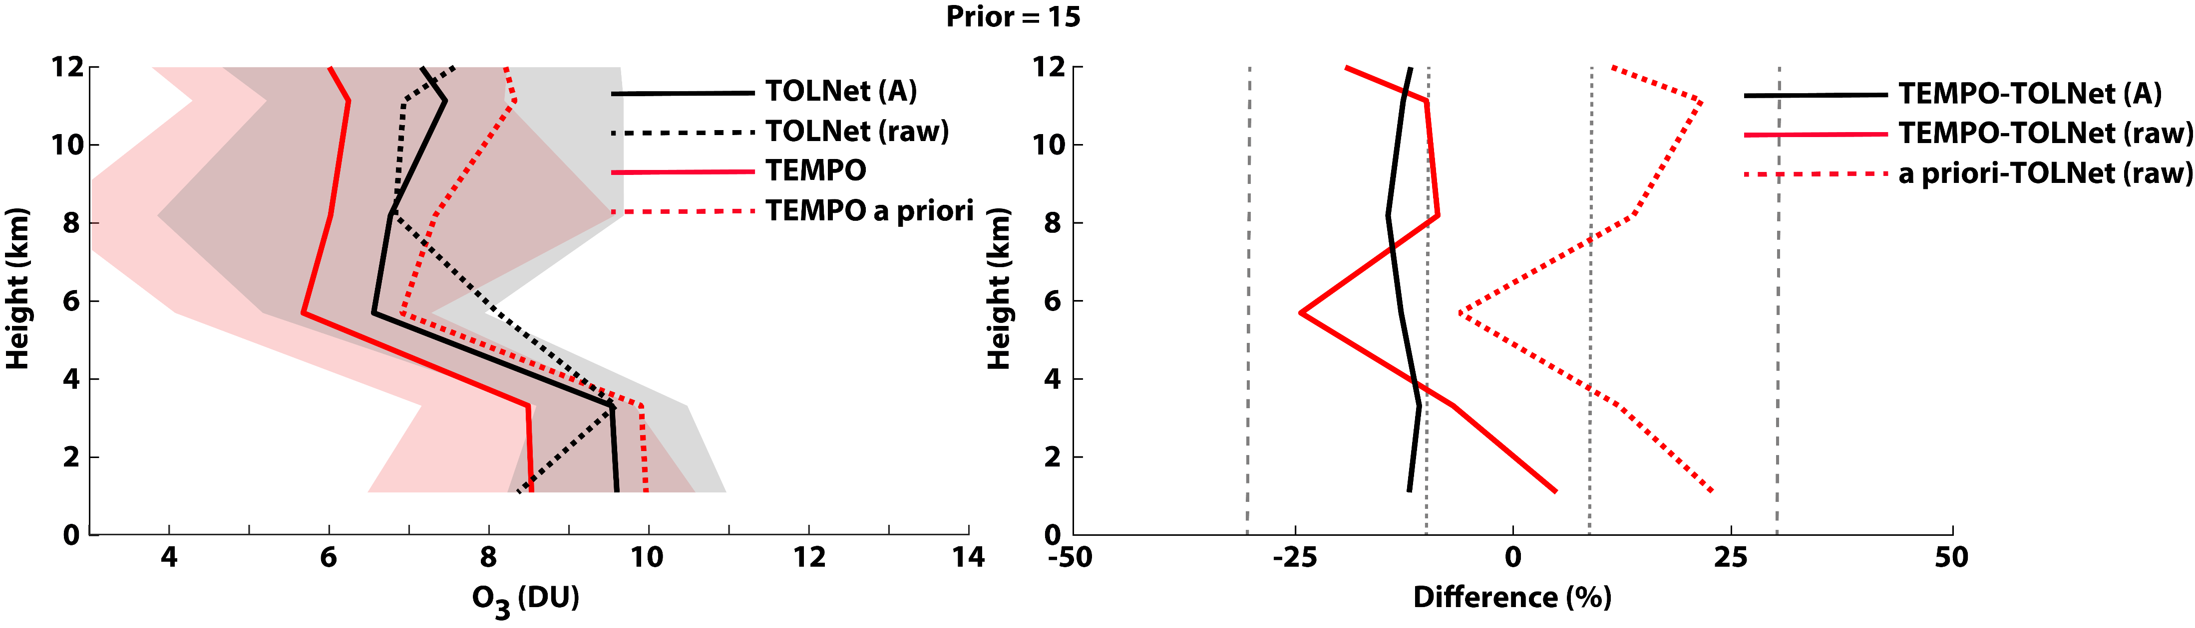
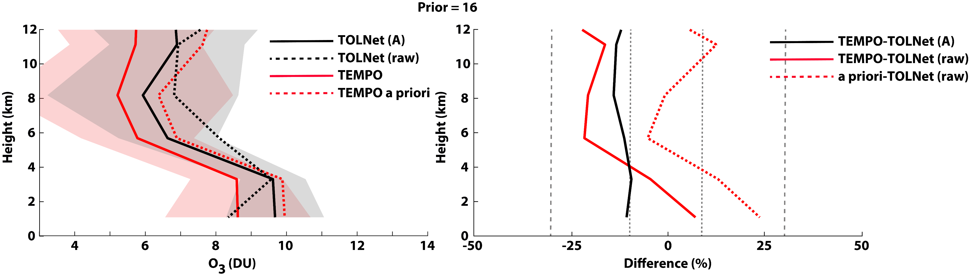
TEMPO V4* O₃ evaluation: AGES+
N = 862
TOLNet-AK:
TEMPO Bias (DU) = -0.99
TEMPO Bias (NMB%) = -11.8
TEMPO R² = 0.63
TOLNet-Raw
TEMPO Bias (DU) = -0.97
TEMPO Bias (NMB%) = -8.3
TEMPO R² = 0.17
Prior Bias (DU) = 0.52
Prior Bias (NMB%) = 13.3
Prior R² = 0.12
TOLNet-AK:
TEMPO Bias (DU) = -0.97
TEMPO Bias (NMB%) = -12.1
TEMPO R² = 0.65
TOLNet-Raw
TEMPO Bias (DU) = -1.17
TEMPO Bias (NMB%) = -11.5
TEMPO R² = 0.21
Prior Bias (DU) = 0.20
Prior Bias (NMB%) = 8.2
Prior R² = 0.17

Slide 8
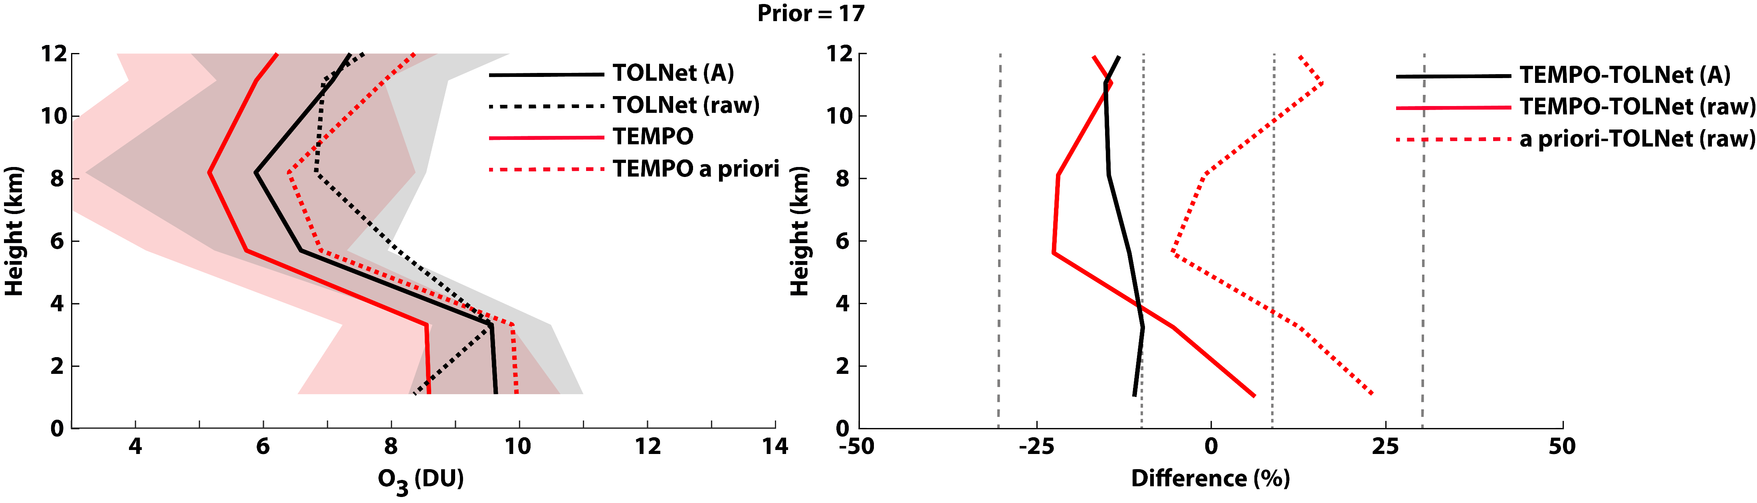
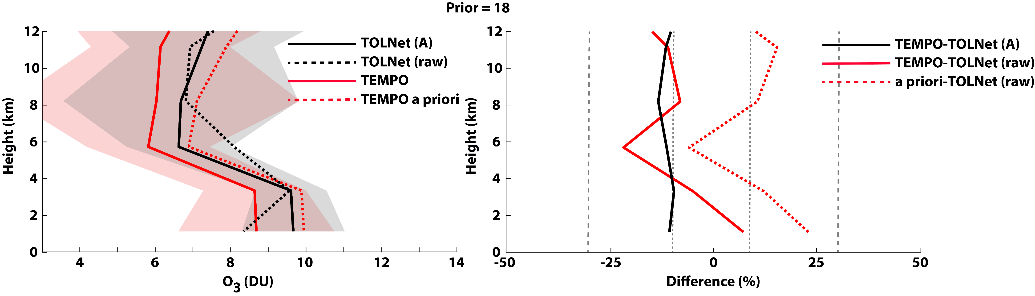
TEMPO V4* O₃ evaluation: AGES+
N = 862
TOLNet-AK:
TEMPO Bias (DU) = -0.97
TEMPO Bias (NMB%) = -12.4
TEMPO R² = 0.64
TOLNet-Raw
TEMPO Bias (DU) = -1.18
TEMPO Bias (NMB%) = -11.6
TEMPO R² = 0.20
Prior Bias (DU) = 0.25
Prior Bias (NMB%) = 9.0
Prior R² = 0.17
TOLNet-AK:
TEMPO Bias (DU) = -0.89
TEMPO Bias (NMB%) = -10.9
TEMPO R² = 0.63
TOLNet-Raw
TEMPO Bias (DU) = -0.89
TEMPO Bias (NMB%) = -7.3
TEMPO R² = 0.17
Prior Bias (DU) = 0.39
Prior Bias (NMB%) = 11.4
Prior R² = 0.14

Slide 9
TEMPO V4* tropospheric O₃ profile evaluation: Different a priori profiles
GEOS-CF v1 (#13) only prior profiles compared best to raw TOLNet observations (least bias and RMSE, highest correlation) in the troposphere.
Validation using TEMPO AK convolved TOLNet observations suggest retrievals using a prior #18 (GEOS-CF except for above UTLS where TB climatology is used) performs best (least bias and RMSE).
Overall, validation statistics of TEMPO V4* with various a priori profiles are similar:
  Tropospheric O₃ retrievals display systematic low bias (NMB ~10-12%).
  Capture the profile shape of O₃ in the troposphere; primarily due to good performance of the GEOS-CF a priori profile shape.
Next steps not yet conducted in this preliminary analysis:
  Evaluate TEMPO retrievals which use GEOS-CF v2 a priori profiles.
    Focus more on performance at separate locations for more years and seasons.
    Investigate TEMPO O₃ profile performance more thoroughly in the stratosphere.
    Reproduce this same analysis with official (not beta) TEMPO V4 O₃ profile product.
    Continue to help identify avenues of retrieval improvement for future versions.

Slide 10
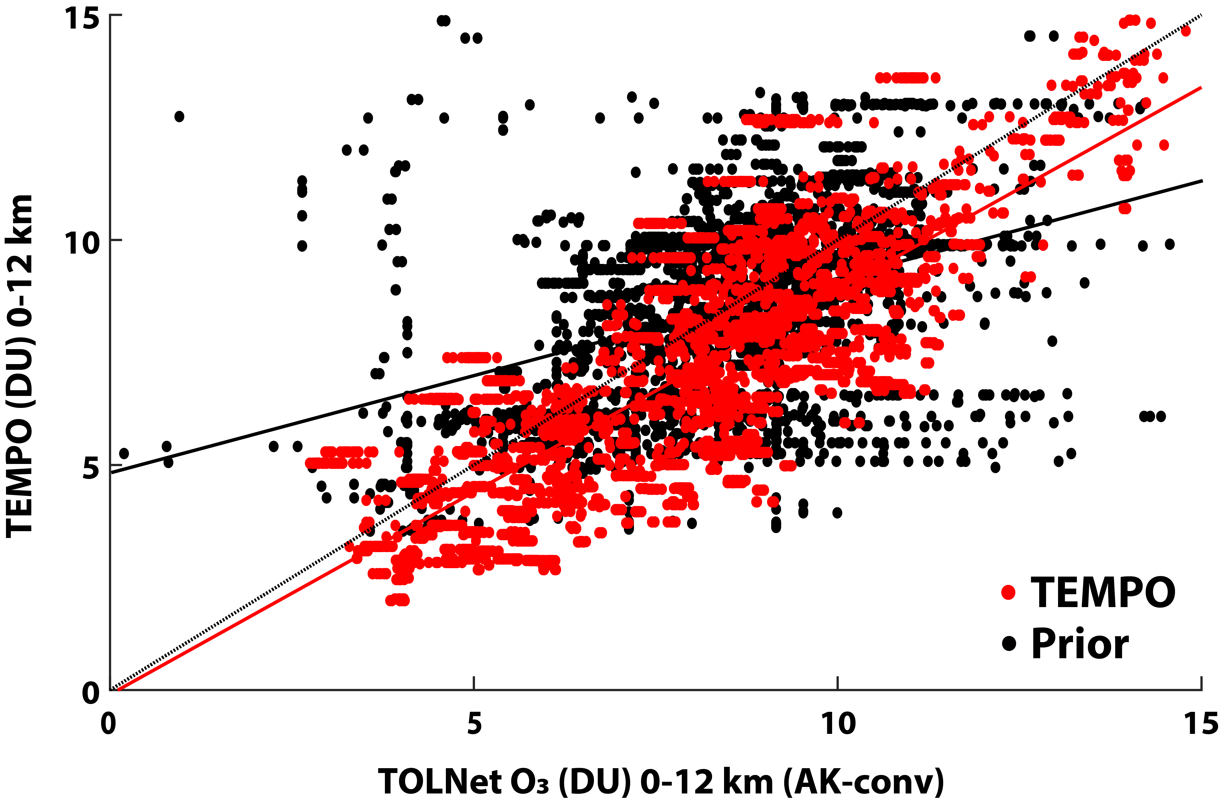
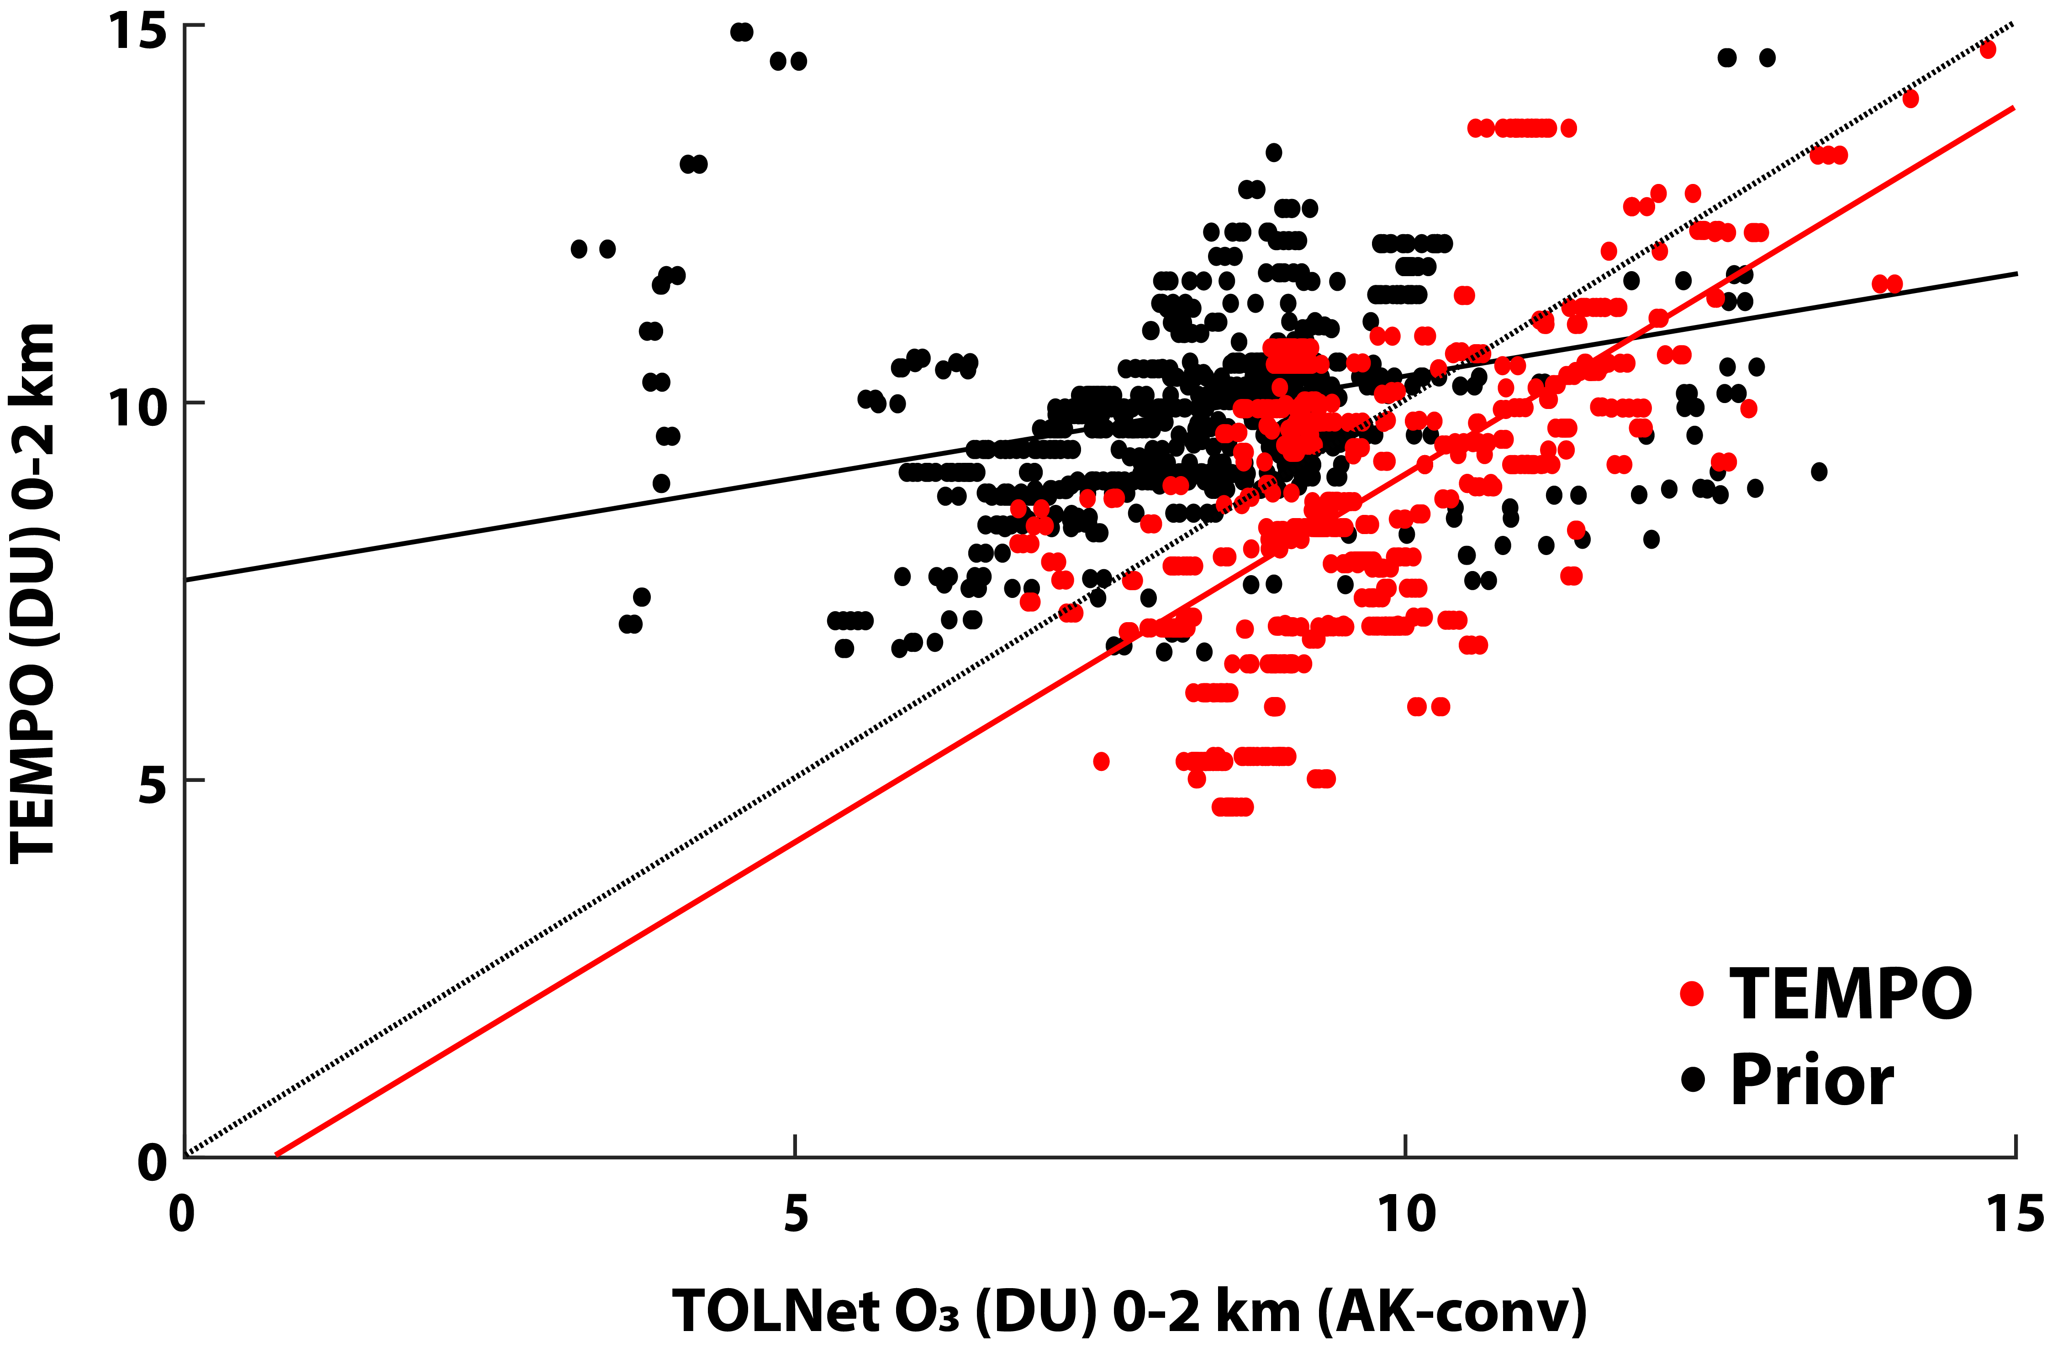
TEMPO V4* tropospheric (0-12 km) and PBL (0-2 km) O₃ validation
N = 862
N = 192
TEMPO 0-12 km retrievals: mean bias = -0.9±1.8 DU; NMB% = -11%; R² = 0.63; Slope = 0.90; y-int = -0.1 DU.
TEMPO 0-2 km retrievals: mean bias -1.0±1.3 DU; NMB% = -10%; R² = 0.77; Slope = 0.97; y-int = -0.7 DU.
TEMPO O₃ profiles have systematic low bias at all levels of the troposphere (ranging -10% to -15%).

Slide 11

TEMPO V4* tropospheric (0-12 km) and PBL (0-2 km) O₃ evaluation
N = 862
TEMPO 0-12 km retrievals: mean bias -0.9 DU; NMB% = -7%; R² = 0.17; Slope = 0.56; y-int = 2.5 DU.
TEMPO 0-2 km retrievals: mean bias = 0.3 DU; NMB% = 7%; R² = 0.06; Slope = 0.33; y-int = 5.9 DU.
  Compared to raw observations, TEMPO PBL O₃ displays small high bias.
TEMPO PBL O₃ has low correlation likely due to limited lower tropospheric sensitivity (average deviation from prior only ~20%). Hopefully could be improved when the UV+VIS wavelengths are used in future products.

Slide 12
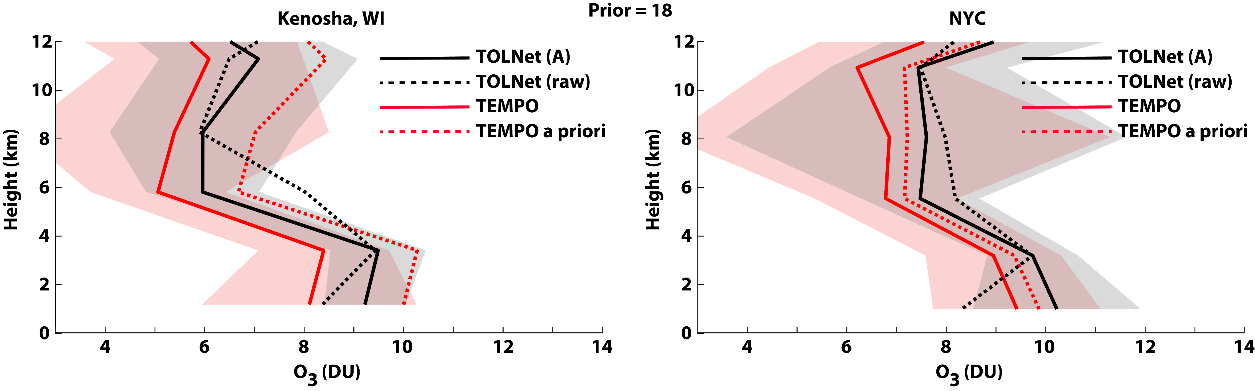
TEMPO V4* O₃ retrieval comparison: Chicago v. NYC
TEMPO retrievals have similar bias throughout the troposphere in both regions.
Better performance in the PBL-region in NYC where the a priori better replicates observation magnitudes.
Main difference is in the PBL when compared to raw TOLNet observations: TEMPO is slightly lower near Chicago (NMB = -5%) and has a high bias in the NYC area (NMB = 21%).

Slide 13

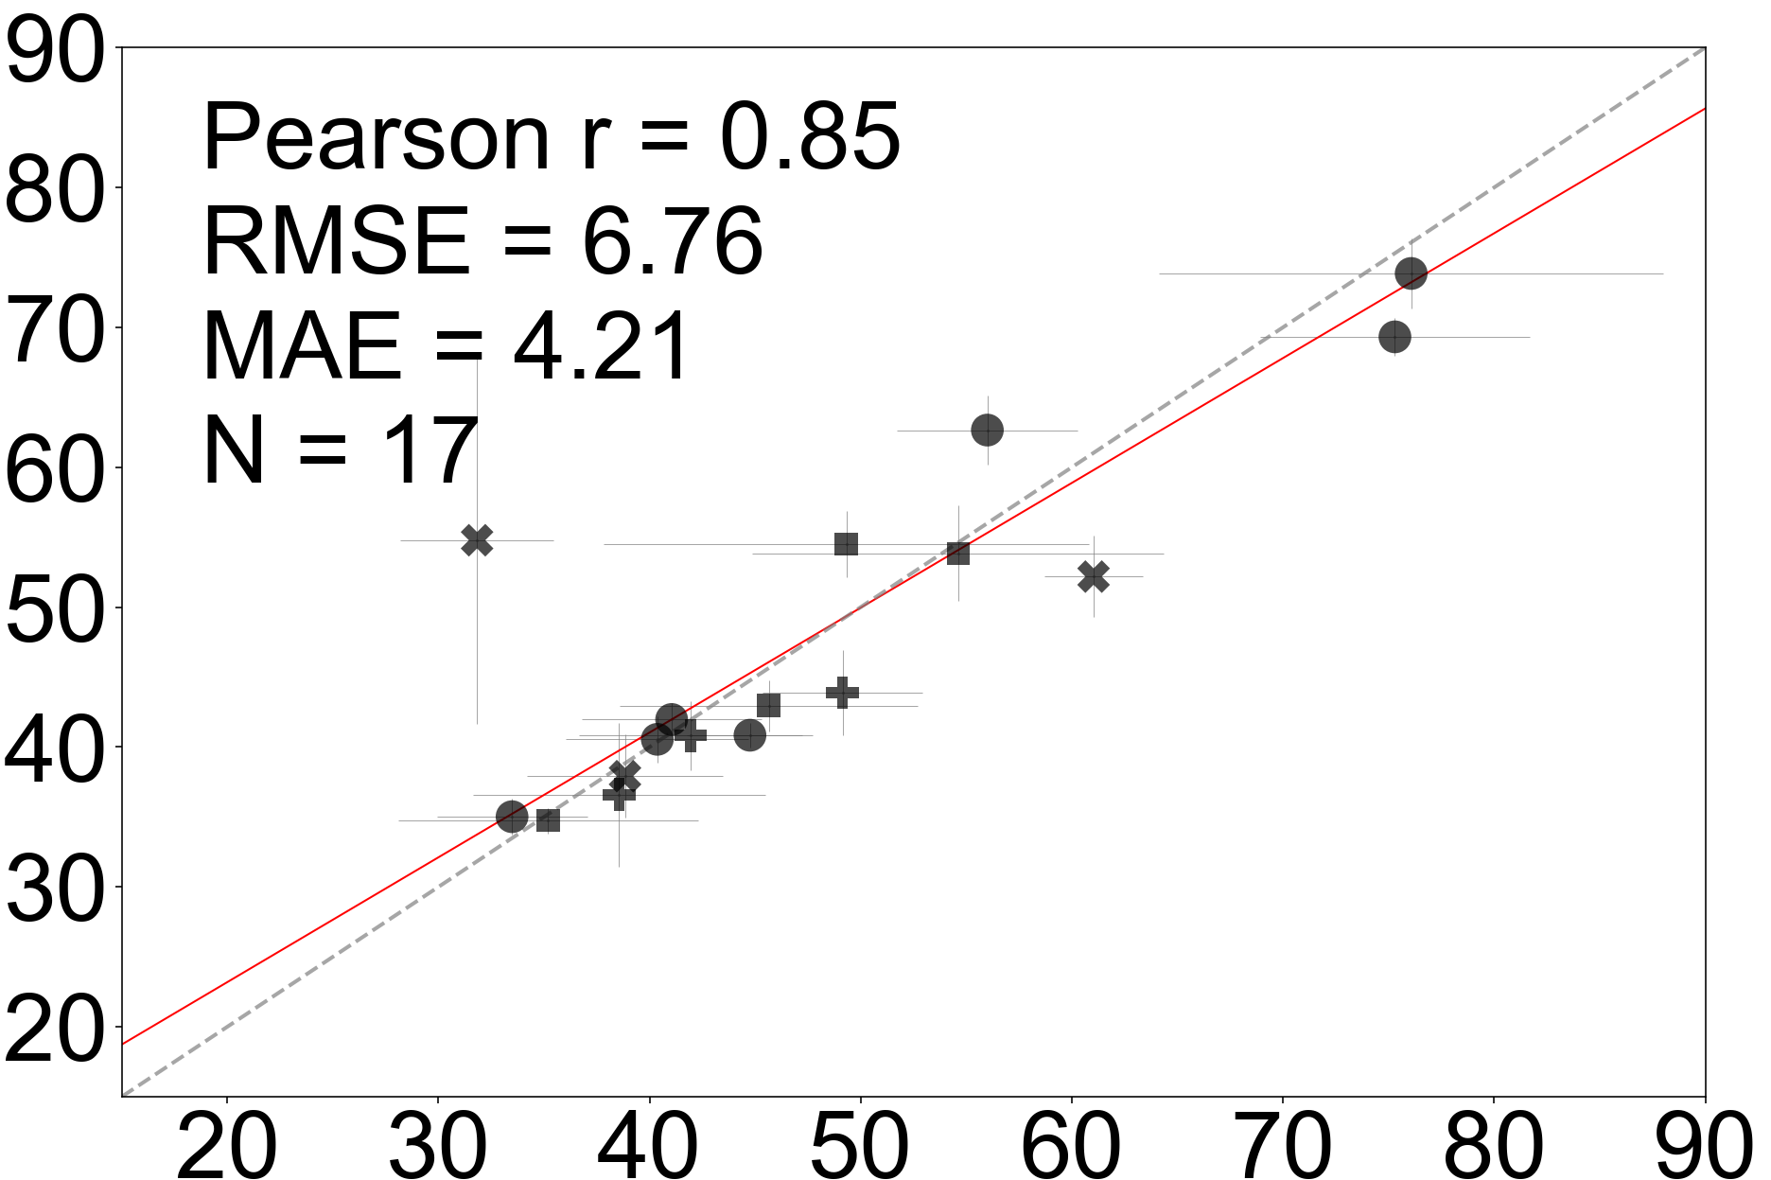
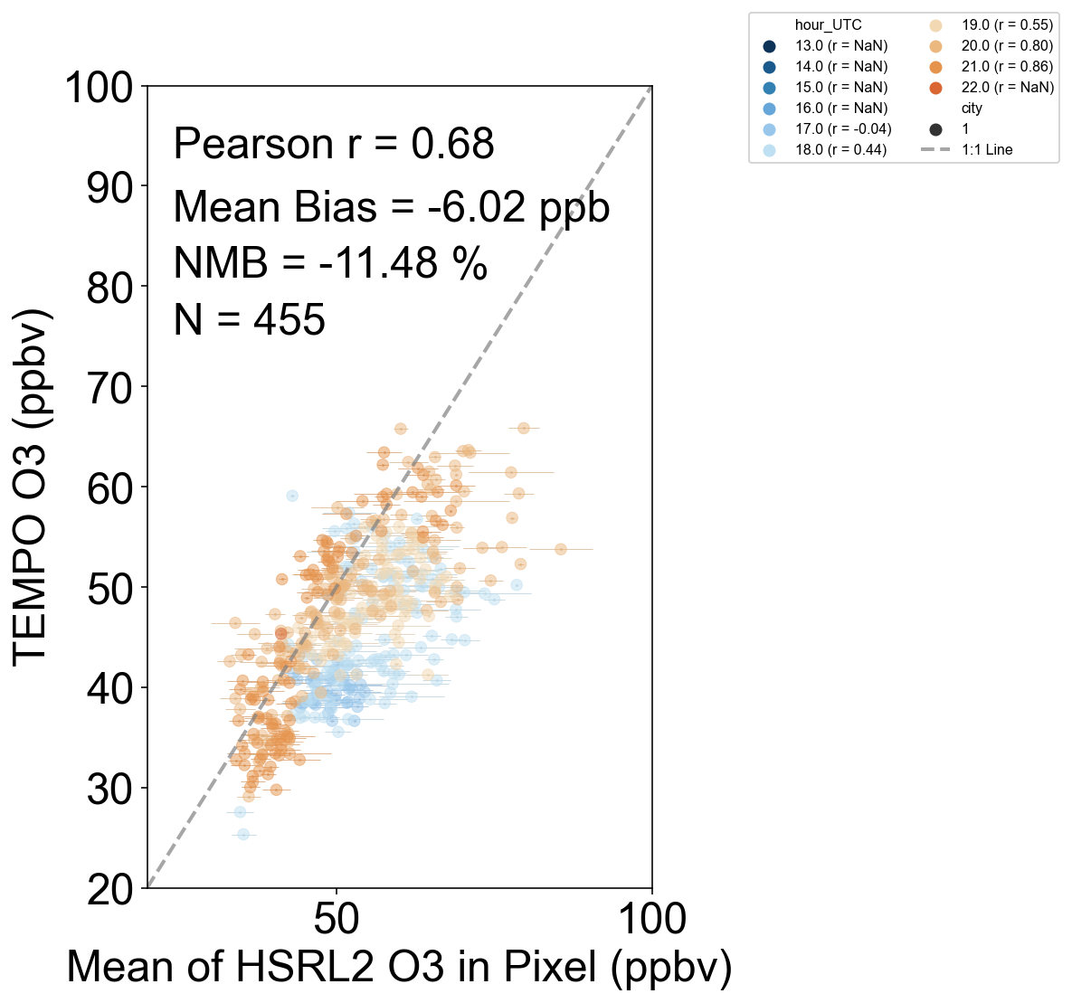
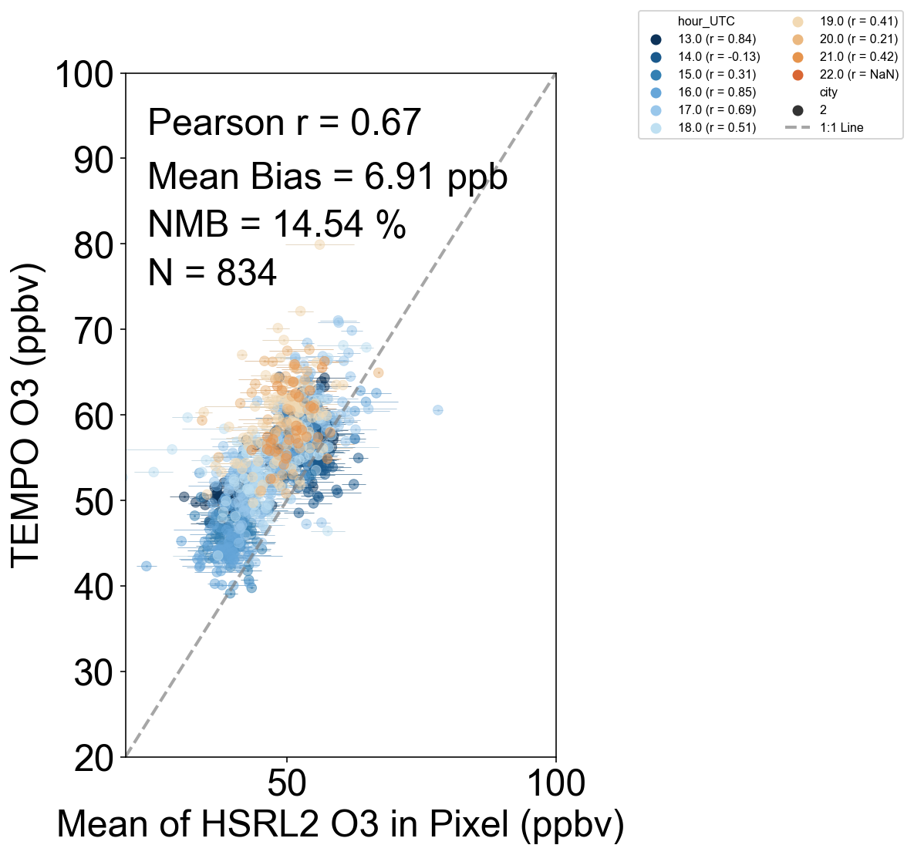
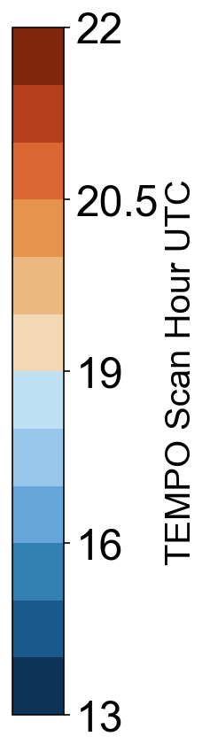
Poster #19: Assessing TEMPO O₃-profile and NO₂ Products for Informing Surface Air Quality
Mary Angelique G. Demetillo¹ (mary.a.demetillo@nasa.gov), Laura M. Judd¹, Xiong Liu², Junsung Park², Matthew Johnson³, John T. Sullivan⁴, James Crawford¹, Katherine R. Travis¹, Prajjwal Rawat¹, Tabitha Lee¹, Johnathan W. Hair¹, Taylor Shingler¹, Marta Fenn⁵
HSRL-2 vs TOLNet
HSRL-2 vs TEMPO
Chicago, IL
New York City, NY
TOLNet 0 – 2 km
ozone (ppbv)
TEMPO O3PROF V04*
0 – 2 km ozone (ppbv)
TEMPO V04* 0 – 2 km ozone (ppbv)
Markers are different TOLNet sites in WI and NYC
HSRL-2 subcolumn ozone means in TEMPO pixel (ppbv)
Mean of HSRL-2 ozone subcolumns within 3 km radius and < 10 min (ppbv)
Mean HSRL-2 subcolumn ozone in TEMPO pixel (ppbv)
Poster also investigates aircraft and satellite subcolumns vs. ground-based monitoring
Disclaimer: This work includes preliminary validation of the TEMPO O3PROF V04*.
This version is subject to change before public release of V04.

Slide 14
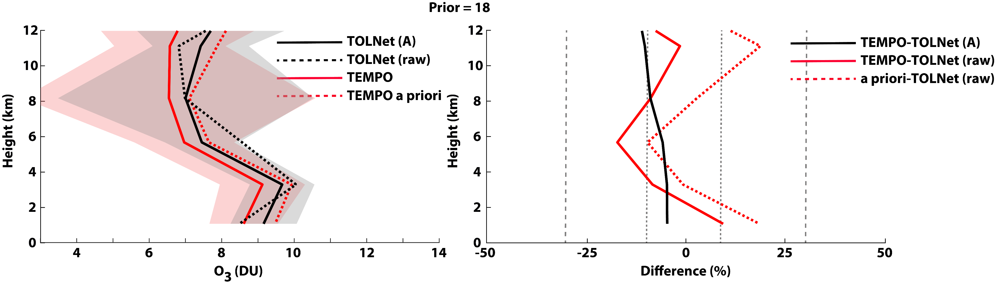
TEMPO V4* performance throughout the day: morning (<15 UTC)
N = 116
Good Performance
Validation with TOLNet-AK:
  TEMPO 0-12 km retrievals: bias = -0.6±1.2 DU; NMB% = -7.5%; R² = 0.79; Slope = 1.00; y-int = -0.6 DU.
  TEMPO 0-2 km retrievals: bias = -0.5±1.1 DU; NMB% = -5.3%; R² = 0.10; Slope = 0.33; y-int = 5.5 DU.
Evaluation with raw TOLNet:
  TEMPO 0-12 km retrievals: bias = -0.6 DU; NMB% = -5.9%; R² = 0.34; Slope = 0.74; y-int = 1.5 DU.
  TEMPO 0-2 km retrievals: bias = 0.1 DU; NMB% = 8.7%; R² = 0.03; Slope = 0.08; y-int = 7.9 DU.
  Prior profiles 0-12 km: bias = 0.2 DU; NMB% = 5.3%; R² = 0.33; Slope = 0.67; y-int = 2.9 DU.
  Prior profiles 0-2 km: bias = 1.0 DU; NMB% = 17.8%; R² = 0.12; Slope = 0.24; y-int = 7.5 DU.

Slide 15

TEMPO V4* performance throughout the day: mid-day (15-19 UTC)
N = 308
Worst Performance
Validation with TOLNet-AK:
  TEMPO 0-12 km retrievals: bias = -2.0±1.9 DU; NMB% = -25%; R² = 0.80; Slope = 0.94; y-int = -1.5 DU.
  TEMPO 0-2 km retrievals: bias = -2.1±1.3 DU; NMB% = -22%; R² = 0.63; Slope = 1.06; y-int = -2.8 DU.
Evaluation with raw TOLNet:
  TEMPO 0-12 km retrievals: bias = -1.7 DU; NMB% = -18%; R² = 0.15; Slope = 0.47; y-int = 2.5 DU.
  TEMPO 0-2 km retrievals: bias = -0.4 DU; NMB% = -1.5%; R² = 0.05; Slope = 0.21; y-int = 5.9 DU.
  Prior profiles 0-12 km: bias = 0.4 DU; NMB% = 12%; R² = 0.07; Slope = 0.29; y-int = 6.0 DU.
  Prior profiles 0-2 km: bias = 1.8 DU; NMB% = 27%; R² = 0.11; Slope = 0.24; y-int = 7.9 DU.

Slide 16
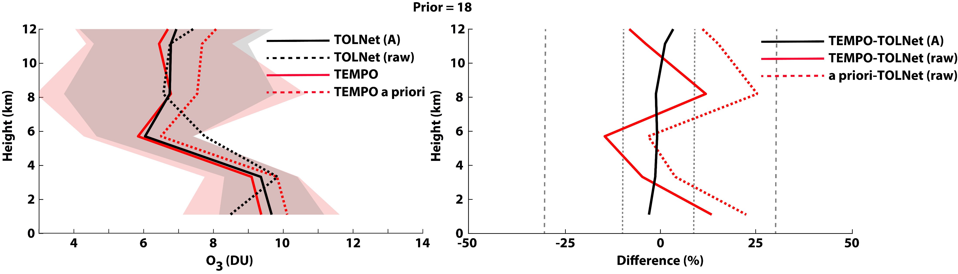
TEMPO V4* performance throughout the day: afternoon (19-24 UTC)
N = 438
Best Performance
Validation with TOLNet-AK:
  TEMPO 0-12 km retrievals: bias = -0.2±1.8 DU; NMB% = -1.4%; R² = 0.65; Slope = 0.91; y-int = 0.5 DU.
  TEMPO 0-2 km retrievals: bias = -0.3±1.3 DU; NMB% = -3.4%; R² = 0.51; Slope = 1.06; y-int = -0.9 DU.
Evaluation with raw TOLNet:
  TEMPO 0-12 km retrievals: bias = -0.4 DU; NMB% = 0.1%; R² = 0.18; Slope = 0.58; y-int = 2.9 DU.
  TEMPO 0-2 km retrievals: bias = 0.9 DU; NMB% = 13%; R² = 0.08; Slope = 0.44; y-int = 5.6 DU.
  Prior profiles 0-12 km: bias = 0.4 DU; NMB% = 12%; R² = 0.15; Slope = 0.47; y-int = 4.6 DU.
  Prior profiles 0-2 km: bias = 1.6 DU; NMB% = 22%; R² = 0.11; Slope = 0.33; y-int = 7.3 DU.

Slide 17
Conclusions
TOLNet+ozonesonde profiles prove to be an excellent evaluation and validation data source for understanding the performance of TEMPO O₃ profile retrievals.
Validation (0-12 km): Systematic low mean bias in the troposphere (NMB = -11%) with precision ~1.8 DU.
Validation (0-2 km): Systematic mean low mean bias in the PBL (0-2 km) (NMB = -10%) with precision ~1.3 DU.
Evaluation: tropospheric low mean bias (NMB = -7%) and PBL high bias (NMB = 7%); much larger random error when compared to raw obs.
TEMPO retrieval validation statistics better during morning and afternoon compared to the middle of the day. Further investigation needed.
Improved performance of the O₃ profile retrieval product expected when the combined UV+VIS wavelengths are used.
Sources or bias/error to be investigated more closely:
  Radiometric calibration, performance in the stratosphere, surface albedo representation, impact of total column O₃ bias, etc.

Slide 18
EXTRA SLIDES

Slide 19
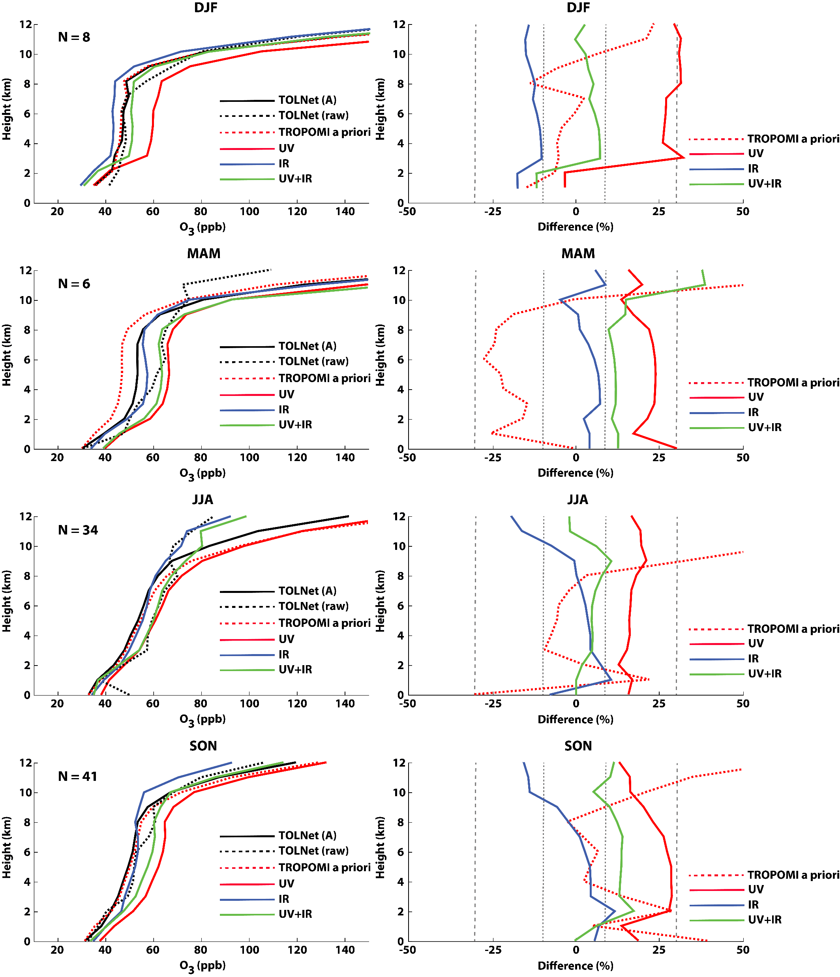
TROPOMI/CrIS O₃ Profile Validation using TOLNet
TOLNet proved to be an excellent validation source for TROPOMI and CrIS O₃ profile retrievals.
Winter statistics:
  UV-only: NMB = 29%; RMSE = 24 ppb
  IR-only: NMB = -12%; RMSE = 13 ppb
  UV+IR: NMB = 3%; RMSE = 13 ppb
Spring statistics:
  UV-only: NMB = 22%; RMSE = 14 ppb
  IR-only: NMB = 3%; RMSE = 7 ppb
  UV+IR: NMB = 17%; RMSE = 19 ppb
Summer statistics:
  UV-only: NMB = 17%; RMSE = 17 ppb
  IR-only: NMB = 1%; RMSE = 11 ppb
  UV+IR: NMB = 4%; RMSE = 14 ppb
Fall statistics:
  UV-only: NMB = 25%; RMSE = 16 ppb
  IR-only: NMB = 2%; RMSE = 10 ppb
  UV+IR: NMB = 11%; RMSE = 14 ppb
Johnson et al. (2024)

Slide 20
Validation: Systematic low bias in the trop. (0-12 km) (NMB = -11%) with precision ~1.8 DU which does not yet meet the TEMPO bias requirement of ~1.5 DU (~10 ppb).
Validation: Systematic mean low bias in the PBL (0-2 km) (NMB = -10%) with precision ~1.3 DU which meets the TEMPO bias requirement of ~1.7 DU (~10 ppb).

