Slide 1
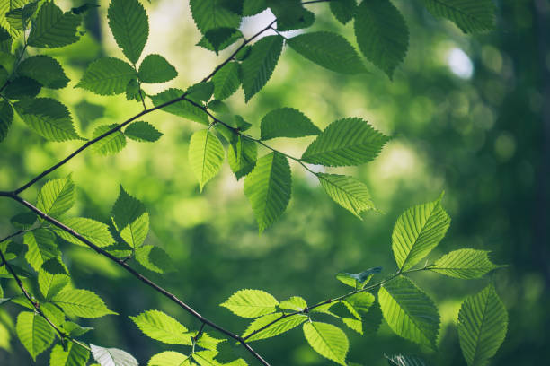



Diurnal GPP patterns from TEMPO?
Matt Bandel, Zach Fasnacht, Joanna Joiner
TEMPO Science Team Meeting, August 19, 2025

Slide 2
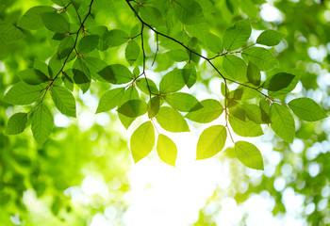
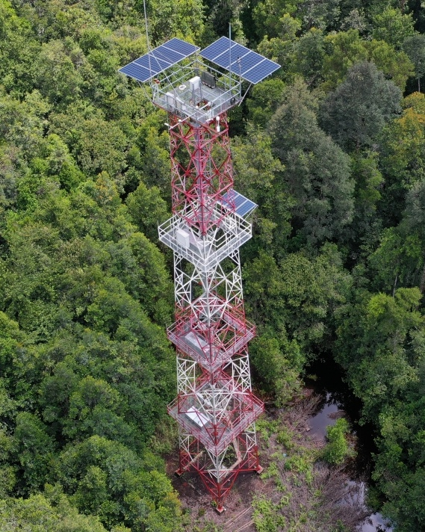
Why Diurnal GPP?
GPP:
• Gross Primary Productivity
• Measurement of carbon fixation rate
• Essential component of global carbon budget
• Indicator of ecosystem health
• Diurnal patterns are an even better diagnostic
i.e., moisture stress
Eddy covariance flux towers:​
• Extract net CO₂ flux from the covariance of
vertical wind and CO₂ concentration
measurements under turbulent conditions
• Nighttime flux used to convert Net Ecosystem
Exchange ( NEE ) to GPP by accounting for
respiration

Slide 3
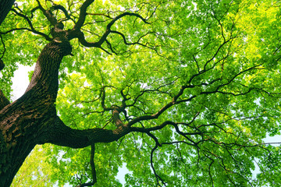
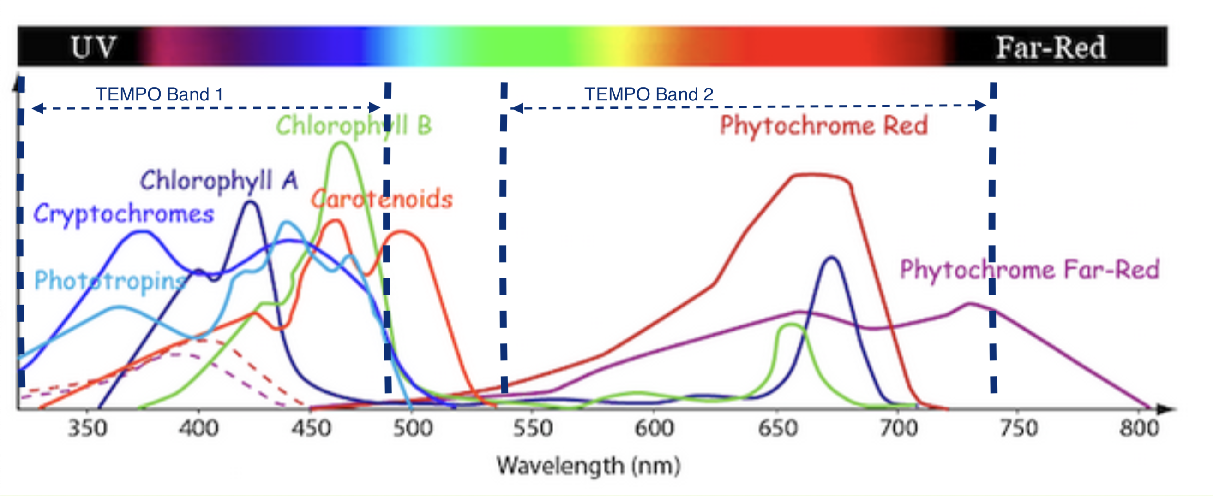
Why TEMPO?
TEMPO:
• Hourly scans throughout daytime
• Hyperspectral, covers main plant pigments ( 290nm – 490nm, 540m – 740nm )
Challenges:
• Misses far red, infrared regions, and has gap in blue green region
• Poor overlap with eddy flux tower records ( 2003 – 2025 )
• Pixel size large compared to flux tower ( 200m vs 2 x 5 km )
• Geolocation precision is difficult from 36,000 km away

Slide 4

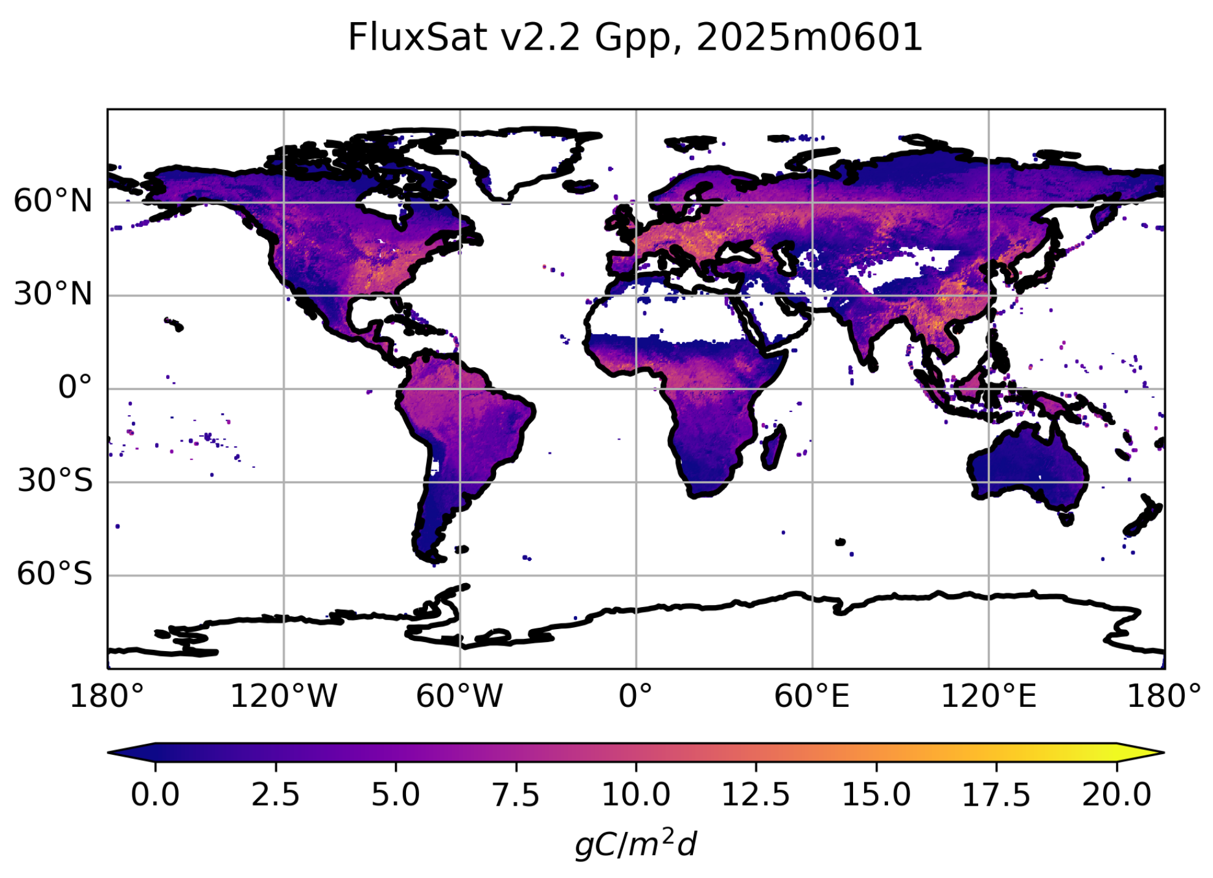
MODIS / MERRA-2 to Bridge the Gap
MODIS:
• 7 discrete bands in visible and infrared
• High spatial resolution ( 0.5 km )
• Great temporal overlap with tower data
• But daily measurements ( 8 day averages )
MERRA-2:
• Hourly measurements of radiation and
meteorology
• Also great temporal overlap with towers
• But poor spatial resolution ( 50 km )
FluxSat:
• Strategy already used for global daily GPP
• Developed by J. Joiner and Y. Yoshida
• Available from GES DISC

Slide 5
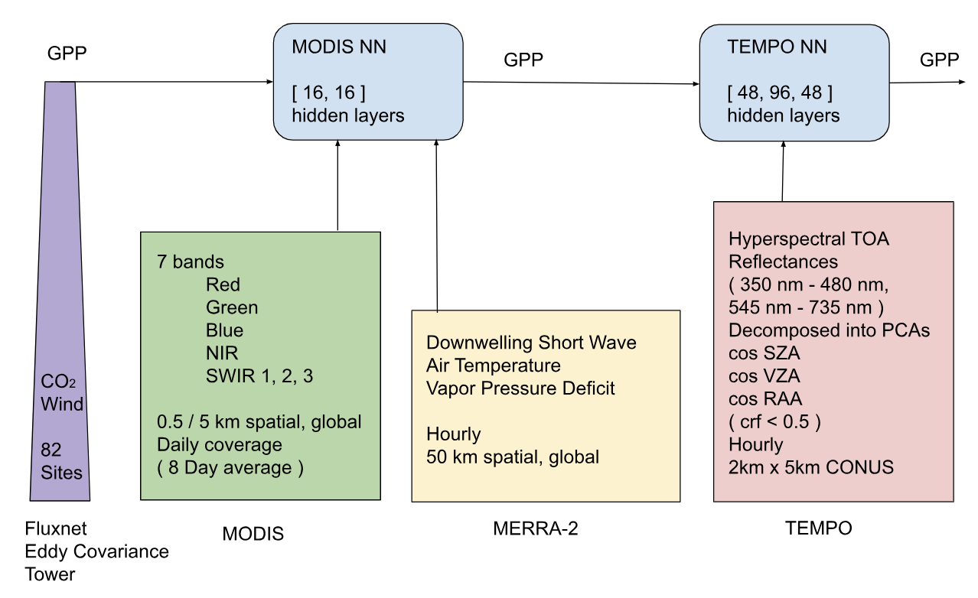
Dual Model Strategy

Slide 6
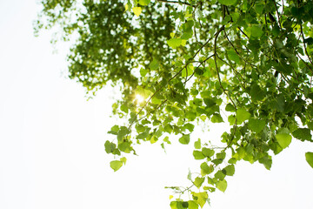
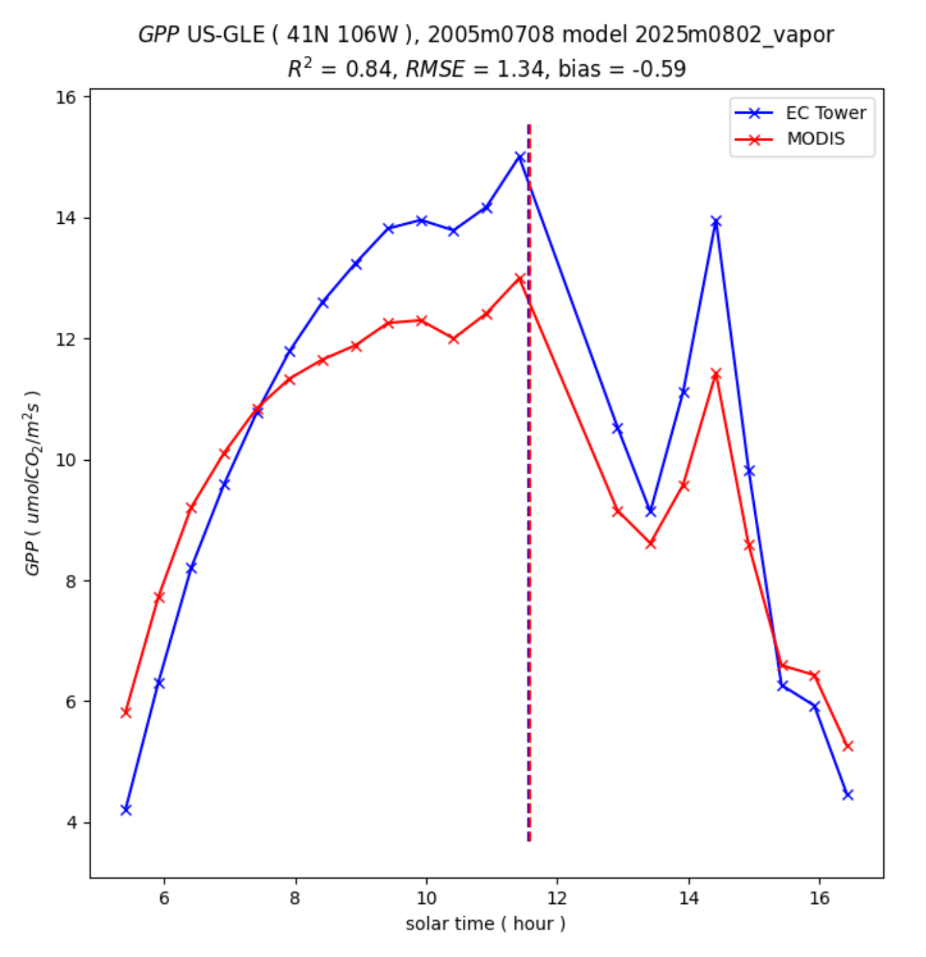
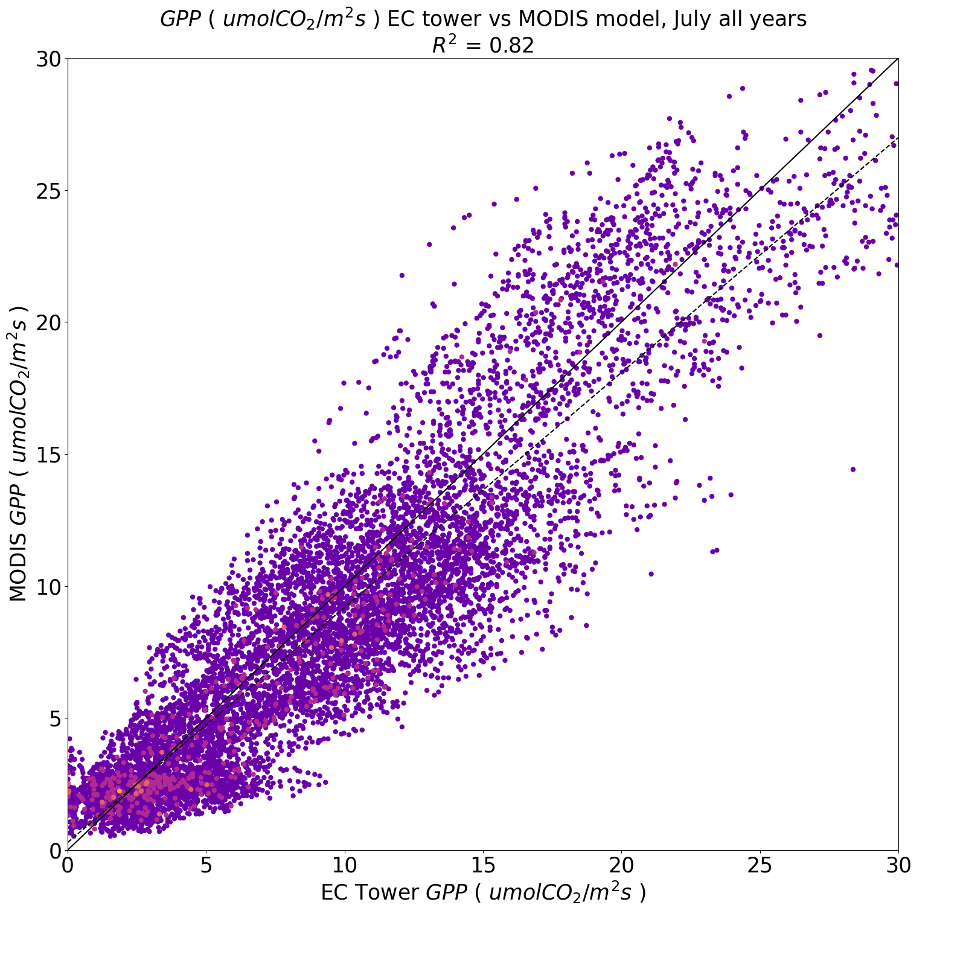
MODIS model results
MODIS Model:
• Reasonable job across 32 US, CA sites
• R² = 0.82
• Generally matches diurnal contours well
( large site to site variance )
GPP centroids:
• GPP Often peaks
before noon
• Moisture stress
causes stomata
​to close during
​strong sun

Slide 7
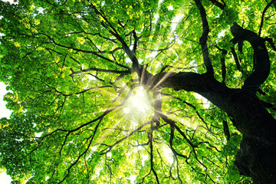
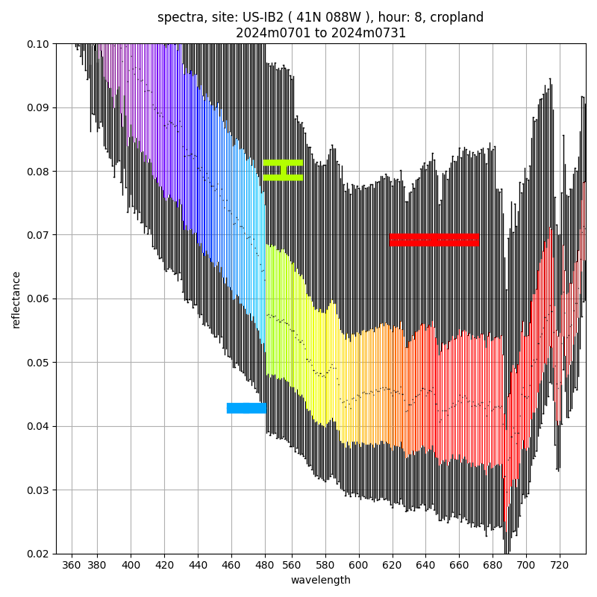
MODIS vs TEMPO spectra
MODIS:
• Discrete band ranges
• Nadir adjusted albedos
• Atmospherically corrected
TEMPO:
• Hyperspectral
• Top of the atmosphere reflectances
• Sun normalized, but not adjusted for
viewing geometry
• No cloud, aerosol, or Rayleigh

Slide 8
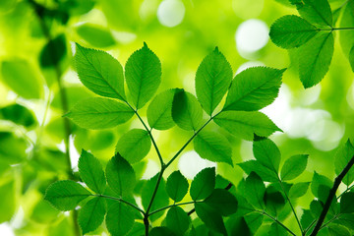
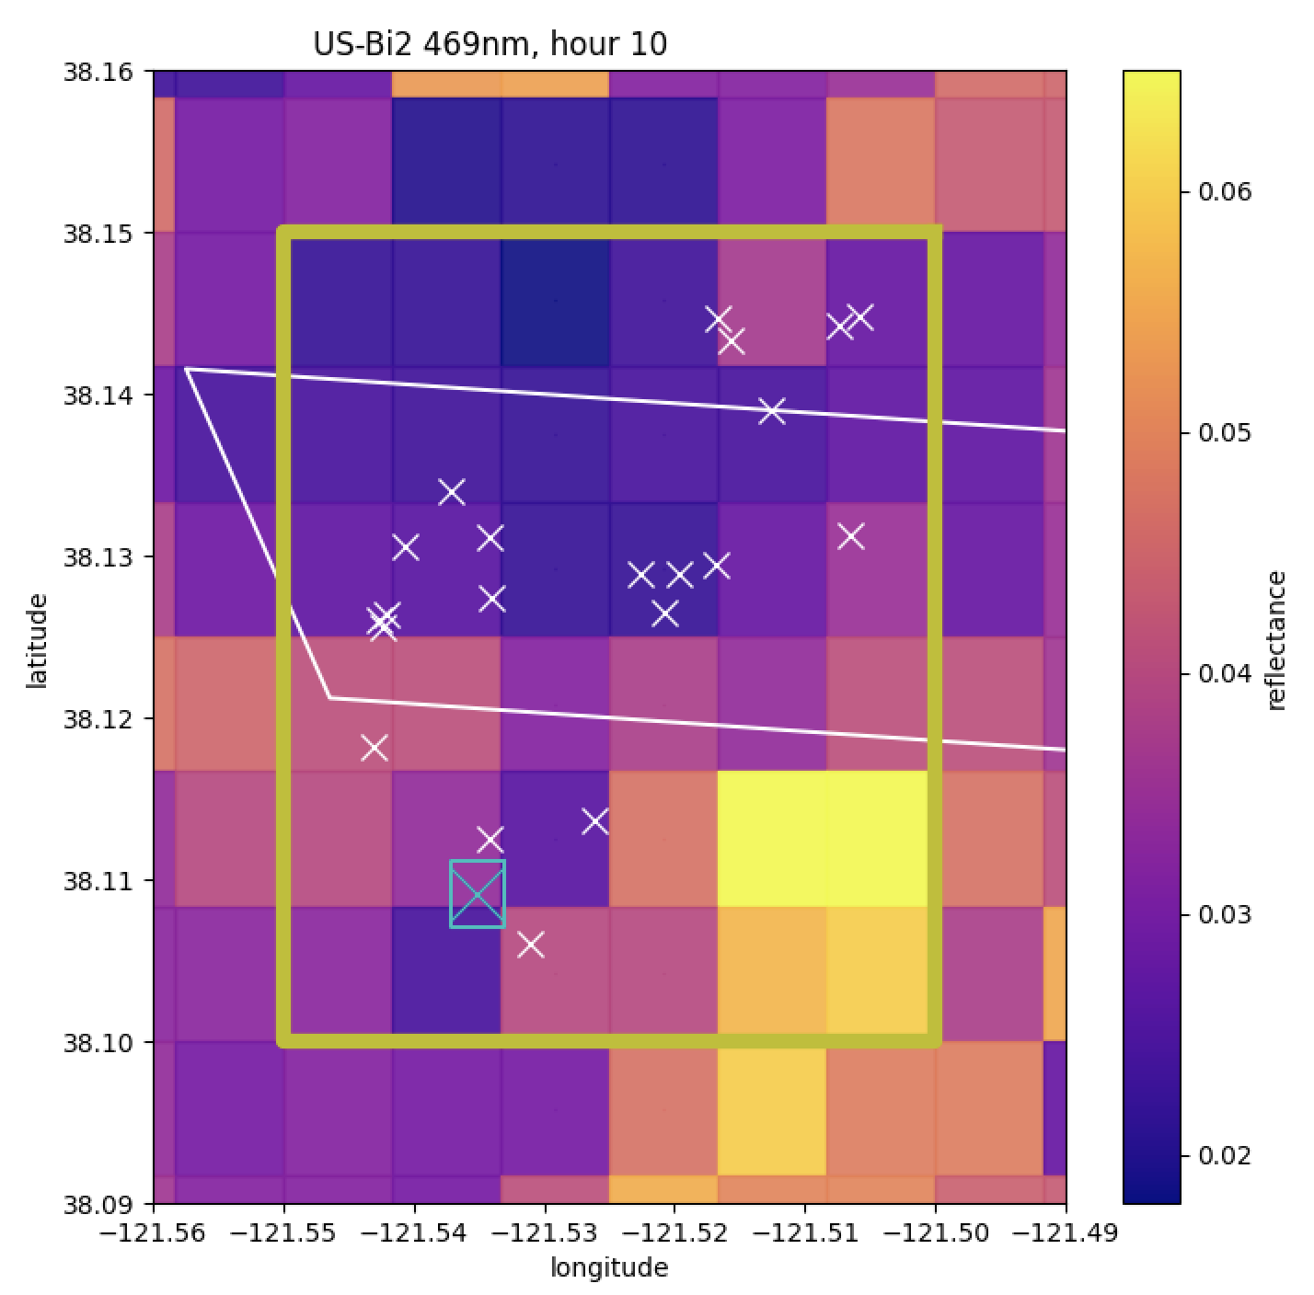
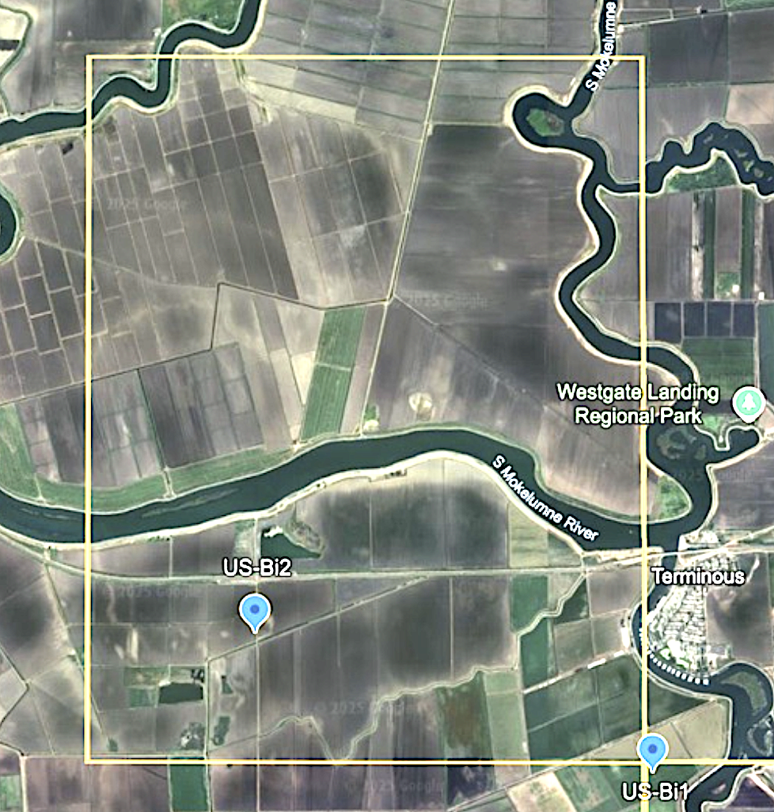
MODIS vs TEMPO pixels
Grid sizes:
• High resolution MODIS shows large
spatial heterogeneity
• TEMPO pixels occupy large portion of
low resolution MODIS grid cell

Slide 9
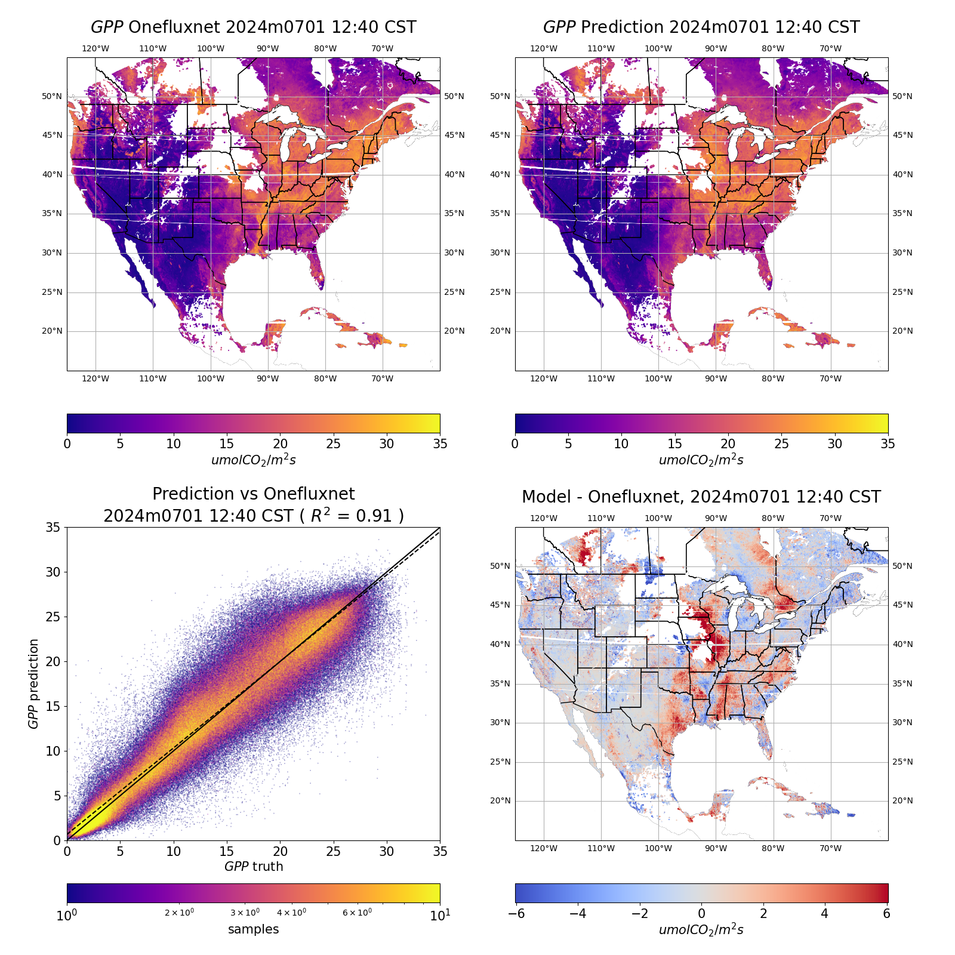
TEMPO Model Results
TEMPO Results:
• Mimics results of MODIS model well
• R² of 0.91 across entire TEMPO scan
• Most errors associated with edge of
cloudy regions

Slide 10
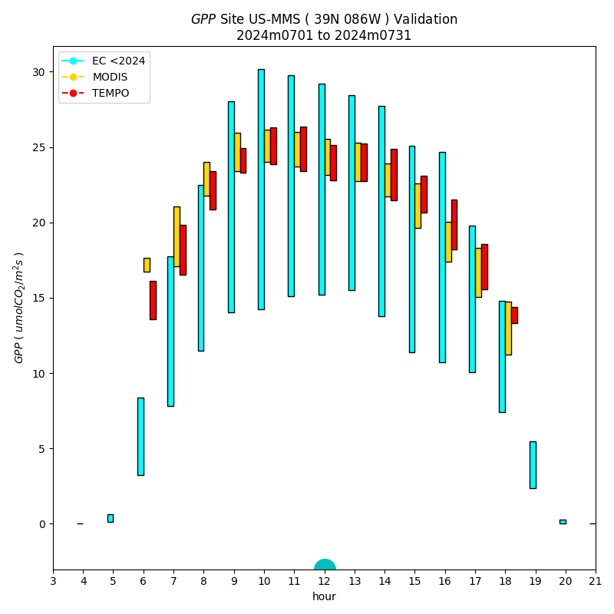
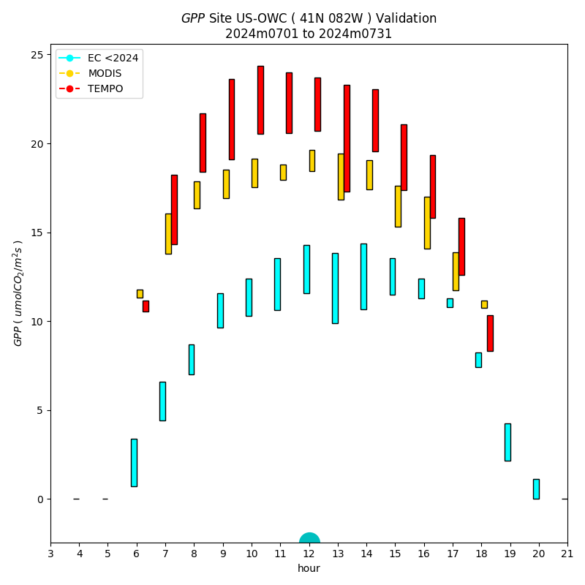
Diurnal Patterns
Diurnal Results:
• At most sites, diurnal patterns are well
modeled
• Comparisons of TEMPO to MODIS and both
to flux towers are good
• Some sites
match poorly

Slide 11
Preliminary Conclusions
Conclusions:
• TEMPO is able to effectively capture signals related to GPP seemingly as well as
MODIS / Merra-2
• TEMPO spectra, even without atmospheric corrections can capture contours in
diurnal GPP consistent with flux tower data
• MODIS model supplies meterology that implies moisture stress, but TEMPO model
must get this directly from reflectances, are we seeing physiological responses?
Thank you!
Please feel free to direct comments or questions to matthew.bandel@ssaihq.com

