Slide 1



TEMPO surface and underwater hyperspectral UV Irradiance (UVI)
¹ Nickolay A. Krotkov, ^{1 ,2}Alexander P. Vasilkov,
^{1 ,2} Matthew Bandel, ^{1,2} Zachary Fasnacht, ^{1 ,3} Jerald R. Ziemke
¹ NASA Goddard Space Flight Center
² Science Systems and Applications, Inc.
^{3.}GESTAR-II/Morgan State University
Funding from Interagency Satellite Needs Working Group (SNWG)
managed by NASA Marshall Space Flight Center

Slide 2
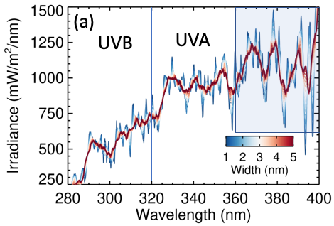

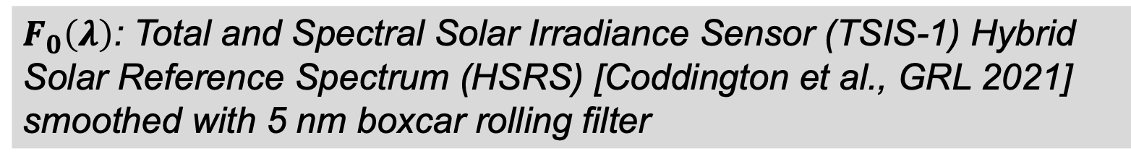
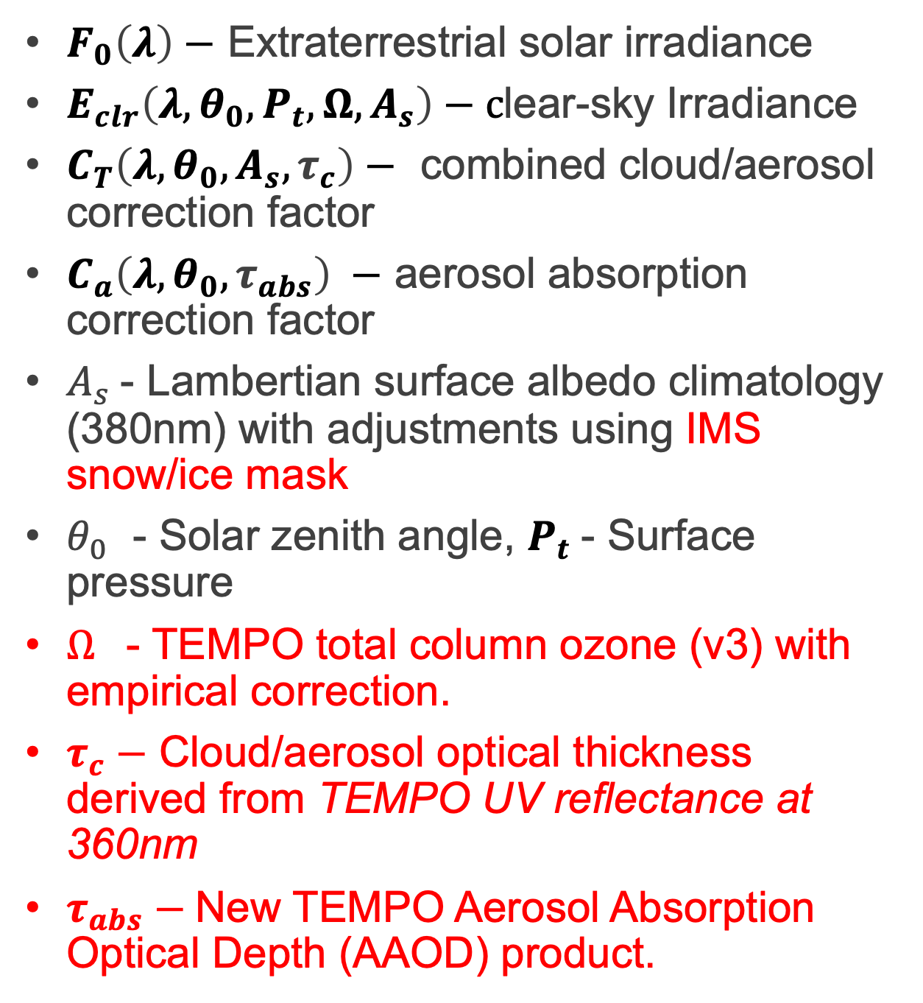
Adapting OMI UV Irradiance algorithm to TEMPO
${E\left(λ,θ_{0},P_{t},Ω,A_{s}\right)=E}_{clr}×$ $C_{T}×C_{a}$
$F_{0}\left(λ\right)−$ Extraterrestrial solar irradiance
$E_{clr}\left(λ,θ_{0},P_{t},Ω,A_{s}\right)−c$lear-sky Irradiance
$C_{T}\left(λ,{θ_{0}, A_{s}, τ}_{c}\right)−$ combined cloud/aerosol correction factor
$C_{a}\left(λ,{θ_{0}, τ}_{abs}\right) −$ aerosol absorption correction factor
$A_{s}$- Lambertian surface albedo climatology (380nm) with adjustments using IMS snow/ice mask
$θ_{0}$ - Solar zenith angle, $P_{t}$- Surface pressure
$Ω$ - TEMPO total column ozone (v3) with empirical correction.
$τ_{c}−$ Cloud/aerosol optical thickness derived from TEMPO UV reflectance at 360nm
$τ_{abs}−$New TEMPO Aerosol Absorption Optical Depth (AAOD) product.
$F_{0}\left(λ\right)$: Total and Spectral Solar Irradiance Sensor (TSIS-1) Hybrid Solar Reference Spectrum (HSRS) [Coddington et al., GRL 2021] smoothed with 5 nm boxcar rolling filter
Notes:
TSIS-1 Hybrid Solar Reference Spectrum agrees with Stuttle Atlas ETS solar measurements within few percent.
Eclr – Accounts for atmospheric Rayleigh scattering and trace gas absorption , mainly ozone in the short UVB part of the spectrum
C_T accounts for cloud and aerosol scattering;
C_a accounts for aerosol absorption

Slide 3

Action Spectrum $A\left(λ\right)$ describes UV effects
An action spectrum describes the wavelength dependent response to UV radiation of a certain biological or environmental effect.
The UV dose rate can be computed for different health and environmental effects:
  erythema (same as UV Index),
  DNA-damage
  eye-damage
  plant and phytoplankton growth inhibition
  vitamin-D production in the skin (CIE-174)
  virus inactivation on surface and underwater
The UV index (UVI) is based on the International Commission on Illumination (CIE-98) Erythemal action spectrum for the susceptibility of the Caucasian skin to sunburn (erythema).
https://www.temis.nl/uvradiation/product/action.html
Notes:
Note logarithmic scale

Slide 4
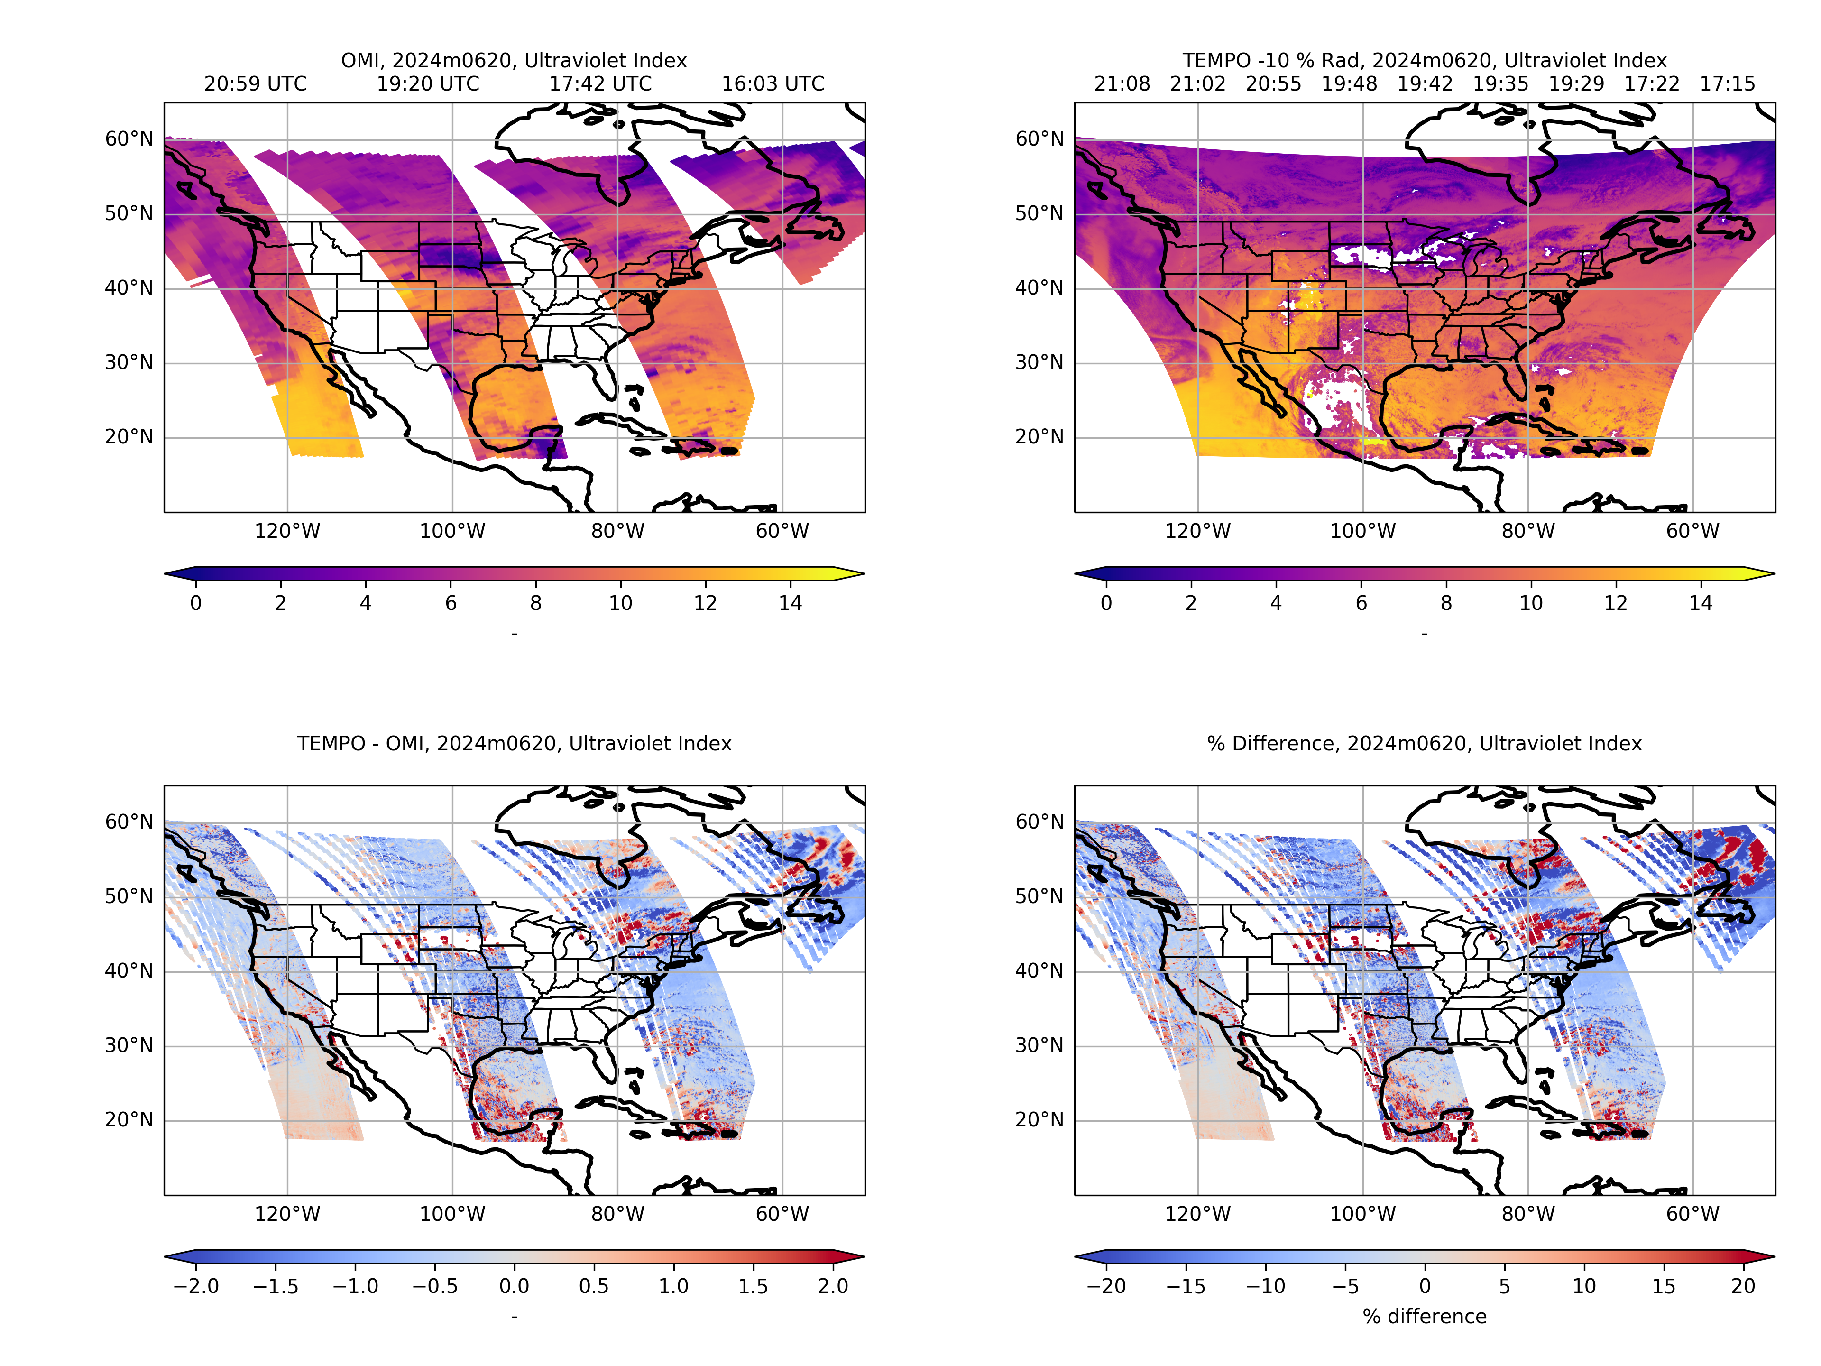
Erythemally Weighted UV Irradiance at noon
(UV Index)
OMI col. 4
TEMPO v3
TEMPO ozone is corrected using OMPS data
TEMPO 360nm reflectance (V3) is reduced by 10%)
Absolute difference
%
Difference
Notes:
Good news: negative bias with OMI reduces after we adjusted TEMPO UV reflectance by 10%
We look forward to using TEMPO v4 L1b data

Slide 5
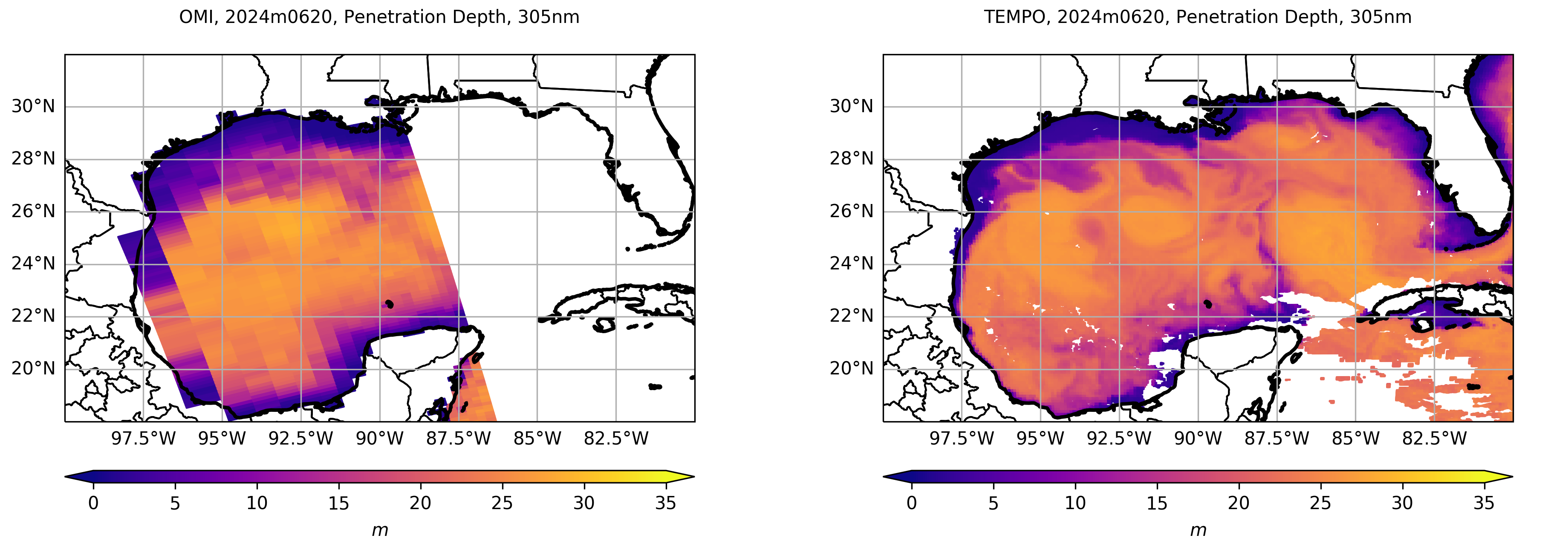
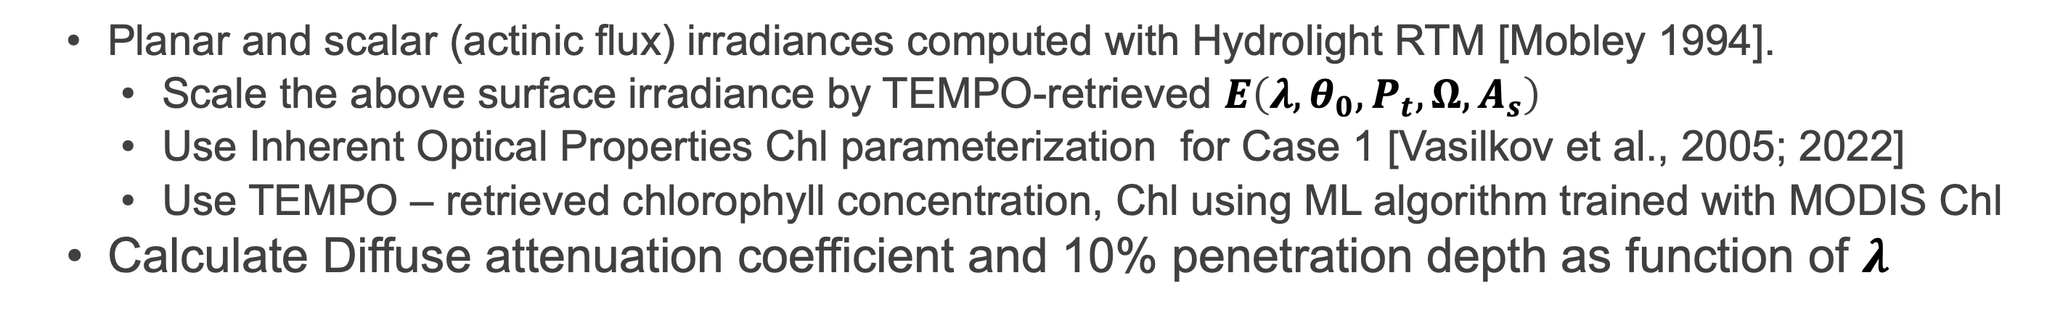
Underwater UVI algorithm using Hydrolight RTM
  Planar and scalar (actinic flux) irradiances computed with Hydrolight RTM [Mobley 1994].
    Scale the above surface irradiance by TEMPO-retrieved $E\left(λ,θ_{0},P_{t},Ω,A_{s}\right)$
    Use Inherent Optical Properties Chl parameterization for Case 1 [Vasilkov et al., 2005; 2022]
    Use TEMPO – retrieved chlorophyll concentration, Chl using ML algorithm trained with MODIS Chl
  Calculate Diffuse attenuation coefficient and 10% penetration depth as function of $λ$

Slide 6
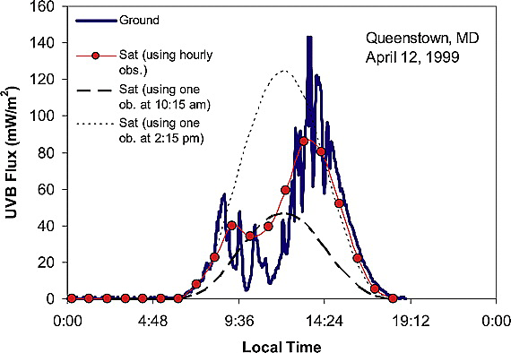
Next steps
Will use TEMPO new absorbing aerosol product to account for smoke and dust events.
Will use PACE advanced Ocean Color products to improve UV Inherent Optical Properties model for coastal waters and lakes.
Will combine hourly measurements from TEMPO scans to calculate daily UV exposures for different action spectra, e.g., Erythemal daily exposure.
Gadhavi, H., R. T. Pinker, and I. Laszlo (2008), Estimates of surface ultraviolet radiation over north America using Geostationary Operational Environmental Satellites observations, J. Geophys. Res., 113, D21205, doi:10.1029/2007JD009308.
Notes:
Erythemal UVB flux observed at Queenstown, MD on 12 April 1999.
Solid line: ground based observations; circles: estimates from GOES data; dashed and dotted lines: estimates using one GOES observation at 10:15 hrs only and at 14:15 hr only, respectively, and assuming them constant over the day.

