Slide 1

TEMPO-ABI Hybrid Aerosol Detection Product
Pubu Ciren^{1,2} and Shobha Kondragunta²
¹STC@NOAA ²NOAA/NESDIS/STAR
Disclaimer: The scientific results and conclusions, as well as any views or opinions expressed
herein, are those of the author(s) and do not necessarily reflect those of NOAA or
the Department of Commerce.

Slide 2
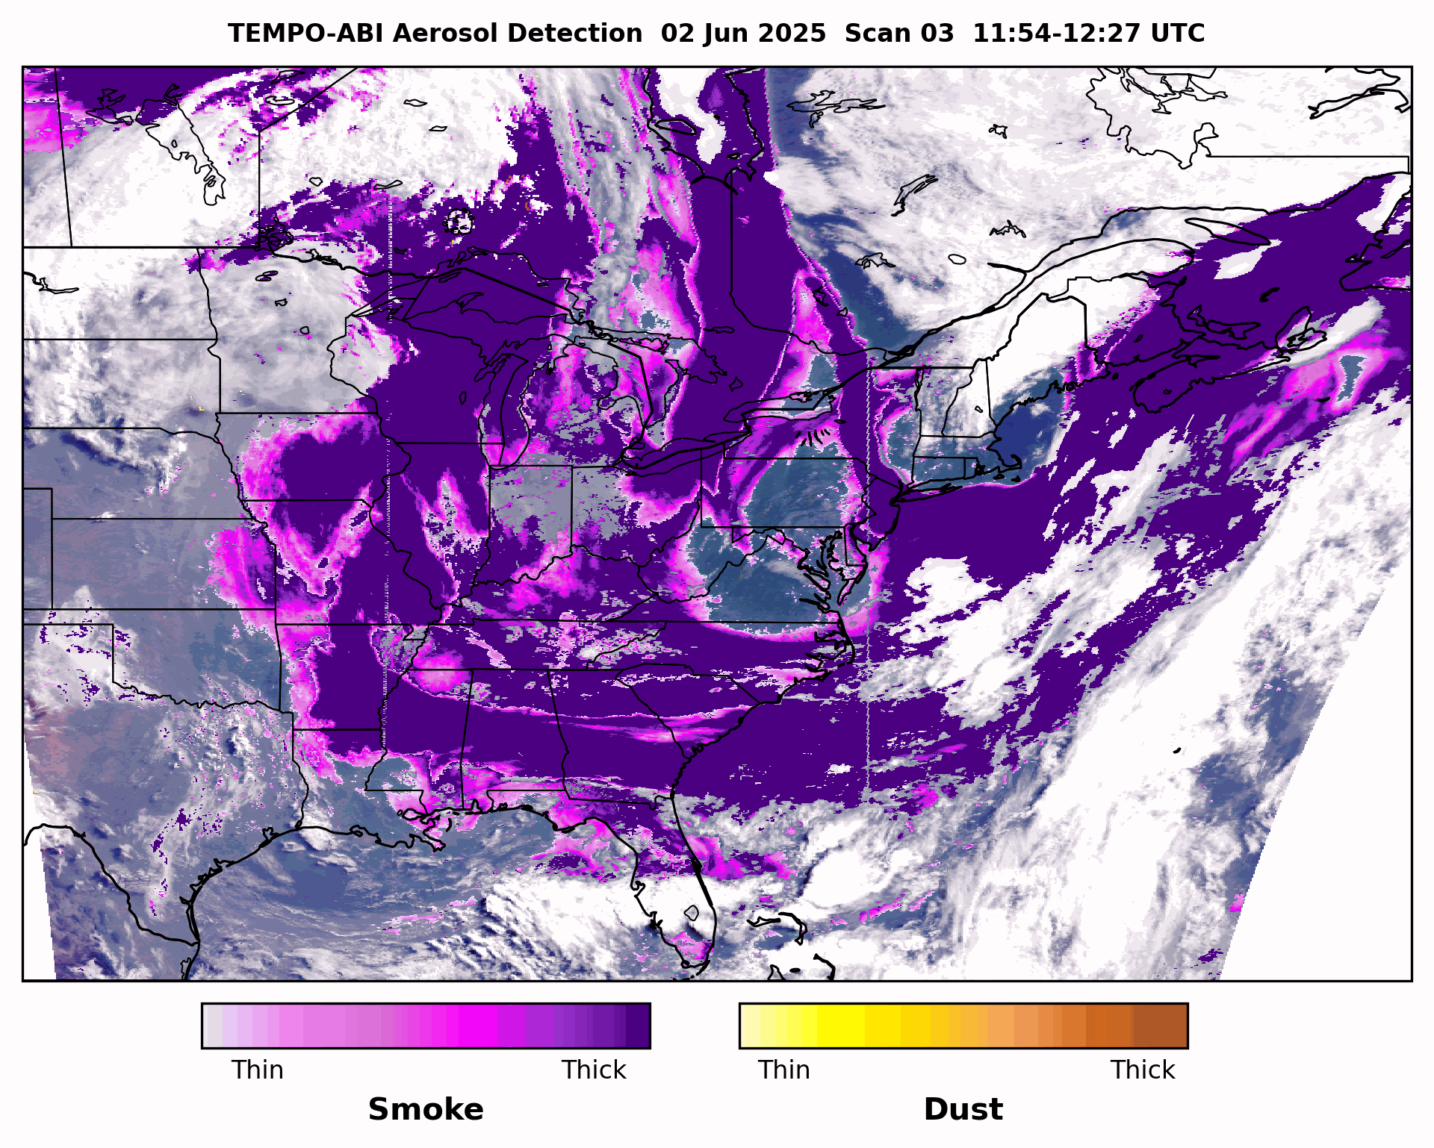
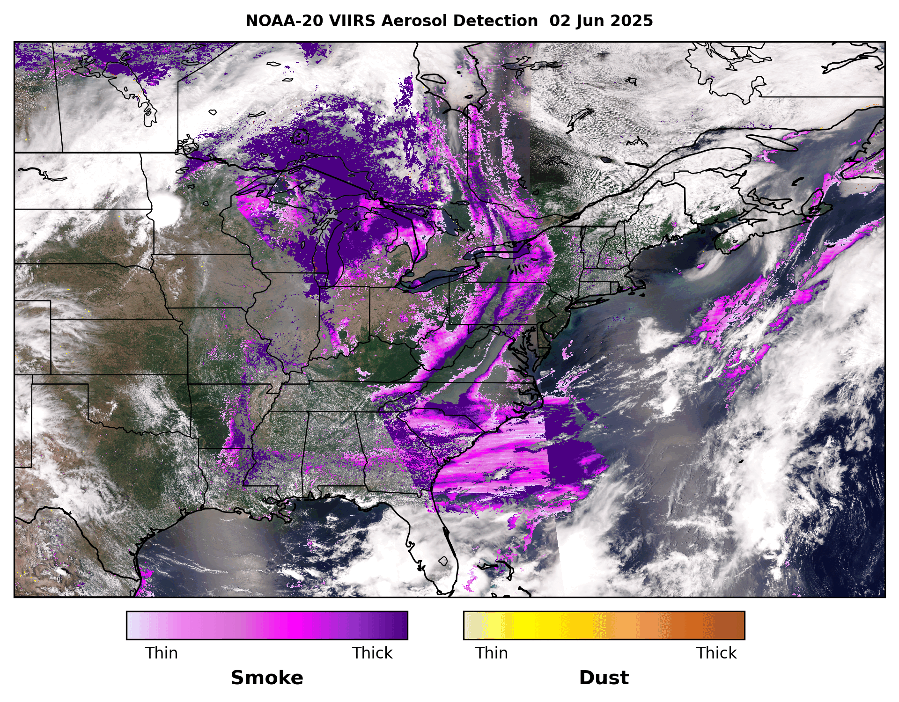
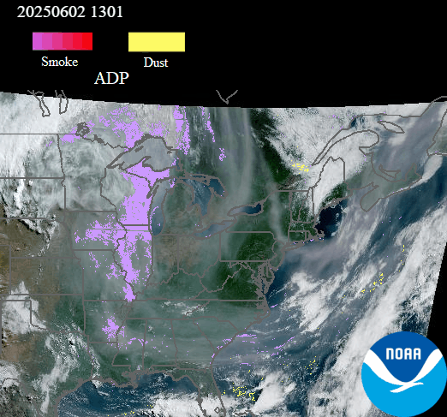
Evolution of NOAA’s Aerosol Detection Algorithm
UV-Deep Blue-IR Hybrid
Smoke/Dust Intensity
Deep Blue-IR
TEMPO+ABI
Smoke/Dust Intensity
Visible-IR
JPSS VIIRS ADP
Binary (“yes/no”) detection
GOES-R ABI ADP
GOES-19 ABI

Slide 3
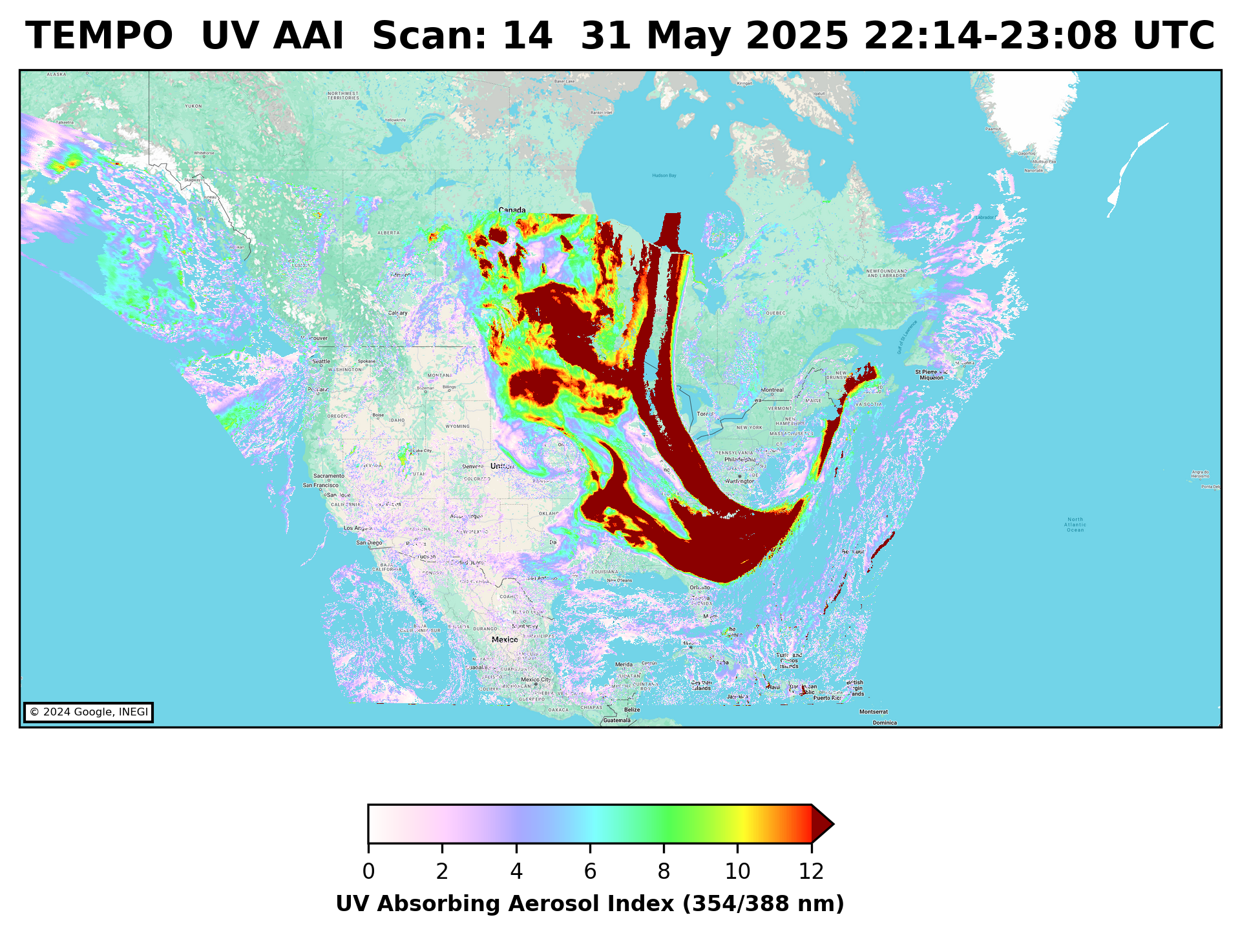
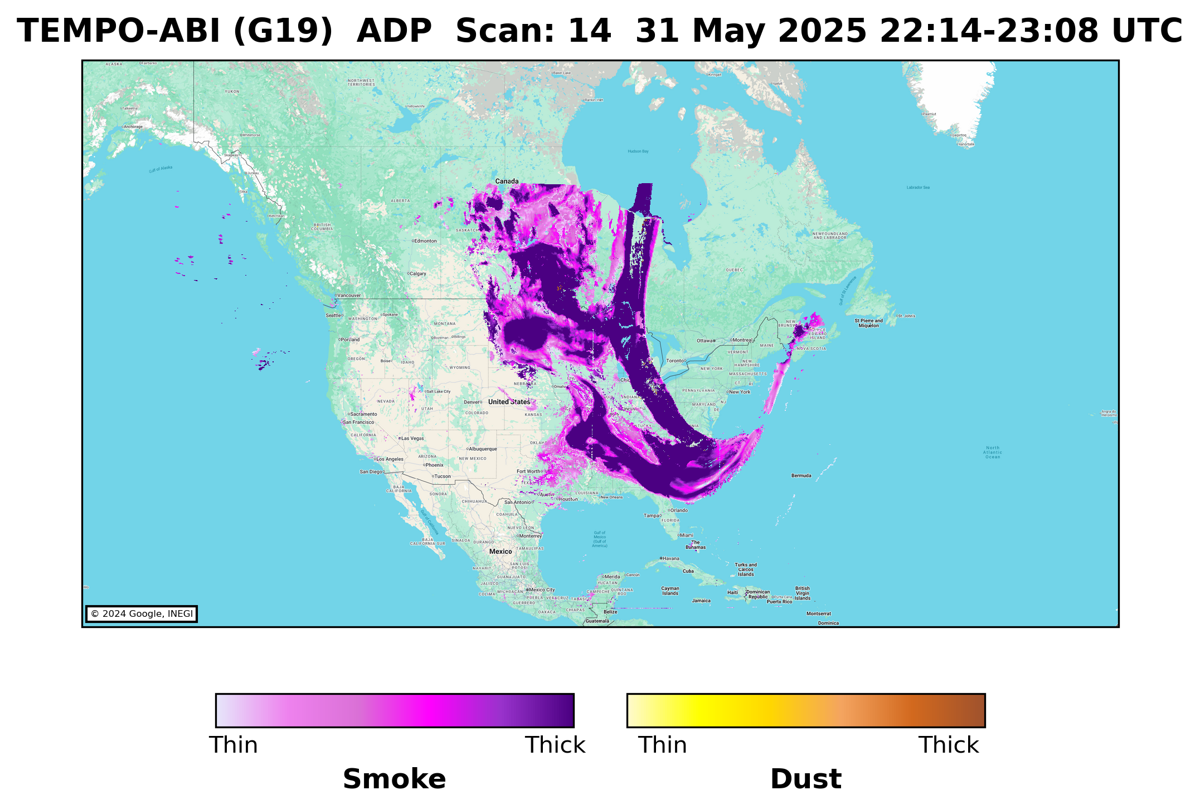
NOAA TEMPO-ABI Hybrid Aerosol Detection Algorithm
Hybrid approach for smoke and dust detection.
TEMPO+ABI synergy (East and West, dual view).
Cloud screening: Remapped cloud mask from ABI
Cloud/Snow-ice Callback: Identifies high UV AAI values over clouds and snow-ice
Outputs
  1. Smoke/Dust mask
  2. UV AAI (354/388 nm)
  3. Visible AAI (412/440 nm)
Absorbing Aerosol Index
Visible AAI = -100[1og₁₀(R₄₁₂/R₄₄₀) – log₁₀(R’₄₁₂/R’₄₄₀)]
UV AAI = -100[1og₁₀(R₃₅₄/R₃₈₈) – log₁₀(R’₃₅₄/R’₃₈₈)]
Dust Smoke Discrimination Index
DSDI = -10[1og₁₀(R₄₁₂/R₂₂₅₀)
TEMPO:
ABI/GXI:

Slide 4
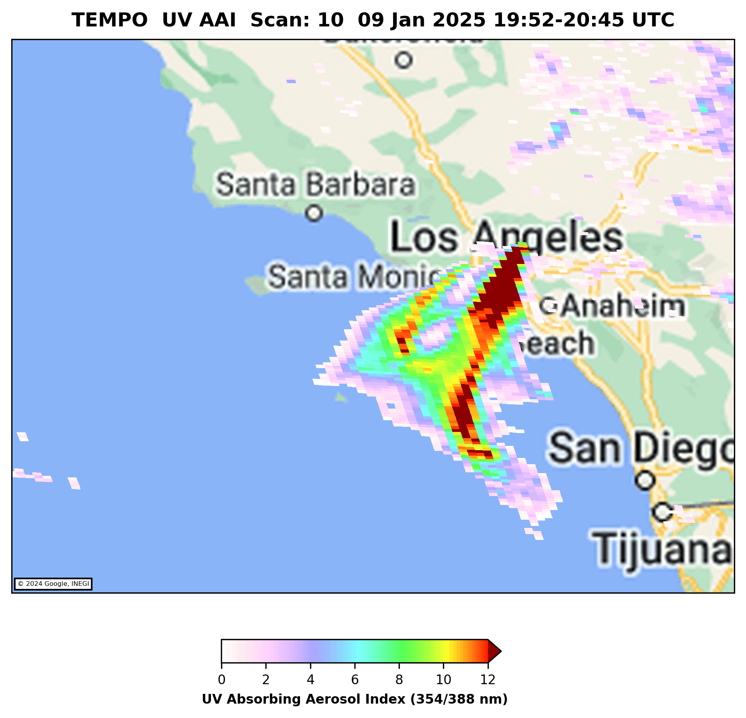
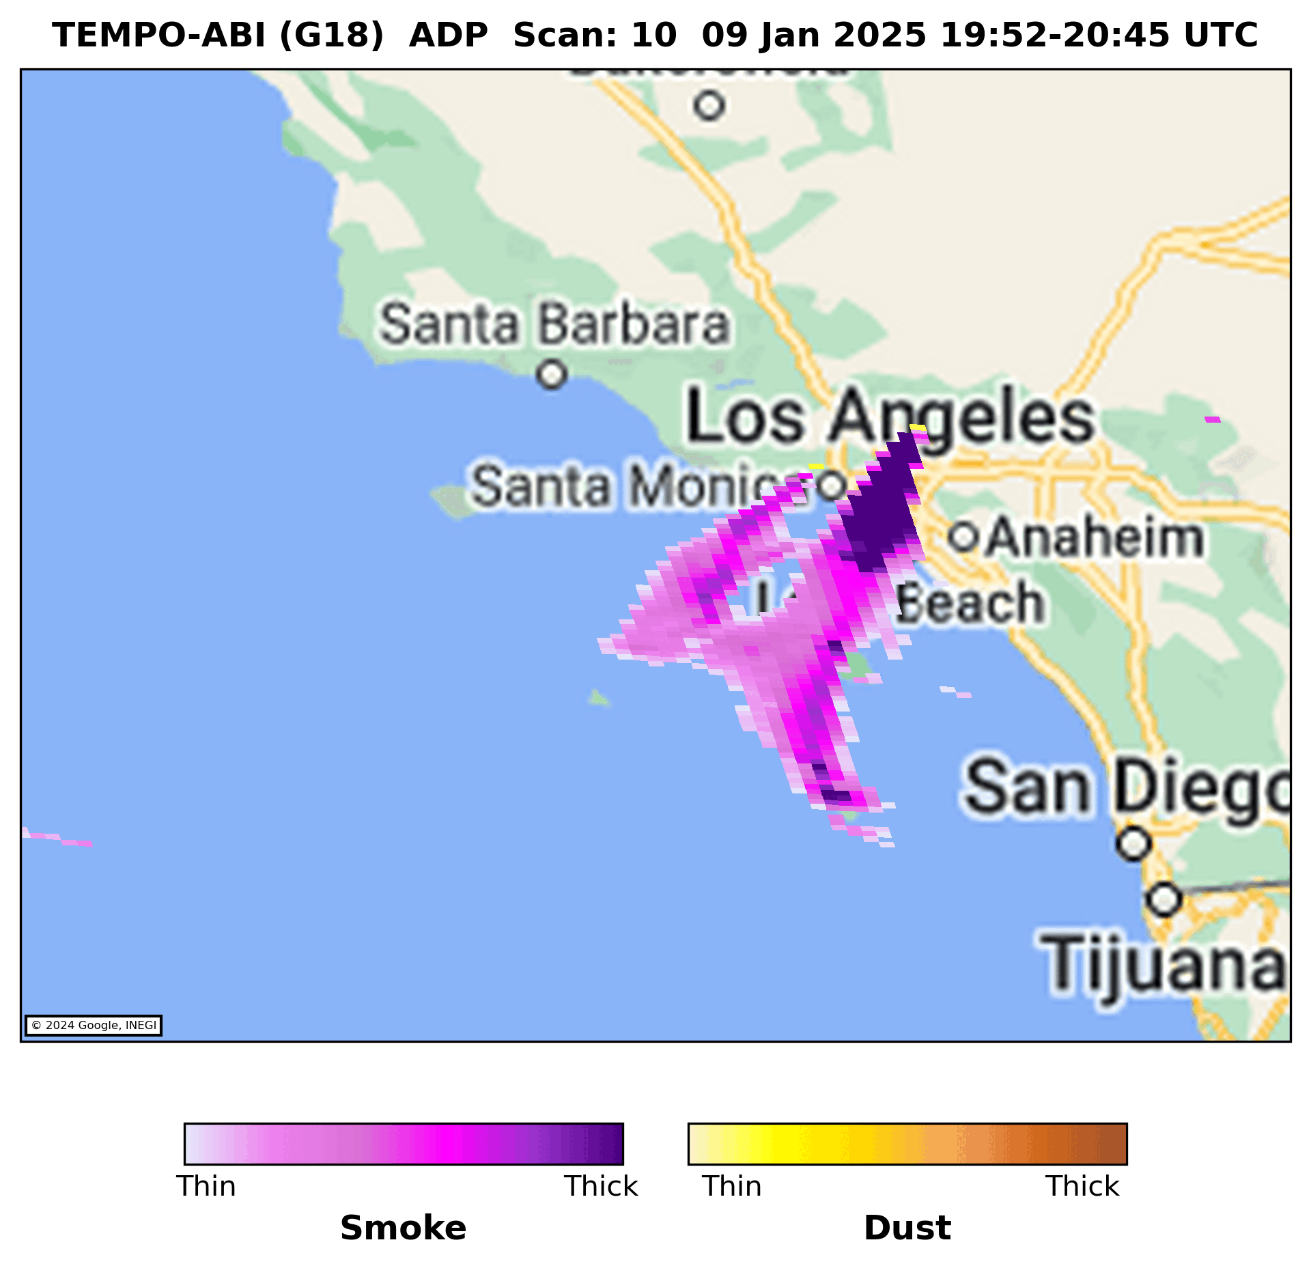
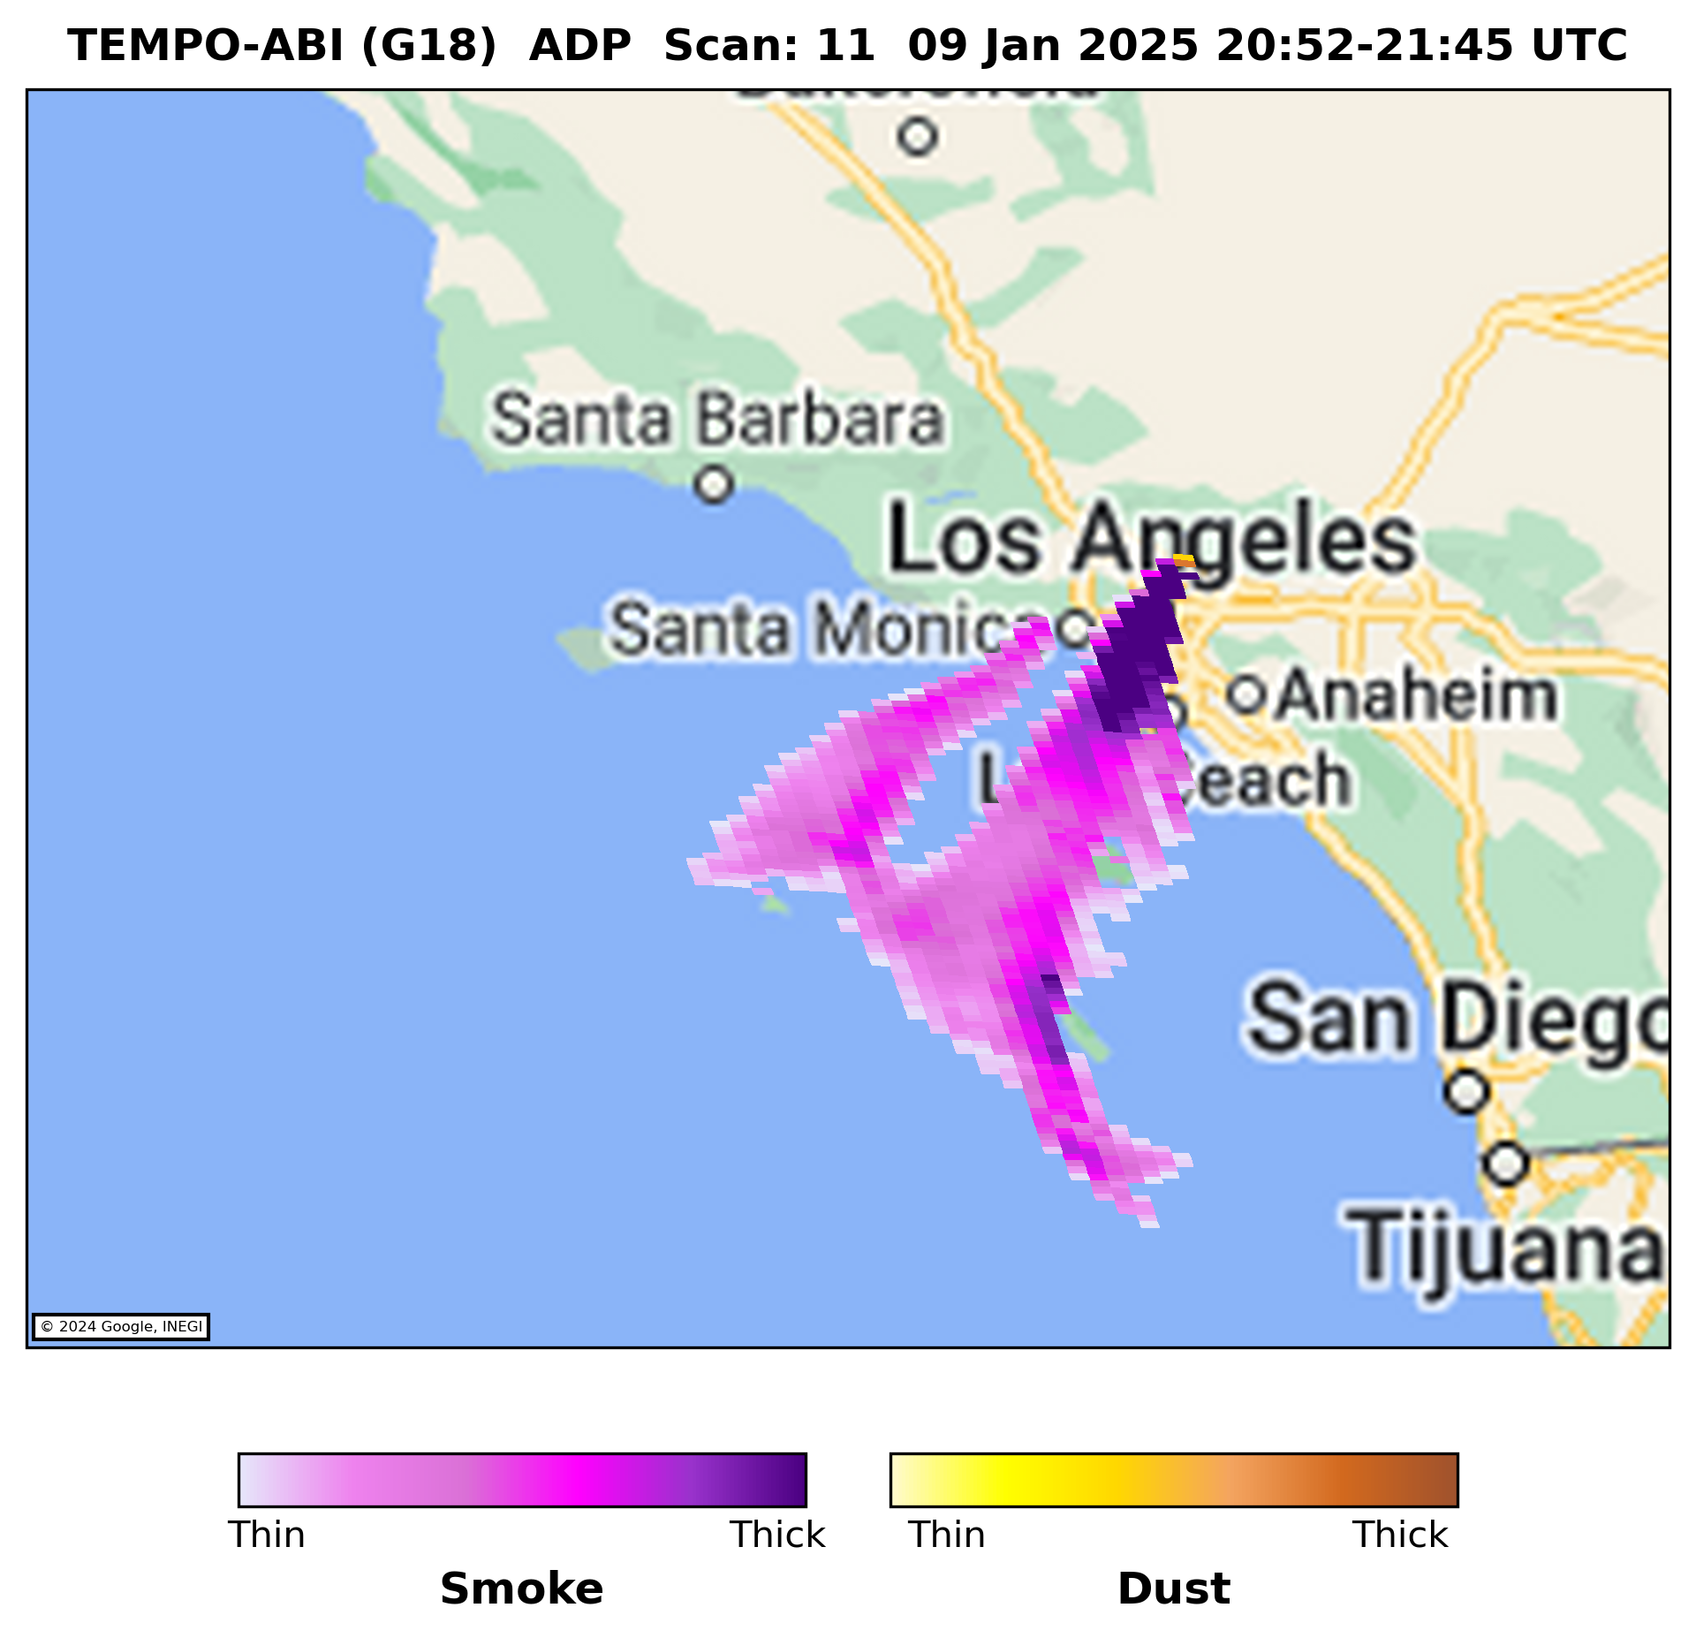


Case Study: Smoke Plumes from L.A. Fires (01/09/25)
GOES-18: 137.0º W
GOES-19: 89.5º W
GOES-16 75.2º W
TEMPO+GOES 18
TEMPO+GOES 19
TEMPO+GOES 16
Consistent detection of smoke plumes across all three TEMPO-ABI synergies

Slide 5
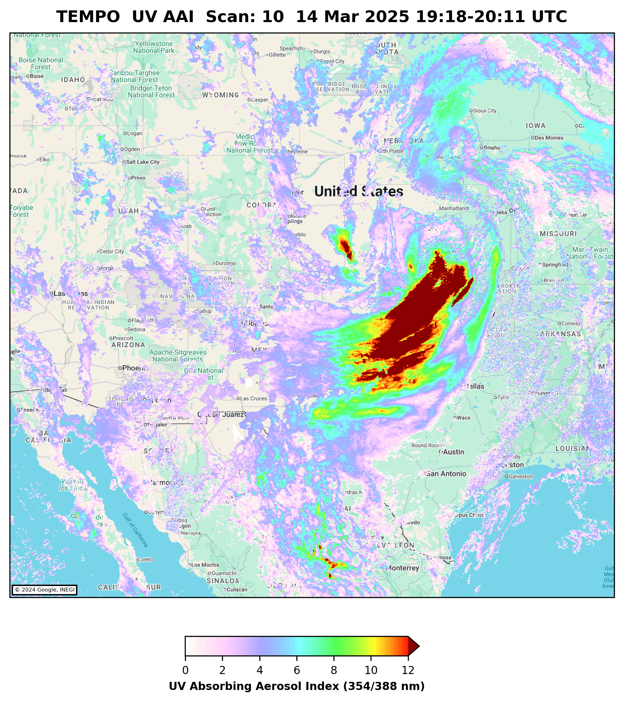
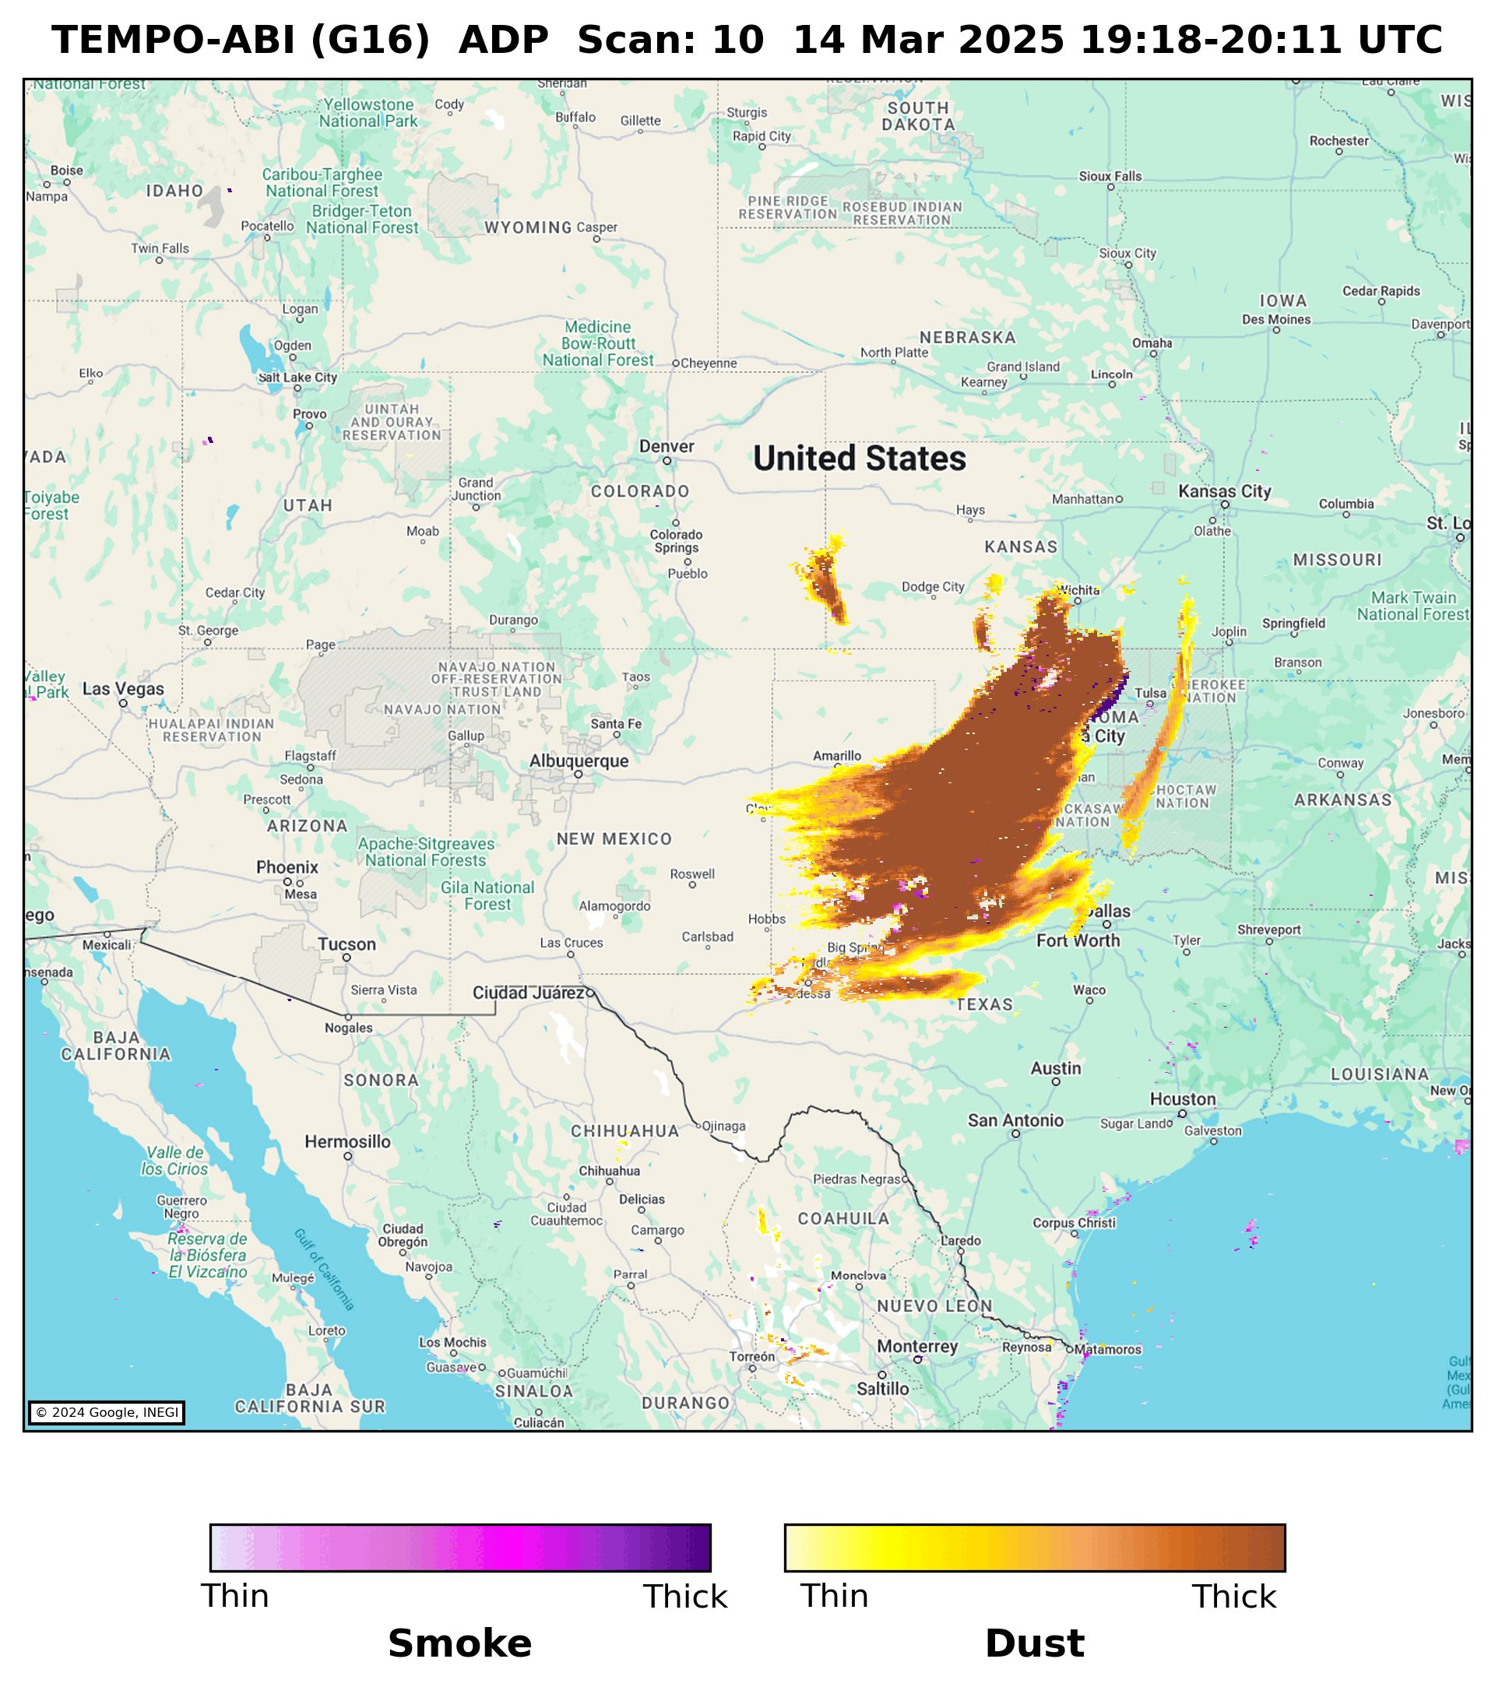
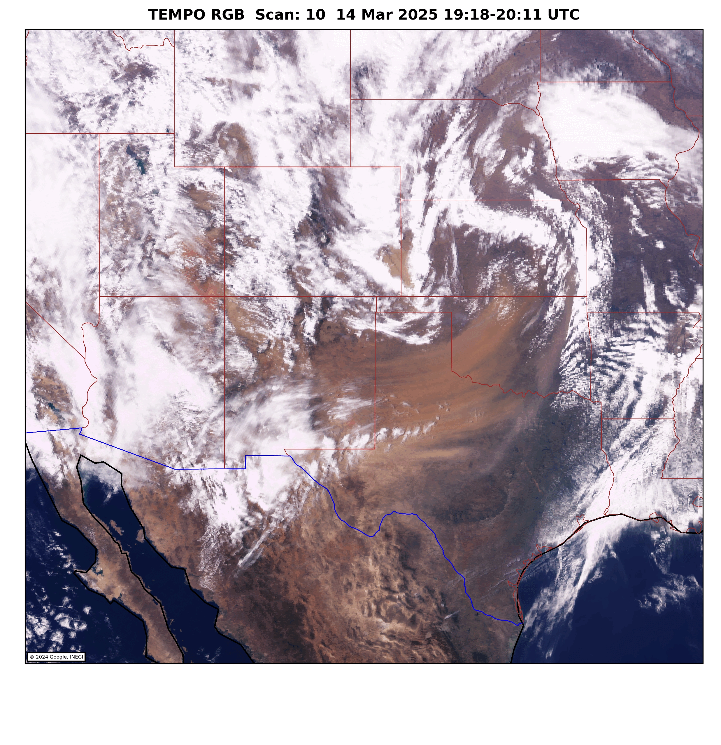
Case Study: Dust Outbreak Over New Mexico (03/14/25)

Slide 6
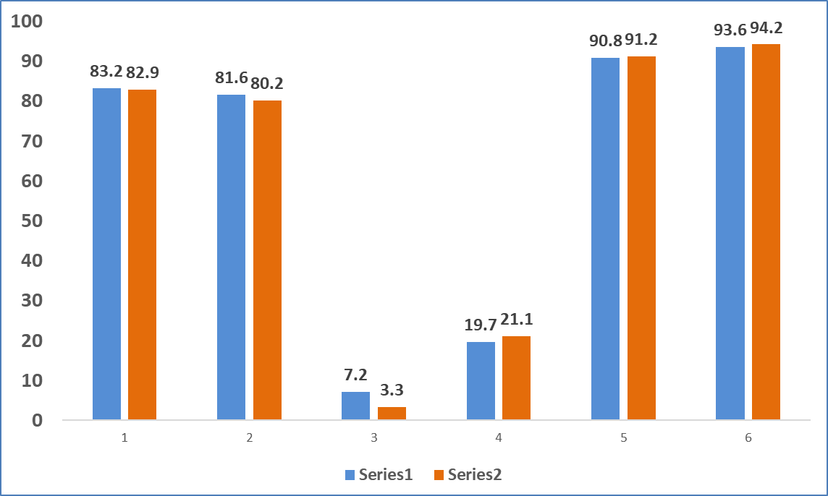
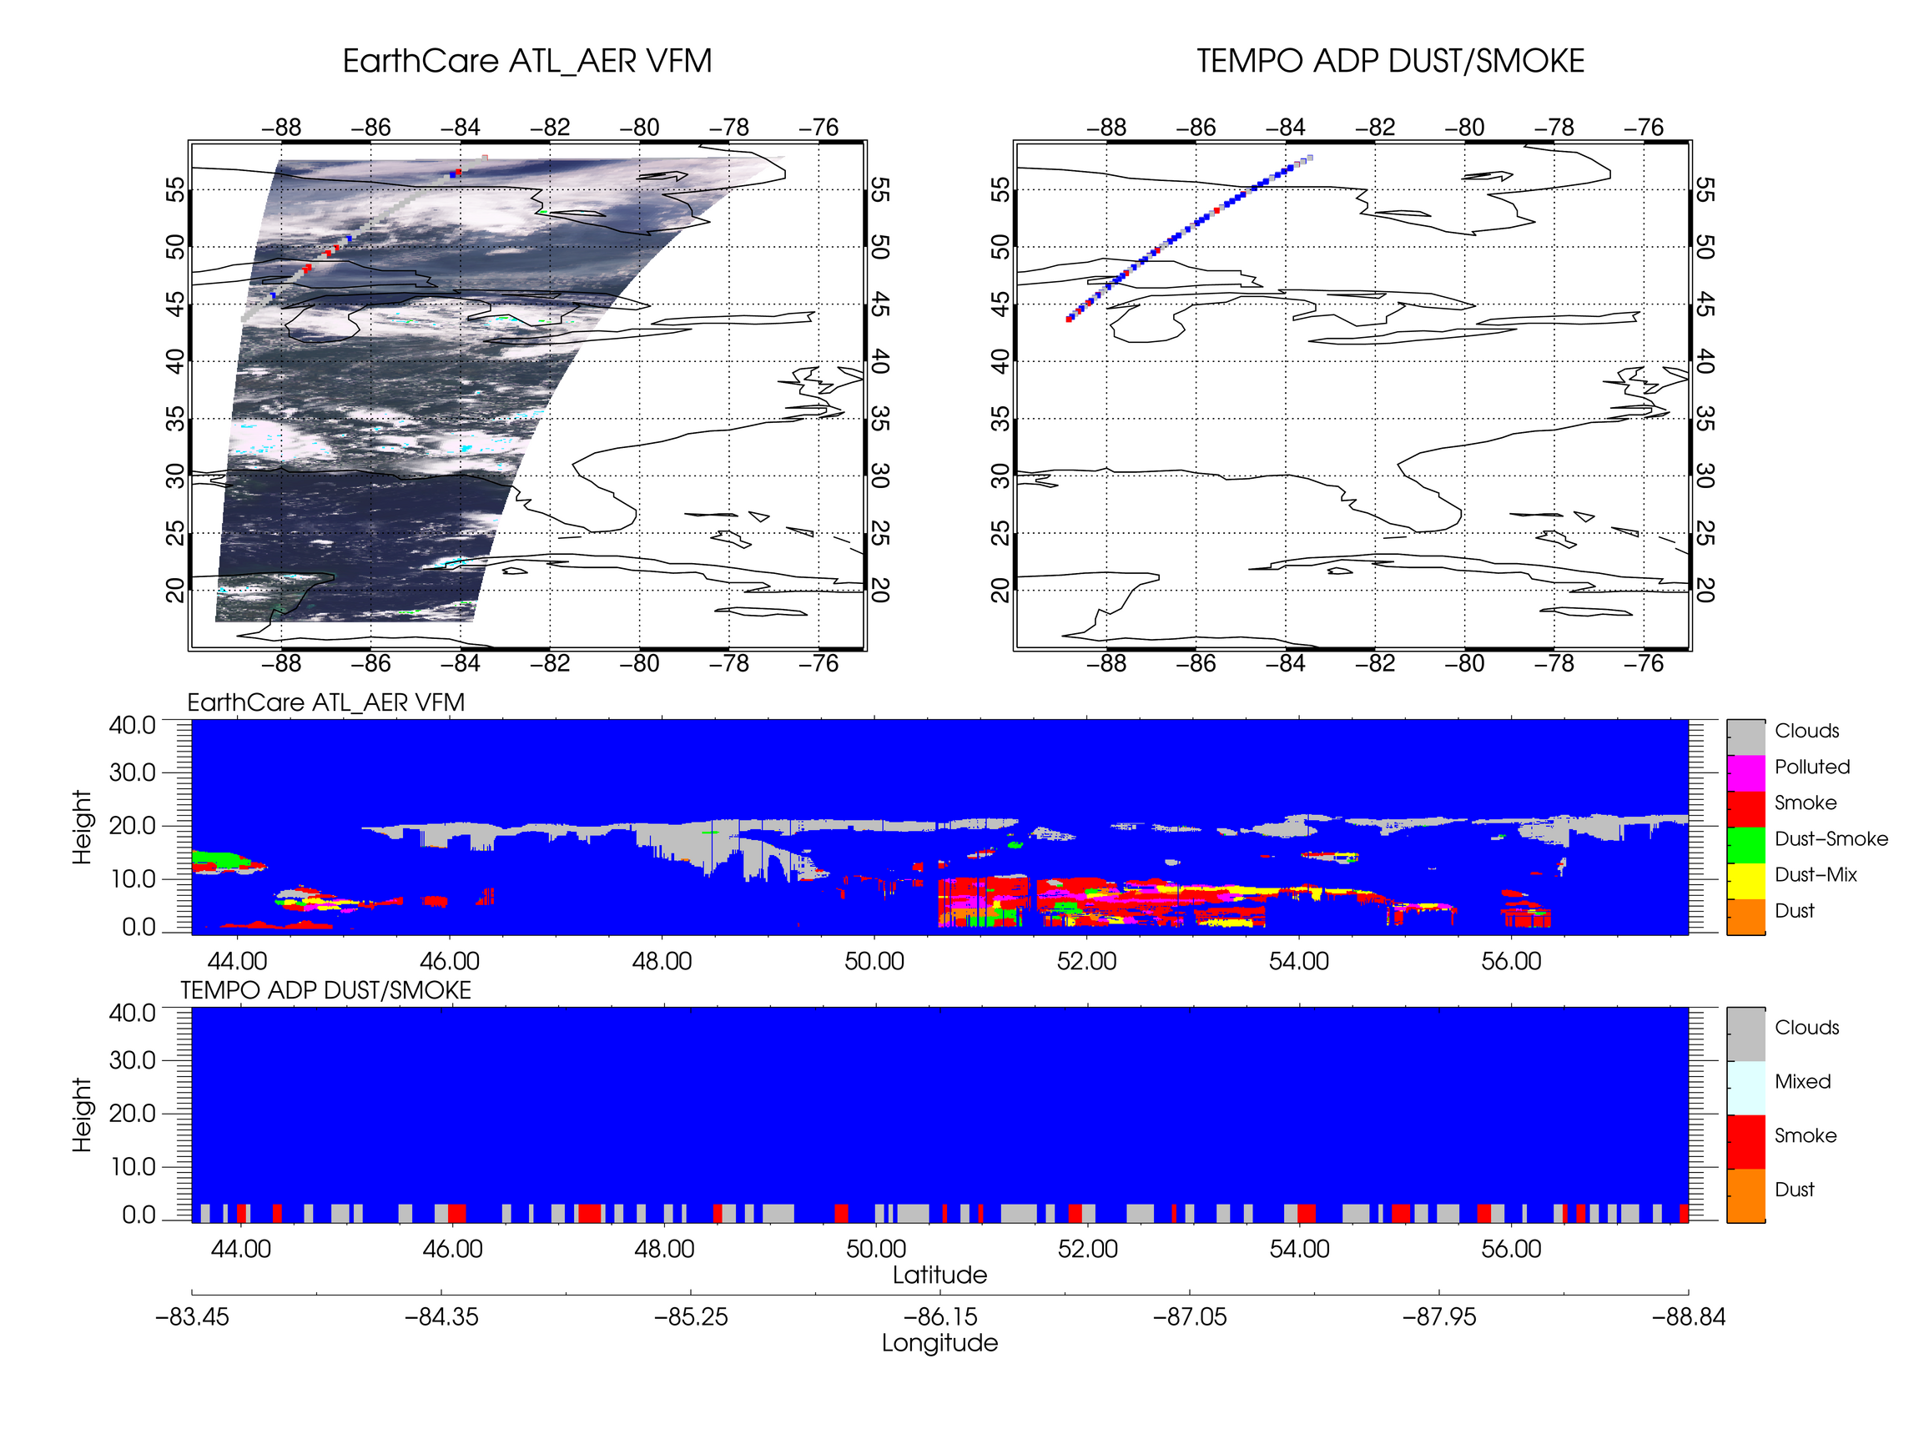
Validation of TEMPO-ABI Hybrid Aerosol Detection Product
Ground-Based Reference
Space-Borne Reference
EarthCARE ATLID
    ATLID AER L2A (available since 03/2025)
  Global vertical aerosol/cloud profiles along a narrow LIDAR track
  Resolution: ~100-500 m vertically,~300 m horizontally
AERONET
~150 AERONET stations (Level 1.5)
Smoke/Dust Detection Statistics
Time period: 08/2023-07/2025
Smoke Dust
Hit Rate
Smoke Dust
False Alarm Rate
Smoke Dust
Accuracy
TEMPO+G16/19
TEMPO+G18

Slide 7
Summary
Product Availability
  Become available since 08/2023.
  V01 reprocessed: with TEMPO V03 L1B (Aug 2023-May 2025).
  V01 NRT product: with TEMPO NRT V01 L1B (June 2025-present, ~ 2 hr. latency).
  Archived at NOAA STAR → transfer to NASA ASDC.
  One year of data (Aug 2023-Aug 2024) on STAR FTP.
  Contact: Amy Huff (amy.huff@noaa.gov)
Validation Status
  Ongoing validation using both ground-based and space-based observations.
  Preliminary results show strong performance.
Known issues
  False smoke detection over bright surfaces (e.g., White Sands, Great Salt Lake).
  Occasional false smoke/dust detection over large cloud shadows in the early and late evening.

Slide 8
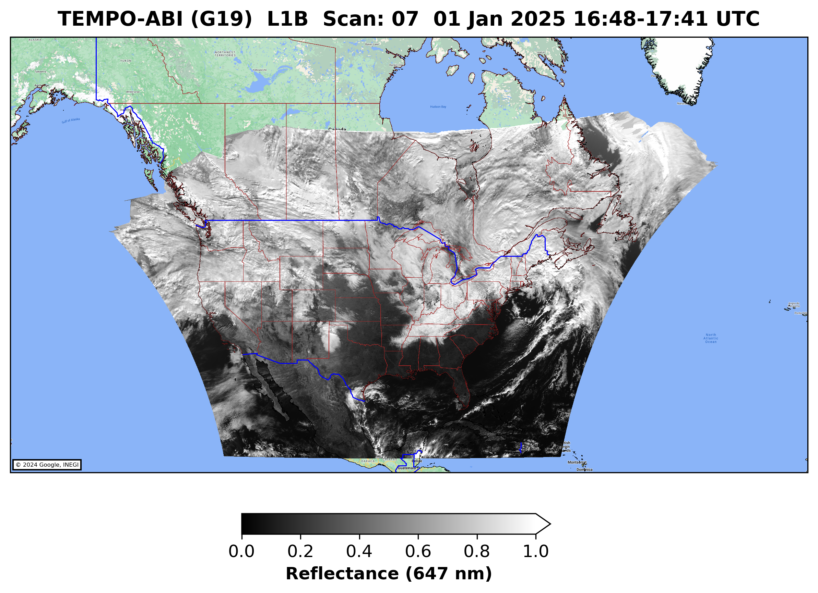
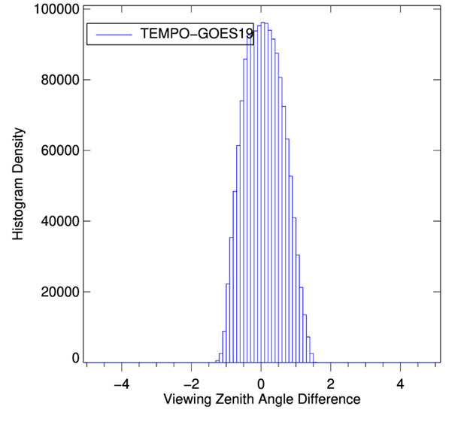
GOES-19 ABI Band 2 (647 nm) Reflectance vs. TEMPO Observations
GOES-19 at checkout Location:
Satellites located very close to each other:
  TEMPO on Intelsat-40e at 91°W
  ABI on GOES-19 at 89.5°W
  Small difference in VZA (viewing zenith angle)
  ABI band 2 fully within TEMPO visible spectrum
Date: Feb 20, 2025
  Region:30-50°N x 100-80°W (red rectangle)
VZA difference is limited to ± 0.5º
TEMPO is ~10% brighter than ABI, larger
differences for darker scenes
Slight diurnal variation observed

Slide 9
Validation of TEMPO-ABI Hybrid Aerosol Detection Product
Ground-Based Reference
Space-Borne Reference
EarthCARE ATLID
    ATLID AER L2A (available since 03/2025)
  Global vertical aerosol/cloud profiles along a narrow LIDAR track
  Resolution: ~100-500 m vertically,~300 m horizontally
AERONET
~150 AERONET stations (Level 1.5)
AERONET Detections |  | AOD @550nm | Ångström Exponent (440nm/870nm)
Smoke | Yes | > 0.2 | > 1.0
 | No |  | < 0.5
Dust | Yes | > 0.2 | < 0.5
 | No |  | > 1.0
Smoke (Dust) Detection Statistics
AERONET |  | Hit Rate | False Alarm Ratio | Accuracy
08/2023-07/2025 | G16/19 | 83.2 (81.6) | 7.2 (19.7) | 90.8 (93.6)
08/2023-07/2025 | G18 | 82.9 (80.2) | 3.3 (21.1) | 91.2 (94.2)

