Slide 1
TEMPO/GeoXO ACX Joint Science Team Workshop
August 19-22, 2025
Cambridge, Massachusetts
Planned TEMPO Near UV Aerosol Product
Omar Torres¹, Changwoo Ahn², Hiren Jethva³
¹NASA/GSFC,² Science Systems and Applications, Inc, ³Morgan State University

Slide 2
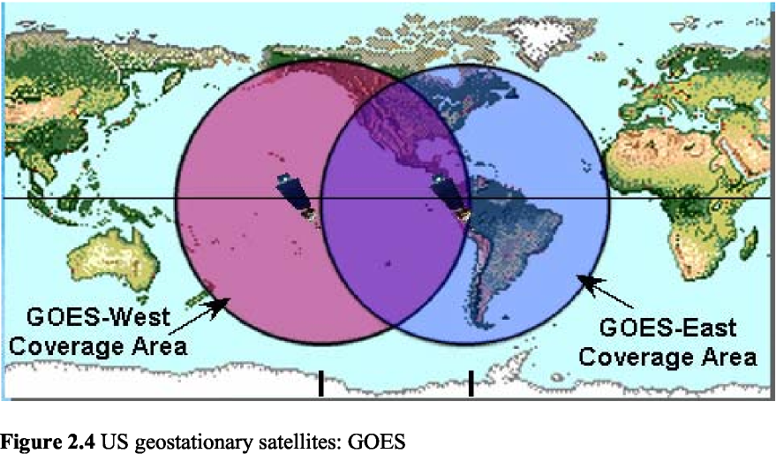
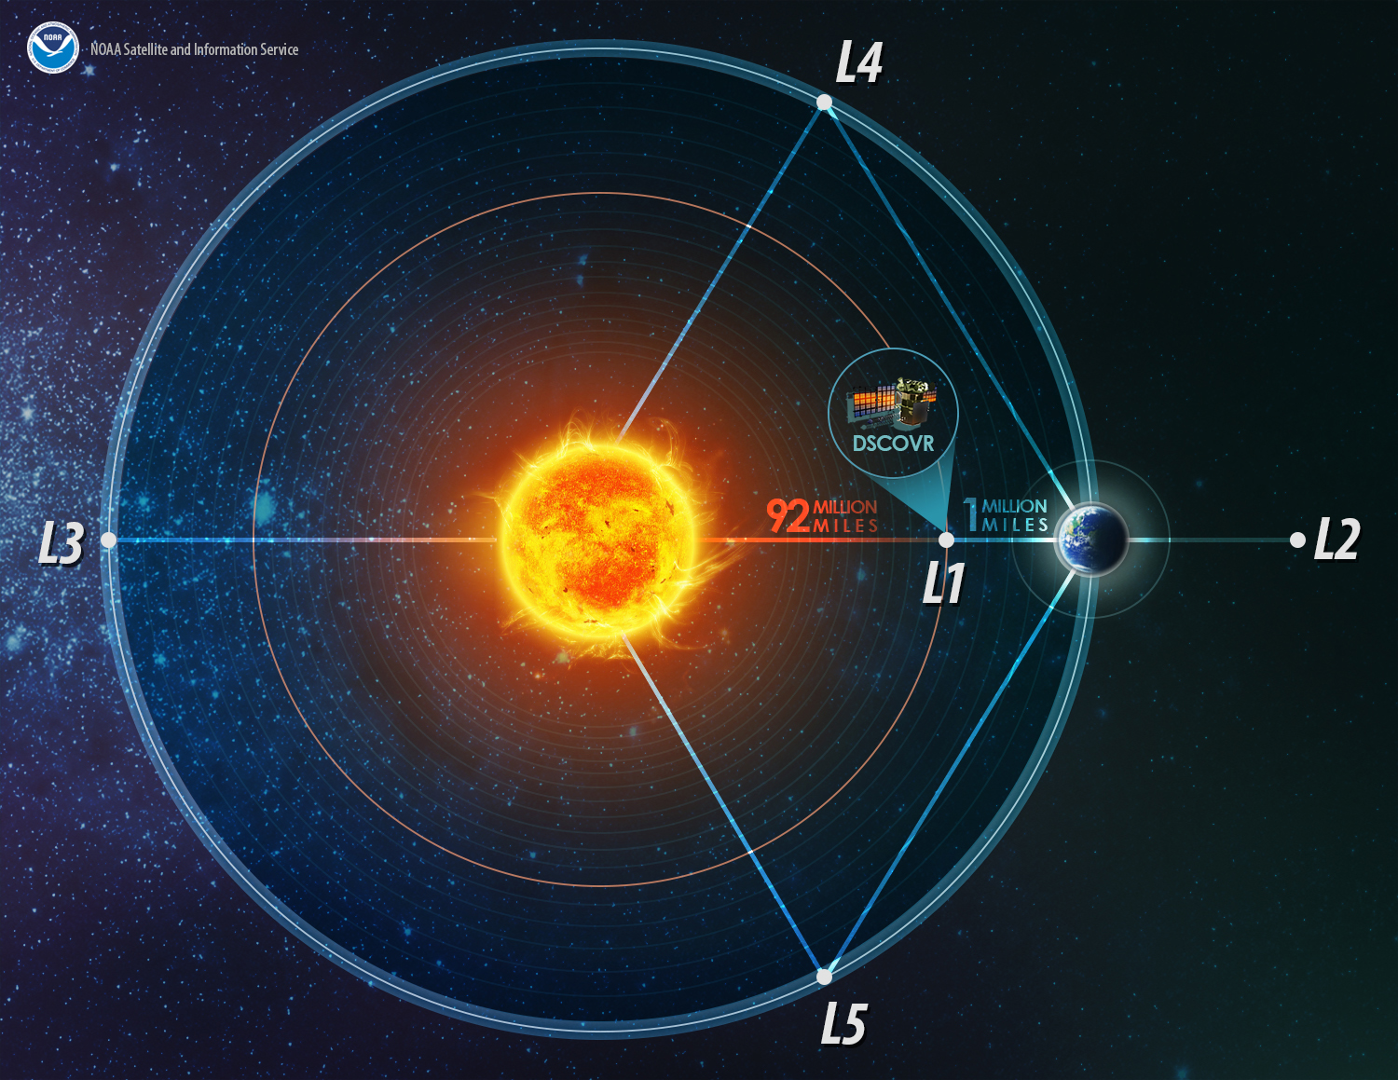
New Generation of UV and O2-B Capable Satellite Sensors
Agency | Sensor | Satellite | Spectral range of observations (nm) | Resolution | Period | Orbit
NASA EU (CAMS/ESA) NASA-SAO NASA | EPIC TROPOMI TEMPO OCI | DSCOVR Sentinel 5 Precursor Intelsat-40 PACE | 318,340, 388, 443,551,680,688,764,780 nm 270-500; 675-775 & 2305-2385 (Hyp.) 290-490 & 540-740 (Hyp.) 340-890 nm (2.5nm steps) | ~ 18 km 3.5X5.5 km 2.1x4.7 1.2 km | 2015-Present 2018-Present 2023-Present 2024-Present | L1 LEO GEO LEO
Geo-Synchronous Orbit (GEO)
Lagrangian1 Orbit (L1)
-Aerosol Characterization from near UV satellite observations requires information on aerosol layer height.
-Recently deployed UV-capable sensors also include Oxygen-B band channels that allow ALH derivation.
-EPIC, TROPOMI and planned TEMPO sensors use a similar algorithm.
-In this presentation we use EPIC L1 observations as a TEMPO proxy

Slide 3
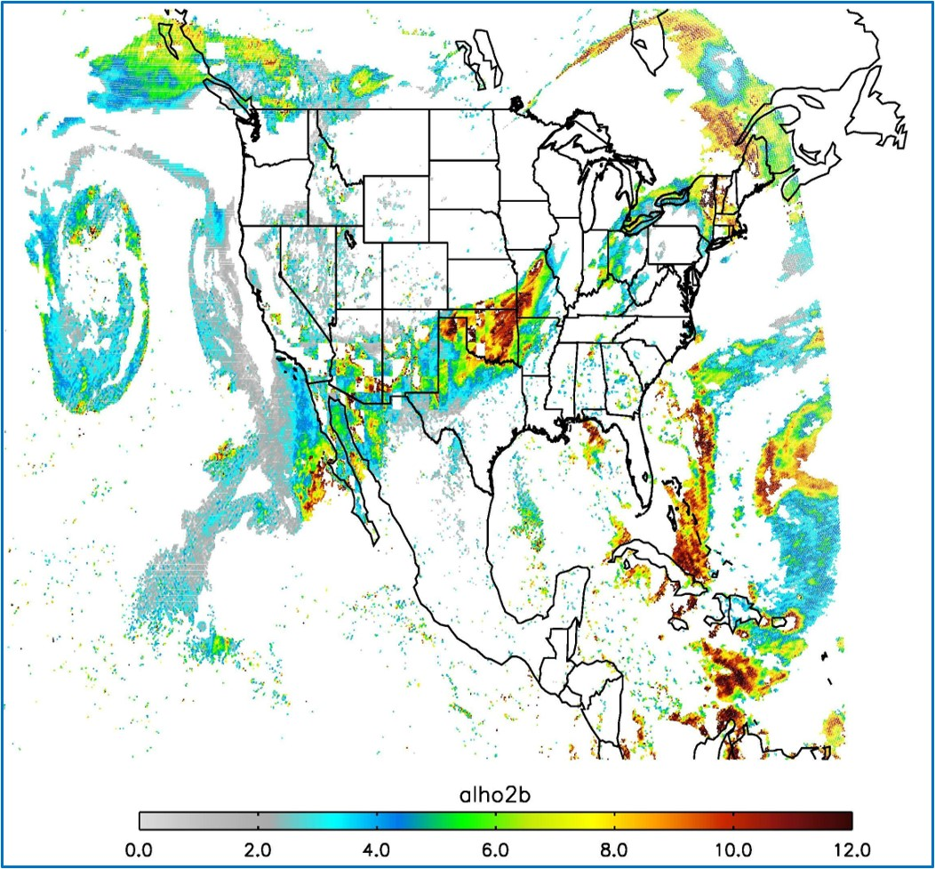
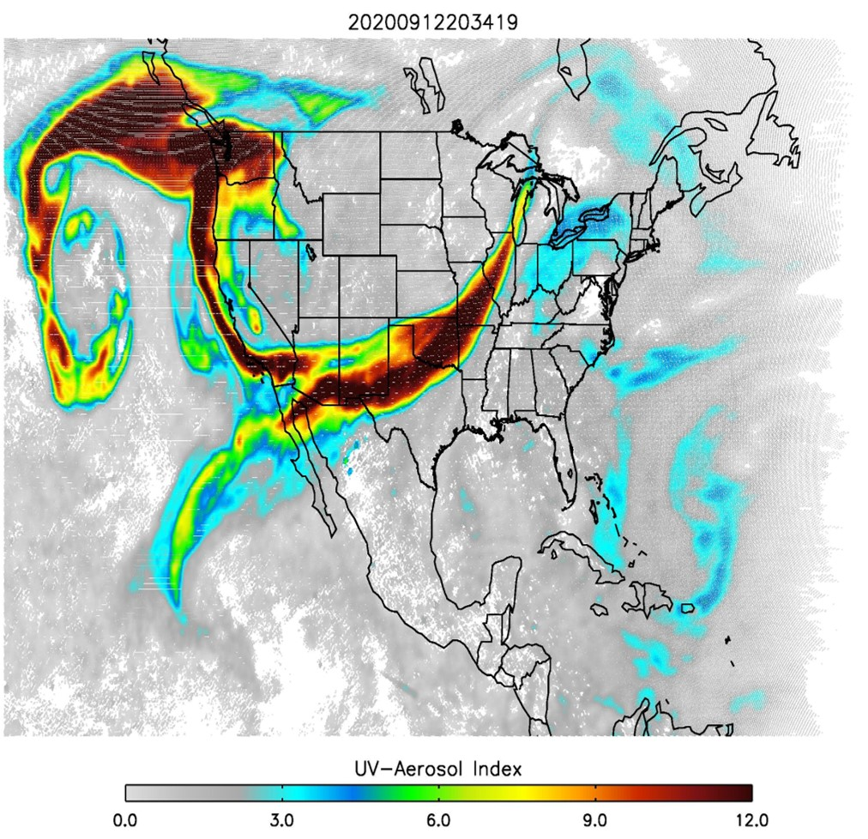
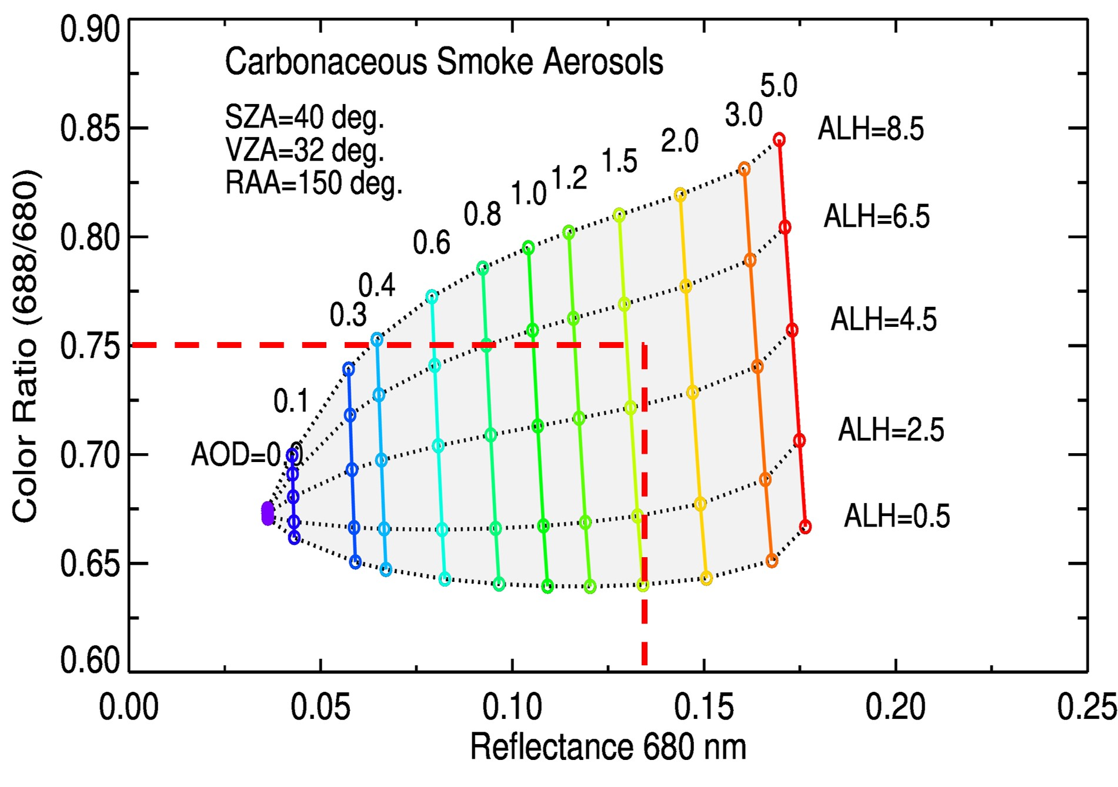
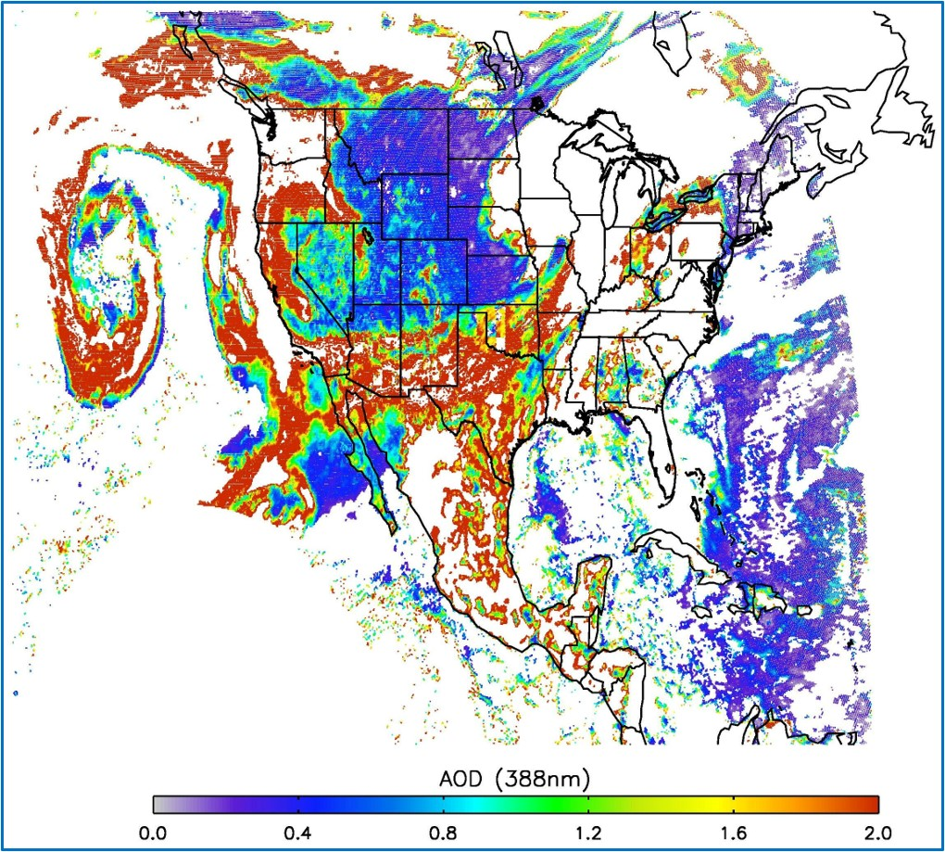
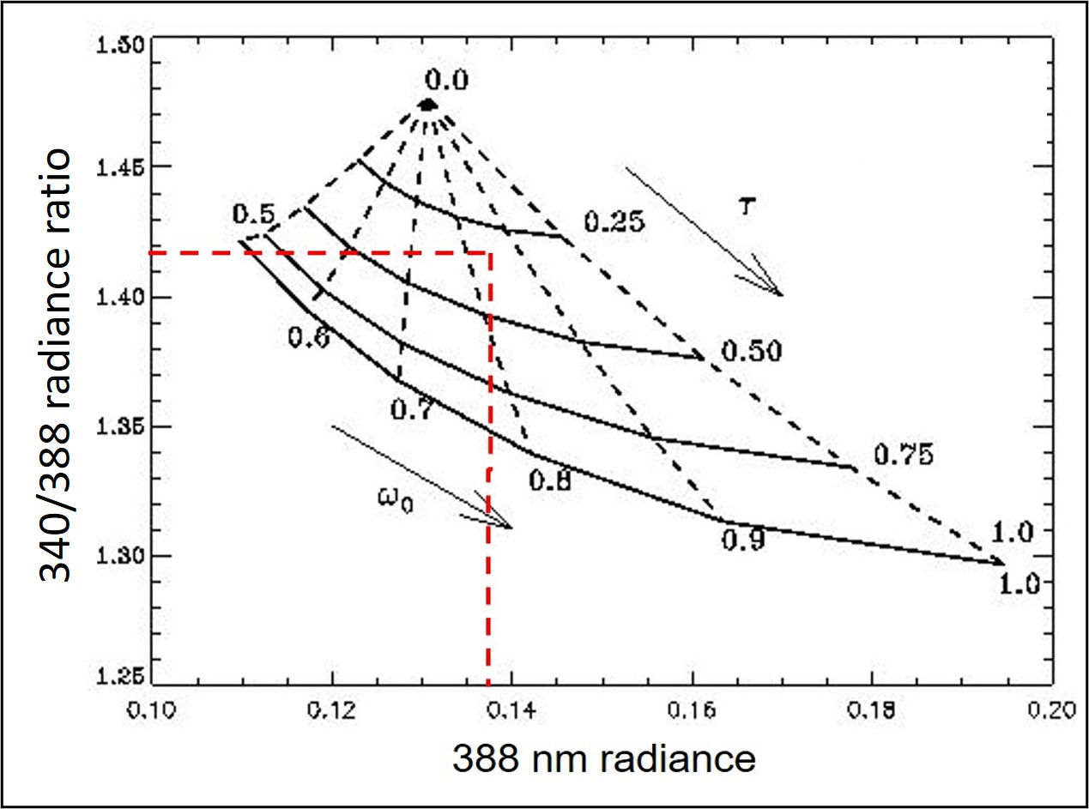
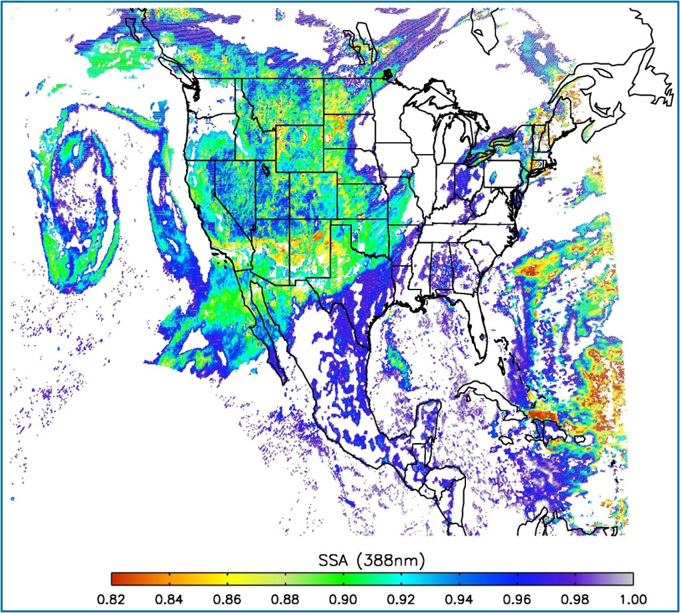
A DSCOVR/EPIC-based TEMPO UV Aerosol Retrieval Algorithm
September 12, 2020
680,688 nm pair is used to simultaneously
retrieve ALH nm 680 nm AOD (Xu, et al., 2019)
Aerosol Layer Height (km)
Aerosol Layer Height (km)
ALH
ALH
340,388 nm pair is used to simultaneously
retrieve 388 nm AOD and SSA

Slide 4
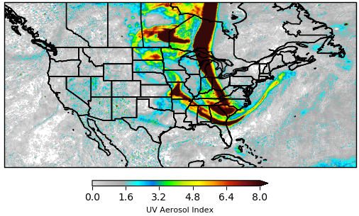
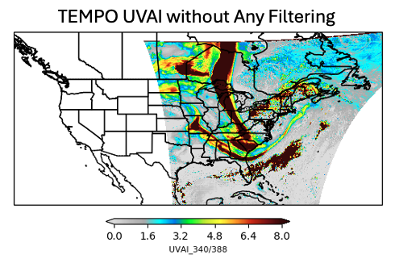
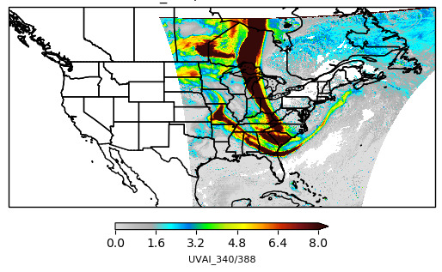
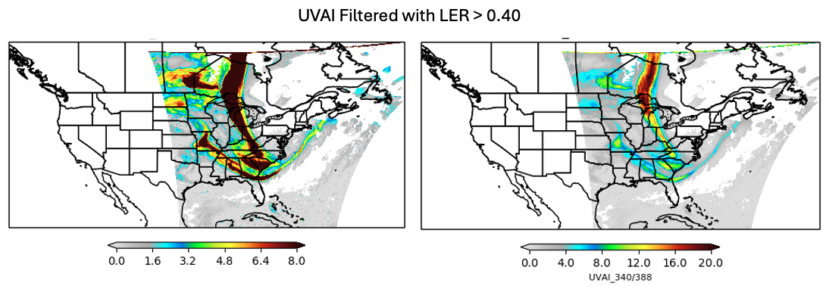
Comparison of EPIC and TEMPO UVAI on May 31, 2025
Standard EPIC UVAI
For both sensors UVAI is calculated using 340 and 388 nm radiances
EPIC time frame at 18:13:14 UTC
TEMPO time frames of 6 granules for S010 (18:14:57 – 18:45:19 UTC)
TEMPO Filtered with Saturated Pixels
UVAI Filtered with LER >0.40
Spurious UVAI Signal
Spurious UVAI Signal
An 0.40 Lambert Equivalent Reflectivity (LER)
upper limit eliminates almost all
spurious UVAI signal.
SAO-filter removes largest spurious UVAI signal but the feature over Quebec remains.

Slide 5
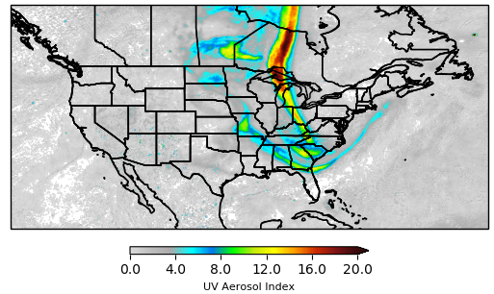
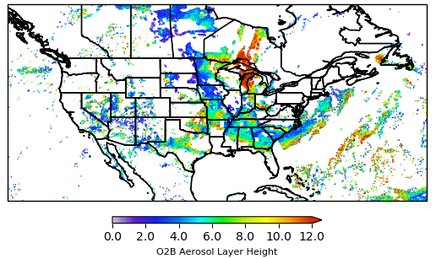
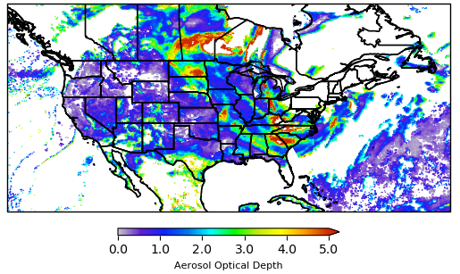
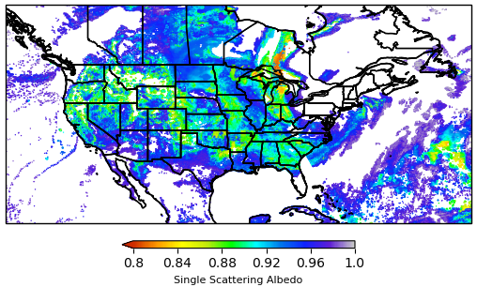
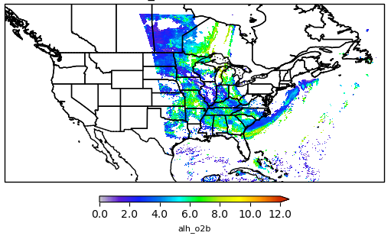
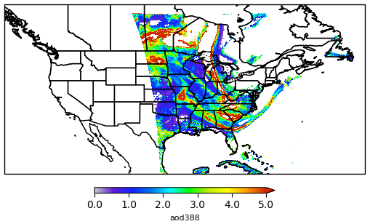
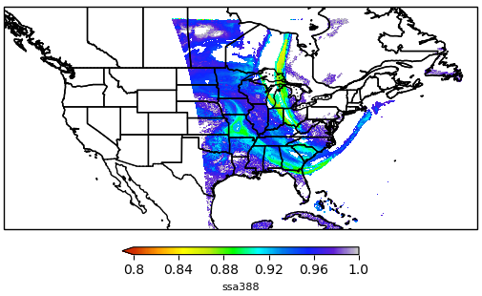
UV Aerosol Products from EPIC and TEMPO for May 31, 2025
UV Aerosol Index Aerosol Layer Height (km) Aerosol Optical Depth Aerosol Single Scattering Albedo
EPIC
UVAI
EPIC
ALH
EPIC
AOD
EPIC
SSA
TEMPO
UVAI
TEMPO
ALH
TEMPO
AOD
TEMPO
SSA
Spatial distributions and magnitudes of TEMPO retrieved aerosol parameters resemble those obtained by the EPIC
sensor. The main exception is the ALH product. The current TEMPO algorithm does not account for ALH’s larger than
about 8 km.

Slide 6
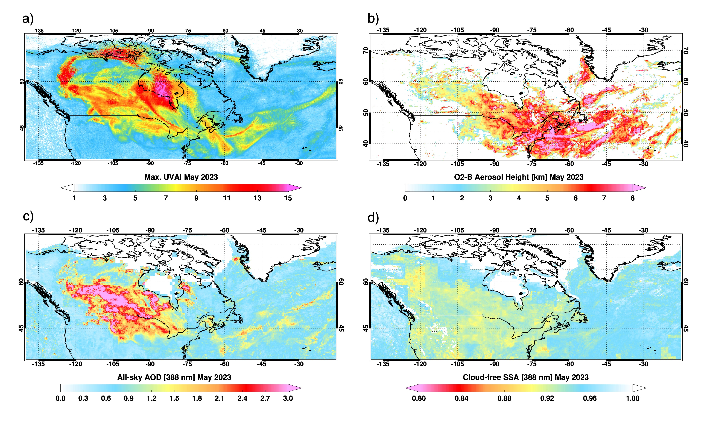
May 2023 composite of EPIC aerosol products associated with Canadian wildfires
UV Aerosol Index
Aerosol Layer Height
All-sky AOD
Cloud-free SSA

Slide 7
Summary
- A research version of TEMPO UV aerosol algorithm has been developed and preliminarily evaluated for a case study (Canadian wildfires on May 31, 2025).
- Retrieved TEMPO aerosol products (i.e., AOD, SSA, O2B ALH, and UVAI) are consistent with those from DSCOVR/EPIC algorithm.

