Slide 1

TEMPO NO₂ Retrieval for ACX and Impact of Polarization Correction
Kai Yang – UMD
Shobha Kondragunta – NOAA
Lawrence E. Flynn – NOAA
Zigang Wei – STC
Disclaimer: The scientific results and conclusions, as well as any views or opinions expressed herein, are those of the author(s) and do not necessarily reflect those of NOAA or he Department of Commerce.
19 − 22 August 2025, TEMPO/GeoXO ACX STM, CFA, Cambridge, MA and online everywhere

Slide 2



GeoXO ACX NO₂ Algorithm Development
We are developing an advanced NO₂ algorithm for GeoXO ACX processing and demonstrating its accuracy using proxy data.
We plan to make a series of algorithm advancements, from correcting imperfections in spectral measurements to enhancing algorithmic physics:
  Perfecting techniques to correct spectral measurements
    wavelength registrations
    variations in instrument spectral responses
    anomalous pixels
    stray lights, polarization sensitivity
    inhomogeneous slit illumination, under-sampling correction
    calibration biases
    ﻿common mode spectra
  Accurate algorithm physics implementation
    Stratosphere-troposphere separation (STS)
    Surface reflection (inclusion of BRDF)
    Explicit treatment of aerosols/clouds
Proxy Data

Slide 3
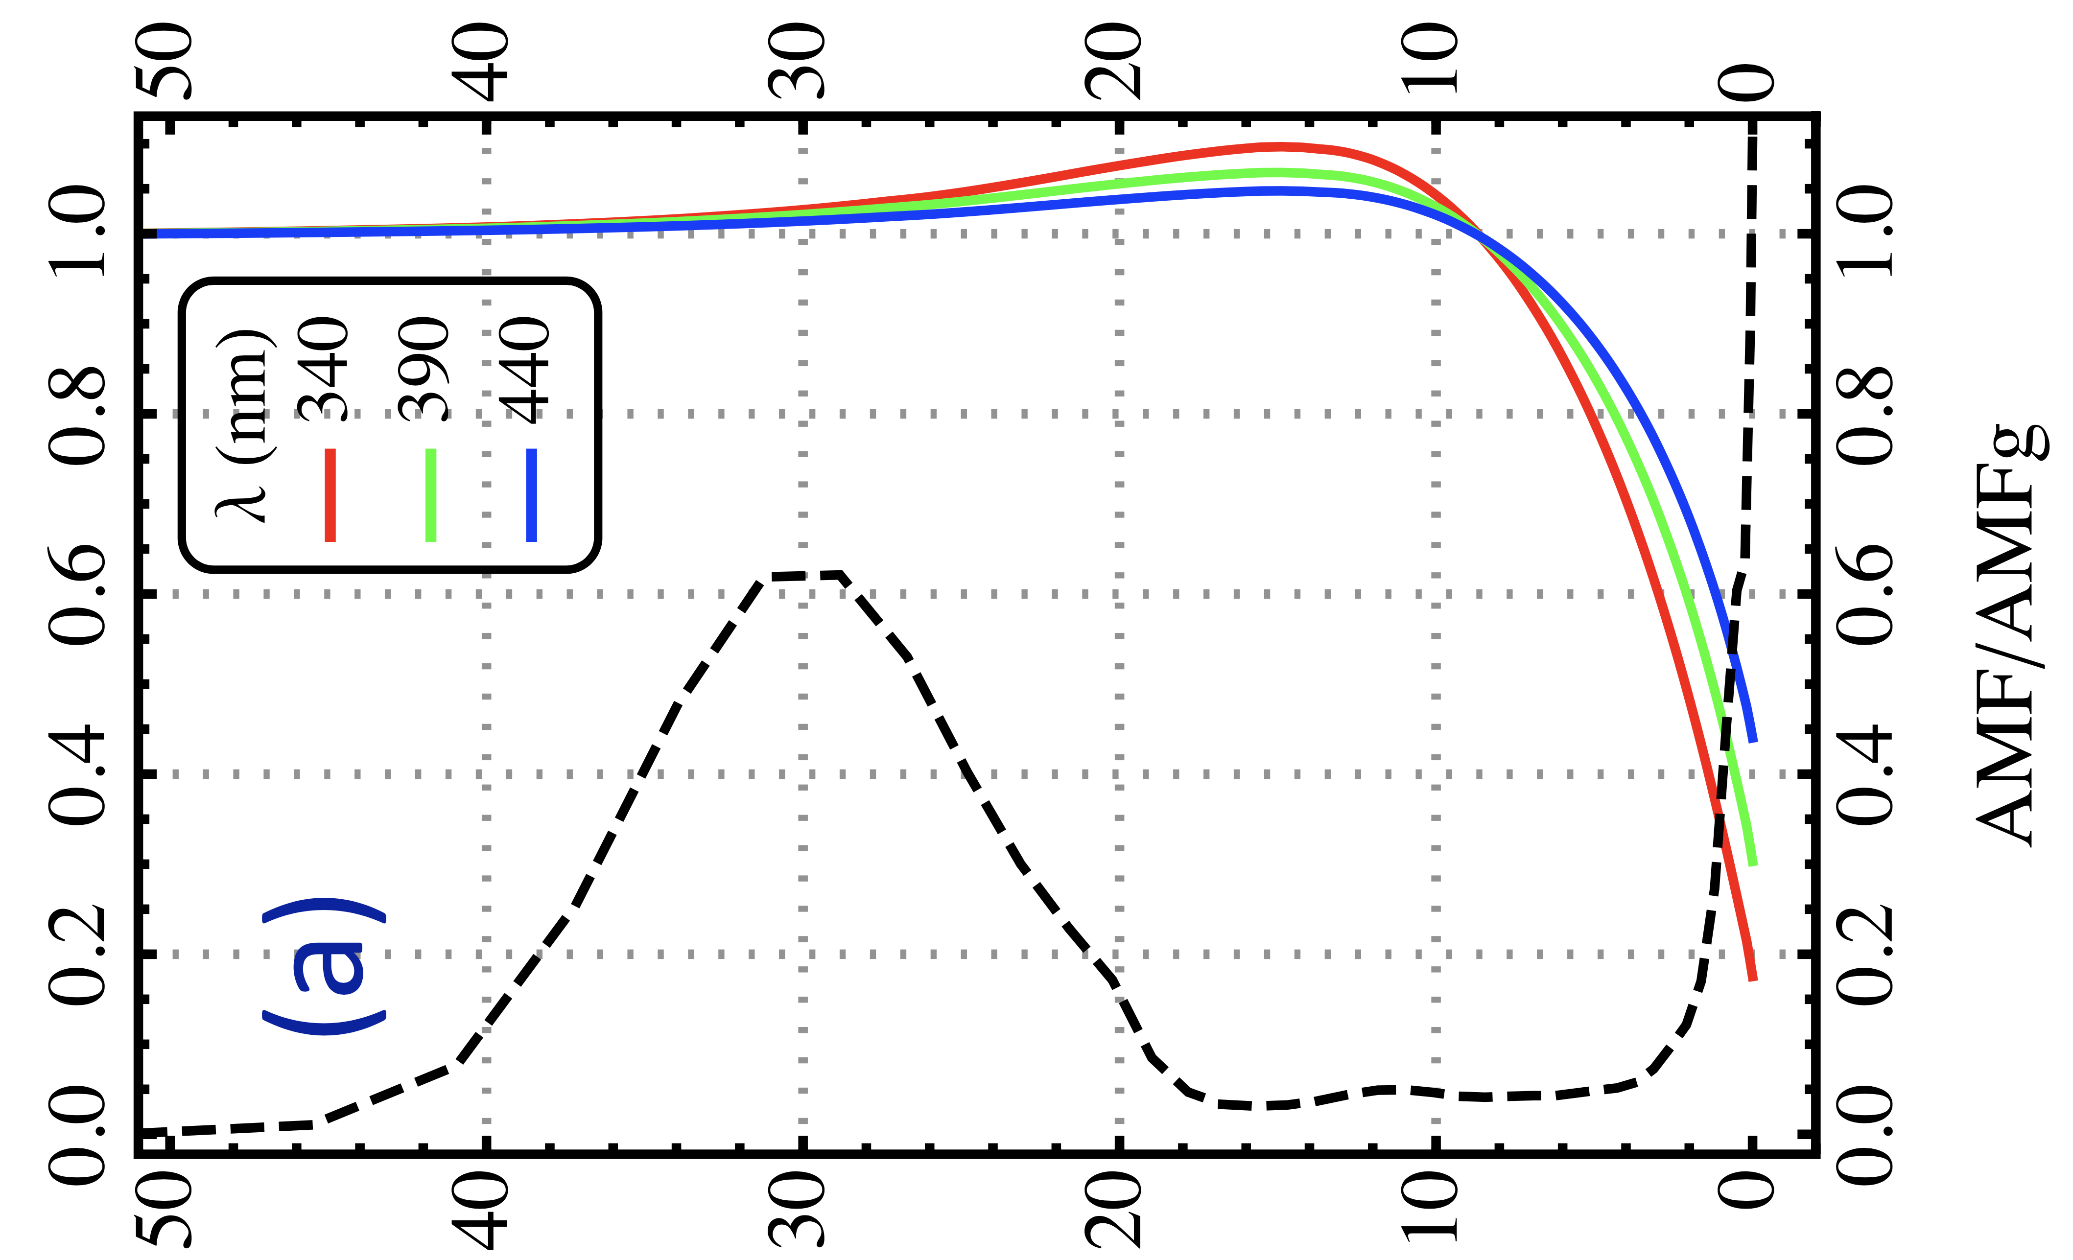
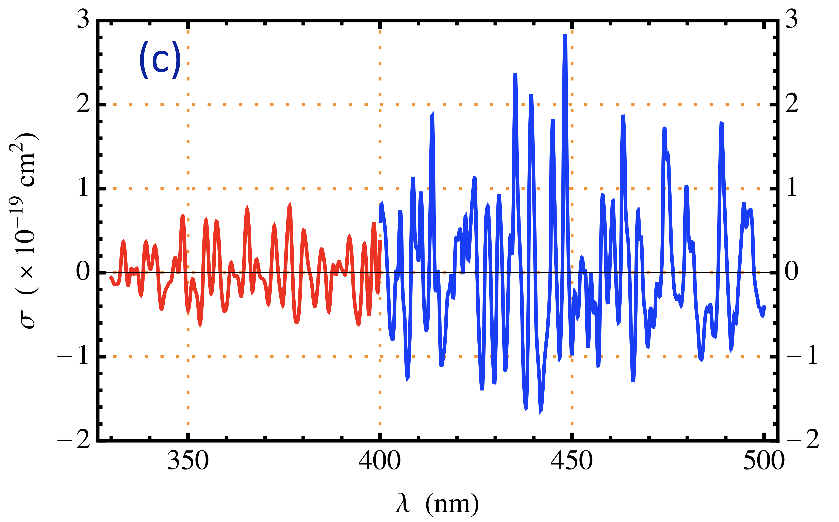
Joint UV-Vis Retrieval to Separate
Stratospheric and Tropospheric NO₂ Columns
Idea:
Use retrieval from UV to constrain the stratospheric NO₂, then retrieval from VIS to determine tropospheric NO₂
AMF
vs
Z and λ
NO₂ Differential Cross Sections

Slide 4
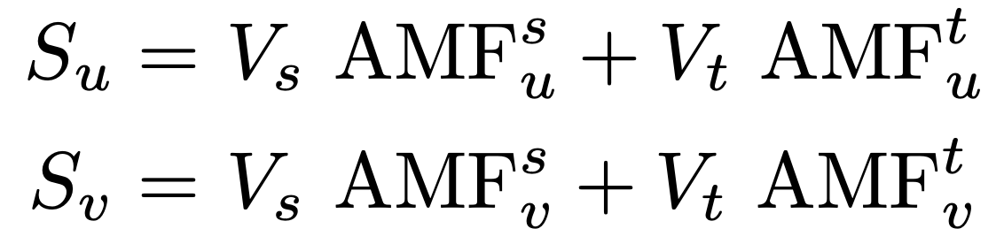
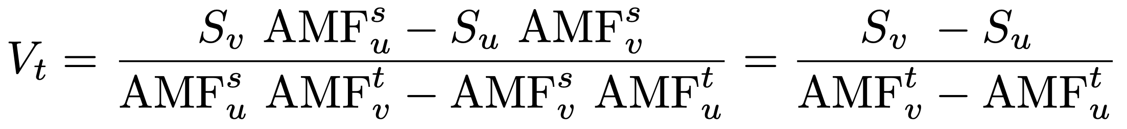
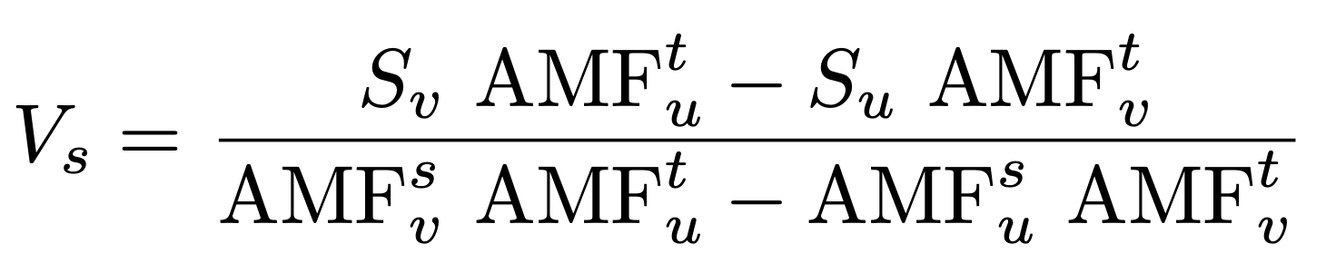
Joint UV-Vis Retrieval to Separate
Stratospheric and Tropospheric NO₂ Columns
S | Slant Column
V | Vertical Column
AMF | Air Mass Factor
u | UV
v | VIS
s | stratosphere
t | troposphere
Slant Column Equations for UV and VIS

Slide 5
Joint UV-Vis STS: Pros and Cons
Pros
Self consistency, without relying on CTMs or interpolation/extrapolation from clean regions
  CTMs : Likely biases
  Interpolation/extrapolation : small-scale variations and/or insufficient nearby clean regions
Cons
The deficiency is the relative NO₂ biases between UV and Vis, due to different spectral bands are affected by spectral interferences differently.
Next analysis of polarization sensitivity on UV and VIS retrievals

Slide 6
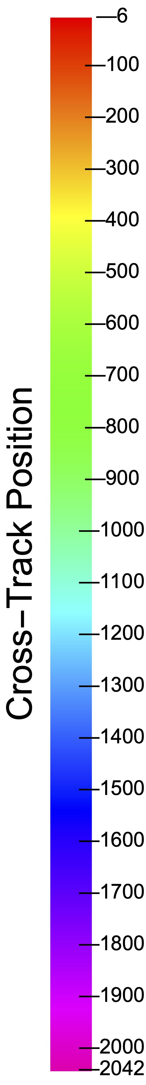
TEMPO Linear Polarization Sensitivity (LSP)
PCA of LSP, First 4 PCs are shown here.
LSP From Xiong Liu
LPS spectra can be accurately reconstructed with a few (<7) PCs

Slide 7
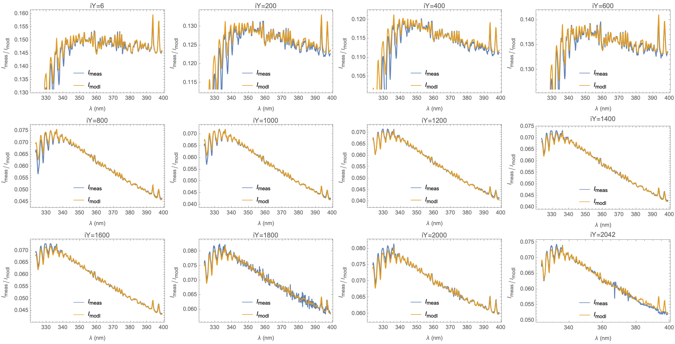
Measurement vs Modeling : UV

Slide 8
Measurement vs Modeling : VIS

Slide 9
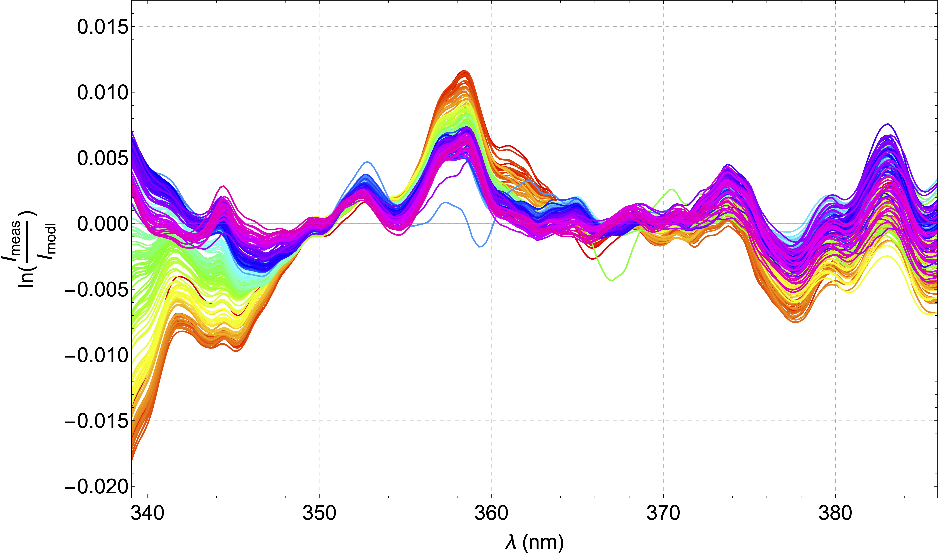
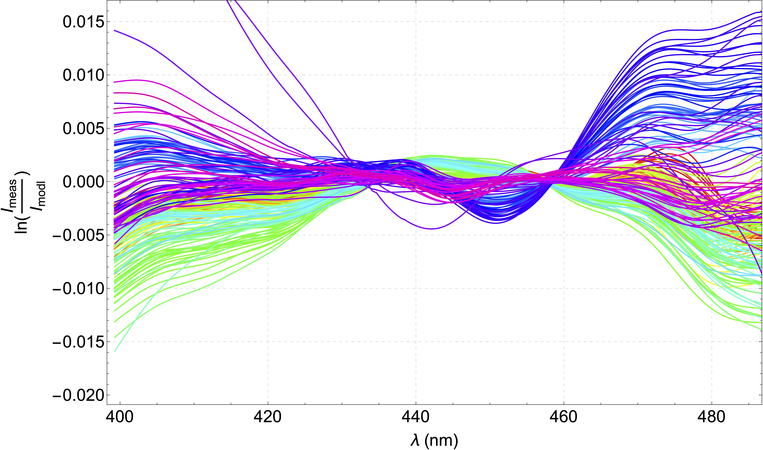
Polarization Sensitivity: Derived vs Measured
UV VIS

Slide 10
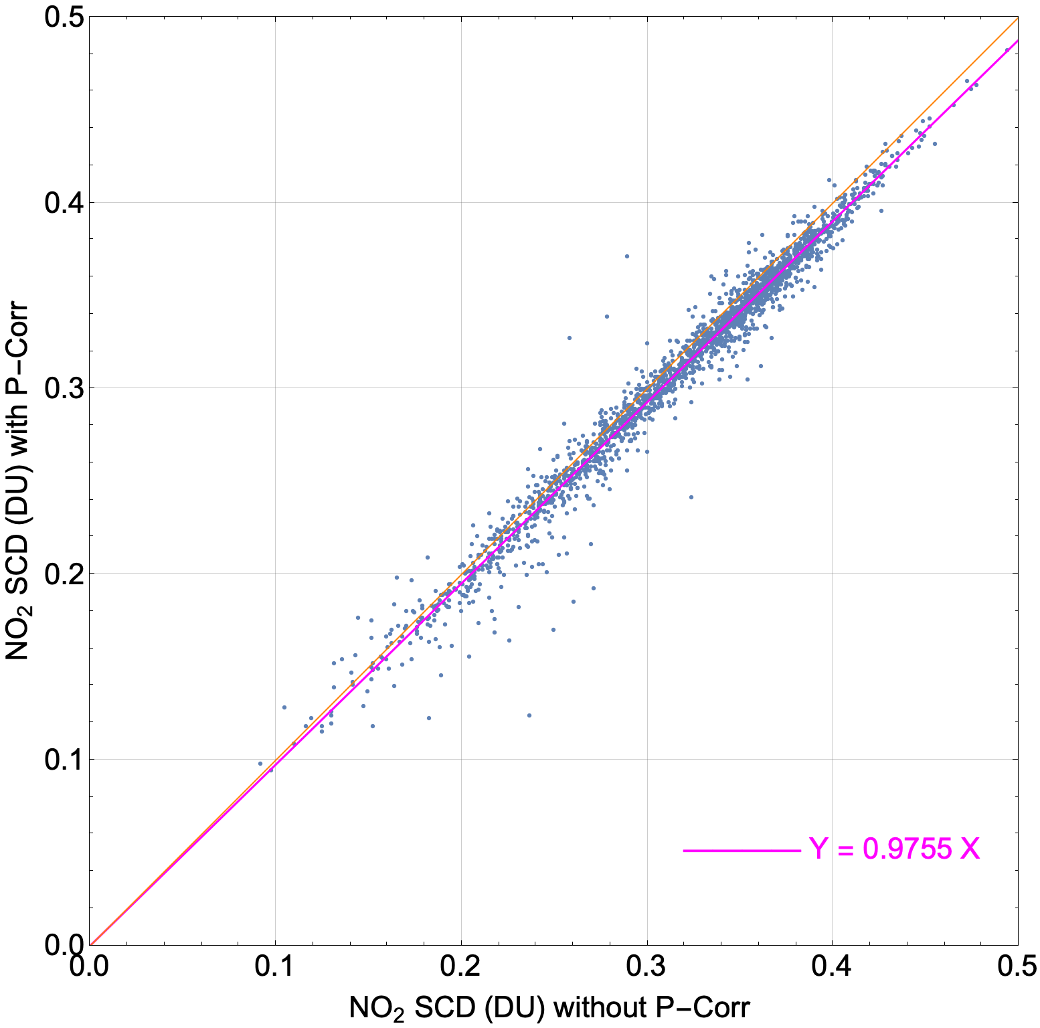
Impact of Polarization Correction (P-Corr)
NO₂ Slant Columns (405– 465 nm)
P-Corr reduces NO₂ slant columns by ~2.5% compared to without P-Corr.

Slide 11
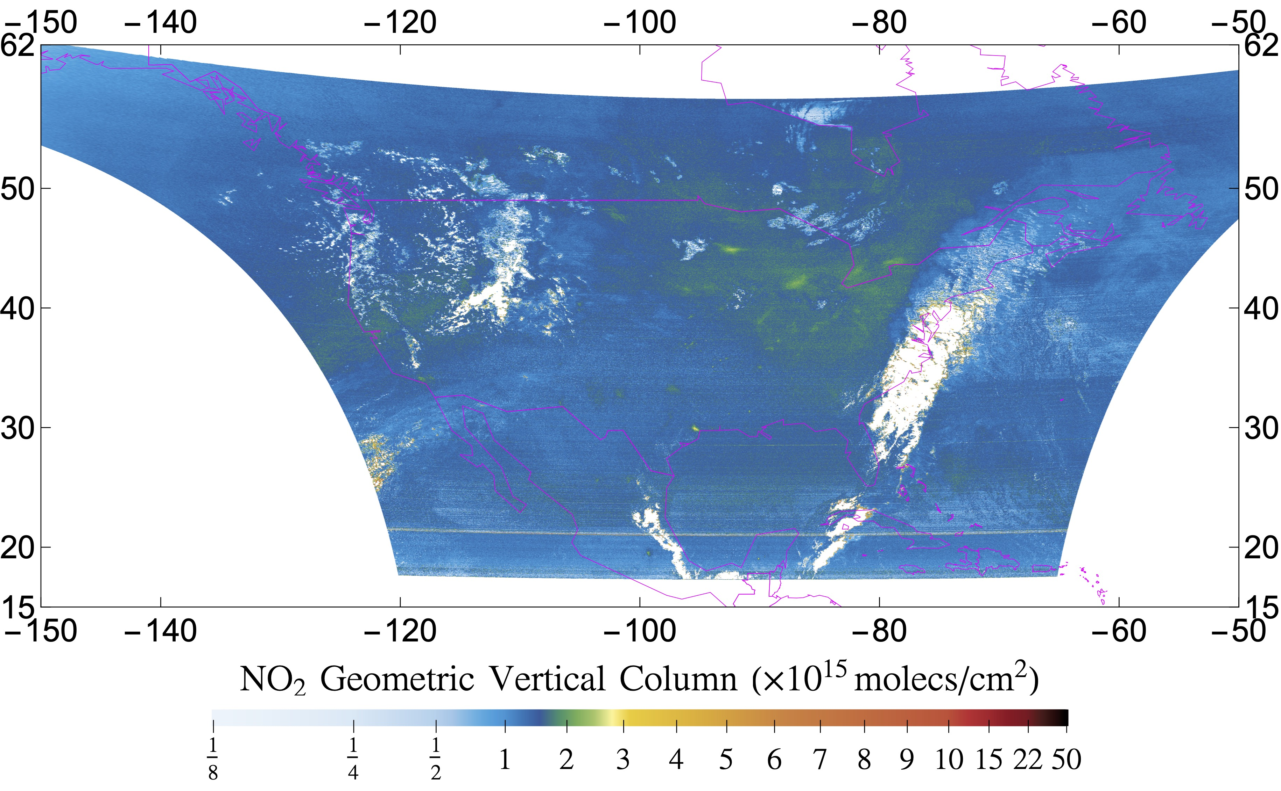
NO₂ Geometric Vertical Column from TEMPO UV
20240328_S011

Slide 12
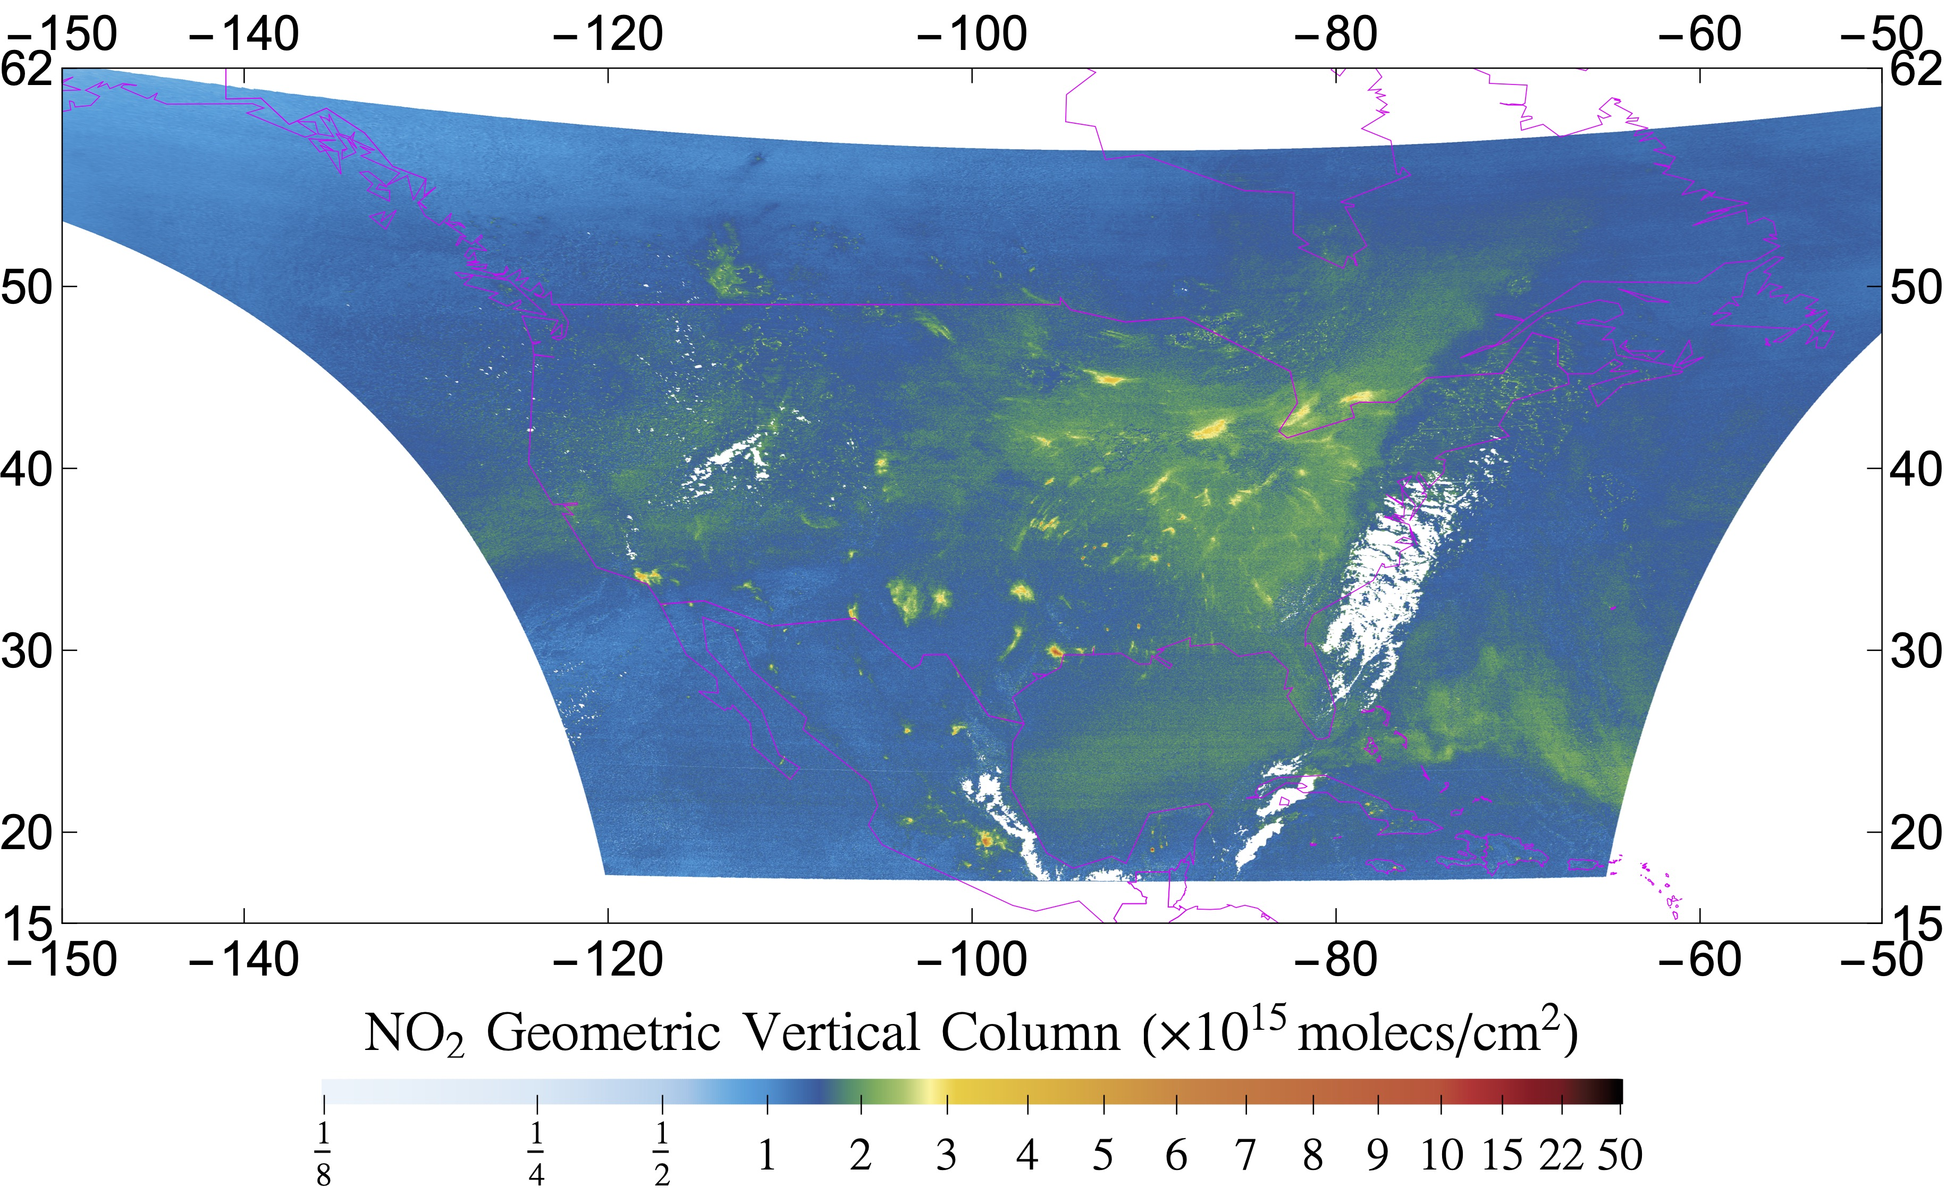
NO₂ Geometric Vertical Column from TEMPO VIS
20240328_S011

Slide 13
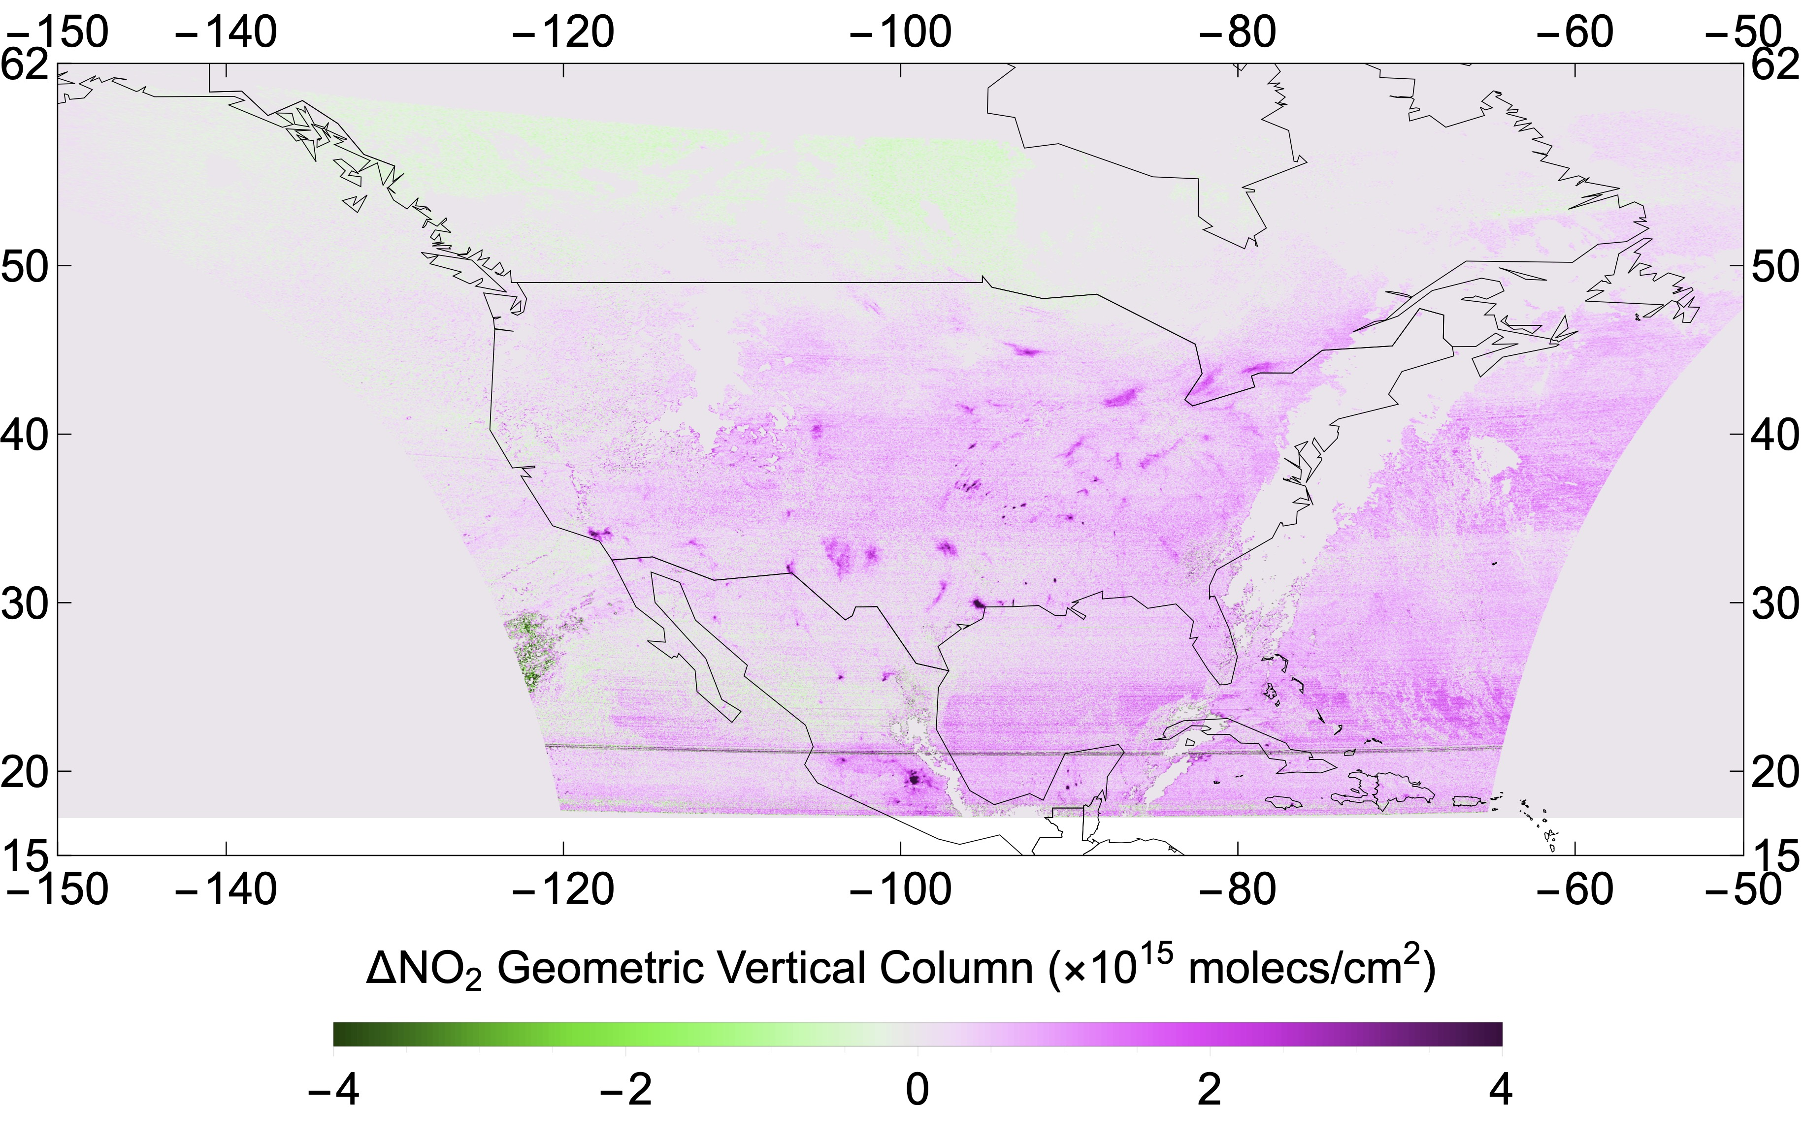
NO₂ Geometric Vertical Column Difference (VIS – UV)
20240328_S011

Slide 14
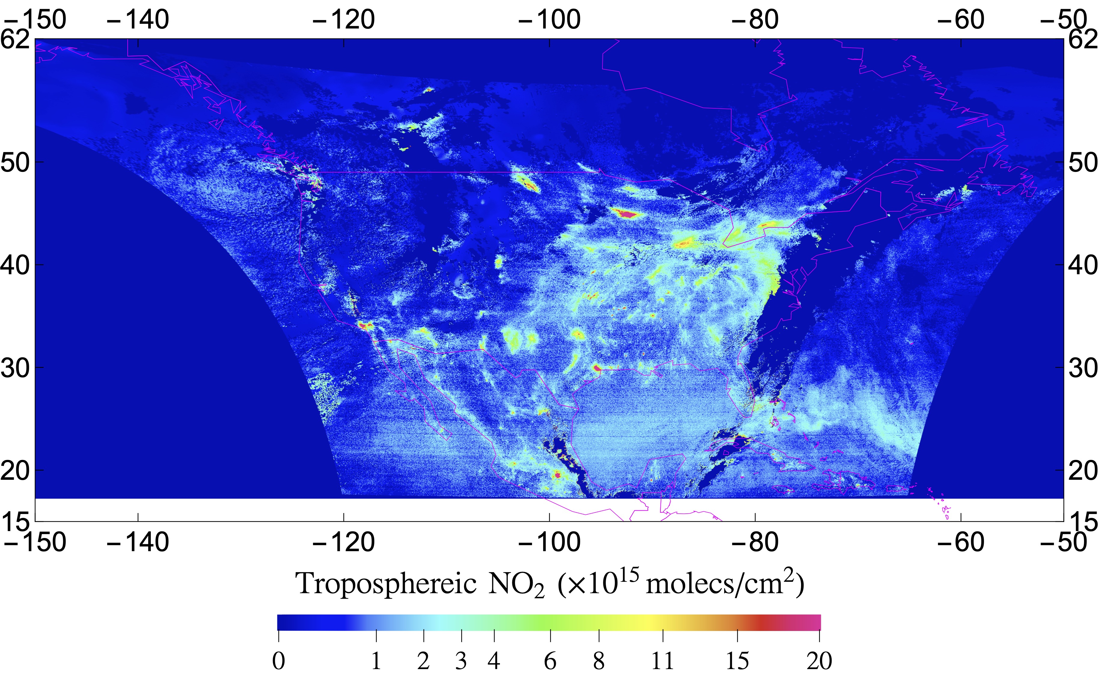
NO₂ Tropospheric Vertical Column from TEMPO
20240328_S011

Slide 15
Summary
Consistent UV and VIS retrievals can be accomplished after corrections of various instrumental effects.
This new STS scheme is successfully demonstrated with TEMPO observations, showing stratospheric NO₂ can be estimated without relying on the traditional STS scheme based on CTMs simulation or interpolation from clean regions.

