Slide 1

GEMS Cloud Algorithm:
Update and Ongoing Progress
TEMPO/GeoXO ACX meeting 2025
Aug 19th, 2025
Gyuyeon Kim, Minjeong Cho, and Yong-Sang Choi
Ewha Womans University

Slide 2
CONTENTS
Overview of GEMS cloud algorithm
Update result of GEMS cloud V3
Temperature correction of O₂-O₂
Summary

Slide 3
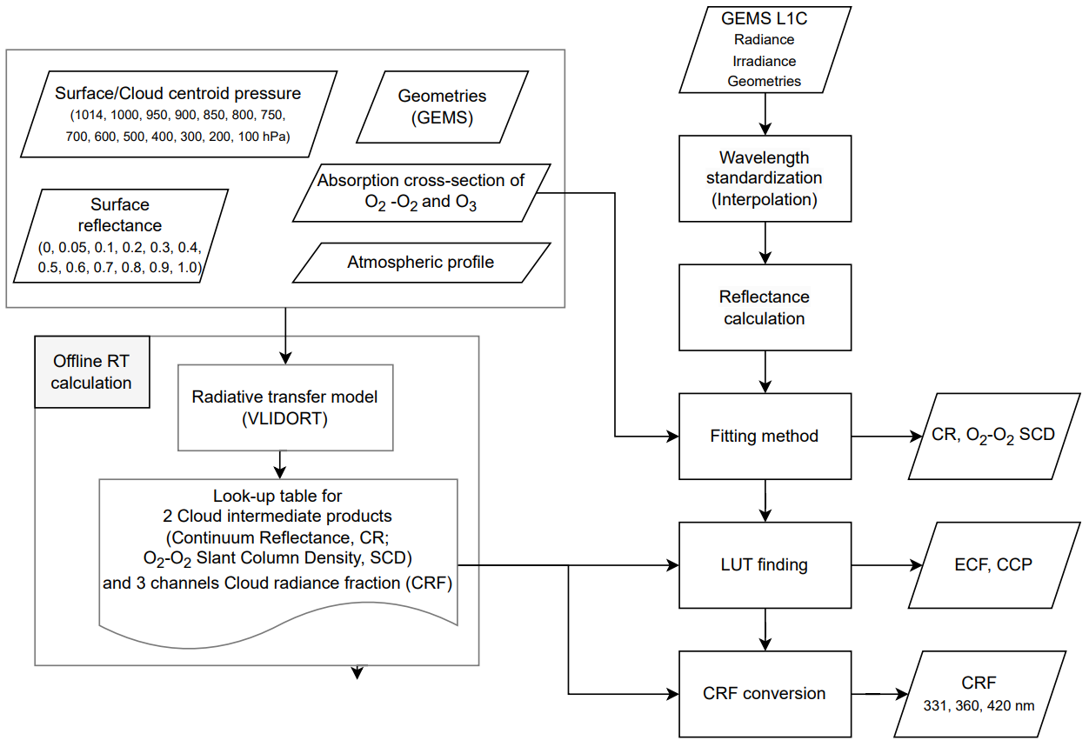
I. Overview of GEMS cloud algorithm
CR: Continuum Reflectance
SCD: Slant Column Density of O₂-O₂
DOAS: Differential Optical Absorption
Spectroscopy
ECF: Effective Cloud Fraction
CCP: Cloud Centroid Pressure
CRF: Cloud Radiance Fraction

Slide 4
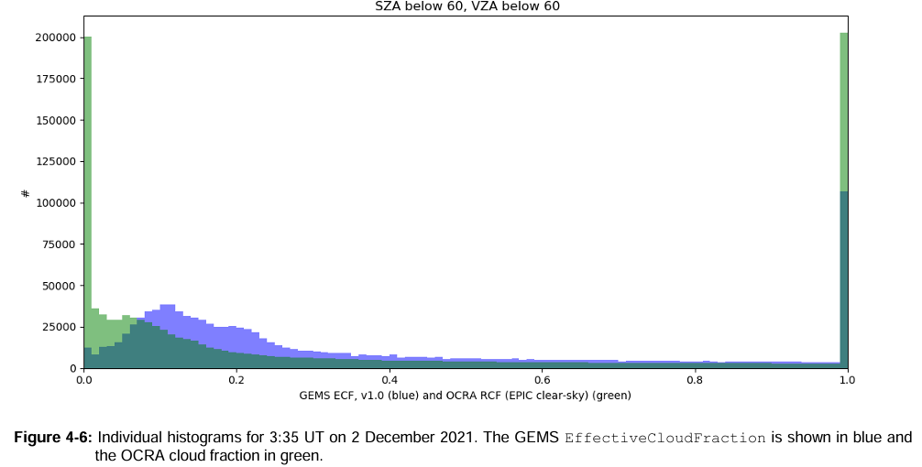
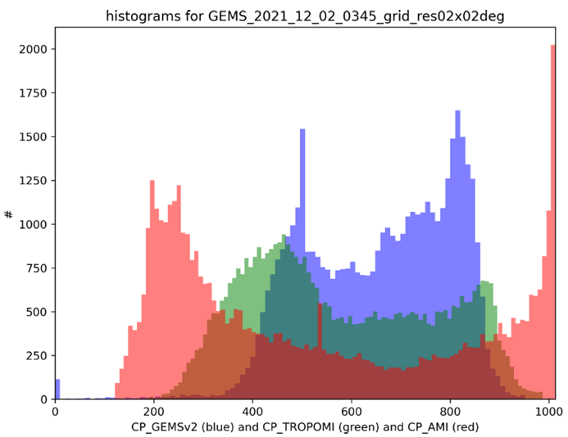
II. Update result of GEMS cloud version 3
Issue in CLD V2 | CLD V2 | CLD V3
Replacement of surface reflectance data | OMI SFC at 477 nm | GEMS SFC at 463 nm, OMI SFC at 463 nm
Updated Look-Up Table (LUT) | - | Updated
Overestimation of ECF | - | Updated LUT interpolation method
Striped-pattern in CCP validation | -
Clear sky value of CCP | Clear sky = 1,013 hPa | Clear sky is replaced by L1C surface pressure
GEMS ECF
TROPOMI CF
GEMS CP
AMI CP
TROPOMI CP
Source: PEGASOS Report (DLR)

Slide 5
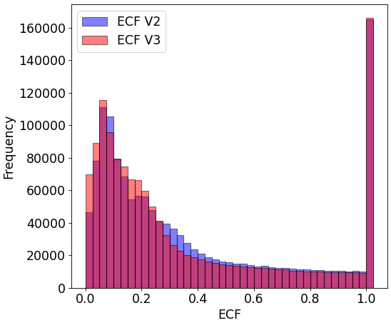
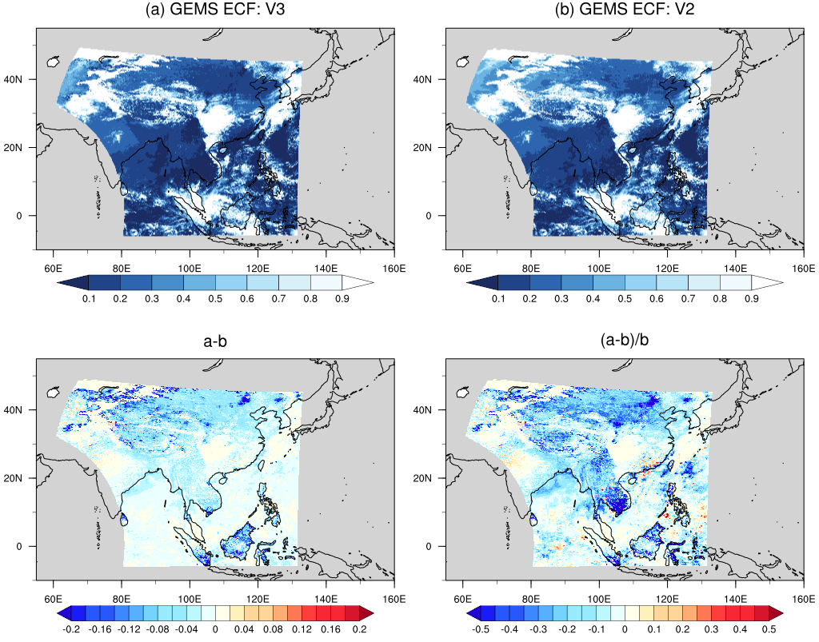
II. Update result of GEMS cloud version 3
ECF result
2023.03.01. 0445 UTC
V3
V2
Underestimation
Discontinuity over Northeastern China was eliminated by using GEMS SFC data.
V3 reduces the overestimation of ECF in clear-sky pixels.

Slide 6
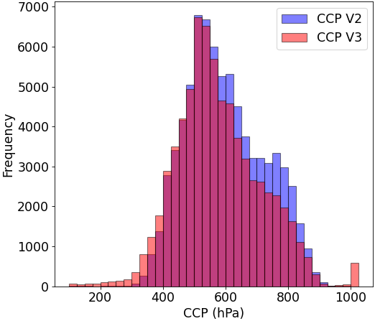
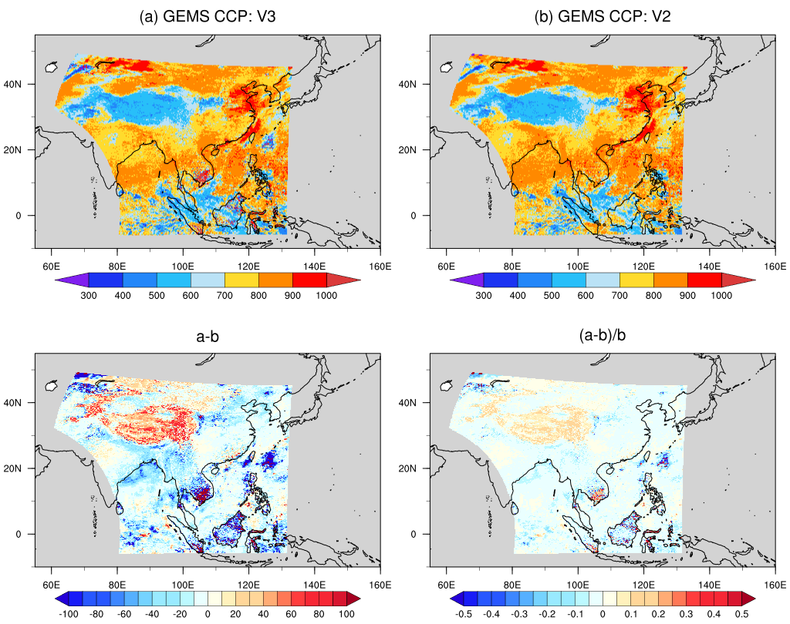
II. Update result of GEMS cloud version 3
CCP result
2023.03.01. 0445 UTC
V3
V2
V3 generally retrieves higher altitudes than V2,
while clear-sky pixels are retrieved at lower altitudes.
V3 retreive higher and lower values compared to V2.

Slide 7
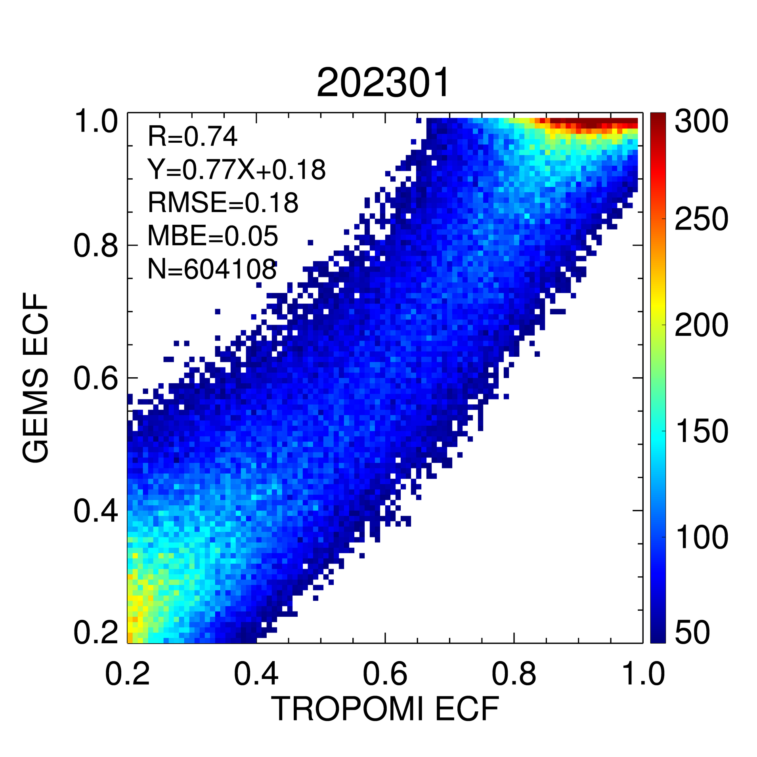
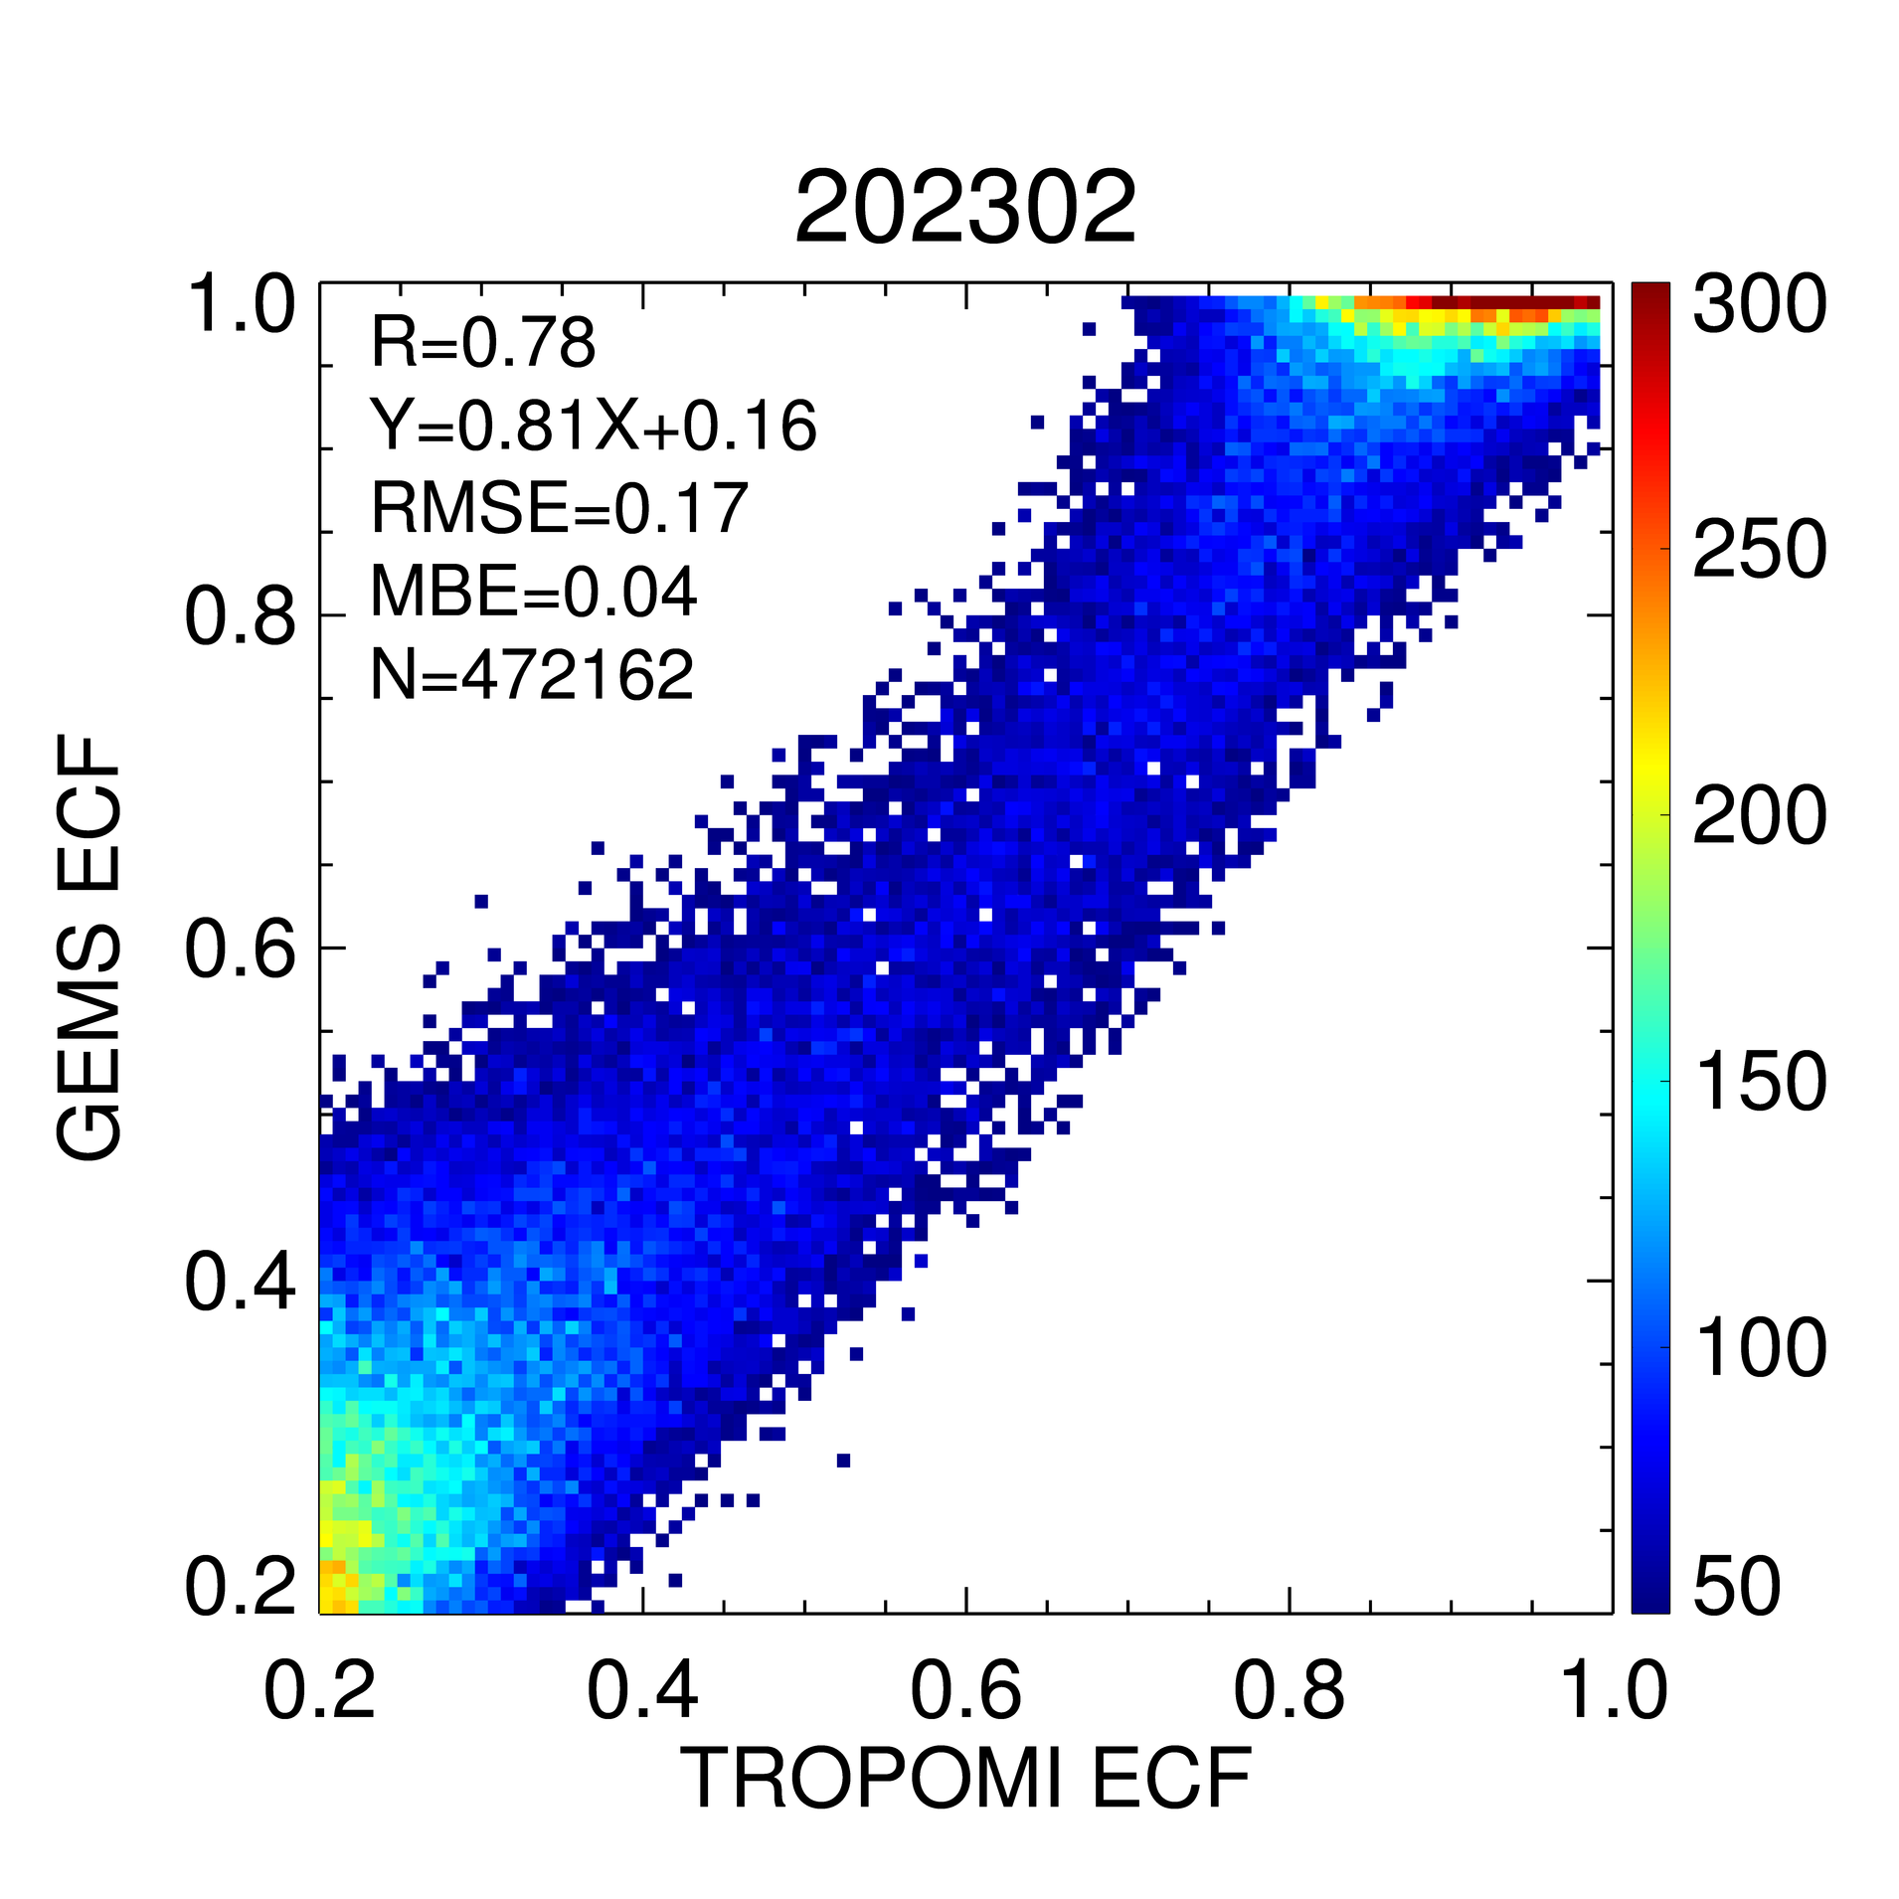
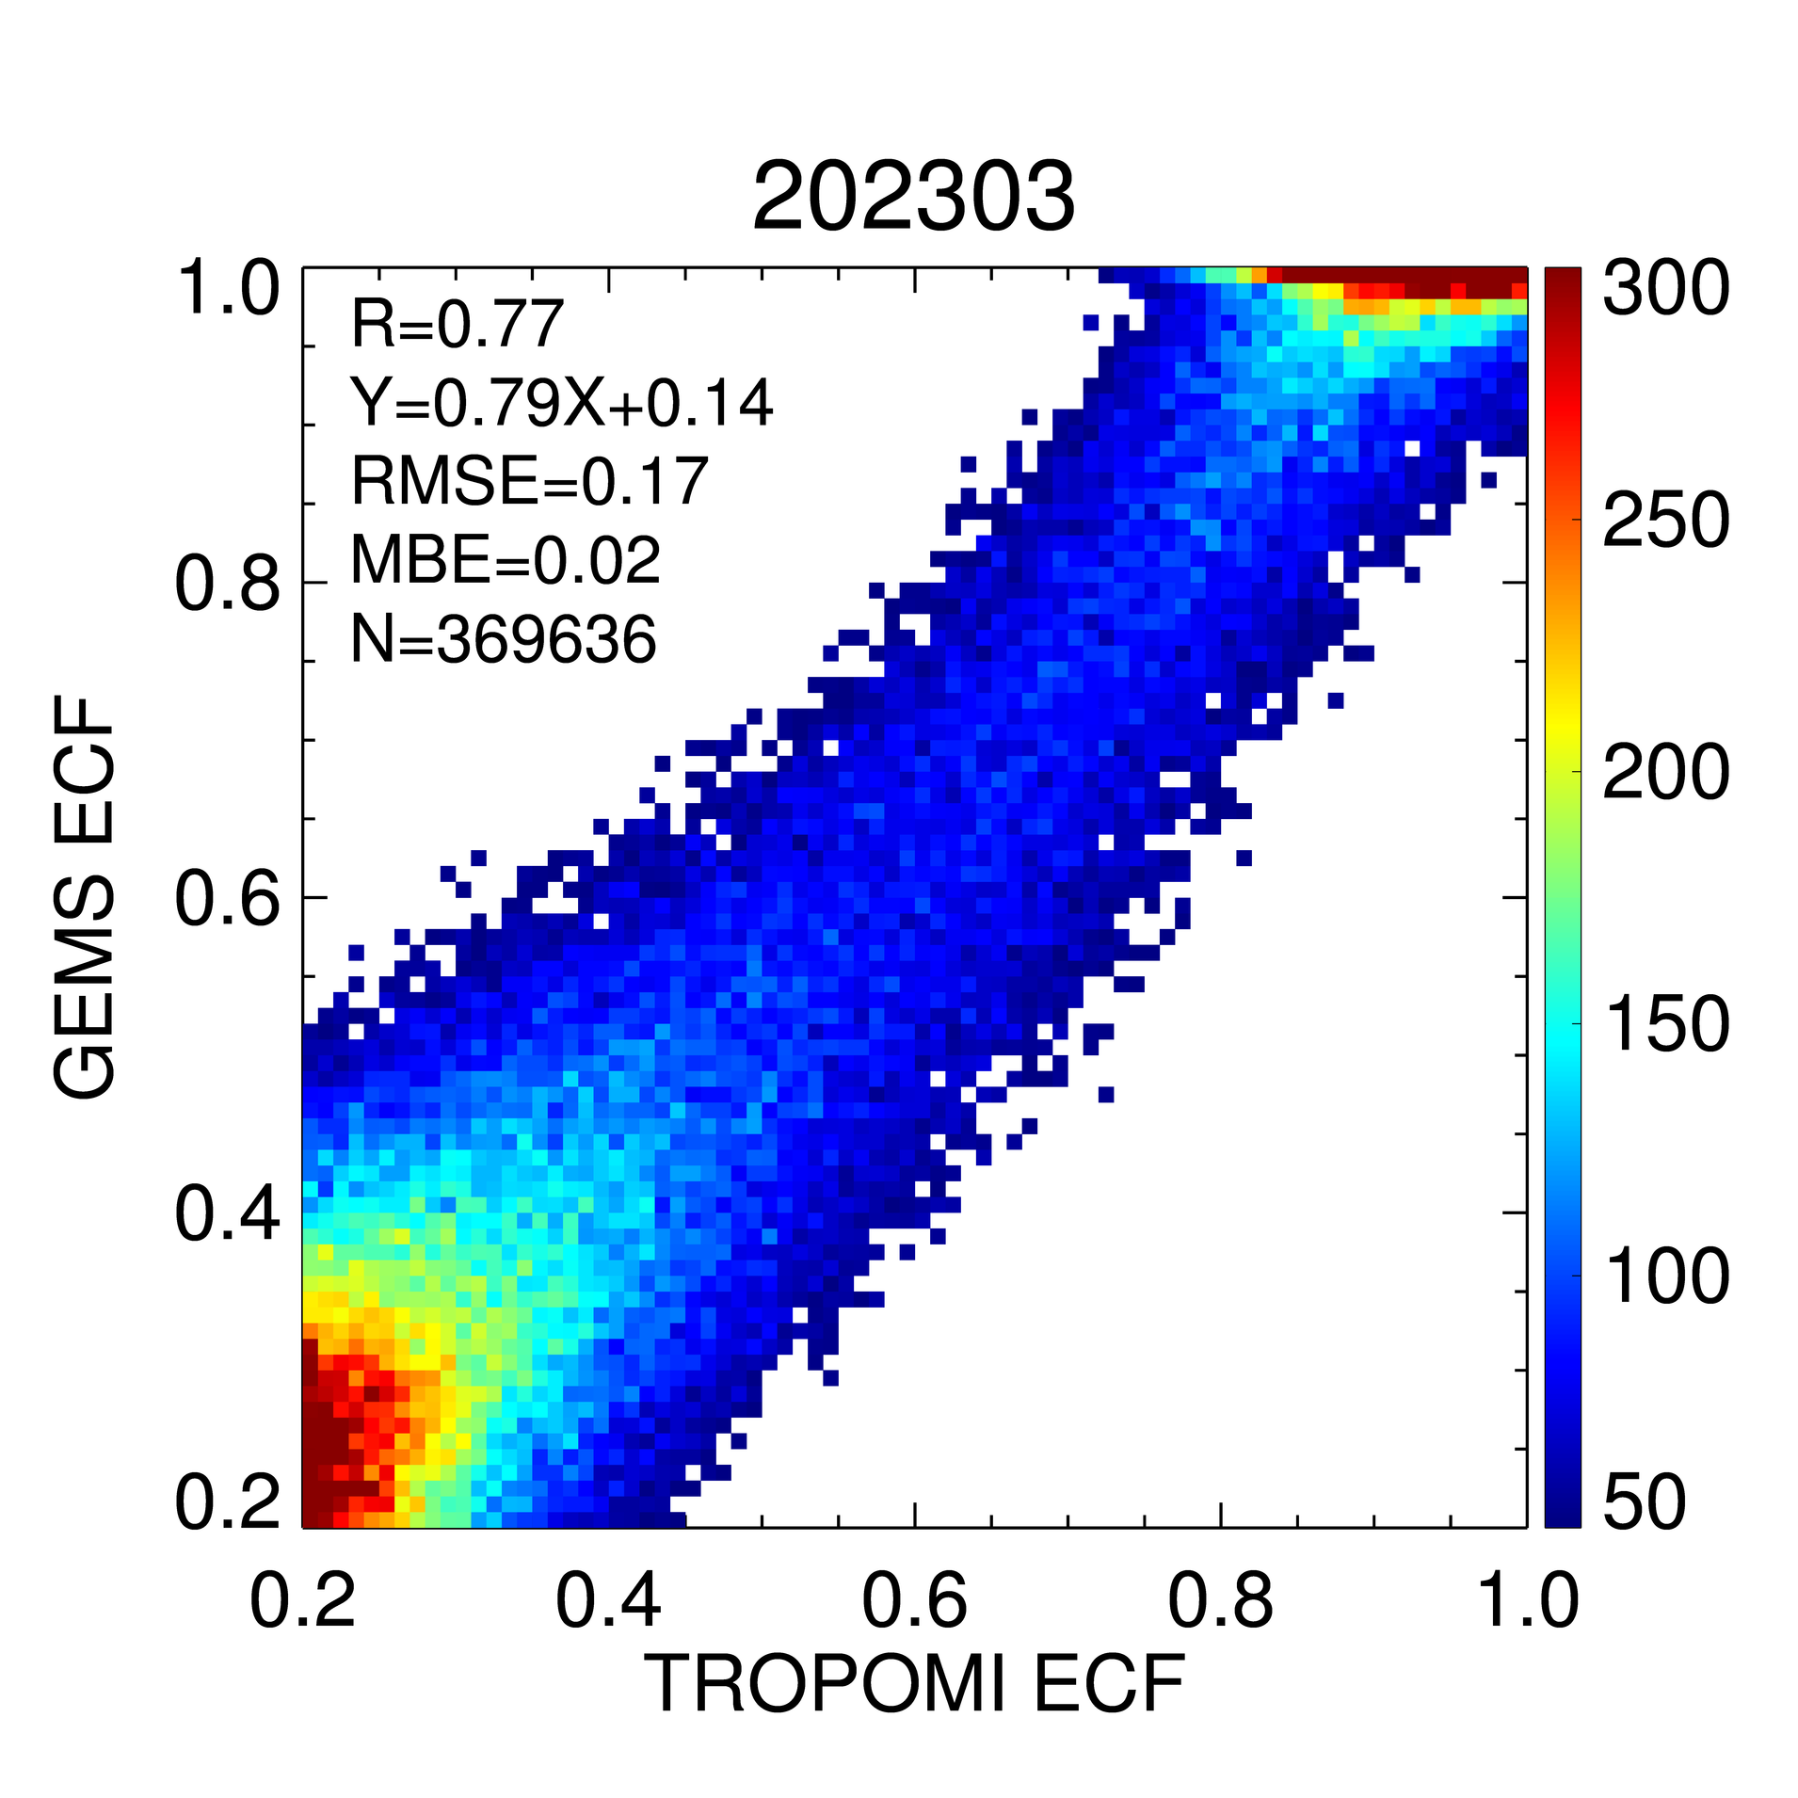
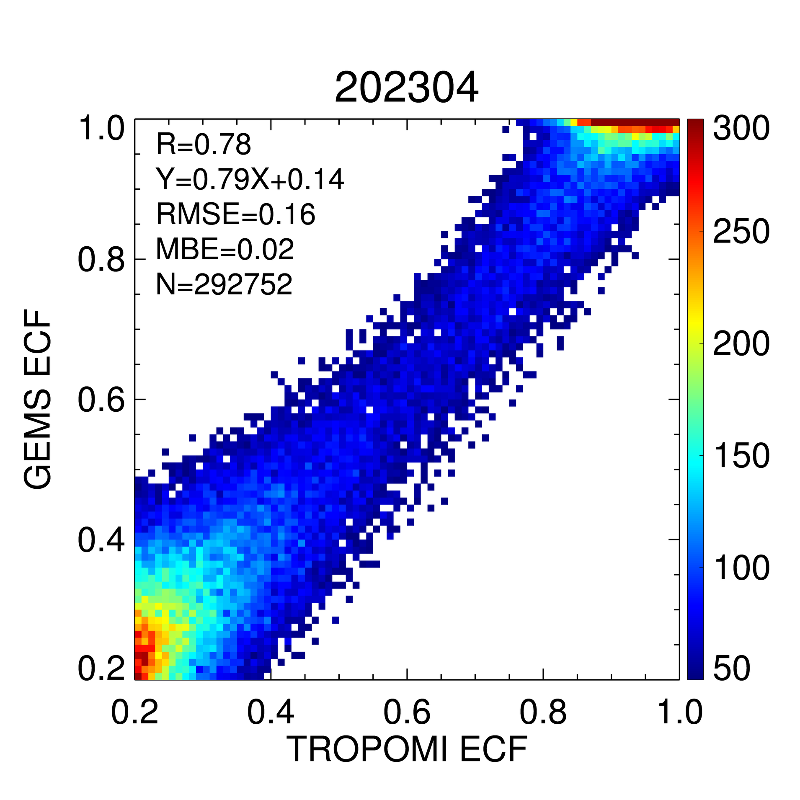
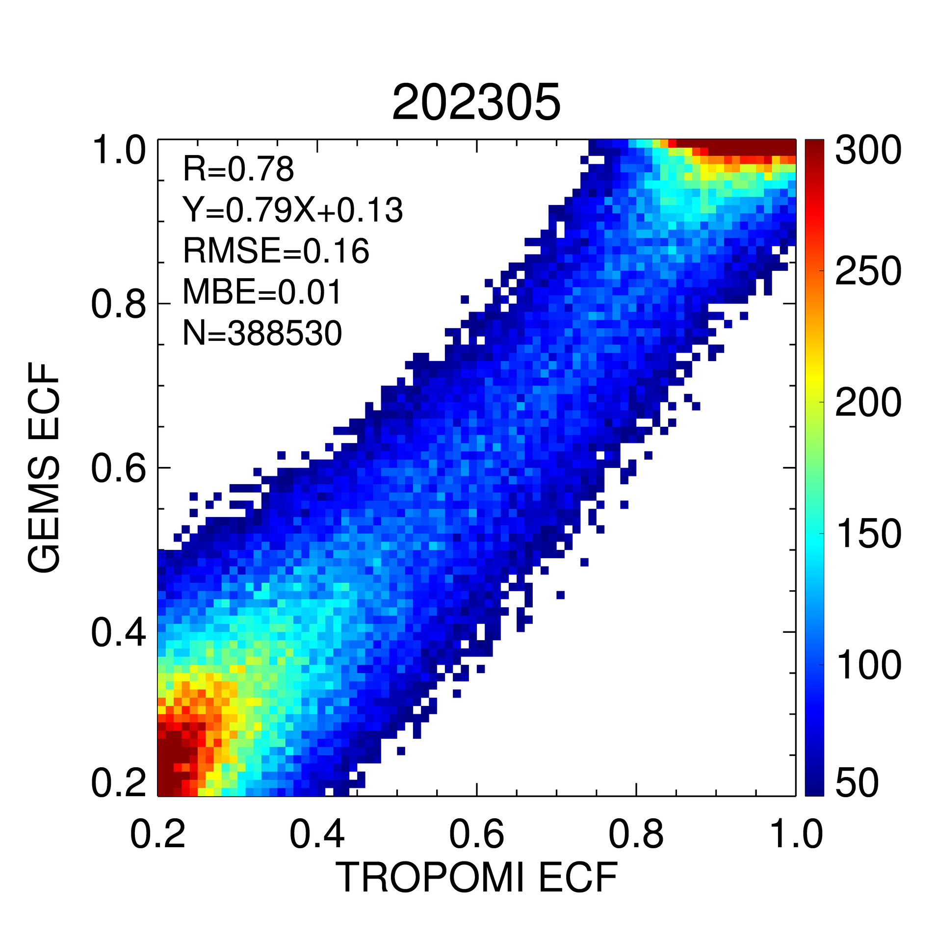
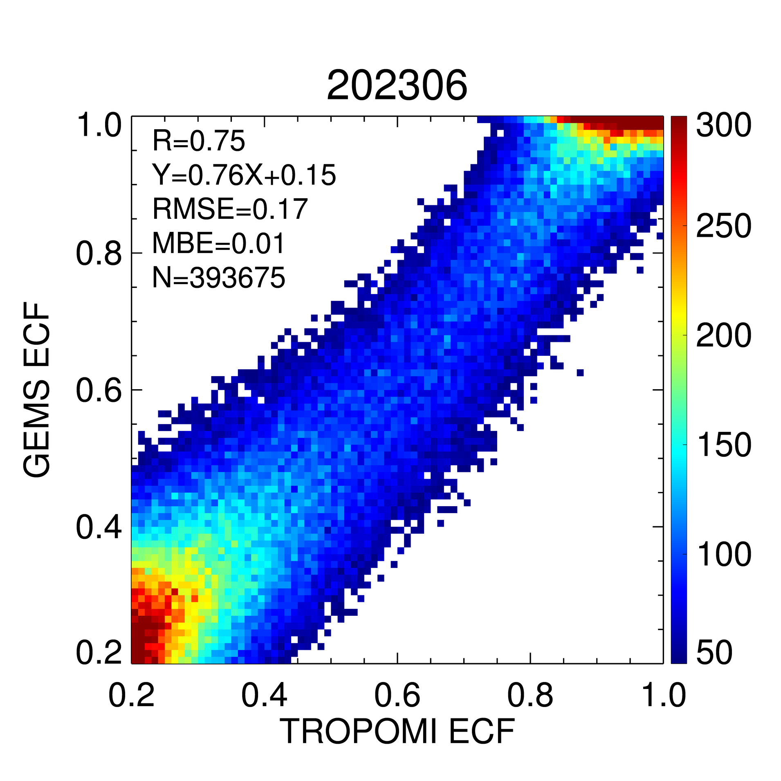
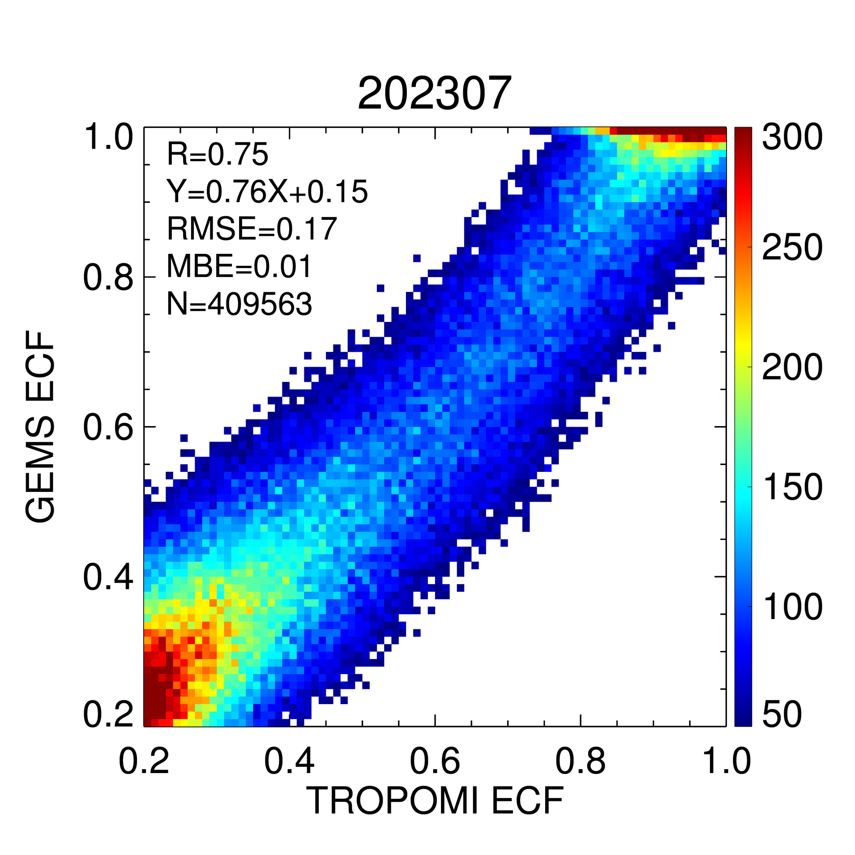
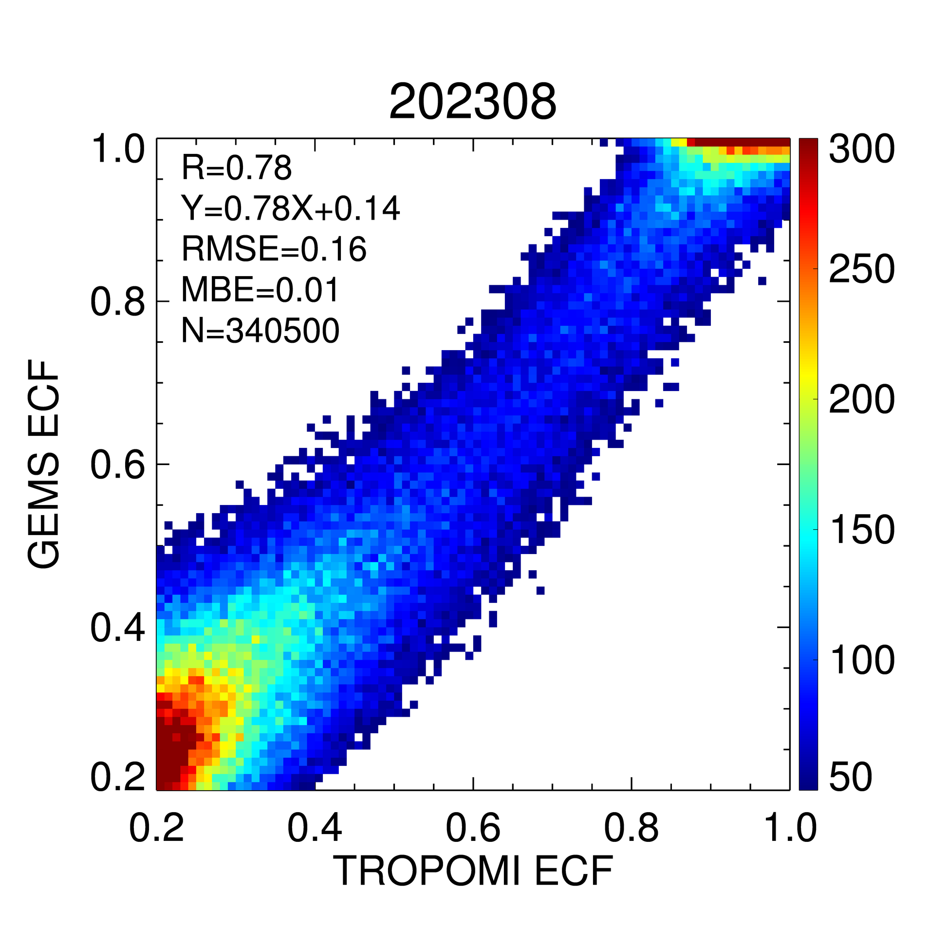
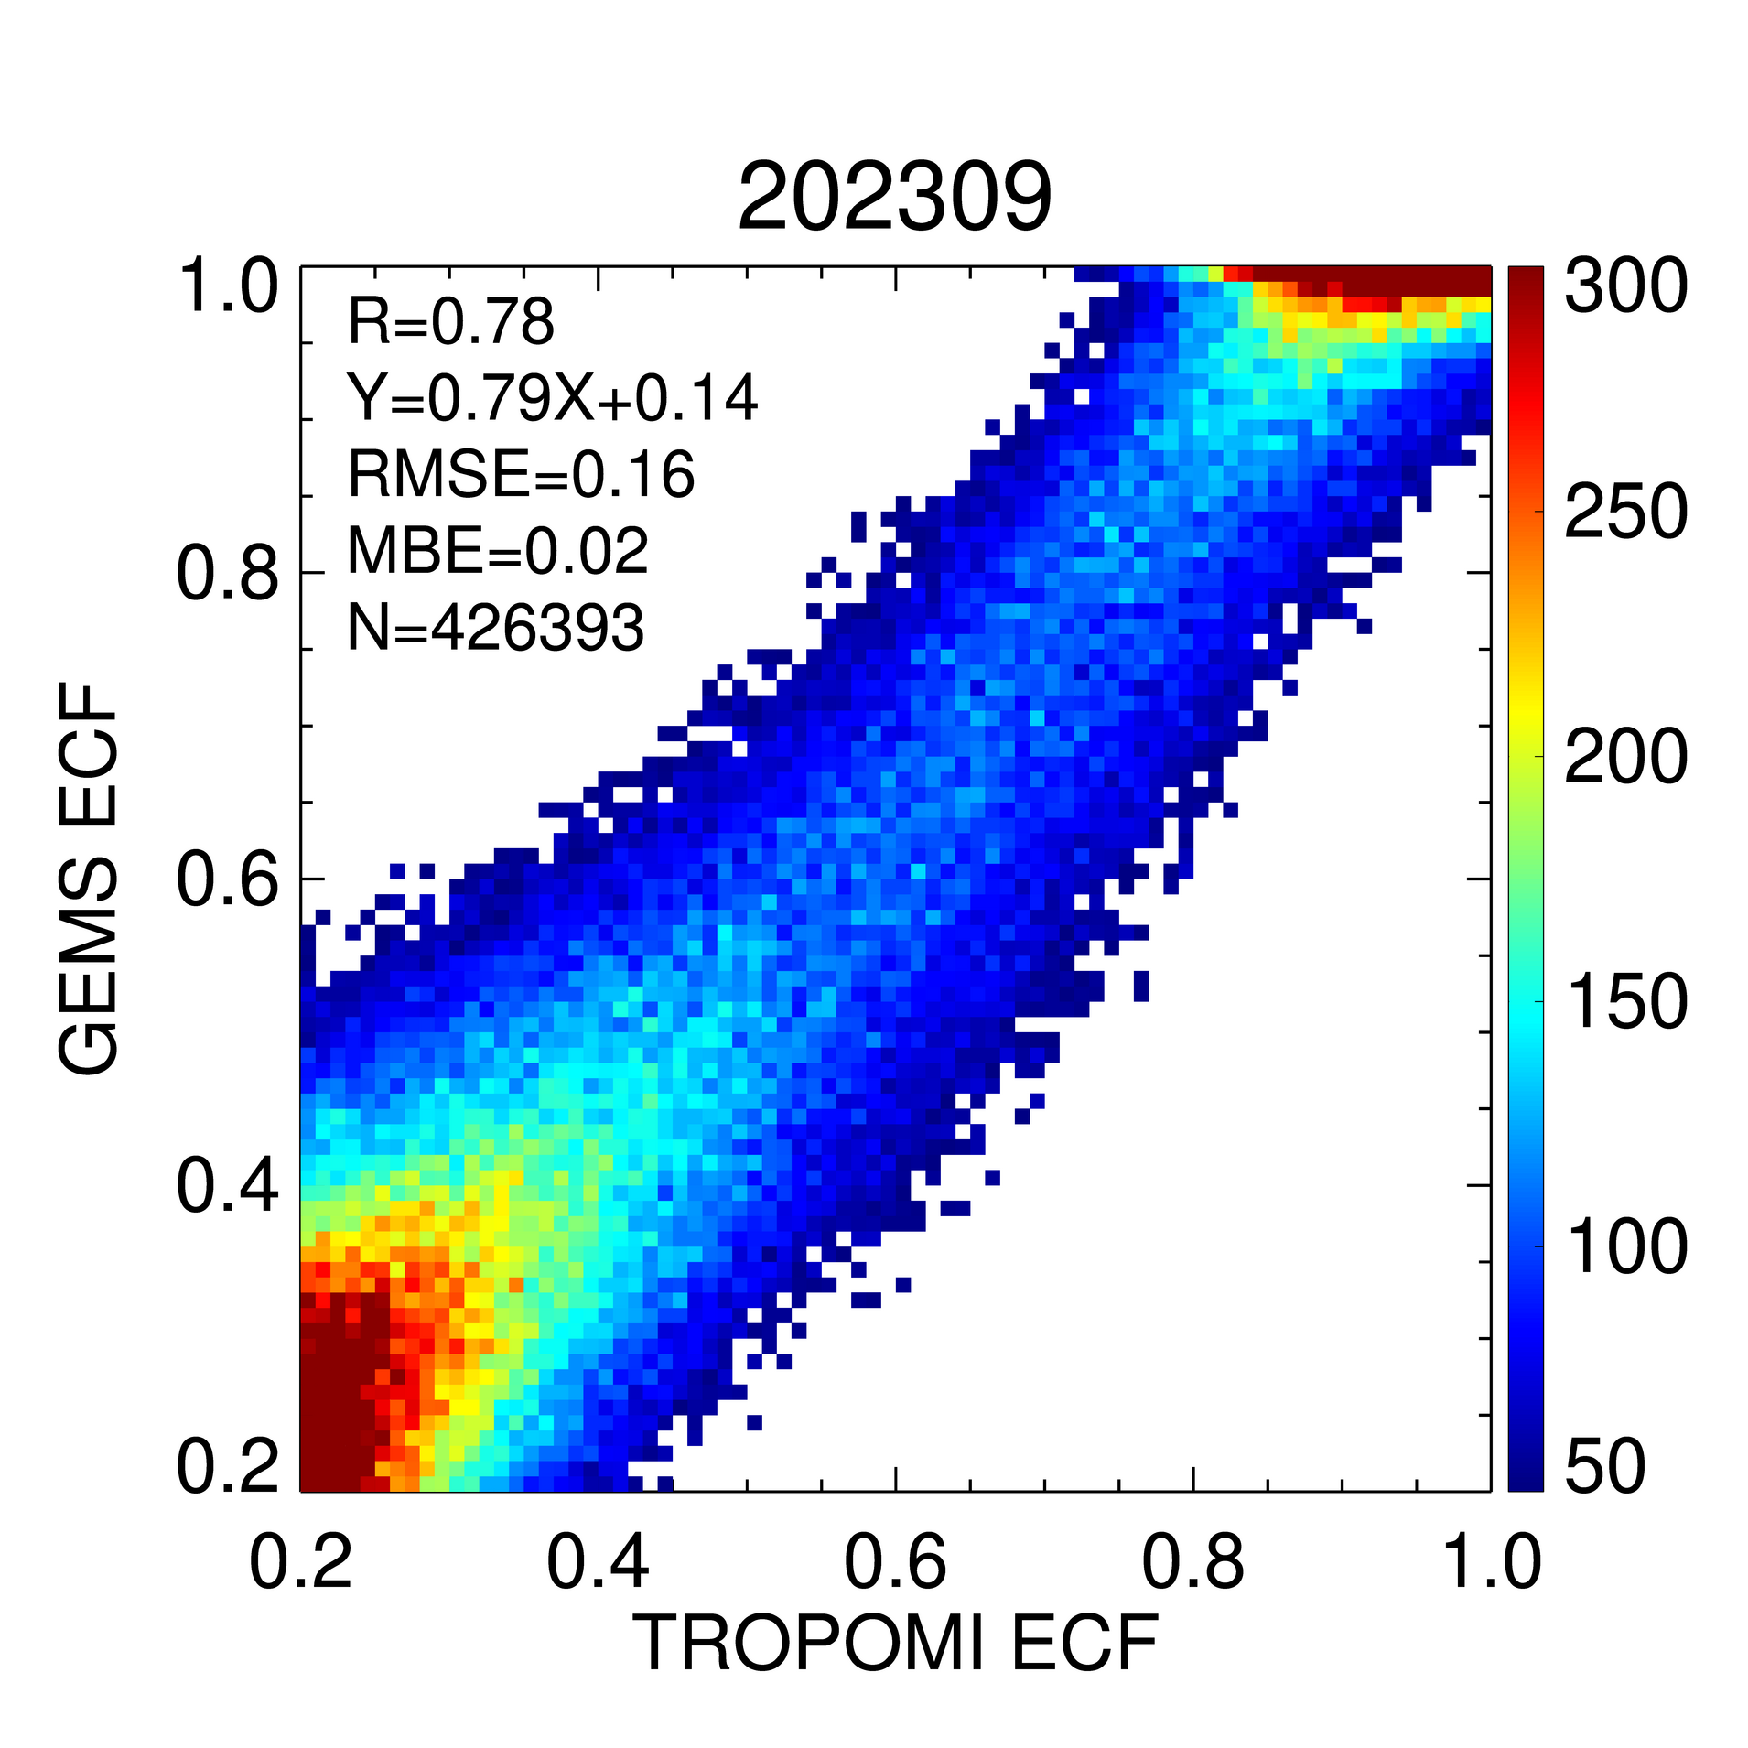
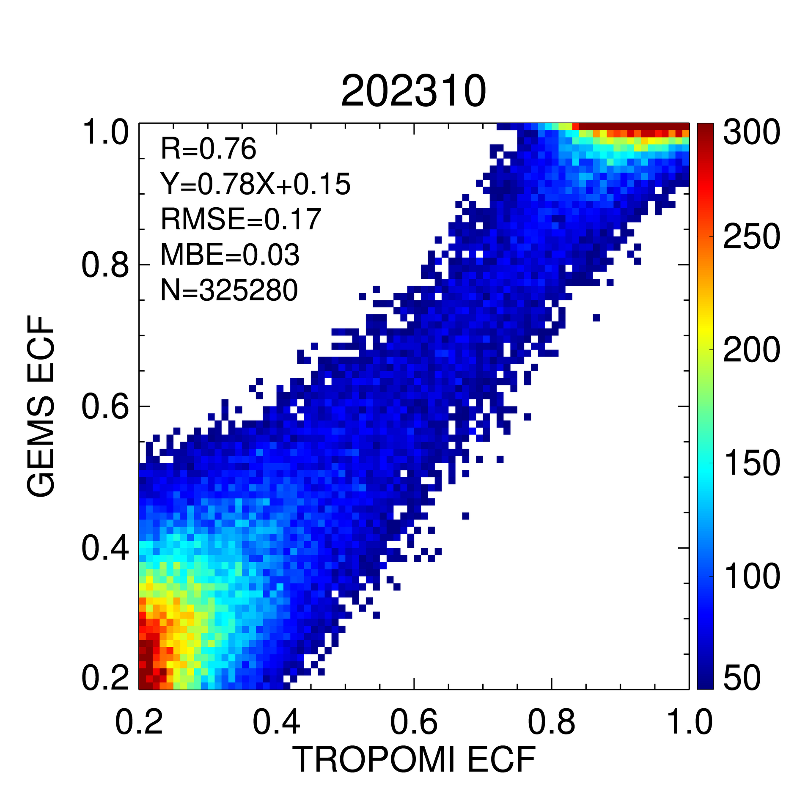
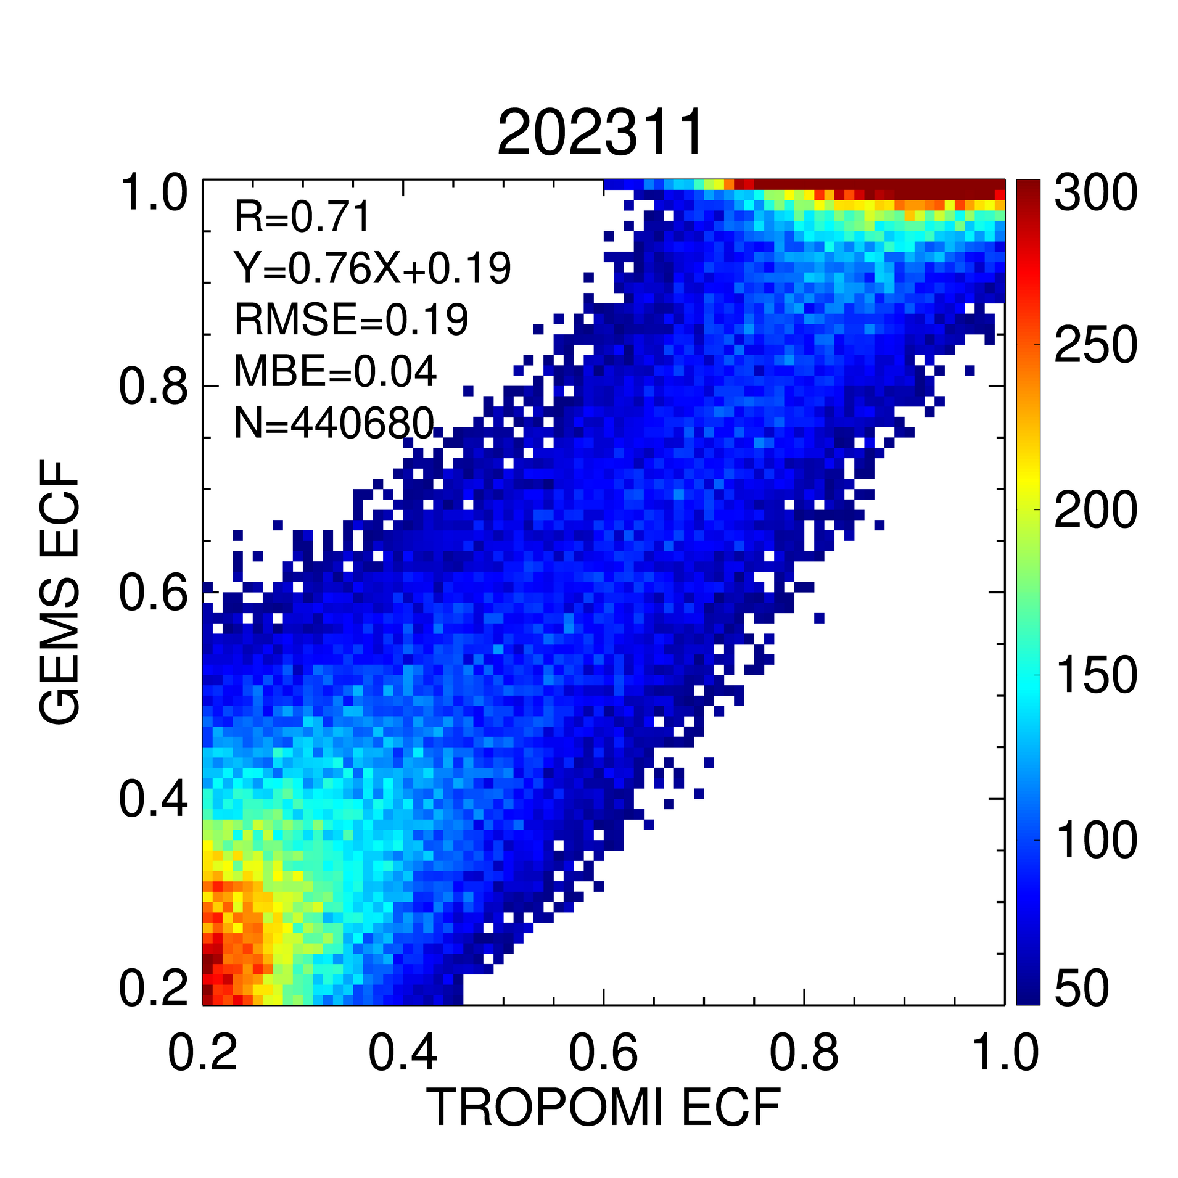
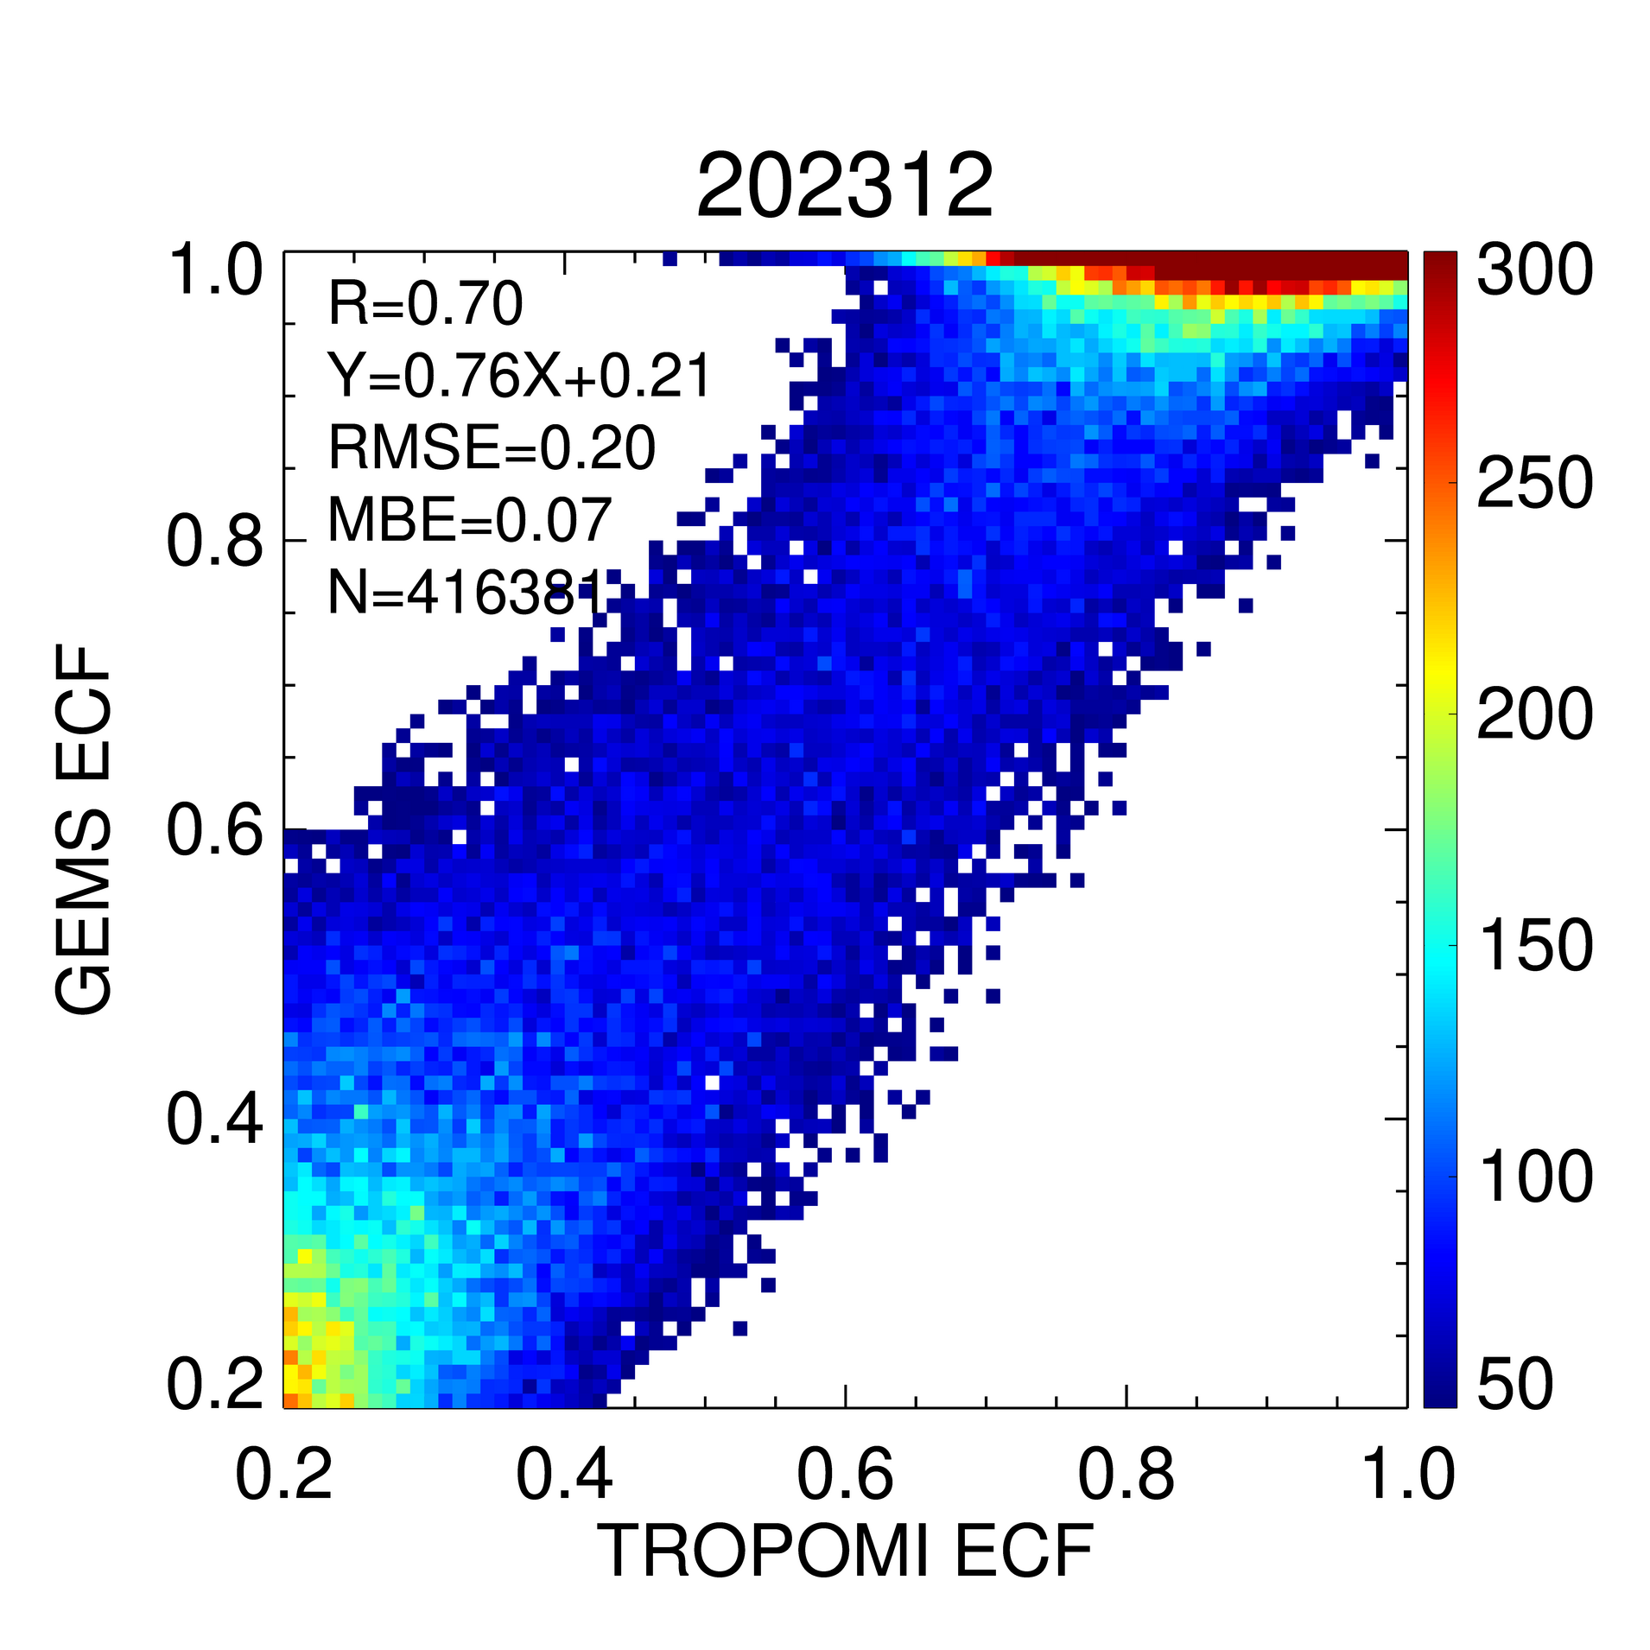
II. Update result of GEMS cloud version 3
ECF: Montly validation with TROPOMI
→ Mean R = 0.76
Monthly validation results show that GEMS ECF has a reasonable correlation with TROPOMI (R > 0.75) and is successfully retrieved across seasons.

Slide 8
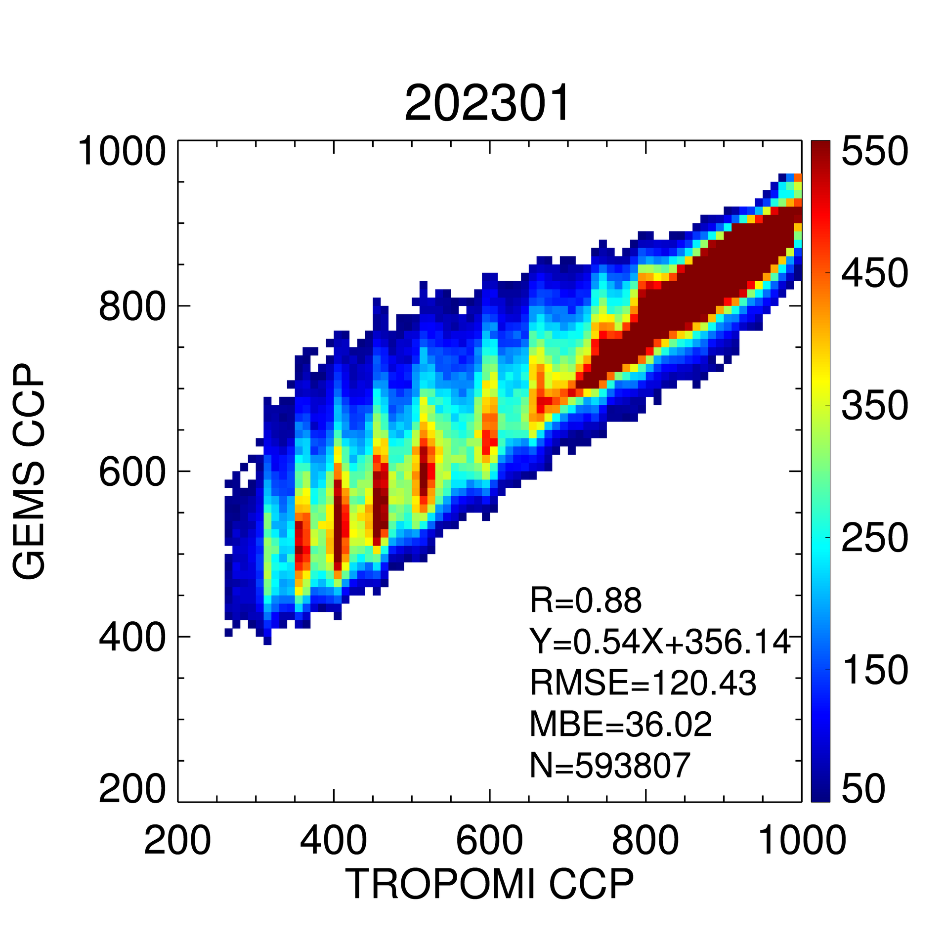
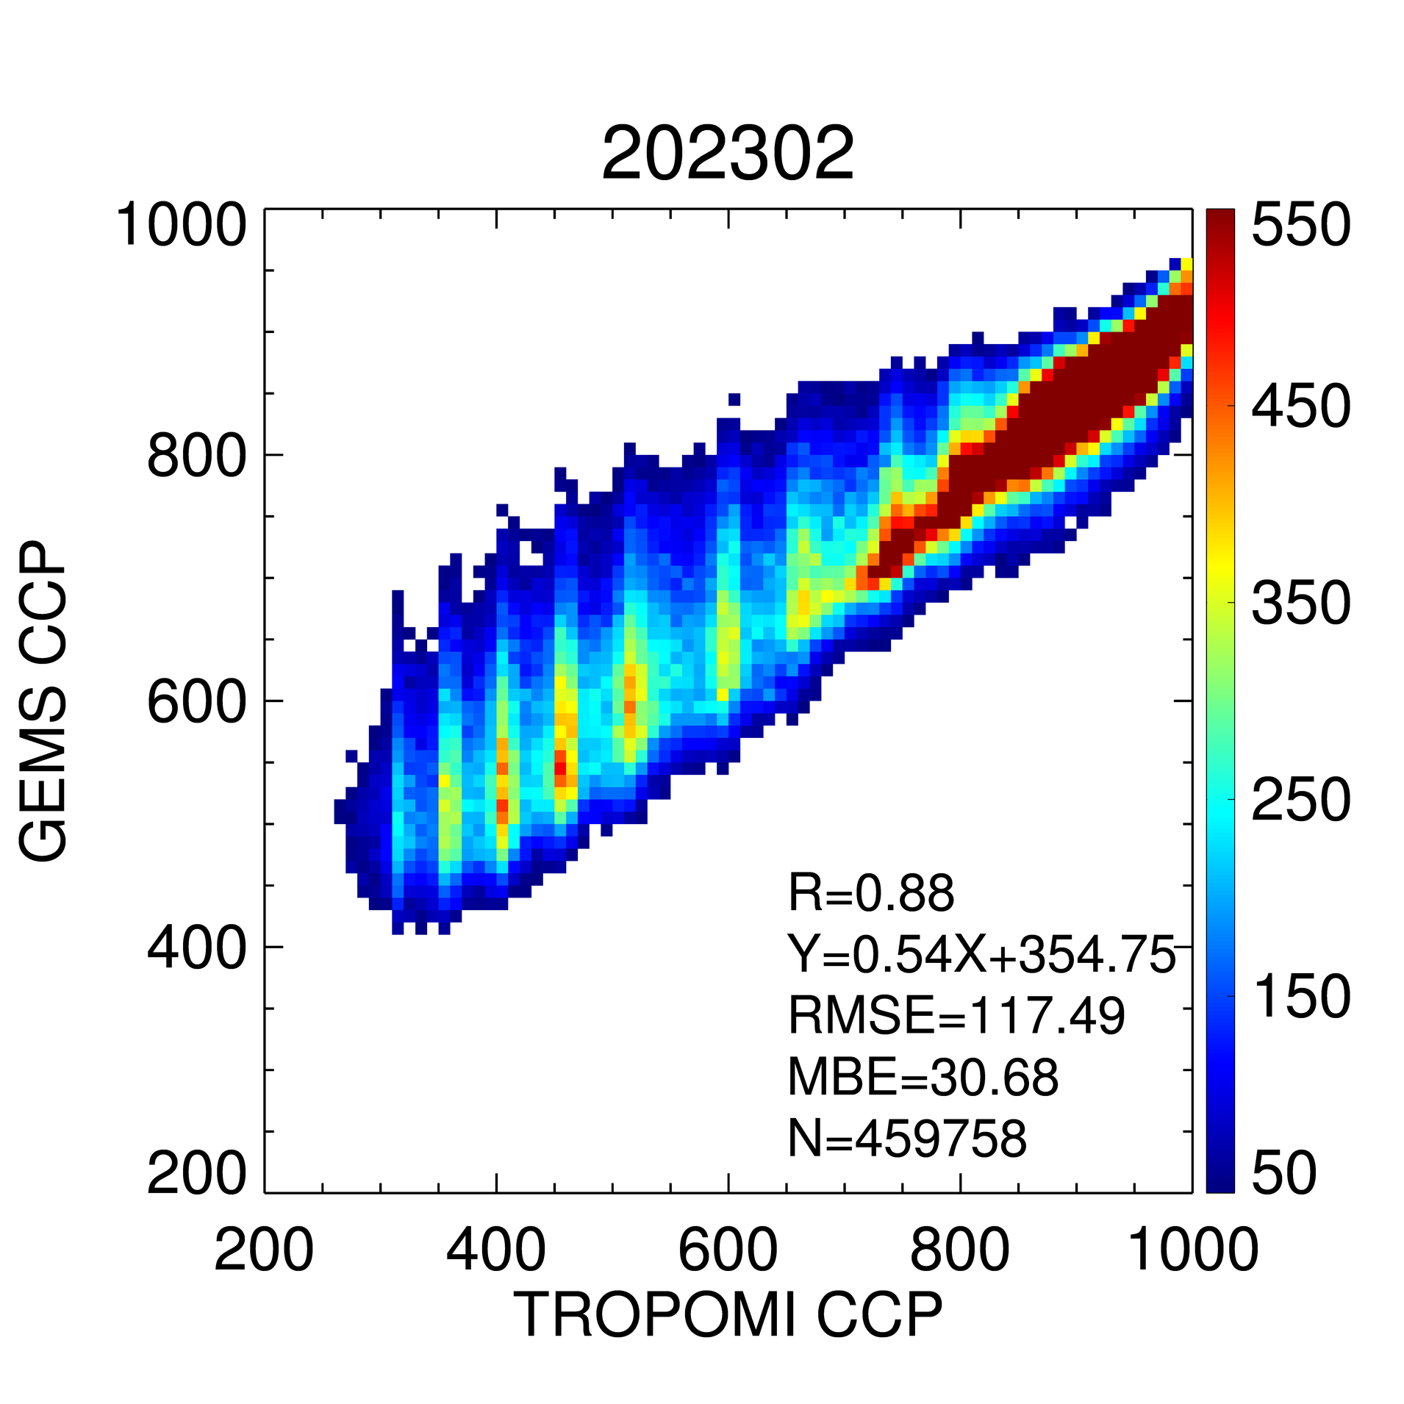
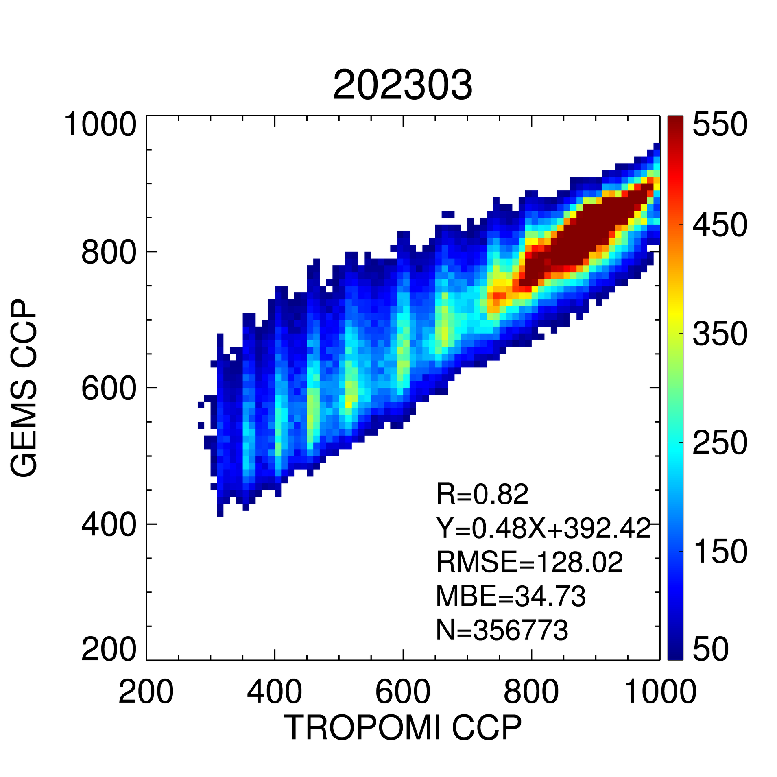
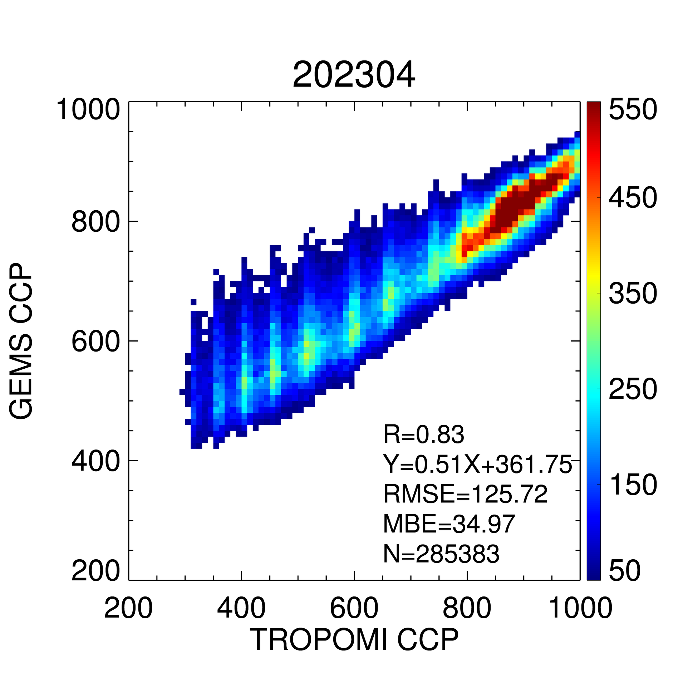
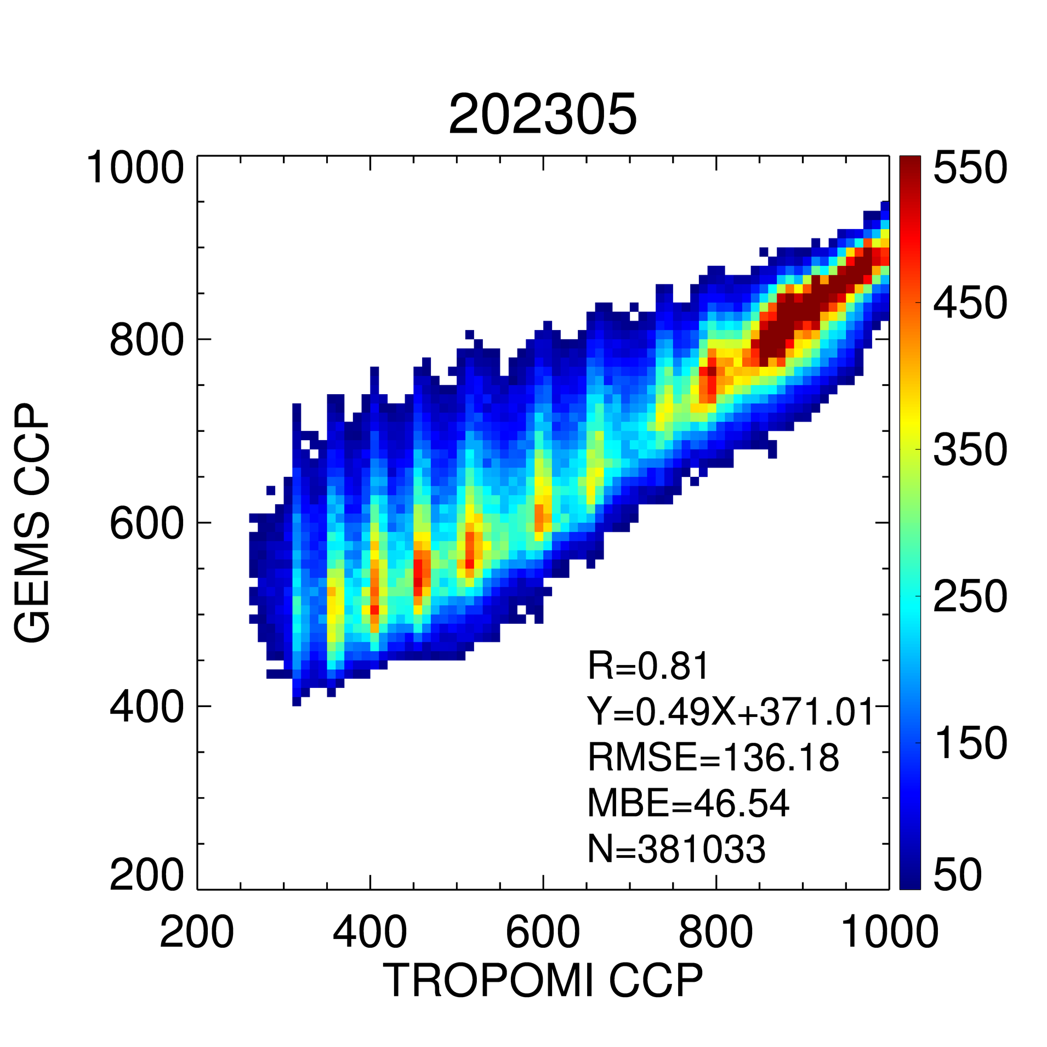
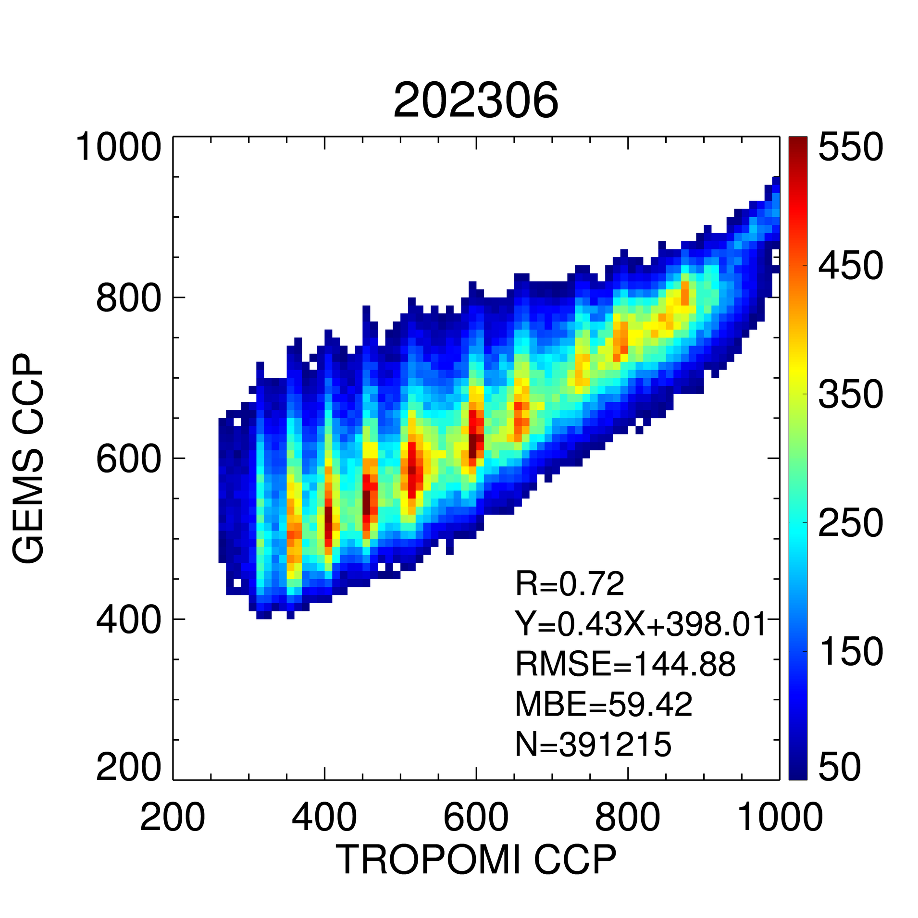
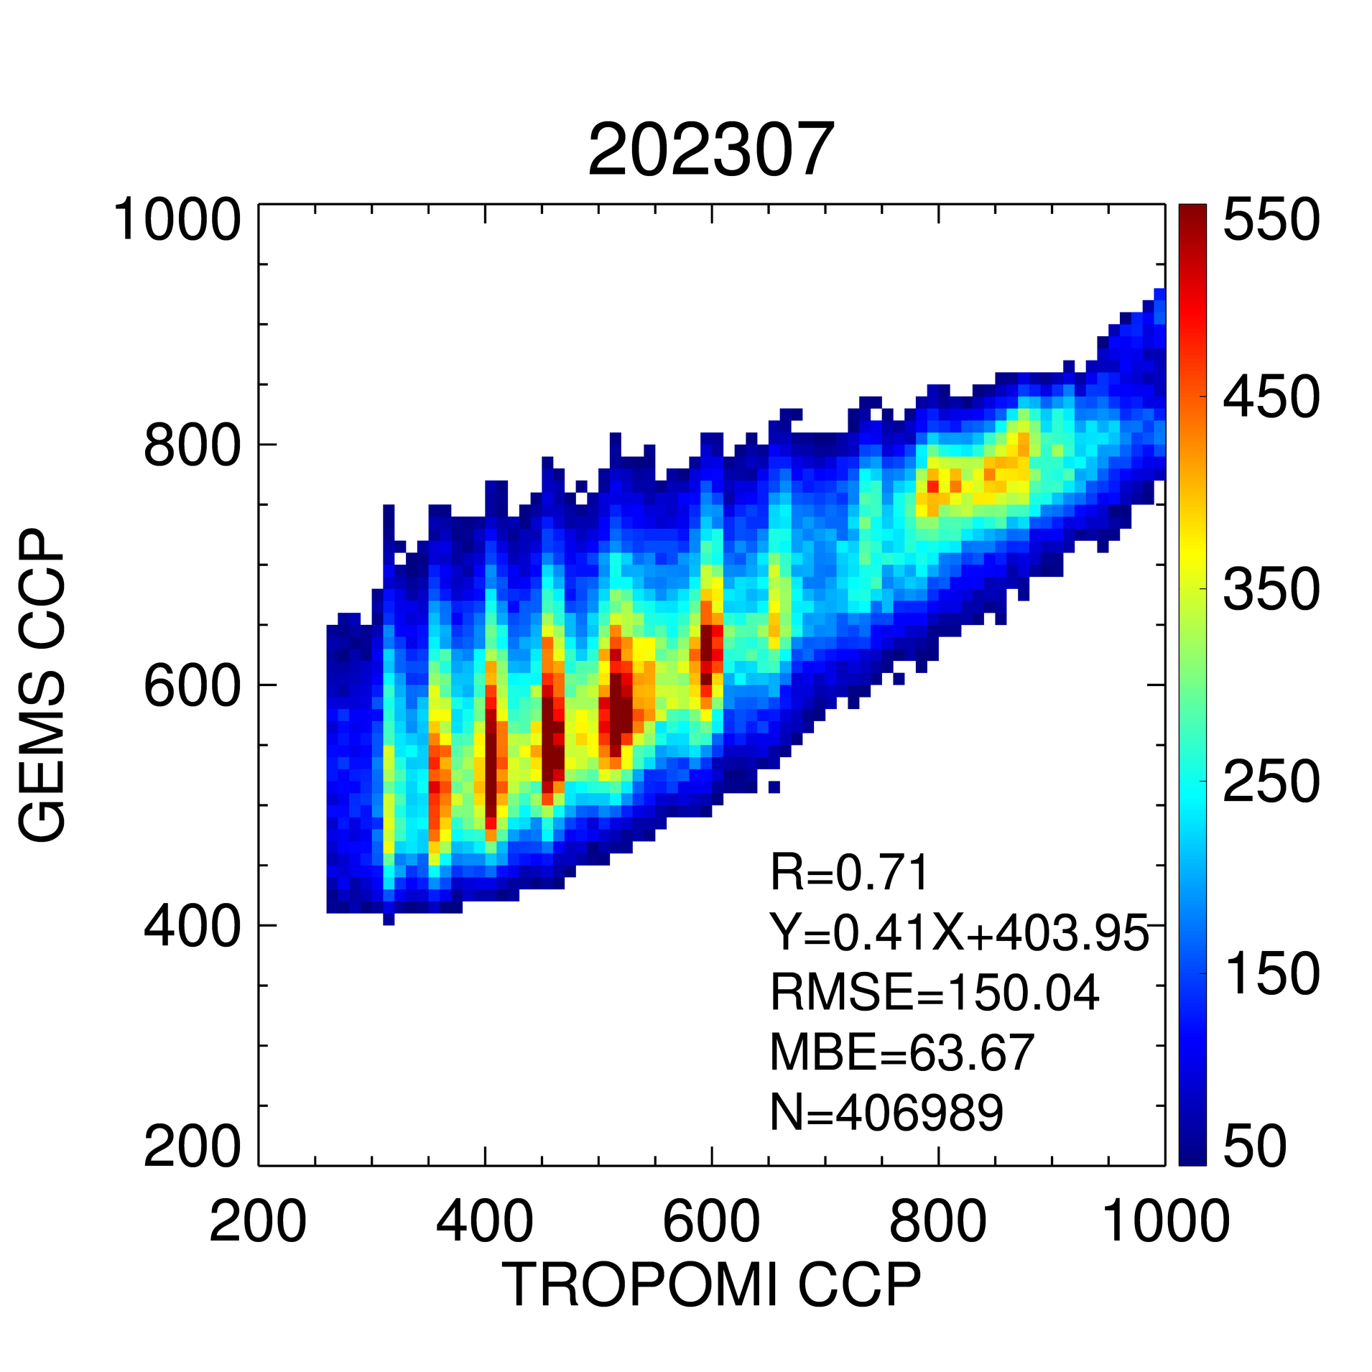
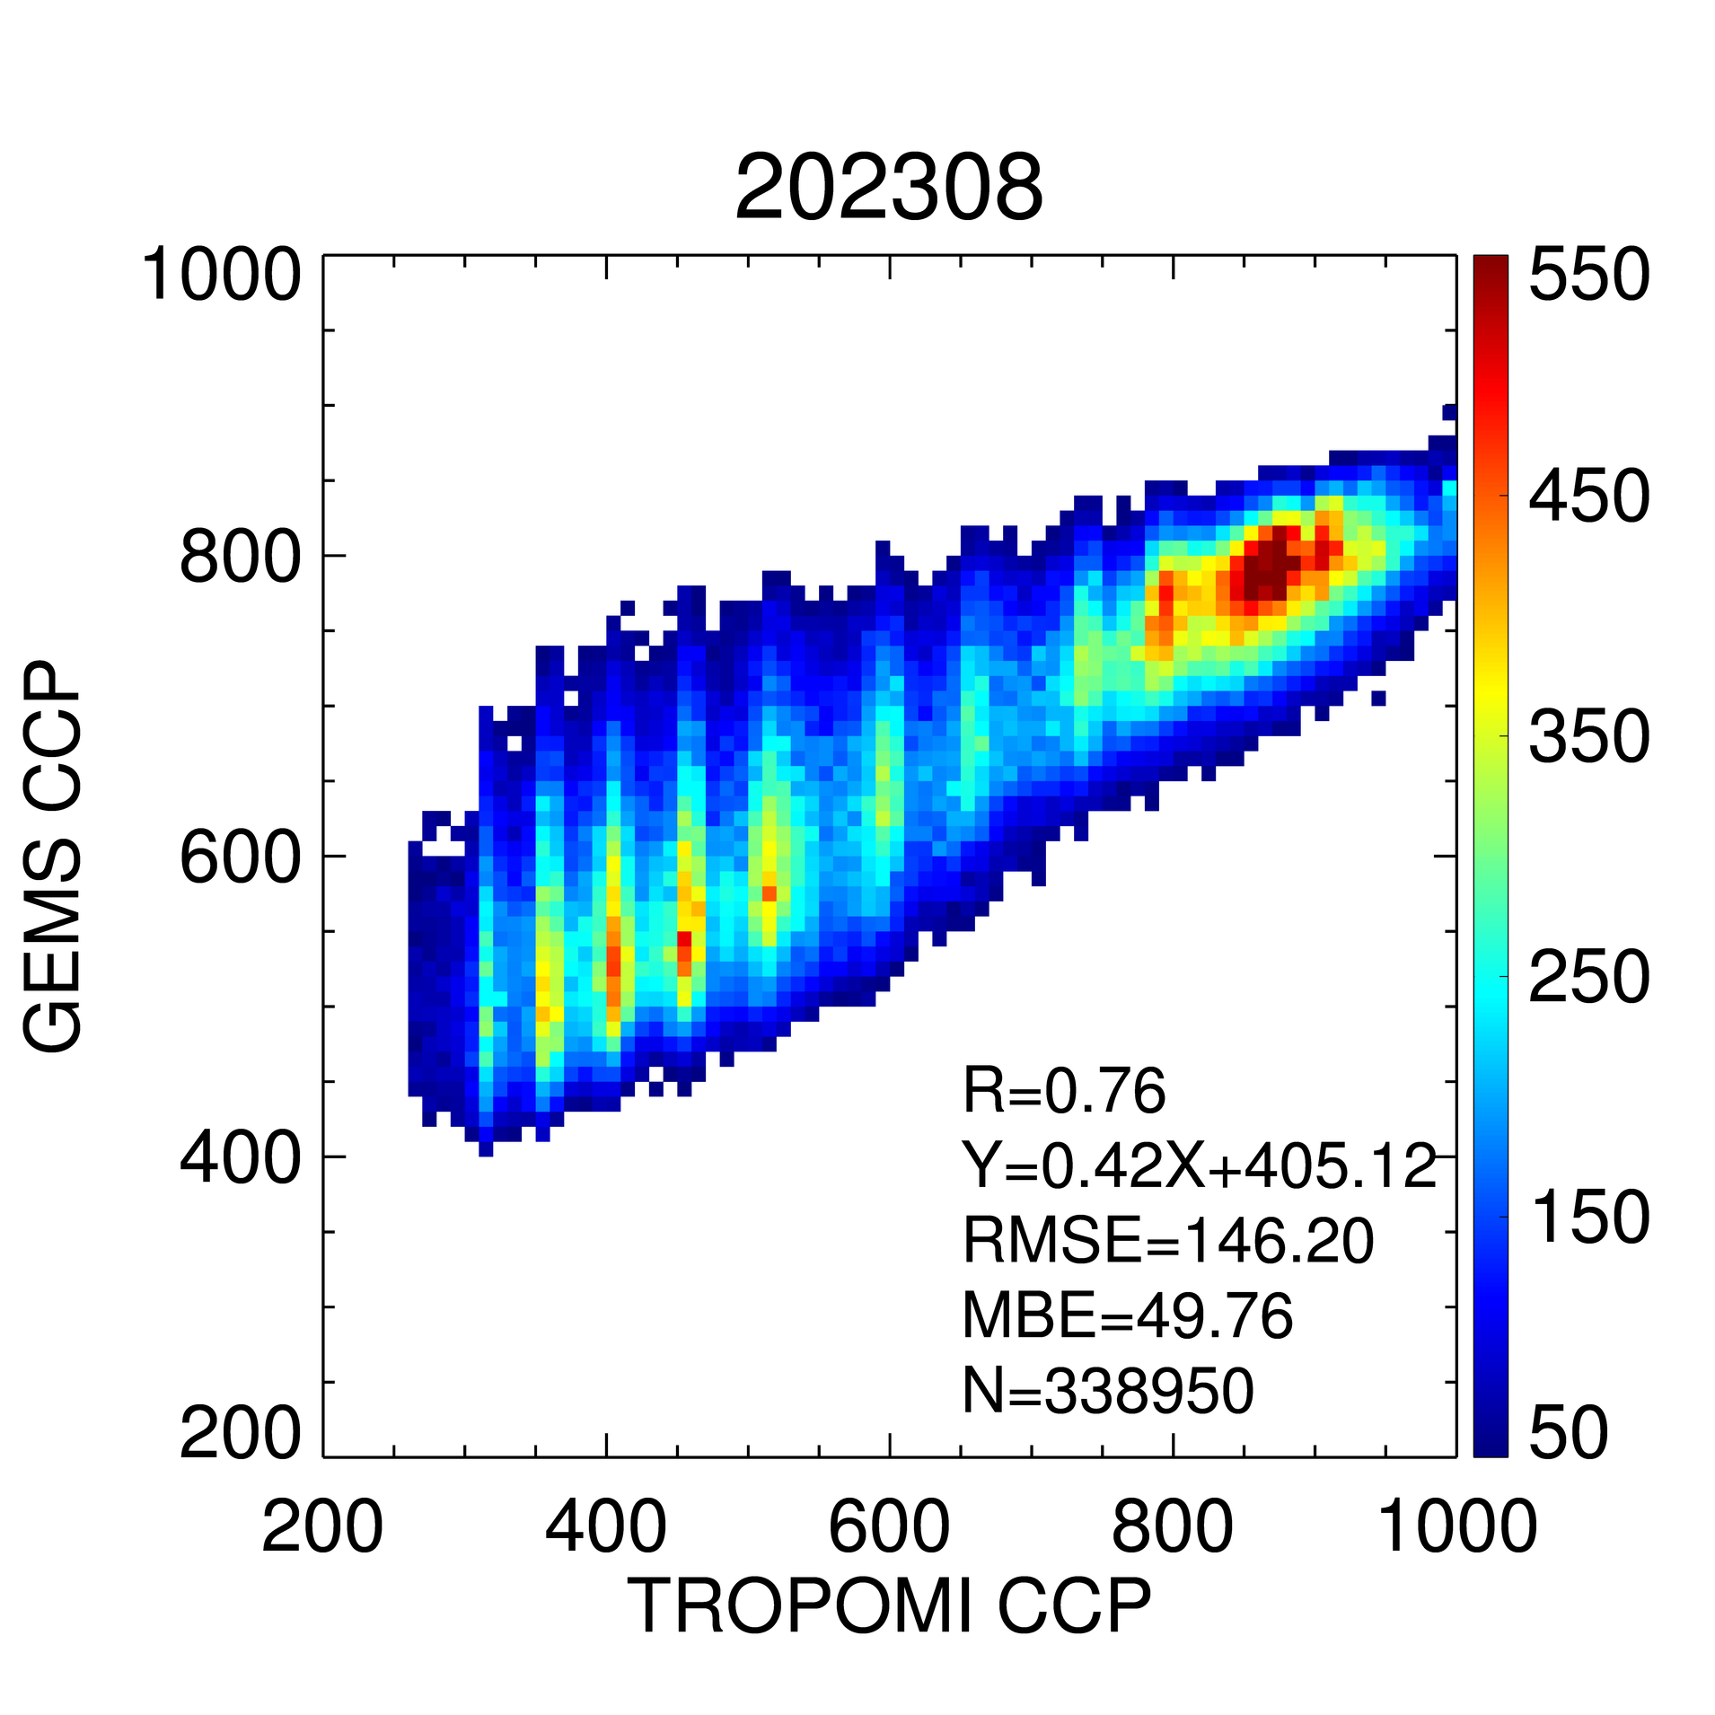
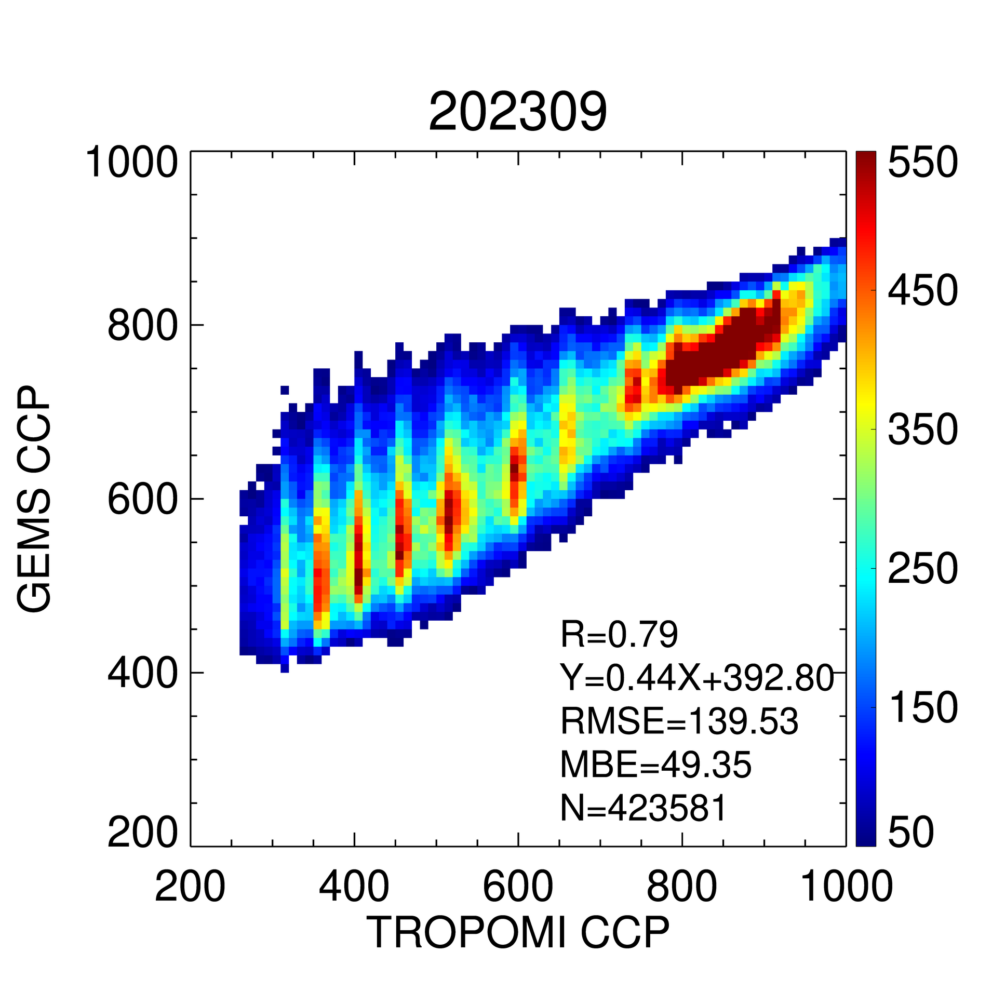
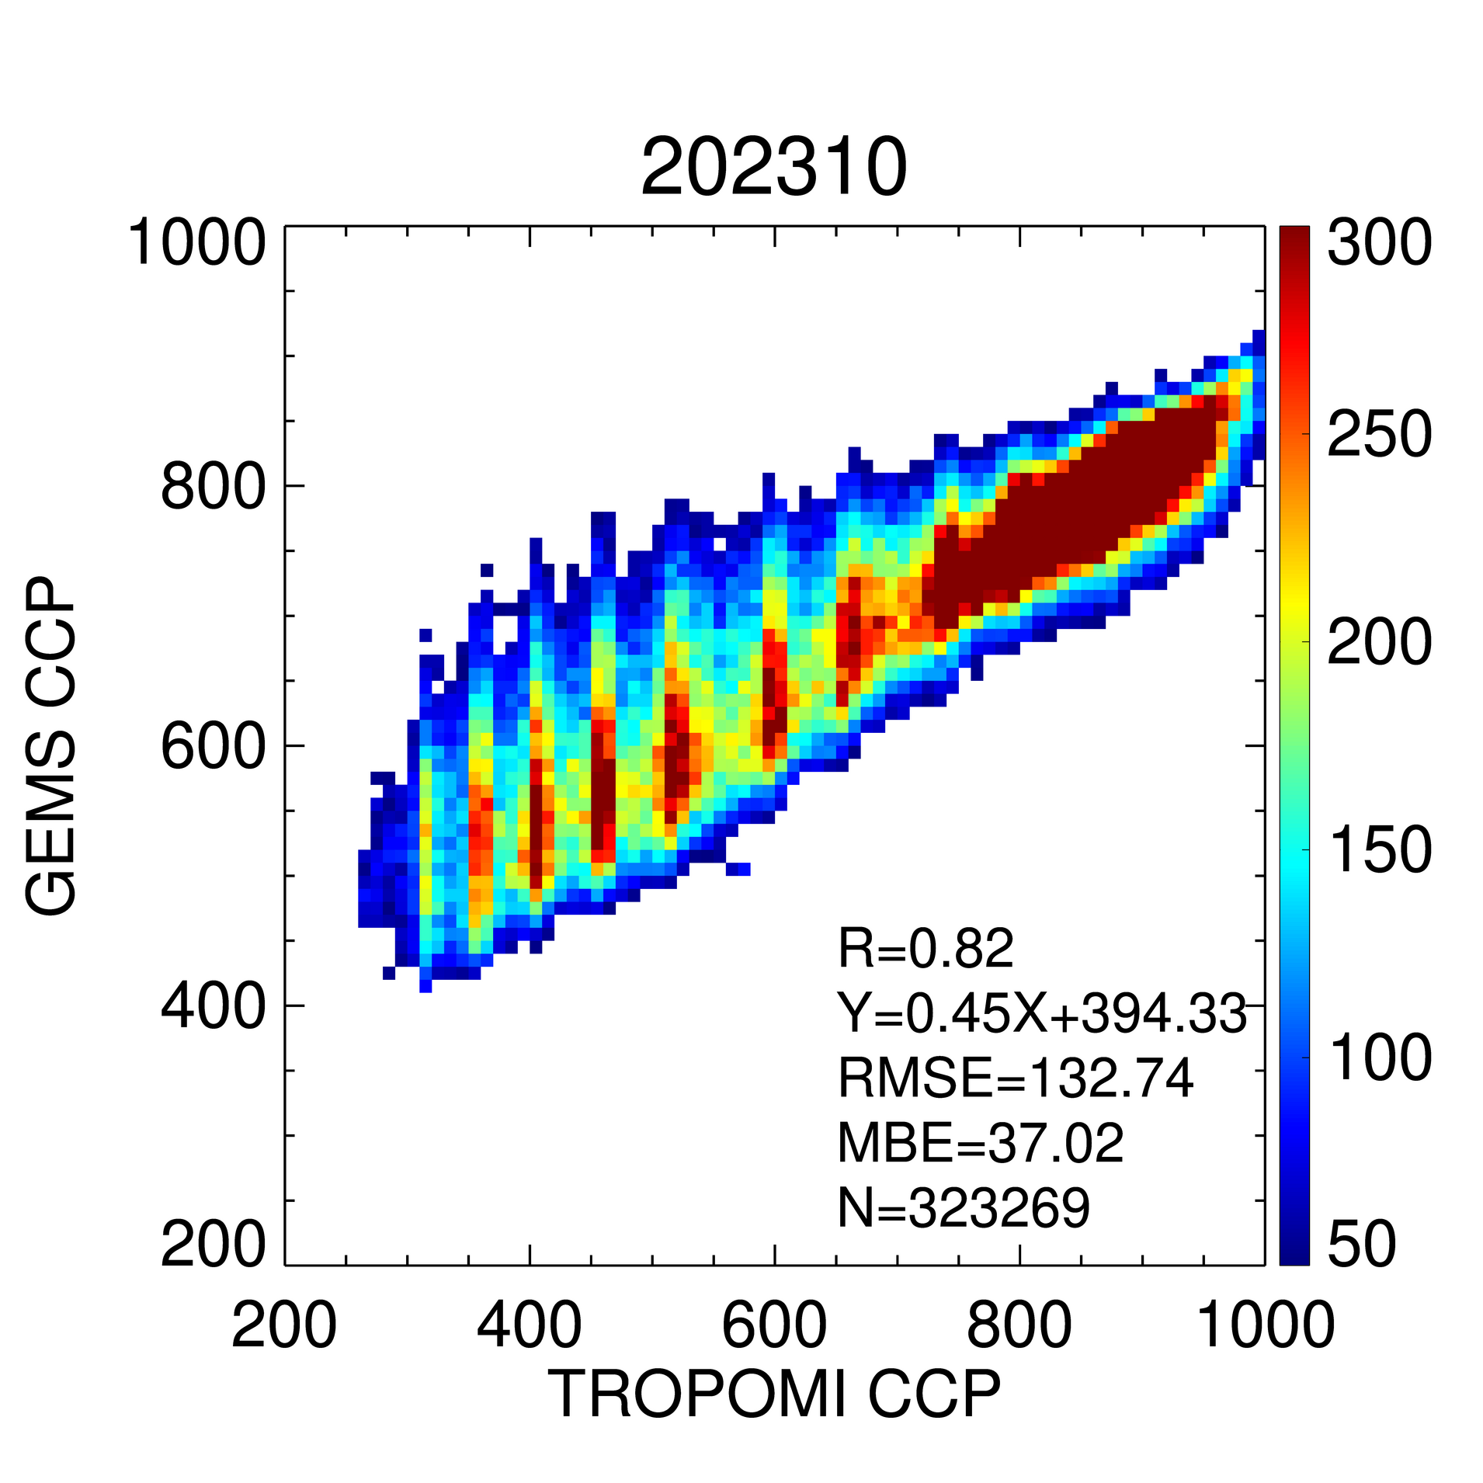
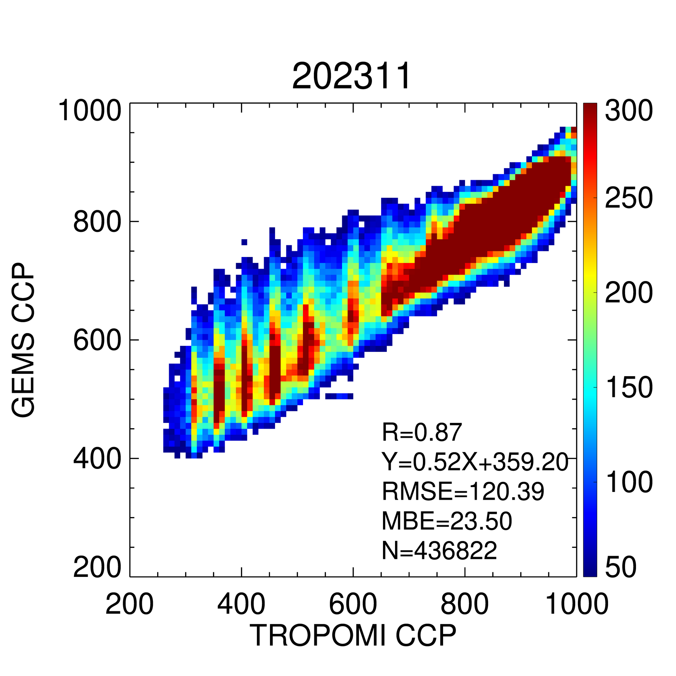
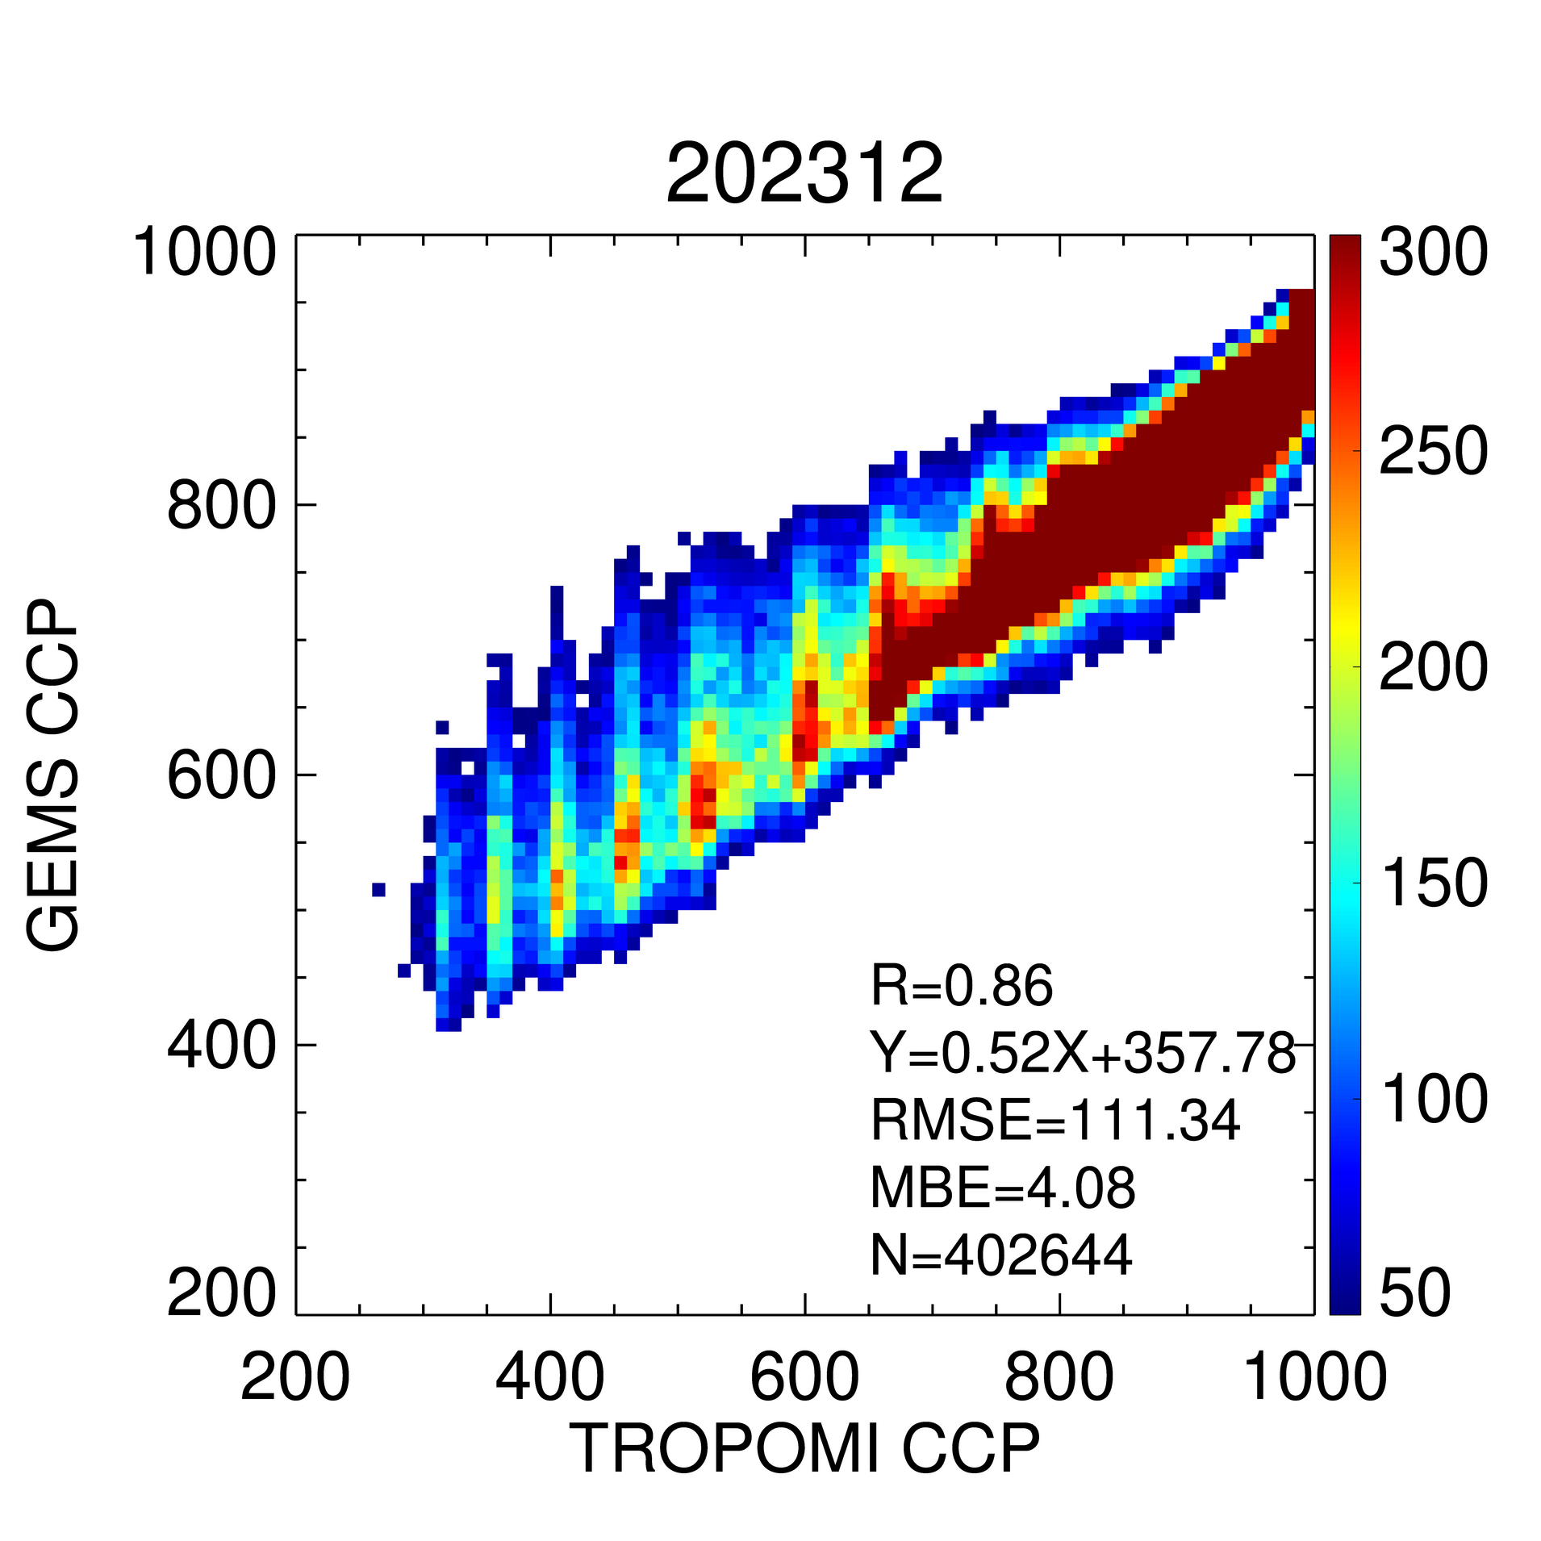
II. Update result of GEMS cloud version 3
CCP: Montly validation with TROPOMI
→ Mean R = 0.81 (ECF > 0.2)
Monthly validation results show a reasonable correlation between GEMS and TROPOMI (R > 0.80).
The stripe issue, possibly caused by the collocation area, will be investigated.

Slide 9
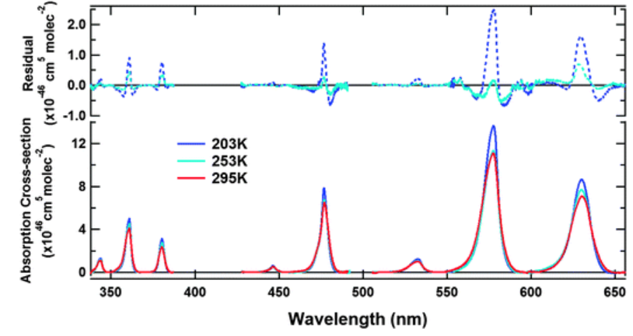
III. Temperature correction of O₂-O₂
Temperature correction of O₂-O₂ absorption band
The O₂–O₂ absorption peak depends on temperature.
A fixed atmospheric profile is used to make an LUT.
The SCD of O₂–O₂ retrieved from DOAS affects CCP retrieval.
Thalman and Volkamer, 2013

Slide 10
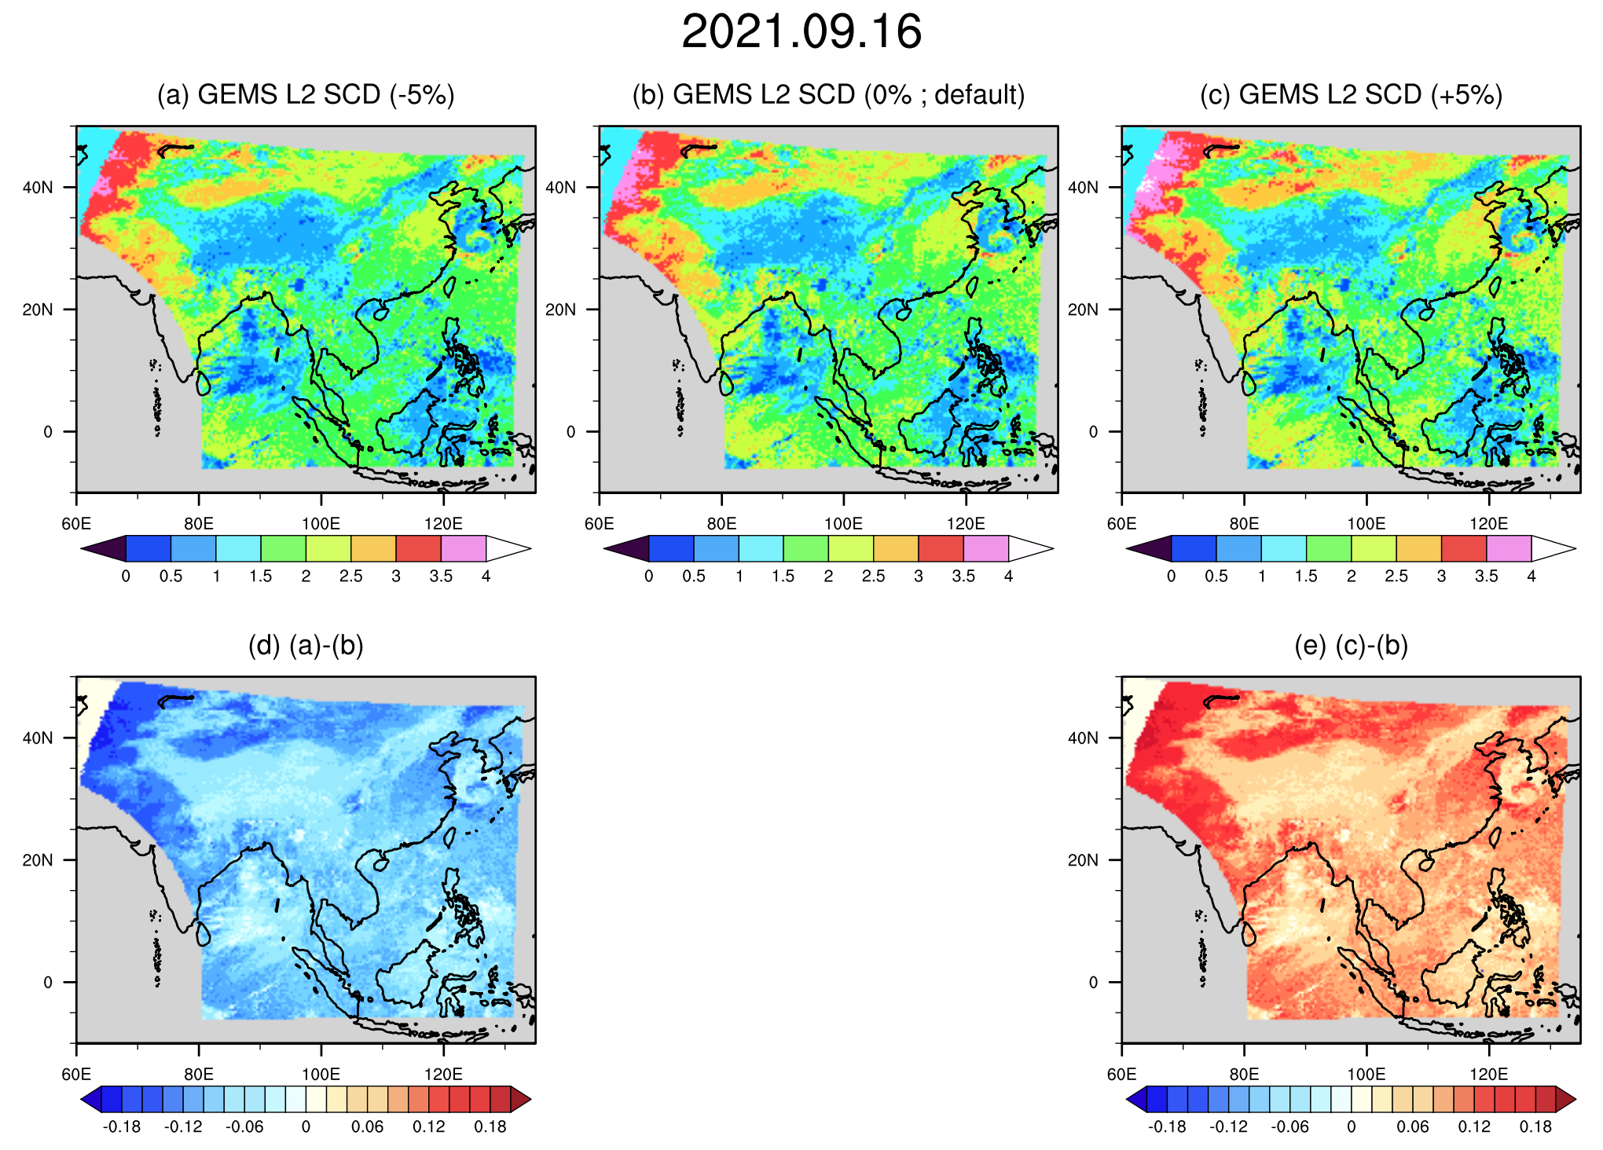
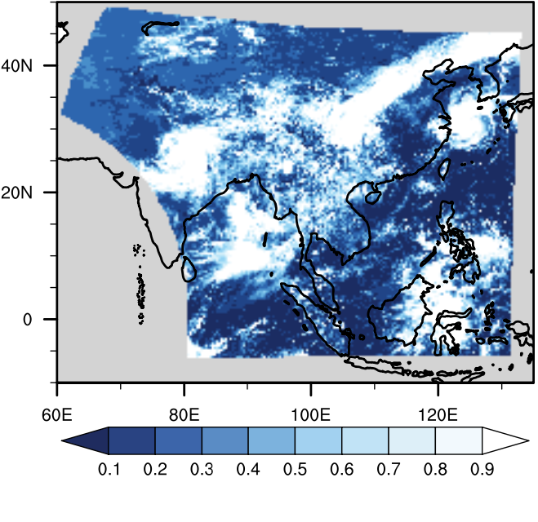
III. Temperature correction of O₂-O₂
Date: Sep 16, 2021
(a) SCD (-5%) (b) SCD (Default) (c) SCD (+5%)
Adjusted the SCD from DOAS by ±5% from the default values.
The difference in SCD values is larger in clear-sky pixels.
(d) (a)-(b) (e) (c)-(b)
ECF

Slide 11
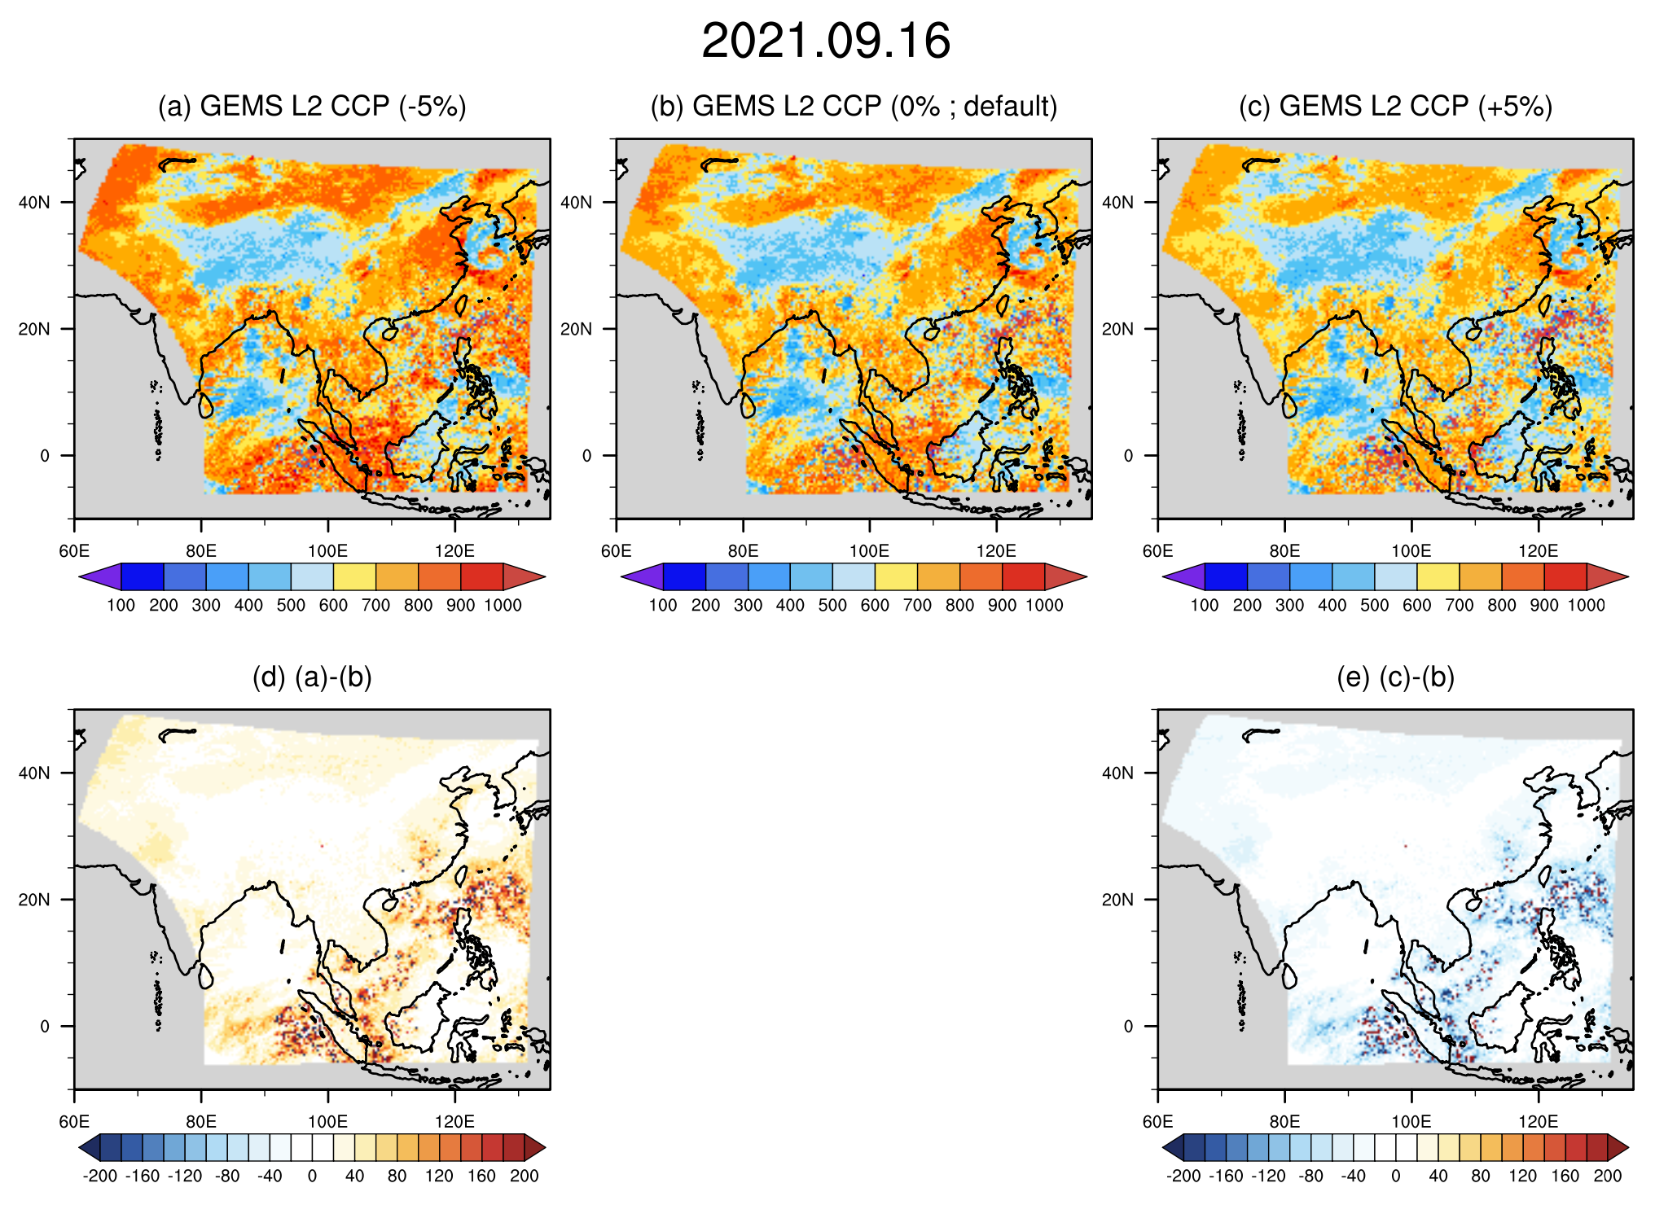
III. Temperature correction of O₂-O₂
Date: Sep 16, 2021
(a) CCP (SCD -5%) (b) CCP (Default) (c) CCP (SCD +5%)
In clear sky pixels,
A smaller SCD results in a
lower CCP.
A larger SCD results in a
higher CCP.
(d) (a)-(b) (e) (c)-(b)
ECF

Slide 12
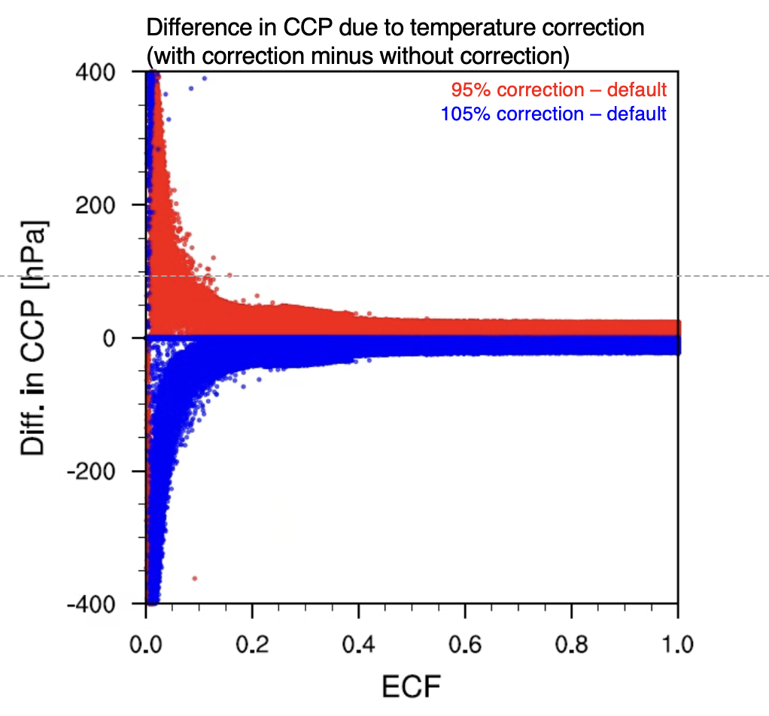
III. Temperature correction of O₂-O₂
Difference = w/ correction minus w/o correction
The significant discrepancies in clear-sky regions, with differences reaching up to
400 hPa when ECF is below 0.2.

Slide 13


Summary
Improved the overall performance of GEMS cloud retrievals in V3.0
  The ECF discontinuity area is improved.
  The overestimation of ECF in clear-sky pixels is reduced
  The Lower-level CCP retrieval is improved.
In preparation for GEMS Cloud version 4
  Consideration of temperature profile for cloud retrieval.
  The ±5% change in the slant column density of O₂–O₂ absorption causes CCP differences of about ±400 hPa.
Kim et al. 2021 (IJRS)
Kim et al. 2024 (AMT)

