Slide 1
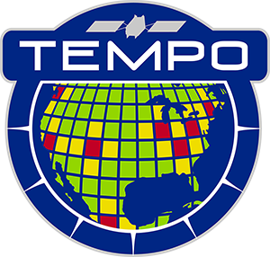





Tropospheric Emissions:
Monitoring of Pollution
TEMPO HCHO product updates
Gonzalo González Abad
Heesung Chong, Weizhen Hou, John Houck, Xiong Liu, Caroline Nowlan, Huiqun Wang
TEMPO/GeoXO ACX Joint Science Team Workshop
August 19, 2025

Slide 2
Talk outline
  TEMPO trace gas retrievals 101
  Major version 4 updates affecting formaldehyde retrievals:
    Improved straylight correction
    Improved GLER climatology (details in Weizhen Hou’s poster)
    Cloud parameter changes (see Helen Wang’s poster)
    Cloud, GLER and GEOS-CF v2 AMF effects
    Revisited surface pressure calculation
  HCHO Near Real Time
  Version 3 vs. version 4 vs. NRT

Slide 3
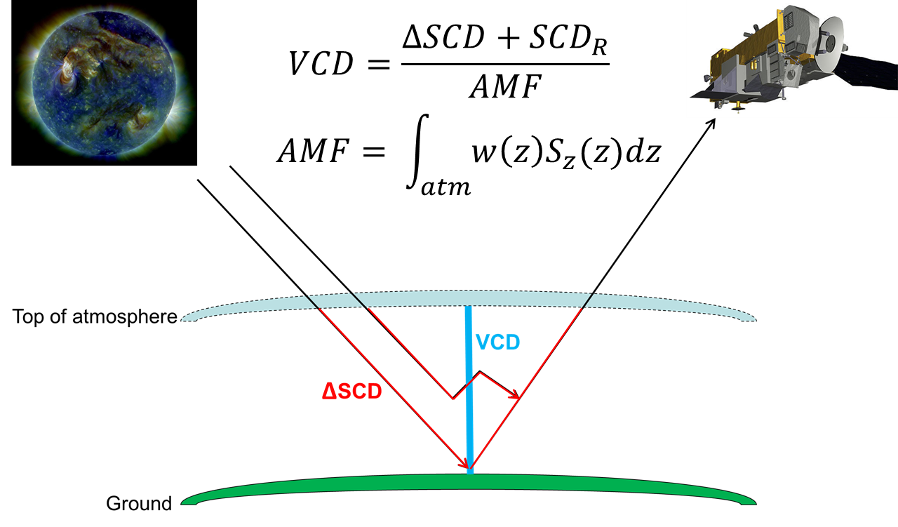
TEMPO trace gas retrievals 101
TEMPO HCHO shares the differential slant column fit (also used for cloud O₂-O₂ columns), and air mass factor calculation with NO₂.
HCHO columns are corrected to account for the use of radiance reference source spectra with a GEOS-CF based “background correction”
TROPOMI NO₂, ESA

Slide 4
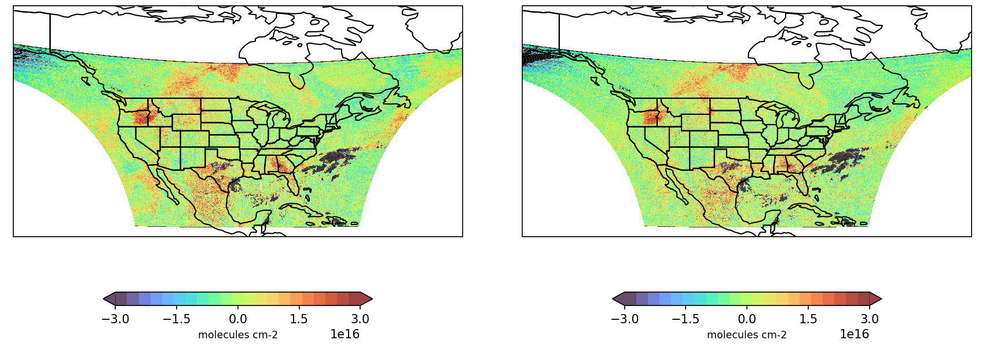
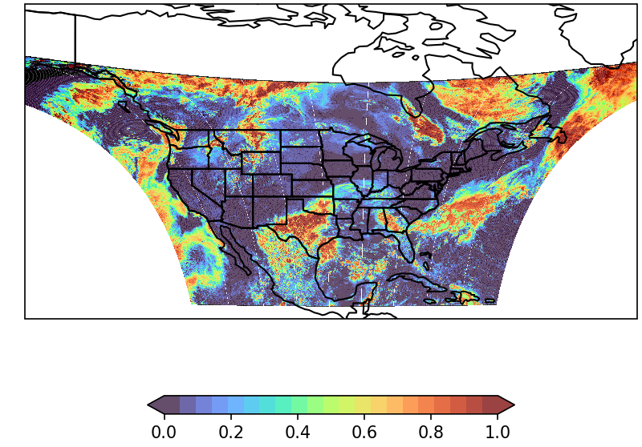
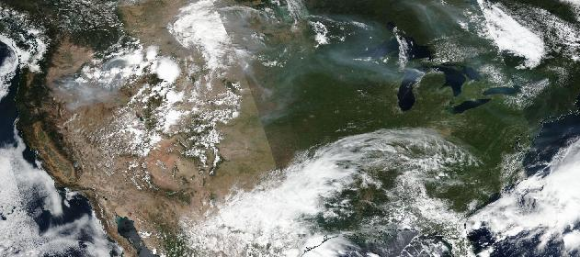
L1b improved straylight correction reduces slant columns over clouds
Slant column reduction over clouds
September 3, 2024; S007
Version 3 slant column
Version 4 slant column
Smoke plume
Cloud fraction
Suomi NPP VIIRS image from Worldview

Slide 5
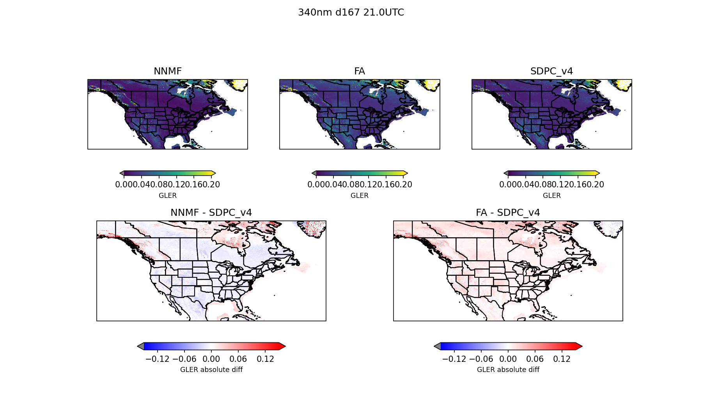
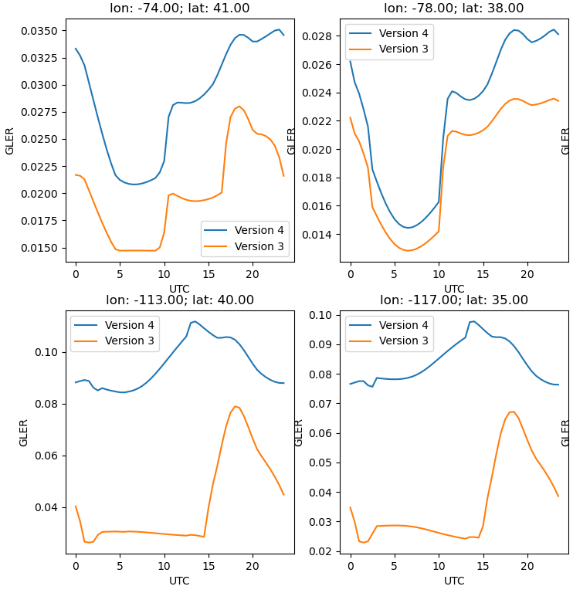
Improved GLER (details in Weizhen Hou’s poster; s[ecial thanks to Wenhan Qin)
340 nm; June; 21 UTC
Version 4 GLER
Version 3 GLER
Version 3 – Version 4

Slide 6
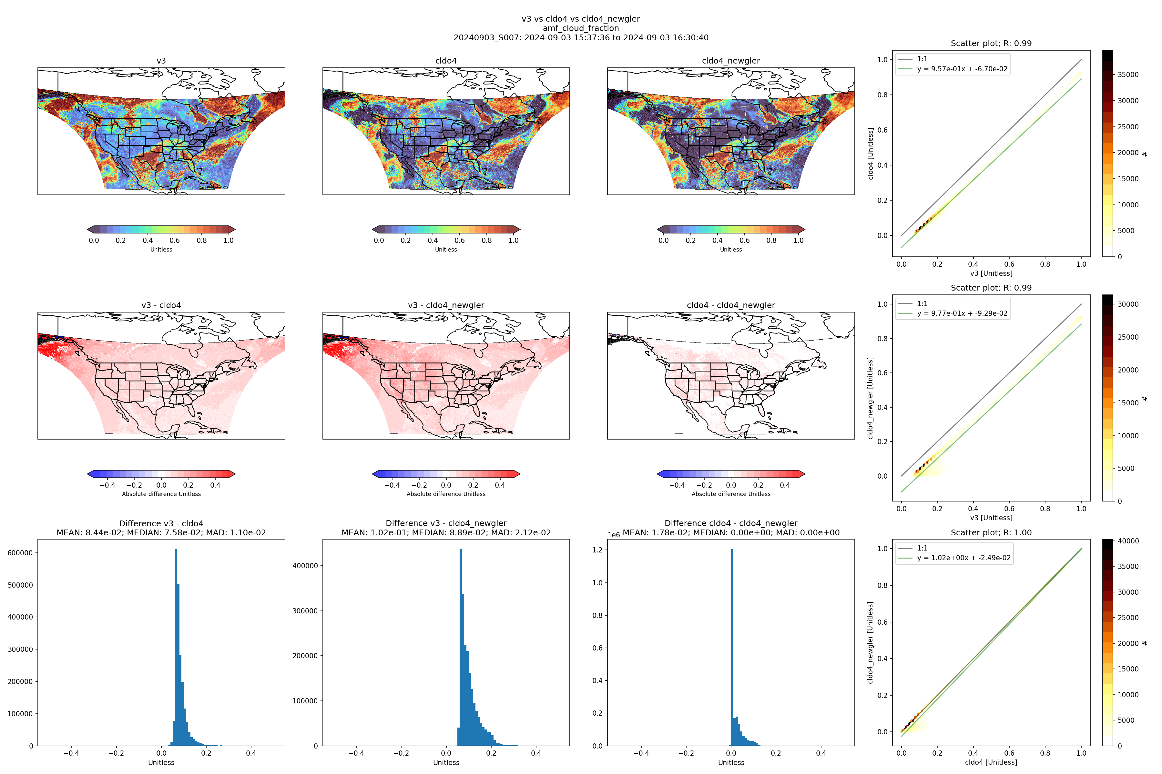
Significant reduction of cloud fractions (see Helen Wang’s poster)
Version 3 cloud fraction at 340 nm
September 3, 2024; S007
Version 4 cloud fraction at 340 nm
Version 3 – Version 4 cloud fraction change

Slide 7
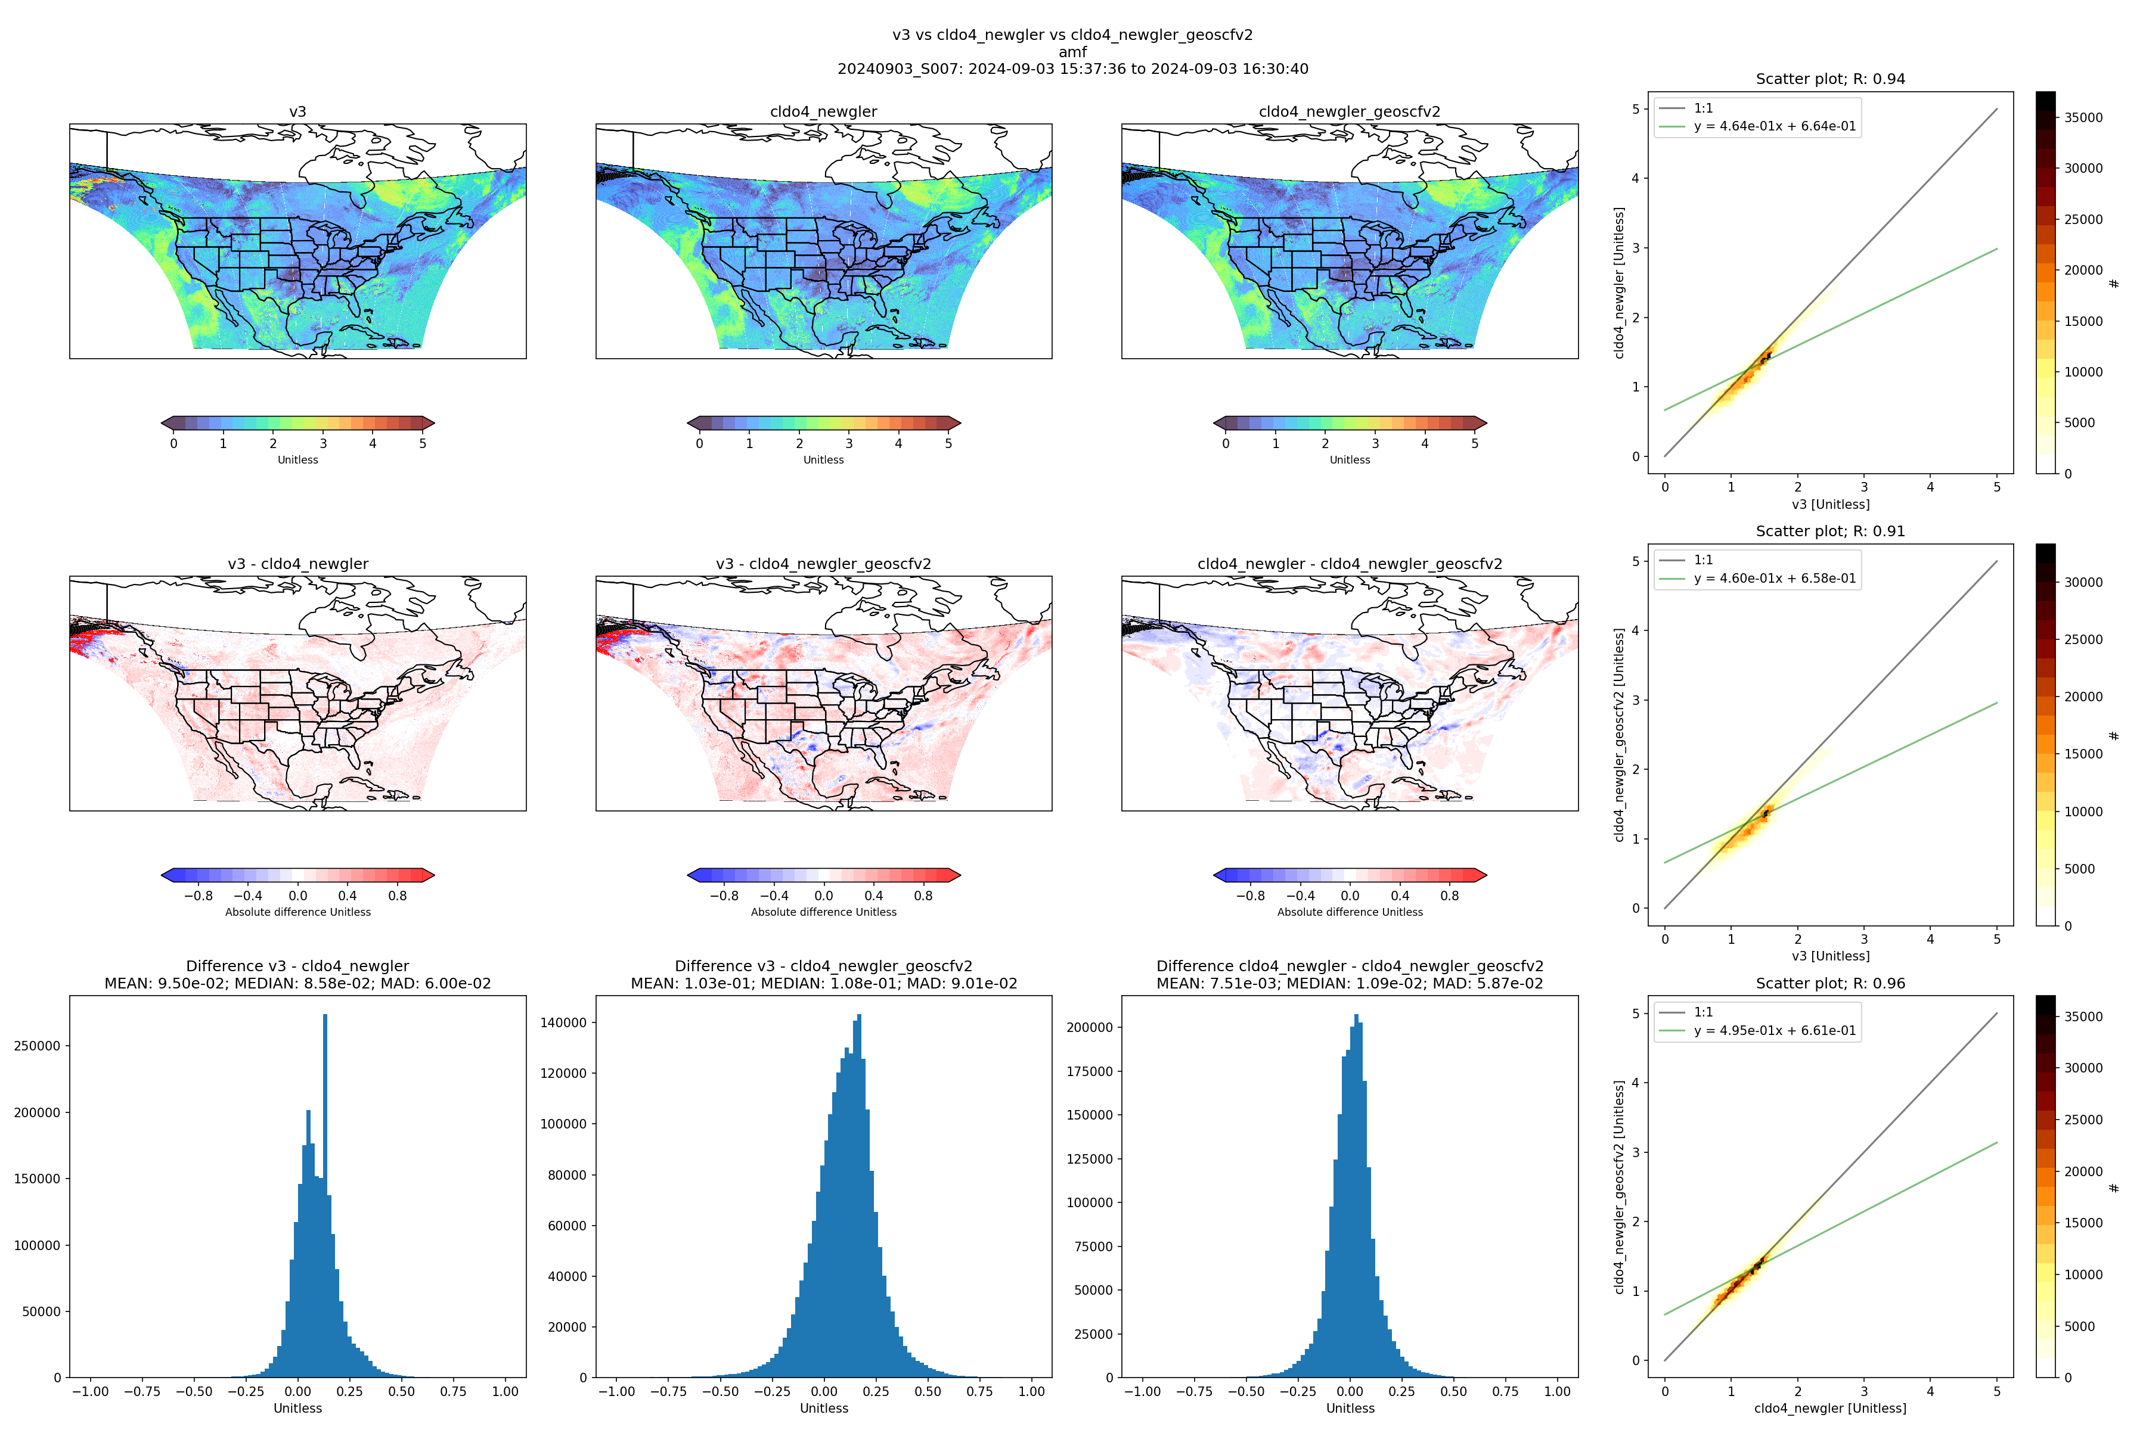
Cloud, GLER and GEOS-CF v2 (details on Viral Shah’s presentation) AMF effects
Version 3 AMF
Version 4 (cloud and GLER change) AMF
Version 4 (cloud, GLER + GEOS-CF V2 change) AMF
AMF change due to clouds + GLER
Version 3 – Version 4 AMF change
AMF change due to GEOS-CF V2

Slide 8
Cloud, GLER and GEOS-CF v2 (details on Viral Shah’s presentation) AMF effects
Version 3 AMF
Version 4 (cloud and GLER change) AMF
Version 4 (cloud, GLER + GEOS-CF V2 change) AMF
AMF change due to clouds + GLER
Version 3 – Version 4 AMF change
AMF change due to GEOS-CF V2

Slide 9
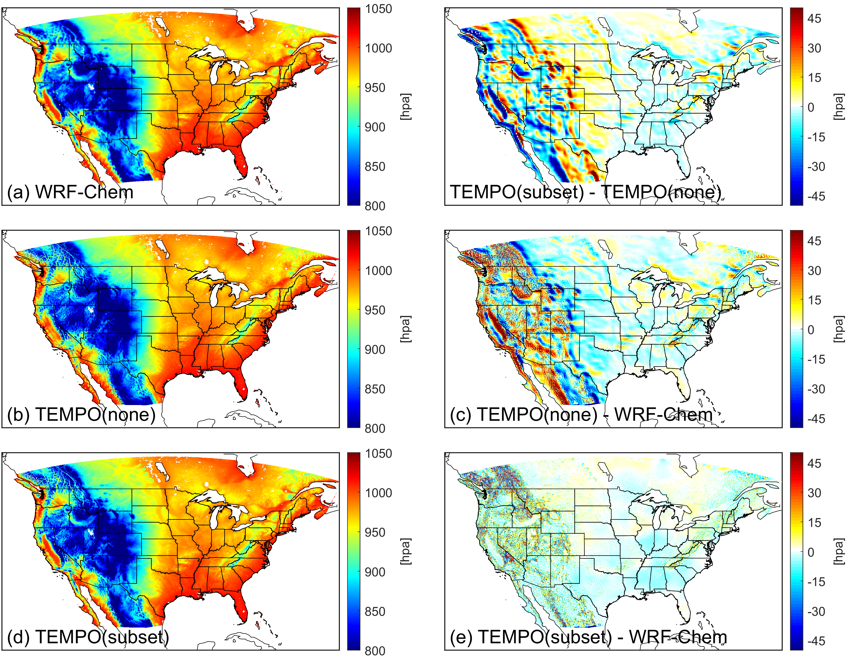
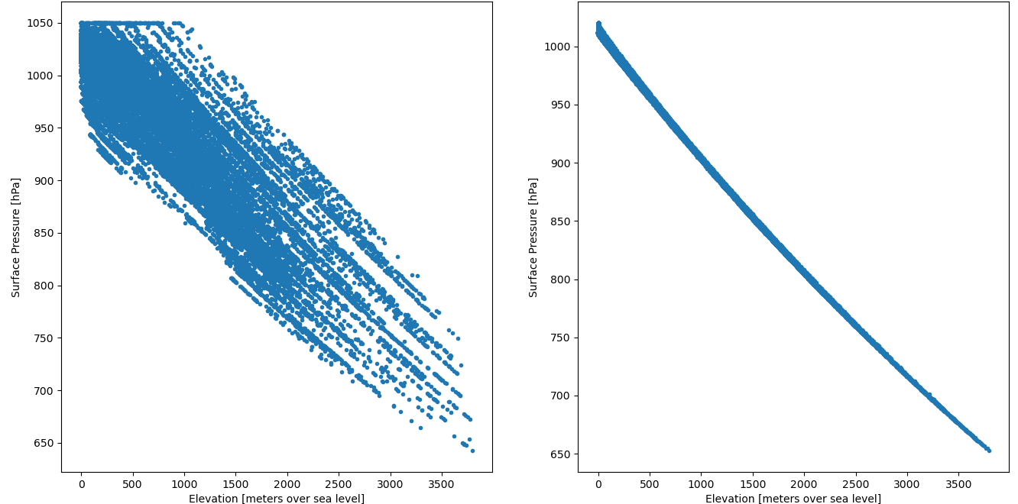
Fix surface pressure interpolation thanks to Chia-Hua’s feed back
Surface pressure vs. altitude
Version 3
Version 4
Image credit: Chia-Hua Hsu

Slide 10
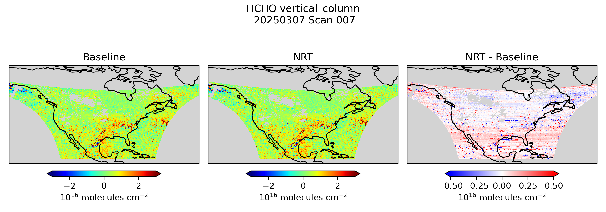
Near Real Time HCHO
HCHO differences are well within the typical precision of 6 × 10¹⁵ molecules cm⁻².
Largest differences result from the use of a radiance reference computed using spectra from the previous day.

Slide 11
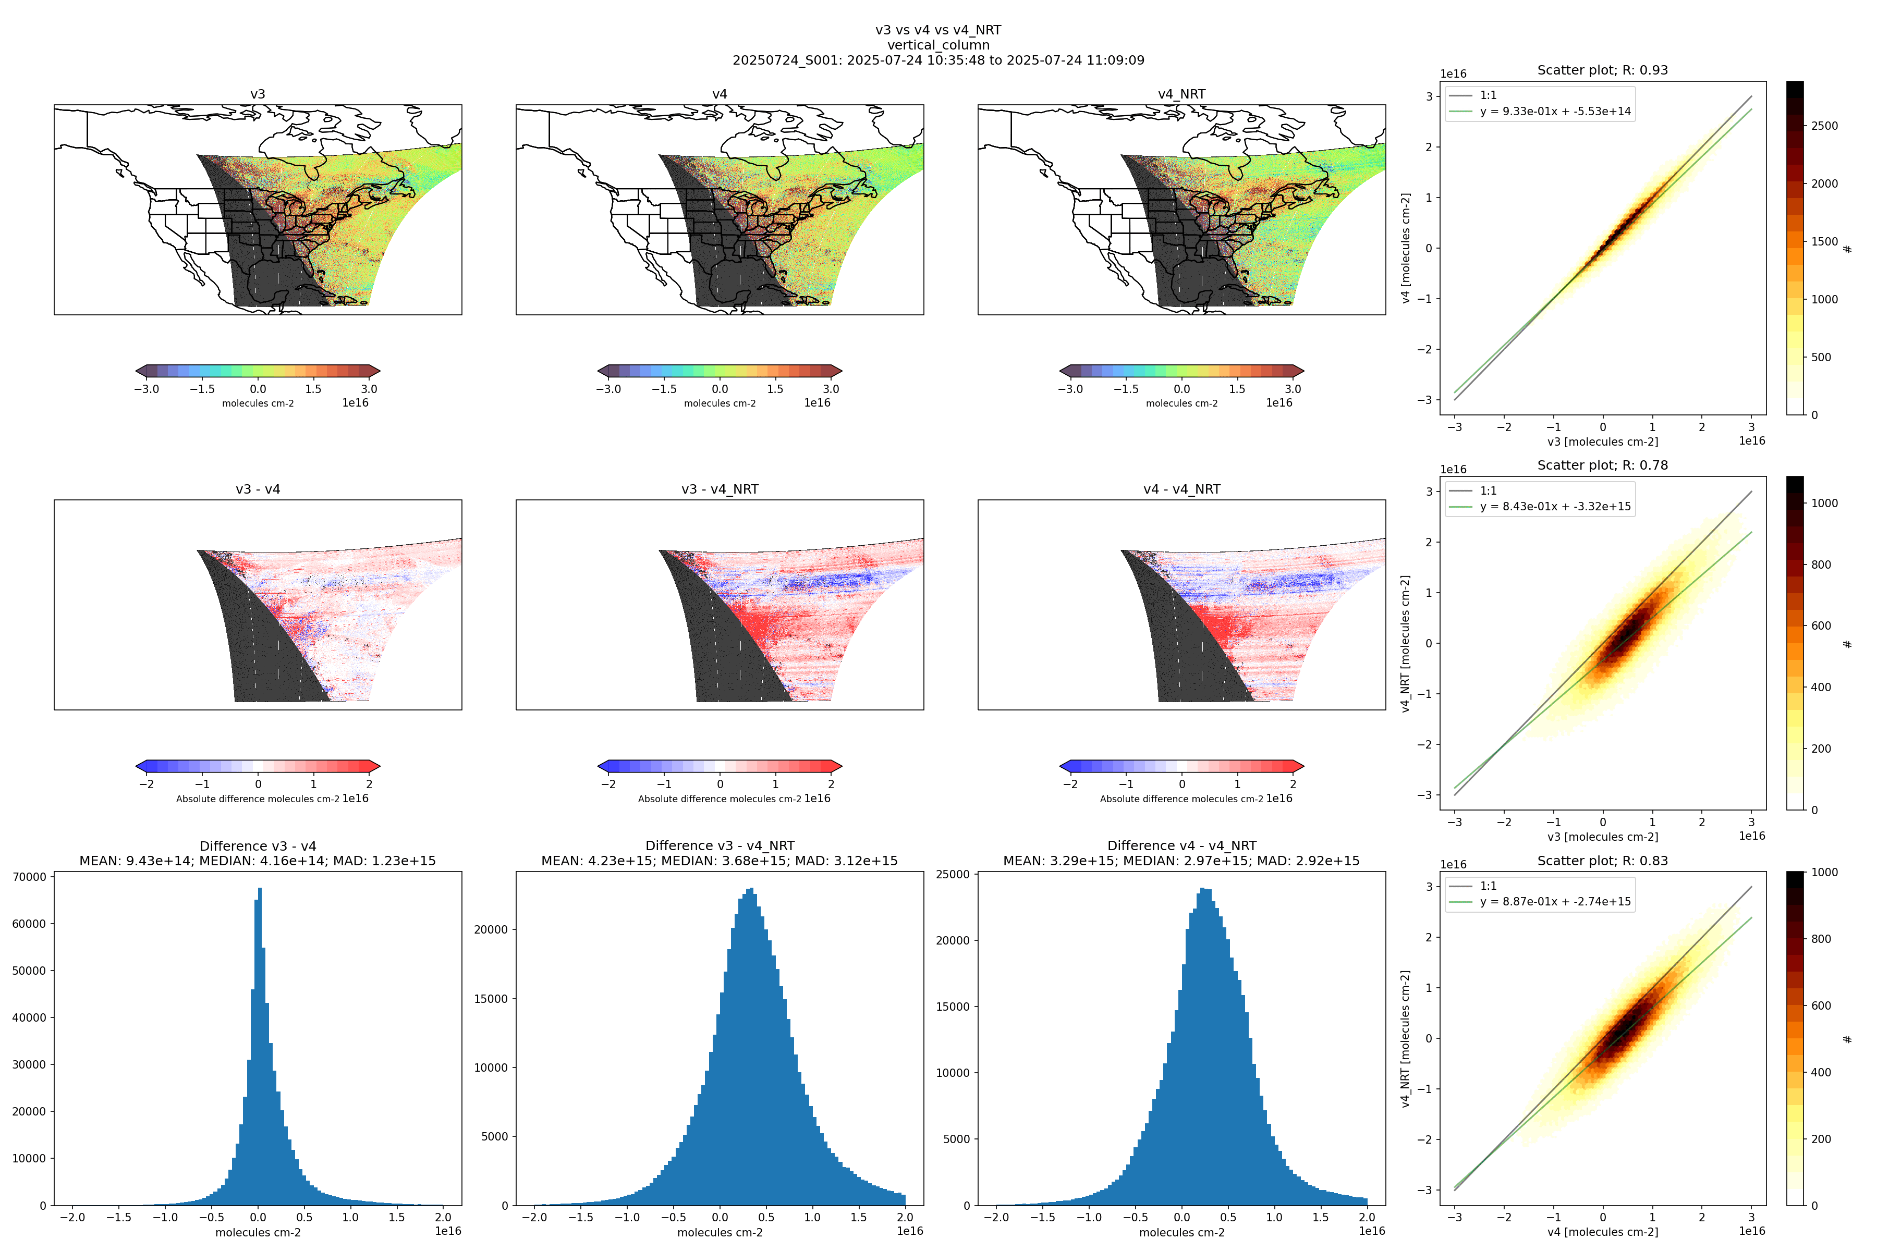
Version 3 vs. Version 4 vs. NRT
Future work
Revisit radiance reference and background correction
Improve slant column fitting over heterogeneous scenes
Develop TEMPO based surface reflectance product
Improve spherical correction in AMF calculations

Slide 12
Questions?

Slide 13
Air mass factor calculation inputs
Input | Source
Cloud fraction and pressure | TEMPO cloud product. Defaults to a cloud pressure climatology (OMI-derived) if cloud retrieval is unavailable.
Trace gas profiles | GEOS-CF hourly forecast from prior day (25-km resolution). Defaults to monthly 1-hour climatology derived from GEOS-CF if forecast is unavailable.
Vertical layers | 72 layers on GEOS-CF vertical grid
Surface albedo | GLER climatology (0.05° resolution) using OMI GSFC team methodology over land (Fasnacht et al., 2019) and water (Qin et al., 2019). Derived from MODIS BRDF v6.1, extended to shorter wavelengths 340 nm (HCHO) using visible surface reflectance EOFs updated from Zoogman et al. (2016) and SCIAMACHY reflectance climatologies.
Snow/ice fraction | IMS snow and ice (1-km resolution)
Meteorological variables: Temperature profile (for hypsometric equation and NO₂ T-dependency), surface pressure, tropopause pressure (for NO₂ stratospheric correction), wind speed (for ocean GLER) | GEOS-CF hourly forecast from prior day (25-km resolution). Defaults to monthly 1-hour climatology derived from GEOS-CF if forecast is unavailable.
Terrain height correction | Corrected following Boersma et al. (2011) using GMTED2010 (30 arcsec) DEM
Aerosols | Not applied (considered implicitly in cloud retrieval)

Slide 14
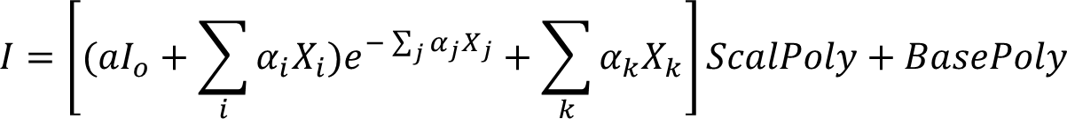
Differential slant column spectral fit set up
Fitting window | 328.5 - 356.5 nm
I₀ | CCD position dependent radiance reference calculated using same scan
Baseline polynomial | 3rd order
Scaling polynomial | 3rd order
Solar reference spectrum | Coddington et al., (2023) TSIS-1 Hybrid Solar Reference Spectrum
Raman Scattering | Derived using Chance and Spurr (1997)
Undersampling correction | Derived using Chance et al. (2005)
O₃ | Serdyuchenko et al. (2014) at 223K and 243K
NO₂ | Vandaele et al. (1998) 220K
O₂-O₂ | Finkenzeller and Volkamer (2022) 293K
BrO | Wilmouth et al. (1999) 228K
HCHO | Chance and Orphal (2011) 300K

Slide 15
Algorithm updates from pre-launch version till public release (version 3)
SDPC v4.2 (V1) pre-PLAR
  Update O₂-O₂ cross sections
  Optimize wavelength shift parameter limits
  Optimize order of closure polynomials in solar and radiance fit
  Use radiance reference as source term in HCHO retrievals
  Fix bug on AMF calculation wavelength set up
  Minor updates related to file formatting
SDPC v4.3 (V2)
  Carry on retrieval for a given North-South position even if radiance wavelength calibration fails
  Increase spatial resolution of Level 3 files to 0.02° x 0.02°
  Address some Level 2 & 3 file format feedback from ASDC

Slide 16
Algorithm updates from pre-launch version till public release (version 3)
SDPC v4.4 (V3) & Level 2-3 release: May 20, 2024
  Perform retrievals up to SZA 90
  Update main data quality flag (AMF > 6 as suspect, ~SZA 70 + VZA 70)
  Revisit convergence flag & AMF diagnostic flag
  Add temperature profile to output (for AMF)
  Revise Level 3 quality flag logic
  Address remaining Level 2 & 3 file format feedback from ASDC (fill in attributes, valid range…)

Slide 17
Algorithm updates public release (version 4)
SDPC v4.X (V4) & Level 2-3 release: September 2, 2025
  Use of GEOS-CF version 2
  Improved GLER climatology
  Revisited surface pressure calculation
  Include wind speed, clear sky AMF and scattering weights in level 2 files
  Fix bug in interpolation of Radiance_cld (was using surface instead of cloud pressure)
  Near Real Time capacity

