Slide 1

Tropospheric Emissions:
Monitoring of Pollution
TEMPO Nitrogen Dioxide:
Product Status
Caroline Nowlan
Center for Astrophysics | Harvard & Smithsonian
With contributions from:
Gonzalo González Abad
Masoud Ghahremanloo
Xiong Liu
John Houck
Helen Wang
Heesung Chong
Weizhen Hou
TEMPO/GeoXO ACX Joint Science Team Workshop
August 19, 2025

Slide 2
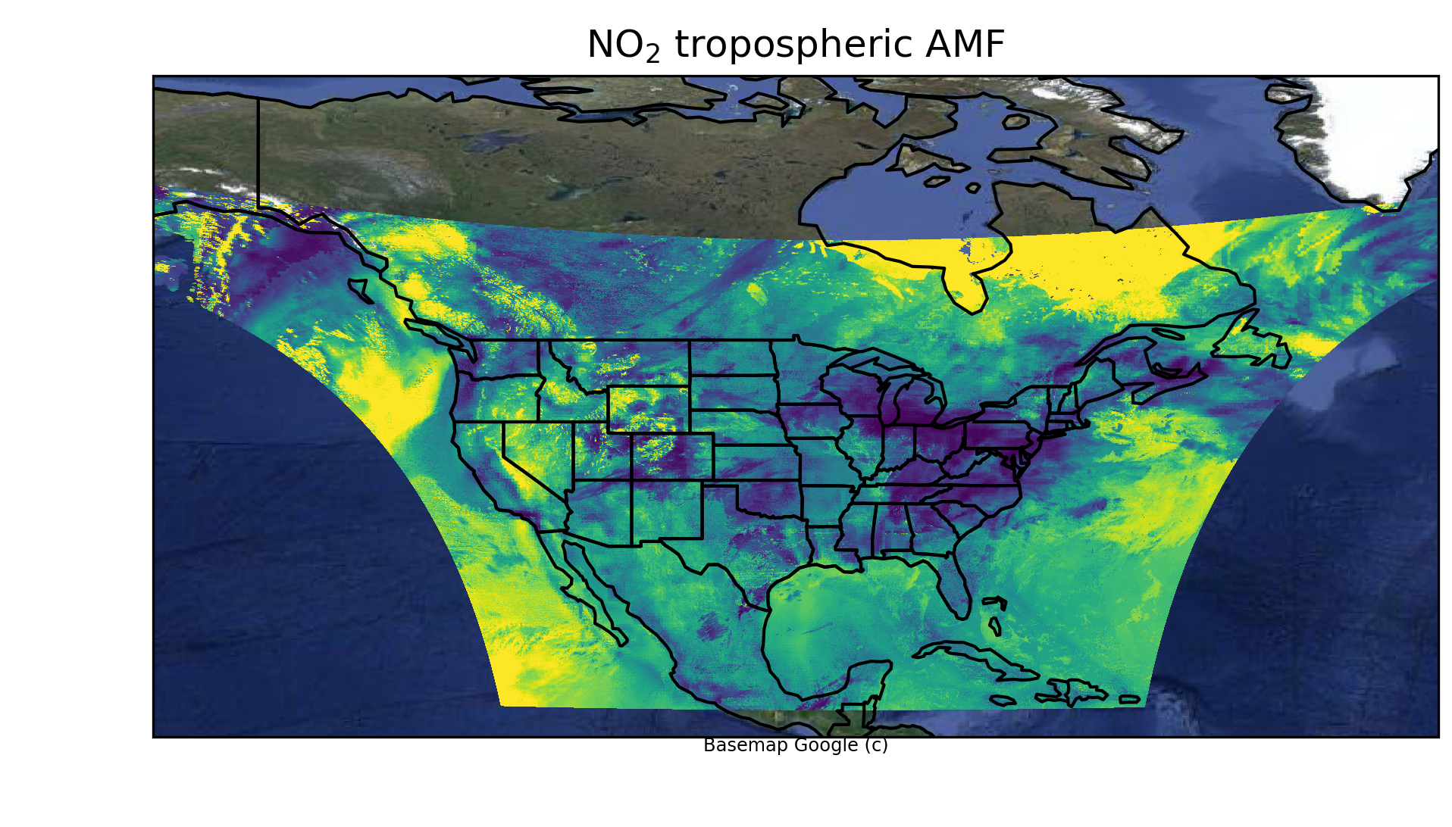
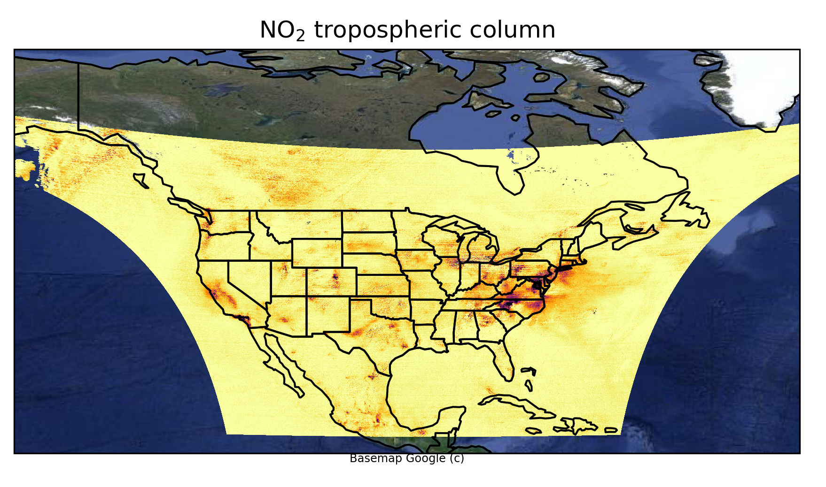
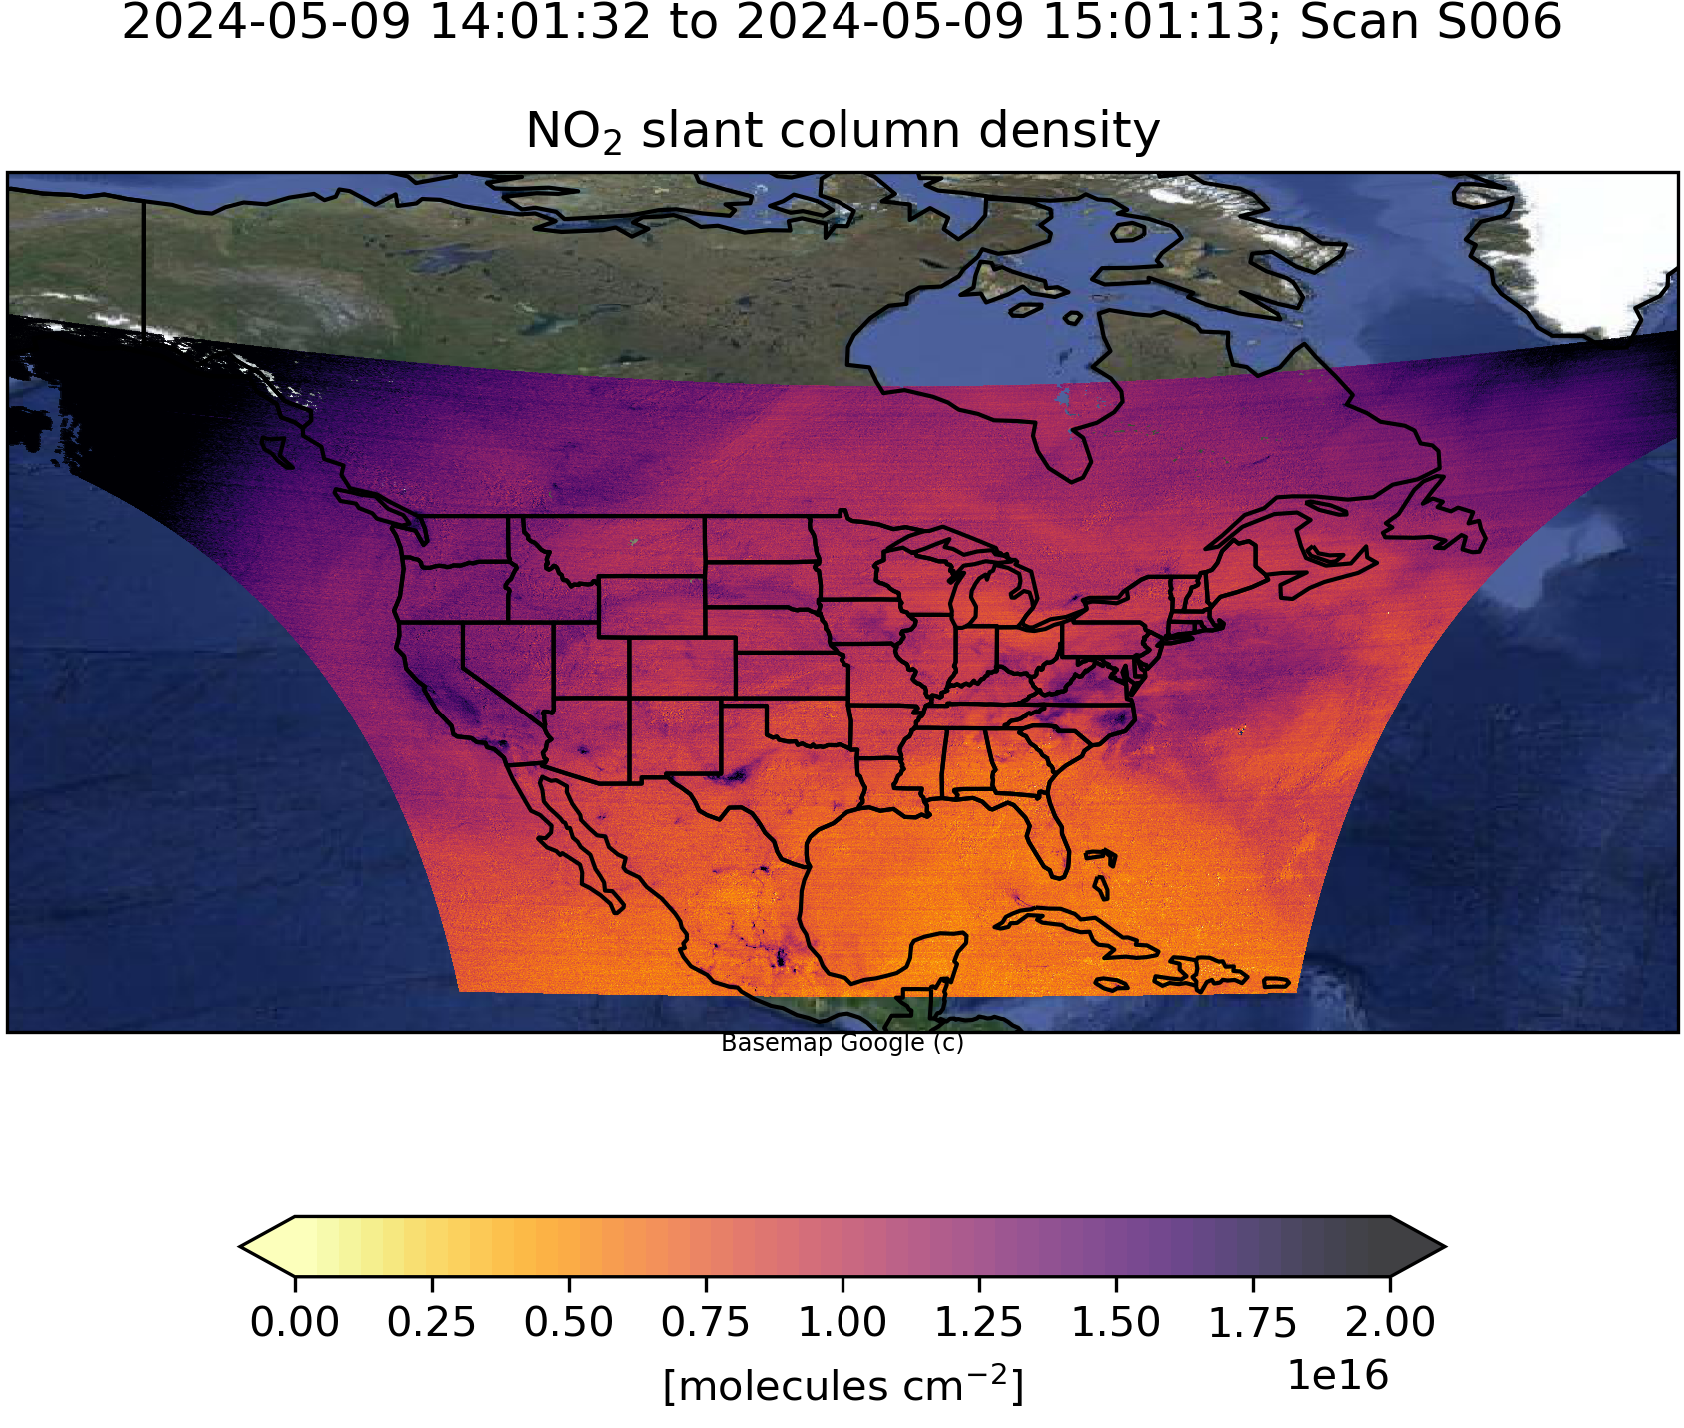
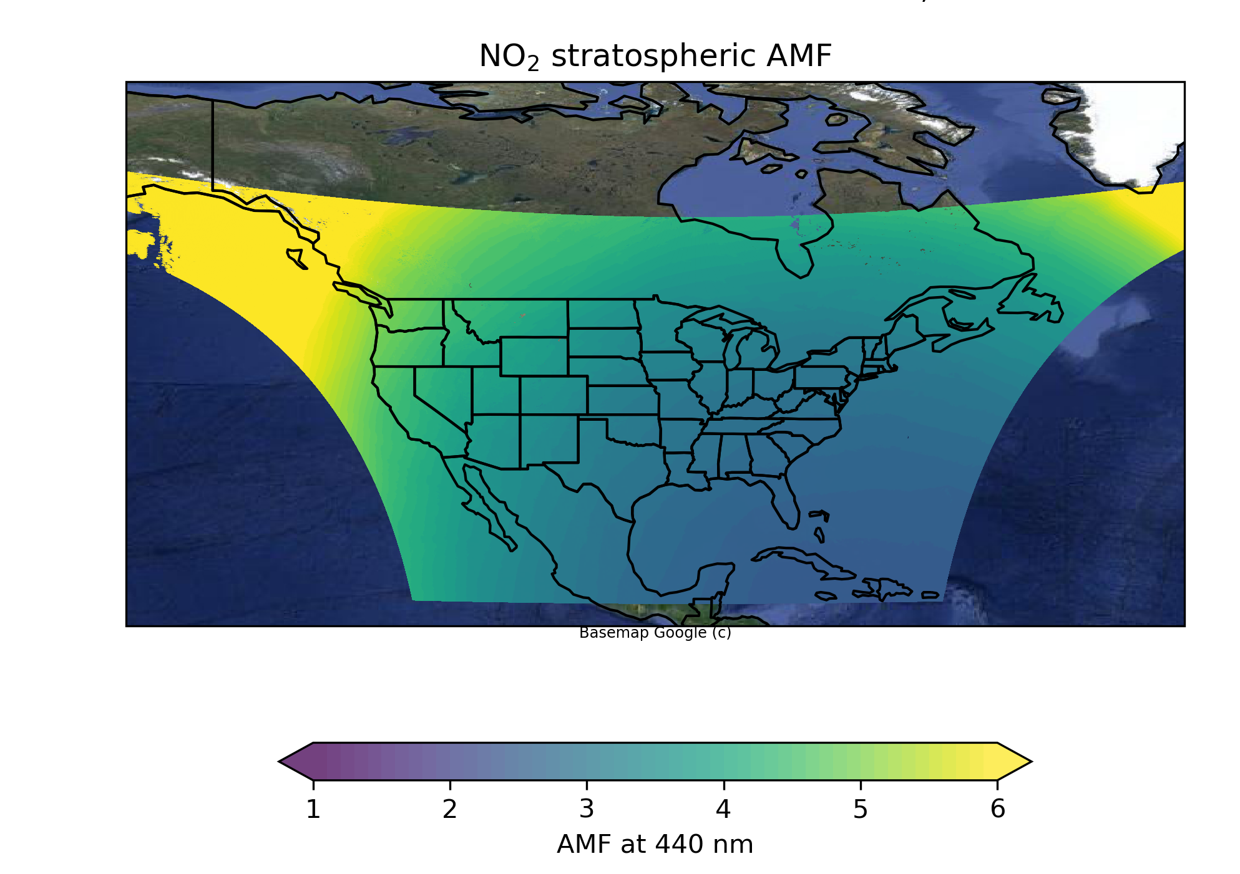
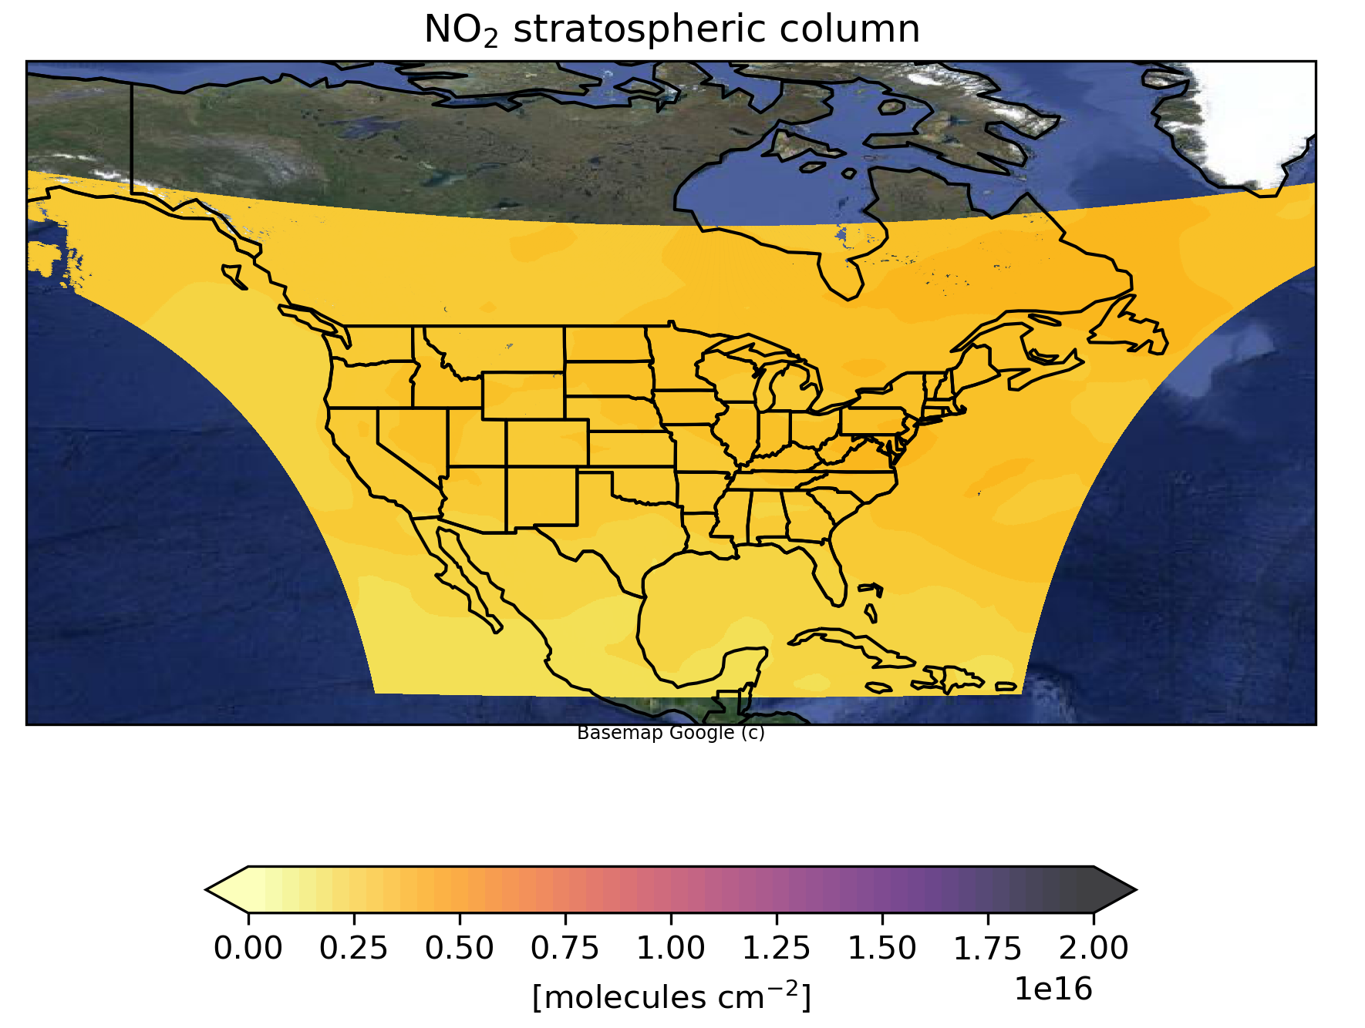
NO₂ Retrieval Algorithm
1) Slant column density retrieval (spectral fitting)
2) Air mass factor (AMF) calculation
3) Stratosphere/troposphere separation

Slide 3
Major Updates for Version 4 NO₂
Level 1B absolute calibration improvements change cloud parameters
Update to GEOS-CF version 2
Improved surface GLER climatology (land only)
Updates to surface pressure calculation
Update in reading scattering weight look-up table for clouds
Destriping correction
New variables: Cloud-free AMFs and scattering weights
These impact both standard (V04) and NRT V02 products.

Slide 4
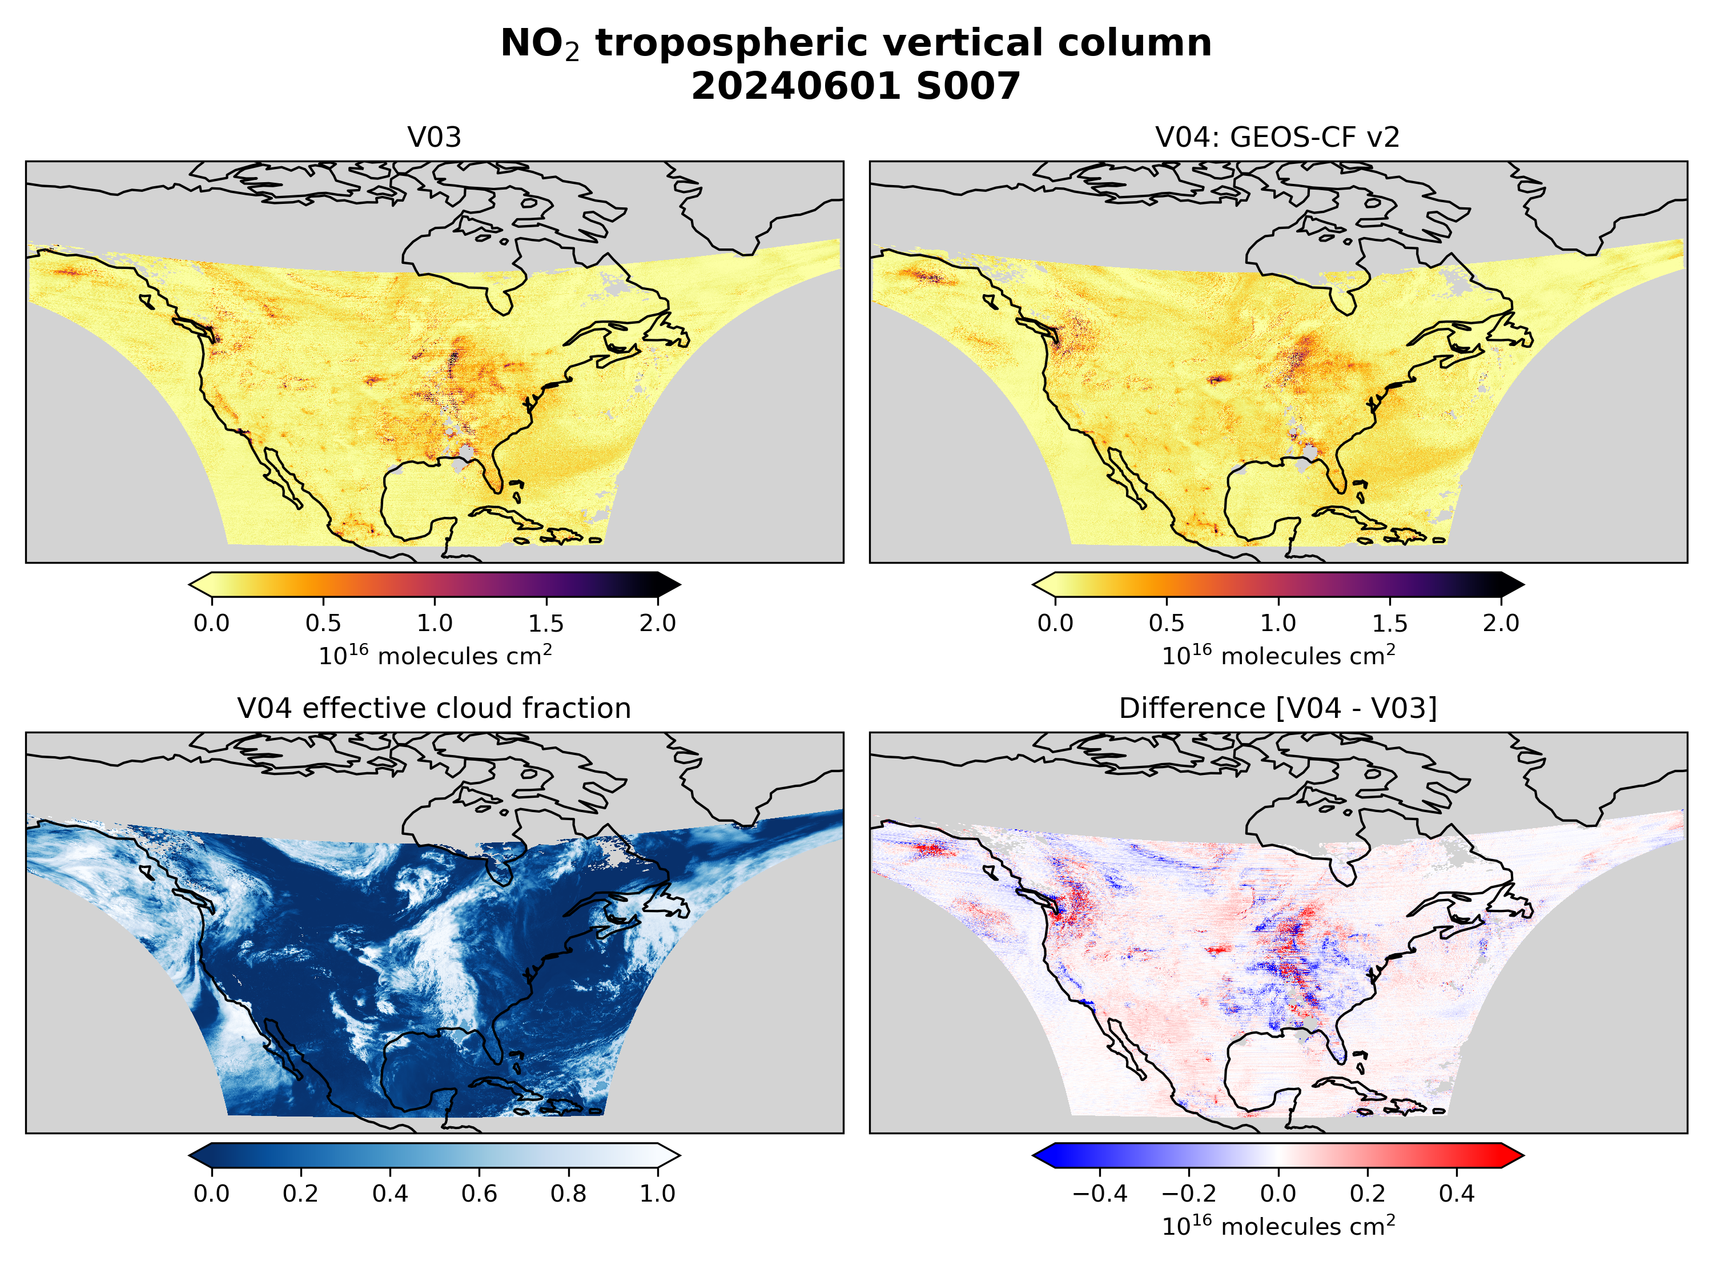
Version 3 vs. Version 4
Large changes in tropospheric NO₂ vary and mostly depend on:
GLER update
Cloud changes
GEOS-CF version 2

Slide 5
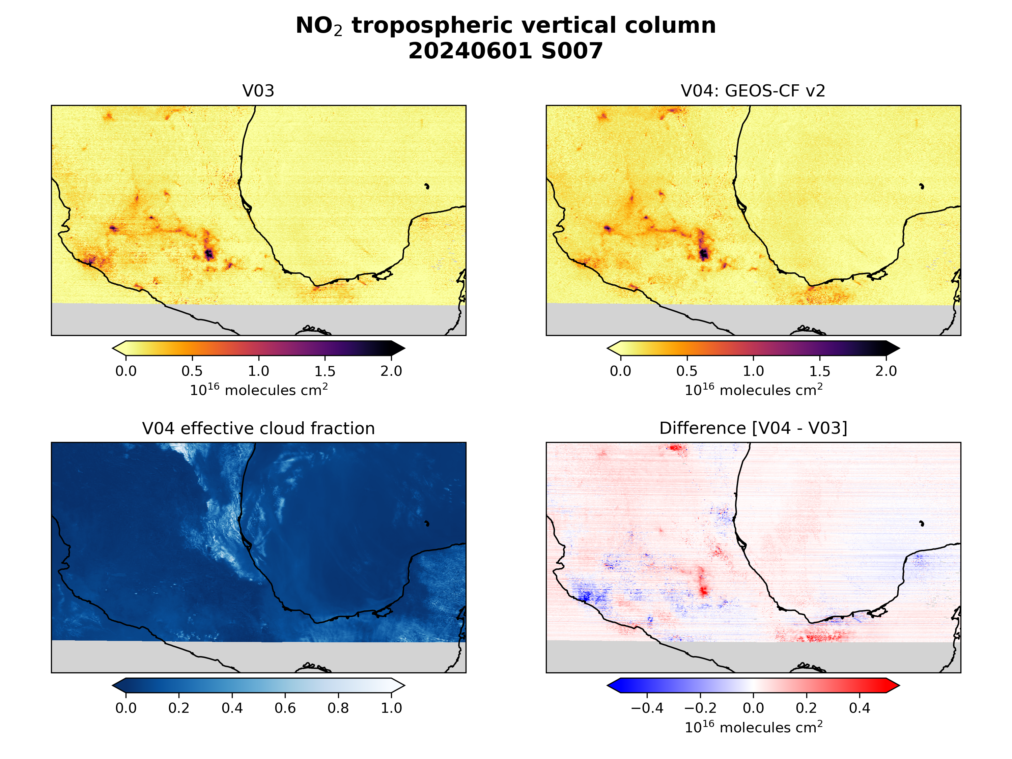
Version 3 vs. Version 4: Mexico

Slide 6
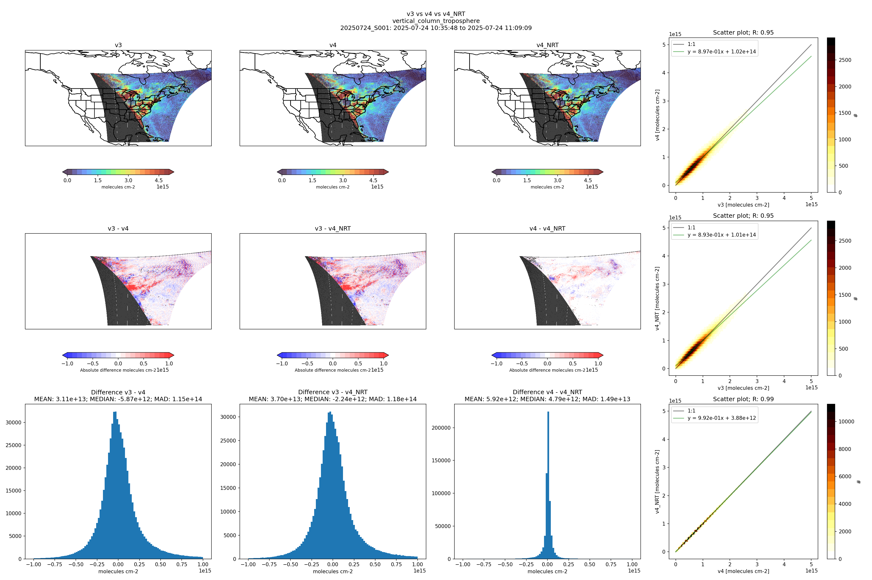
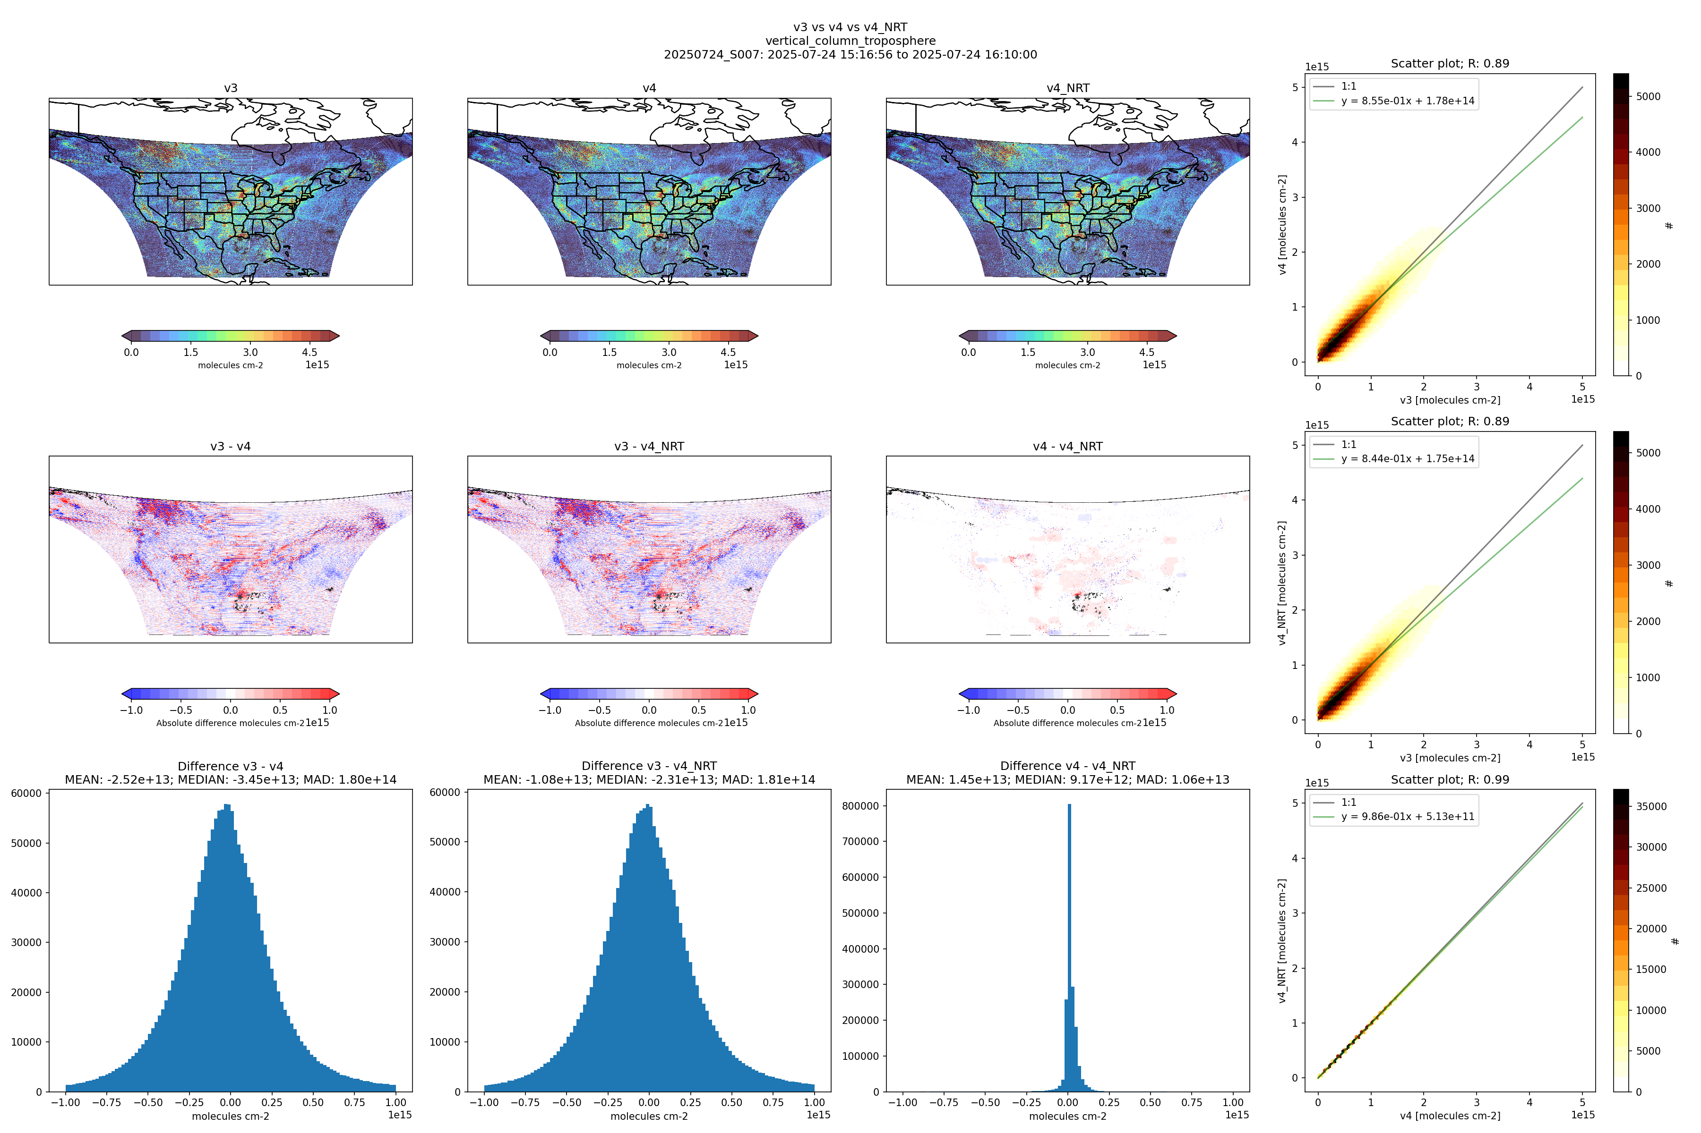
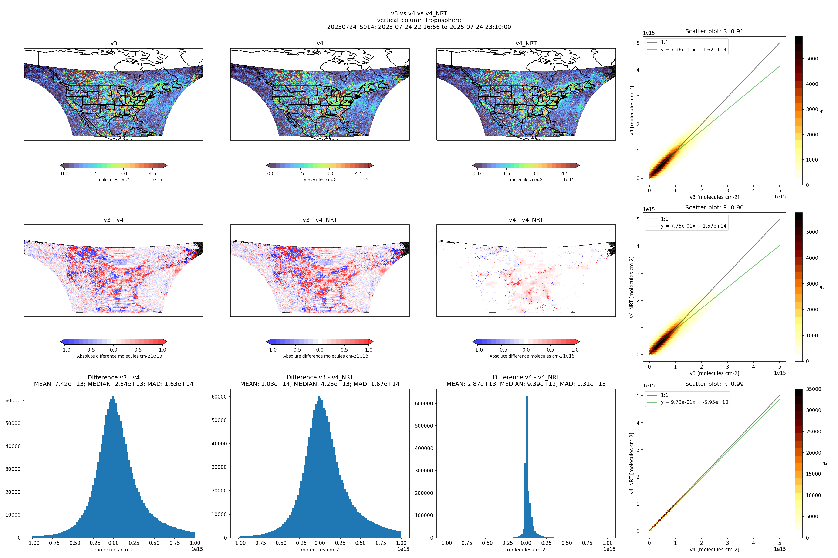
Version 3 vs. Version 4
NO₂ tropospheric vertical column
24 July 2025 pipeline test
Scan 001
Scan 007
Scan 014
V04
V03
Slope is ~0.8 – 0.9
Overall v4 < v3 at all times of day

Slide 7
Near-Real Time NO₂
NO₂ tropospheric vertical column
24 July 2025 pipeline test
Scan 001
Scan 007
Scan 014
NRT V02
V04
NRT is highly consistent with standard product (R=0.99)

Slide 8
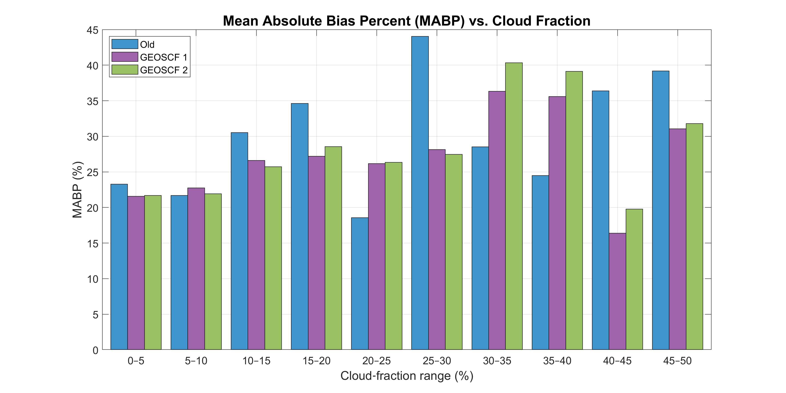
Comparisons with Pandora
V03
V04 GEOS-CF v1
V04 GEOS-CF v2
Limited 4-day validation of total NO₂ column with 59 Pandora stations shows:
Mean absolute bias reduced in version 4 for cloud fractions <0.2
Version 4 with GEOS-CF v2 (analysis) shows the best performance
  Correlation of all coincidences increases
    (R=0.77 → 0.86)
  Mean of all site correlations increases
  (R=0.40 → 0.58)
Four days of data:
2024/06/01
2024/09/03
2025/01/27
2025/03/23
[Credit: Masoud Ghahremanloo]

Slide 9
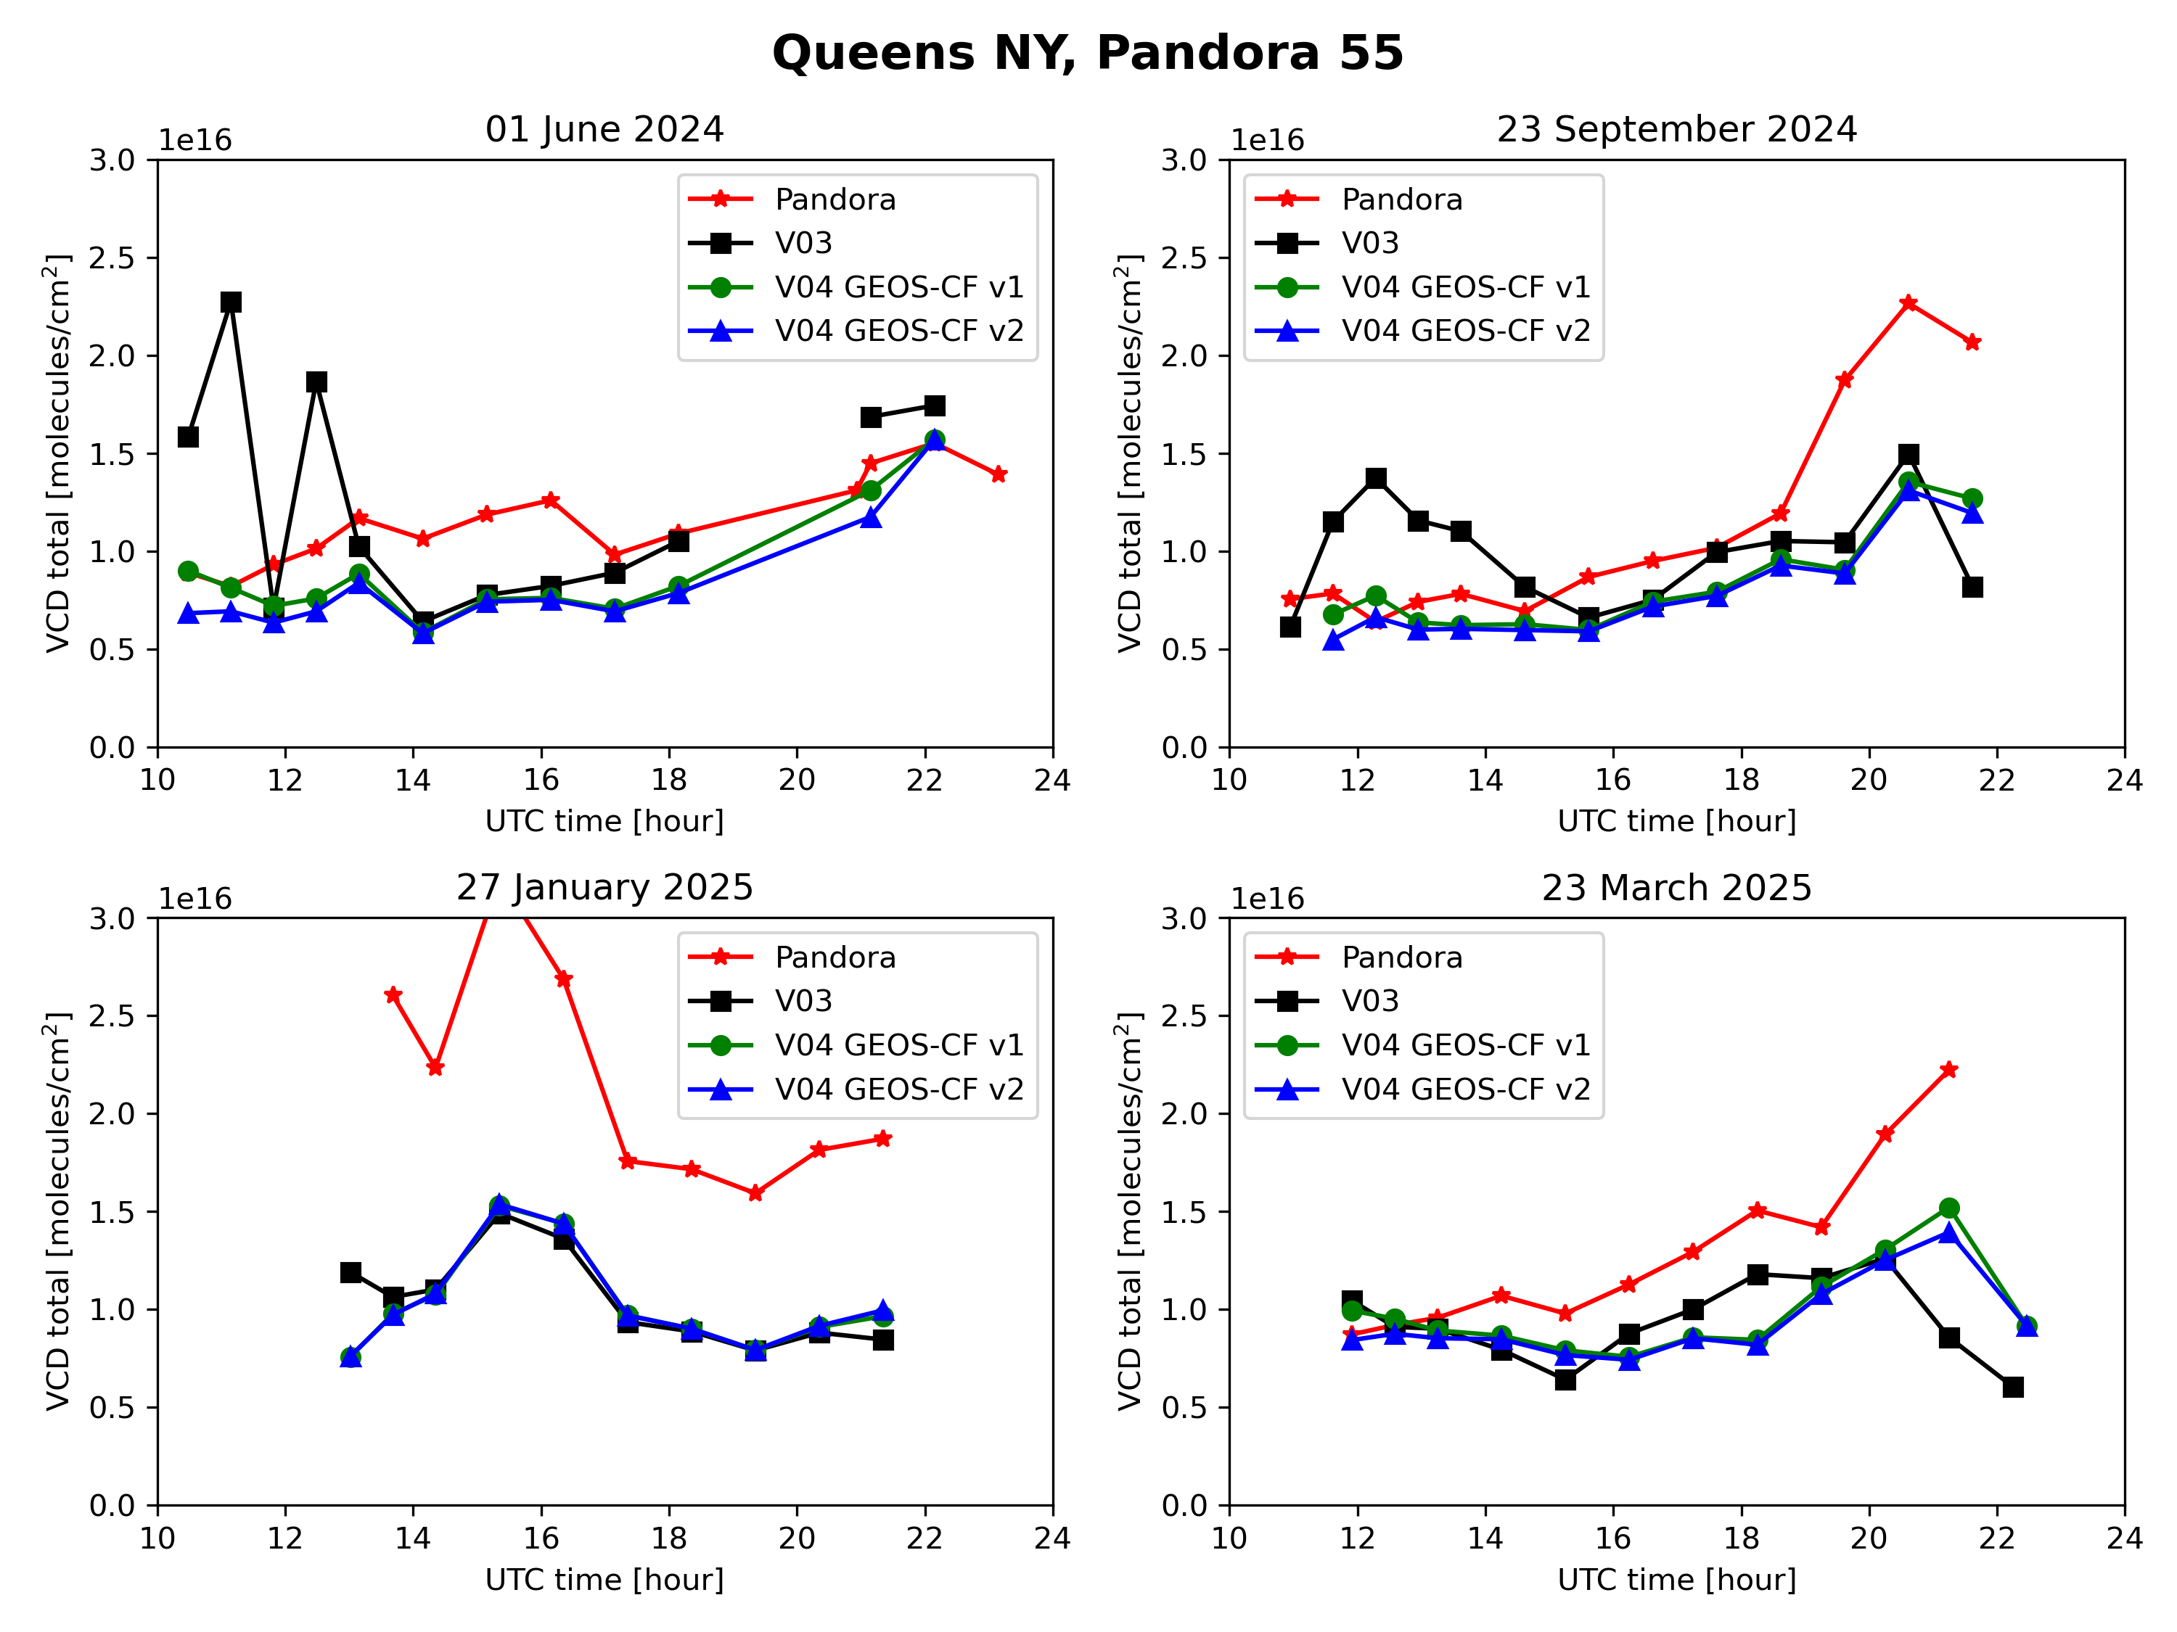
Comparisons with Pandora
03
GEOS-CF v1: 1-day forecast
GEOS-CF v2: analysis

Slide 10
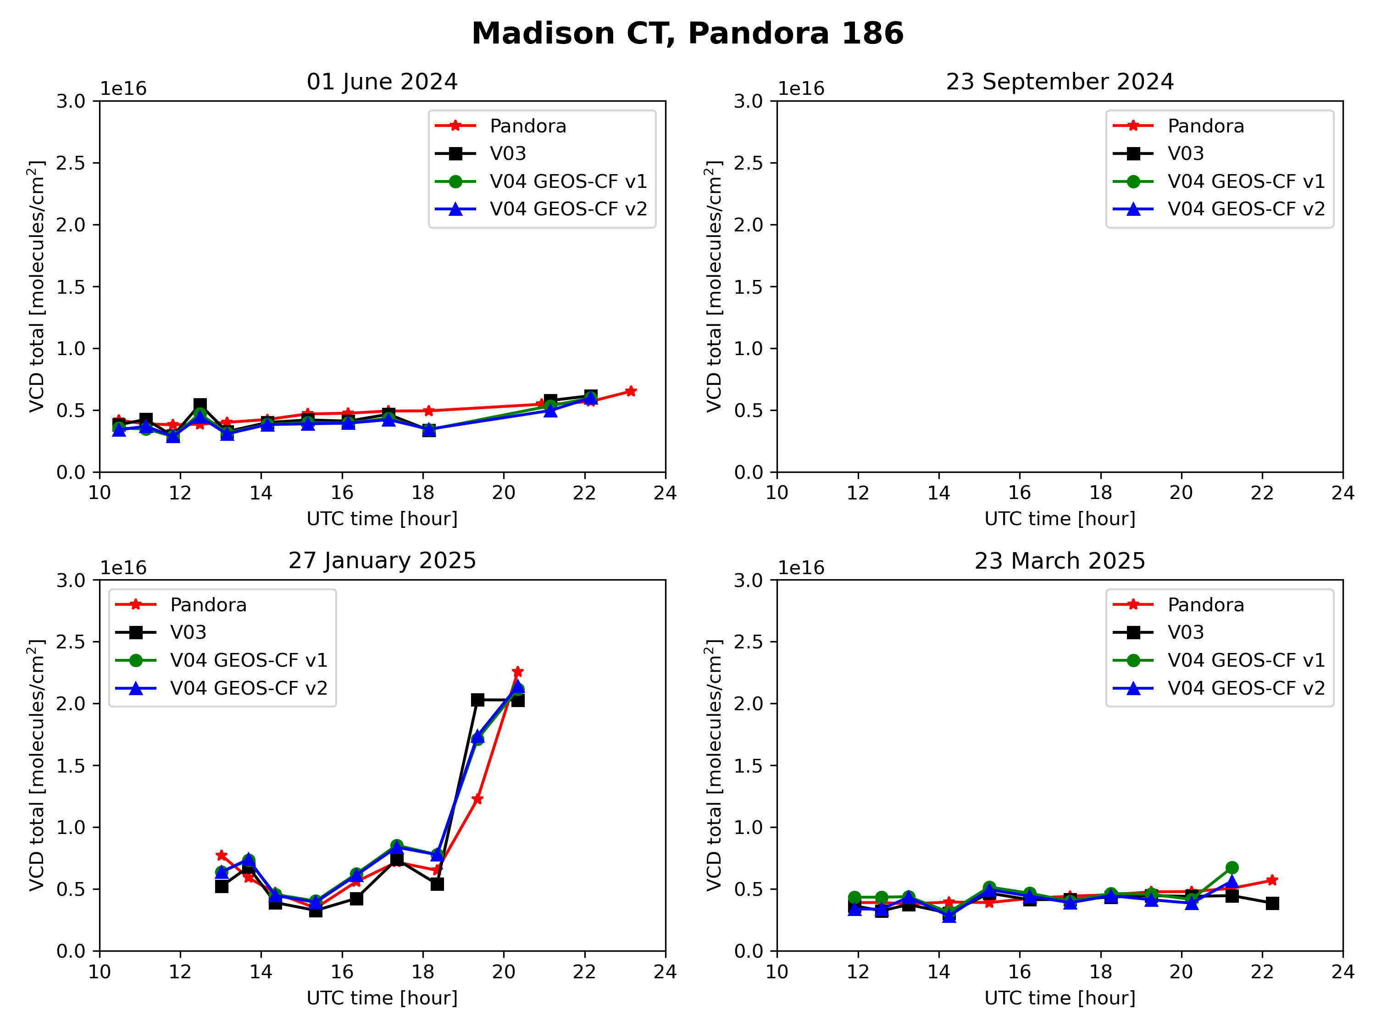
Comparisons with Pandora
03
GEOS-CF v1: 1-day forecast
GEOS-CF v2: analysis

Slide 11
Summary and Outlook
Version 4 tropospheric NO₂ changes can be large in some cases.
  Standard (V04) and NRT (V02: first public release) products are very similar.
Pandora comparisons with a limited set of data (four days) indicate improvements.
  Repeat (and more) validation is needed!
Future plans:
  Improve fitting in partly cloudy pixels
  Improve retrieval approach over snow
  Use a TEMPO-derived surface reflectance
  Consider polarization in spectral fitting
  Improve latency of the NRT product

Slide 14

Influence of GEOS-CF v2
GEOS-CF version 2 (analysis) causes significant changes over GEOS-CF version 1 (forecast)

Slide 15
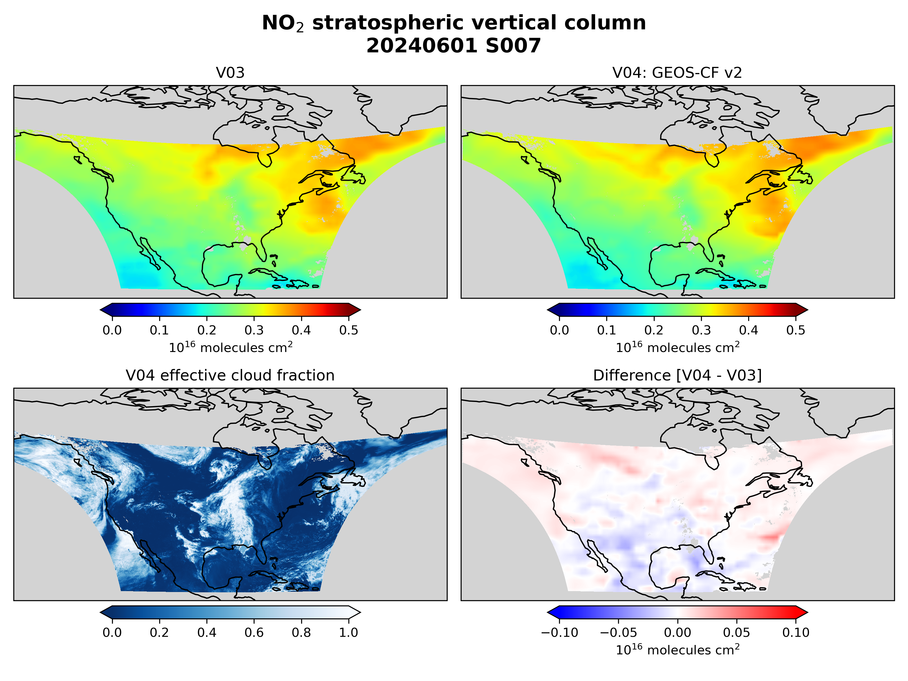
Version 3 vs. version 4
Stratospheric NO₂ changes are mostly due to GEOS-CF v2.

Slide 16
Quantifying NO₂ Biases with Pandora
Ghahremanloo et al., Comprehensive Analysis of Bias in TEMPO NO₂ Column Densities through Pandora Observations, JGR-Atmos, 2025.
65 Pandora stations in direct Sun mode
August 2023 to December 2024
SZA < 70, cloud fraction < 0.15, quality flag = 0
Comparisons indicate:
  TEMPO NO₂ is higher at low NO₂ levels
  TEMPO NO₂ is lower at high NO₂ levels
[Credit: Masoud Ghahremanloo]
Notes:
Note that these are done on Level 3 data, but similar tests with Level 2 are consistent.

Slide 17
Quantifying NO₂ Biases with Pandora
65 Pandora stations in direct Sun mode
August 2023 to December 2024
cloud fraction < 0.15, quality flag = 0
Comparisons indicate:
  TEMPO NO₂ is higher at high SZA
  TEMPO NO₂ is lower at low SZA
[Credit: Masoud Ghahremanloo]

Slide 18
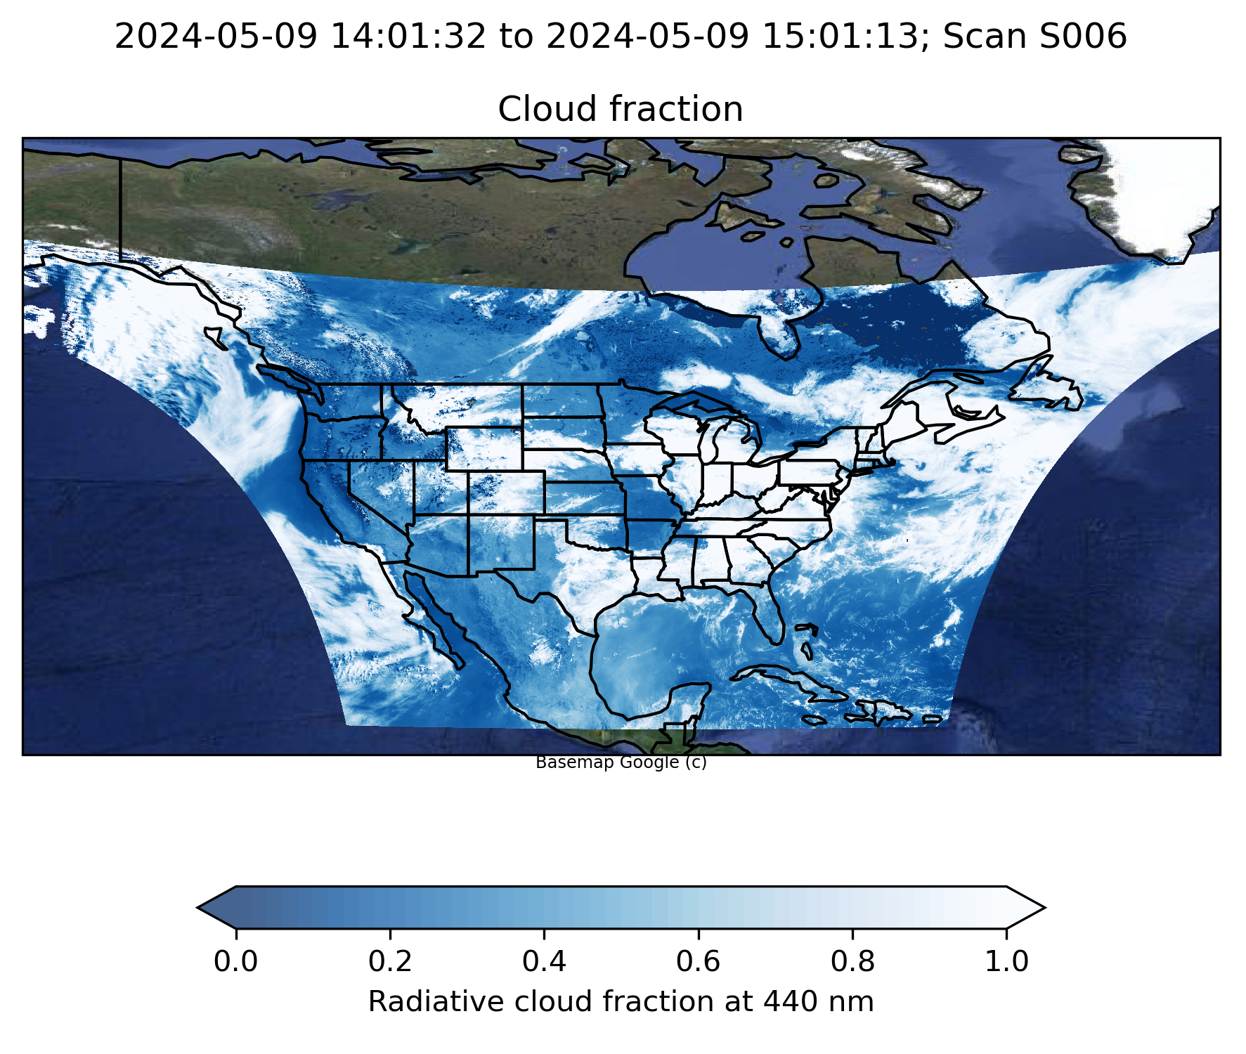
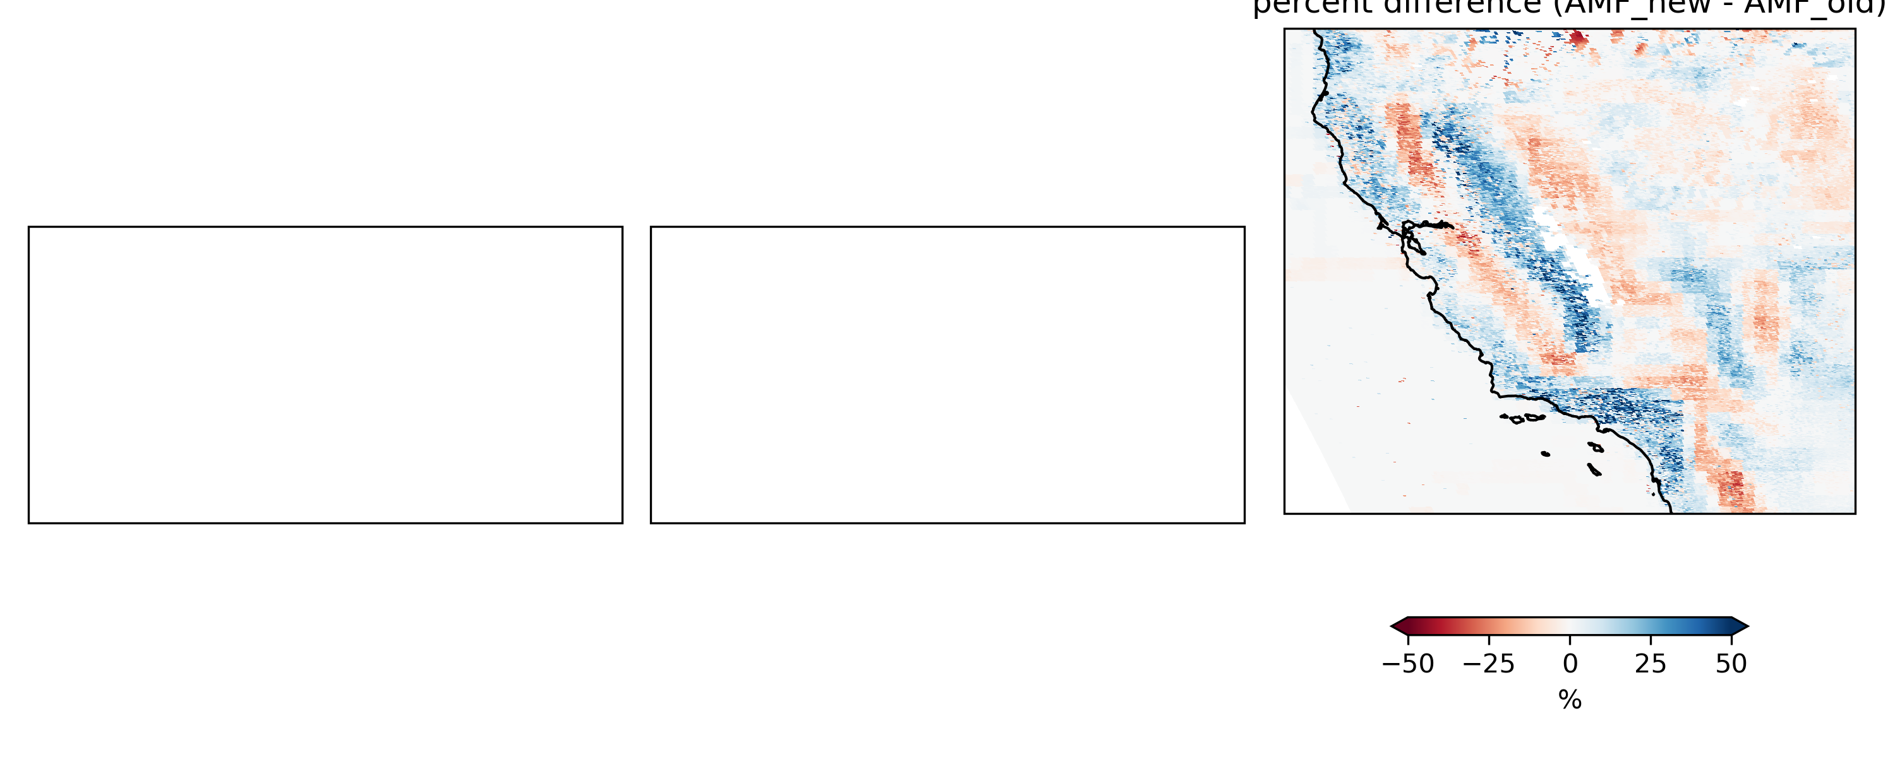
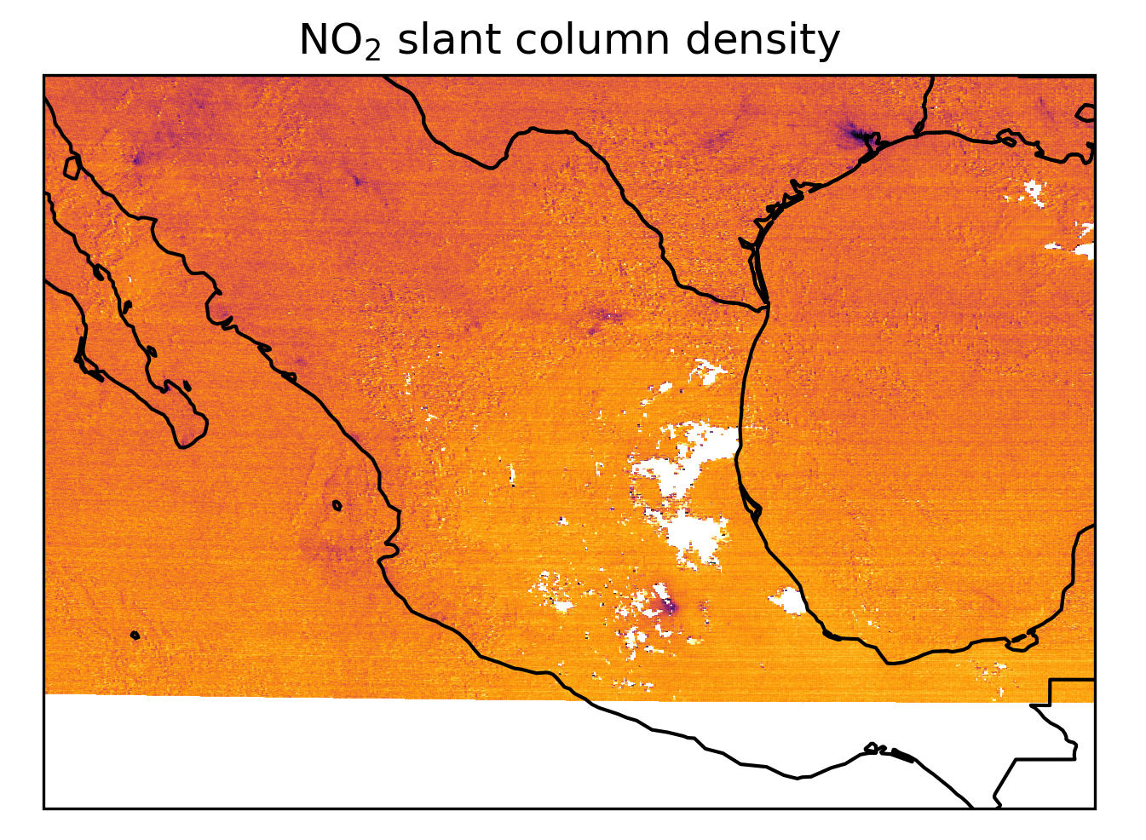
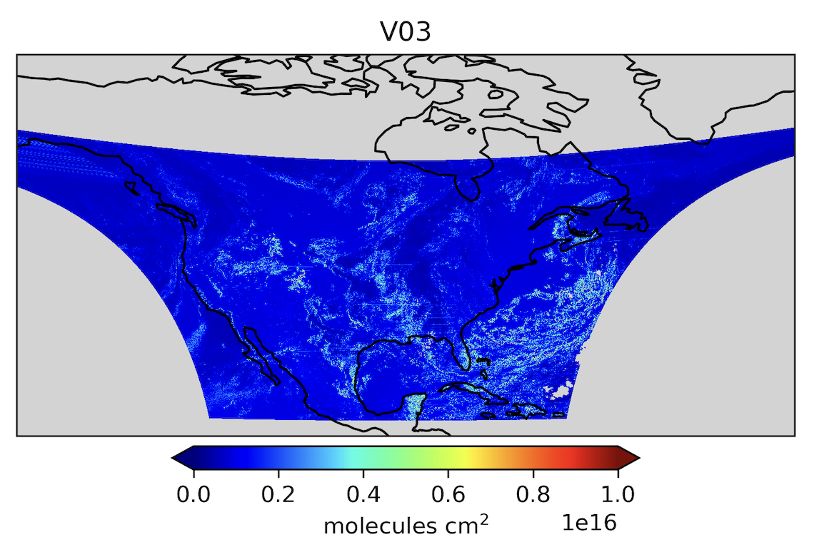
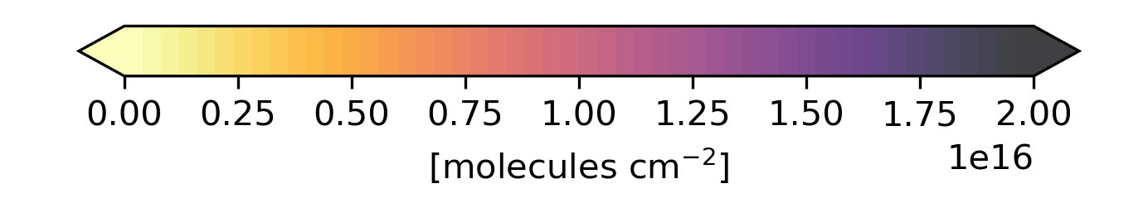
Some Issues in Version 3 NO₂
A
Tropospheric AMF
New – old
High bias in radiance causes high bias in cloud fraction.
Bug in surface pressure indexing causes errors where terrain height changes.
Surface Reflectance
Diurnal cycle does not look as expected in morning (albedo often far too low)
Biases over snow
SCD fitting uncertainty
North/South striping in the NO₂ slant column
Large SCD uncertainties over partial clouds (slit not filled homogeneously)

