Slide 1
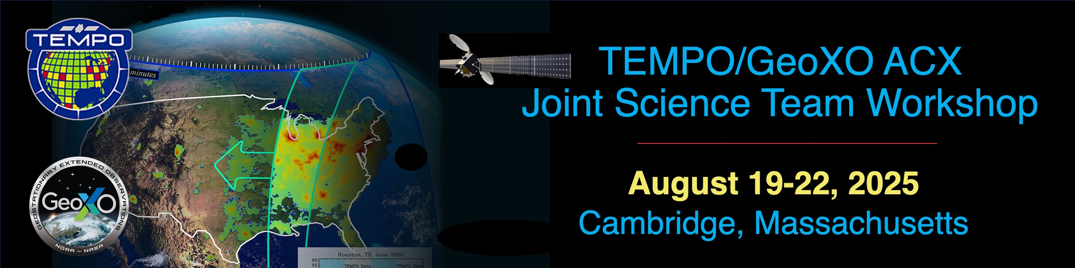
TEMPO CLDO4 updates
Helen Wang (hwang@cfa.Harvard.edu), Gonzalo Gonzalez Abad, Caroline Nowlan, Heesung Chong, Weizhen Hou, Junsung Park, John Houck, Masond Ghahremanloo, Xiong Liu & TEMPO science team
L1B
CLDO4
Trace gases (NO₂, HCHO,…)
Effective Cloud Fraction (ECF) & Optical Centroid Pressure (OCP): filtering & AMF
Assumption: Cloud albedo Ac = 0.8
Ac1: (ECF1, OCP1) Ac2:(ECF2, OCP2)
Parameterization for Trace Gas Column instead of Cloud physical parameters

Slide 2
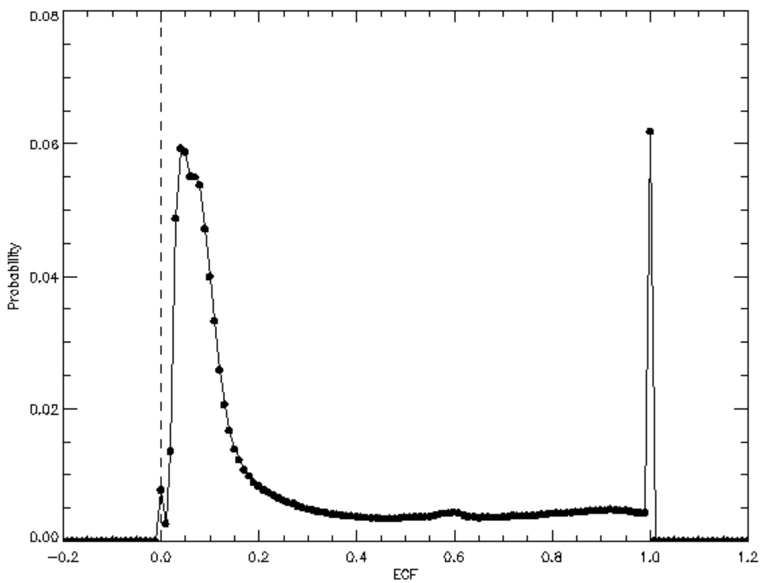
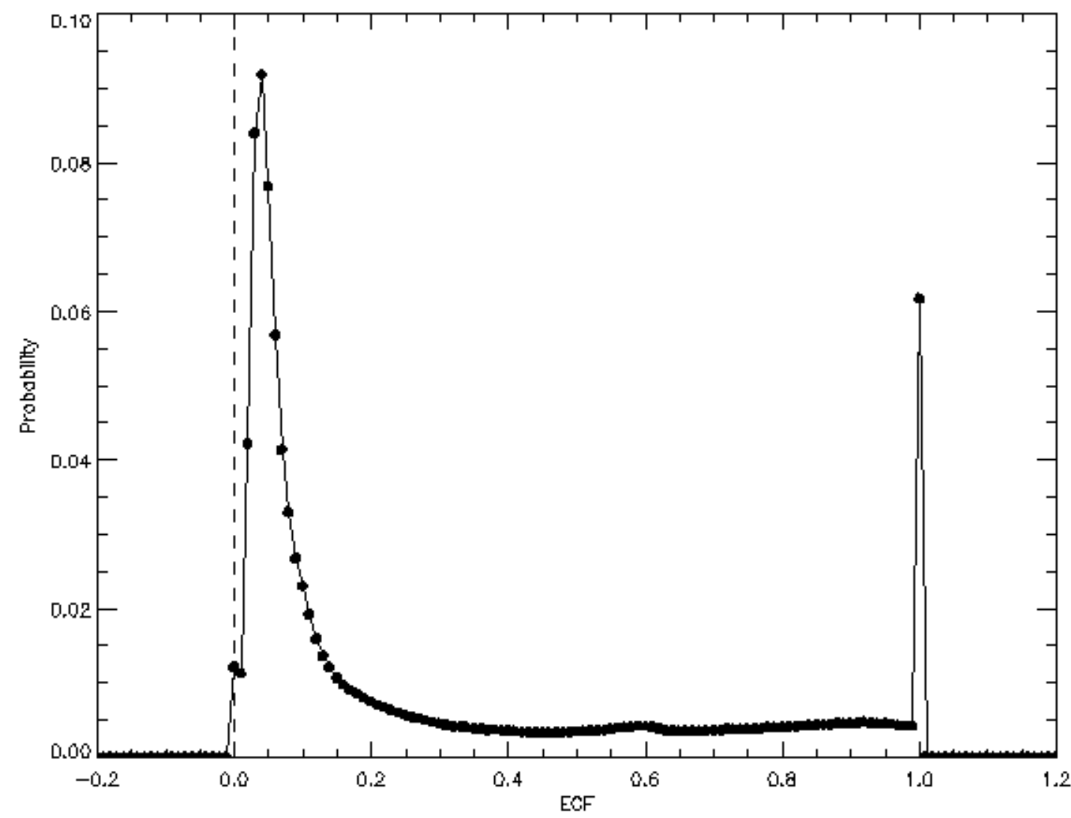
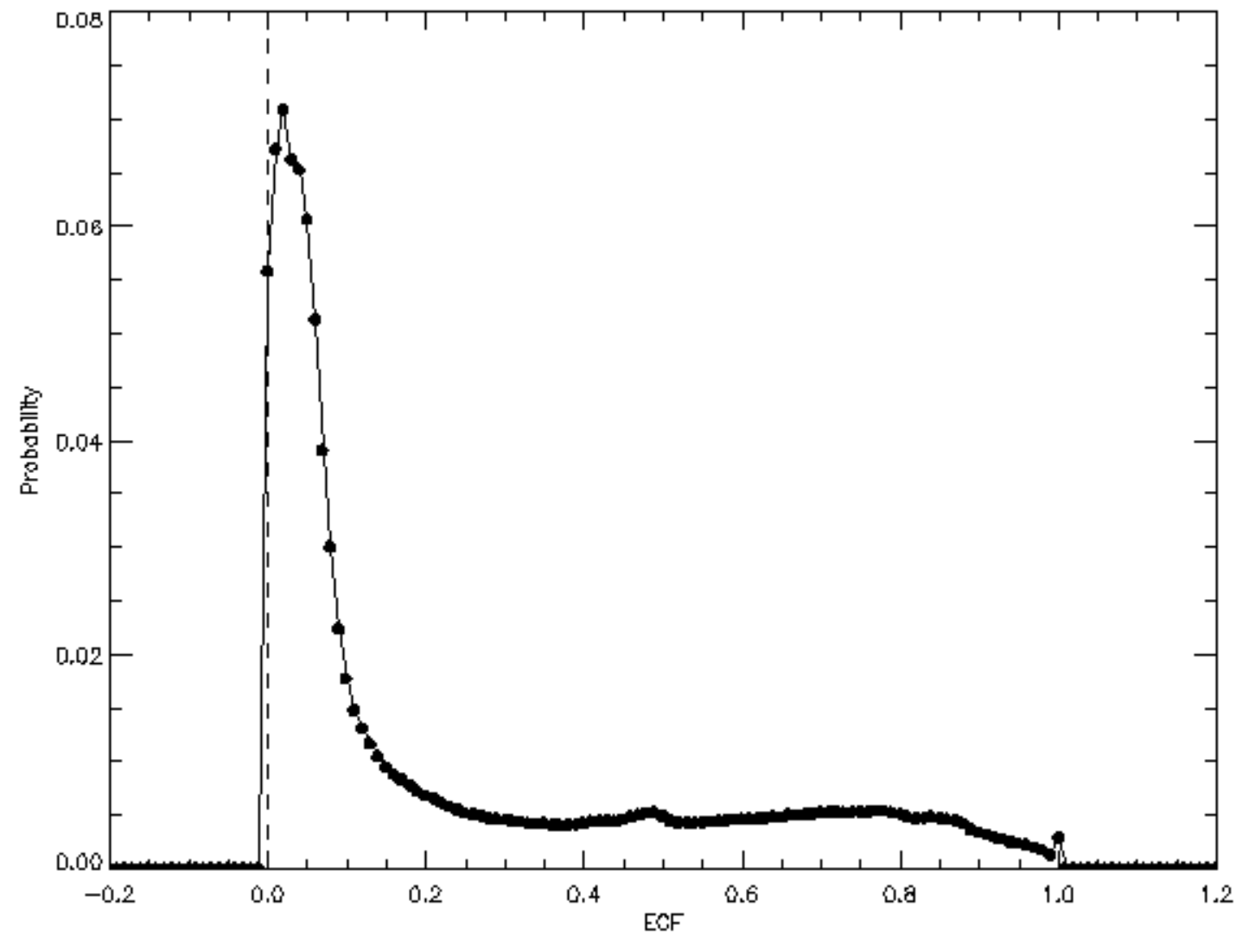
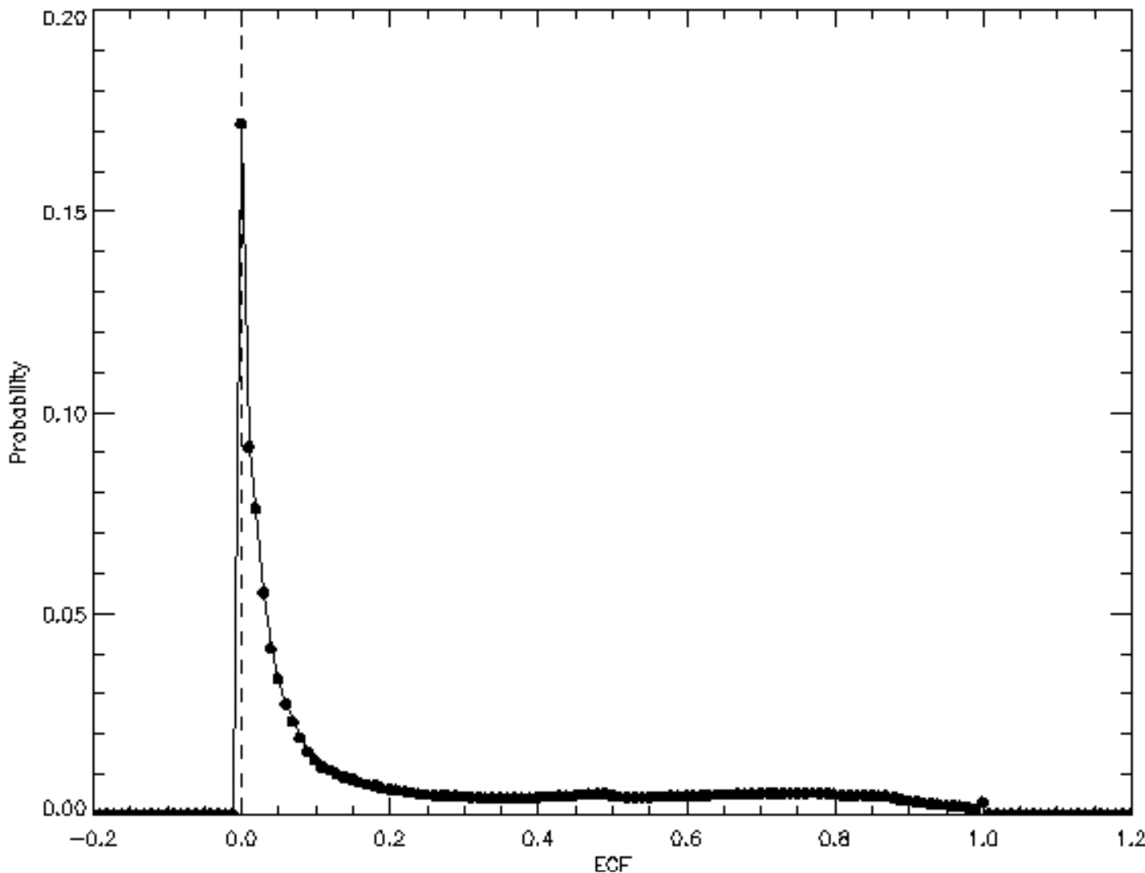
20240601 S007
Before
UPDATES for V4
ASDC V3 L1b+
Old GLER
ASDC V3 L1b+
New GLER
(1). ECF overestimate fixed
ECF histogram peaks at 0:
(a) L1b update
(b) GLER update
After
V4p7 L1B+
Old GLER
V4p7 L1b+
newGLER

Slide 3
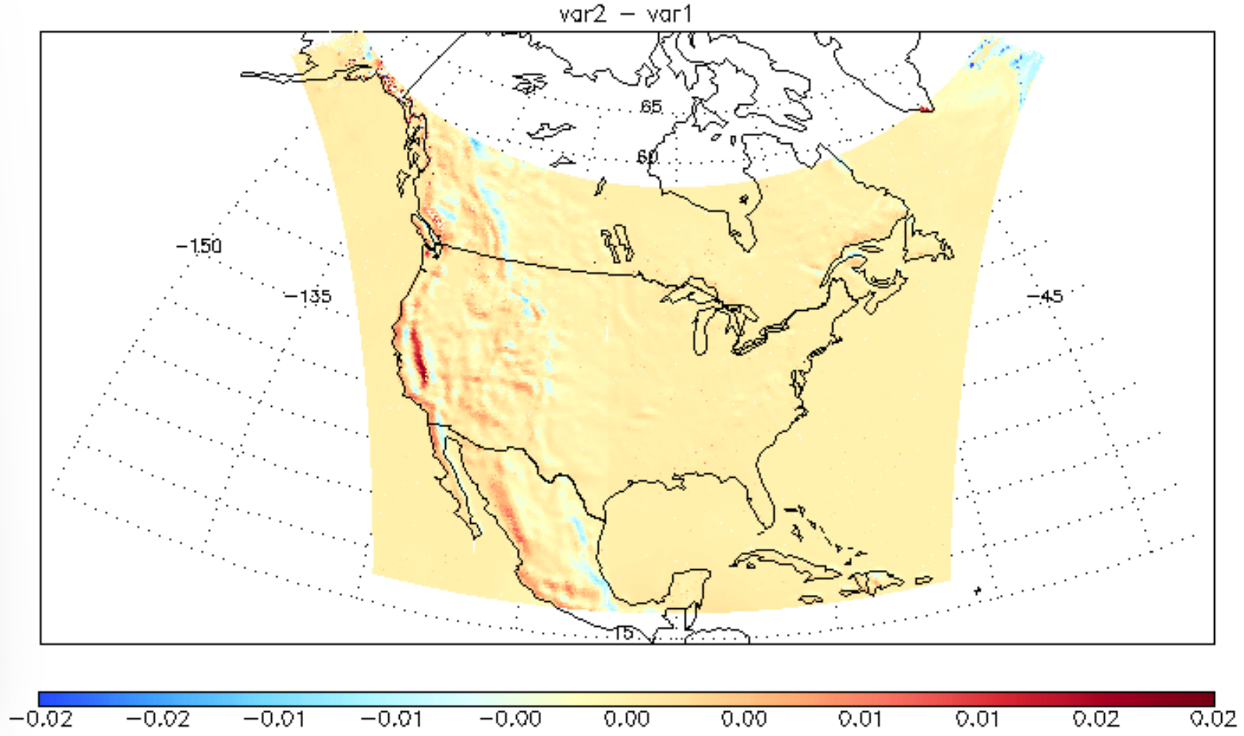
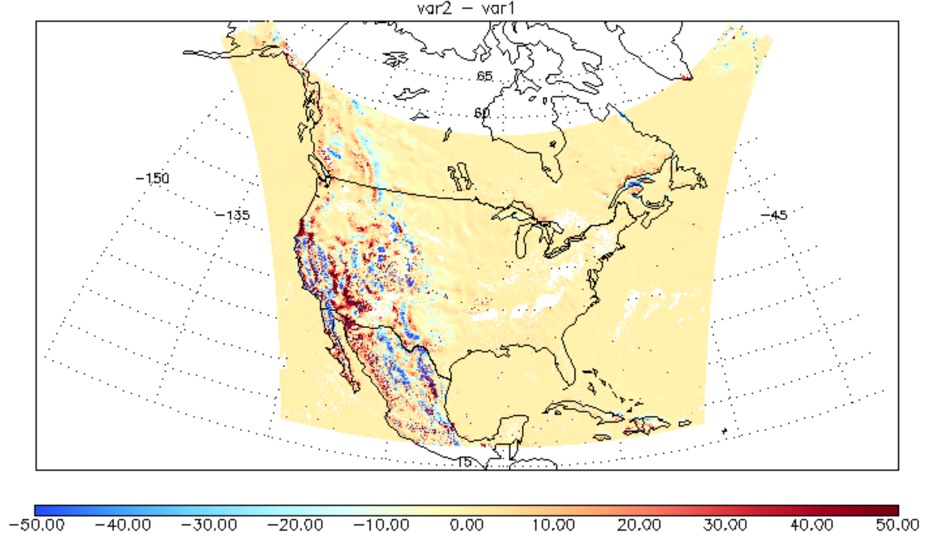
(2) Effect of surface pressure bug fix
20230807 after - before
∆ECF
∆OCP (hPa)
Complex topography areas are preferentially influenced

Slide 4
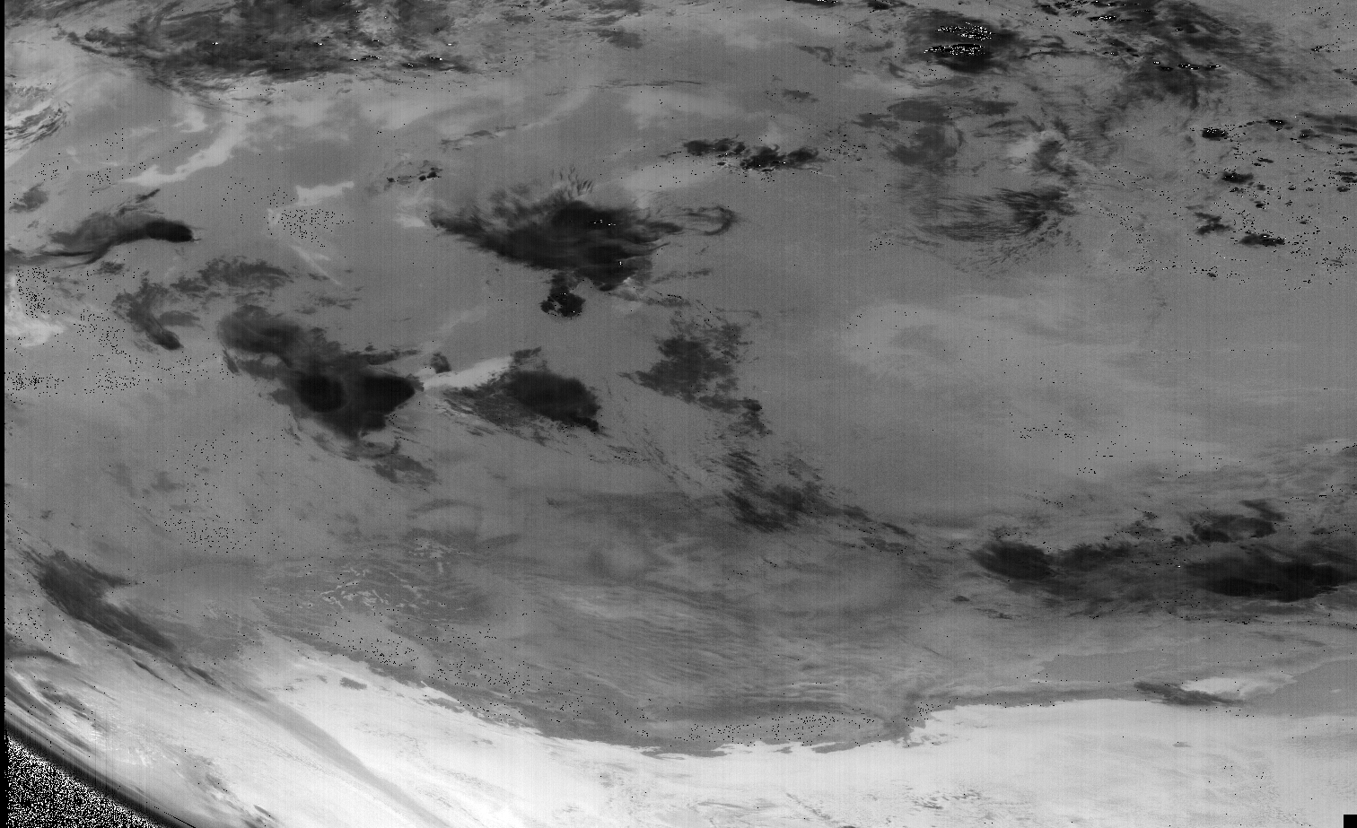
North
(3) Increase niter from 15 to 60 improves convergence

Slide 5
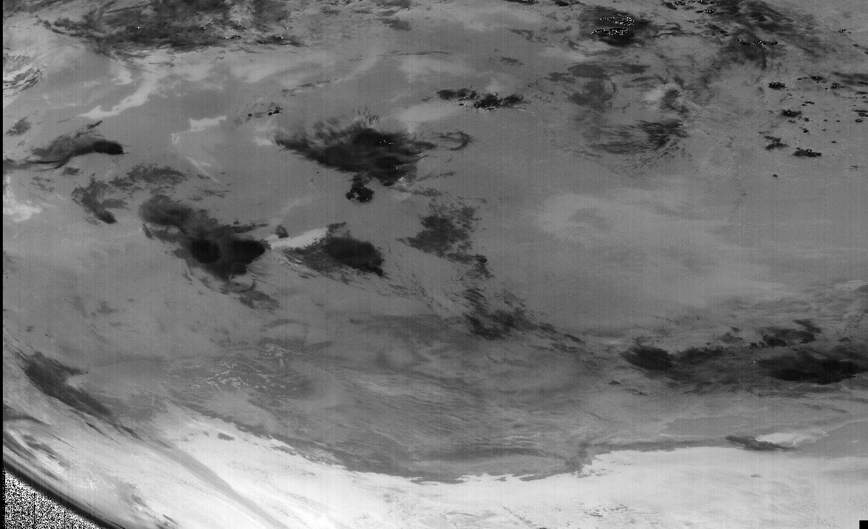
North
(3) Increase niter from 15 to 60 improves convergence

Slide 6
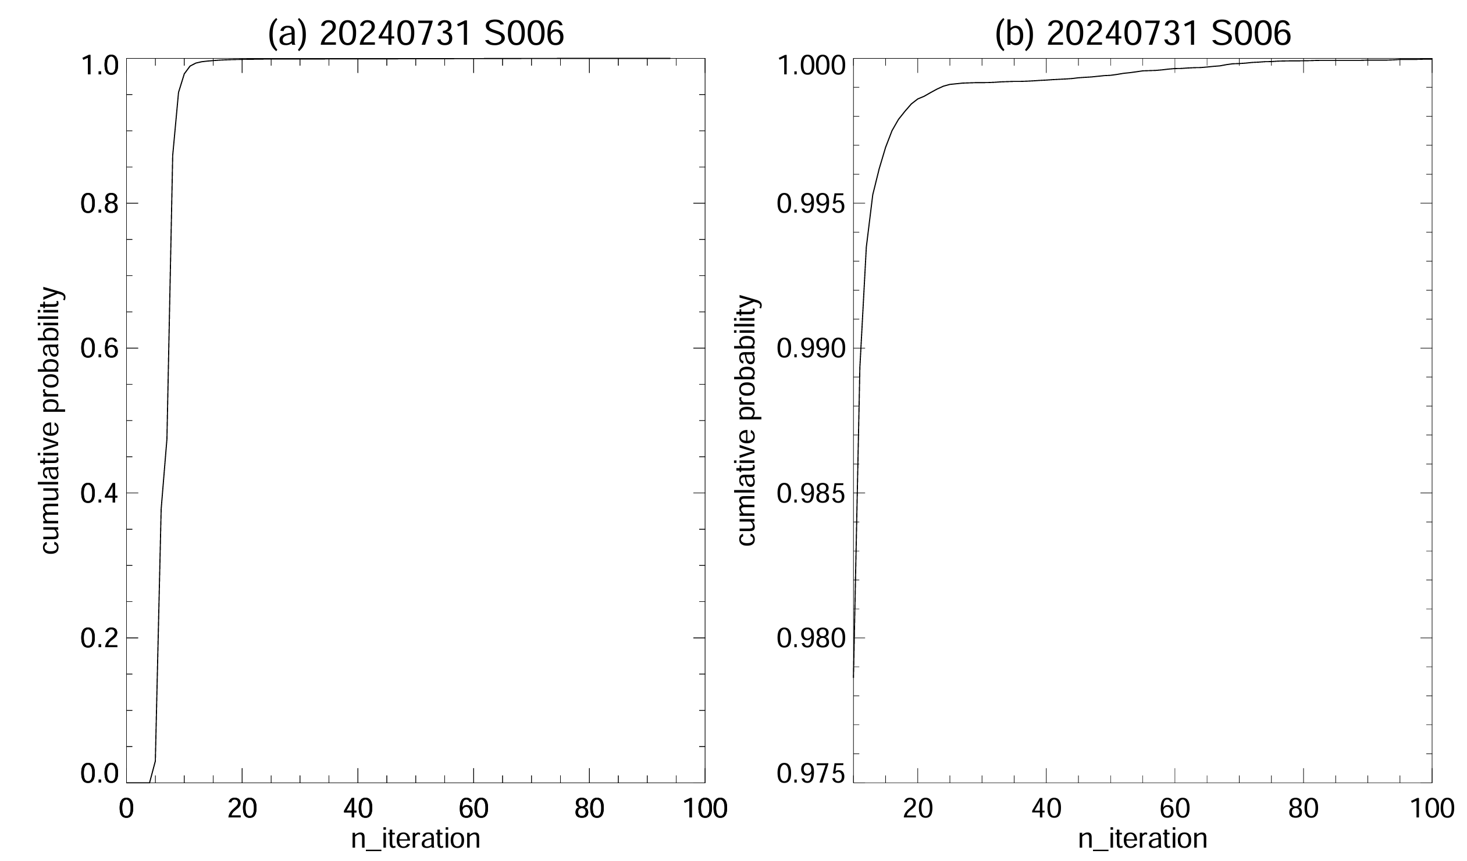
(3) Increase # of iterations improves convergence (99.7% -> 99.9%)
convergence

Slide 7
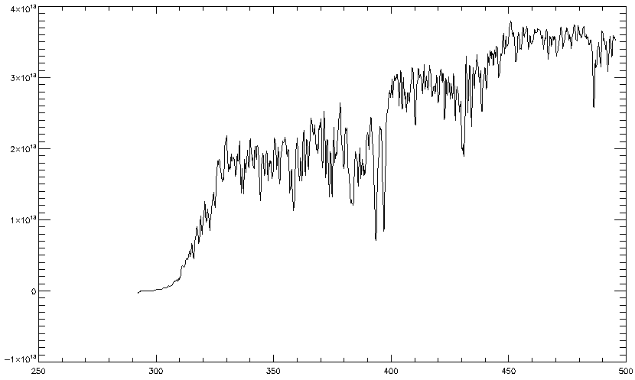
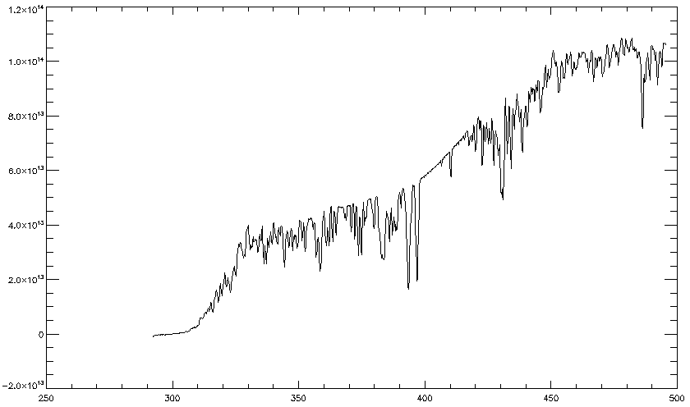
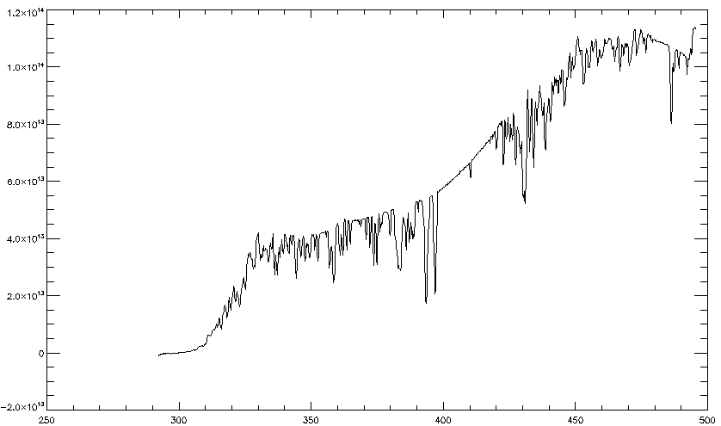
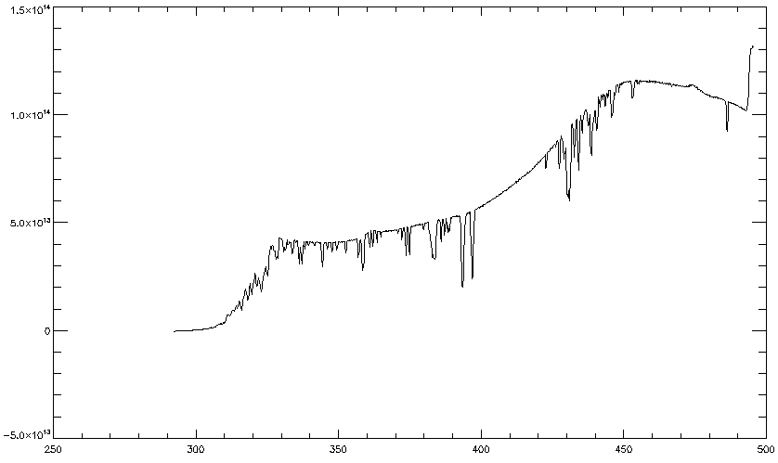
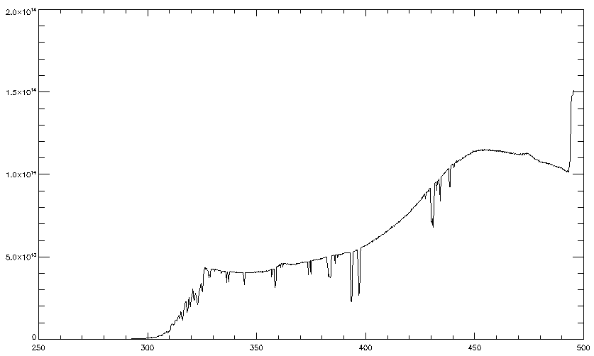
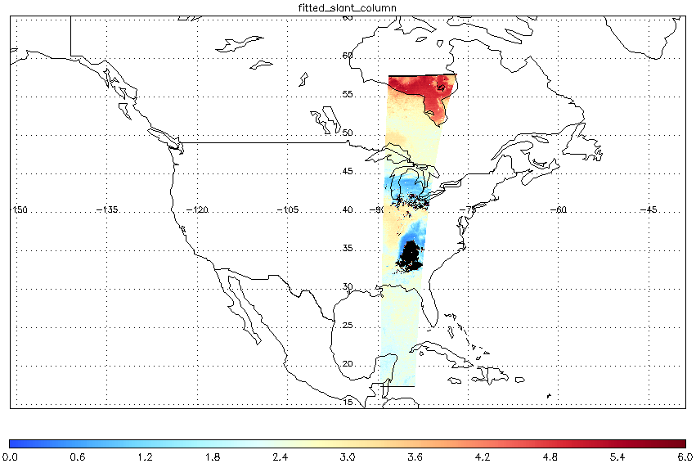
(4) Spectral Saturation and O₂O₂ fitting
normal
partially saturated
partially saturated
pix800,40
Pix860,40
Pix870,40
wavelength(nm)
wavelength
439
488
largely saturated
almost fully saturated
O2O2 SCD
Pix890,40
Pix1000,40
Saturation occurs first on the 439nm side, then on the 488nm side

Slide 8
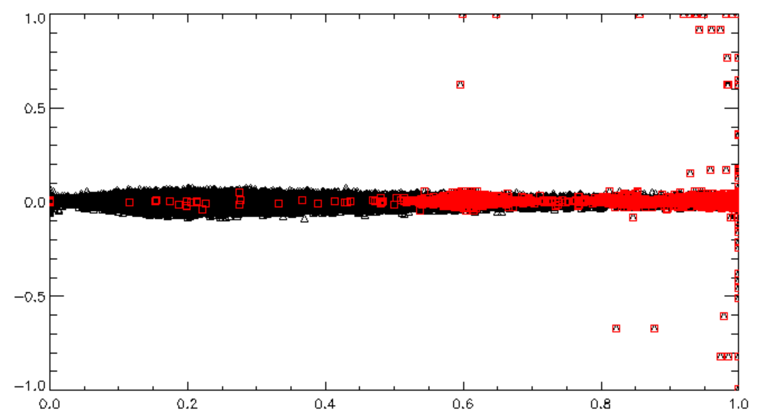
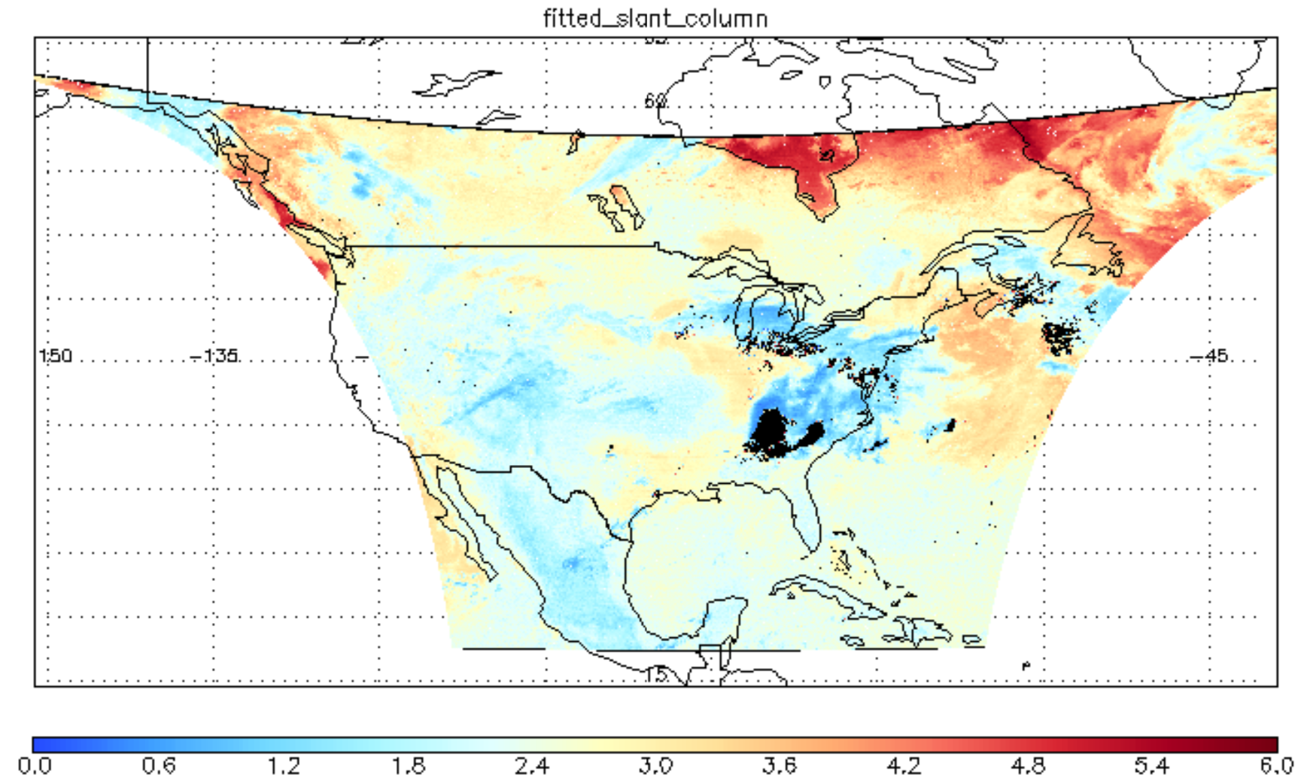
(4). Unrealistic wavelength shift resulting from saturation
20240509 S007G04
Wavelength Shift (nm)
Bad
All
ECF
Abnormal wavelength shifts now excluded from ECF calculation

Slide 9
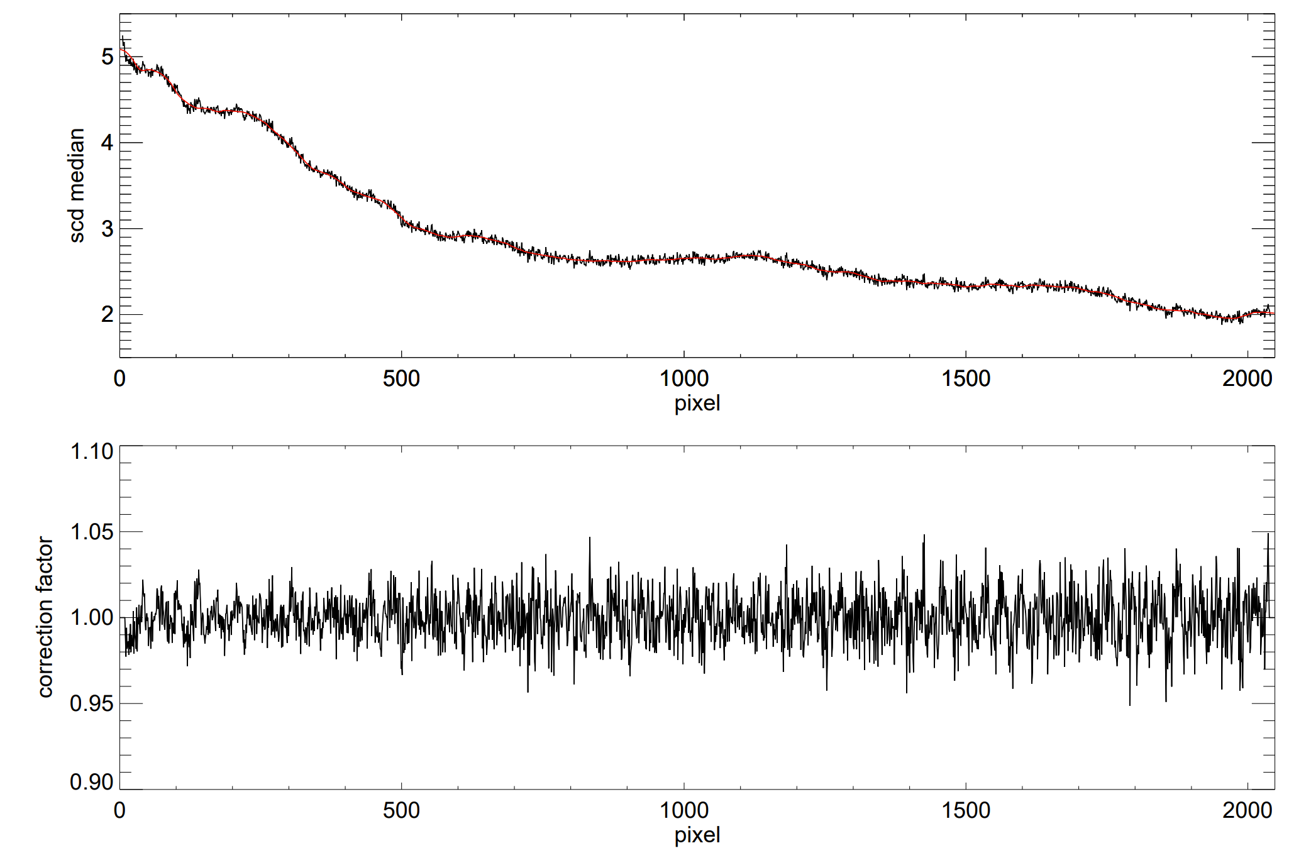
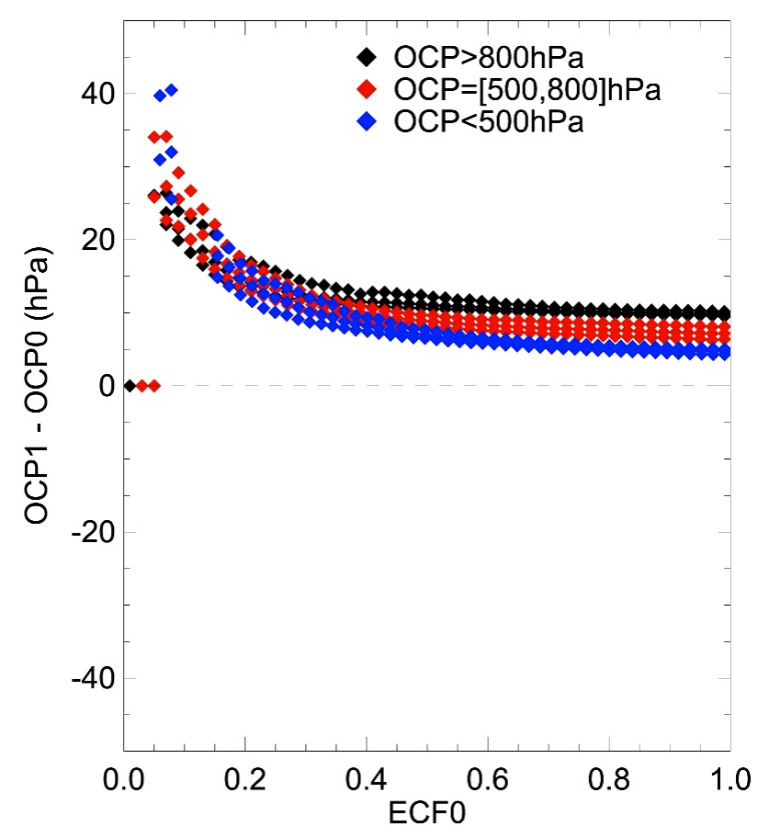
(5). O₂O₂ Destriping
Derivation of destriping factor
∆OCP for a 2% increase in O₂O₂ SCD
Build statistics from many granules
Divide by smooth curve
Destriping Factor
Application: Destriped = Original / Factor

Slide 10
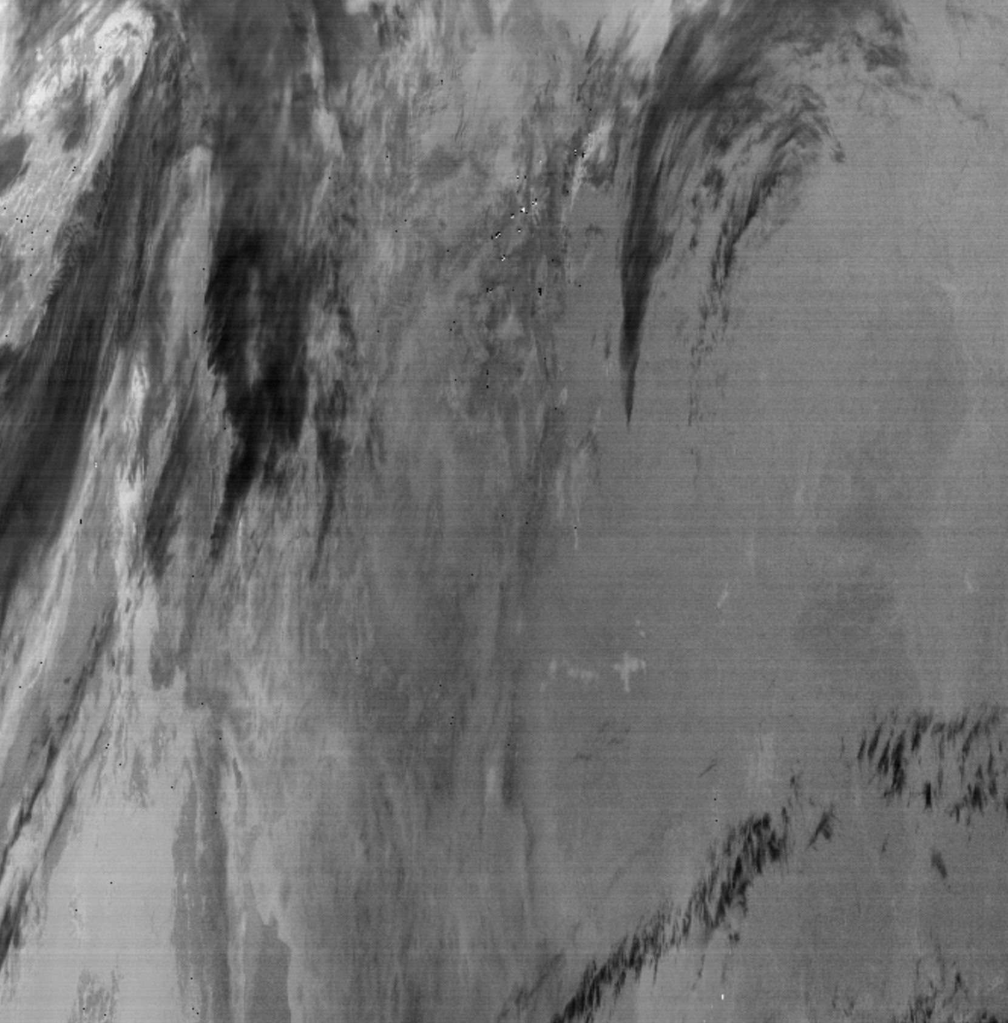
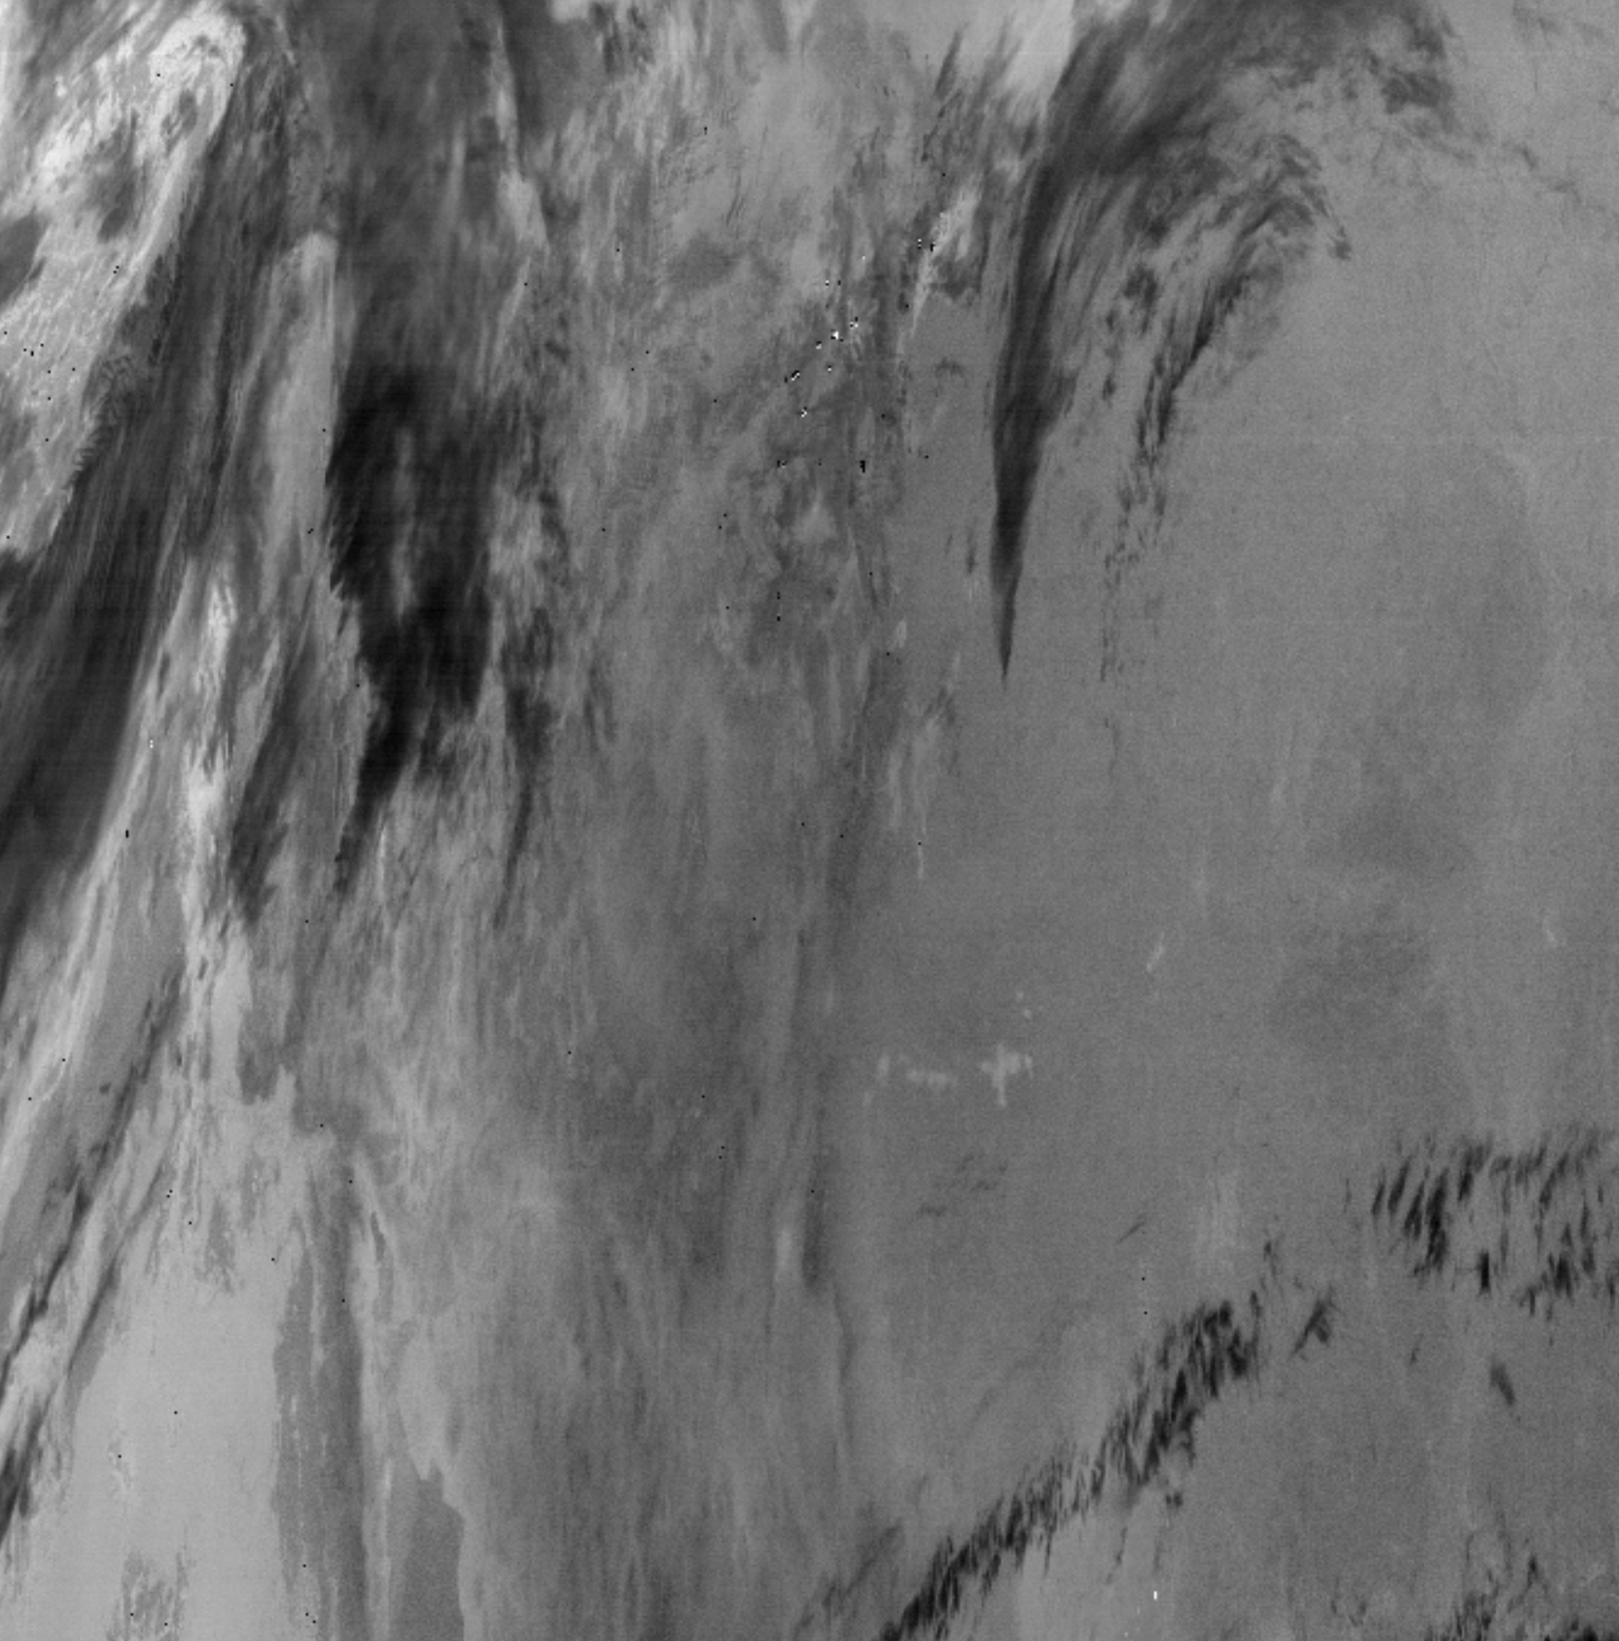
Original 20240214 S007
(5) Destriping
Destriped 20240214 S007 using 20240213
Worked
Same IRR on 20240213 & 20240214

Slide 11
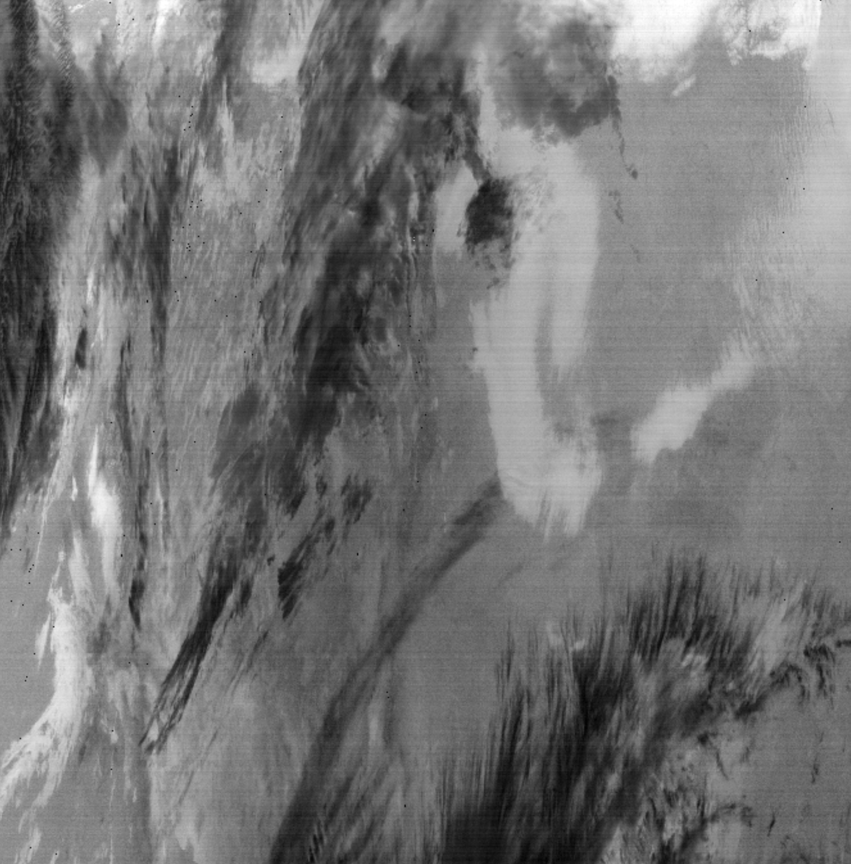
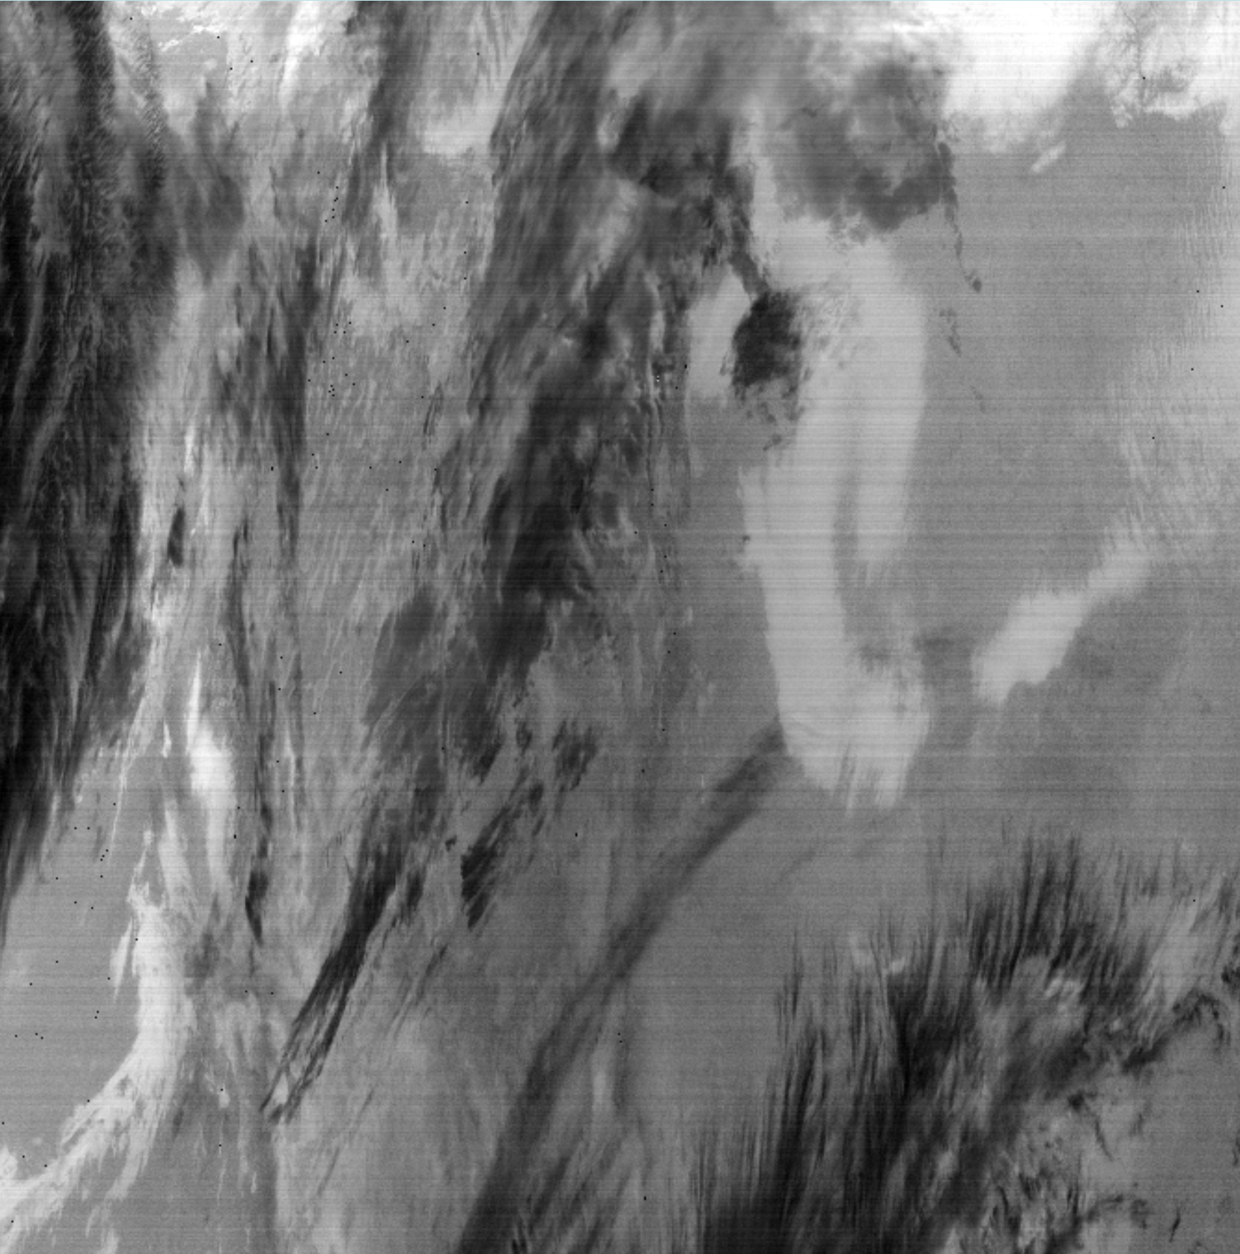
Original 20240215 S007
(5) Destriping
20240215 S007 destriped using 20240214
worse
Different IRR on 20240214 & 20240215

Slide 12
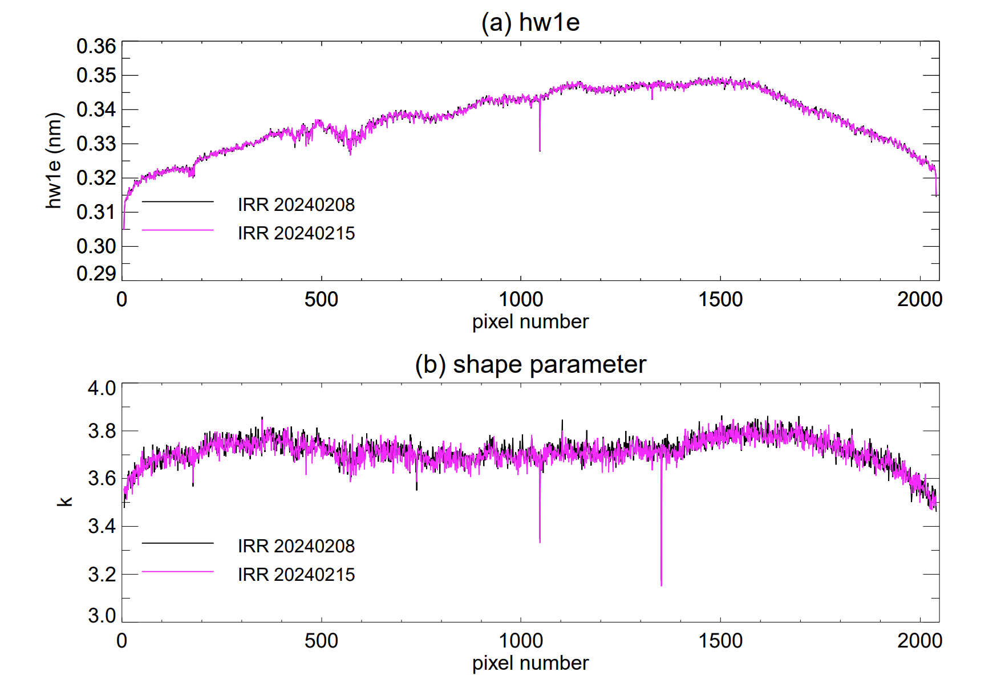
(5) Different IRR : different slit function parameter : different stripe pattern
Good:
Factor from granules using the same IRR
Bad:
Factor from granules using a different IRR
Forward operational processing: Wait for enough granules once new IRR is taken

Slide 13
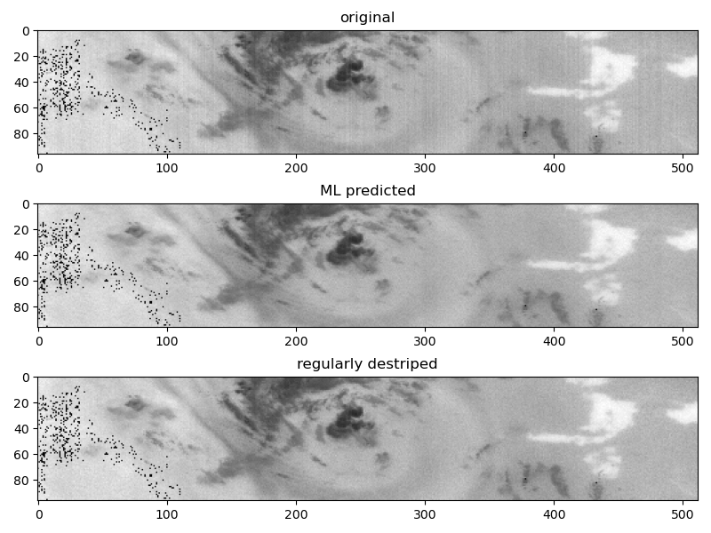
(6) ML destriping
Image processing oriented
Independent of other granules

Slide 14
Remaining Issues
Spectral saturation above bright clouds
Larger uncertainty for more challenging geometries
Unreliable cloud information over snow/ice
Larger uncertainty for inhomogeneous partially cloudy scenes
Cloud shadow
GLER
Other

Slide 16
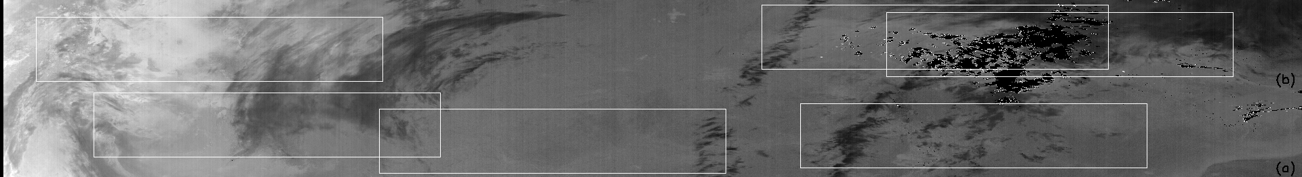
(6) ML destriping
Data Augmentation
Original patches
Destrriped patches
Train CNN (Unet)
Split granule into overlapping patches
Apply model to each patch
Combine patches

Slide 17
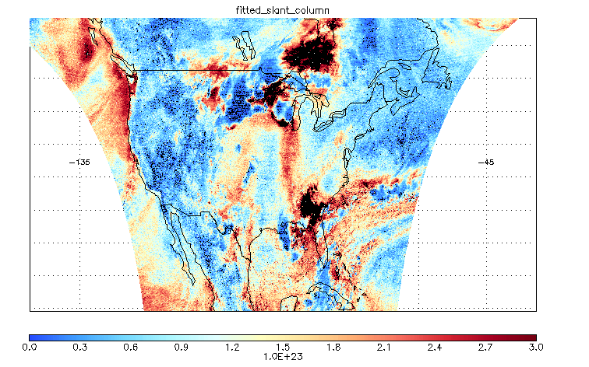
20250723 Corn Sweat from TEMPO
Water Vapor Fitted Slant Column

