Slide 1
[TEMPO-GeoXO Workshop, SAO 2025]
Cal/Val of GEMS Level 1 Data:
Current Status and Inflight Approaches
Yeeun Lee^{1,2)}, Myoung-Hwan Ahn^{1,2)}, Mina Kang^{3,4)}, Junghyun Seo⁵⁾, Hyunkee Hong⁵⁾, Jaehoon Jeong⁵⁾, Wonjin Lee⁵⁾, Dai Ho Ko⁶⁾, Jhoon Kim⁷⁾
¹⁾ Severe Storm Research Center (SSRC), Ewha Womans Unversity, Republic of Korea
²⁾ Department of Climate and Energy Systems Engineering, Ewha Womans Unversity, Republic of Korea
³⁾ City College of New York, USA
⁴⁾ NOAA-Cooperative Science Center for Earth System Sciences and Remote Sensing Technologies, USA
⁵⁾ Environmental Satellite Center, National Institute of Environmental Research (NIER), Republic of Korea
⁶⁾ Korea Aerospace Research Institute (KARI), Republic of Korea
⁷⁾ Department of Atmospheric Science, Yonsei University, Republic of Korea
August 19, 2025

Slide 2
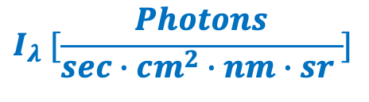
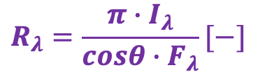
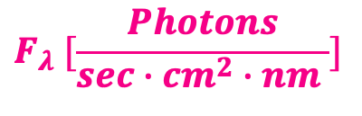
GEMS: MORE THAN FIVE YEARS IN OPERATION
GEMS data monitoring system
  Since its launch in February 2020:
+) Temperature information
$I_{λ}$ (radiance) $I_{λ}→e^{−}$ $e^{−}→DC$
z
Radiation
Solar diffuser
Scan mirror
Telescope
Spectrometer
Detector
Electronics
…
DC
Solar Irradiance
(WSD & RSD)
Earth Radiance
Dark Current & LED
$$F_{λ} [\frac{Photons}{sec∙cm^{2}∙nm }]$$
$$I_{λ} [\frac{Photons}{sec∙cm^{2}∙nm∙sr }]$$
$$R_{λ}=\frac{{π∙I}_{λ}}{{cosθ∙F}_{λ}}[−]$$
: Input data for Level 2 retrievals
Issues related to:
1) Solar irradiance only (inversely to reflectance)
2) Both solar irradiance & Earth radiance

Slide 3
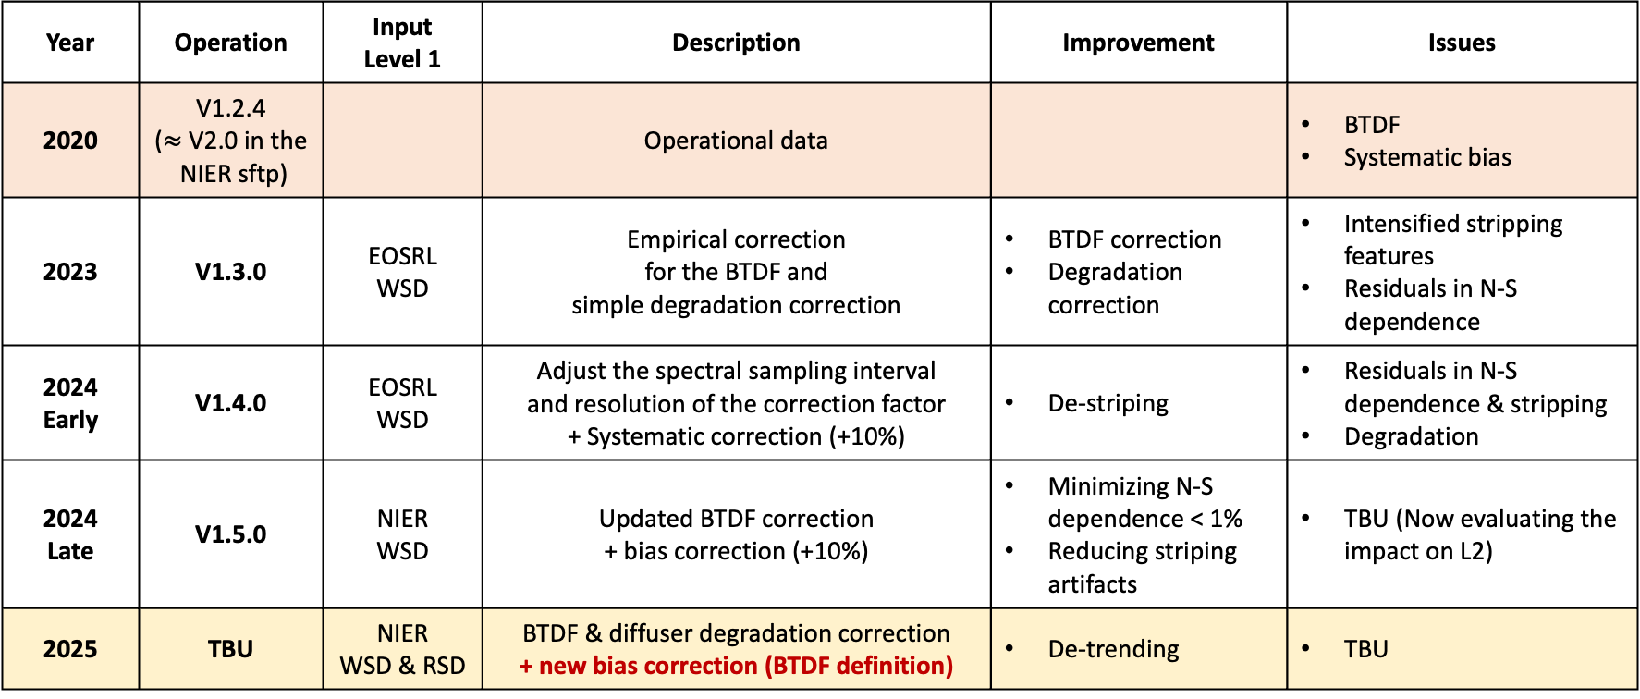
GEMS: MORE THAN FIVE YEARS IN OPERATION
Version history of Level 1 data (solar irradiance)
Year | Operation | Input Level 1 | Description | Improvement | Issues
2020 | V1.2.4 ($≈$ V2.0 in the NIER sftp) |  | Operational data |  | BTDF Systematic bias
2023 | V1.3.0 | EOSRL WSD | Empirical correction for the BTDF and simple degradation correction | BTDF correction Degradation correction | Intensified stripping features Residuals in N-S dependence
2024 Early | V1.4.0 | EOSRL WSD | Adjust the spectral sampling interval and resolution of the correction factor + Systematic correction (+10%) | De-striping | Residuals in N-S dependence & stripping Degradation
2024 Late | V1.5.0 | NIER WSD | Updated BTDF correction + bias correction (+10%) | Minimizing N-S dependence < 1% Reducing striping artifacts | TBU (Now evaluating the impact on L2)
2025 | TBU | NIER WSD & RSD | BTDF & diffuser degradation correction + new bias correction (BTDF definition) | De-trending | TBU

Slide 4
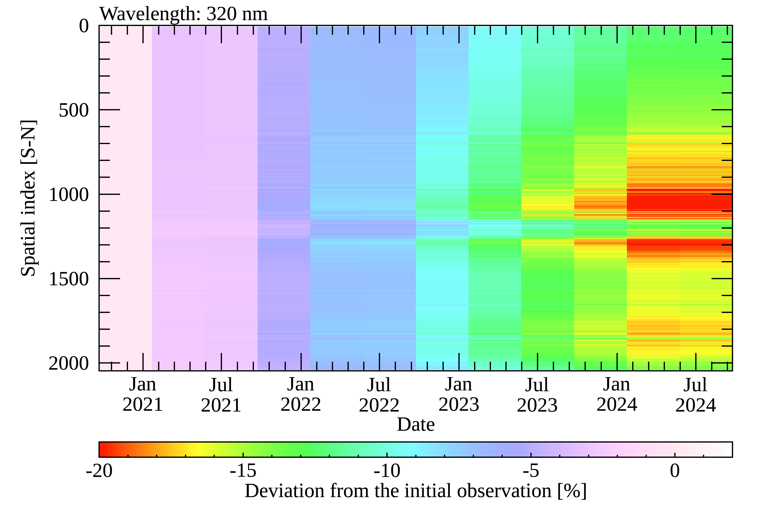
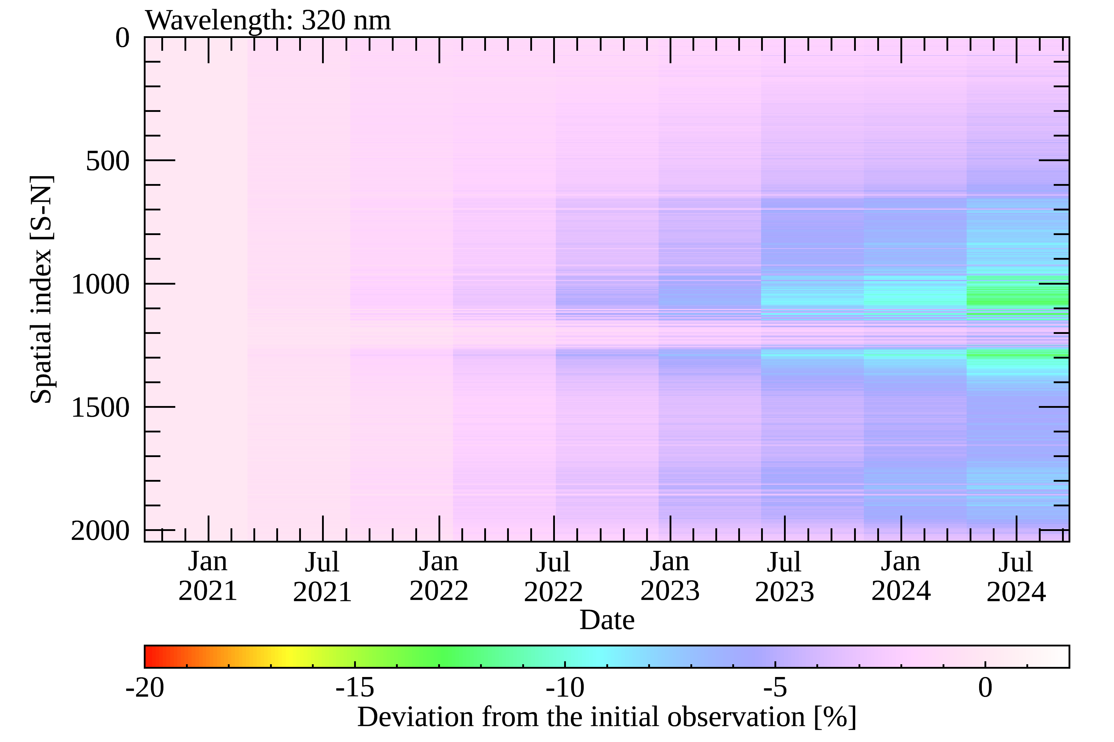

DEGRADATION: DIFFUSER + OPTICS/ELECTRONICS
Solar irradiance changes @ 320 nm
  GEMS has the two solar diffuser, the primary (WSD, left), and the secondary diffuser (RSD, right).
  Solar diffusers are degraded most significantly compared to other optics.
* Solar azimuth angle${ φ}_{0}=95°$
The primary diffuser, WSD (daily observation) The secondary diffuser, RSD (every 6 months
(exposure times = ~1800) (exposure times = 13)
Residual degradation

Slide 5
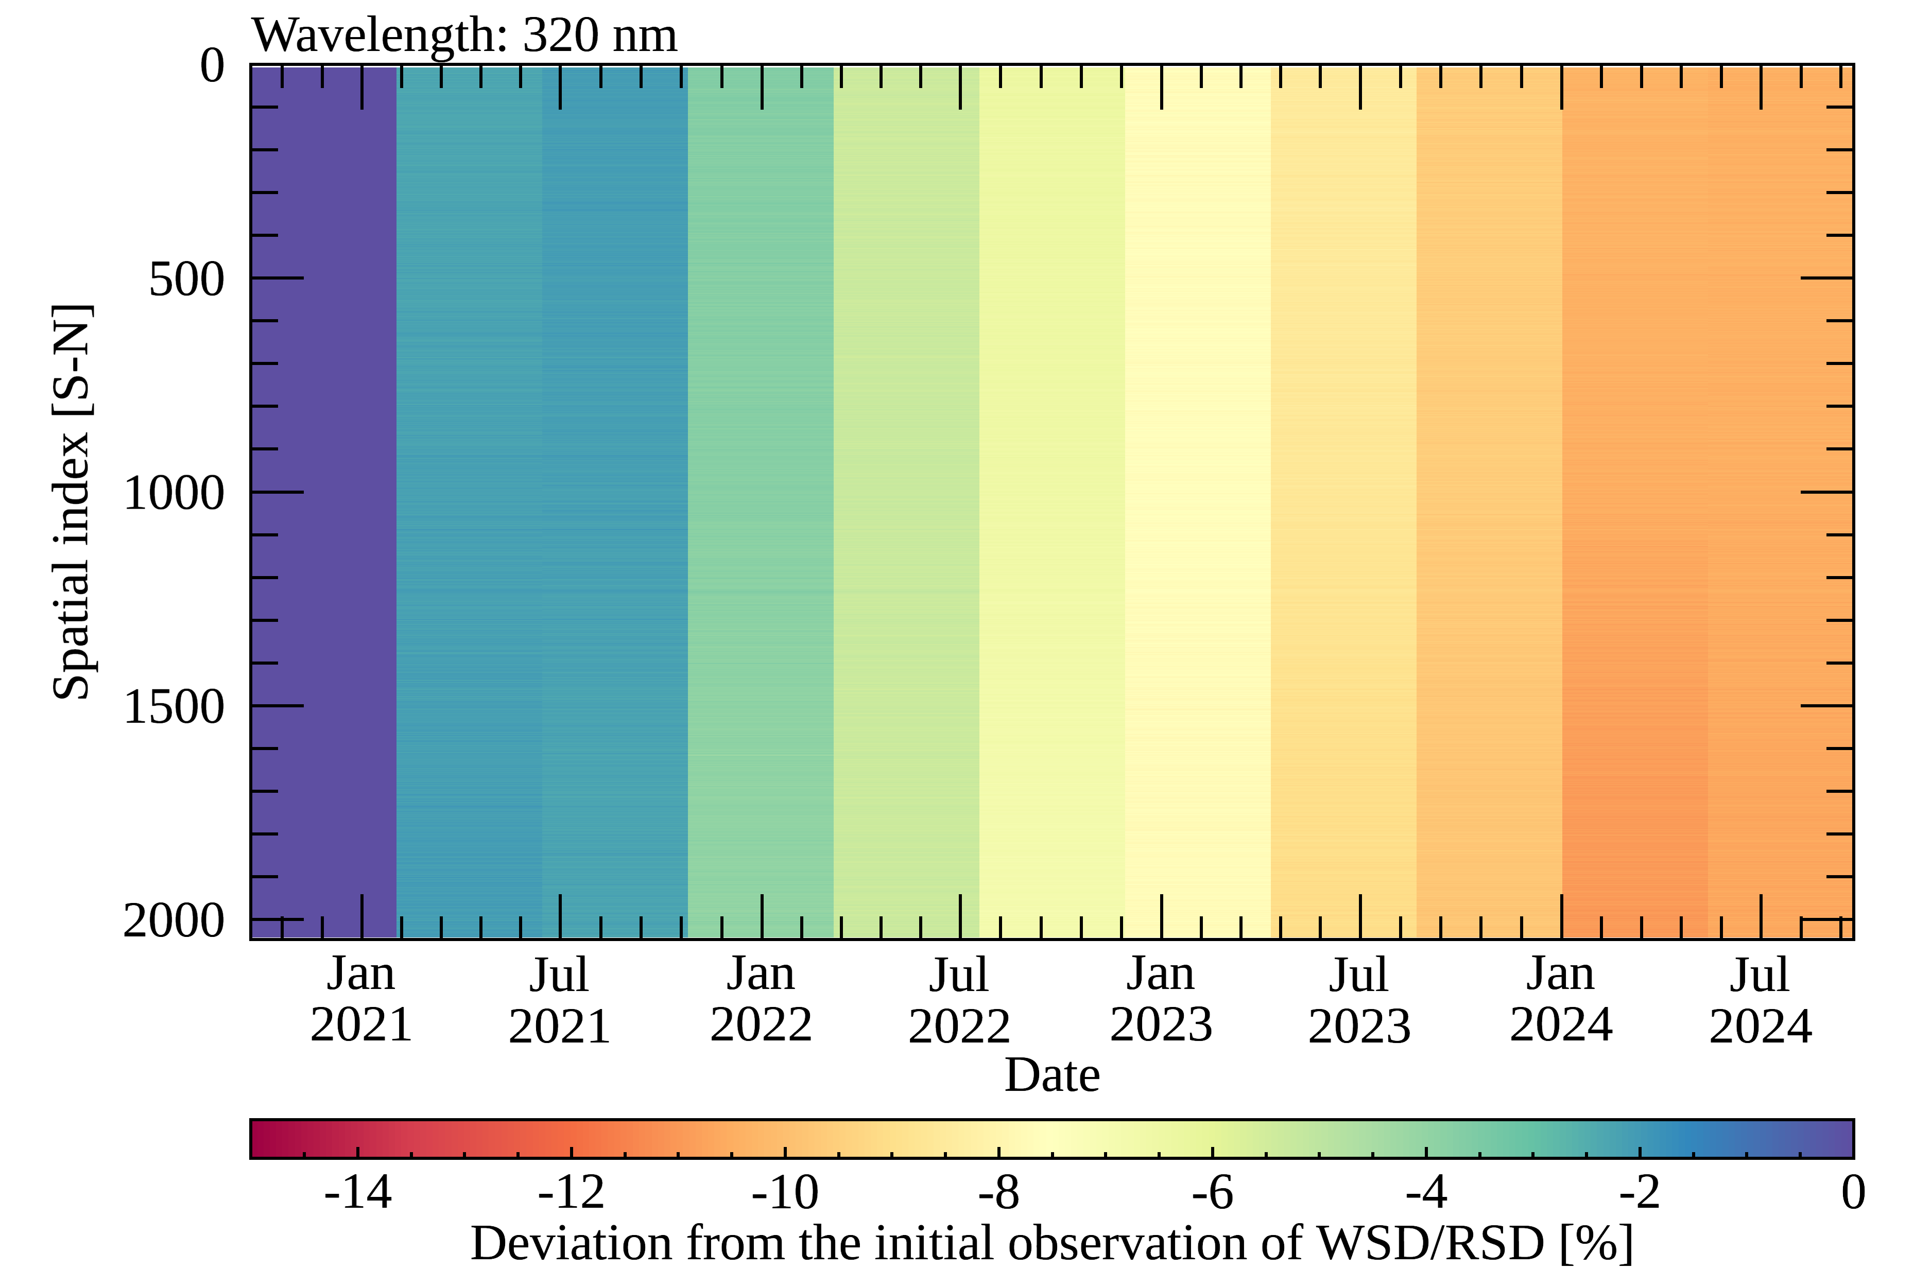
DEGRADATION: DIFFUSER + OPTICS/ELECTRONICS
Solar irradiance changes @ 320 nm
* Solar azimuth angle${ φ}_{0}=95°$
Deviation of WSD/RSD from the initial observations [%]
In WSD/RSD,
common degradation perfectly cancel out.
-> Only diffuser degradation remain
5

Slide 6
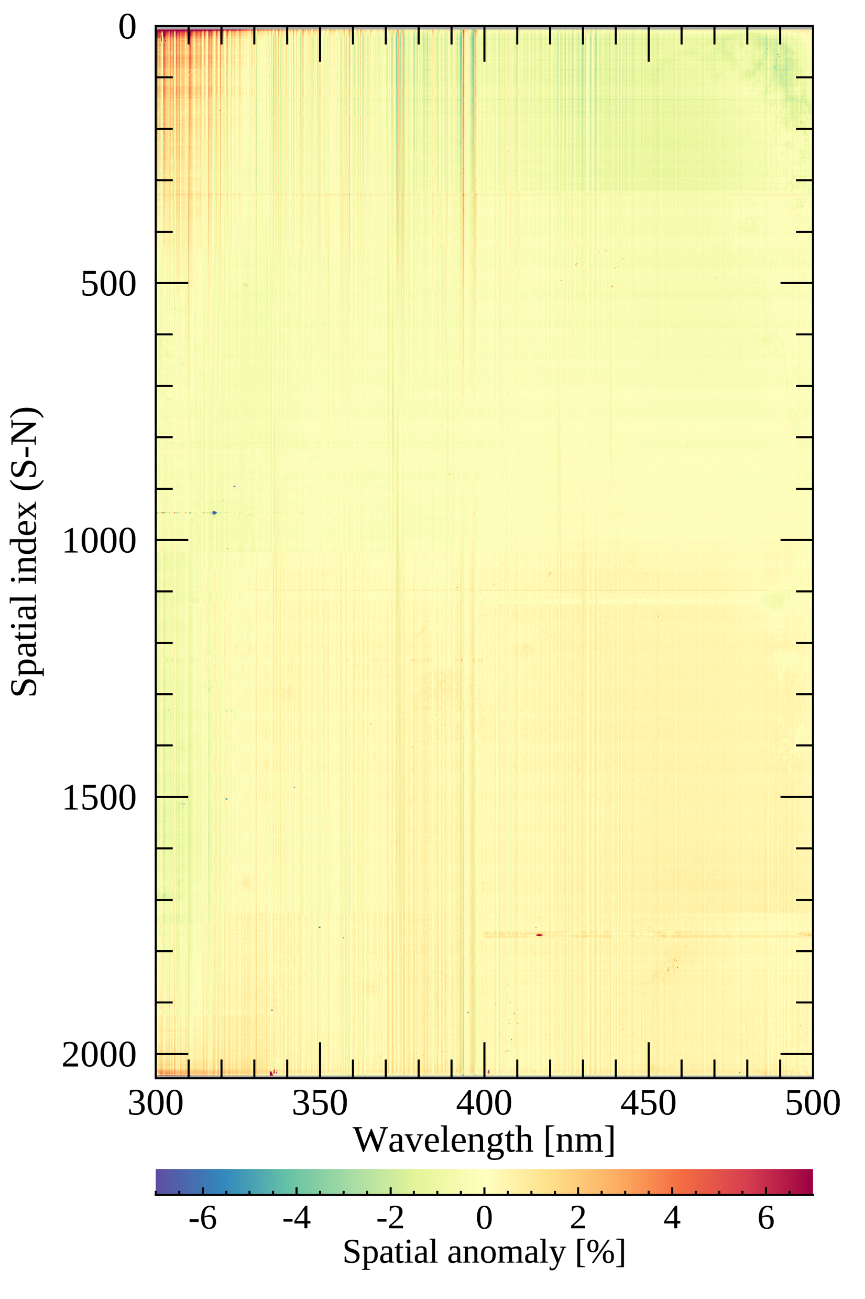
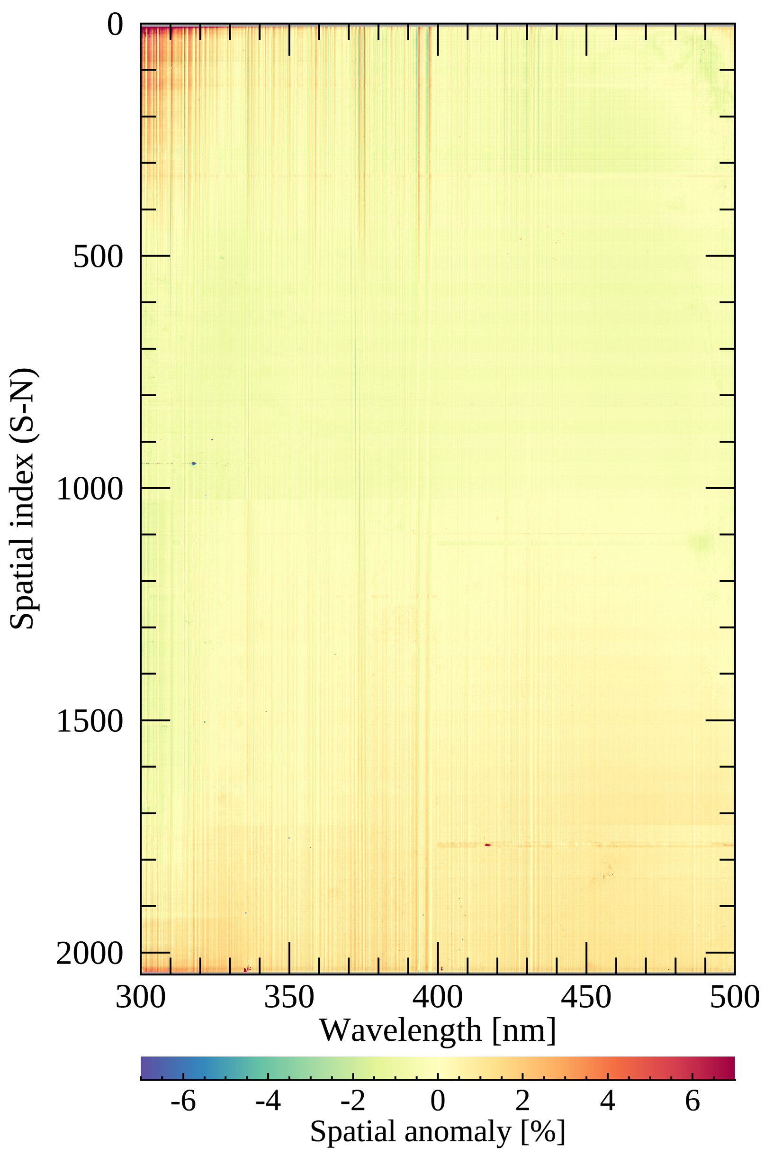
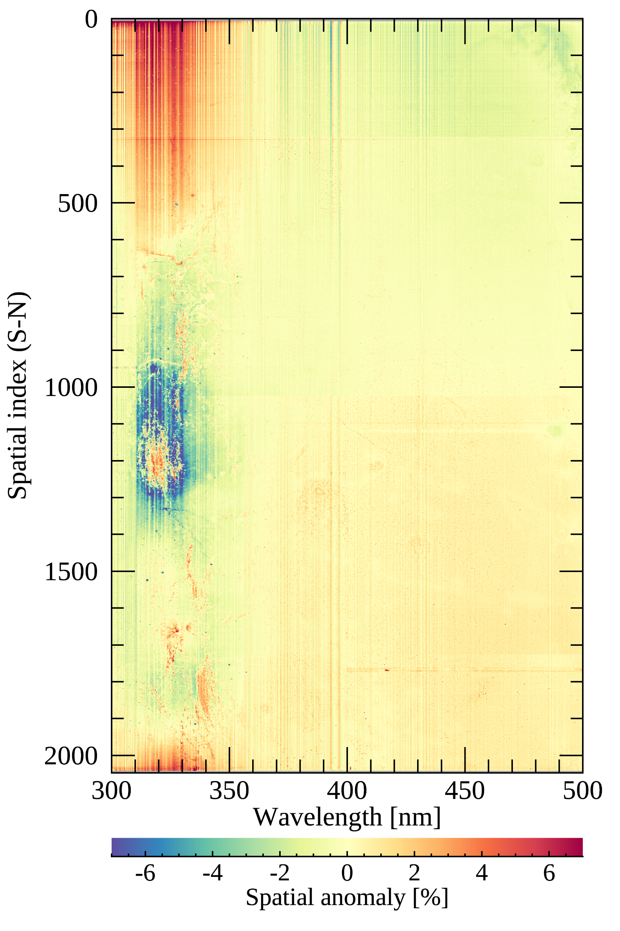
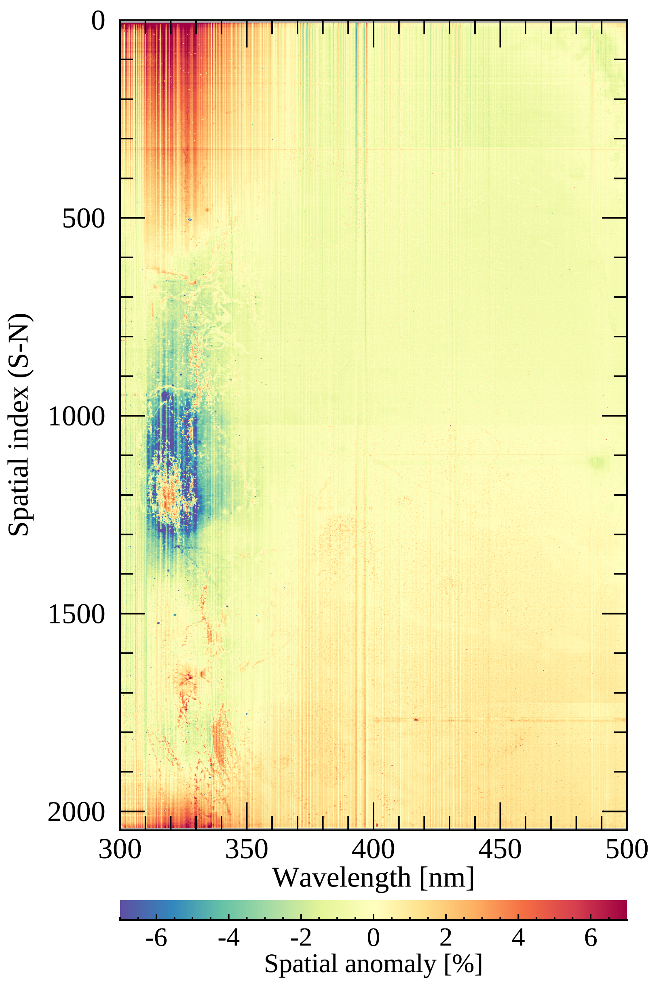
DEGRADATION: DIFFUSER + OPTICS/ELECTRONICS
Solar irradiance changes
  Along spectral & spatial (N-S) directions
* Solar azimuth angle${ φ}_{0}=95°$
% differences along the N-S direction at each wavelength for WSD & RSD
Sep 21, 2020, WSD Sep 22 2020, RSD Sep 23 2024, WSD Sep 22, 2024, RSD
$I_{λ}$ (radiance) $I_{λ}→e^{−}$ $e^{−}→DC$
z
Solar diffuser
Scan mirror
Telescope
Spectrometer
Detector
…
Electronics
4 yrs passed
Solar Irradiance
Earth Radiance
Dark Current & LED

Slide 7
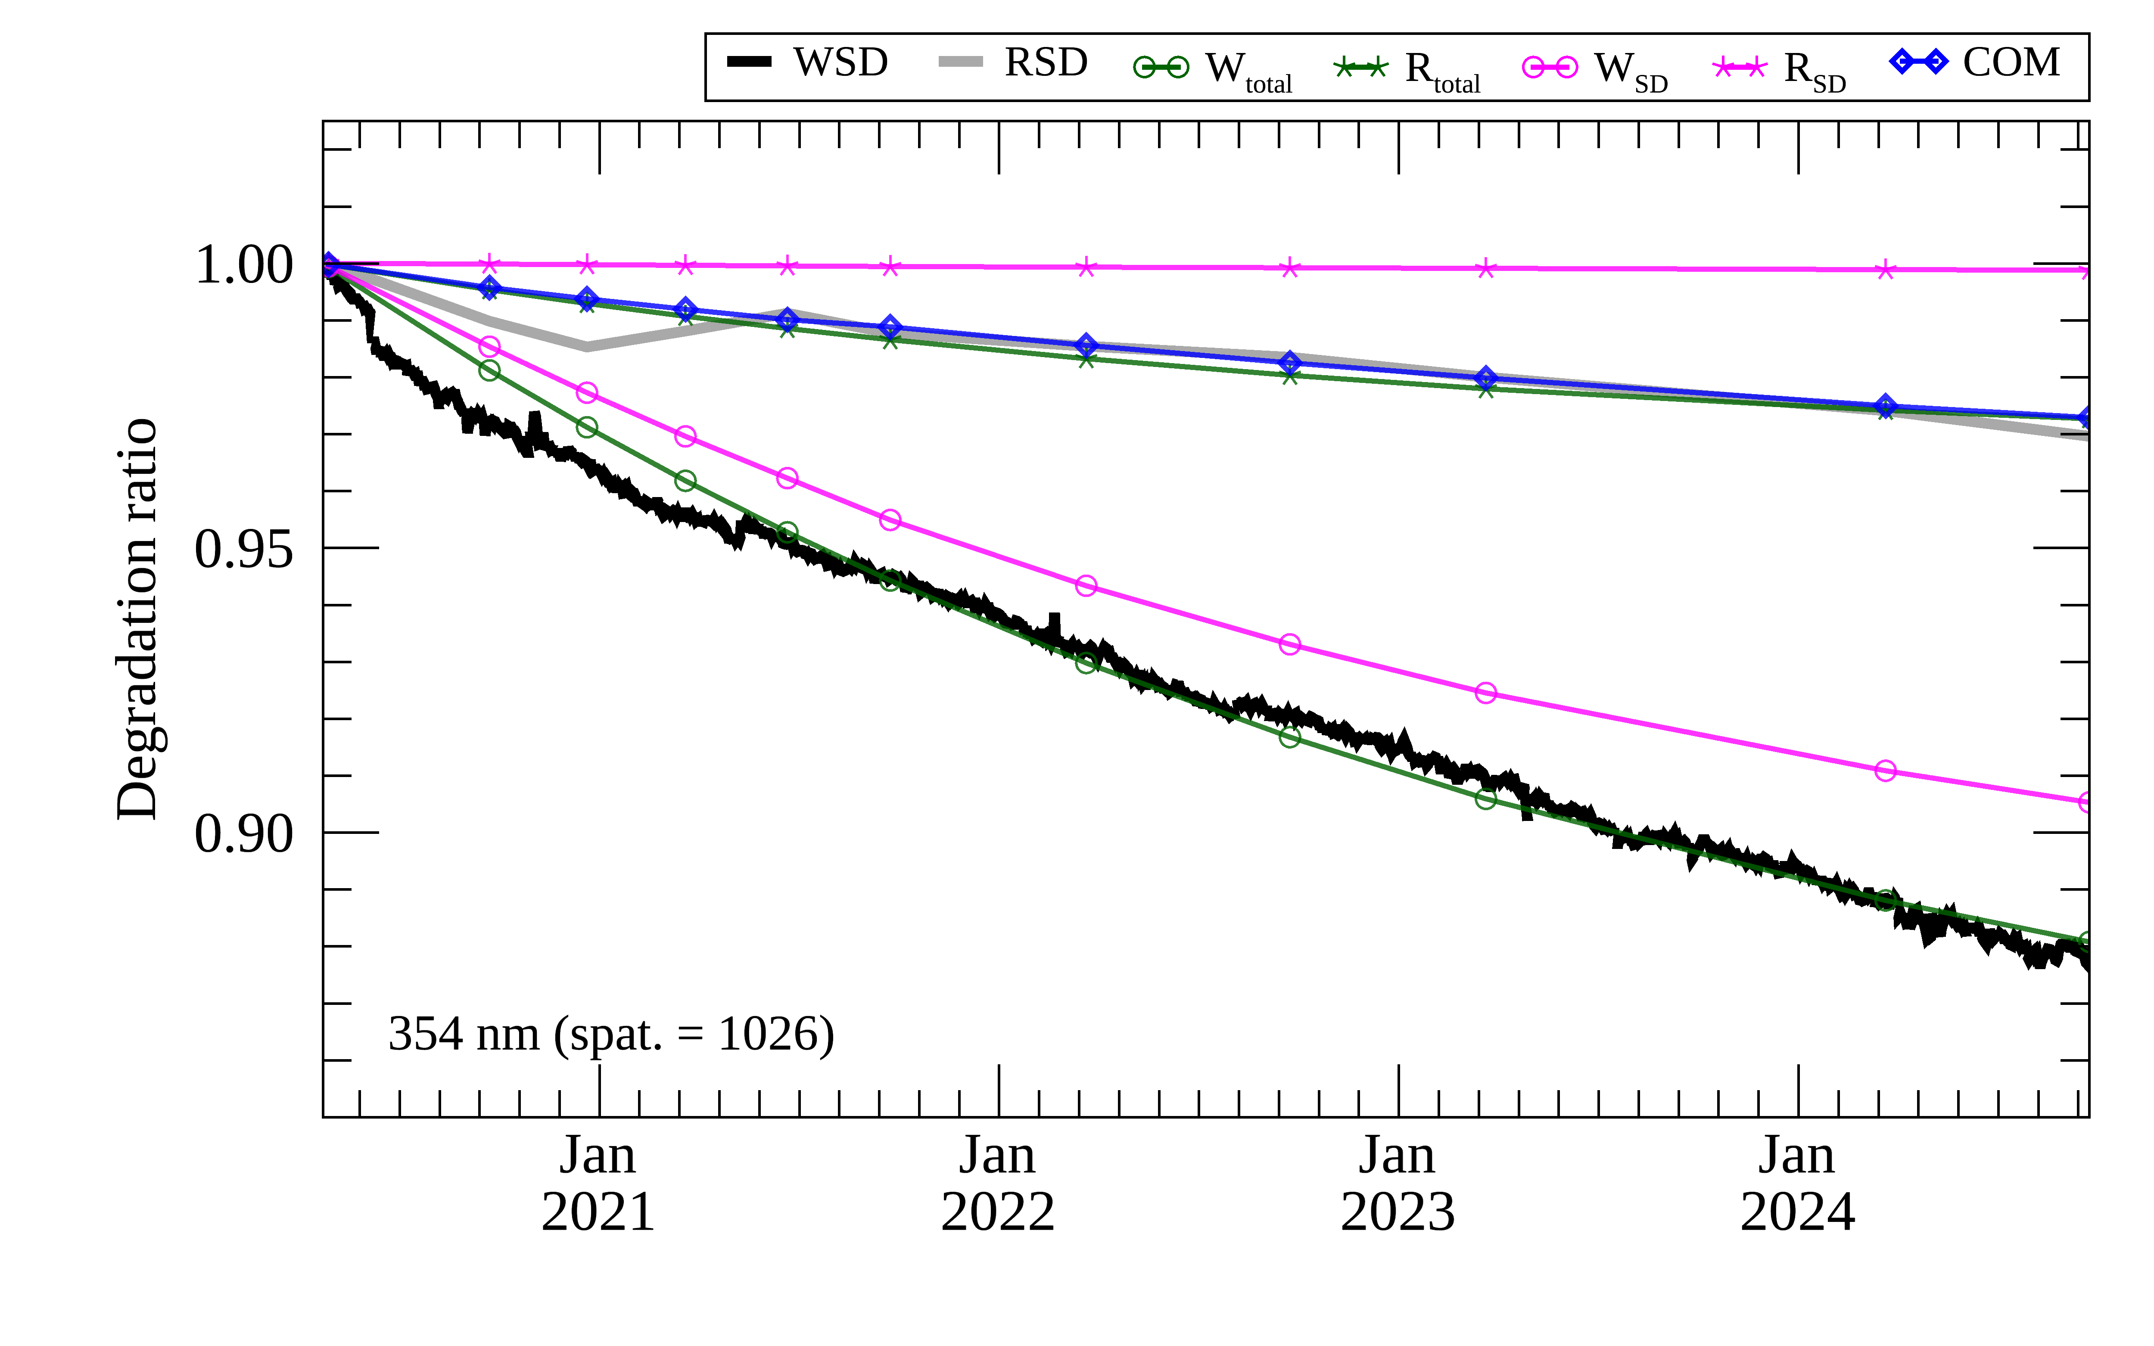
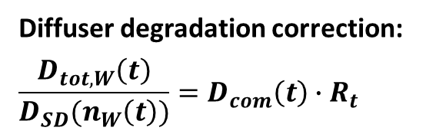
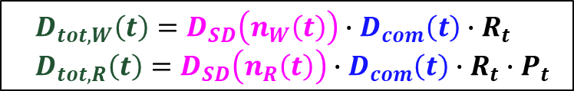
DEGRADATION: DIFFUSER + OPTICS/ELECTRONICS
Diffuser degradation correction
W: The primary solar diffuser (daily)
R: The secondary solar diffuser (bi-annually)
(Ludewig et al., 2020)
$$D_{tot,W}\left(t\right)=D_{SD}\left(n_{W}\left(t\right)\right)∙D_{com}\left(t\right)∙R_{t}$$
$$D_{tot,R}\left(t\right)=D_{SD}\left(n_{R}\left(t\right)\right)∙D_{com}\left(t\right)∙R_{t}∙P_{t}$$
Ratio to
the initial observation
Diffuser degradation correction:
$$\frac{D_{tot,W}\left(t\right)}{D_{SD}(n_{W}\left(t\right))}=D_{com}\left(t\right)∙R_{t}$$
: Methodology established -> Optimization in progress

Slide 8
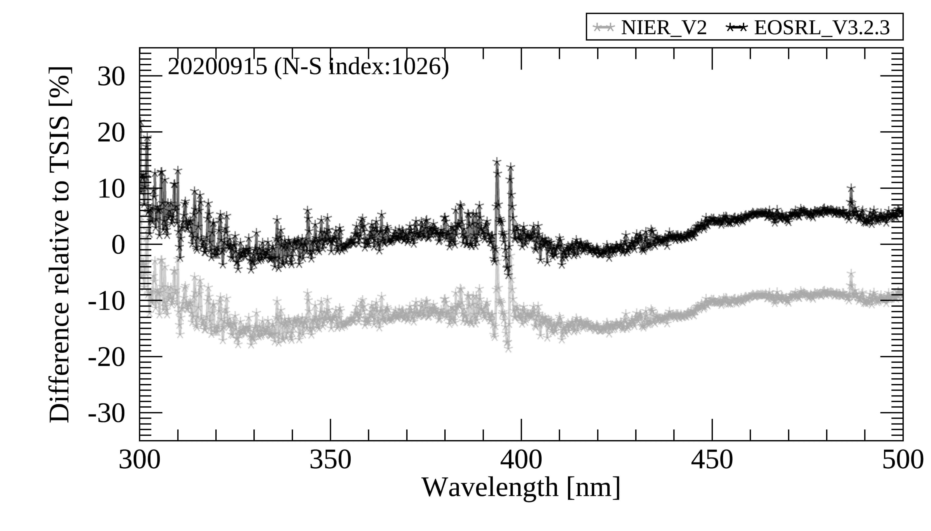
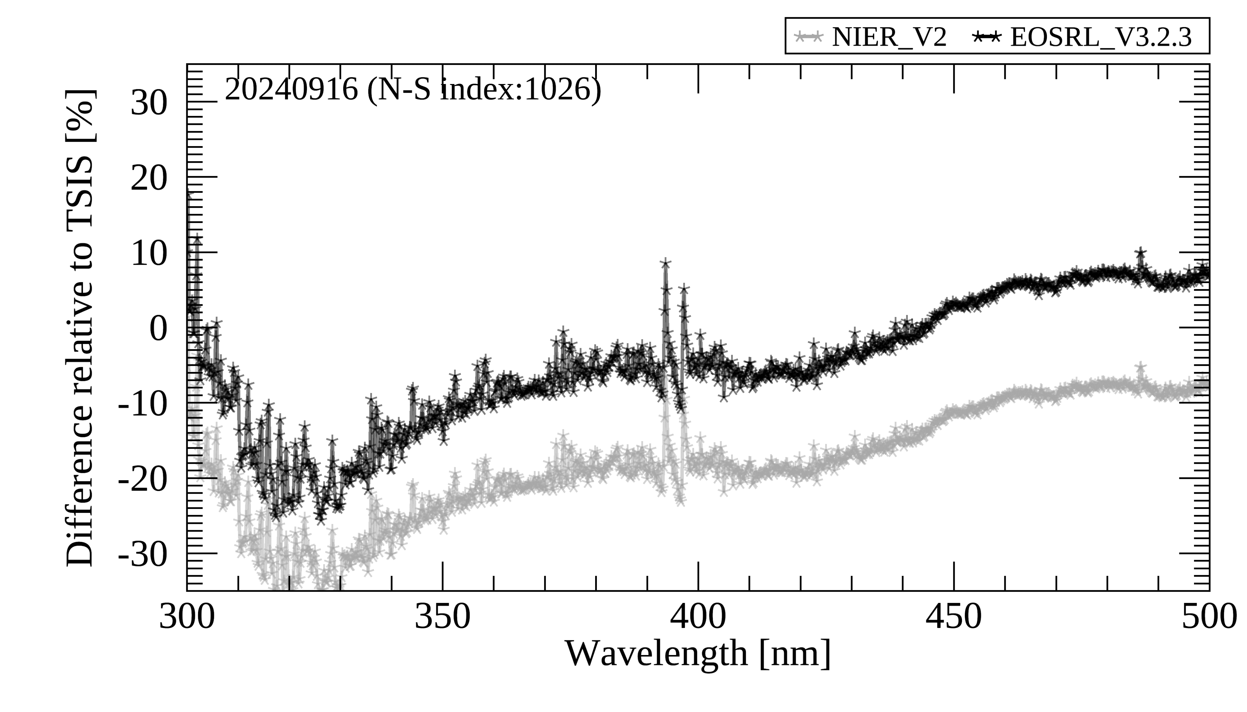

SYSTEMATIC BIAS – TSIS COMPARISON
Bias in solar irradiances
  Radiometric calibration
  BTDF definition (refer to the presentation of Dr. Heesung Chong, SAO)
Spectral difference of GEMS solar irradiances compared to TSIS
Sep 15, 2020 ($φ_{0}=\sim 90°$) Sep 16, 2024 ($φ_{0}=\sim 90°$)
4 yrs passed
Increase by ~15% ($\frac{1}{cos\left(30.5°\right)}$)

Slide 9
SYSTEMATIC BIAS – VALIDATION APPROACHES
Inter-calibration approach
  GEO (twin satellites – GK2A & GK2B) & hyperspectral instrument onboard LEO
GEMS (Hyperspectral)
GEO
LEO
AMI
GOCI-2
OMPS
TROPOMI
MODIS
Higher availability for ray-matching
Potential for spectral analysis
At the same 1) time
With same 2) spatial and 3) spectral response
With same 4) viewing geometry
View an
identical target
Collocation process

Slide 10
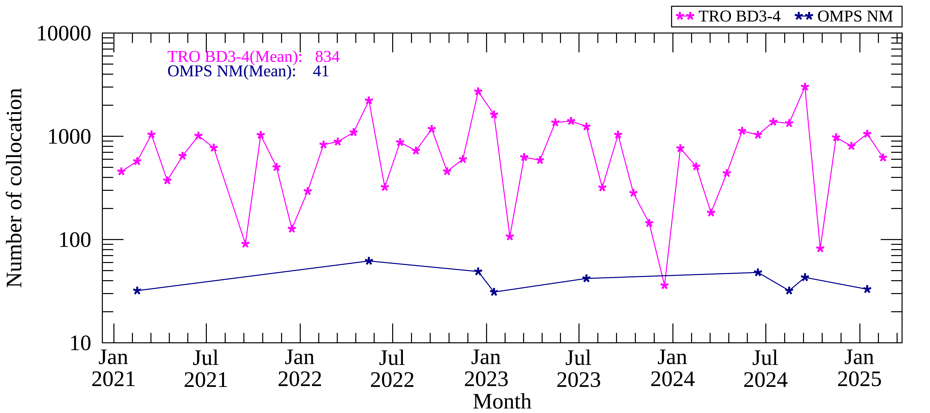
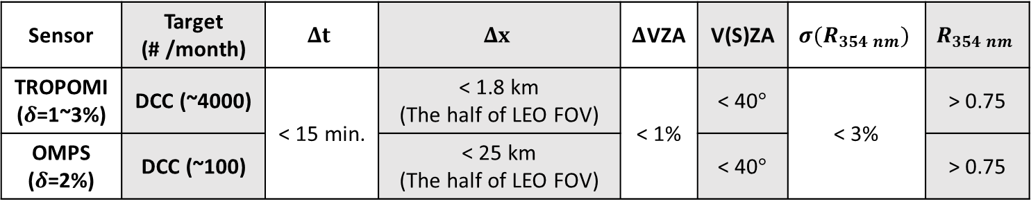
SYSTEMATIC BIAS – VALIDATION APPROACHES
Evaluation with LEO sensors (TROPOMI & OMPS)
  2021 –2025, every five days / Deep convective clouds (DCC)
The number of collocation samples
Sensor | Target (# /month) | $$Δt$$ | $$Δx$$ | $Δ$VZA | V(S)ZA | $${σ(R}_{354 nm})$$ | $$R_{354 nm}$$
TROPOMI ($δ$=1~3%) | DCC (~4000) | < 15 min. | < 1.8 km (The half of LEO FOV) | < 1% | < 40$°$ | < 3% | > 0.75
OMPS ($δ$=2%) | DCC (~100) |  | < 25 km (The half of LEO FOV) |  | < 40$°$ |  | > 0.75
Collocation thresholds

Slide 11
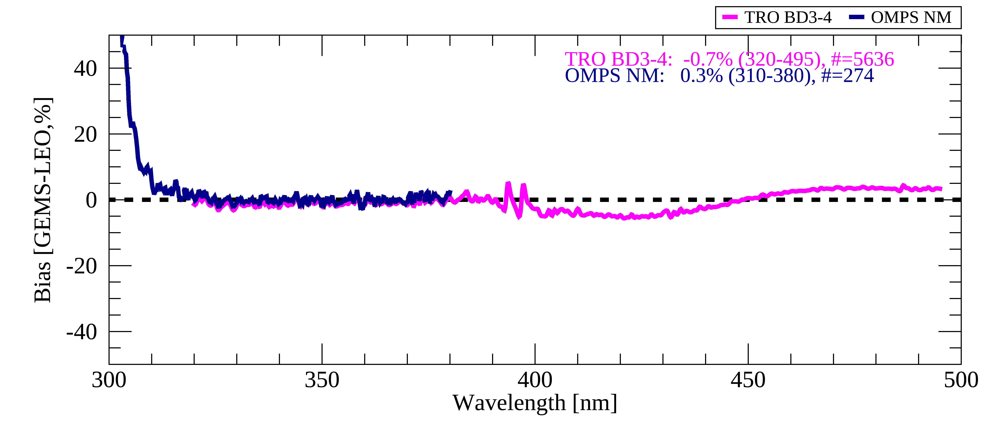
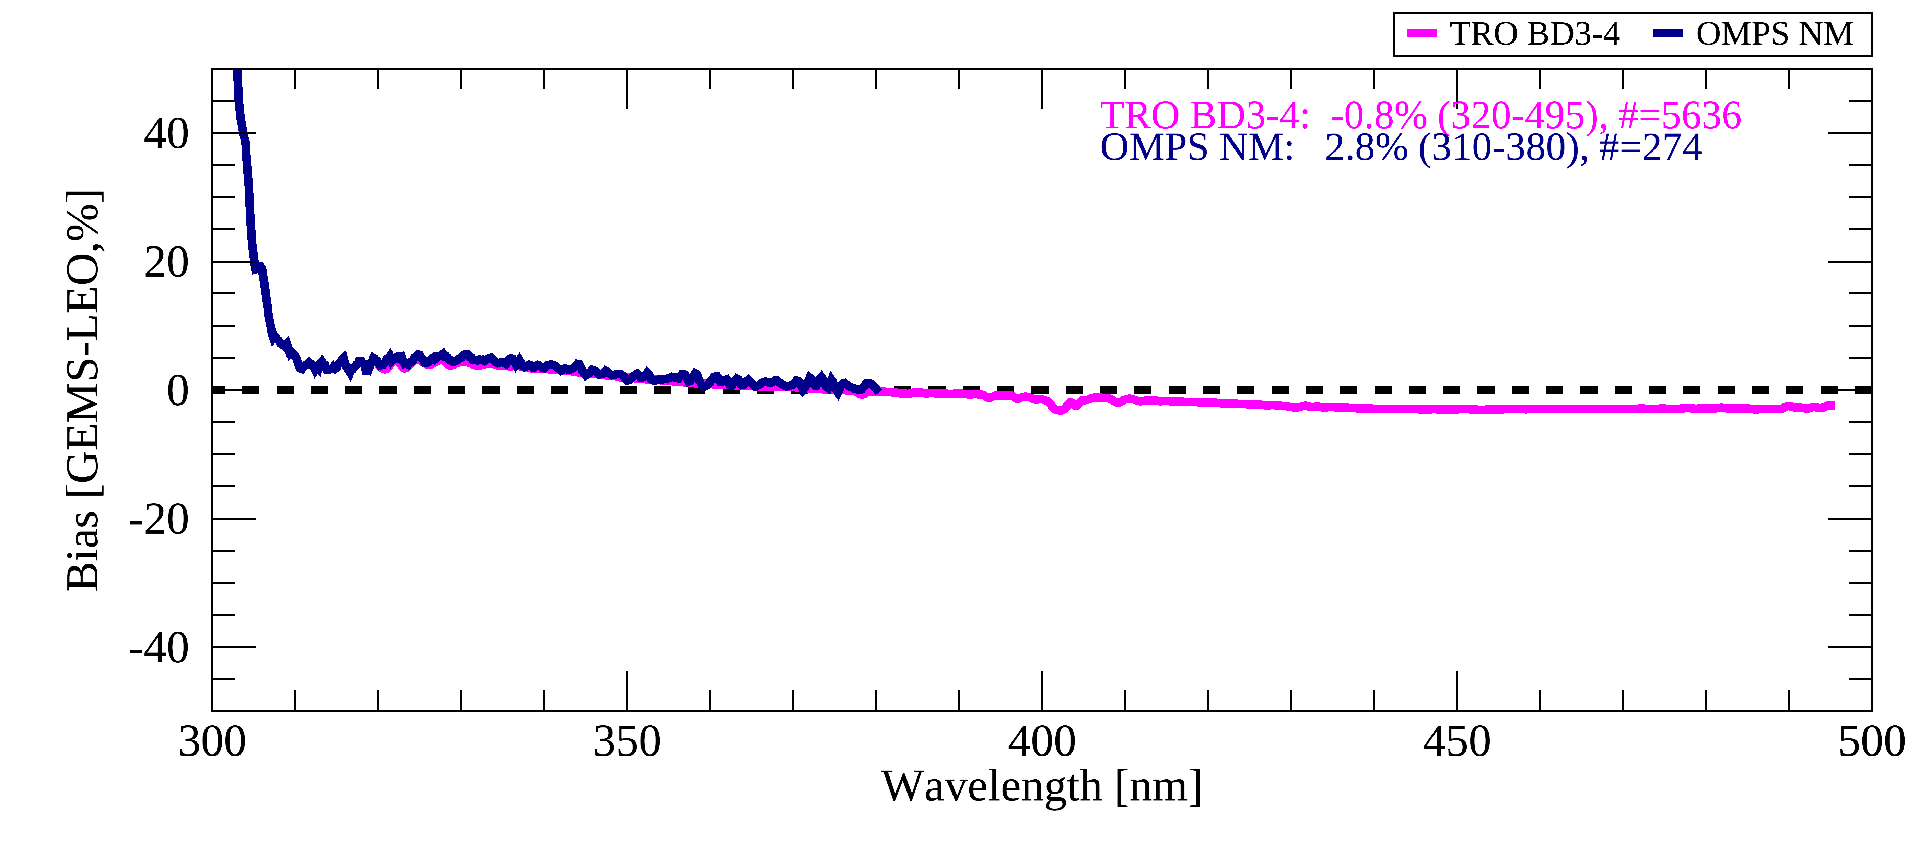
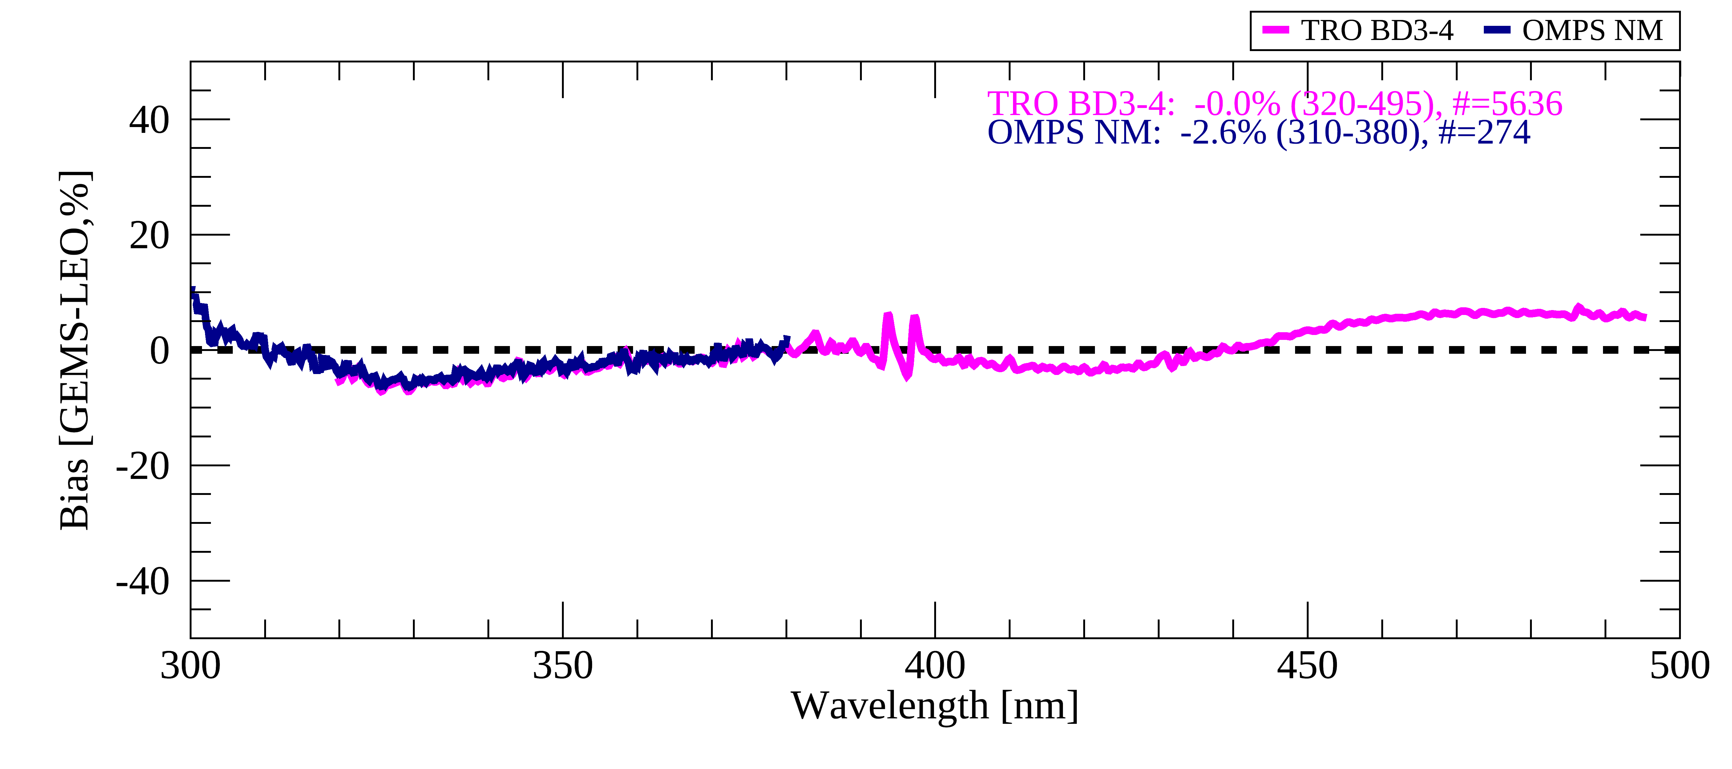
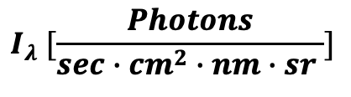
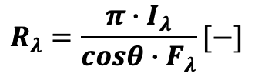
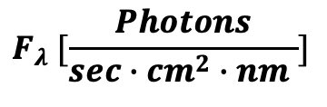
SYSTEMATIC BIAS – VALIDATION APPROACHES
Evaluation with LEO sensors (TROPOMI & OMPS)
$$R_{λ}=\frac{{π∙I}_{λ}}{{cosθ∙F}_{λ}}[−]$$
Earth radiance
$$I_{λ} [\frac{Photons}{sec∙cm^{2}∙nm∙sr }]$$
$$F_{λ} [\frac{Photons}{sec∙cm^{2}∙nm }]$$
In 2021
Solar irradiance

Slide 12
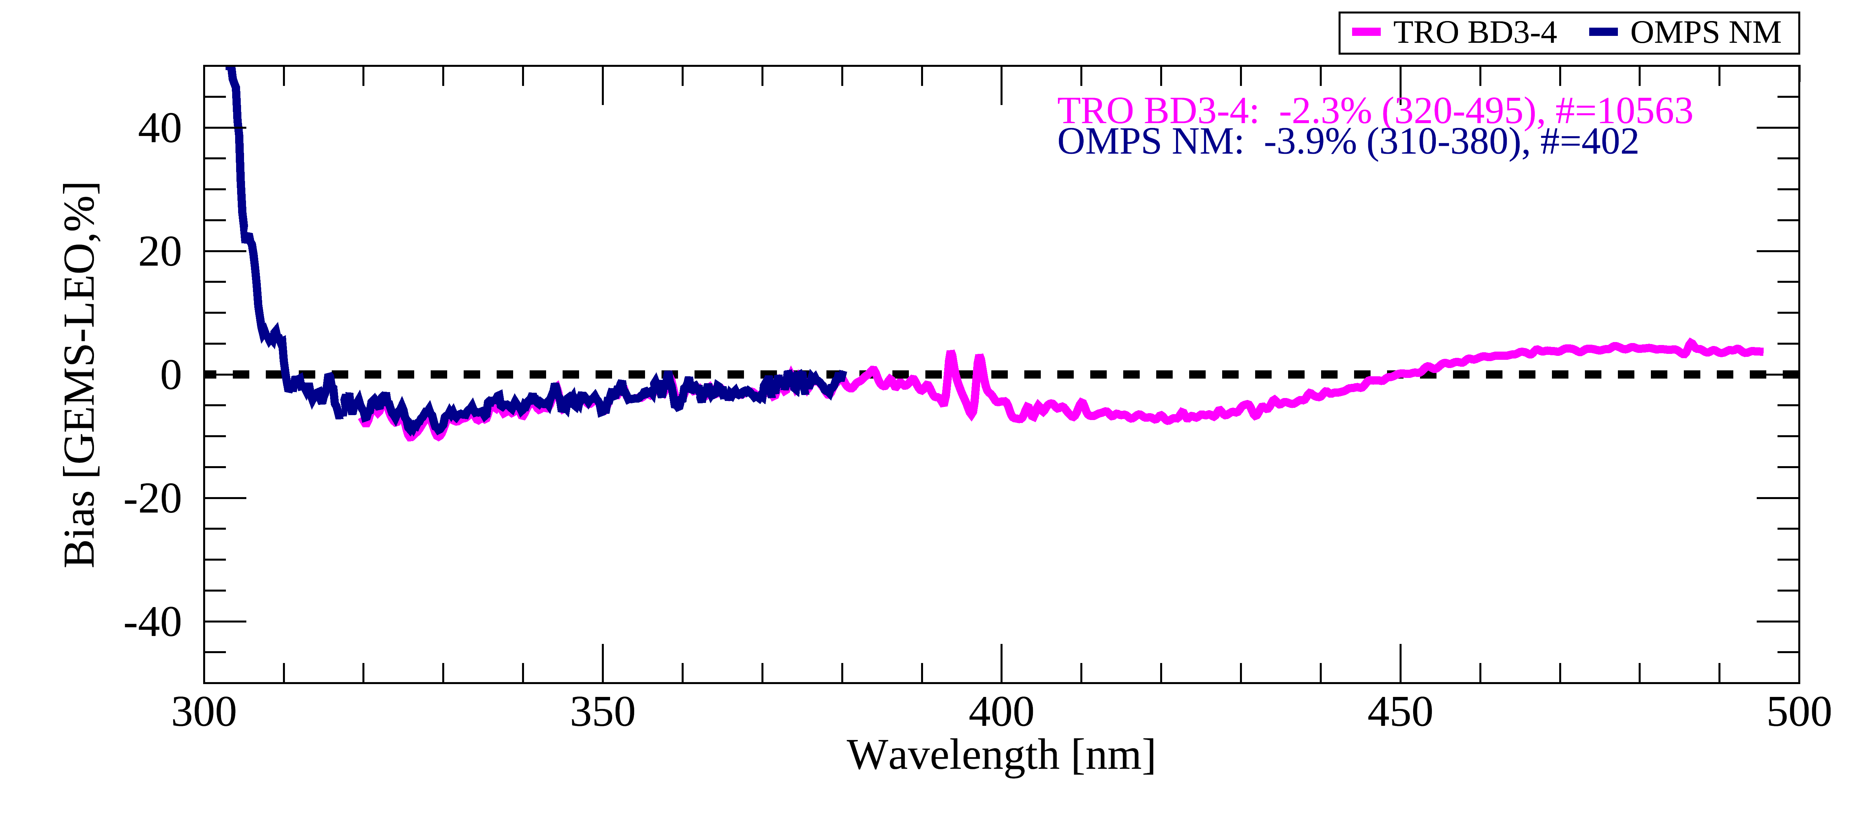
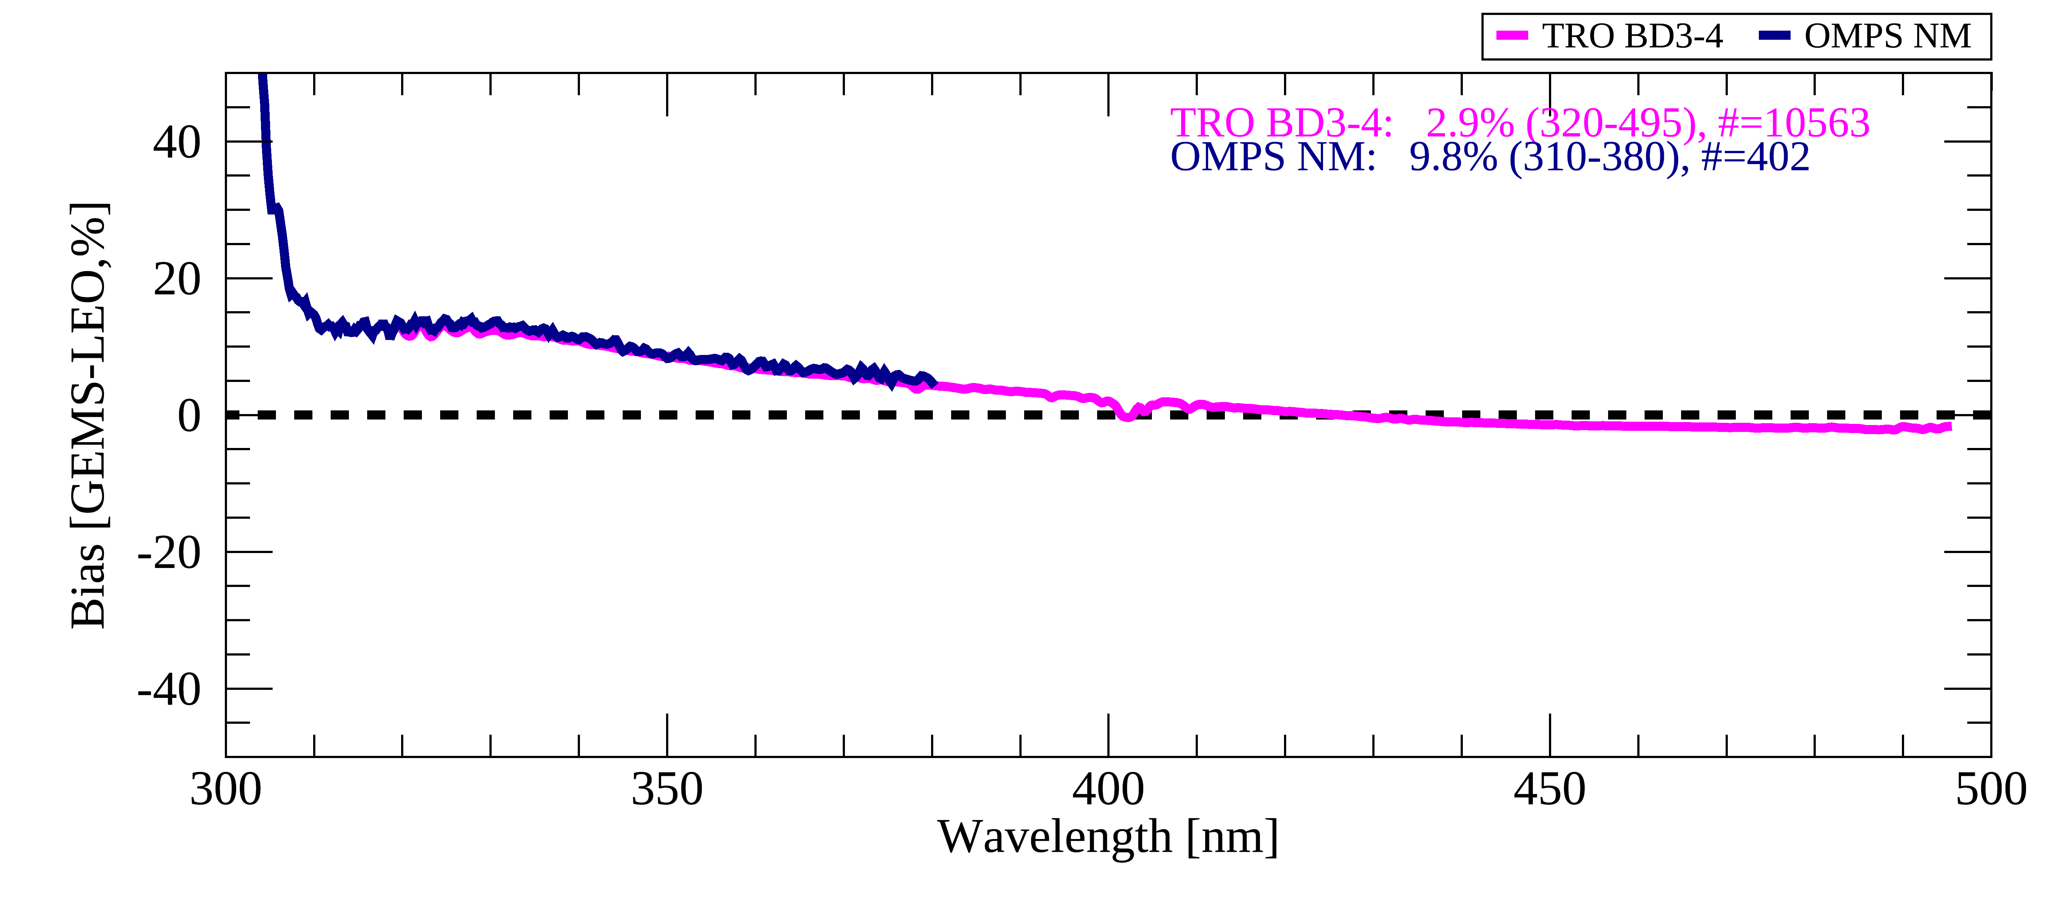
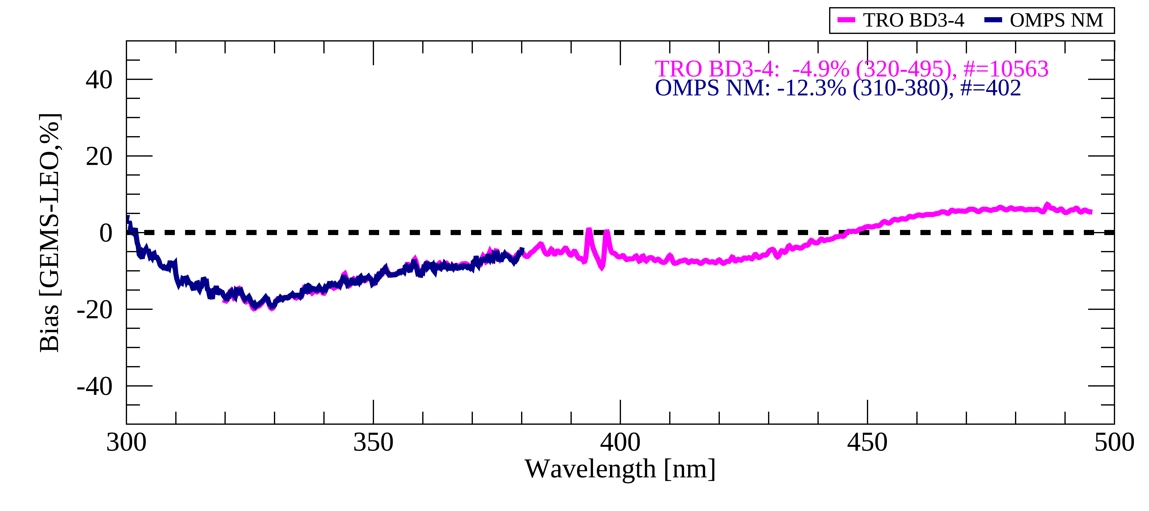
SYSTEMATIC BIAS – VALIDATION APPROACHES
Evaluation with LEO sensors (TROPOMI & OMPS)
$$R_{λ}=\frac{{π∙I}_{λ}}{{cosθ∙F}_{λ}}[−]$$
Earth radiance
$$I_{λ} [\frac{Photons}{sec∙cm^{2}∙nm∙sr }]$$
$$F_{λ} [\frac{Photons}{sec∙cm^{2}∙nm }]$$
In 2024
Solar irradiance

Slide 13
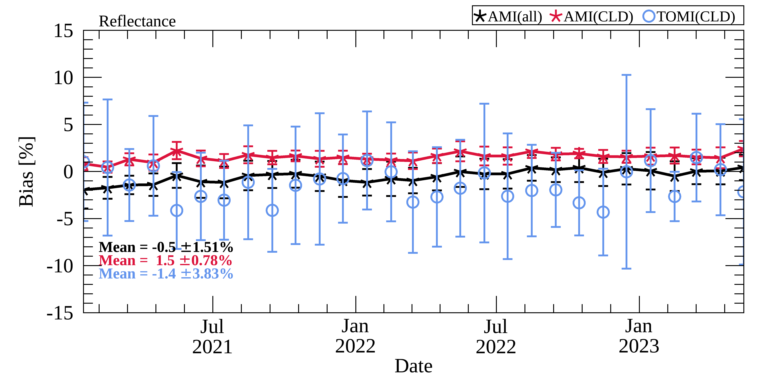
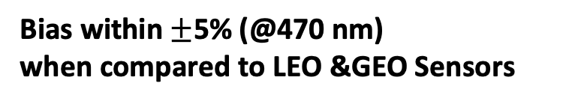
SYSTEMATIC BIAS – VALIDATION APPROACHES
Evaluation with LEO & GEO sensors (AMI/GK-2A – atmospheric imager)
Bias of GEMS compared to TROPOMI & AMI (all, DCCs)
@ 470 nm
Bias within $±$5% (@470 nm)
when compared to LEO &GEO Sensors

Slide 14

SUMMARY & FUTURE WORKS
REMAINING ISSUES
  Solar irradiance only (inversely to reflectance):
    Diffuser BTDF N-S dependence : $±10\%$ & Sinusodial pattern
    Diffuser degradation : $λ$-dependent $(−20\% @320 nm)$
    Diffuser BTDF definition : $−15\%$
  Both solar irradiance & Earth radiance:
    Temporal discontinuity & striping : $±1\sim 2\%$
    Throughput change : $λ$-dependent $(@\sim 320 nm)$
    Radiometric calibration : $λ$-dependent
Temporal variation
Degradation
Bias
Temporal variation
Degradation
Bias

Slide 15
Yeeun Lee: yeeunlee@ewha.ac.kr

Slide 16
GEMS: five years of operation
Level 0-1B Process
Level 0
Stray Light Correction
Co-addition Correction
(Ir)radiance Calibration
Green Box: updates
Pixel Flagging
Diffuser BTDF
Crosstalk/
Nyquist Phase Correction
Spectral Shift Correction
Spectral Shift Correction
Offset/Linearity Correction
2-Pixel Binning
2-Pixel Binning
Smear Correction
Spatial Registration
Spatial Registration
Gain/
FPE Temperature Correction
L1B-Earth
L1B-Solar
Integration Time/PRNU
BTDF Correction
Dark Correction
Empirical correction
(On-going update)
Degradation Correction
Geometric Calibration

Slide 17
GEMS Level 1C calibration updates:
* Updated only for IRR
Issue (prominent) | Irradiance (IRR) | Radiance (RAD) | Reflectance (REF) | Effect | Status
North-South dependence | O | X | O (inverse) | Systematic N-S bias | Reduced (<1%, REF)
Diffuser degradation | O | X | O (inverse) | Higher degradation @ shorter WVs | To be updated this year
Sensor degradation (post diffuser) | O | O | X | Degradation | -
BTDF Negative bias | O | X | O | Systematic negative bias | Removed (Courtesy: SAO)
Stripping | O | O | X | N-S spatial discontinuity | -
Reboot discontinuity | O | Potential | Potential | Temporal discontinuity | -
Radiometric calibration coefficient | O | O | X | Systematic bias | To be investigated this year
Straylight | X | O | O | Spectral dependence @ shorter WVs | -

Slide 18
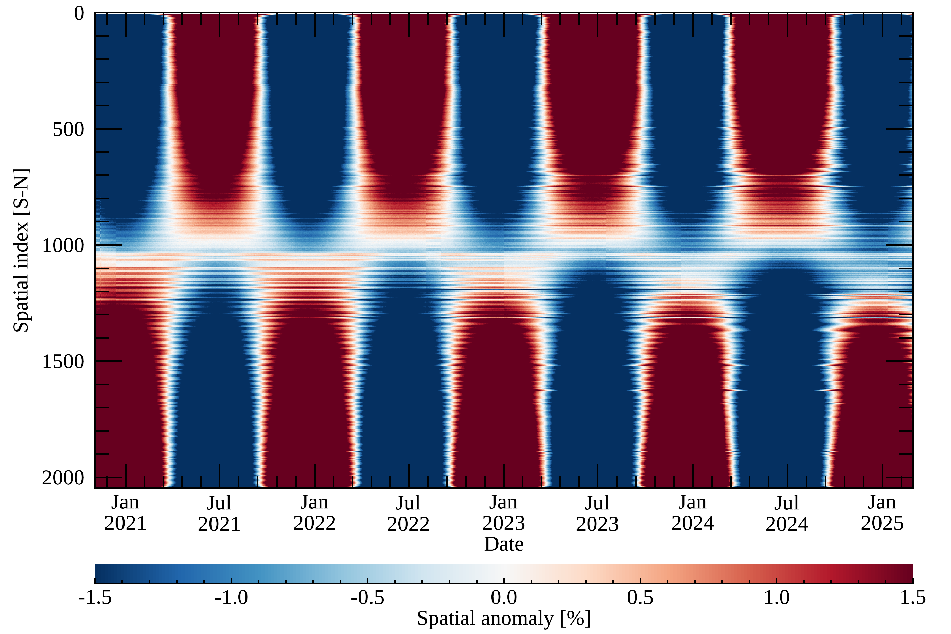
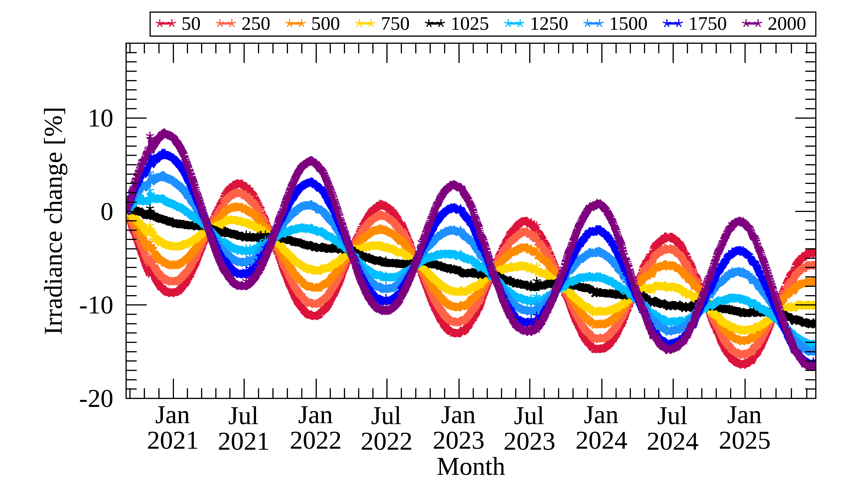
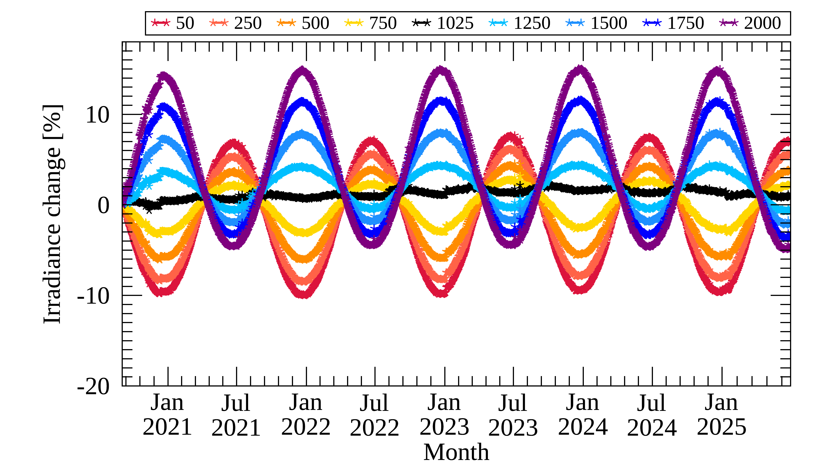
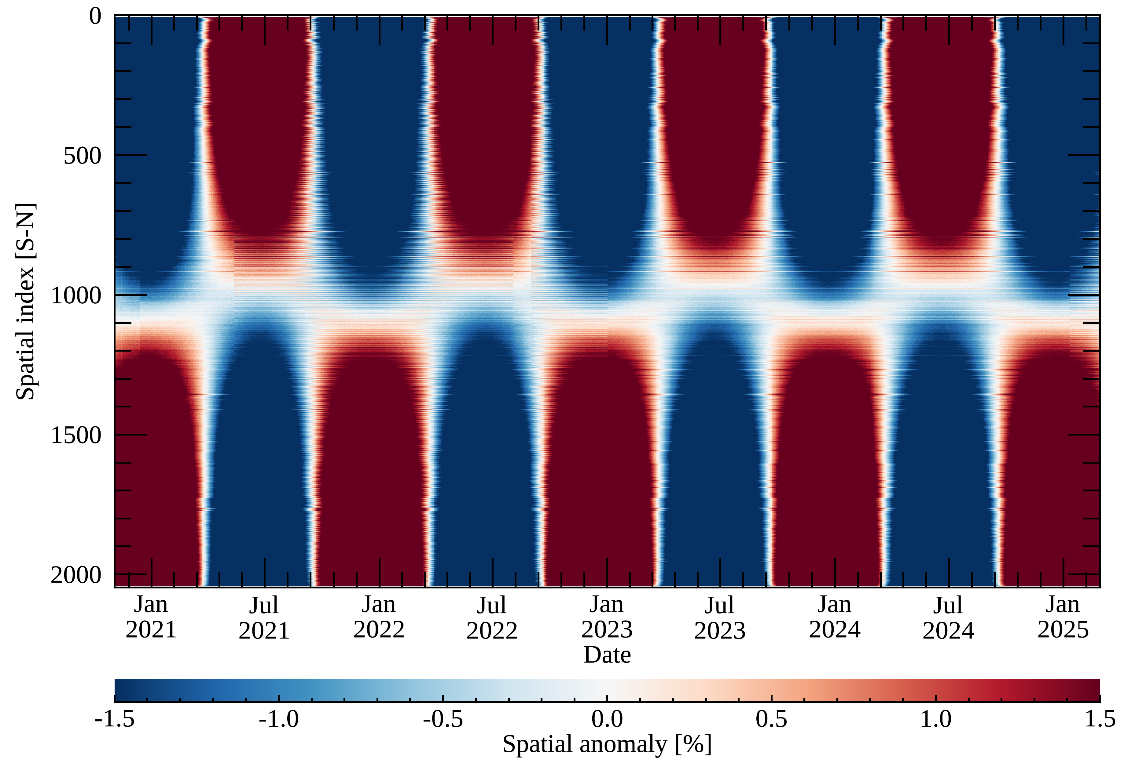
GEMS Level 1C calibration updates:
Solar irradiance (w/o BTDF update, V2.0)
* BTDF: Bi-directional Transmittance Distribution Function
Spatial anomaly [%]
Temporal variations at each spatial index [%]
@ 354 nm
@ 480 nm

Slide 19
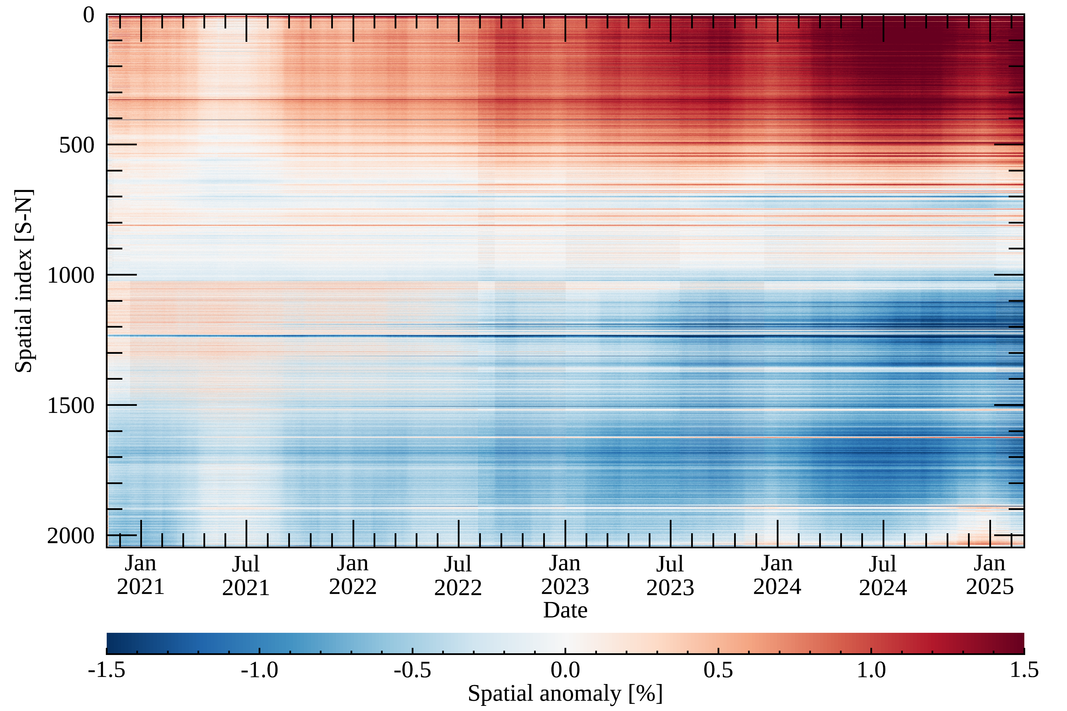
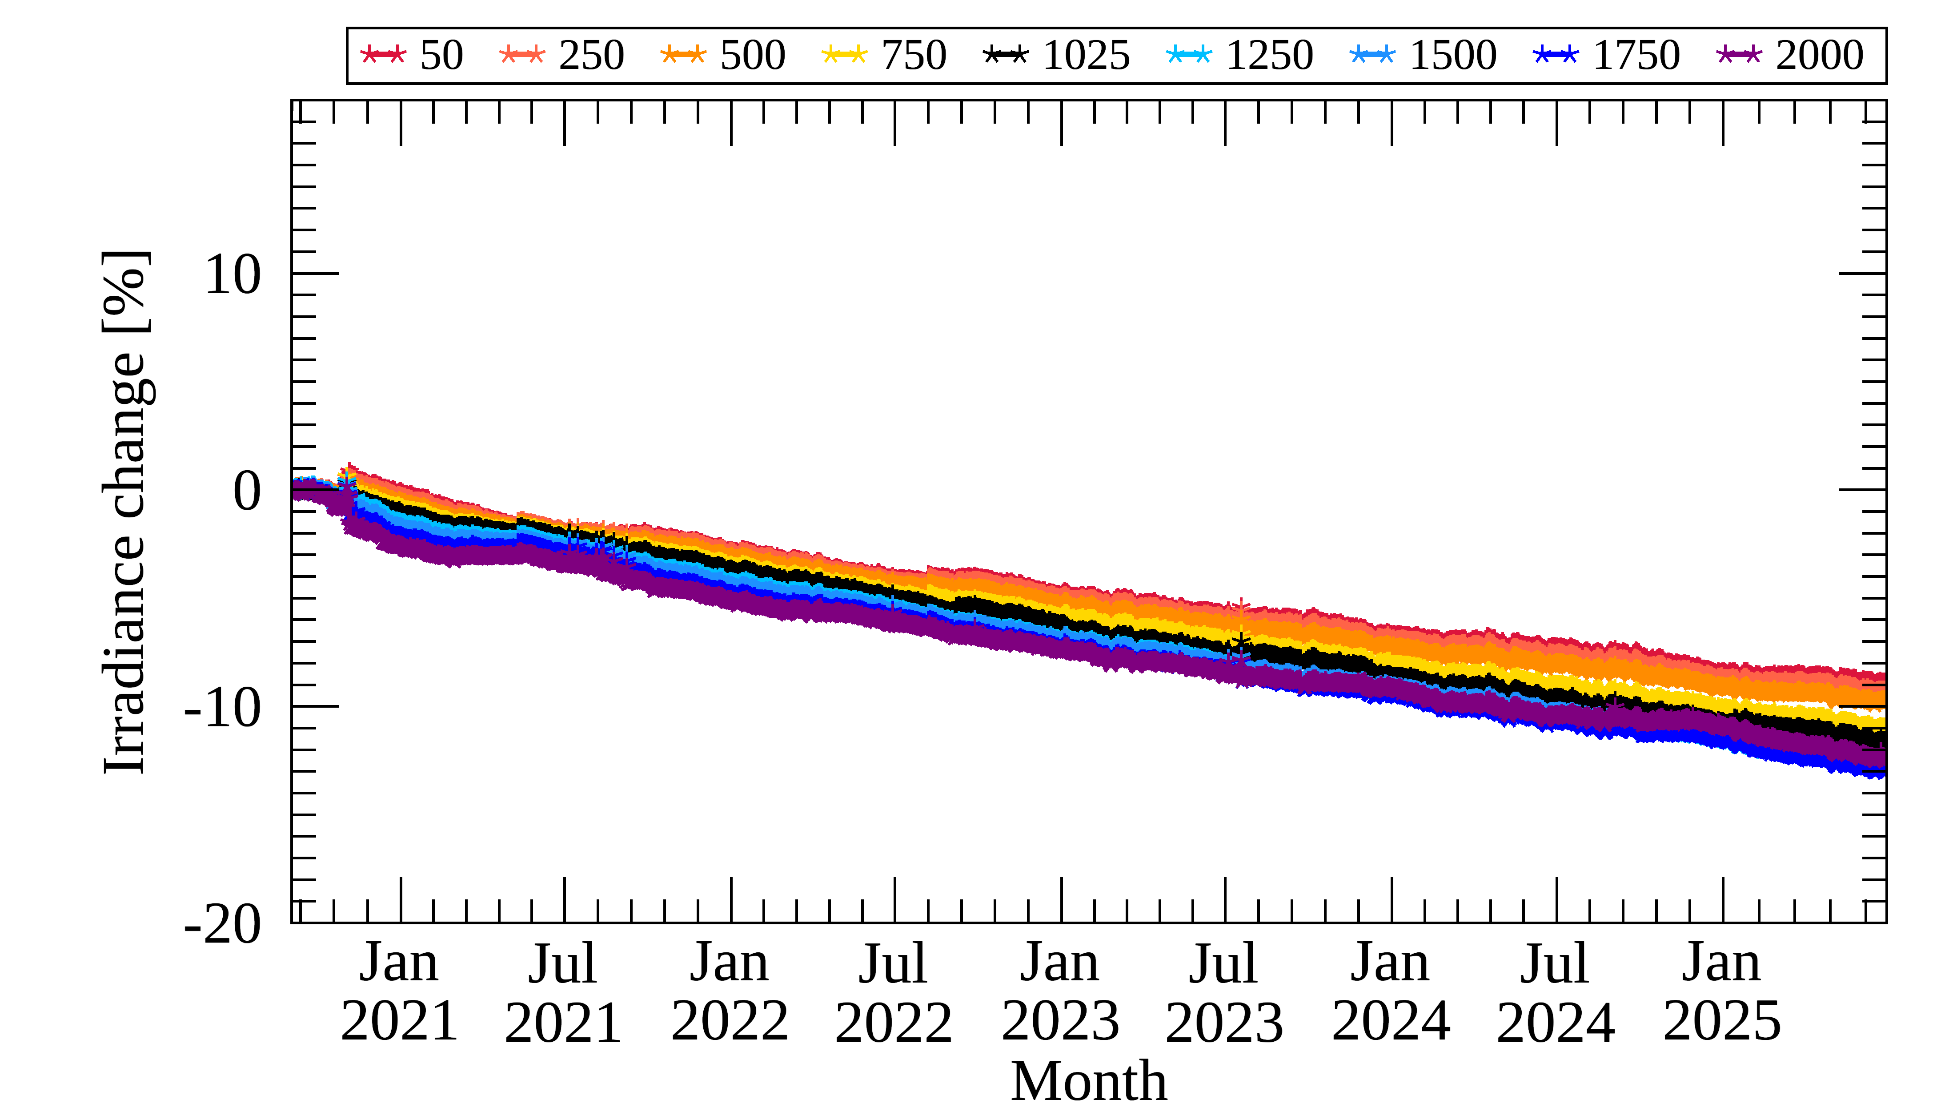
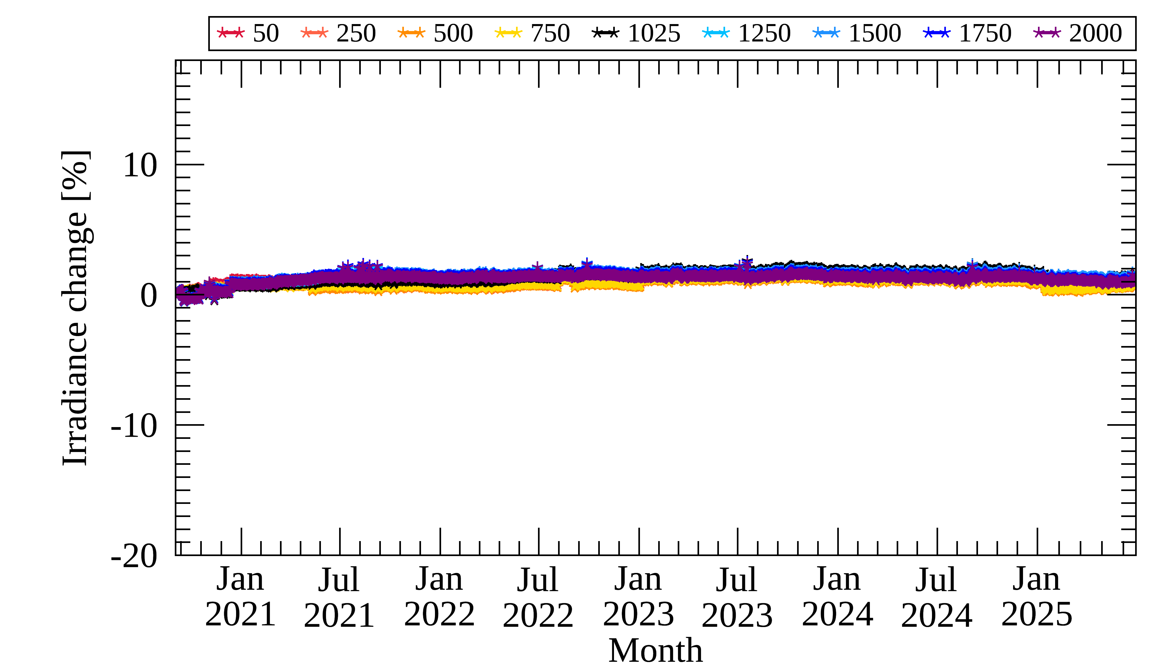
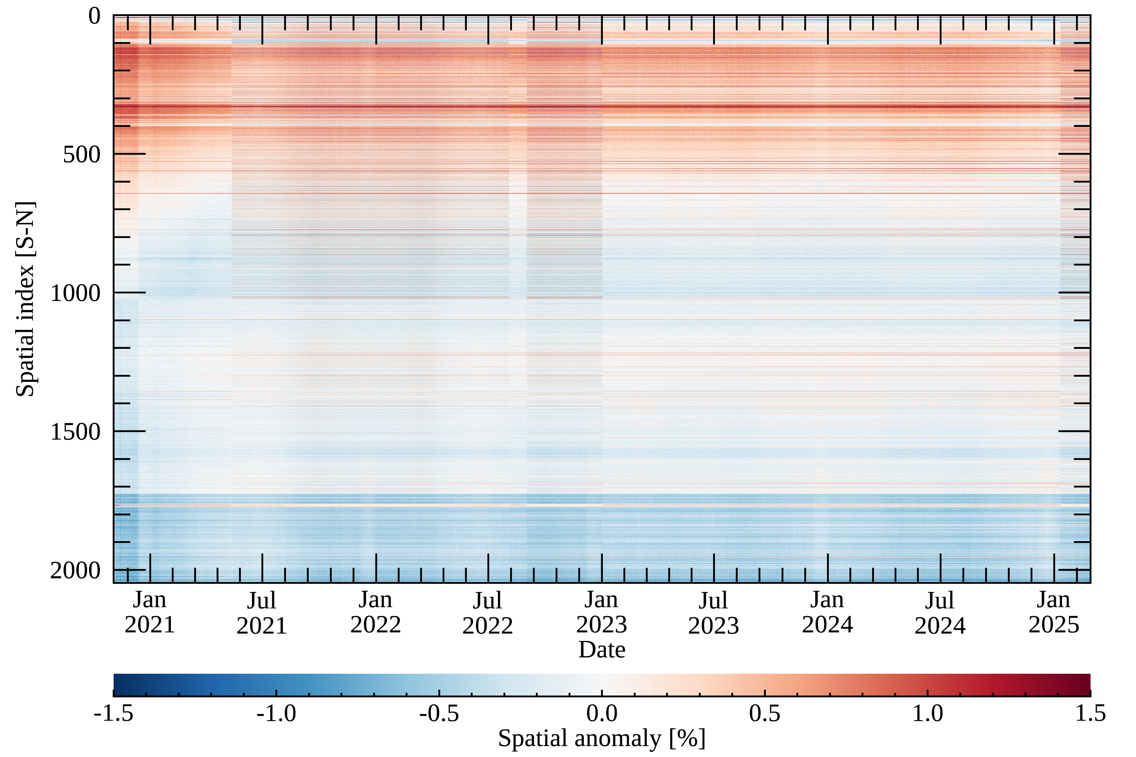
GEMS Level 1C calibration updates:
Solar irradiance (w/ BTDF update, V1.5.0)
Spatial anomaly [%]
Temporal variations at each spatial index [%]
@ 354 nm
Degradation (10% @ 354 nm )
Over 17% @ 320 nm
@ 480 nm

Slide 20
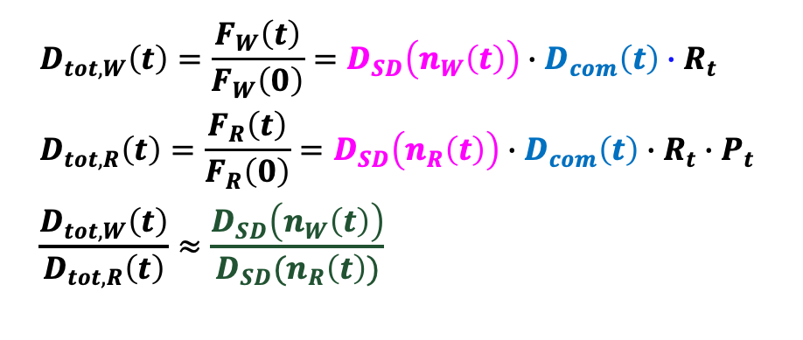
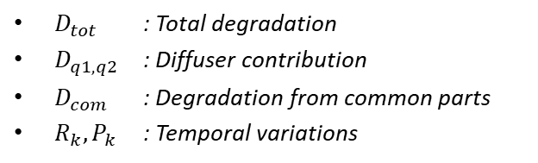
GEMS Level 1C calibration updates:
GEMS diffuser degradation
Solar Irradiance
z
Solar diffuser
(WSD or RSD)
Scan mirror
Telescope
Spectrometer
Detector
…
Electronics
Earth Radiance
$$D_{tot,W}\left(t\right)=\frac{F_{W}\left(t\right)}{F_{W}\left(0\right)}=D_{SD}\left(n_{W}\left(t\right)\right)∙D_{com}\left(t\right)∙R_{t}$$
$$D_{tot,R}\left(t\right)=\frac{F_{R}\left(t\right)}{F_{R}\left(0\right)}=D_{SD}\left(n_{R}\left(t\right)\right)∙D_{com}\left(t\right)∙R_{t}∙P_{t}$$
$$\frac{D_{tot,W}\left(t\right)}{D_{tot,R}\left(t\right)}≈\frac{D_{SD}\left(n_{W}\left(t\right)\right)}{D_{SD}(n_{R}\left(t\right))}$$
WSD:
Similar approach
for OMI and TROPOMI
RSD :
$D_{tot}$ : Total degradation
$D_{q1, q2}$ : Diffuser contribution
$D_{com}$ : Degradation from common parts
$R_{k},P_{k}$ : Temporal variations
Ludewig et al. (AMT 2020) & Kleipool et al. (AMT 2022)

Slide 21
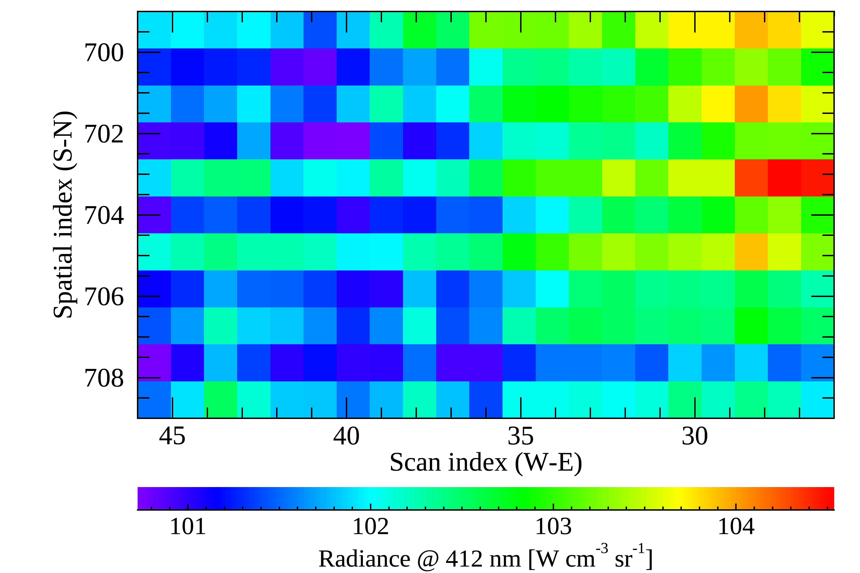
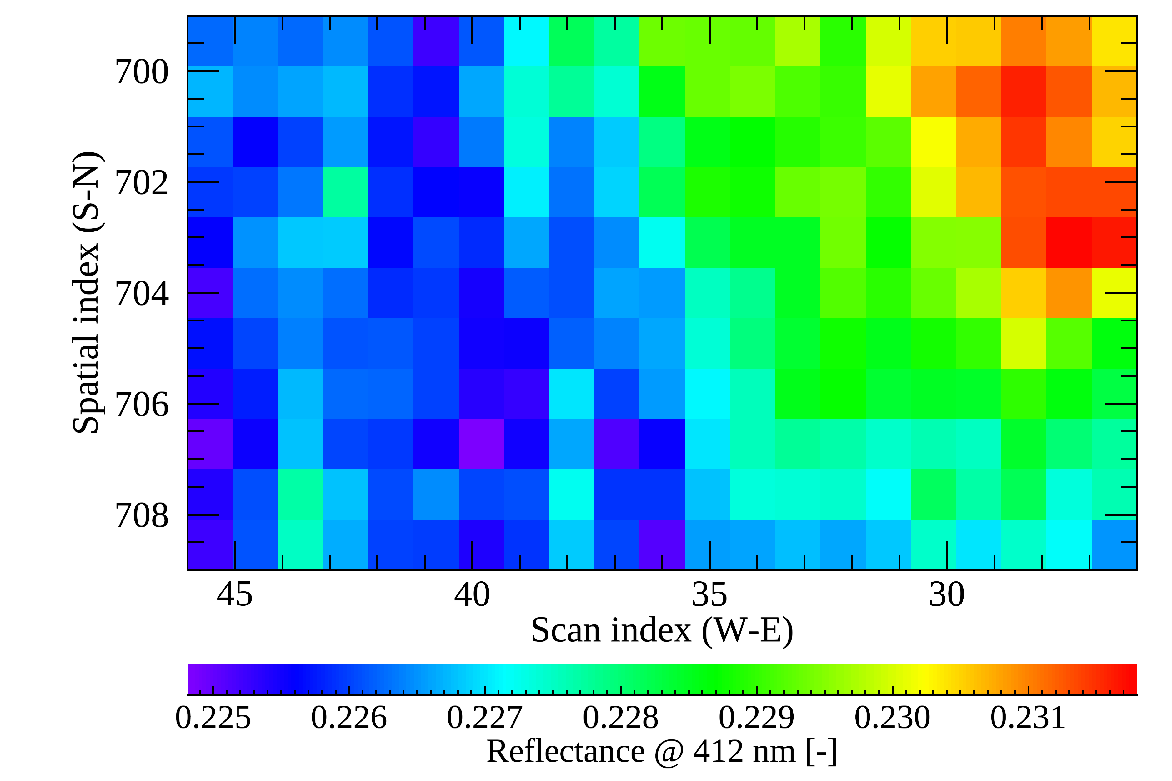

GEMS Level 1C calibration updates:
Stripe-like artifacts along north-south direction on the CCD
  Clearly appear in weak signals about 2% variations (i.e., dark ocean)
Radiance
March 20, 2022
Reflectance = $\frac{Earth Rad}{Solar irrad}$
* Potentially by non-linearity correction in the ADC process

Slide 22
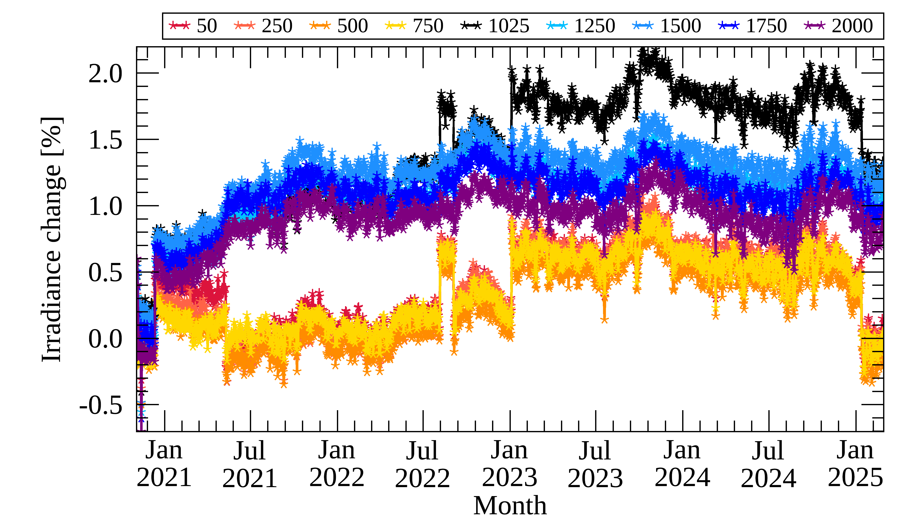

GEMS Level 1C calibration updates:
Instrument reboot
  Occurs when GEMS is rebooted after entering survival mode, potentially related to electronic chain
5/9, 2021
@ 480 nm (Nadir)
$±1$% depending on WV

Slide 23
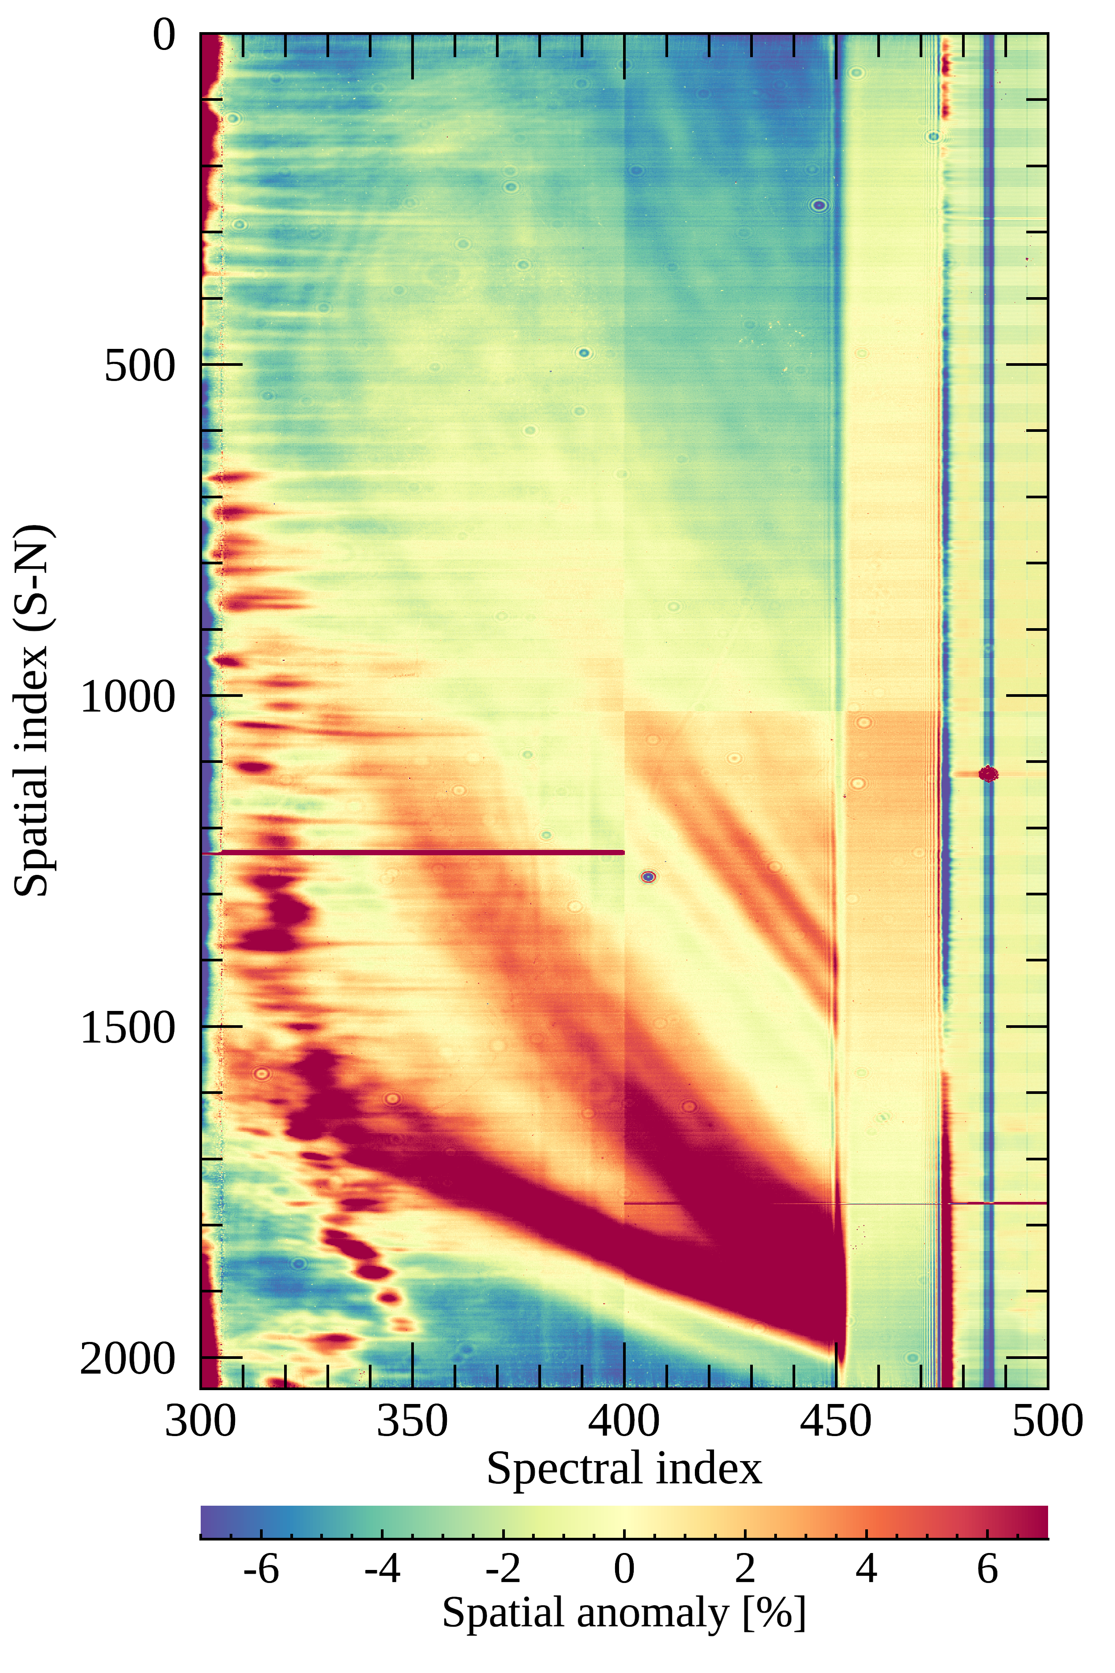
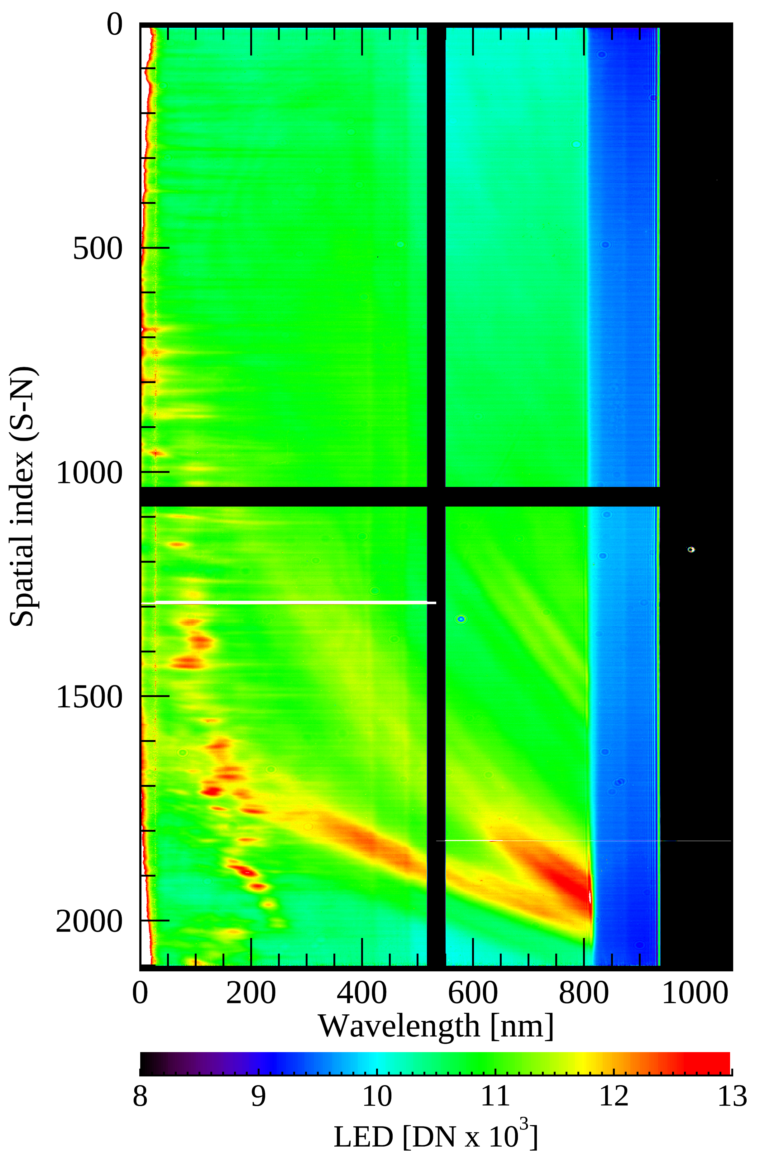
GEMS Level 1C calibration updates:
Optics degradation - LED observations:
Spatial anomaly of LED signals along the N-S direction (2024/09/22)
Spatial anomaly [%]
LED Signals

Slide 24
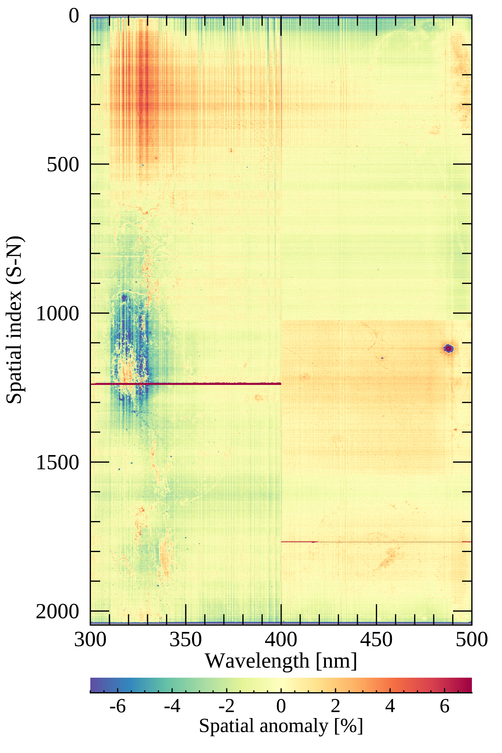
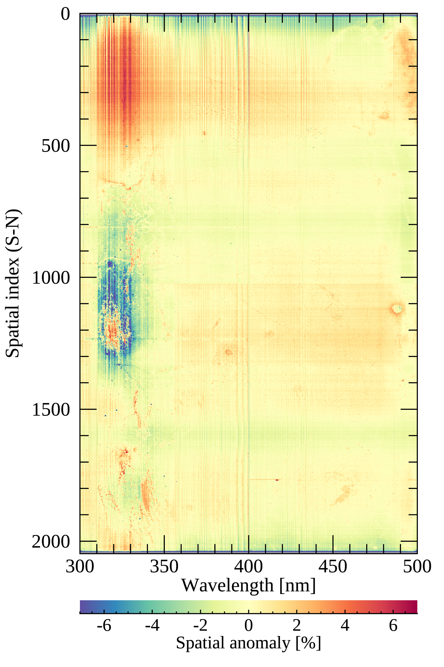

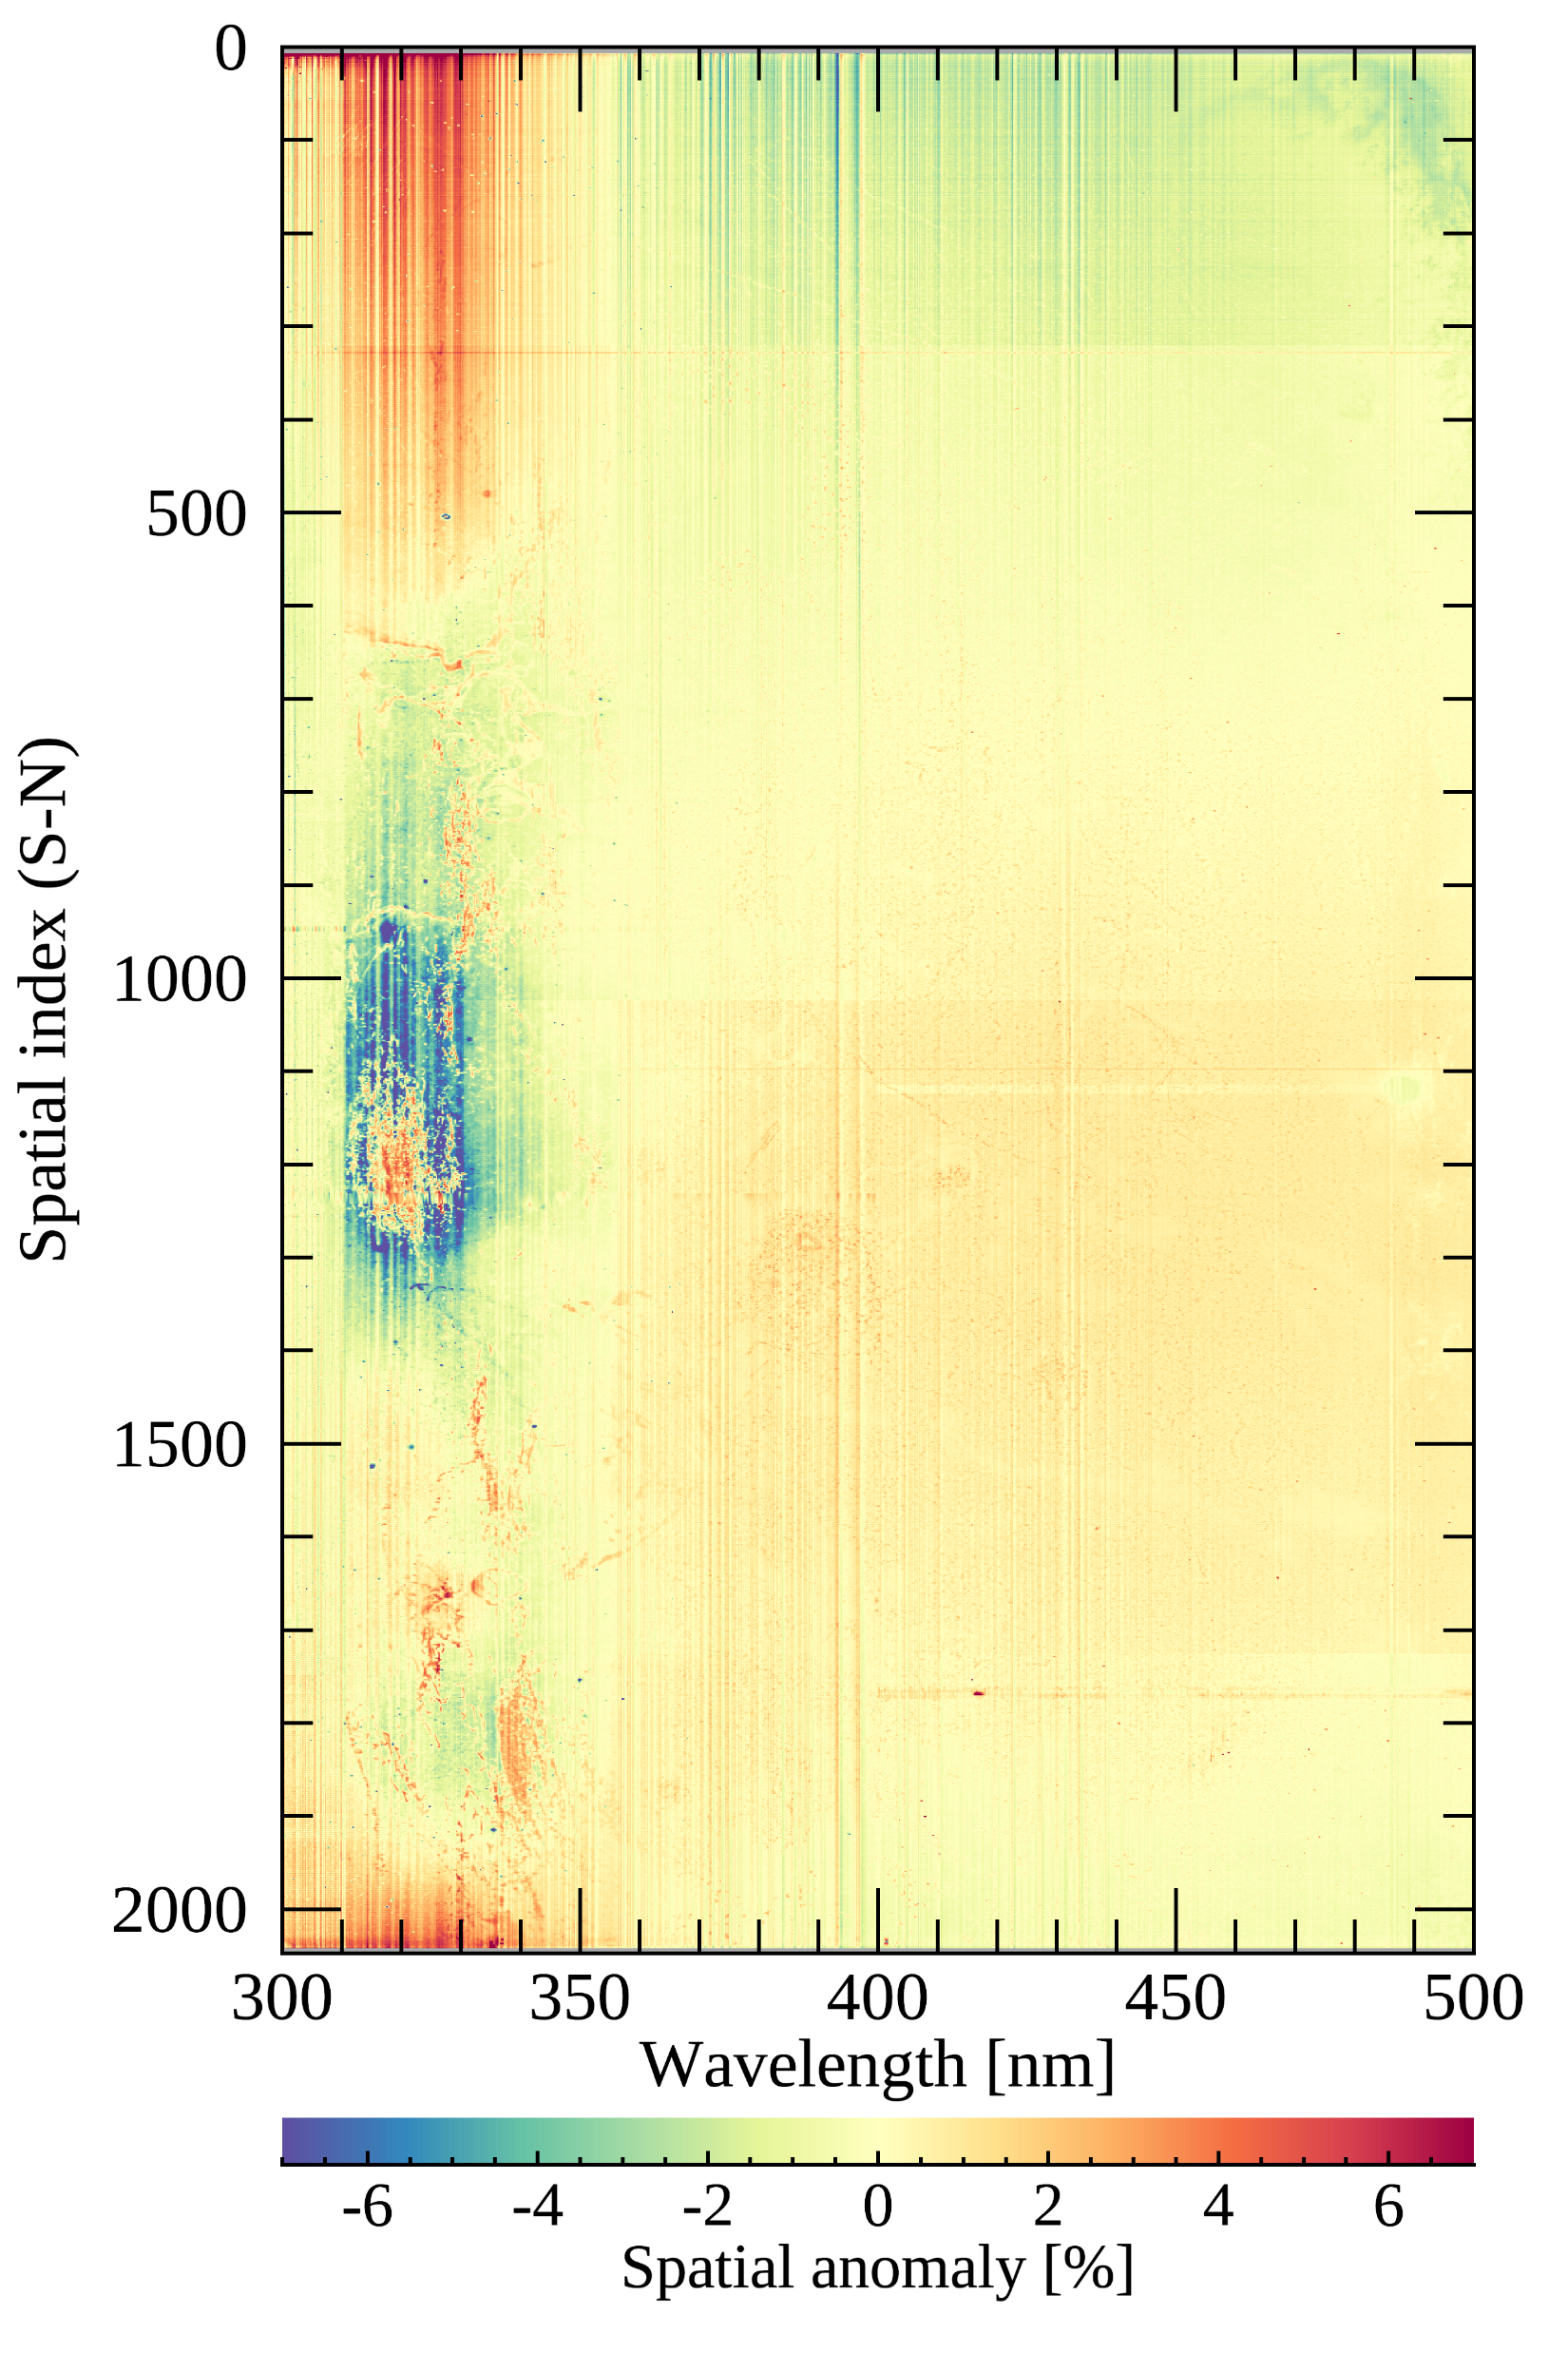
GEMS Level 1C calibration updates:
Optics degradation – Level 0-1 calibration process
Spatial anomaly along the N-S direction (Sep 22, 2024)
DCs (co-addition) Electrons (b/f dark cal.) Electrons (a/f dark cal. ) a/f Radiometric cal.
* After the spectral cal.

