Slide 1




Tropospheric Emissions:
Monitoring of Pollution
TEMPO Level 1 Status
Heesung Chong¹, X. Liu¹, D.E. Flittner², J. Houck¹, J. Carr³,
W. Hou¹, J. Park¹, G. González Abad¹, C.R. Nowlan¹, H. Wang¹,
L. Flynn⁴, S. Marchenko⁵, J. Joiner⁵, J. E. Davis¹,
R. M. Suleiman¹, J. Fitzmaurice¹, L. Yatsuhashi¹, K. Chance¹,
B. Baker⁶, C. Seftor⁵, G. Jaross⁵, J. O. Robaidek⁷, X. Wu⁴,
H. Xu⁴, B. Basnet⁴, Y. Bai⁴, C. Cao⁴, D. Doelling²
¹SAO, CfA ²NASA LaRC ³Carr Astro.
⁴NOAA/NESDIS ⁵NASA GSFC ⁶BAE ⁷UW–Madison
August 19, 2025

Slide 2
Updates in Version 4
Major updates
  Absolute calibration
  Stray light correction
  Spectral calibration
Additional updates
  Diffuser goniometry correction
  Etalon fringe correction
  Smear correction

Slide 3
Absolute calibration
Issue to resolve in Version 3: Positive bias in Sun-normalized radiance (on the order of 10%)
(Earth radiance)
(Sun-normalized radiance) =
(Solar irradiance)
(Earth-radiance electric current) * (Calibration coefficient)
=
(Solar-irradiance electric current) * (Calibration coefficient) / (Diffuser transmittance)
Approach: Adjust the solar diffuser transmittance.

Slide 4
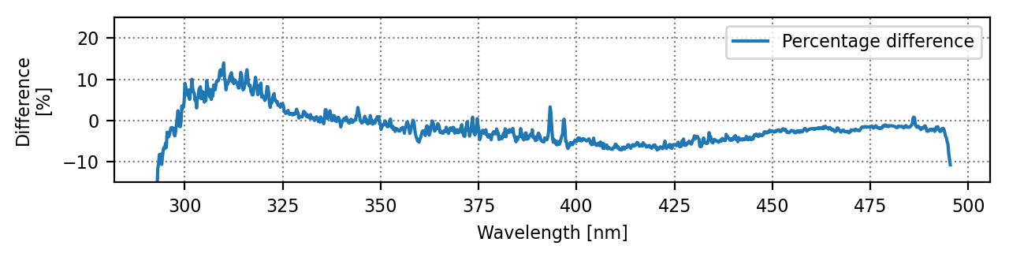
Absolute calibration
(TEMPO Version 3 irradiance) – (TSIS-1 reference irradiance)
2023/08/01 (first-light)
1024th spatial index
Why did the transmittance bias not appear in Version 3? → Biases in calibration coefficients
(Solar irradiance) = (Solar-irradiance electric current) * (Calibration coefficient) / (Diffuser transmittance)
How to verify the hypothesis? → Earth radiance
(Earth radiance) = (Earth-radiance electric current) * (Calibration coefficient)

Slide 5





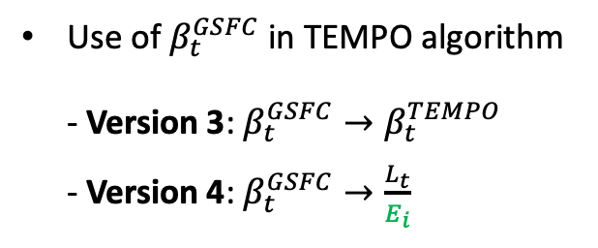
Absolute calibration
Update in BTDF (Bidirectional Transmittance Distribution Function) data interpretation
Definition of BTDF at GSFC
during on-ground calibration
$β_{t}^{GSFC}=\frac{L_{t}}{E_{i}}$
Definition of BTDF in TEMPO algorithm
$β_{t}^{TEMPO}=\frac{L_{t}}{E_{sol}}=\frac{L_{t}}{E_{i}}×\cos{θ_{SD}}$
$\sim \frac{L_{t}}{E_{i}}×0.866$
Use of $β_{t}^{GSFC}$ in TEMPO algorithm
- Version 3: $β_{t}^{GSFC}→β_{t}^{TEMPO}$
- Version 4: $β_{t}^{GSFC}→\frac{L_{t}}{E_{i}}$
$$E_{sol}$$
$$E_{i}=E_{sol}\cos{θ_{SD}}$$
$$θ_{SD}\sim 30°$$
Solar diffuser
$$L_{t}$$
Applying $\cos{θ_{SD}}$ in Version 4 will decrease Sun-normalized radiances by ~13.4%.

Slide 6
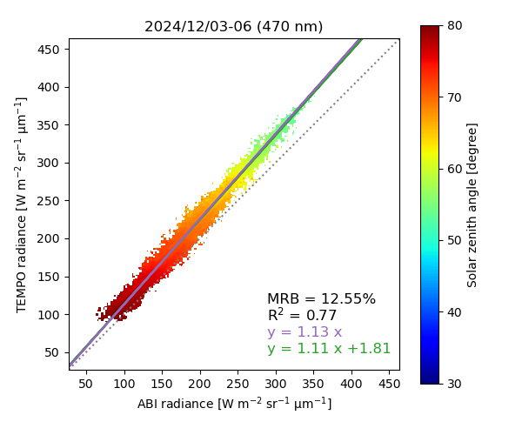
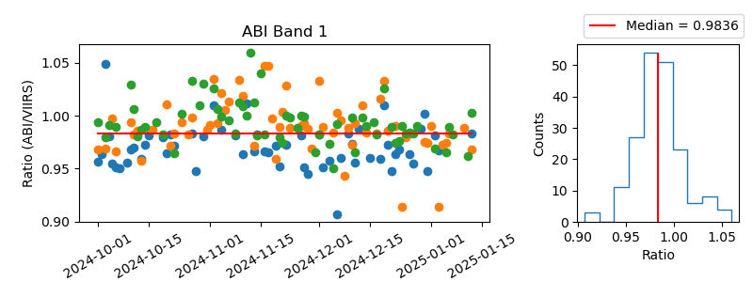

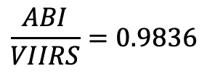
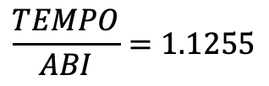
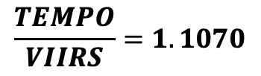

Absolute calibration
Earth radiance intercomparison (TEMPO vs. ABI vs. VIIRS)
Example: 470 nm (UV), GOES-19
$$\frac{TEMPO}{ABI}=1.1255$$
$$×$$
$$\frac{ABI}{VIIRS}=0.9836$$
$$→$$
$$\frac{TEMPO}{VIIRS}=1.1070$$
In Version 4, the UV and visible calibration coefficients will be reduced by 11% and 7%, respectively.

Slide 7
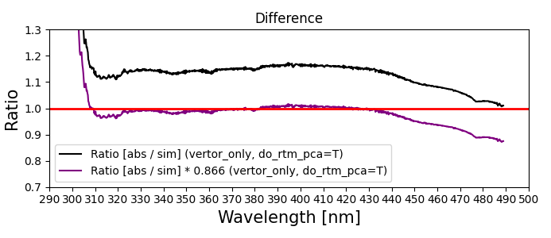
Absolute calibration
Sun-normalized radiance (Version 3 → Version 4)
Ratio: TEMPO / VLIDORT simulation
2023/11/06, scan 009, granule 02
Version 3
Updated
*Note: Spectral-independent, constant surface albedo (0.074) was used.
[Credit: Junsung Park]
Most significant outcome: Cloud fraction bias will be significantly reduced.
(For details, see Huiqun (Helen) Wang’s presentation at 14:00 today.)

Slide 8
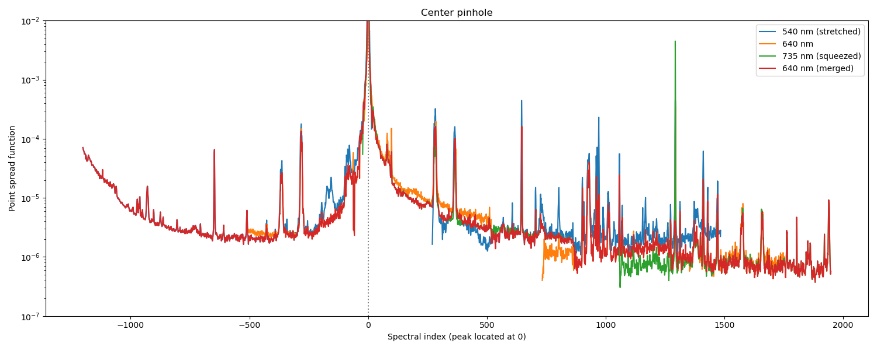
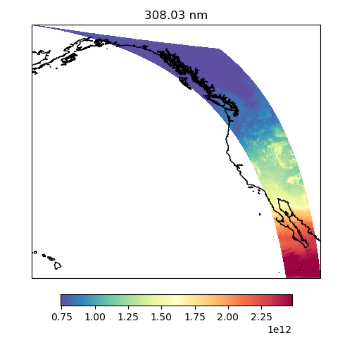

Stray light correction
Issues to resolve in Version 3:
Overcorrection at short wavelengths
Background stray light remaining in the UV channel
Approach 1
Update PSFs (Point Spread Functions).
Approach 2
Implement a background stray light correction.
VIS PSF
Before
(308.03 nm)
After
(308.03 nm)
Most significant outcome: Ozone profile retrieval will be stabilized.
(For details, see Junsung Park’s presentation at 14:30 today.)

Slide 9
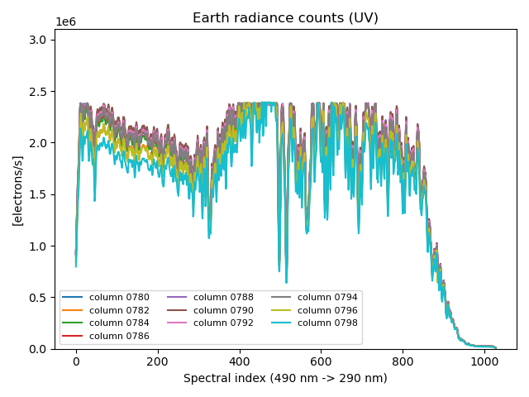
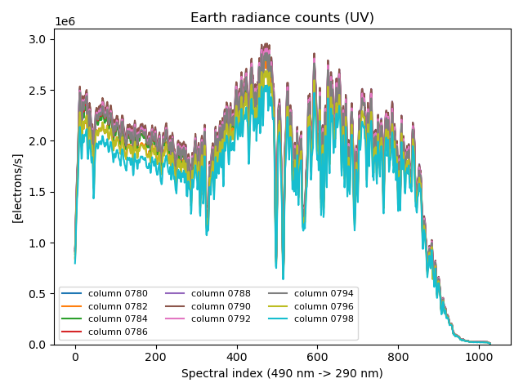
Stray light correction
Approach 3: Reconstruct radiances for CCD pixels with signal saturation.
Before reconstruction
After reconstruction
Without reconstructing these flat-tops,
stray light is underestimated.
Most significant outcome: Positive biases in formaldehyde retrieval over cloudy pixels will be mitigated.
(For details, see Gonzalo González Abad’s presentation at 14:20 today.)

Slide 10
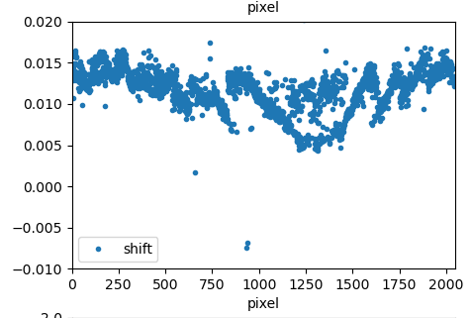
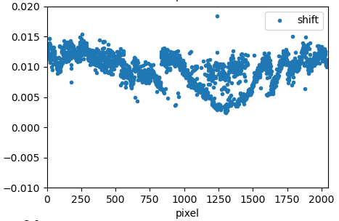
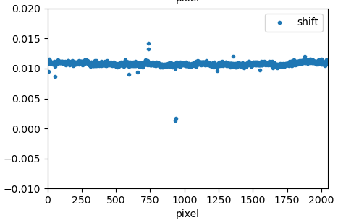
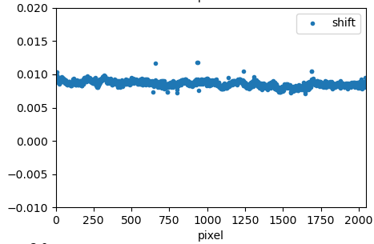
Spectral calibration
Issue to resolve in Version 3: Spatial variability (North-South) in wavelength registration
Approach: Remove the slit-function asymmetry factor from the fitting to increase stability.
Version 3
Updated
NO₂ fitting window
HCHO fitting window
NO₂ fitting window
HCHO fitting window
Spectral shift [nm]
Spectral shift [nm]
CCD spatial index (North ➝ South)
CCD spatial index (North ➝ South)
[Image credit: Gonzalo González Abad]
Most significant outcome: The Level 1 calibration will capture spectral changes with enhanced accuracy.
(For details, see Weizhen Hou’s poster tomorrow.)

Slide 11
Summary
For Version 4, we have enhanced
  the Sun-normalized radiance absolute calibration
  the stray light correction
  the spectral calibration
  the diffuser goniometry correction, etalon fringe correction, and smear correction.
Calibration work will continue.

Slide 12
Thank you for your attention!

