Slide 1

TROPOMI on
Sentinel-5 Precursor mission status
The TROPOMI team
Pepijn Veefkind, Principal Investigator
KNMI | TU-Delft | NCAR
pepijn.veefkind@knmi.nl

Slide 2
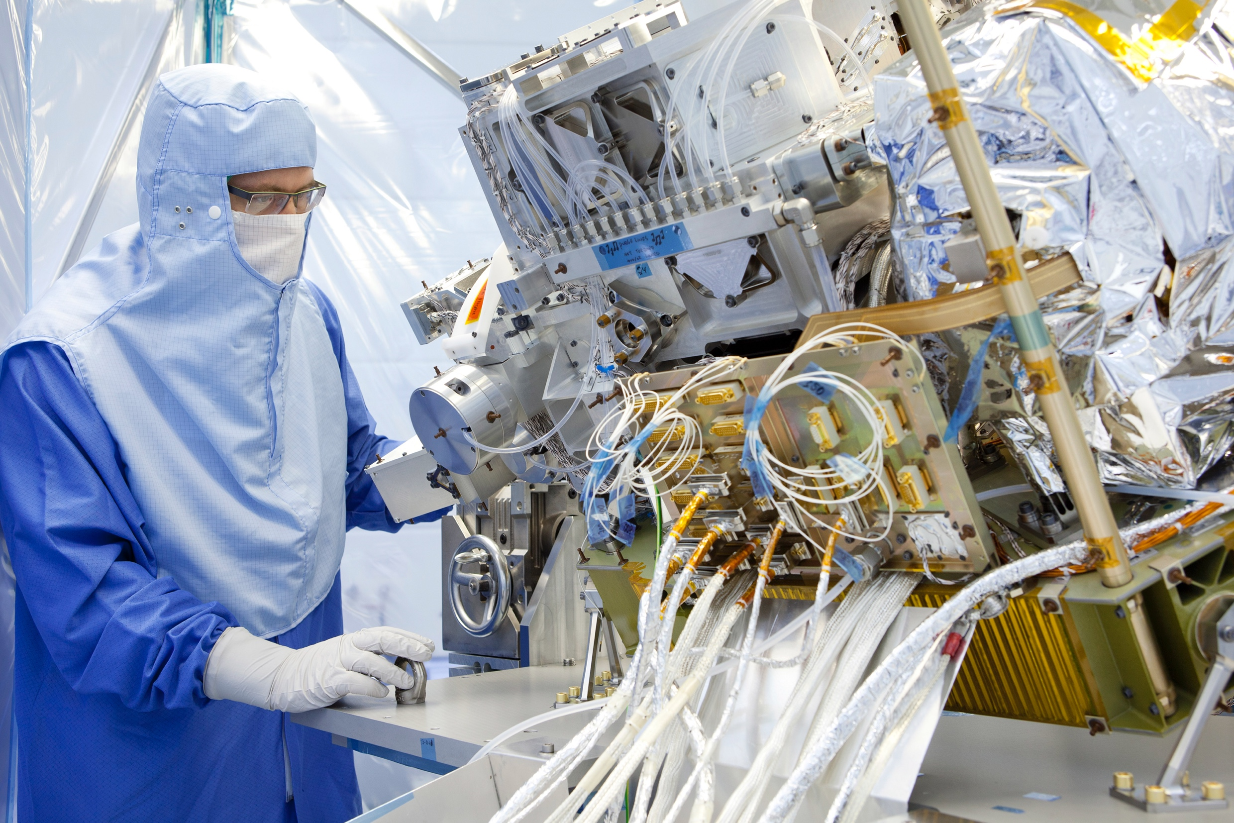


Slide 3

Tropomi measures more than 20 million spectra per day
Tropomi Observation over De Bilt, The Netherlands 17-04-2022
UV
28 x 5.5 km²
UV-VIS
3.5 x 5.5 km²
NIR
3.5 x 5.5 km²
SWIR
7.0 x 5.5 km²
Reflectance [-]
Wavelength [nm]

Slide 4
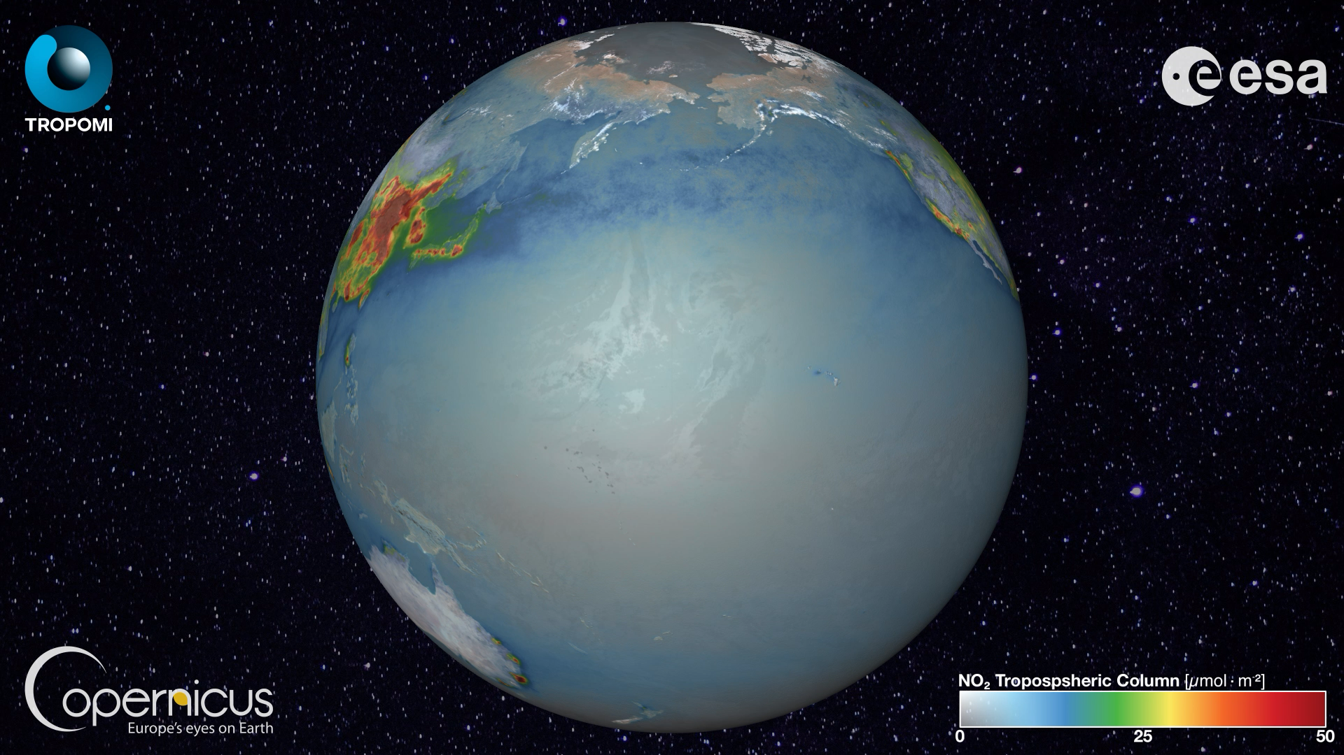

Slide 5


S5P/TROPOMI
NL National Programme
Tropomi Commanding
L0-1B algorithm data processor
Instrument monitoring & calibration
L1-2 algorithm & data processor
NO₂, Aerosol, O₃ Profile, CO, CH₄
EU Copernicus Programme
Flight Operations
Ground segment
Routine validation
L1-2 algorithm data processor
O₃, SO₂, HCHO, Cloud
GE and BE National Programme
Algorithm development and prototyping
ESA Programme
Scientific product development and data processing
Notes:
Instrument monitoring and in-flight calibration
Level 0-1B algorithms and data processor
Level 1-2 algorithms and software:
NO₂, ozone profile, aerosol index and aerosol layer height data products
QA & geophysical validation
Dutch national programme & MPC lead

Slide 6
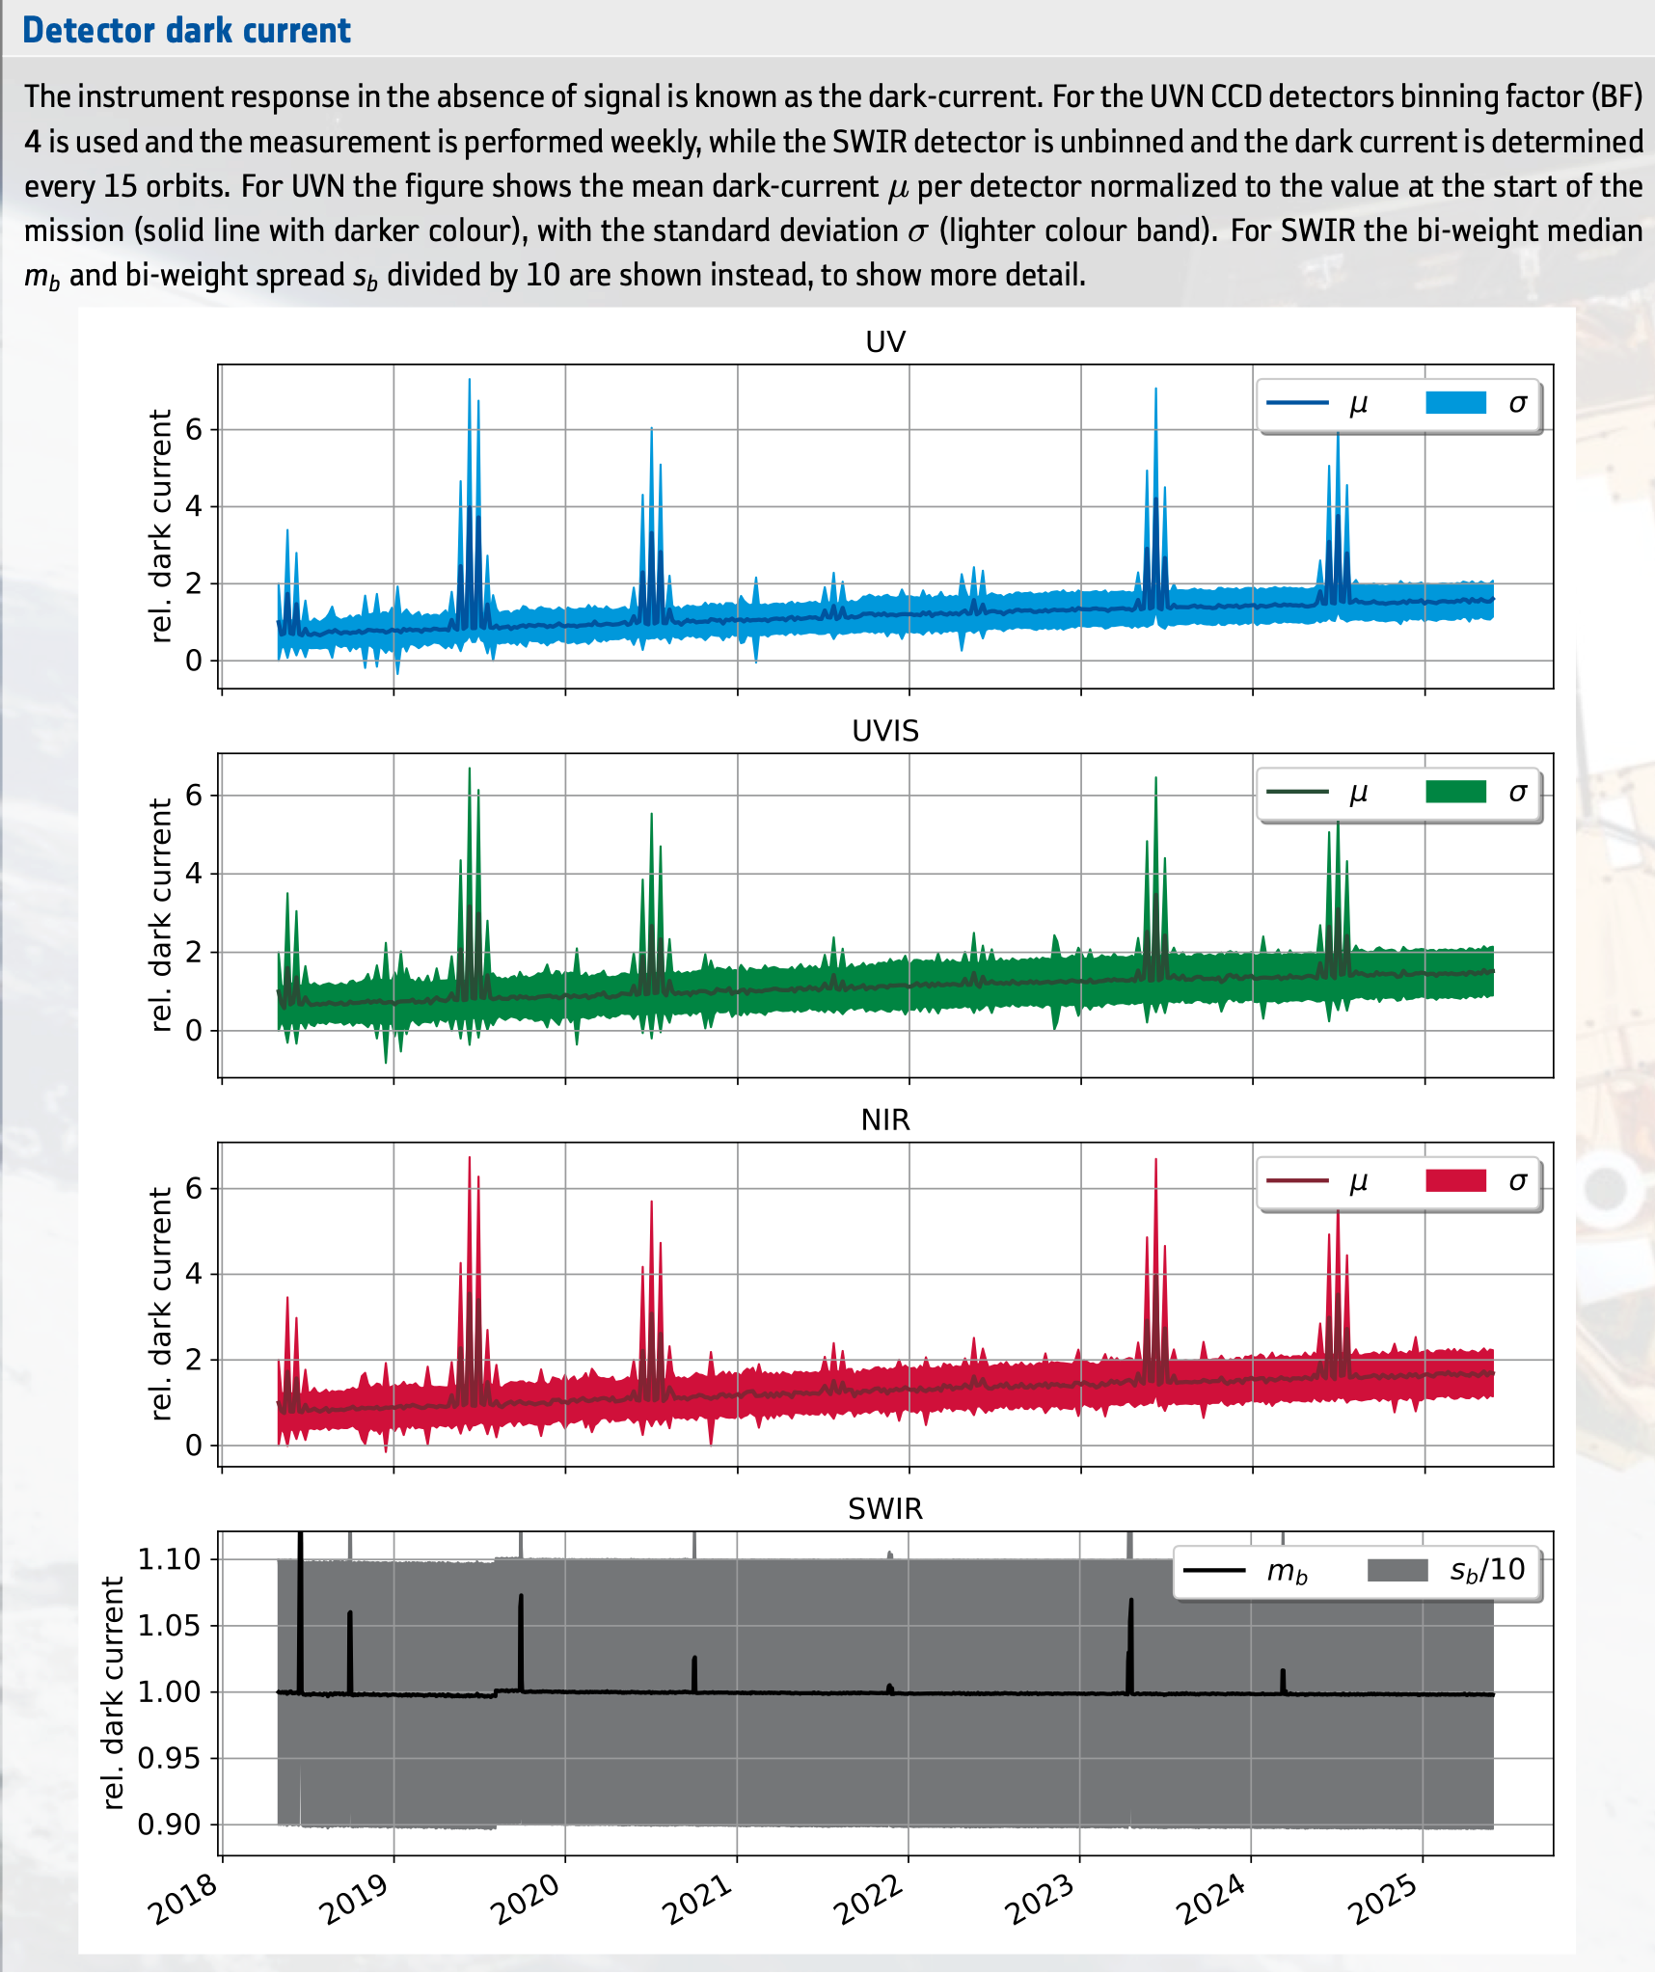
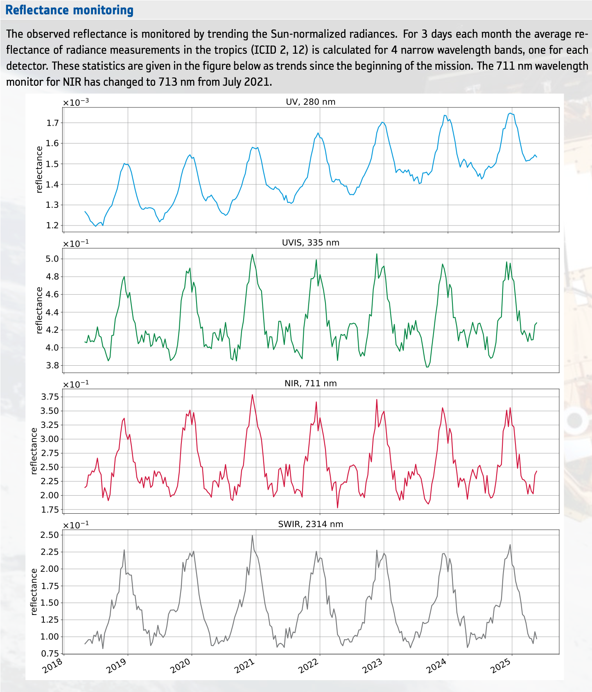
Detector Dark Current
Reflectance Monitoring
TROPOMI can continue for another 10+ years
See https://mps.tropomi.eu
Notes:
After 7½ years in orbit the instrument performance is excellent.
Optical degradation is monitored and corrected for.
Level 1B improvements focus on UV straylight corrections.
TROPOMI can continue for another 10+ years.

Slide 7
TROPOMI Data Products | Type | Air Quality | Climate | Ozone
Nitrogen Dioxide | SP | o
Formaldehyde | SP | o
Glyoxal | RP | o
Sulfur Dioxide | SP | o | o
Carbon Monoxide | SP | o
Aerosol UV Index | SP | o | o
Aerosol Layer Height | SP | o | o
Aerosol Optical Thickness | RP | o | o
Methane | SP |  | o
Ozone Total Column | SP |  |  | o
Ozone Profile | SP |  |  | o
OCLO | RP |  |  | o
Surface Reflectance DLER | RP
Solar Induced Fluorescence | RP
Ocean Color | RP
Cloud | SP
HDO & Water Vapor | RP |  | o

Slide 8
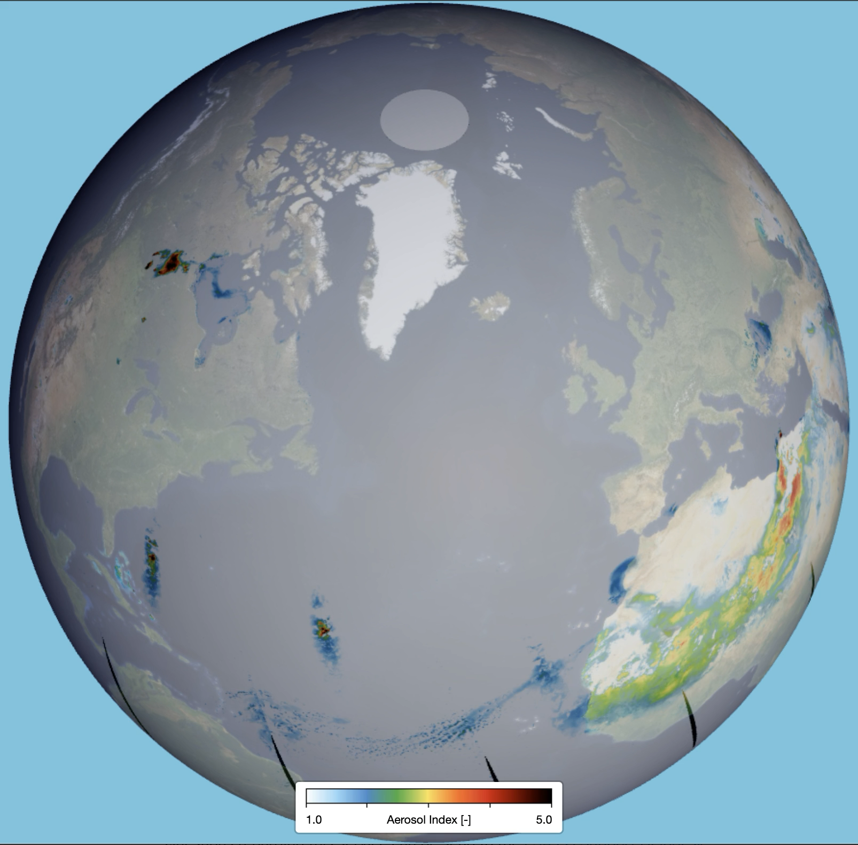
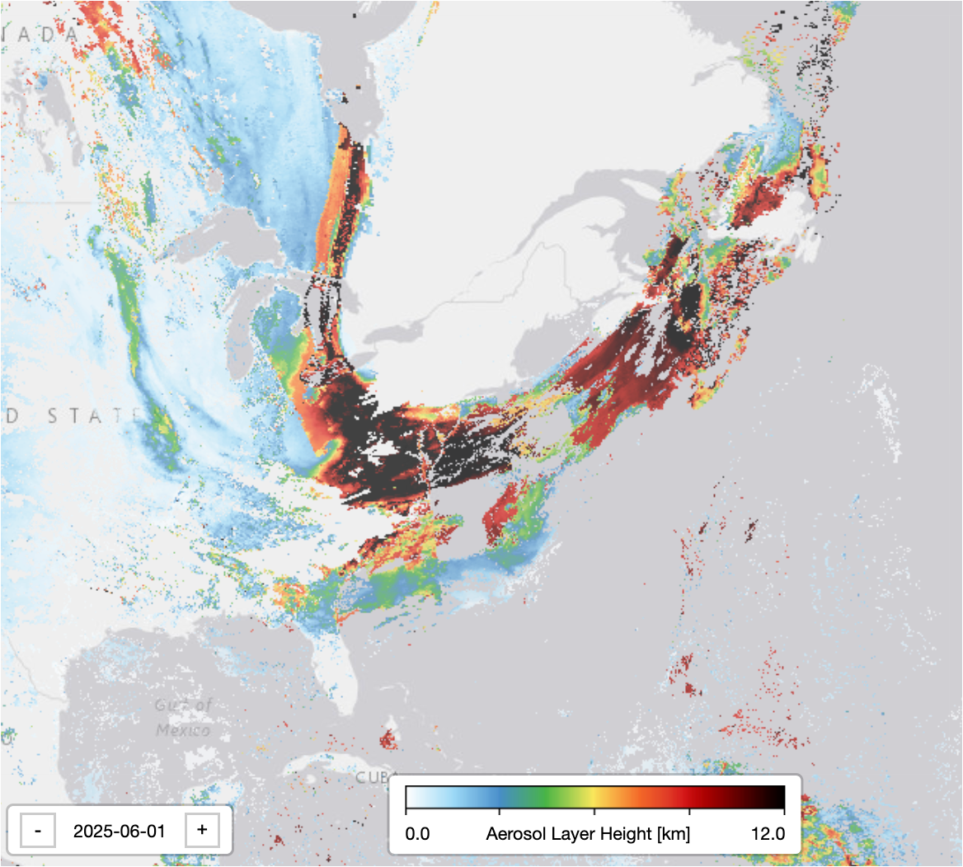
Canadian Wildfires
ALH 2025-06-01
UVAI 2025-05-25 2025-06-10

Slide 9
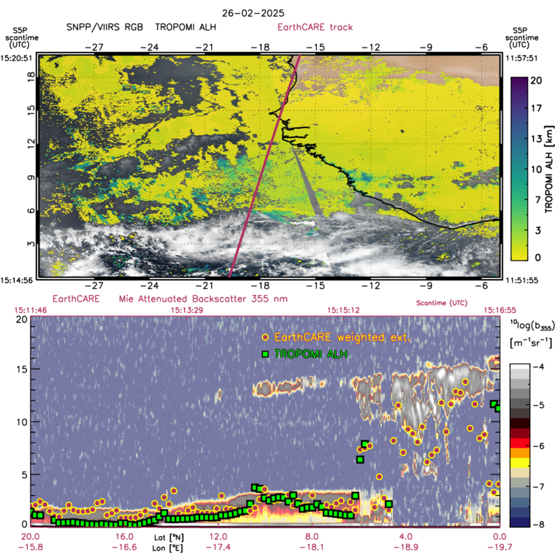
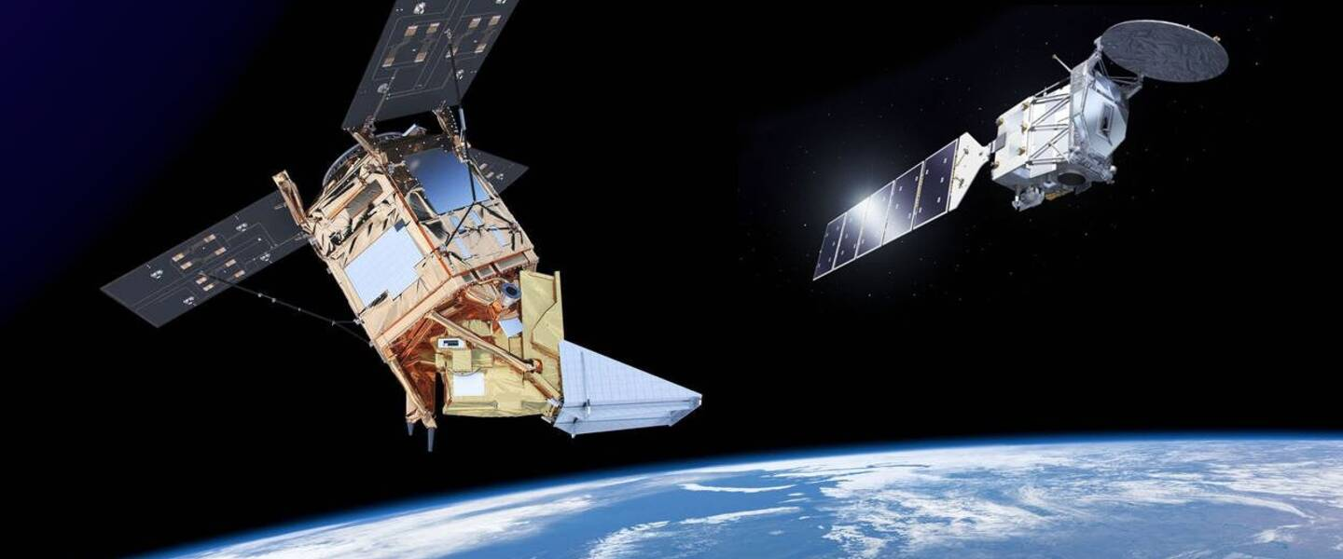
https://amt.copernicus.org/articles/18/2553/2025/

Slide 10
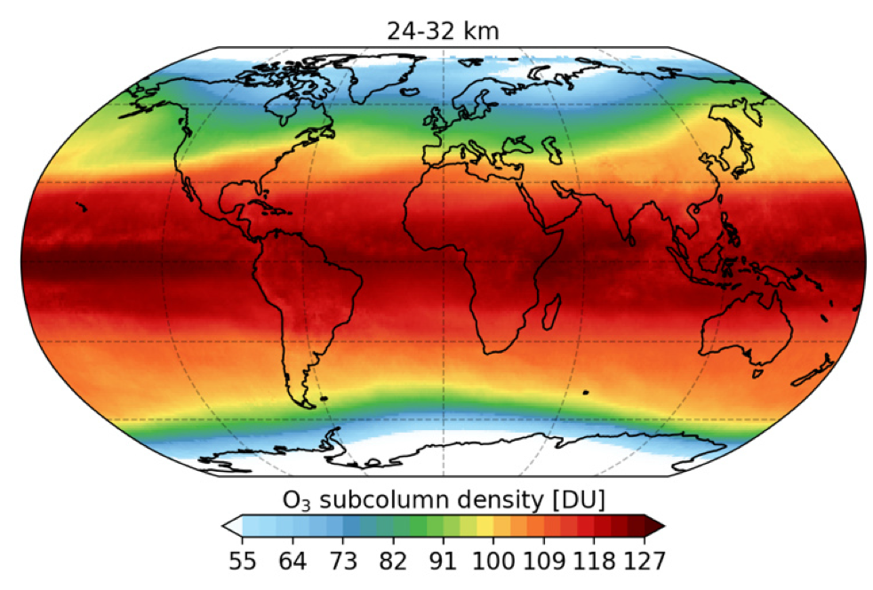
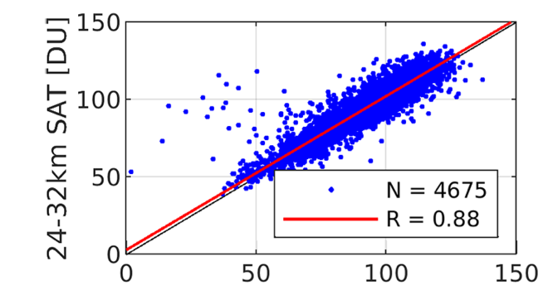
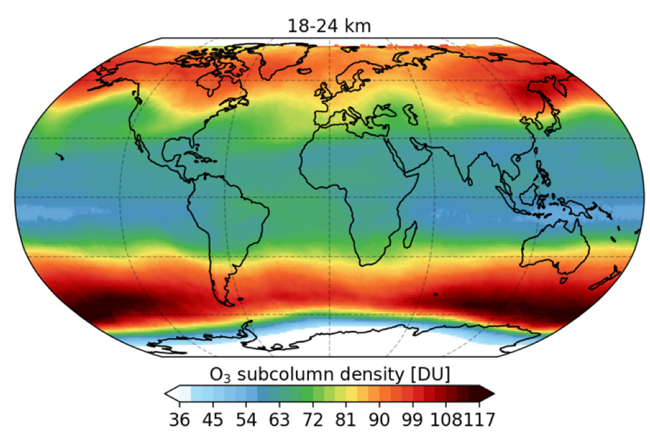
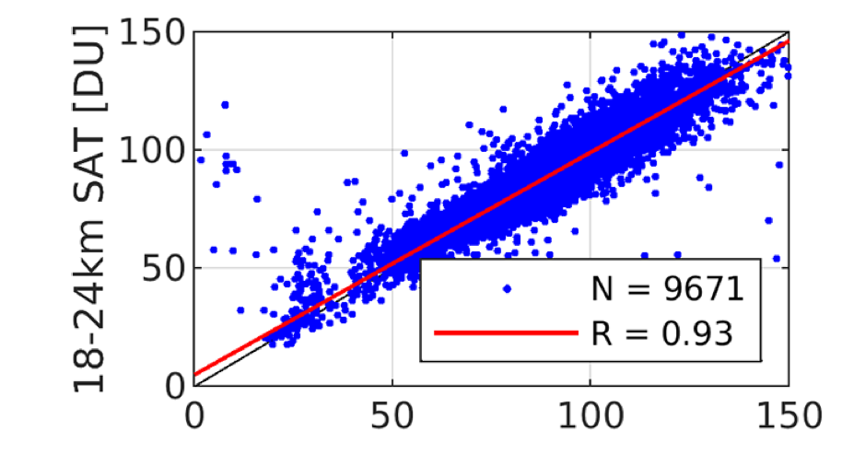
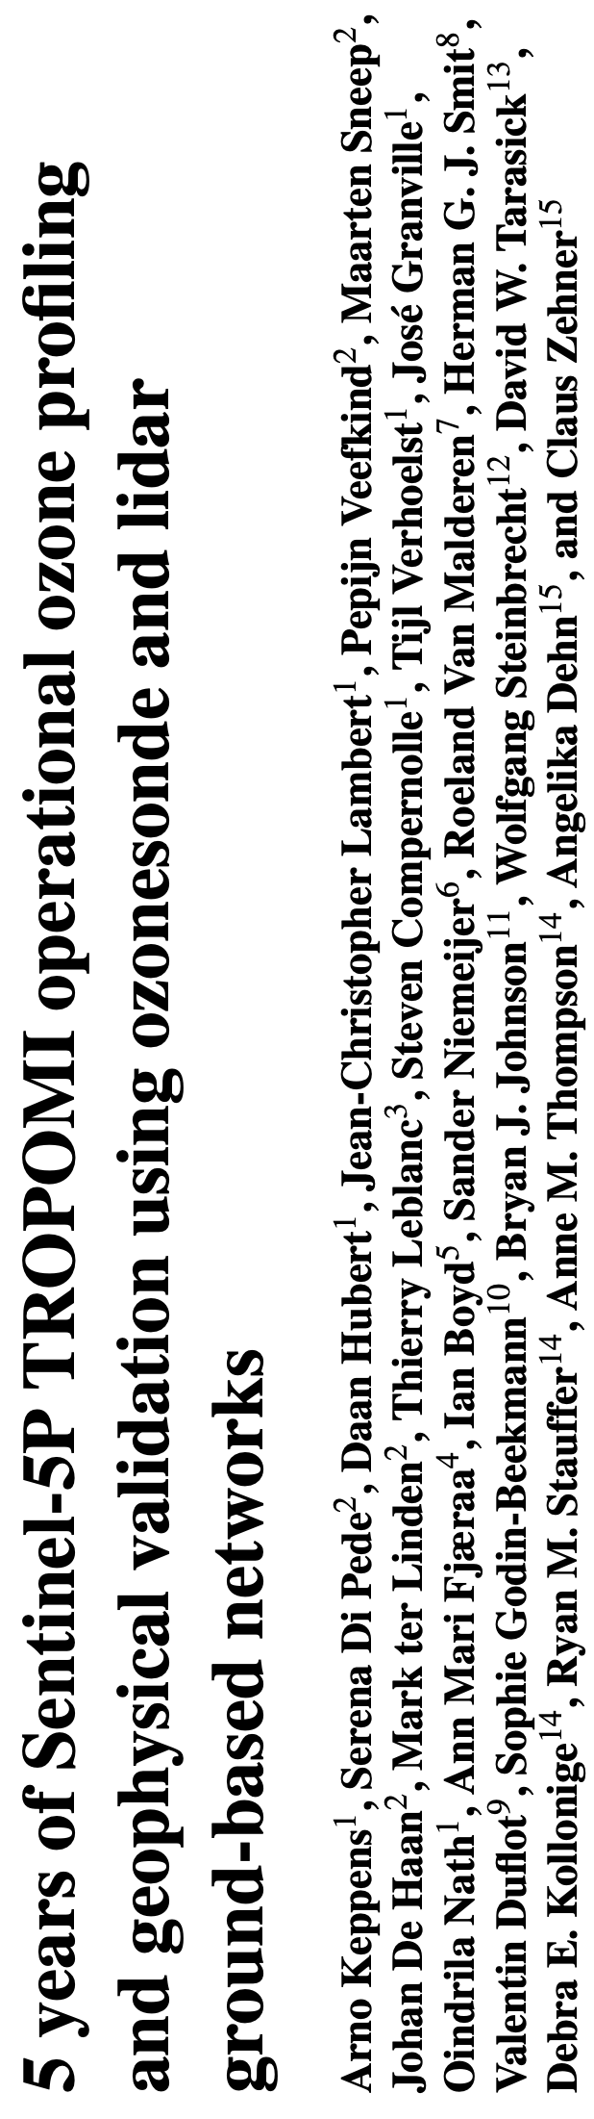
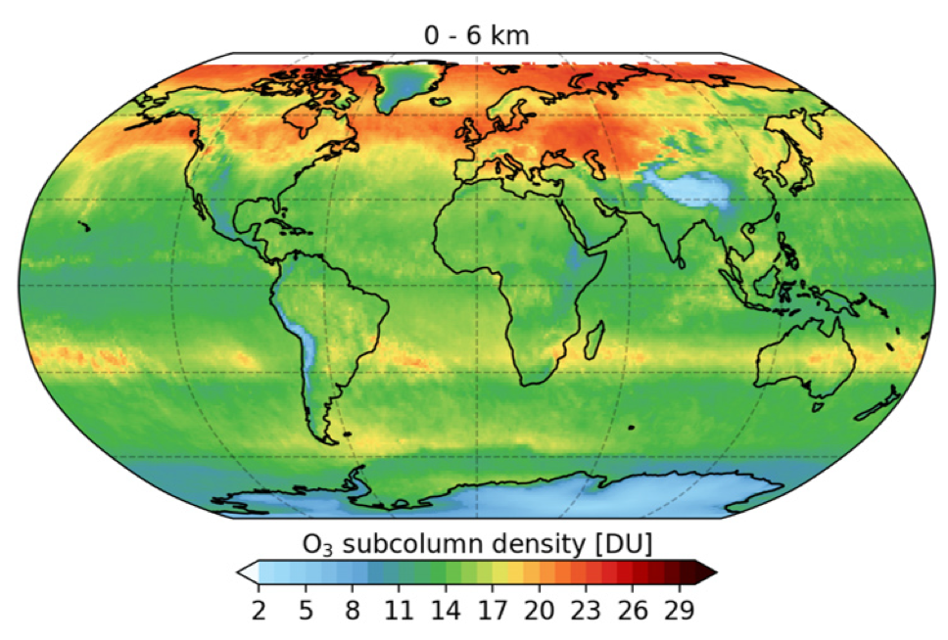
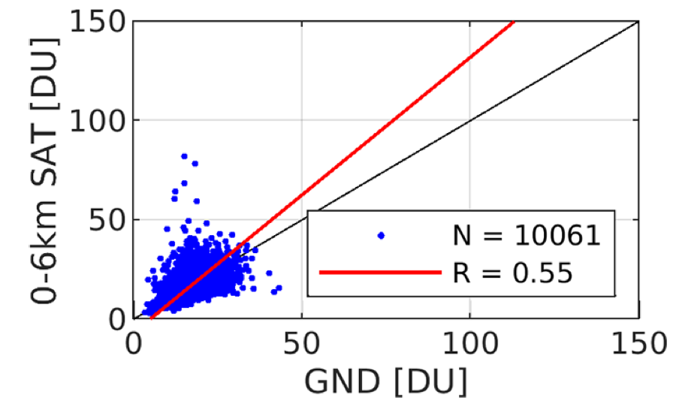
Ozone profile
Comparison with ozone sondes
24-32 km
18-24 km
0-6 km
mean October 2020

Slide 11

Monitoring NO₂ the success of pollution control policies
OMI NO₂ (log-scale)
2005
OMI NO₂
2024 - 2005

Slide 12
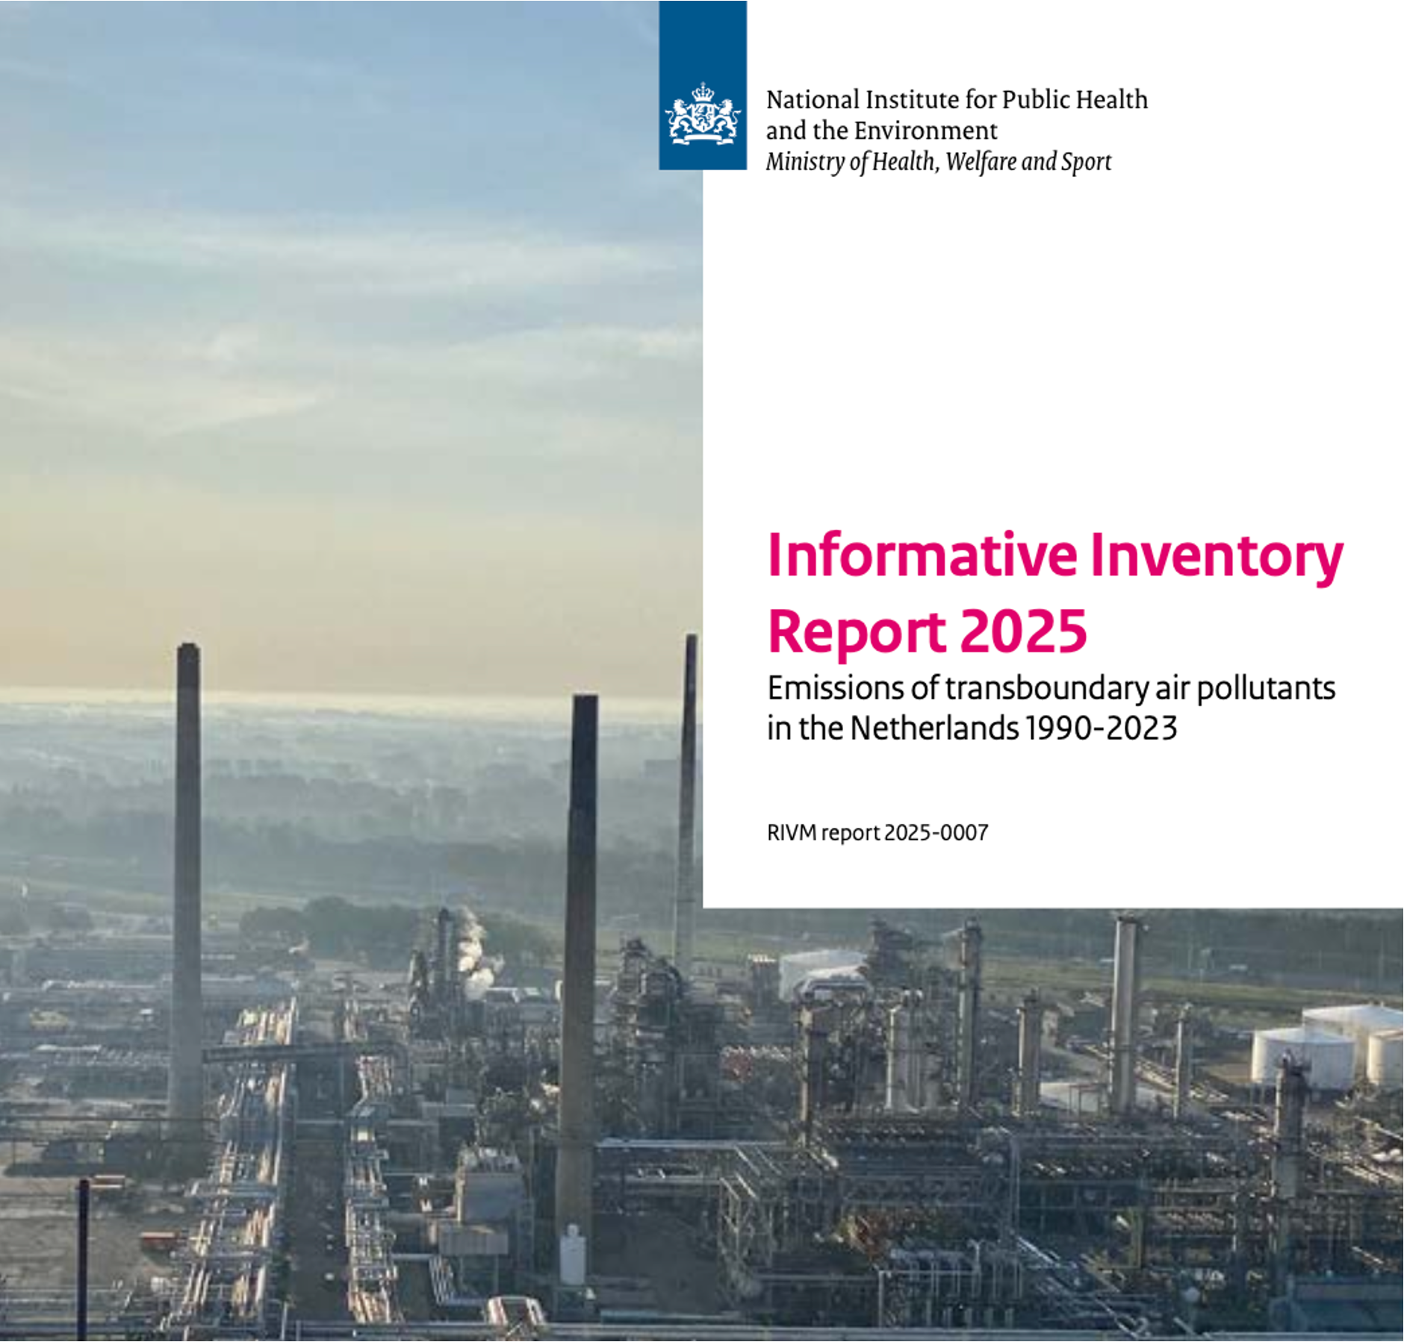
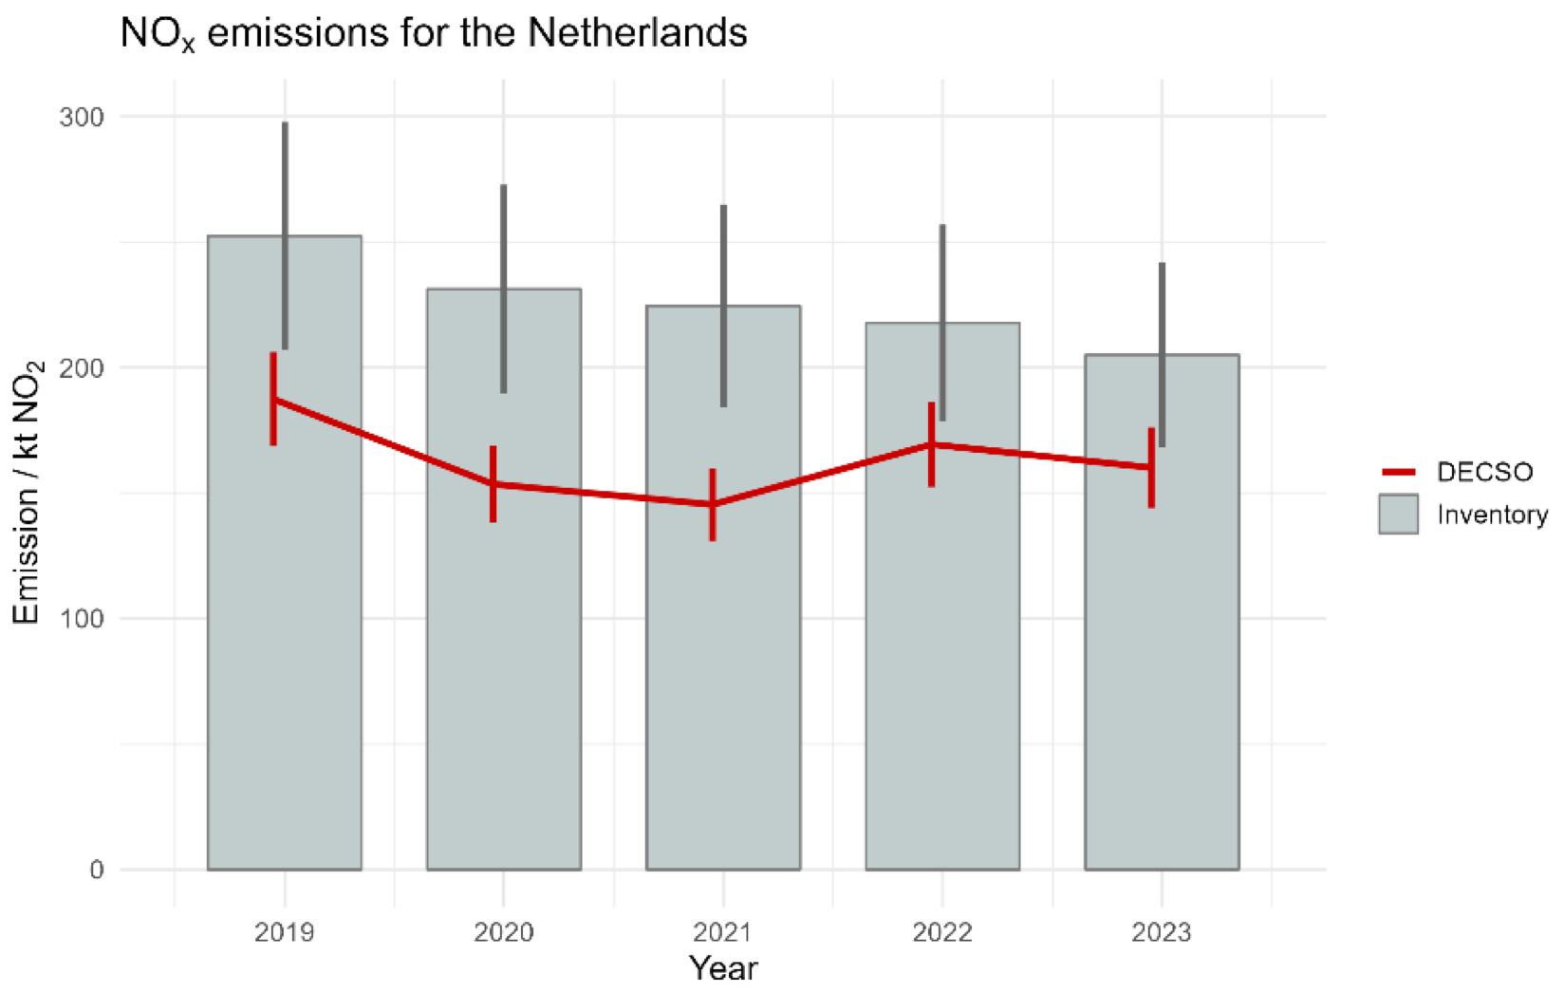
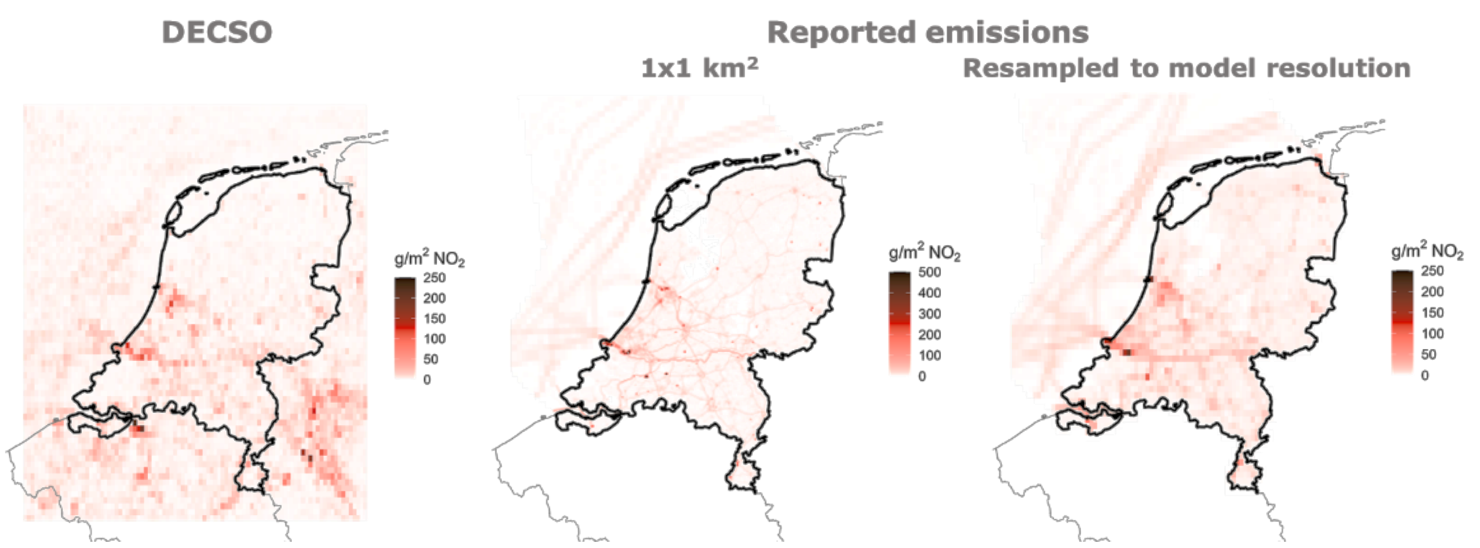
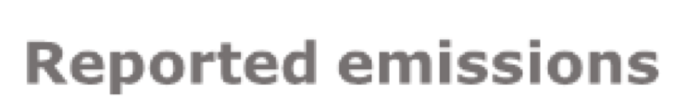
Emission Registration
TROPOMI
Map of Dutch NOx emissions in 2019 according to satellite observations and as reported (in native resolution and resampled to the resolution of the satellite observations); this figure uses the 0.05° dataset

Slide 13

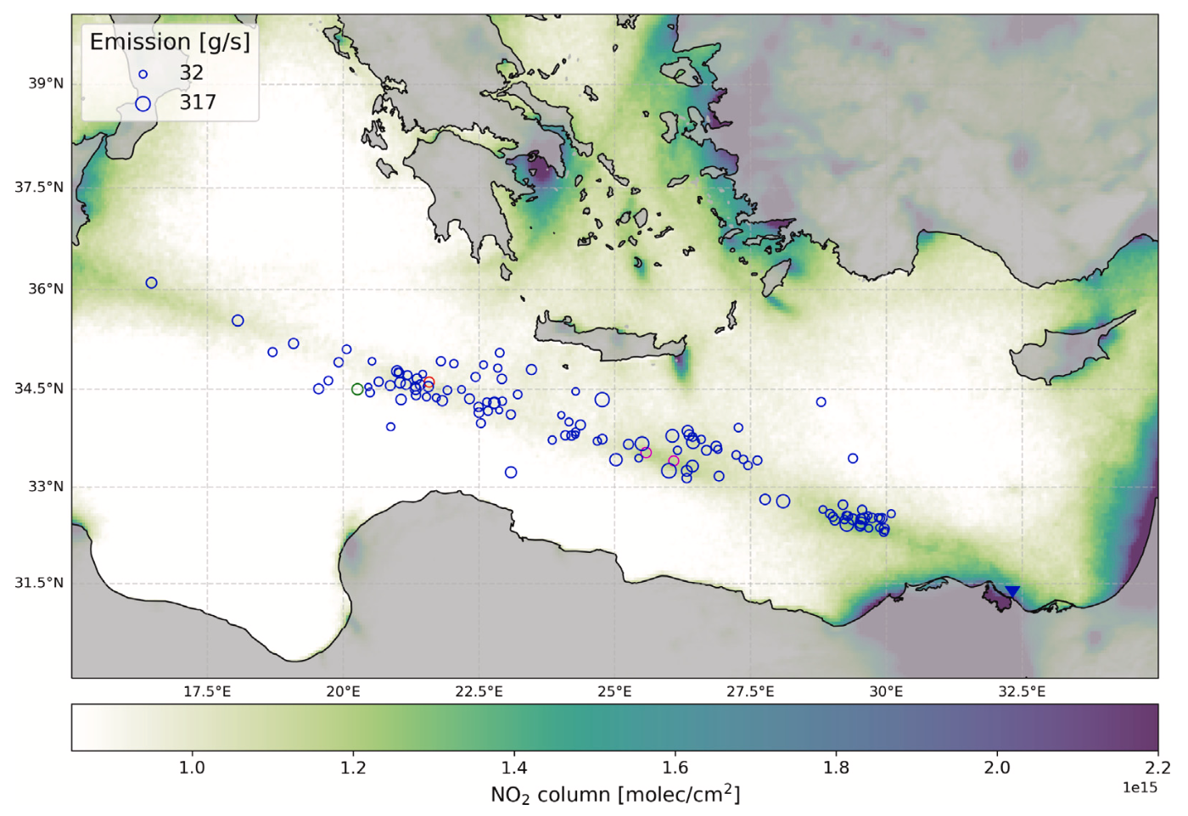
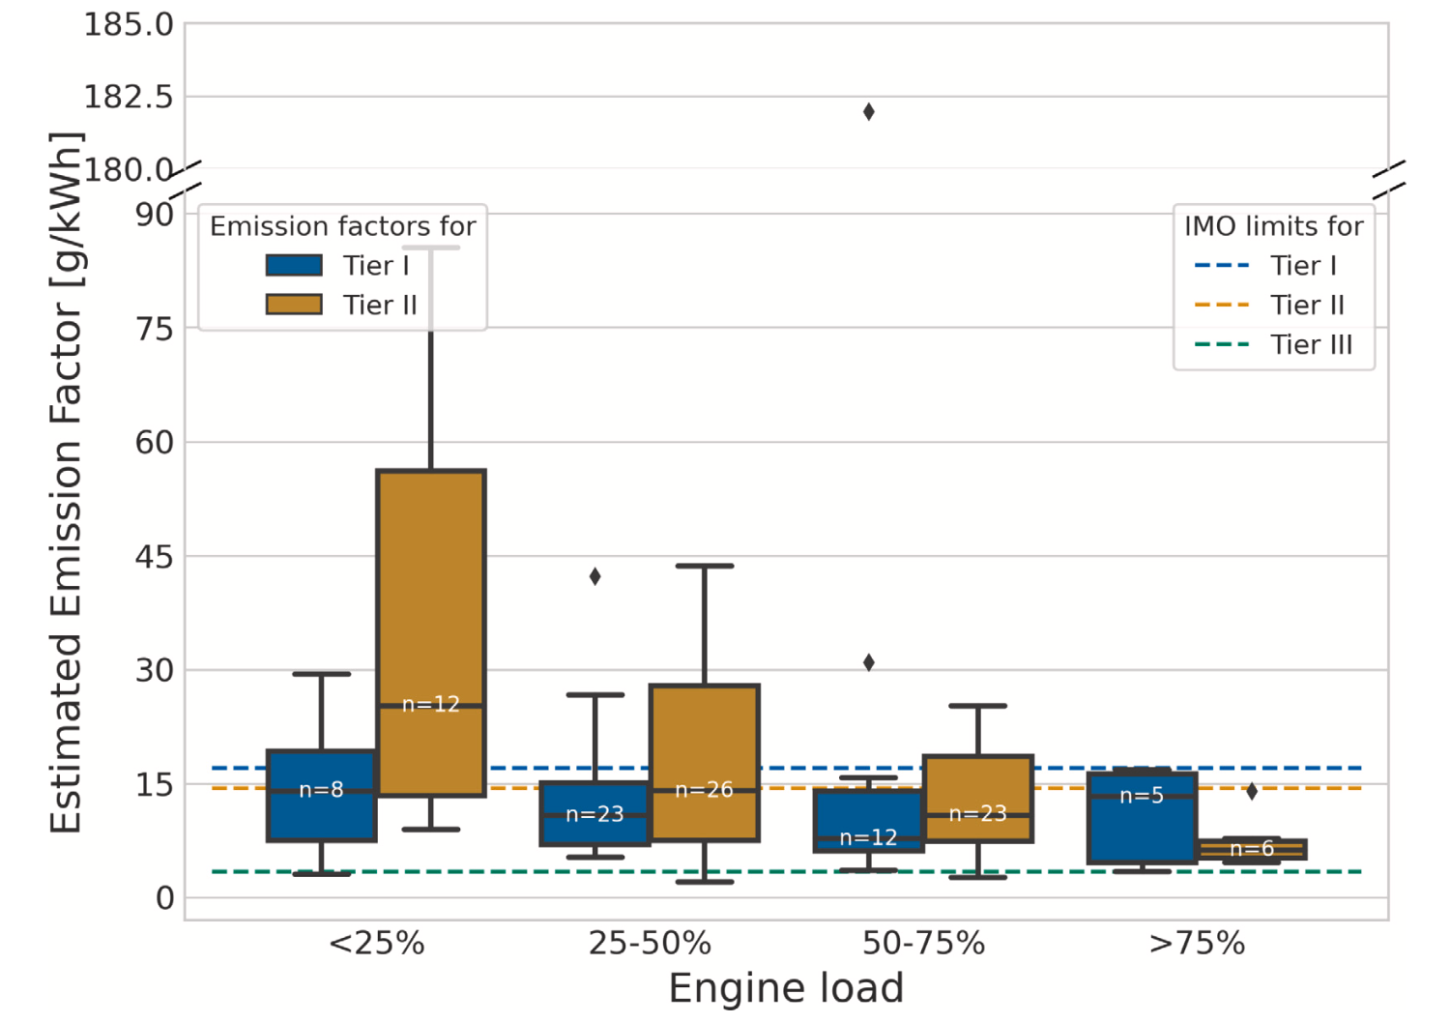
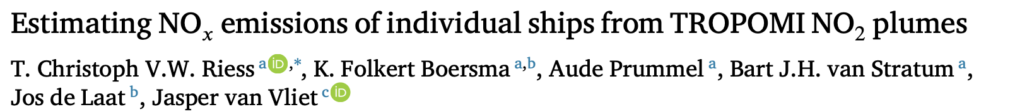
Shipping Emissions

Slide 14
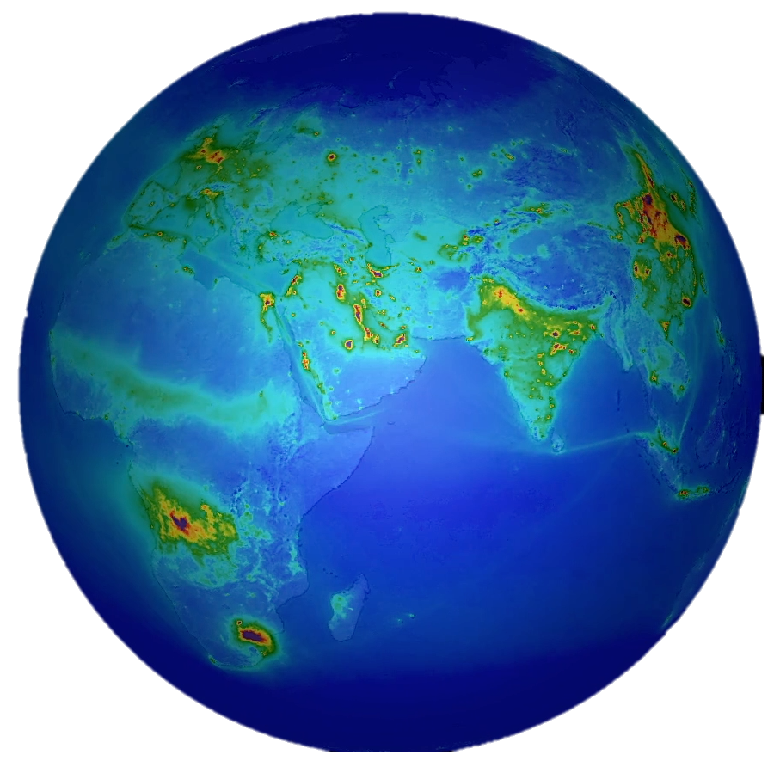
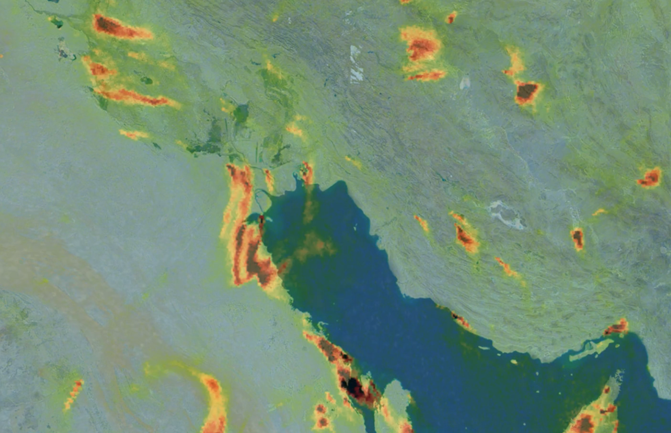
TROPOMI Data Availability
Copernicus Dataspace
Operational L1 and L2 data
https://dataspace.copernicus.eu
S5P-PAL
Scientific L2 and L3 data
https://data-portal.s5p-pal.com
TEMIS
Regional and gridded NO2 data
https://www.temis.nl
NASA
Operational L1 and L2 data
https://www.earthdata.nasa.gov/sensors/tropomi
... and …
Google Earth Engine
https://geoservice.dlr.de
https://terrascope.be/en

Slide 15
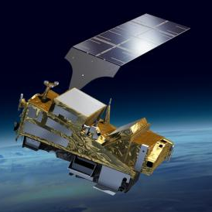
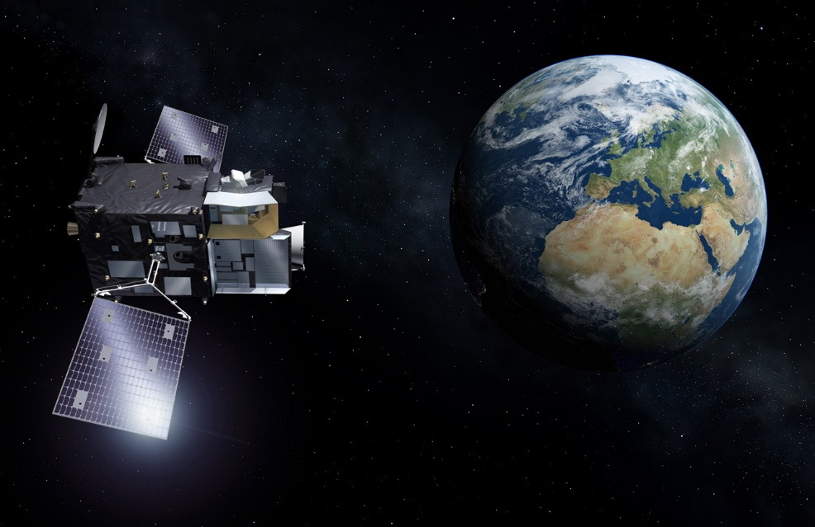
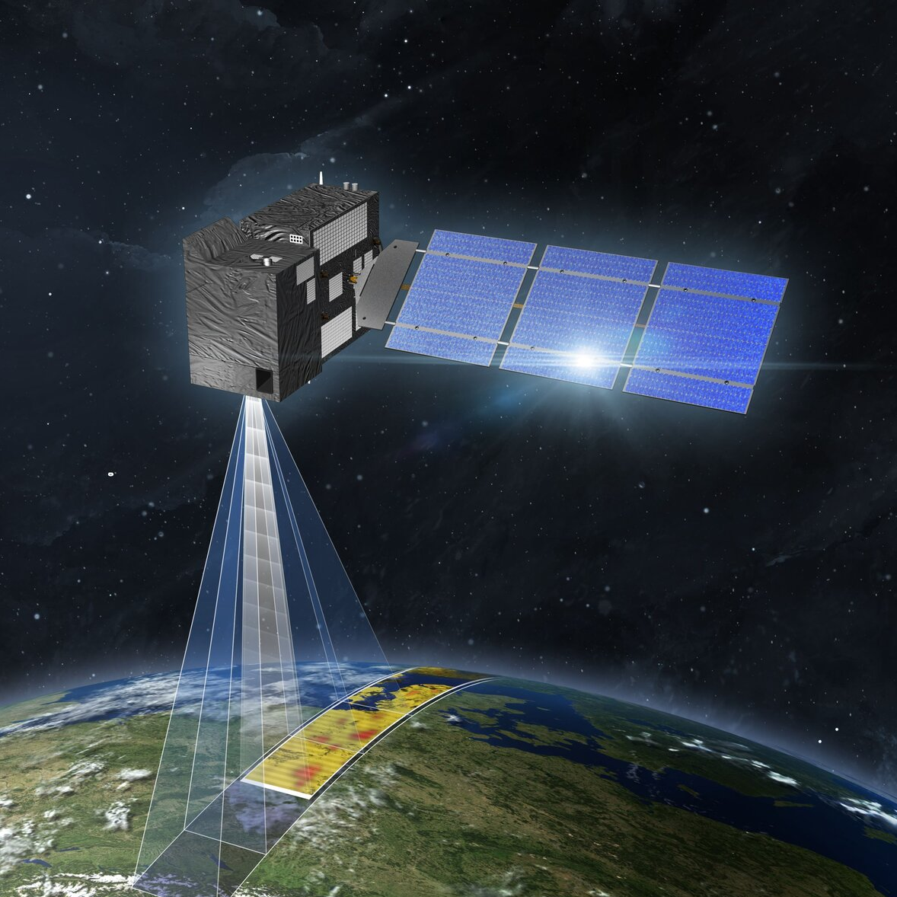
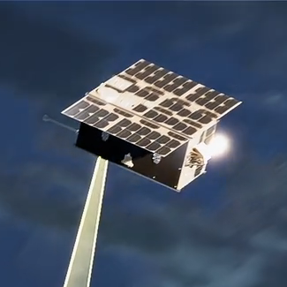
Metop SG
MTG-S Sentinel 4
S5/UVNS (Tropomi like)
IASI-NG
3MI
Metimage
August 2025
S4/UVN
Resolution ~8x8 km²
Geostationary over Europe
July 2025
On MTG-S with IRS
CO2M
TANGO
CO₂, CH₄, NO₂, Sif
Resolution 2x2 km²
Swath width ~270 km
Launch 2027
Constellation of 3 identical satellites
ESA scout programme
CO₂, CH₄, NO₂
Resolution 300x300 m²
Targets 30x30 km²
2 cubesats flying in formation
Launch 2028

Slide 16


TROPOMI and S5P are in excellent shape
  …technically the mission can continue for 10+ years…
TROPOMI is used for applications and research
  …forecasting, monitoring, emission registration…
Synergy with the GEO and LEO missions
  … 2x daily observations globally, regional hourly observations …

Slide 17
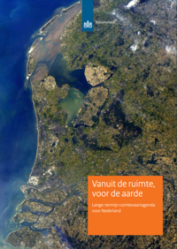
KNMI Responsibilities
Lead of the Dutch National Programme [NSO]
Lead of the ATM-MPC [ESA]
Instrument Commanding & Monitoring
QA & Validation
Routine validation & QA
Field campaigns (CINDI)
L1B data product
in-flight calibration
algorithm development
L0-1B data processor
L2 data products
Algorithm development
L1-2 data processor
NO₂, Aerosol, O₃ Profile
Notes:
Instrument monitoring and in-flight calibration
Level 0-1B algorithms and data processor
Level 1-2 algorithms and software:
NO₂, ozone profile, aerosol index and aerosol layer height data products
QA & geophysical validation
Dutch national programme & MPC lead

Slide 18

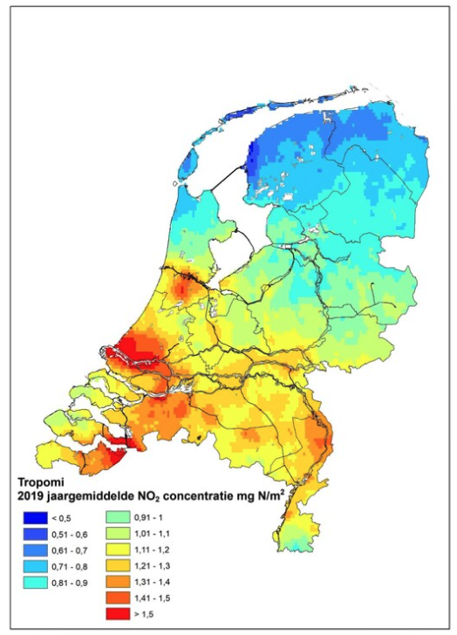
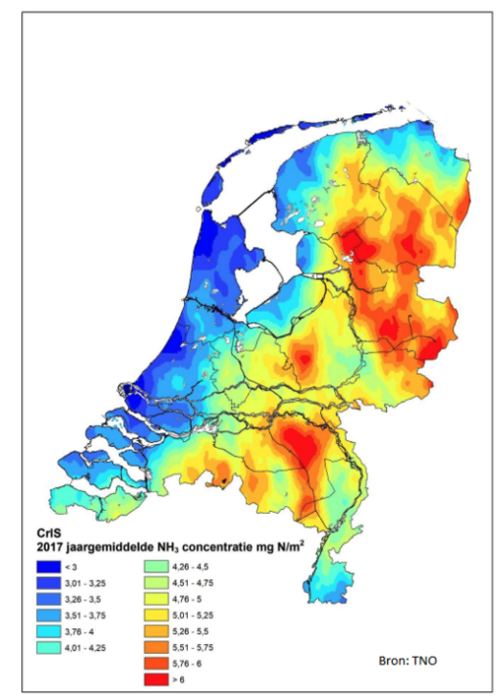
Reactive Nitrogen
TROPOMI NO₂
CRIS NH₃

