Slide 1
NOAA GeoXO Status Update
Gregory (Greg) Frost
NOAA Office of Oceanic and Atmospheric Research (OAR)
ACX User Scientist
Shobha Kondragunta
NOAA National Environmental Satellite, Data, and Information Service (NESDIS)
ACX Product Scientist
Acknowledgements: Ed Grigsby, GeoXO Program Office, NESDIS User Engagement, NESDIS Office of Common Services
TEMPO/GeoXO ACX Joint STM, 19 August 2025

Slide 2
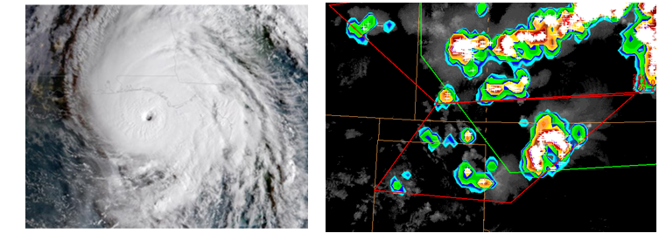
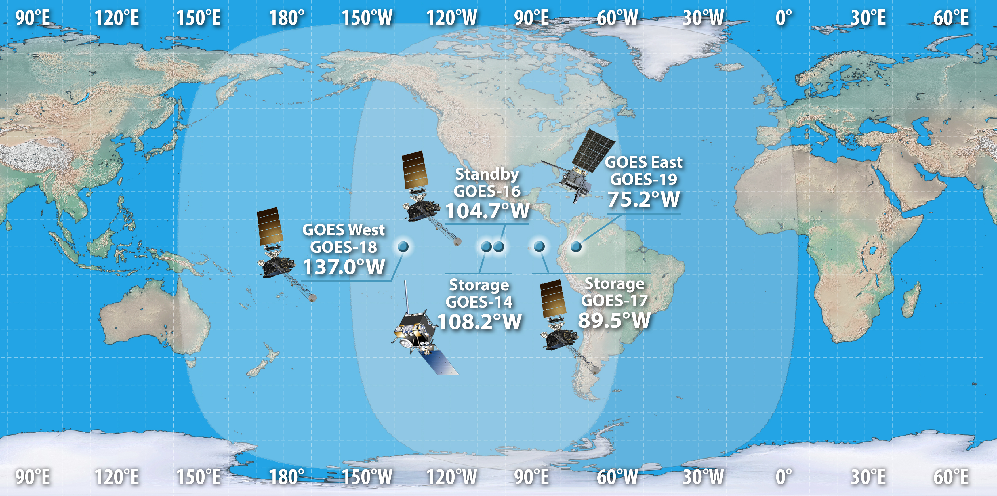
Current Generation: The GOES-R Series
The GOES-R Series is the Western Hemisphere’s most advanced weather-observing and environmental monitoring system, with observations contributing to public safety, protection of property, and our nation’s economic health and prosperity.
ABI
GLM
  Hurricane forecasts
  Early severe storm warning
  Fire detection, monitoring, and intensity
  Air quality warnings and alerts
  Low cloud and fog detection
  Aviation planning and traffic management
  Volcanic eruption detection and plume monitoring
  First-ever operational lightning mapper from geostationary orbit

Slide 3
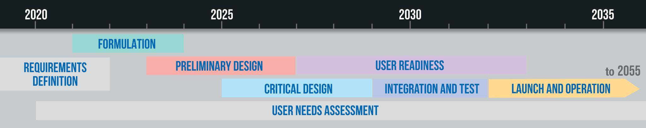
GeoXO Timeline
Program formally approved by Department of Commerce: Dec. 2022
Program formally approved to enter preliminary design phase: Feb. 2025
First launch scheduled: 2032

Slide 4
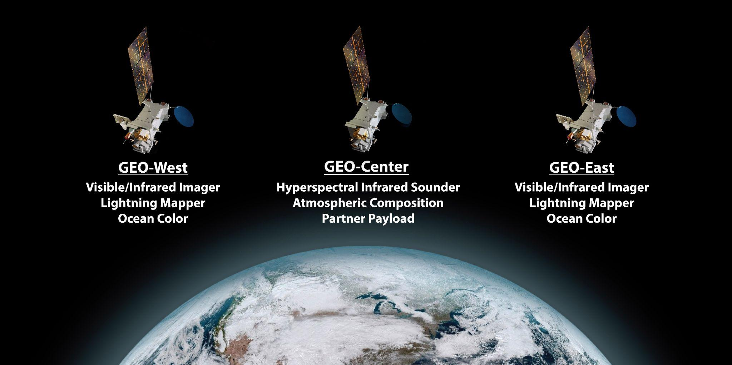
GeoXO Baseline Restructuring in FY25-FY26
Pending Further Direction

Slide 5
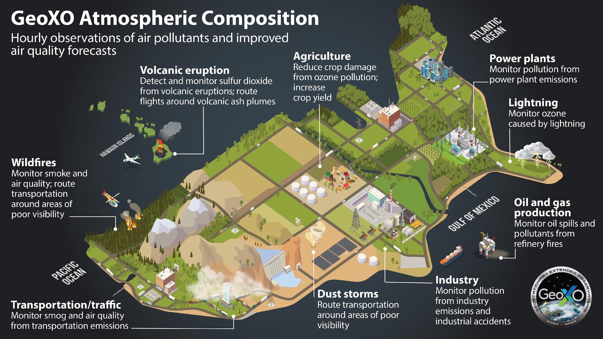
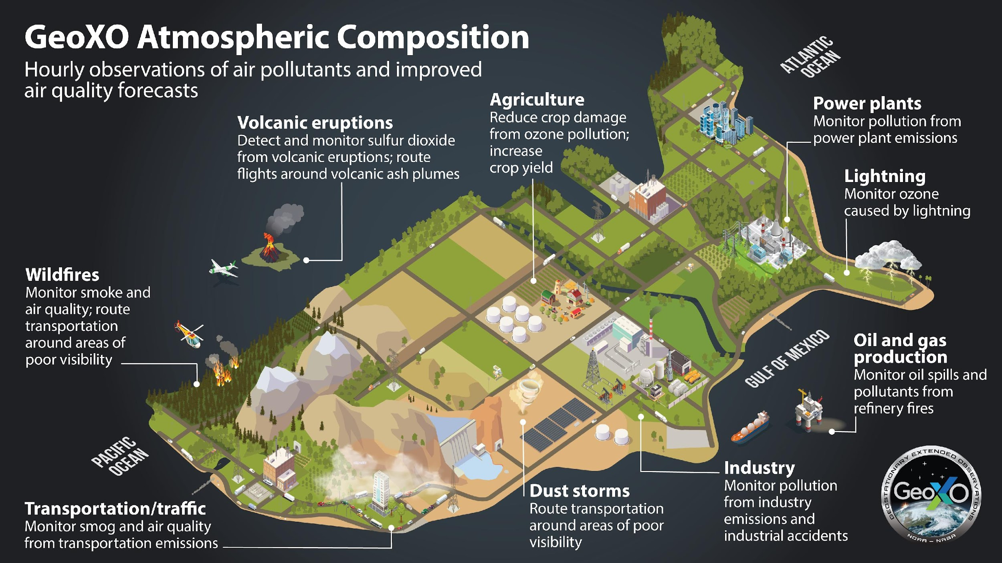
GeoXO will produce AC products from multiple sensors
ACX
GXI
GXS
ACX
GXS
ACX
GXI
GXS
ACX
GXS
LMX
ACX
GXI
GXS
ACX
GXI
GXS
ACX
GXI
GXS
ACX
GXI
GXS
ACX
GXI
Notes:
NOAA continues to focus on natural hazards and their impacts on Americans: floods, precip, fires/AQ

Slide 6














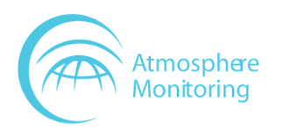









Using TEMPO data in preparation for ACX has strengthened NOAA’s user readiness activities and built stakeholder awareness of its atmospheric composition products and applications
NOAA’s many atmospheric composition stakeholders benefit from TEMPO data for applications that protect lives and property and inform the public
NOAA conducts outreach to build stakeholder awareness and advocacy and disseminates near-real-time data and imagery from current GEO and LEO sensors, including TEMPO
NESDIS STAR Trainings
NESDIS STAR Aerosol Watch

Slide 7
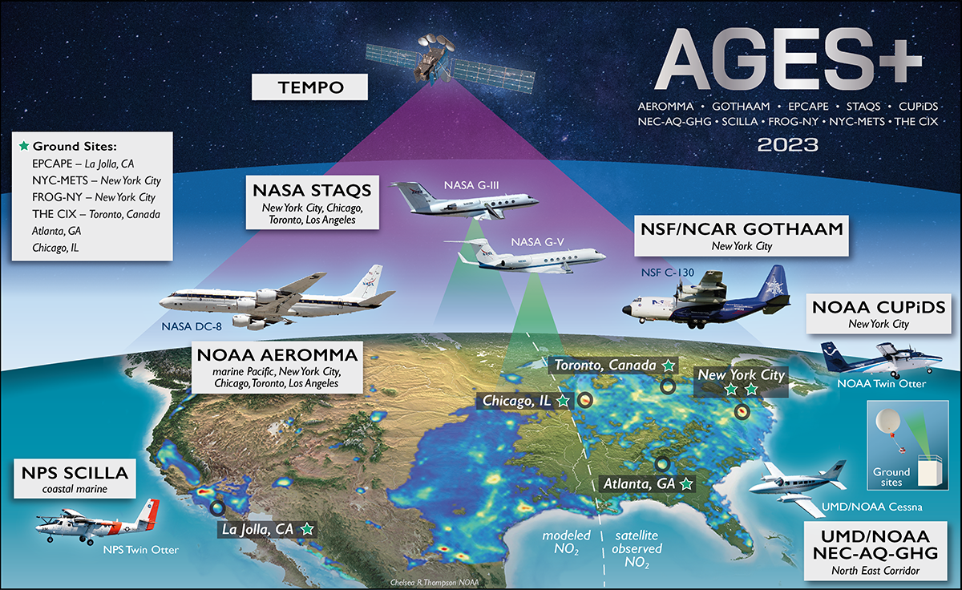
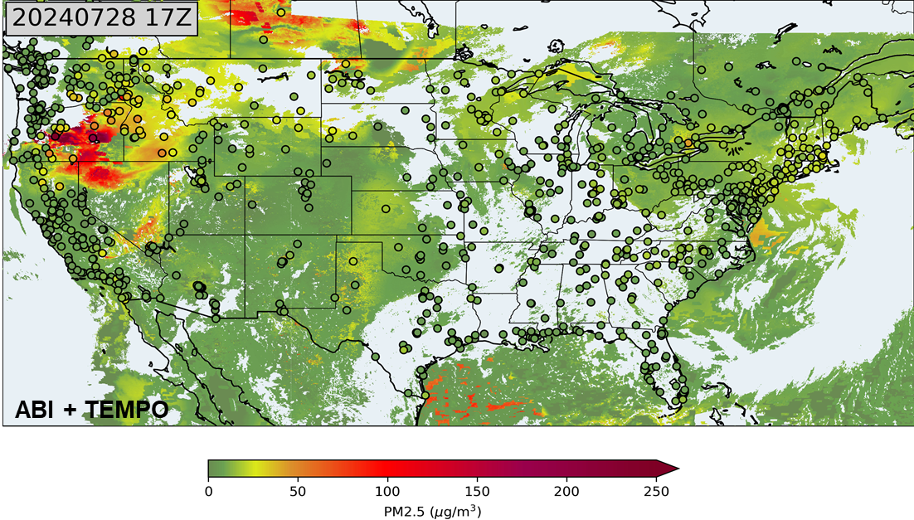
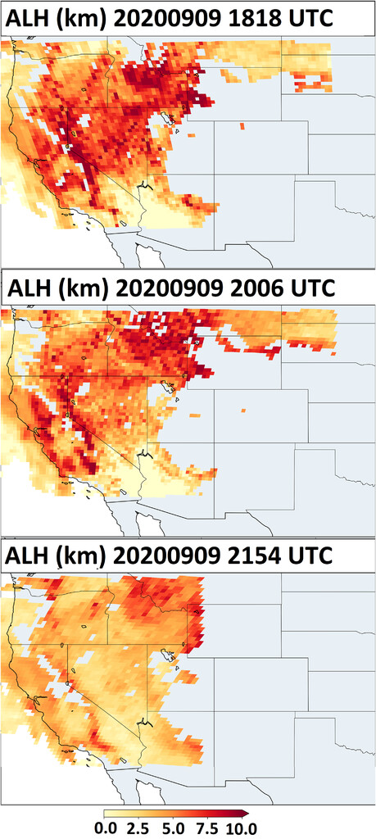
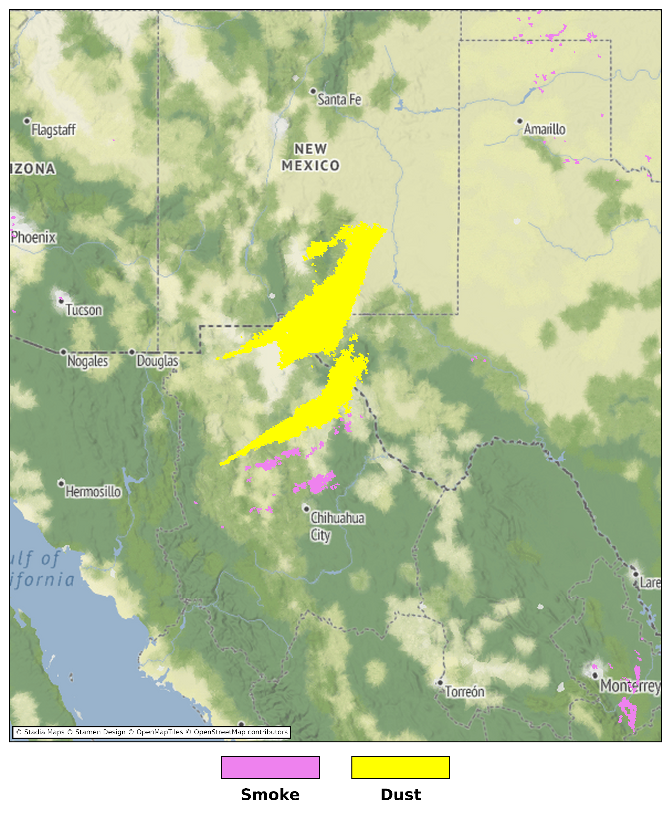
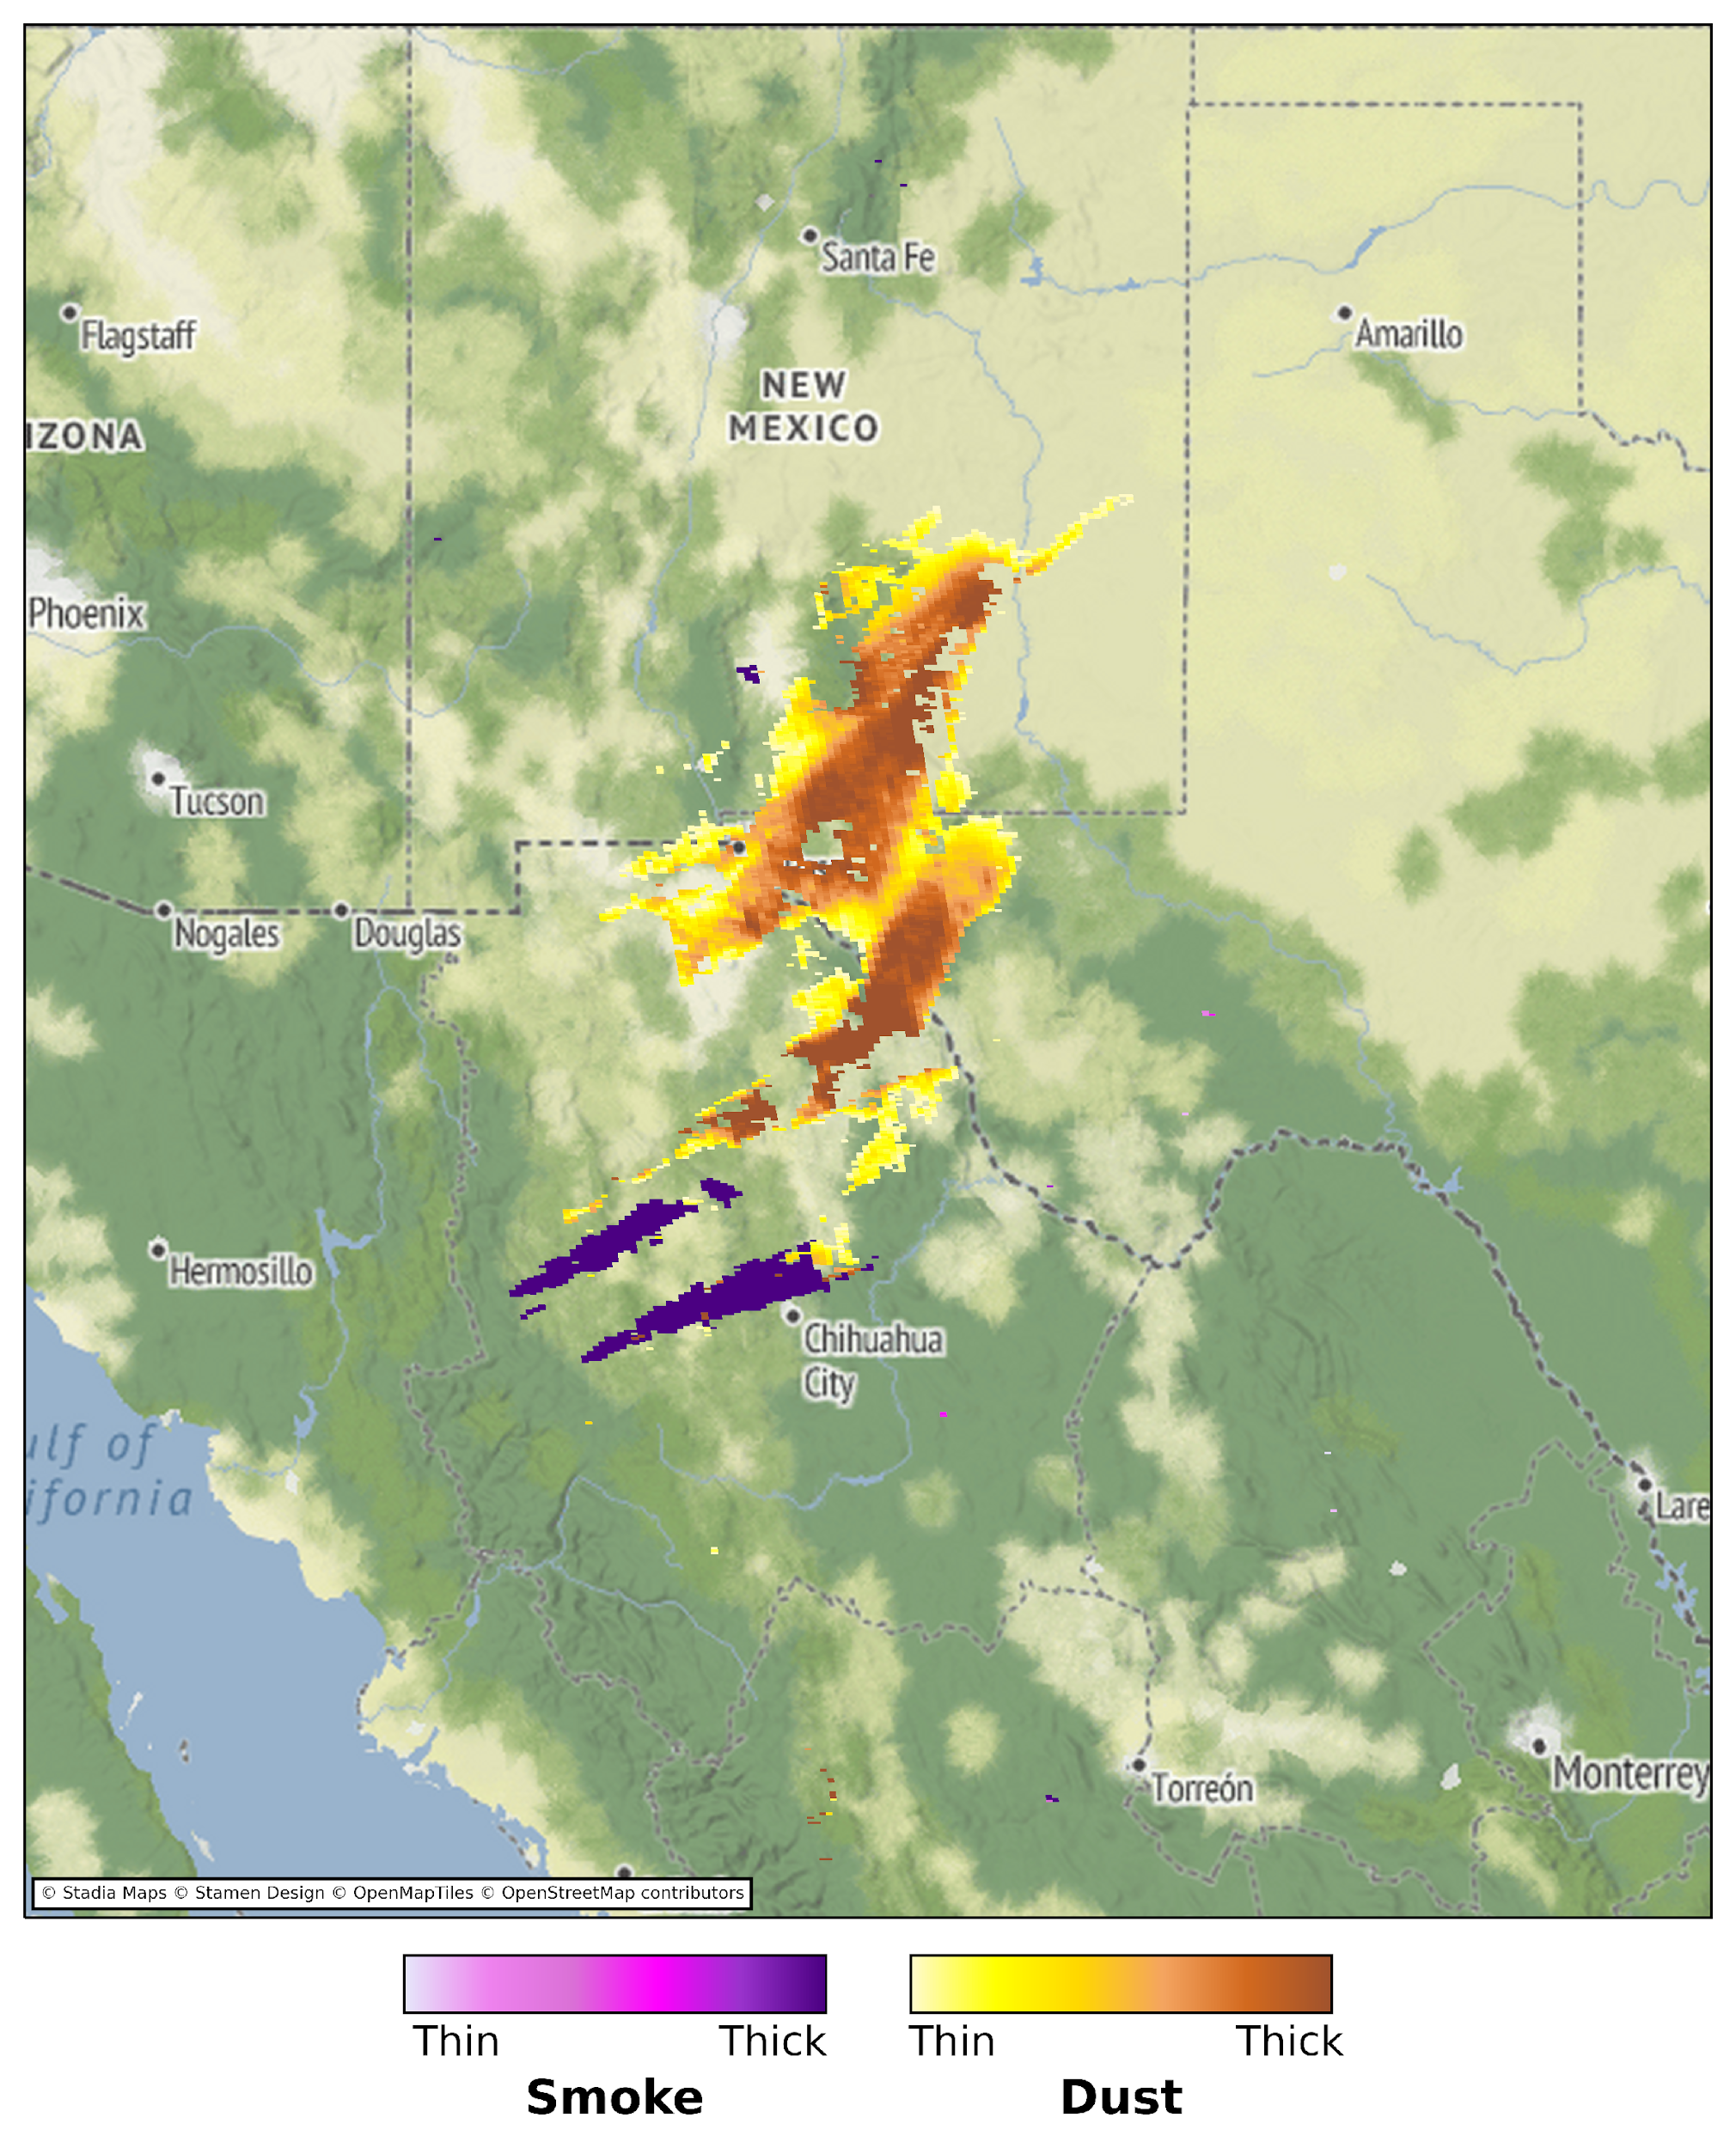
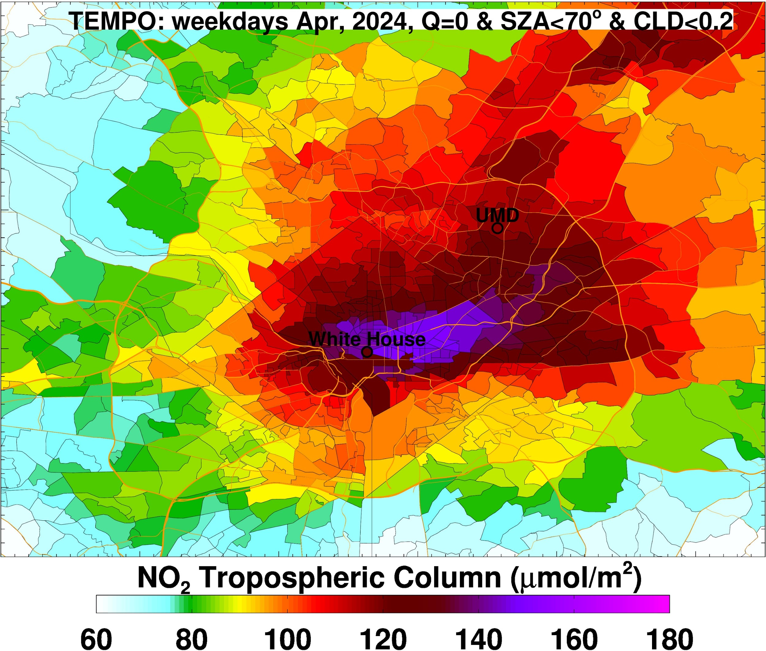
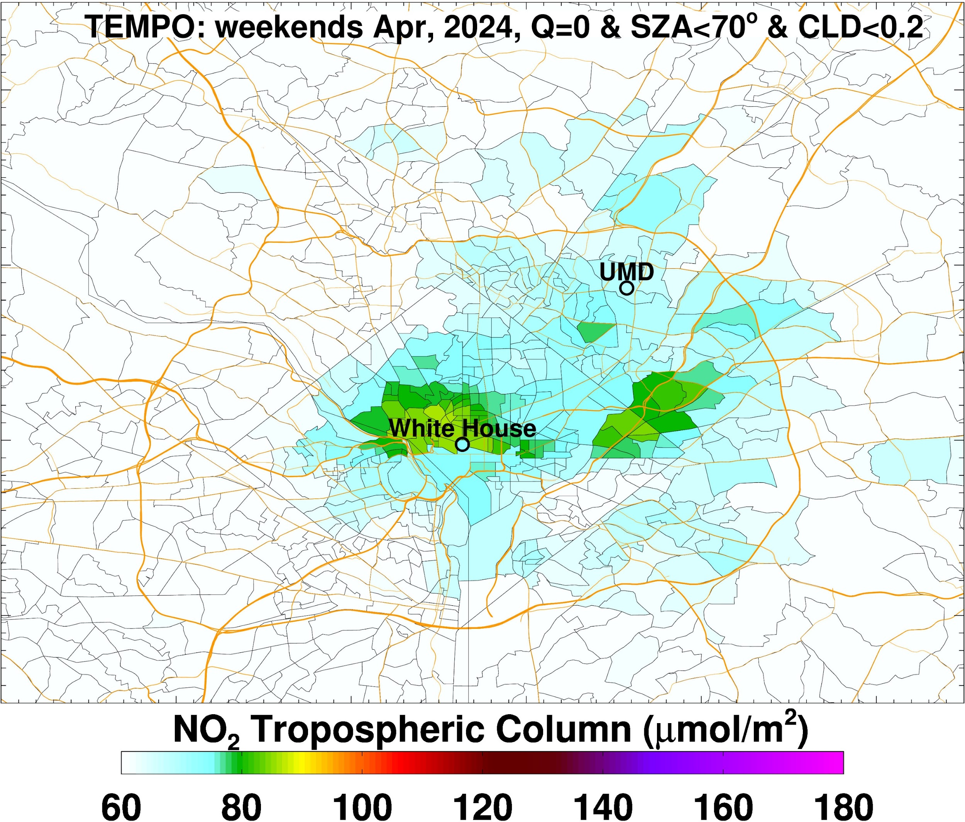
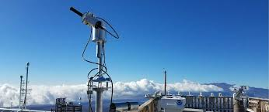
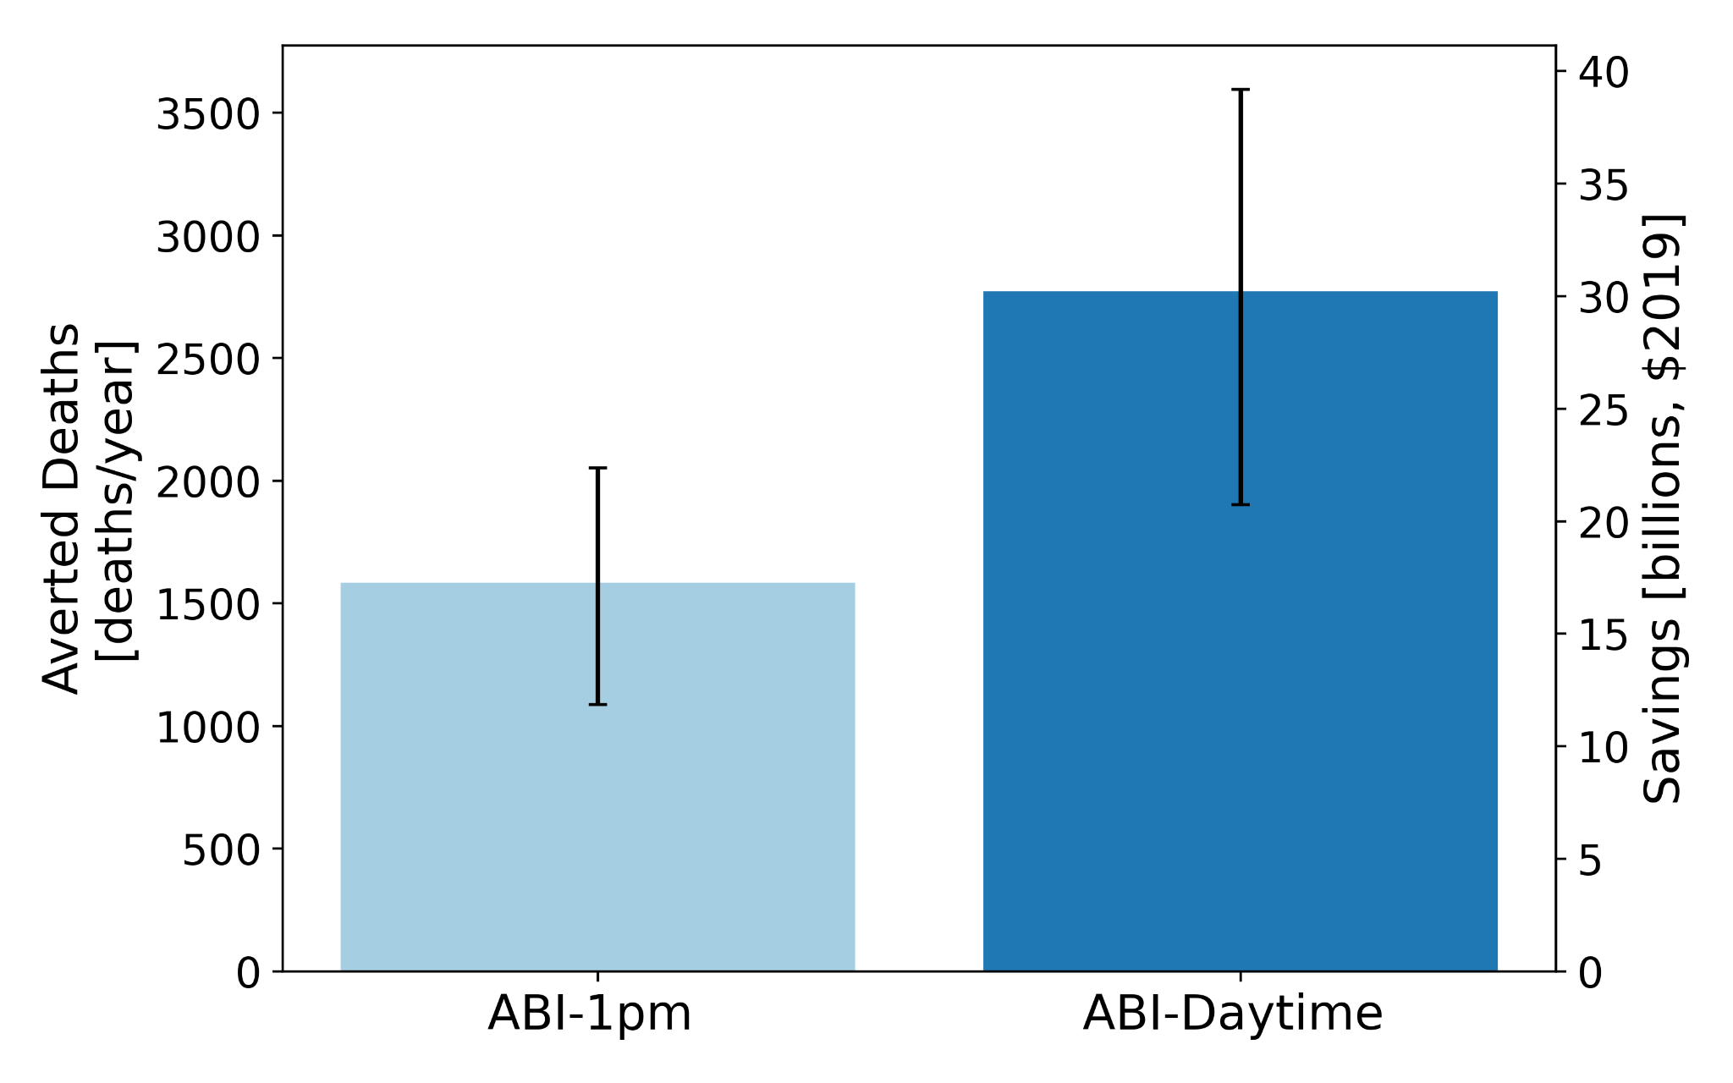
TEMPO and ACX efforts have guided NOAA’s development and evaluation of atmospheric composition products
https://pandora.gsfc.nasa.gov/PGN/
Building & testing new products & applications
Evaluations with field and network data
Near surface PM_{2.5}
Aerosol layer height
GOES-16 ABI
GOES-16 ABI + TEMPO
Washington DC, Weekdays
Washington DC, Weekends
https://csl.noaa.gov/projects/ages/
Dust detection
Near-real-time emissions
Demonstrating societal benefits
https://pandora.gsfc.nasa.gov/PGN/
O’Dell et al., GeoHealth, 2024
LEO
GEO
Notes:
Mention Jun W’s contributions to ALH product

Slide 8
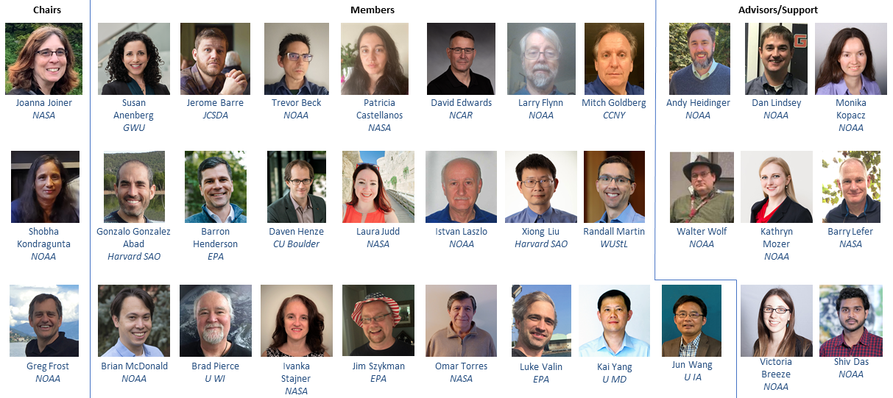
We thank the ACX Science Team for their input and advice, and for building awareness of GeoXO’s and NOAA’s capabilities!

Slide 9
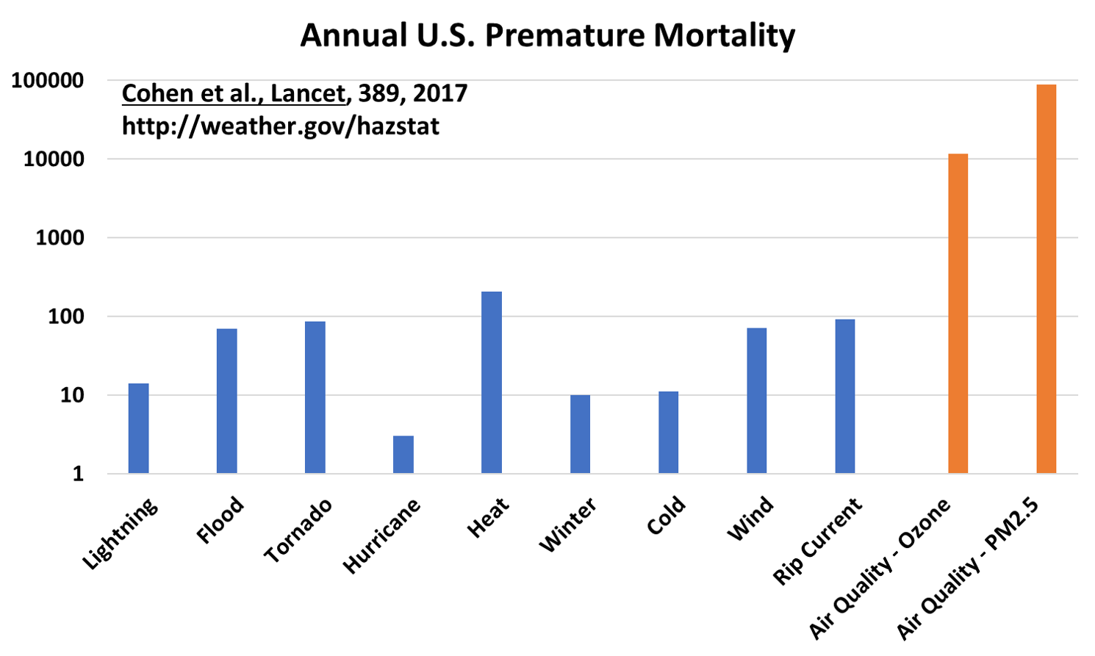
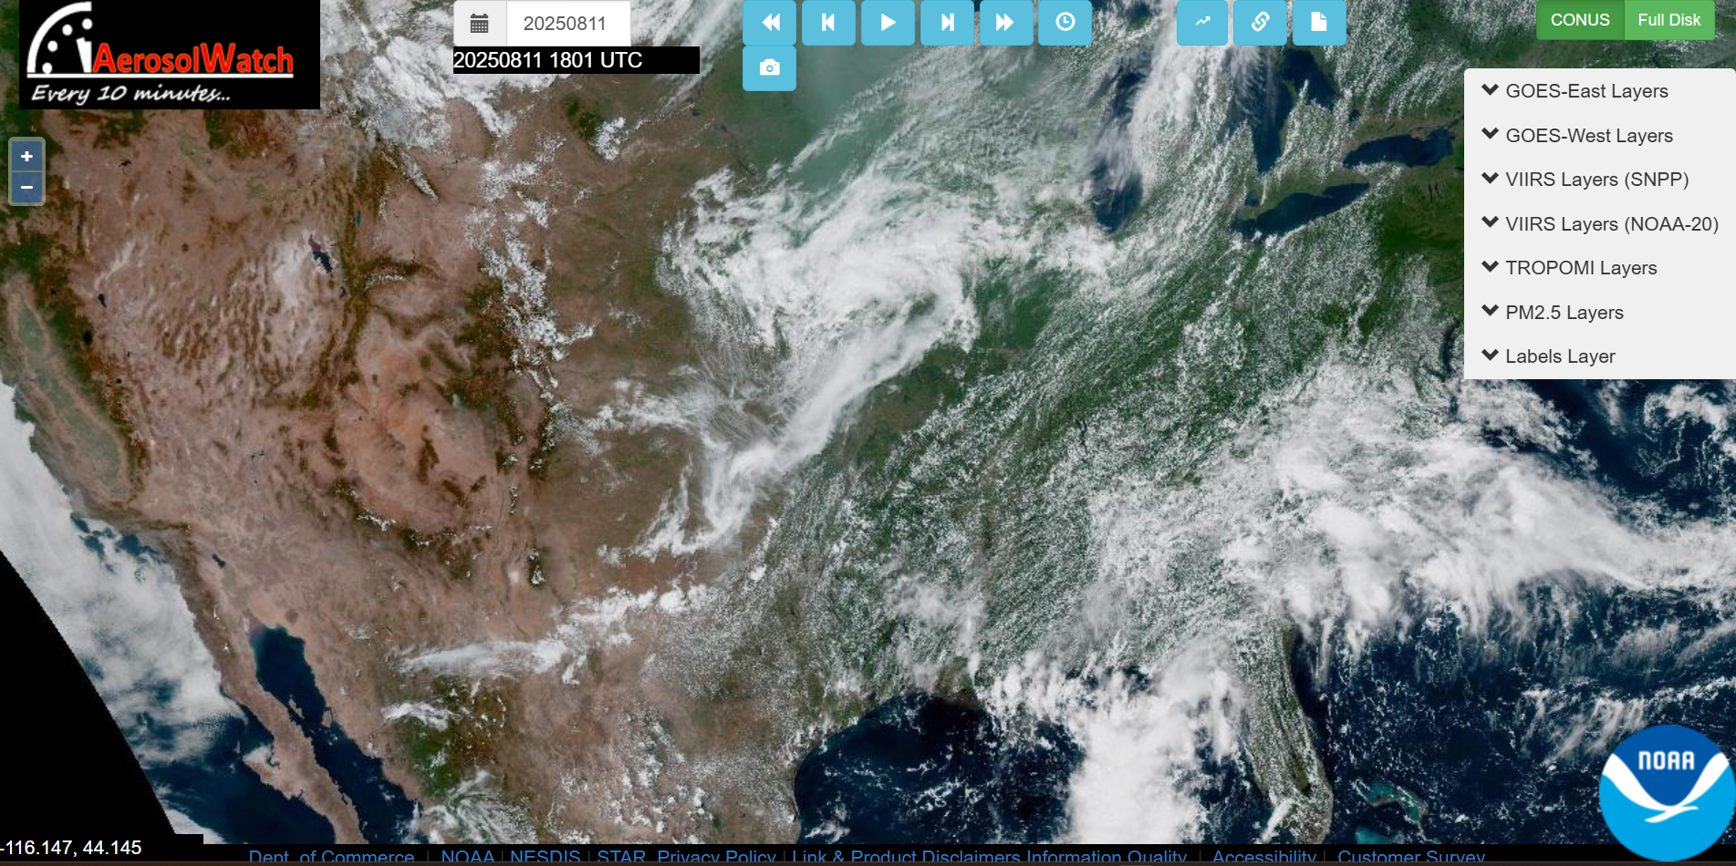
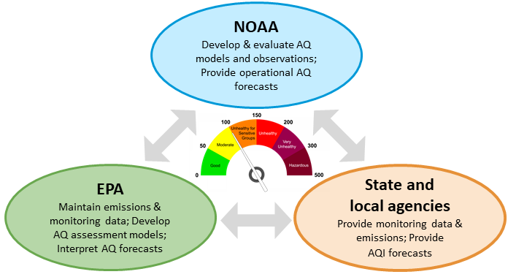
Looking ahead
Air quality hazards continue to impact Americans’ well-being and prosperity
NOAA has mandates to deliver air quality information and engage with researchers and decision makers
GEO atmospheric composition products are essential to NOAA’s mission
Notes:
Mention CEOS recommendation that in light of ACX descope, NASA and NOAA form task team for TEMPO-2 follow on

