Slide 1
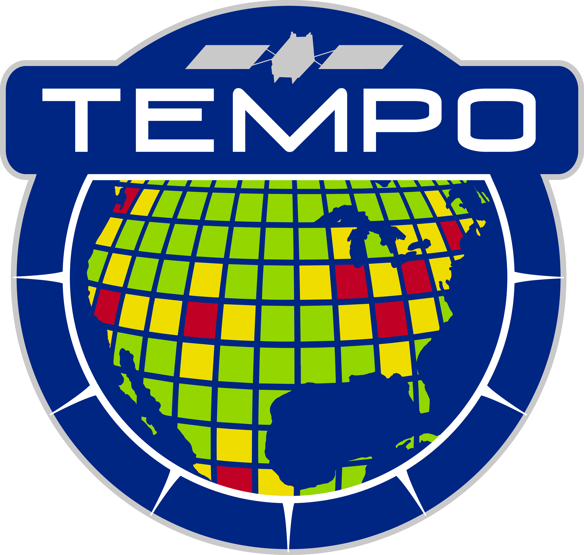
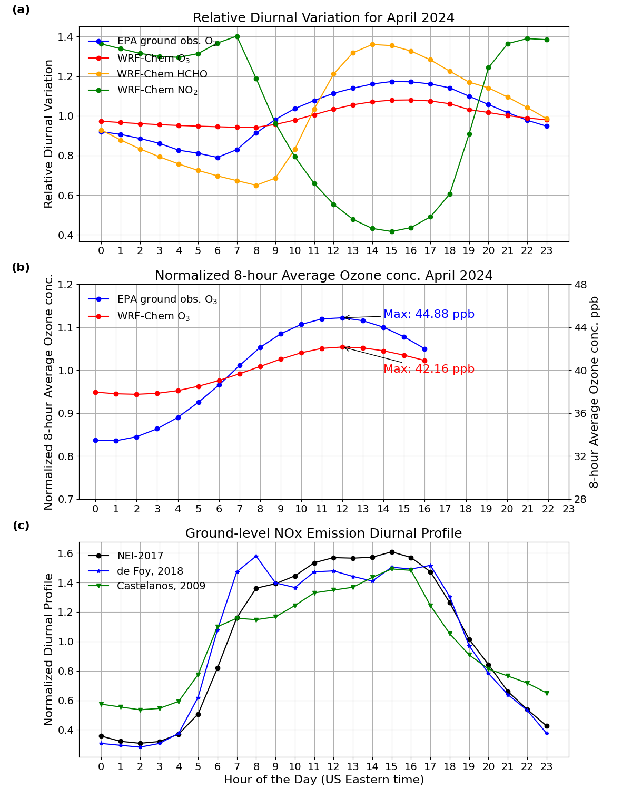
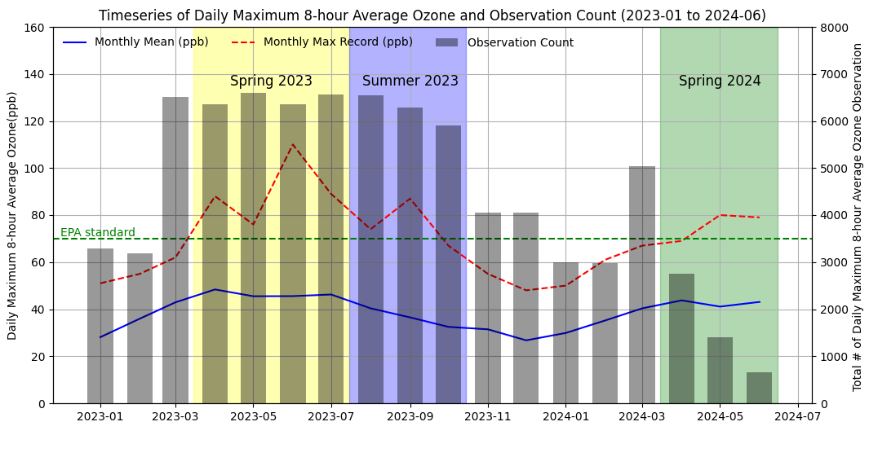
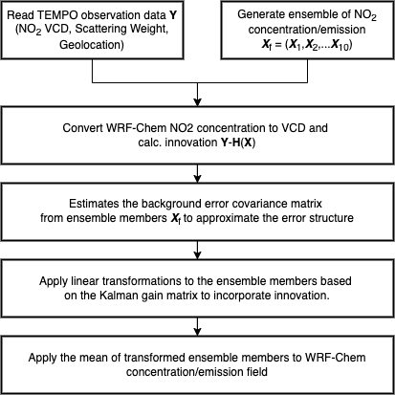
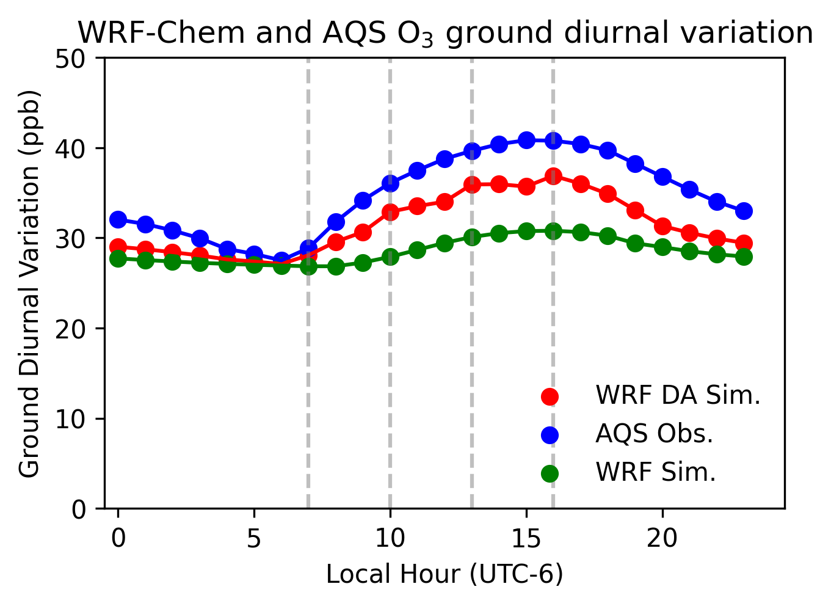
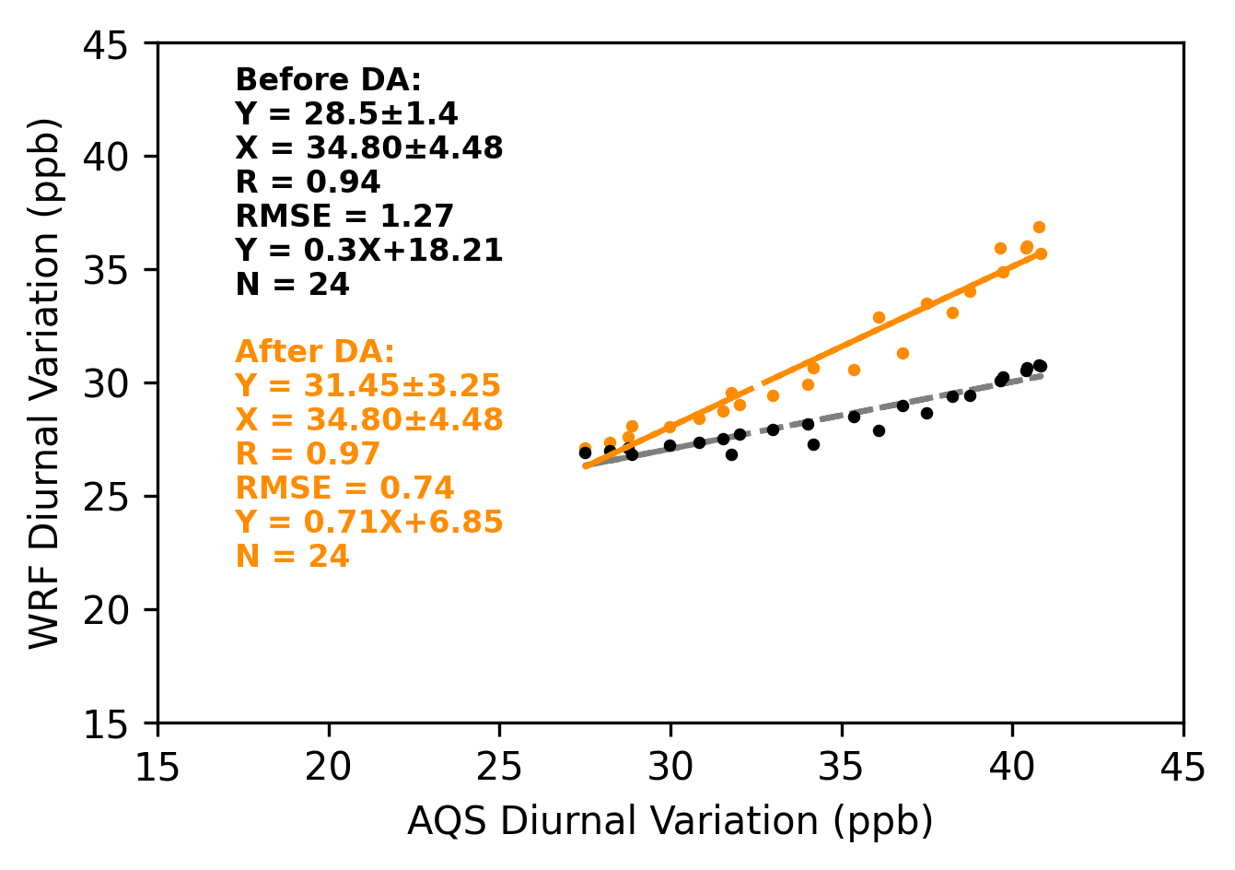
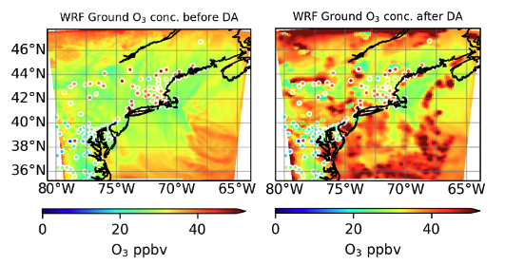
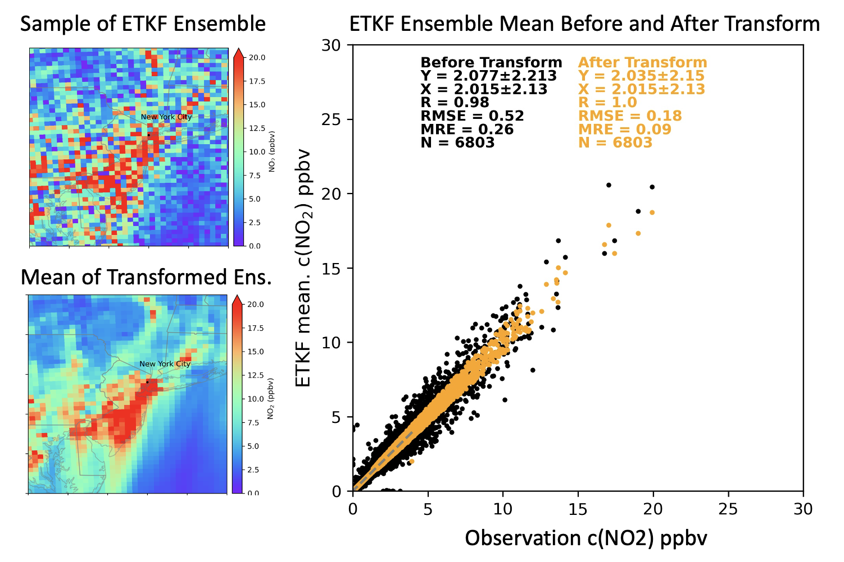
Enhancing Atmospheric Composition Forecasting over continental United States: Assimilating TEMPO data in Regional Air Quality Models with the ETKF method
Chengzhe Li¹, Jun Wang¹, Huanxin (Jessie) Zhang¹
1. Department of Chemical and Biochemical Engineering, Center for Global & Regional Environmental Research, The University of Iowa, Iowa City, 52240, Iowa, United States.
Motivation and Research Goal
Methodology
Case Study: April 2024
UI-WRF-Chem setting
（h）
Domain | Boston-NY
Time Period | April 2024
Domain size | 10°×14°
# of grid box | 108×116
Resolution | 9km×10km
Emission inventory | NEI 2017
Vertical layer | 48
Aerosol chemical scheme | RADM2/MADE/SORGAM
（d）
Flow chart of WRF-Chem-ETKF method
Period 1: 202304-07, 484 ozone exceedance days
Period 2: 202308-10, 14 ozone exceedance days
Period 3: 202404-06, 13 ozone exceedance days
TEMPO observation available
Comparison between WRF-Chem and AQS O₃ ground diurnal variation
△ = 6.45%
（i）
（j）
Errors in Diurnal Pattern would lead to false air quality alarm
（k）
（l）
（e）
（g）
How to decrease the error from diurnal profile of emission inventory?
Performing DA of TEMPO NO₂ VCD every three hours during the daytime (marked by dashed lines in figure (i)) improves the alignment of the WRF-Chem ozone diurnal pattern with EPA observations.
Here we shows the WRF-Chem ozone spatial pattern at 11 AM (ET) April 07th 2024 , which also better matches EPA observations, as shown by the colored dots in figures (k) and (l).
Atmospheric chemical transport models (CTMs), such as the Unified Inputs (Initial and Boundary Conditions) Weather Research and Forecasting model coupled with Chemistry (UI-WRF-Chem), can simulate and forecast aerosol and trace gases distribution, capturing these diurnal variations effectively.
Overall goal:
Enhance UI-WRF-Chem simulation of the diurnal variation of aerosol and trace gas concentrations and aerosol properties (including vertical and size distribution) in the United States through data assimilation (DA) of aerosol and trace gases products from TEMPO.
Update the existing anthropogenic emission inventory of trace gases and aerosols by assimilating TEMPO observation into WRF-Chem.
（f）
Ensemble Transfer Kalman Filter (ETKF) utilizes a linear transformation matrix to avoid direct computation of high-dimensional error covariance matrices by using the ensemble error covariance matrix instead, and update the state vector (here as NO₂ concentration or emissions).
Acknowledgement
This work is supported by This work was supported by in part by NASA’s ACMAP, HAQ and HAQAST program.
Contact: Jun Wang(jwang-6@uiowa.edu), Chengzhe Li(chengzli@uiowa.edu)

