Slide 1
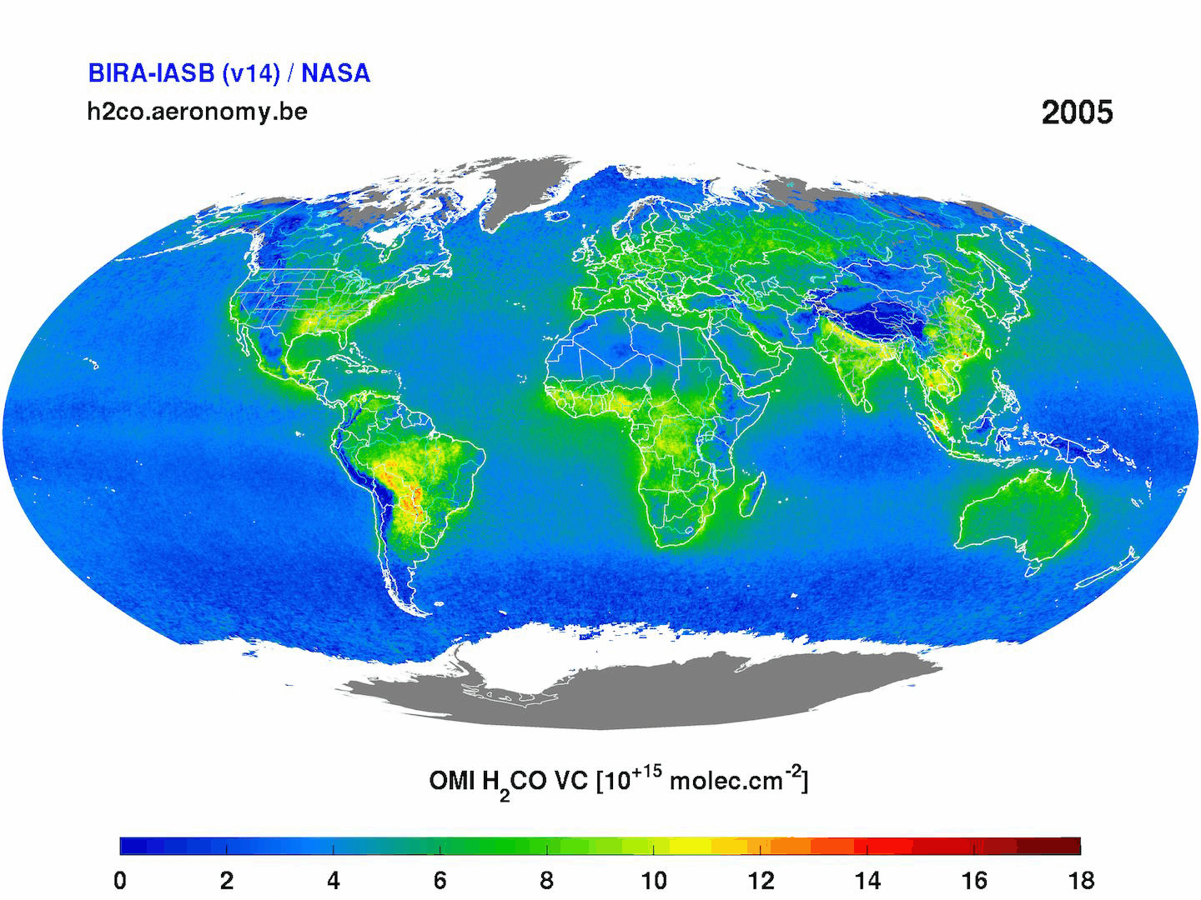
Observing downwind structures of urban HCHO and CHOCHO plumes with TROPOMI and GEMS: Implications to non-methane volatile organic compound emissions
Lei Zhu¹ (zhul3@sustech.edu.cn), Xiaoxing Zuo¹, Song Liu¹, Weitao Fu¹, Wenfu Sun², Isabelle De Smedt², Hyeong-Ahn Kwon³, Eunjo Ha⁴, Gitaek Lee⁴, Rokjin Park⁴
¹Southern University of Science and Technology
²Royal Belgian Institute for Space Aeronomy
³University of Suwon ⁴Seoul National University
TEMPO/GEMS Joint Science Team Workshop
Kailua-Kona, 08/30/2024

Slide 2
Relating HCHO column to volatile organic compound (VOC) emissions
Ozone
Particulate Matter
Global
background
CH₄
VOC_{i}
(E_{i})
Biogenic
(e.g., Isoprene)
Anthropogenic
(e.g., Ethene)
Open fires
VOCs are key precursors of ozone and particulate matters

Slide 3
Relating HCHO column to volatile organic compound (VOC) emissions
Ozone
Particulate Matter
Global
background
CH₄
VOC_{i}
(E_{i})
Oxidation
hv (~340 nm), OH
HCHO
Yield y_{i}
k ~ 0.5 h⁻¹
(Lifetime ~ 2 h)
Biogenic
(e.g., Isoprene)
Anthropogenic
(e.g., Ethene)
Open fires
VOCs are key precursors of ozone and particulate matters
HCHO column is a reliable proxy for VOC emissions, providing top-down constraint
CHOCHO indicates isoprene and aromatic VOC emissions

Slide 4
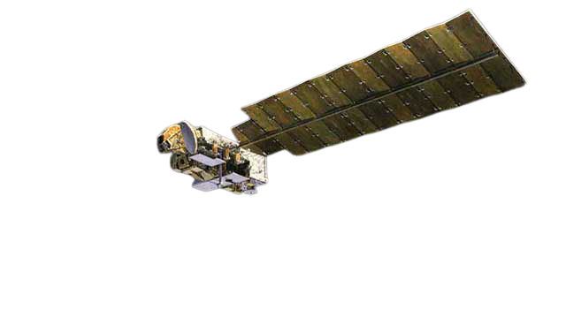
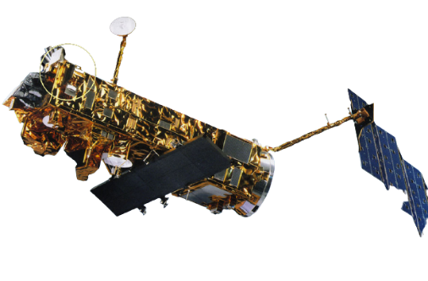
Observing HCHO and CHOCHO from space since 1995: LEO to GEO
2006-
80 × 40 km²
2011-
50 × 50 km²
2004-
13 × 24 km²
2002-2012
30 × 60 km²
2017-
7.0/5.5 × 3.5 km²
1995-2011
40 × 320 km²
GOME-2
A/B/C
OMI
OMPS-NPP/N20
SCIAMACHY
TROPOMI
GOME
GEO:
GEMS (2020-; Hourly), TEMPO (2023-; Hourly)
LEO: Low earth orbit
GEO: Geostationary orbit

Slide 5
Satellite observations reveal enhanced HCHO from different sources
OMI annual mean HCHO columns

Slide 6
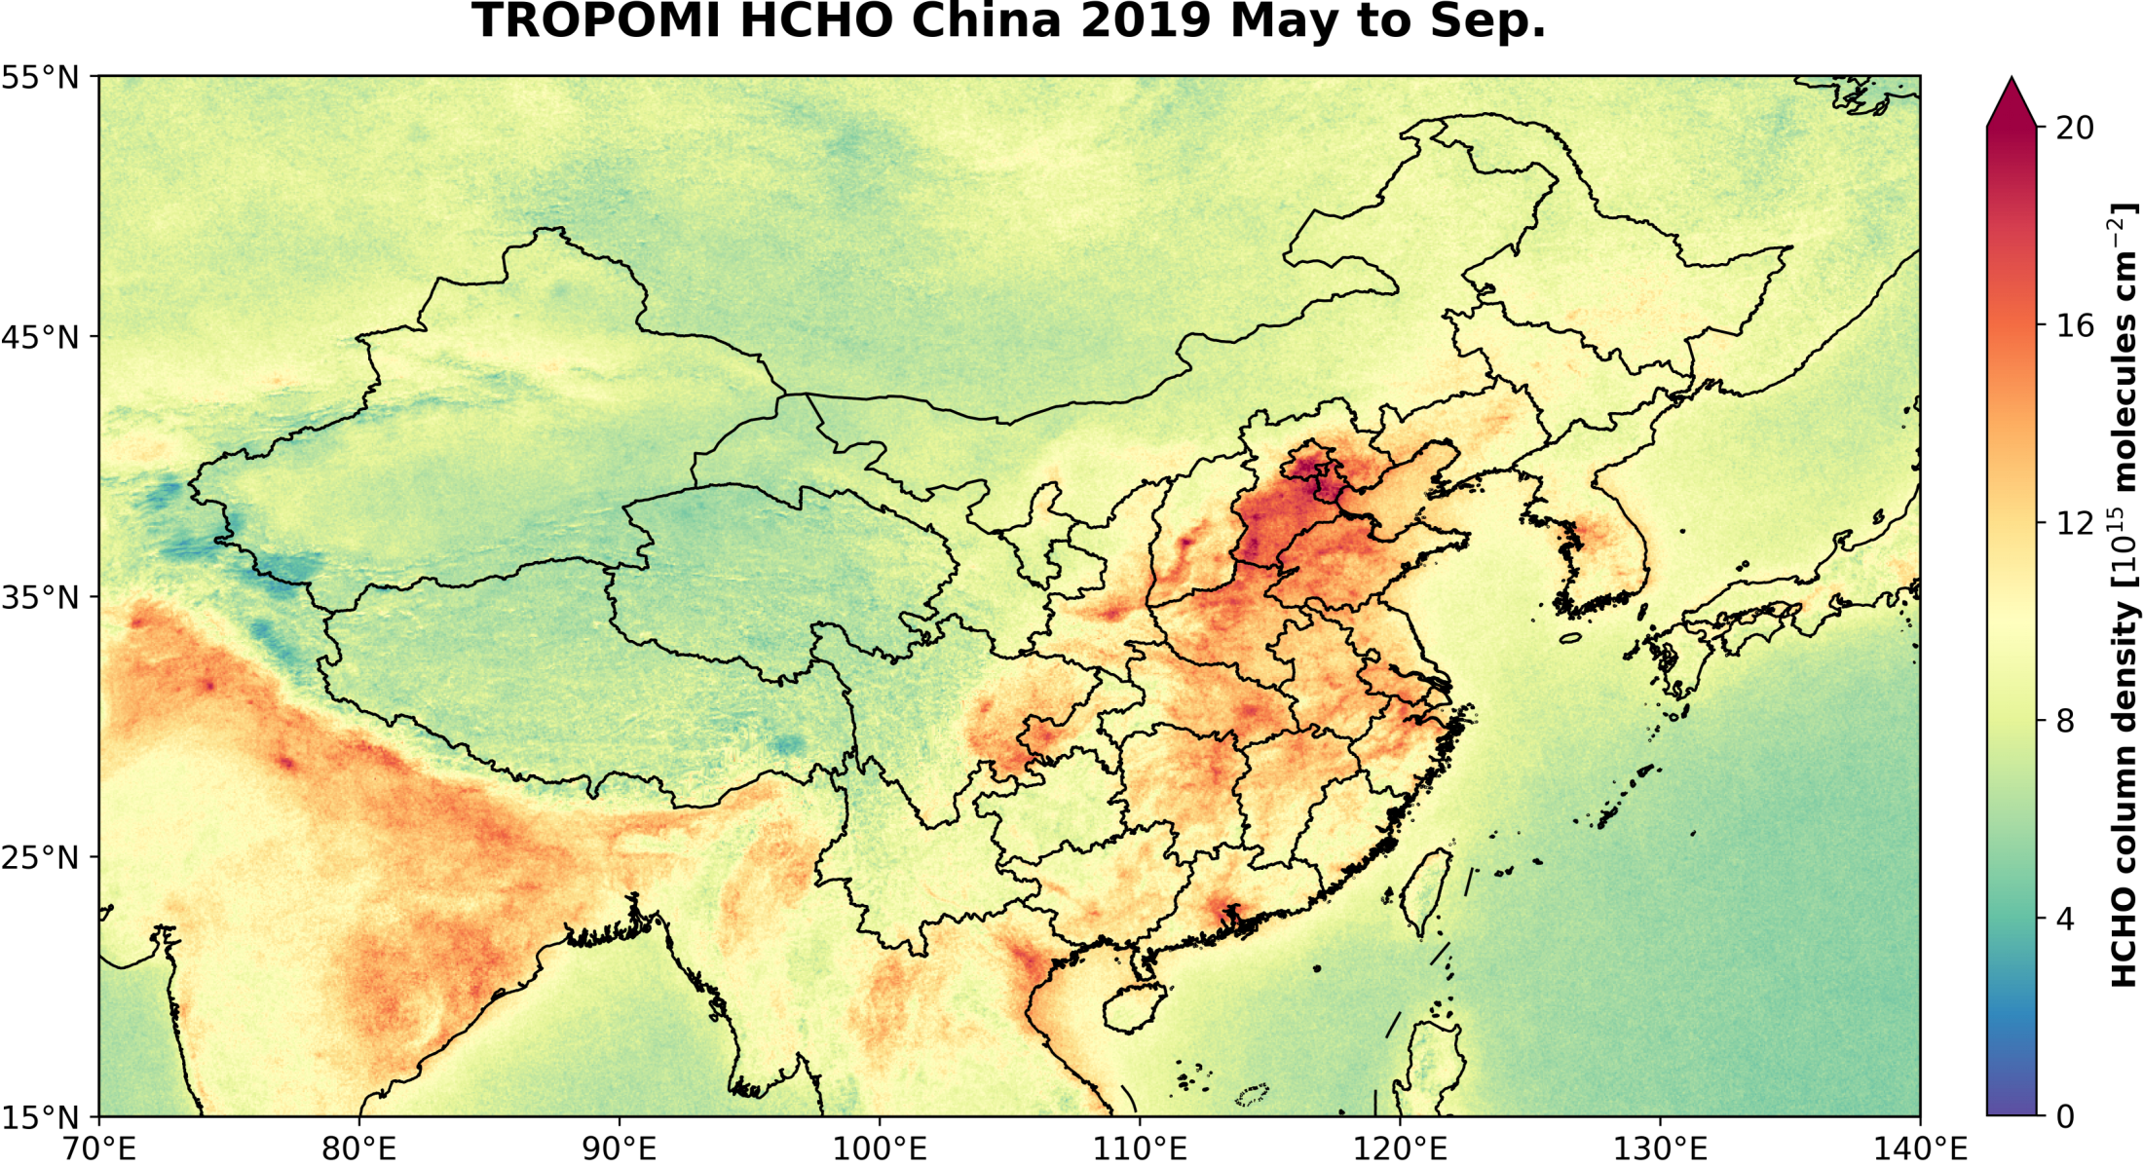
Satellite (TROPOMI) picks up urban HCHO signals
HCHO
May-Sep, 2019
5 km x 5 km

Slide 7
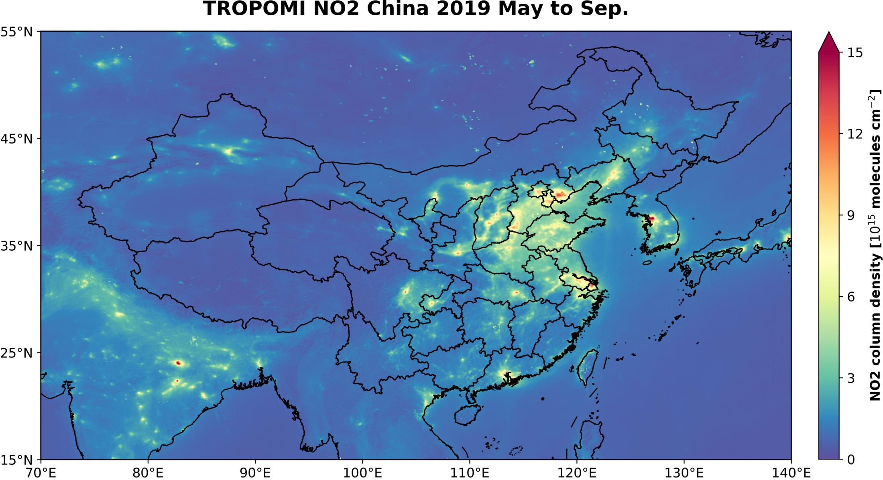
Satellite (TROPOMI) picks up urban HCHO signals
NO₂
May-Sep, 2019
5 km x 5 km

Slide 8
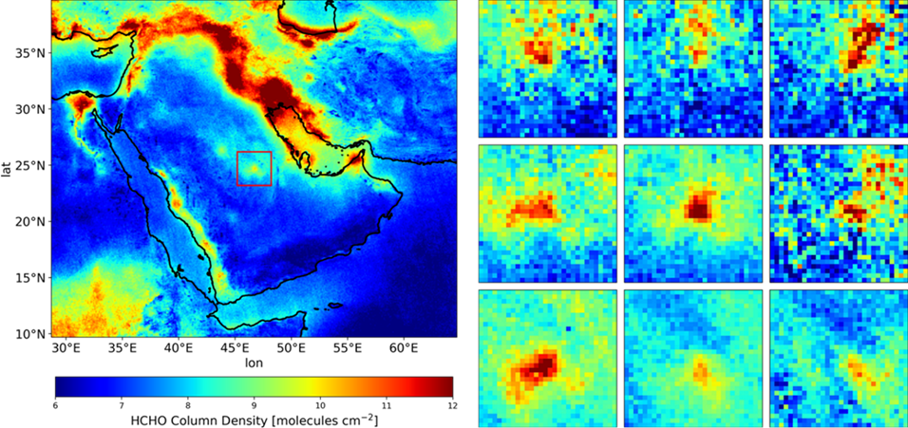
Observing urban HCHO plumes: Riyadh as an example
TROPOMI HCHO Apr-Sep, 2018-2021
Isolated location
Large emission
Frequent clear sky
w < 2 m s⁻¹

Slide 9
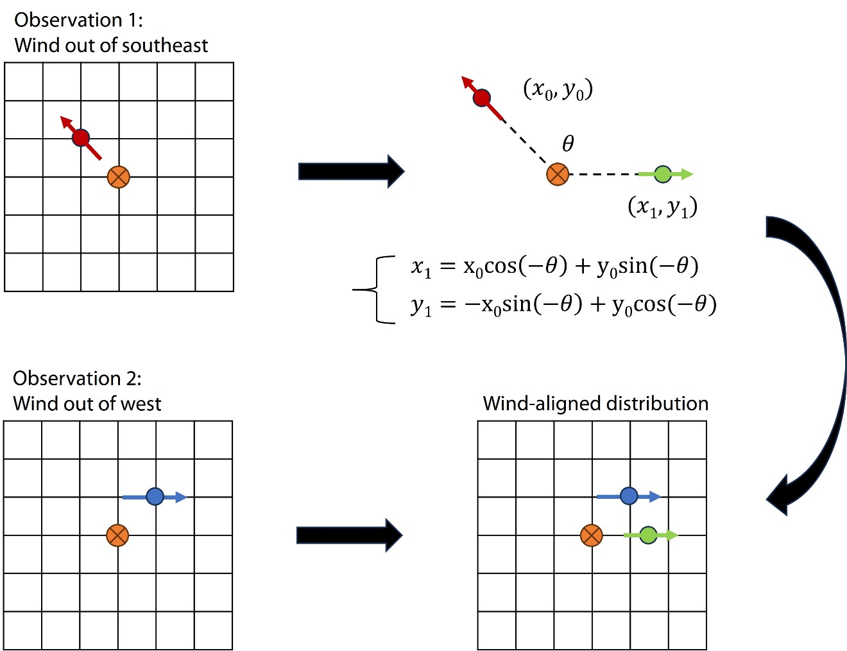
Schematic diagram of wind rotation technique
Pommier et al. (2013)
Each observation is rotated with a wind direction θ around a reference point (orange dot) to obtain a wind-aligned distribution

Slide 10
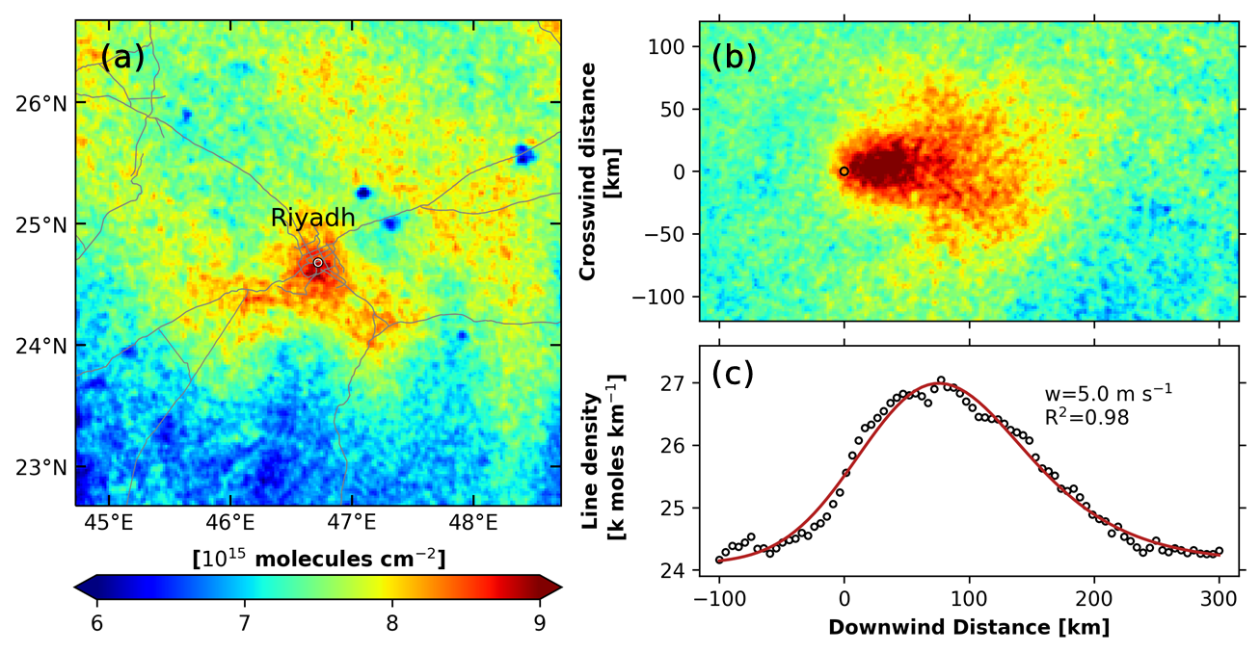
Wind-aligned urban HCHO plume and its downwind structure
Wind-aligned
HCHO plume
Integration
Downwind
structure

Slide 11
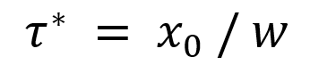
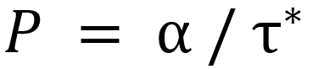
Fitting downwind structure with the exponentially modified Gaussian (EMG) model
Chemical processes
(production + loss）
⊗
Gaussian dispersion
Wind-aligned
HCHO plume
Integration
α scale factor (mol)
B background (mol km⁻¹)
μ location of the point source (km)
x₀ e-folding distance downwind (km)
σ standard deviation of the Gaussian (km)
Effective lifetime (h)
Effective production rate (mol s⁻¹)
Downwind
structure
HCHO production rate
P(HCHO) = 45.5 ± 3.9 mol s⁻¹

Slide 12
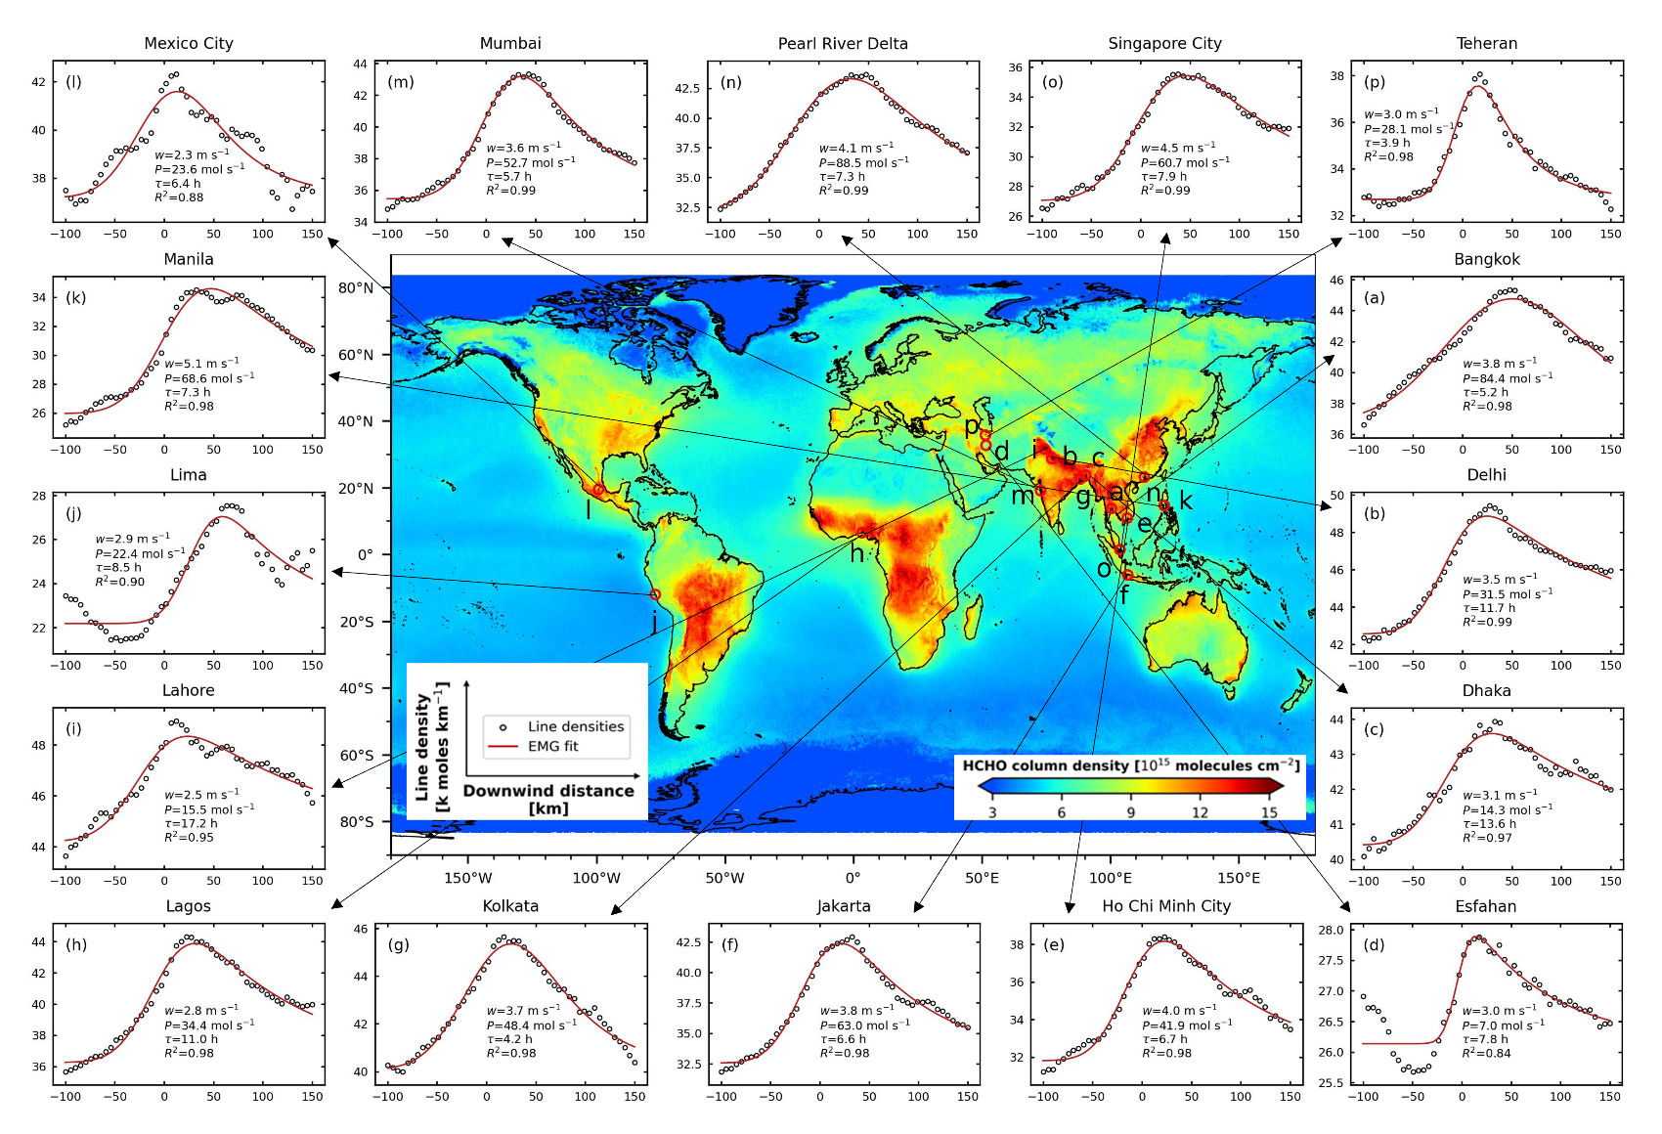
Global urban HCHO plumes seen from space
Zuo et al., 2023, Geophysical Research Letters

Slide 13
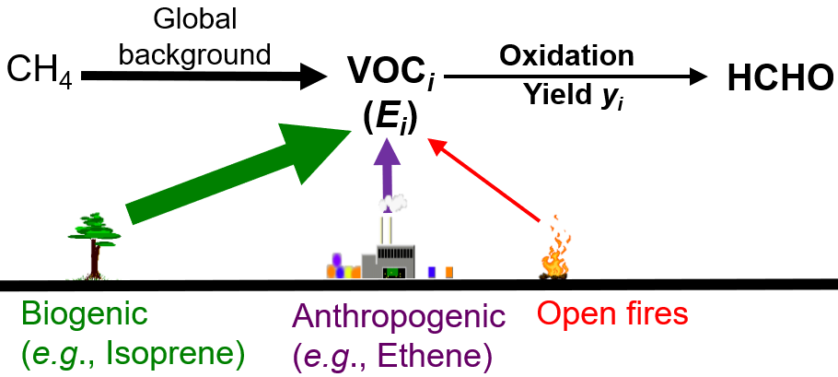
HCHO downwind structures provide constraints on total NMVOC emissions
Highly reactive VOCs
$$P= \sum_{i}{E_{i}Y_{i}}$$
P: HCHO production rate
E_{i}: Emission of VOC i
Y_{i}: HCHO yield from VOC i
Zuo et al., 2023, Geophysical Research Letters

Slide 14
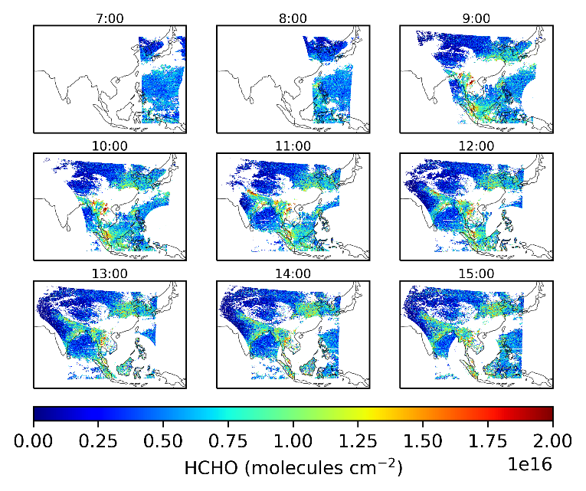
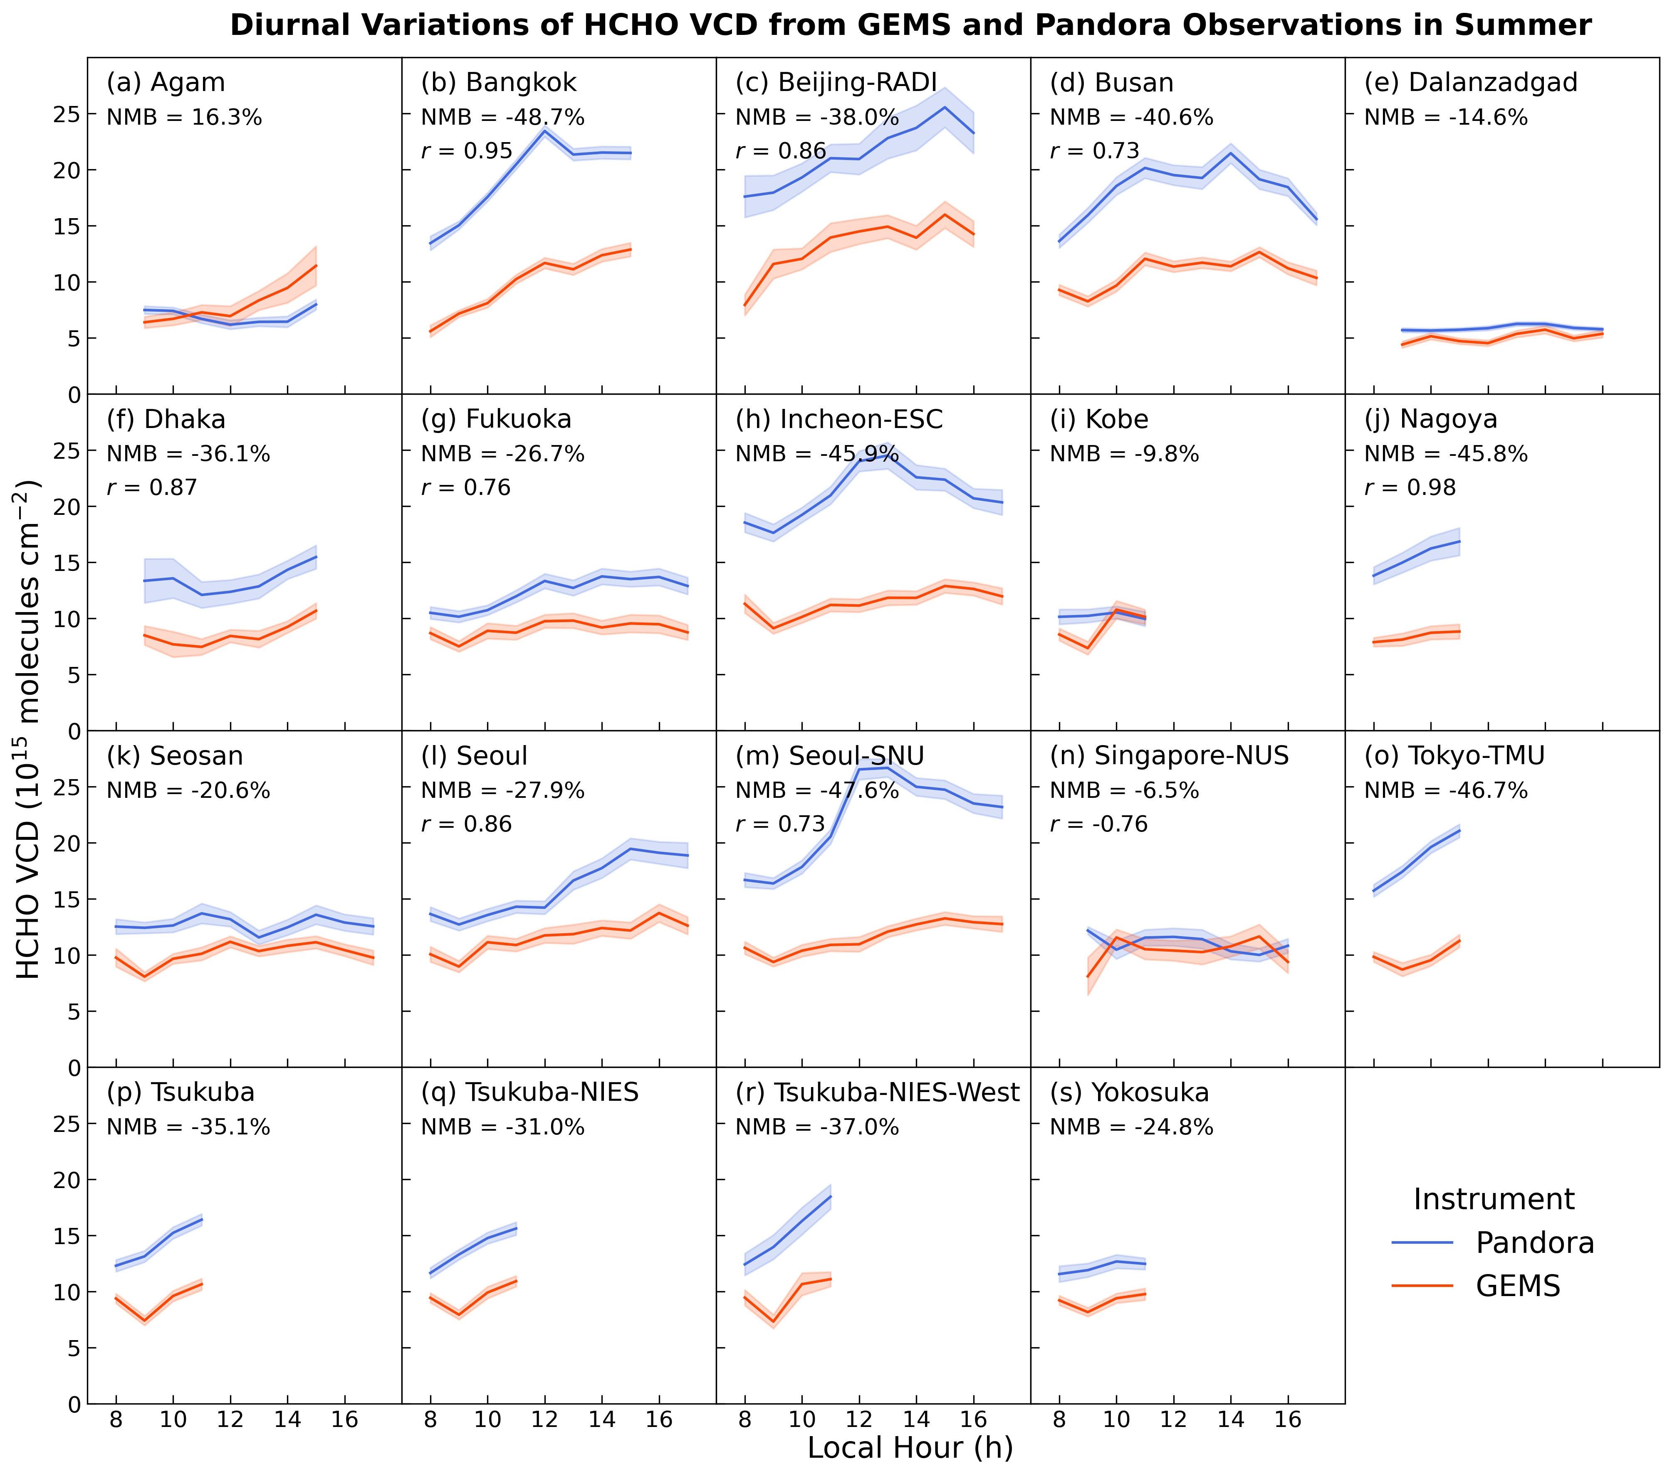
HCHO diurnal variations according to GEMS
GEMS HCHO on May 1st, 2022
Diurnal variations in summer
Fu et al., 2024, submitted

Slide 15
Take-home messages:
We show clear urban HCHO and CHOCHO plumes by relating satellite pixels with wind fields
Satellite-based effective HCHO production rates provide potential measures of total NMVOC emissions
GEO satellites offer a great opportunity to study the diurnal variations in NMVOC emissions and chemistry
Atmospheric Chemistry Modeling & Remote Sensing
https://www.acmrsg.org

