Slide 1
POMINO-TROPOMI consistent HCHO and NO₂ retrieval with insights for TEMPO and GEMS instruments
Yuhang Zhang^{1,2}
yuhang_zhang@pku.edu.cn
Huan Yu², Isabelle De Smedt², Jintai Lin¹, Nicolas Theys², Michel Van Roozendael², Gaia Pinardi², Steven Compernolle²
Department of Atmospheric and Oceanic Sciences, School of Physics, Peking University
Royal Belgian Institute for Space Aeronomy (BIRA-IASB)
TEMPO/GEMS Joint Science Team Workshop
Hawaii, 30 August 2024

Slide 2
From TROPOMI to the new era of Geo-ring

Slide 3
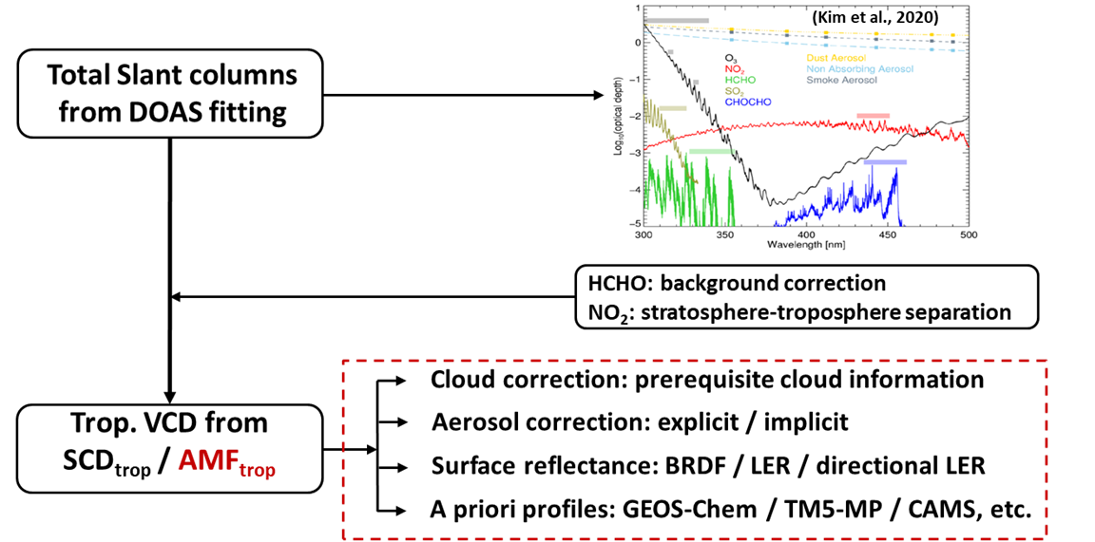
Inconsistency of ancillary parameters in operational NO₂ and HCHO air mass factor (AMF) algorithm
Algorithm | RTM | Aerosol correction | Surface reflectance | A priori profiles | Cloud correction
NO₂ (RPRO v2.4.0) | DAK v3.2 (LUT) | Implicit | TROPOMI DLER | TM5 (1 x 1) | CP: from FRESCO-S; CF: calculated at 440 nm
HCHO (RPRO v2.4.1) | VLIDORT v2.6 (LUT) | Implicit | OMI-based monthly MLER | TM5 (1 x 1) | CF and CP: from OCRA/ROCINN-CRB

Slide 4
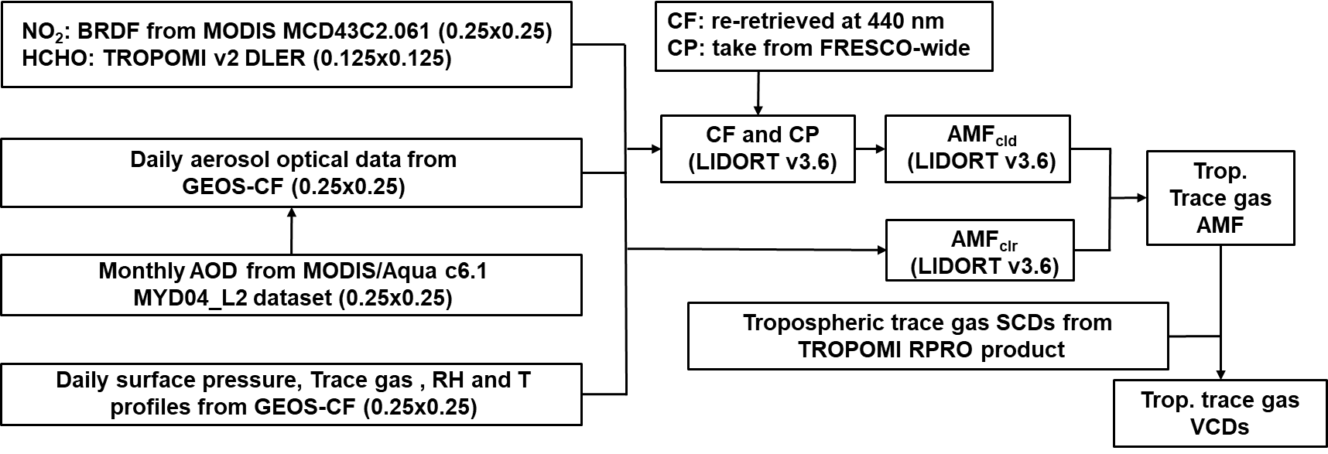
POMINO algorithm for consistent global HCHO and NO₂ AMF calculation
Improved consistency in POMINO algorithm
POMINO Algorithm | RTM | Aerosol correction | Surface reflectance* | A priori profiles | Cloud correction
NO₂ | LIDORT v3.6 (online) | Explicit | MODIS BRDF + TROPOMI DLER | GEOS-CF (0.25 x 0.25) | CP: from FRESCO-S; CF: re-calculated at 440 nm with consistent parameters
HCHO | LIDORT v3.6 (online) | Explicit | TROPOMI DLER | GEOS-CF (0.25 x 0.25) | The same as NO₂

Slide 5
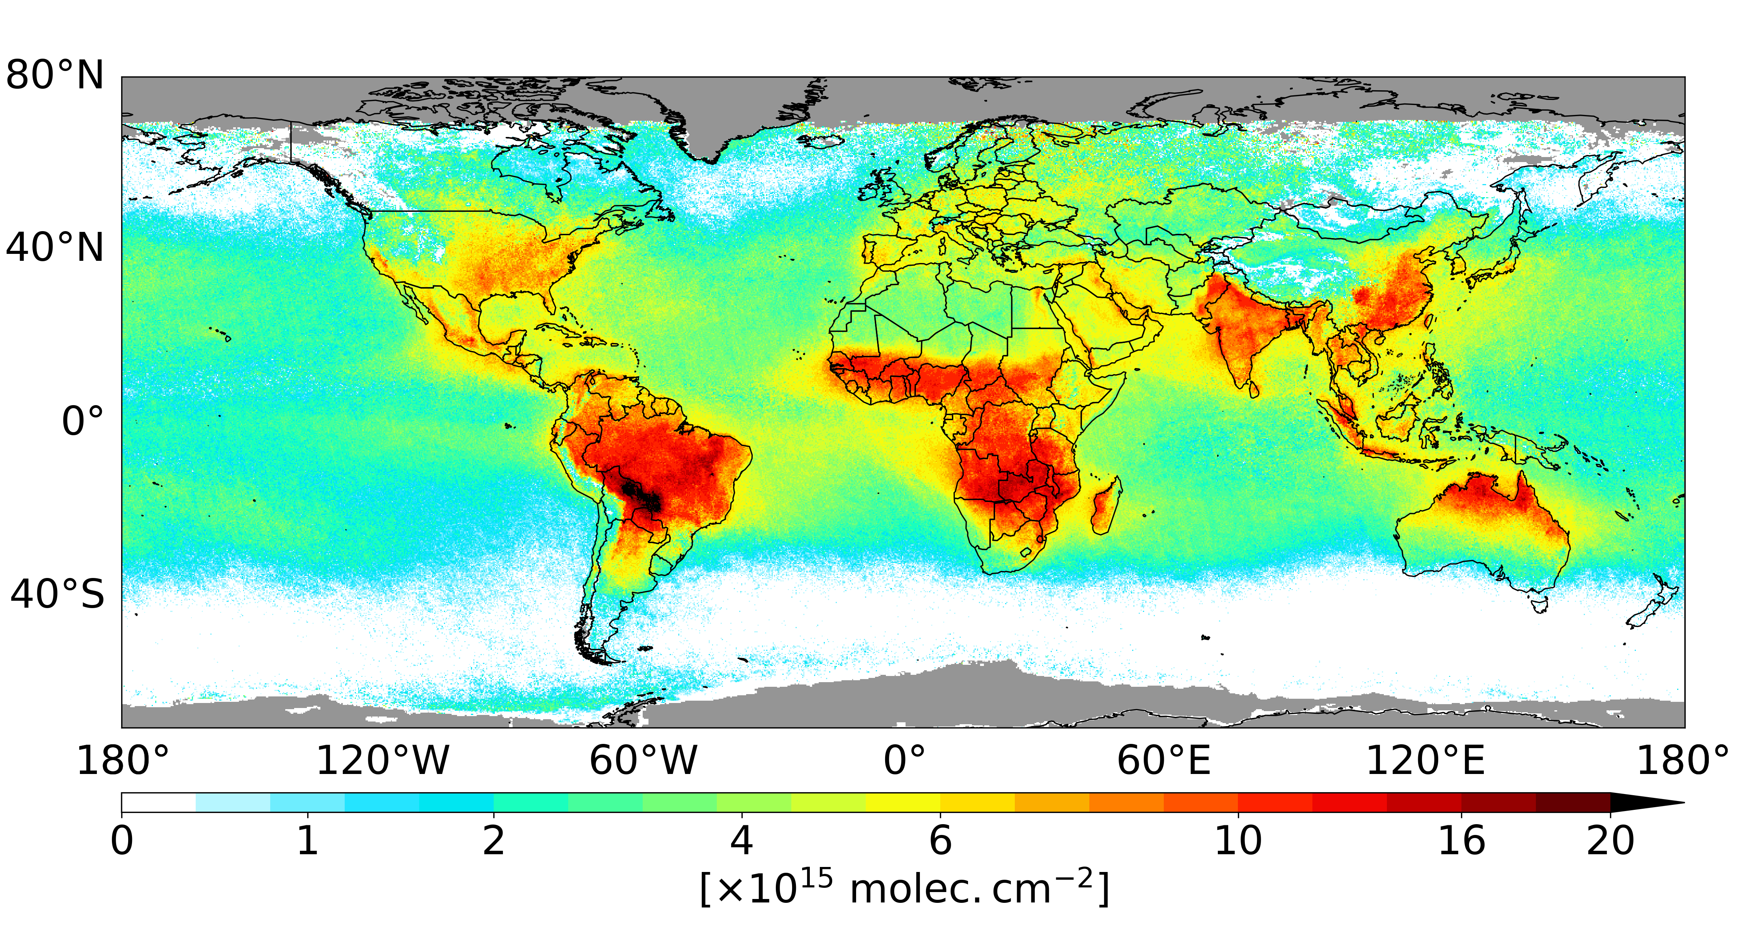
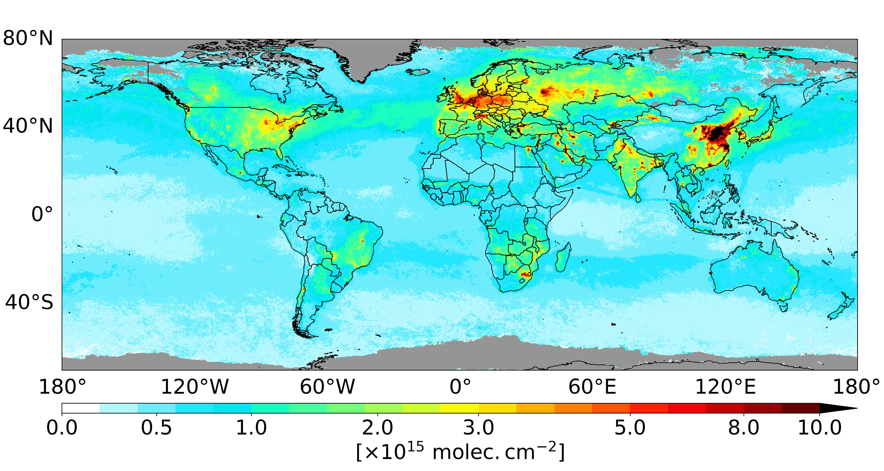
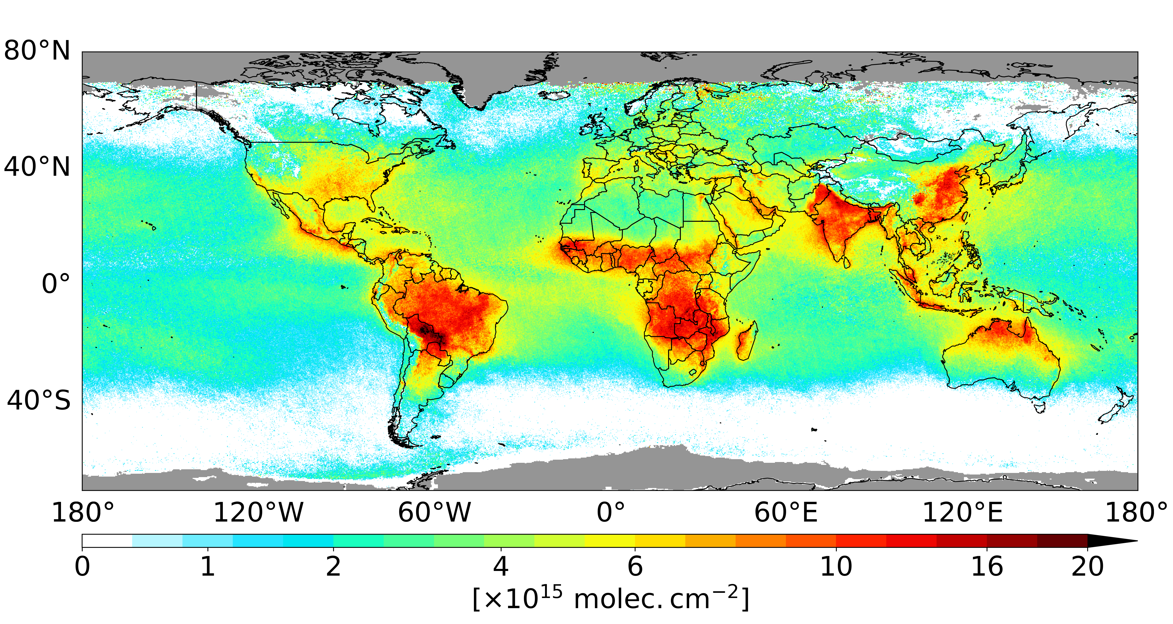
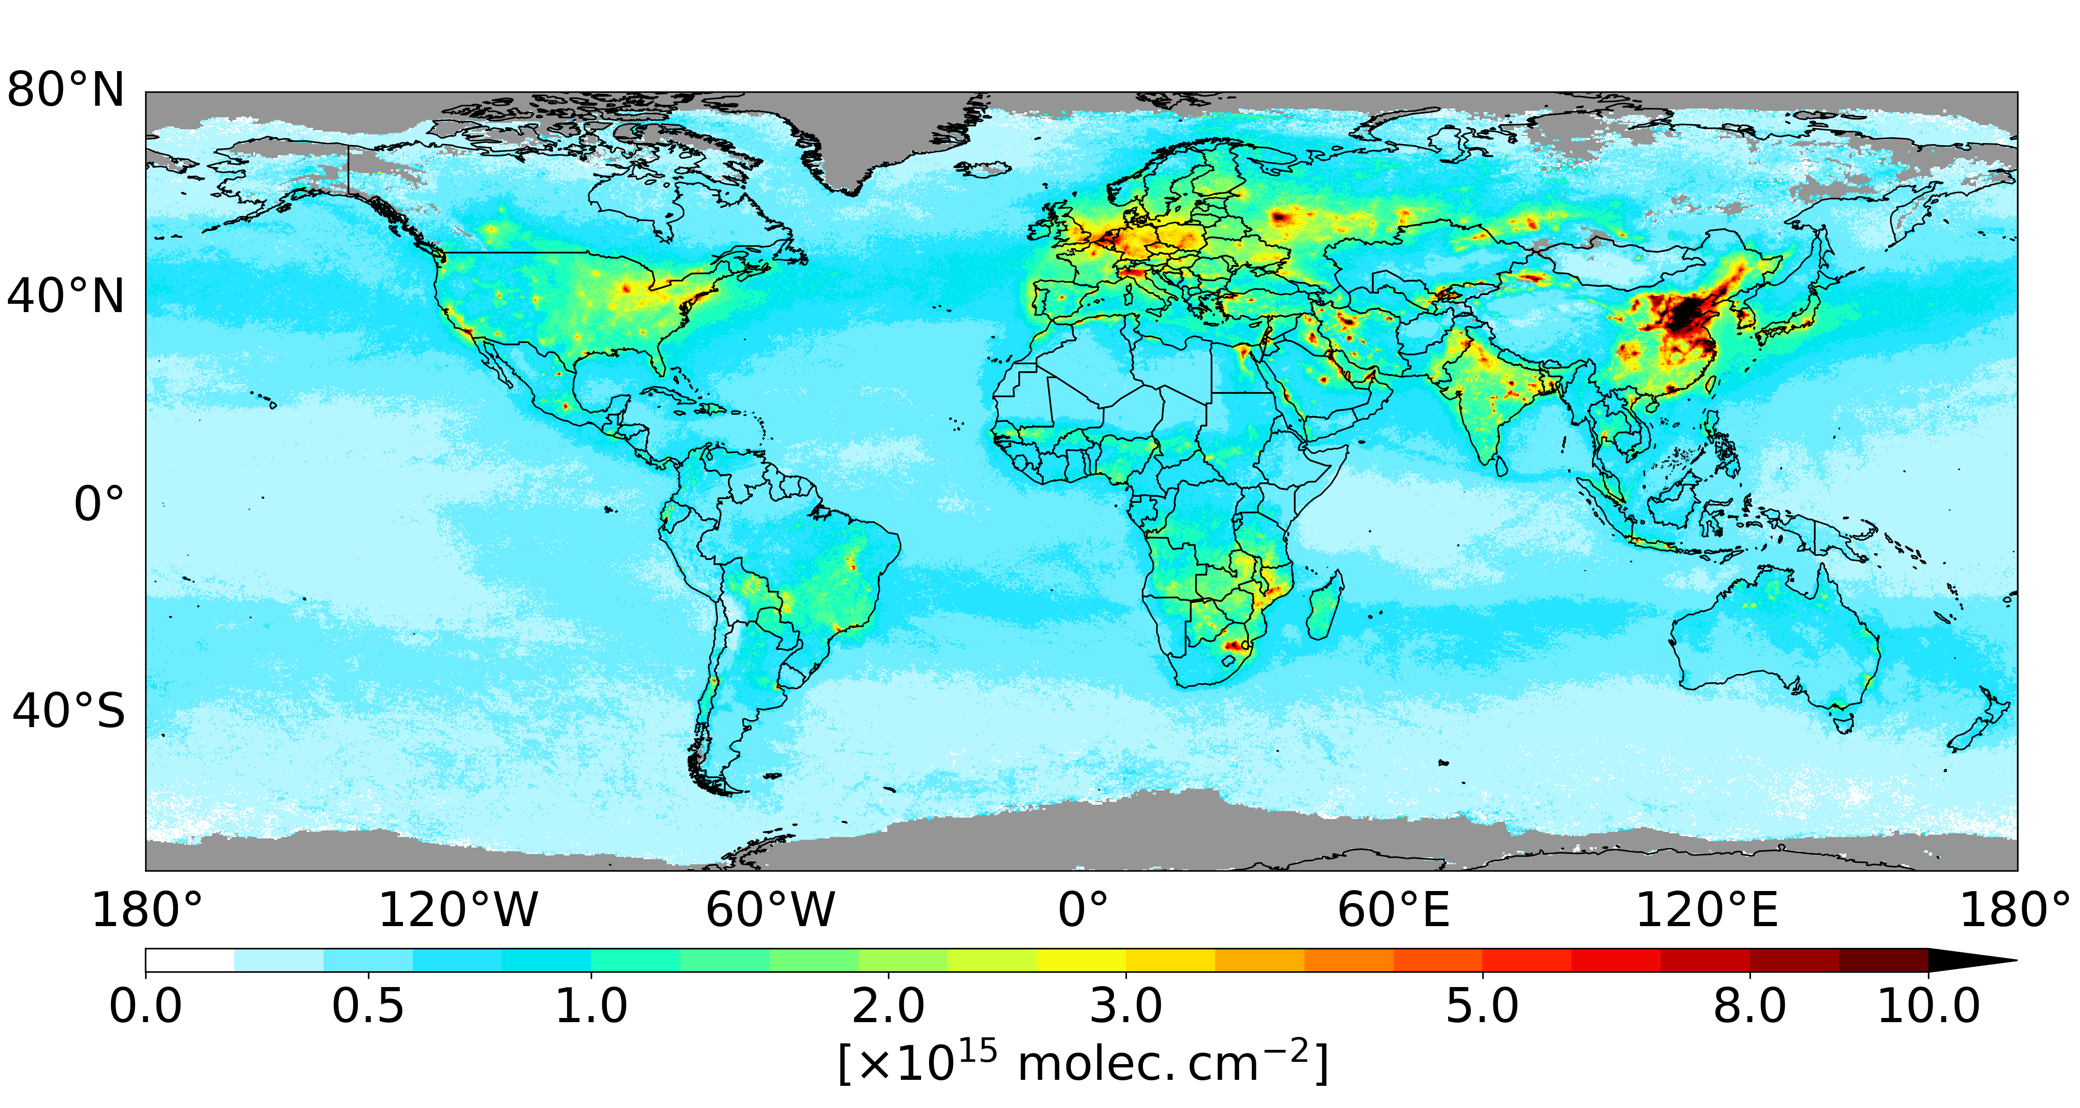
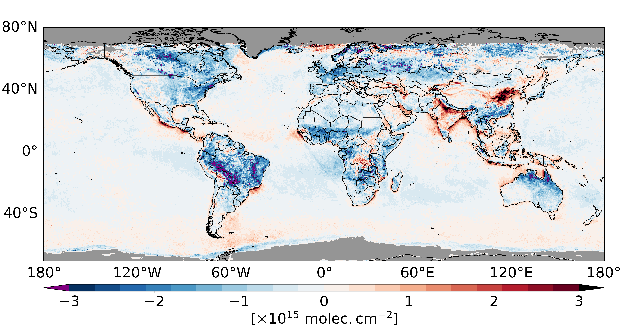
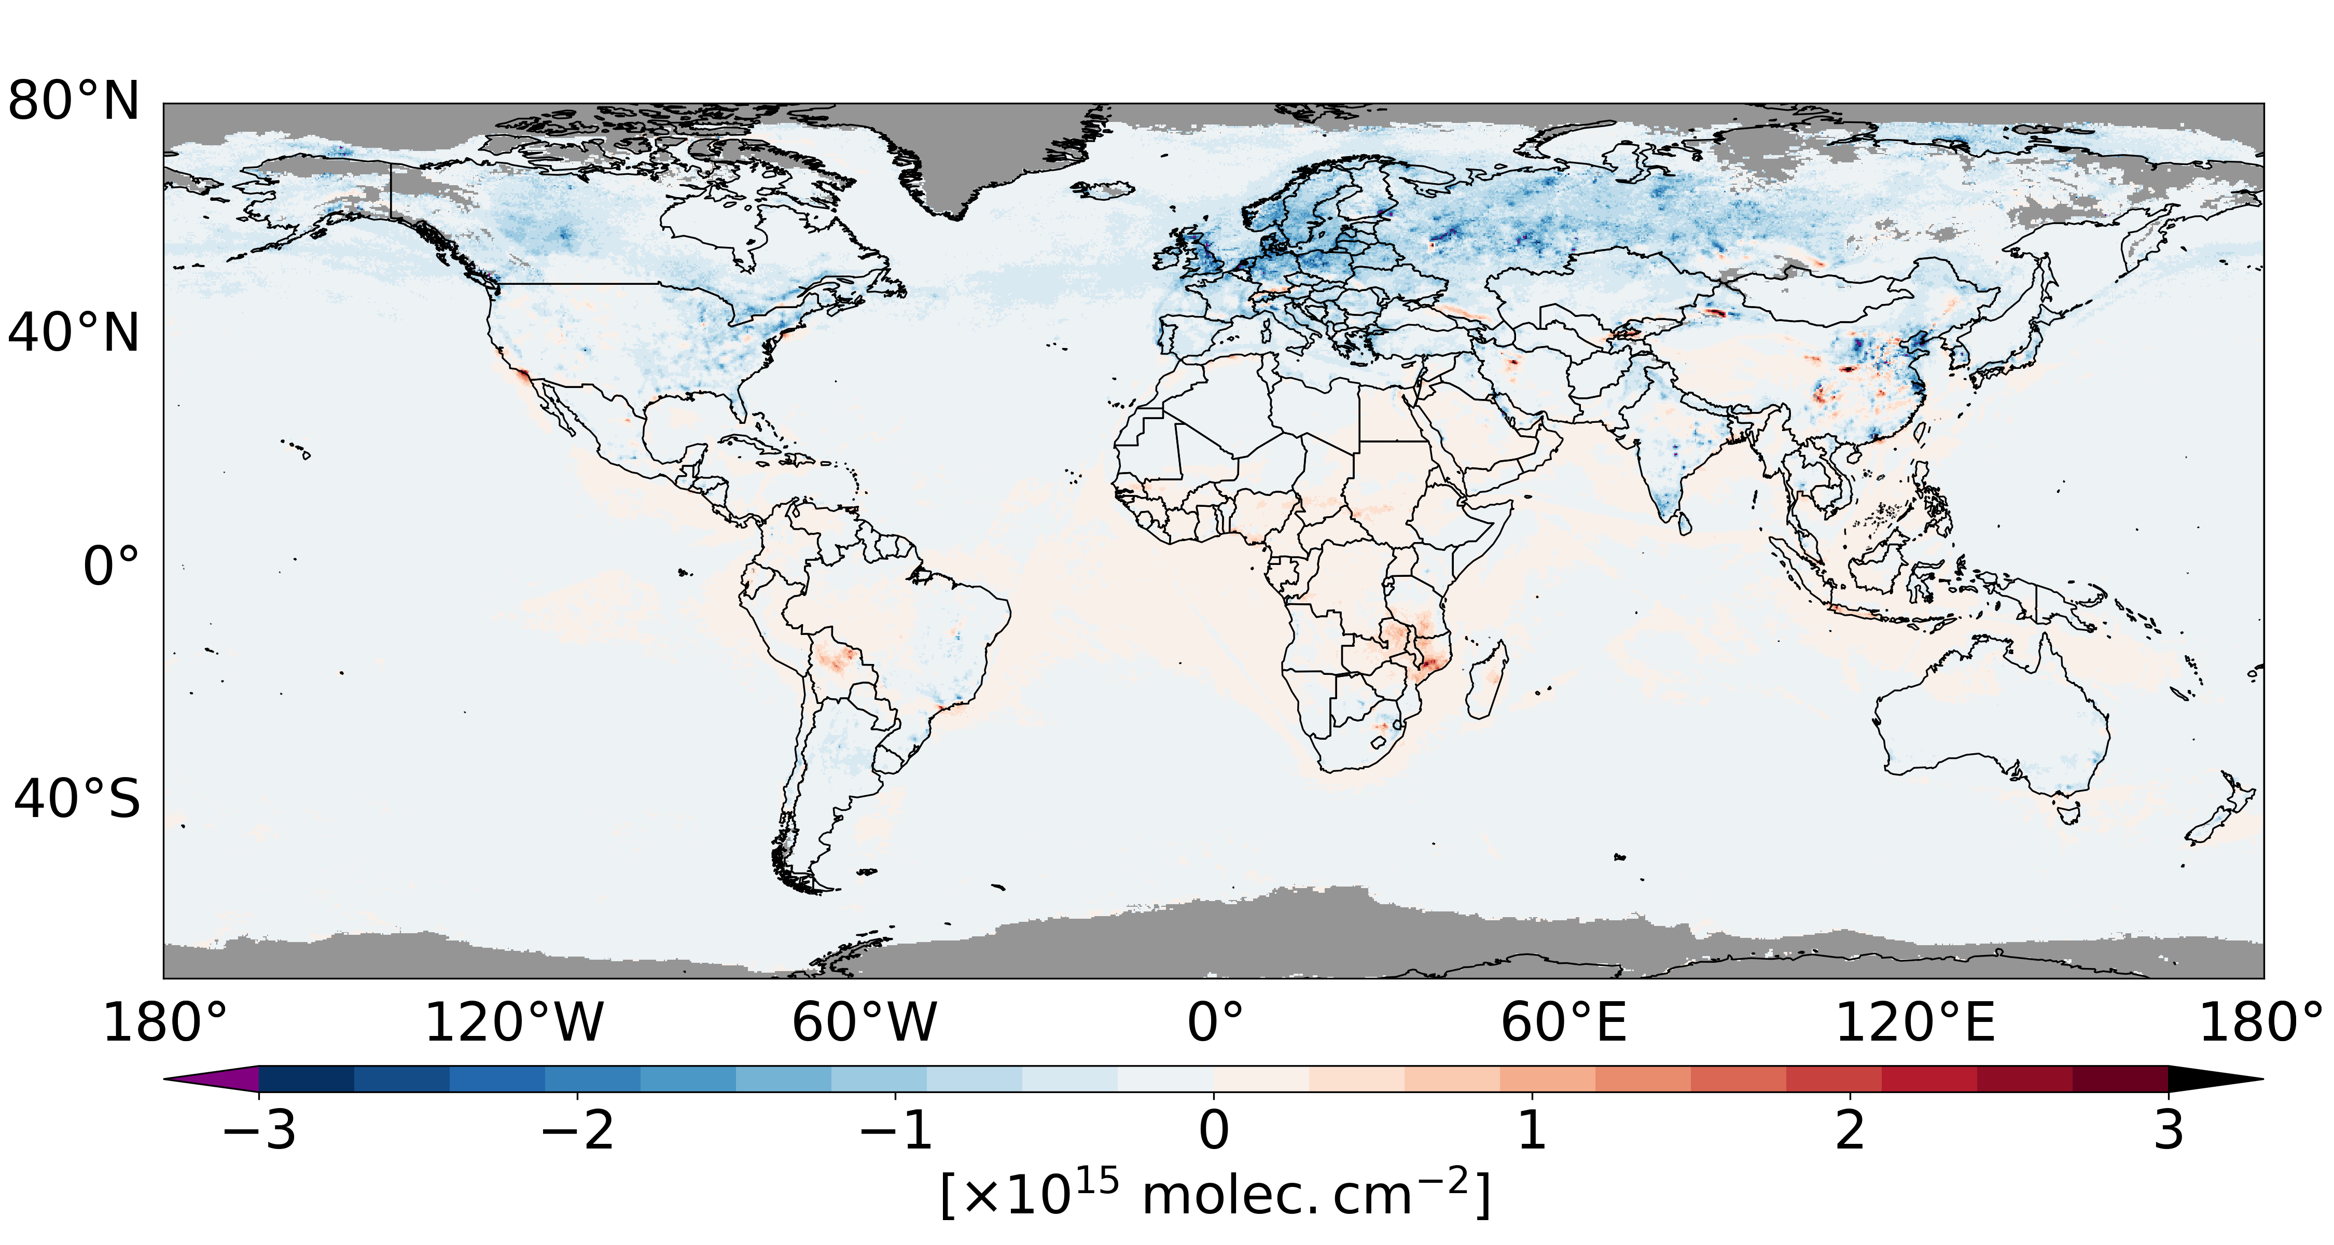
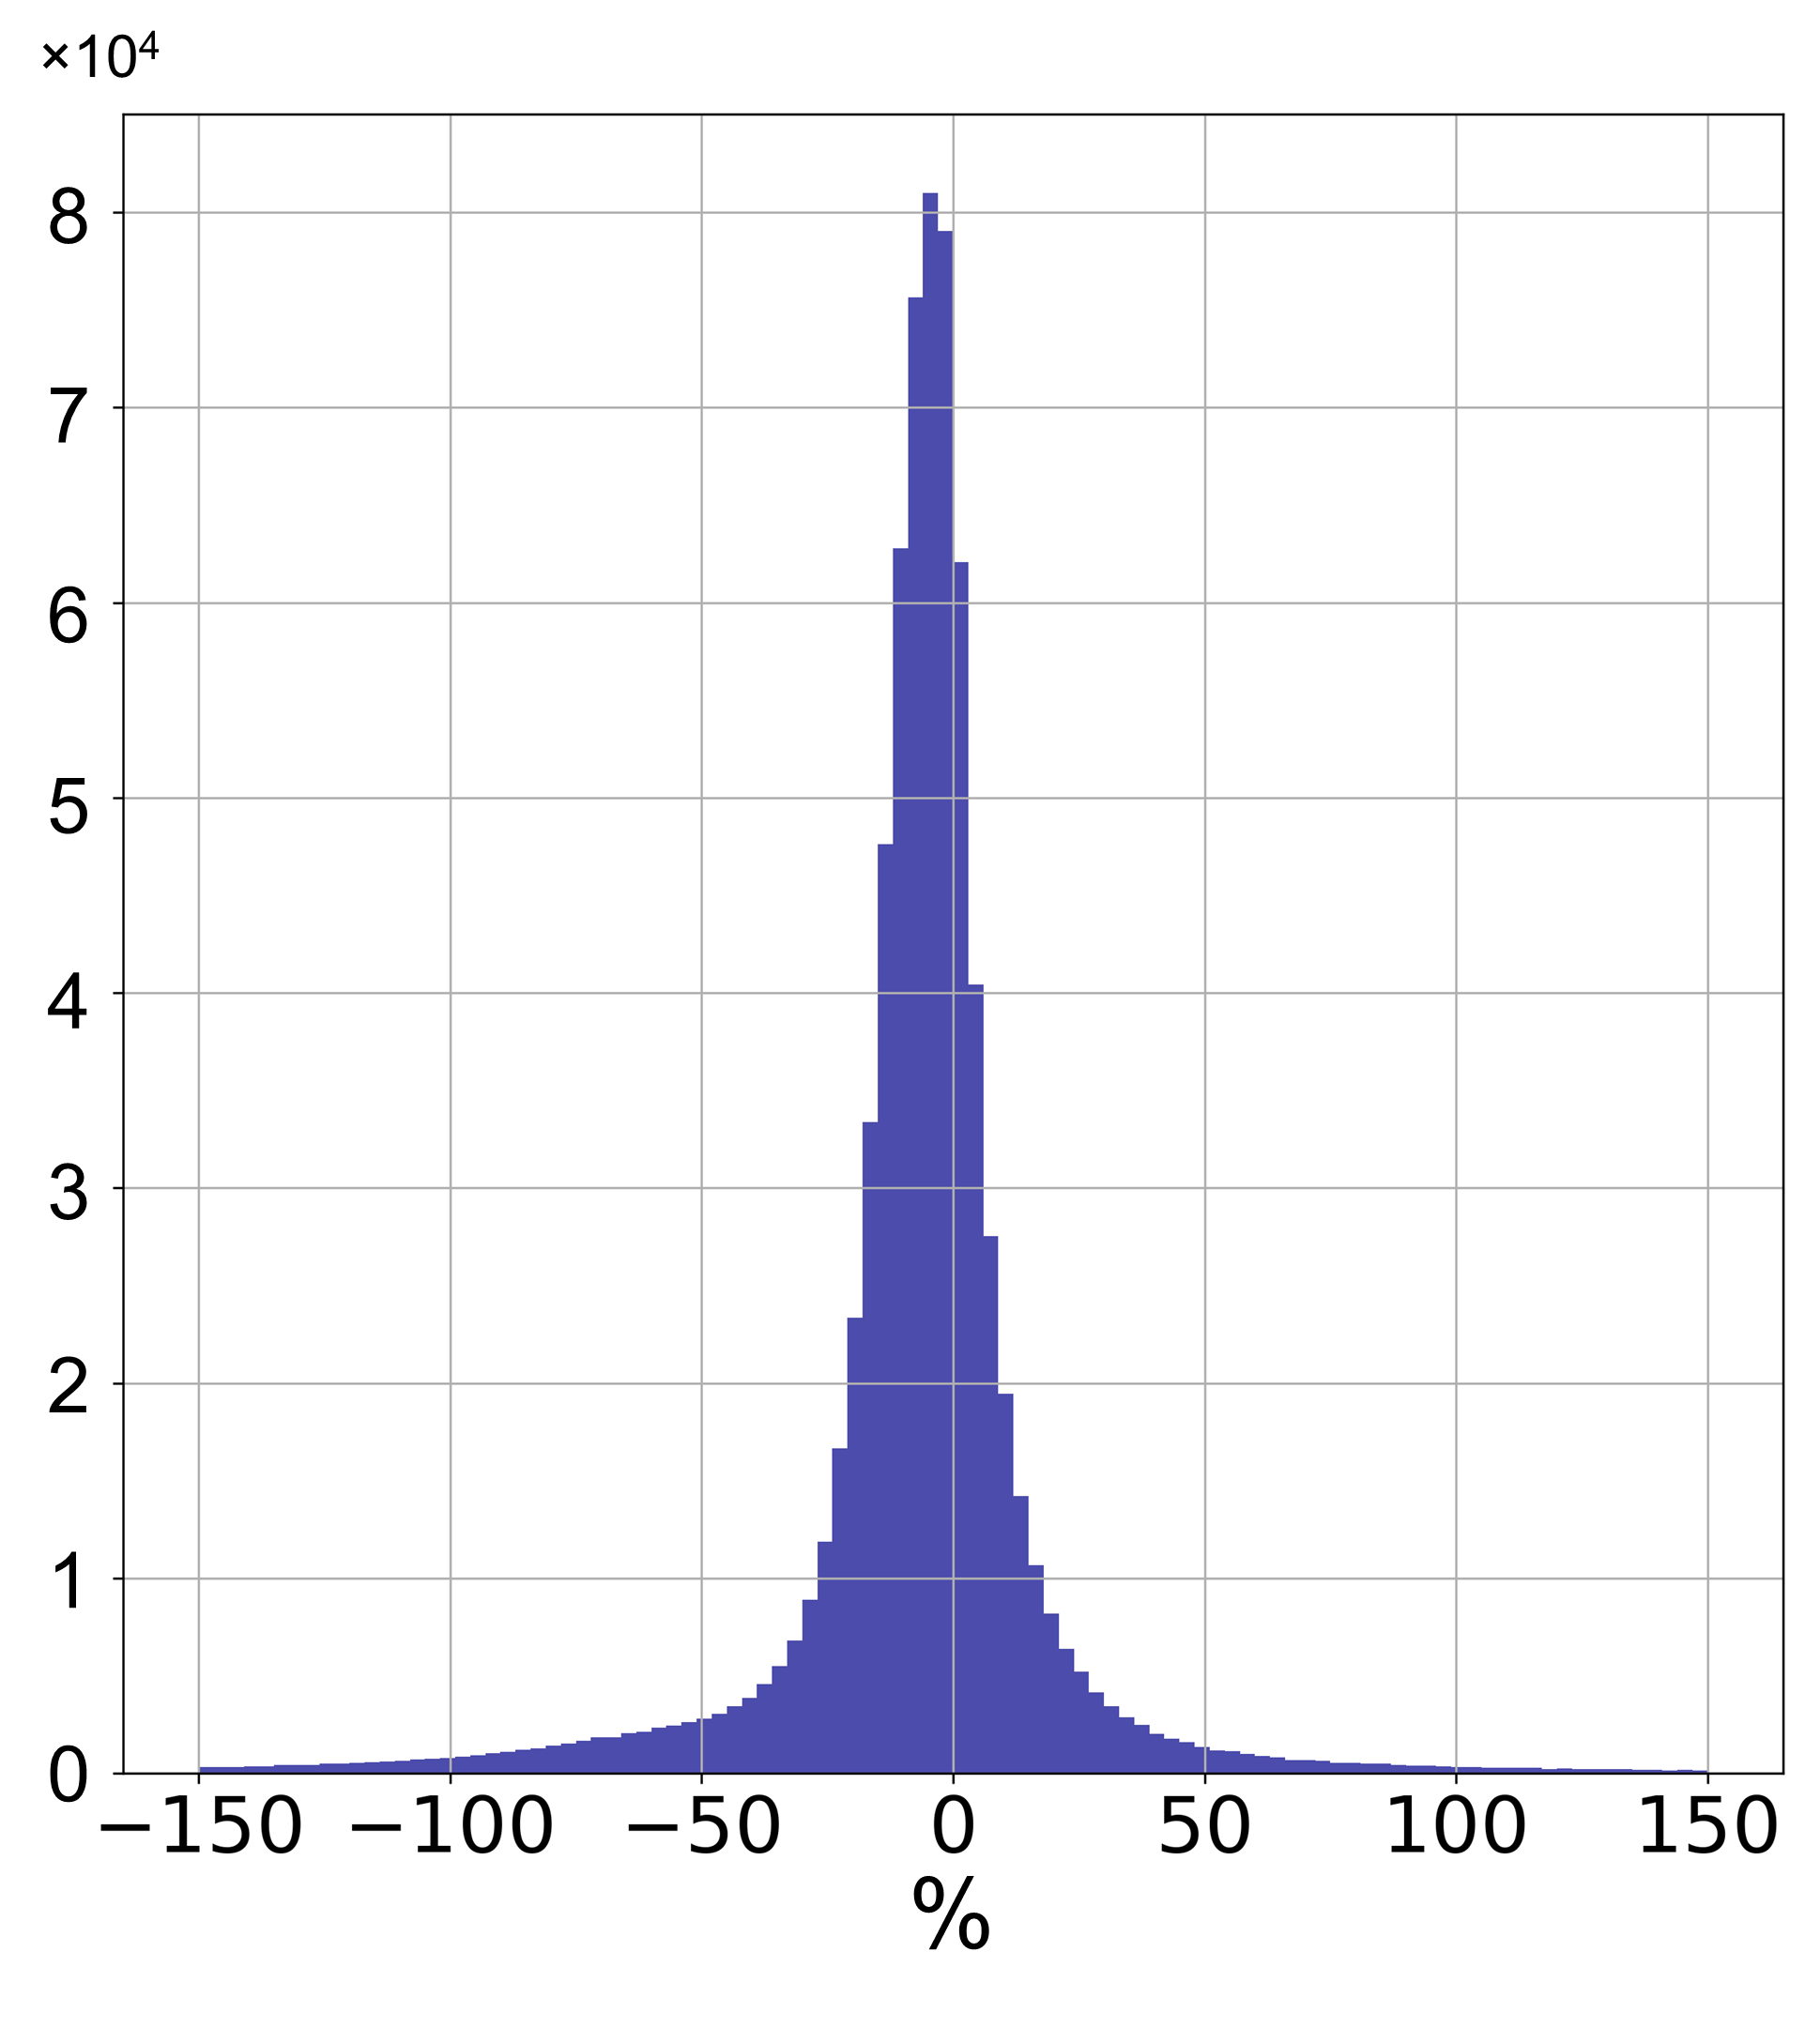
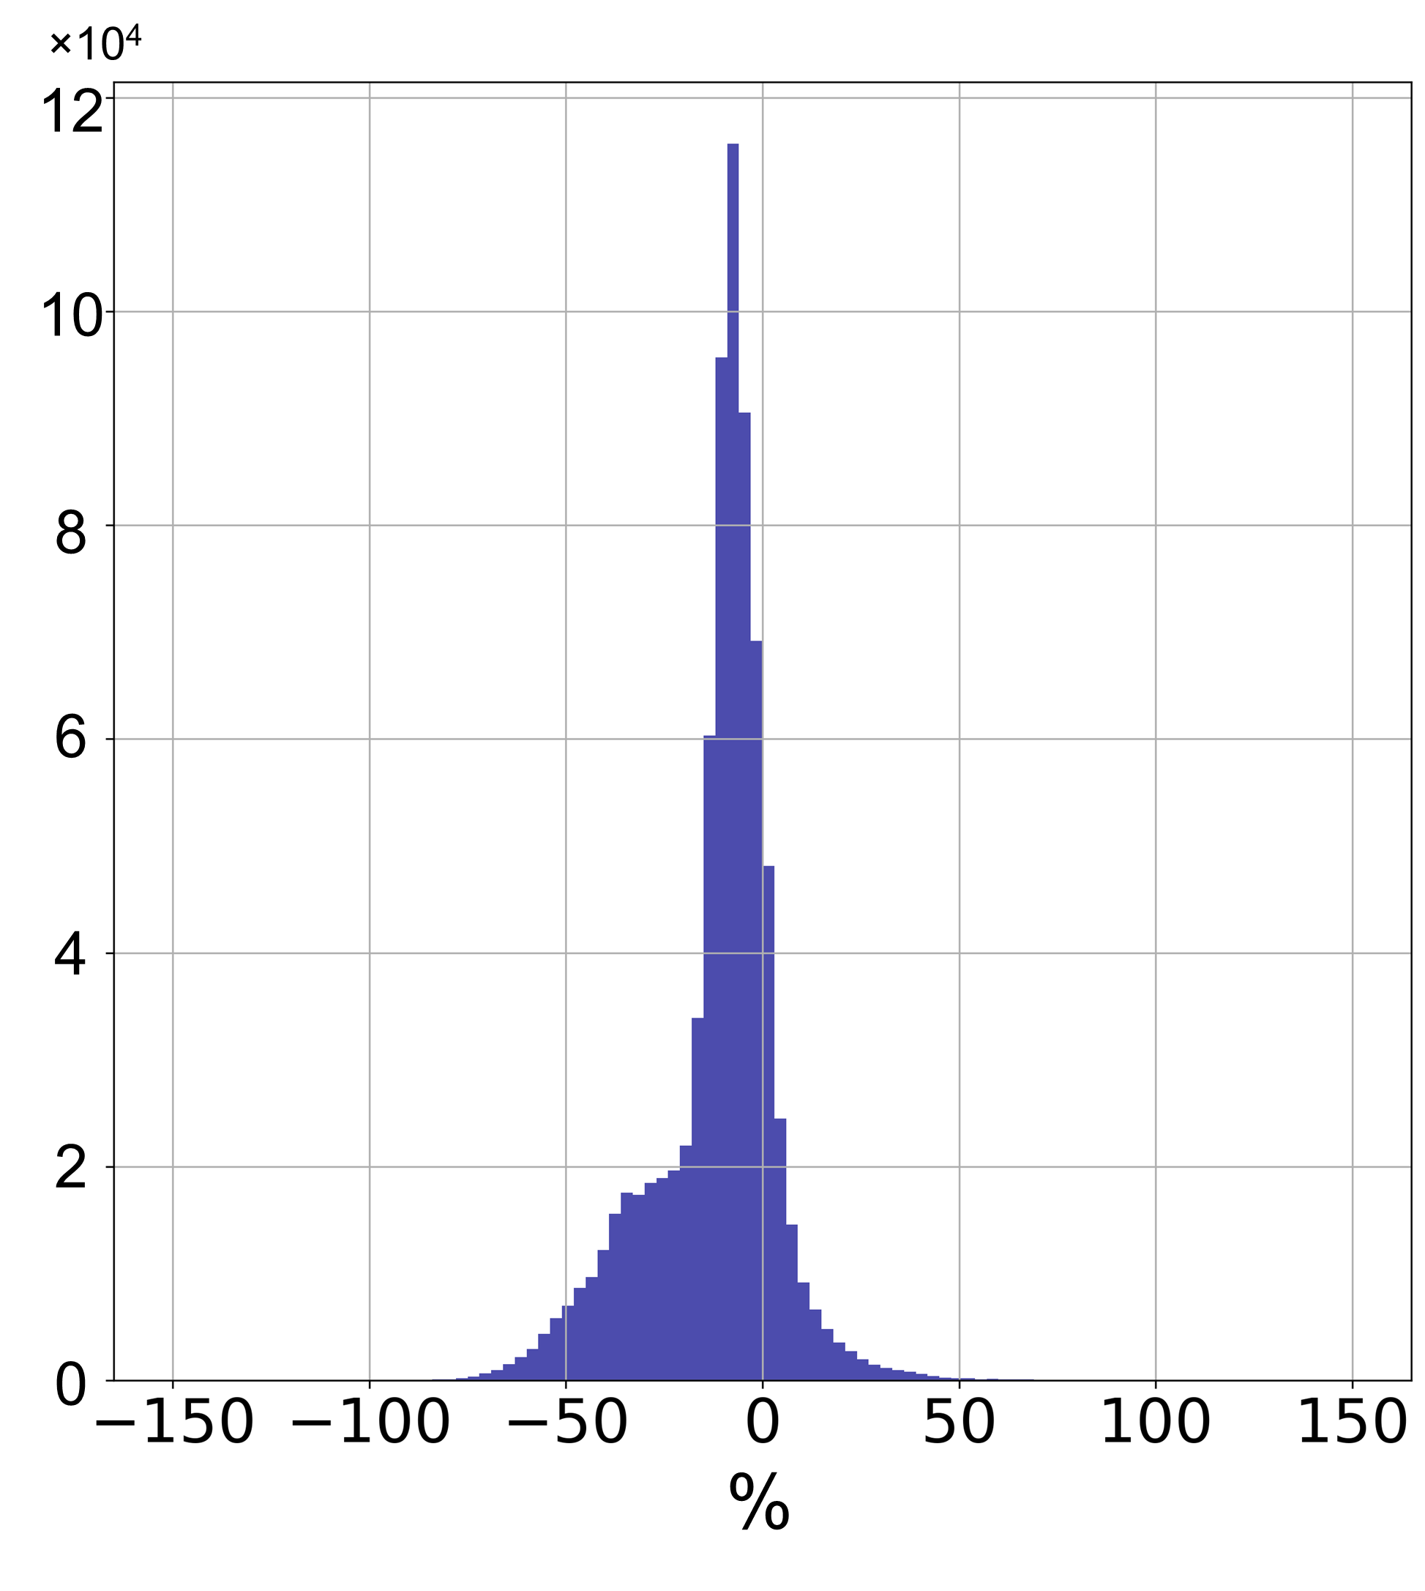
Good spatial agreement but lower RPRO HCHO and NO₂ columns by 10-20% over polluted regions
HCHO: POMINO
NO₂: POMINO
HCHO: RPRO v2.4.1 – POMINO
NO₂: RPRO v2.4.0
HCHO: RPRO v2.4.1
NO₂: RPRO v2.4.0 – POMINO
(averaged in April, July, October 2021 and January 2022)

Slide 6
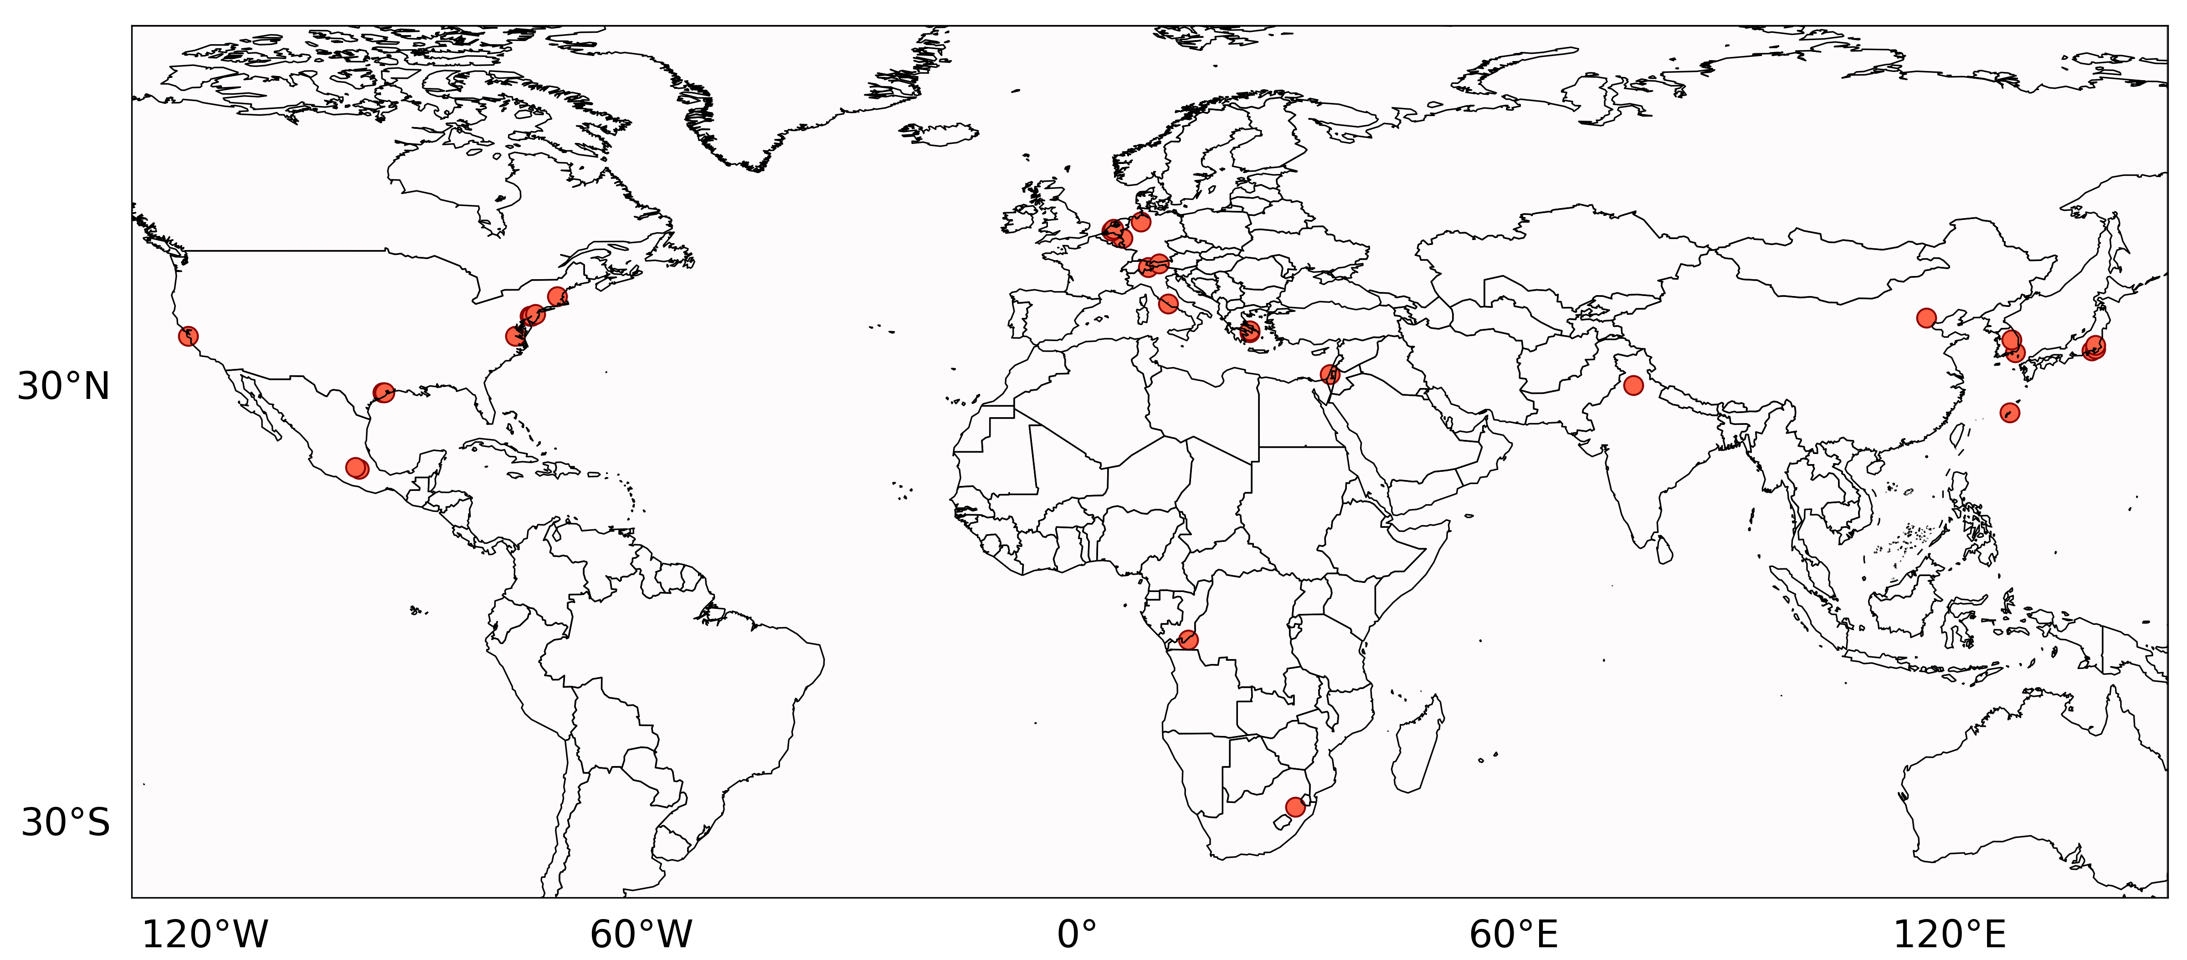
POMINO retrievals feature reduced bias compared with measurements of global MAX-DOAS and PGN/Pandora network
Global MAX-DOAS and PGN/Pandora network
POMINO
RPRO
Data processing:
PGN/Pandora & MAX-DOAS daily columns:
11:00 – 16:00 LT averaging window for HCHO
13:00 – 14:00 LT averaging window for NO₂
Valid collocation criteria:
Satellite pixel QA flag > 0.5
Cloud radiance fraction <= 50%
20km sampling radius for HCHO
5km sampling radius for NO₂
Statistics:
linear regression using robust Theil-Sen estimator

Slide 7
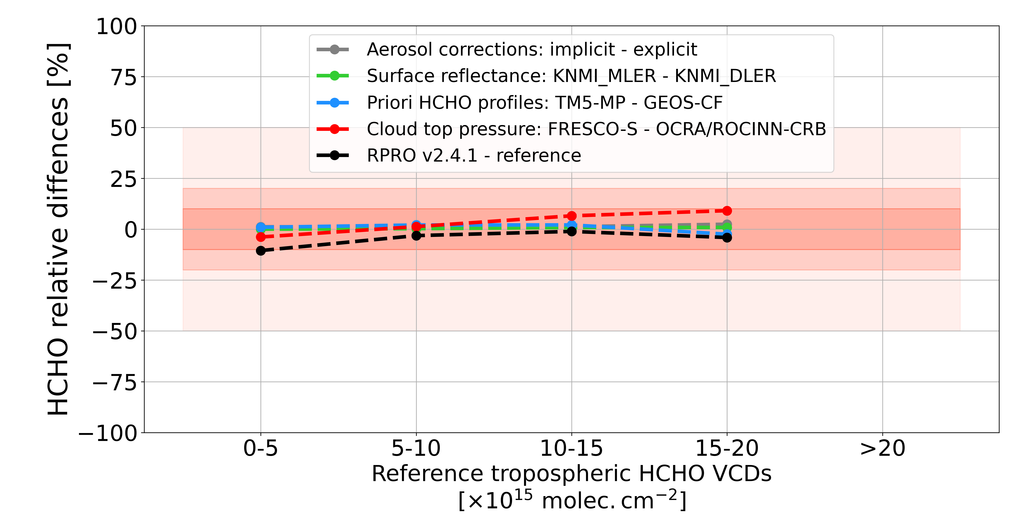
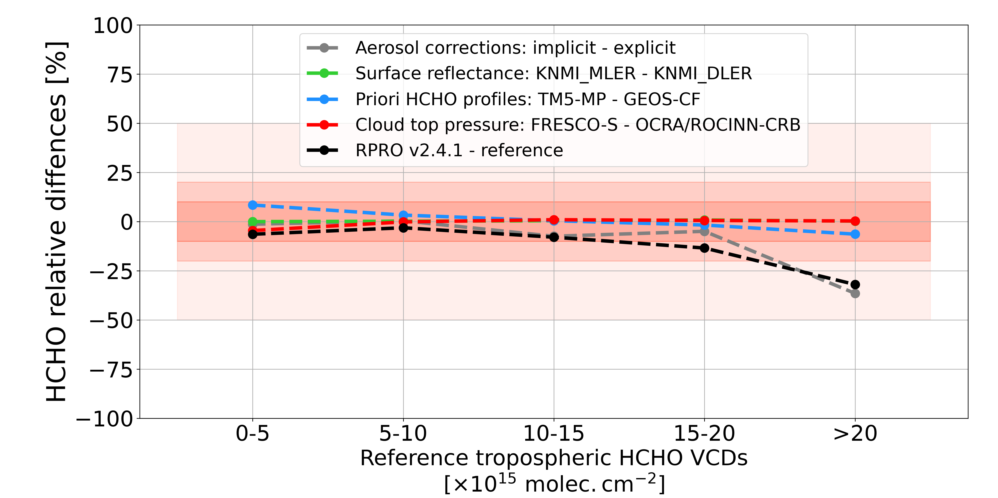
Implicit aerosol corrections lead to lower HCHO columns by ~35% over polluted areas in North America during summertime
North America
East Asia
July 2021
RPRO v2.4.1 – POMINO
RPRO v2.4.1 – POMINO
Implicit aerosol corrections dominate the negative HCHO differences of RPRO over polluted areas in North America → Explicit aerosol corrections should be included under extreme situations (e.g., wildfires)
Directional dependence of HCHO AMF on surface reflectance is very weak, but note systematic differences between different products, e.g., TROPOMI MLER and OMI MLER

Slide 8
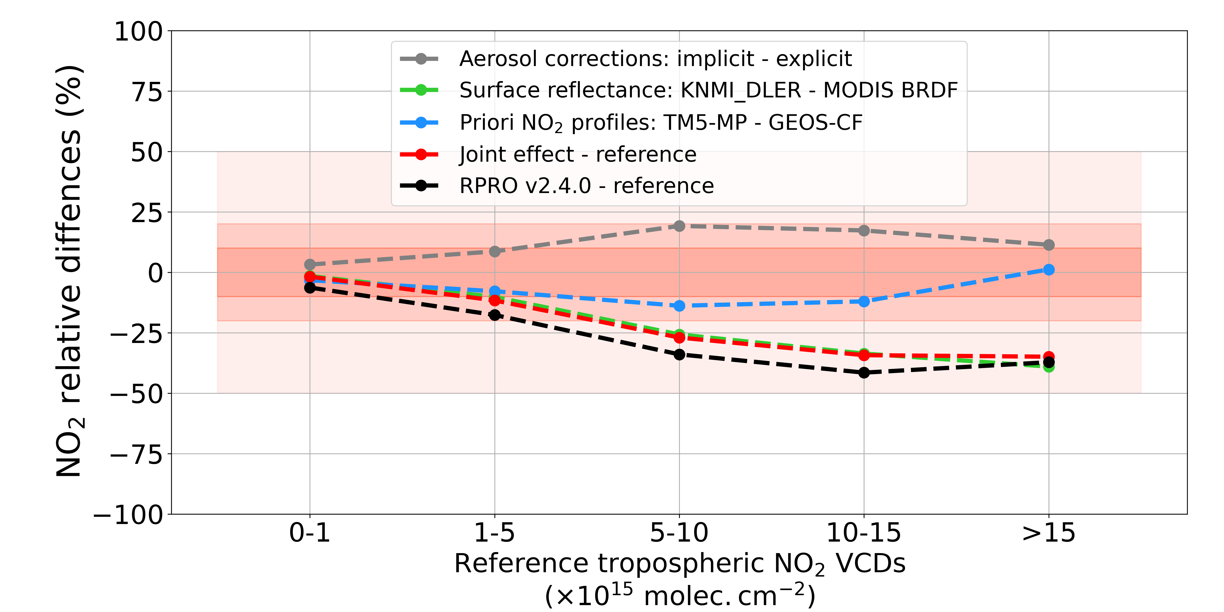
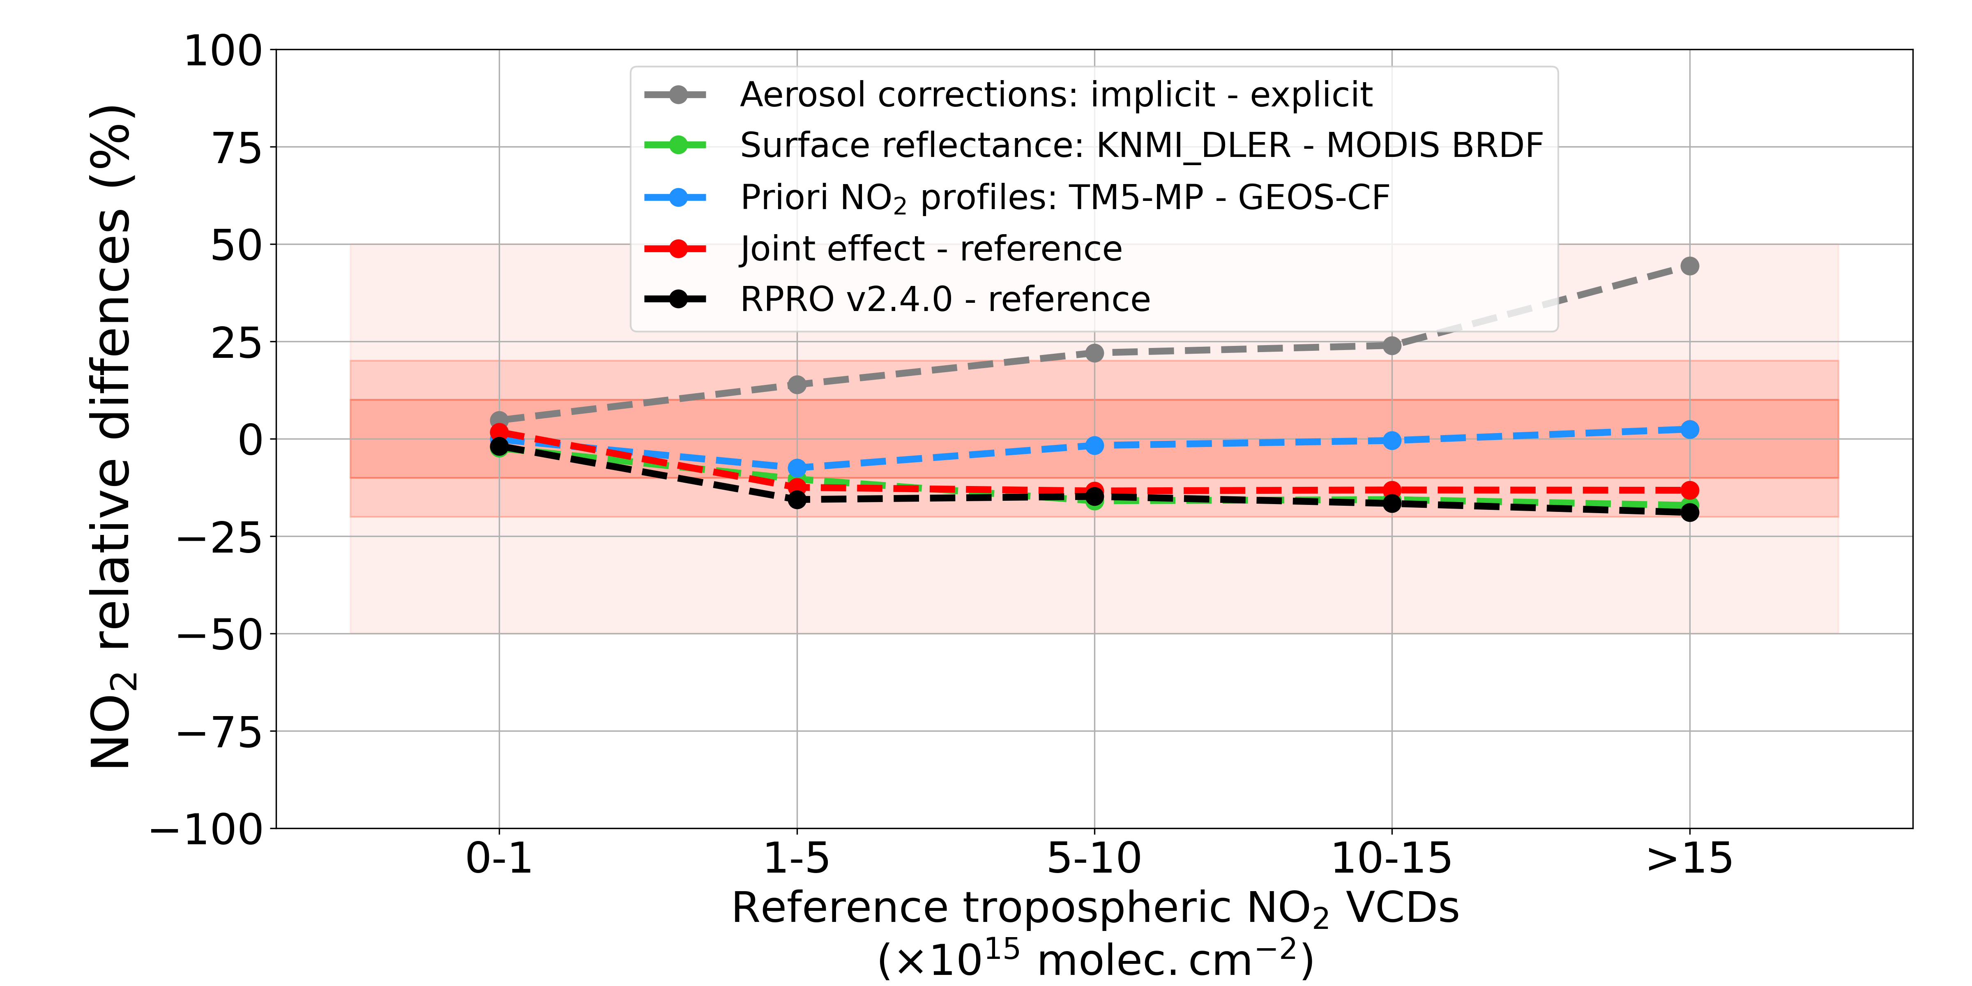
Complex structural uncertainties of NO₂ VCDs from ancillary parameters in AMF calculation
North America
East Asia
Jan. 2022
Structural uncertainty caused by surface reflectance is up to 30% in North America and 25% in East Asia (MODIS blue-sky albedo systematically lower than TROPOMI DLER)
Higher NO₂ columns with implicit aerosol corrections in East Asia are due to enhanced cloud “shielding” effect (increased cloud fraction & cloud layer height > NO₂ layer height)

Slide 9
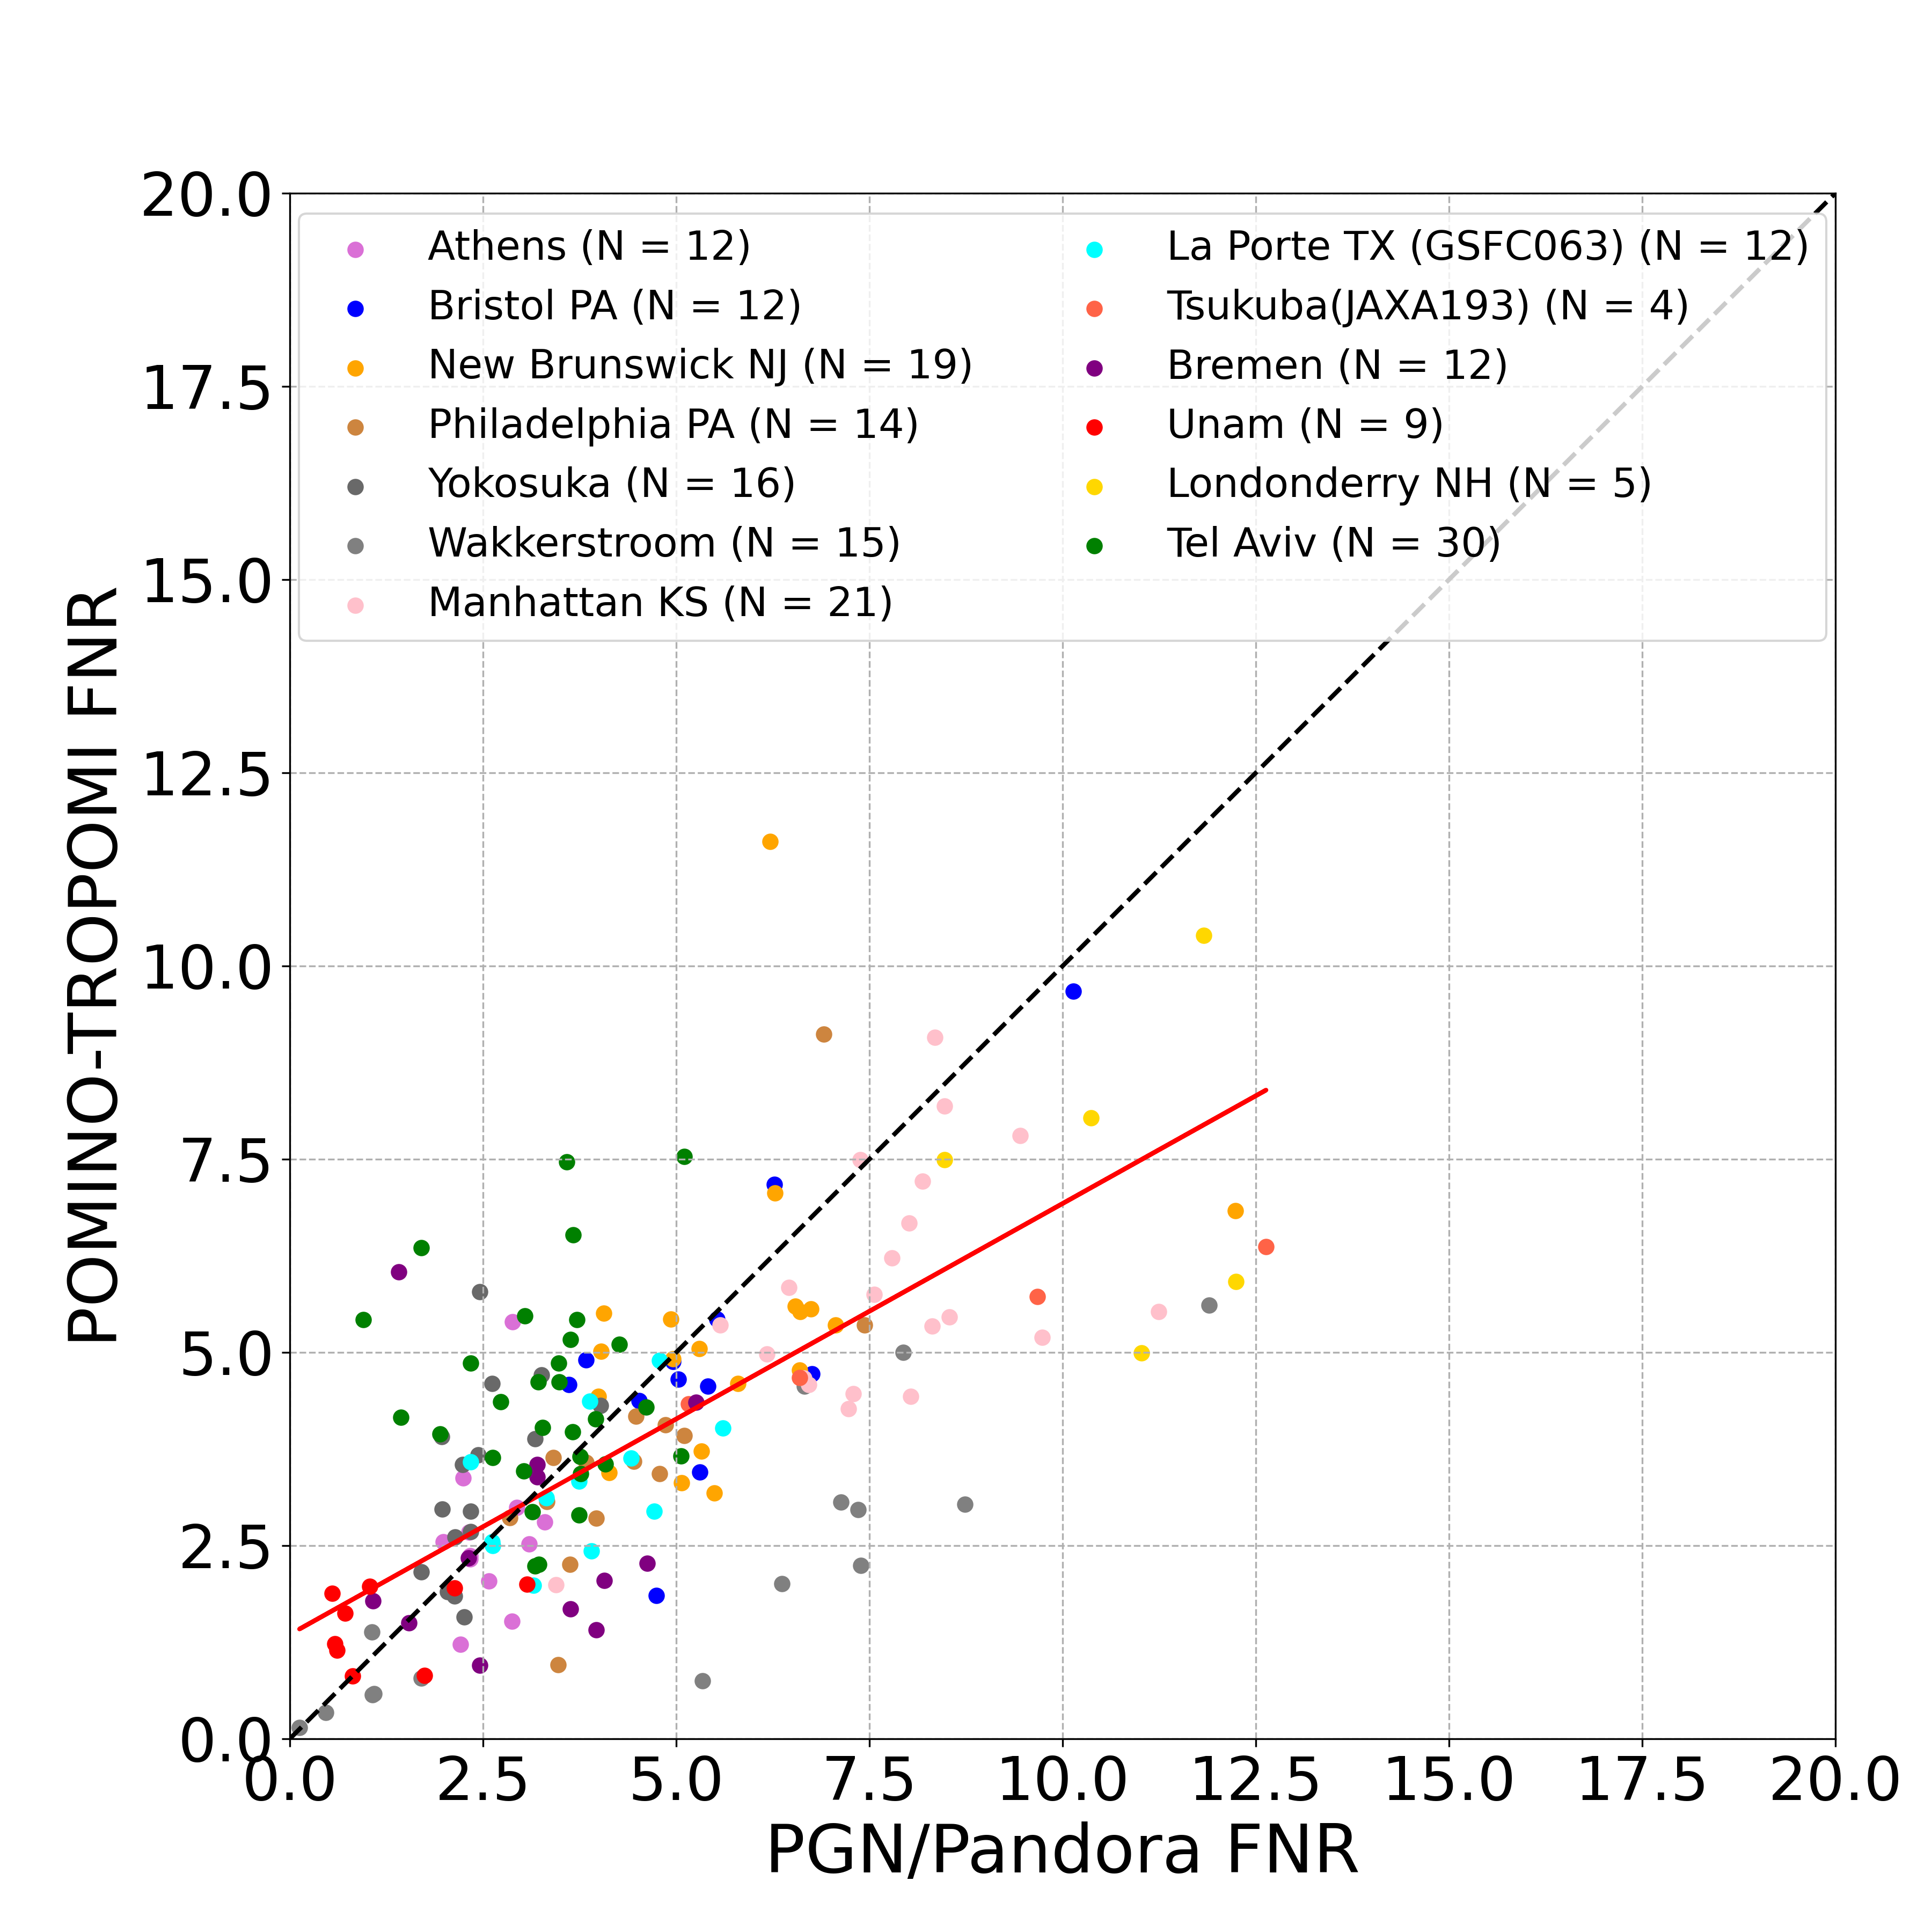
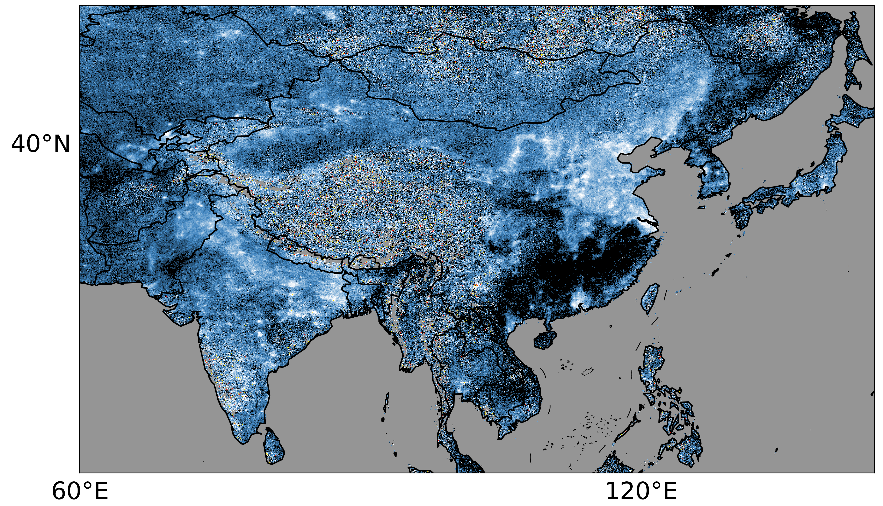
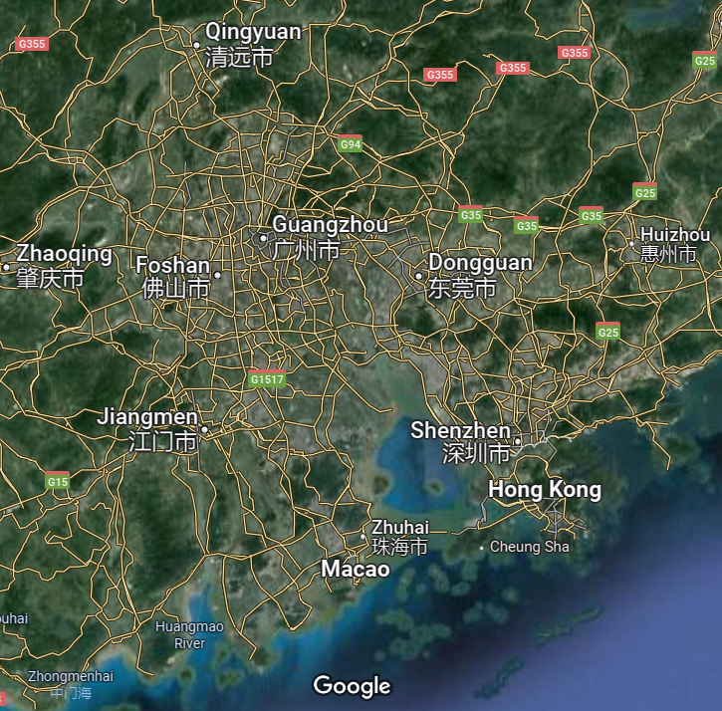
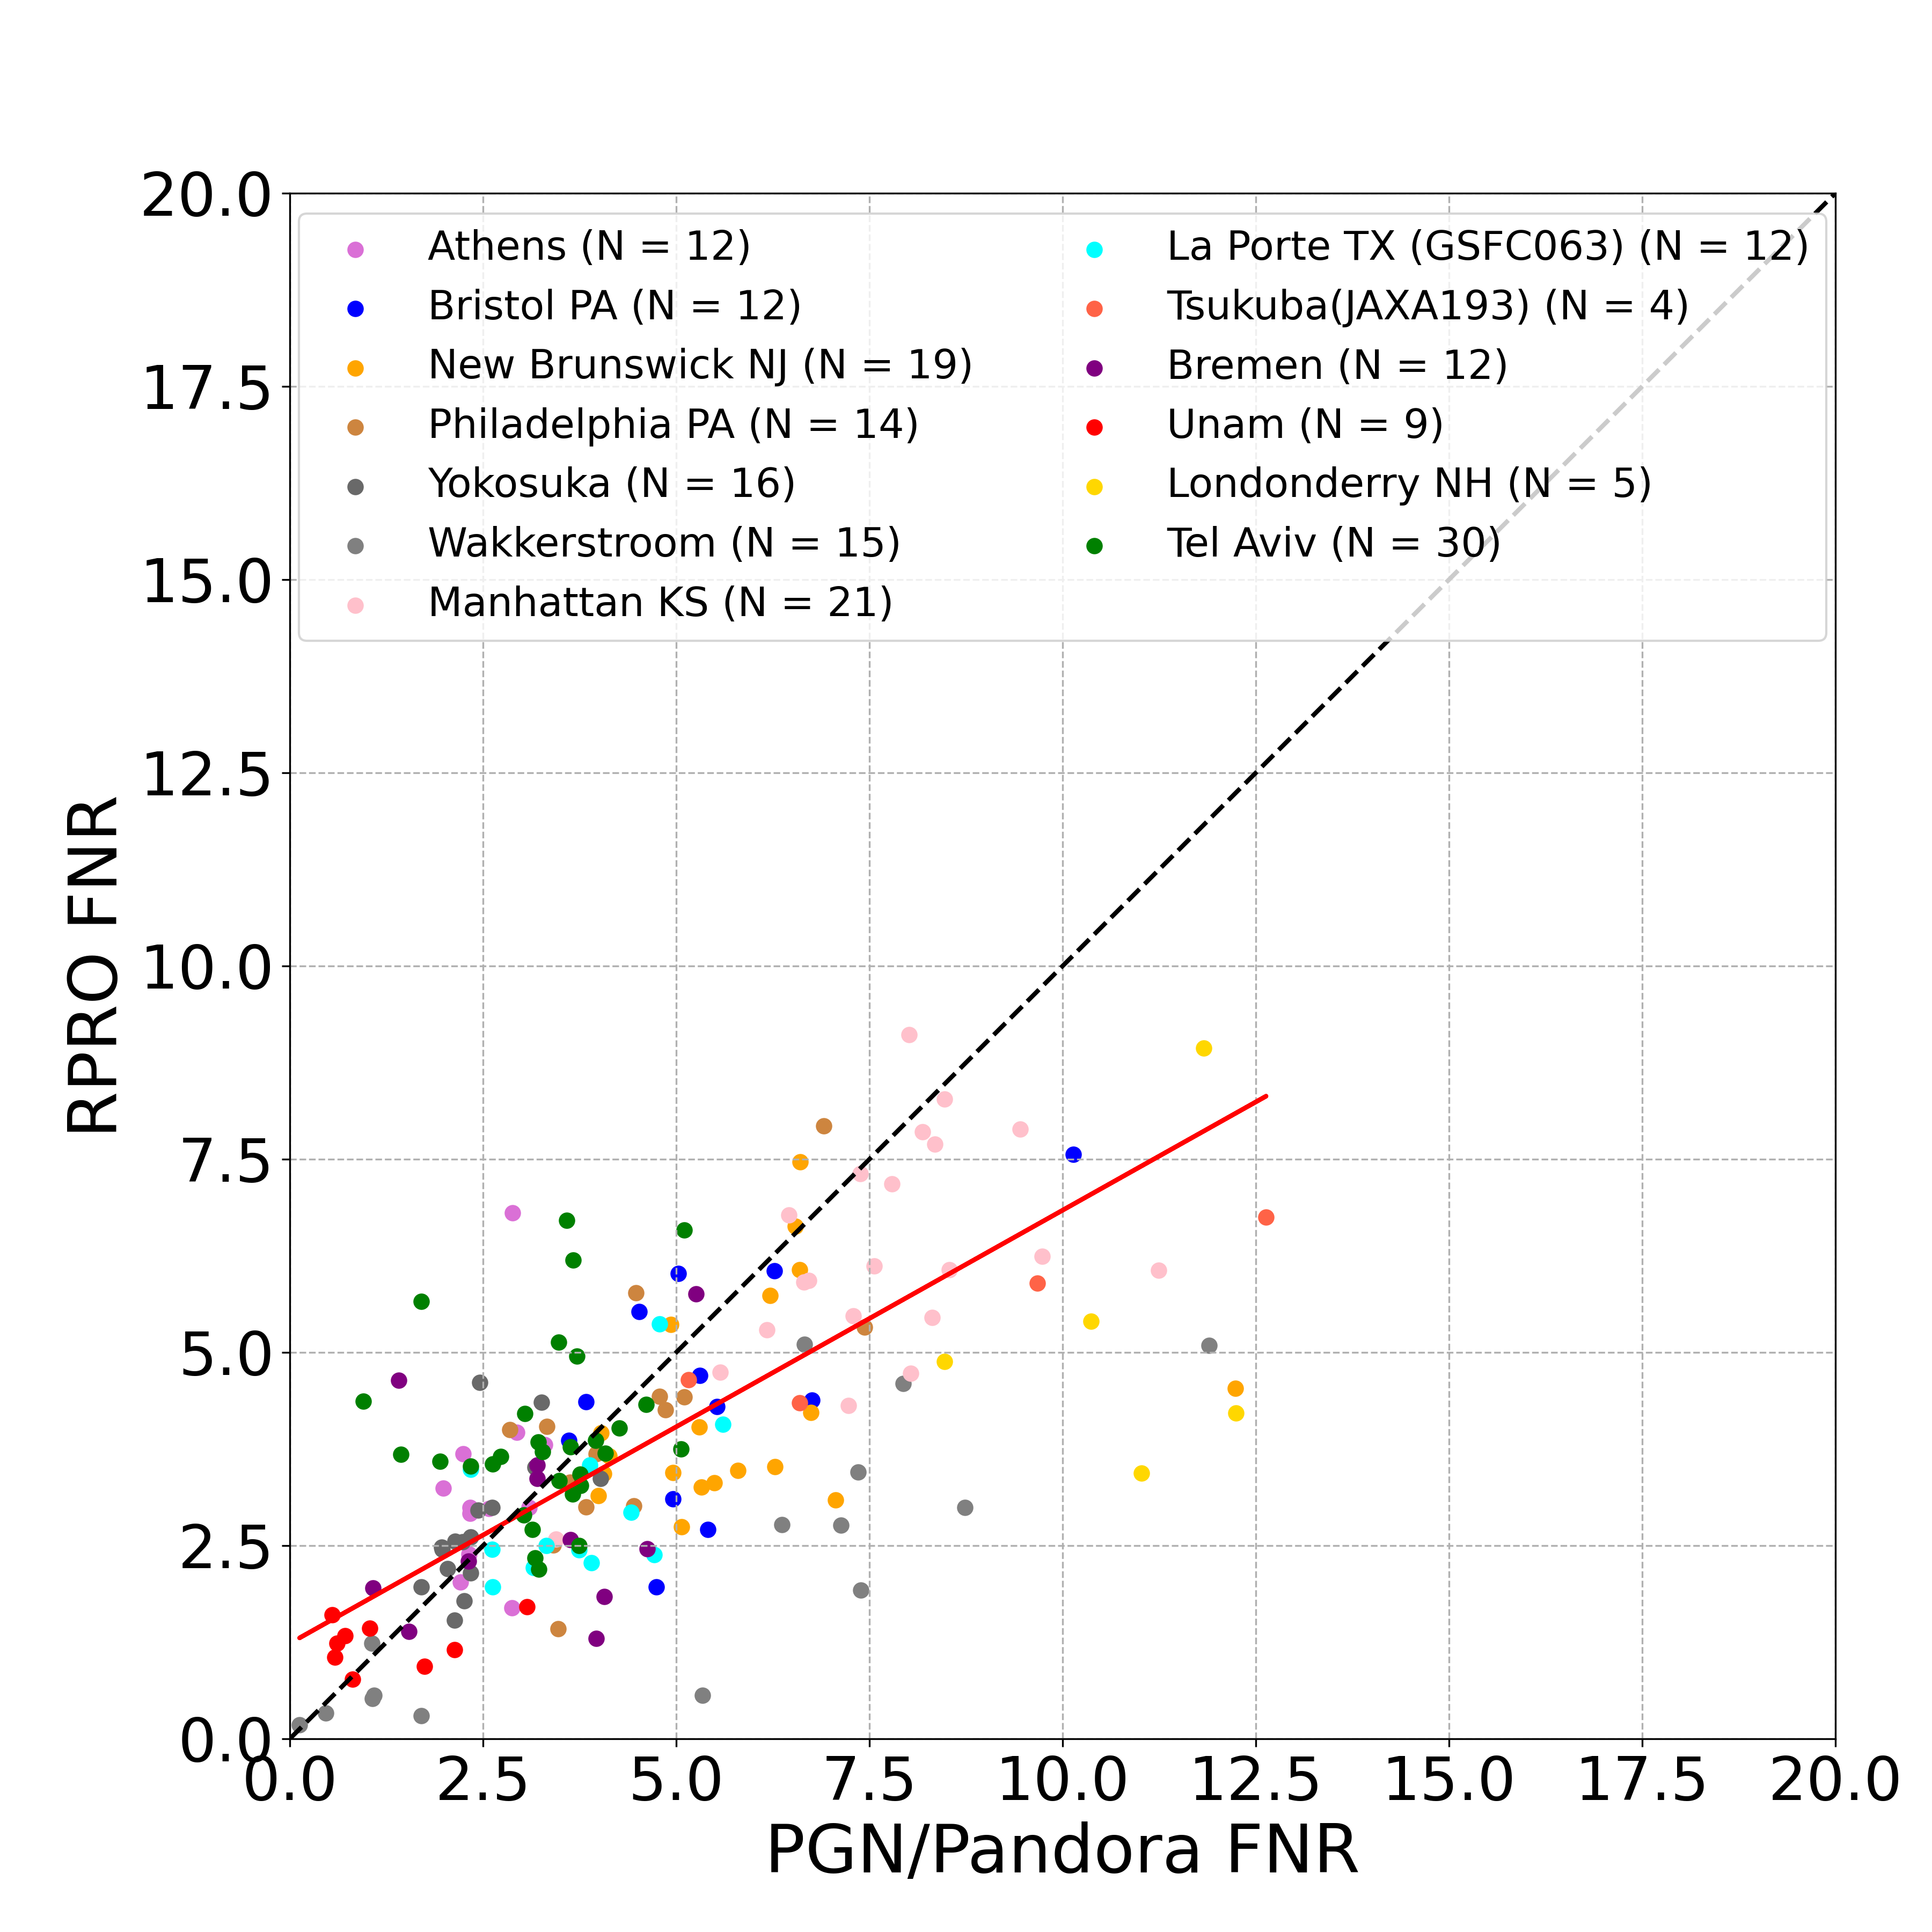
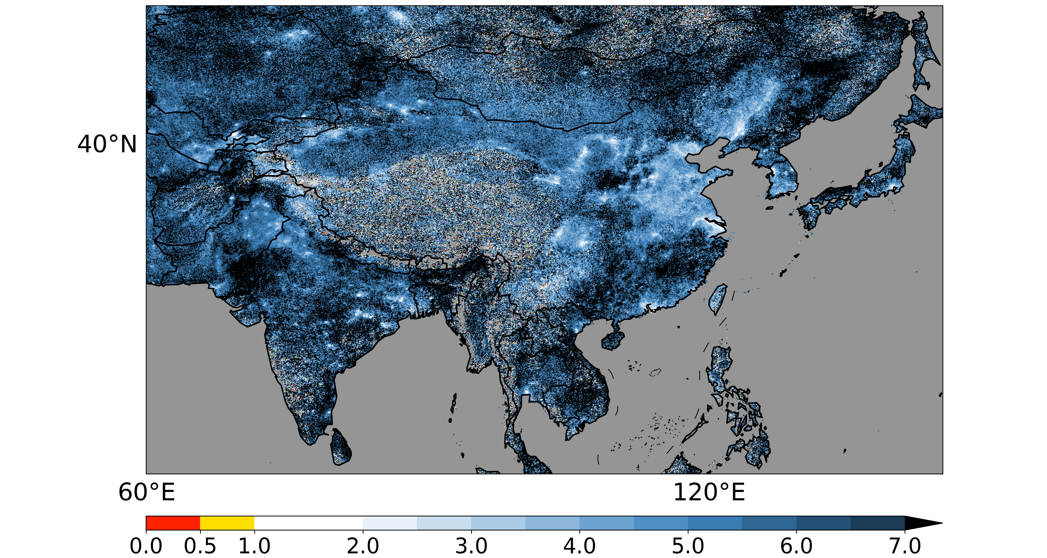
More regions with O₃ sensitivity in transitional regime in East Asia are revealed by POMINO retrievals
July 2021
Y = 0.56 X + 1.35
R = 0.71
NMB = -11.7%
$$FNR= \frac{Ω_{HCHO}^{POMINO}}{Ω_{NO_{2}}^{POMINO}}$$
Pearl River Delta
Y = 0.56 X + 1.23
R = 0.73
NMB = -17.1%
$$FNR= \frac{Ω_{HCHO}^{RPRO v2.4.1}}{Ω_{NO_{2}}^{RPRO v2.4.0}}$$
VOC-limited
Transitional
NOx-limited

Slide 10
Summary
POMINO consistent global HCHO & NO₂ retrievals show promising results
POMINO retrievals feature reduced biases compared with ground-based measurements
Explicit aerosol corrections should be included under extreme situations (e.g., wildfires)
Further evaluation of surface reflectance datasets are needed
POMINO retrievals provide consistent database for ozone sensitivity analysis
*Acknowledgement: We thank the PIs, support staff and funding for establishing and maintaining all the sites of the MAX-DOAS and PGN used in this investigation.

