Slide 1
Ground-based remote sensing validation efforts for the GEMS during the ASIA-AQ campaign
Ukkyo Jeong, Hyunkee Hong, Hanlim Lee, Jhoon Kim, Limseok Chang,
Hyeong-Ahn Kwon, Juseon Park, Myoung Hwan Ahn, Suna Shin, Donghee Kim, Soi Ahn, Dongwon Lee,
Serin Kim, Seong Y. Kim, Subin Lee, Heojun Choi, Sehyeon Park, Mina Kang, Minseok Kim, Jiwoo Lee,
James Crawford, Barry Lefer, Pawan Gupta, Zane E. McBride, Daeho Ko
and many international collaborators
2024 GEMS/TEMPO STM, 30 August 2024, Hawaii, USA
Pukyong National University National Institute of Environmental Research
Kongju National University Pusan National University University of Suwon
Korea Aerospace Research Institute Ehwa Women’s University NASA

Slide 2
Ground Remote Sensing Goals : Provide INTENSIVE reference dataset for VALIDATING the GEMS and GCAS during the Asia-AQ campaign
8~9 Sun/sky spectroradiometers for NO₂, HCHO, O₃, SO₂ and Aerosols
5 AERONET instruments distributions within the GCAS domain (NASA AERONET team)
~ 2 hand-held sunphotometers (microtops are provided by the NASA AERONET team)
~ 10 times of ozone sonde measurements (P.I. Joowan Kim)
Airborne Remote Sensing Instrument (EMSA)
Ancillary data from KME in-situ network (Air Korea)
GEMS in-pixel heterogeneity analysis using the collocated GCAS/ground-based networked instruments
Validation of the GEMS inter-pixel variability (for small-scale emission sources)
Validation of the GEMS diurnal variability within a small scale with a high spatial resolution

Slide 3
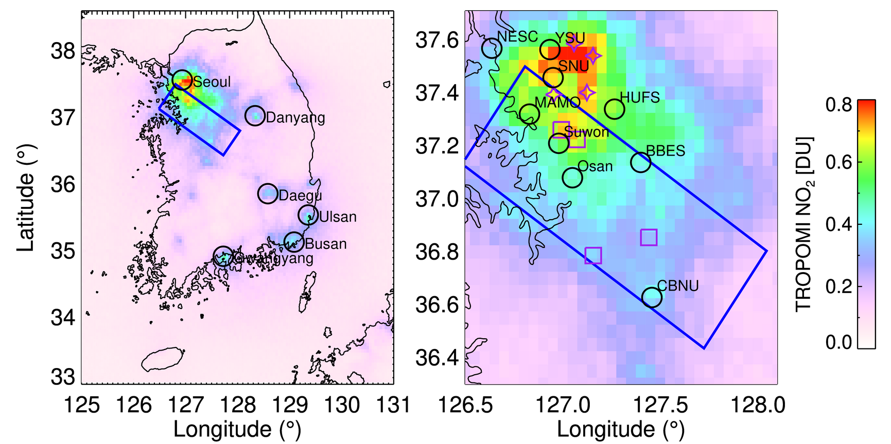
NASA G-III flight domain
- UV/Vis spectrometer (NO₂, HCHO, SO₂, …)
- Aerosol/Ozone lidar
NO₂
AAQ Sites

Slide 4
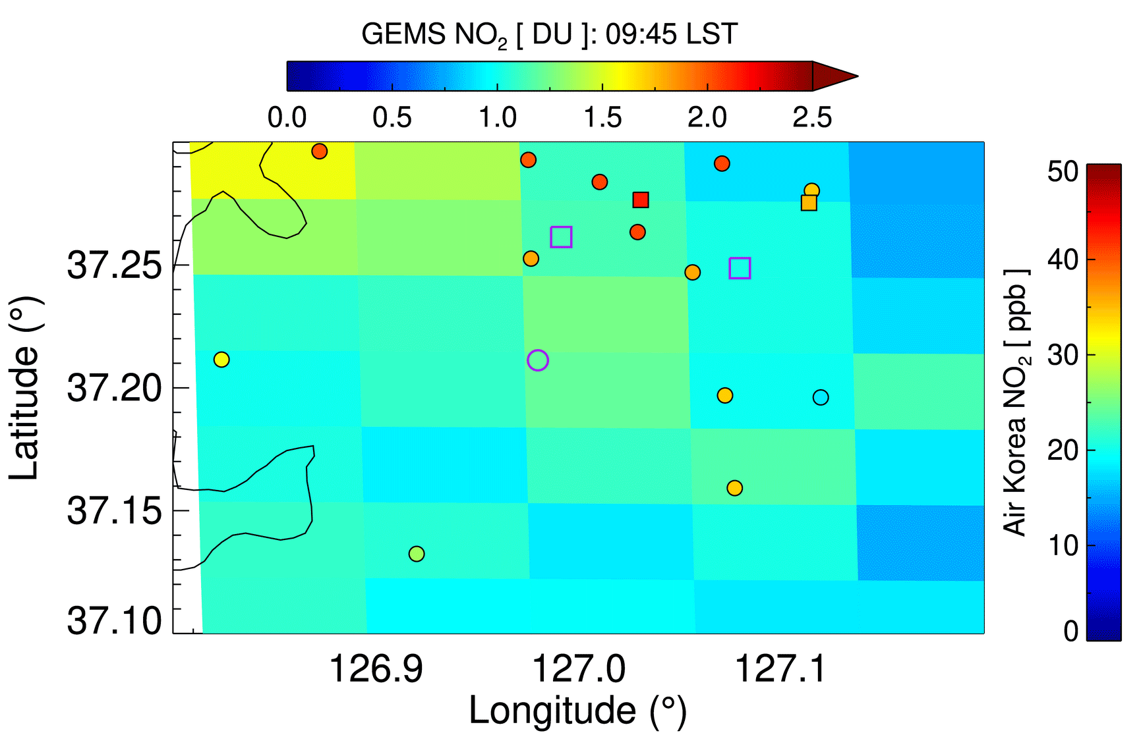
Pandora
AERONET
AQ-Profiler
Pandora
Pandora

Slide 5
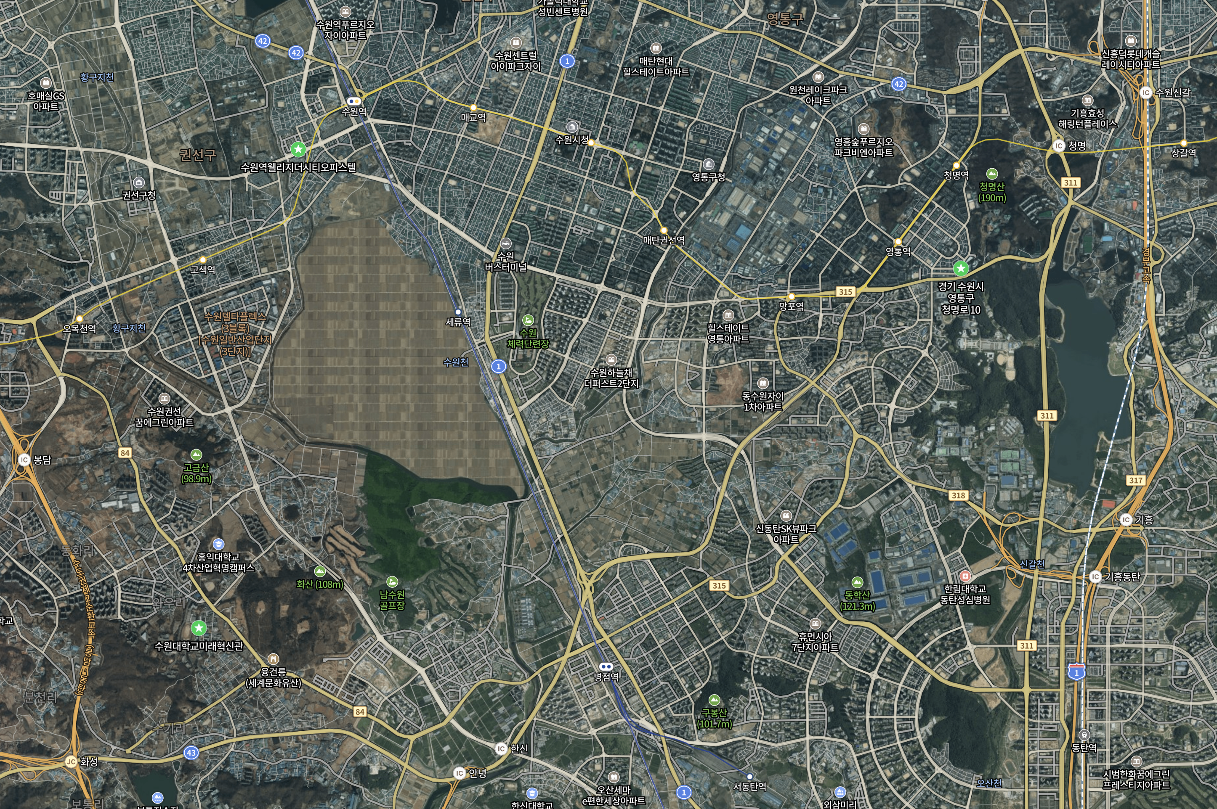
11:45 LST, 1 January 2022
DRAGON site 2
Industrial Complex
Residential Area
DRAGON site 1
Airforce base
DRAGON site 3
DRAGON-Suwon 2024
“Distributed Regional gAs Gridded Observation Network”
University of Suwon

Slide 6
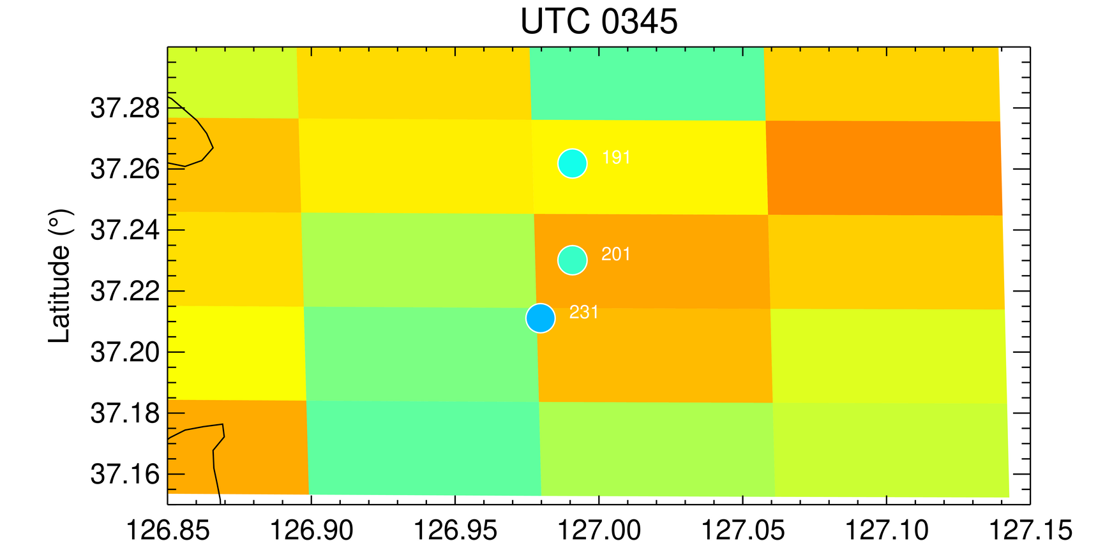
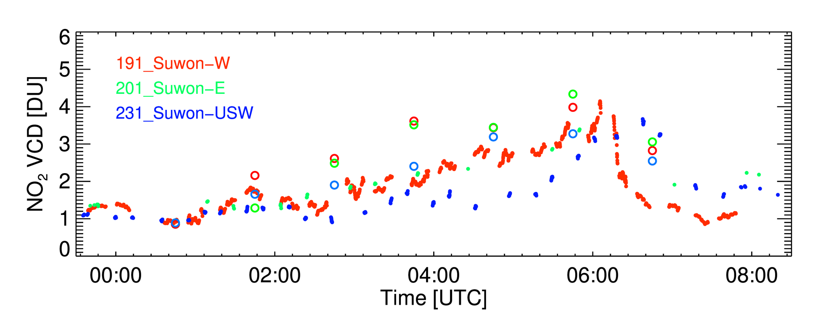
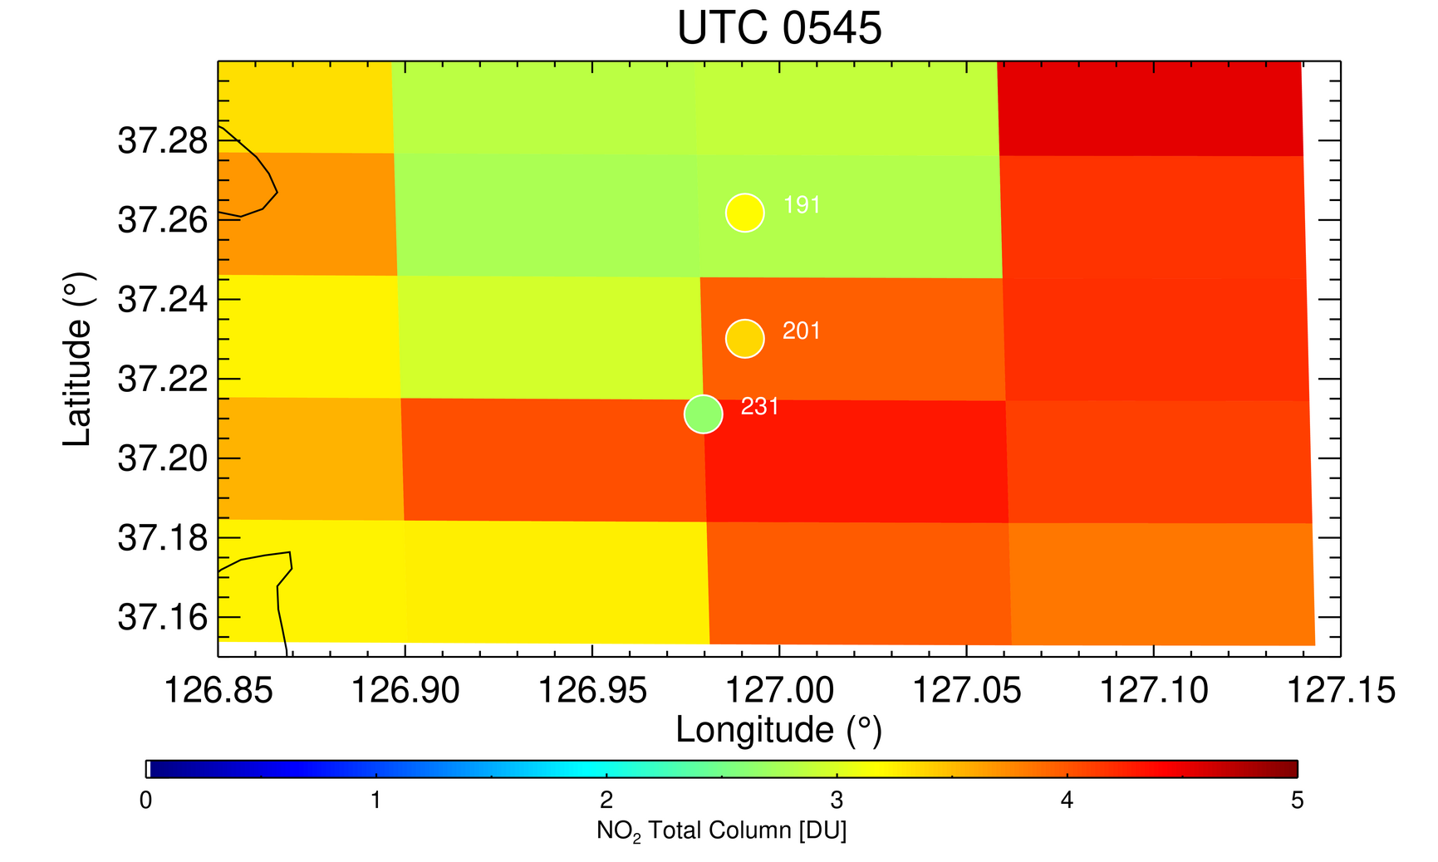
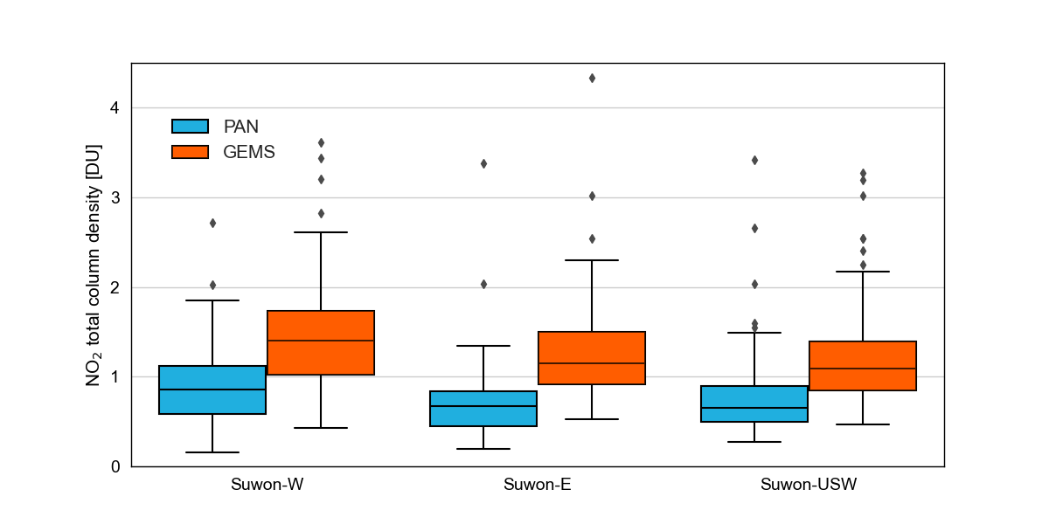
Diurnal variations in NO₂ over Suwon
(31 January 2024)
Mean values of NO₂ during the campaign

Slide 7
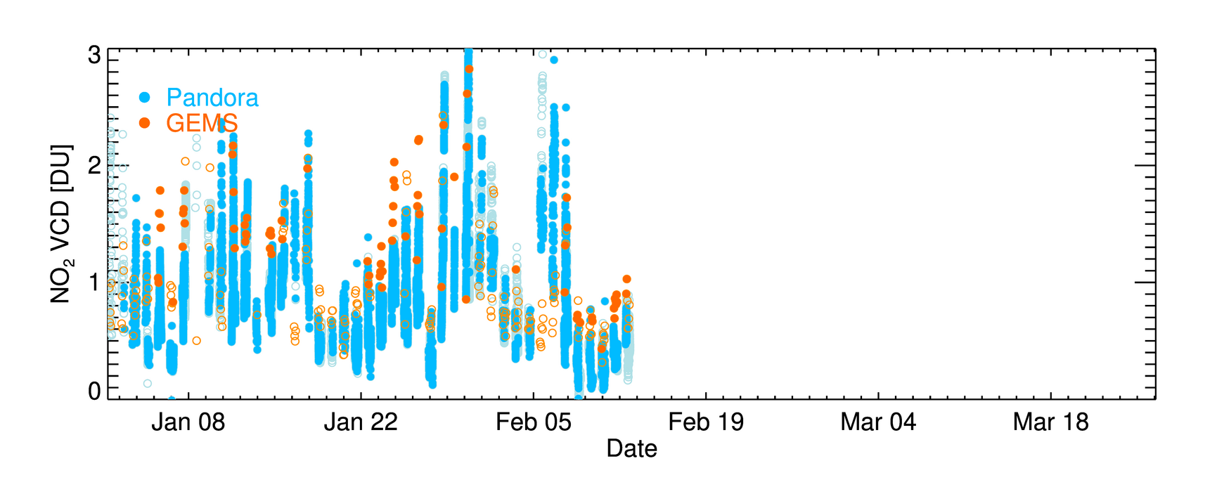
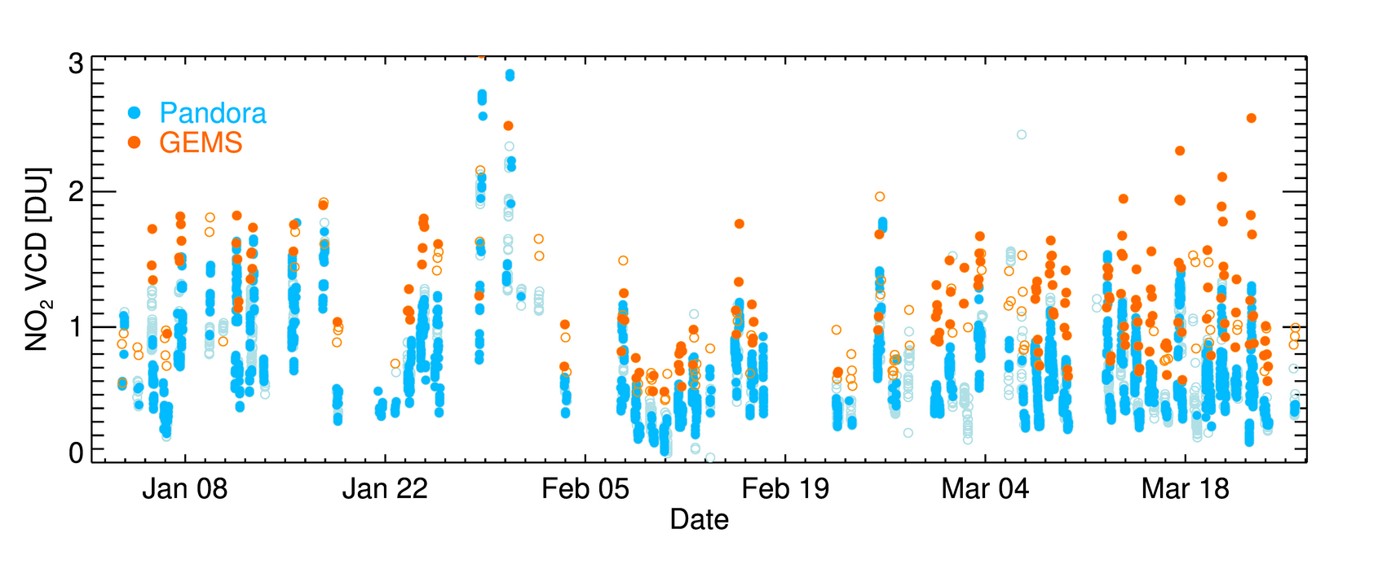
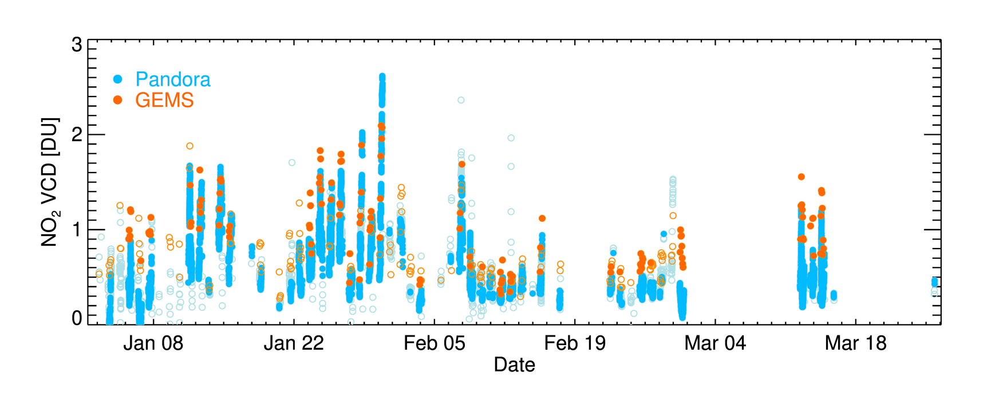
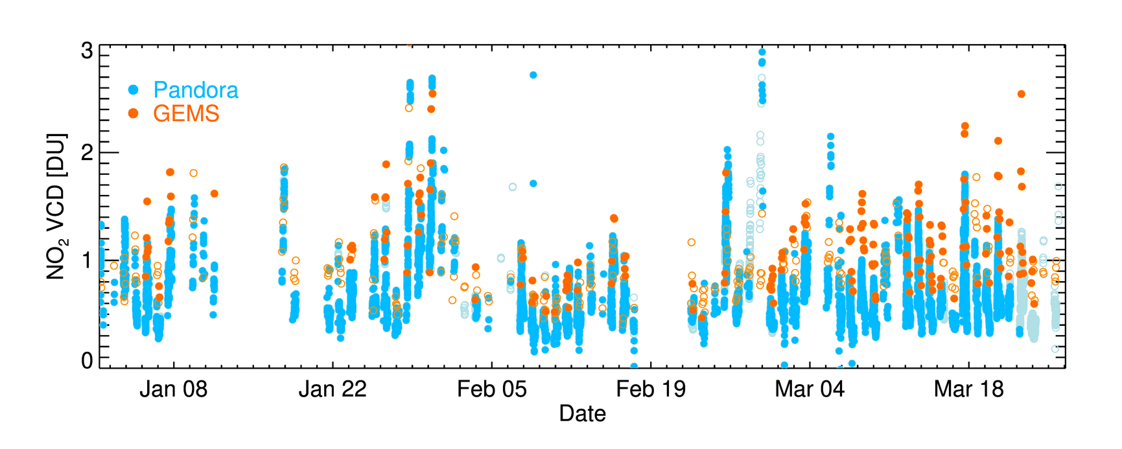
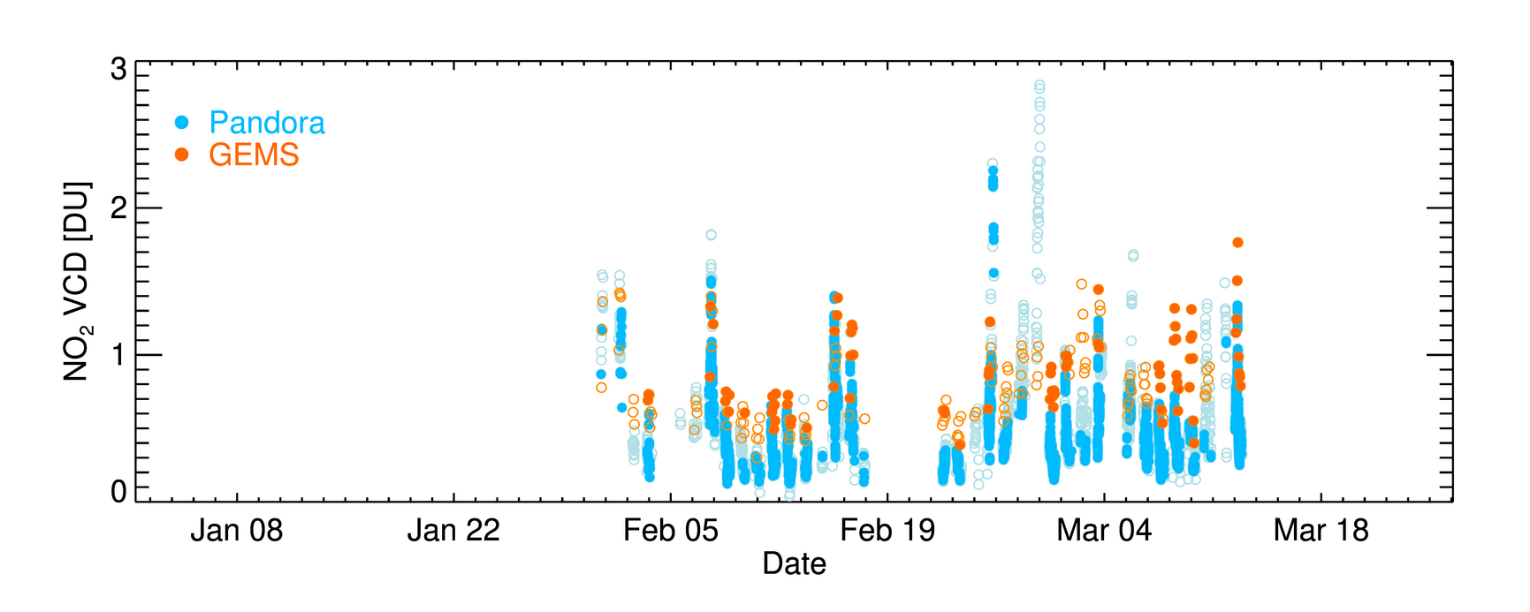
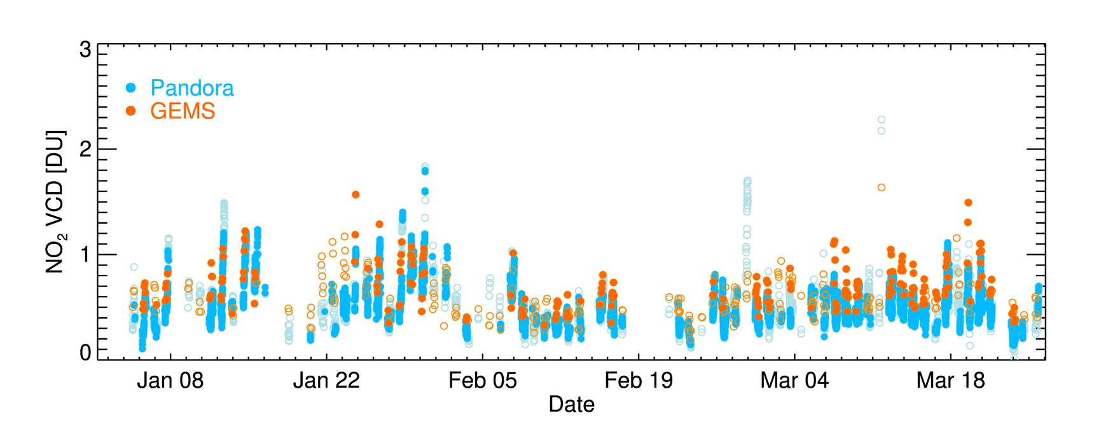
Suwon-W
Suwon-E
Anseong
Suwon-USW
Osan
Jincheon

Slide 8
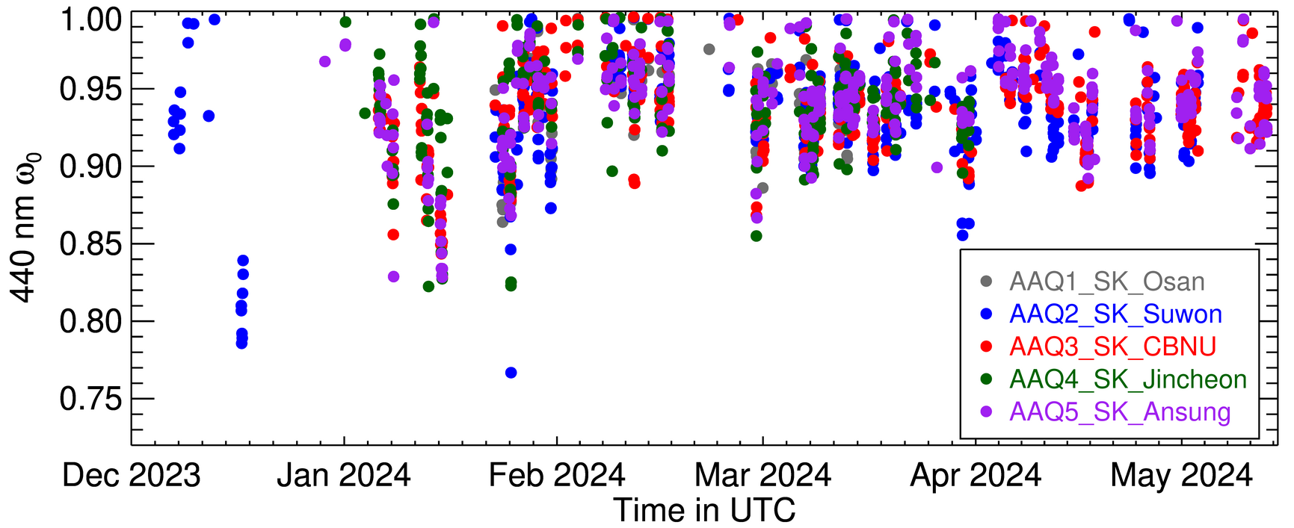
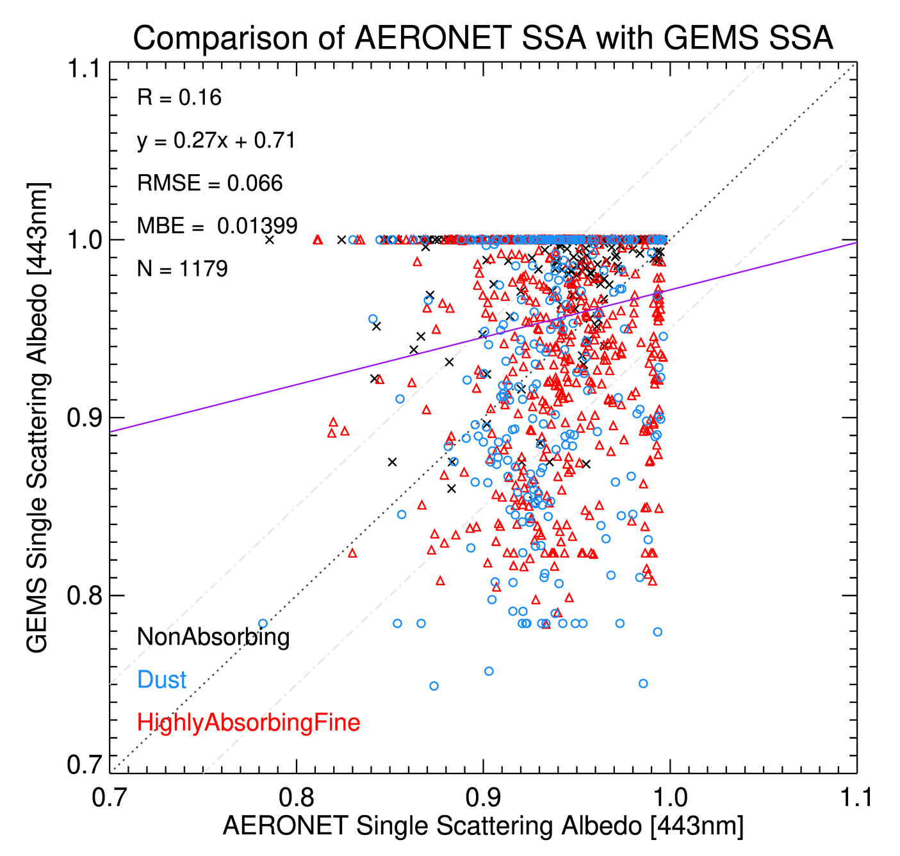
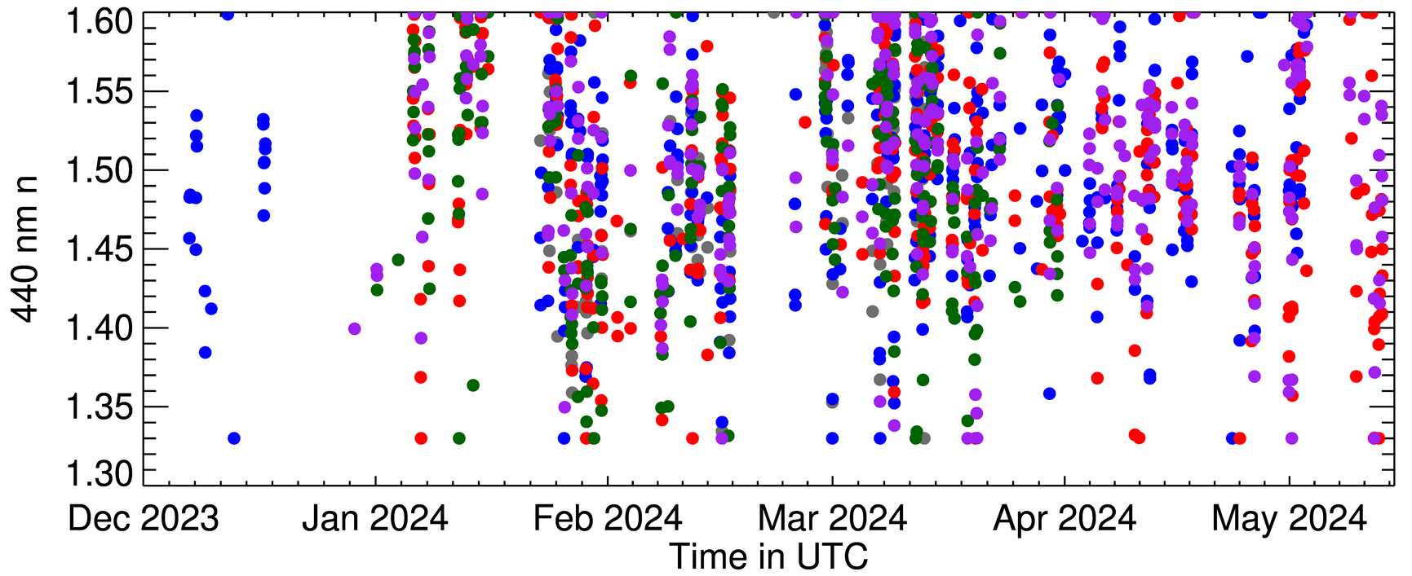
Validation/comparison of the GEMS aerosol products during the campaign (AERONET)

Slide 9
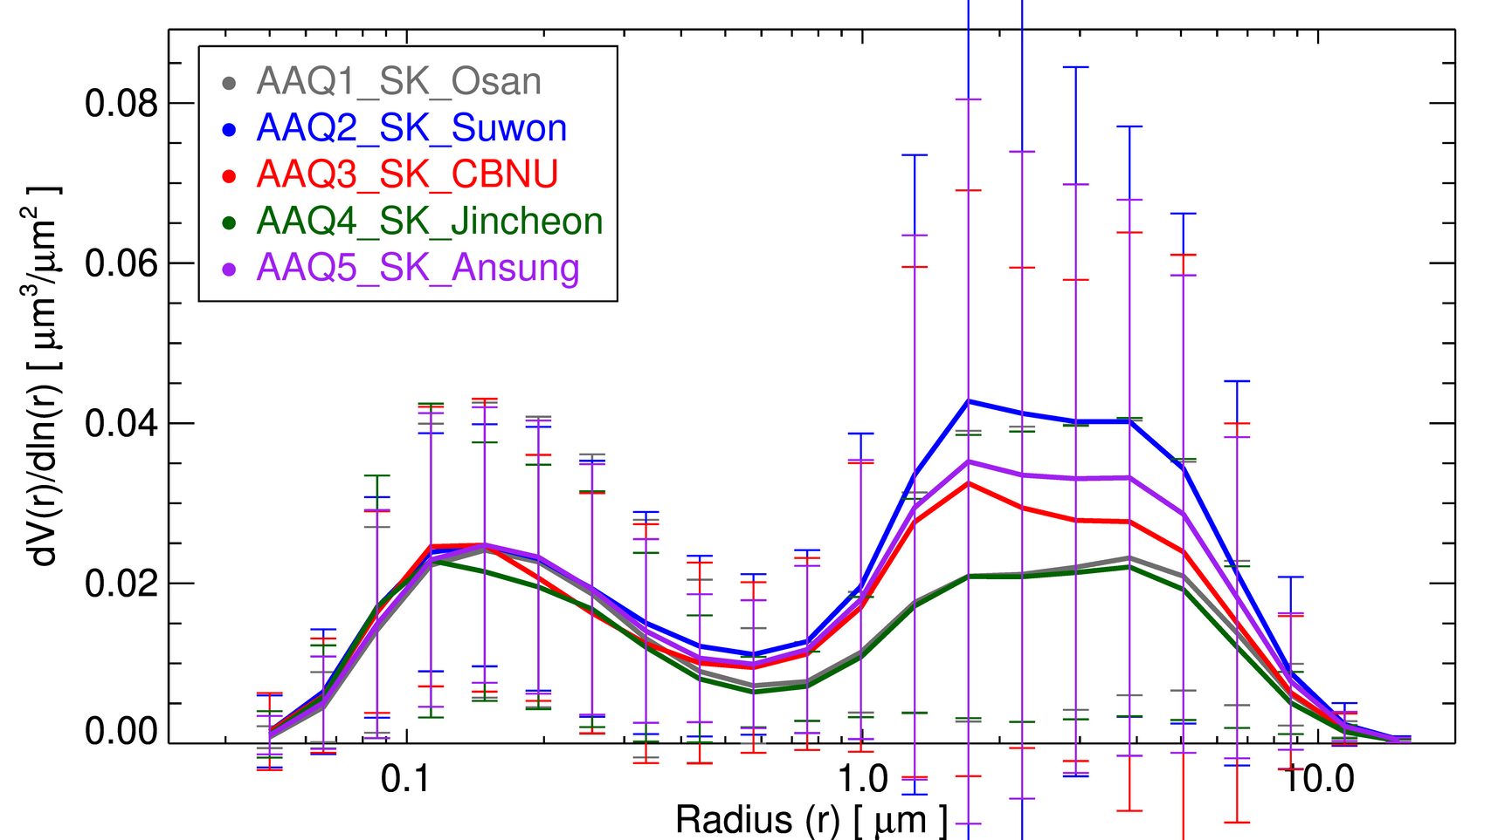
Validation/comparison of the GEMS aerosol products during the campaign (AERONET)

Slide 10
NO2 Total Column Retrievals
SIJAQ/ASIA-AQ campaign in Seoul
Most of the data (AOD, NO₂, …) were processed and uploaded at the AAQ website
Clear sky: Feb 16, 17, 26 / Mar 01, 03
 | Feb. |  |  |  |  |  |  |  |  |  |  |  |  |  |  | Mar.
 | 15 | 16 | 17 | 18 | 19 | 20 | 21 | 22 | 23 | 24 | 25 | 26 | 27 | 28 | 29 | 1 | 2 | 3
Weather
AQProfiler1
AQProfiler2
P201
P229
P231
P235
P241
: Date the direct-sun mode L0 data was observed

Slide 11
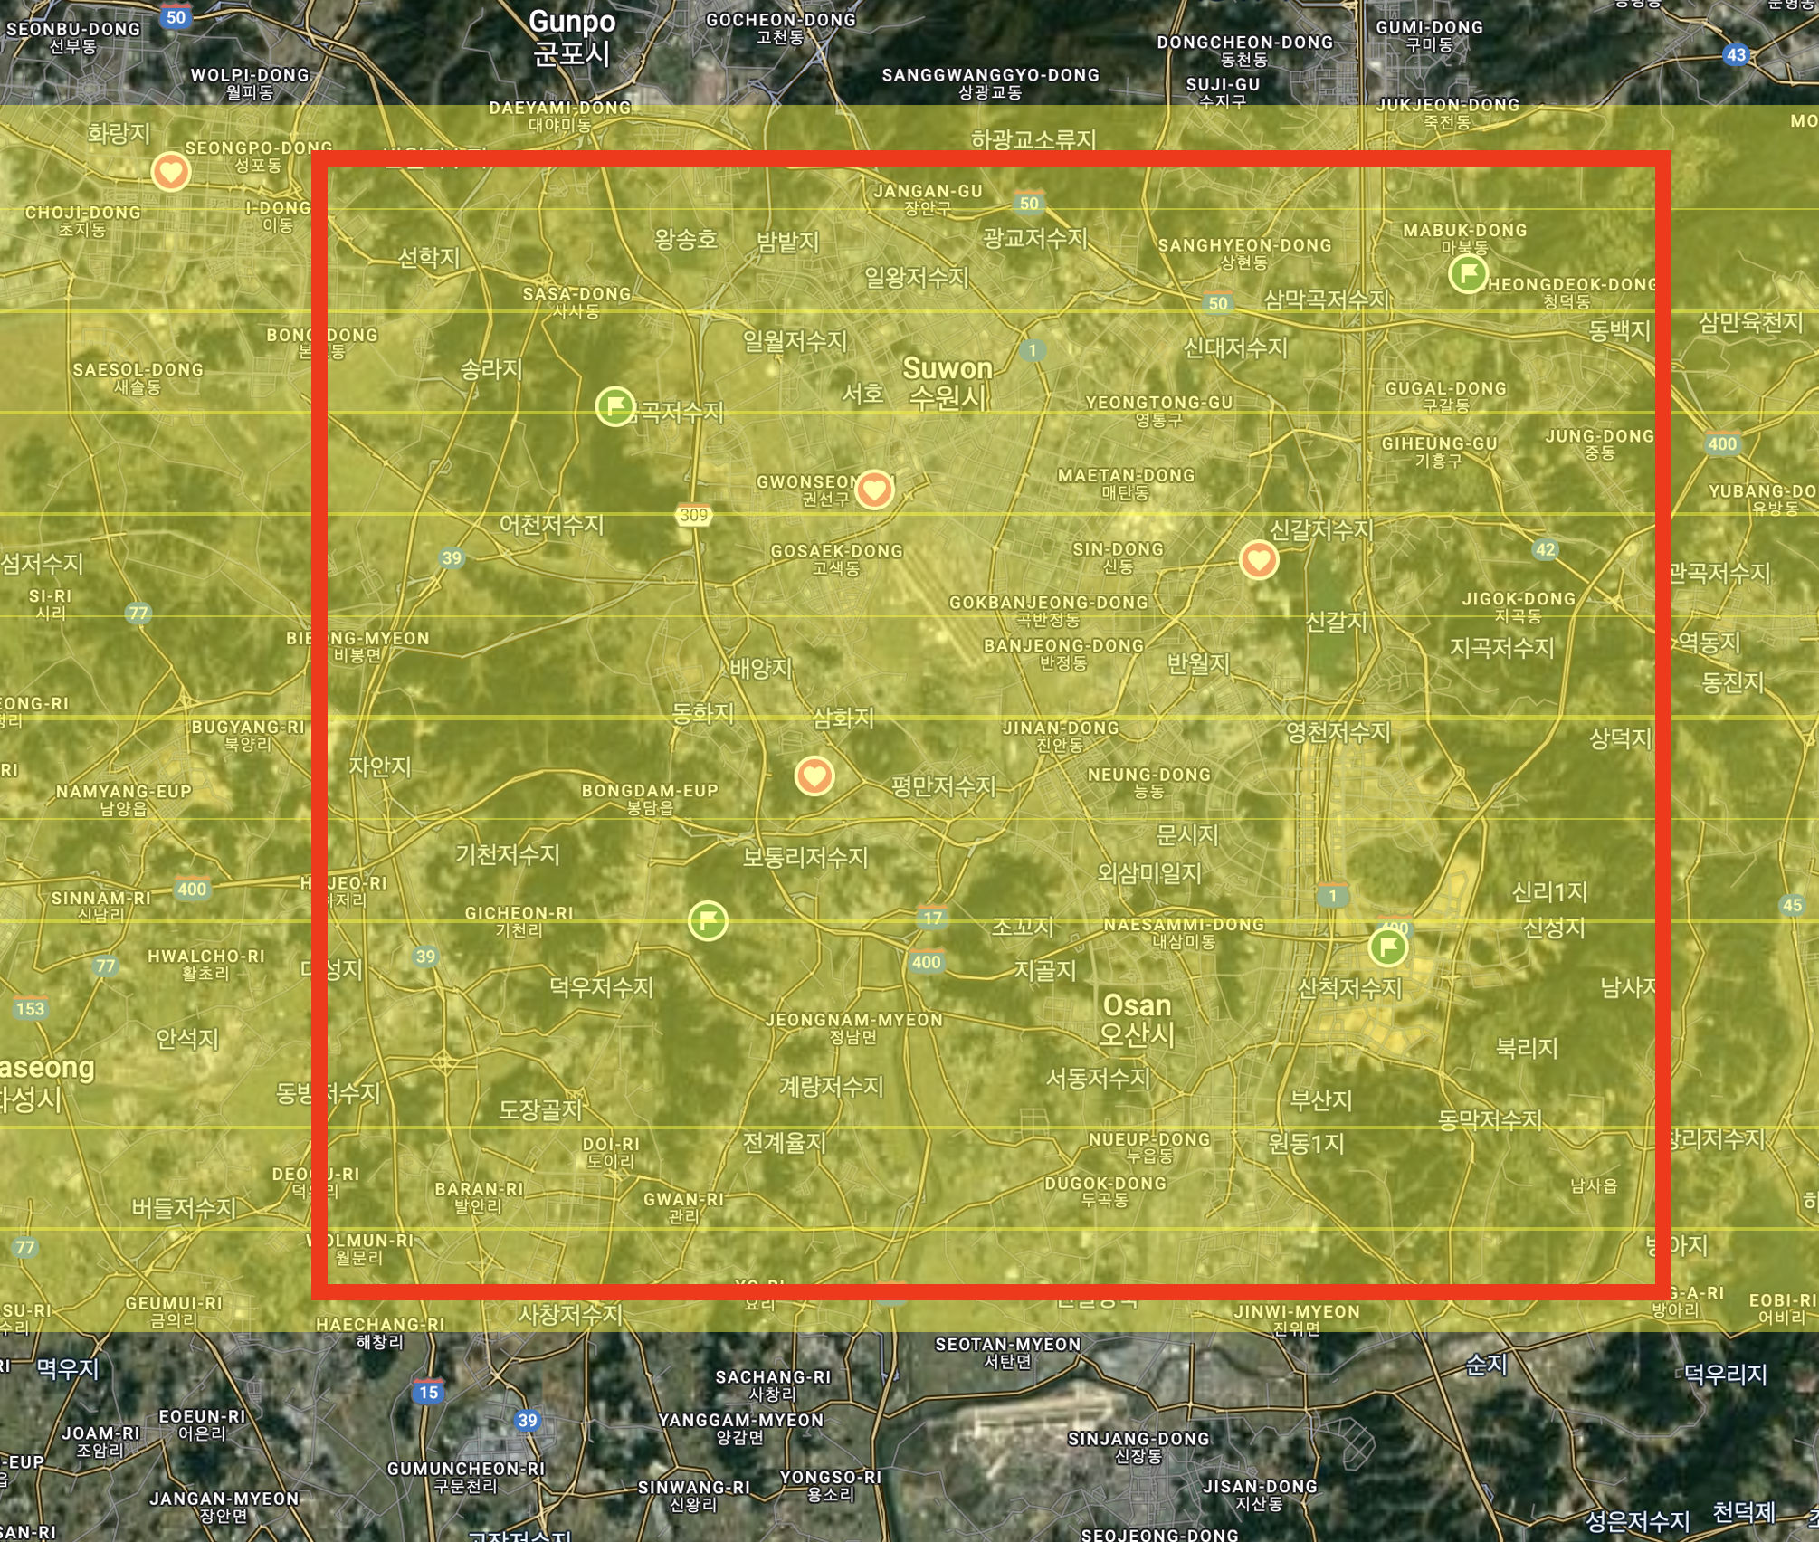
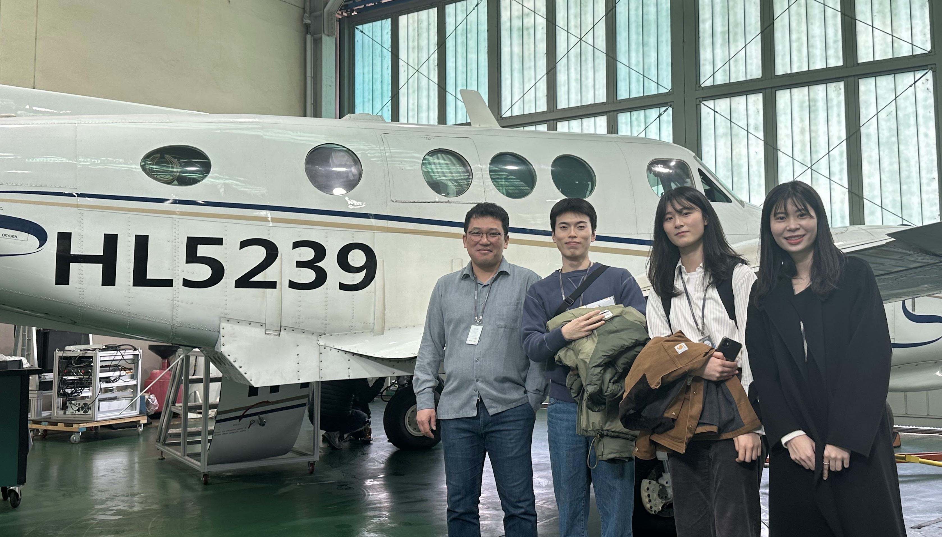
EMSA Measurements (Geostationary Environment Monitoring Spectrometer for Aircraft platform)
A sister sensor of the GeoTASO
Similar FOV & wavelength coverage
CMOS detector
3 km altitude (~2 km swath)
Three times of flight (16, 23, 26 Feb)

Slide 12
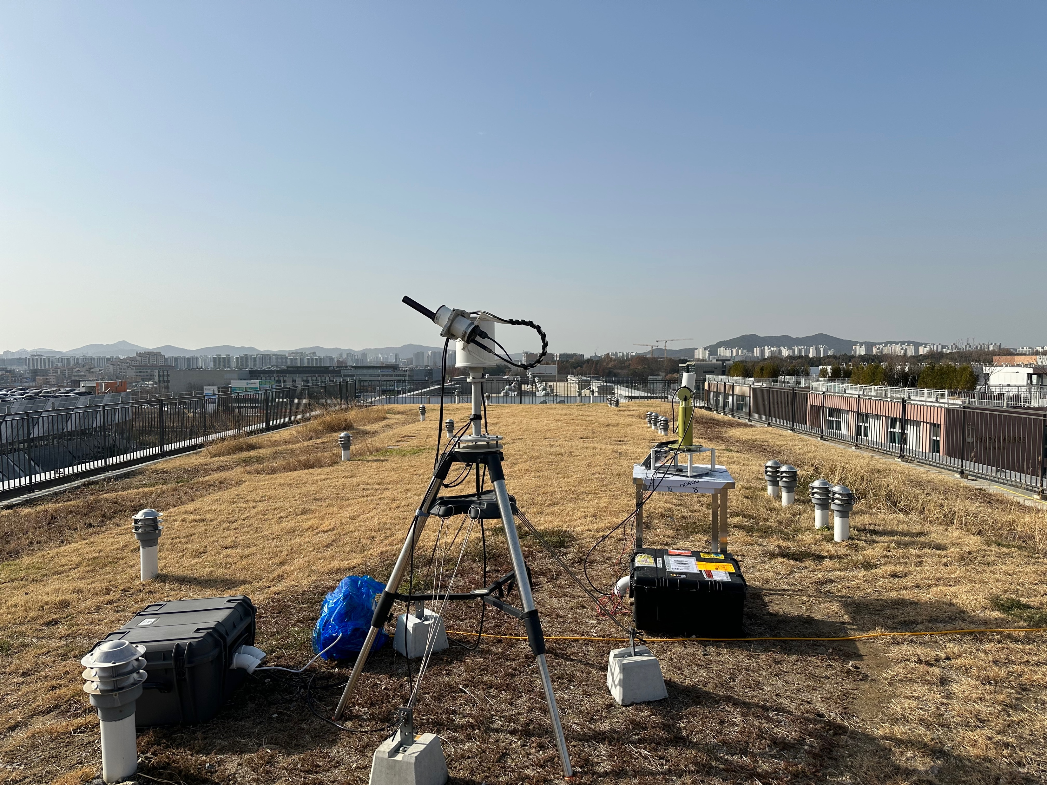
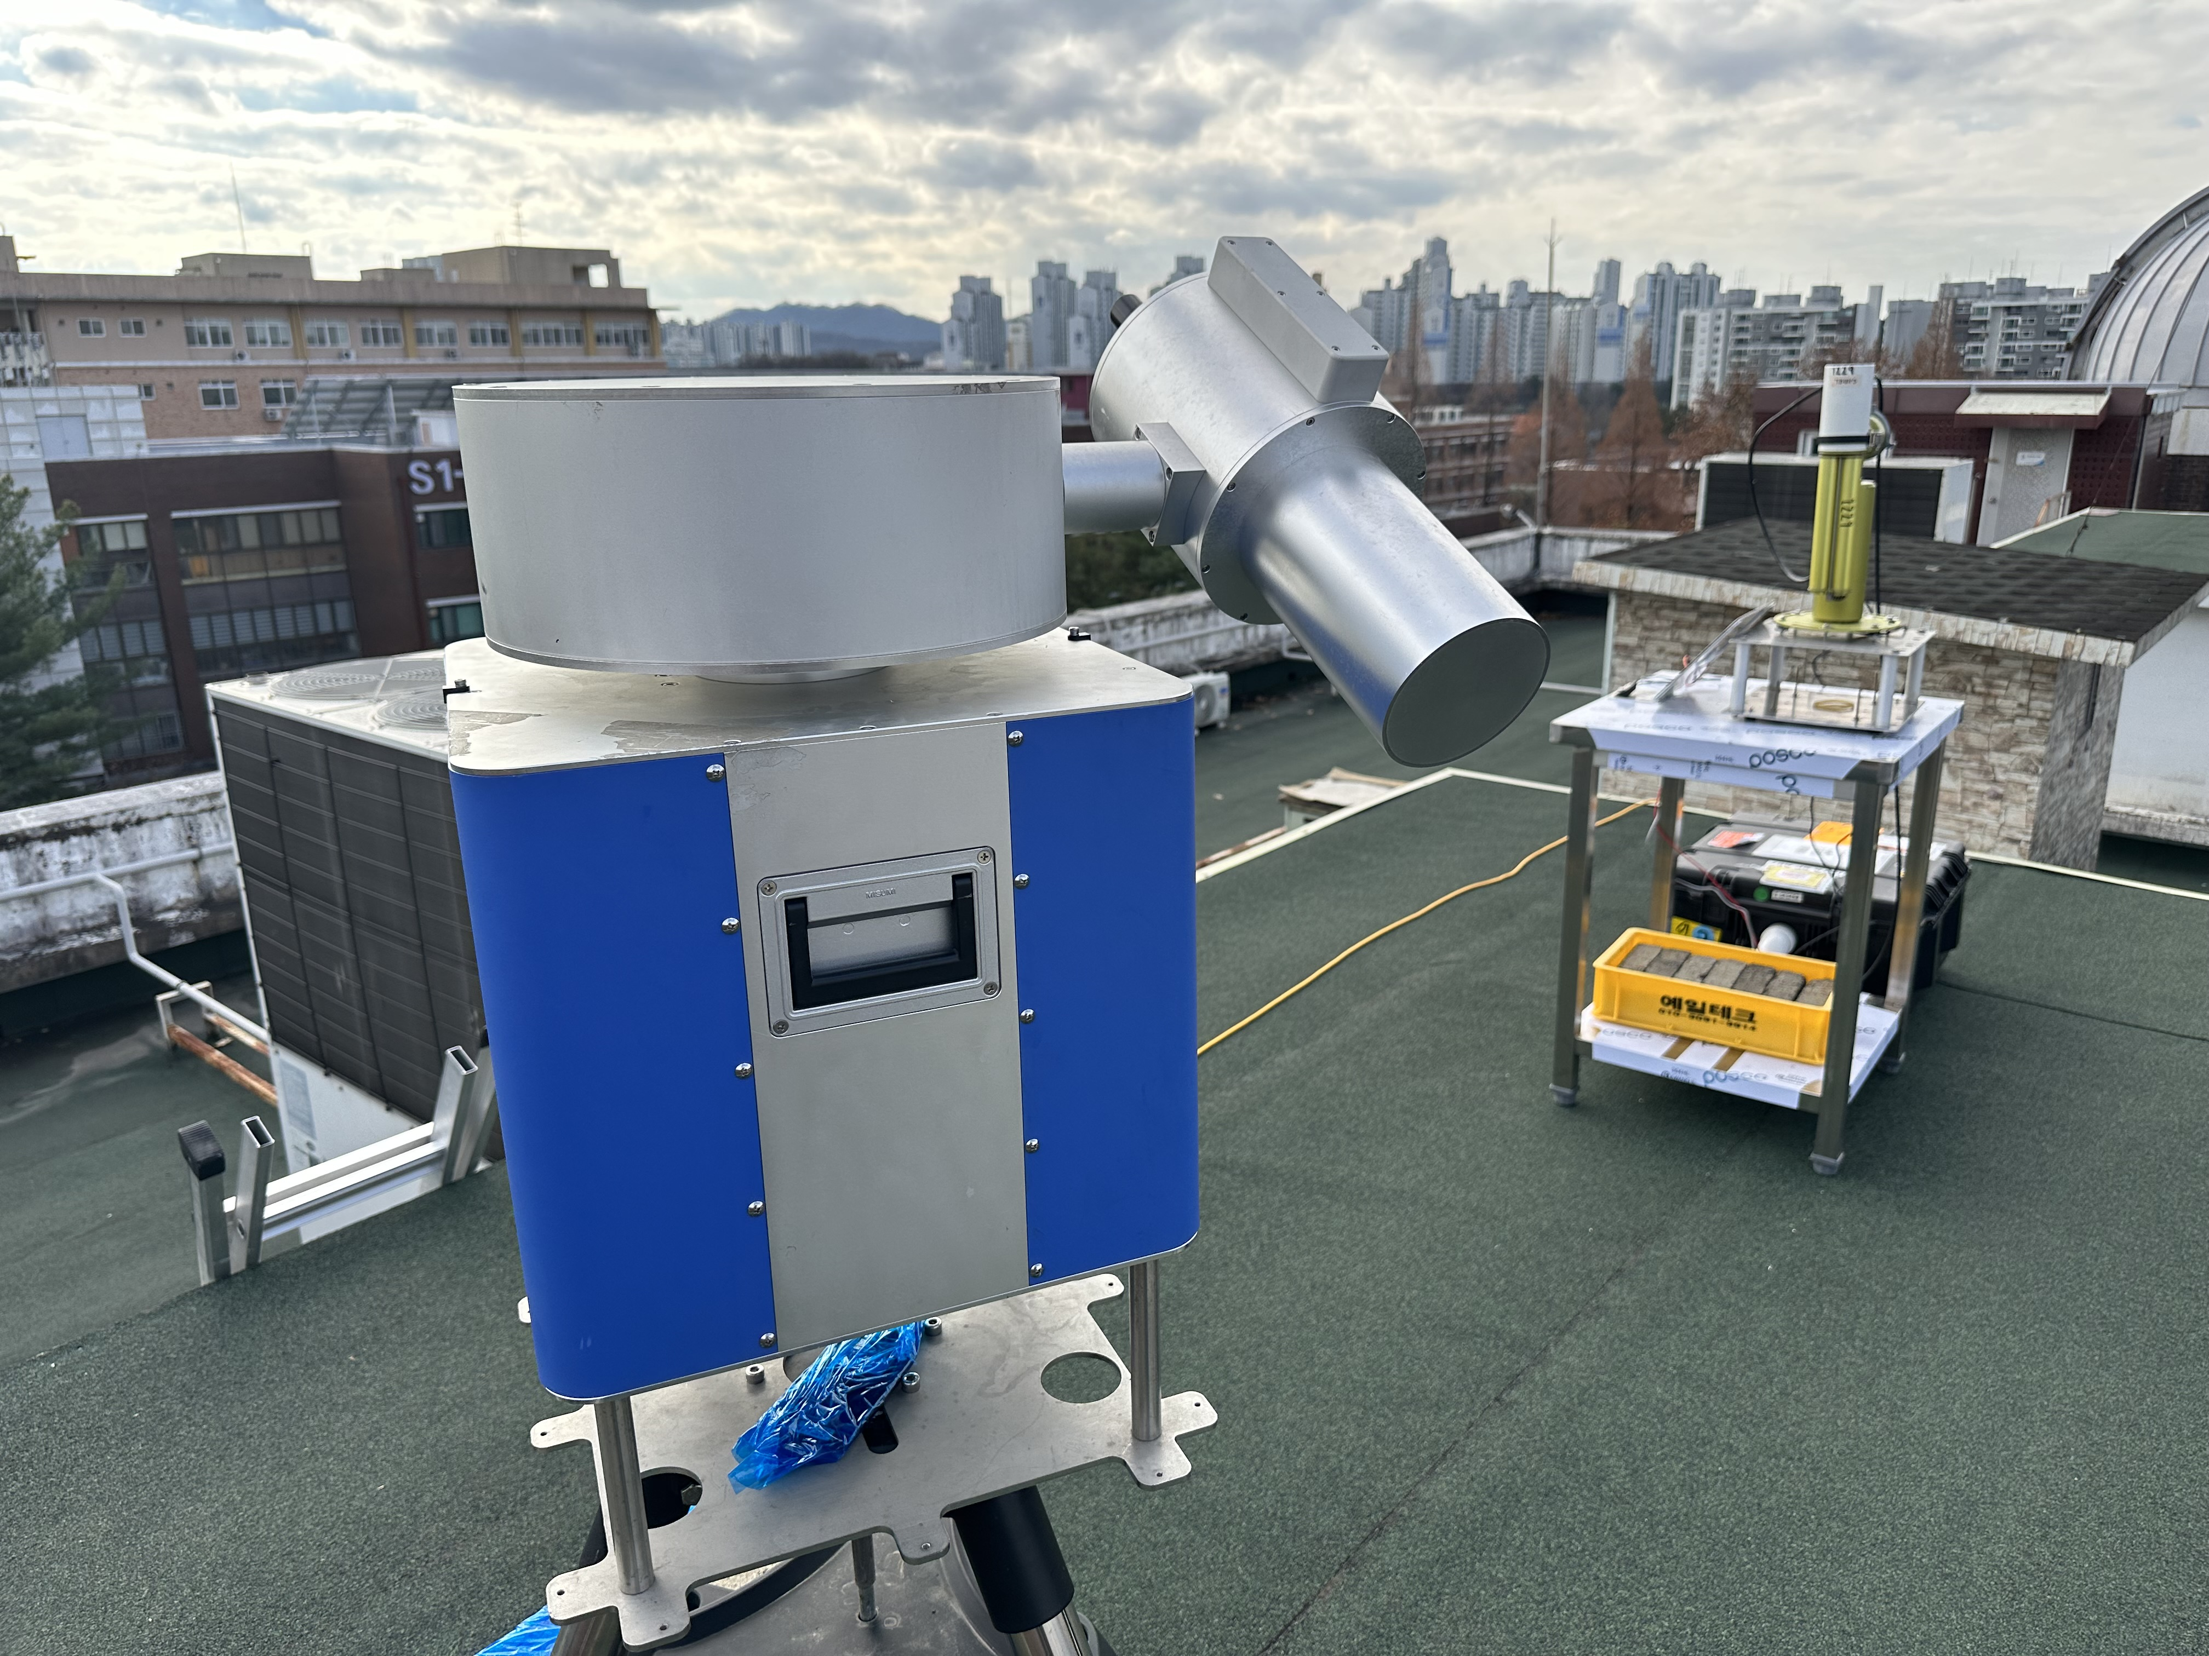
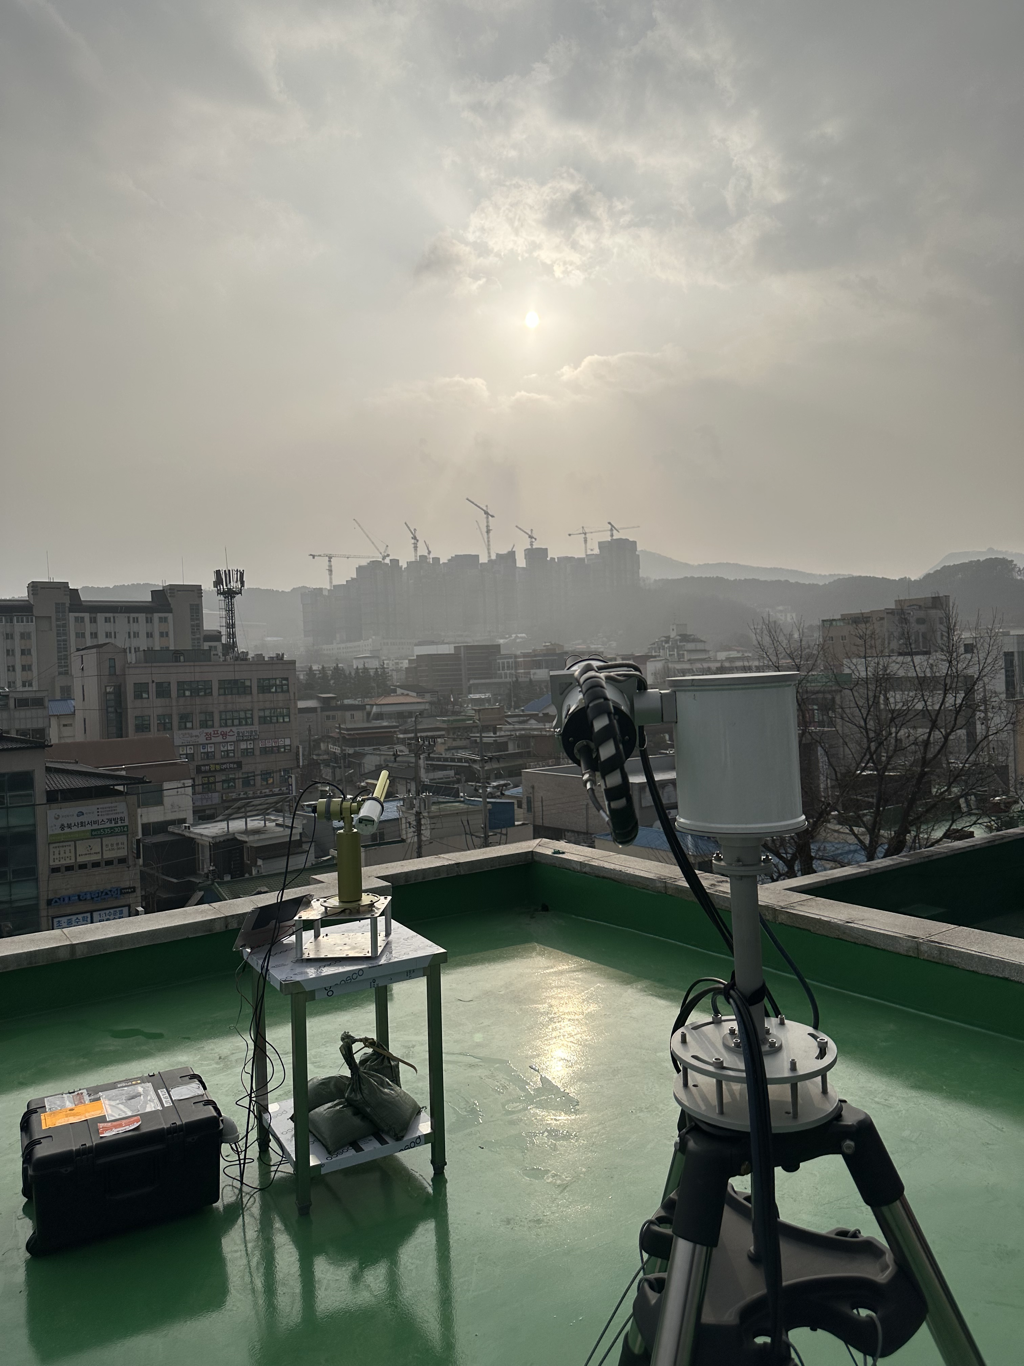
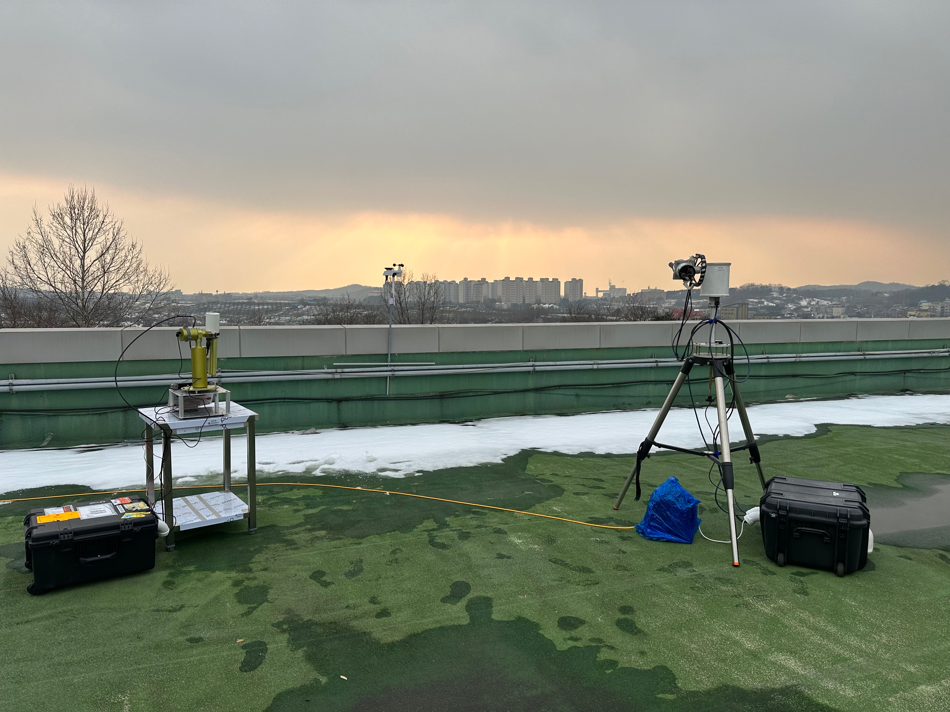
Thank you for your attention

