Slide 1
GEMS total O₃ evaluation within the ESA PEGASOS project
Katerina Garane¹, T. Verhoelst², K.-P. Heue³, S. Compernolle², A. Keppens², M. Koukouli¹, D. Balis¹
1 Laboratory of Atmospheric Physics, Aristotle University of Thessaloniki (LAP/AUTH), Greece
2 Royal Belgian Institute for Space Aeronomy (BIRA-IASB), Belgium
3 Remote Sensing Technology Institute (DLR-IMF), Germany

Slide 2
Total Ozone datasets
GEMS total ozone:
v2.0, Time range: Nov. 2020 – June 2024
All scans/day
Filters (Baek et al., 2023):
FinalAlgorithmFlags = 0 and 1 (corrected sun-glint)
Exclude CCD pixels 1-8 and 2044-2048
Keep measurements with Solar Zenith Angle ≤70° and Viewing Zenith Angle ≤ 70°
Effective Cloud Fraction <0.2 → Not applied (too strict, no particular dependency)
First results for the (interim)
GEMS O3T v2.1 dataset:
Jan 2022 – May 2024
Updates:
new LUT
new GEMS L2 Cloud

Slide 3
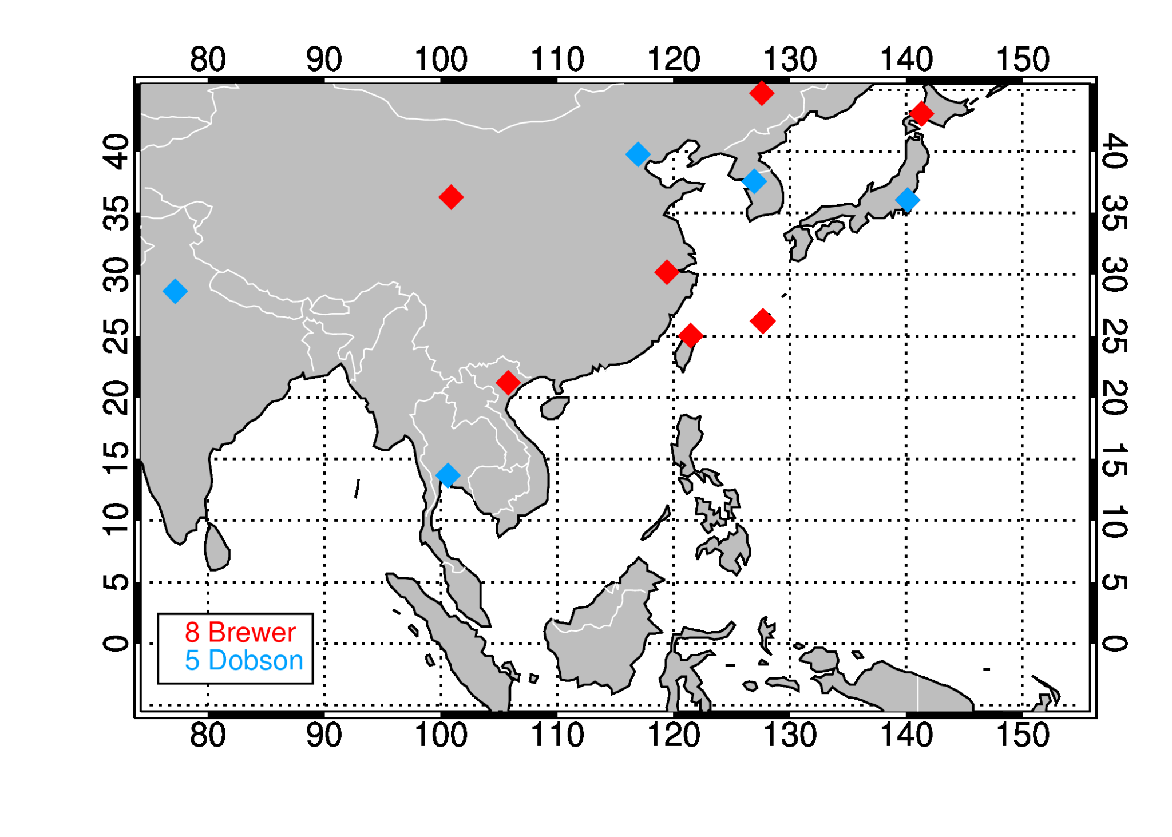
Total Ozone datasets - Reference measurements
Ground
Dobson and Brewer spatiotemporally co-located observations of total ozone (Quality controlled ground-based observations from WOUDC). Only Direct Sun measurements.
Pandonia Global Network (PGN), co-located observations of total ozone, latest processing (v1.8) (5 stations)
Satellite
TROPOMI/S5P NRTI total ozone column (repro before Aug. 2022)
GOME-2/MetOp-B/C total ozone GDP4.8(4.9) operational product
8 Brewer
5 Dobson
OMI GODFIT operational product

Slide 4
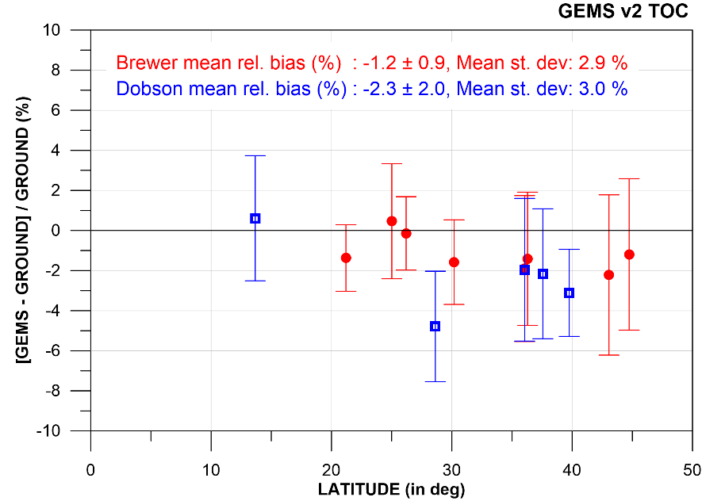
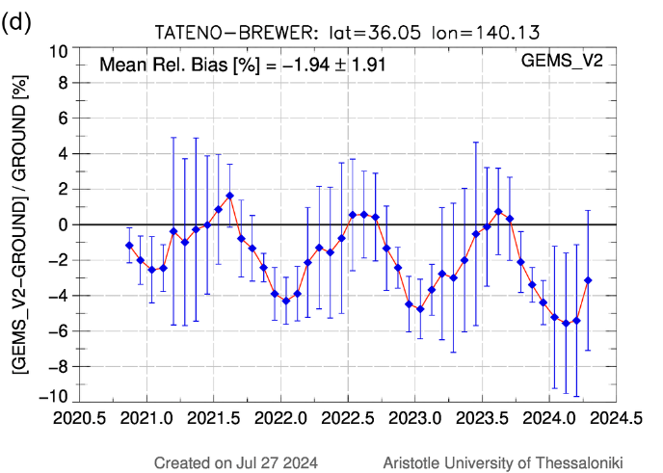
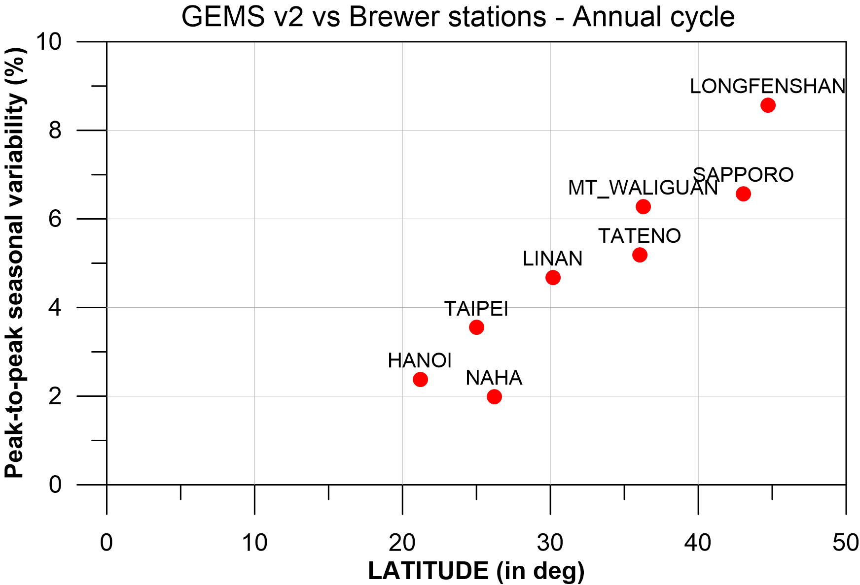
Total Ozone Evaluation results – Statistics per station
GEMS V2 O3T vs. WOUDC
Pixel within 5 km of station
Same day of measurement
All GEMS filters applied
Mean rel. biases within +0.6 to -3%
Mean Rel. Bias: -1.9 ± 1.9 %
Mean St. Dev.: 3 %, not solely attributed to GEMS
Annual cycle of the differences increasing with latitude

Slide 5
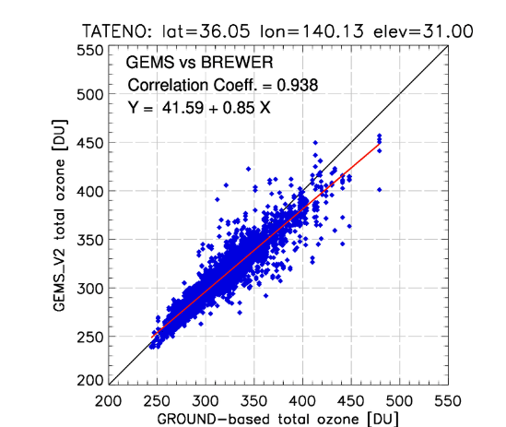
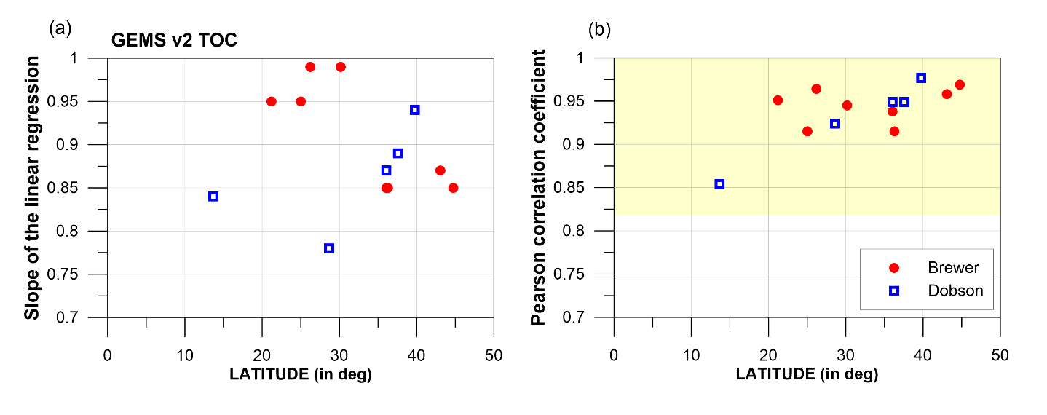
Total Ozone Evaluation results – Statistics per station
Pearson Cor. Coef.: 0.90-0.98
Goal: 0.82 - 0.97
Slopes: 0.85-0.99
Increased underestimation for higher TOCs (therefore during winter months), more evident in the northern part of the domain.

Slide 6
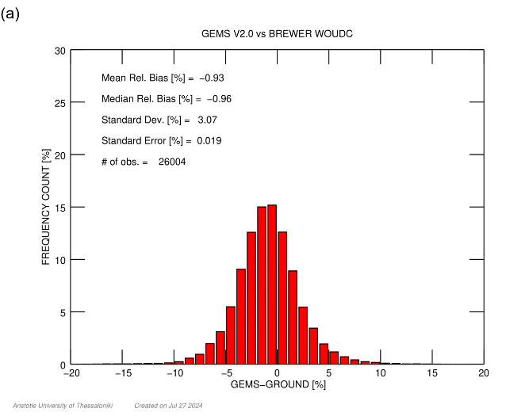
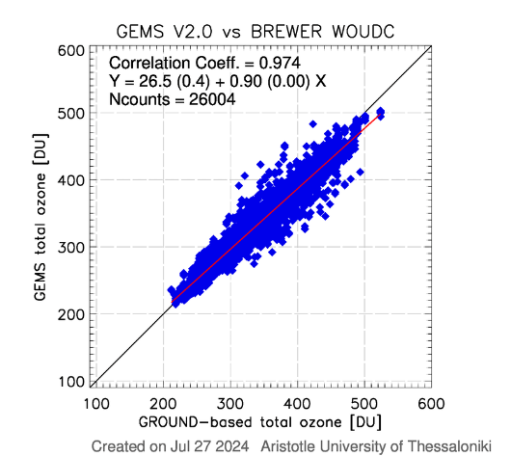
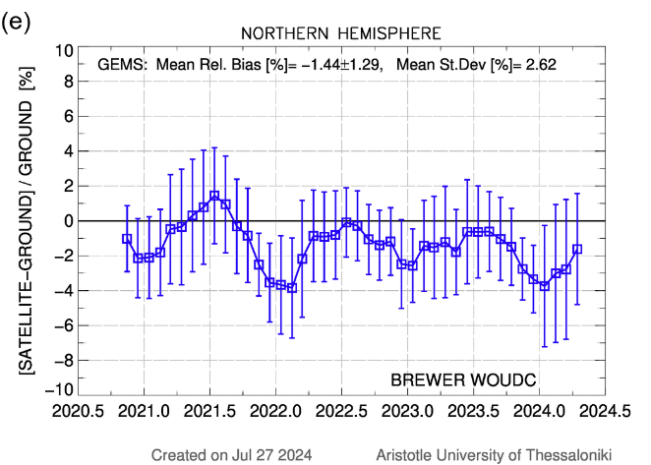
Total Ozone Evaluation results – GEMS domain (Brewer & Dobson)
GEMS v2.0 vs BREWER WOUDC
Mean Rel. Bias (%): -0.9
St. Dev. (%): 3.1
# of co-loc: 26000
Mean Rel. Bias (%): -1.4 ± 1.3 Mean St. Dev (%): 2.8
Overall statistics from individual co-locations per GB instrument:
April – November:
excellent agreement: +0.5 to -1%
Winter months:
GEMS is underestimating total ozone by up to -2% or -4%
 | Brewer | Dobson
Mean Rel. Bias | -0.9 % | -2.0 %
Mean St. Deviation | 3.1 % | 3.5 %
Pearson cor. Coef. | 0.974 | 0.966
Slope | 0.90 | 0.89

Slide 7
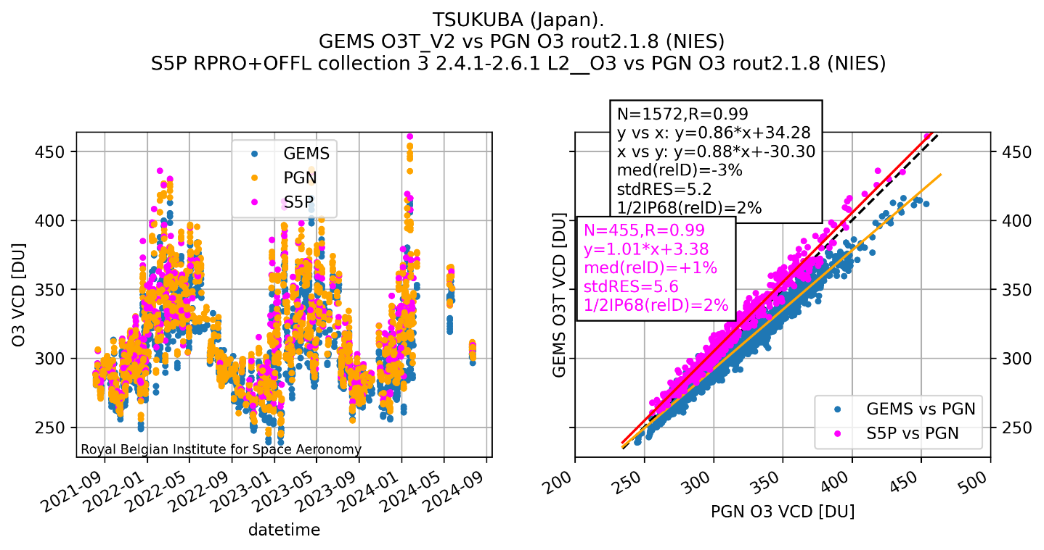
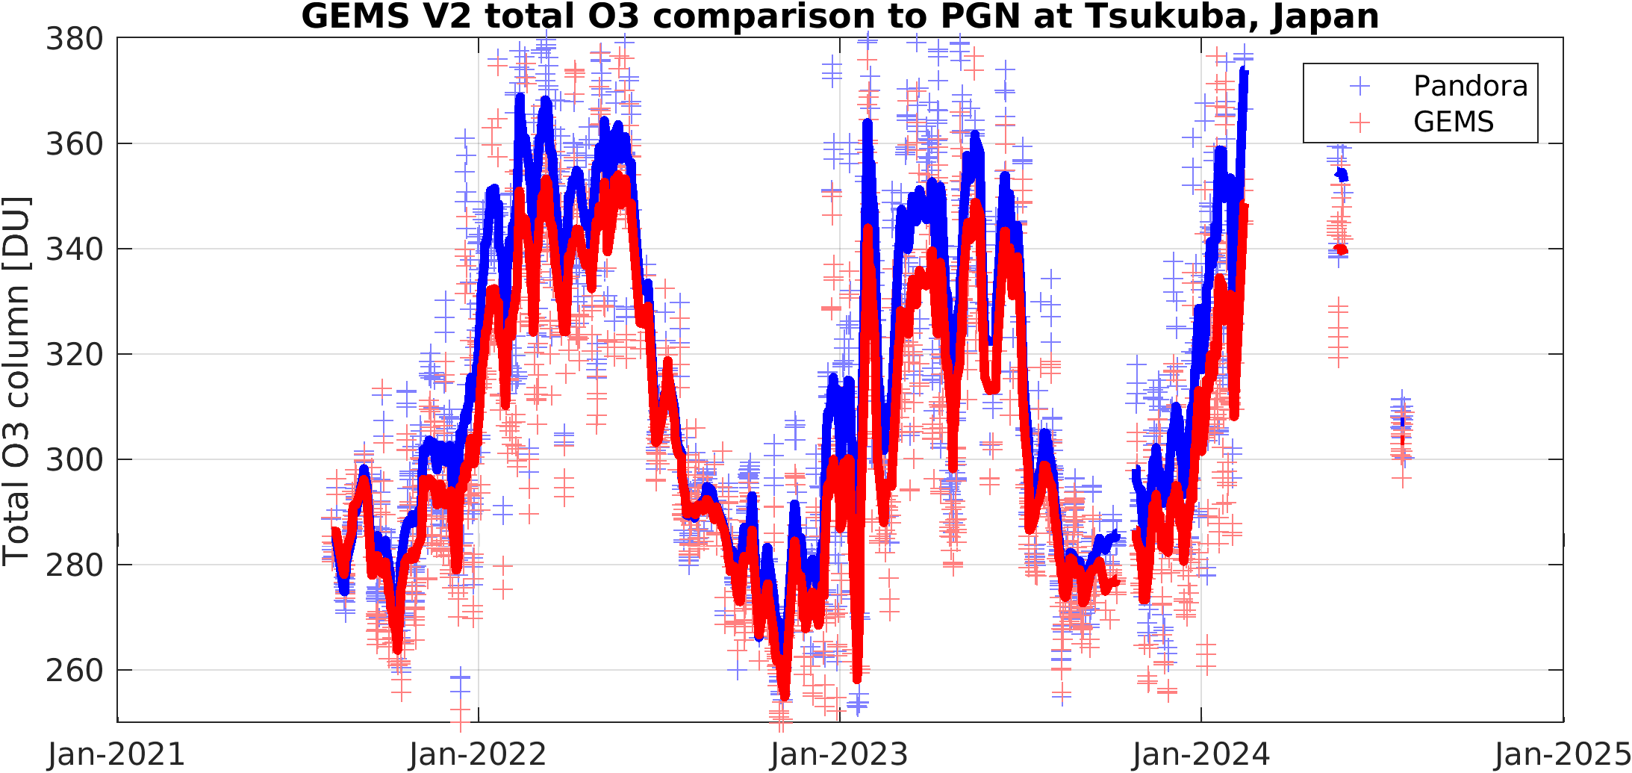
Courtesy of St. Compernolle & T. Verhoelst, BIRA-IASB
Total Ozone Evaluation results vs Pandora
GEMS V2 O3T vs. PGN v1.8
Pixel within 5km of station
Δt < 10 minutes
FinalAlgFlag = 0
PGN quality filtered
Excellent correlation (0.98 - 0.99)
Rel. bias: -3 %, latitude-dependence in line with Brewers and Dobsons
St. Deviation ~ 2 %
Regr. Slope <1 (~0.9)

Slide 8
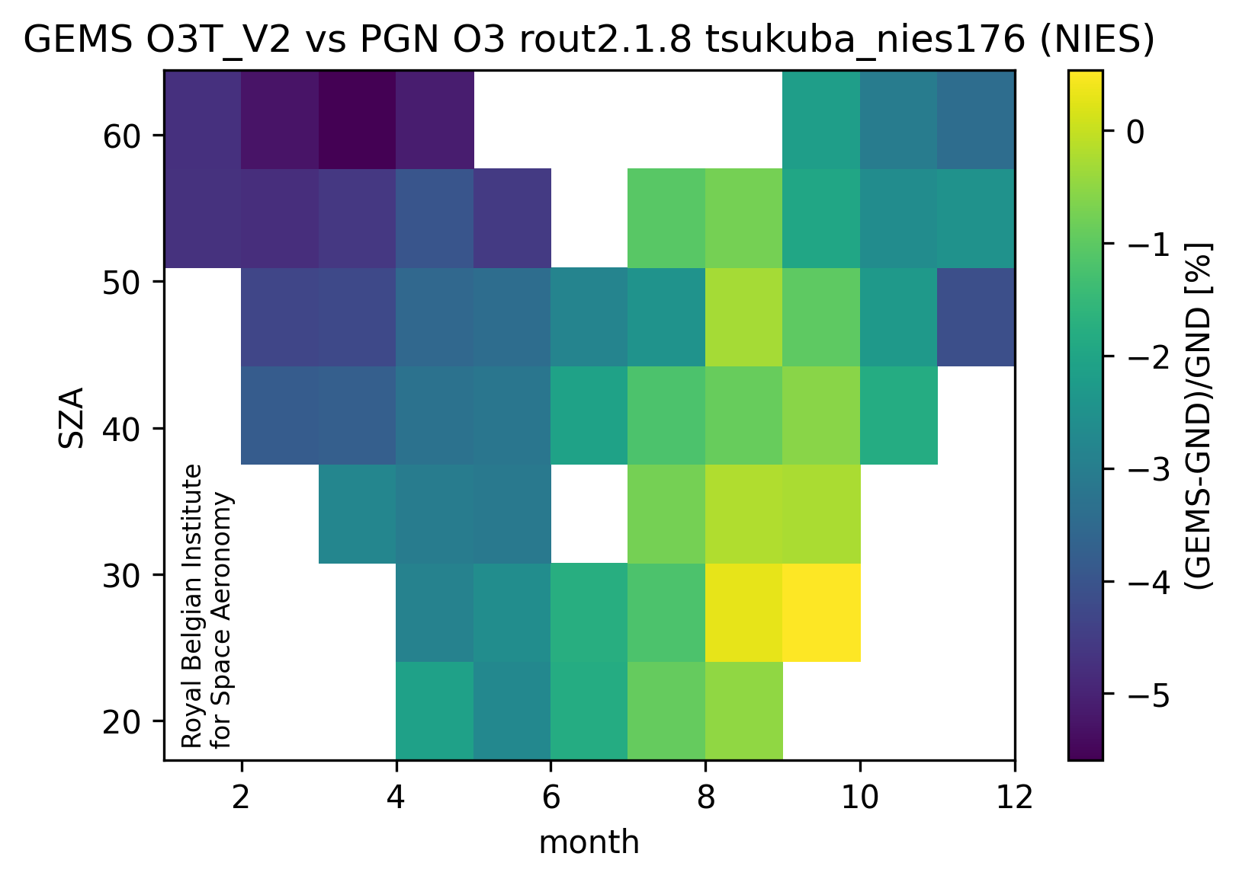
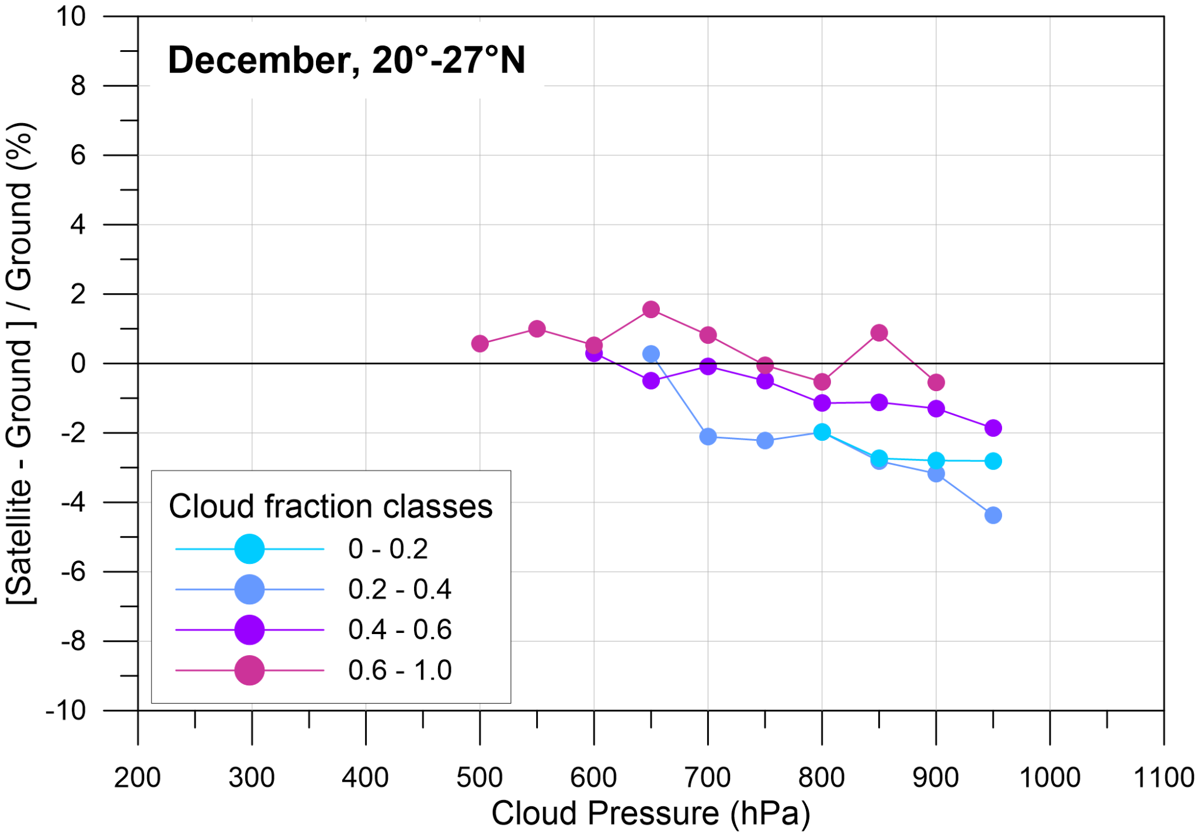
Total Ozone Evaluation results – GEMS domain
Influence quantities
GEMS underestimation up to -4 %:
for high SZAs (not really a SZA effect)
for low clouds (ctp >900 hPa)
But no conclusive dependence on eff. cloud fraction:
Dependency on CTP mainly during winter months, December – February:
Negative bias during winter months → almst cloud free skies or in the presence of low scattered clouds.

Slide 9
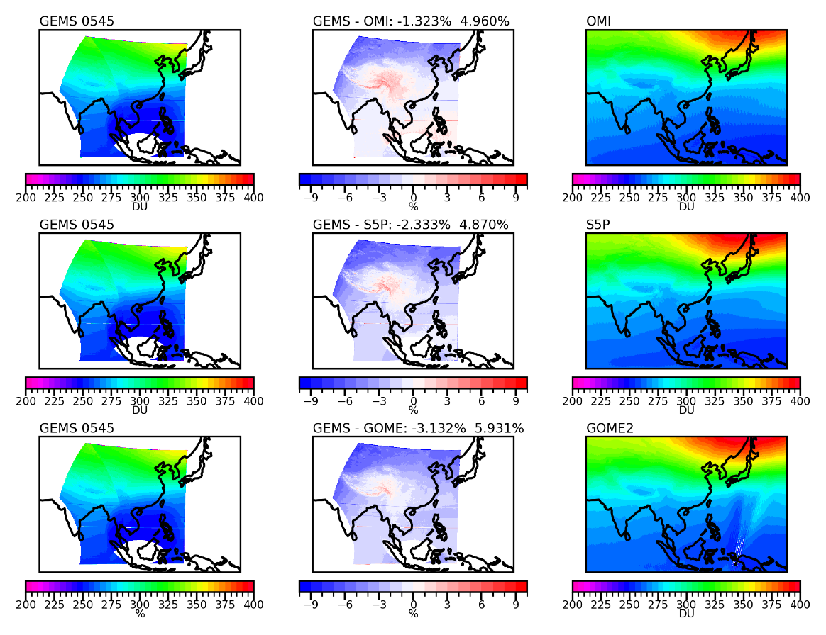
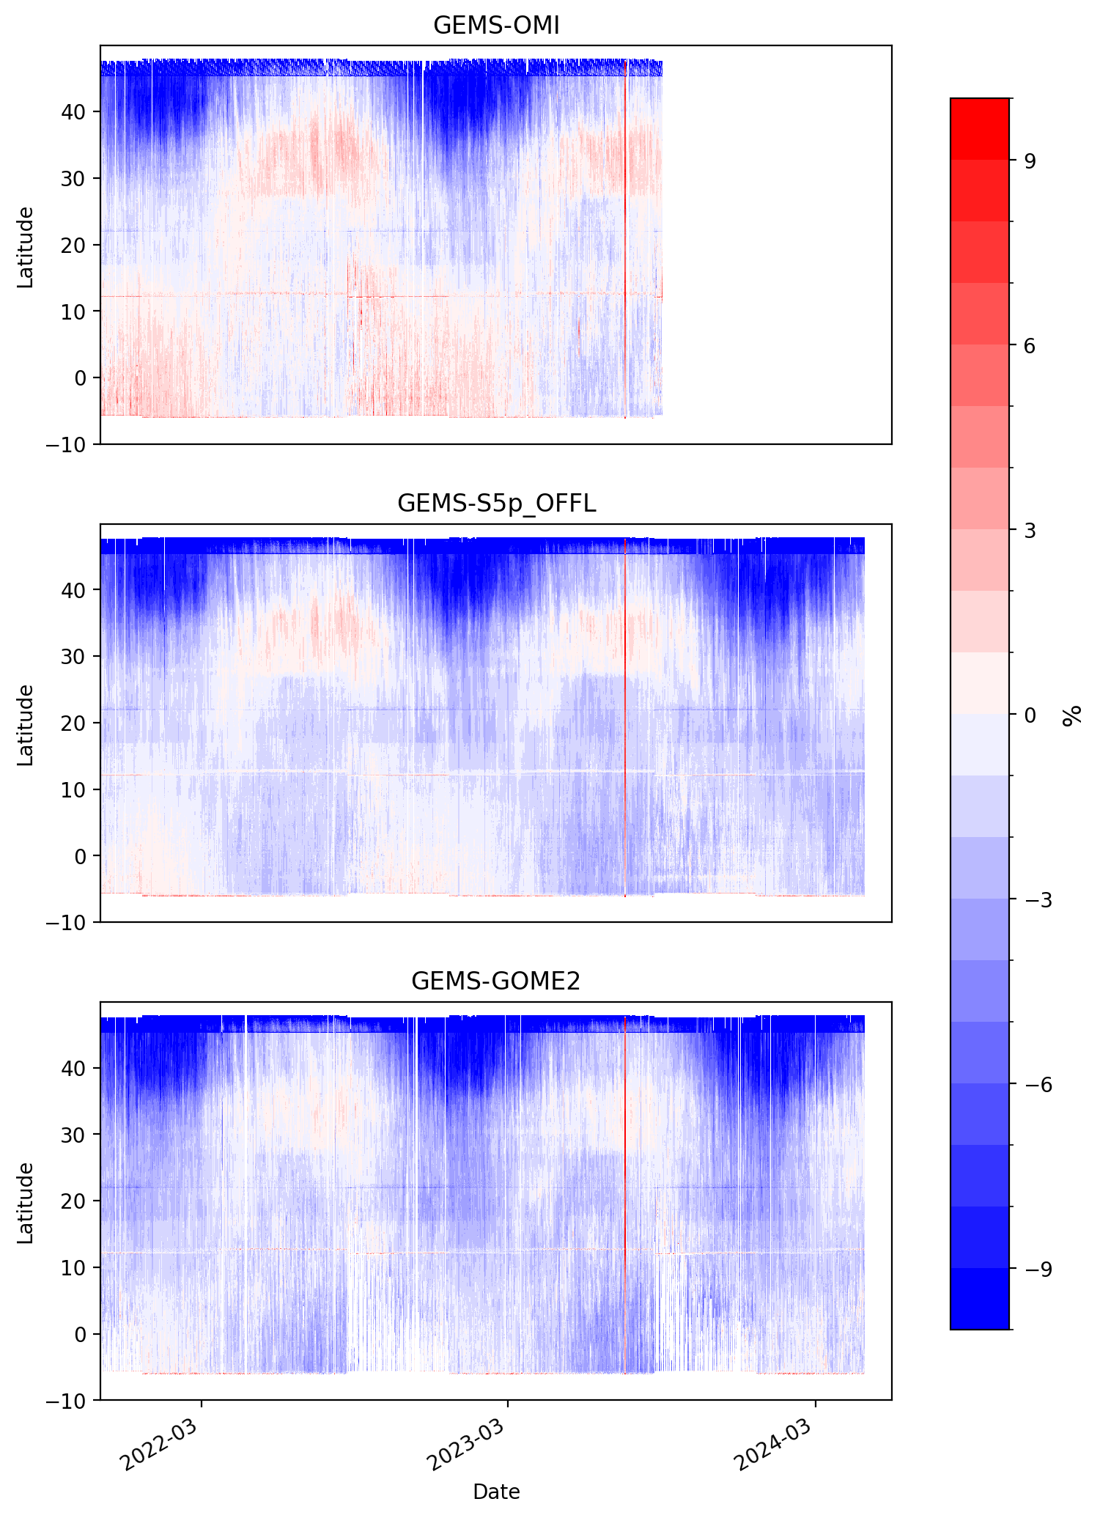
Evaluation of the GEMS O3T product against other satellite missions
Courtesy of K.-P. Heue, DLR
November 2021 to May 2024
Data gridded to a spatial resolution of 0.1° (lat & lon)
Filters:
GEMS → FinalAlgorithmFlag =0 or 1
S5P → QA > 0.5
GOME2 → QualityFlag=0
GEMS data with time stamp 5:45
Mean overall difference w.r.t. S5P: -2.3 %
Tropical data: better agreement
Increased GEMS underestimation northern mid-latitudes
Overestimation over the Himalayas

Slide 10
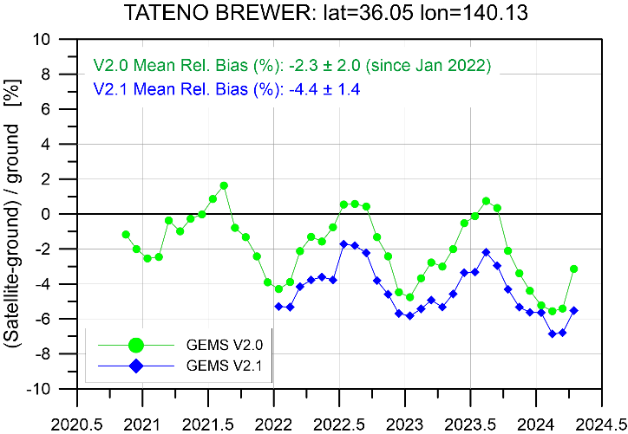
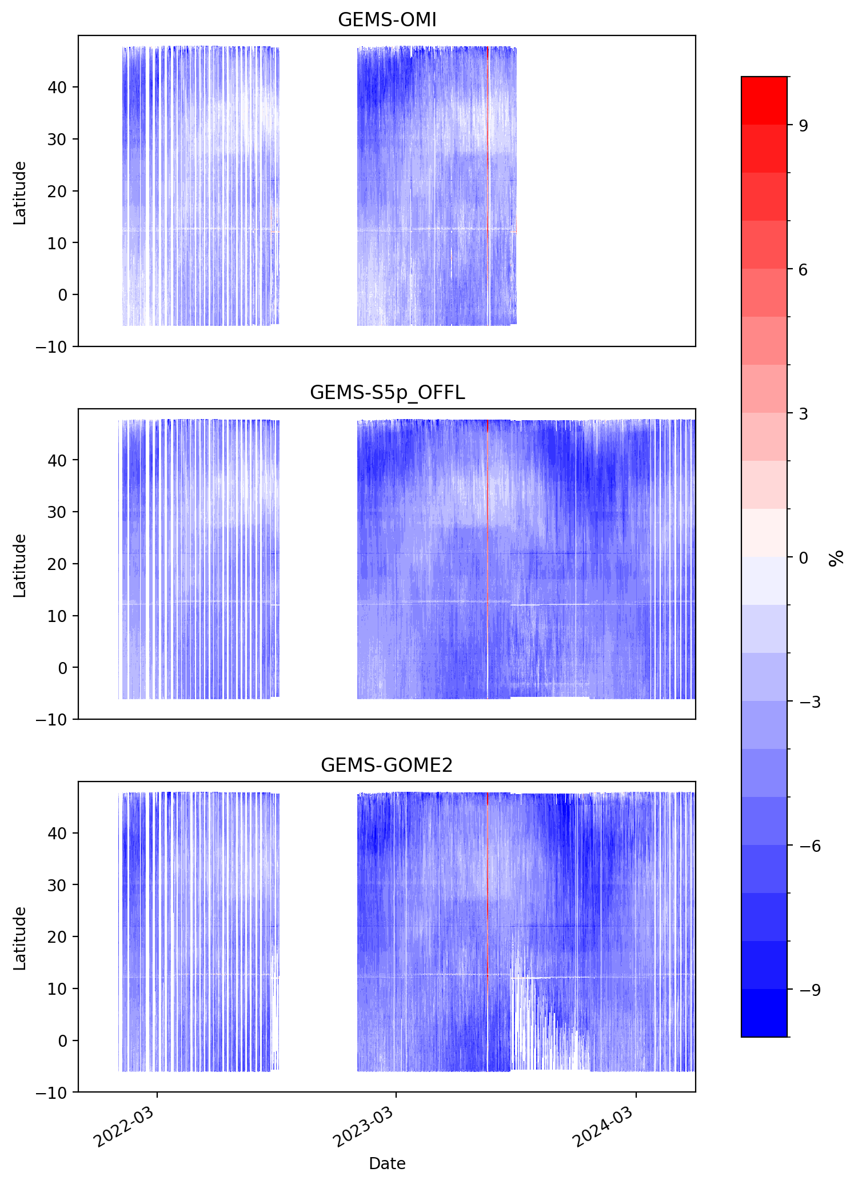
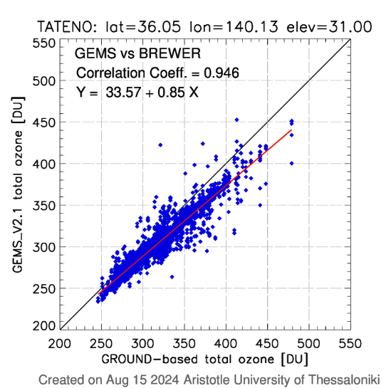
Evaluation of the GEMS O3T v2.1
GEMS
v2
GEMS
V2.1
V2: 6 % p-t-p
V2.1: 4 % p-t-p
GEMS vs | V2.0 | V2.1
OMI | -1.3 ± 5.0 (%) | -3.2 ± 2.5 (%)
S5P | -2.3 ± 4.9 (%) | -4.3 ± 2.2 (%)
GOME2 | -3.1 ± 5.9 (%) | -4.6 ± 2.5 (%)
V2.0 statistics:
Pearson cor. Coeff: 0.938
Slope: 0.85

Slide 11
Conclusions
Evaluation of 3.5 years of GEMS O3T v2.0 data:
Overall mean relative bias w.r.t. gr-based stations and other missions: -2 % [4 PGN stations: -3 %]
Mean standard deviation of the differences: 2-3 %
Pearson correlation coefficient > 0.88 (within GEMS requirement)
Clear non-unity slope
Temporally: North – South gradient with an annual cycle
Very good agreement (within +0.5 to -1%) of GEMS and reference total ozone measurements during spring, summer and autumn months
During winter months and for higher latitudes GEMS underestimates total ozone by up to 5%.
GEMS O3T v2.1:
Overall mean relative bias w.r.t. gr-based stations and other missions: -4 %
Significantly reduced annual cycle
Irradiance corrections are in progress (O3T v3 is expected soon)

Slide 12
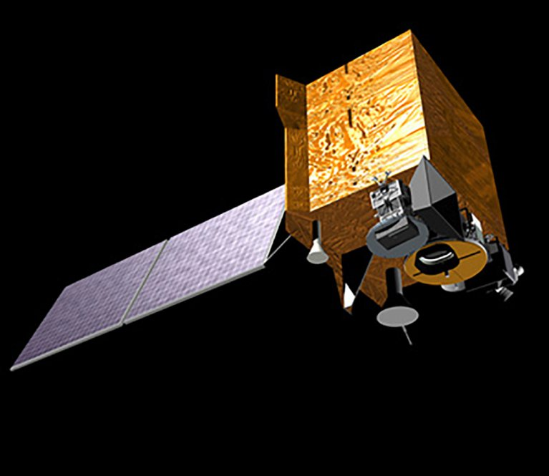
Thank you for your attention!
agarane@auth.gr

