Slide 1
An Overview of the Airborne and Satellite Investigation of Asian Air Quality (ASIA-AQ)
Jim Crawford
NASA Langley Research Center
and the many, many, many members of the ASIA-AQ science team

Slide 2
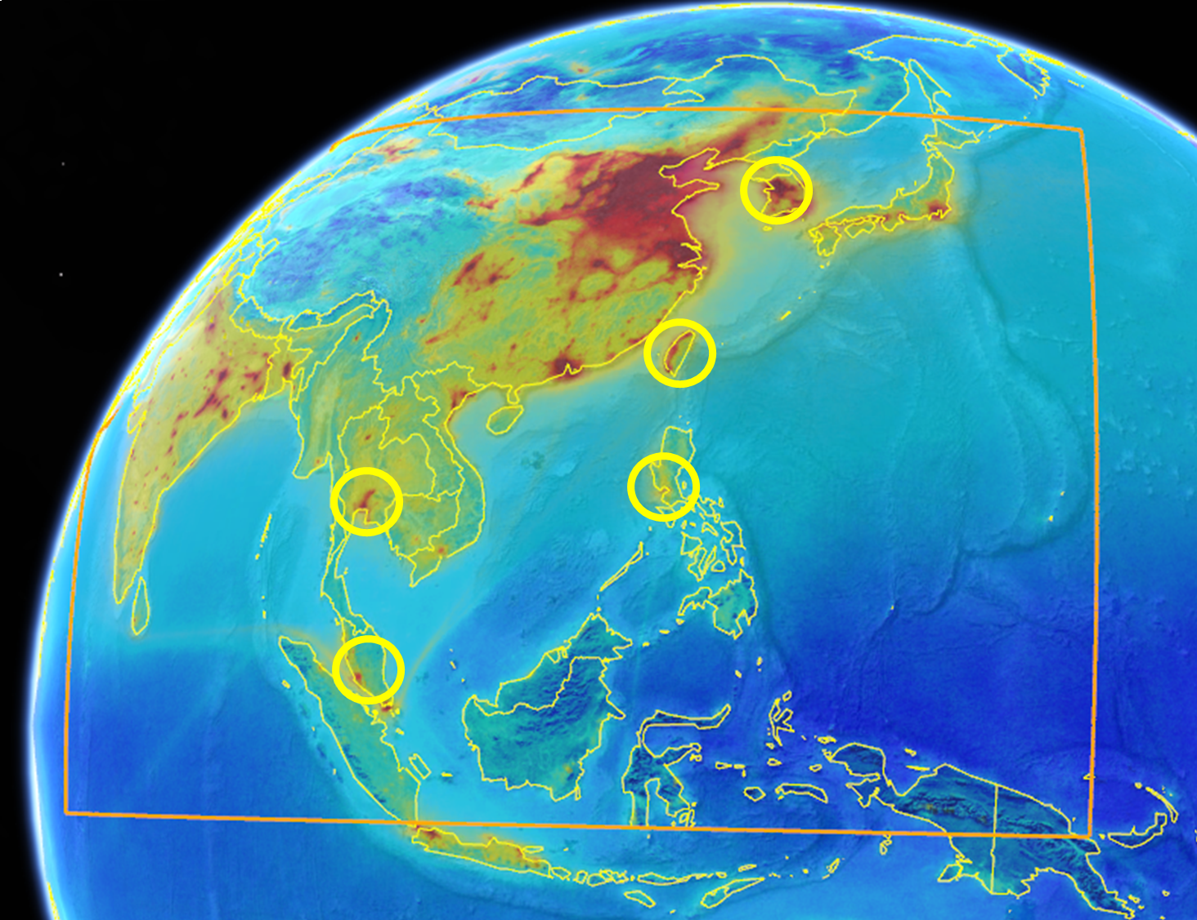
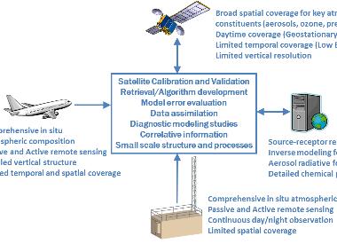
Airborne and Satellite Investigation of Asian Air Quality (ASIA-AQ)
Purpose: Improve understanding of the factors controlling local air quality across Asia through multi-perspective observations and modeling
Approach: Conduct airborne sampling across multiple locations in collaboration with local scientists, air quality agencies, and other relevant government partners.
Philosophy: Openly share data during all phases, conduct joint analysis with local scientists and air quality agencies, and report findings to local governments
Satellite Observations
Research Aircraft
Improved Air Quality Understanding
Air Quality Models
Air Quality Monitoring and Research Observations
Notes:
ASIA-AQ is an opportunity for international collaboration, working with local partners to apply multi-perspective observations in a consistent strategy across interested Asian countries to improve both specific understanding of local air quality issues and general understanding of common challenges in the interpretation of satellite observations and modeling of air quality.
Colormap shows the average distribution of nitrogen dioxide (NO2) from the TROPOMI satellite instrument.
Orange box defines the scanning region for South Korea’s GEMS satellite instrument.
Yellow circles indicate target regions for ASIA-AQ.

Slide 3
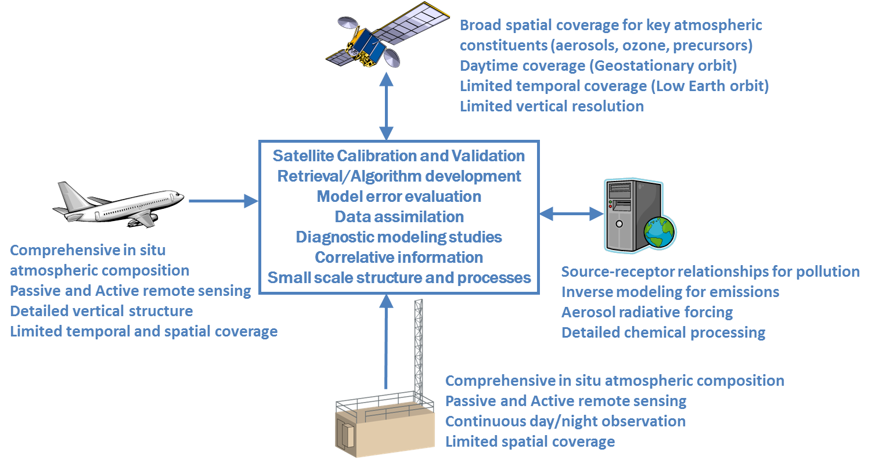
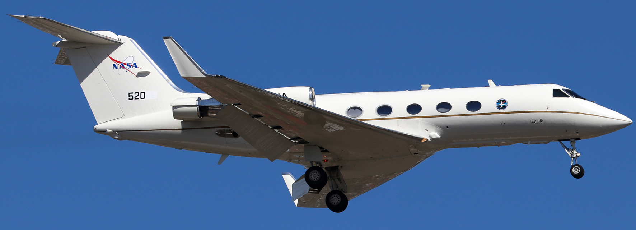
An integrated observing strategy is needed to bridge between satellite and ground measurements and to improve air quality models.
GEMS, TROPOMI, VIIRS, IASI, CrIS, etc.
NASA GIII for remote sensing of
air quality and GHG emissions
Satellite validation and detailed mapping of air quality
Emissions evaluation and model improvement
Improved understanding through process studies
NASA DC-8 for detailed in situ profiling
of air quality above the surface
Operational and Research-Grade
Air Quality Forecasts from Regional and Global models
Local air quality monitoring networks, research sites, Pandora Asia Network, AERONET, etc.
Notes:
Schematic representation of the observing strategy used to support ASIA-AQ science goals and explore the synergy between multi-perspective observations from the ground, air, and space.
This more detailed diagram outlines the elements of the integrated observing strategy to be implemented by ASIA-AQ and the role of aircraft observations in supporting Satellite Validation, Emissions Evaluation, Model Improvement, and understanding of processes controlling air quality. While airborne observations are short-term, they provide a level of detail that is otherwise impossible to obtain. The context provided by airborne observations is most valuable for the observing period, but it also informs longer-term interpretation of the more continuous satellite and ground-based observations. Two aircraft would be employed. The NASA DC-8 would have an extensive in situ instrument suite for profiling of the lower atmosphere over each location, measuring hundreds of constituents related to local gas-phase and particulate pollution. The NASA GV would fly at a higher altitude to map pollutant distributions with a spectrometer, lidar, and polarimeter. The measurement suites for these two aircraft are described in greater detail in the white paper. While GEMS will be a satellite of major focus, it is important to acknowledge that there are many other satellites that will benefit from validation observations. On the ground, it is important to acknowledge observations beyond the air quality monitoring networks. Research sites and ground-based remote sensing observations such as those from the emerging Pandora Asia Network and existing AERONET sites will likely be augmented during the ASIA-AQ study period. The combination of observations from all three perspectives: satellite, aircraft, and ground will provide for rigorous evaluation of operational and research-grade air quality forecast models which will play an important role in planning the ASIA-AQ research flights.

Slide 4
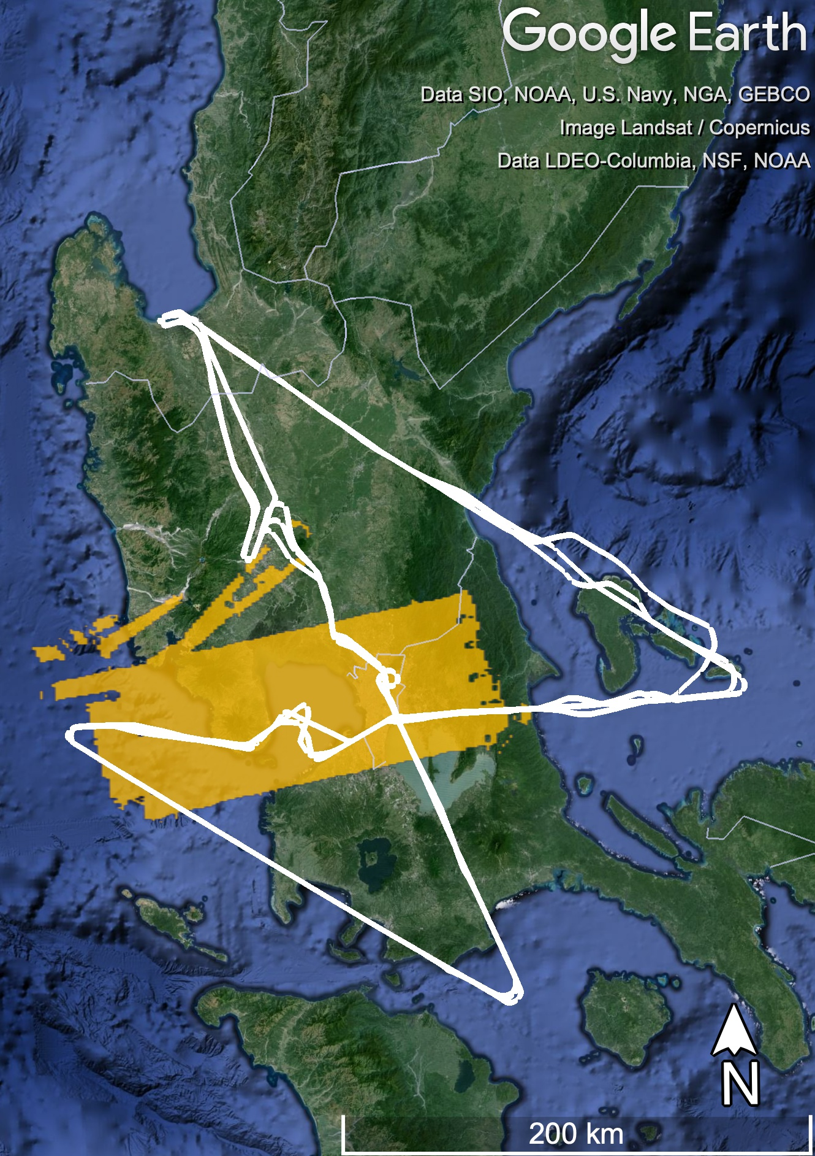
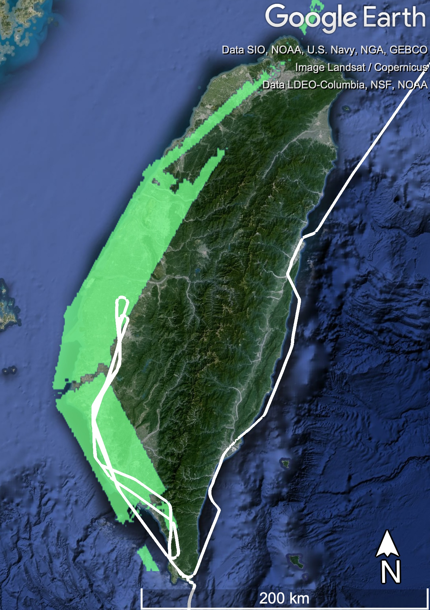
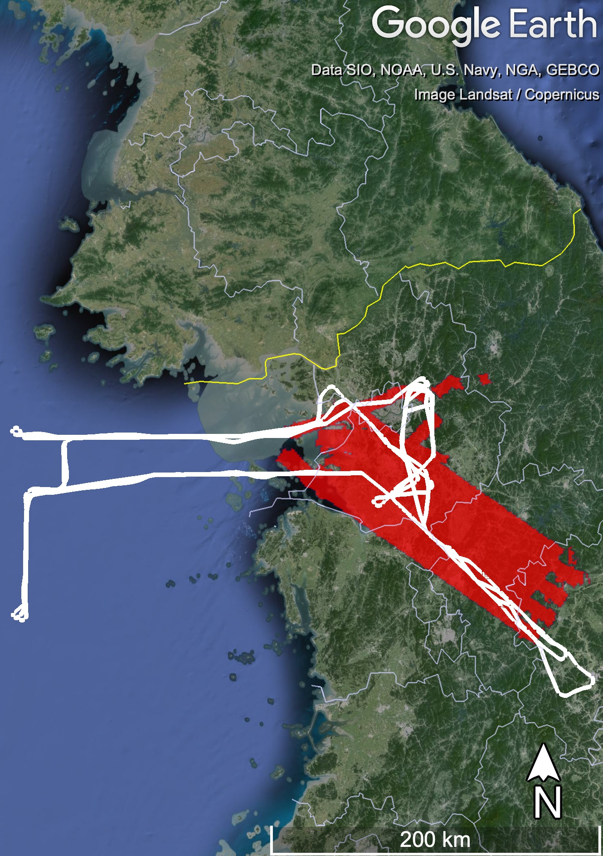
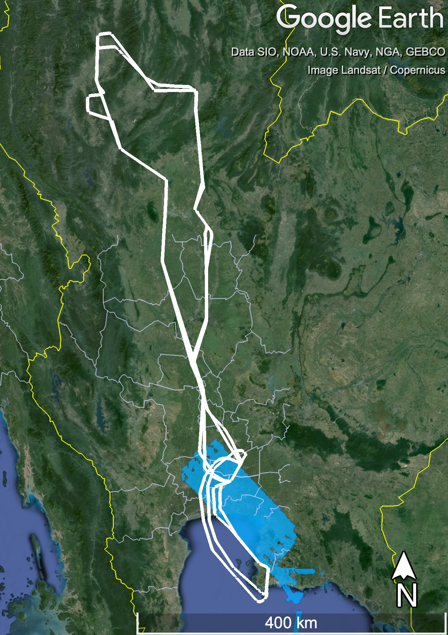
Platforms and instruments:
NASA DC-8 (161 hours): 26 instruments measuring in situ parameters relevant to
gas phase and aerosol composition
LaRC GIII (209 hours): GCAS + HSRL2 measuring column densities of NO₂ and HCHO and profiles of aerosol characteristics and ozone.
Primary collaborators include:
DENR, PhilSA, and Manila Observatory in the Philippines,
NIER and KMA in South Korea,
GISTDA and PCD in Thailand,
Ministry of Environment, NCU and Academia Sinica in Taiwan
with numerous other agencies and research institutions https://espo.nasa.gov/asia-aq/content/ASIA-AQ_Participants
Philippines
Feb 6, 7, 10,
11, 13
Taiwan
Feb 14, 28
March 13, 27
South Korea
Feb 17, 23, 26
March 1, 2, 3, 8,
10, 11
Thailand
March 16, 18, 19,
21, 23, 25
Maps of the geographical regions sampled in February-March 2024 during ASIA-AQ. Colored areas are those mapped by the GIII and the white lines represent one flight from the DC8.
Data will be released before Oct 2024
Notes:
After data release in October, data analysis in collaboration with partners in each country will result in reports on relevant findings to policy makers in early 2025 with another follow-up when peer-reviewed papers are completed.

Slide 5
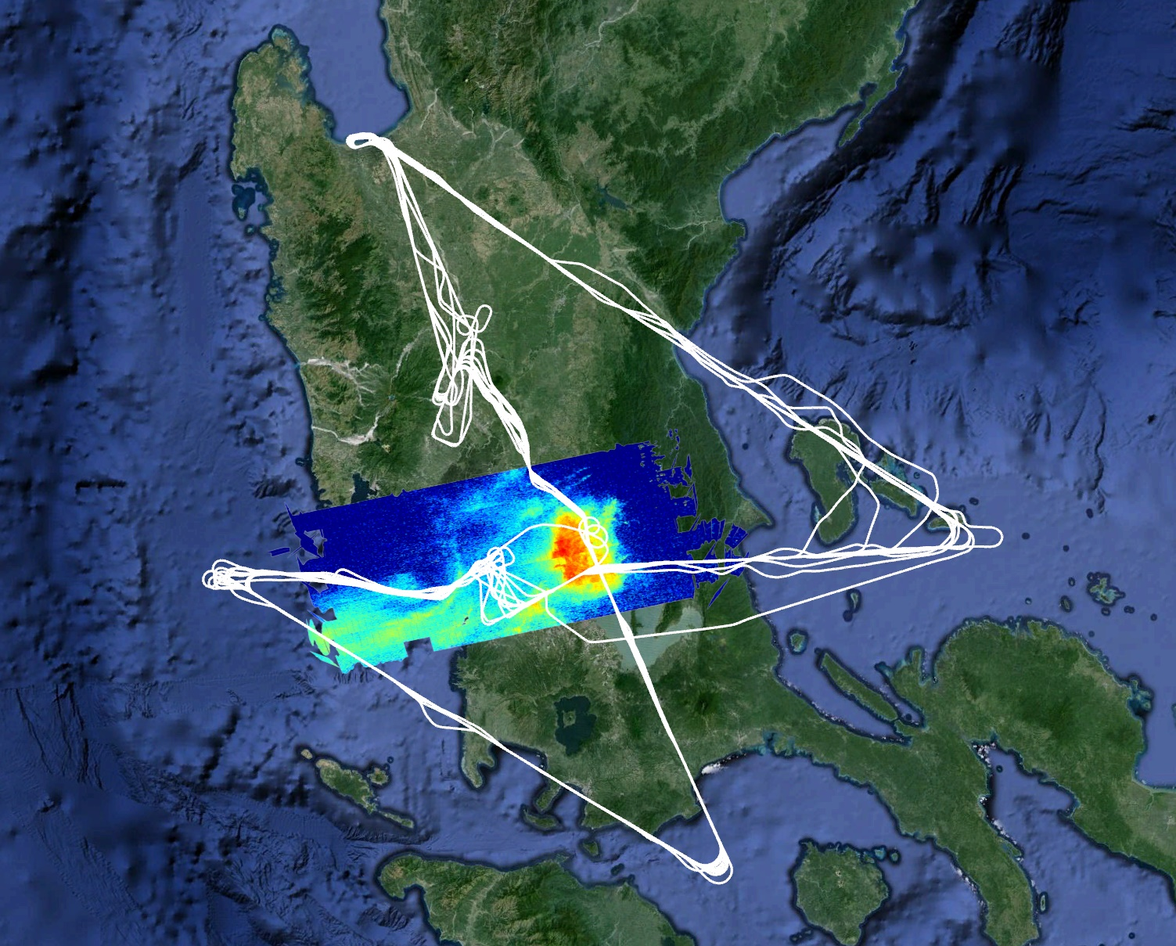
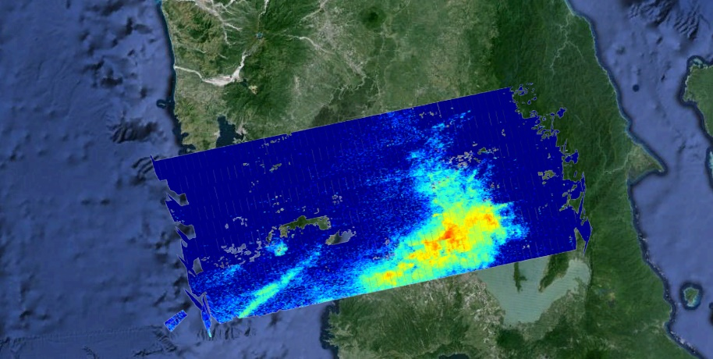
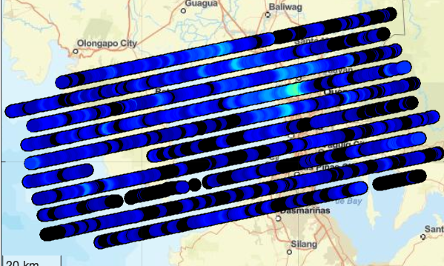
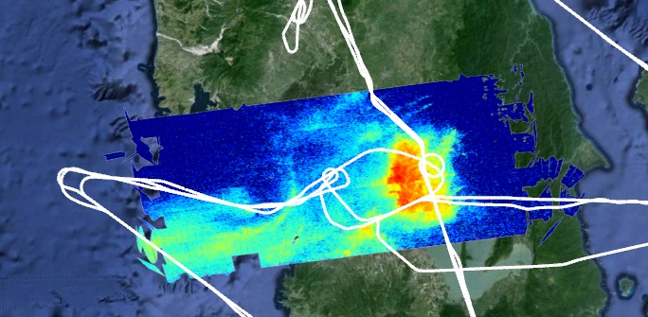
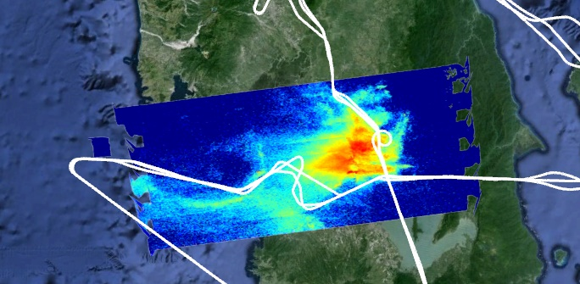
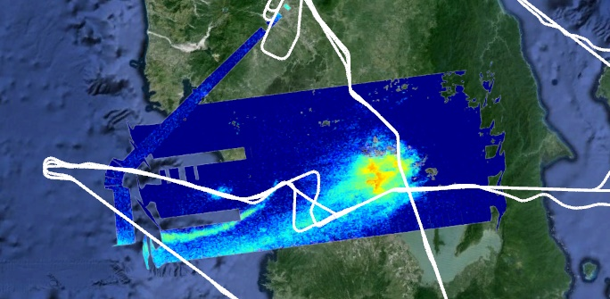
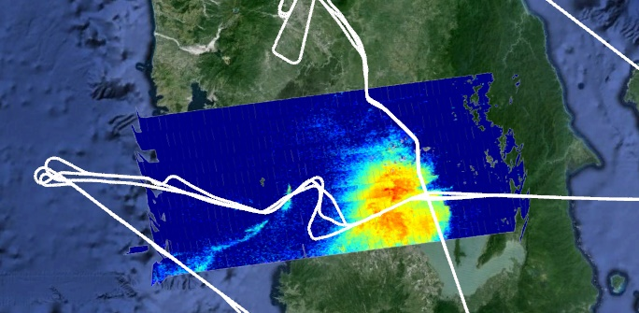
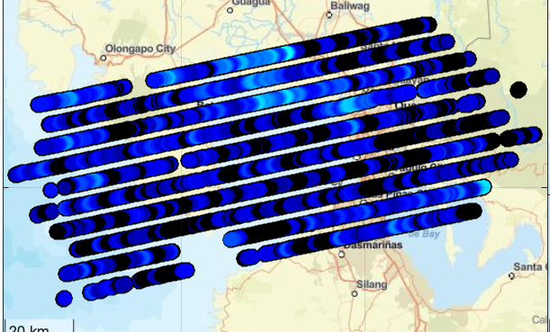
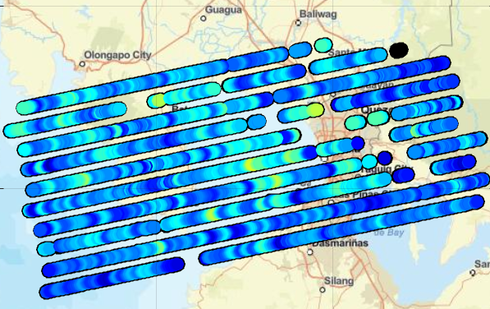
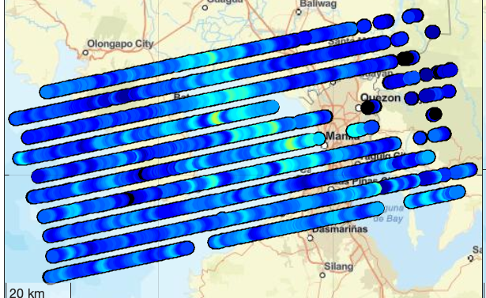
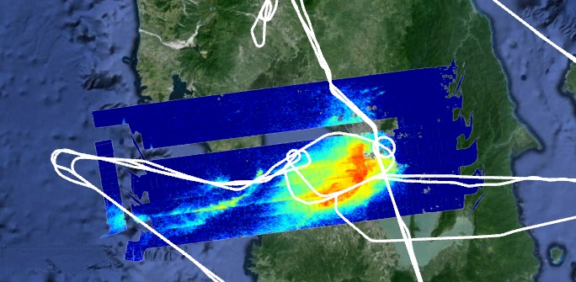
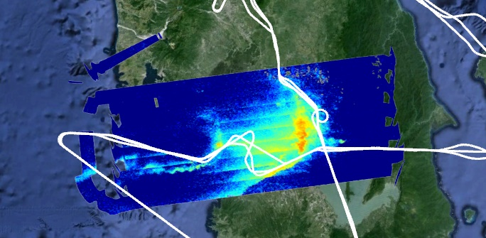
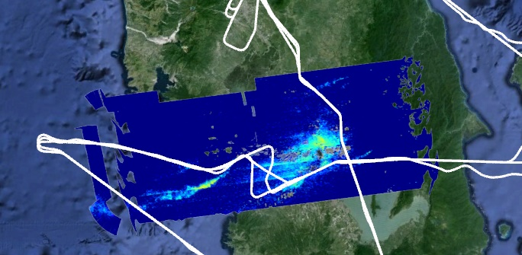
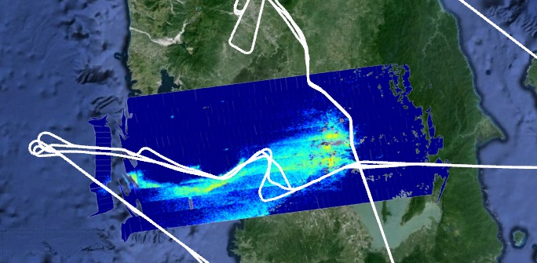
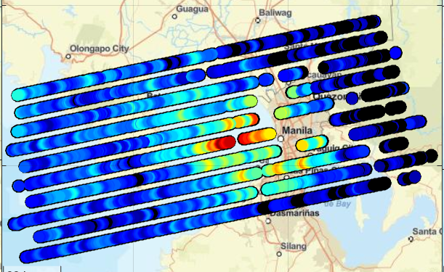
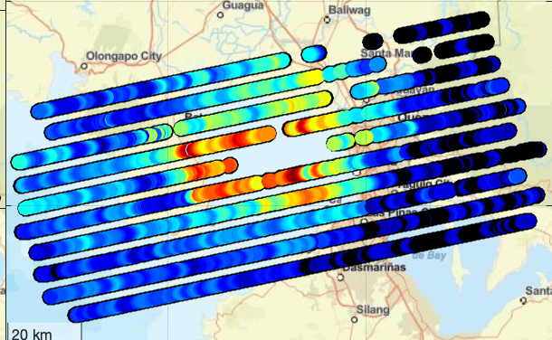
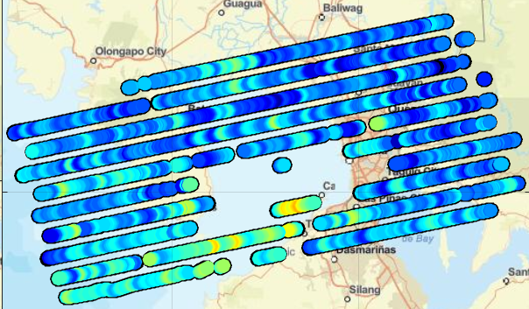
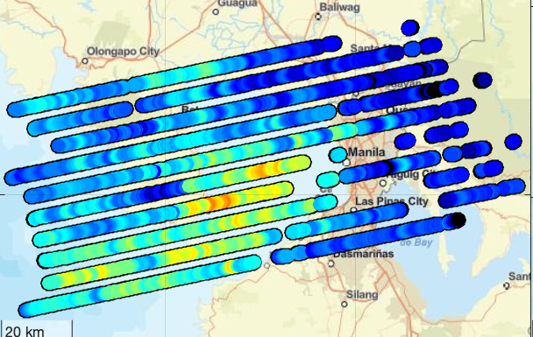
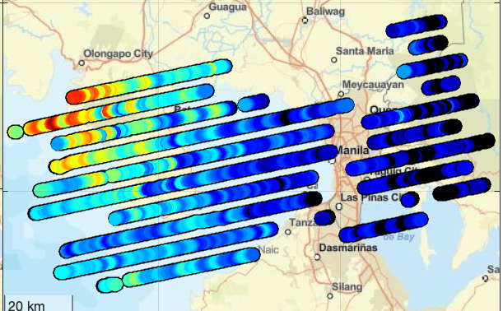
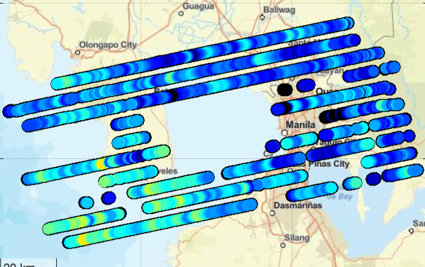
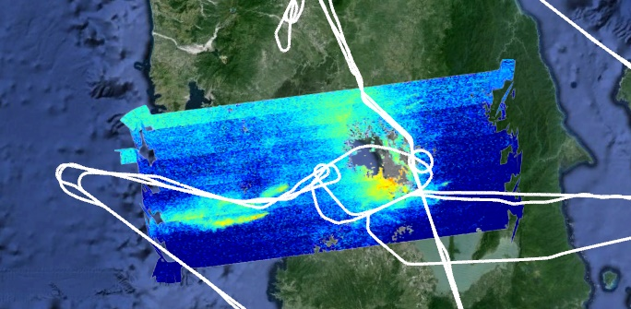
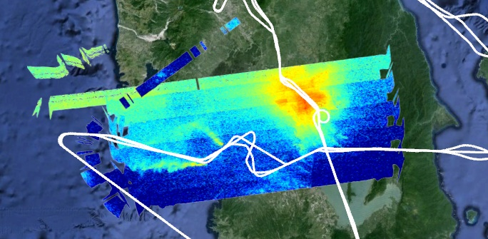
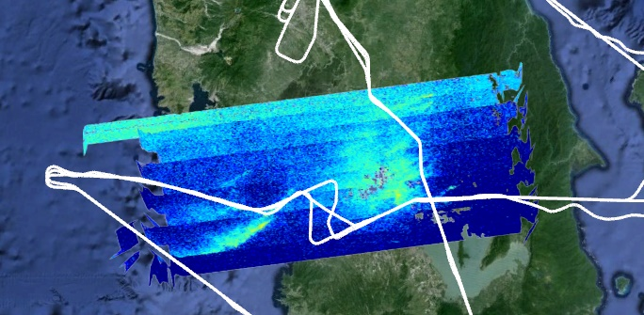
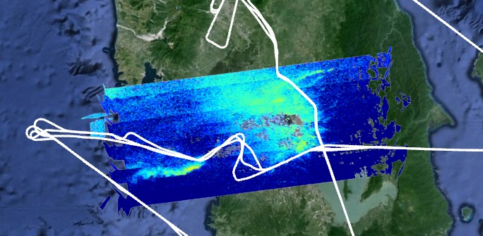
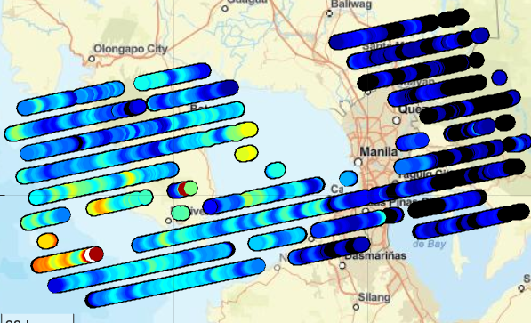
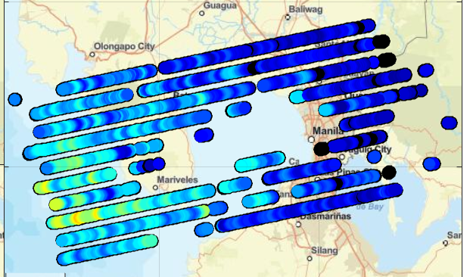
Full extent of DC-8 sampling
ASIA-AQ Philippines Science Flights
4 days with three G-III rasters and three DC-8 circuits
1 day with a morning G-III raster
10 Feb Morning
GCAS Preliminary Slant column data
6 Feb Morning
7 Feb Morning
11 Feb Morning
13 Feb Morning
6 Feb Midday
7 Feb Midday
11 Feb Midday
13 Feb Midday
6 Feb Afternoon
7 Feb Afternoon
11 Feb Afternoon
13 Feb Afternoon

Slide 6
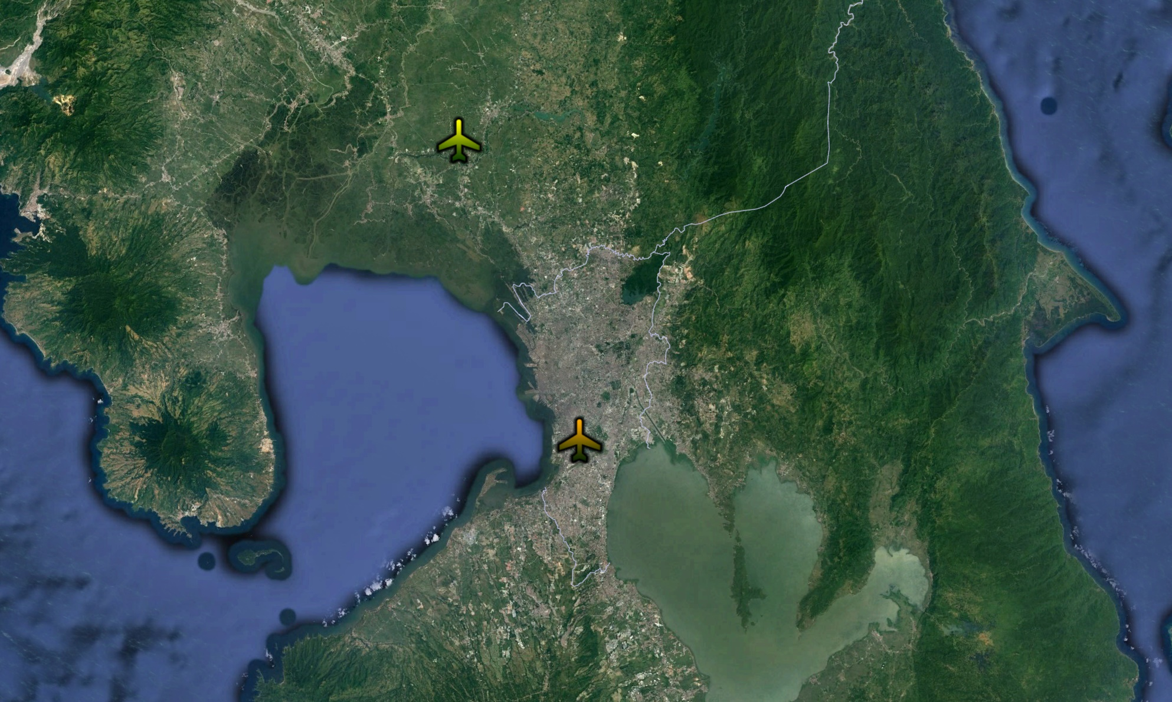
Example time series and vertical sampling regime used during ASIA-AQ (Philippines)
Plaridel
Ninoy-Aquino

Slide 7
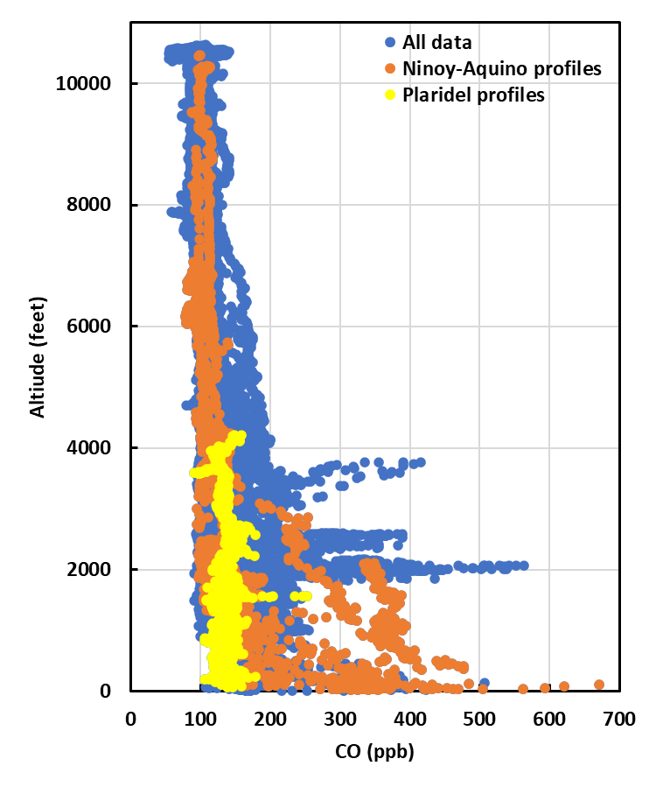
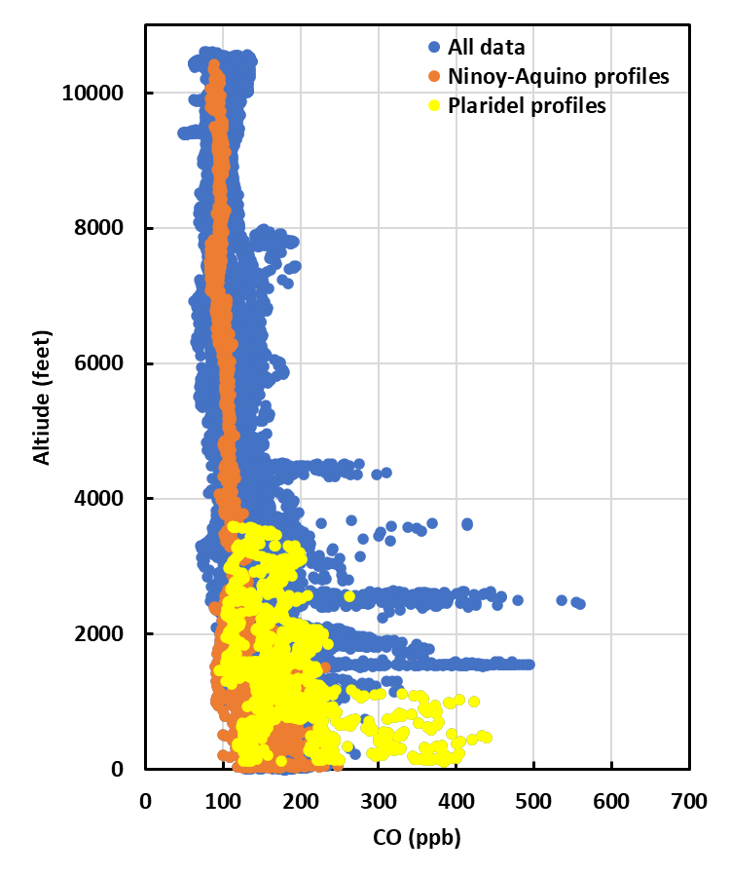
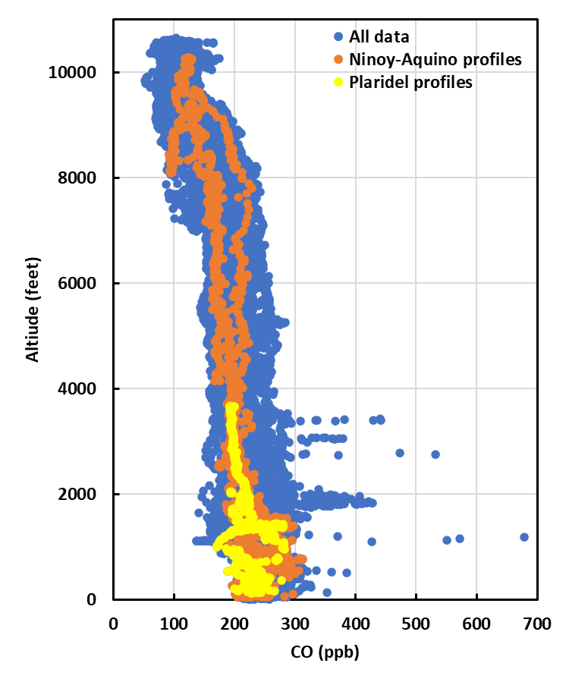
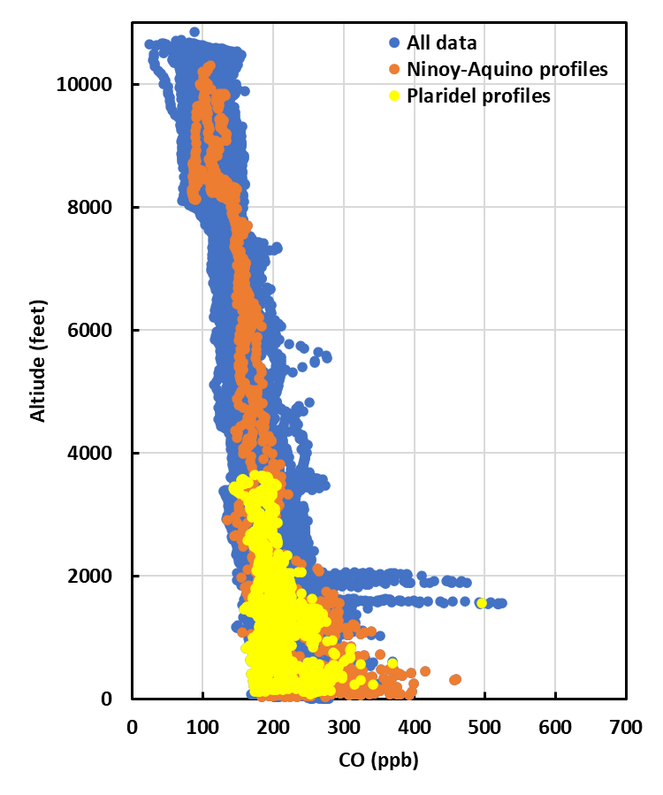
Example time series and vertical sampling regime used during ASIA-AQ (Philippines)
6 Feb 7 Feb 11 Feb 13 Feb

Slide 8
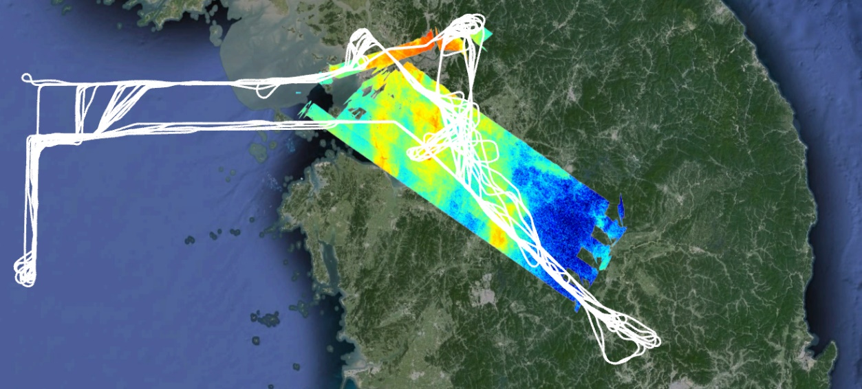
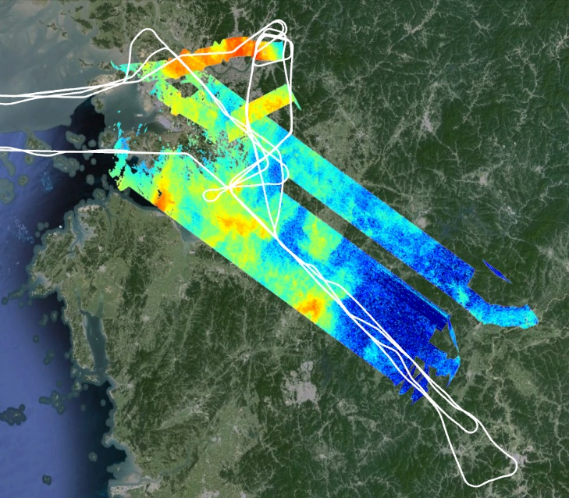
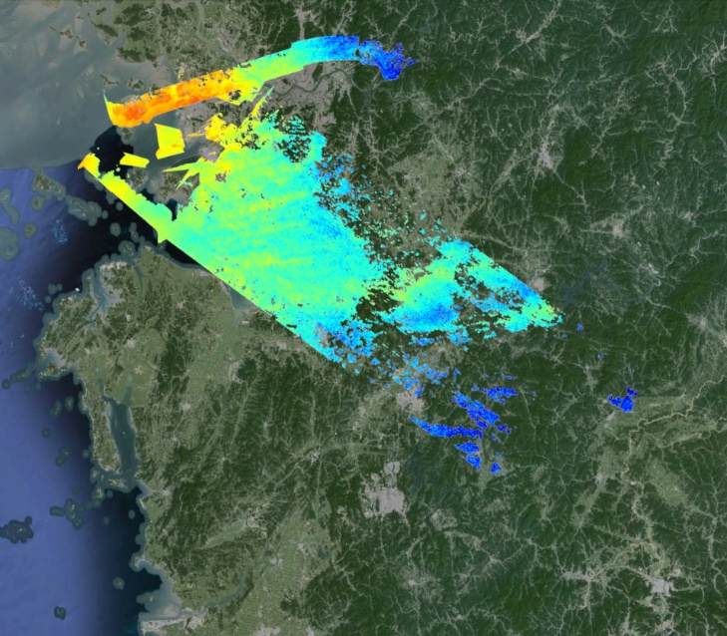
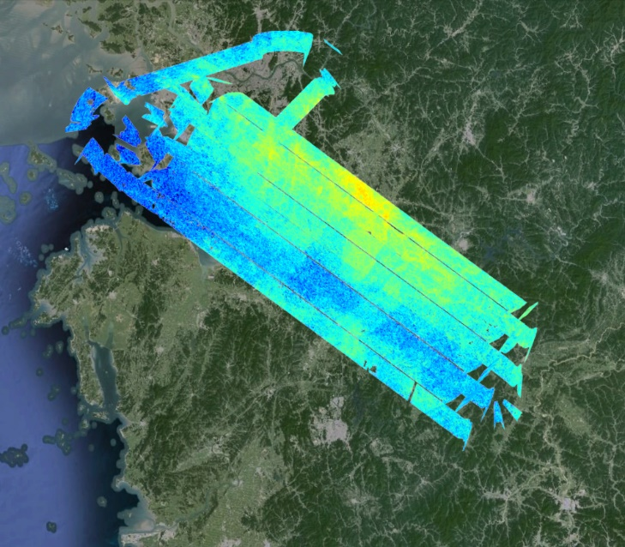
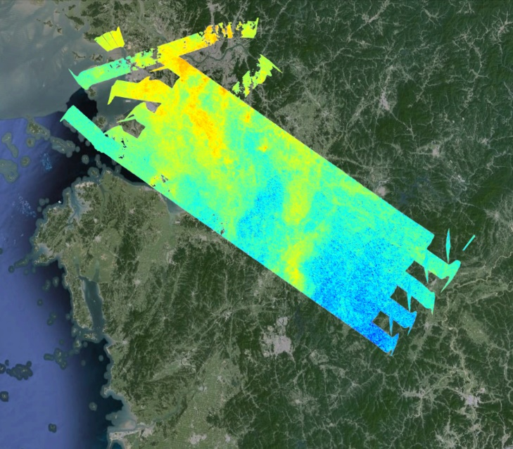
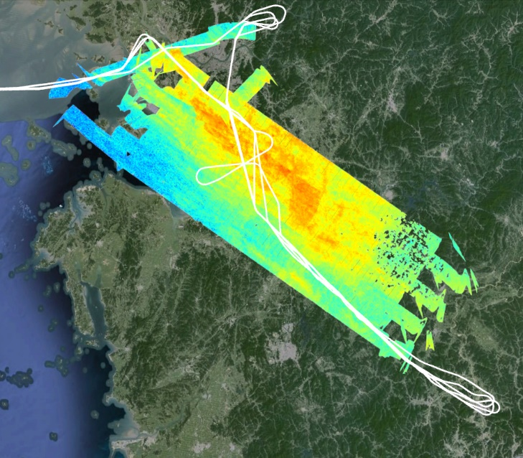
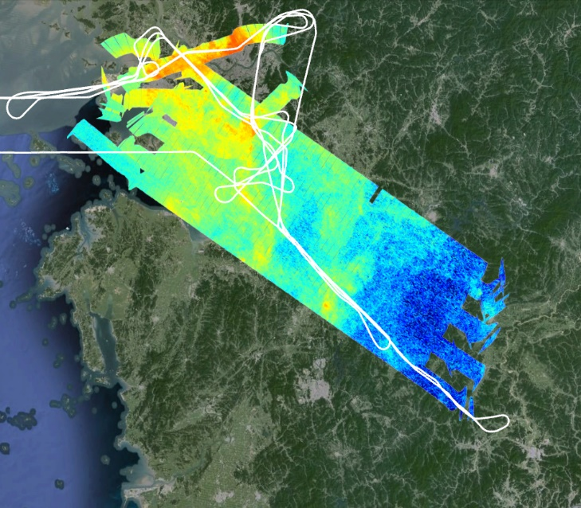
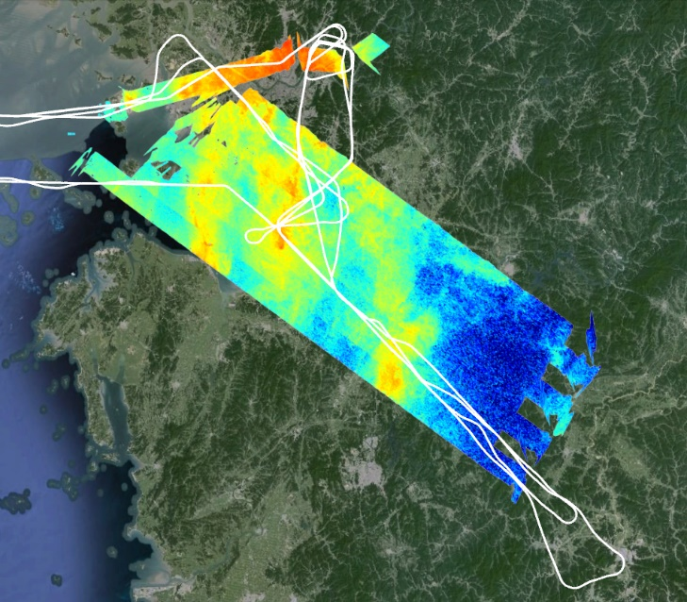
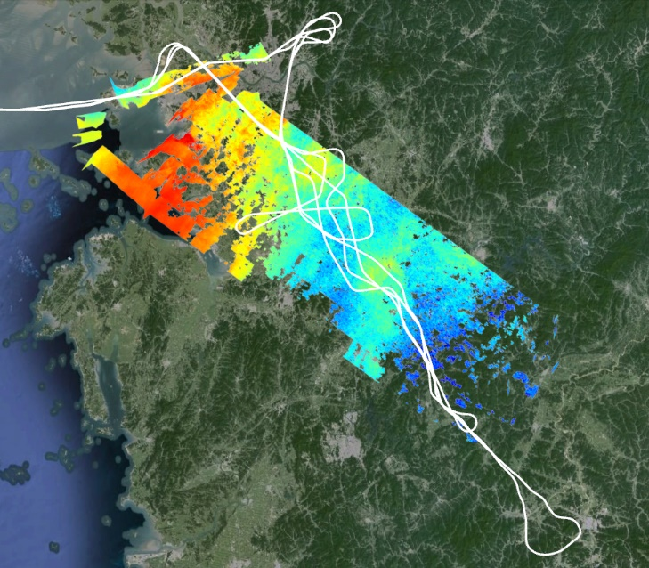
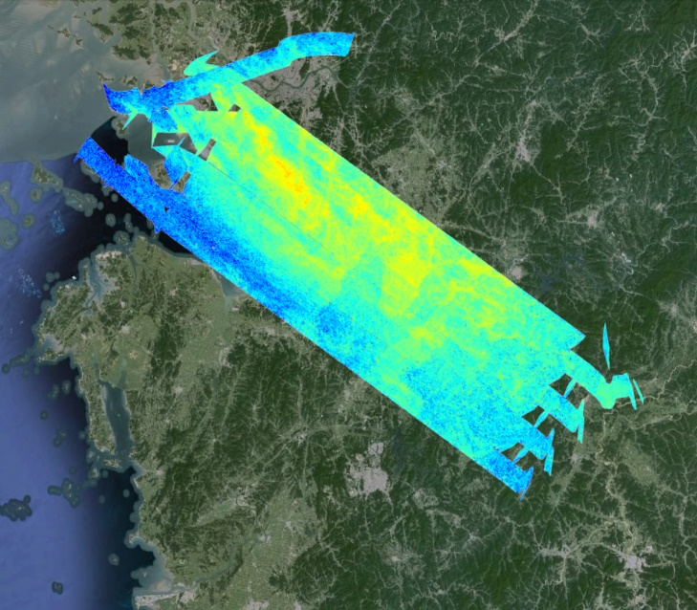
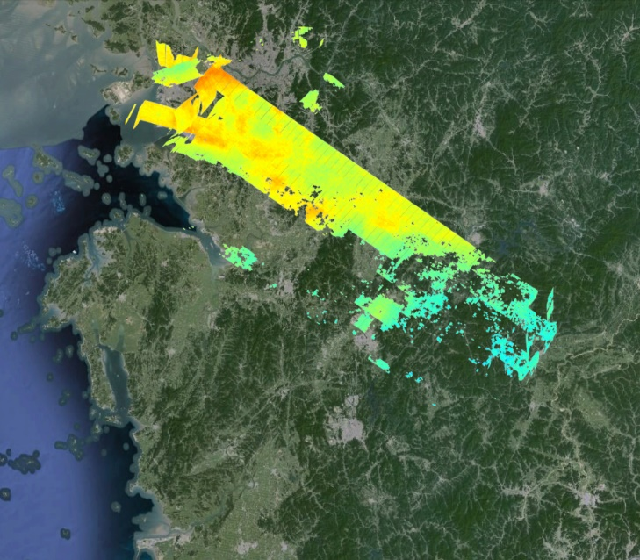
ASIA-AQ Korea Science Flights
3 Days with three G-III rasters with DC-8
1 Day with two G-III rasters with DC-8
4 Days with G-III alone
1 Day with DC-8 alone
GCAS Preliminary
Slant column data
Full extent of
DC-8 sampling
17 Feb
23 Feb
1 Mar
2 Mar
8 Mar
10 Mar
17 Feb
26 Feb
1 Mar
3 Mar
8 Mar
10 Mar
17 Feb
26 Feb
2 Mar
3 Mar
8 Mar
10 Mar

Slide 9
Notable gradients in Carbon Monoxide over South Korea
Reversed gradient with pollution over water on 26 Feb
Cleanest with layer aloft on 8 Mar
Gradual transition from 8-11 Mar
Similarity between 17 Feb and 11 Mar (with deeper BL)
17 Feb 26 Feb
8 Mar 10 Mar 11 Mar
Land
Water
Land
Water
Land
Water
Land
Water
Land
Water

Slide 10
ASIA-AQ Thailand Science Flights
3 Days with three G-III rasters with DC-8
1 Day with DC-8 and G-III with data only from HSRL2
2 Days with G-III alone
GCAS Preliminary Slant column data
Full extent of
DC-8 sampling
18 Mar
21 Mar
23 Mar
25 Mar
18 Mar
19 Mar
21 Mar
23 Mar
25 Mar
18 Mar
19 Mar
21 Mar
23 Mar
25 Mar

Slide 11
Notable gradients in Carbon Monoxide over Thailand
CO is expected to be greater in the north (>16N) where burning was more prevalent.
On 21 March, the gradient in CO reverses due to synoptic shift and cleaner conditions.
25 March shows least gradient from north to south as pollution from fires begins to build again.
16 Mar 18 Mar
21 Mar 25 Mar
<16N
>16N
<16N
>16N
<16N
>16N
<16N
>16N

Slide 12
ASIA-AQ Taiwan Science Flights
3 Days with G-III and DC-8
1 Day with G-III alone
GCAS Preliminary Slant column data
15 Feb
28 Feb
13 Mar
27 Mar

Slide 13
Carbon Monoxide over Taiwan
Flights over Taiwan were farther apart in time (left panel shows all three flight days).
Highest CO aloft on 13 March and highest near surface on 27 March.
Substantial differences in profile shapes between flights.
15 Feb/13 Mar/27 Mar 13 Mar 27 Mar

Slide 14
Example derivations of surface PM_{2.5} from HSRL2

Slide 15
Example of diversity in surface PM_{2.5} from HSRL2

Slide 16
Example of vertical distribution of PM_{2.5} from HSRL2

Slide 17
ASIA-AQ Data Archive
https://www-air.larc.nasa.gov/missions/asia-aq/index.html
1 October 2024: Deadline for processing of DC-8 and G-III preliminary field data into research quality data for public release
Users can access individual data files for each instrument. These files contain valuable metadata and contact information for instrument investigators.
Custom merging tools available for in situ aircraft observations.
Merging tool allows a user to select the variables of interest, averaging time, dates, etc. to quickly generate integrated data files ready for analysis.

Slide 18
Next Steps
Begin integrated data analysis – October 2025
ASIA-AQ Science Team Meeting – 20-24 January 2025, Universiti Kebangsaan Malaysia
Disseminate Rapid Science Synthesis Reports to each country – Early 2025
Conduct ongoing analysis for peer-reviewed publications
Expect to see much more next year!
Special Thanks to:
Scott Janz and Laura Judd – GCAS data
John Hair, Taylor Shingler, Marta Fenn, Rich Ferrare – HSRL2 data
Josh Digangi and Glenn Diskin – DACOM CO data

