Slide 1
Empirical Uncertainty Analysis of GEMS AEH by AOD and Surface reflectance
Sang Seo Park, Seungjae Lee (UNIST)
Jhoon Kim, Yujin Chai (Yonsei Univ.)

Slide 2
Introduction
Aerosol Retrieval from Environmental Satellite
Aerosol, Cloud information : Important for accuracy of trace gases.
Environmental Satellite : Fine spectral resolution, Coarse spatial Resolution
Aerosol Information : AOD, Type, and Single Scattering Albedo
Aerosol Height from Satellite is still challenging Issue.
GEMS Aerosol Product
GEMS Aerosol Optical Properties (L2AERAOD) → AOD, SSA, Types (ABS, NA, Dust)
In addition, Aerosol Effective Height product (L2AEH) from GEMS is also now in operation.
Aerosol Effective Height Algorithm
Aerosol Effective Height is representative parameter for aerosol layer height information based on the assumed profiles.
Theoretically, error budget study was performed by Park et al. (2016). However, empirical based error analysis is not yet studied.

Slide 3
Introduction- Theoretical Error Analysis
Error source
- AOD : AOD ↑ → O₄ SCD↓ (Shielding effect)
- SSA : SSA ↑ → Scattering↑ → O₄ SCD ↑
- Albedo: High albedo → O₄ SCD ↑
-Aerosol vertical distribution Exponential vs Gaussian (MITR) Exponential vs Box-shape (WASO,COPO)
Error source [unit : m] | MITR | WASO |  | COPO
AOD (ΔAOD = 0.2) | 193±109 | 182±102 |  | 201±116
SSA (10% change) | 1068±914 | 2373±1882* |  | 488±436*
Surface Albedo (Δα = 0.01) | 93±185 | 89±126 |  | 252±571
Aerosol vertical distribution | 1843±4570 | 1884±2172 |  | 928±3332
Atmospheric Gases | < 10
O₄ cross section | ~1.7% (O₄ SCD)
Instrument (Shift : 0.02 nm) | < 10
Total Error [unit : %] | 28.2 | 56.6 | 22.9
Negligible
[Park et al., 2016, ACP]
*Aerosol Model : MITR (for dust), WASO (for non-absorbing), COPO (for absorbing) (Hess et al., 1998) – OPAC Aerosol Model

Slide 4
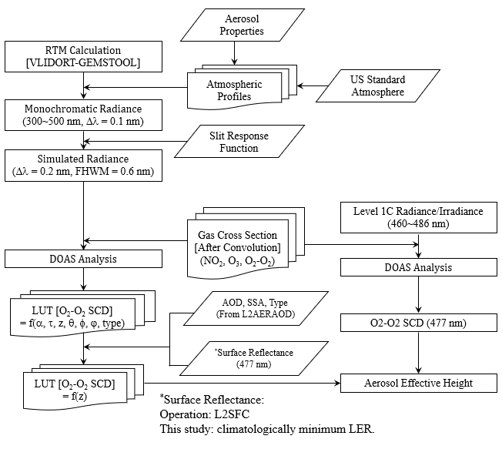
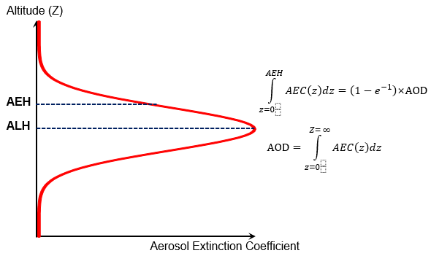
GEMS AEH Retrieval Algorithm (V2.X)
[Park et al. (2023, AMTD)]

Slide 5
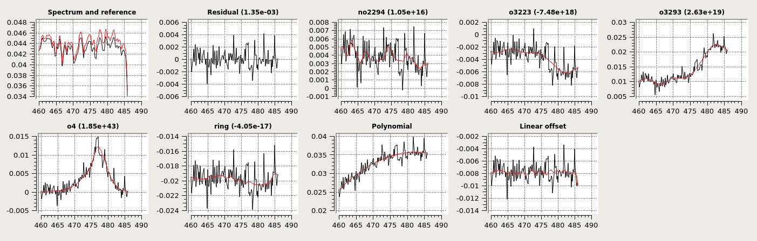
GEMS AEH Retrieval Algorithm (V2.X)
DOAS Fitting
Spectral Range : 460 ~ 486 nm
Reference : GEMS Irradiance Dataset (L1IRR)[Daily Observation]
Cross Section: O₃ (228 K, 295 K; Bogumil et al., 2001) NO₂ (298 K; Vandaele et al., 1998) O₄ (293 K; Thalman and Volkamer, 2013), Ring
[Park et al. (2023, AMTD)]
Polynomial | Offset = none | Offset = 0th
2nd order | 6.06±2.07 | 6.79±2.31
3rd order | 6.32±2.20 | 6.79±2.32
4th order | 7.86±2.78 | 7.34±2.85

Slide 6
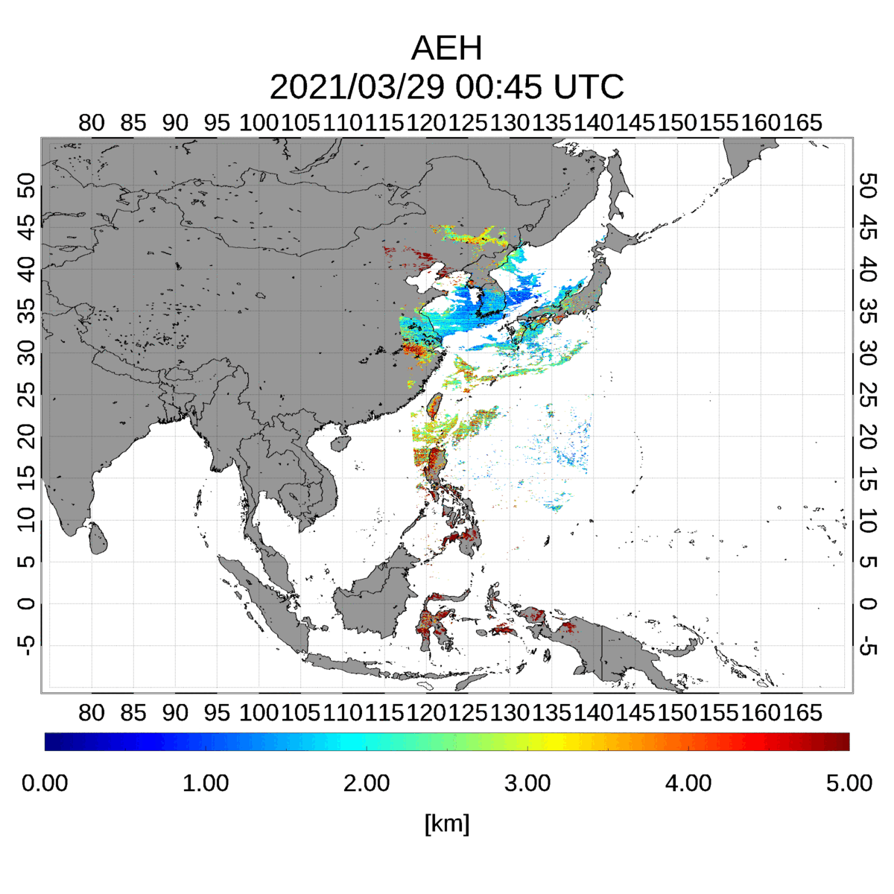
GEMS AEH Retrieval Algorithm (V2.0)
2021/03/29 ~31 – Dust Transport
03/29
TROPOMI ALH
03/30
GEMS AEH
03/31

Slide 7
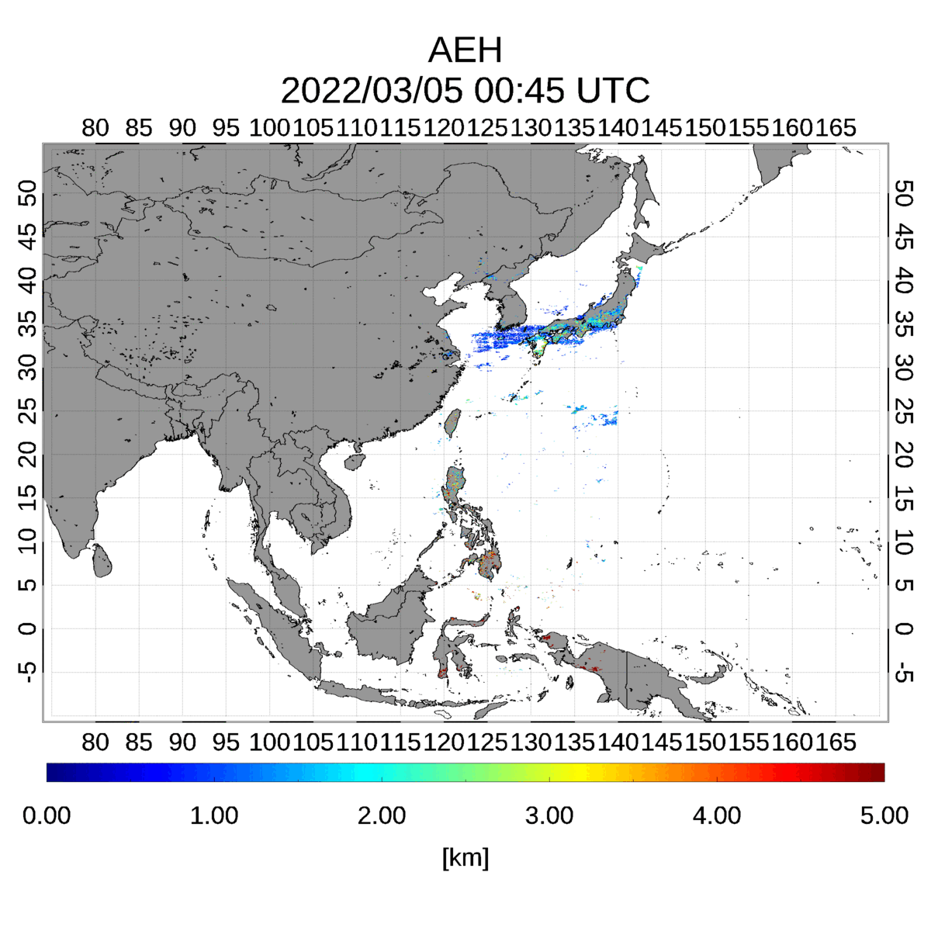
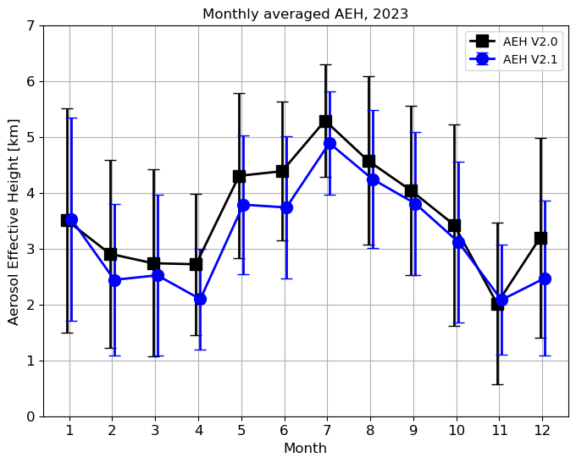
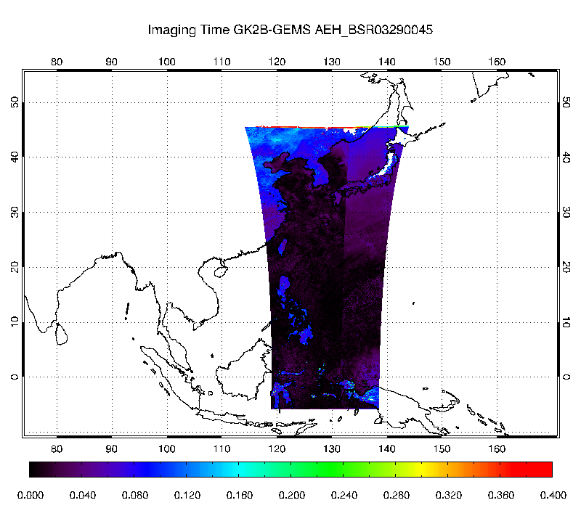
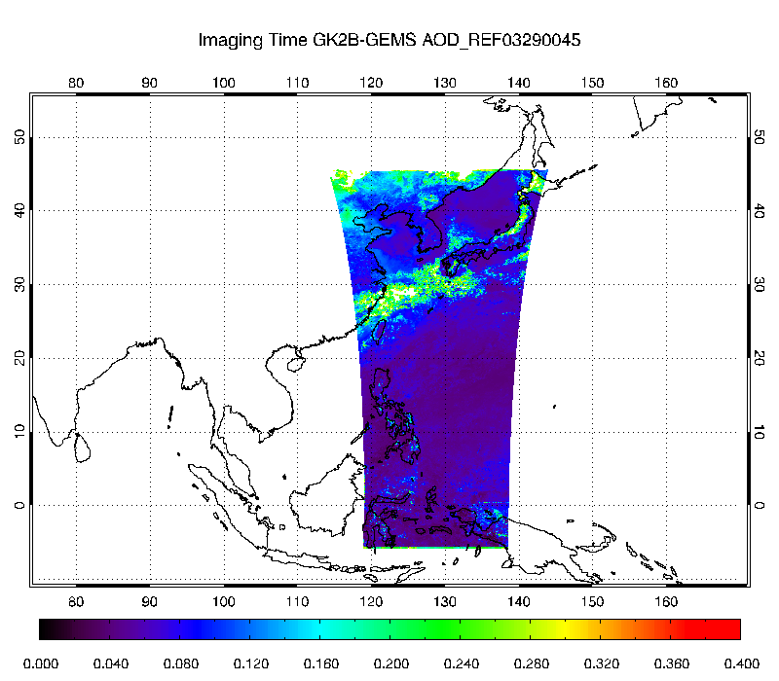
GEMS AEH V2.0→V2.1
Main Update Issue
Surface Reflectance Data Change (L2SFC → Climatology)
Aerosol product Input (V2.0 → V2.1)
V2.0
V2.1
Reflectance (L2SFC)
Reflectance (L2AERAOD)
300~600 m shift

Slide 8
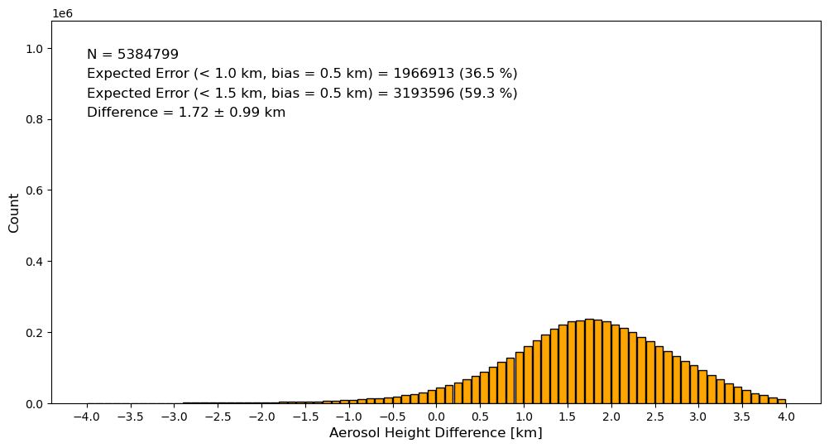
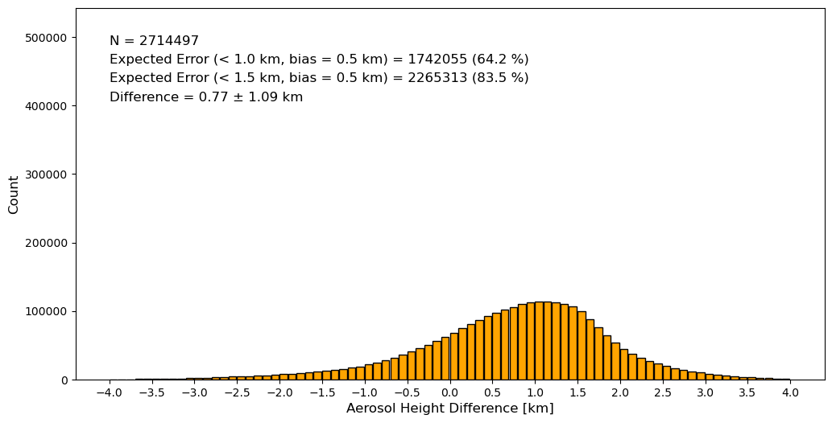
GEMS AEH Validation Result (V2.0 vs V2.1)
AEH difference: Land > Ocean ➔because of surface reflectance?
V2.0
V2.1
Land
Terrain height > 0
Difference 2.12 ± 1.05 km
Difference 1.72 ± 0.99 km
Ocean
Terrain height = 0
Difference 0.91 ± 1.10 km
Difference 0.77 ± 1.09 km
[Lee et al. in preparation]

Slide 9
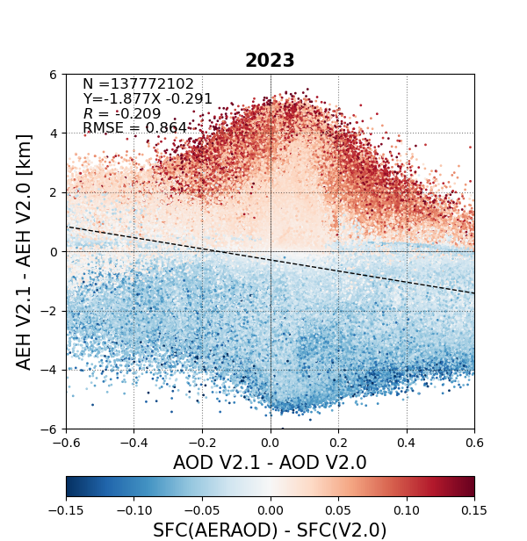
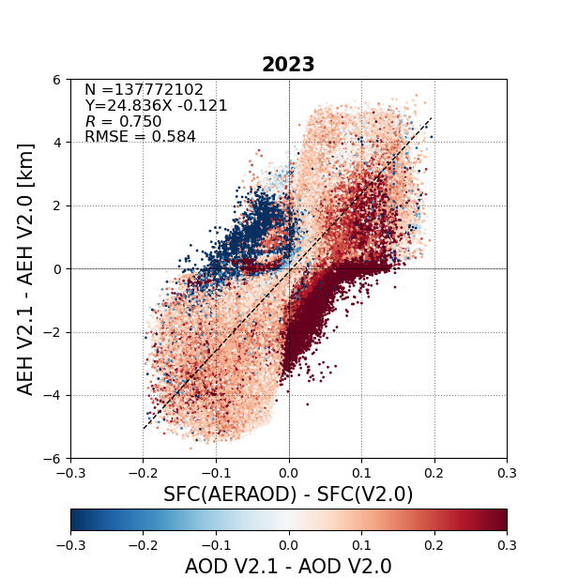
AEH difference analysis
V2.0 vs V2.1 → Different AOD and SFC input condition
Weak negative correlation in δAOD vs δAEH
Positive correlation in δSFC vs δAEH →Increase of reflectance = Increase of AEH
[Lee et al. in preparation]

Slide 10
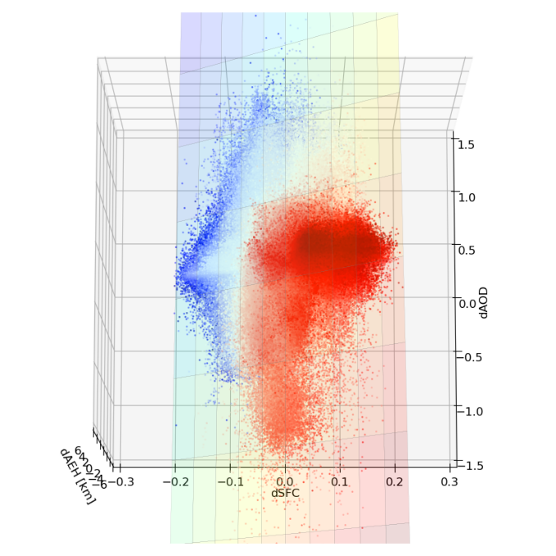
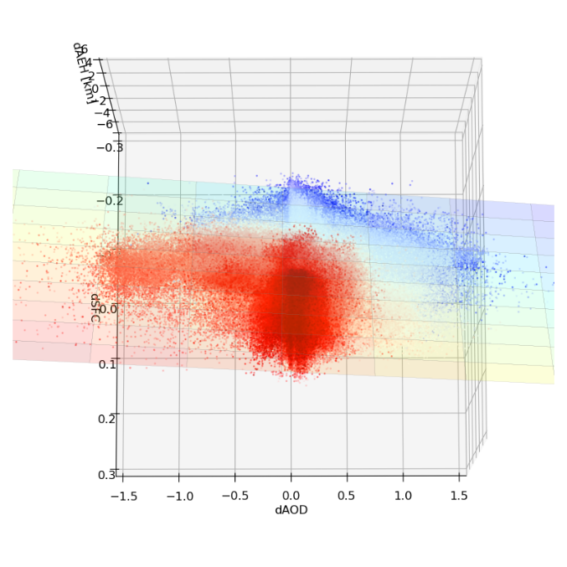
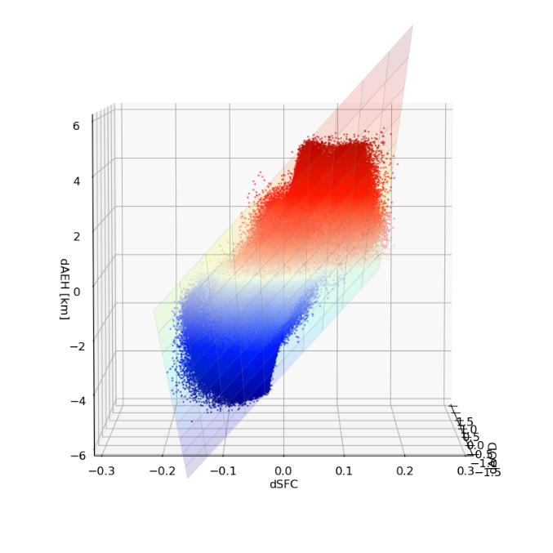
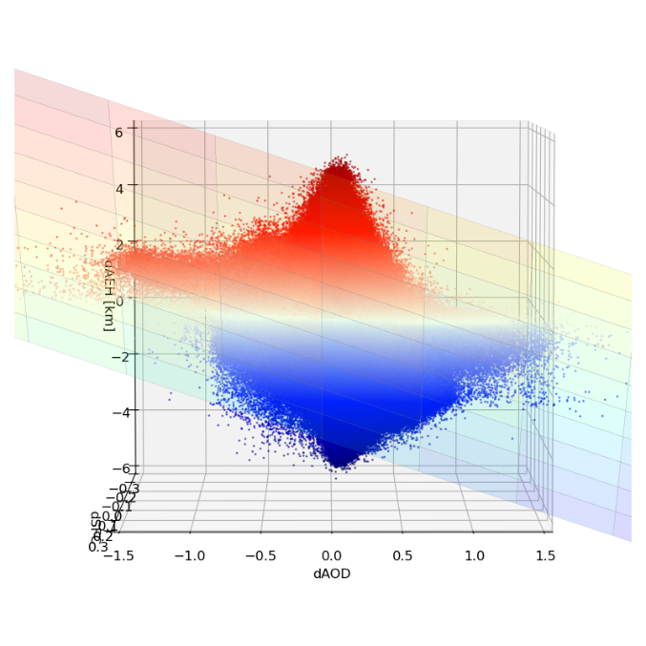
AEH difference analysis
Three-dimensional graph of dAOD vs dSFC vs dAEH
2
1
1
2
4
δAEH
3
δAOD
δSFC
Relationship of dAEH with dAOD and dSFC:
δAEH = -3.27δAOD + 17.39δSFC + (-0.07)
3
4
- 0.327 km change with AOD error of 0.1
- 0.174 km change with Surface albedo error of 0.01
[Lee et al. in preparation]

Slide 11
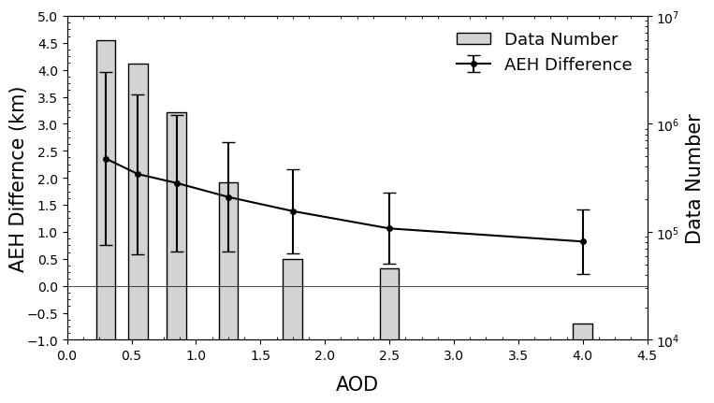
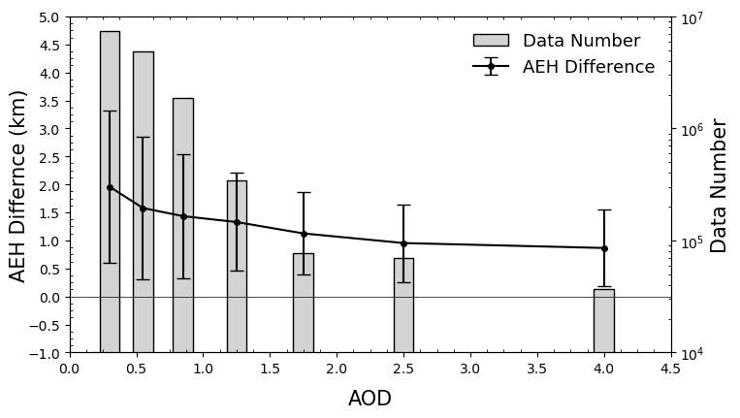
GEMS AEH Validation Result
AEH difference reduced especially at lower AOD (vs TROPOMI ALH)
GEMS AEH
V2.0
2023
Difference 1.66 ± 1.22 km
Difference b.w. ALH and AEH?
V2.1
2023
Difference 1.41 ± 1.12 km
GEMS AEH - TROPOMI ALH

Slide 12
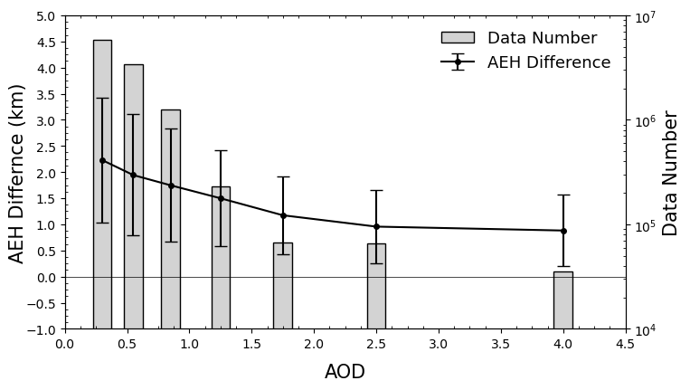
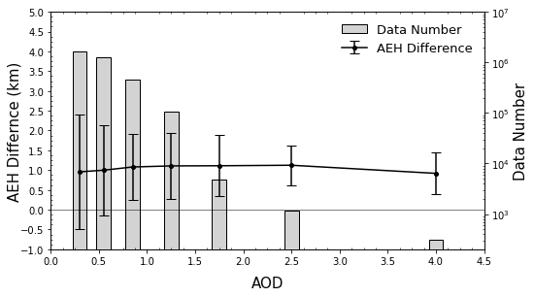
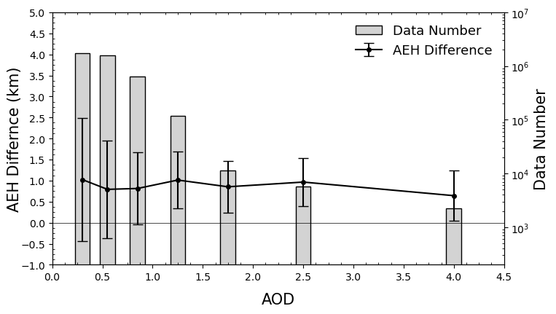
GEMS AEH Validation Result
V2.0
V2.1
Land
Terrain height > 0
Ocean
Terrain height = 0
[Lee et al. in preparation]

Slide 13
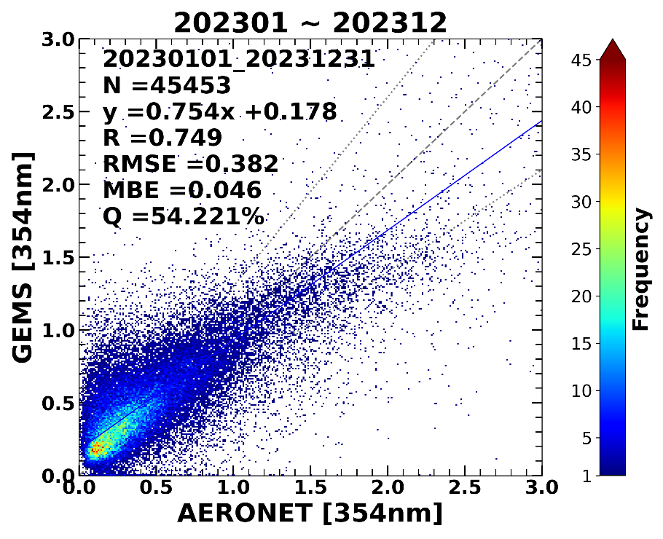
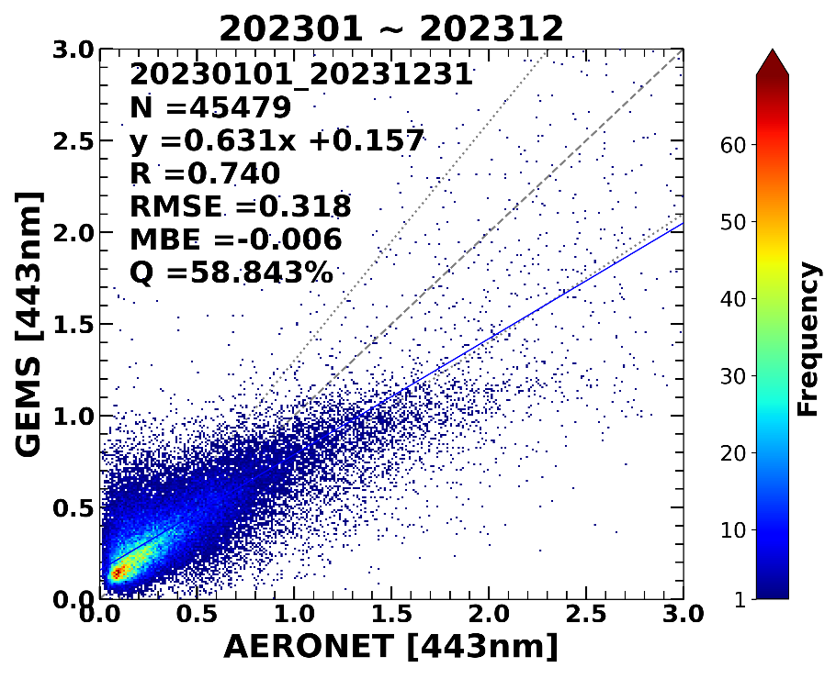
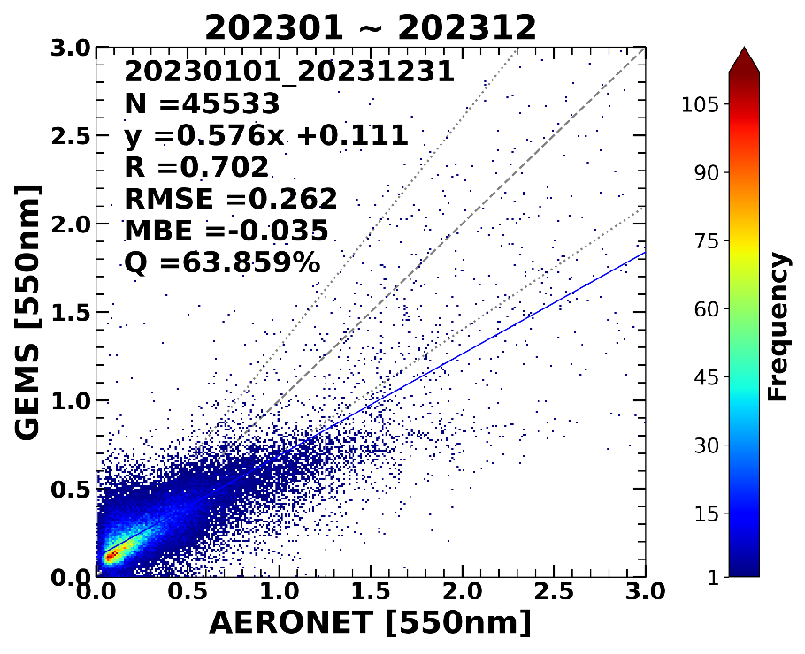
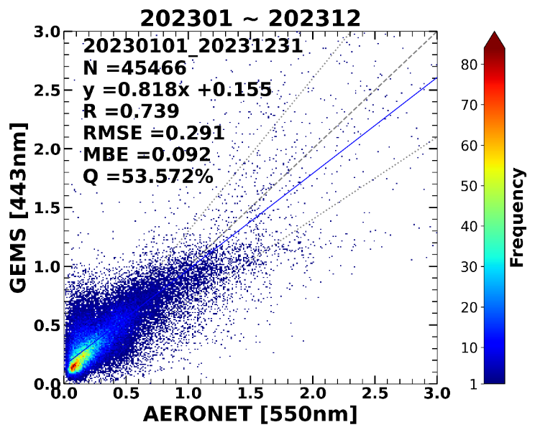
GEMS AOD V2.1 compared to AERONET, Period: 2023/01/01 ~ 2023/12/31
354nm | 443nm | 550nm
Slope: 0.754
Slope: 0.631
Slope: 0.576
AERONET [443nm] vs. GEMS [443nm] | AERONET [550nm] vs. GEMS [443nm]
[Courtesy of Yujin Chai and Jhoon Kim]
Slope: 0.631
Slope: 0.818

Slide 14
Summary
Recent V2.1 GEMS AEH product has some updates:
Directly estimate the O₄ SCD from the L1C radiance
Update LUTs (Coverage Improvement & Optical Properties)
Coincide the Surface albedo information (with L2AERAOD)
After update the AEH retrieval product, the AEH retrieval results show the improvement of accuracy.
Empirical Uncertainty of AEH by AOD and surface reflectance was identified.
δAEH = 0.327 km (δAOD = 0.1)
δAEH = 0.174 km (δSFC = 0.01)
Some improvement points are still remained.
Surface Reflectance over land (Check the accuracy with TROPOMI)
Spectral uncertainty of AOD & Type Determination uncertainty

