Slide 1
Tropospheric NO₂ retrieval algorithm for Geostationary satellite instruments:
Application to GEMS
Sora Seo, Diego Loyola, Pieter Valks, Ronny Lutz, Klaus-Peter Heue, Pascal Hedelt
: German Aerospace Center (DLR), Remote Sensing Technology Institute, Germany
Hanlim Lee
: Pukyong National University, Busan, Republic of Korea
Jhoon Kim
: Yonsei University, Seoul, Republic of Korea

Slide 2
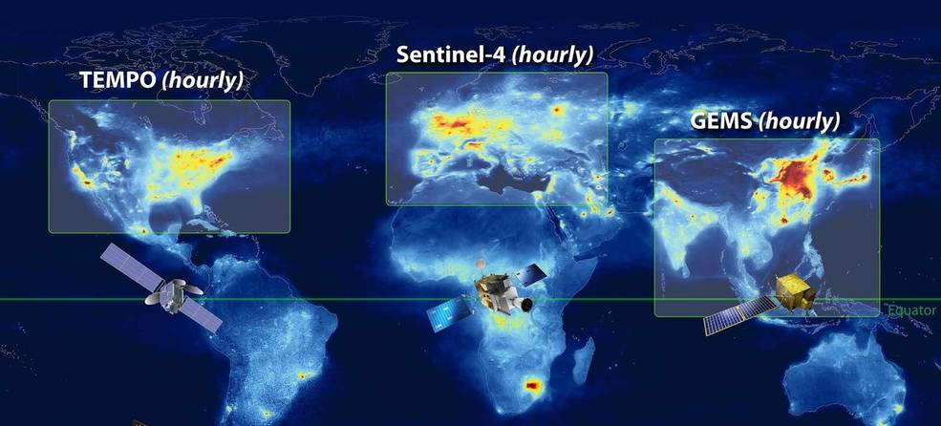
Motivation
Nitrogen dioxdies (NO₂) plays an important role in atmospheric chemistry process in both stratosphere and troposphere
Tropospheric NO₂ is an important amospheric trace gas → formation of tropospheric ozone, urban haze, and acid deposit
Over the past few decades, global NO₂ columns have been provided from low-earth-orbiting (LEO) satellites
-> LEO instruments only observe NO₂ once a day at a specific local time
-> limitations in monitoring diurnal variations in NO₂
-> need for a geostationary (GEO) satellite monitoring system
Geostationary Air Quality (Geo-AQ) constellation mission: GEMS, TEMPO, and Sentinel-4
In this study,
Tropospheric NO₂ retrieval algorithm for Geostationary satellite instruments
-> Application to GEMS measurements
credits: KNMI/ESA and NASA

Slide 3
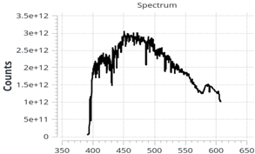
DLR GEMS tropospheric NO₂ retrieval algorithm
Spectral fitting (DOAS)
Stratosphere-Troposphere Separation (STS)
Tropospheric AMF calculation
Spectrum
SCD
VCDstrat
VCDtrop
DLR GEMS tropospheric NO₂ retrieval algorithm mainly follows a classical three-step:
Spectral fitting of NO₂ slant columns based on DOAS technique
Separation of slant columns into stratospheric and tropospheric contributions
Conversion of tropospheric slant columns to vertical columns using air mass factors (AMFs)
To account for the characteristics of the geostationary satellite (hourly sampling, limited spatial coverage, and larger zenith angles), a number of improvements are implemented in the DLR GEMS NO₂ algorithm

Slide 4
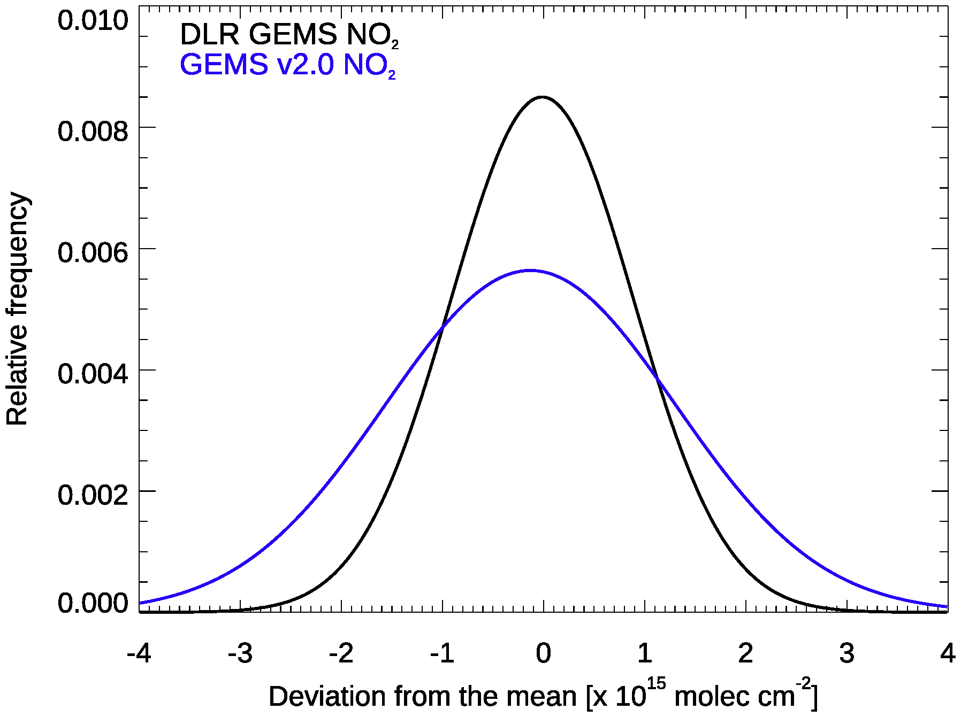
DLR GEMS NO₂ slant column retrieval
Spectral fitting window
425 – 480 nm
(cf. GEMS v2.0 : 432 - 450 nm)
Fitted parameters
NO₂, O₃, O₂-O₂, H₂O_{vap}, H₂O_{liq},
Ring spectrum
Polarisation correction (pseudo cross section)
Linear intensity offset correction
Wavelength calibration (Chance and Kurucz, 2010)
DLR GEMS NO₂ slant columns
-> improved quality and lower uncertainties

Slide 5
DLR GEMS Stratosphere-Troposphere Separation (STS)
Current STS methods should be updated to be applied to geostationary satellites
GEO samples diurnal variability -> hourly estimates of stratospheric NO₂ columns
Limited number of unpolluted clean pixels
Limited spatial coverage (a portion of the globe)
For the STS in geostationary satellite instruments,
STREAM (STRatospheric Estimation Algorithm from Mainz) adapted to GEMS observations
: advanced reference method (Beirle et al., 2016)
: originally employed for STS in polar orbiting satellite observations (TROPOMI, GOME-2)
(2) Estimation of stratospheric NO₂ columns using the CAMS forecast (IFS Cy48R1) model data
: CAMS forecast (IFS Cy48R1) model introduced comprehensive stratospheric chemistry
-> enable to represent the diurnal cycle of stratospheric NO₂ fields

Slide 6
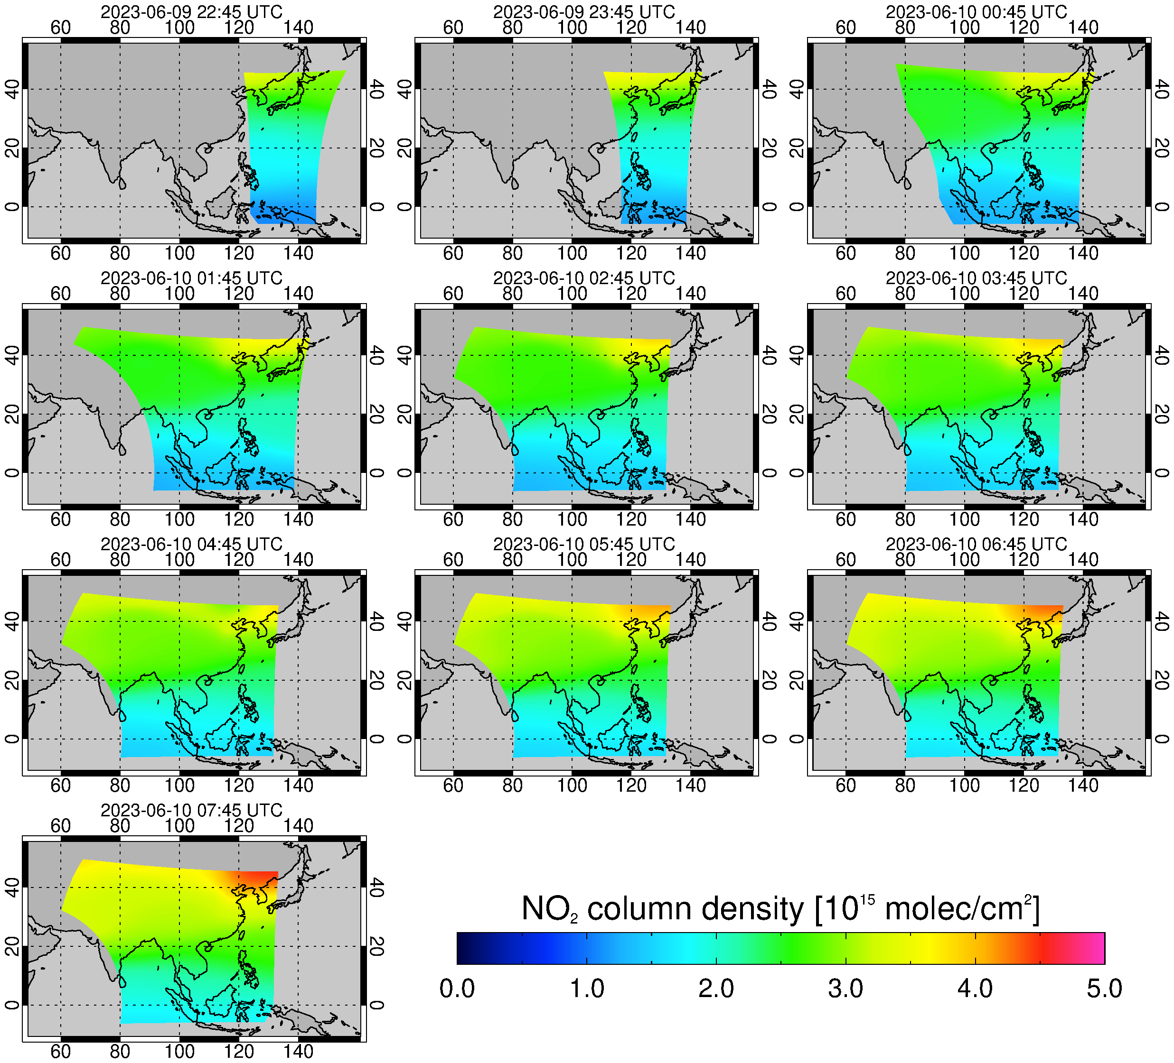
DLR GEMS STS: 1. STREAM adapted to GEMS measurements
Diurnal variability of stratospheric fields
-> successfully provide hourly estimates with reasonable values
Limitations in describing small-scale variations
Systematic biases near the boundary of FOV

Slide 7
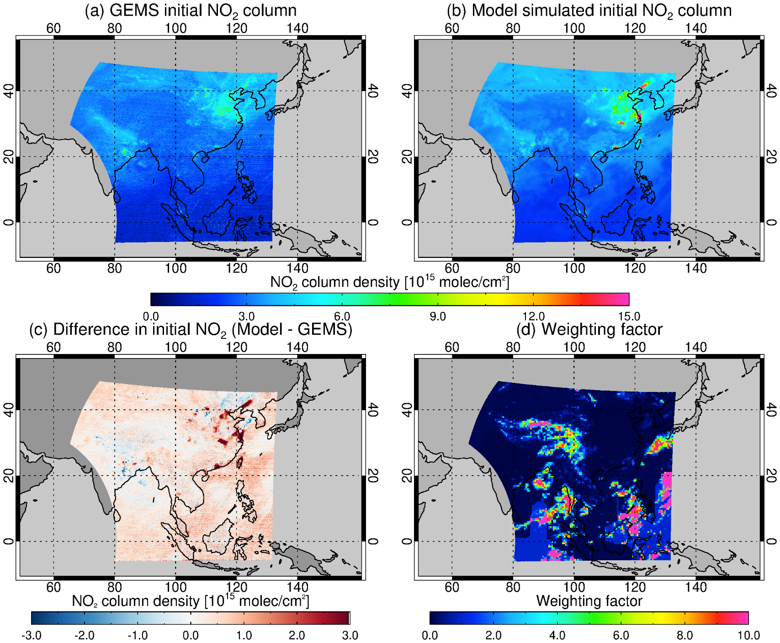
DLR GEMS STS : 2. Estimation of stratospheric NO₂ using CAMS forecast
GEMS observed NO₂ column
Modelled NO₂ column
Estimate the stratospheric NO₂ column using the CAMS forecast NO₂ profiles
-> cannot be directly applied
Biases between the modelled columns and satellite observations
-> Model bias correction is needed
Model bias patterns in the stratosphere is analysed using the stratospheric dominant pixels (clean or clouded pixels)
Biases (b - a)

Slide 8
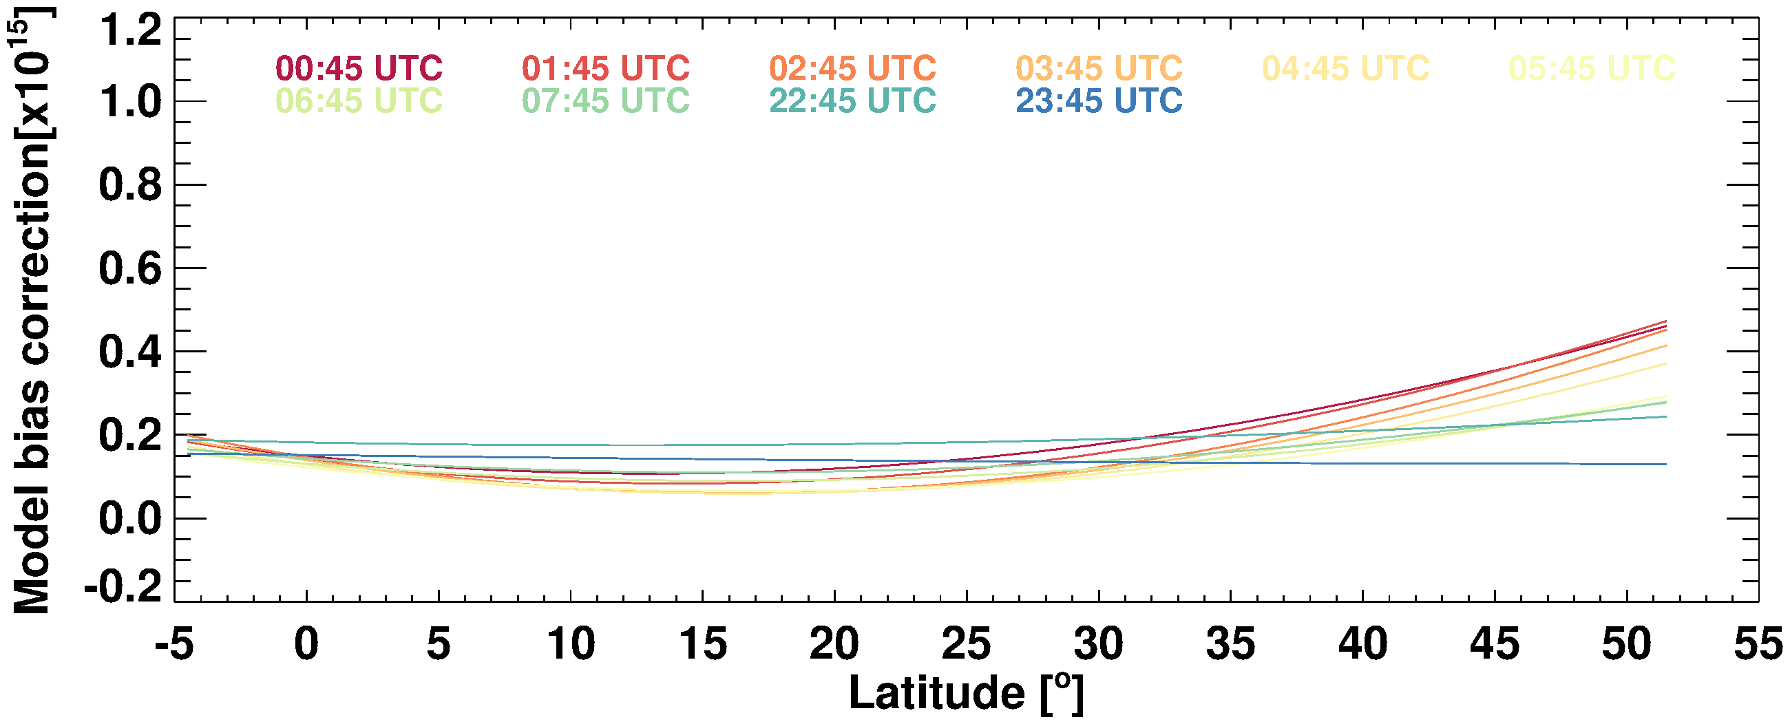
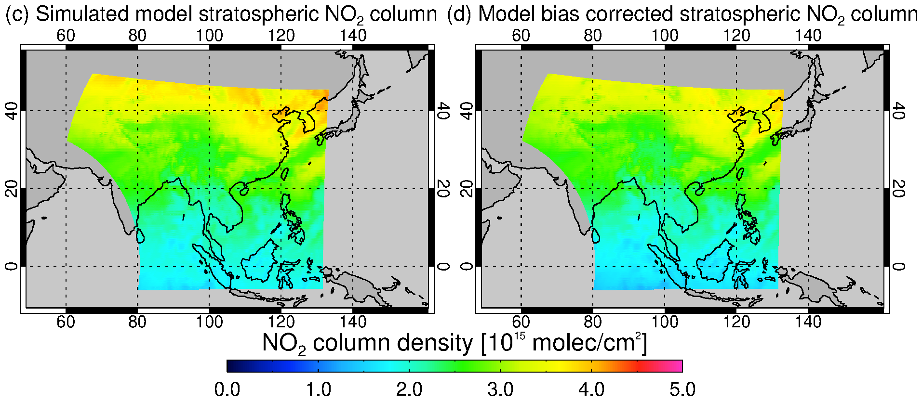
DLR GEMS STS : 2. Estimation of stratospheric NO₂ using CAMS forecast
-> Model bias patterns in the stratosphere are parameterized as a function of latitude for scan hour on a daily basis

Slide 9
DLR GEMS STS : 2. Estimation of stratospheric NO₂ using CAMS forecast
Diurnal variability
Small-scale variations in stratospheric NO₂ fields
-> more suitable for application to GEMS with high spatiotemporal resolution

Slide 10
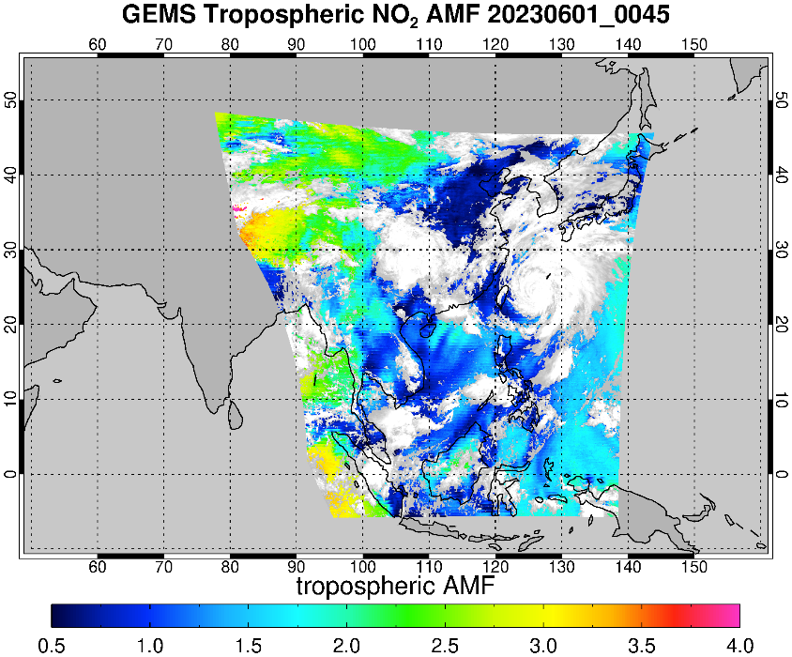
DLR GEMS Tropospheric AMF calculation
$$VCD=\frac{SCD}{AMF}$$
$$AMF=\frac{\sum_{l}{m_{l}\left(b\right)x_{l}c_{l}}}{\sum_{l}{x_{l}}}$$
m_{l}: a box-AMF in layer l, x_{l}: the partial column from a priori NO₂ profile
c_{l}: a correction coefficient to correct for the temperature dependency of NO₂ cross section
The conversion of the tropospheric slant column to a vertical column using a tropospheric AMF
The box AMFs LUT is pre-calculated with the VLIDORT radiative transfer model
Tropospheric AMF depends on the viewing geometry, surface albedo and pressure, cloud properties, and a priori NO₂ profiles
Overview of auxiliary data inputs for GEMS tropospheric AMF calculation
 | DLR GEMS | GEMS operational v2.0
Cloud | - Cloud fraction: OCRA adapted to GEMS L1 - Cloud pressure: GEMS cloud v2.0 | GEMS cloud v2.0
Surface albedo | GEMS BSR v2.0 | GEMS BSR v2.0
A priori NO₂ profile | CAMS forecast (IFS Cy48R1) | Monthly mean hourly NO₂ profiles from GEOS-Chem v13

Slide 11
DLR GEMS Tropospheric AMF calculation : Cloud correction
OCRA
GEMS L2 v2.0
OCRA - GEMS L2 v2.0
(a) Cloud fraction retrieved from OCRA adapted to GEMS L1
OCRA: retrieve cloud fraction by analysing the colour of the scene
(b) Cloud fraction from GEMS L2 v2.0
(O₂-O₂ based retrieval)
NO₂ trop with OCRA
NO₂ trop with GEMS v2.0
OCRA - GEMS L2 v2.0
Lower OCRA cloud fractions for clear-sky
-> increase the tropospheric AMFs
-> decrease the tropospheric NO₂ VCDs

Slide 12
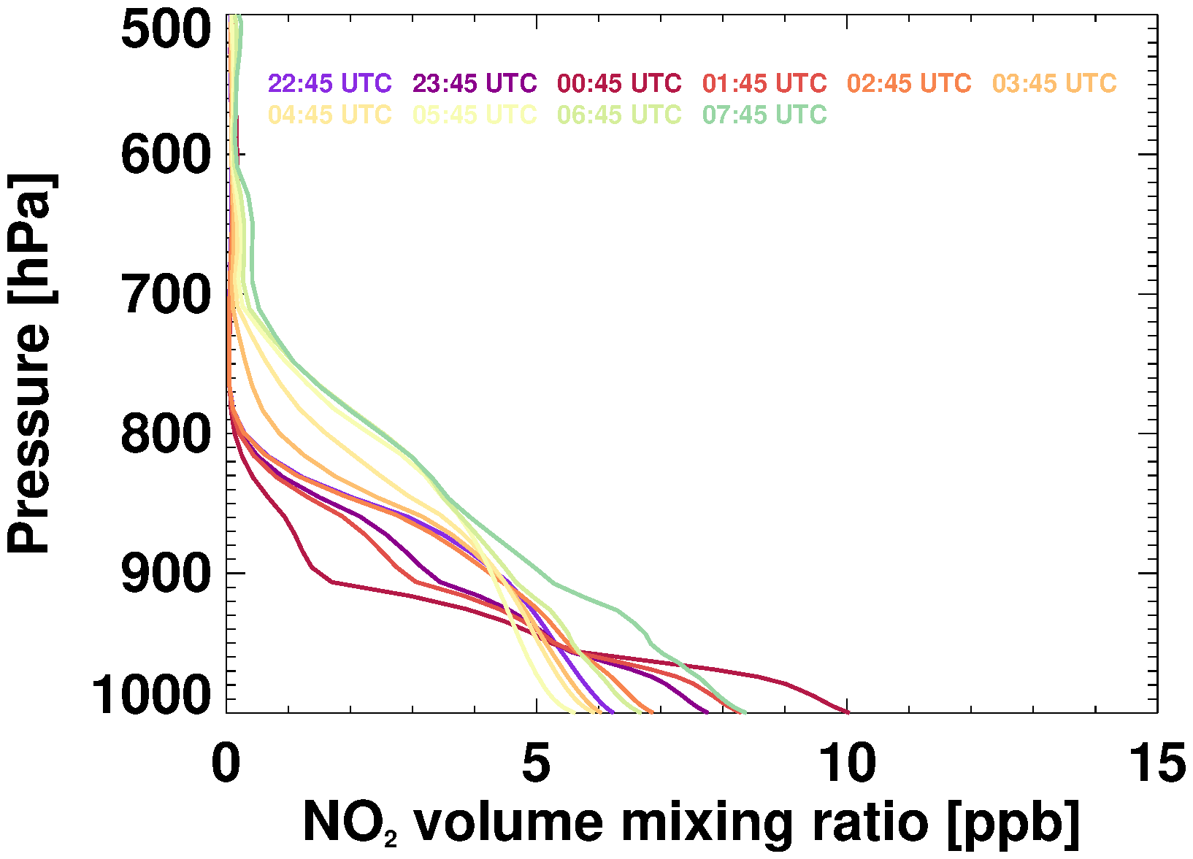
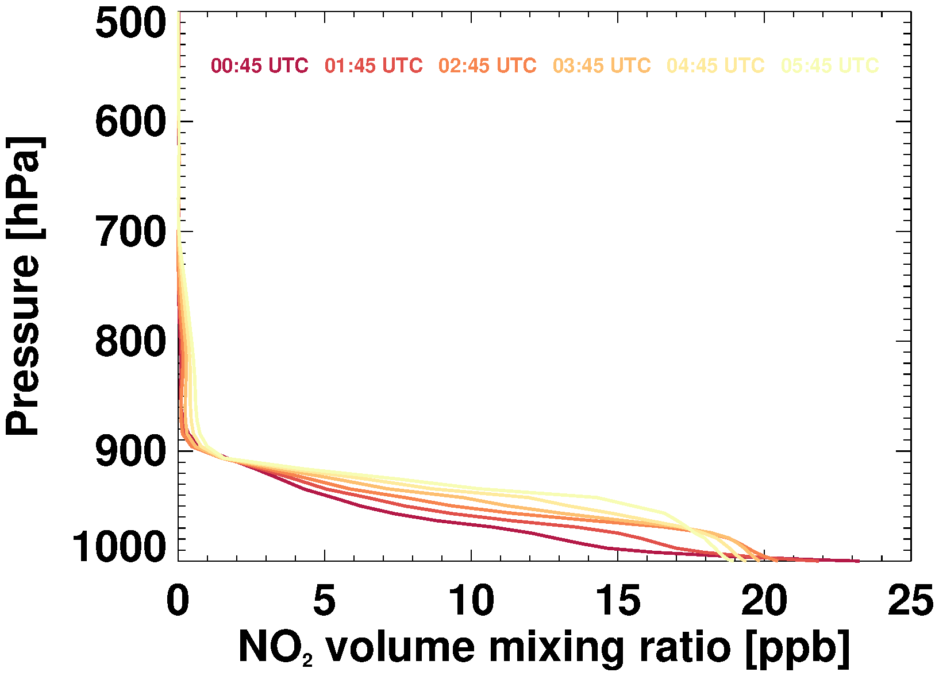
DLR GEMS Tropospheric AMF calculation : A priori NO₂ profiles
Seoul (Jun 15 2023)
Seoul (Dec 12 2022)
A priori NO₂ profiles from the CAMS forecast model (applied in DLR GEMS algorithm)
-> effectively capture variations in NO₂ concentrations depending on emission patterns and meteorological conditions throughout the day with a high spatial and temporal resolution

Slide 13
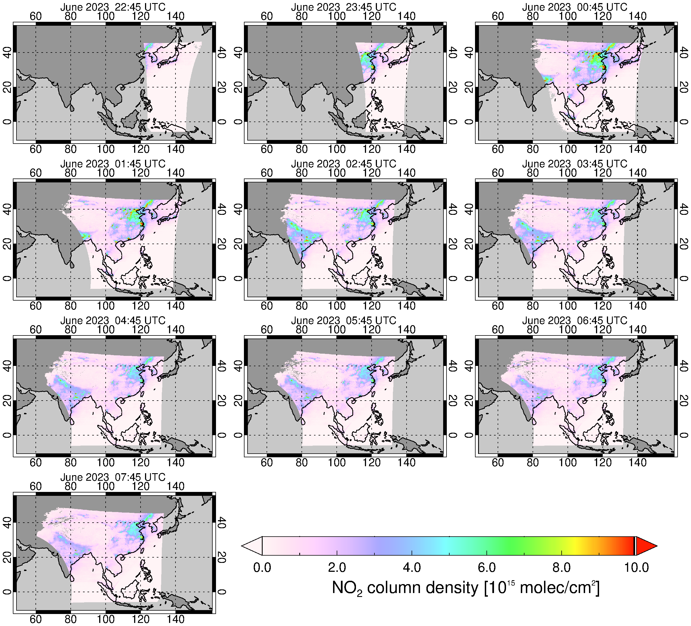
Examples of DLR GEMS tropospheric NO₂ columns
High tropopspheric NO₂ columns are evident over urban regions in eastern China, South Korea and northern India
Hotspot signals detected in city cluster
Spatial gradients from city centers to surrounding areas
Tropospheric NO₂ levels peak in the morning in the urban areas
(increased commuter traffic emissions)
-> decrease around noon
-> increase again in the later afternoon
22:45 UTC (07:45 KST)
07:45 UTC (16:45 KST)

Slide 14
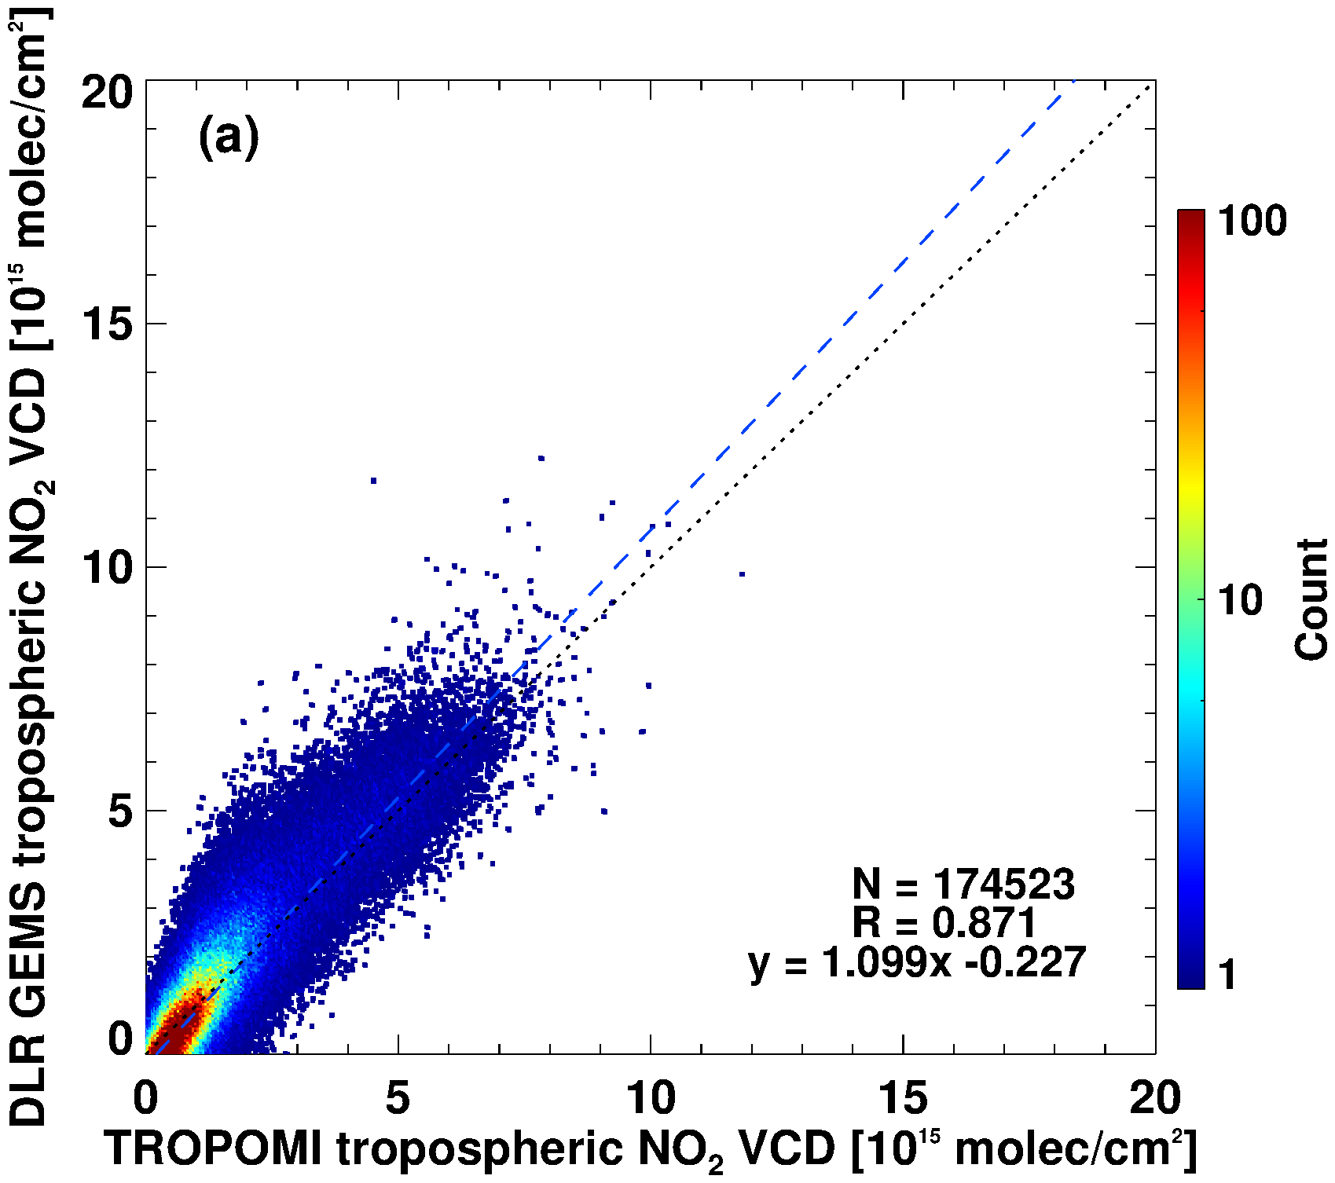
Comparison of DLR GEMS with TROPOMI v2.5 NO₂ product
DLR GEMS tropo NO₂
TROPOMI tropo NO₂
DLR GEMS – TROPOMI
Spatiotemporally regridded DLR GEMS and TROPOMI NO₂ data were used for comparisons
Good agreement in terms of spatial distribution and value range of tropospheric NO₂ (R = 0.87 - 0.96)
Systematic biases are observed
-> systematic gradients in GEMS NO₂ slant columns in the N-S direction (primarily attributed to GEMS L1 spectra; radiometric calibration and residual correction)
-> tropospheric AMFs calculated using different ancillary inputs

Slide 15
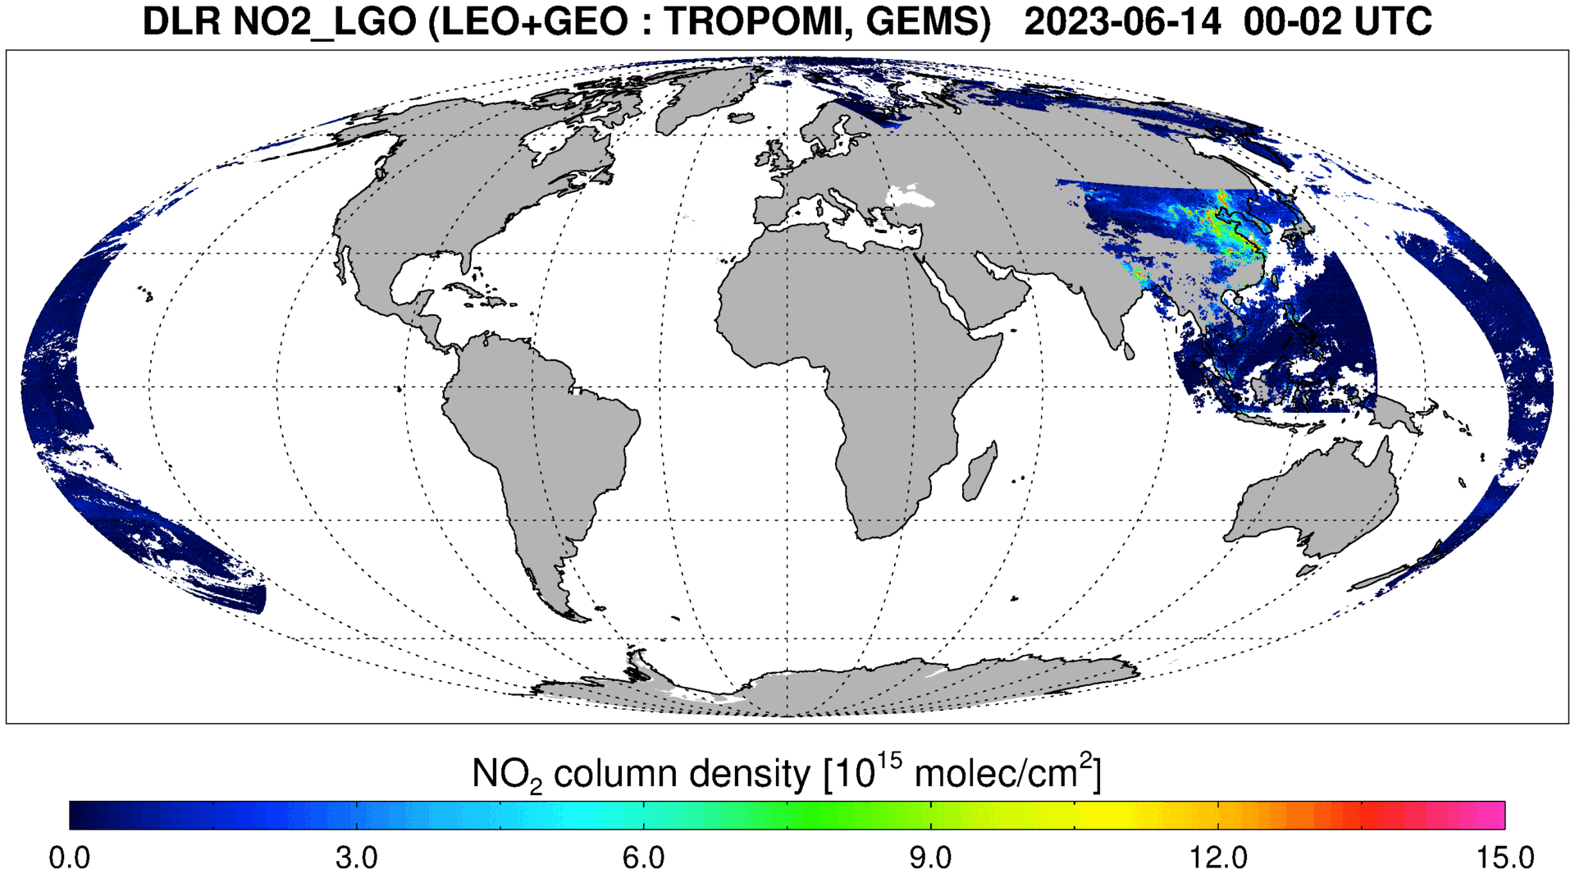
Summary and Conclusions
DLR tropospheric NO₂ retrieval algorithm for GEO was developed and applied to GEMS
The baseline for DLR GEMS NO₂ retrieval approach follows the heritage from LEO, but several improvements are implemented to account for GEO characteristics
DLR GEMS tropospheric NO₂ columns capture diurnal variability, hot spot signals, spatial gradients
Comparisons of DLR GEMS tropospheric NO₂ columns with TROPOMI v2.5 (r = 0.87 to 0.96) and GEMS v2.0 (r = 0.80 to 0.92) show good agreements on average
This retrieval algorithm can be easily adapted to LEO (e.g. TROPOMI) and other GEO (e.g. TEMPO and Sentinel-4), enabling harmonized NO₂ monitoring and analysis across continents in the future.
Pre-printed
(Seo et al., 2024)

