Slide 1
Comparison of GEMS tropospheric NO₂ products and
validation with the Asian ground-based network
TEMPO-GEMS Workshop
30 August 2024
Kezia Lange¹, Andreas Richter¹, Tim Bösch¹ , Bianca Zilker¹, Miriam Latsch¹, John P. Burrows¹, Hartmut Bösch¹, Alexis Merlaud², Gaia Pinardi², Caroline Fayt², Martina M. Friedrich², Michel Van Roozendael², Steffen Ziegler³, Simona Ripperger-Lukosiunaite³, Leon Kuhn³, Bianca Lauster³, Thomas Wagner³, Donghee Kim⁴, Hyunkee Hong⁴, Lim-Seok Chang⁴, Kangho Bae⁵, Chang-Keun Song⁵, Jong-Uk Park⁶, Hanlim Lee⁷, Jhoon Kim⁸
(1) IUP Bremen, (2) BIRA, (3) MPIC, (4) NIER, (5) UNIST, (6) SNU, (7) PKNU, (8) Yonsei University

Slide 2
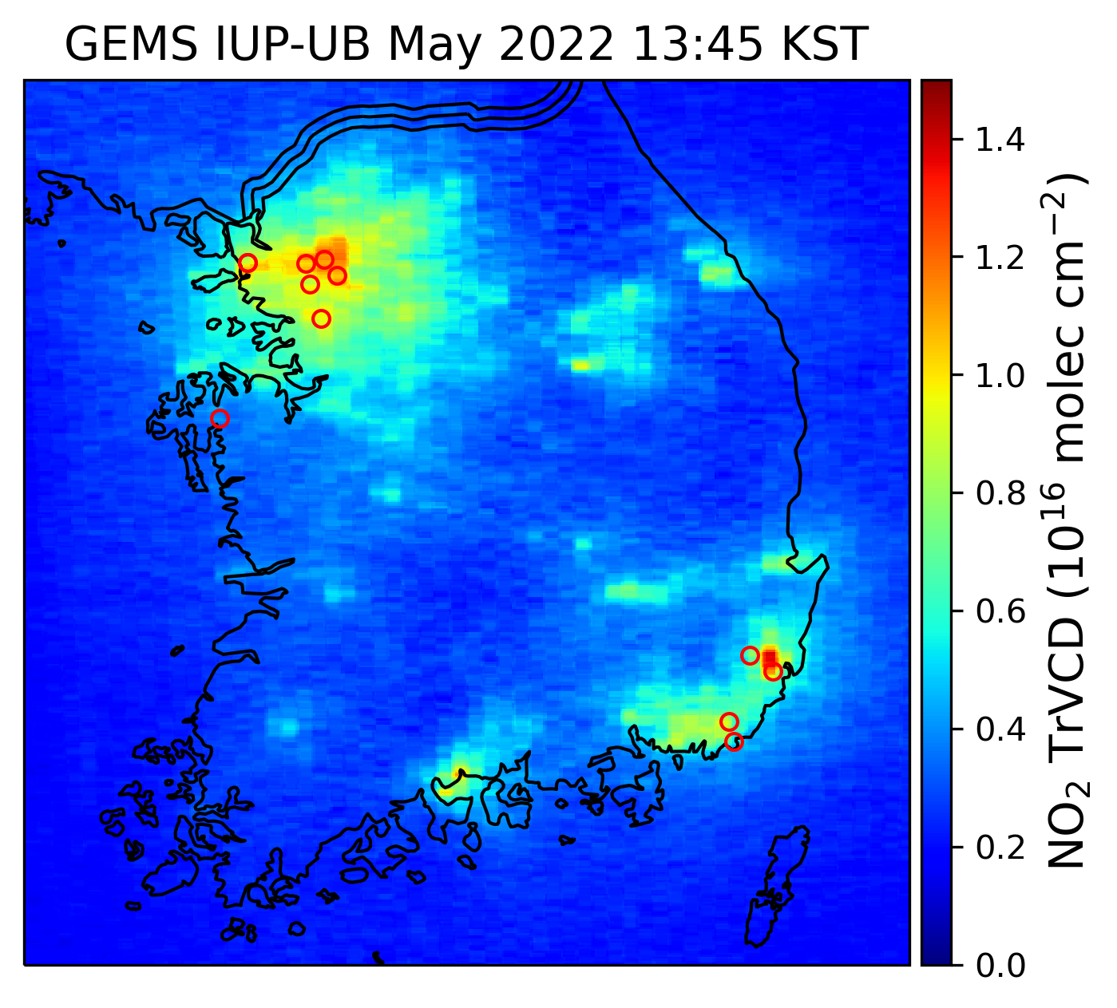
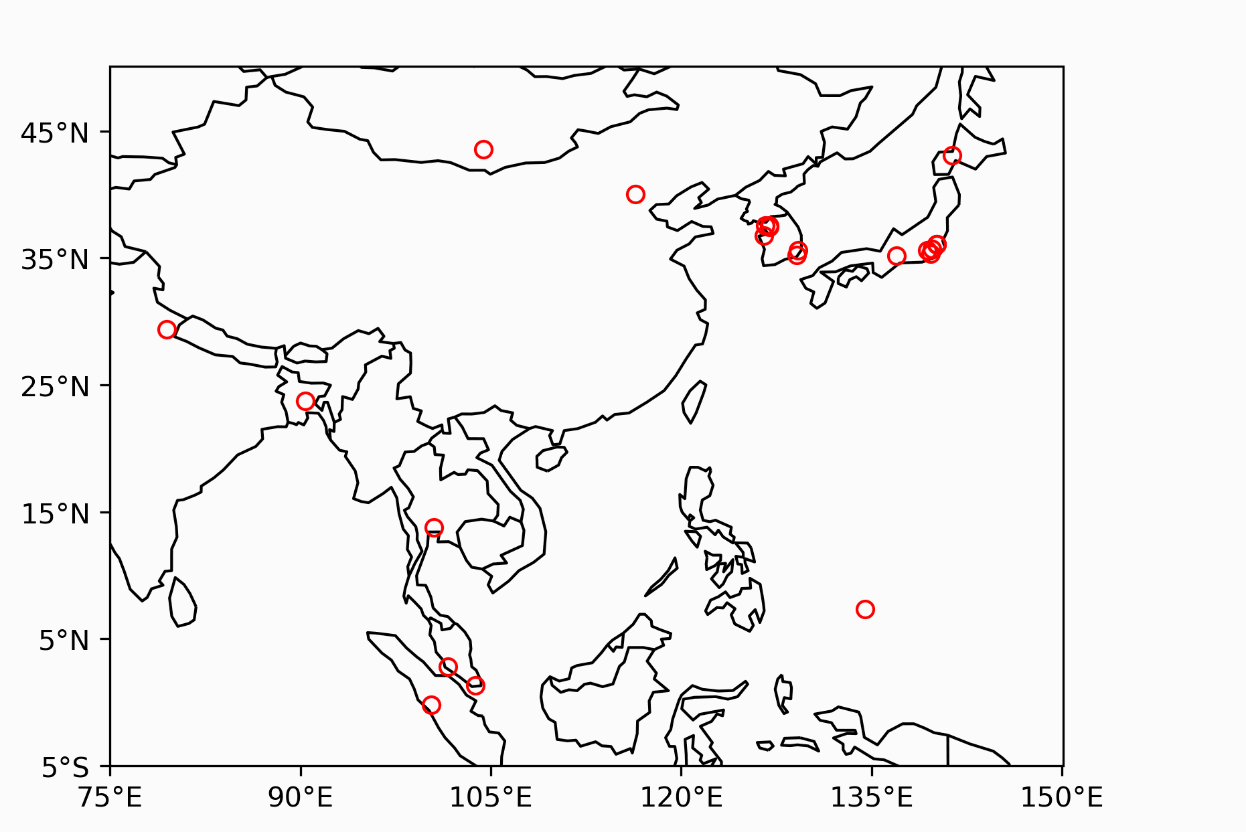
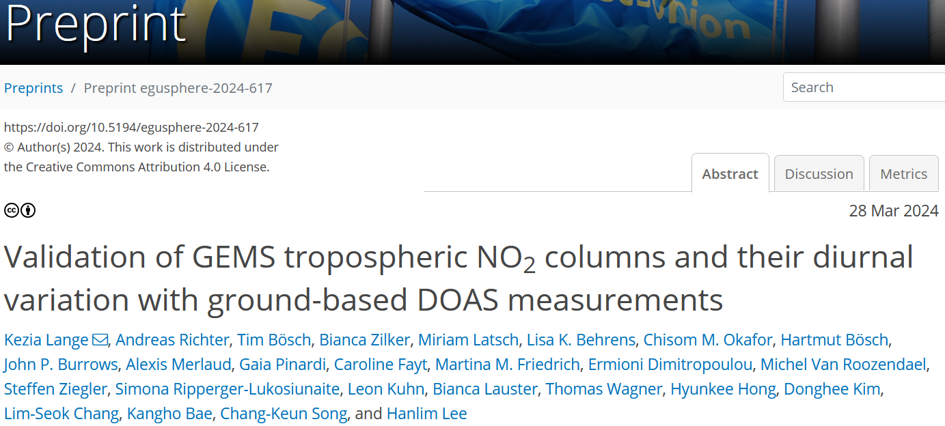
Ground-based observations in GEMS area

Slide 3
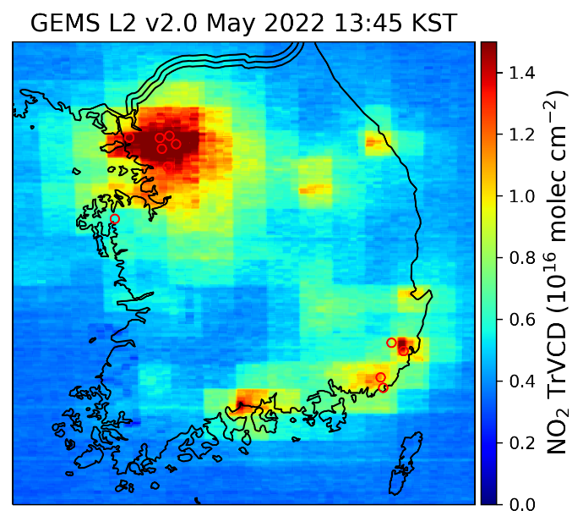
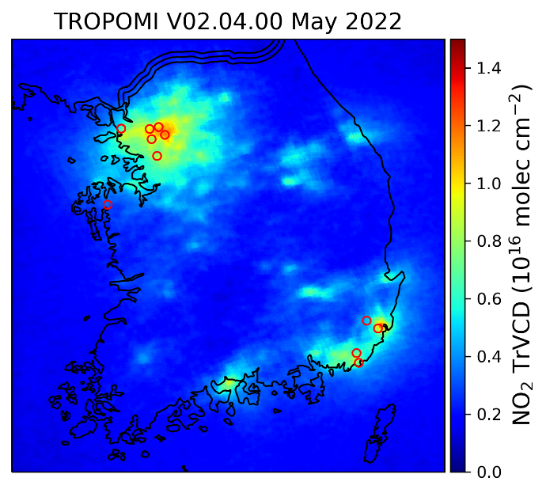
Satellite tropospheric NO₂ VCD products
GEMS L2 v2
GEMS IUP-UB v1.0
TROPOMI
GEMS L2 v2:
Box structures → Missing interpolation of AMF
Overestimation compared to GEMS IUP-UB and TROPOMI
Higher background columns

Slide 4
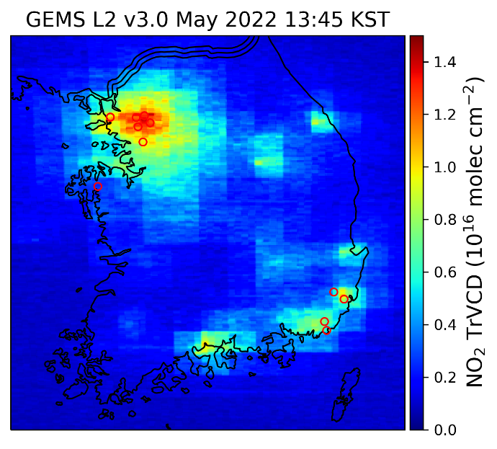
Satellite tropospheric NO₂ VCD products
GEMS L2 v2
GEMS L2 v3
GEMS IUP-UB v1.0
TROPOMI
GEMS L2 v3:
Box structures → Missing interpolation of AMF
Overestimation reduced from v2.0 to v3.0
Lower background

Slide 5
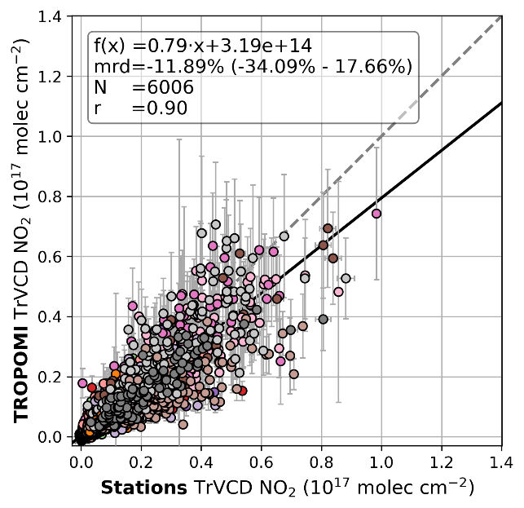
Evaluation of satellite tropospheric NO₂ VCD with ground-based data
GEMS L2 v2
GEMS IUP-UB v1.0
TROPOMI
2 years: January 2022 – December 2023
Asian ground-based network, mainly Pandora data
Station data averaged ± 20 min around nearest satellite observation to station

Slide 6
Evaluation of satellite tropospheric NO₂ VCD with ground-based data
GEMS L2 v2
GEMS IUP-UB v1.0
TROPOMI
TROPOMI low biased by -12 % with high correlation of 0.9

Slide 7
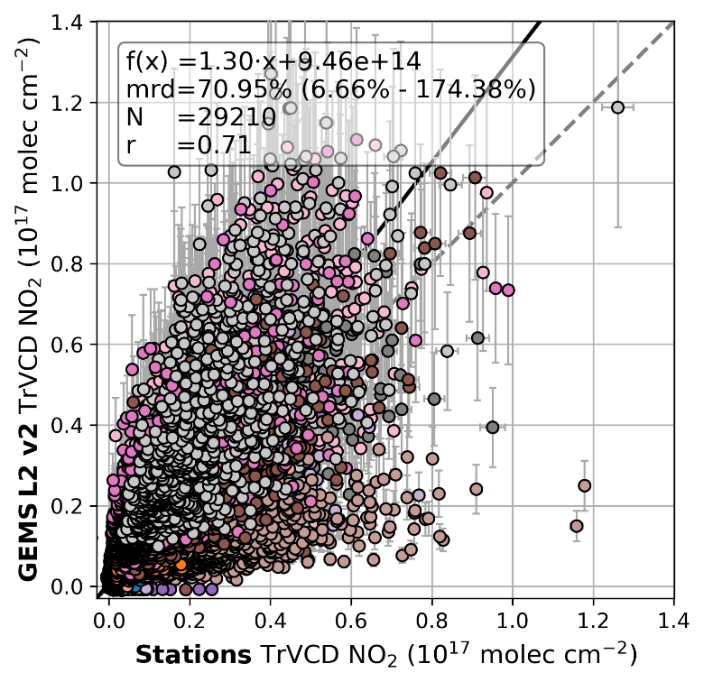
Evaluation of satellite tropospheric NO₂ VCD with ground-based data
GEMS L2 v2
GEMS IUP-UB v1.0
TROPOMI
TROPOMI low biased by -12 % with high correlation of 0.9
GEMS L2 v2.0 high biased by 71% with correlation of 0.7

Slide 8
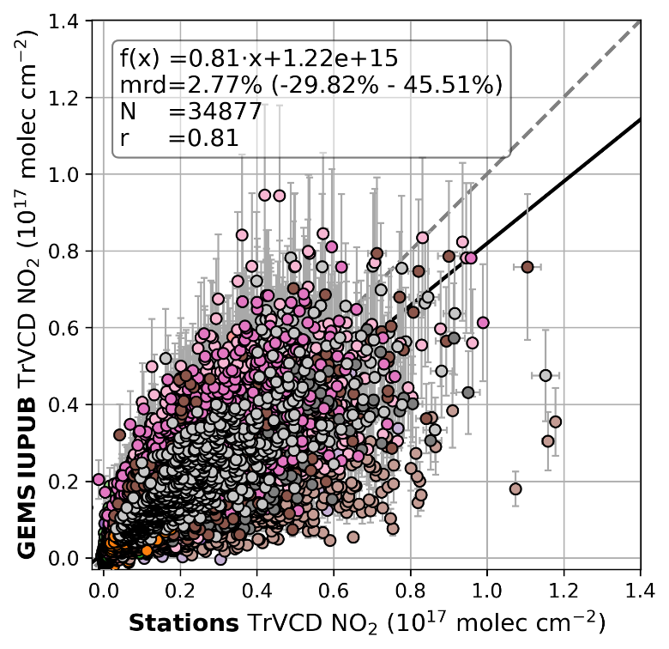
Evaluation of satellite tropospheric NO₂ VCD with ground-based data
GEMS L2 v2
GEMS IUP-UB v1.0
TROPOMI
TROPOMI low biased by -12 % with high correlation of 0.9
GEMS L2 v2.0 high biased by 71% with correlation of 0.7
GEMS IUP-UB bias of 3% with correlation of 0.8

Slide 9
Evaluation of satellite tropospheric NO₂ VCD with ground-based data
GEMS L2 v2
GEMS IUP-UB v1.0
TROPOMI
Explanations for deviations?
Stratospheric correction
AMF assumptions: model profiles (TM5/GEOS-Chem), aerosol, surface reflectivity

Slide 10
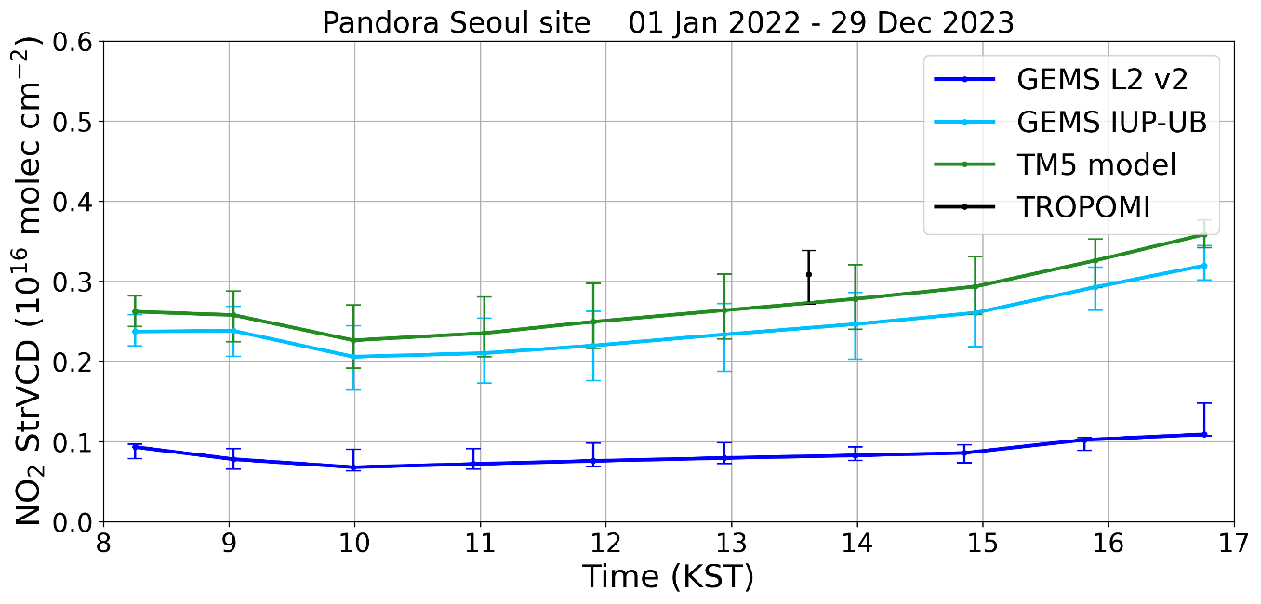
Stratospheric correction – Stratospheric VCD
GEMS IUP-UB STREAM-based strVCD very similar to TM5 strVCD
GEMS L2 v2.0 strVCD lower by a factor of 2.5

Slide 11
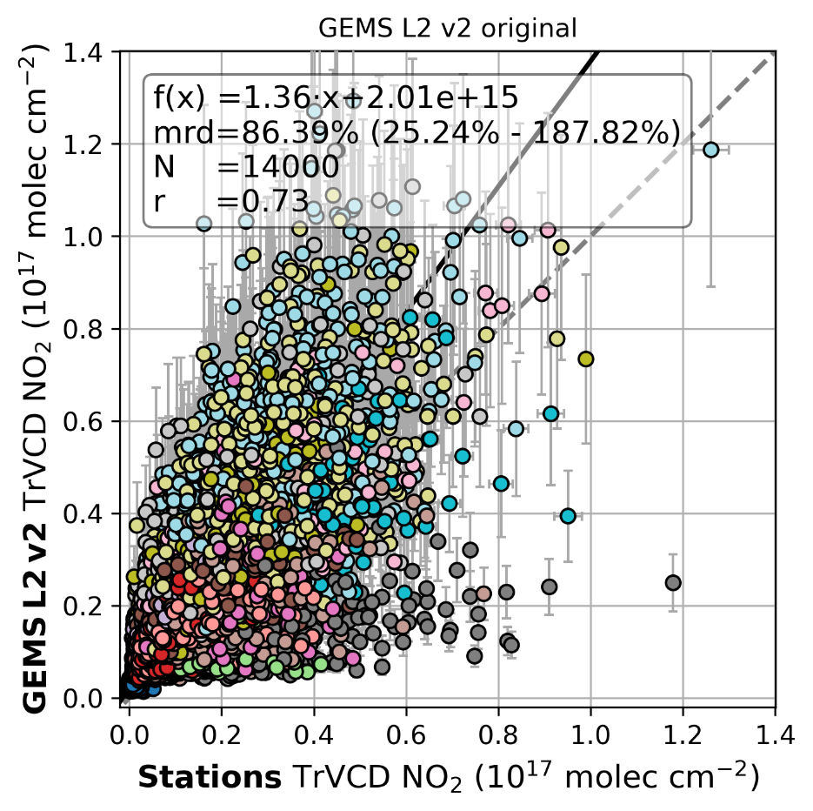
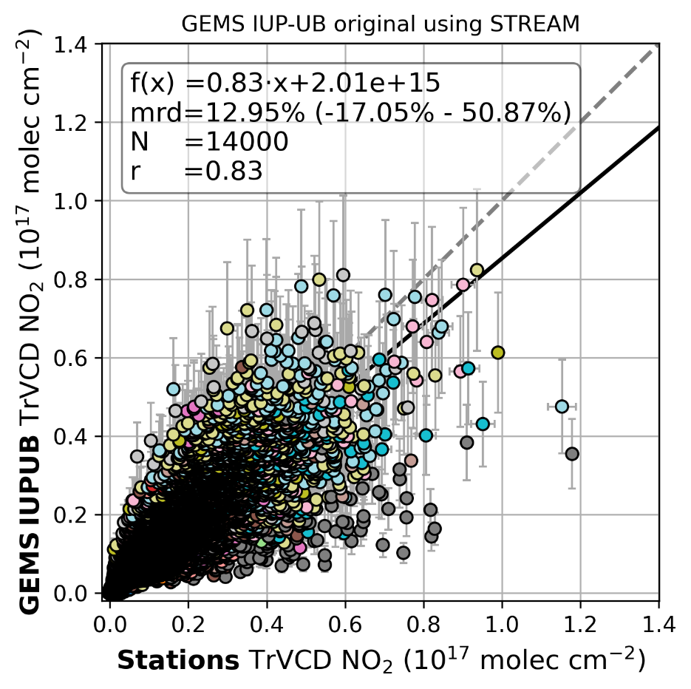
Stratospheric correction - Evaluation
GEMS IUP-UB v1.0 original
Using STREAM
GEMS L2 v2

Slide 12
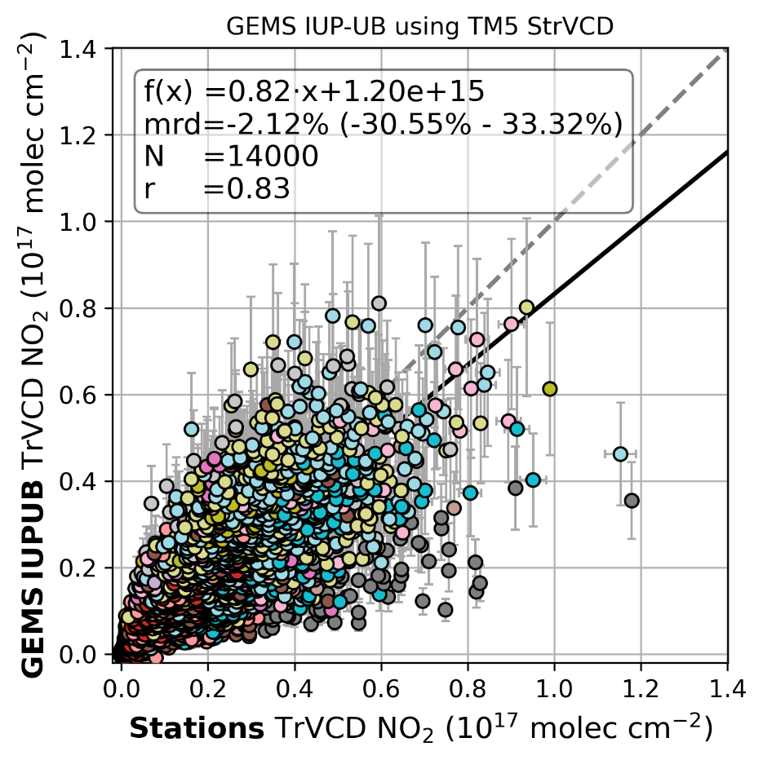
Stratospheric correction - Evaluation
GEMS IUP-UB v1.0 original
Using TM5 strVCD
GEMS L2 v2
GEMS IUP-UB STREAM-based strVCD very similar to TM5 strVCD

Slide 13
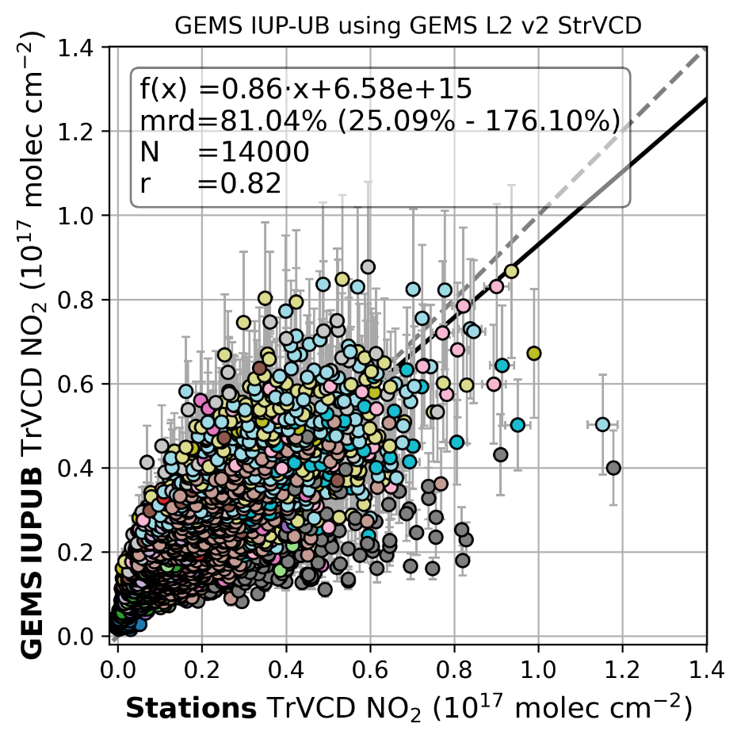
Stratospheric correction - Evaluation
GEMS IUP-UB v1.0 original
Using GEMS v2 strVCD
GEMS L2 v2
GEMS IUP-UB STREAM-based strVCD very similar to TM5 strVCD
GEMS L2 v2 strVCD too low

Slide 14
Surface reflectivity
GEMS IUP-UB v1.0 original
Using TROPOMI LER
GEMS L2 v2

Slide 15
Surface reflectivity
GEMS IUP-UB v1.0 original
Using TROPOMI LER
GEMS IUP-UB v1.0 original
Using GEMS reflectivity
GEMS L2 v2
GEMS L2 surface reflectivity causes a large part of the positive bias and the scatter

Slide 16
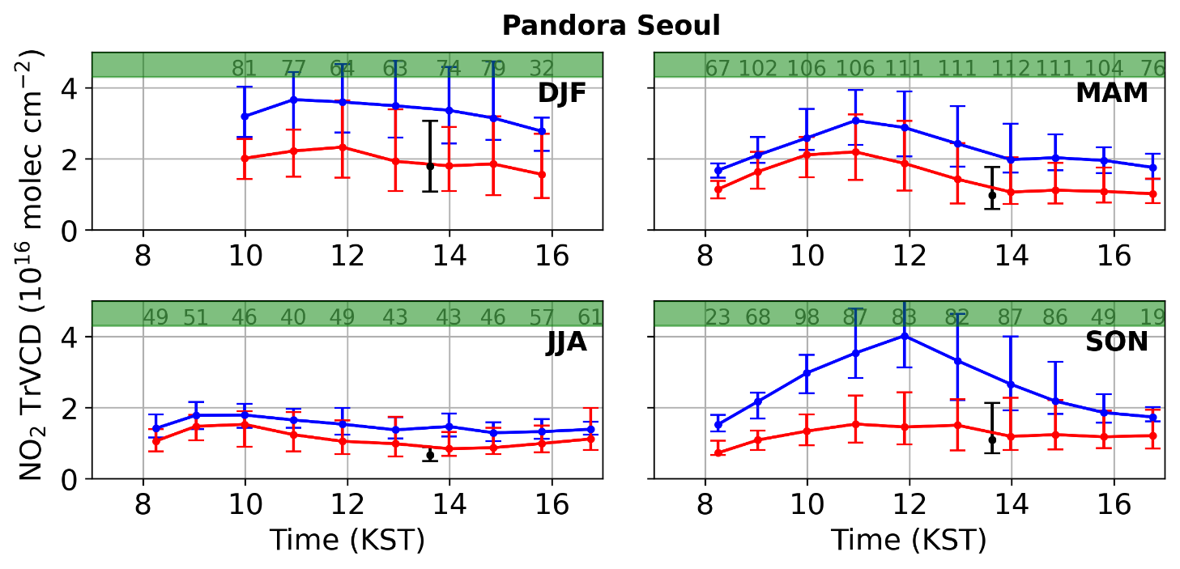
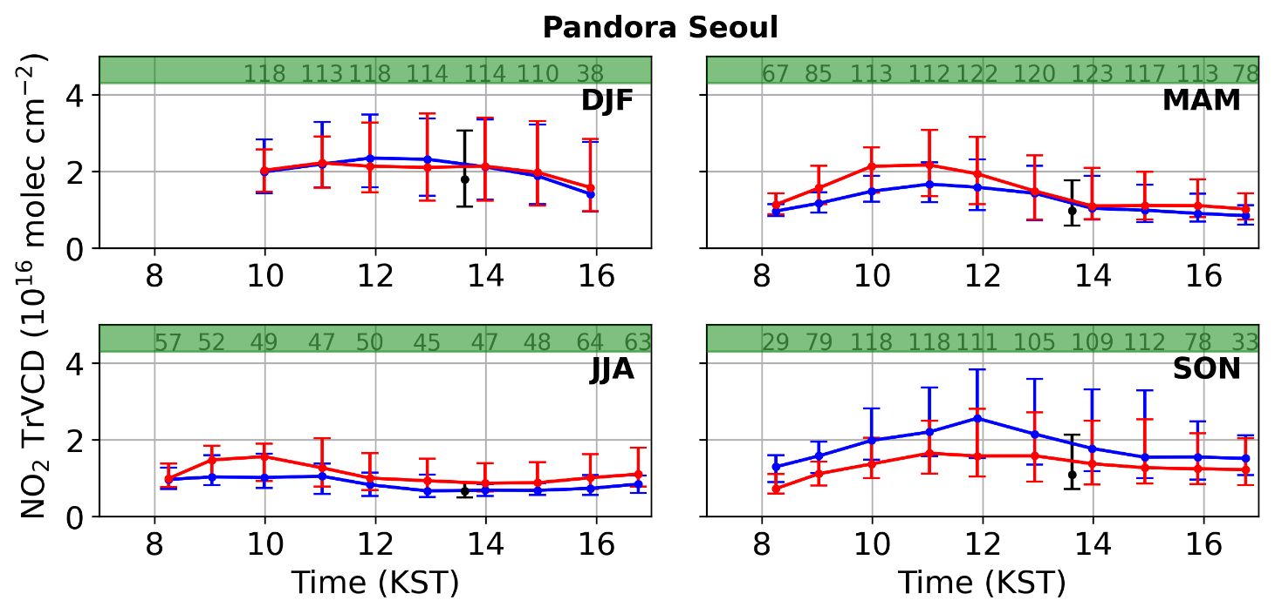
Seasonal diurnal variation – Tropospheric NO₂
GEMS L2 v2
GEMS IUP-UB v1.0
GEMS L2 v2
Summer: Minimum of NO₂ around noon Chemical loss is strong
Winter: Decreasing NO₂ over the day Chemical loss low → Accumulation of NO₂

Slide 17
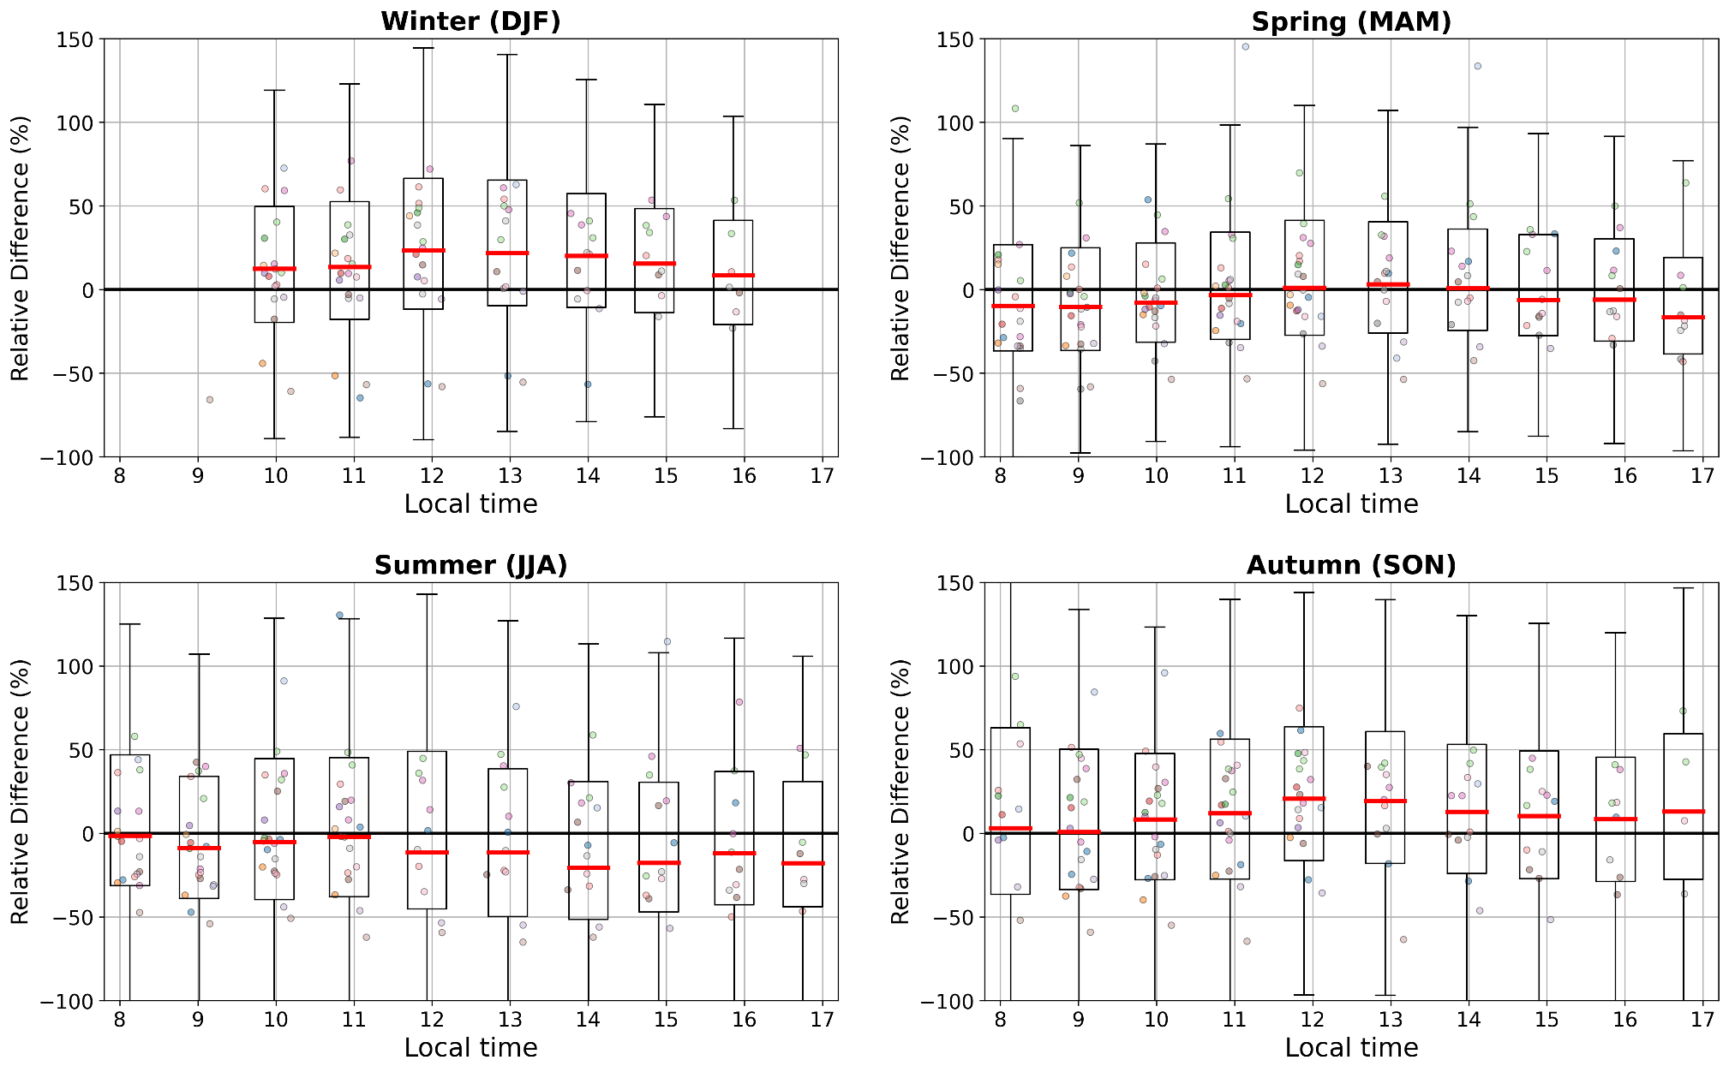
Bias diurnal variation – GEMS IUP-UB v1.0
GEMS IUP-UB v1.0:
nearly no diurnal bias variation
High biased in winter

Slide 18
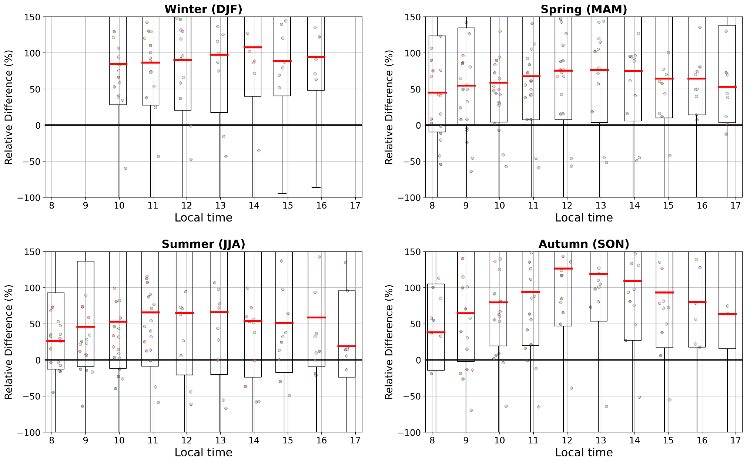
Bias diurnal variation – GEMS L2 v2
GEMS IUP-UB v1.0:
nearly no diurnal bias variation
High biased in winter
GEMS L2 v2:
High biased
Diurnal bias variation, especially in autumn

Slide 19
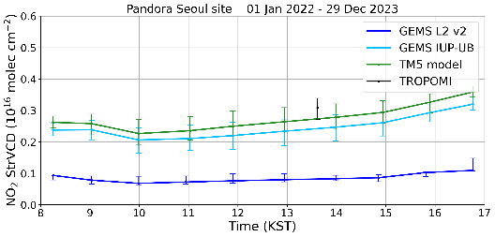
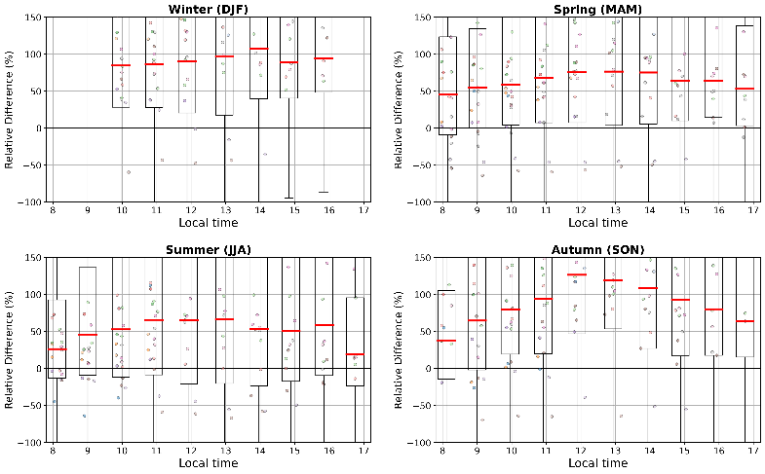
Summary
GEMS L2 v2 high biased (Looking forward to v3!)
Influence of different stratospheric corrections
GEMS L2 surface reflectance causes scatter and high bias
Good agreement between GEMS IUP-UB and ground-based data
GEMS IUP-UB high biased in winter, no diurnal bias variation
GEMS L2 v2 high biased
Diurnal bias variation for GEMS L2 v2
Thank you to NIER and Yonsei University for funding and providing GEMS data.
We thank the PIs and support staff for establishing and maintaining the Pandora sites. PGN is a bilateral project supported with funding from NASA and ESA.
Project support from KI4S4 50EE2204

Slide 20
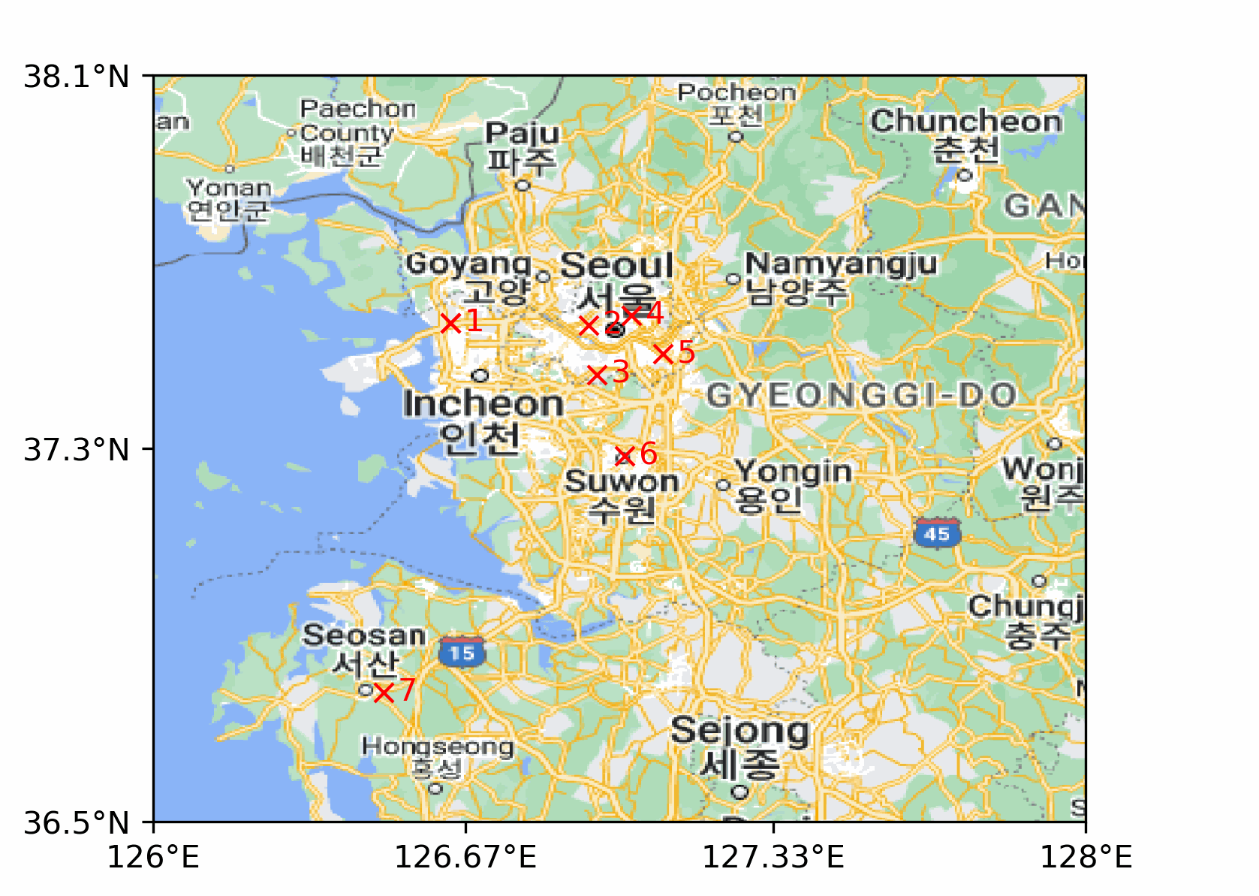
Thank you to NIER and Yonsei University for funding and providing GEMS data.
We thank the PIs and support staff for establishing and maintaining the Pandora sites. PGN is a bilateral project supported with funding from NASA and ESA.
Project support from KI4S4 50EE2204

Slide 21
Backup - slides

Slide 22
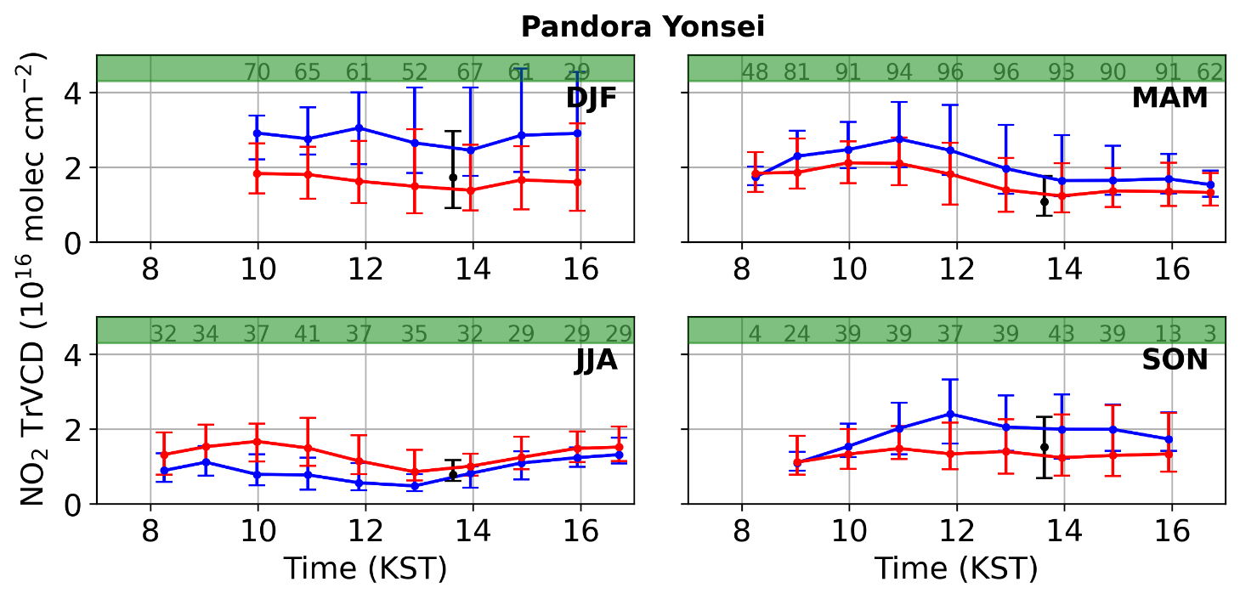
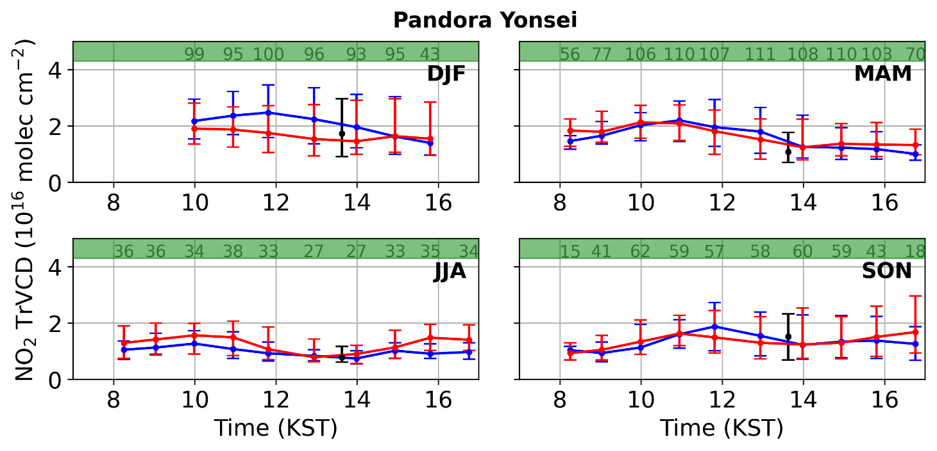
Seasonal diurnal variation – Tropospheric NO₂
GEMS L2 v3
GEMS IUP-UB v1.0
Preliminary results

Slide 23
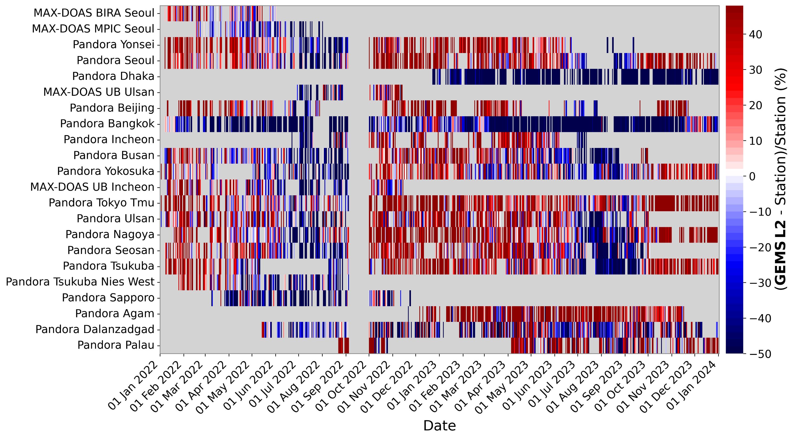

Slide 24
