Slide 1
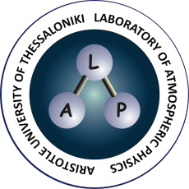
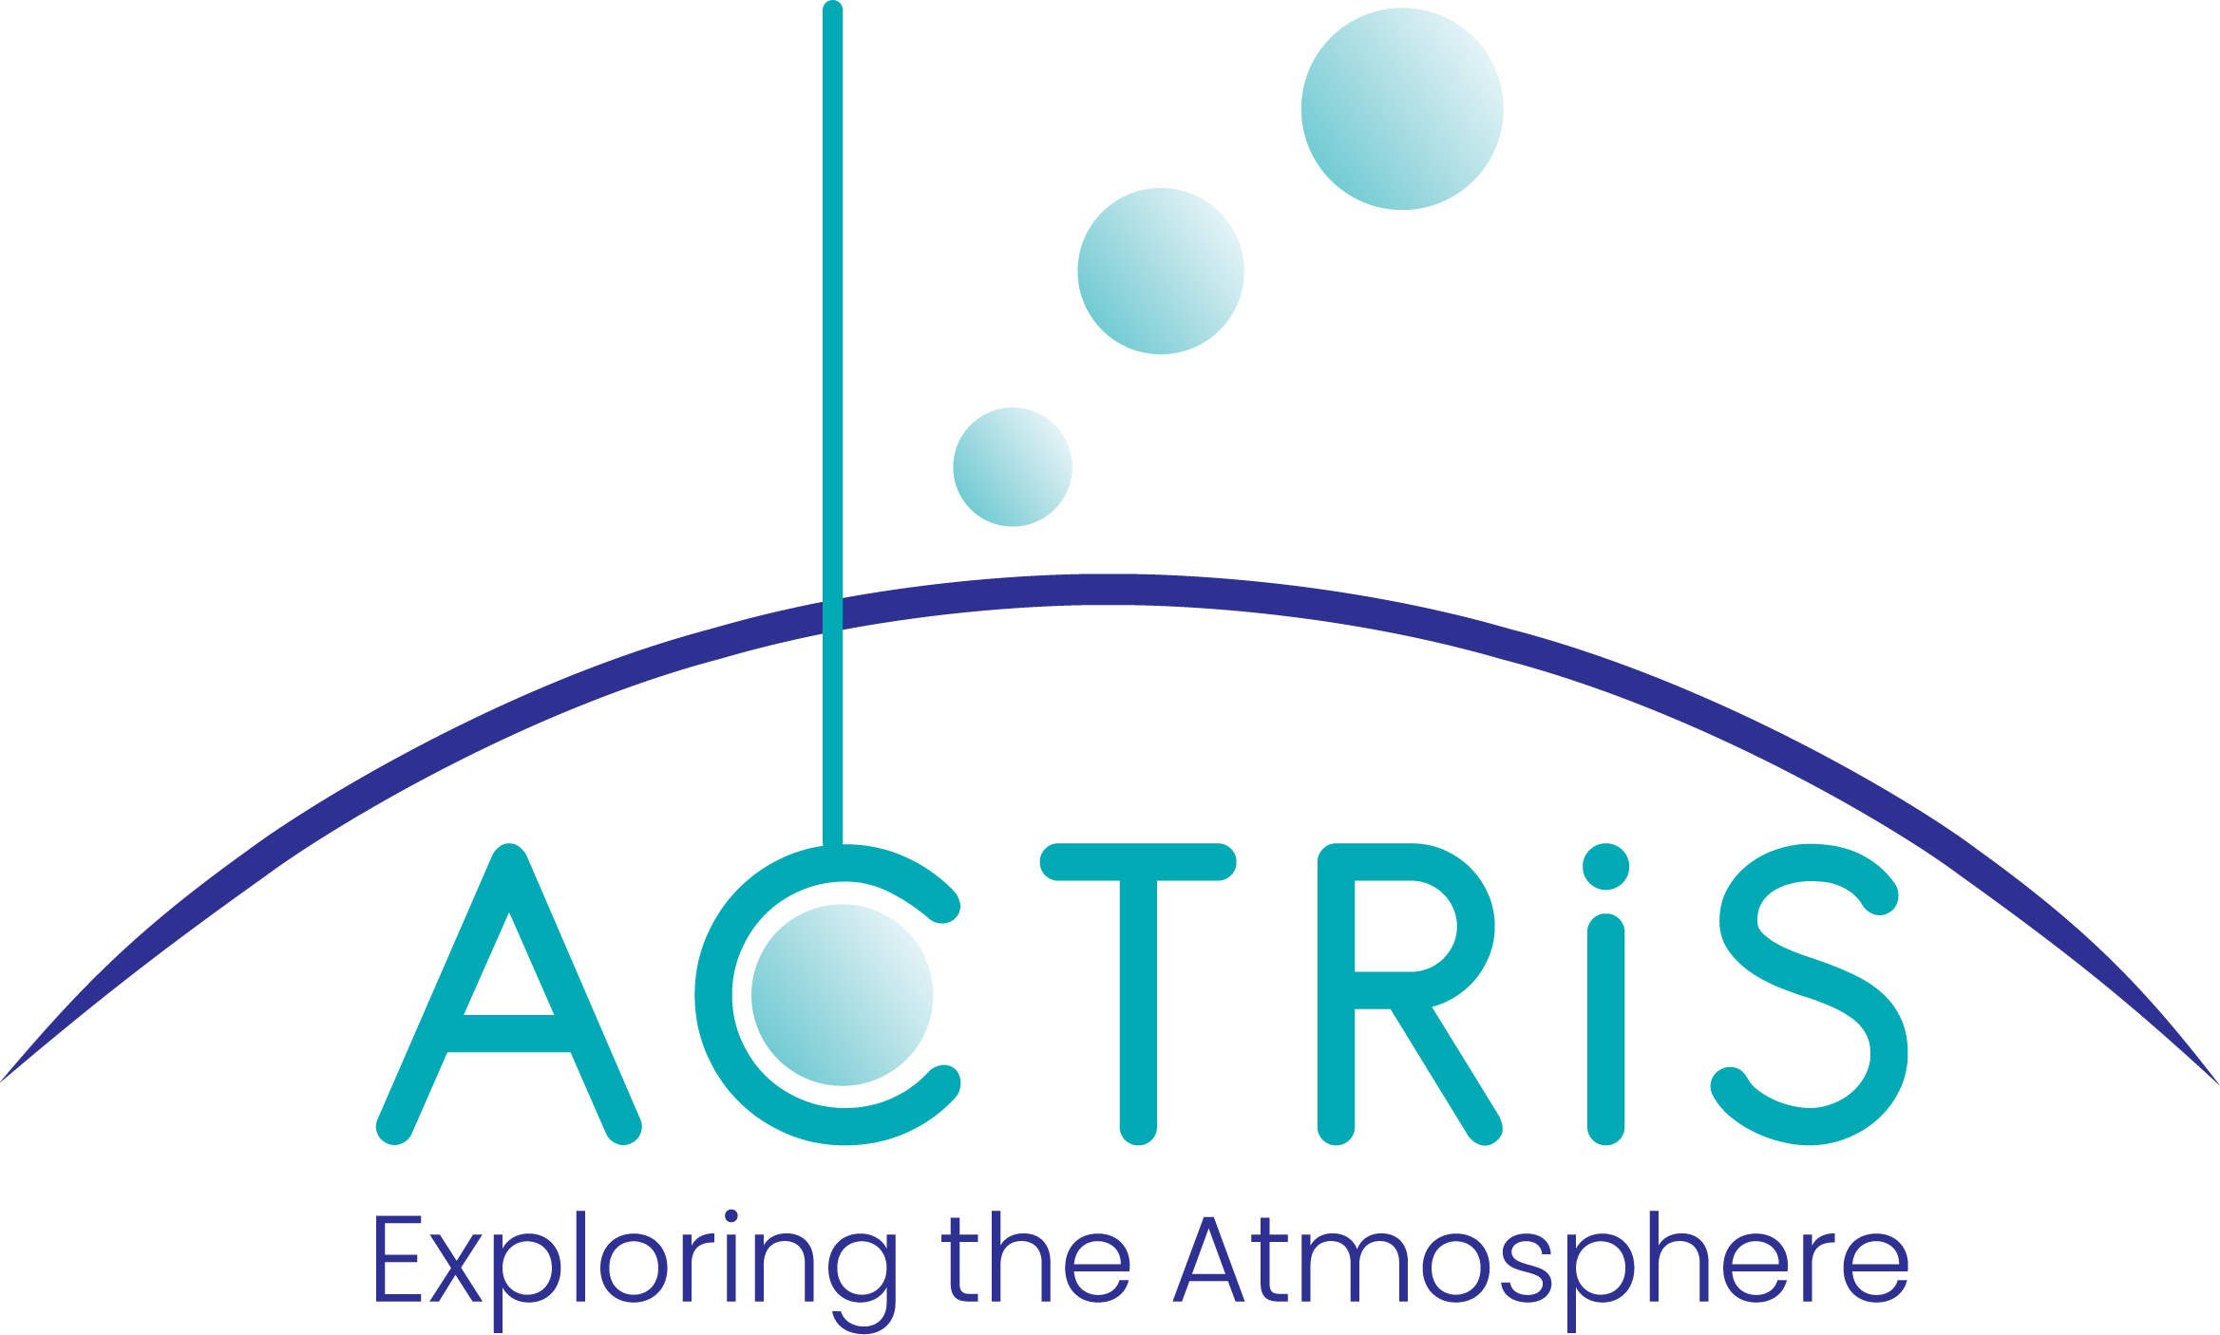
Exploring the quality of Aerosol Layer Height and Aerosol Index products obtained by Polar and Geostationary passive satellites
Dimitris Balis, Konstantinos Michailidis, Panagiotis Fountoukidis and MariLiza Koukouli
Aristotle University of Thessaloniki, Greece
ATM-MPC
PEGASOS

Slide 2
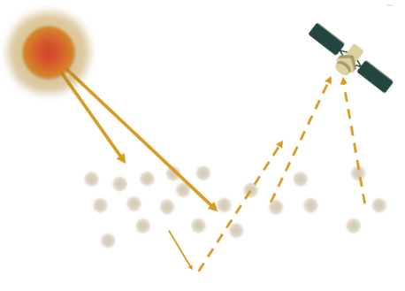
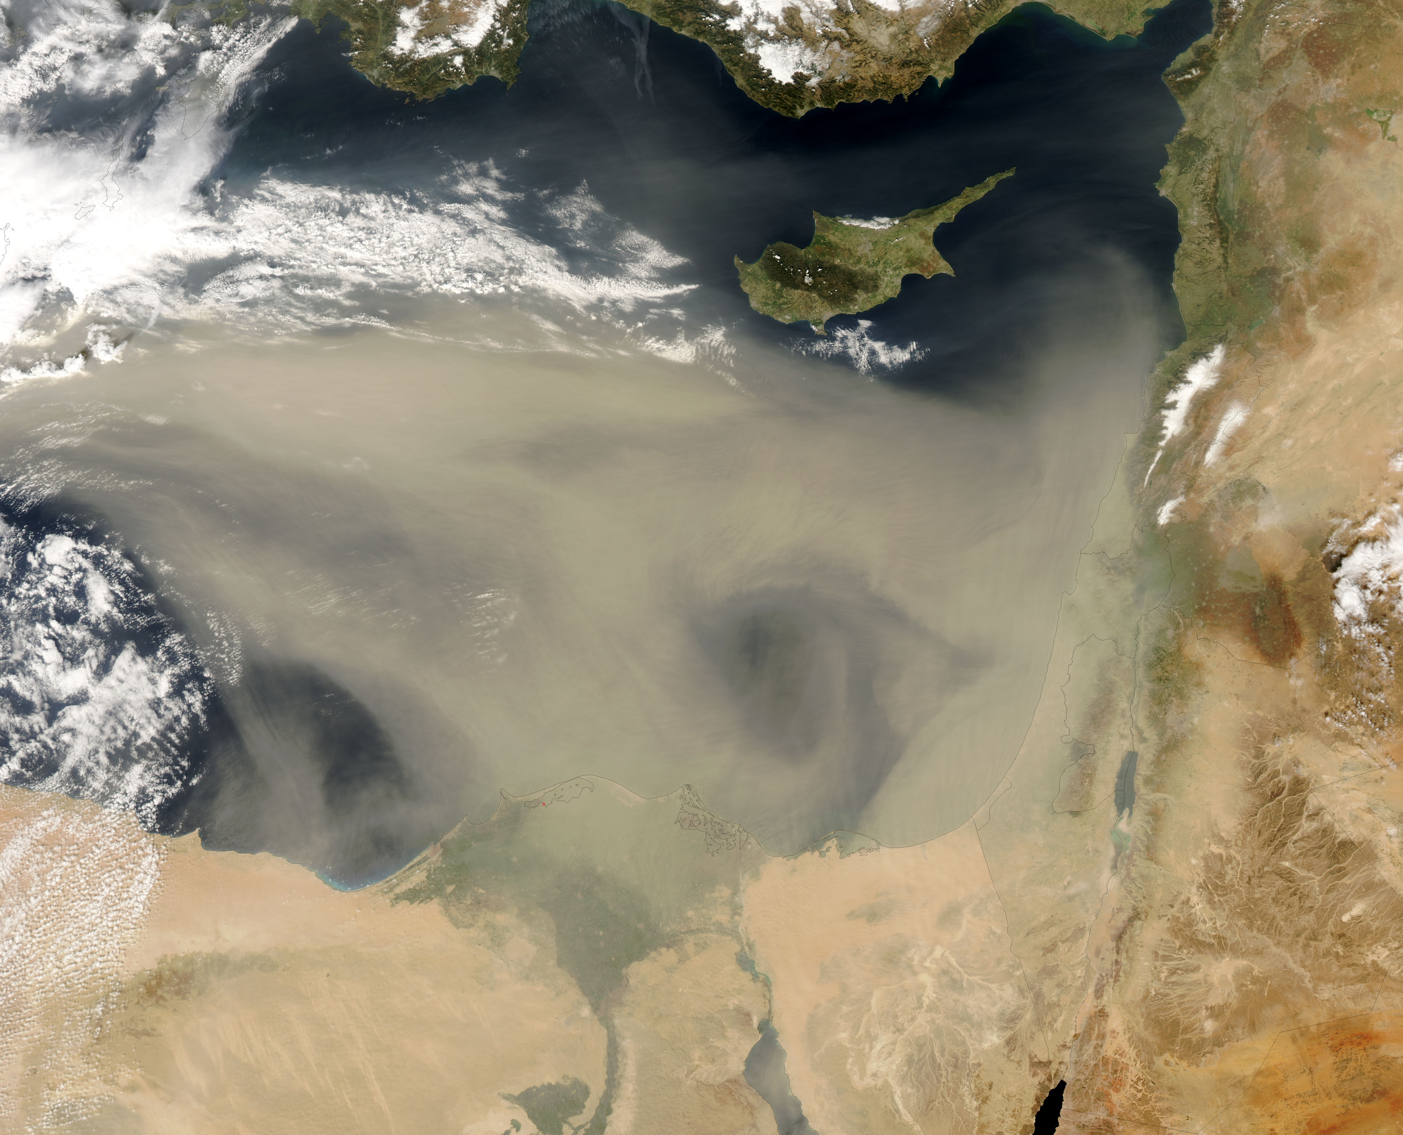
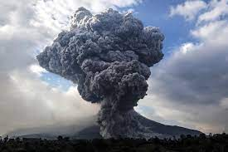
Why is the height of the aerosol layer important?
Knowledge of the ALH, is essential for understanding the impact of aerosols on the climate system
Important in the framework of aviation safety, transported dust, smoke and ash aerosols over large distances
Can provide accurate values to the modelling communities and improve air quality forecasting.

Slide 3
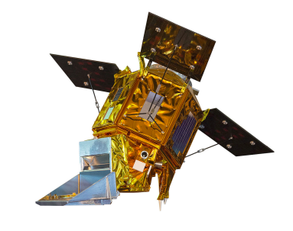
Satellite aerosol layer height products in this work
GOME-2/MetOp
TROPOMI/S5P
GEMS
Since 2006
MetOp-A, -B, -C
Daily global coverage
Cross. Time ~09:30LT
Swath ~ 1920 km
Spatial res. (40x80km)
Since 2017
Daily global coverage
Cross. Time~13:30LT
Swath ~2600 km
Spatial res. (5.5 x 3.5km)
Since 2020
Geostationary
Coverage: 5°S - 45°N, 75°E - 145°E Swath ~5000km
Temporal res. 8-10/day
Spatial res. (3.5 x 8 km2)
Absorbing Aerosol Height (AAH)
Aerosol Layer Height (ALH)
Aerosol Layer Height (ALH)
The AAH algorithm based on FRESCO+ retrieves cloud fraction (CF), cloud Height (CH), scene albedo (SA) and scene height (SH) from simulated 02-A band reflectance spectra
Absorbing Aerosol Index (AAI) identifies scenes
The algorithm determines whether CH/SH should be reported as AAH
Based on absorption in the Oxygen O2-A band
Aerosols are assumed to be distributed in a single layer
ALH algorithm applies a forward model and employs a NN scheme for speedy processor performance
Based on the AER-AOD algorithm
OEM-Spectral fitting 354, 388, 412, 443, 477, 490 nm

Slide 4
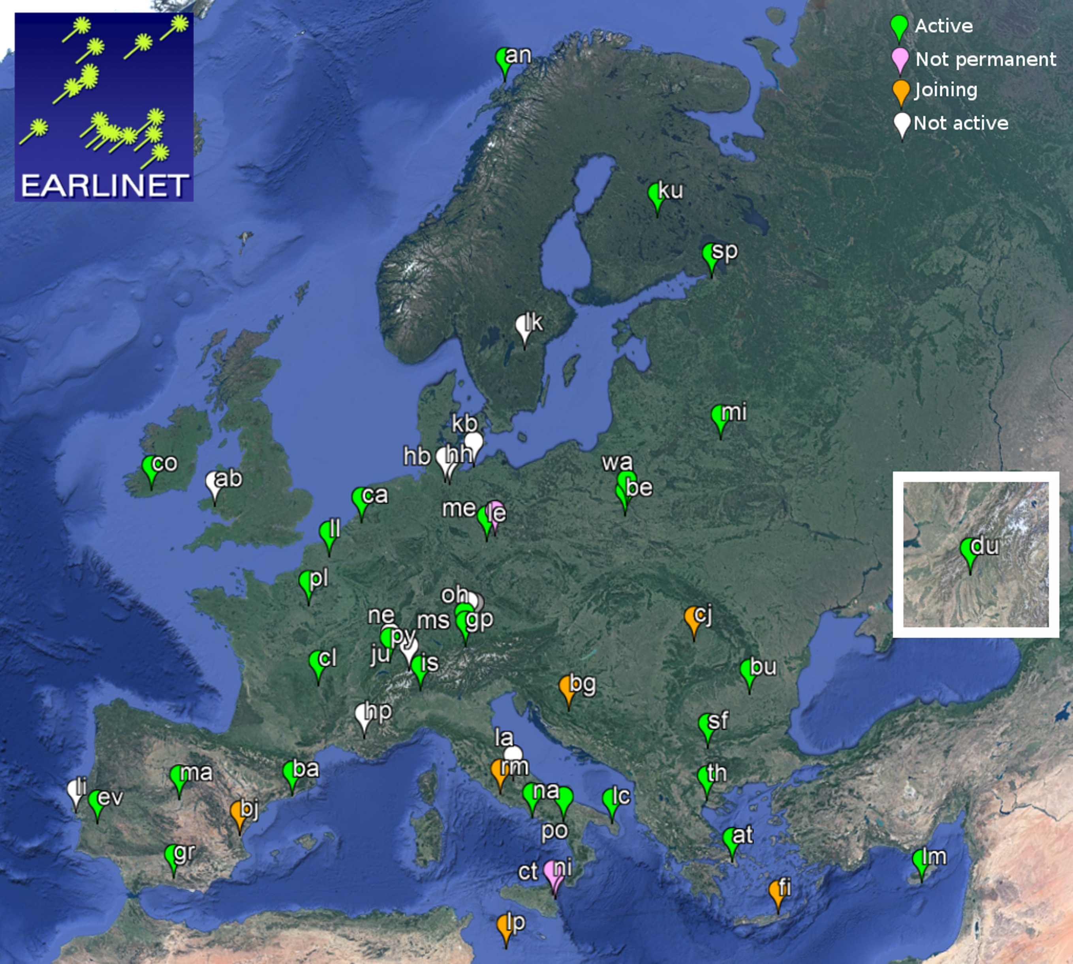
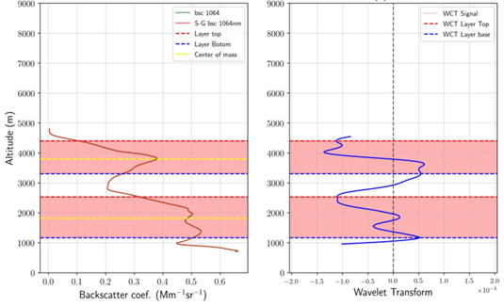
Aerosol layer height from ground-based measurements
How can we estimate layering information from the lidar measurements
Wavelet Covariance Transform (WCT)
Aerosol Effective Height (Center of mass)
Apply
to the signal
Quality assured lidar data
Lidar measurements from the ACTRIS-EARLINET database
Data processed with the Single Calculus Chain.
Volume Backscatter coefficient at 1064nm or 532nm
Only Level-2 aerosol optical products are included.
The choice of a (spatial extend or dilation)
and b (centered location or vertical translation)
affect the number of detected layers and thus their geometric characteristics (layer top height, layer bottom height)
Can be applied to the whole profile or to individual layers
Problem:
It is this affected by the incomplete overlap of a lidar system (uncertainty 100-400m)
Limitation: There might be aerosol layers beyond the vertical range of the archived lidar measurements

Slide 5
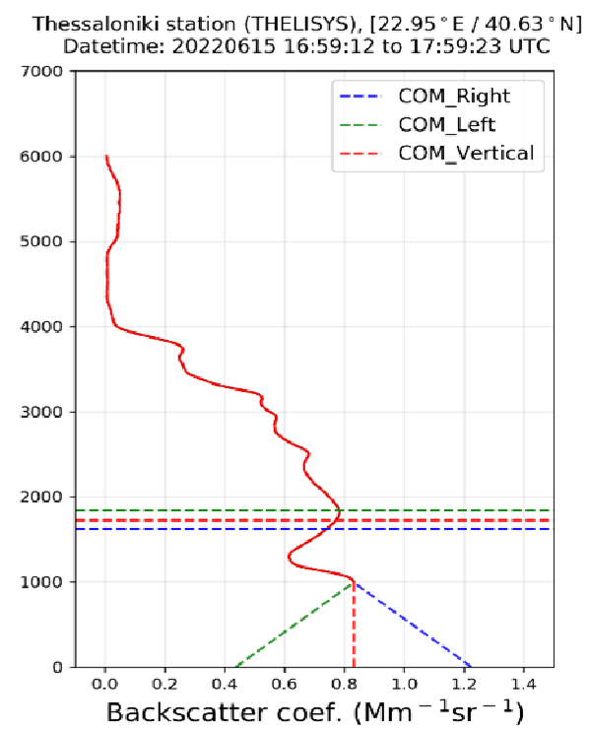
Aerosol layer height from ground based measurements
Uncertainties and issues when estimating layering information from the lidar measurements
Investigation of Overlap height impact on the weighted lidar ALH determination
The uncertainty due to the overlap in determining the ALH is of the order of 100 - 400m, depending on the technical characteristics of each lidar system
Investigation of Lidar Ratio impact on the weighted lidar ALH determination
The results show that in both cases the effect of the different lidar ratio values on the weighted height calculation (ALH_{bsc}) is small, lower than 40m.
How the errors of the EARLINET measurements affect the the weighted lidar ALH determination
The effect of the error in the retrieval of the backscatter coefficient on the estimation of the ALH_{bsc} ranges between 10 - 60 m.

Slide 6
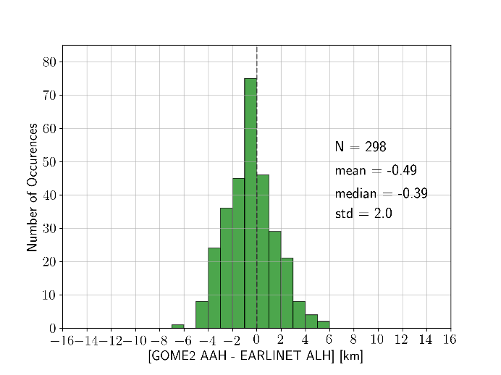
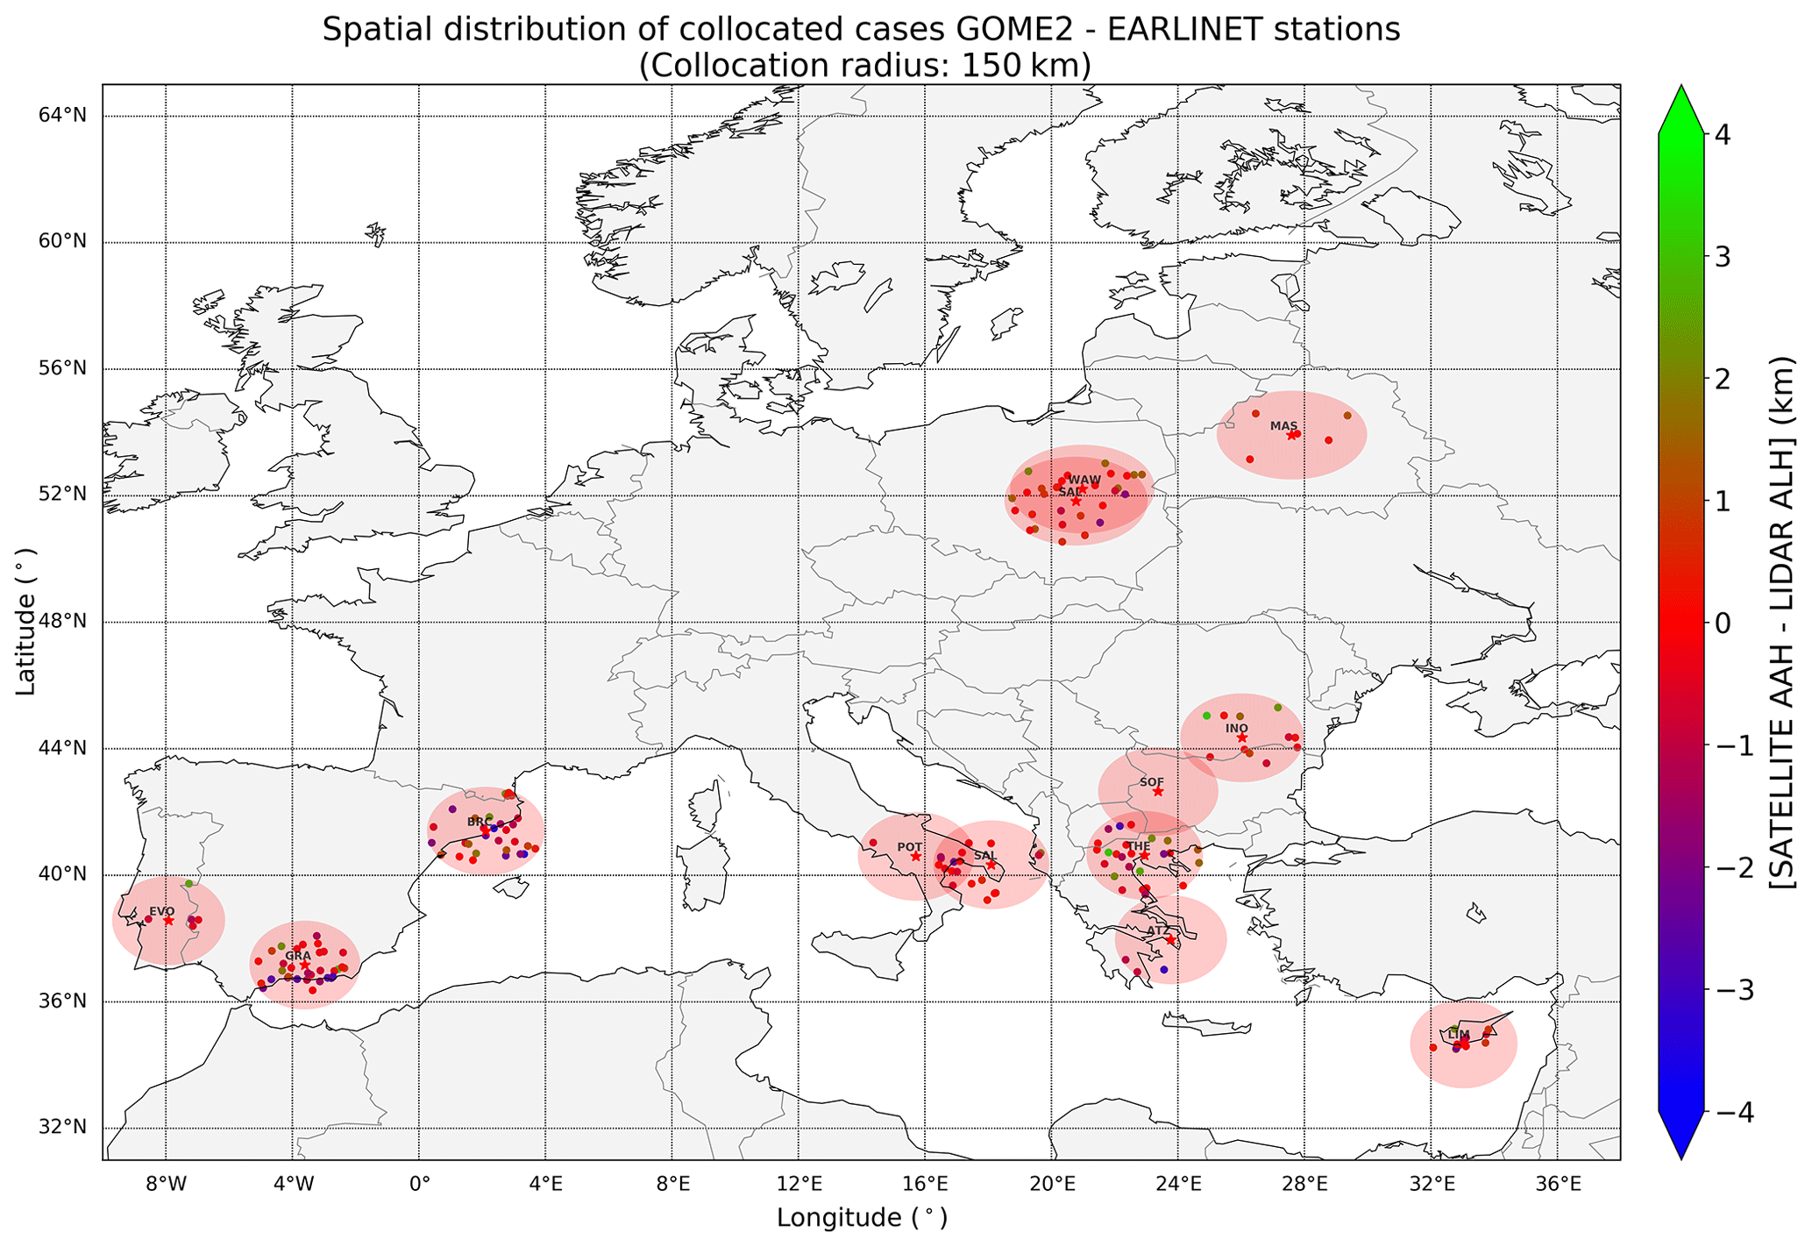
Validation of GOME-2 AAH
13 ACTRIS/EARLINET stations
We compare the top boundary of the upper most aerosol layer with GOME-2 AAH
Metric
Number of collocated cases | 298
Mean difference | -0.49 km
Standard deviation | 2.01 km
Min/Max of the differences | -6.7/5.2 km
Correlation/ Slope / Y-inter. | 0.39 / 0.53 / 1.24
Collocation criteria
Spatial (Δx): 150km
Temporal (Δt): 4-h interval
Flags
Use AAI >2
Flag sun glint
Michailidis et al, ACP, 2021

Slide 7
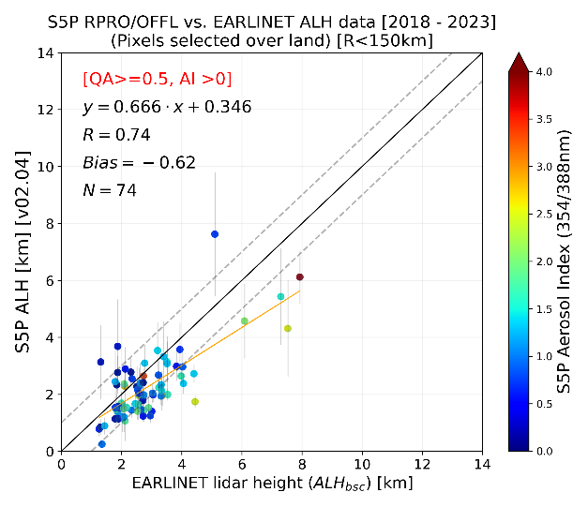
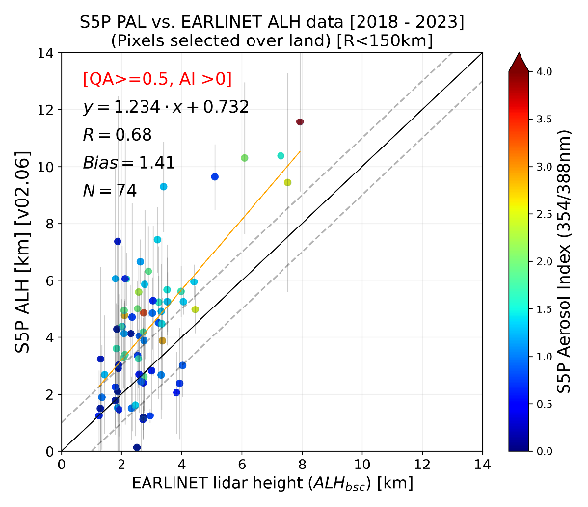
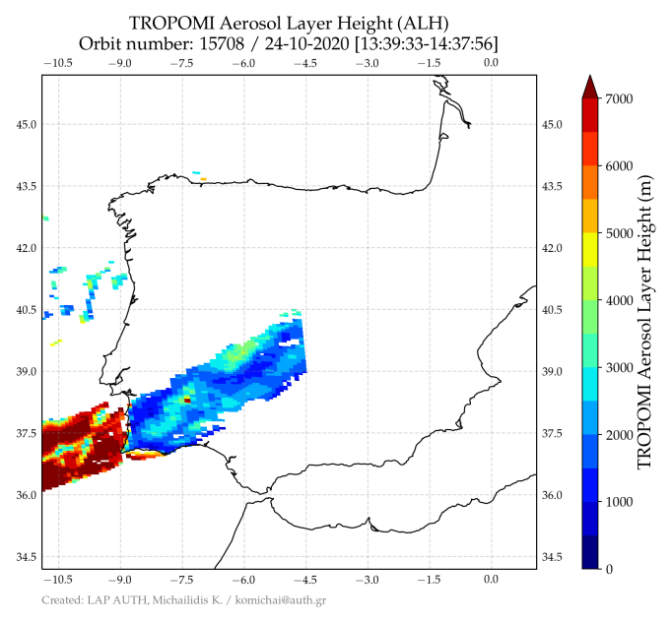
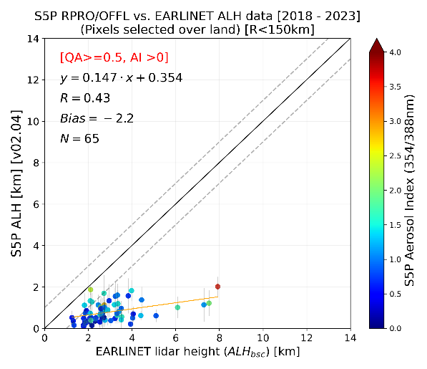
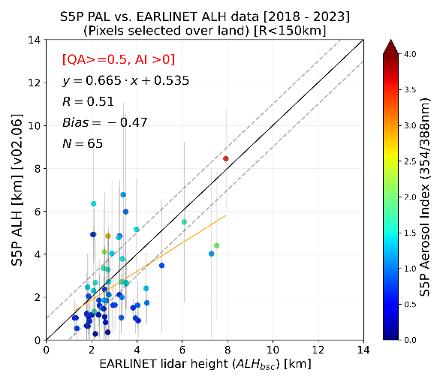
Validation of TROPOMI ALH
Over Ocean: (Left) v02.04/02.05 (Right) v02.06
AER_LH Version | Number of Points | Mean Bias [km] | Pearson (R)
Over Ocean
V02.04 / 02.05 | 74 | -0.62±0.92 | 0.74
V02.06* | 74 | 1.41±1.77 | 0.68
Over Land
V02.04 / 02.05 | 65 | -2.2±1.23 | 0.43
V02.06* | 65 | -0.47±1.59 | 0.51
Over Land: (Left) v02.04/02.05 (Right) v02.06
Selected stations close to the ocean
*AER_LH data processed via S5P-PAL System, includes the surface albedo in the optimal estimation fit
We compare the effective aerosol height with the TROPOMI ALH
Why? Increasing surface albedo negatively influences the ALH
Co-location criteria:
Spatial Δx: 150km
Temporal Δt: ±2hour
Flags: Sunglint effect, snow/ice pixels, Cloud screening, cirrus contamination, QA-value > = 0.5, ALH for only UVAI > 0
Michailidis et al, ACP, 2023
ATM-MPC
Notes:
Suggestion: add hyperlink to paper.
Τα 12/14άρια δεν θα φαίνονται την αίθουσα,

Slide 8
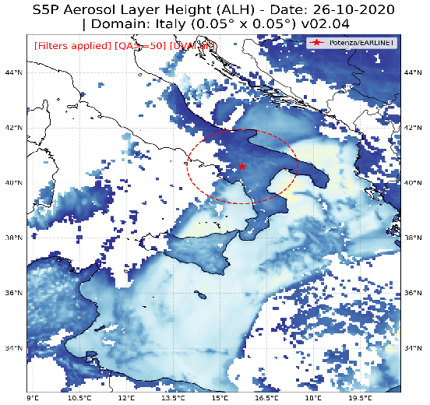
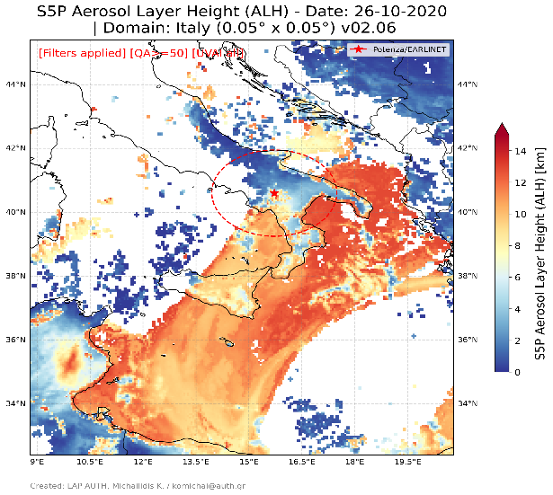
Validation of TROPOMI ALΗ
L2 RPRO version v02.04
L2 S5P-PAL version v02.06
The representativeness of the TROPOMI ALH when multiple layers are present is an issue for further investigation
TROPOMI pixels over Ocean
Number of layers | R | MB [km] | Y=Ax+b
1 | 0.8 | -0.46 | 0.71x+0.38
>2 | 0.85 | -0.55 | 0.67x+0.47
Improvement when considering the surface albedo in the fit
ATM-MPC

Slide 9
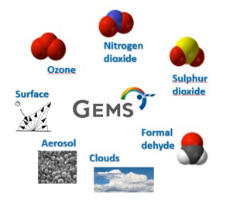
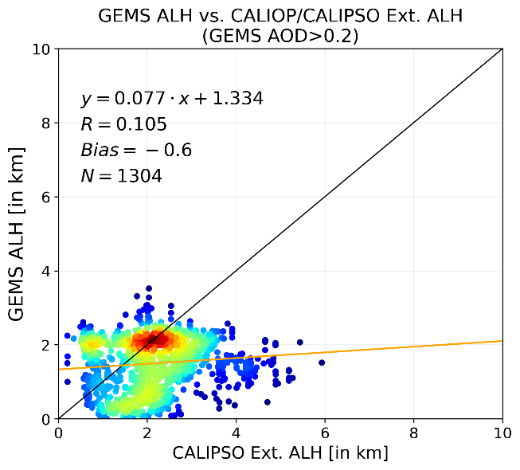
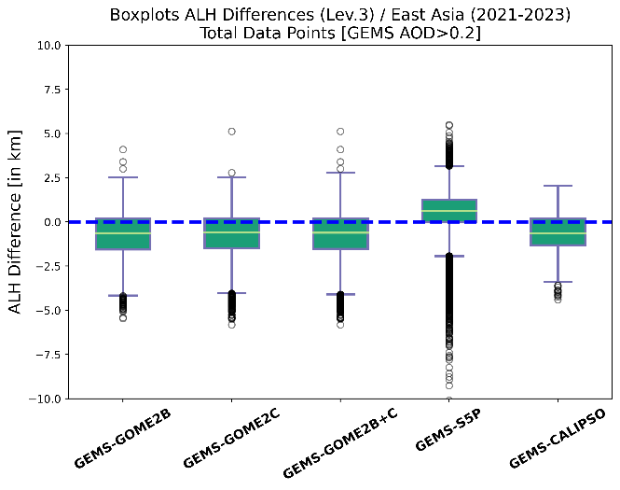
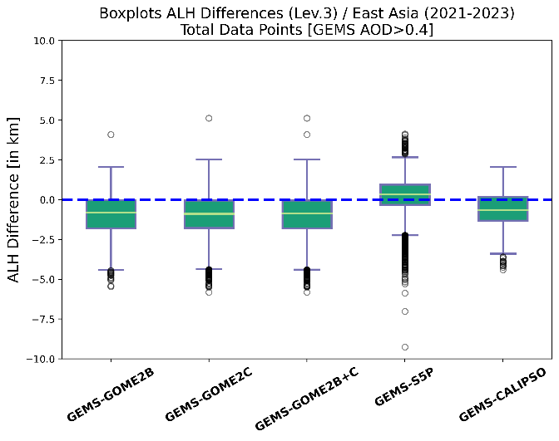
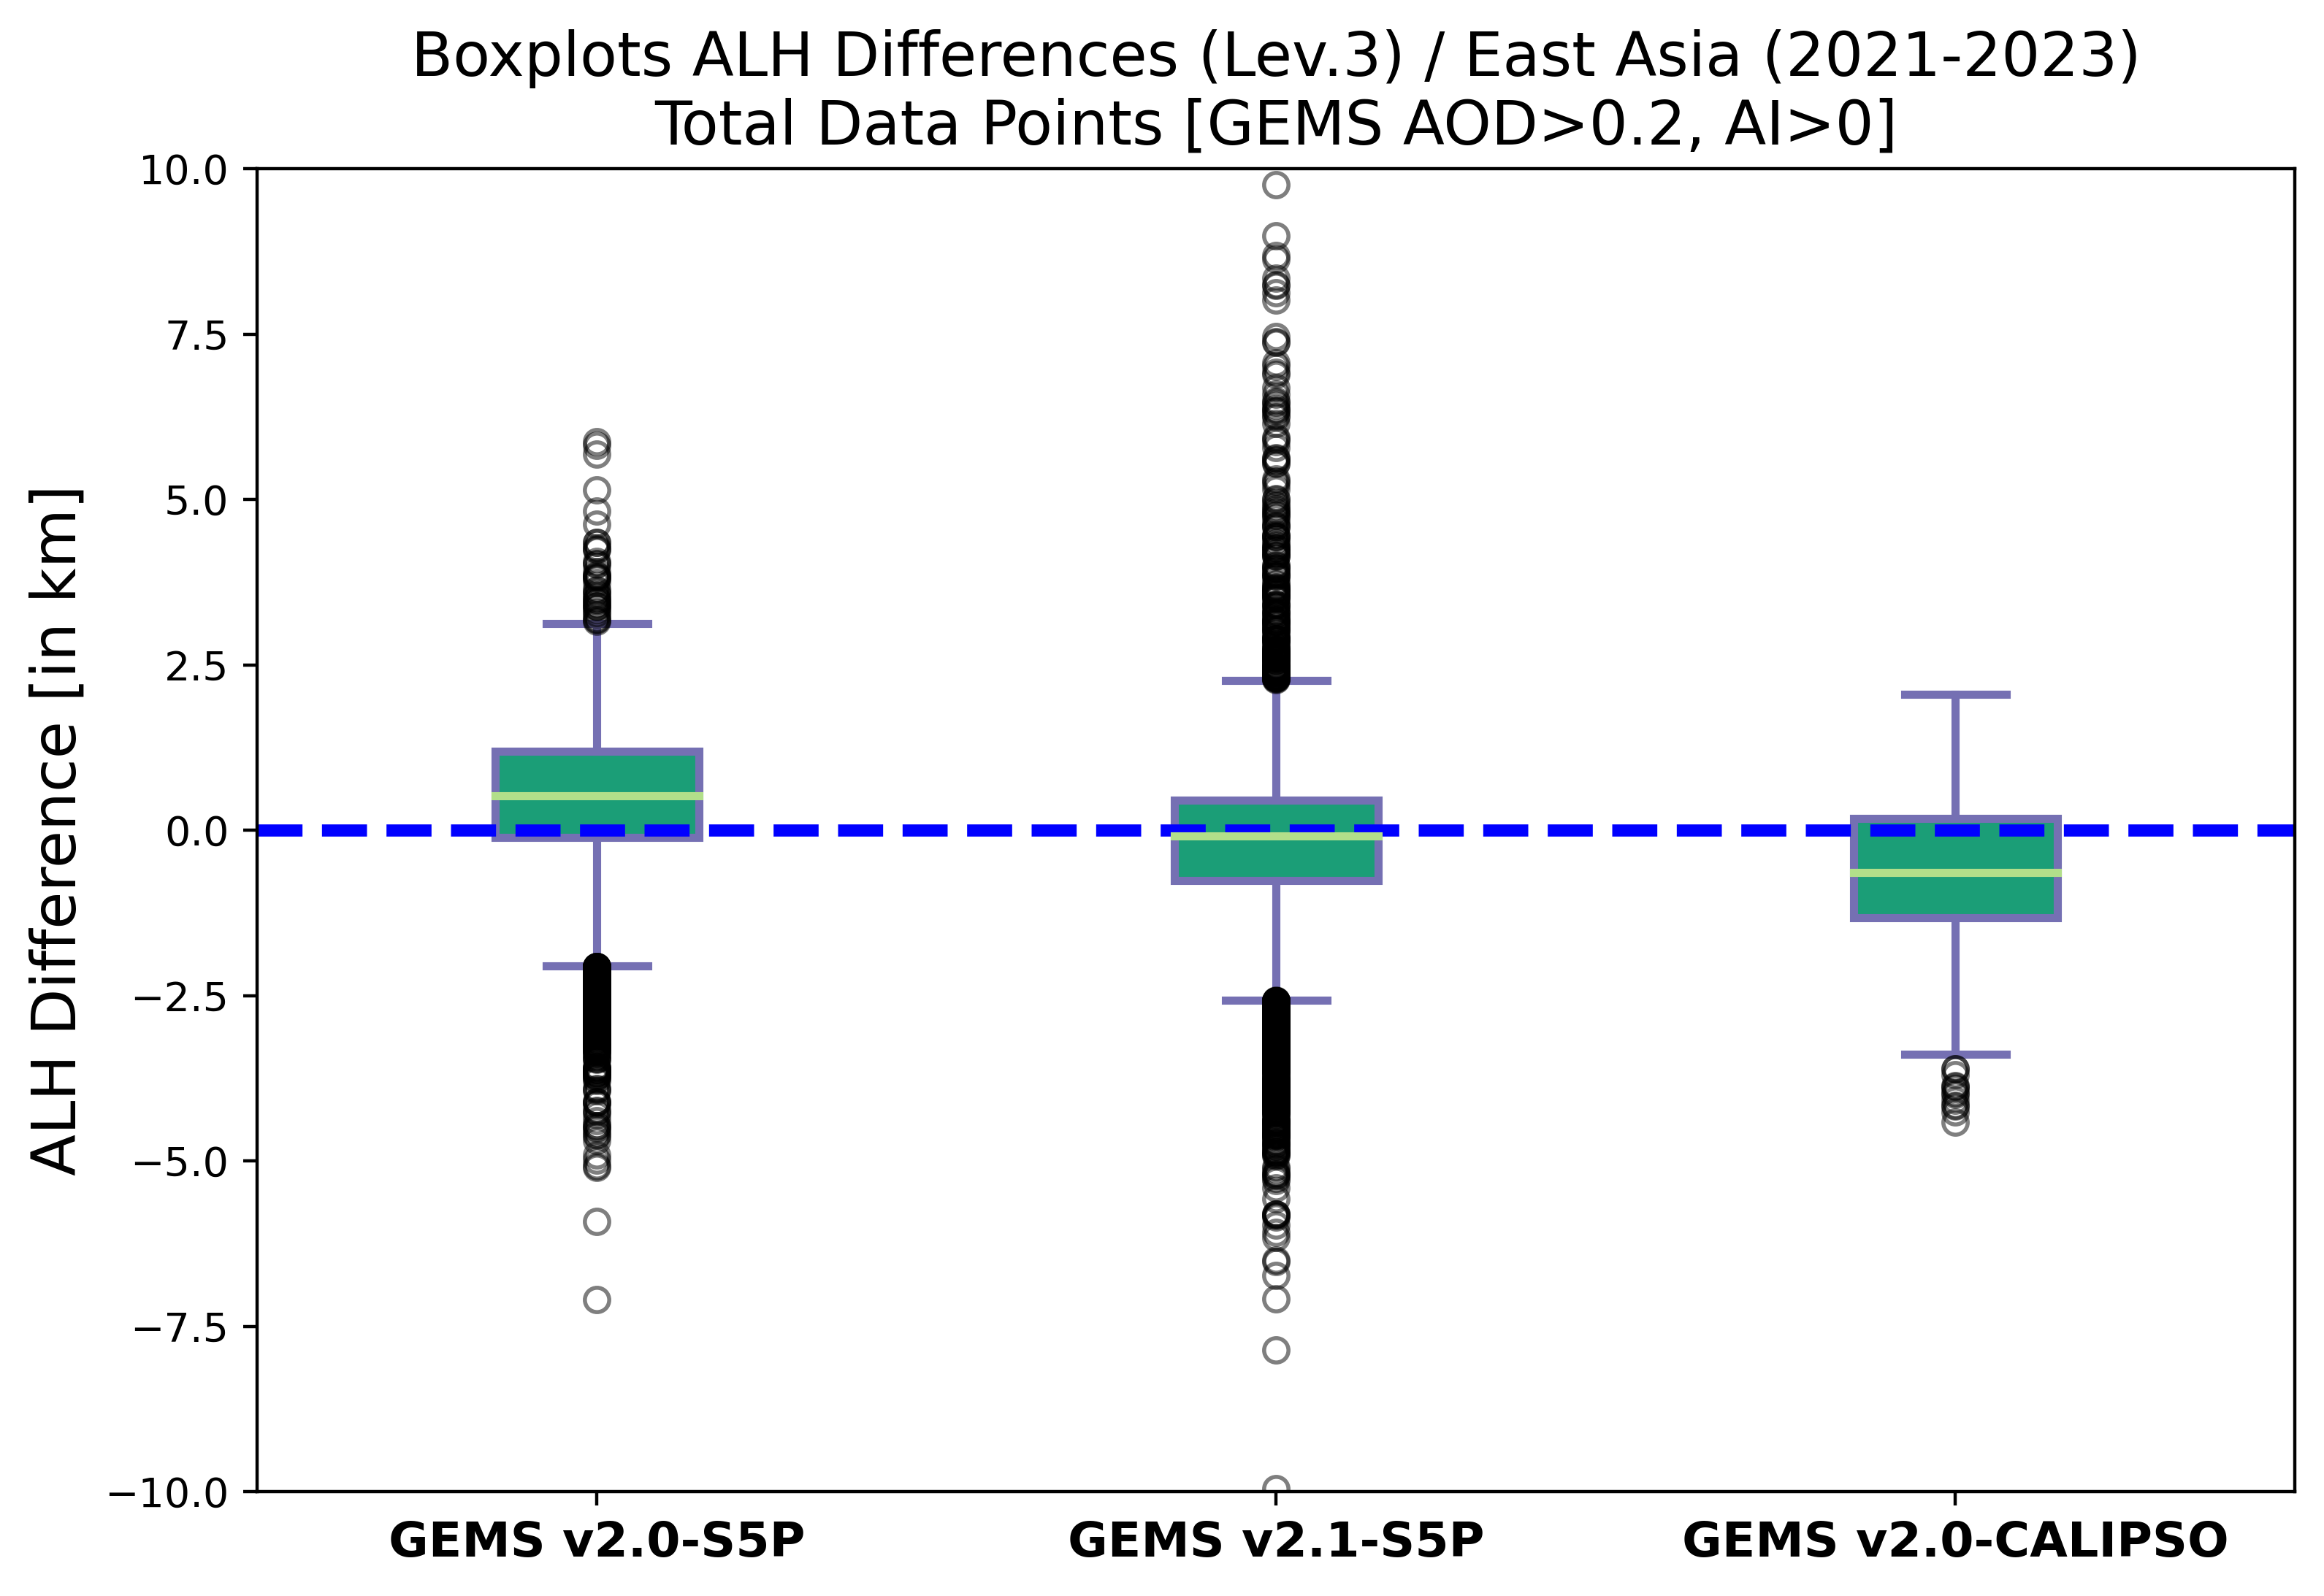
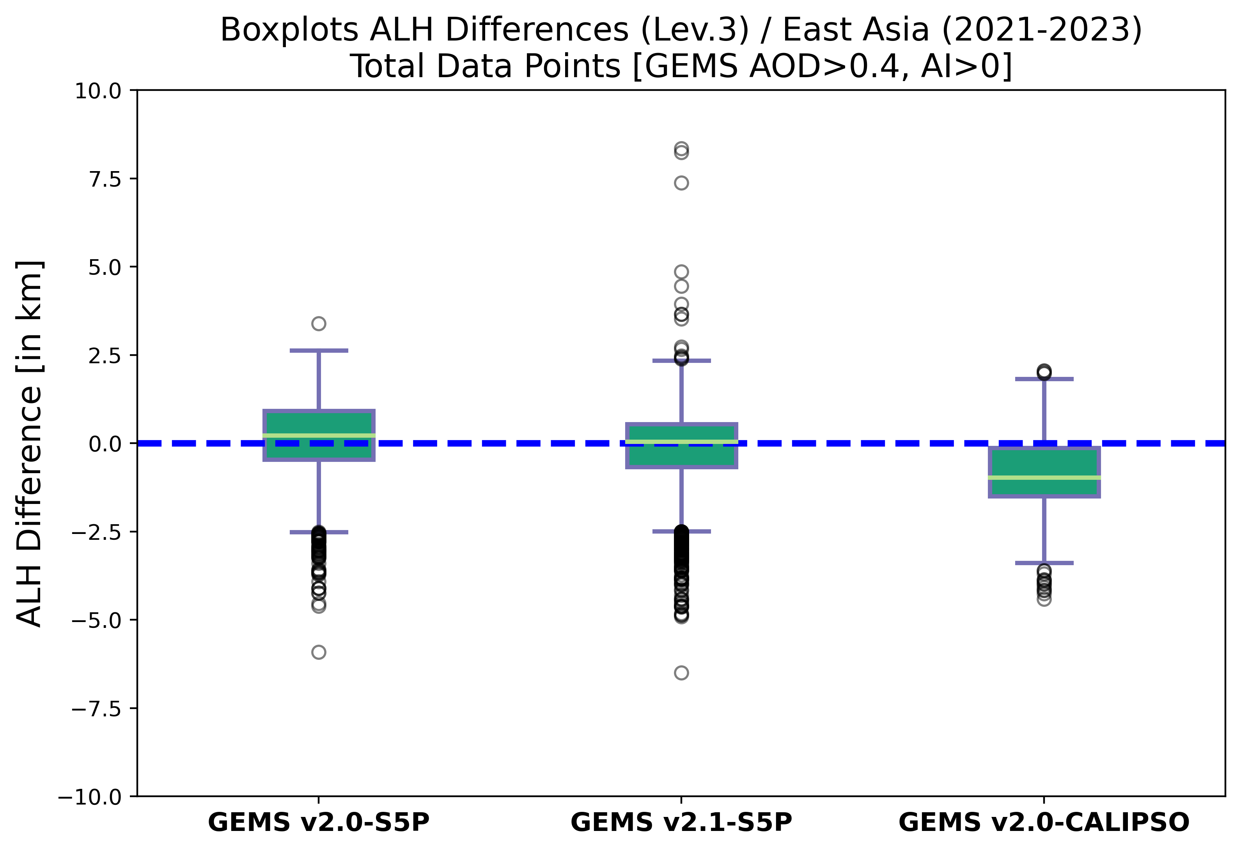
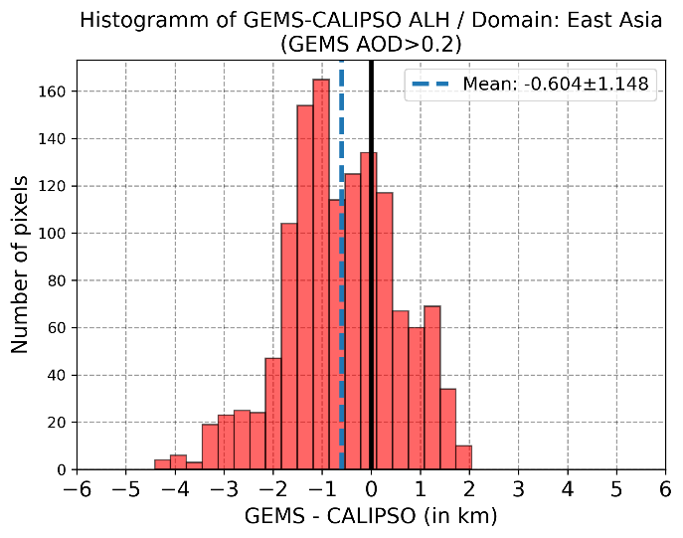
Validation of GEMS ALH
PEGASOS
GEMS AOD>0.2, UVAI>0
GEMS AOD>0.2
GEMS AOD>0.4
Similar for GOME-2 and S5P
L2 ALH products converted το 0.2° x 0.2° grid for the GEMS observational times closer to the other satellite crossing time

Slide 10
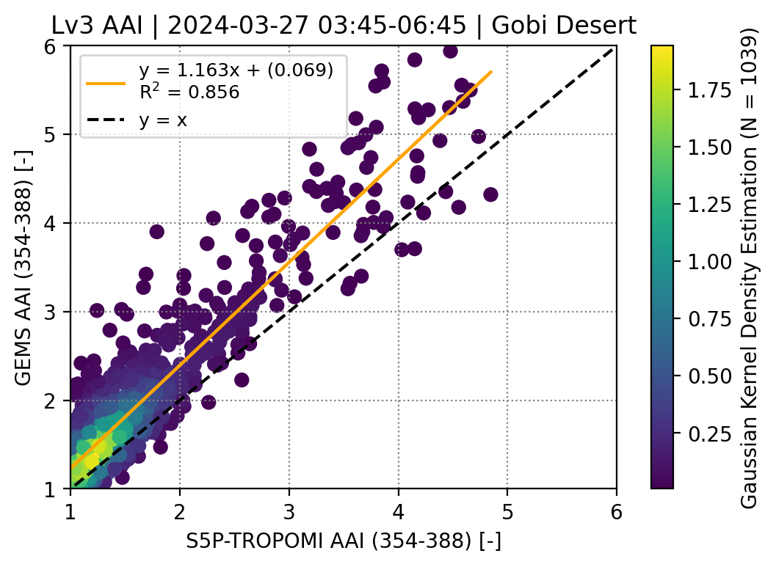
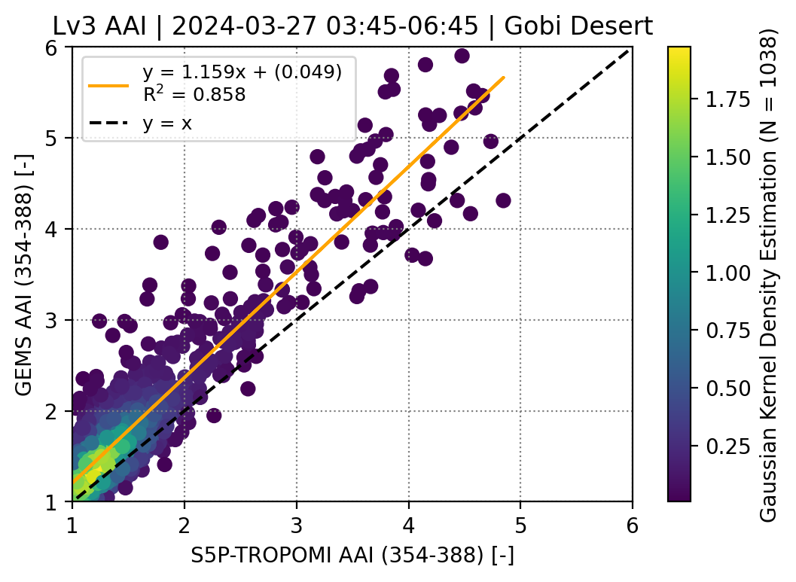
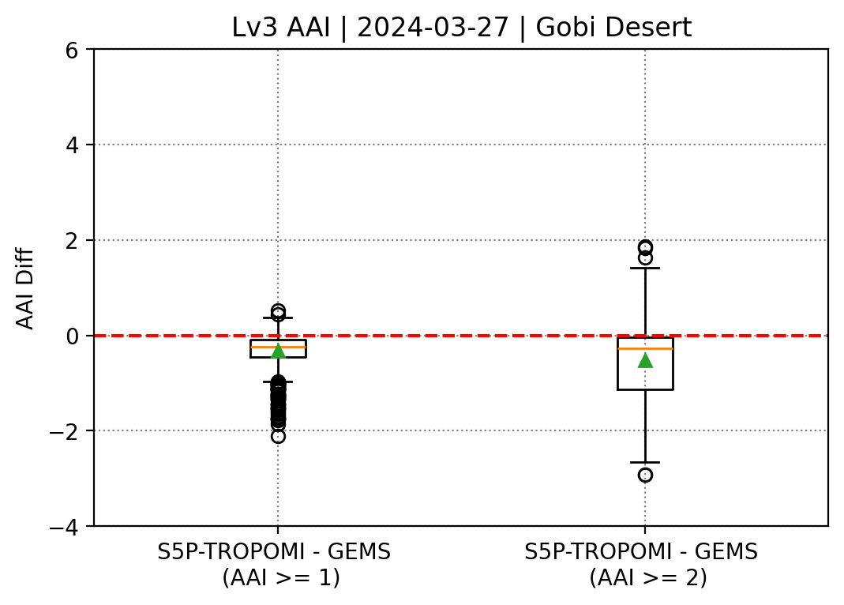
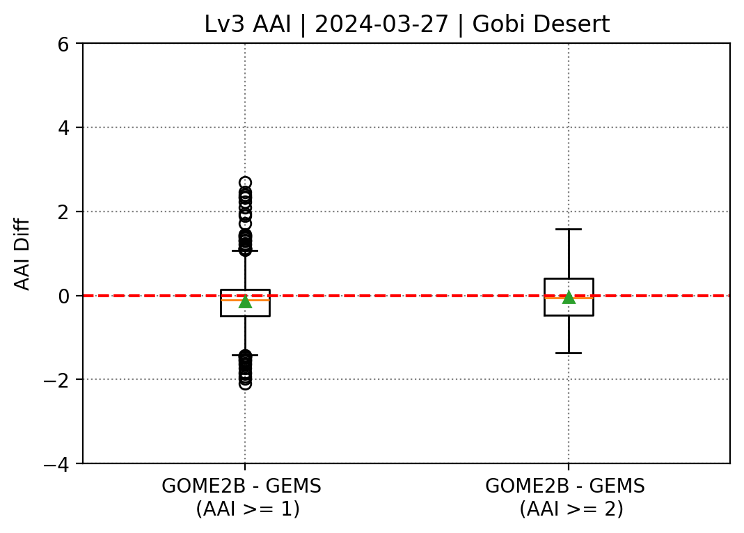
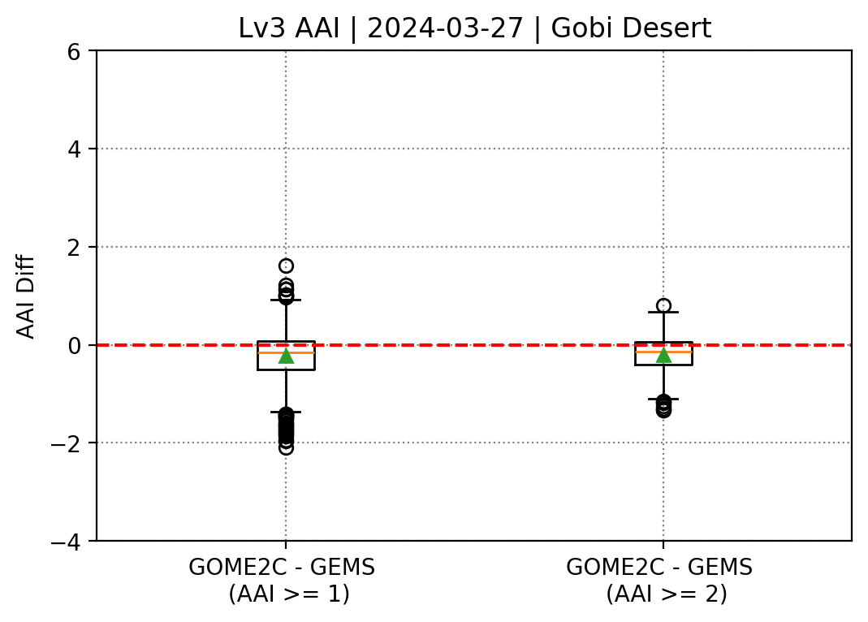
Consistency of different Aerosol Index estimates
PEGASOS
S5P-TROPOMI – GEMS v2.0
GOME2B – GEMS v2.0
GOME2C – GEMS v2.0
GEMS version 2.0
GEMS version 2.1
Absolute Differences | Mean (AAI ≥ 1) | Median (AAI ≥ 1) | Mean (AAI ≥ 2) | Median (AAI ≥ 2)
S5P/TROPOMI – GEMS | -0.321±0.352 | -0.241 | -0.521±0.837 | -0.279
GOME2B – GEMS | -0.136±0.634 | -0.109 | -0.035±0.601 | -0.053
GOME2C – GEMS | -0.222±0.526 | -0.156 | -0.207±0.442 | -0.136

Slide 11
Concluding remarks and future plans
ACTRIS database is valuable for the validation of aerosol layer height satellite products providing estimates with an uncertainty of about 100m
GOME-2 AAH when compared with the top boundary of the upper most layer detected from the lidar has a bias of -0.5km
Latest version of TROPOMI ALH when compared with effective aerosol height estimated from the lidar has a bias between -0.4km and 1.4km depending on the surface albedo and the number of aerosol layers
GEMS ALH when compared to other satellite retrievals shows a small negative bias both in 2.0 and 2.1 versions
AAI from different satellite instruments are consistent
Validated EARTHCARE measurements of ALH will be integrated in the validation
Participation of ACTRIS Expert Group in the forthcoming AO for S4 and S5 aerosol products and validation of Sentinel-3 OLCI ALH

Slide 12
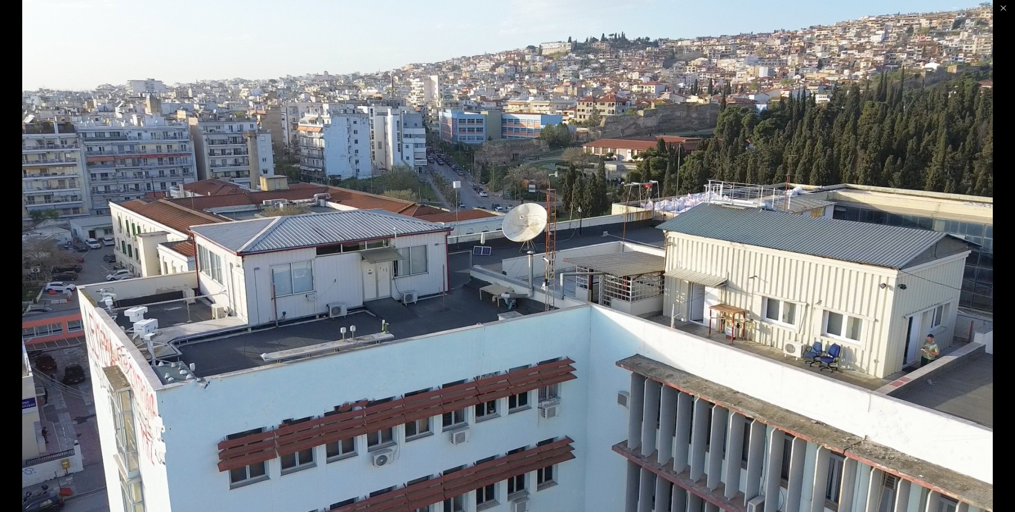
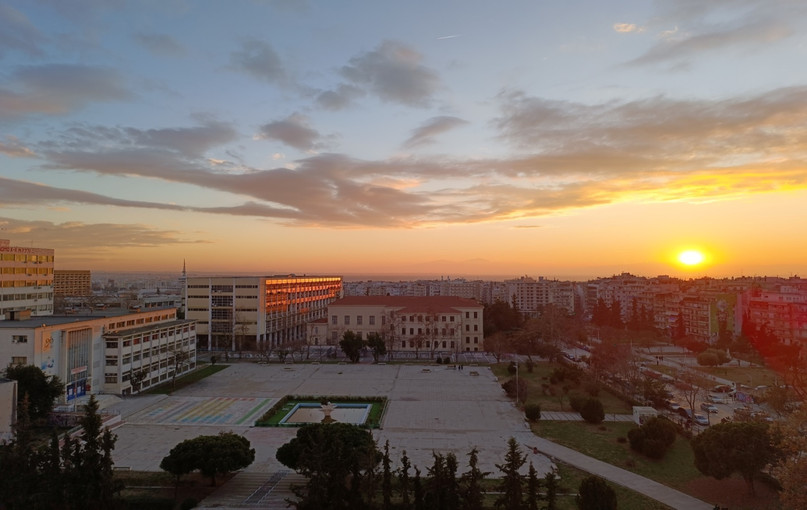
Thank you for your Attention!

