Slide 1
Integrated Tropospheric NO₂ Data Fusion for Air Quality Monitoring
Zigang Wei¹ Shobha Kondragunta² Kai Yang³
¹IMSG at NOAA, USA
²NOAA, USA ³UMD, USA
Disclaimer: The scientific results and conclusions, as well as any views or opinions expressed
herein, are those of the author(s) and do not necessarily reflect those of NOAA or
the Department of Commerce.

Slide 2
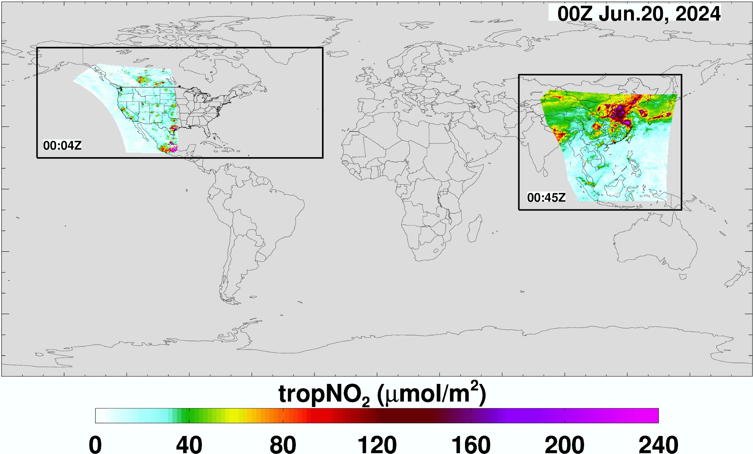
Motivation
Take advantage of strengths of each sensor in LEO and GEO
Bias Correction and Error Reduction using Kalman Filter technique
Data Fusion for Enhanced Monitoring
Provide enhanced and accurate product globally.

Slide 3
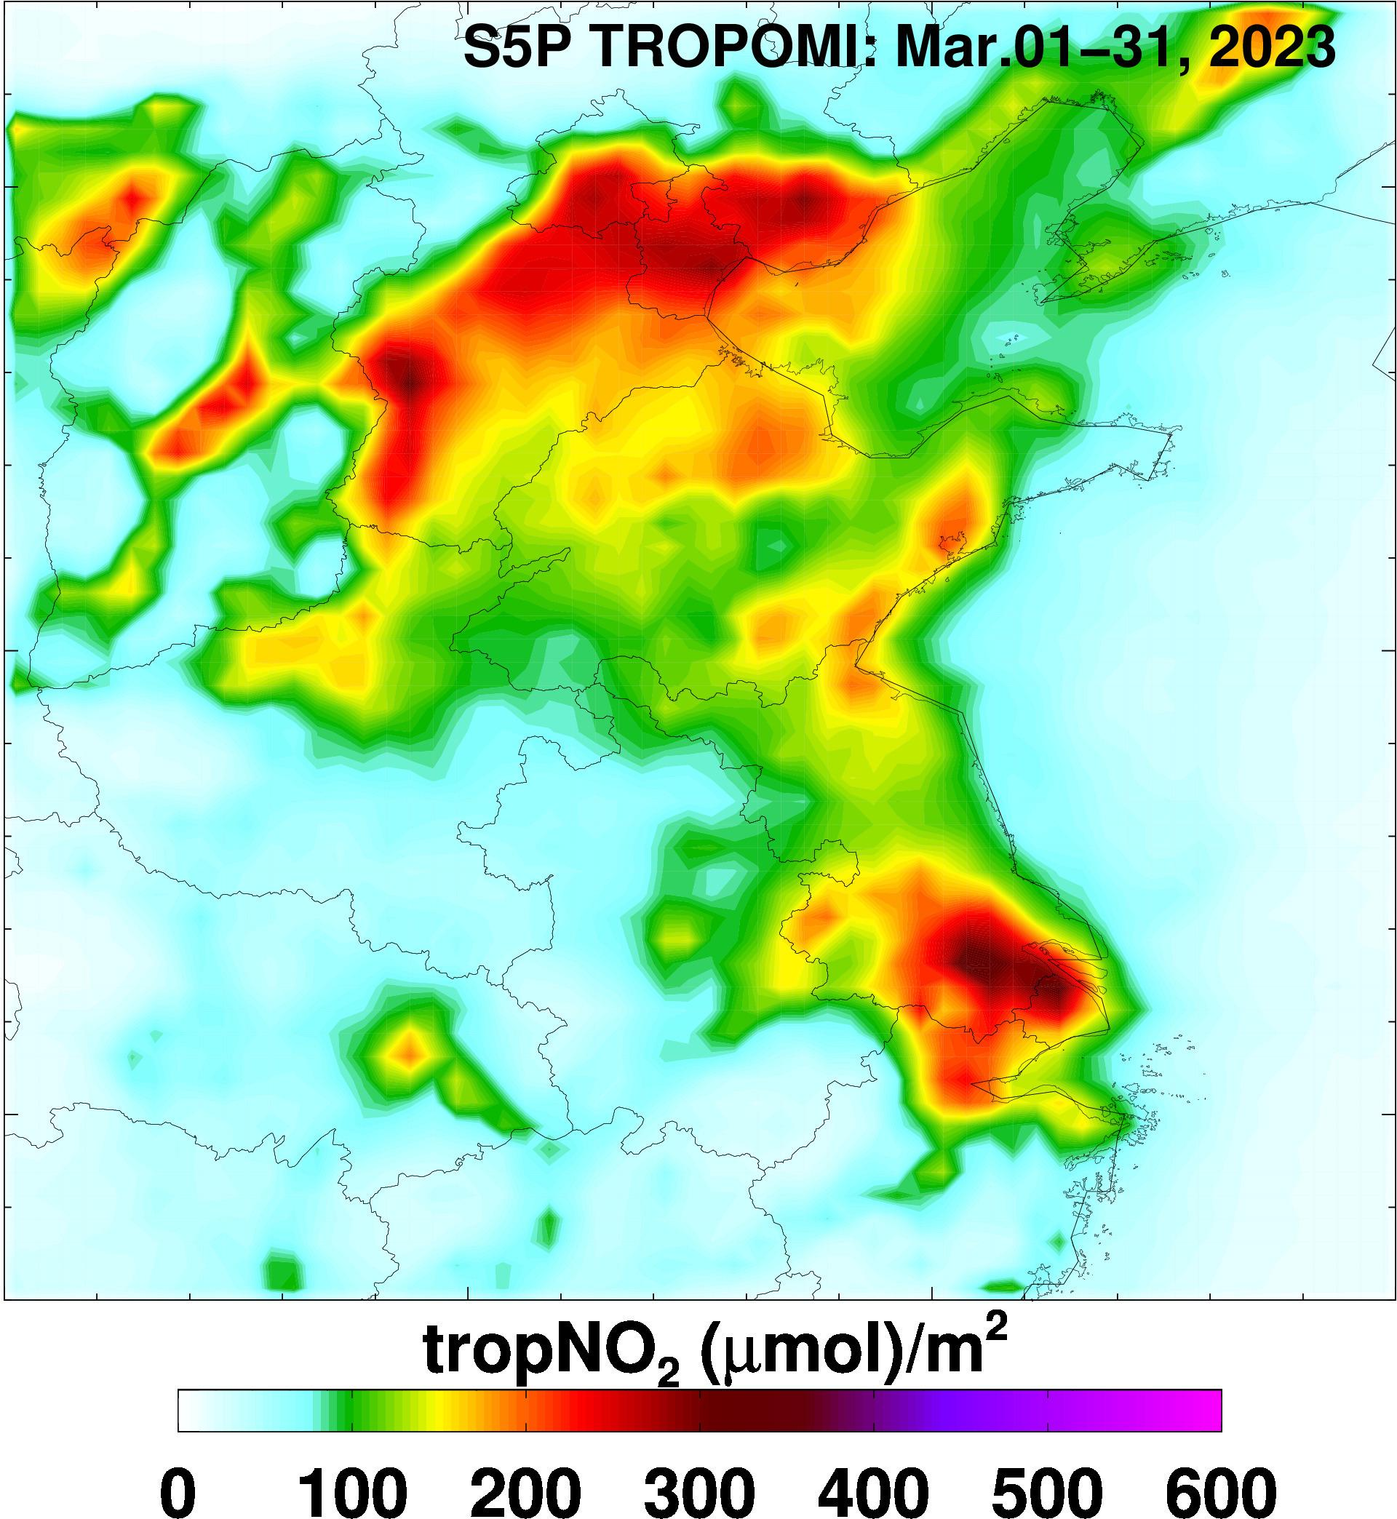
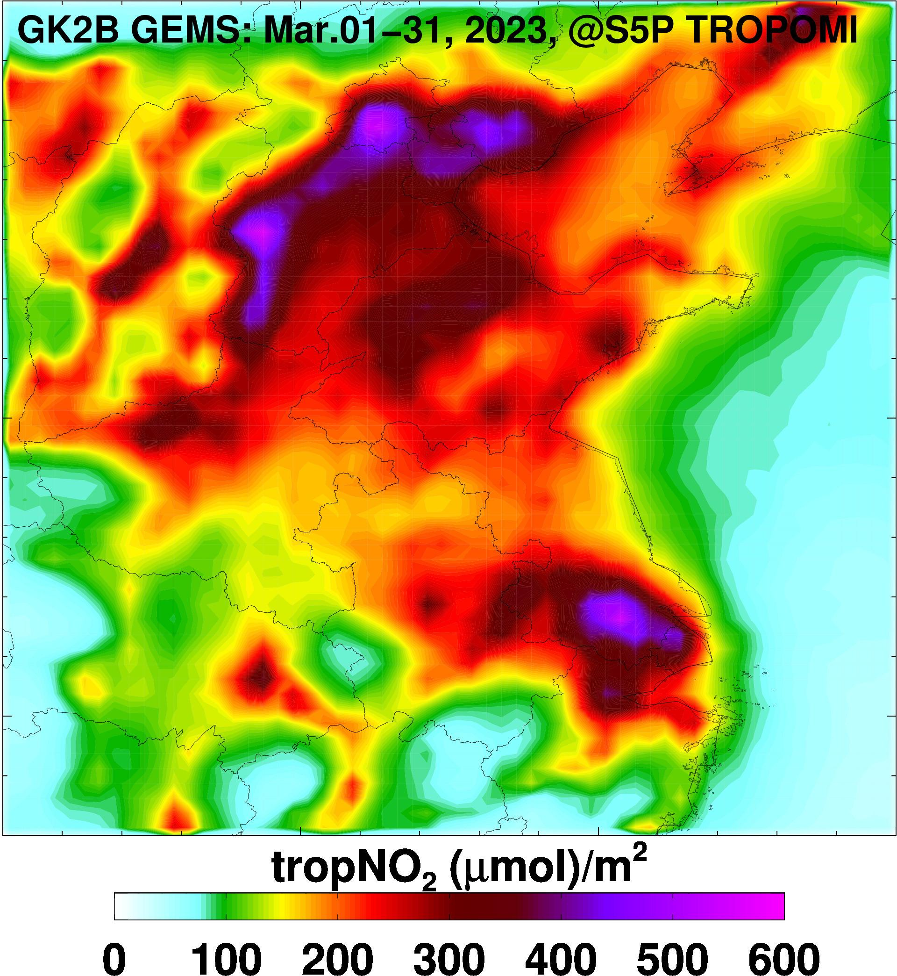
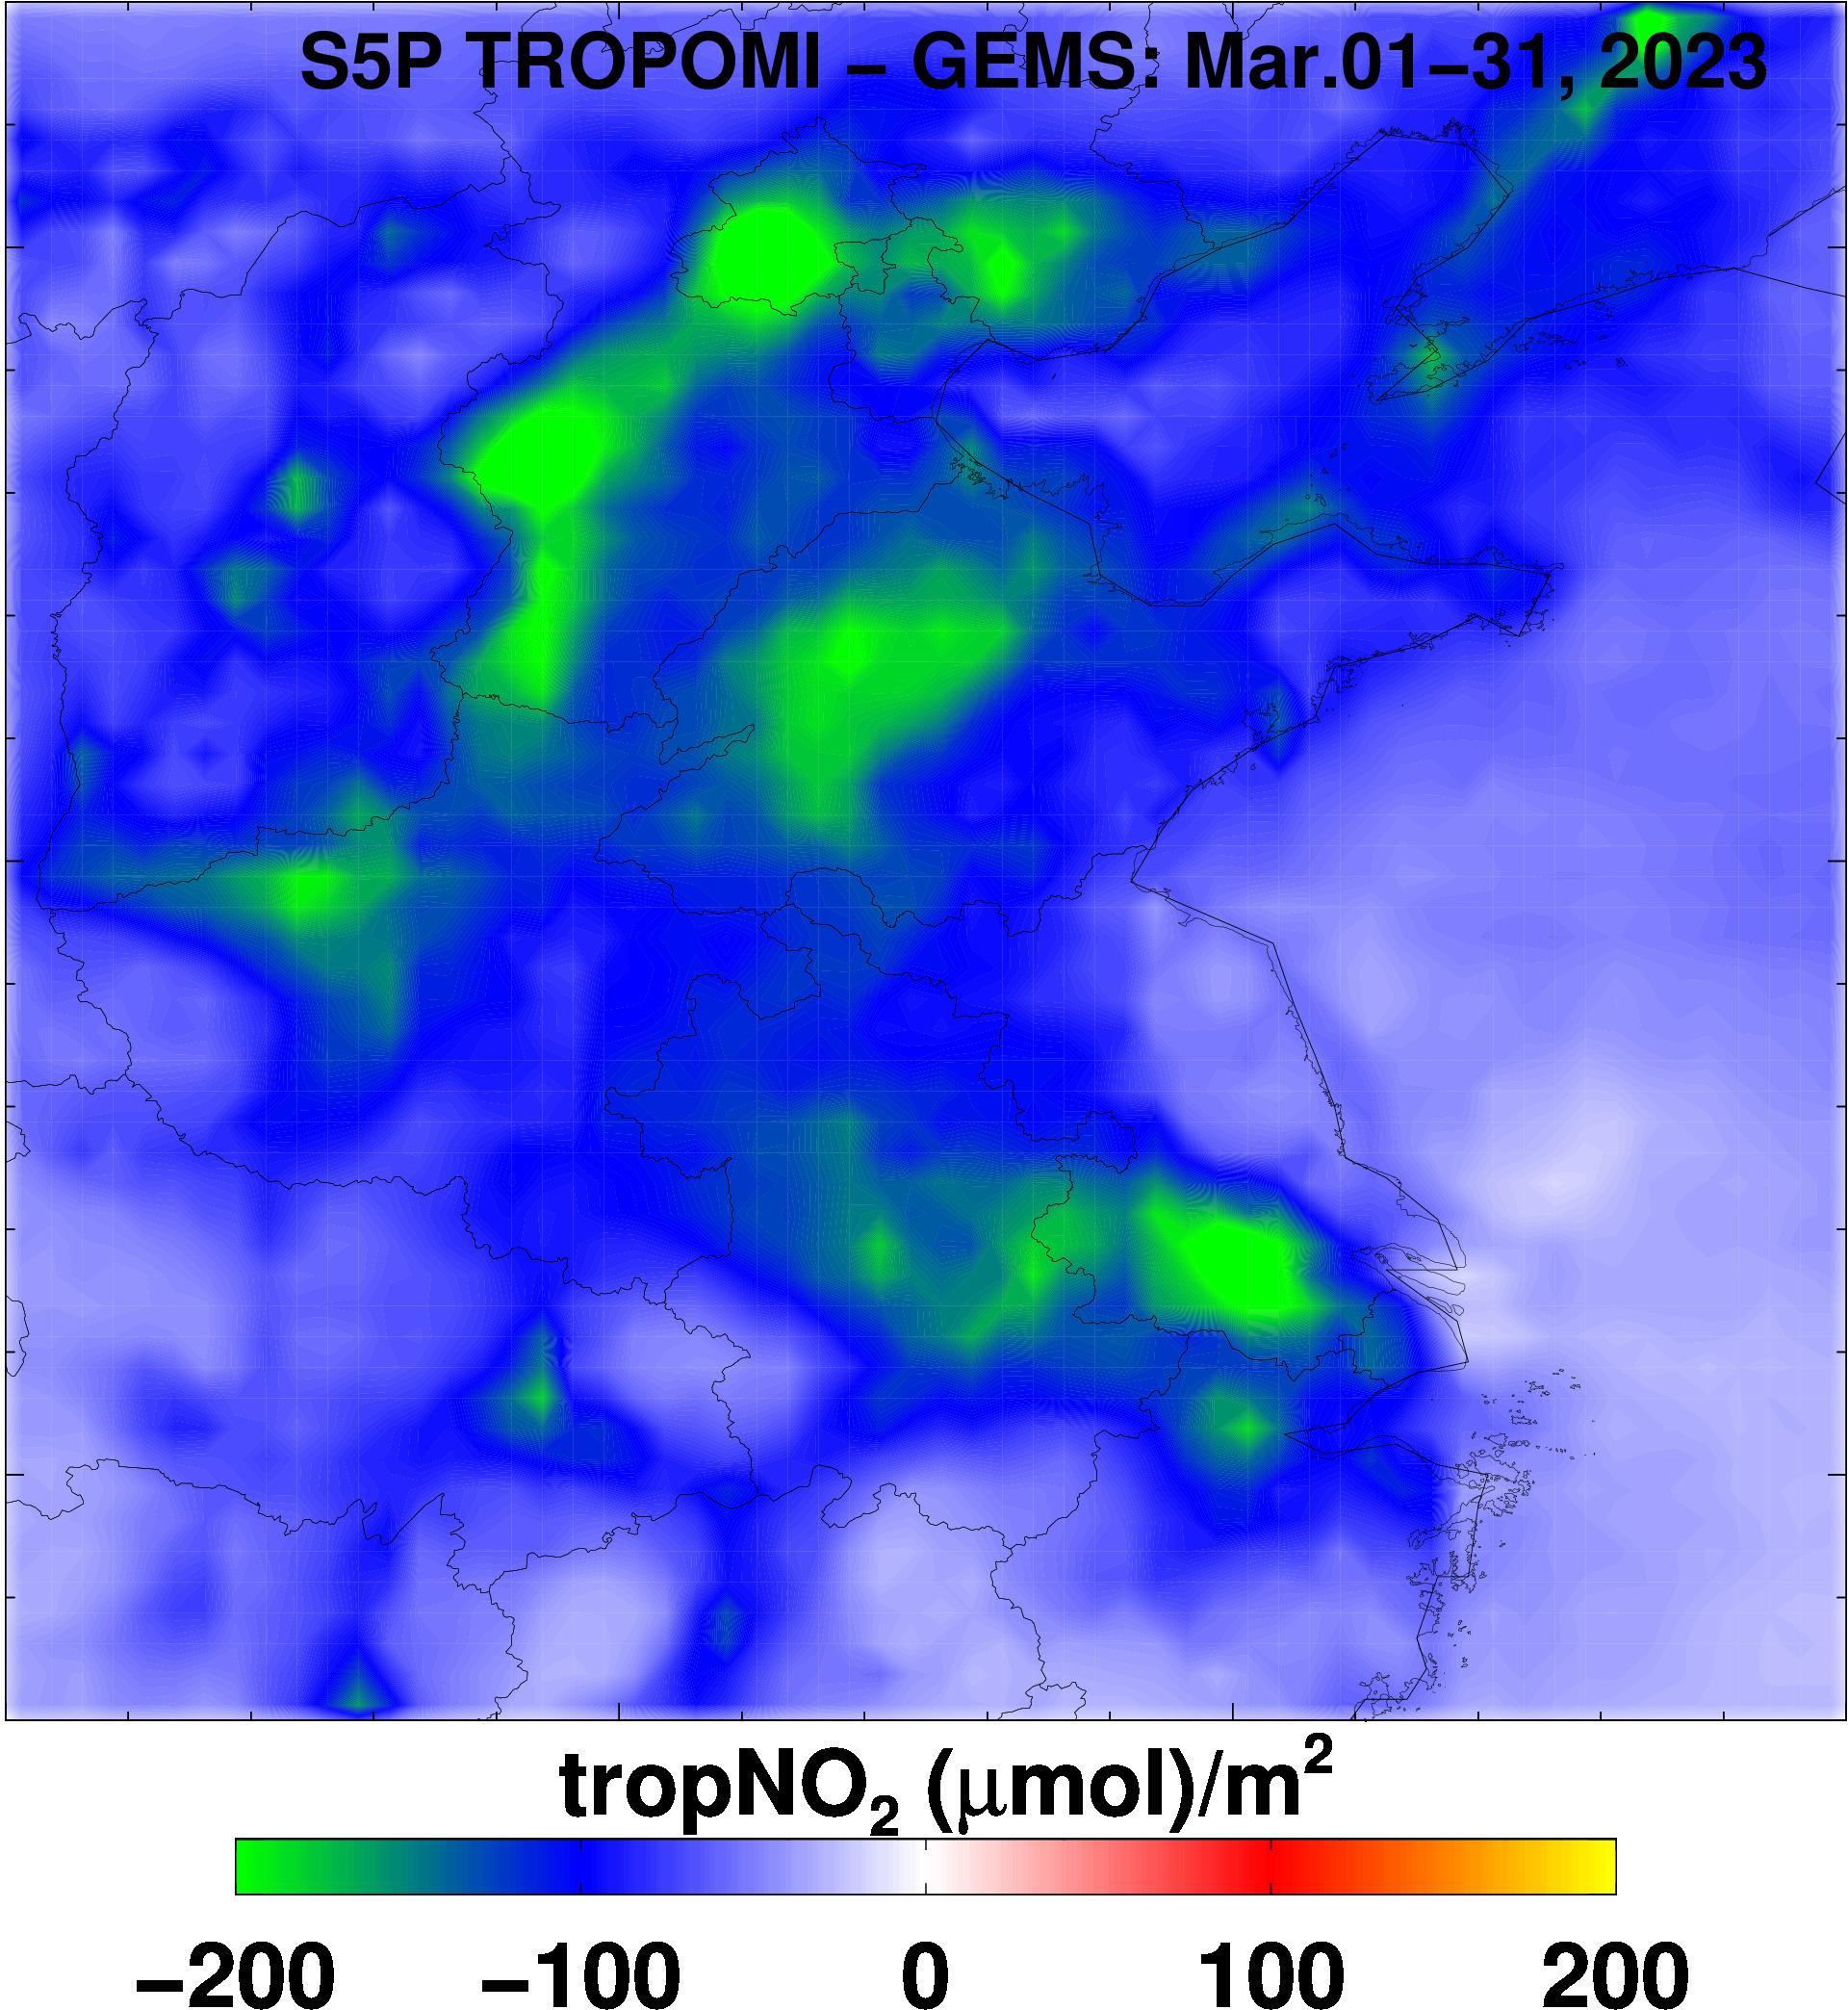
Inter-comparison
Monthly mean tropNO₂ in March 2023 in Northern China
Matching time window ±1.5 hour, re-grid to 0.25ºx0.25º.
GEMS tropNO₂ concentrations (middle column) are higher than TROPOMI (left)

Slide 4
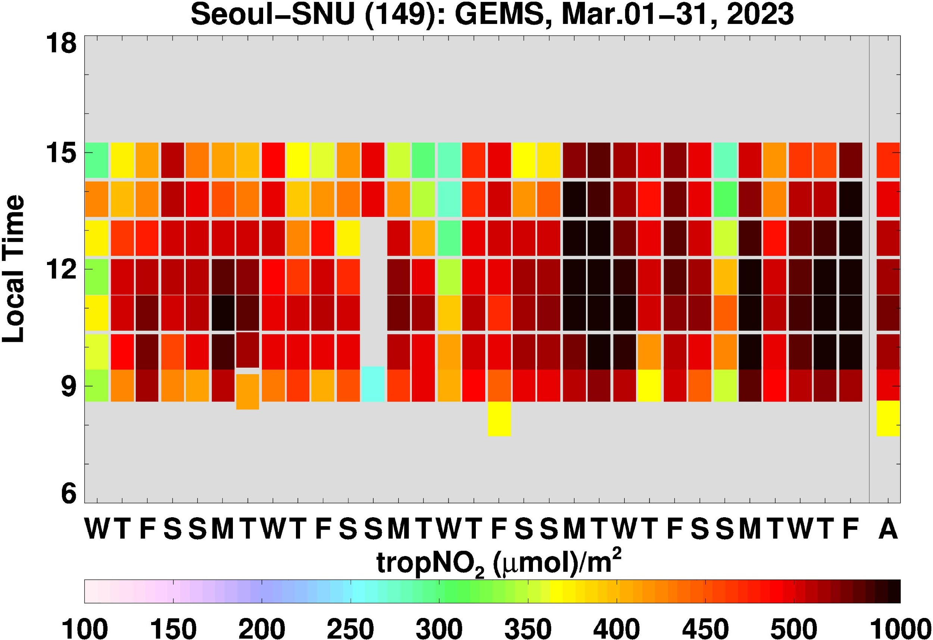
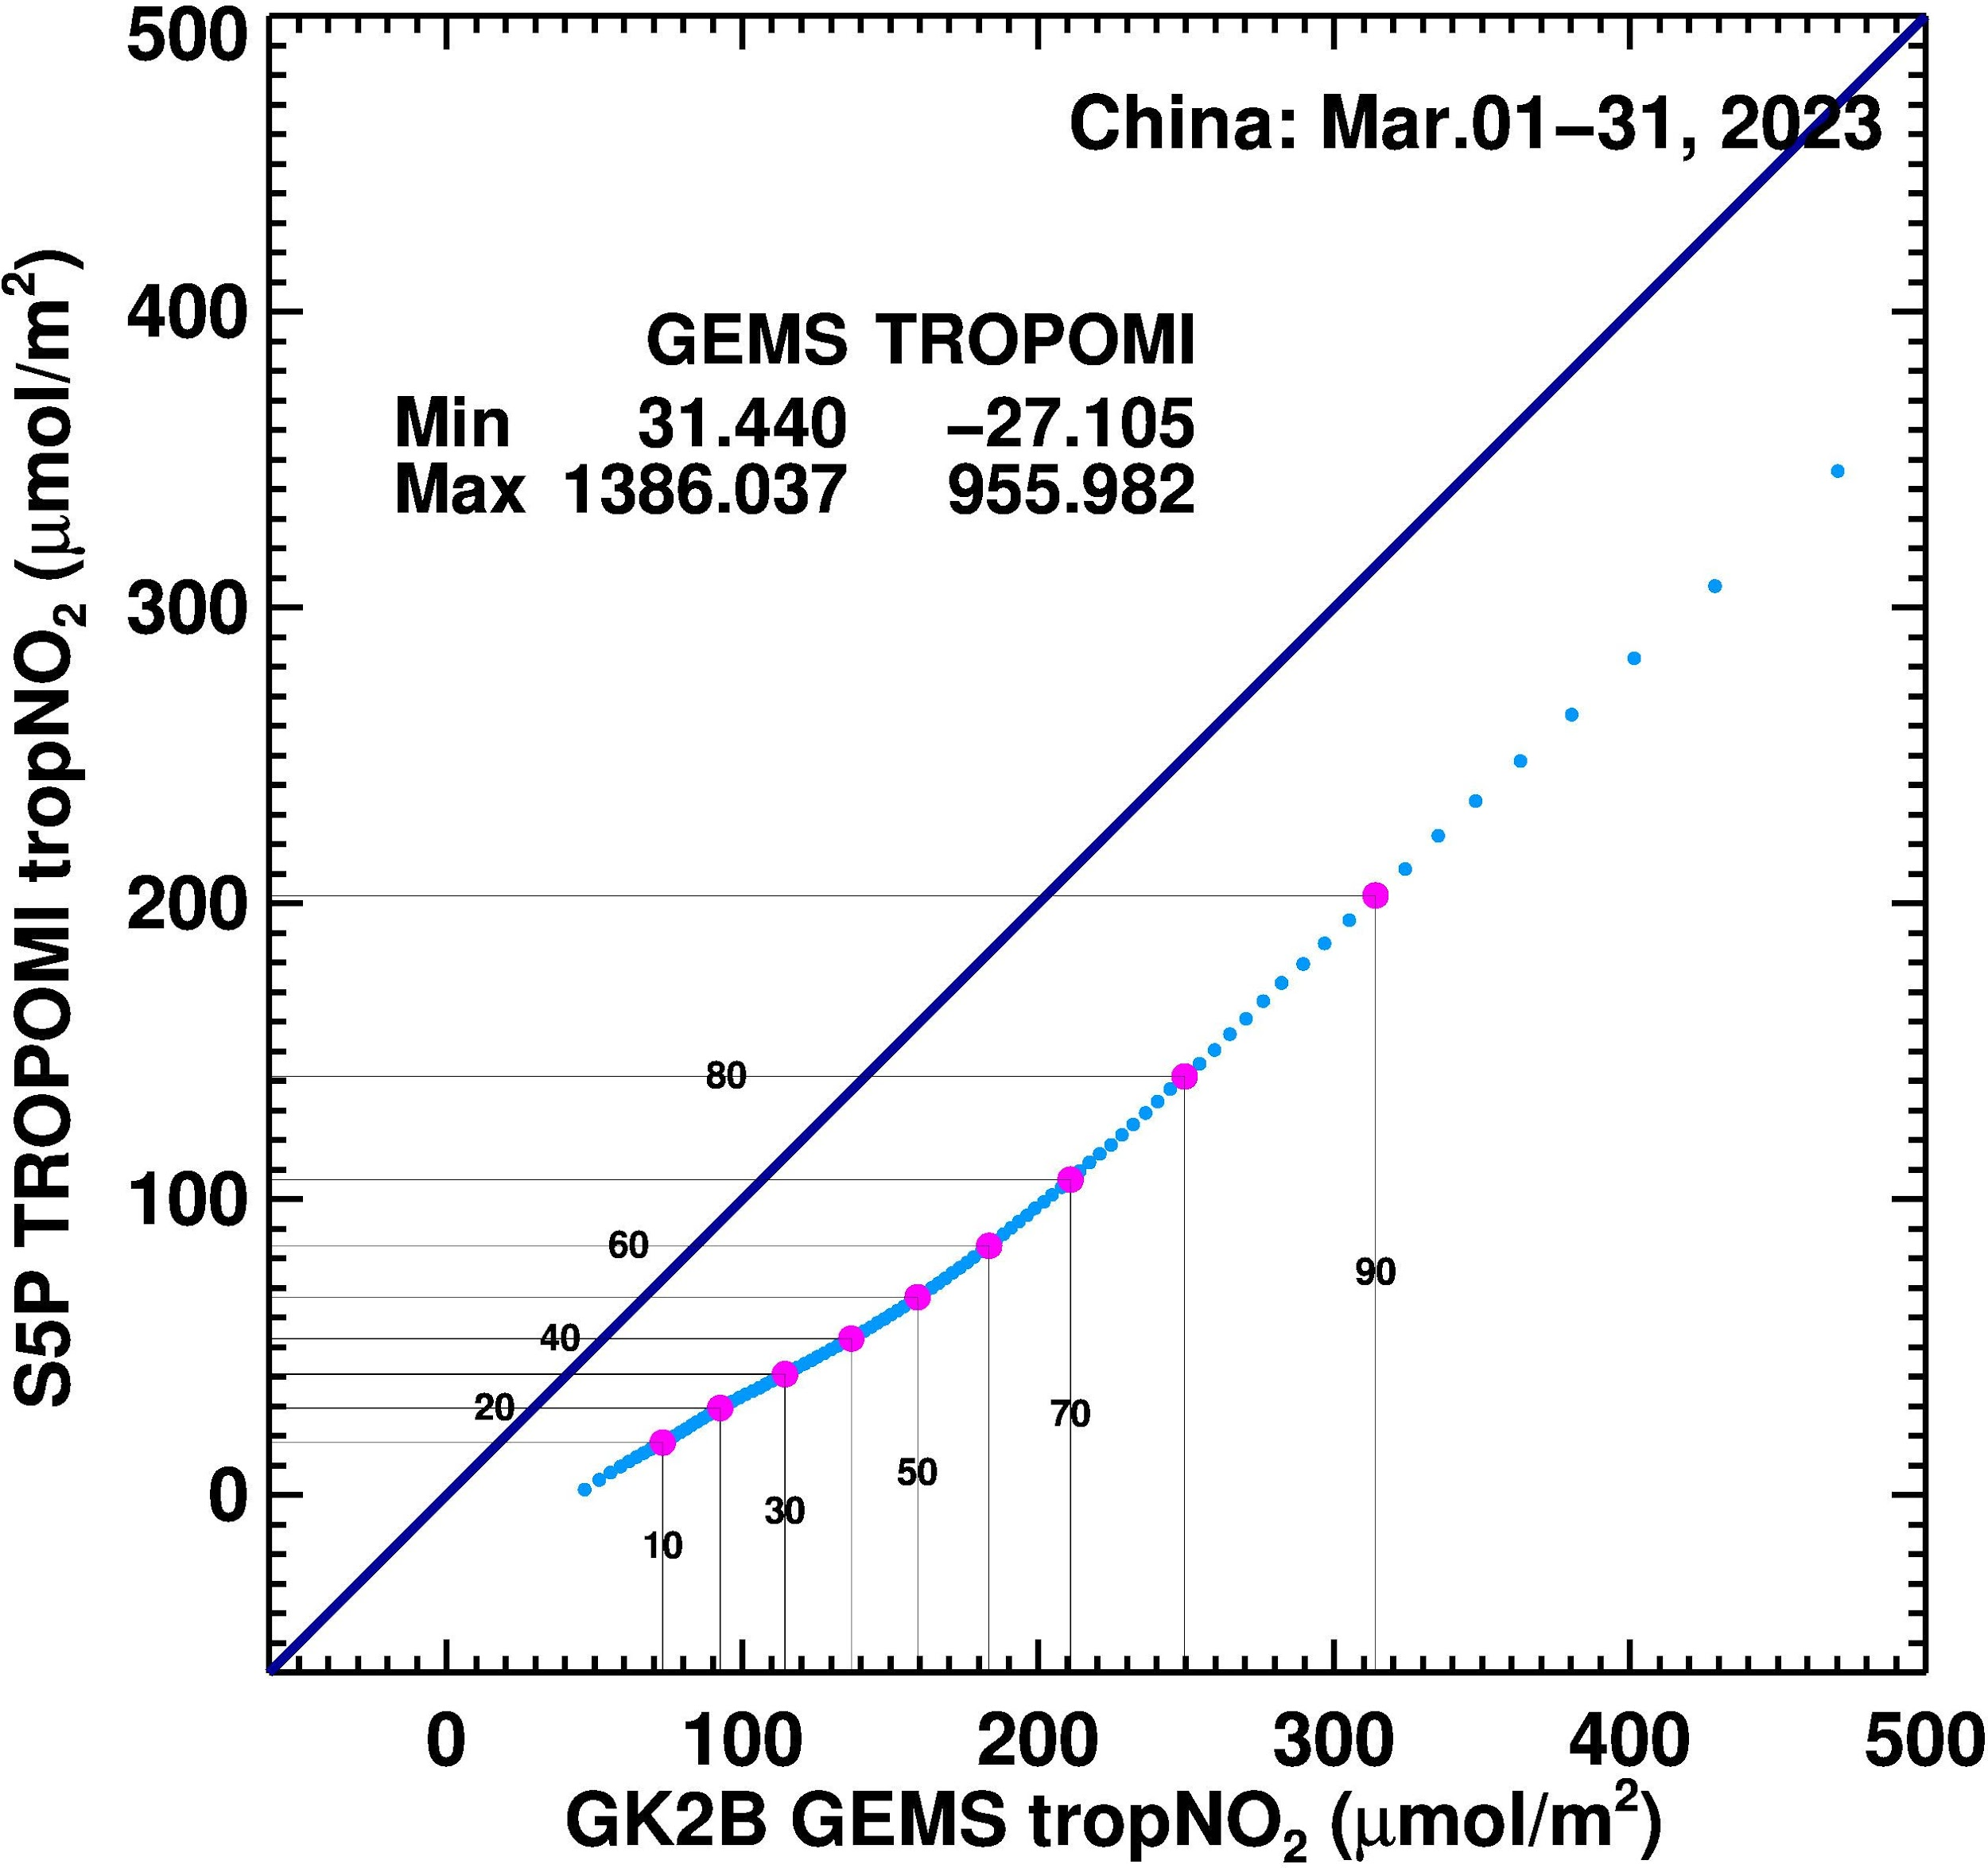
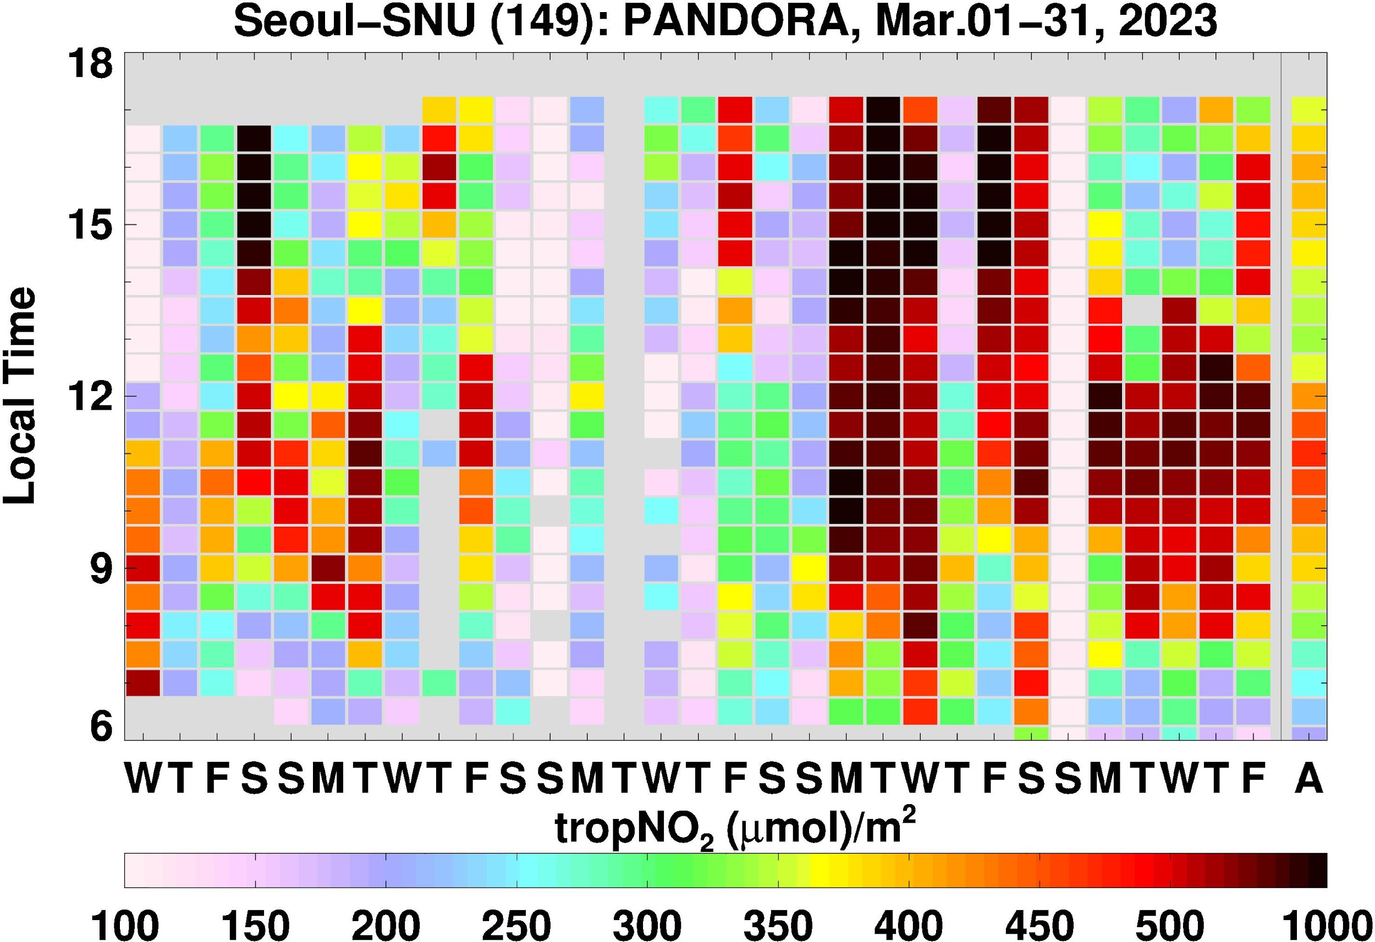
Quantify Biases

Slide 5
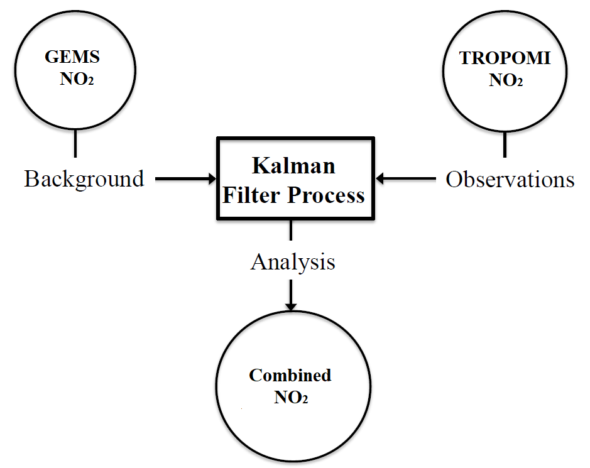
Data Fusion Methodology

Slide 6
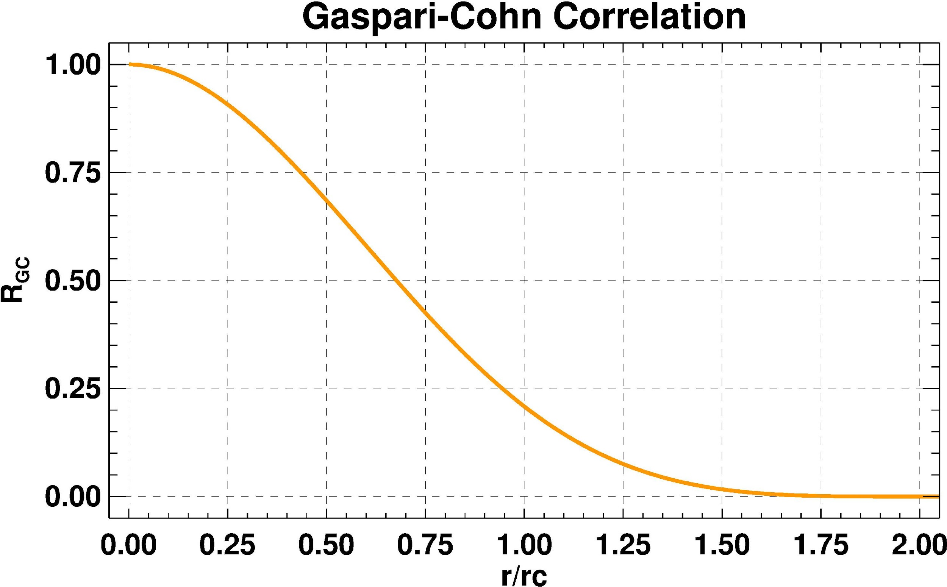
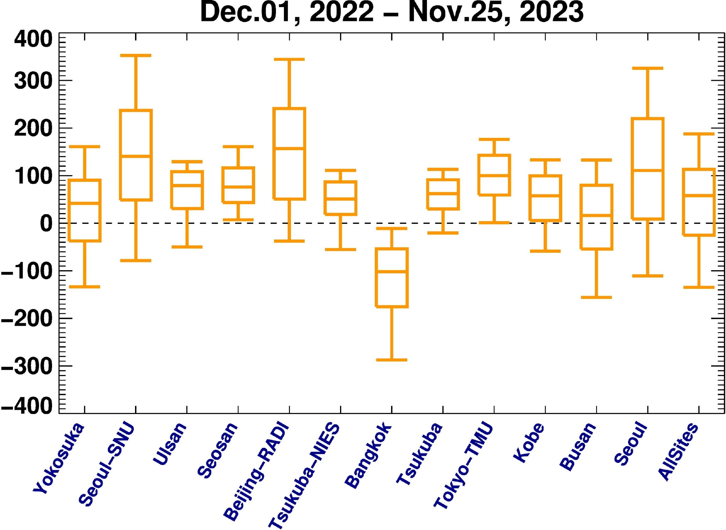
Error Covariance Matrix for Kalman Filter
Observation Error Variance: The observation error variance R is derived from TROPOMI's retrieval error estimates.
Background Error Correlation: The background error correlation matrix C is determined based on the distance between background pixels, using the Gaspari-Cohn function as shown in the left figure.
GEMS Variance Determination: GEMS variance D was determined through validation at 12 PANDORA sites between December 1, 2022, and November 25, 2023. The left figure illustrates that GEMS tropNO₂ generally shows a high bias, except in Bangkok, with a mean bias of approximately 41 μmol/m². To account for varying NO₂ concentrations, a mean relative error of 65% was used in our analysis.

Slide 7
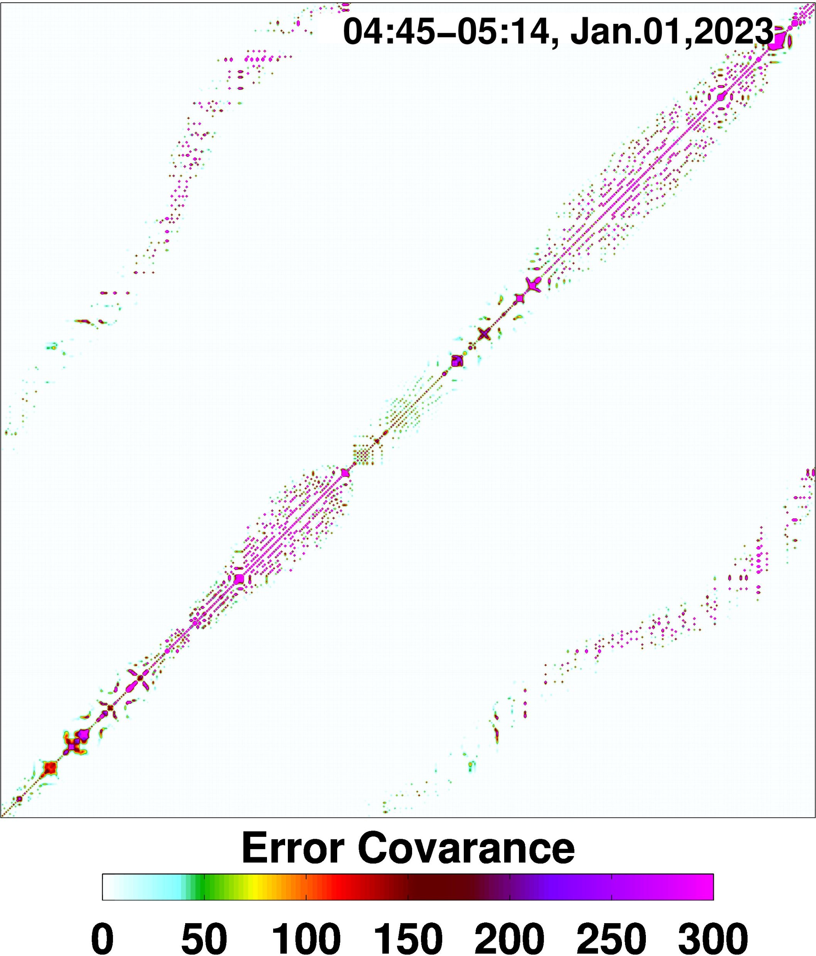
Results
Test GEMS scan: 04:45 Jan 01, 2023
Prematch time window: ±1.5-hr
Resolution: 0.25°x0.25° for whole GEMS domain.
Correlation length: 600 km.
Background Error Covariance matrix built with 65% relative error estimated from GEMS.
Background Error Covariance Matrix

Slide 8
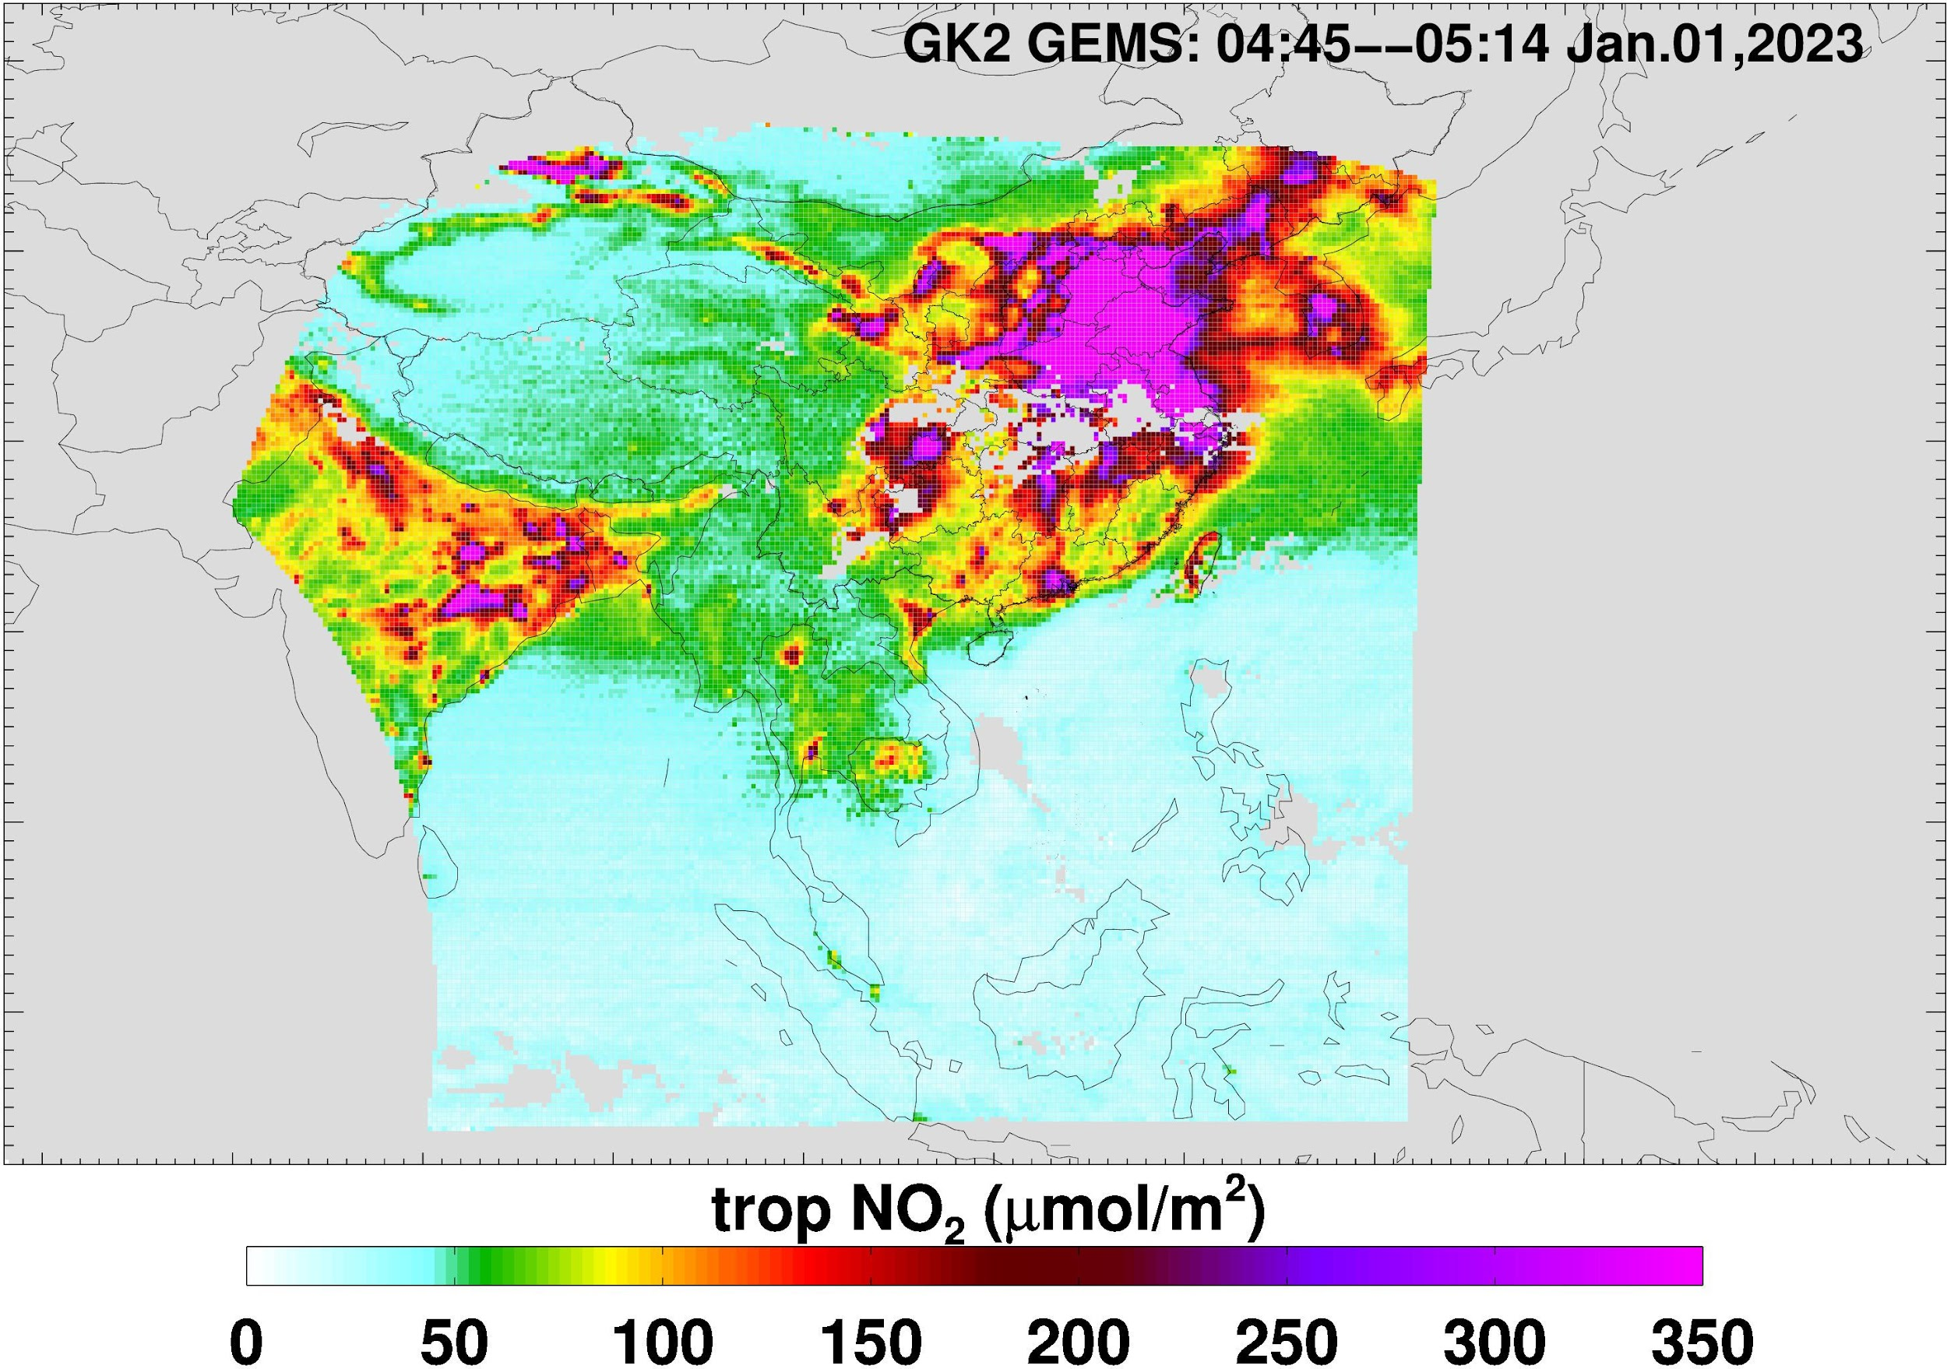
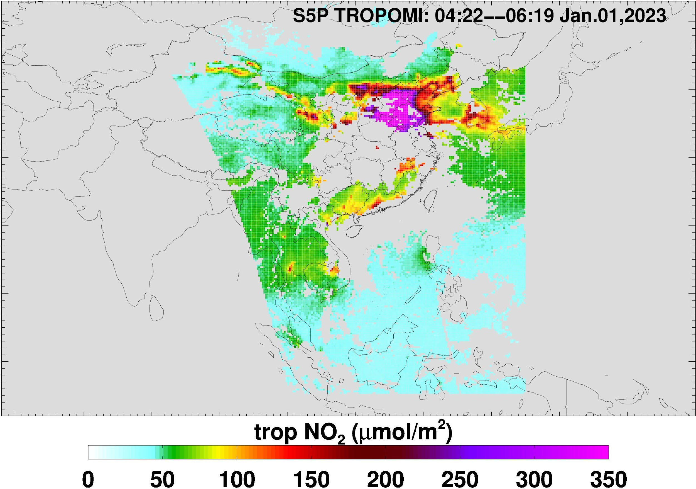
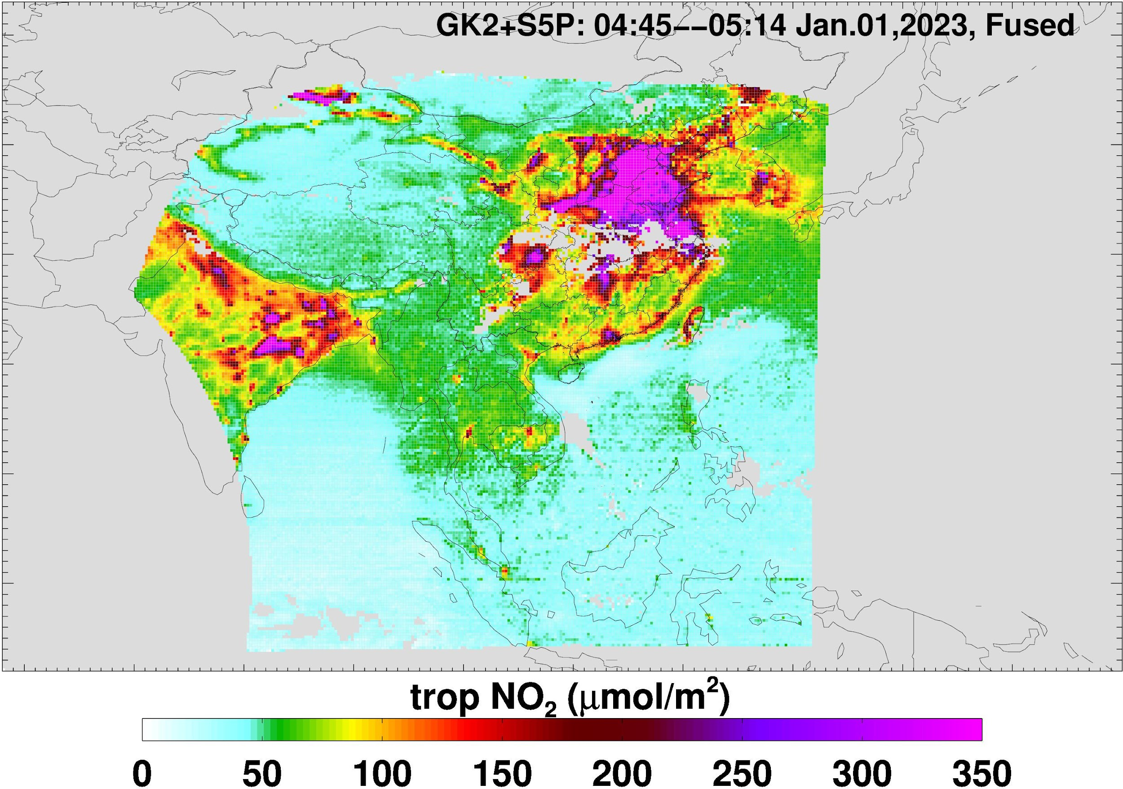
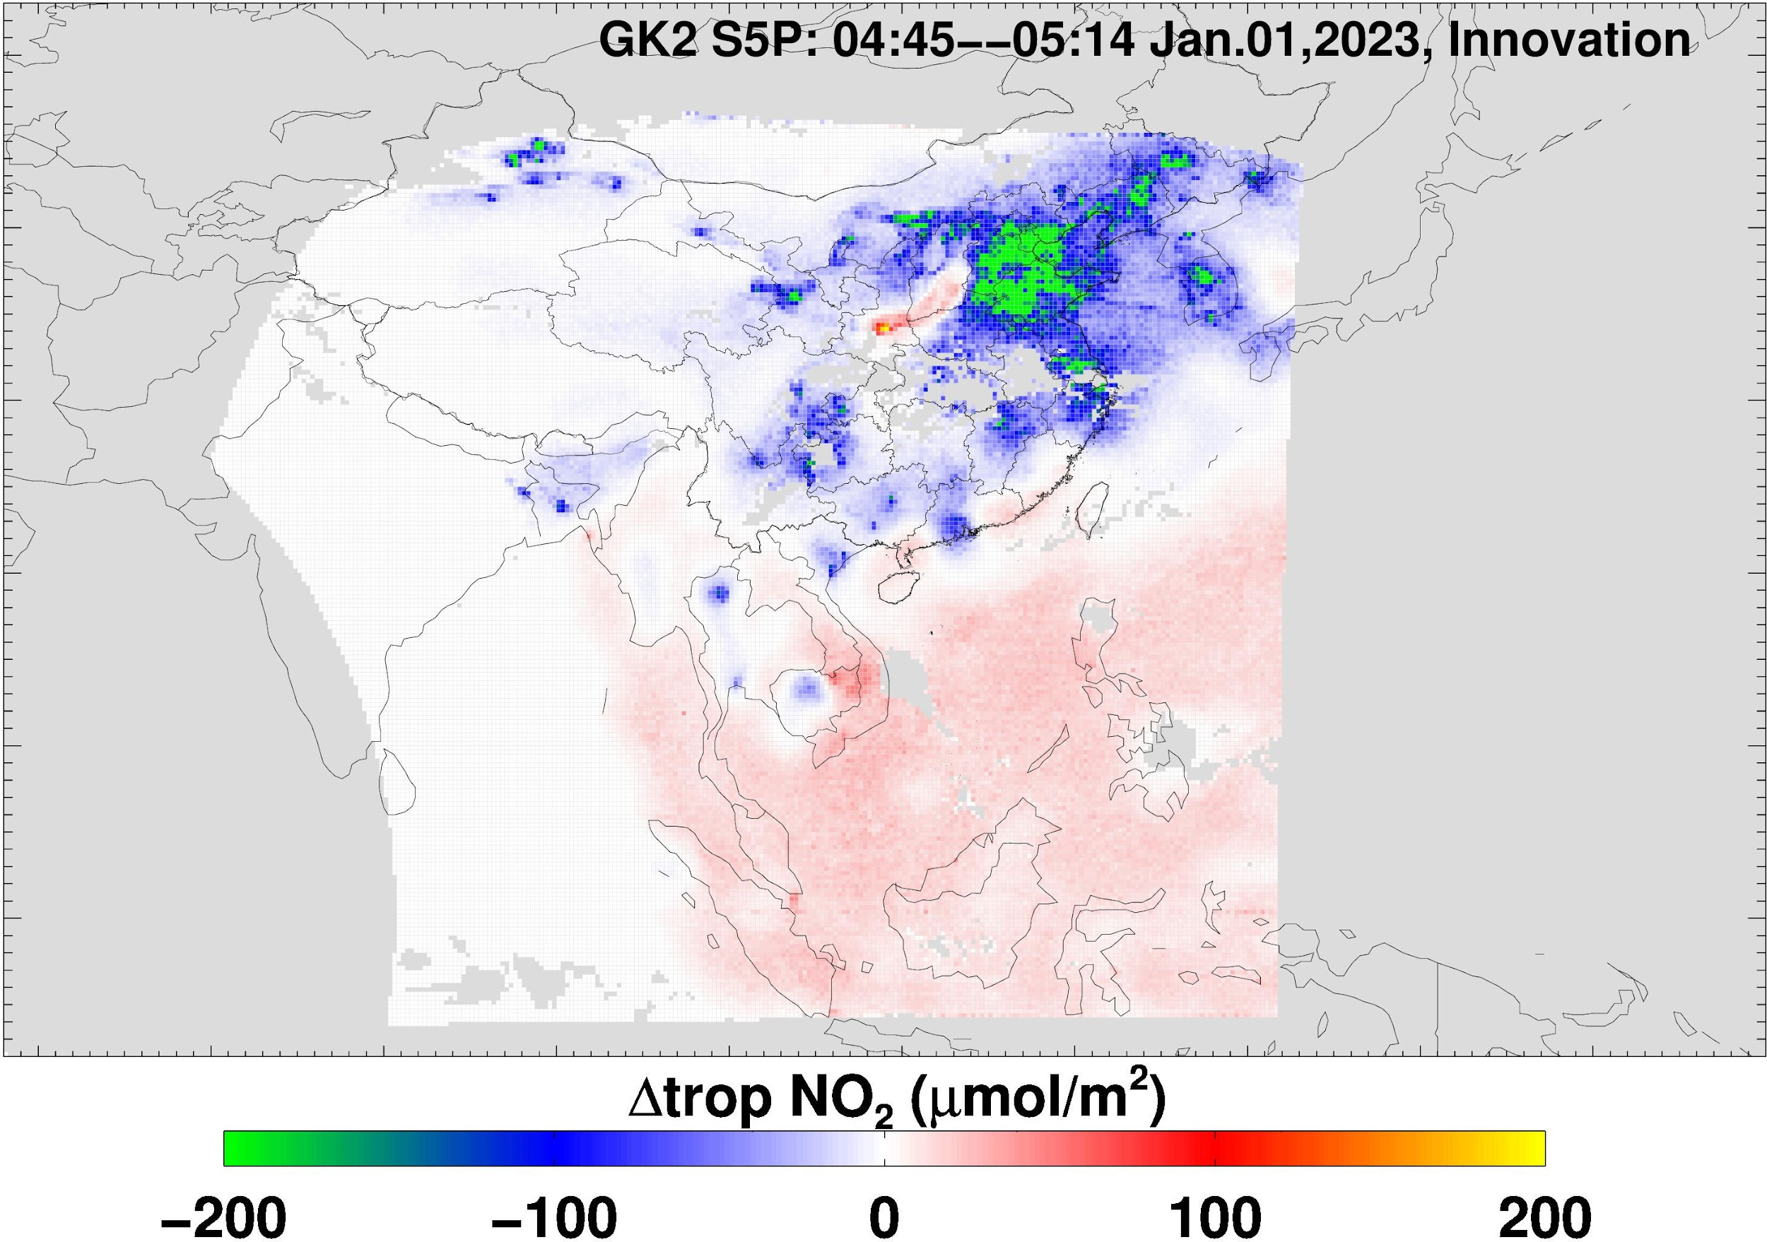
(a). GEMS
(b). TROPOMI
Polluted Regions: In heavily polluted regions, such as Northern China, the fused tropNO₂ values are lower than those in the GEMS
Less Polluted Areas: In less polluted areas, like over the ocean, the fused tropNO₂ values are higher compared to GEMS
(c). GEMS+TROPOMI
(d). Differences

Slide 9
Summary
Developed a new Kalman filter method to correct biases in GEMS tropNO₂ data using TROPOMI as a calibration standard
Kalman filter approach is unique as it does not involve external transfer standards (e.g., models)
Assumptions are made that TROPOMI tropNO₂ data are closer to the true atmospheric state
Algorithm Expansion:
Add correlation on temporal dimension
TEMPO/TROPOMI
Sentinel-4/TROPOMI

