Slide 1




NO₂ diurnal and seasonal variation from GEMS and TEMPO
David Edwards, Sara Martinez-Alonso, Ivan Ortega, Shima Shams, Louisa Emmons, Helen Worden
National Center for Atmospheric Research, USA
Duseong Jo
Seoul National University, South Korea
Jhoon Kim
Yonsei University, South Korea
Hanlim Lee, Junsung Park
Pukyong National University, South Korea
Hyunkee Hong
National Institute of Environmental Research, South Korea
Thanks to the GEMS and TEMPO Teams
Image credit: GEMS Team

Slide 2
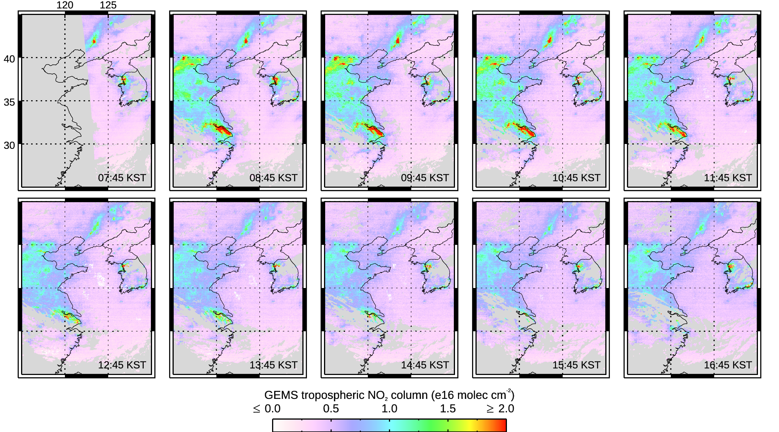
GEMS V2 NO₂ diurnal variation maps, June 15 2023
07:45 KST
08:45 KST
09:45 KST
10:45 KST
11:45 KST
High NO₂ over the Beijing region, industry of the North China Plain, Shanghai and the Yangtze Delta, and Seoul in South Korea
Large temporal variation of pollution amount and spatial distribution; usual morning maximum
Hourly observations provide at least some measurements in regions of changing cloud
12:45 KST
13:45 KST
14:45 KST
15:45 KST
16:45 KST
Edwards et al., ACP, 2024
Notes:
Figure 3: Northeast Asia NO₂ TrC hourly values, 15 June 2023. Observation times are quoted at Korean Standard Time (KST), i.e., Coordinated Universal Time (UTC) plus 9 hours. Gray indicates no data were taken during night-time or missing data due to clouds.
High NO₂ over the Beijing region and the industrial areas of the North China Plain.
Pollution is also high over Shanghai and the Yangtze Delta with another hotspot over Seoul in South Korea.
The most striking first impression of this GEO perspective on atmospheric composition is how large the temporal variation of the pollution is in magnitude as well as how much the spatial distribution shifts hour-by-hour.
In certain locations, changing cloud fields do not permit for all ten possible retrievals to pass the data filters. However, the hourly observations do provide at least some measurements, thus demonstrating an advantage of the GEO perspective.
2

Slide 3
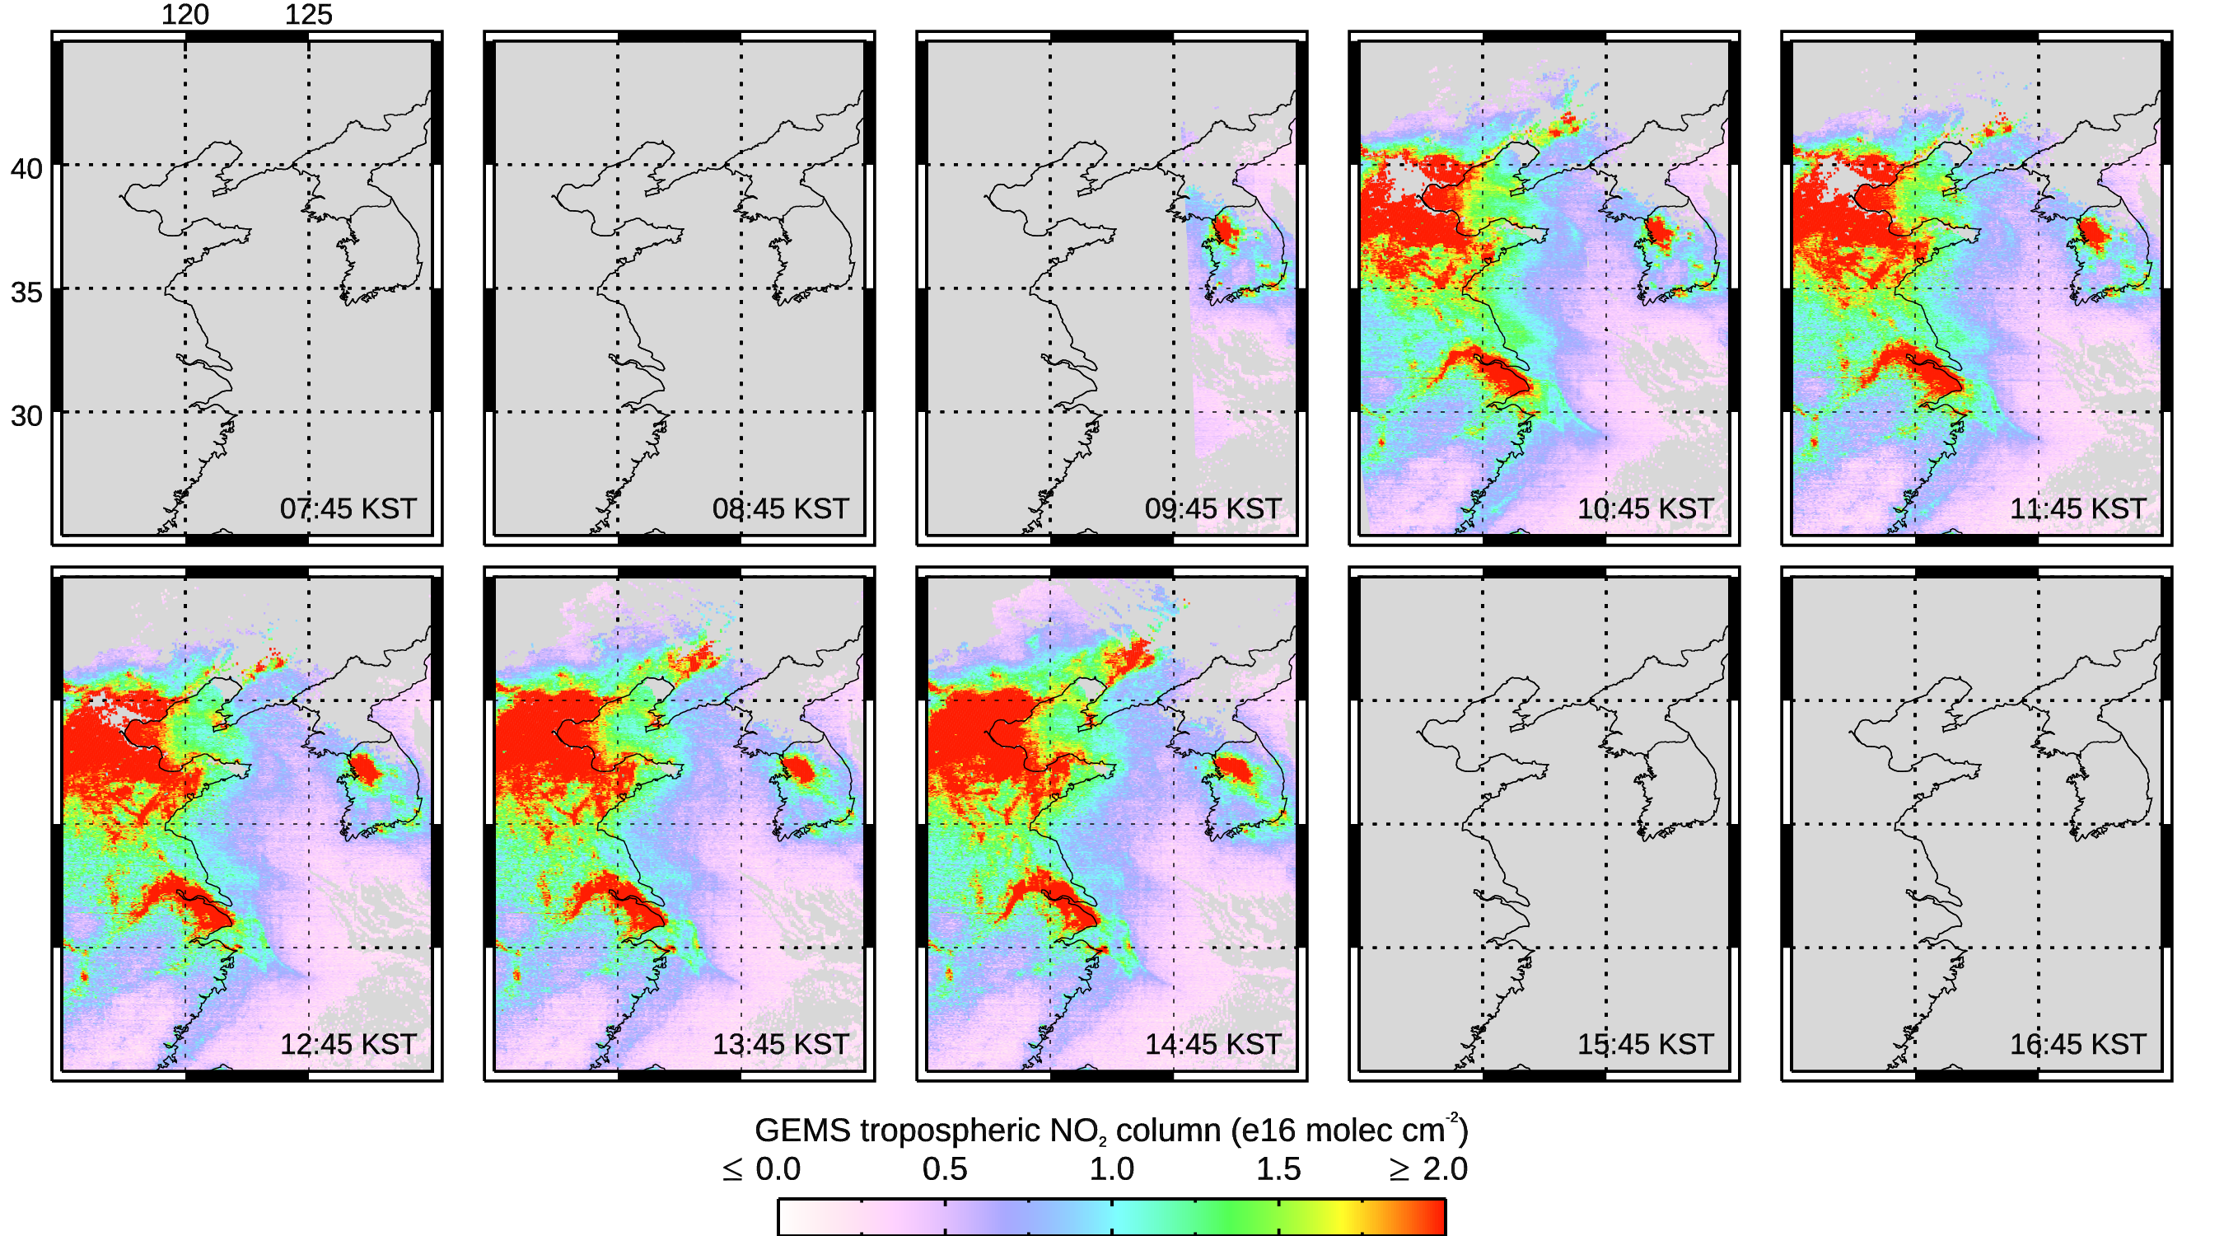
GEMS V2 NO₂ diurnal variation maps, Jan 30 2023
07:45 KST
08:45 KST
09:45 KST
10:45 KST
11:45 KST
During winter, with the sun low in the sky, there are fewer GEMS hourly retrievals
NO₂ burden is high because of reduced NO_{x} photochemical loss
NO₂ build-up during the day but less relative diurnal variation compared to summer
12:45 KST
13:45 KST
14:45 KST
15:45 KST
16:45 KST
Notes:
Figure 4: Same as Fig. 3 but now for 30 January 2023 NO₂ TrC.
3

Slide 4
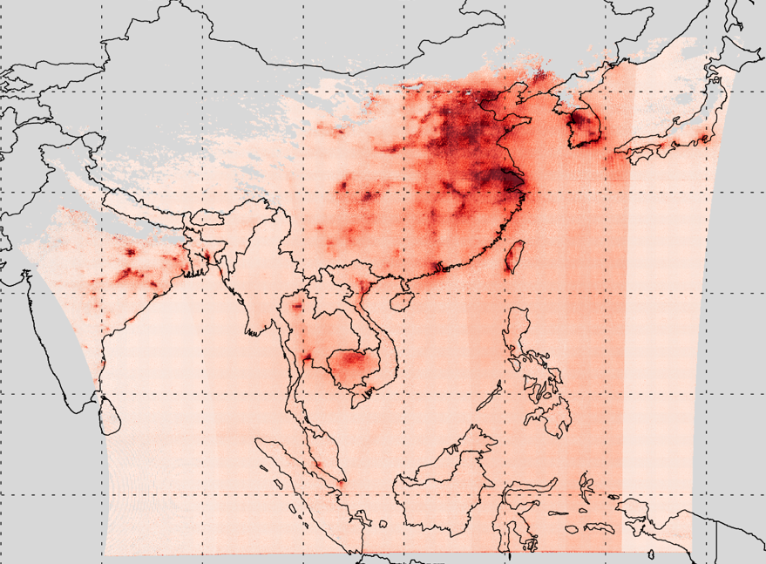
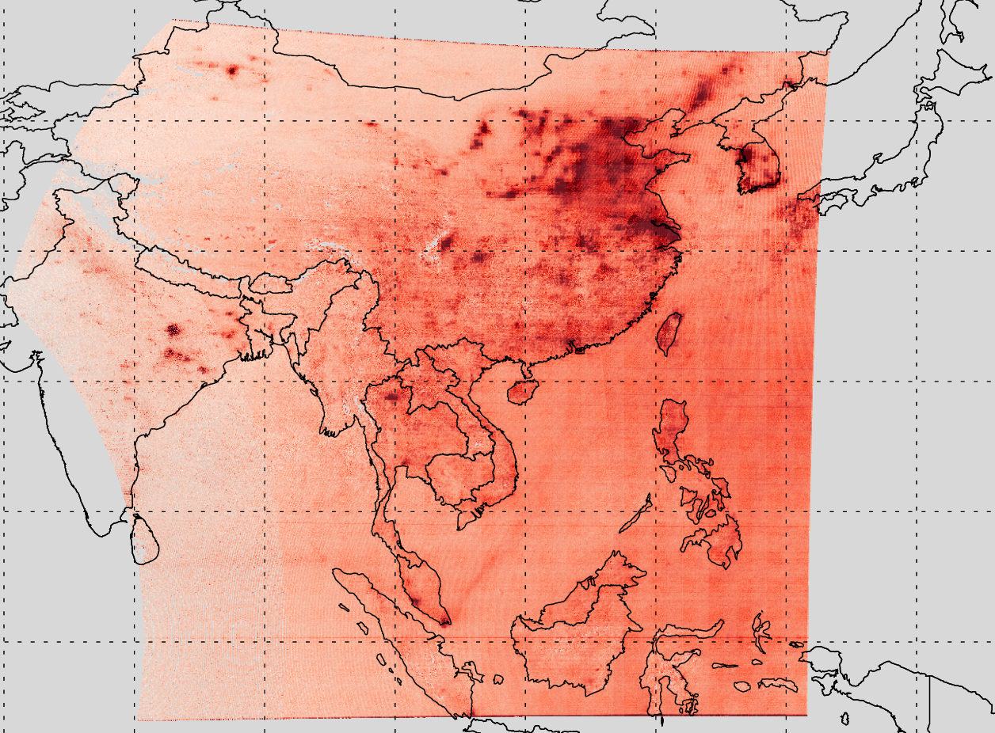

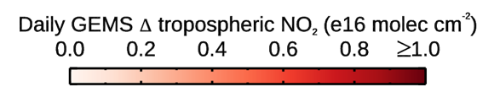
Seasonal change in diurnal variation
Monthly average of the absolute daily change in GEMS NO₂ TrC
High diurnal variation usually coincides with regions of high NO₂, though not always!
Chinese and Korean industry and cities, Indian power facilities are clear
Shows the importance of time-resolved observations for characterizing diurnally changing NO_{x} emissions and pollution exposure
Edwards et al., ACP, 2024
GEMS V2 June 2022
GEMS V2 Jan 2023
Notes:
Figure 5: Monthly average of the absolute daily change in GEMS NO2 TrC for June 2023.
The region east of ~130o E is not mapped because only data points with 5 or more observations per day were included in this analysis.
Diurnal variability is generally higher in the summer, driven by more active photochemistry
Interesting features to understand – lightning in Jan over Cambodia? Fires?

Slide 5
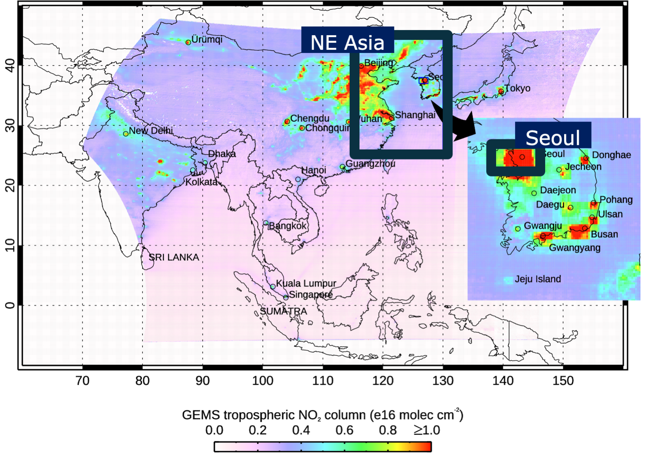
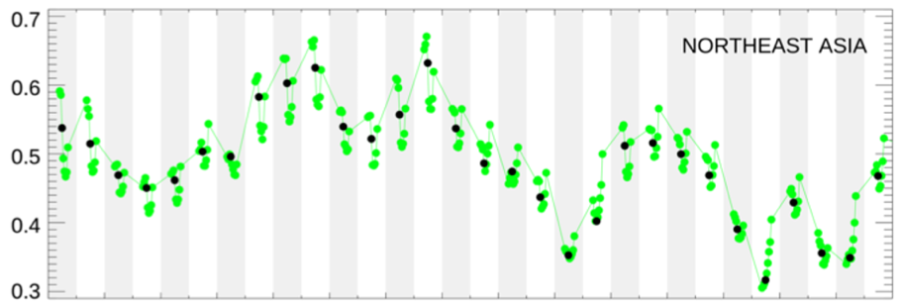
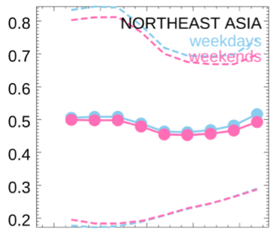
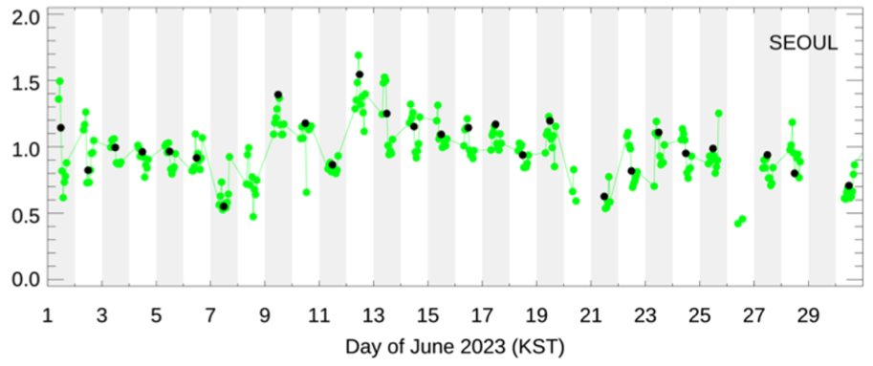
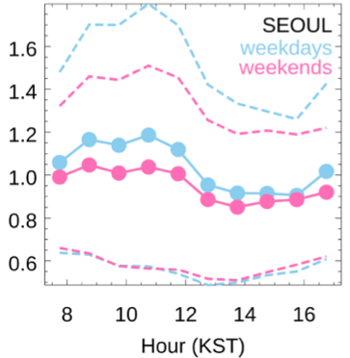
Comparing GEMS V2 NO₂ over NE Asia & Seoul Jun 2023
Obs closest to local noon
NE Asia NO₂ timeseries shows a consistent diurnal variation with an afternoon minimum driven by photochemistry
Seoul diurnal cycle is less consistent - more affected by local emissions and meteorology – providing examples of both morning and afternoon peaks in NO₂
Notes:
NE Asia: NO₂ TrC decreasing through the morning hours, reaching a minimum in the early afternoon, and then increasing again late in the afternoon.
Little difference is seen between weekdays and weekends at this spatial scale.
Summer cycle primarily due to photochemistry being the dominant driver of diurnal variation since at this regional scale, diurnal variation due to different local-scale emissions and meteorology is averaged-out.
Seoul: The NO₂ diurnal variation is less consistent at local scale where, in addition to photochemistry, changing emissions and, more importantly, meteorology determine day-to-day variability.
GEMS observations sometimes show build-up of pollution during the day (as seen by GeoTASO during KORUS-AQ) but more often show a photochemical 10:00-11:00 morning maximum in NO₂ contributed by urban emissions followed by a decrease and a small late afternoon increase
5

Slide 6
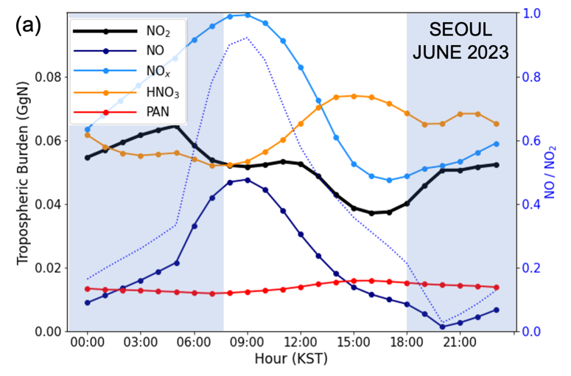
Tropospheric column NO_{x} budget analysis
Notes:
Figure 11: MUSICAv0 (a) June and (b) January 2023 average daily NO_{x} TrC budget analysis over Seoul. Constant anthropogenic emissions during the day (Base simulation). The time windows corresponding to the periods during which GEMS retrievals are shown in Figs. 7 and 8 are indicated by the unshaded hours.

Slide 7
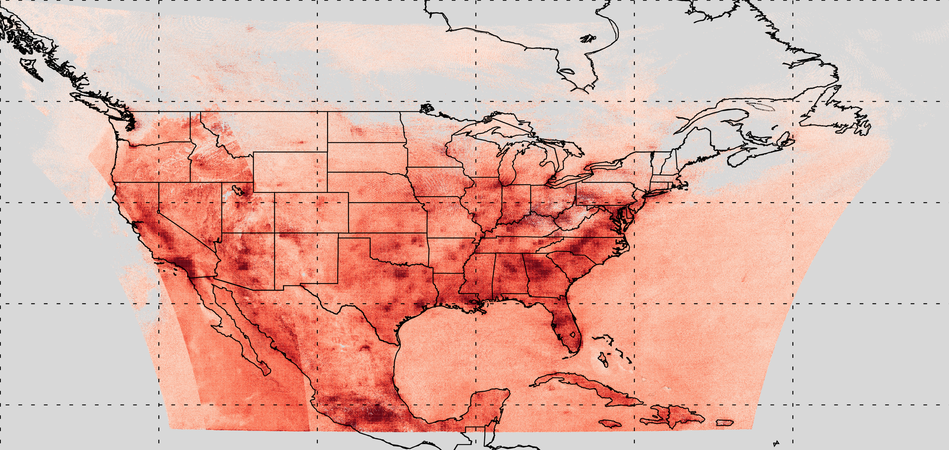
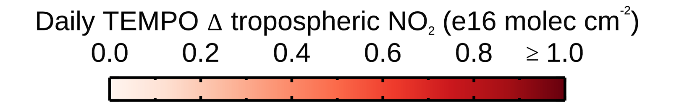
TEMPO diurnal variability
Aug 2023 monthly average of the absolute daily change in TEMPO V1 NO₂ TrC
DENVER

Slide 8
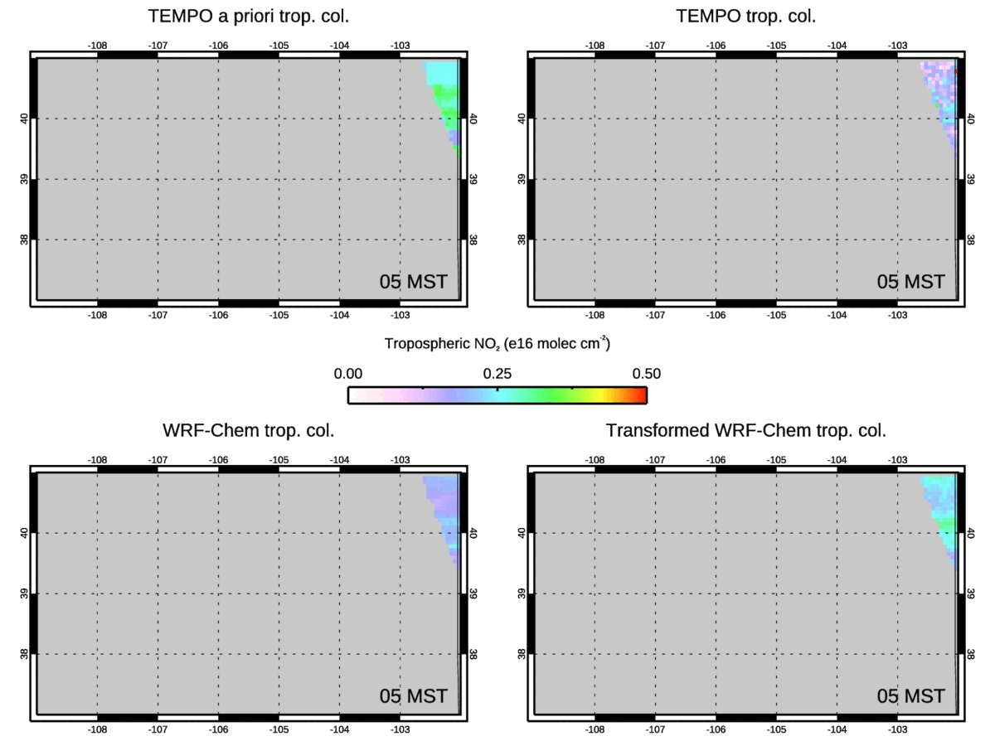
Denver case study, TEMPO NO₂ TrC V3 Jun 2024 (1)
GEOS-CF
TEMPO
WRF-Chem (~4km) usually shows similar values but more detail than the CEOS-CF (~25km) TEMPO a priori
Over the Front Range, TEMPO columns are low compared to both WRF-chem and the a priori
Transforming WRF-chem to compare with TEMPO often reduces values at the lowest NO₂ profile levels and reduces the column
WRF-Chem
AK WRF-Chem
Thanks to Brad Pierce for discussions and help!

Slide 9
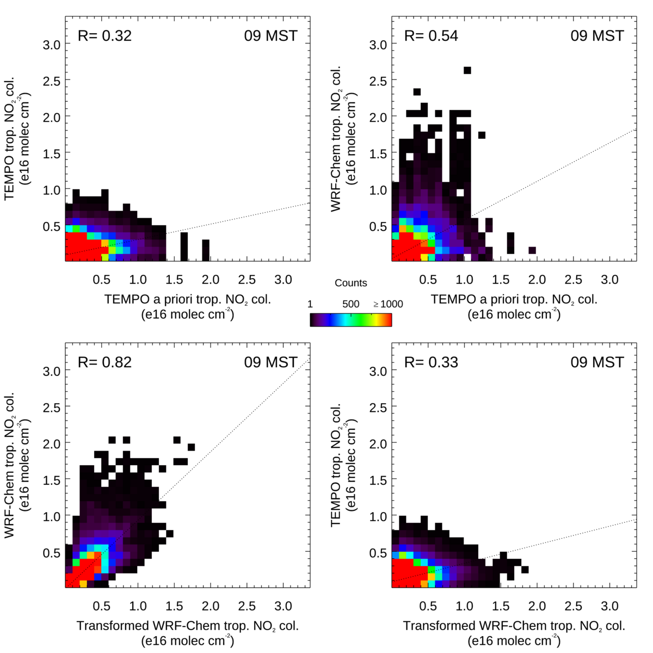
Denver case study, TEMPO NO₂ V3 Jun 2024 (2)
Generally low correlation between TEMPO NO₂ TrC and the GEOS-CF a priori
Generally better correlation between the a priori and WRF-Chem models on their own with lower WRF-Chem values
Good correlation between initial WRF-Chem and WRF-Chem transformed to compare with TEMPO
Generally low correlation between TEMPO and the WRF-Chem transformed TrC, similar to that between TEMPO and its a priori – still need to explain differences!
TEMPO vs GEOS-CF
WRF-Chem vs GEOS-CF
1
2
WRF-Chem vs AK WRF-Chem
TEMPO vs AK WRF-Chem
3
4

Slide 10
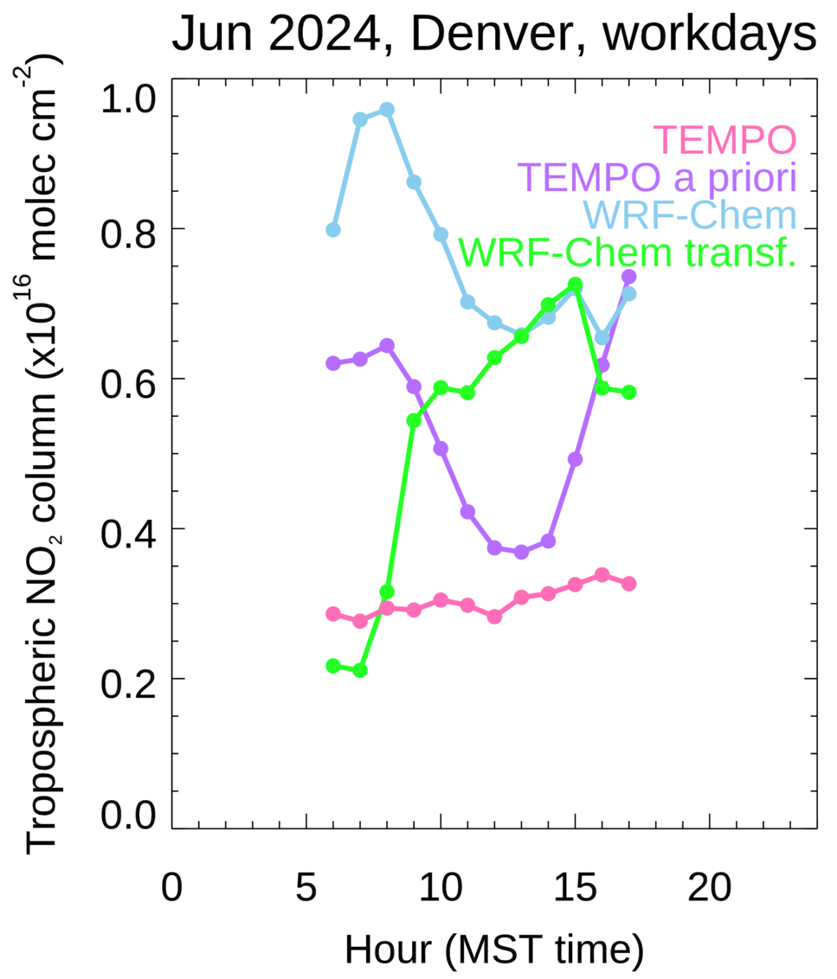
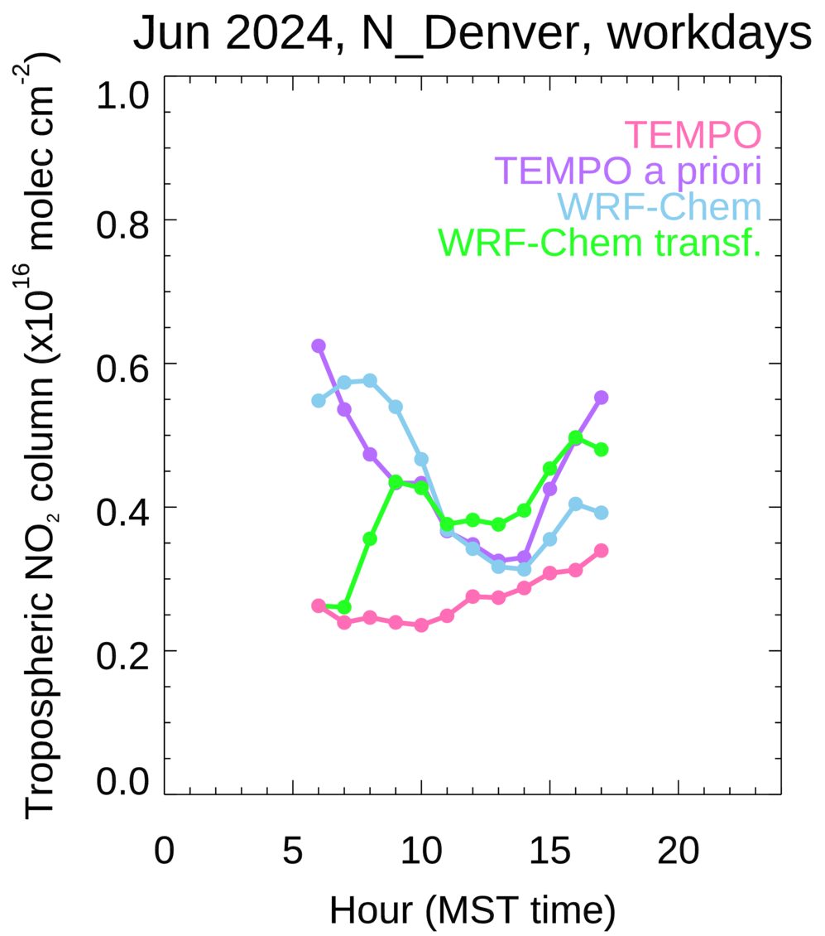
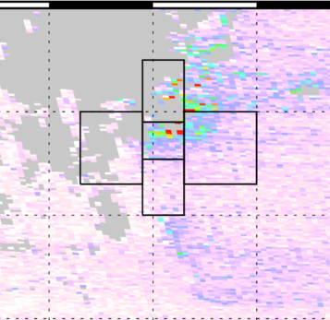
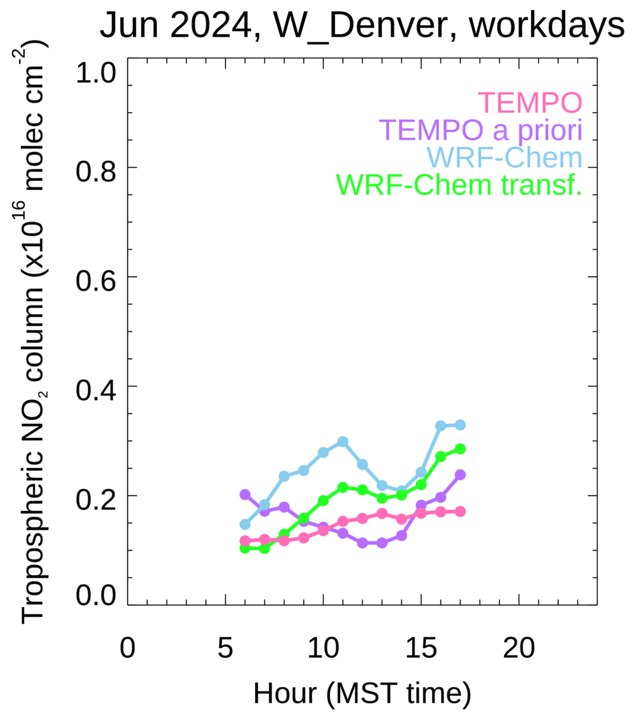
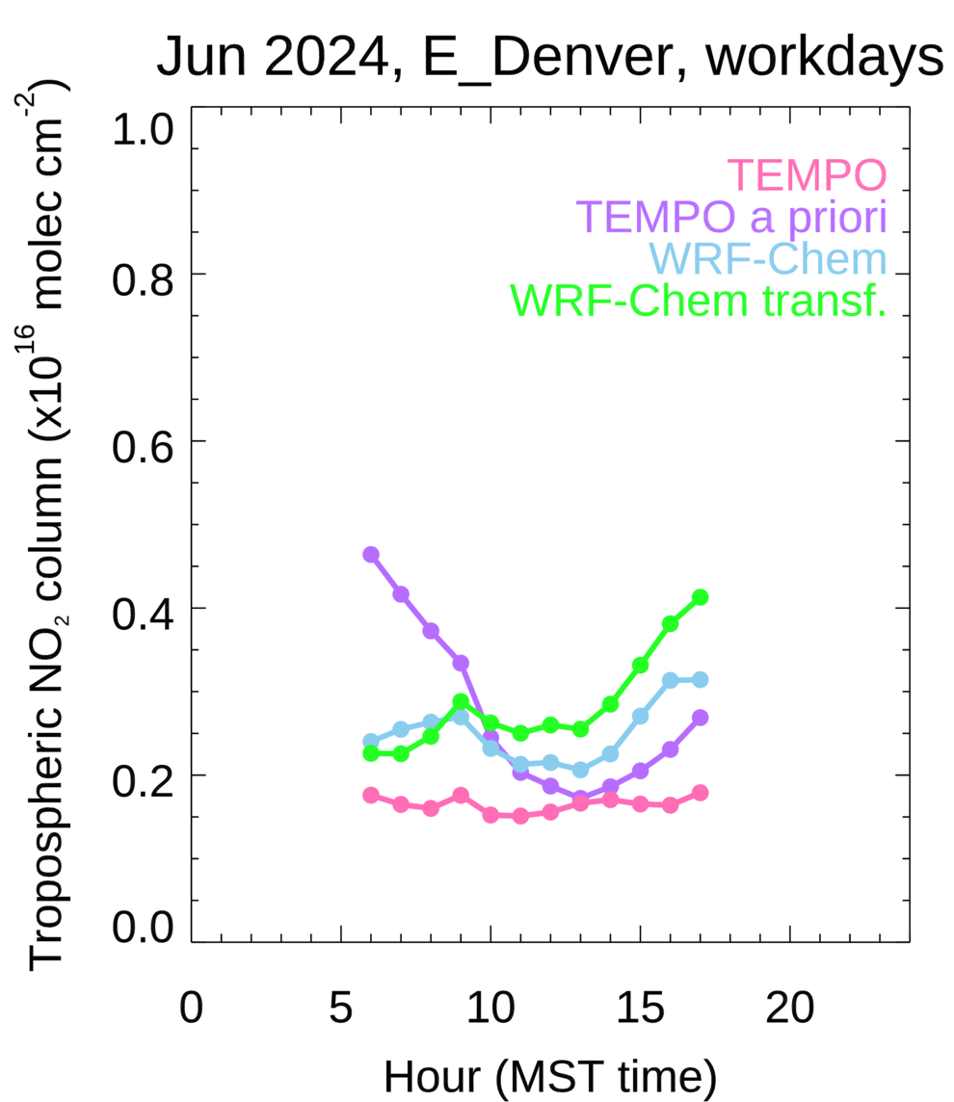
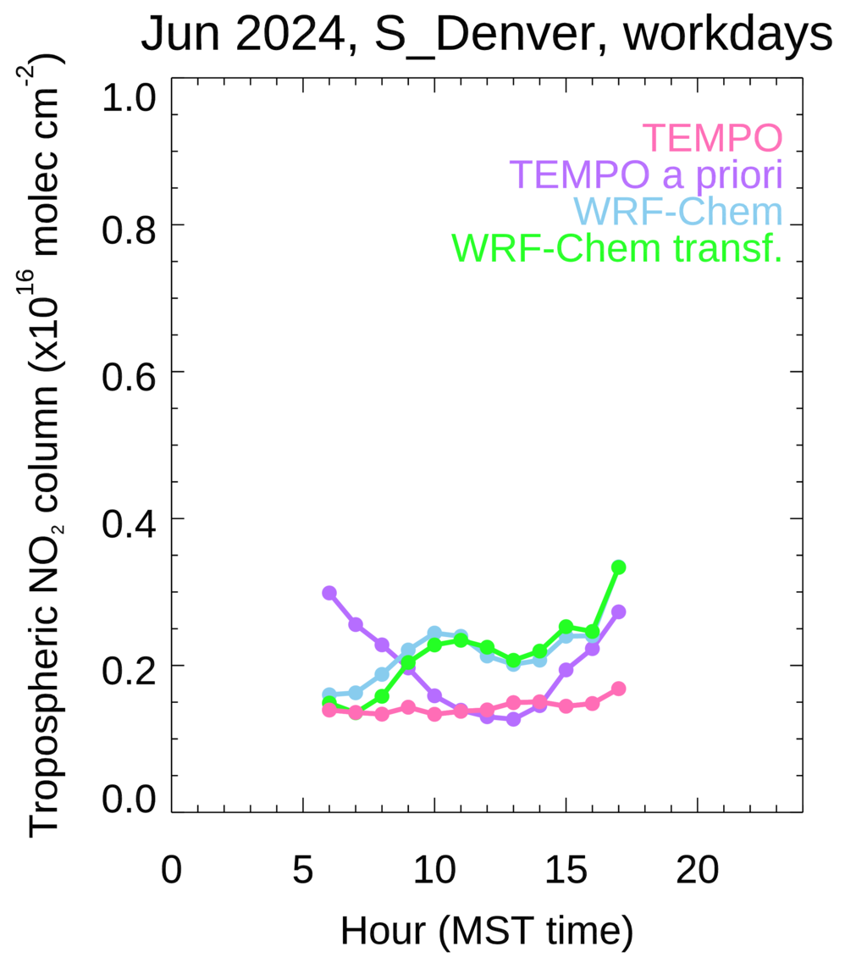
Denver regions
Over smaller Denver regions, diurnal cycle is affected more by local emissions and transport
NO₂ higher over Denver and to the North where O&G is located
Models show a strong diurnal cycle, TEMPO shows a gradual buildup during the day
Lower values to West and South, slightly higher outflow values do the East
Afternoon incease to the West maybe upslope meteorology
Notes:
Sorting for upslope days would help show transport to West. Need to look at high ozone days in EPA archive. Usually high O3 = upslope.
And making sure that upslope conditions lasted all day and were not interrupted by afternoon storms.
Using our WRF-Chem output for it would be a first step but probably better to look at surface wind observations (e.g. MADIS data). You could just pick a couple of sites near the Foothills and some out East.
Might be also worthwhile to check these days separately as upslope can vary from SE to NE and also start at different times of the day. Either way you should see an elevated signal over the Foothills on these days.

Slide 11
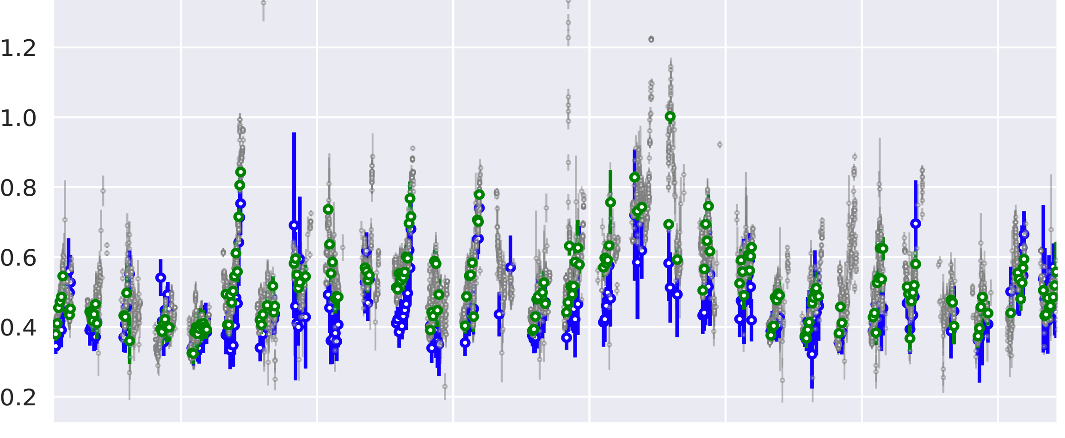
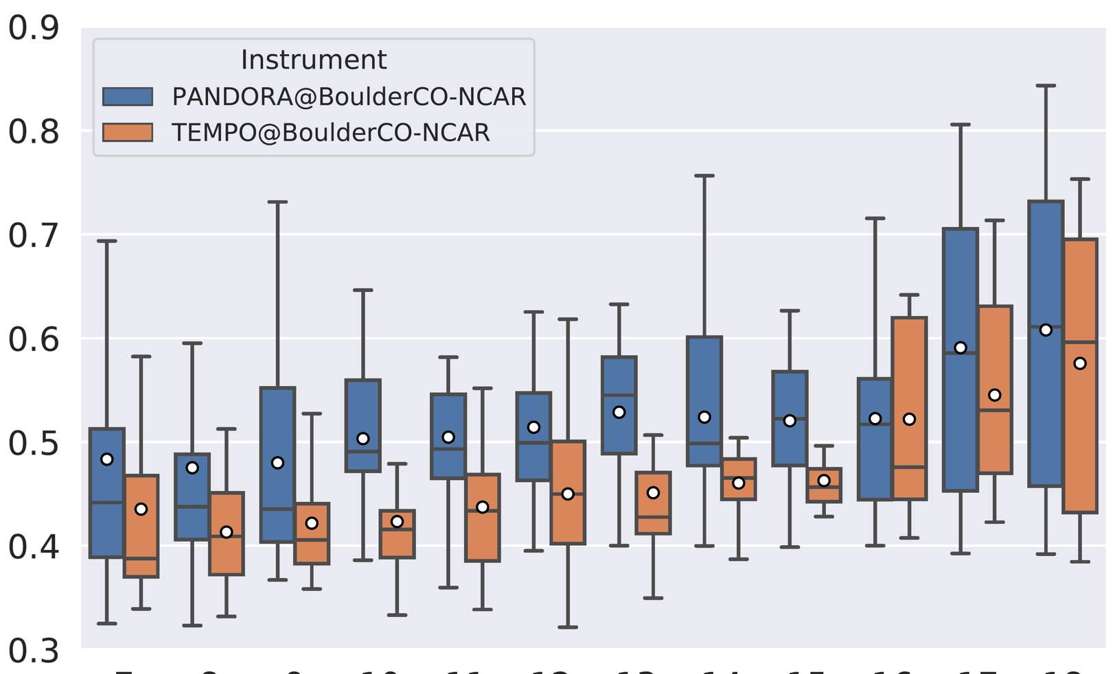

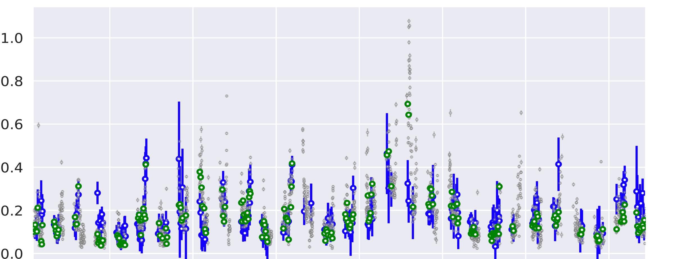
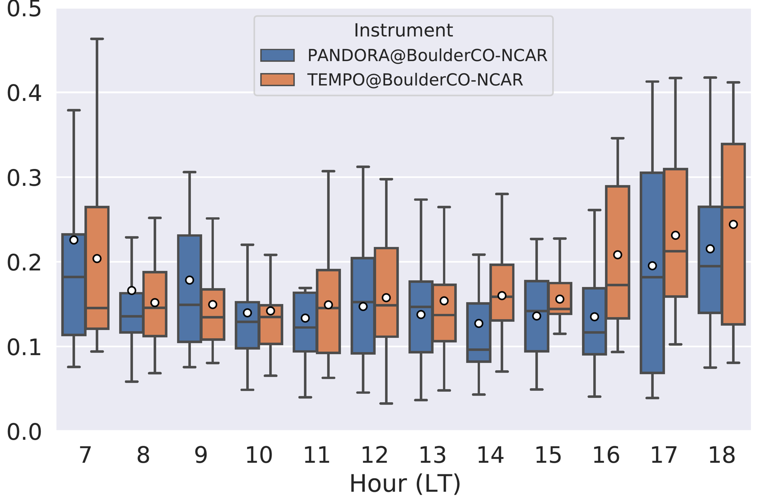
TEMPO NO₂ V3 and Boulder Pandora Jun 2024 (1)
TotC is ~2-3x TrC and is significant where pollution is low
TotC: Pandora higher than TEMPO, variation agrees fairly well, generally flat or increasing through the morning with a rise in the late afternoon
TrC: Surprisingly good agreement, generally high in the morning, flat through the day with an afternoon increase
Might reflect afternoon rush-hour and/or upslope transport
This is derived from 4 strategic azimuth views around NCAR, interesting differences in Pandora TrC retrieved for different azimuth views
Total Col NO₂
Total Col NO₂
Trop Col NO₂
Trop Col NO₂
Day 5 9 13 17 21 25 29
Notes:
Note: Averaging over the month “flattens” the apparent diurnal variation
WACCM at 0.5 deg resolution over Boulder/Denver shows:
total column NO2 ~8e15 molec. cm-2
trop column NO2 ~3e15 molec. cm-2
strat column NO2 ~5e15 molec cm-2
evidence seems a bit contradictory:
- The TEMPO TotC is low compared to Pandora, but the TEMPO StratC matches well with the FTIR.
- This would imply the TEMPO TrC is too low, but then the agreement with Pandora TrC is very good!
I suspect from other things I am hearing here that TEMPO TrC is low. So should we be wary of the Pandora TrC comparison?
Same analysis for Mexico City, TC and TrC show good agreement. I still haven't identified the cause of the differences observed in Boulder, but I suspect it might be related to how the reference spectra is calculated in Pandora for obtaining the Total Column. I've also noticed variations in comparisons across different sites.

Slide 12
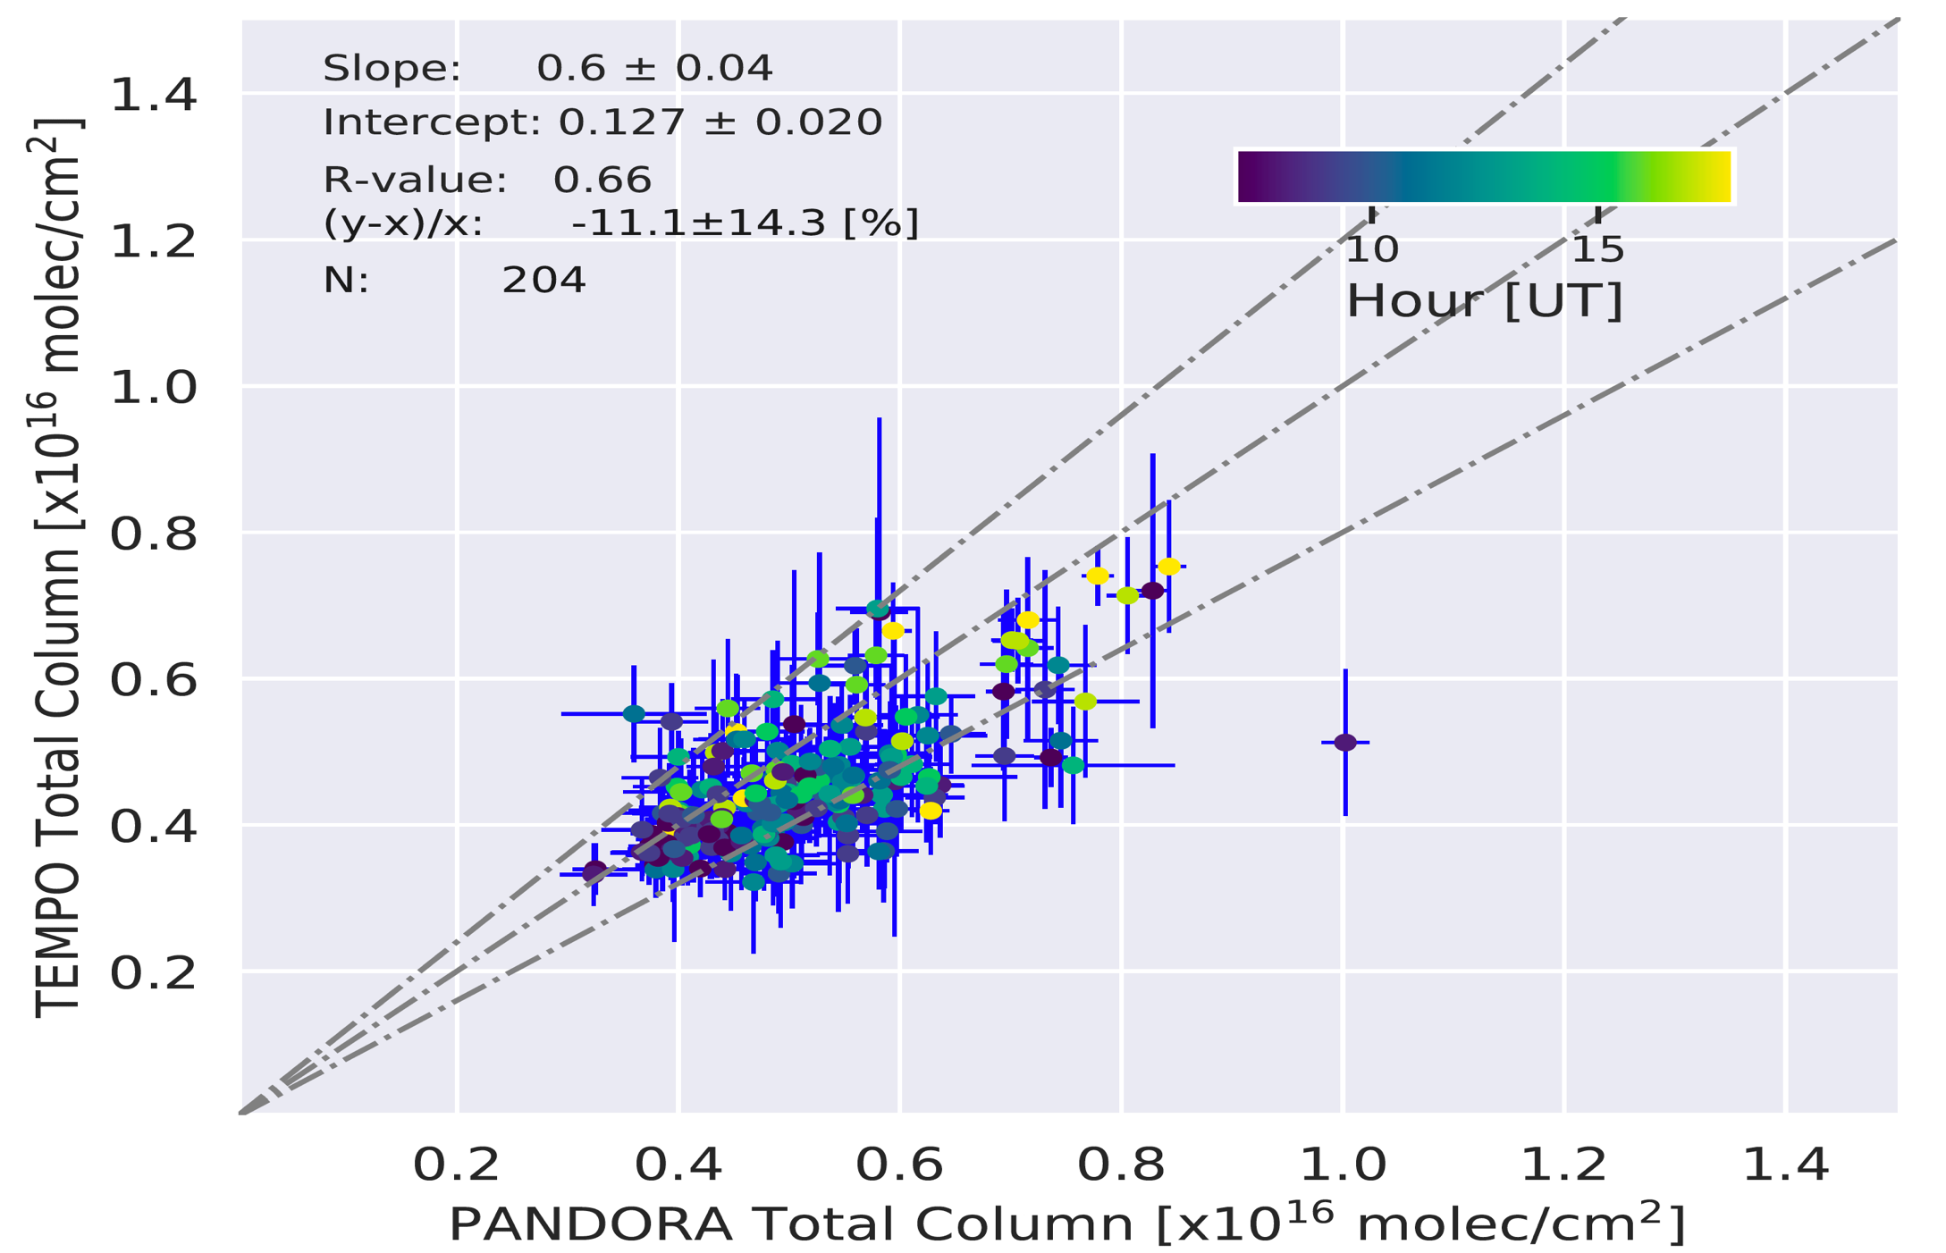
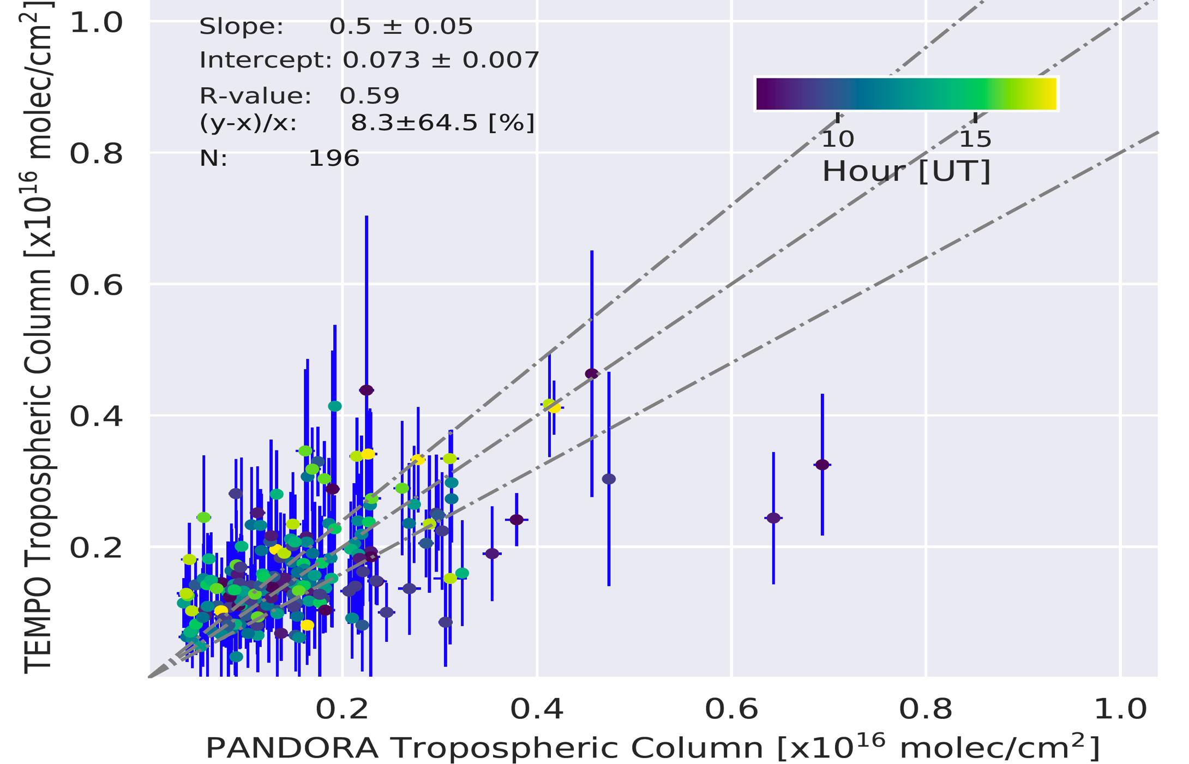
TEMPO NO₂ V3 and Boulder Pandora Jun 2024 (2)
Total Col NO₂
Trop Col NO₂
Pandora TotC is higher than TEMPO maybe representativeness and/or bias?
TrC appears to be generally in good agreement
Correlation is better for TotC compared to TrC
No obvious local hour dependence to the bias

Slide 13
Summary
GEO shows that diurnal NO₂ spatial and temporal variability is large, and that compared with once-a-day LEO observations, the new data will advance understanding of pollutant distributions, emissions and human exposure
In summer, NO₂ photochemistry is an important driver of diurnal variability, especially at the regional scale
At local scale, NO₂ magnitude and diurnal variability patterns change day-to-day, showing the impact of emissions and meteorology
In winter, NO₂ columns are higher and diurnal variability is lower as a result of reduced photochemistry
Still trying to understand NO₂ over Denver and comparisons between TEMPO, Pandora and models
Validation is going to be be very important to avoid uncertainties in diurnally varying retrieval algorithm parameters aliasing onto the retrieved products

