Slide 1
Current state of sulphur emissions over Asia observed by GEO and LEO space-born instruments
MariLiza Koukouli, Laboratory of Atmospheric Physics, Aristotle University of Thessaloniki, Greece
and
Nicolas Theys, Royal Belgian Institute for Space Aeronomie, Belgium

Slide 2
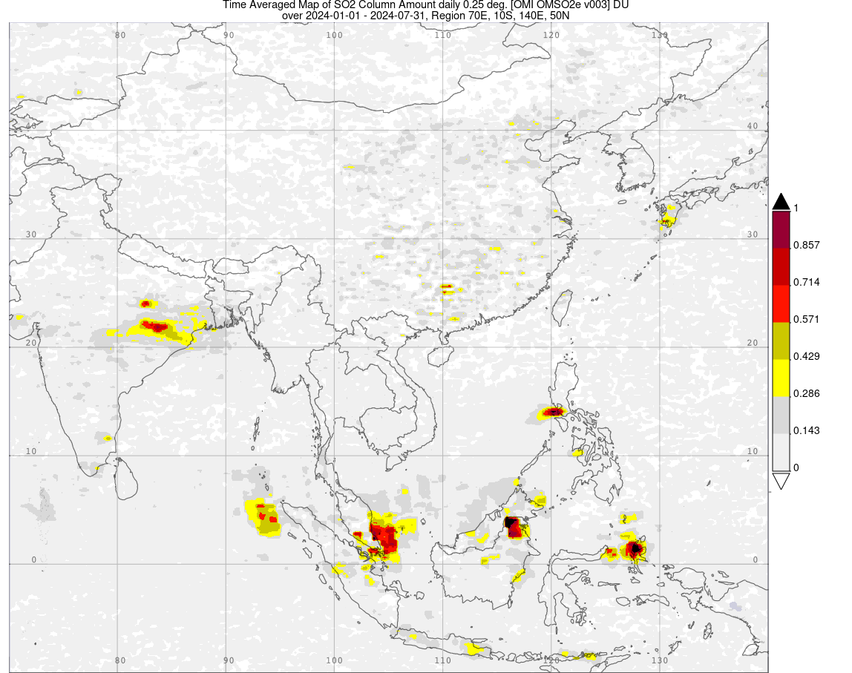
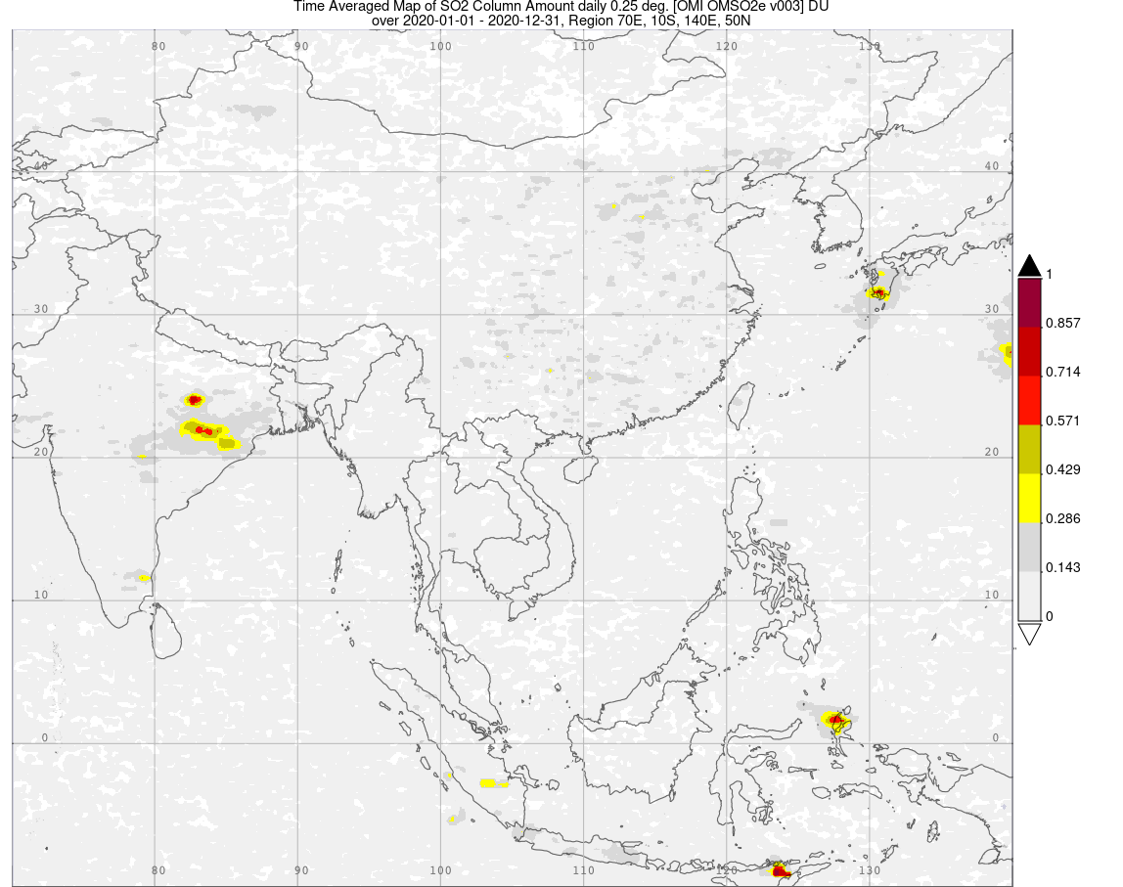
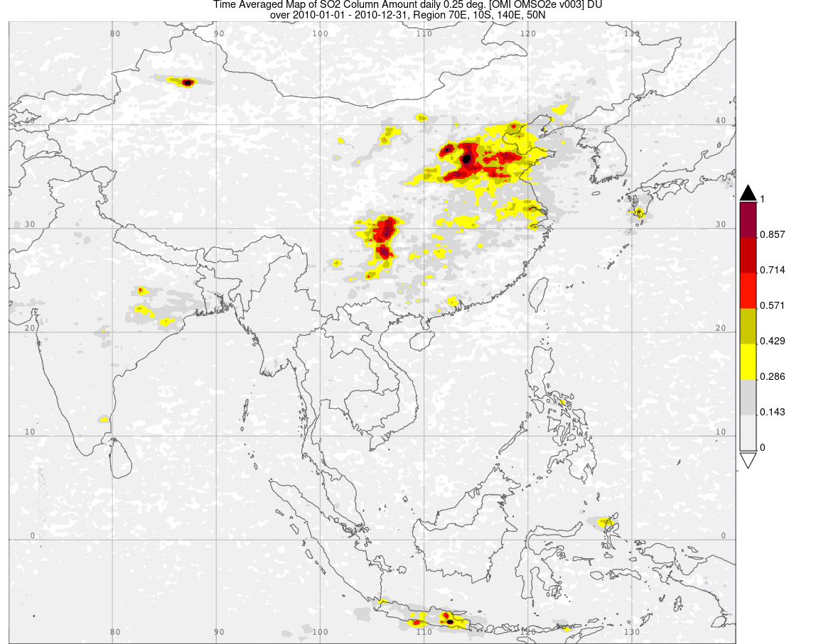
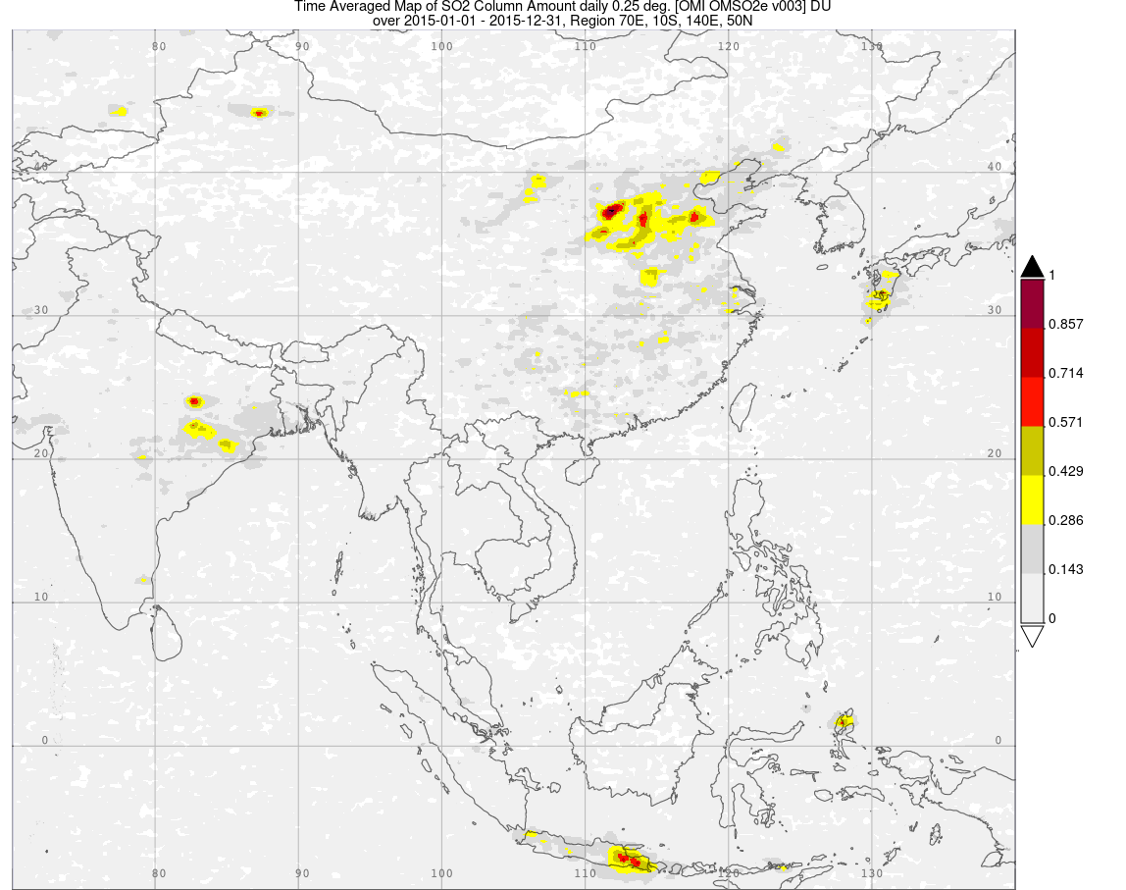
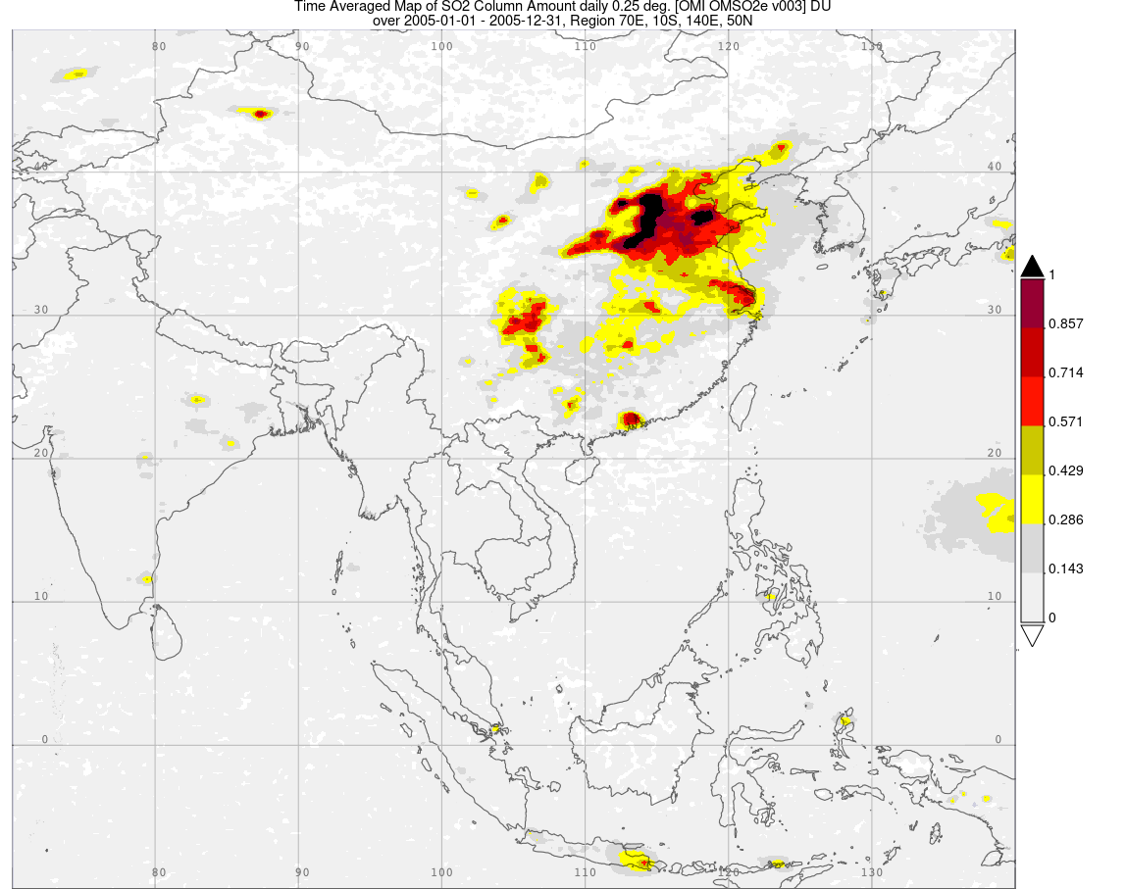
Can Li, Nickolay A. Krotkov, and Peter Leonard (2020), OMI/Aura Sulfur Dioxide (SO2) Total Column L3 1 day Best Pixel in 0.25 degree x 0.25 degree V3, Greenbelt, MD, USA, Goddard Earth Sciences Data and Information Services Center (GES DISC), 2024.

Slide 3
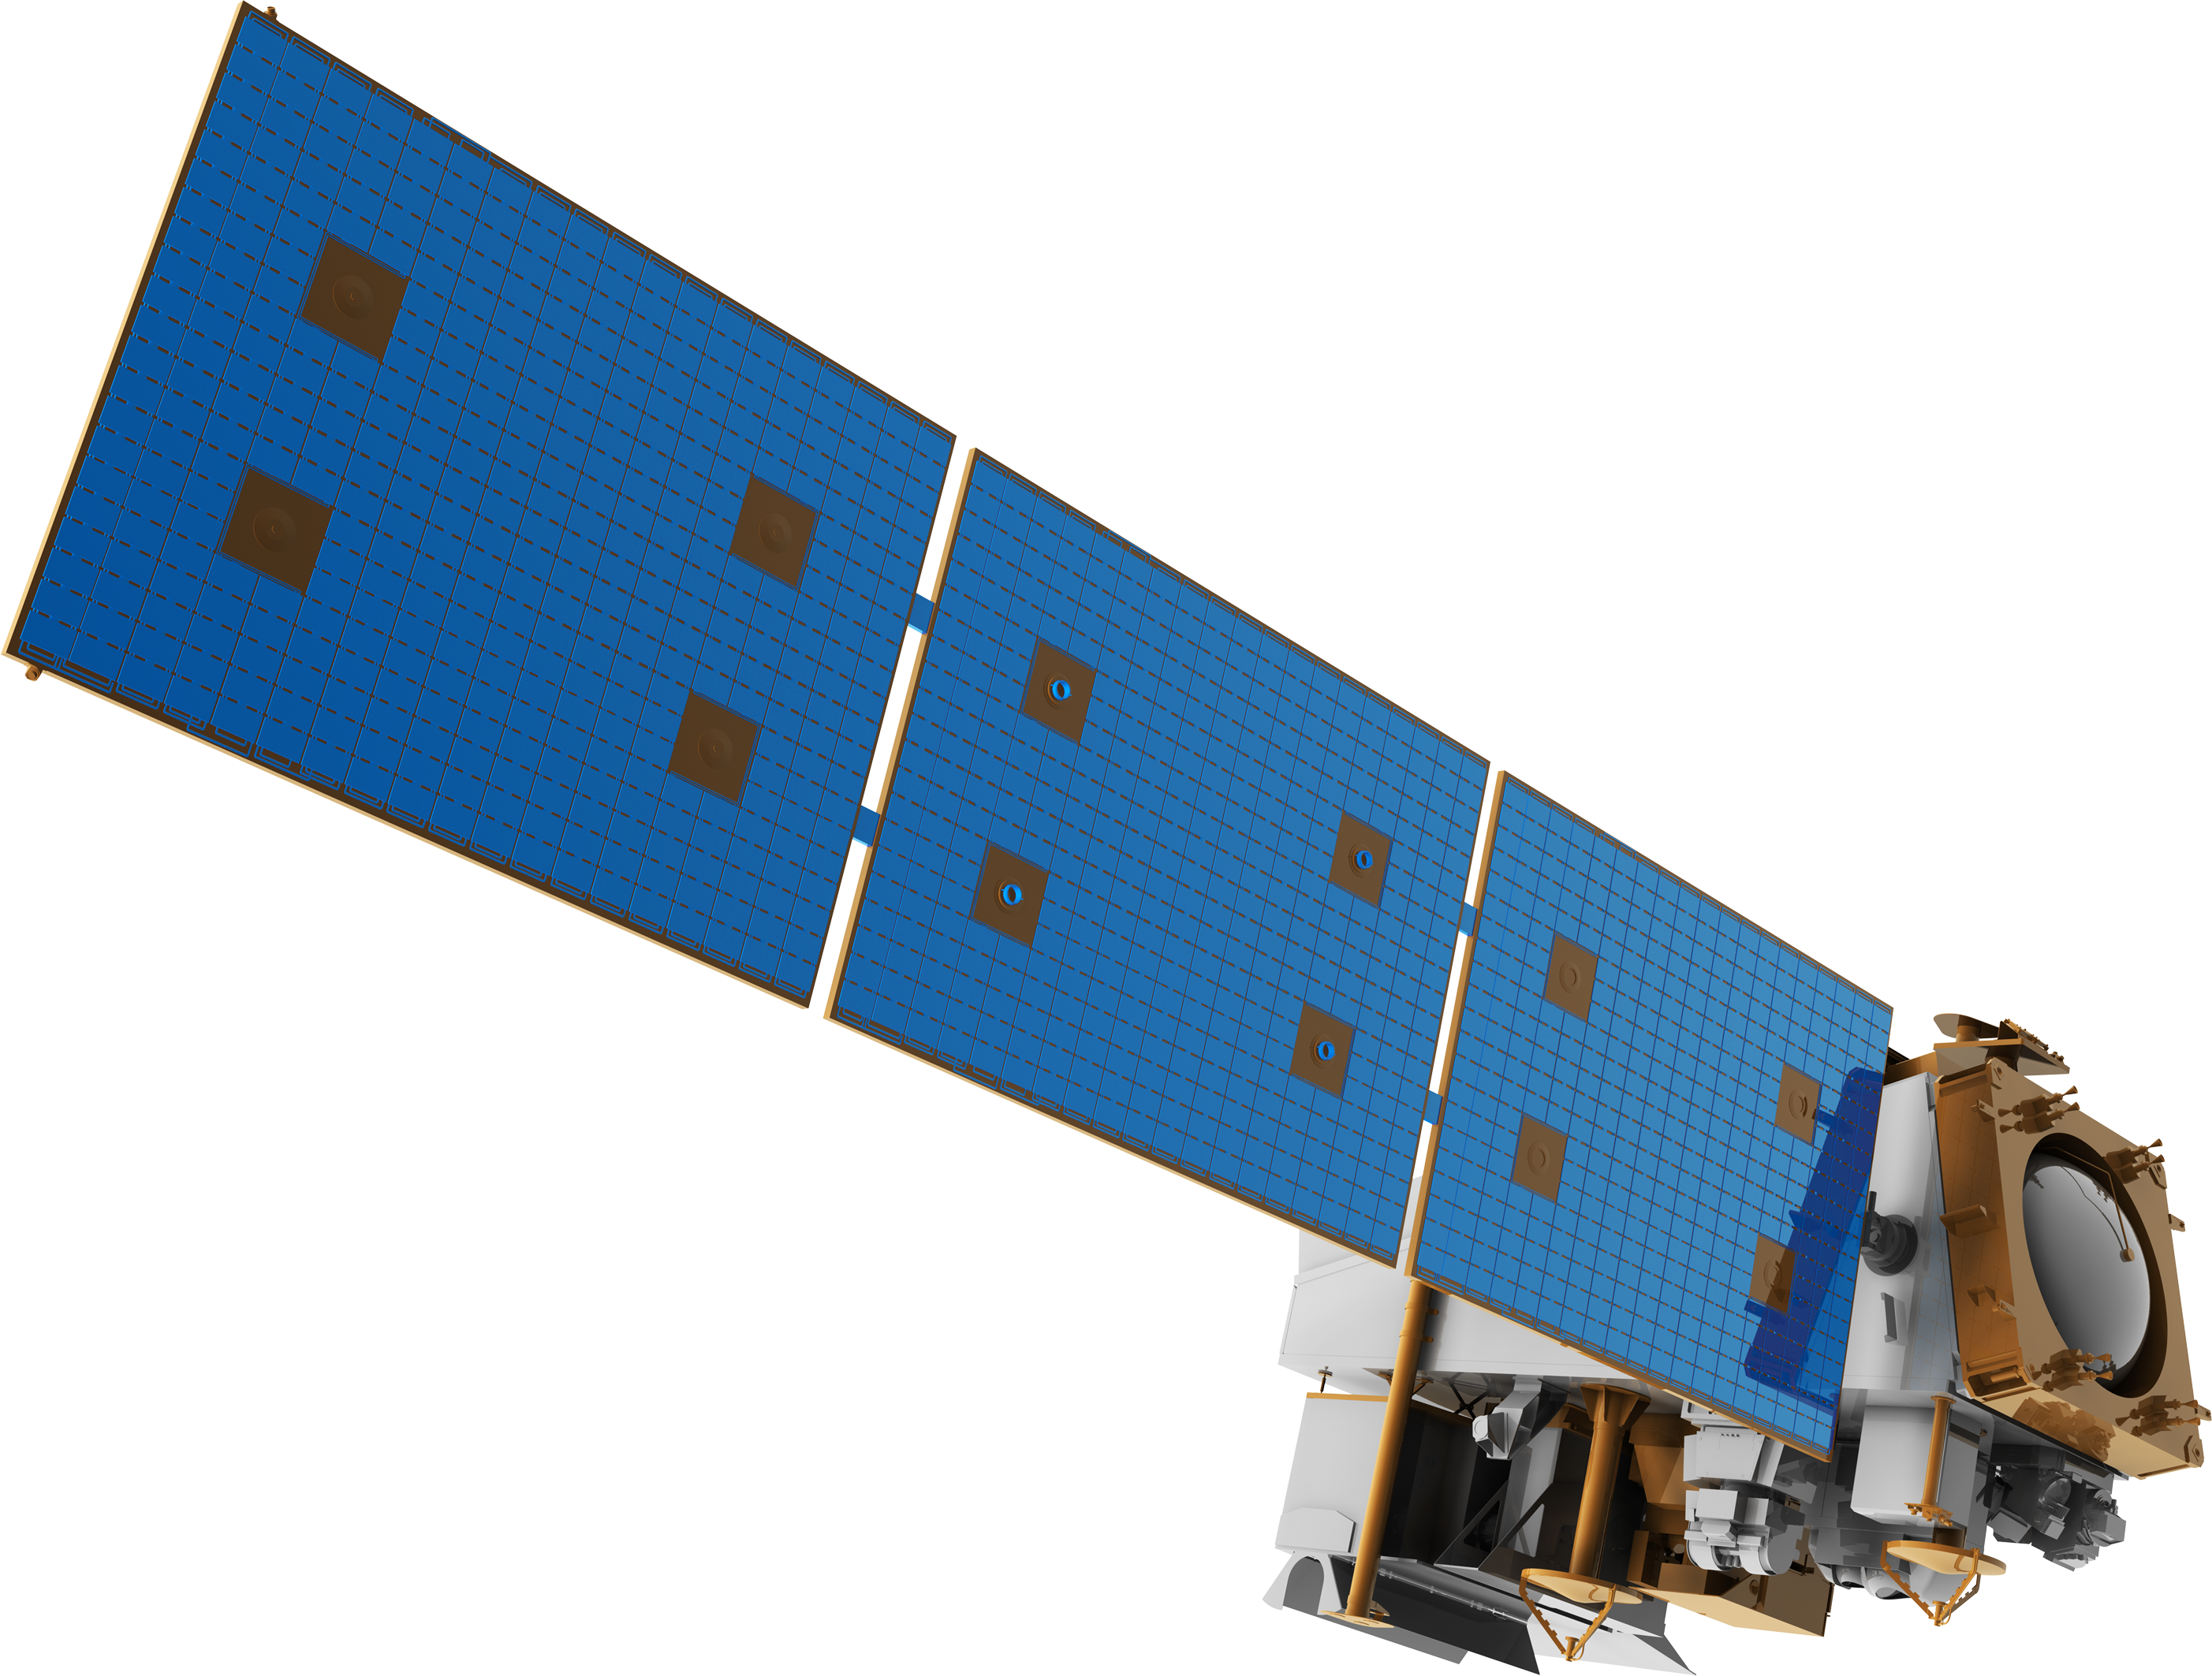
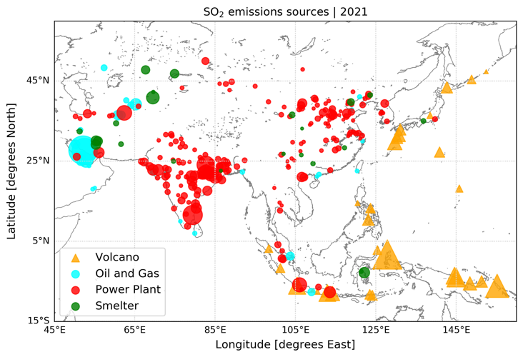
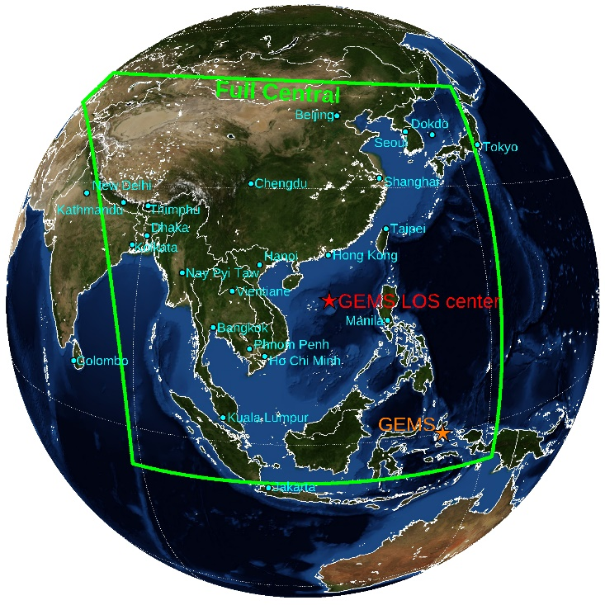
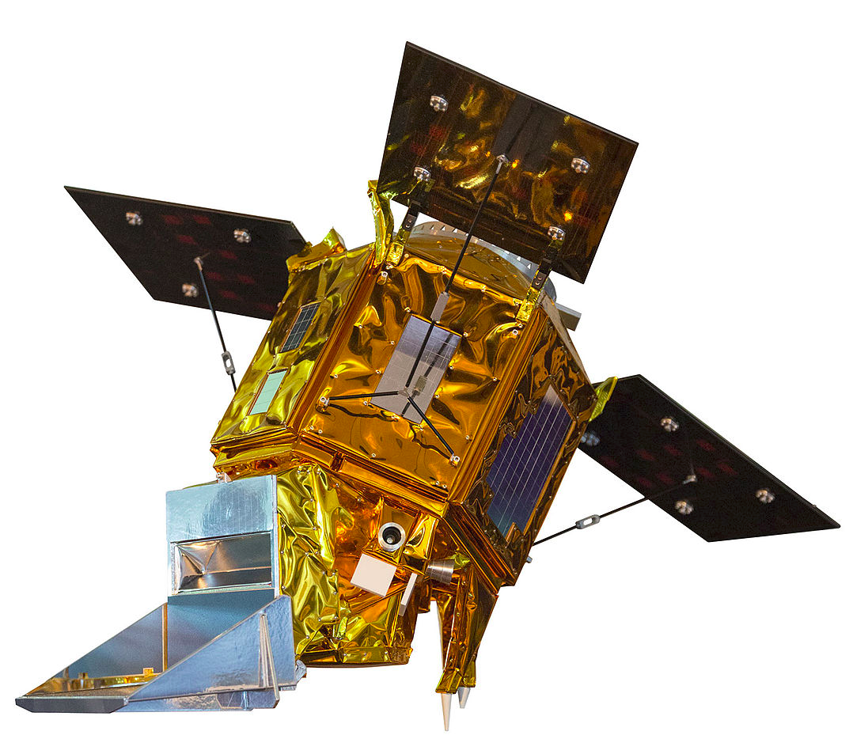
OMPS
GEMS
TROPOMI
TROPOMI
Locations of anthropogenic SO₂ in the GEMS region of interest separated by source used in the GEMS L2 SO₂ evaluation. (Fioletov et al., 2022)
The primary goal of the ESA project “Product Evaluation of GEMS L2 via Assessment with S5P and Other Sensors (PEGASOS)” is to compare and evaluate a set of operational GEMS Level 2 products with co-located operational L2 products from TROPOMI and other satellite-based instruments, as well as with independent ground-based data and methods.
Ronny Lutz, talk at 09:30 on Friday morning
Notes:
GEMS: v2.0 L2 SO₂ product. The GEMS SO₂ slant column retrieval is based on the PCA (Li et al., 2013) and DOAS methods (Platt and Stutz, 2008). For details on the DOAS and PCA algorithm settings, as well as the AMF calculations, refer to the GEMS SO₂ ATBD. Datasets provided via inter-agency collaboration.
TROPOMI: operational L2 SO₂ v02.04.01 and v02.05.00, Details on the S5P/TROPOMI SO₂ algorithm and products can be found in the ATBD, the PUM, while extensive and routine validation can be found in the latest ROVCR. Publicly available from Copernicus Data Space Ecosystem | Europe's eyes on Earth.
OMPS: OMPS-NPP L3 NM PCA Sulfur Dioxide Total Column Daily Best Pixel Global Gridded 0.25 x 0.25° product based on the NASA Goddard Space Flight Center principal component analysis (PCA) spectral fitting algorithm (Li et al., 2013, 2017). Publicly available from NASA Earth Observation Data.

Slide 4
GEMS v2.0 SO₂ slant column comparisons
… with S5P/TROPOMI
GEMS v2.0

Slide 5
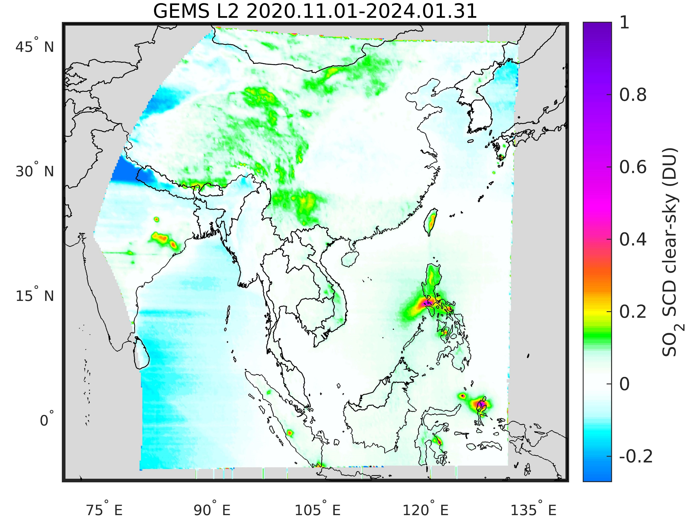
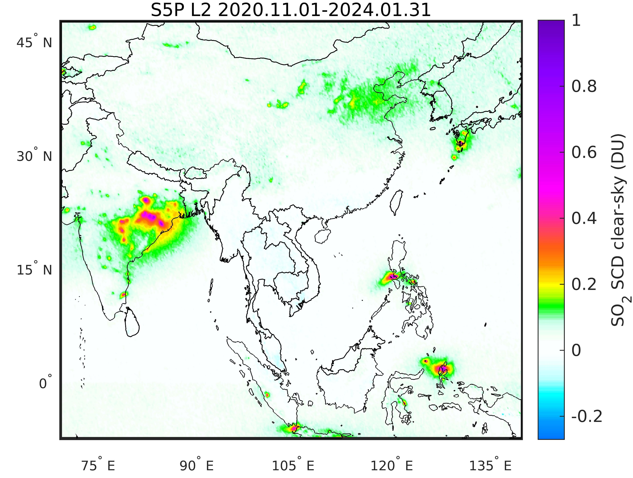
GEMS Multi-Annual Mean
S5P Multi-Annual Mean
Volcanic SO₂ load and dispersion well represented
Indian Power plants underestimated
Possible remaining artefacts over Central Asia
GEMS v2.0

Slide 6
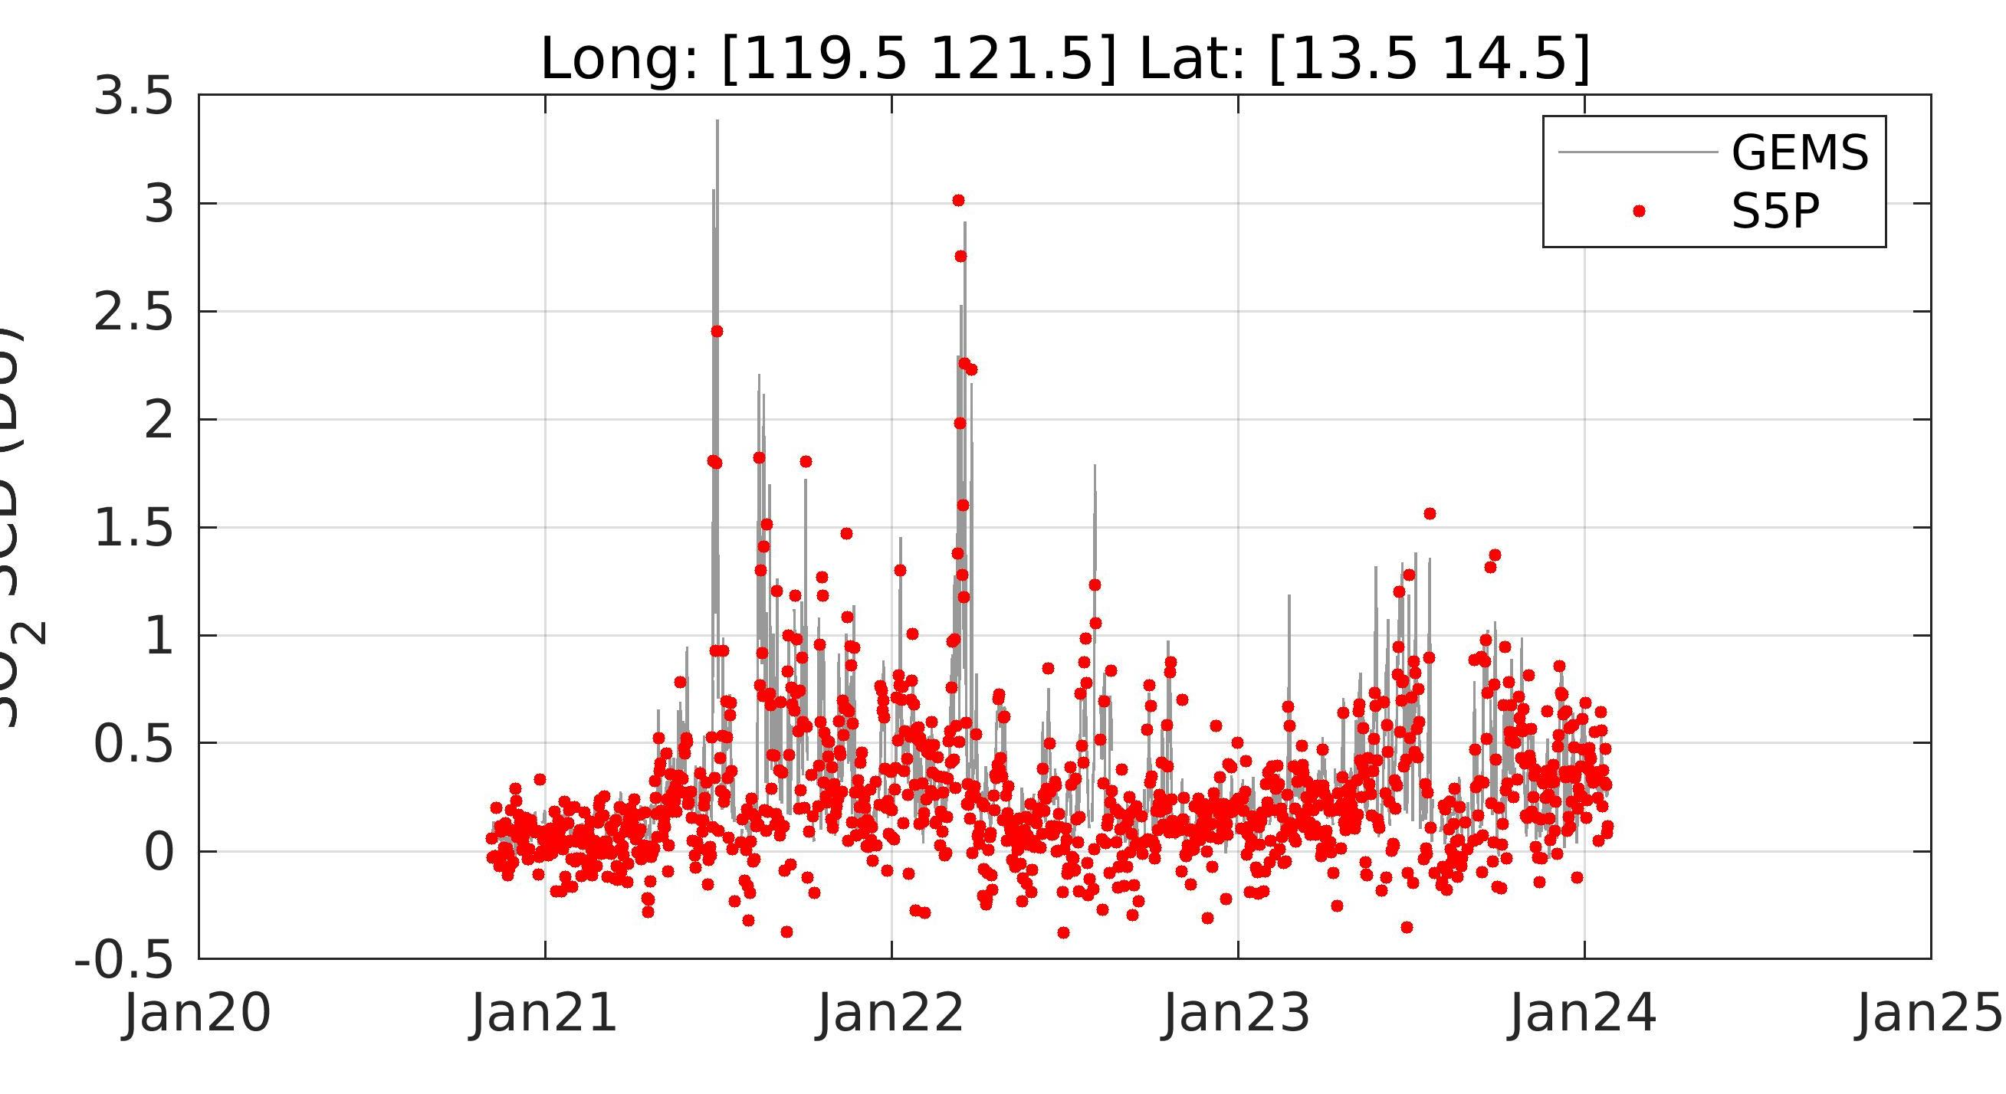
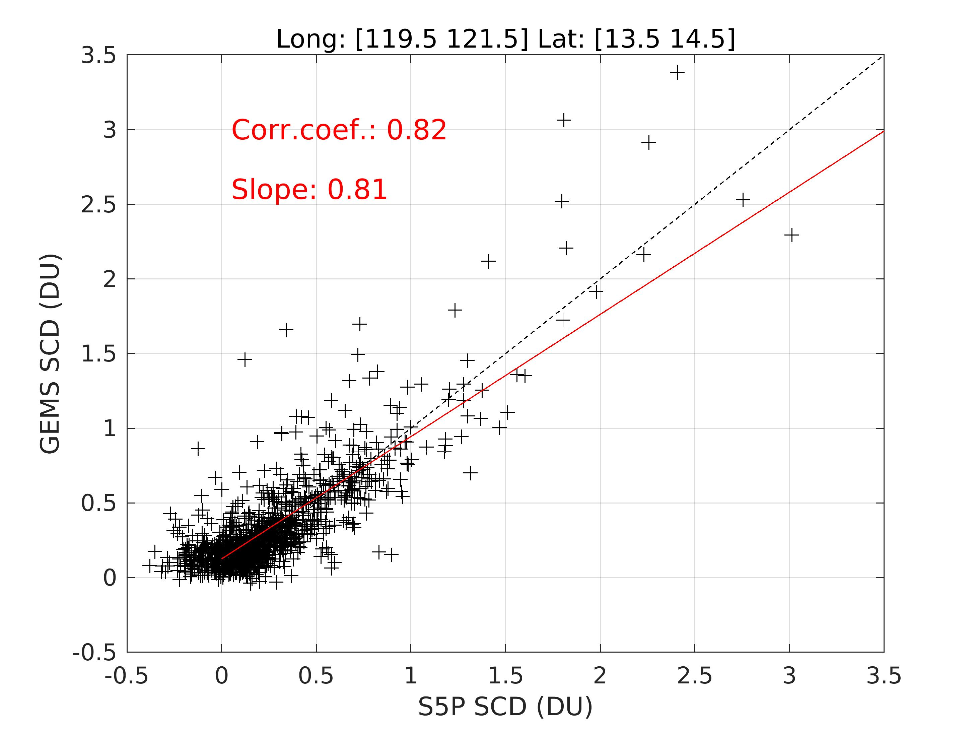
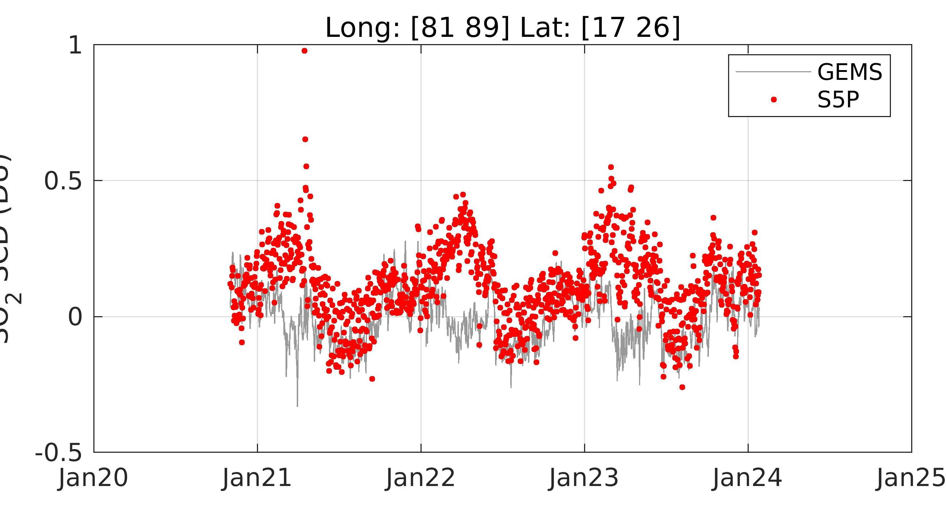
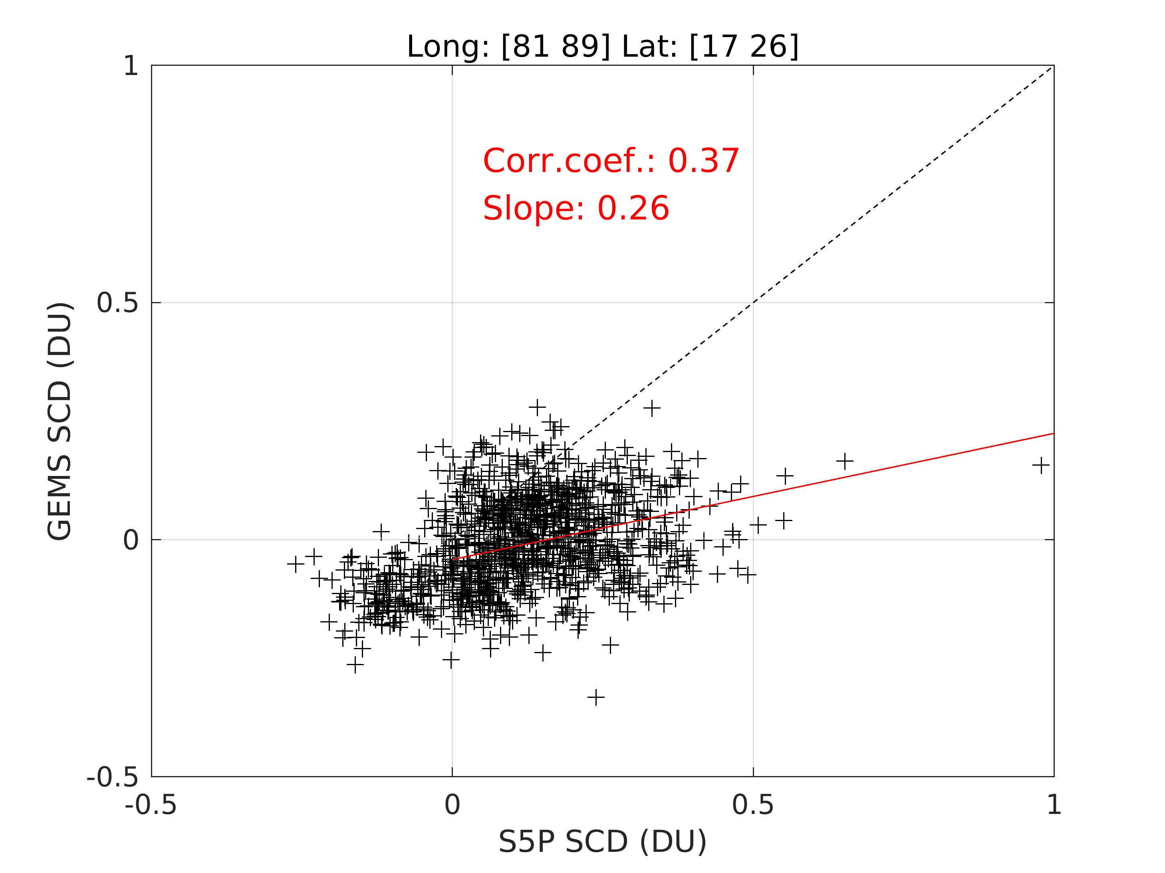
SO₂ Slant Columns [D.U.]
Taal Volcano, Philippines
Taal Volcano, Philippines
Power Plants, India
Power Plants, India
SO₂ Slant Columns [D.U.]
GEMS v2.0

Slide 7
GEMS v2.0 SO₂ vertical column comparisons
… with OMPS/Suomi-npp
GEMS v2.0

Slide 8
Long-term monitoring of SO₂ sources over Asia from GEO & LEO instruments
GEMS v2.0
GEMS v2.0
OMPS-NPP L3 NM PCA Daily Best Pixel Global Gridded

Slide 9
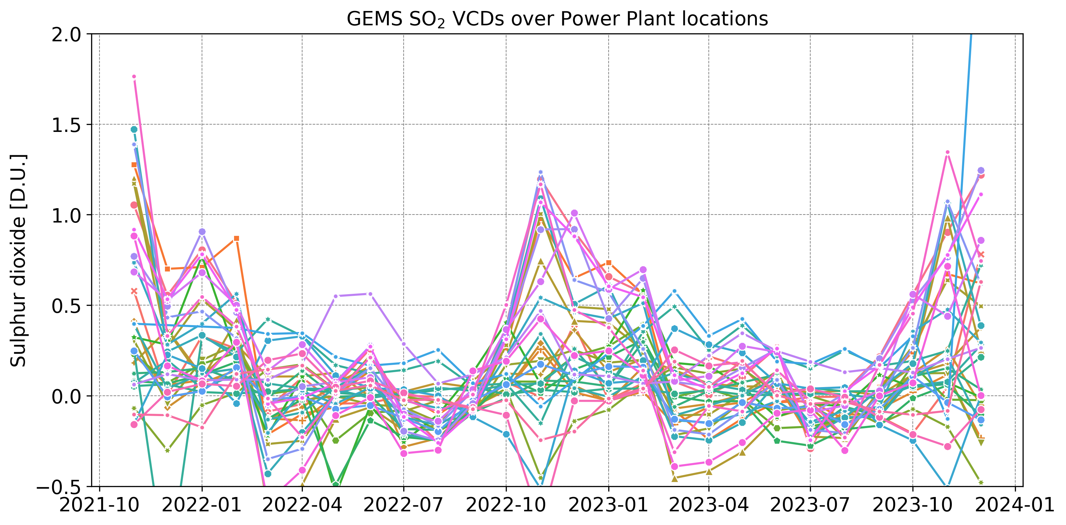
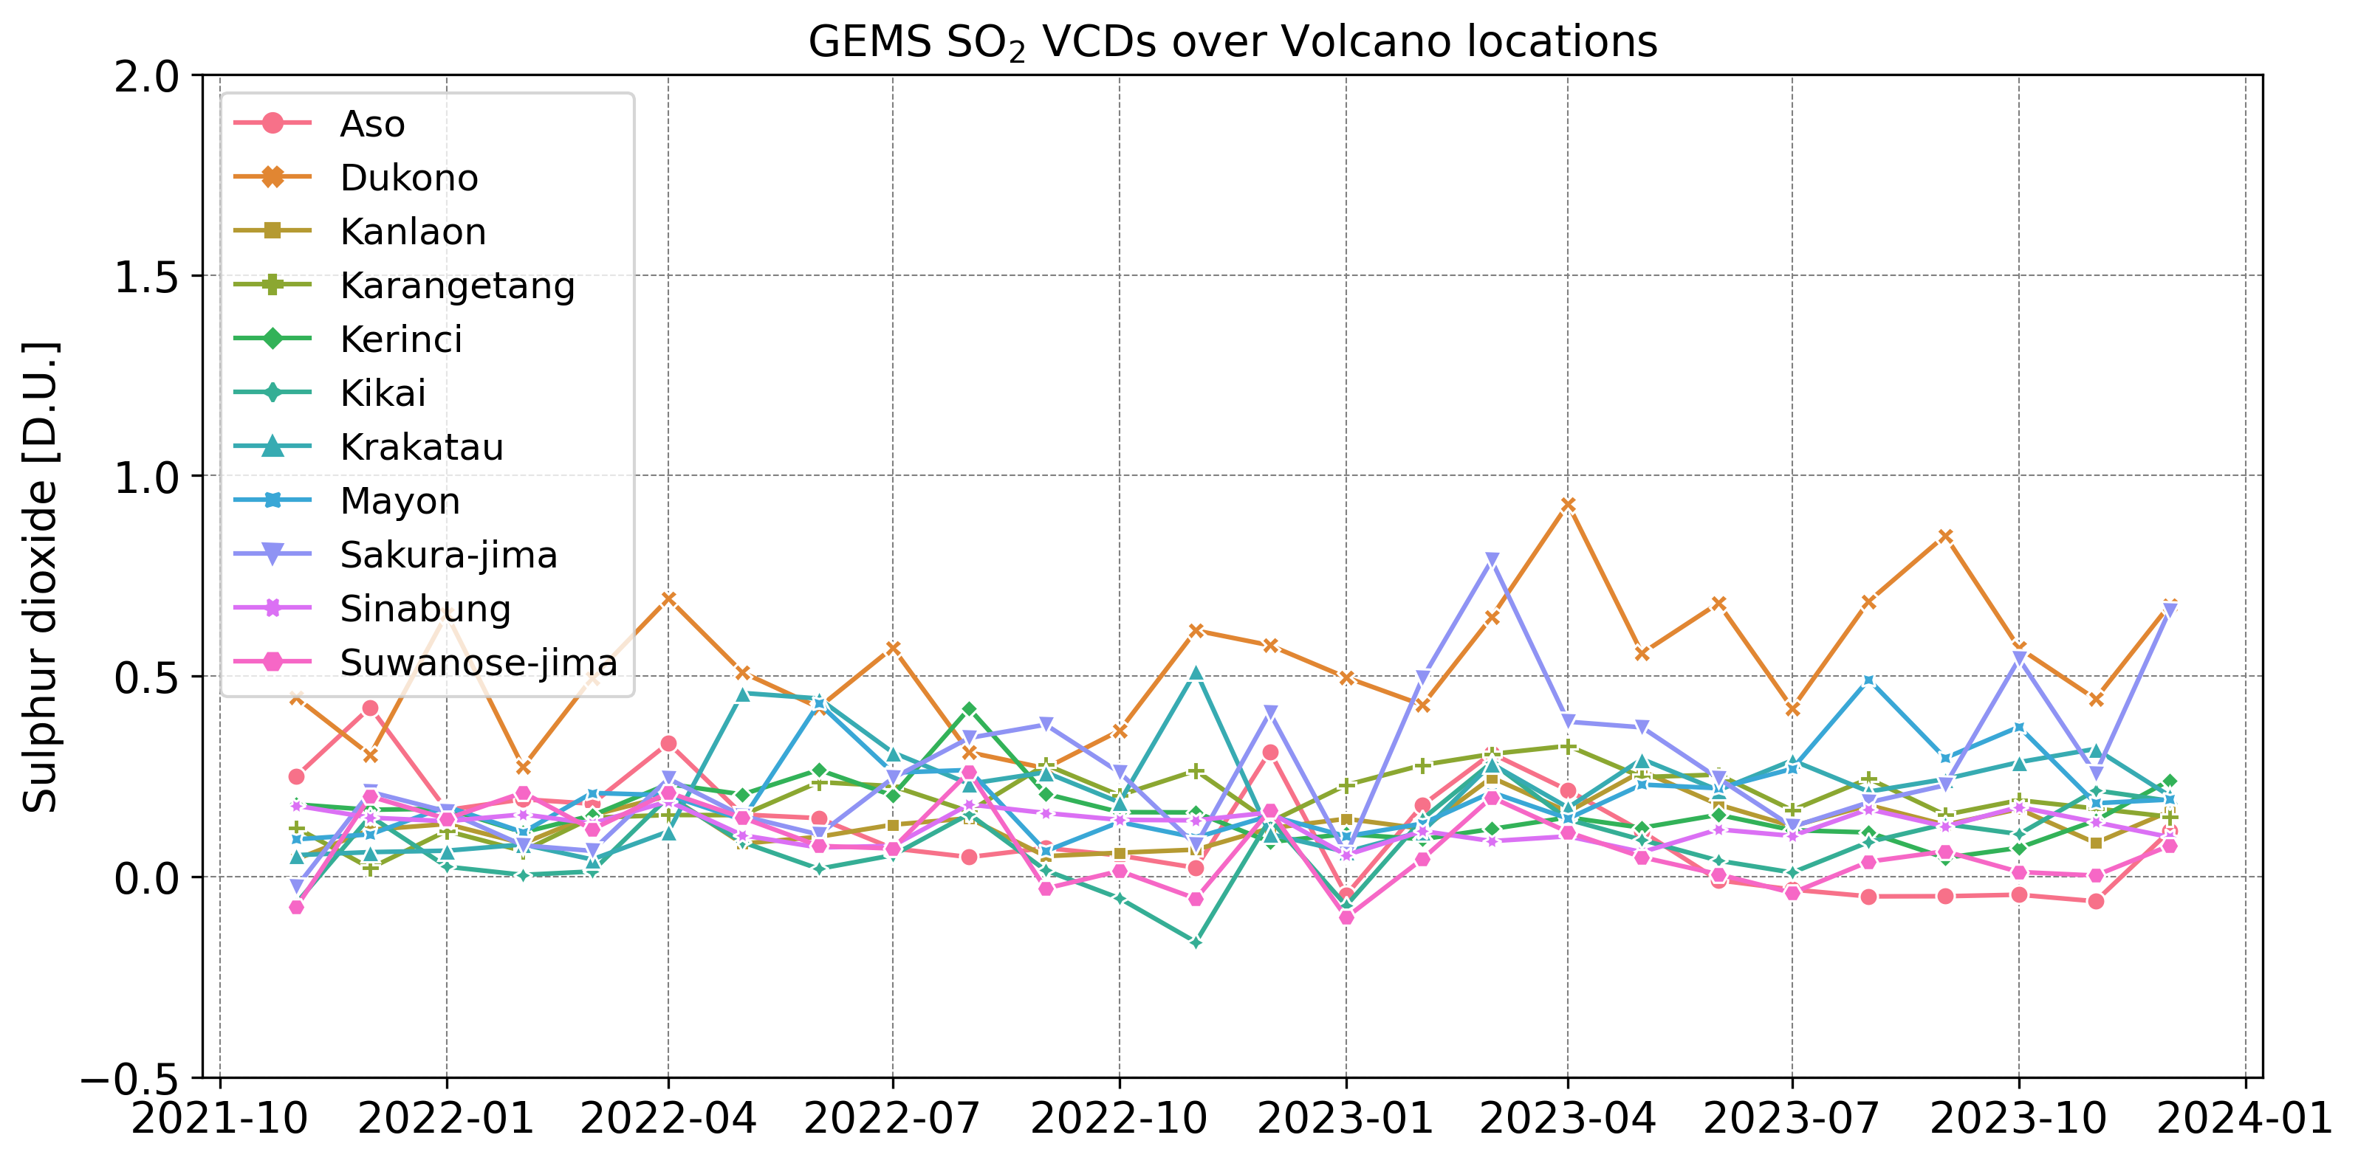
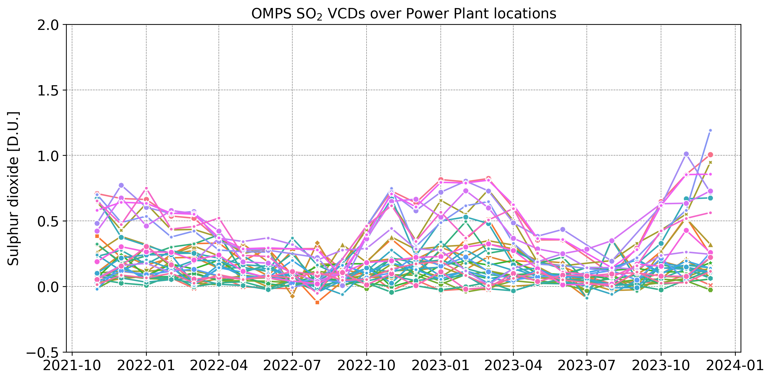
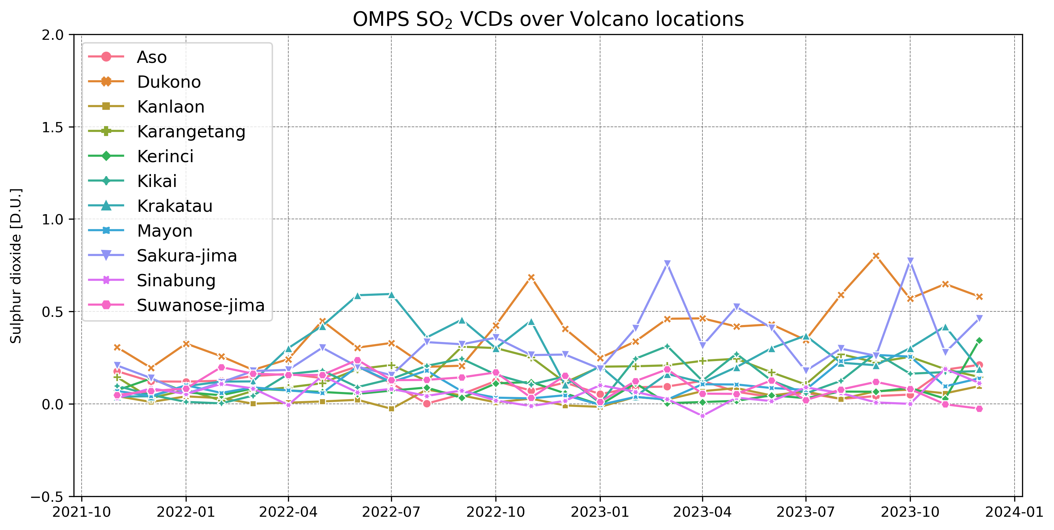
Power Plants
Volcanoes
GEMS
OMPS
Similar SO₂ reported loads between GEMS & OMPS
GEMS shows higher dispersion per location, with a seasonal component
GEMS v2.0

Slide 10
Power Plants
Volcanoes
GEMS SO₂ [D.U.]
GEMS SO₂ [D.U.]
GEMS v2.0

Slide 11
Recent updates to the GEMS SO₂ product
Interim version v2.1
Slit function updated
All relevant input parameters updated, such as the cloud fraction, the total ozone column, etc.

Slide 12
GEMS v2.0 vs v2.1 slant column density
GEMS v2.0
GEMS v2.1
Nearly indistinguishable SCDs

Slide 13
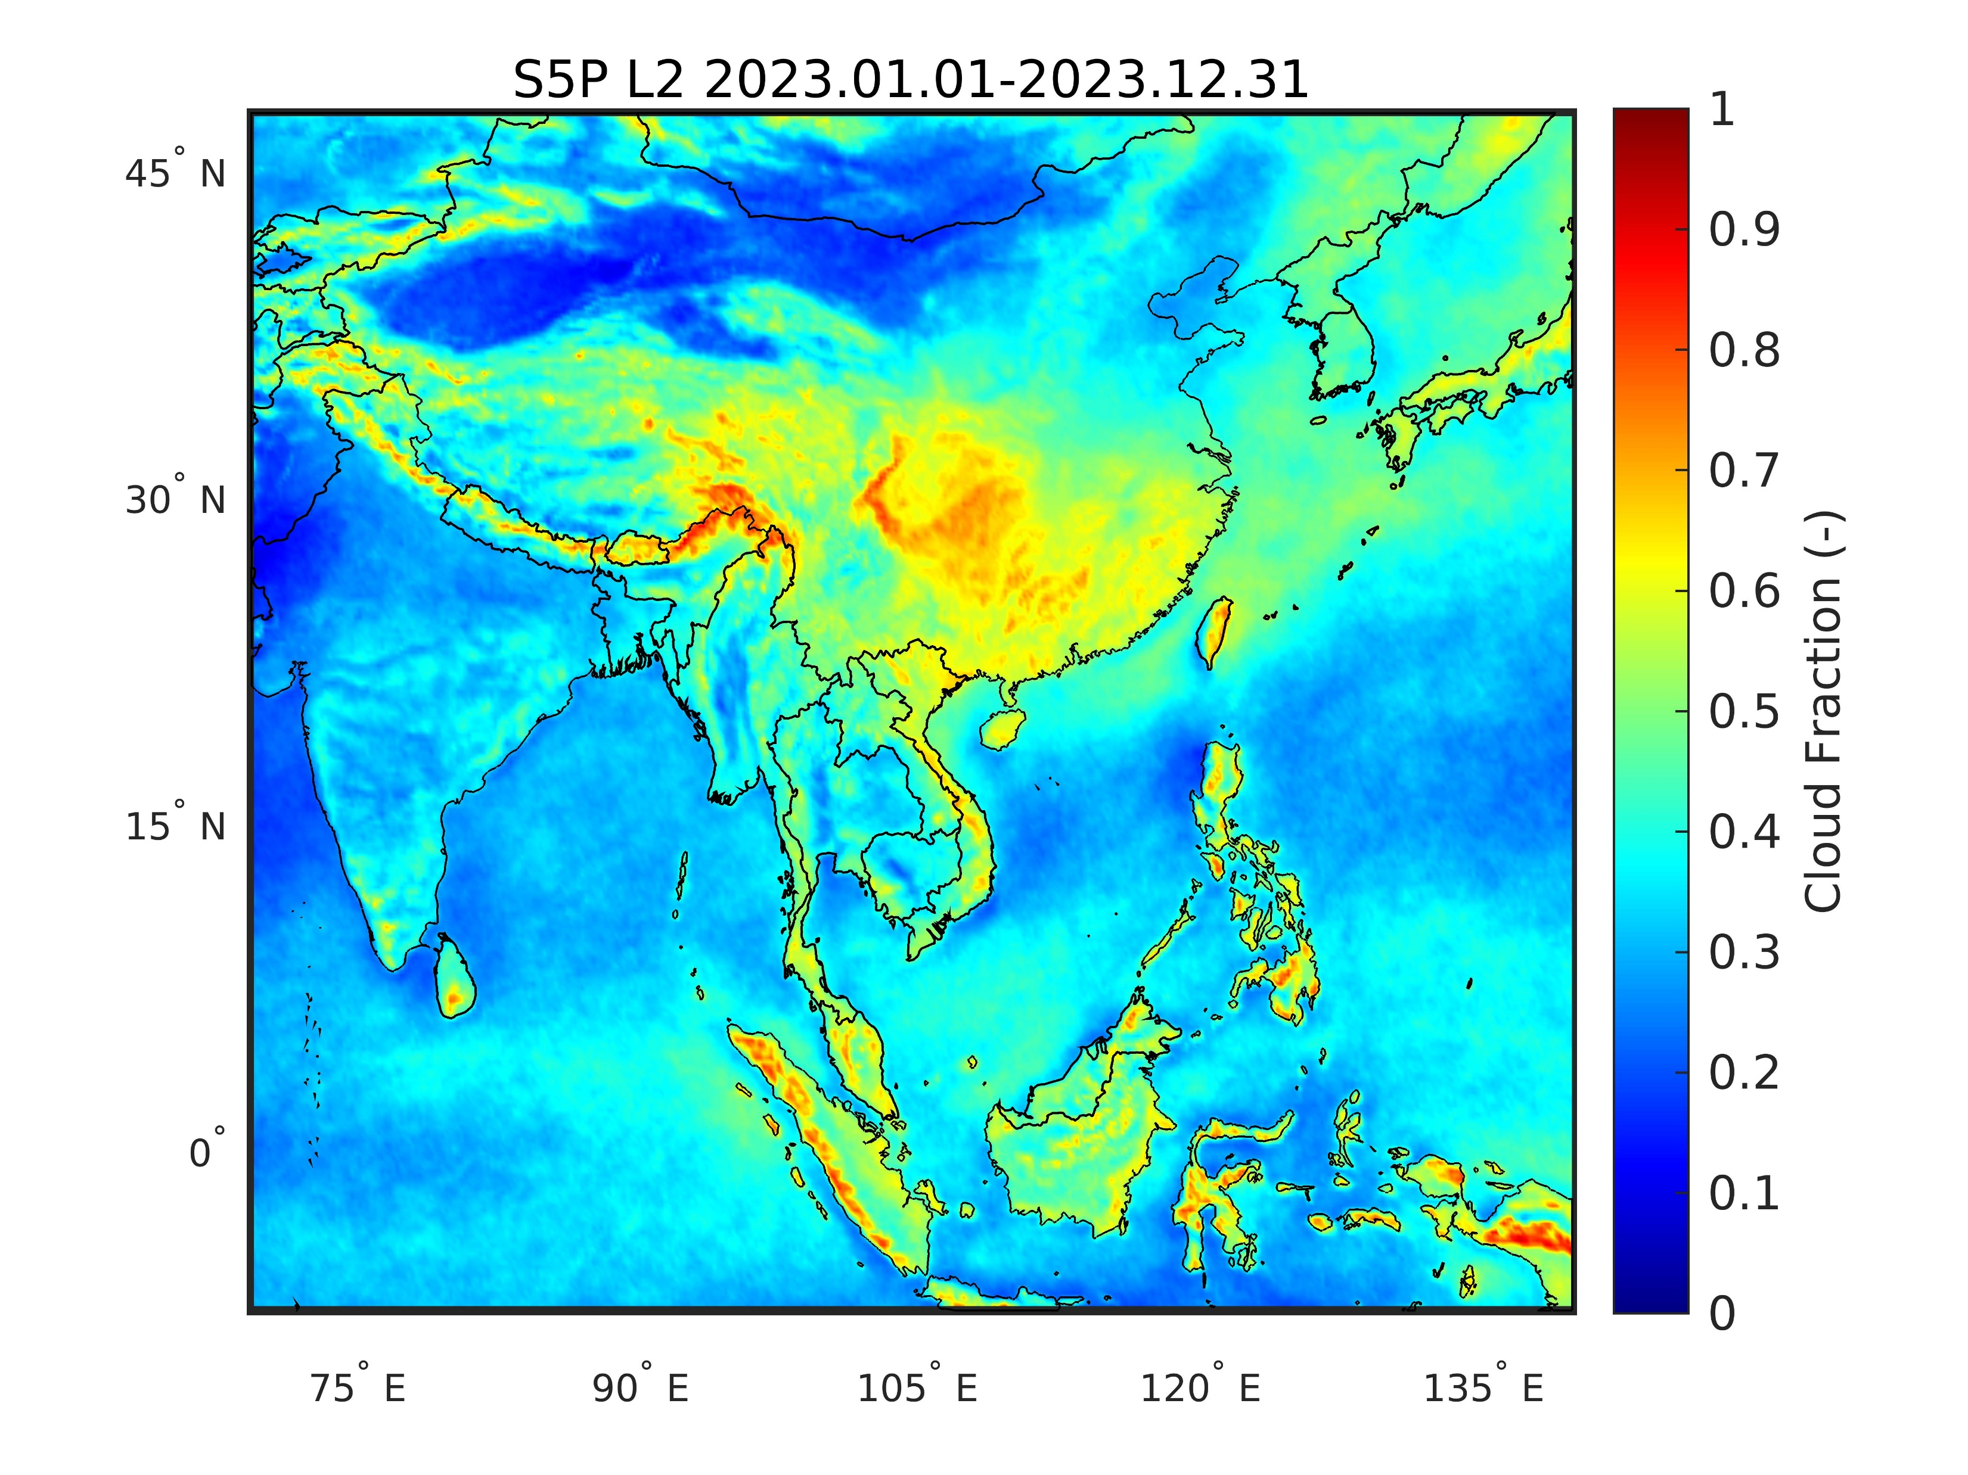
GEMS v2.0 vs v2.1 cloud fraction
GEMS v2.0
GEMS v2.1
Updated GEMS v2.1 cloud fraction relates more to the S5P reported levels

Slide 14
GEMS v2.0 vs v2.1 vertical column density
GEMS v2.0
GEMS v2.1

Slide 15
Power Plants
Volcanoes
GEMS SO₂ [D.U.]
GEMS v2.1

Slide 16
Summary and future work
GEMS monitors SO₂ loads over Asia, identifying both outgassing and eruptive volcanic as well as anthropogenic sources in the region.
Comparisons to S5P/TROPOMI, OMPS/Suomi-NPP and OMI/Aura have shown a high level of agreement over volcanoes and a moderate level of agreement over the Indian power plants, seasonally dependent.
Using the diurnal component to calculate SO₂ mass emitted and compare to current emission inventories.
Focus future GEMS algorithm developments over the Indian Power plants
Lessons learned, and in tandem analysis, will also be included in the forthcoming AO for S4 and S5 SO₂ products

