Slide 1
Application of GEMS measurements for NO₂ monitoring in Asia
Naveed Ahmad, Changqing Lin, Alexis Lau
The Hong Kong University of Science and Technology
Jhoon Kim
Yonsei University
TEMPO/GEMS Joint Science Team Workshop, Hawaii
August 26-30, 2024

Slide 2
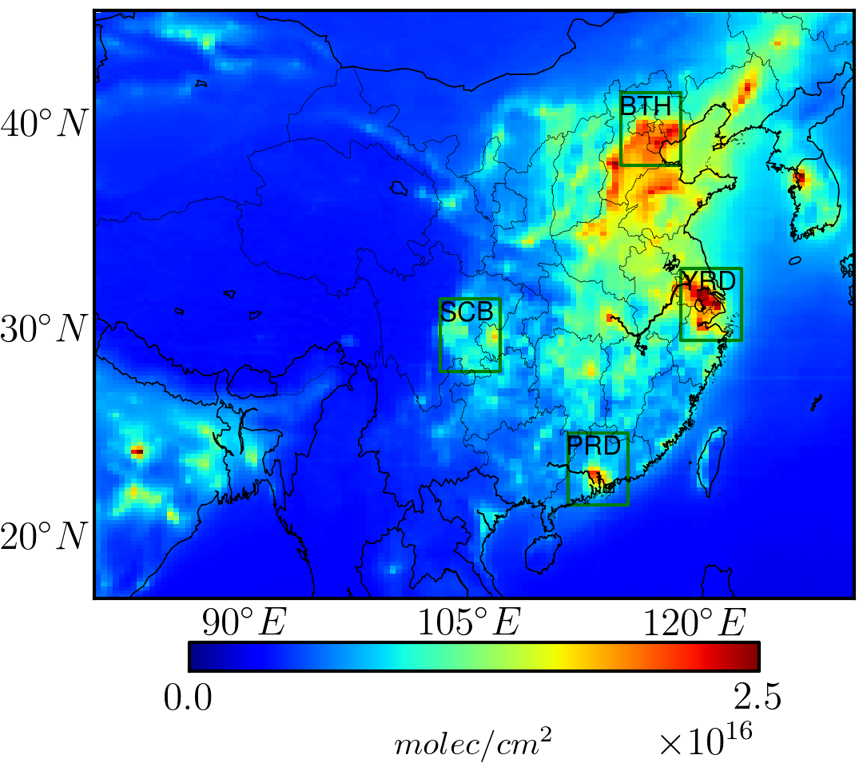
GEMS columnar measurements
Annual average of the VCDs of NO₂ from GEMS in 2021
Satellite provides vertical column densities (VCDs) of NO₂. Ground-level concentrations are important in air quality study.
Major bridge linking satellite VCDs with ground-level concentration is NO₂ mixing height (NMH), which is determined by the properties (e.g., stability) of the PBL.
$$NMH\left(m\right)=\frac{{VCD}_{NO2}\left(\frac{μg}{m^{2}}\right)}{C_{g}\left(\frac{μg}{m^{3}}\right)}$$

Slide 3
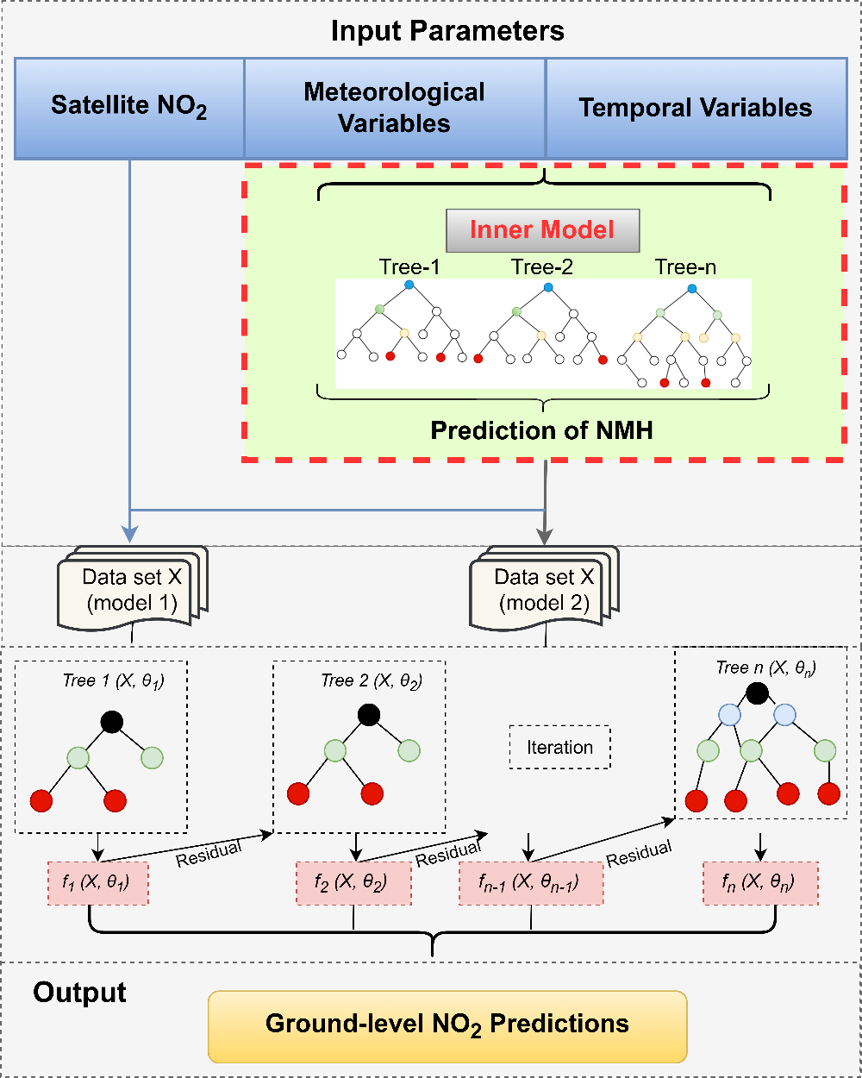
A nested machine learning model to estimate ground-level NO₂ from its VCDs
The nested machine learning model directly incorporates NO₂ mixing height (NMH) into the methodological framework.
The inner machine learning model predicts the NMH from meteorological parameters, which were then input into the main machine learning model (XGBoost) to predict ground-level NO₂ from its VCDs.

Slide 4
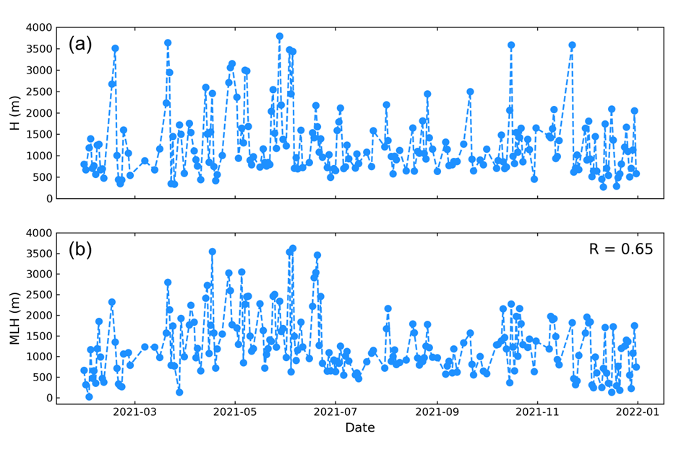
A comparison of NO₂ mixing height (NMH) and traditional mixing layer height (MLH)
Beijing in 2021
$$NMH\left(m\right)=\frac{{VCD}_{NO2}\left(\frac{μg}{m^{2}}\right)}{C_{g}\left(\frac{μg}{m^{3}}\right)}$$
Mixing layer height (MLH) calculated from vertical profiles of meteorological values from balloon measurements

Slide 5
Associations between NO₂ mixing height (NMH) and meteorological parameters
T & NMH
WS & NMH
P & NMH
Positive correlation between the NO₂ mixing height and temperature and wind speed (increased T and WS→ unstable), while negative associations were found with ground air pressure (increased P→ stable).

Slide 6
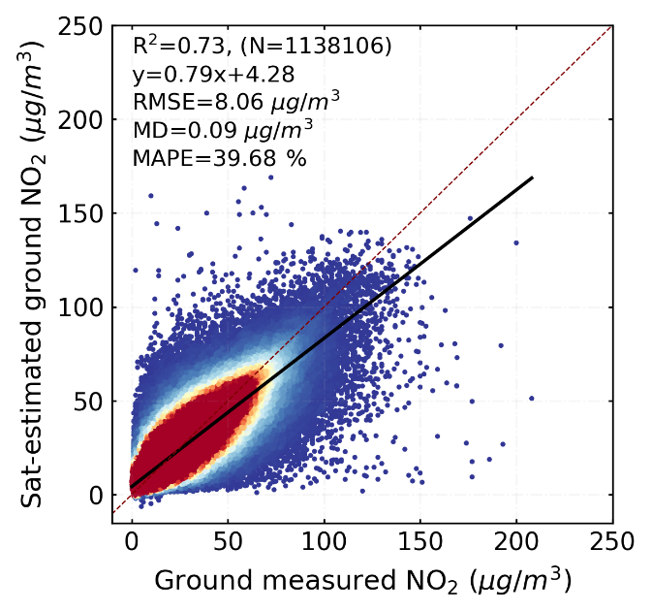
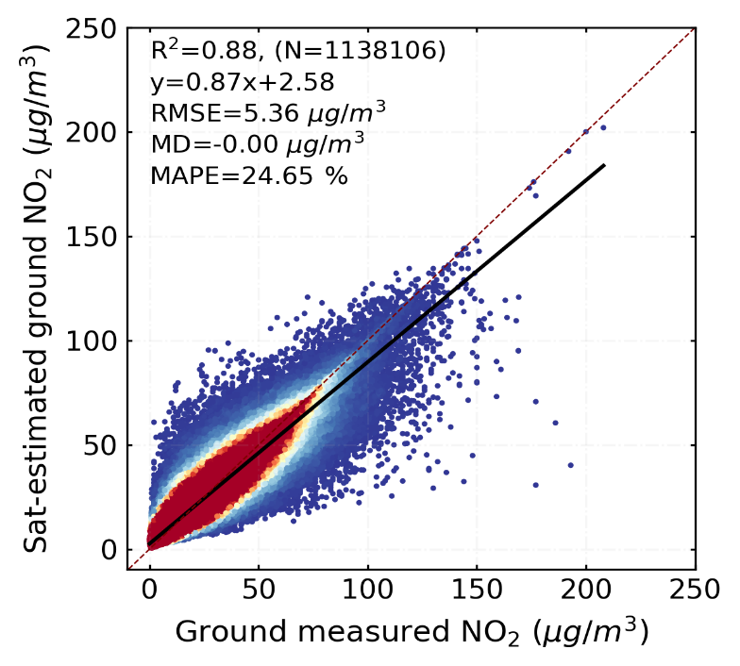
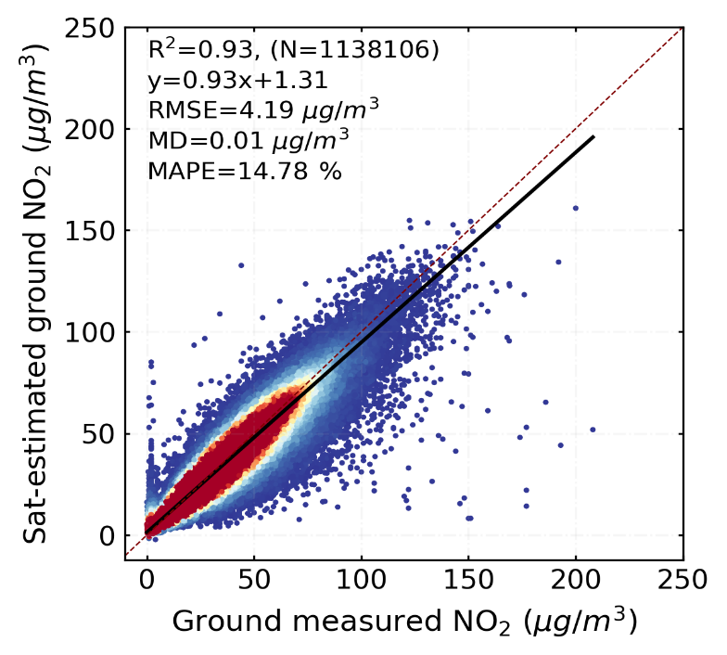
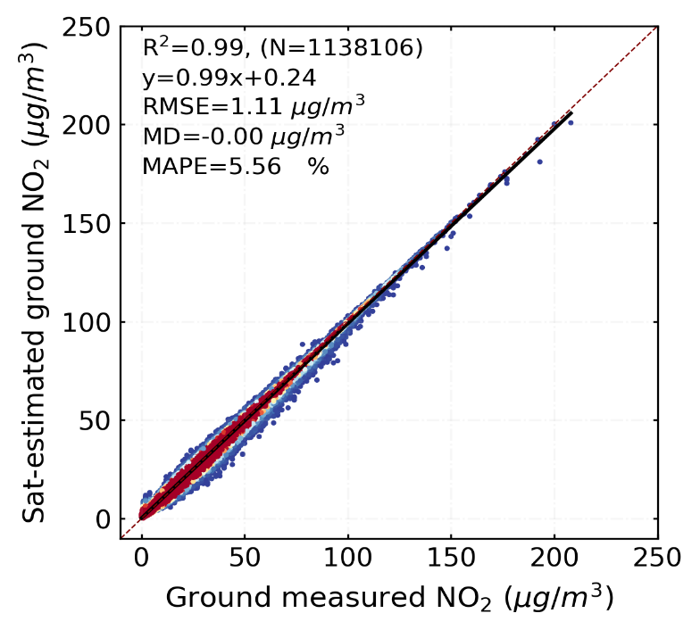
Effect of NMH on column-to-ground conversion
10-fold cross-validation
Full-trained model
R²=0.73
R²=0.88
Basic model does not consider NMH
(a)
(b)
The inclusion of NMH significantly enhances the accuracy of estimating ground-level NO₂, reducing bias and improving R² values.
R²=0.93
R²=0.99
Nested model considers NMH
(c)
(d)

Slide 7
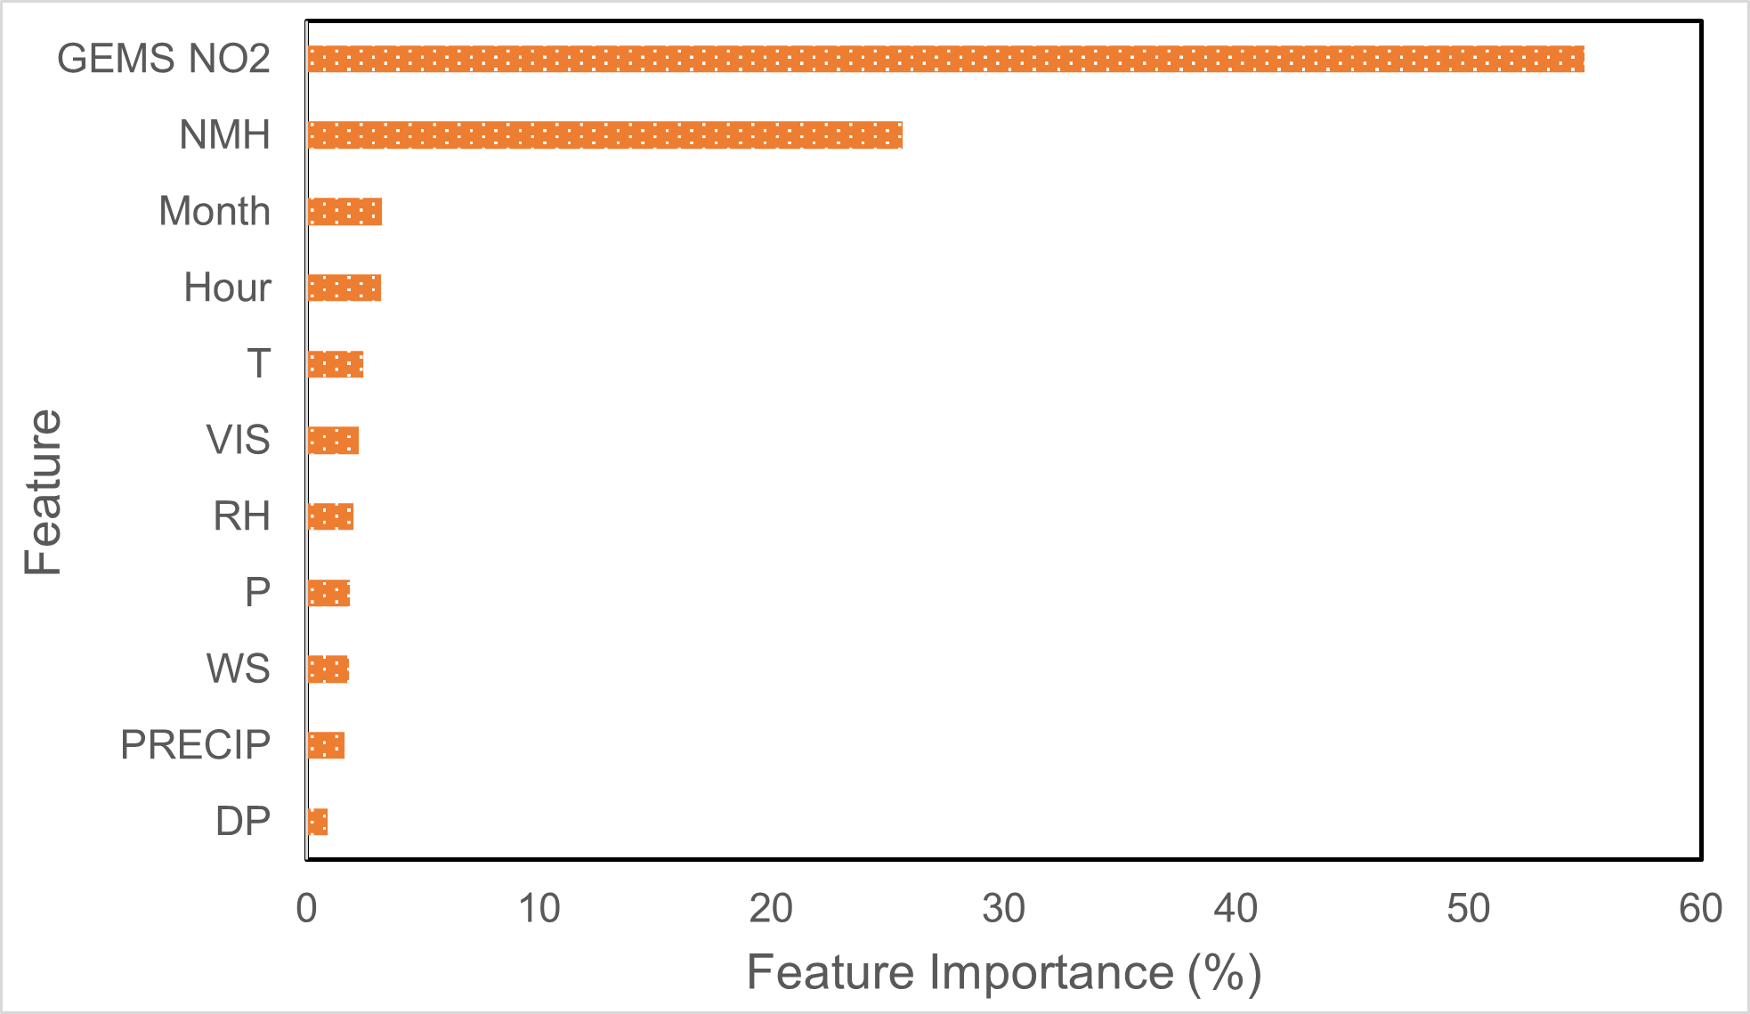
Feature contribution from different input variables
GEMS NO₂ VCDs were identified as the top important predictor variable, while the second important predictor was NO₂ mixing height (NMH).

Slide 8
Diurnal variations in ground-level NO₂ in China
Light populated
Highly populated
Moderately populated
Supremely highly populated
Highly populated urban areas typically experienced peak NO₂ during early morning rush hours, whereas lightly populated rural areas observed a slight increase in NO₂ levels one or two hours later, likely due to local emissions or regional pollutant dispersion from urban sources.

Slide 9
Summary
We developed a nested XGBoost machine learning model to convert VCDs of NO₂ into ground-level NO₂ using GEMS measurements. The inner machine learning model predicted NO₂ mixing height (NMH) from meteorological parameters, which were then input into the main machine learning model to predict the ground-level NO₂ from its VCDs. The inclusion of NMH significantly enhanced the accuracy of ground-level NO₂ estimates.
Geostationary satellites show significant advantages in providing detailed air pollution information at an hourly resolution. Highly populated areas typically experienced peak NO₂ concentrations during the early morning rush hours, whereas areas categorized as lightly populated observed an increase in NO₂ levels one or two hours later (local emissions, regional dispersion from urban sources).

Slide 10
Thank you for your attention!
Q & A

