Slide 1
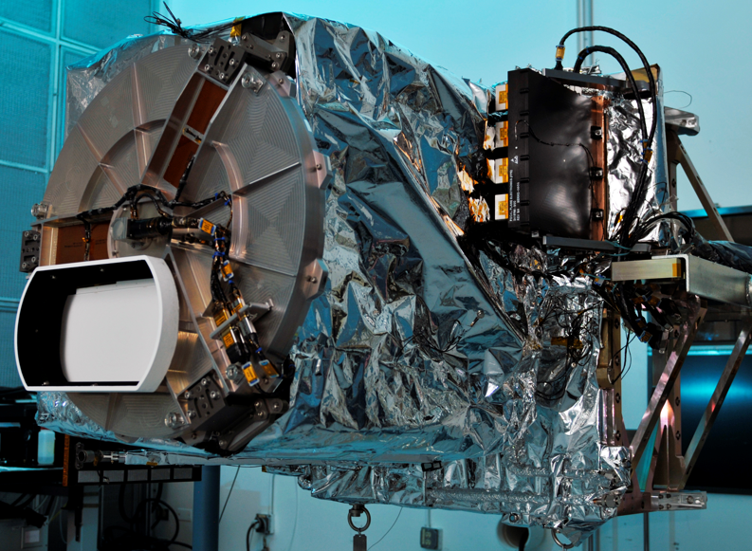
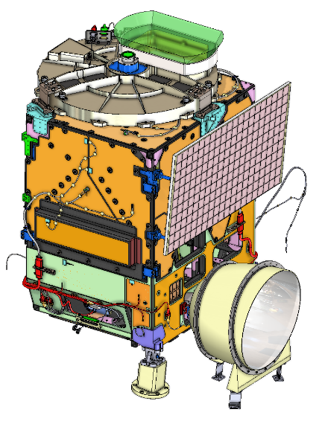
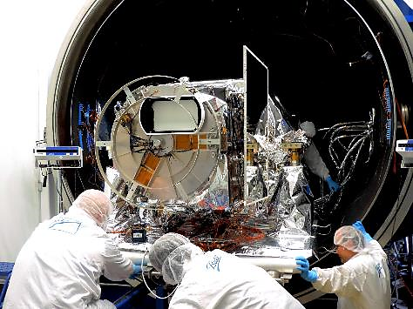
Changes to TEMPO for ACX
Dennis Nicks, BAE Systems, Space & Mission Systems

Slide 2
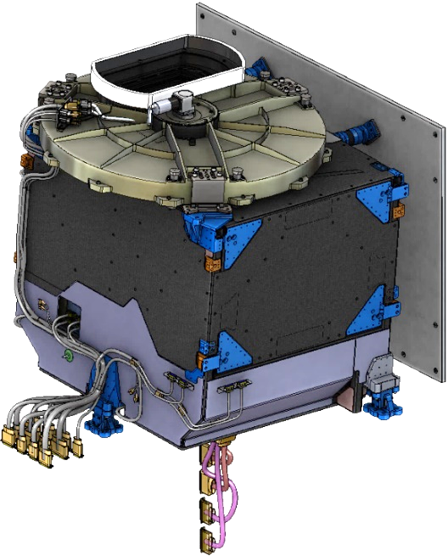
Comparison of GEMS, TEMPO and ACX
Parameters | GEMS | TEMPO | ACX
Mass | 145 kg | 137 kg | 157 kg (CBE)
Volume (x,y,z) meters | 1.0 x 1.1 x 0.87 | 1.4 x 1.1 x 1.2 | 1.4 x 1.1 x 1.2
Average Operational Power | 155 W | 139 W | 145.3 W (CBE)
Field of Regard | 7.8° N/S x 11.2° E/W | 4.76° N/S x 8.95° E/W | 4.76° N/S x 8.95° E/W
Ground Sample Distance | 6 km x 8 km (N/S x E/W) | 2.2 km x 5 km (N/S x E/W) | 2.2 km x 5 km (N/S x E/W)
Spectral Range | 300-500 nm | 290-490 nm, 540-740 nm | 300-500 nm, 540 – 740 nm
Spectral Bandwidth | 0.6 nm | 0.6 nm | 0.6 nm
Status | 2/2020 launch / 128° E | 4/2023 launch / 91° W | In development

Slide 3
ACX will build on TEMPO & GEMS success
TEMPO was an aggressive development for a NASA Earth Venture Instrument (EVI) budget
TEMPO & GEMS are first ever geostationary UV/Vis hyperspectral imagers
NASA LaRC, SAO and BAE made lots of concessions to get there
Co-development with GEMS was critical for success
Overall successful developments, with some lessons learned
ACX allows us to build on TEMPO success
Modernize focal plane subsystem
Improve optical performance
Improve calibration performance and stability
GEMS and TEMPO were the First Ever Geostationary UV/Vis Hyperspectral Imagers

Slide 4
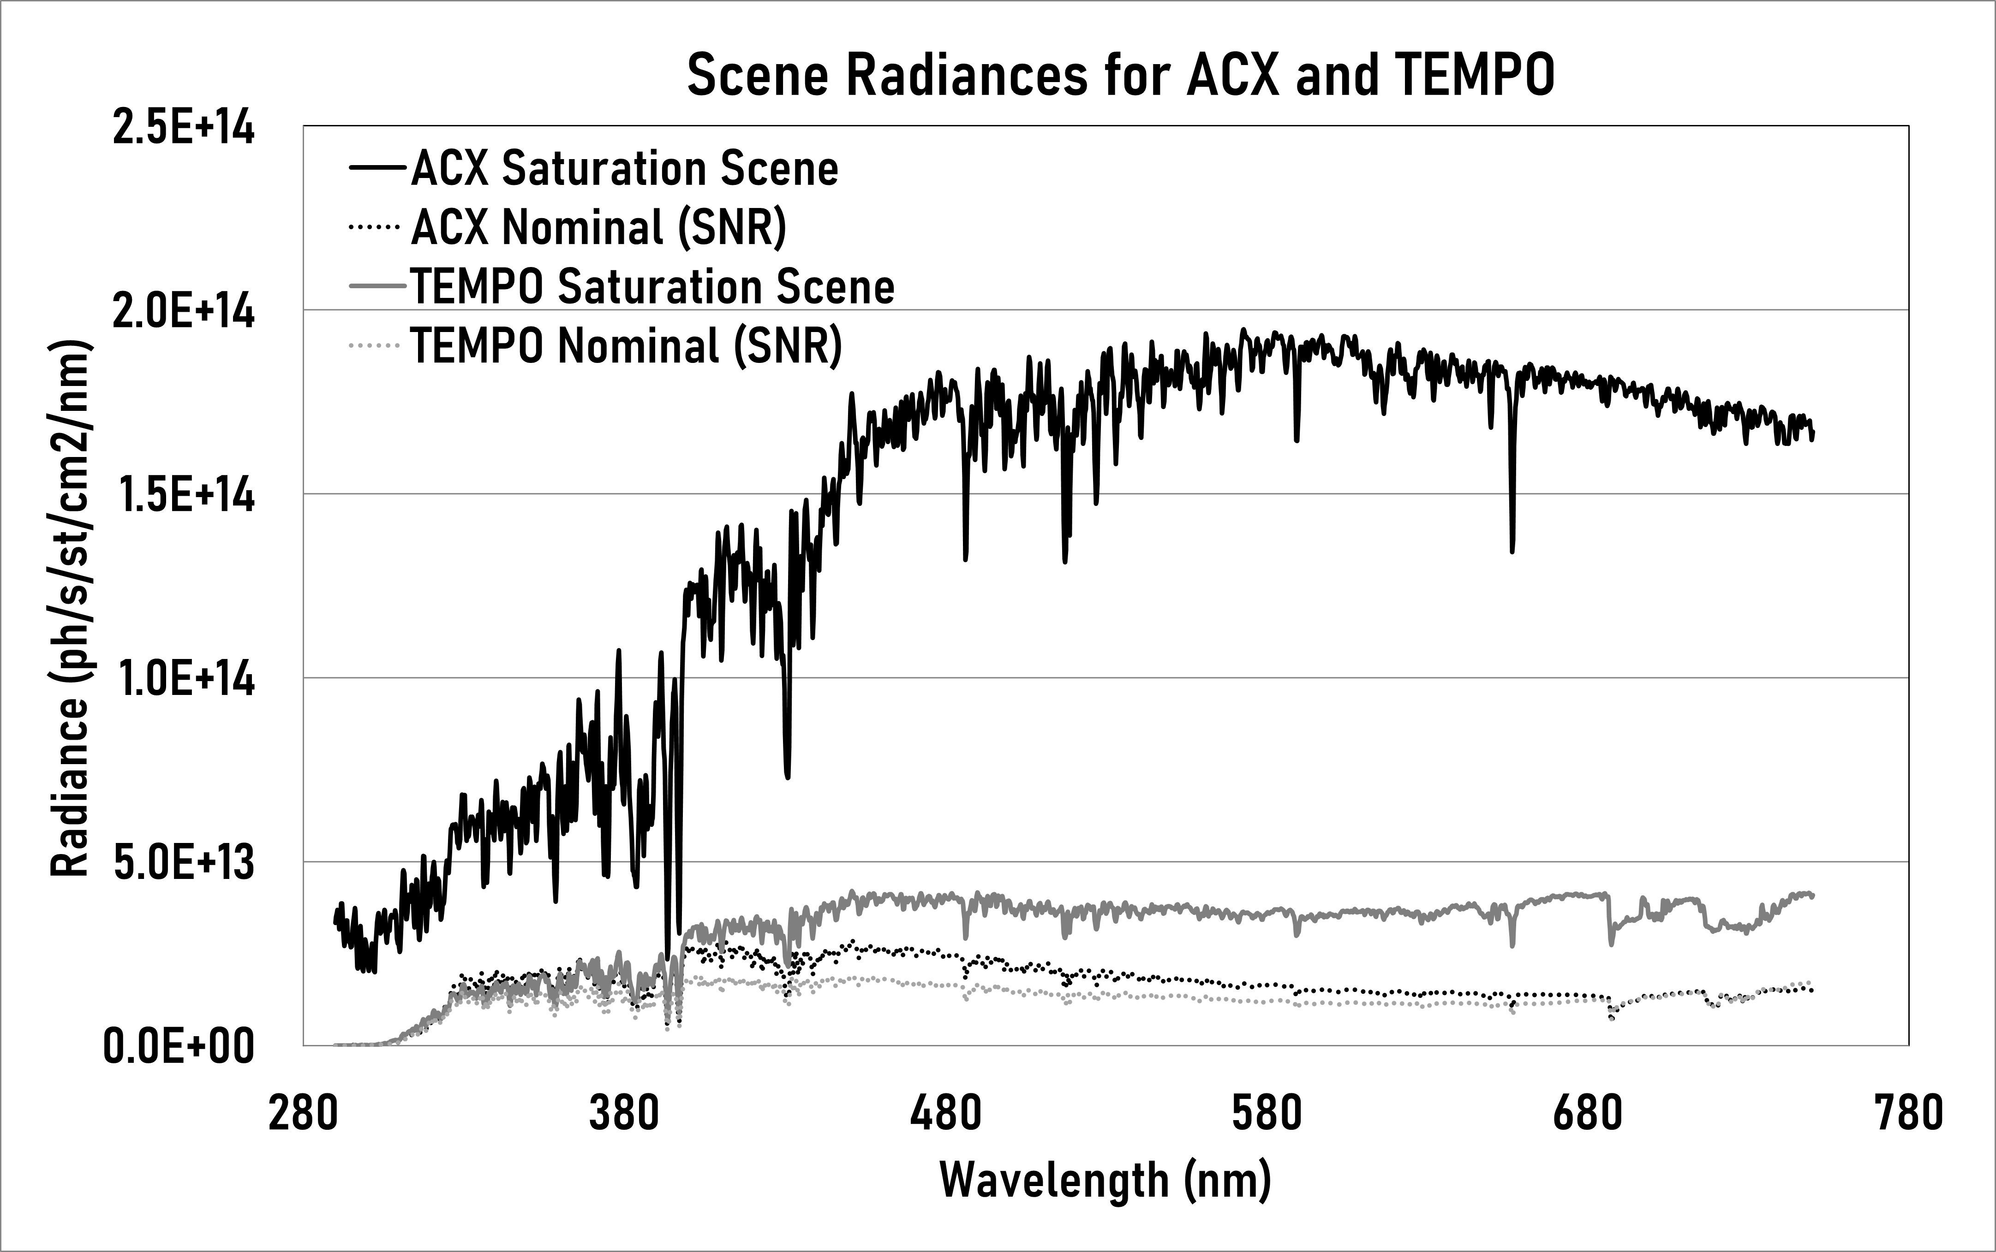
ACX requires higher dynamic range
ACX scene radiance is >> than TEMPO scene radiance
Will minimize saturation during observations
Requires larger pixel well depth, faster frame rate, or both
TEMPO max frame rate ~9 Hz
Nominal ACX frame rate ~ 30Hz
ACX utilizes a digital CMOS focal plane
Monolithic 3k x 3k detector
Pros: higher frame rate, lower noise than TEMPO CCD
Pros: Additional operational capabilities (programmable gain stages)
Cons: lower QE than TEMPO CCD

Slide 5
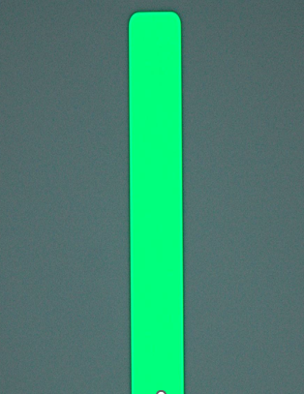
Improved slit for spectral bandpass
TEMPO slit varied ~4 μm over slit length
Caused non-compliance in spectral bandpass
New silicon slit width variability is better than 0.5 um
Provides better precision and uniformity
55 μm
TEMPO: 52 μm

Slide 6
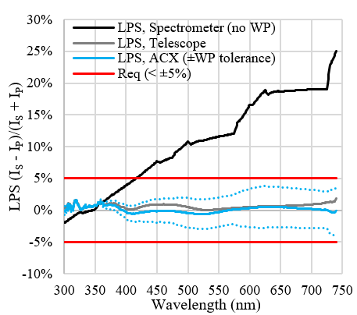
More stringent polarization sensitivity
TEMPO Polarization Sensitivity:
< 5% from 240 – 490 nm
< 20% from 540 – 740
GEMS Polarization Sensitivity
< 2% from 310 – 500 nm
ACX Polarization Sensitivity
< 5% from 300 – 500 nm, 540 – 740 nm
ACX achromatic waveplate design provides improved polarization sensitivity
Early risk reduction testing completed

Slide 7
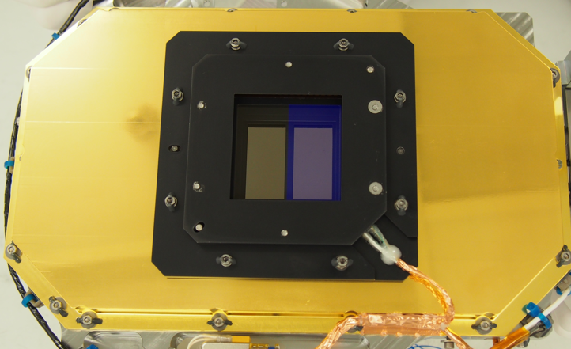
Improvements in Stray Light Performance
TEMPO stray light model did not predict performance well
Diffraction grating scatter not well modelled
Did not predict non-compliance at 290 – 307 nm
Caused by light > 500 nm, so not seen by GEMS
Primary stray light source is the grating
ACX changes
Incorporate a low-pass filter over UV channel
Further characterize flight grating and update stray light model
Use updated stray light model for additional mitigation
ACX to incorporate short-pass filter over UV channel
order-sorting long-pass filter
TEMPO FPA

Slide 8
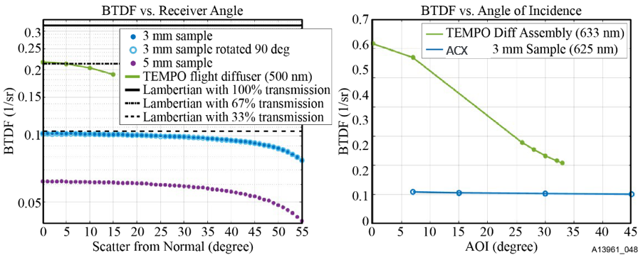
Updated solar calibration diffuser based on GEMS/TEMPO experience
Updates to TEMPO & GEMS ground fused silica transmissive diffuser plates for improved stability and bidirectional transmission distribution function (BTDF) performance
New ACX material has more uniform BTDF over large angles
BTDF measured during ACX study
Will conduct UV exposure testing to validate on-orbit life

Slide 9
Summary
BAE continues to innovate atmospheric composition remote sensing instruments
TEMPO and GEMS first ever Geostationary UV/Vis Hyperspectral imagers
ACX highly leverages GEMS & TEMPO instrument design
Same spectral and spatial performance
Adds modern, digital, focal plane subsystem
Improved optical performance
Improved solar calibrator

