Slide 1
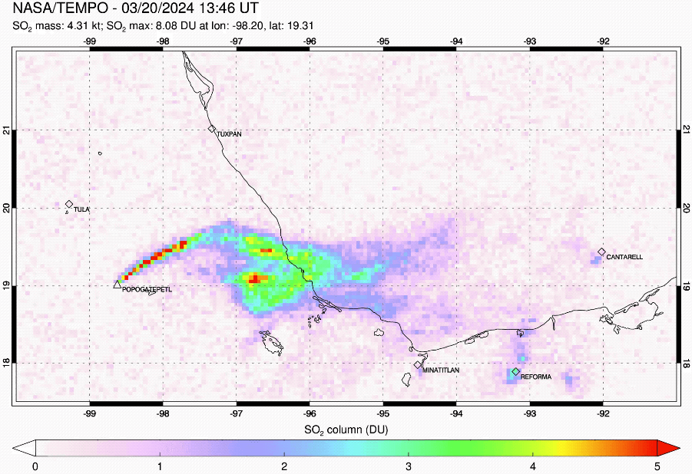
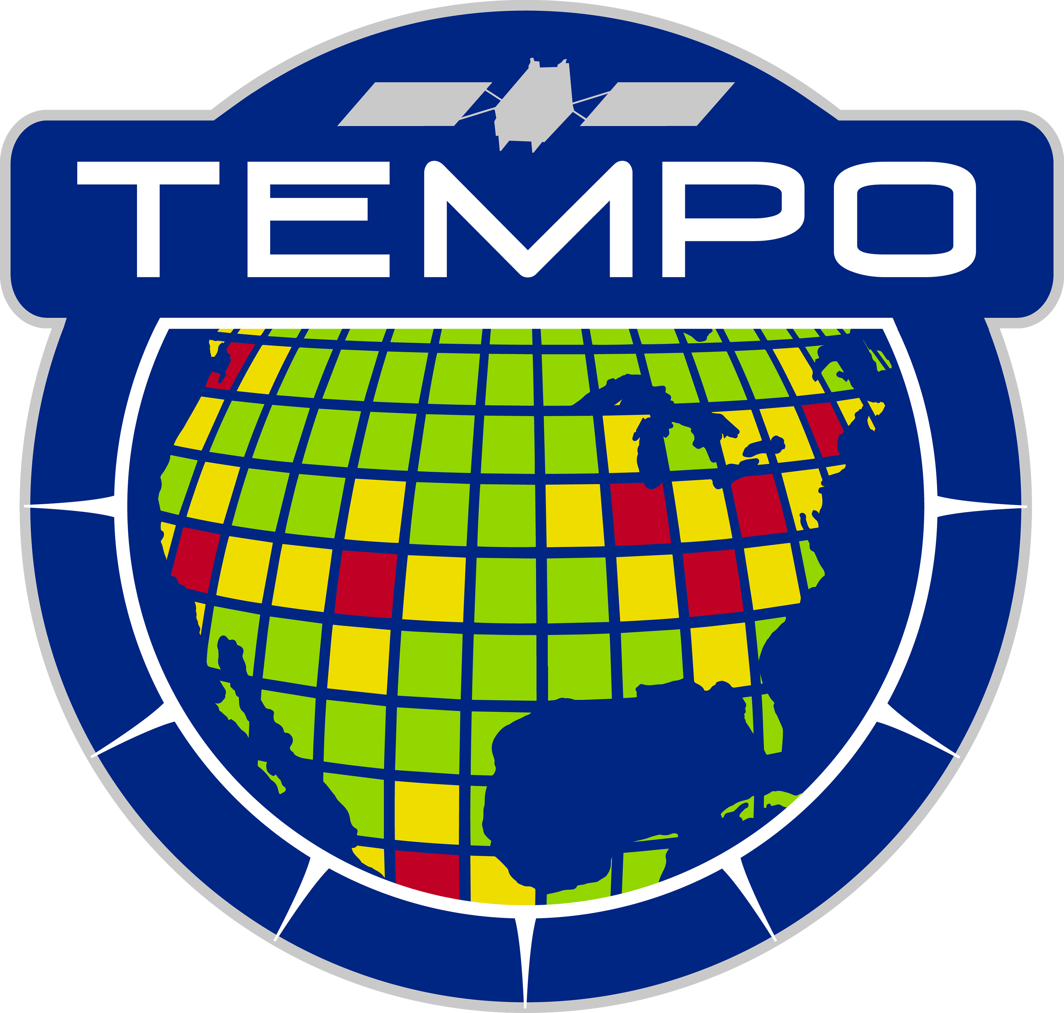
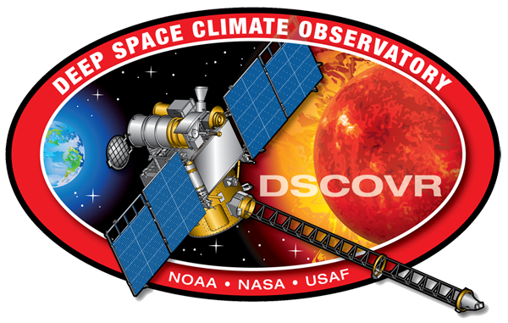
High Cadence Observations of Volcanic Activity from the Geostationary UV Satellite Constellation
Simon Carn¹, Can Li², Brad Fisher^{2,3} and Nick Krotkov²
Michigan Technological University, Houghton, MI, USA
NASA Goddard Space Flight Center, Greenbelt, MD, USA
SSAI, Lanham, MD, USA
Acknowledgments: NASA DSCOVR Science Team for support

Slide 2
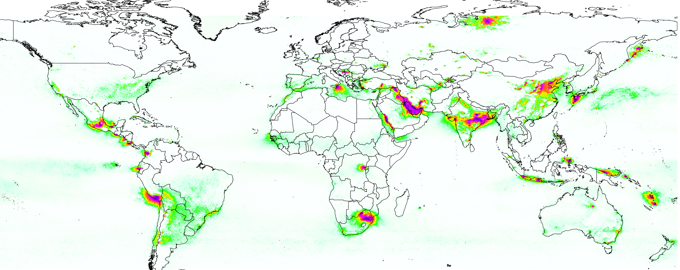
Geostationary UV Air Quality (GEO-AQ) Satellite Constellation
TEMPO (hourly)
2023 -
Iceland
Italy
Sentinel-4 (hourly)
2025 -
Japan
Philippines
N. Indonesia
Mexico
Guatemala
Lesser Antilles
GEMS (hourly)
2020 -
Sentinel-5P/TROPOMI
Average SO₂ column (2018-2020)
Theys et al. (2021)
SO₂ column (DU)
Numerous active volcanoes located within the GEMS, TEMPO and Sentinel-4 fields-of-regard (FoR).
Drifting volcanic SO₂ or ash clouds from other regions can also enter FoR.
Strong motivation for developing and using GEO-AQ SO₂ products for volcanic hazard mitigation.

Slide 3
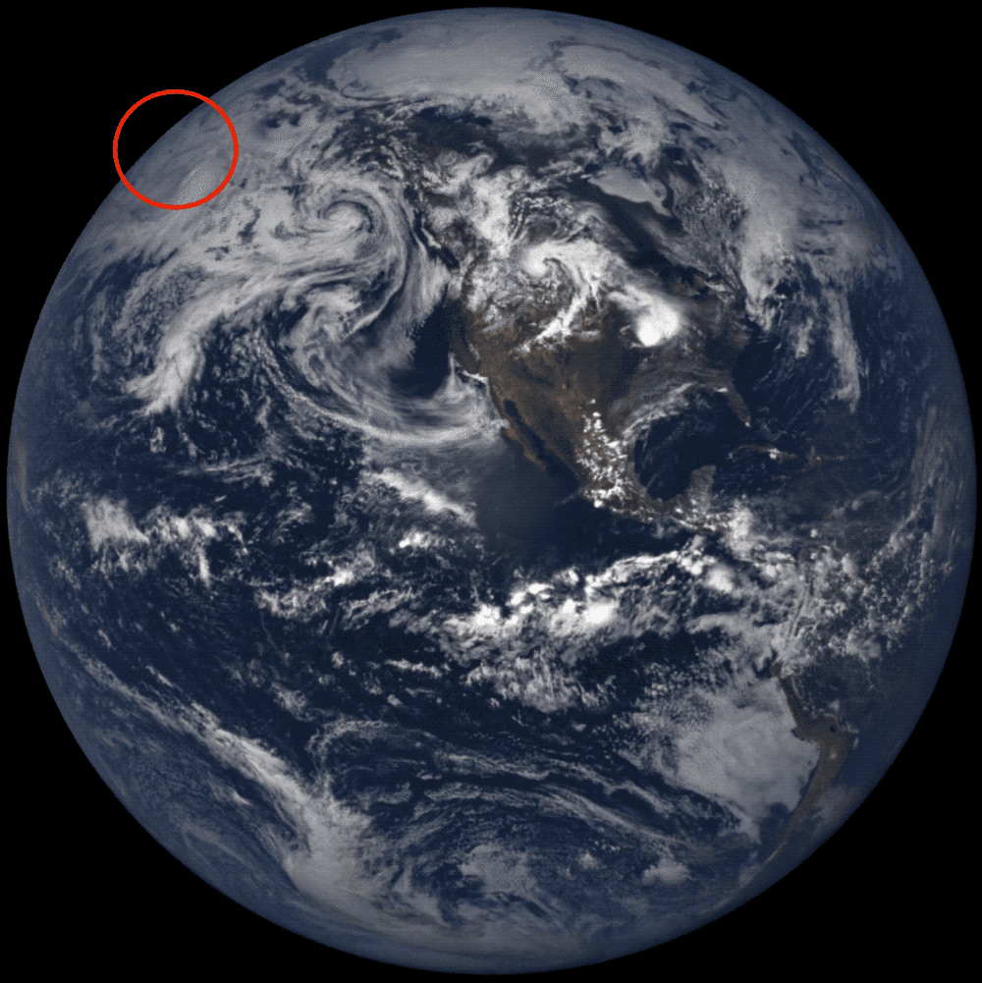
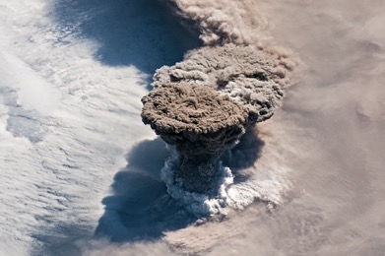
Raikoke eruption (Kuril Islands, Russia) – June 21, 2019
Deep Space Climate Observatory (DSCOVR)
Earth Polychromatic Imaging Camera (EPIC)
Carn et al., GRL, 2018
Gorkyavi et al., Front. Rem. Sens., 2021
Carn et al., Front. Earth Sci., 2022
L₁ Earth-Sun Lagrange Point
(1,000,000 miles from Earth)
10-channel UV-Vis spectroradiometer
18×18 km spatial resolution
International Space Station
L2 SO₂ product available since 2015 for large volcanic eruptions
EPIC RGB images
https://epic.gsfc.nasa.gov/

Slide 4
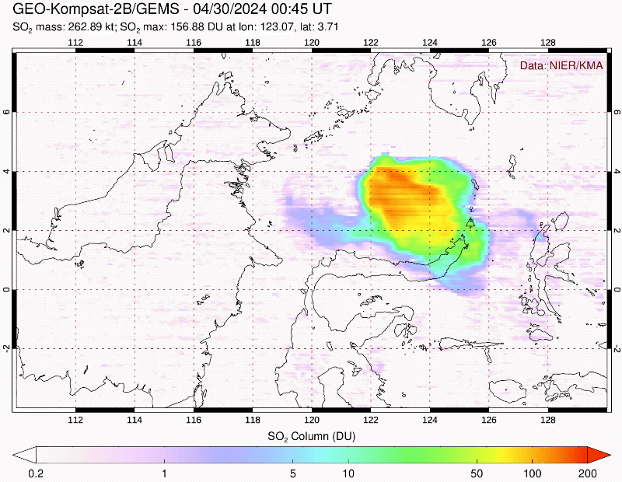
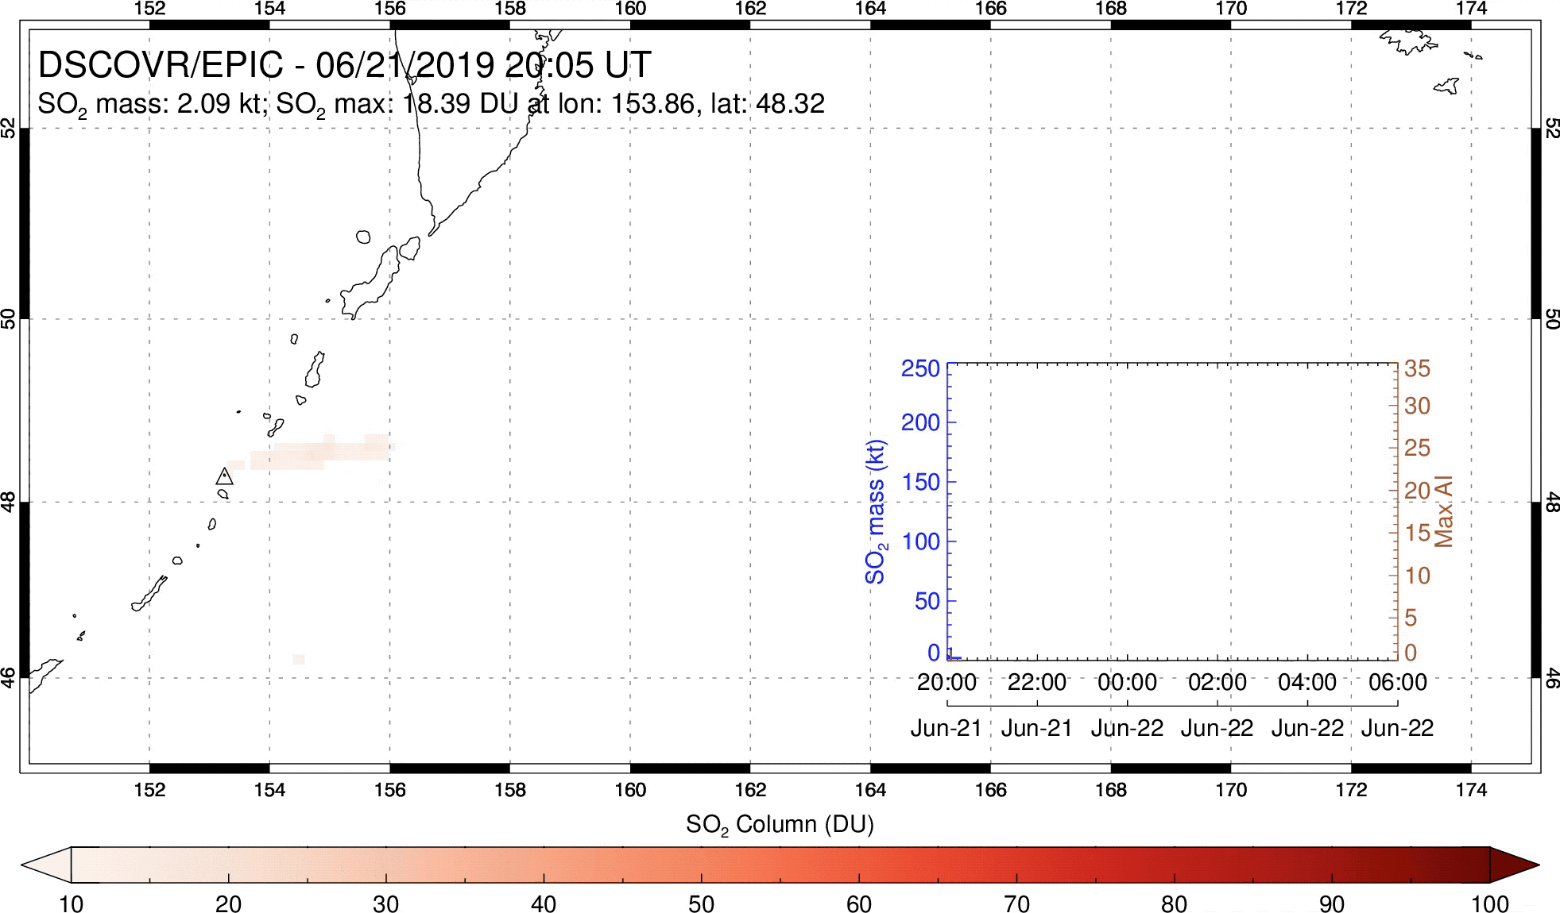
Response to major volcanic eruptions
2019 Raikoke eruption (Kuril Is, Russia)
GEMS
EPIC
SO₂ + UVAI
2024 Ruang eruption (Indonesia)
NASA’s Major Eruption Response plan requires rapid assessment of volcanic SO₂ loading (~5 Tg SO₂ threshold for potential climate impacts) and altitude.
High-cadence UV observations of SO₂ and ash (UVAI) yield temporal trend in SO₂ mass, which shows impact of ash and cloud opacity on SO₂ measurements; pattern of SO₂ dispersal indicates altitude.

Slide 5
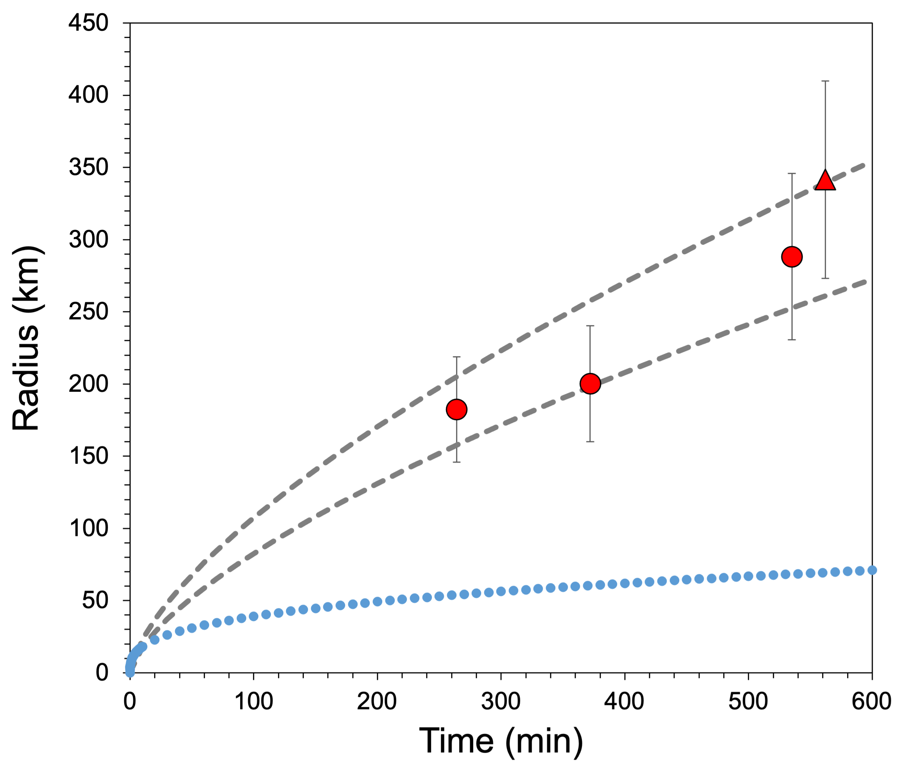
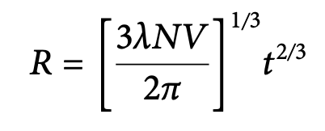
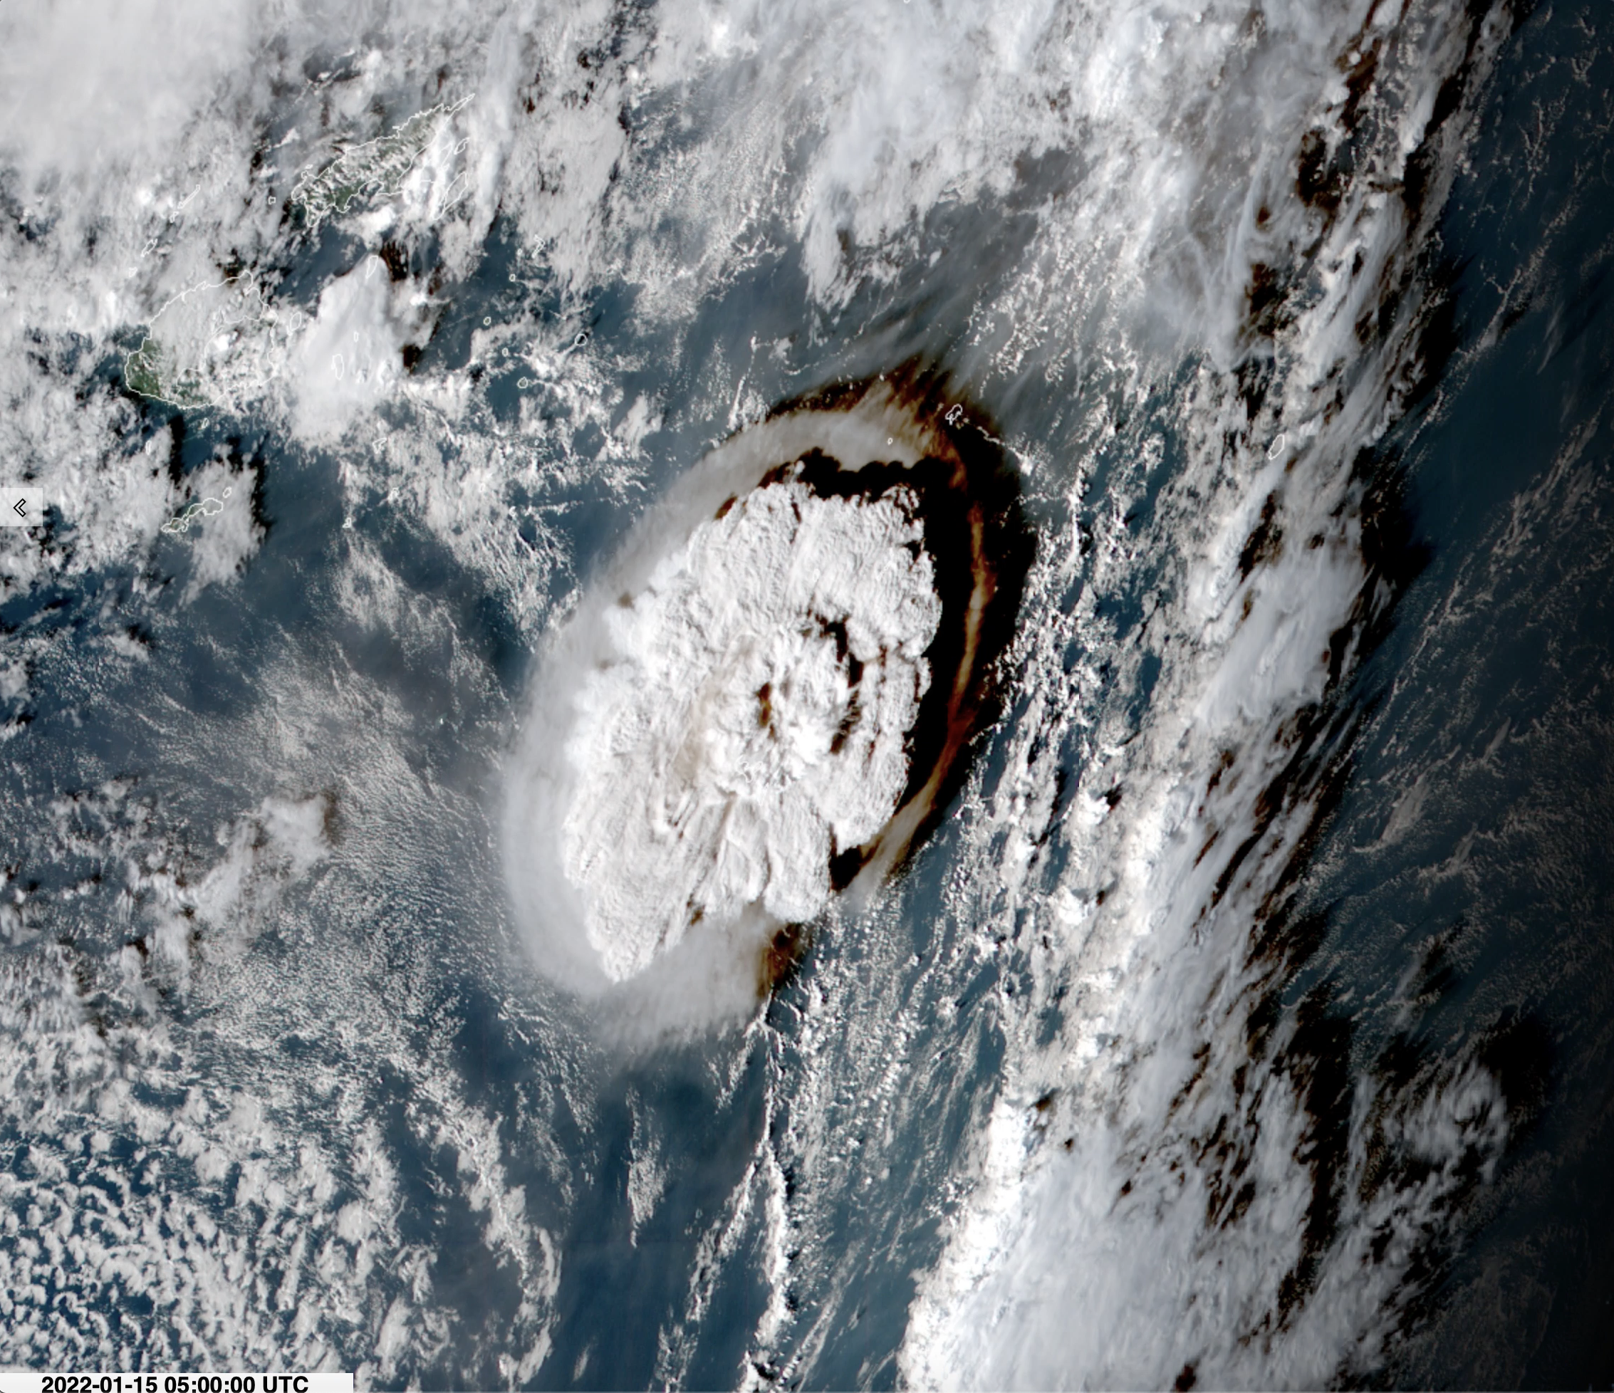
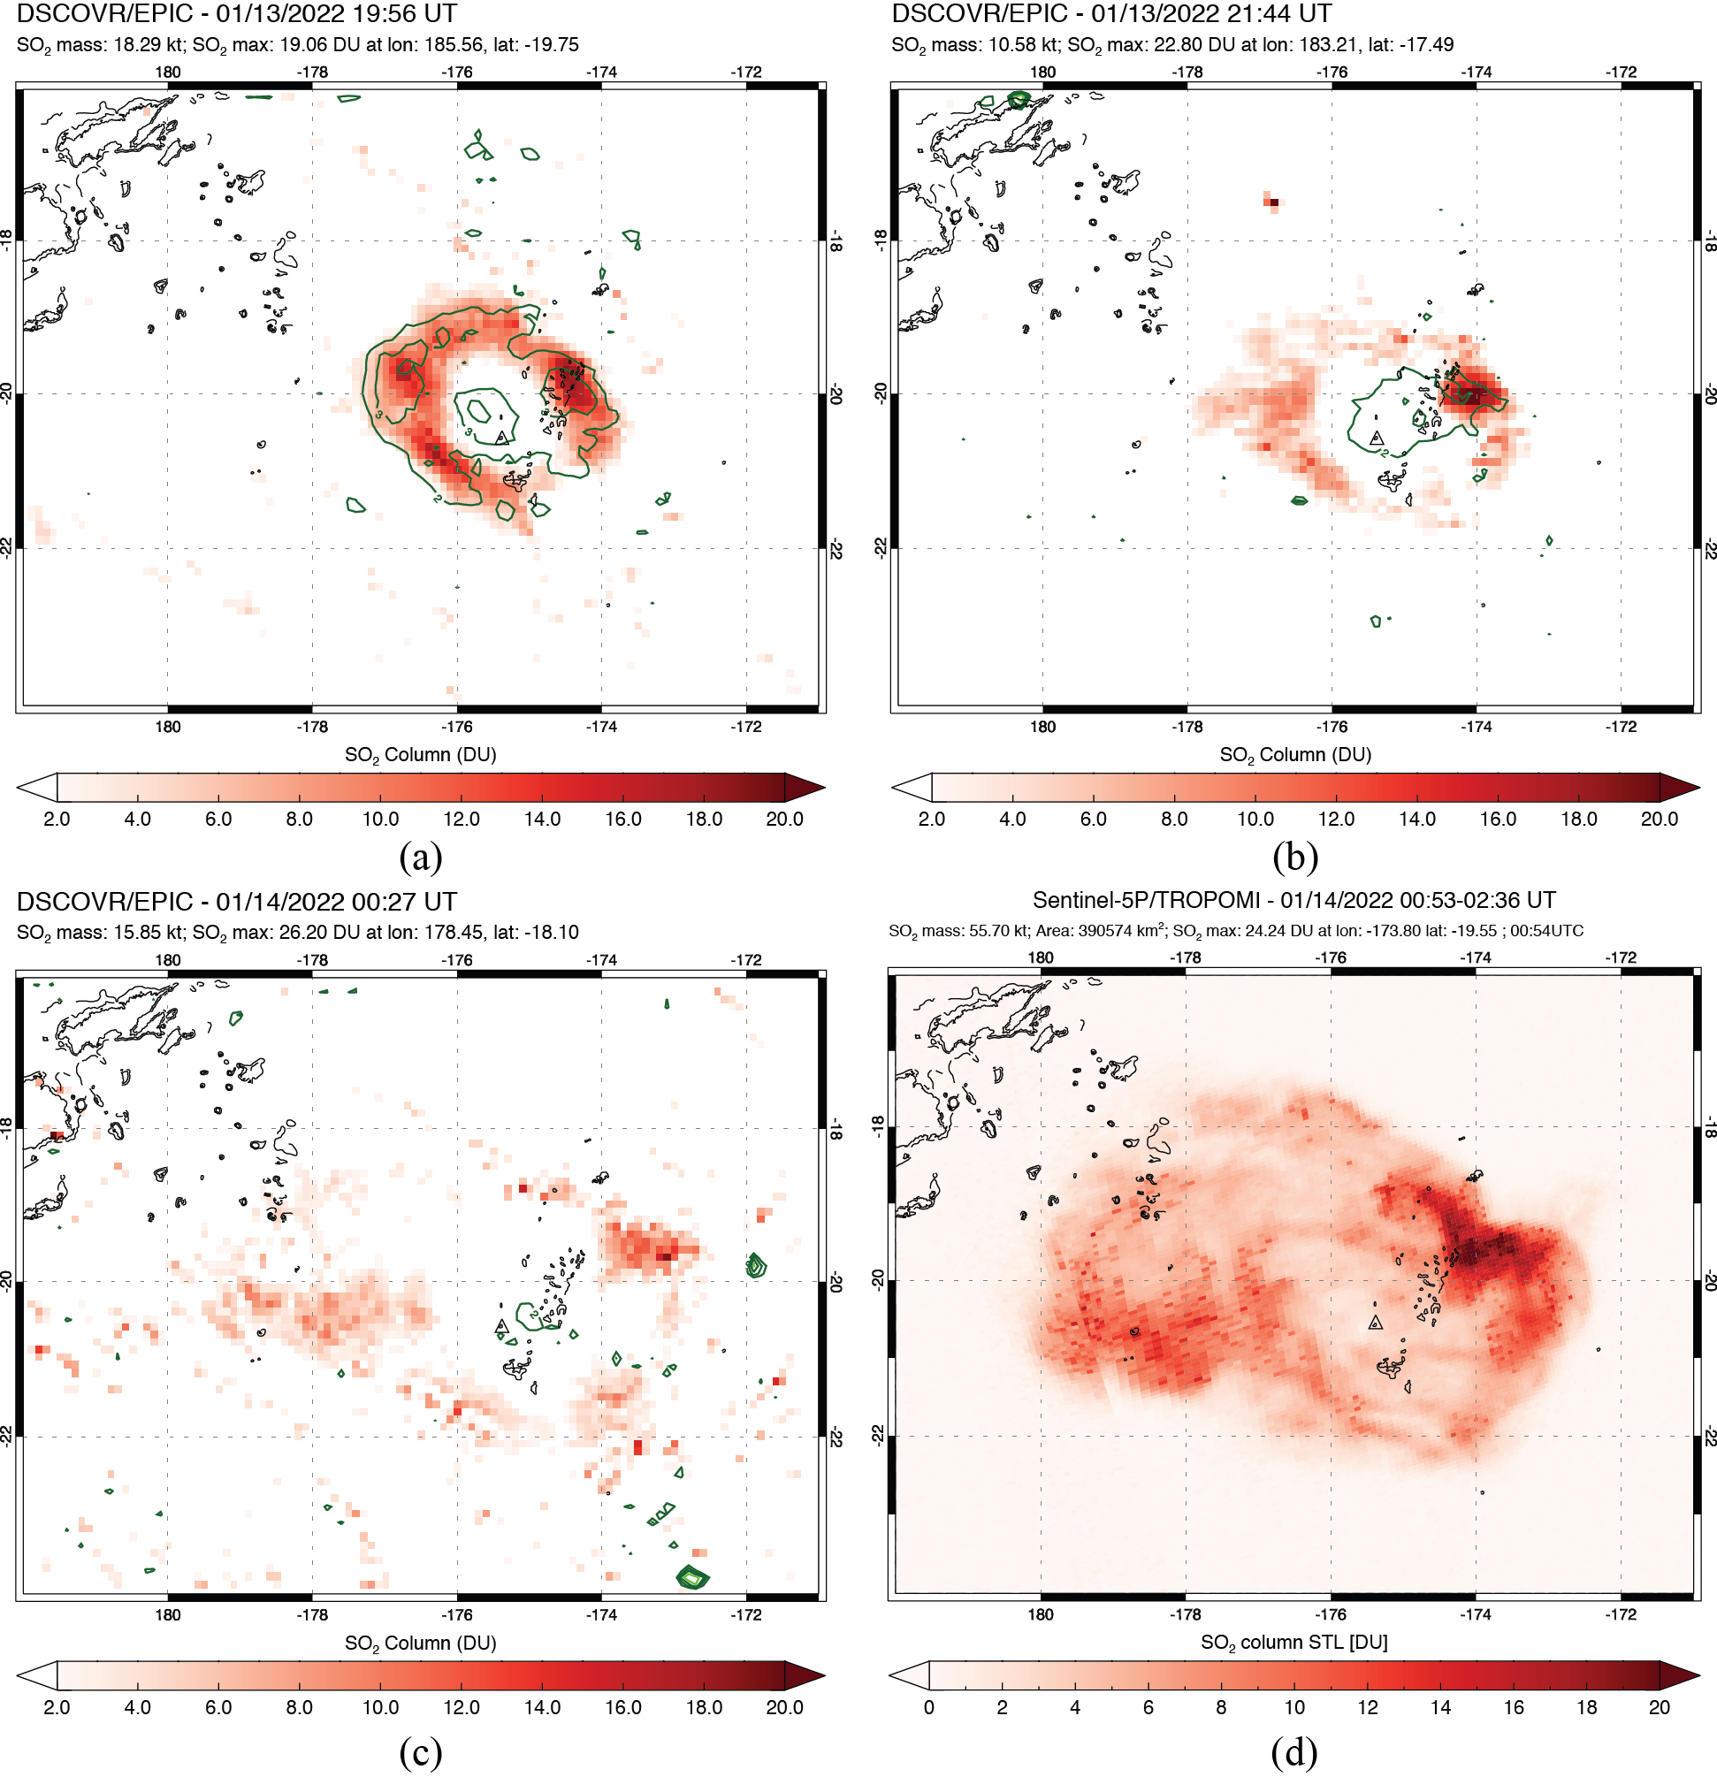
Umbrella cloud analysis with UV data
Pouget et al., 2013
2022 Hunga eruption
EPIC
EPIC
Continuous
V = 14 km³ s⁻¹
EPIC+TROPOMI
V = 6 km³ s⁻¹
EPIC
TROPOMI
Instantaneous
Carn et al., 2022

Slide 6
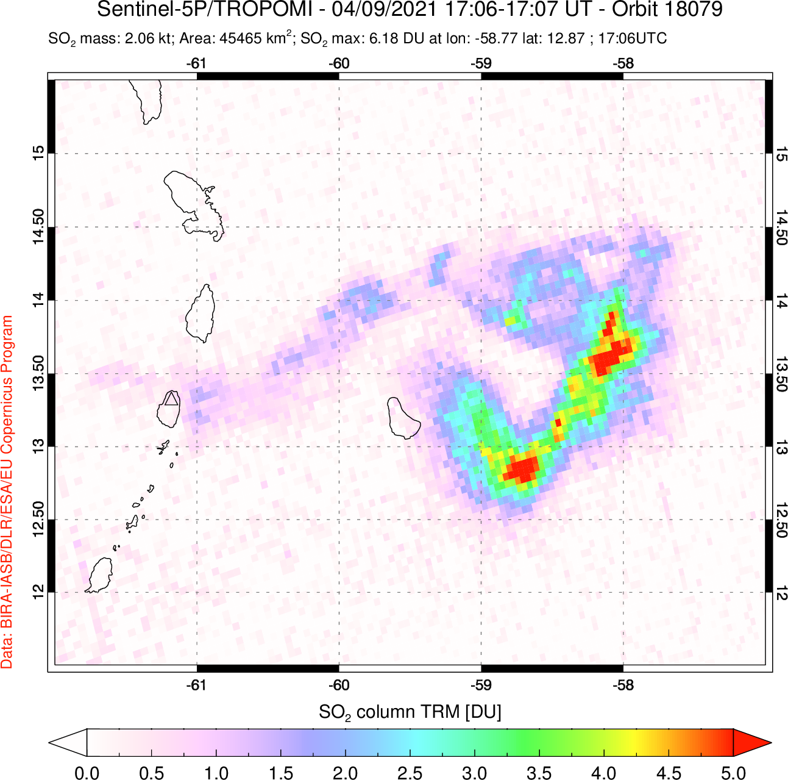
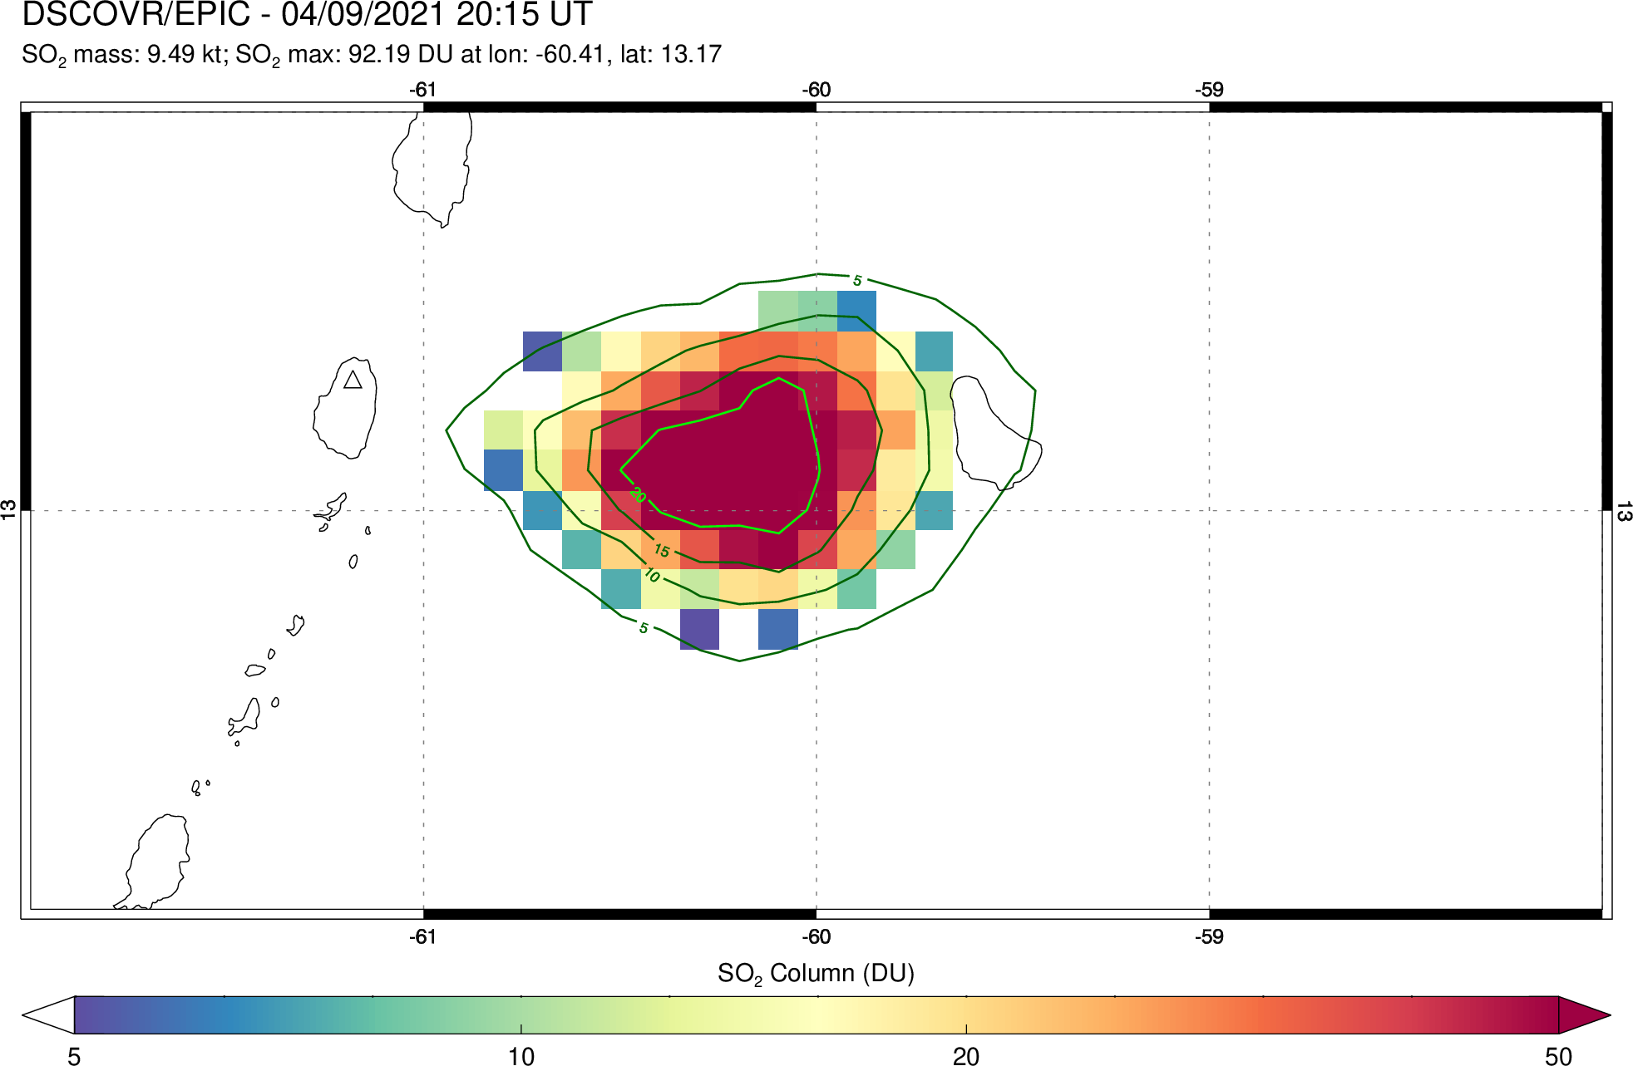
Multiphase eruptions: 2021 La Soufrière (St Vincent)
TROPOMI @ 17:06 UTC
EPIC @ 20:21 UTC (16:21 local)
La Soufrière
La Soufrière
Low SO₂ mass/columns (<10 DU)
Higher SO₂ mass/columns (~100 DU)
2021 La Soufrière (St. Vincent) eruption (April 9-13, 2021): 30 discrete explosive events.
April 9, 2021: TROPOMI overpass captures initial ‘vent clearing’ explosion (low SO₂).
Late afternoon EPIC measurements show significant increase in SO₂ (and ash) emissions.

Slide 7
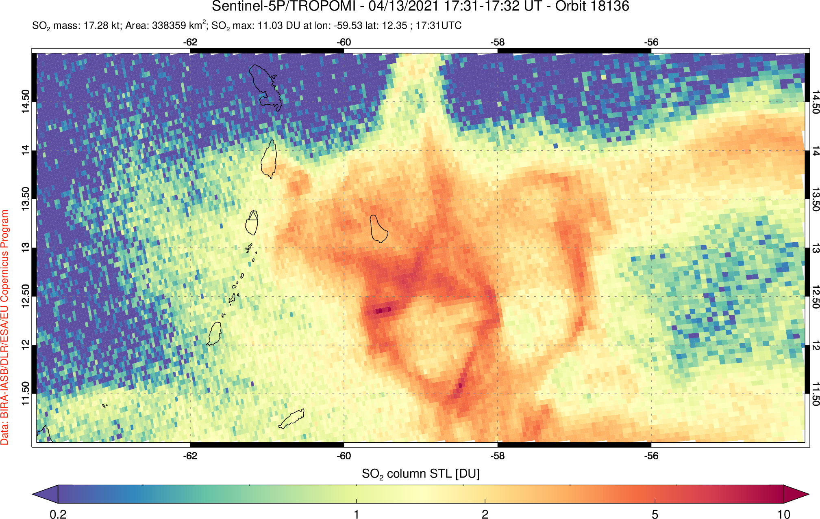
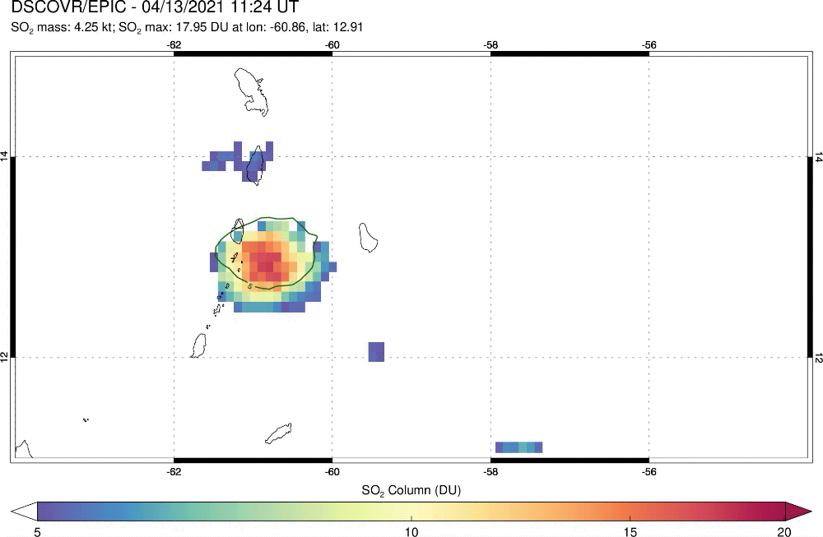
Multiphase eruptions: 2021 La Soufrière (St Vincent)
TROPOMI
EPIC
La Soufrière
La Soufrière
2021 La Soufrière (St. Vincent) eruption (April 9-13, 2021): 30 discrete explosive events.
April 13, 2021: large UTLS background SO₂ columns from prior eruptions (TROPOMI image).
High-cadence EPIC imagery tracks SO₂ cloud (transient increase in SO₂ columns) from new explosion.
Lower SO₂ sensitivity of EPIC advantageous for reducing background interference.

Slide 8
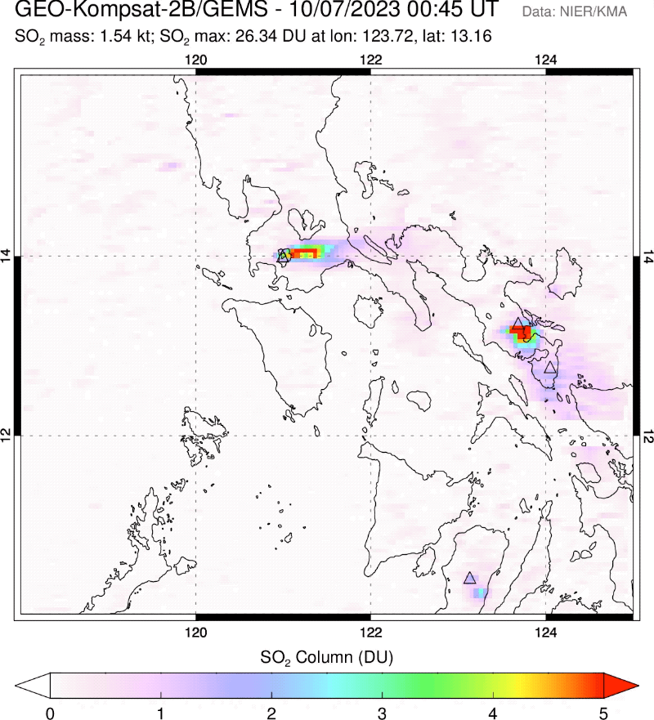
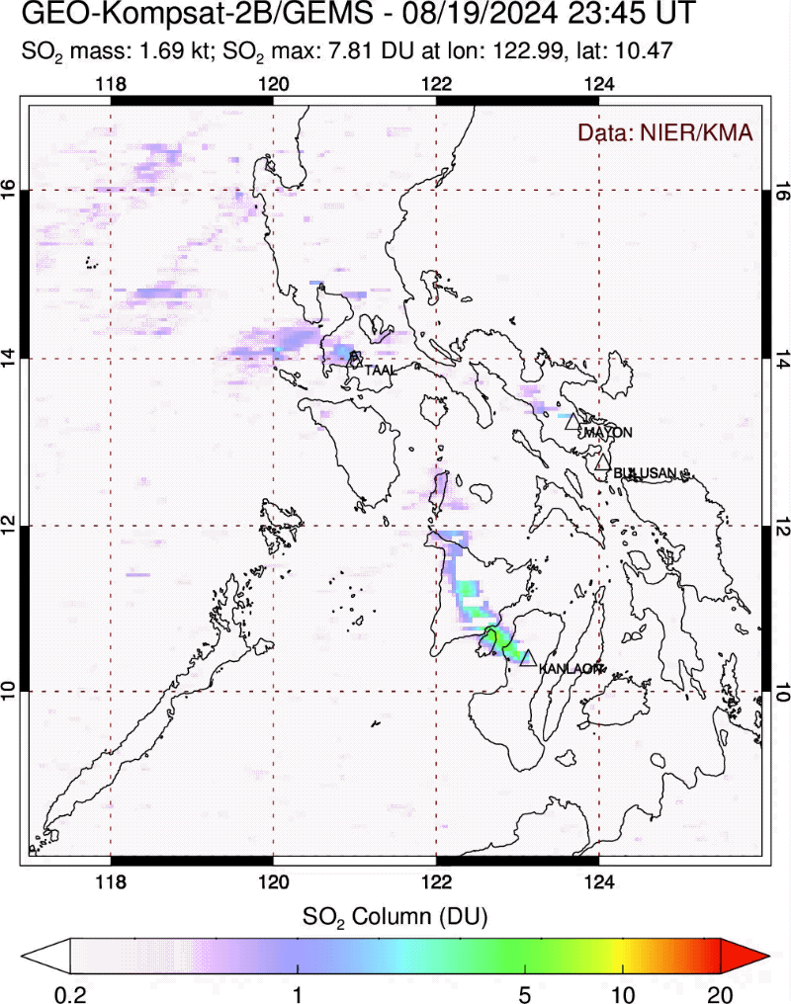
Volcanic air pollution and health hazards in the Philippines
Aug 20, 2024
Taal volcanic smog (vog) event
Significant health hazards due to current high levels of volcanic SO₂ emissions in the Philippines.
GEMS data could aid volcanic smog (vog) forecasting and volcanic source attribution.

Slide 9
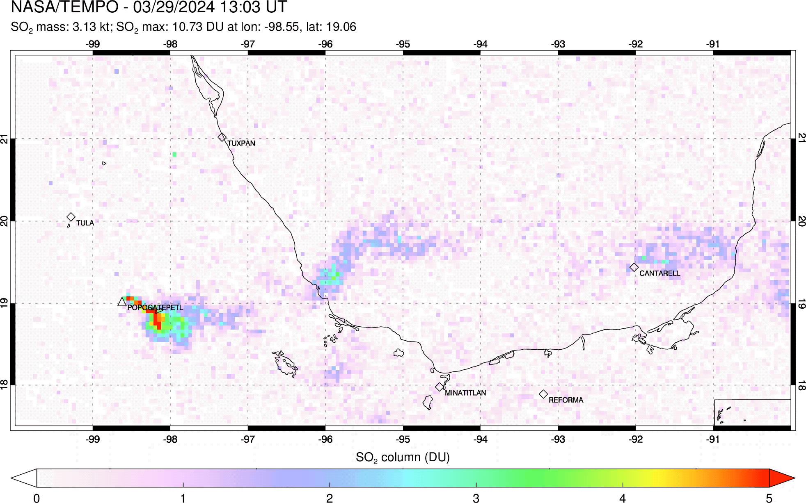
Volcanic and anthropogenic SO₂ in Mexico from TEMPO
Preliminary TEMPO SO₂ retrievals (Can Li, NASA)
PCA algorithm; slant column SO₂ with constant AMF applied
11 hourly observations
Volcanic (Popocatepetl) and anthropogenic SO₂ sources (oil/gas, smelters)
New TEMPO SO₂ retrievals capture dynamics of degassing from Popocatépetl volcano.
Distal volcanic plume interferes with estimates of anthropogenic SO₂ emissions.

Slide 10
Summary
Potential applications of high-cadence UV imaging of volcanic activity from GEO-AQ sensors (GEMS, TEMPO, Sentinel-4):
Volcanic umbrella cloud analysis (e.g., 2022 Hunga eruption)
Eruption response and trends in SO₂ emissions during explosive eruptions (e.g., 2019 Raikoke, 2024 Ruang eruptions)
Monitoring of SO₂ emissions during long-duration, multi-phase explosive eruptions (e.g., 2021 La Soufrière)
Mitigation of health impacts of volcanic degassing (e.g., Philippines)
Impacts of volcanic degassing on anthropogenic SO₂ emission estimates (e.g., Mexico)
Aviation hazard mitigation (timely detection and tracking of volcanic ash clouds)
Volcanic lightning NOx
Requirements:
Rapid (near real-time) processing of large data volumes (~10 times > OMI)
SO₂ products optimized for volcanic clouds (i.e., appropriate SO₂ vertical profile)

