Slide 1
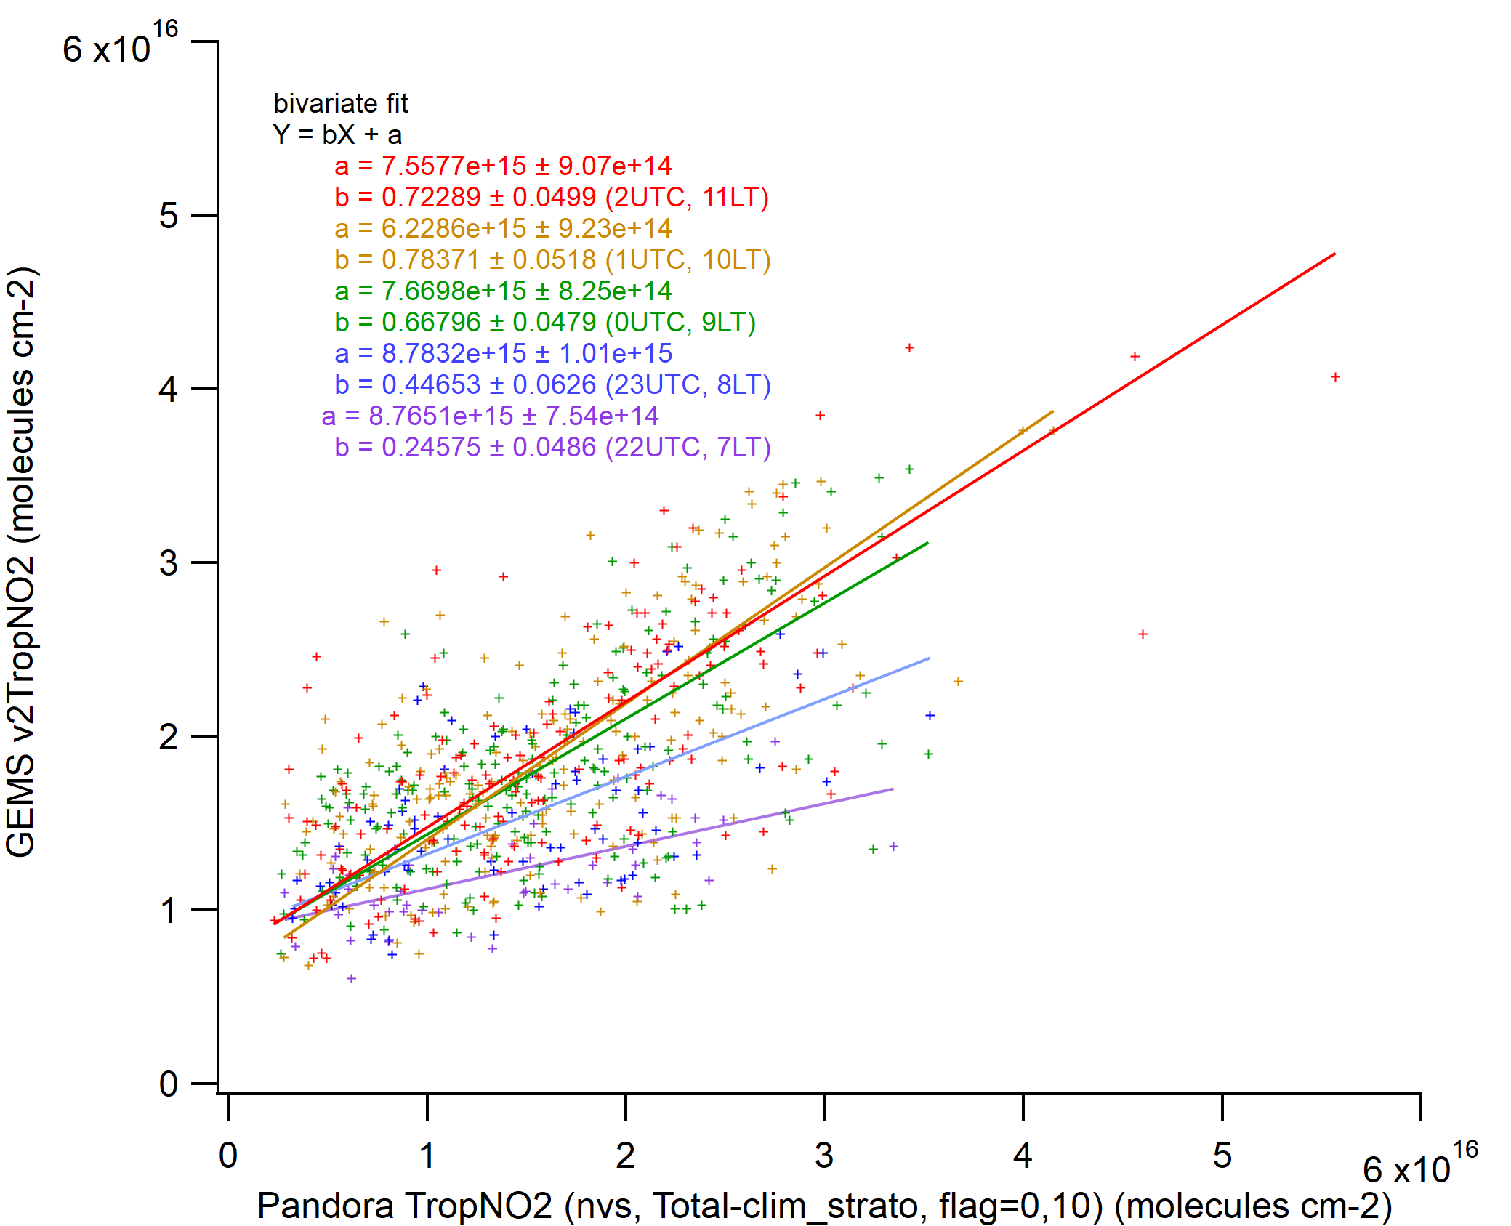
3 major issues, found from GEMSv2 NO₂ validation
(Kanaya et al., 2023 GEMS STM)
1. Diurnally changing sensitivity
2. Positive offset in clean regions
3. AVK profiles
AVK, averaged
2021Nov-2023Apr
Yokosuka
10, 11 LT
Near noon
GEMSv2.0
7 LT
Early morning
Yokosuka, Pandora#146
Fukue, MAX-DOAS

Slide 2








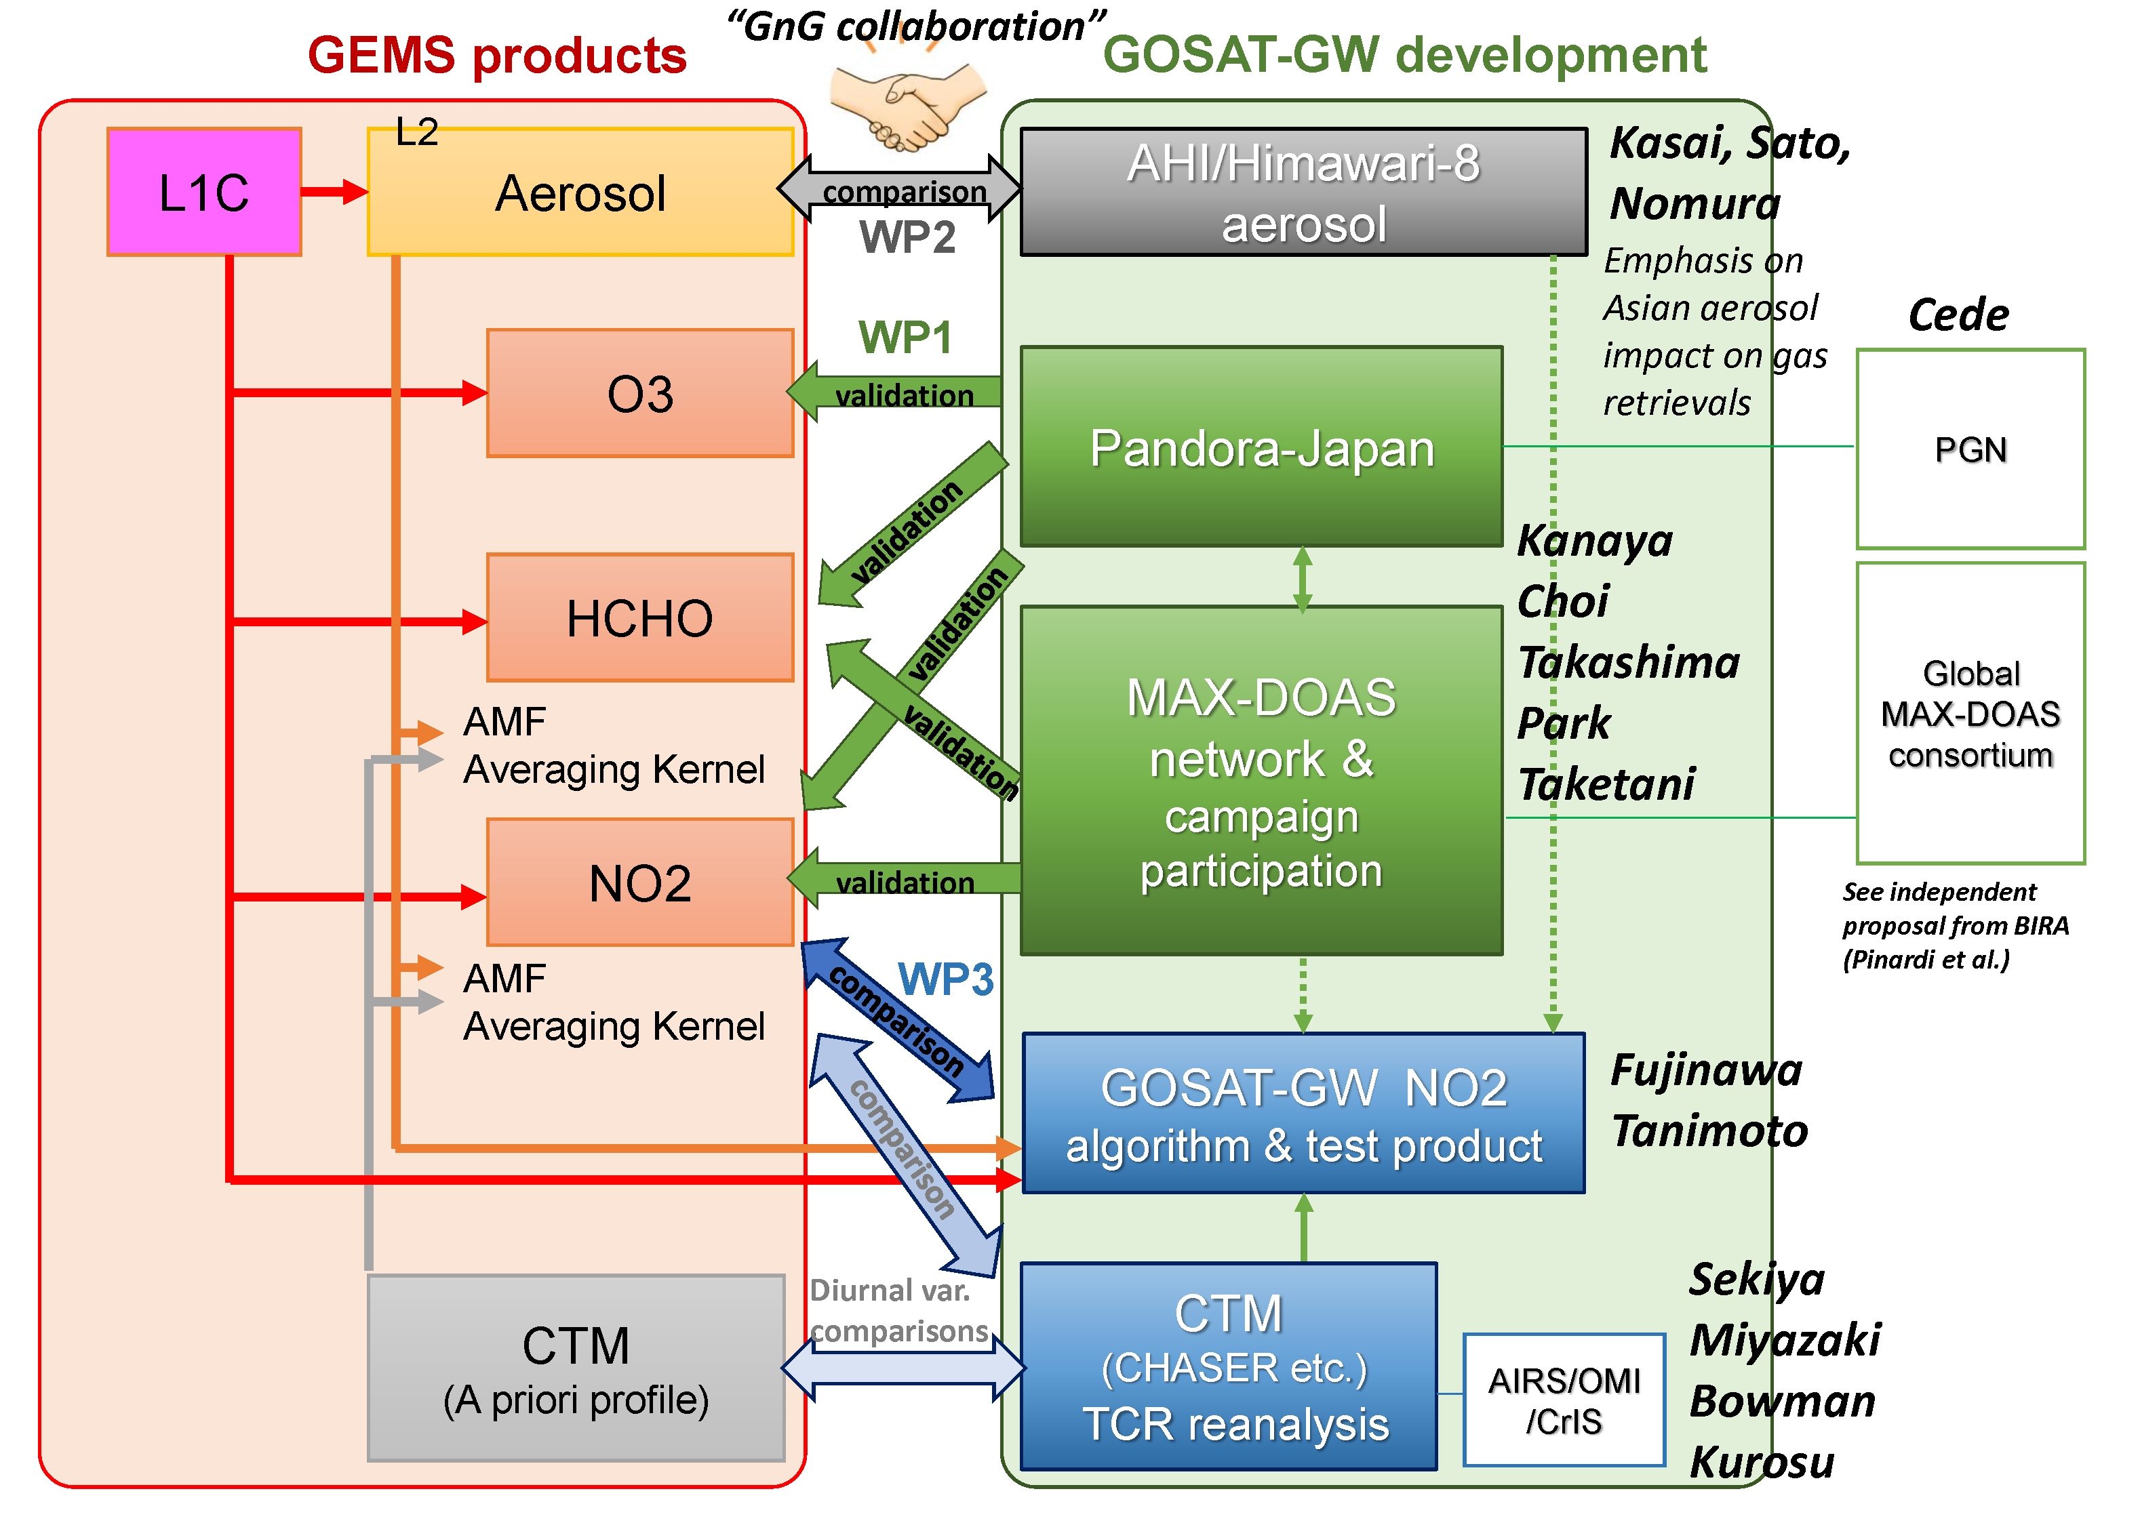
TROPOMI & GEMSv3 NO₂ validation using MAX-DOAS & Pandora at Yokosuka with improved consistency
Yugo Kanaya (JAMSTEC), Yongjoo Choi (HUFS), and GnGval team
GOSAT-GW (Global Observing SATellite for Greenhouse gases and Water cycle)
TANSO-3 (Total Anthropogenic and Natural emissions mapping SpectrOmeter-3)
Project: NIES, funded by MoE-Japan
PIs: T. Matsunaga, H. Tanimoto
Development: JAXA, Mitsubishi
Expected Launch: FY2024
Lifetime: 7 yrs
Orbital altitude: 666 km
Sensor: grating imaging spectrometer
Band: VIS, NIR 0.7, SWIR 1.6 um
Species: CO₂, CH₄, NO₂
Swath: 911 km/90 km
Spatial resolution: 10 km/1-3 km
Global coverage: 3 days
Local time: 13:30
Related presentations by Nakamura (poster)

Slide 3
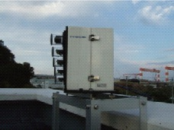
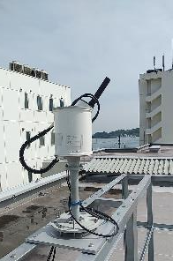
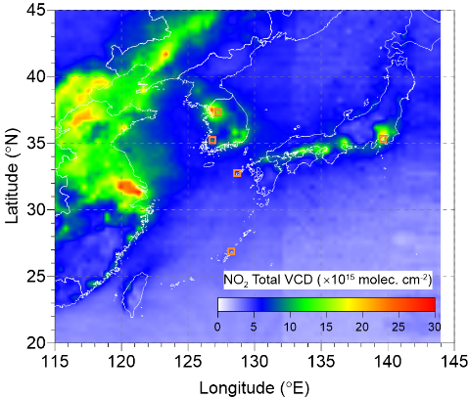
Locations of our validation observations : from polluted to remote
7 x MAX-DOAS
2 x Pandora
June, 2021
Seoul (Korea U.)
Incheon
(POSCO tower)
Yongin w. Pandora
(since 2021/09)
Gwangju
Yokosuka
w. Pandora
(since 2018/11)
Fukue
Cape Hedo
GEMS (grid size 0.5°×0.5°; SZA<85°; CF<30%)
https://www.jamstec.go.jp/egcr/e/atmos/observation/maxdoashp/
Kanaya et al. ACP 2014, Choi et al. (RS, 2021) + extended works

Slide 4
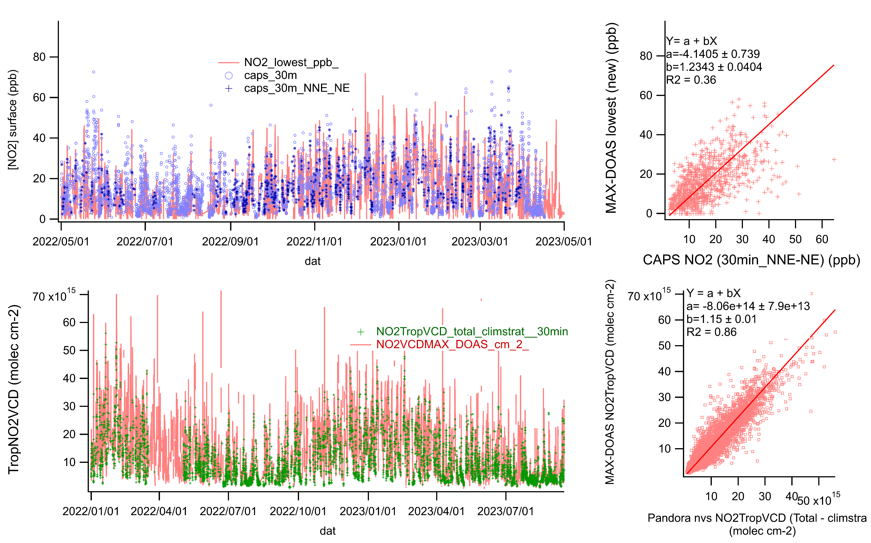
Improved MAX-DOAS retrieval: benchmarked with co-located CAPS and Pandora
Updated optimal estimation parameters :
State vector (TNO2VCD, v_{0-1km}, v_{1-2km}, v_{2-3km}); Uncertainty range (Sa(2,2), (3,3), (4,4)=(0.05, 0.03, 0.03)
v_{0-0.5km}, v_{0.5-1km}, v_{1-2km} (ini = 0.6, 0.5, 0.8)
0.4, 0.4, 0.2
Surface in-situ NO₂
MAX-DOAS retrieval
MAX-DOAS
CAPS(in situ)-NO₂
MAX-DOAS increased by a factor of 2
Slope ~1.2
CAPS(insitu)-NO2
TropNO2VCD
MAX-DOAS retrieval
MAX-DOAS
MAX-DOAS decreased by ~10%, Slope ~1.15
Pandora #146 (nvs) Total - strato
Pandora #146 (nvs)
Total - strato
Notes:
F:\maxdoas\results\was_yok1_22_2405.xlsm
F:\maxdoas\results\was_yok1_22_2405_maxdoas_vs_pandoracaps.png

Slide 5
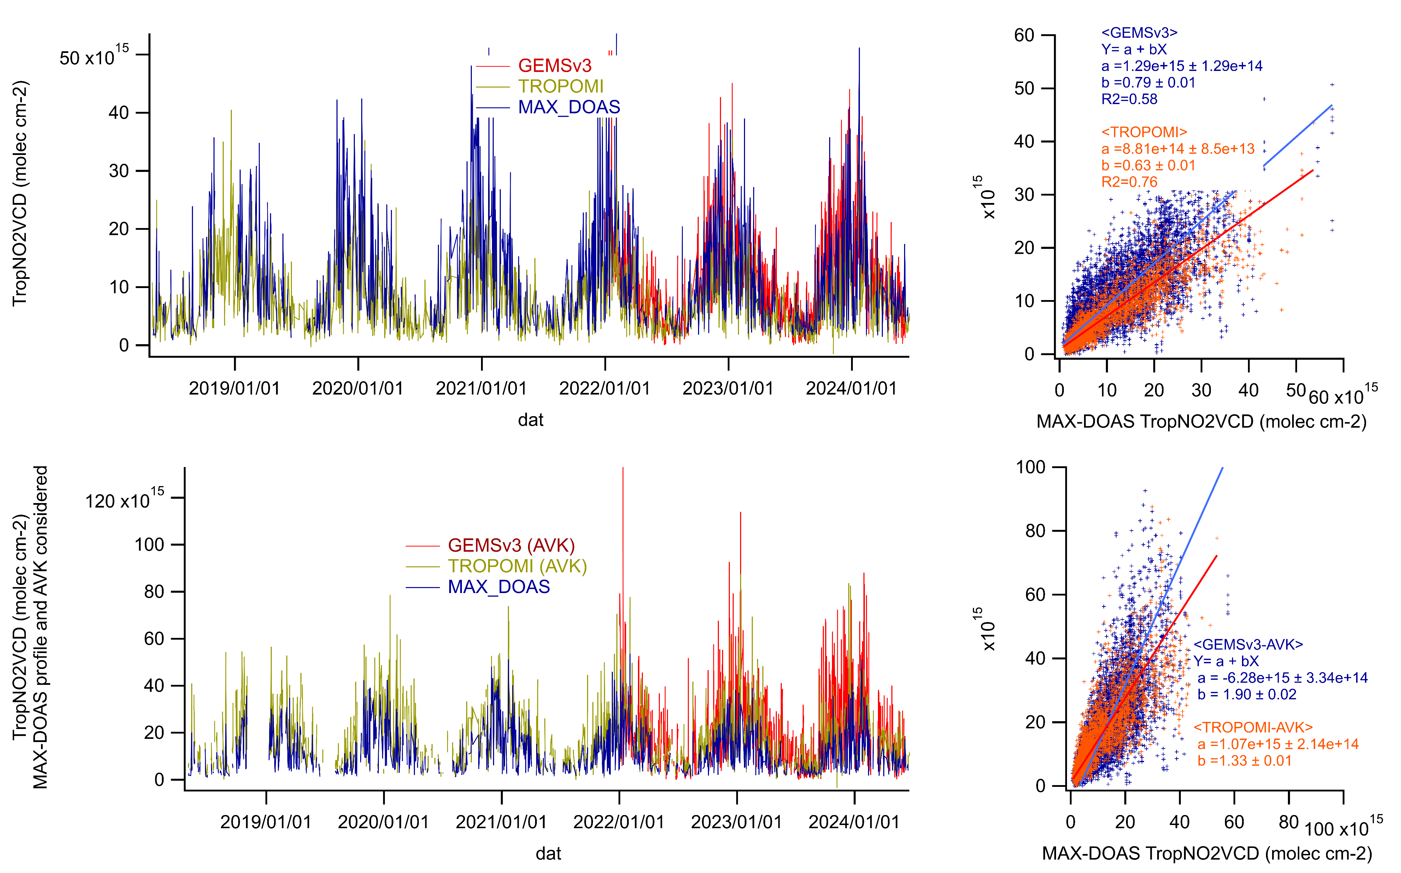

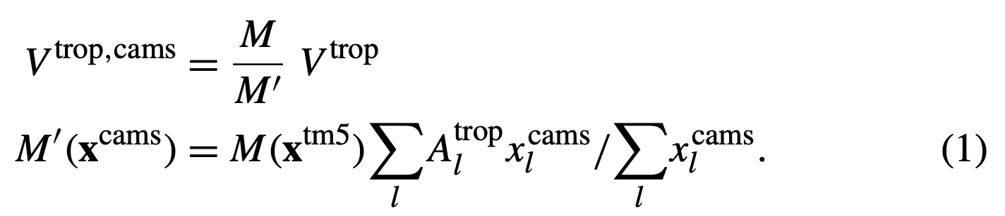
GEMSv3 & TROPOMI TropNO2VCD vs. iMAX-DOAS: Yokosuka
Δlat, lon<0.05, Δt<30min,
GEMS v3: Final Algorithm Flag=0, CF<0.3
TROPOMI: Collection 3 (≥v2.4), qa value>0.75, CRF<0.5
GEMS v3
slope = 0.79
R² = 0.58
GEMSv3 performed well, as TROPOMI, when validated against iMAX-DOAS, in terms of slope and correlation.
Comparisons considering “vertical profile shapes and AVK” are still difficult, as the NO₂ profile shapes are not certain enough (Though GEMSv3(GEOSChem) profiles and AVKs look OK)
TROPOMI
slope = 0.63
R² = 0.76
When AVK & MAX-DOAS profile are used for smoothing..
slope=1.90
MAXDOAS
Douros et al., 2023
MAXDOAS
GEOSChem
MAXDOAS
MAXDOAS
slope=1.33
Notes:
F:\gemsv3no2_Yokosuka\gemsv3_yokosuka_2201-2406avk_r.xlsm
F:\tropomi_yokosuka_out240730reduced_avk240805.xlsm
F:\gemsv3no2_Yokosuka\gemsv3_tropomi_yokosuka_fukue_hedo_2201-2406_avk.pxp, png

Slide 6
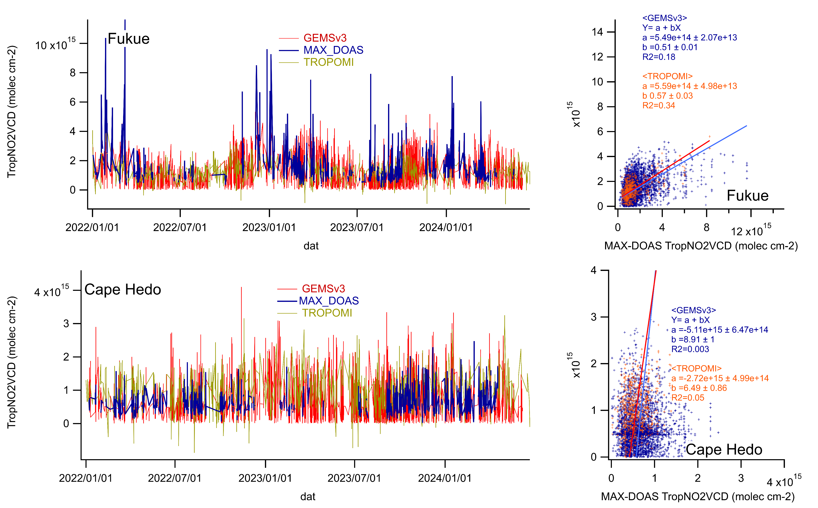
GEMSv3 & TROPOMI TropNO2VCD vs. iMAX-DOAS: Fukue & Cape Hedo
Δlat, lon<0.05, Δt<30min,
GEMS v3: Final Algorithm Flag=0, CF<0.3
TROPOMI: Collection 3 (≥v2.4), qa value>0.75, CRF<0.5
At cleaner sites, GEMSv3 TropNO2VCD also agrees well with iMAX-DOAS as well as TROPOMI.
Y-axis intercepts diminished to (0.5-2) from GEMSv2 (3-10)x10¹⁵ cm⁻².
(Bi-variate regressions are difficult to evaluate for Cape Hedo)
TROPOMI
slope = 0.57
R² = 0.34
GEMS v3
slope = 0.51
R² = 0.18
Notes:
gemsv3_tropomi_yokosuka_fukue_hedo_2201-2406_avk.pxp
gemsv3_tropomi_fukue_hedo_2201-2406_nonavk.png

Slide 7
GEMS v3 NO₂
(Tropo VCD) and MAX-DOAS, from Jan 2022 to Jun 2024 (Korean sites)
CF<0.3, SZA<85º,
FinalAlgorithmFlags=0,
within ±0.05º
TROPOMI: S5P_L2_NO2__HiR
GEMS showed much tight correlation with MAX-DOAS in urban areas in Korea

Slide 8
GEMSv3/MAX-DOAS ratio (TropNO2VCD, Japan): by Season (color) & Local time (x axis)
25%, 50%, and 75%tile are shown
SON
DJF
MAM
JJA
Congratulations! Green light to go ahead!
Notes:
D:\gemsv3no2_Yokosuka\gemsv3_yokosuka_fukue_season_hour_Ratios.xlsx
Three sites for WSA retrievals for MAX-DOAS

Slide 9
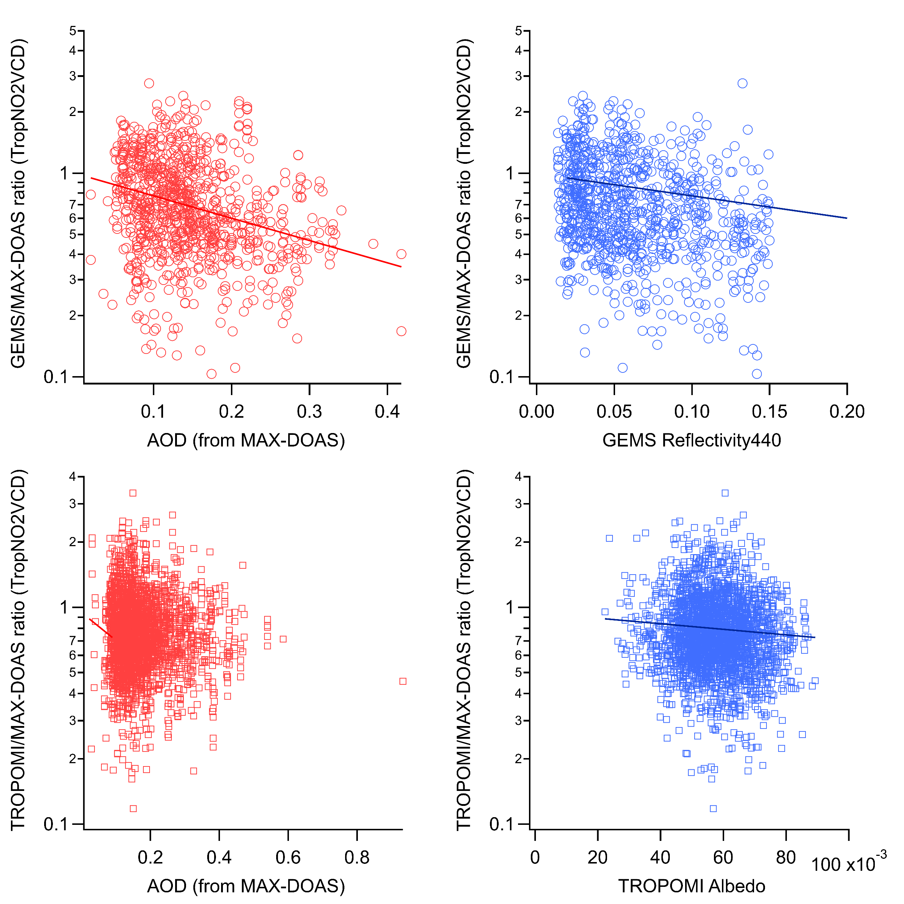
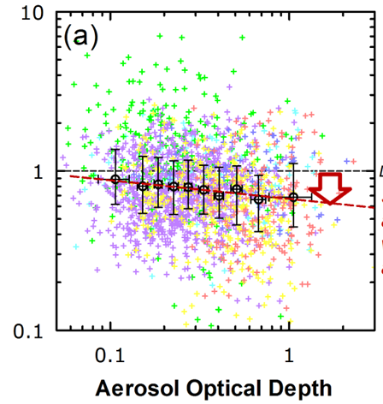
Aerosol shielding effect?
CF<0.05, Yokosuka
GEMS/MAX-DOAS ratio
(TropNO2VCD)
OMI/MAX-DOAS ratio
(TropNO2VCD)
TROPOMI/MAX-DOAS ratio
(TropNO2VCD)
Kanaya et al., ACP 2014 (OMI validation)
AOD
Surface Albedo/Reflectance440
Notes:
F:\gemsv3no2_Yokosuka\gemsv3_tropomi_maxdoasratio_aod_alb.png

Slide 10
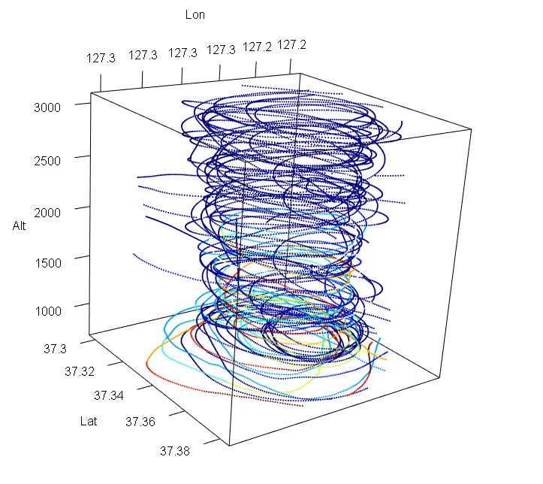

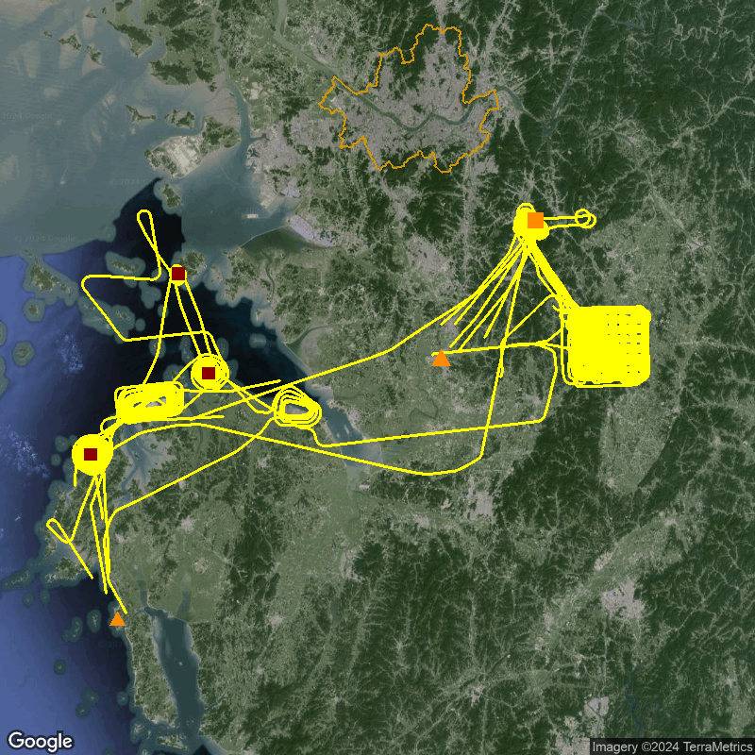
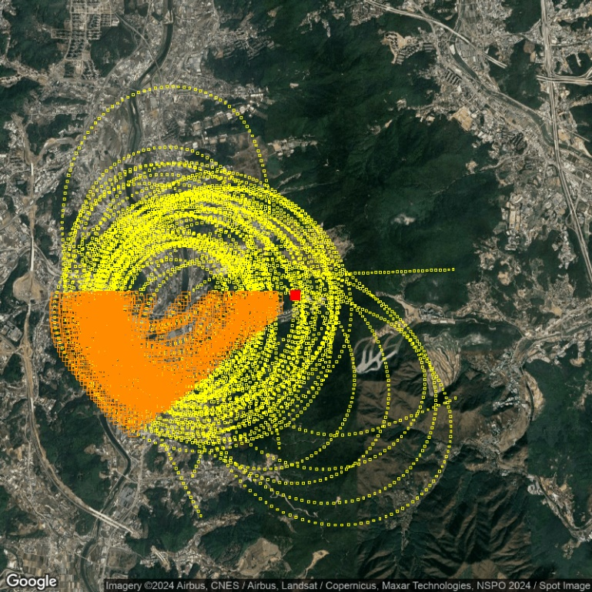
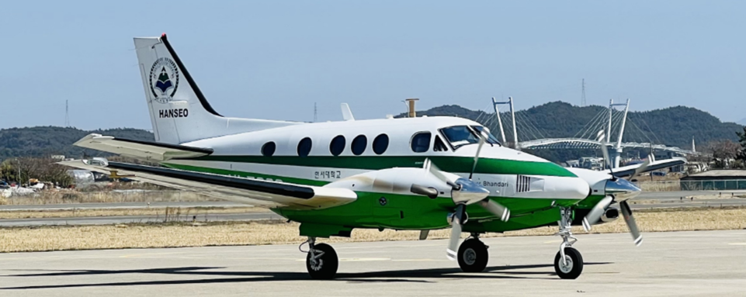
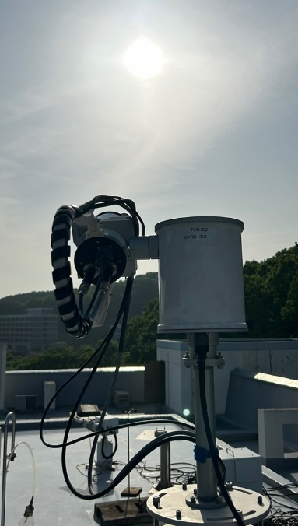
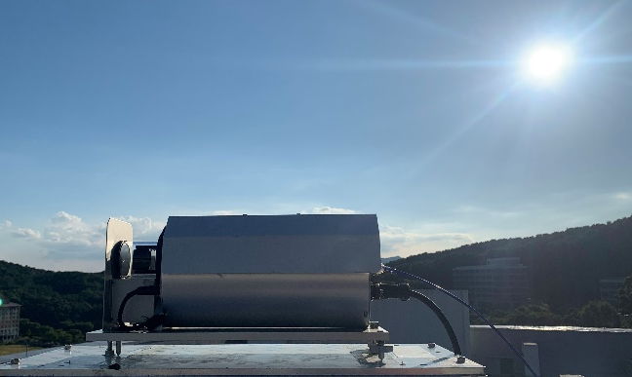
Overview of research flights during ASIA-AQ
Flight paths over HUFS
( ASIA-AQ)
Seoul
Target 1. Power plants
Target 2. HUFS
(Pandora/MAX-DOAS)
NO₂ (ppb)
MAX-DOAS
viewing direction; 250°
Yeonghueng PP
Dangjin PP
±20°
Deasan
Hyundai
Osan Airbase
Livestock
Teaan PP
P-10
Choi et al.
Target 3. Livestock
KingAir C90GT
Pandora
(2023.09~)
~10 km
MAX-DOAS
(2021.10~)
Takeoff from Osan Airbase
  spiral flights over HUFS; Alt.: ~0.6 to 3 km
    in-situ vertical profiles (NO₂, SO₂ and so on)
Teaan

Slide 11
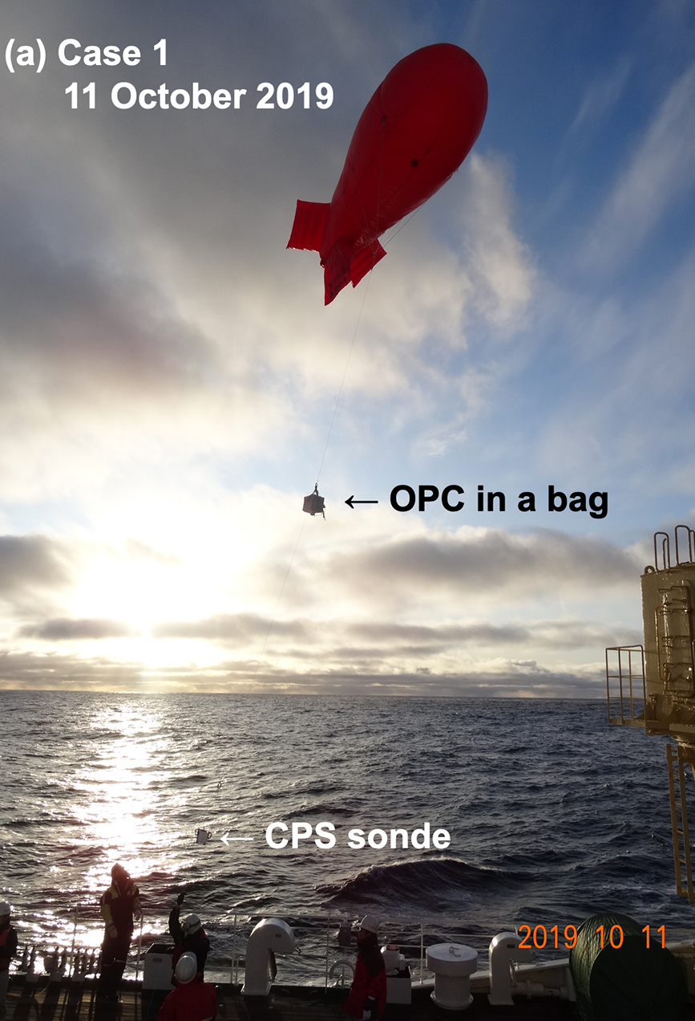
Challenges: NO₂ profile shapes from MAX-DOAS, compared with aircraft during ASIA-AQ
P-10
Choi et al.
Surface & >1 km
New < old MAX-DOAS algorithm
(opposite to seasonally averaged changes)
NO₂ at ~ 0.5 km
New >> old
Still need more data around 0.5-1km
Tethered-sonde
(0~1 km)
(Inoue et al. AMT, 2021)
No in-situ data under ~ 1 km

Slide 12
Summary
Validation tools improved: With algorithm update (optimal estimation), MAX-DOAS agreed better with Pandora (TropNO2VCD) and CAPS (surface NO₂) at Yokosuka.
GEMSv3.0 performed (TropNO2VCD) improved: Against iMAX-DOAS, GEMSv3.0 performed as well as TROPOMI. Diurnal variations are almost reasonable. Same for Fukue, Cape Hedo, and Korean sites.
Challenges: NO₂ vertical profiles are yet difficult to determine from MAX-DOAS, hindering comparisons with AVK-smoothing. Benchmarking with aircraft observations etc. is underway.

